Slide 1
Multi-sensor Passive ranger (MSPR)
Group 3:
Pedro A. Alvarez Fernandez Photonic Science and Engineering
John Haynes Electrical Engineering
Ilina Sunkara Photonic Science and Engineering
Taylor Whitton Computer Engineering

Slide 2
• overall project block diagram, or system design diagram
• discuss the project design approach and proposed implementation
• discuss and support significant design decisions and significant component decisions
• discuss the impact of realistic design constraints including economic, environmental,
social, political, ethical, health and safety, manufacturability, and sustainability
• Identification and review of related standards
• discuss project successes and difficulties for each project subsystem
• show the project budget and financing to date, and to the end of the project
• clear statement of current progress made by the group (% done by category)
• discuss the group's immediate plans for the successful completion of the project

Slide 3
Motivation
In military applications, the element of surprise is of vital importance:
Many range-finding systems utilize detectable means of obtaining the range of a given object.
These systems rely on “active” methods that require the system to send out some form of signal to detect the distance of the object
Radar and laser-based range-finding systems
Ideally, a military adversary should not be aware that they are being tracked, to keep the element of surprise.
General Surveillance purposes (mobile, non-mobile)
For surveillance we want to receive as much information as possible (range, speed, identification)

Slide 4
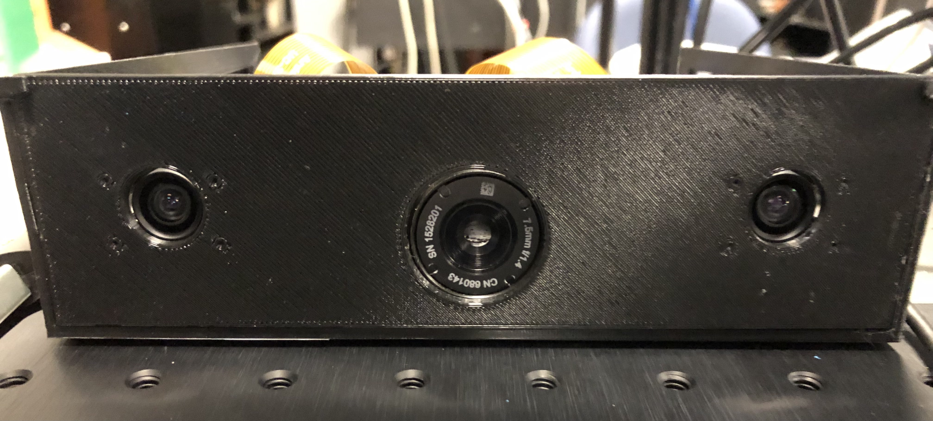
Solution
We present the Multi-Sensor Passive Ranger (MSPR) as our solution to the problem with “active” range finding systems.
Make use of both stereo and infrared cameras to accurately range the distance of an object.
No risk of detection since these cameras only absorb input from the environment, rather than producing some form of output.
The IR band can track in no visible light scenarios and low visibility
Each system can feed information to each other for accuracy

Slide 5
Goals and objectives
Produce a system that can accurately find the range of an object in a passive, undetectable manner.
Other systems, such as radar, transmit radio waves.
Systems can detect these radio waves, leading them to be detectable.
This is suboptimal for military applications where one wants to restrict the enemy’s knowledge as much as possible.
A real-time stream of range data that can be used to continuously monitor an object’s position relative to the device.
Cross reference the range data from the IR camera and the stereo system to detect inconsistencies.
Implement a software algorithm that can extract range from IR camera images

Slide 6
Specifications and requirements
Category | Specification
Range estimation accuracy | ±5% of true value
Range estimation speed | 10 times/sec
Background/Target differentiation | 2 s
Time of arrival estimation (velocity) | ±5% of true value
Disparity image | 15 FPS (480p<)
Object motion tracking | 2 s
Temperature sensitivity | ±5°C or ±5% of reading
IR Field of View | 90°(H) × 69°(V) <- might be less
IR Resolution | 2.267 mrad

Slide 7
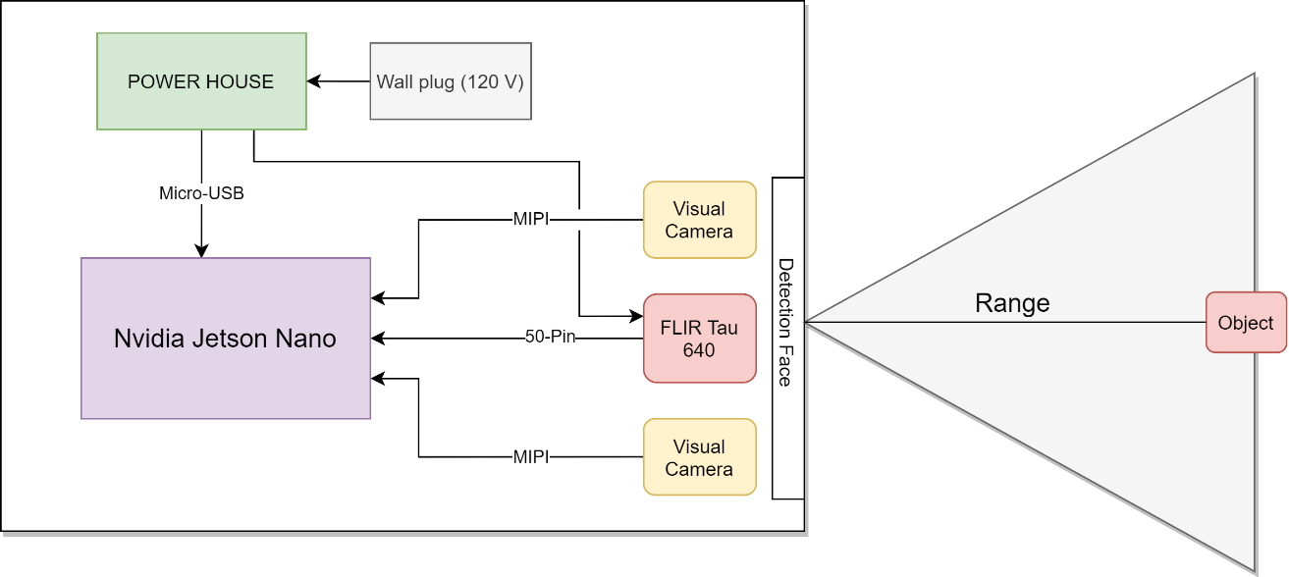
Layout Design: overall
USB Interface

Slide 8
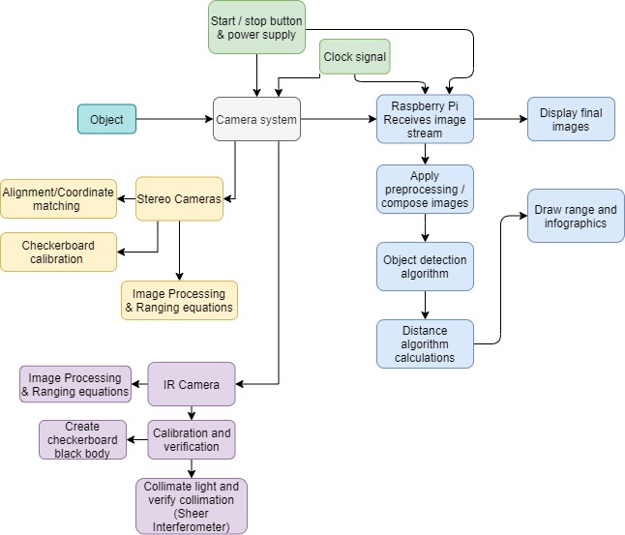
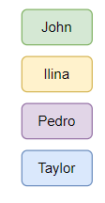
Block Diagram: overall

Slide 9
Block Diagram: Electrical

Slide 10
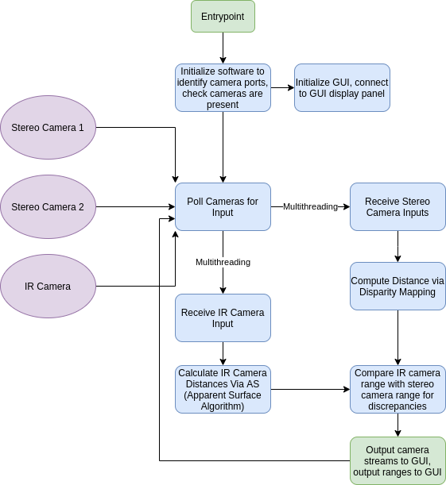
Block Diagram: Software

Slide 11
Software Design
The basic flow of the software system is simple:
Initialize a connection to each camera
Iteratively retrieve a frame from each camera
Apply preprocessing steps to reduce the complexity of each algorithm (convert to greyscale)
Run each image through each system’s respective distance calculating algorithm to extract the range of the object
Output result to GUI, await next frame

Slide 12
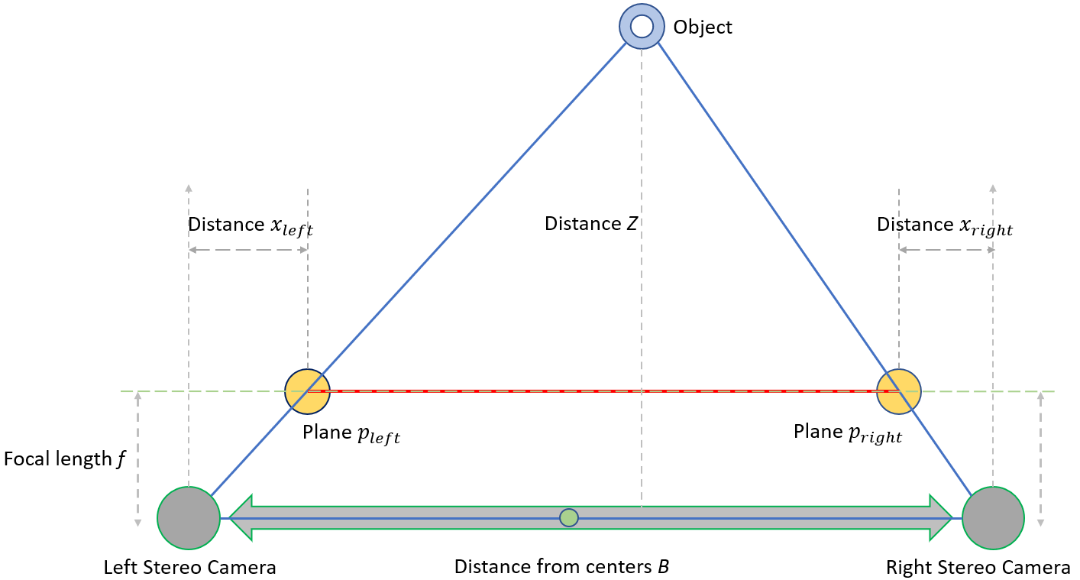
Layout Design: Visual Cameras
Planes p_{left} and p_{right}
Represent intersections between the image plane and lines from the camera centers to the object
Since the two triangles shown in the diagram are similar, the ratios of base to height in both should be equivalent.
$\frac{B}{Z} =\frac{p_{left}{×p}_{right}}{Z−f}$
$p_{left}{×p}_{right}=B−\left(x_{left}+x_{right}\right)$
By taking the center from the distance between the cameras as the origin, the $x_{left}$ can be represented as positive and $x_{right}$ as negative
$Z=f\left(\frac{B}{x_{left}−x_{right}}\right)$
Depth and disparity have an inverse relationship, where the distance Z increases as the disparity $(x_{left}−x_{right})$ decreases

Slide 13
Ir Ranging Theory (Point source)
To be considered a point source, R needs to be larger than 5X the source diameter, or $A_{source}=\frac{A_{source}}{R^{2}}<\frac{A_{detector}}{f^{2}}$ (1).
A point source is subject the inverse square law which says that irradiance (H) decreases as (1/R), with R being the distance away from the point source
The point source radiant intensity is given by $I\left(\frac{w}{sr}\right)=L_{source}A_{source}$ (2) and the detected irradiance at the detector is $H\left(\frac{w}{cm^{2}}\right)=\frac{P}{A_{pupil}}=\frac{I}{R^{2}}=L_{source}A_{source}/R^{2}$ (3)
From this equation we also arrive at the equation for detected power $P=I\frac{πD^{2}}{4R^{2}}=I\frac{A_{pupil}}{R^{2}}=L_{source}A_{source} \frac{A_{pupil}}{R^{2}} (4)$

Slide 14
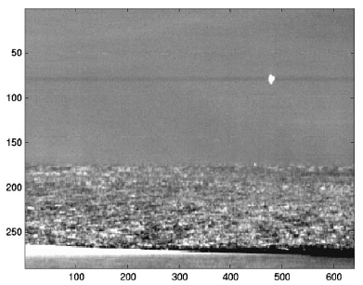
Ir Ranging Theory (Extended source)

Slide 15
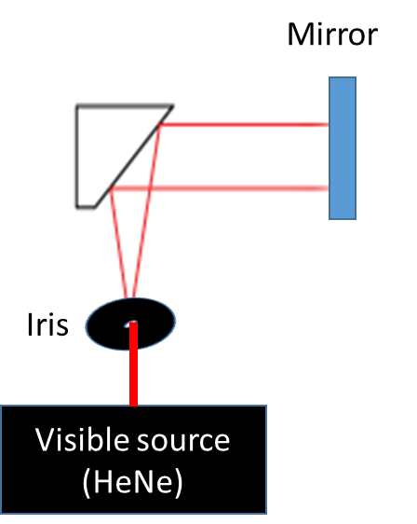
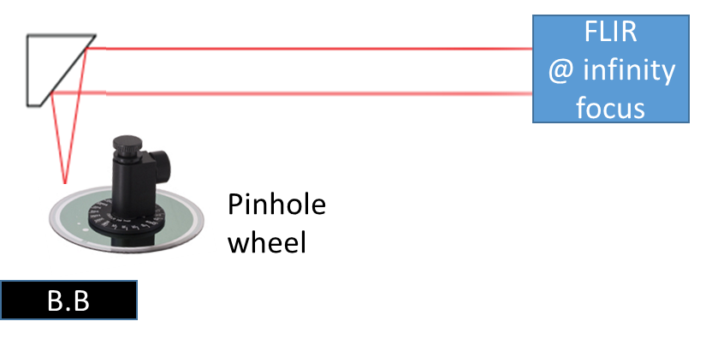
Closing object simulation and alignment

Slide 16
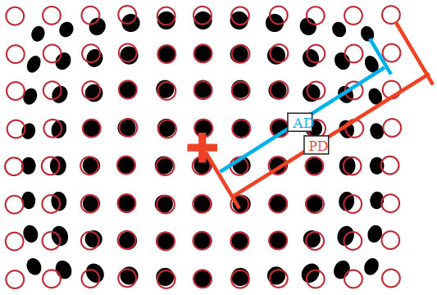
Camera alignment and spatial calibration
Scotch™ Brand 88 black vinyl electrical tape
Emissivity of 0.96 ( for 3-5 um and 8-12 um wavelengths)
Aluminum sheet metal
Emissivity close to 0
$$D=\frac{AD−PD}{PD}∗100$$

Slide 17
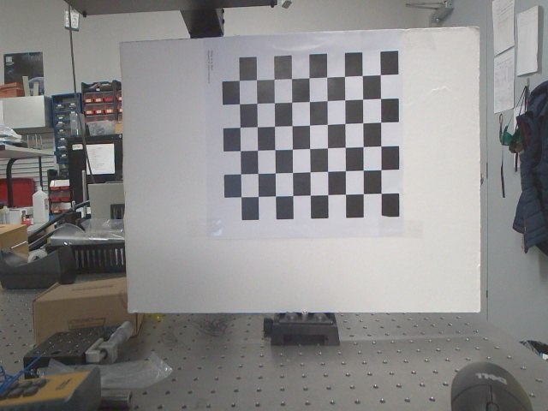
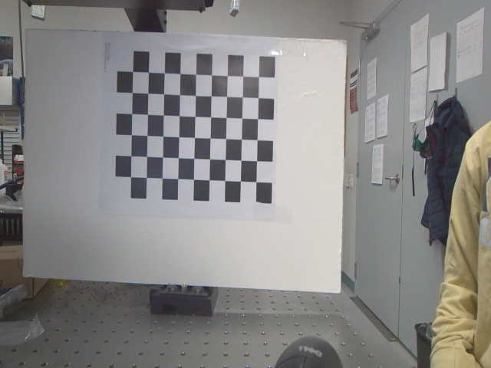
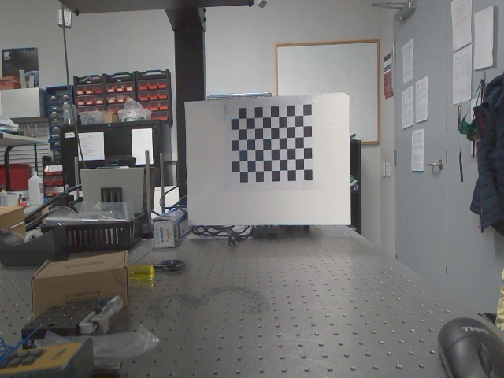
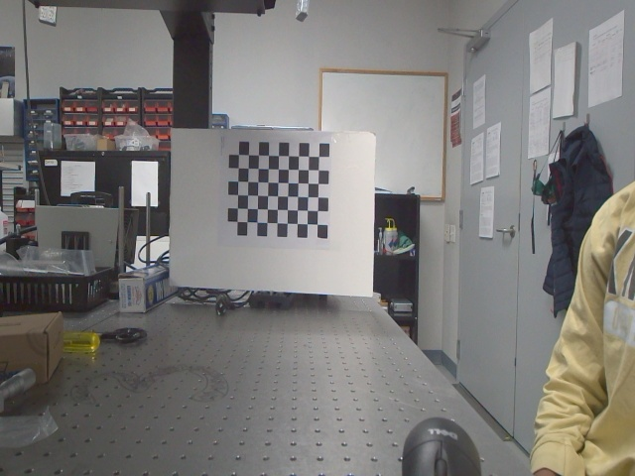
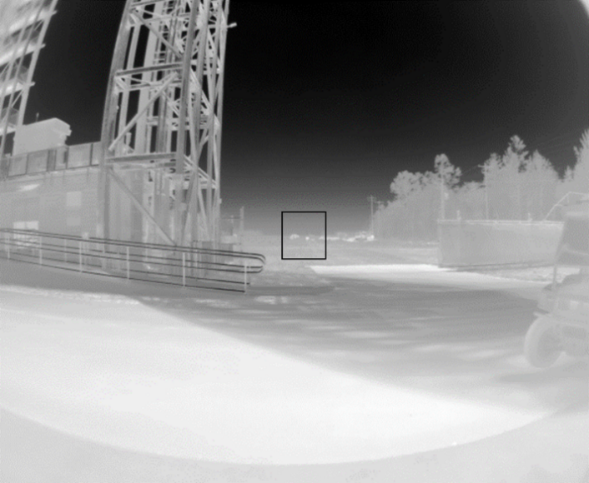
Sample Calibration pictures taken
Tau 640 with 7.5mm Lens for 4ft high x 5ft wide panel at 200 meters.

Slide 18
Part Selection: computer System
Microprocessor Selection
Programming Language Selection
 | Nvidia Jetson Nano | Raspberry Pi 8GB | Google Coral Dev Board 1GB
CPU | ARM A57 | Cortex-A72 | Cortex-A53, Cortex M4F
CPU clock rate | 1.43 GHz | 1.5 GHz | 1.3 GHz
CPU cores | 4 | 4 | 4
Coprocessor | - | - | Google Edge TPU
GPU | 128-core Nvidia Maxwell |  | Integrated GC7000 Lite
Network Connectivity | Gigabit Ethernet | Gigabit Ethernet, 802.11ac wireless, Bluetooth | Wi-Fi, Gigabit Ethernet
Storage | MicroSD | MicroSD | MicroSD, 8GB eMMC
RAM | 4 GB 64-bit LPDDR4 | 8 GB 64-bit LPDDR4-3200 SDRAM | 1 GB 64-bit LPDDR4
MIPI Lanes | 1x MIPI CSI-2 DPHY | 1x MIPI CSI, 1x MIPI DSI | 1x MIPI-DSI, 1x MPIP-CSI2
USB Ports | USB 3.0, USB 2.0, Micro-B | 2x USB 3.0, 2x USB 2.0 | Type-C, Type-A 3.0, Micro-B
Display Ports | HDMI, DP | 2x micro-HDMI | HDMI 2.0a
 | C | C++ | Python | Rust
Paradigms | Imperative | Imperative, Object Oriented | Imperative, Object Oriented | Imperative, Object Oriented
Compilation | Compiled | Compiled | Interpreted | Compiled
Language Level | Medium | Medium | High | Medium
Libraries | Libccv, TensorFlow, OpenCV | OpenCV, TensorFlow, Pytorch | OpenCV, TensorFlow, PyTorch, SimpleCV, Matplotlib, Keras | OpenCV, TensorFlow, PyTorch
Type System | Strong Statically | Strong Statically | Weak Dynamically | Strong Statically
Safety Design | Unsafe | Unsafe | Safe | Safe
Portability | Highly Portable | Highly Portable | Highly Portable | Highly Portable
Standard Library | Large, Extensive | Large, Extensive | Large, Extensive | Large, Extensive

Slide 19
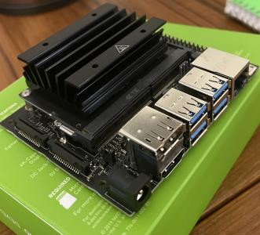
Jetson nano
The Jetson Nano was suitable for this project for several reasons:
Onboard GPU
Runs on Nvidia’s custom Ubuntu distribution
2x MIPI ports for stereo vision
High-performance quad-core processor
Enough RAM for our use-case
Cost of $119.99

Slide 20
Python
Python was chosen as the language of choice for most of the code base for several reasons:
Large selection of libraries relating to computer vision.
Rapid development and prototyping.
Seamless integration with MATLAB and C++ where necessary.
A memory safe language.
Supports parallelism to take advantage of the quad-core microprocessor.

Slide 21
IR camera
Parameter | FLIR A65 25 mm | Tau 2 7.5 mm
FOV | 25° × 20° | 90° x 69°
iFOV | 0.68 mrad | 2.267 mrad
Pixel pitch | 17 μm | 17 µm
Frequency/framerate | 30 Hz | 30/60 Hz (NTSC)
Temp. range | -25°C to +135°C | -25°C to +135°C
Sensitivity | ±5°C (±9°F) | < 30 mK (NETD)
Shock rating | 25 g (IEC 60068-2-27) | 200g shock pulse w/ 11 msec sawtooth
Size | 4.2" × 1.6" × 1.7" | 1.75" x 1.75" x 1.18"
Thermal imager | Focal Plane Array (FPA), Uncooled VOX microbolometer | Uncooled VOX Microbolometer
Connection | Ethernet | 50-pin Hirose / BNC with VPC
Input voltage | 10–30 VDC | 4.0 - 6.0 VDC

Slide 22
IR Lens selection

Slide 23
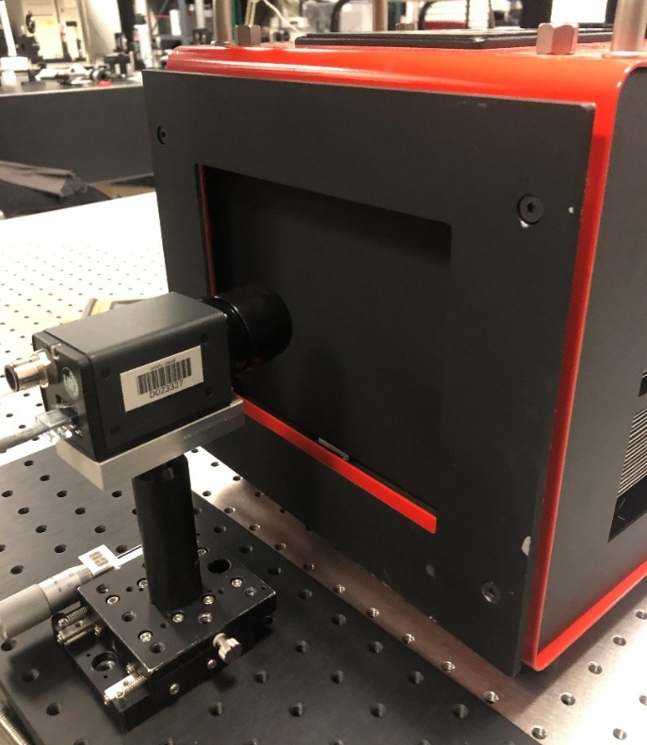
A65 radiometric Calibrations

Slide 24
Part Selection: Visible Cameras
 | Arducam MINI High-Quality Camera IMX477 HQ Camera Module | Arducam 12MP IMX477 Motorized Focus High Quality Camera | Arducam IMX219 Wide Angle Camera Module
Sensor | IMX477 | IMX477 | Sony IMX219
Optical Format | 1/2.3″ (diagonal 7.857mm) | 1/2.3” | 1/4 inch
Resolution | 4056(H) x 3040(V) 12.3MP | 4056 x 3040 pixels, 12.3MP | 8MP
Pixel Size | 1.55um x 1.55um | 1.55 µm x 1.55 µm
Interface | 2-lane MIPI CSI-2 | 2-lane MIPI | MIPI CSI-2 2-lane/4-lane
Frame Rate | 1920×1080 @ 60fps 4032×3040 @ 30fps | 1920×1080 @ 60fps 4032×3040 @ 30fps | 30fps@8MP, 60fps@1080p, 180fps@720p
Format | 1/2.3 inch | 1/2.3” | -
Focal Length | 3.9mm | 3.9mm | 2.5mm
Aperture | F2.8 | F2.8 | 2.8
Field of View | 75° (H) | 75° (H) | 175(D) x 155(H) x 115(V)
MOD | 0.1m | 0.3m | -

Slide 25
Part Selection: Power
120V to 12V AC-DC Flyback Controller Comparison
12V to 5V DC-DC Regulator Comparison
 | TPS56623x | TPSM84624 | TPS543620
Efficiency of Circuit at maximum power (5 amps) | 95.6% | 94.4% | 94.5%
Efficiency of Circuit at half power (2.5 amps) | 96.3% | 94.3% | 95.4%
Efficiency of Circuit at .5 amps | 94.8% | 83.3% | 89.3%
Current Range (at 5 Volts) | Up to 6 amps | Up to 6 amps | Up to 6 amps
BOM count | 15 | 8 | 17
Recommended Maximum Power at 5 volts | 30W | 30W | 30W
Vout peak to peak at 5 volts and 5 amps output | 8.71 mV | 11.9 mV | 8.32 mV
Circuit Footprint | 130 mm² | 145 mm² | 237 mm²
 | UCC28730-Q1 | UCC28631 | LM5023
Efficiency of Circuit at maximum power (3 amps) | 83.4% | 87.2% | 86%
Efficiency of Circuit at half power (1.5 amps) | 84.5% | 87.8% | 85%
Efficiency of Circuit at .5 amps | 84.2% | 84.5% | 78%
Current Range (at 12 Volts) | Up to 8.33 amps | Up to 5 amps | Up to 3.43 amps
BOM count | 26 | 23 | 37
Recommended Maximum Power | 100W | 60W | 41W
Vout peak to peak at 12 volts and 3 amps output | 75.47 mV | 62.27 mV | 92.04 mV

Slide 26
Constraints
Economic
IR camera was donated by Air Force Research Base
All other costs come from out of pocket
Environmental
Power usage of board
Ethical / Political / Social
Could be used by military to aid in ending lives
Our system is only being built to range objects
Specific applications are entirely up to user
COVID19
Precautions and limitations to what can be done as group
Must maintain 6 ft distance between group members when working in person
Time

Slide 27
standards
IPC-2220 (IPC-2221)
Follows the IPC-2220 Generic Standards on Printed Board Design
UL 1642
Follows the UL 1642 Standard for Safety of Lithium Batteries
FLIR Tau 640
Has use restrictions defined by Sony Semiconductor Solutions Tau2
Compliant with the following directives and regulations:
Directive 2002/95/EC, “Restriction of the use of certain Hazardous Substances in electrical and electronic equipment (RoHS)”.
Directive 2002/96/ EC, “Waste Electrical and Electronic Equipment (WEEE)”.
Regulation (EC) 1907/2006, “Registration, Evaluation, Authorization and Restriction of Chemicals (REACH)”.
Arducam MINI 12.3MP IMX477 Camera
Has use restrictions defined by Sony Semiconductor Solutions Corporation (SSS)
Nvidia Jetson Nano
Compliant with the Federal Communications Commission (FCC)

Slide 28
Financing
Item Number | Item Type | Model | Price
1 | IR Camera | FLIR Tau w/ 7.5 mm lens | $6000
2 | Variable pinhole | Thorlabs Pinhole Wheel (PHW16) | $496.70
3 | Off-Axis Parabola | Thorlabs Ø2" 90° OAP (MPD239-P01). | $375.50
4 | Stereo Camera Set | 2X | $128.98
5 | Microprocessor | Nvidia Jetson Nano Microprocessor B01 Model | $119.99
6 | Touch Display | Elecom 7” Display | $73.00
7 | Jumper cables and breadboard | - | $20.00
8 | 120V to 12V AC-DC converter circuit |  | $10.00
9 | 12V to 5V DC-DC converter circuit |  | $5.00
10 | 12V battery | - | $10.00
11 | Misc Electrical Components (resistors, capacitors, etc.) | - | $20.00
12 | Checkerboard Material | Aluminum Metal | $0.00
13 | Checkerboard coating | Scotch™ Brand 88 black vinyl electrical tape | $5.00
14 | Blackbody Source | TC-720 thermoelectric temperature controller | $1000.00
15 | Mechanical-Optical components | - | -
Total | - | - | $8264.17

Slide 29
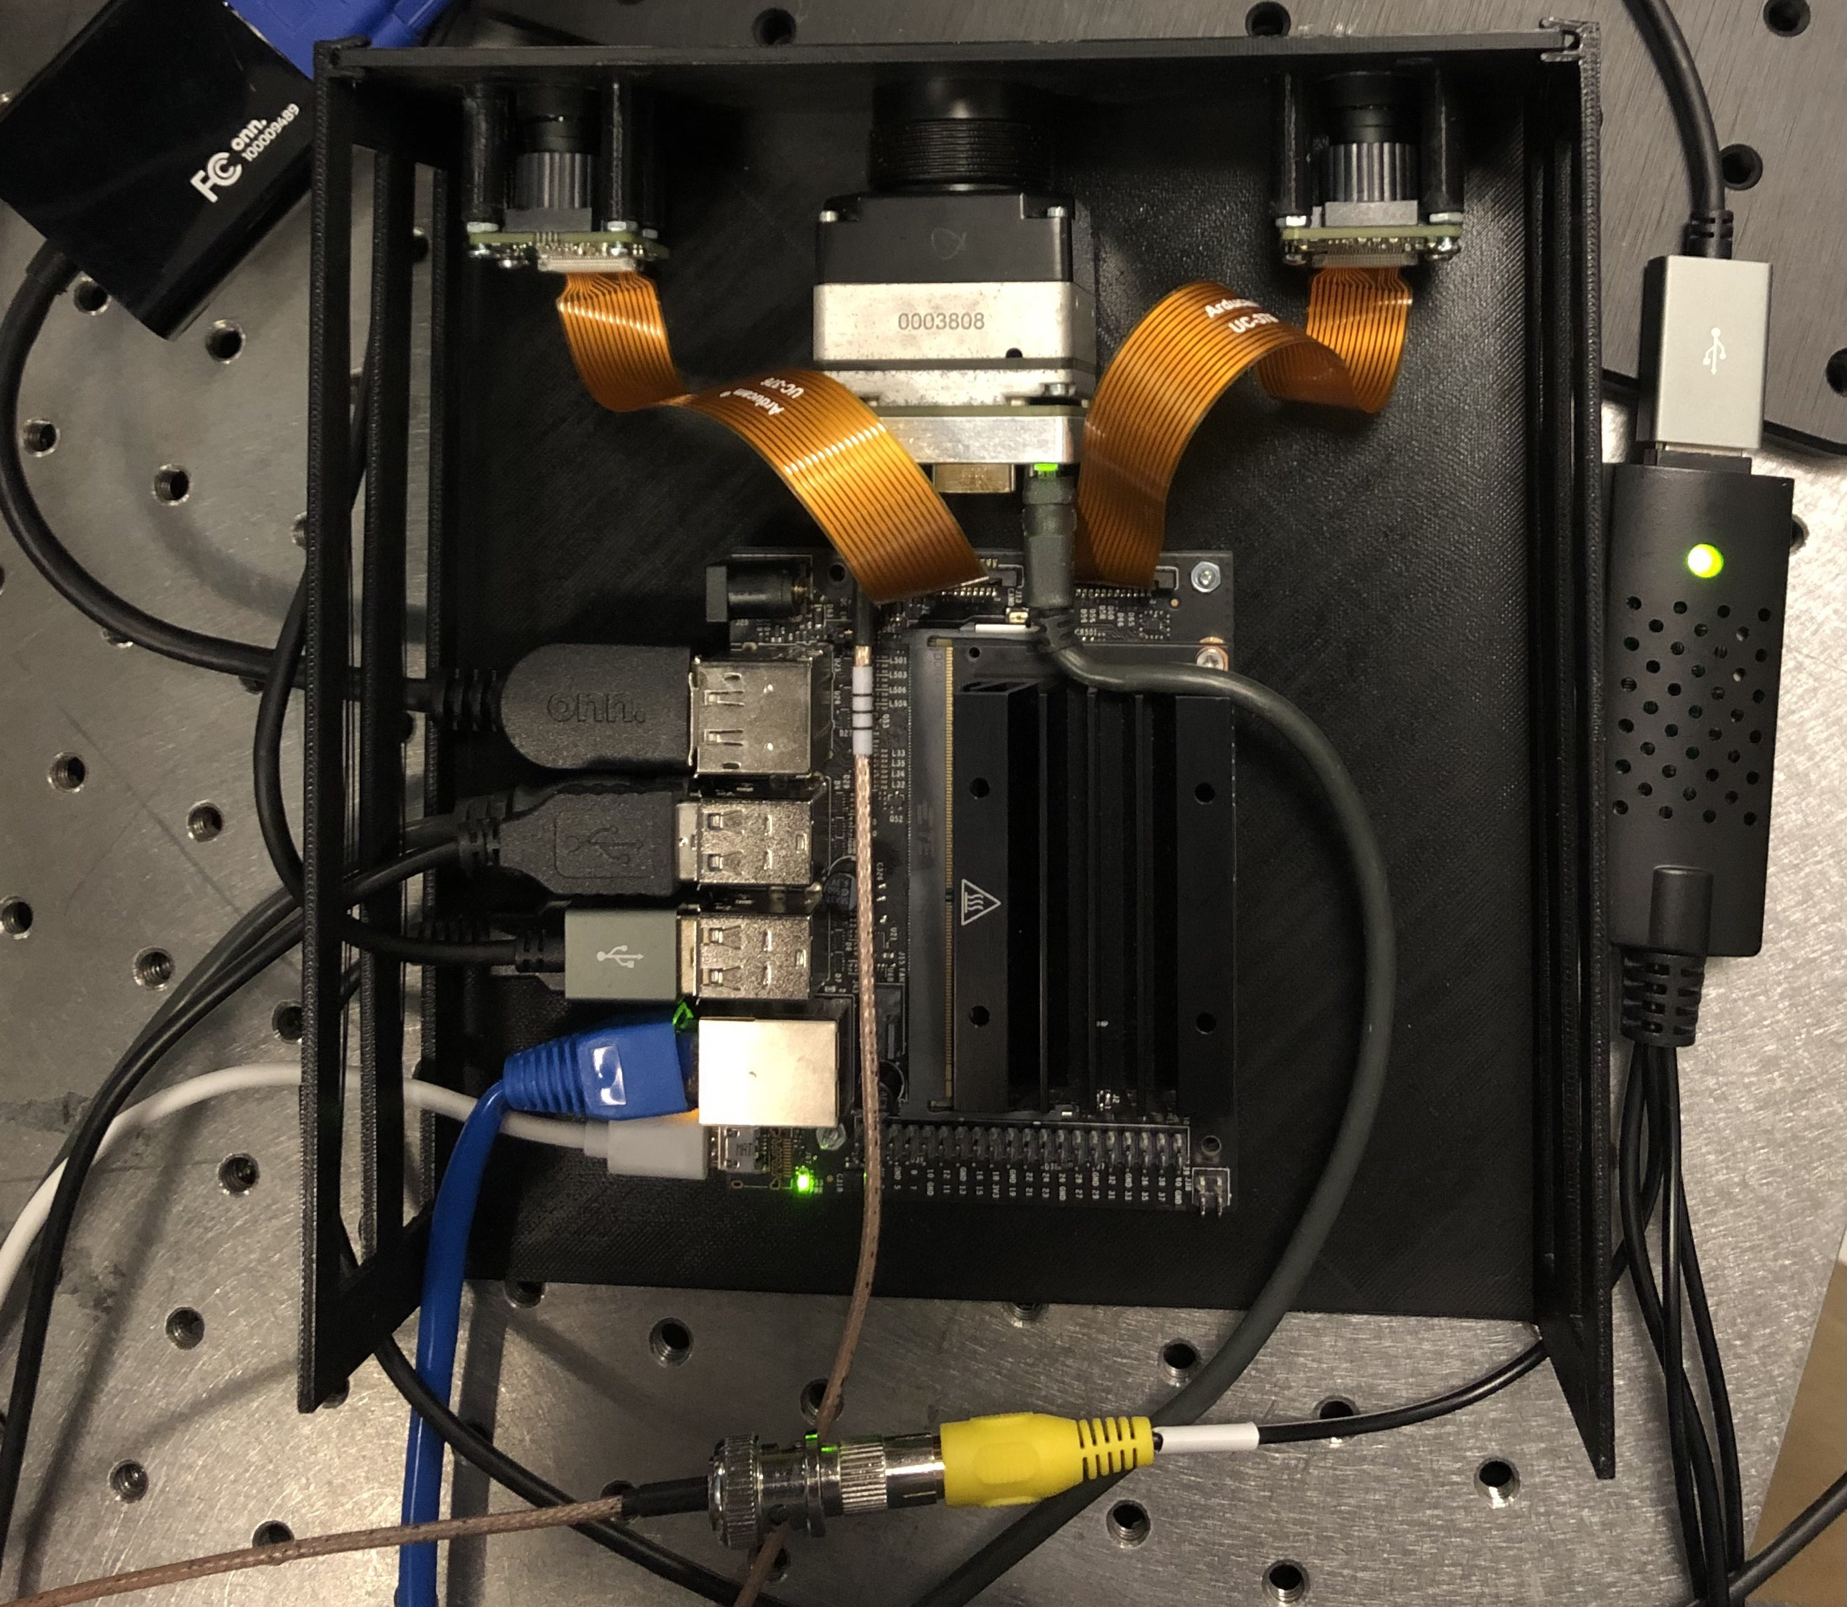
Current progress
Project part | Progress
Housing | 90%
IR and Visible calibration and alignment | 80%
IR range code | 25%
Visible Camera ranging code | 25%
GUI and Streaming | 0%
Electrical interface and implementation | 60%

Slide 30
Successes and Difficulties - Computer
Successes
Screen works and takes touch input.
Difficulties
COVID-19 restrictions limiting the team’s ability to work together as a group on the project.
Financial difficulties in acquiring all the required parts.
Short summer semester.
Design and implementation of IR ranging algorithm.
Can access all camera systems and receive input streams.
Successful manipulation of received input through OpenCV.
SSH support allows for programming on the Jetson Nano remotely.
Hard to begin work until the camera systems are in place and calibrated.

Slide 31
Successes and Difficulties - Power
Successes
Difficulties
Successfully designed a power system to work with the MSPR
Hard to begin work on implementing power system until the rest of the system is finalized
Need to acquire a PCB to begin testing with the system
Selection of components for the power system complete

Slide 32
Successes and Difficulties – Visible Cameras
Successes
Able to connect to the Jetson Nano and LCD Display to show a visual stream and take images
Difficulties
Must write python scripts to manipulate cameras in any way
Could not guarantee alignment until housing was built and cameras were secured in place

Slide 33
Successes and Difficulties – IR Camera
Successes
IR stream is being detected by Jetson and can obtain images
Difficulties
Interfacing was an initial issue
Radiometric calibration done
Spatial calibration works with in house checkerboard
Ranging code complexity
Determining object to demonstrate

Slide 34
Plans for completion
Complete adjustments on housing
Ensure the cameras can be secured and aligned correctly
Set up incoming and outgoing wired connections to go through sides of housing
Develop complete software for visual cameras
Calibrate and create disparity map
Obtain ranging information
Develop complete software for IR camera
Calibrate along visual cameras to establish common grid
Obtain ranging information based on visual camera calculations
Interface display with camera and microprocessor system
Integrate power system

Slide 35
Hot object: cube/sphere/flat surface/car. Perhaps coat it with common application paint.
How will it move to camera?
RC car, drone, string pulled trolley,
Where?
Inside (long hallway)
Outside (open field)
Or Parking garage

