Slide 1
PetAid Harness
Group #8
Group Members:
Adam Henderson, Pascal Balms, Edgar Gonzalez, Pedro Rocha

Slide 2
Project Description
Dog Harness
Harness mounted with smart electronic device
Biometric and location tracking device

Slide 3
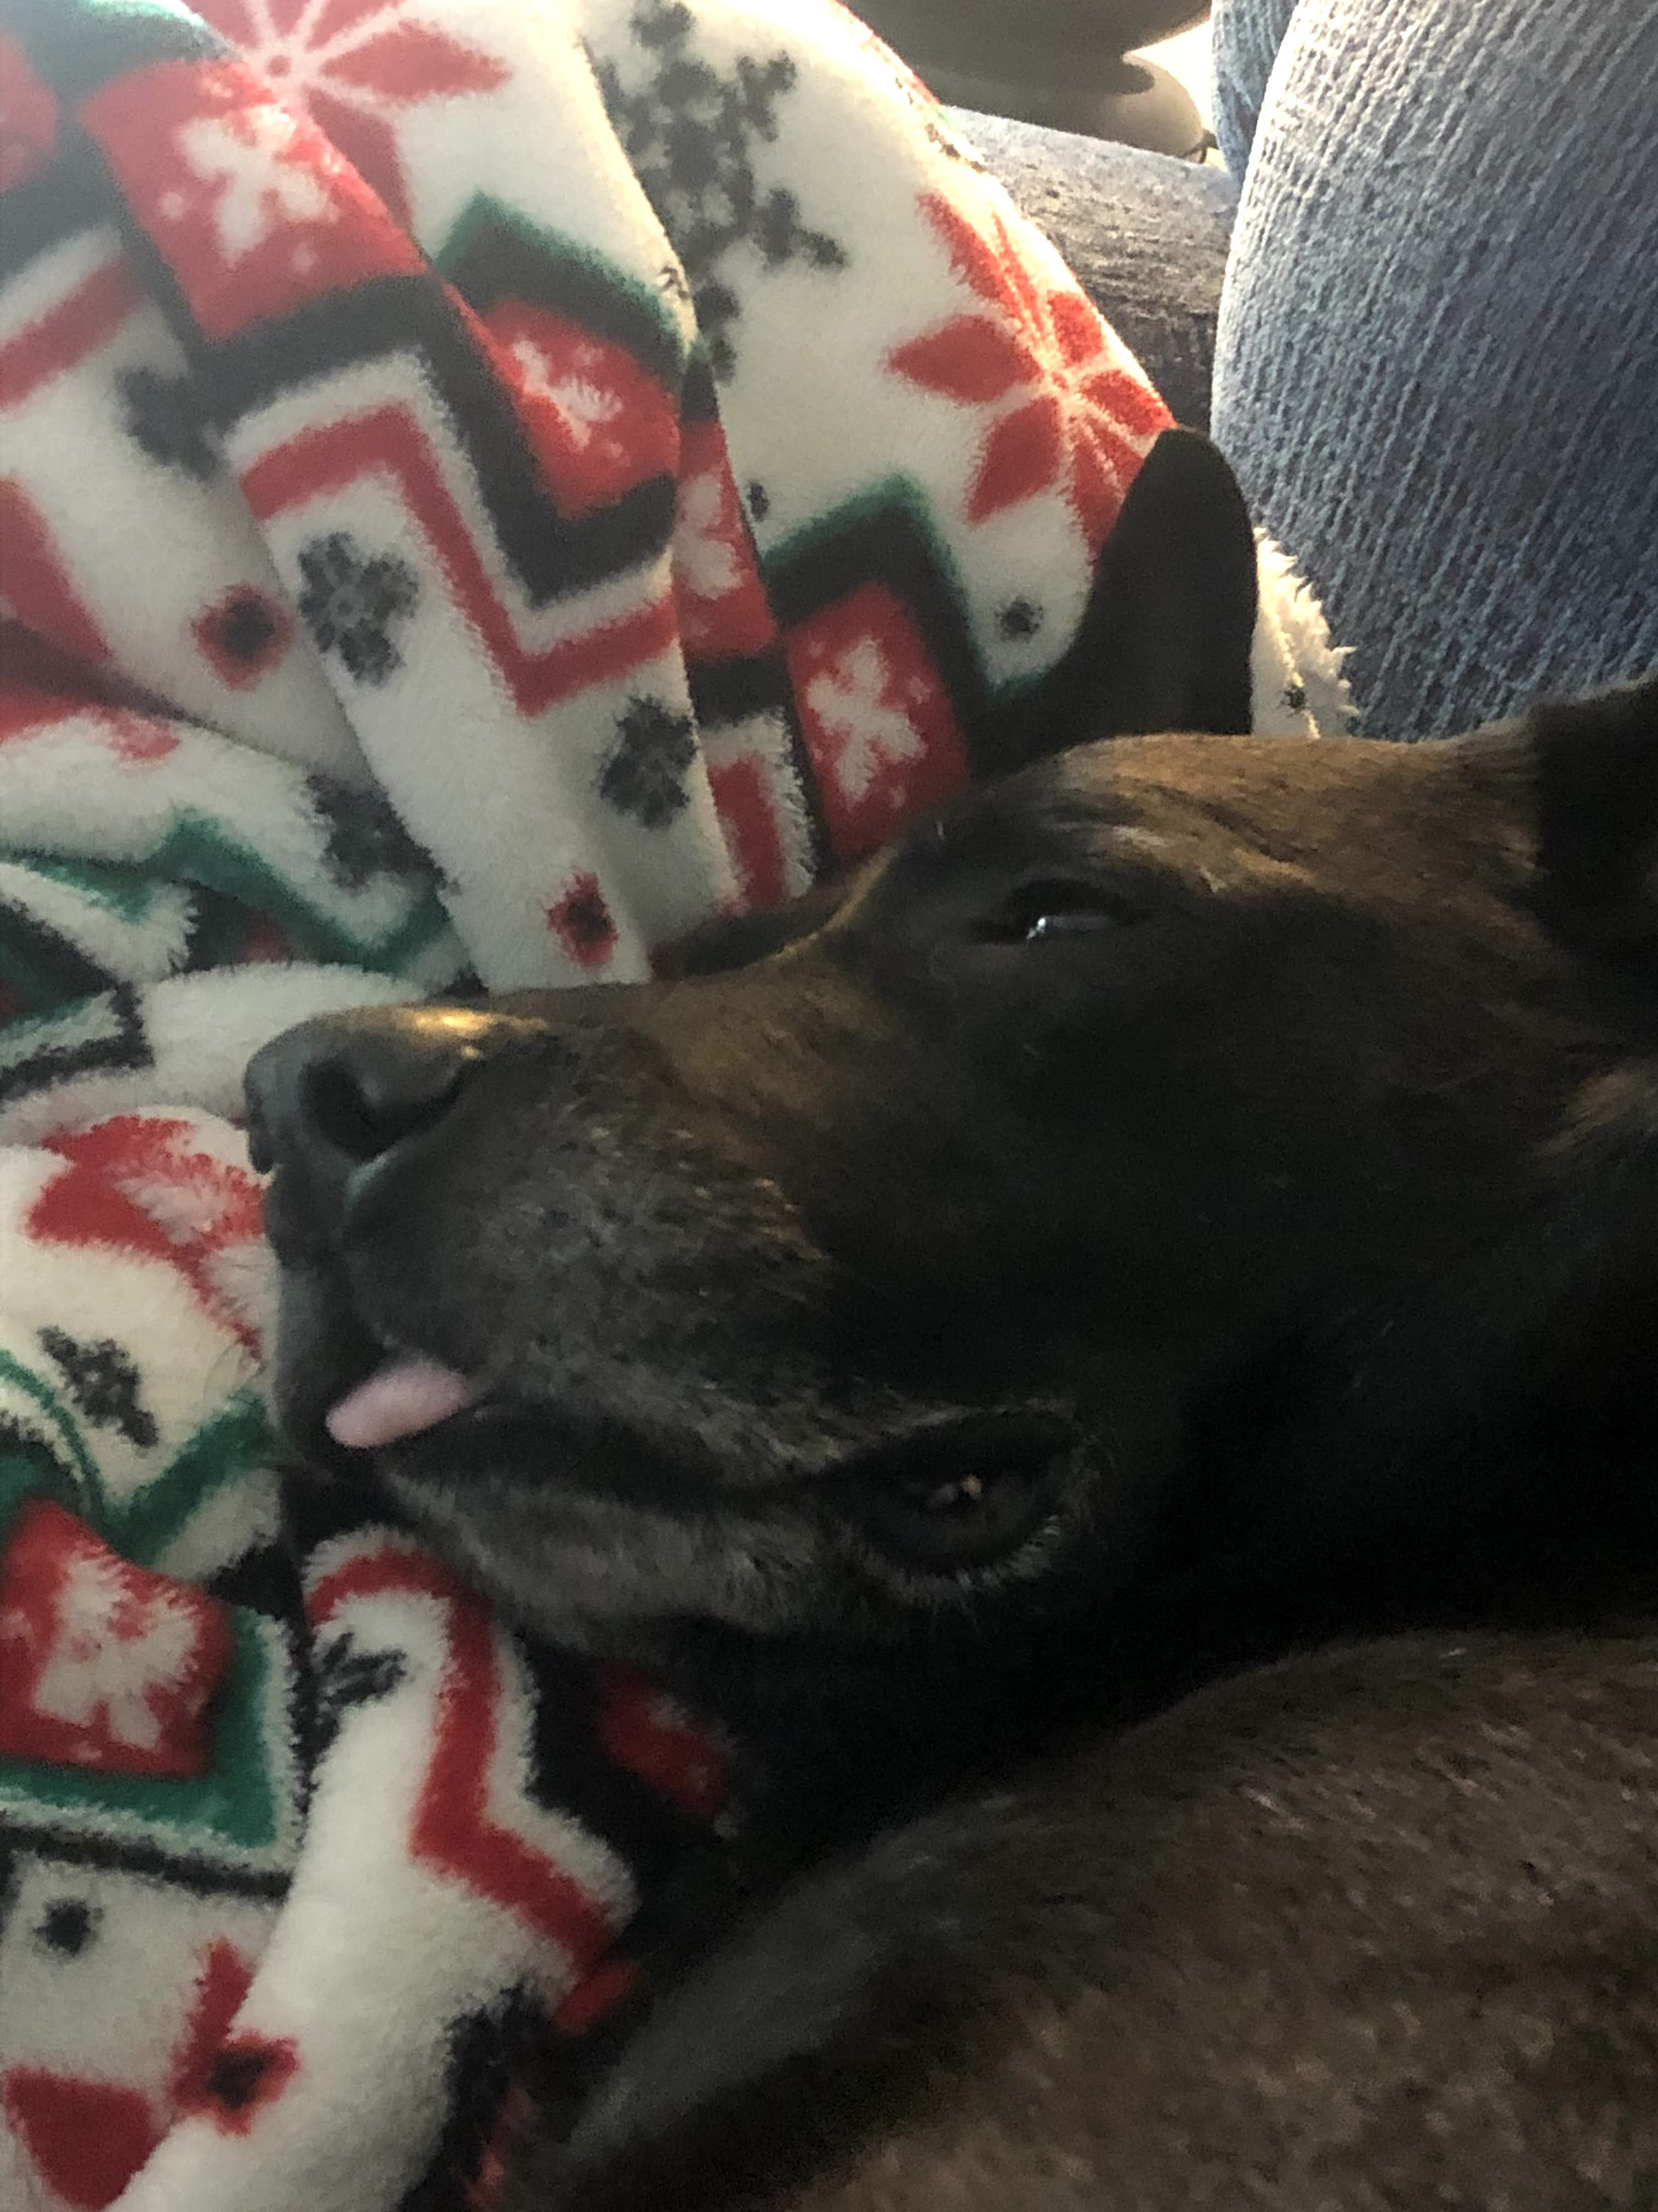
Project Motivation
Survey conducted by the American Pet Products Association (APPA), a total of about 67% of U.S. households
Will help if the pet is having a medical emergency while the owner is not present
Preventative medicine
Close to 10 million dogs and cats are lost or stolen in the US every single year and according to the Coalition for Reuniting Pets and Families, 80% are never found
Decrease the cost of pet care

Slide 4
Project Goals & Objectives
To create a harness for one's pet that can monitor their physical condition and location, making it easier for the owner to ensure their pet's well-being To create a fully functioning PetAid harness To create a phone application that can register, operate, and manage PetAid harnesses

Slide 5
Dog Harness vs. Collar
Harness gives more surface area for devices to be placed
Harness has a more stable position on the dog than a collar
Collar is far more lightweight and easier to put on the dog
Collar could be more familiar and comfortable for dogs

Slide 6
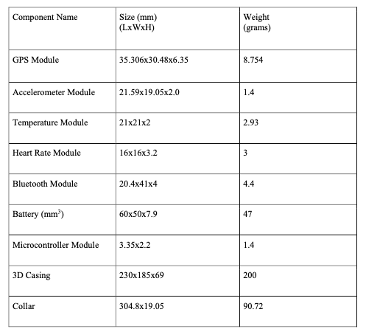
Specifications and Requirements
Overall Weight
Minimum dog weight
Operating Temperature
GPS/GSM capabilities
Wifi/Bluetooth integrated
Battery time

Slide 7
Specifications and Requirements
4 data values monitored
Response time
Notification prerequisites

Slide 8
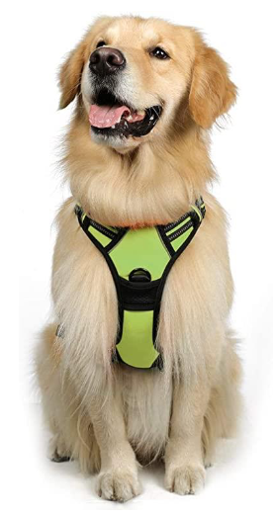
Typical Dog Harness
RabbitGoo Adjustable Oxford No Pull Dog Harness
Space for electronics

Slide 9
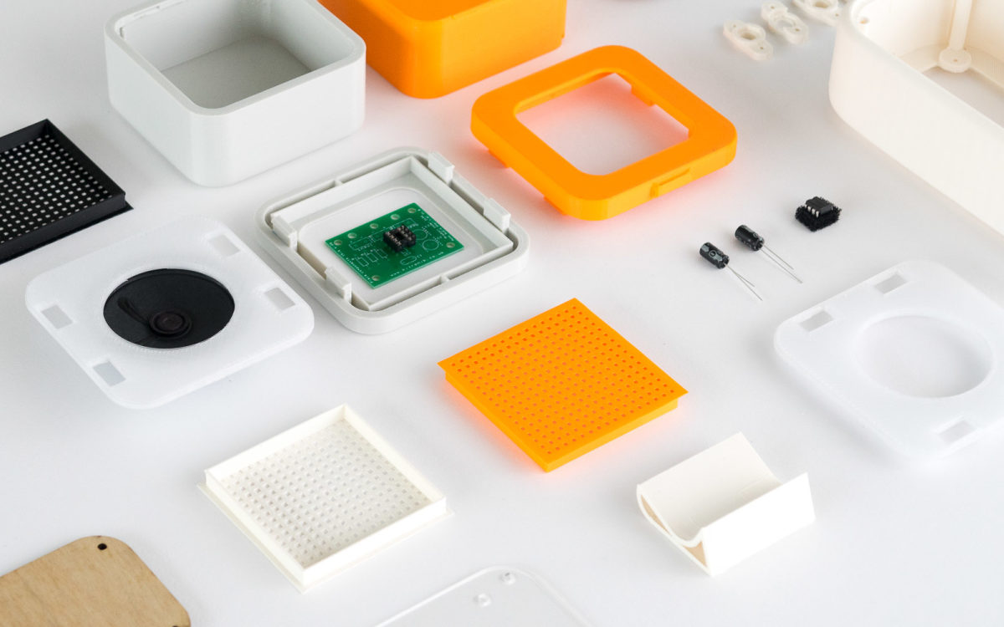
Electronic Device Enclosure
3dhubs.com

Slide 10
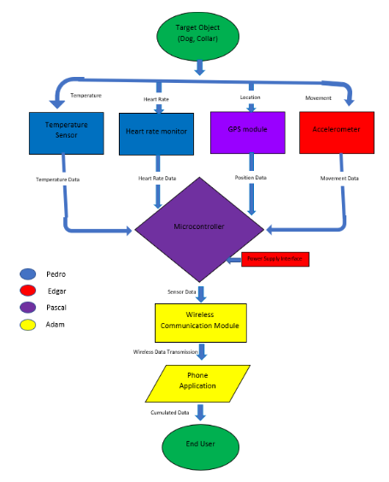
Project Block Diagram

Slide 11
Project Plan
Shipping
Prototype
Gather and receive all materials
Prototype Implementation and Testing
Team
Testing
Finalize
Brainstorm and Project Plan
Hardware Testing
Final Documentation and Product

Slide 12
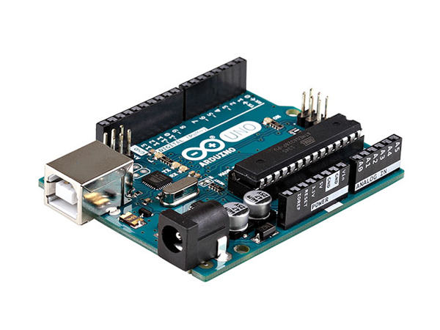
Microcontroller Component Decisions
MCU | MSP430FR6989 | MSP430G2553 | Arduino Uno | Raspberry Pi 3
CPU | 16-bit RISC | 16-bit RISC | Microchip AVR (8-bit) | ARM Cortex-A53
Frequency (MHz) | 16 | 16 | 16 | 300
Memory | FRAM and RAM | FRAM and RAM | Flash memory and SRAM | RAM
Memory Size | 128KB and 2KB | 16KB and 0.5KB | 32KB and 2KB | 1 GB
UART | 2 | 1 | 1 | 2
I2C | 2 | 1 | 2 | 2
SPI | 4 | 2 | 2 | 3
Operation Voltage (V) | 1.8 to 3.6 | 1.8 to 3.6 | 5 | 5
GPIO | 83 | 24 | 23 | 40
Dimensions (WxL)(mm²) | 16x16: 256 mm² | 9.4x24.33 mm² | 68.6x53.3 mm² | 85x56x17mm² (WxLxH)
Price | $20.00 | $23.00 | $22.95 | $41.99
Microchip: Atmel ATMega 328P

Slide 13
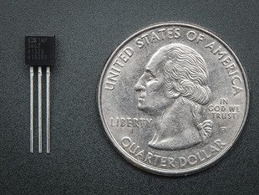
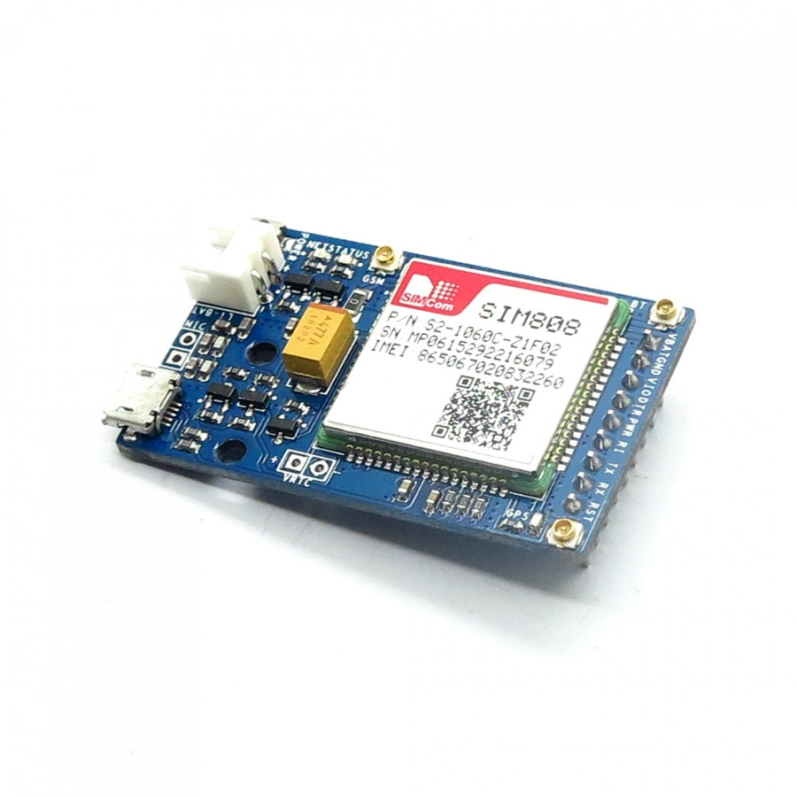
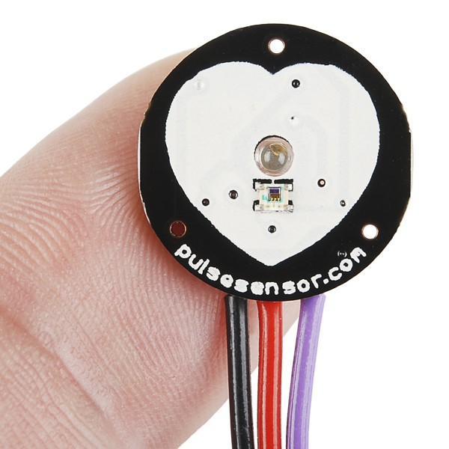
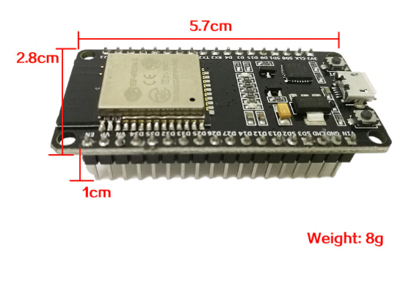
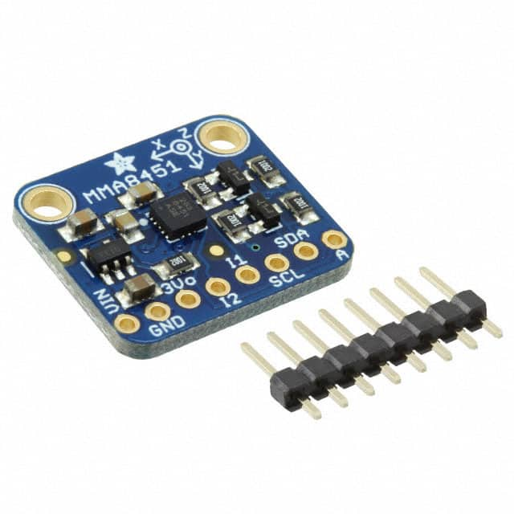
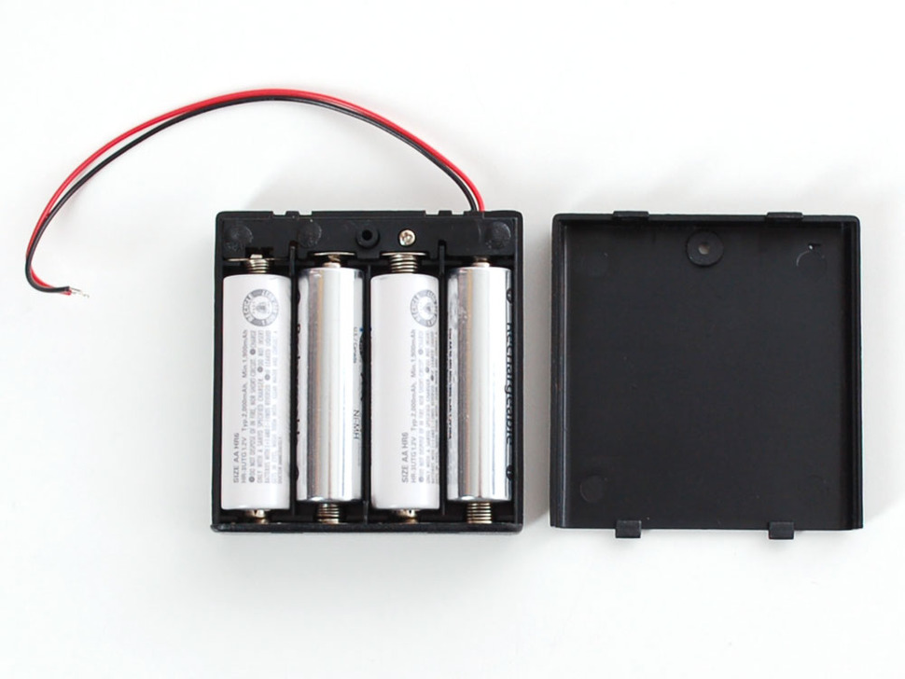
Significant Component Decisions
Temperature Sensor
GPS/GSM Module
Accelerometer
Heart Rate Sensor
Power Supply
WiFi/Bluetooth Module

Slide 14
Temperature Sensor: DS18B20
Thermometer sensor/Temperature sensor | DS18B20 | TMP36 | MCP9800/1/2/3
Criteria | Digital Thermometer ICs | Analog thermometer ICs | Digital Thermometer ICs
Precision | 0.5°C to 2 °C | ± 2°C | 0.5°C to 2 °C
Supply voltage | 3V - 5.5V | 2.7V - 5.5V | 2.7V - 5.5V
Supply current | 1 mA | Less than 50 µA | 200 µA
Size | small | small | small
Cost | $3.95 | $1.40 | $1.20

Slide 15
Heart Rate Monitor Sensor: SEN-11574
HeartRate Module | SEN 11574 | Max30100 | AD8232
Inputvoltage range | 3V - 5.5V | 1.7V - 2.0V | 2.0V - 3.5V
Input current | 3mA - 4mA | 600µA - 1200µA | 50nA - 200nA
Operating Temperature | -40°C - +85°C | -40°C - +85°C | -40°C - +85°C
Dimension | 16 mm x 3.8 mm (W x H) | 14.4 mm x 3.0 mm (W x H) | 4 mm x 4 mm (W x H)
Type | Pulse Sensor | Heart-rate monitor sensor | Heart-rate monitor
For use with/related products | Arduino | Arduino | Raspberry Pi or Beaglebone Black
Price | $24.95 | $12.56 | $19.95

Slide 16
Accelerometer sensor: MMA8451
Accelerometer module | ADXL345 | MPU-9250 | MMA8451 | LSM303
Range | ±2g, ±4g, ±8g, ±16g | ±2g, ±4g, ±8g, ±16g | ±2g, ±4g, ±8g | ±2g, ±4g, ±8g, ±16g
Interface | I2C, SPI | I2C, SPI | I2C | I2C
Sensing Axis | X, Y, Z | X, Y, Z | X, Y, Z | X, Y, Z
Voltage operation | 2V - 3.6V | 2.4V - 3.6V | 1.95V - 3.6V | 2.16V - 3.6V
Current Consumption | 140 µA | 450 µA | 6 µA to 165 µA | 110 µA
Type | Digital | Digital | Digital | Digital
Size | 3 mm x 5 mm x 1 mm | 3 mm x 3 mm x 1 mm | 3 mm x 3 mm x 1 mm | 3 mm x 5 mm x 1
Cost | $7.33 | $14.95 | $7.95 | $14.95

Slide 17
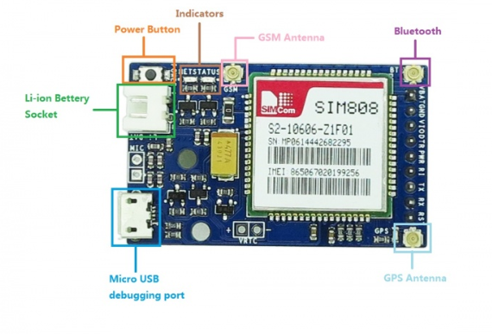
GPS+GSM Module: SIM808
GPS+GSM Module | Raspberry Pi GPRS/GPS Tracker HAT | SIM808 by iTead Studio | SIM808 by DFRobot
Support AT command | Yes | Yes | Yes
GSM network | Quad-band: (850/900/1800/1900)MHz | Quad-band: (850/900/1800/1900)MHz | Quad-band: (850/900/1800/1900)MHz
Operating Temperature | -40°C to +85 °C | -40°C to +85 °C | -40°C to +85 °C
Supply voltage | 5V | 5V | 5V
Tracking sensitivity | -165dBm | -165dBm | -165dBm
Dimensions (LxWxH) | (65x56.5x8)mm | (27x27x2.8)mm | (18x25.5x3.1)mm
Cost | $49.00 | $34.00 | $39.99

Slide 18
WiFi/Bluetooth Module: ESP32(WROOM32)
Wi-Fi/Bluetooth Module | SH-HC-08 | WT8266-S1 | ESP32(WROOM32)
Criteria | Bluetooth module | Wi-Fi Module | Wi-Fi and Bluetooth Module
Operating Temperature | -40°C to +85 °C | -40°C to +85 °C | -40°C to +85 °C
Supply voltage | 3.3V(3.0V - 6.0)V | 3.3V (3.0V - 3.6V) | 3.3 V (3.0-3.6V)
Frequency | 2.4 GHz | 2.4 GHz | 2.4GHz to 2.5GHz
Dimensions | (35.7x15.2x2.54)mm | (20x12.2 x2.9)mm | (18x25.5x3.1)mm Chip itself
Cost | $7.99 | $6.90 | $6.49

Slide 19
Power Supply: 9-Volt
Classification | Alkaline AAA | Alkaline AA | Alkaline C | Alkaline D
Nominal voltage | 1.5V | 1.5V | 1.5V | 1.5V
Operating Temperature | -18℃ - 55℃ | -18℃ - 55℃ | -18℃ - 55℃ | -18℃ - 55℃
Weight | 11.5 g | 23.0 g | 66 g | 139g
Shelf life | 10 years at 21℃ | 10 years at 21℃ | 10 years at 21℃ | 10 years at 21℃
Battery Capacity | 1.25 Ah | 2.85 Ah | 8.35 Ah | 20.5 Ah
External diameter | 10.5mm | 14.5mm | 26.2mm | 34.2mm
External Height | 44.5mm | 50.5mm | 50mm | 61.5mm
Cost | $2.49 (each) | $1.42 (each) | $3.00 (each) | $2.59 (each)
Component | Current draw | Input Voltage
Arduino Uno MCU | 50 mA | 7V - 12V (recommended)
ESP32 Wi-Fi/Bluetooth module | 80 mA | 3.0V - 3.6V
SEN 11574 Heart-Rate sensor | 4 mA | 3V - 5.5V
DS18B20 Temperature sensor | 1 mA | 3V - 5.5V
MMA8451 Accelerometer module | 11 mA | 1.95V - 3.6V
GPS + GSM module | 500mA (Included separately) | 3.4V (Included separately)
Result | The total current drawn is 146 mA | Nominal voltage at 3.5V. 9V for MCU

Slide 20
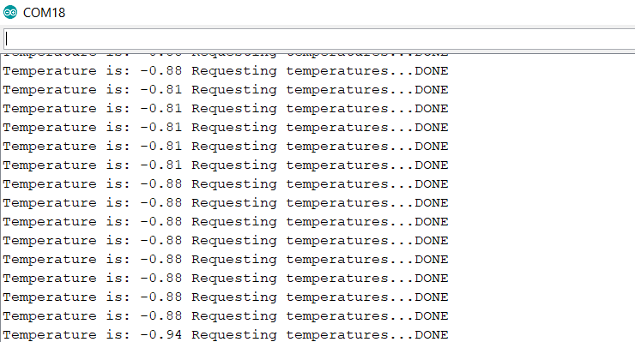
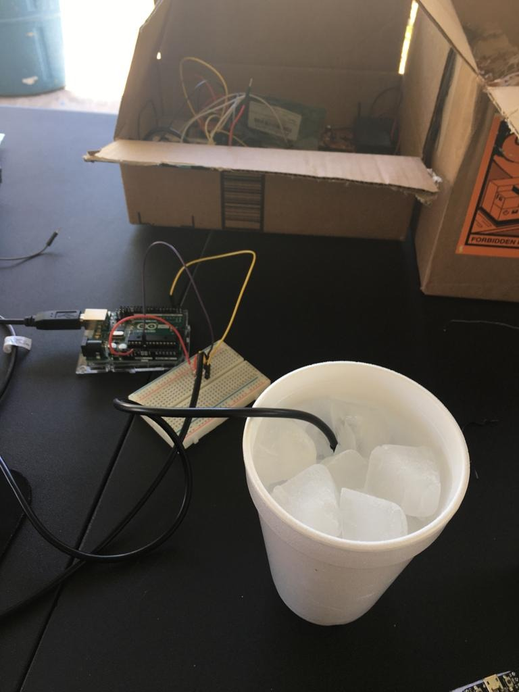
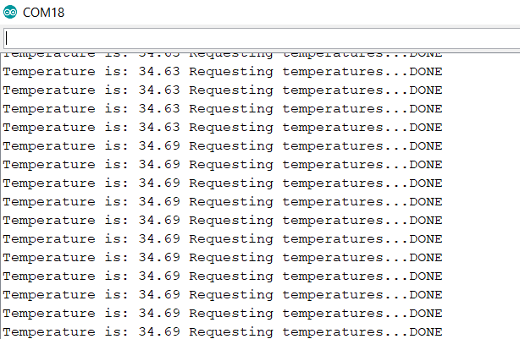
Prototype Hardware Testing: Temperature Sensor
Waterproof DS18B120
Sensor

Slide 21
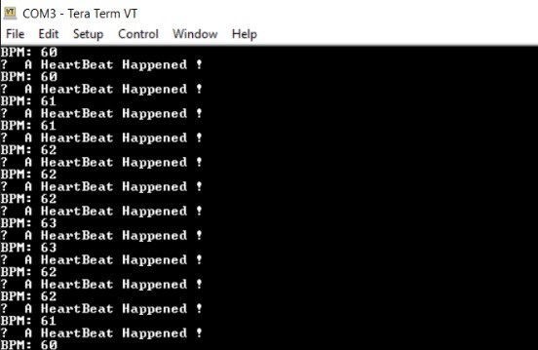
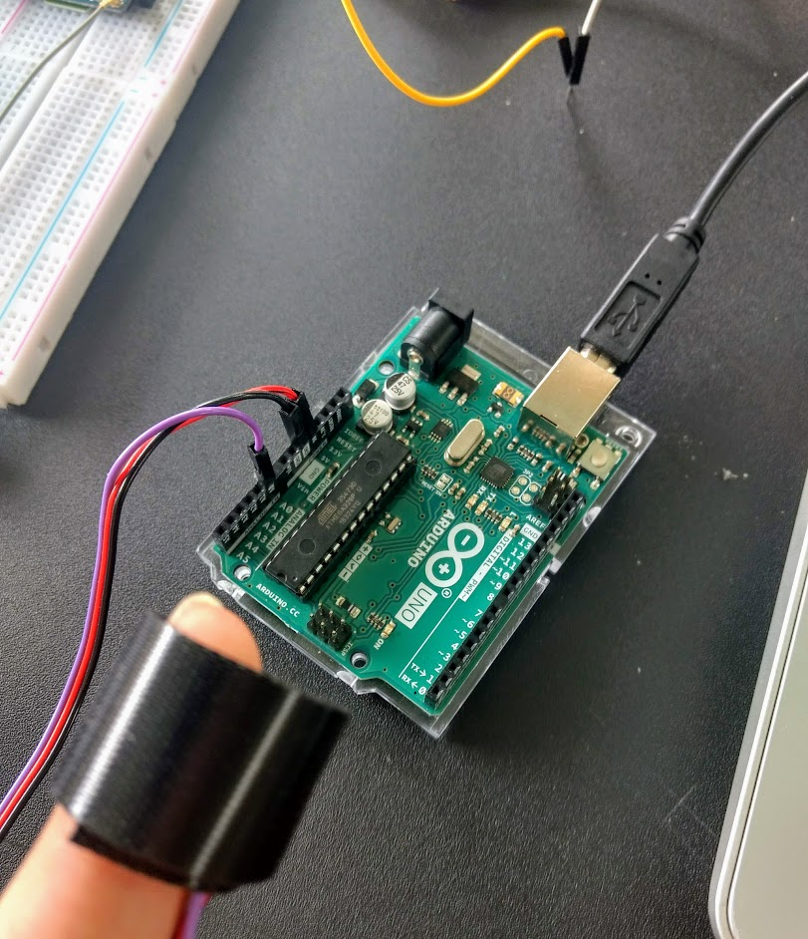
Hardware Testing: Heart Rate Sensor
Heart Rate Sensor: SEN-11574

Slide 22
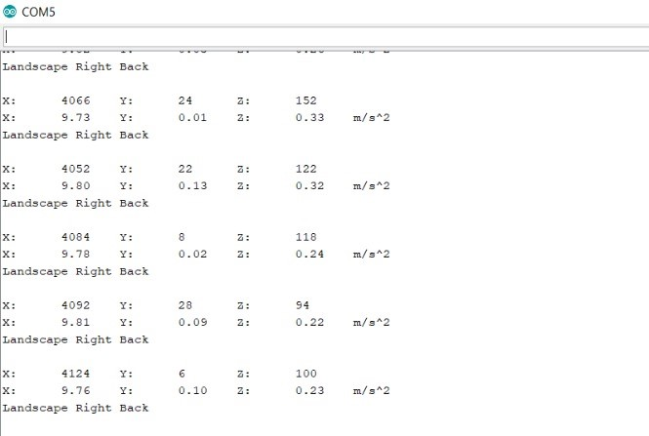
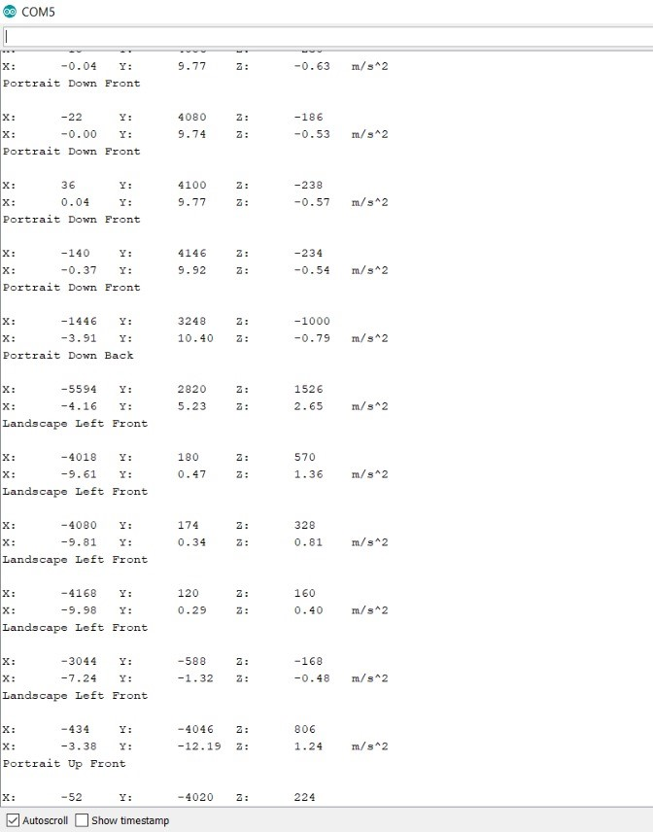
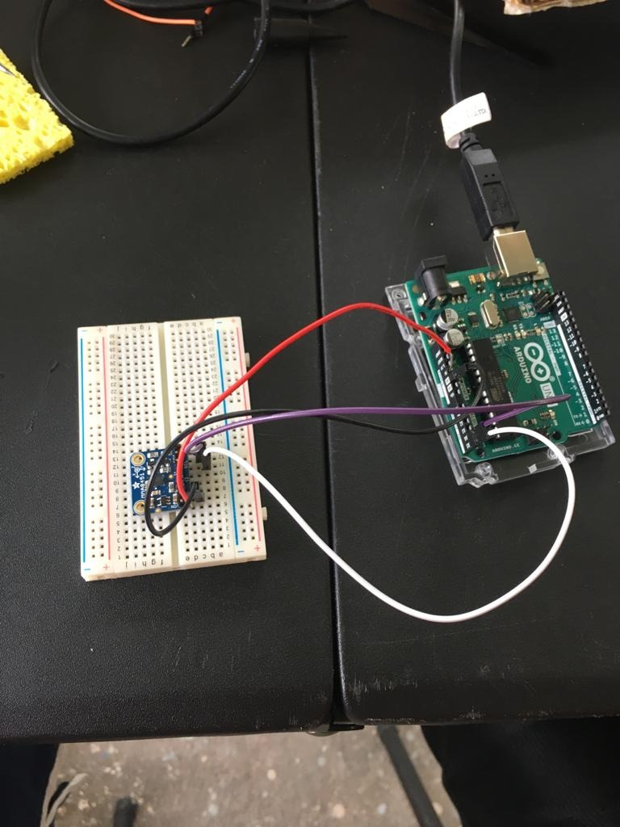
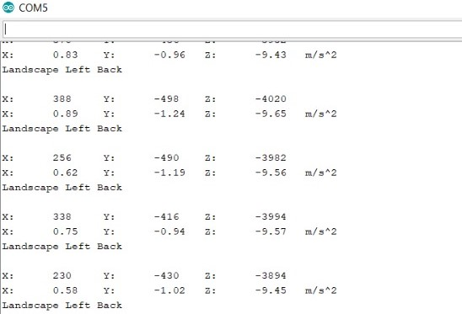
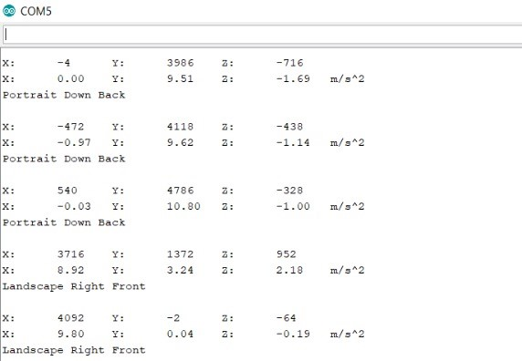
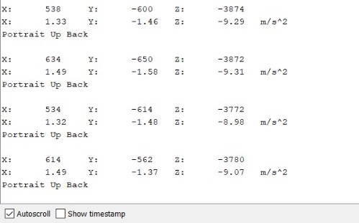
Hardware Testing: Accelerometer
Heart Rate Sensor:
MMA8451
Return Value: 0-7
Orientation:
Portrait Up Front,
Portrait Up Back,
Portrait Down Front,
Portrait Down Back,
Landscape Right Front,
Landscape Right Back,
Landscape Left Front,
Landscape Left Back

Slide 23
Hardware Testing: WiFi+Bluetooth Module
WiFi+Bluetooth Module: ESP32(WROOM32)

Slide 24
PetAid Harness Phone Application
Compatible with iOS, Android
Control panel for Harness devices
Feedback and analysis of data
Interface to contact support

Slide 25
Phone Application Layout
Account registry/login
Status condition display/harness manager
Hardware/software settings
Support contact

Slide 26
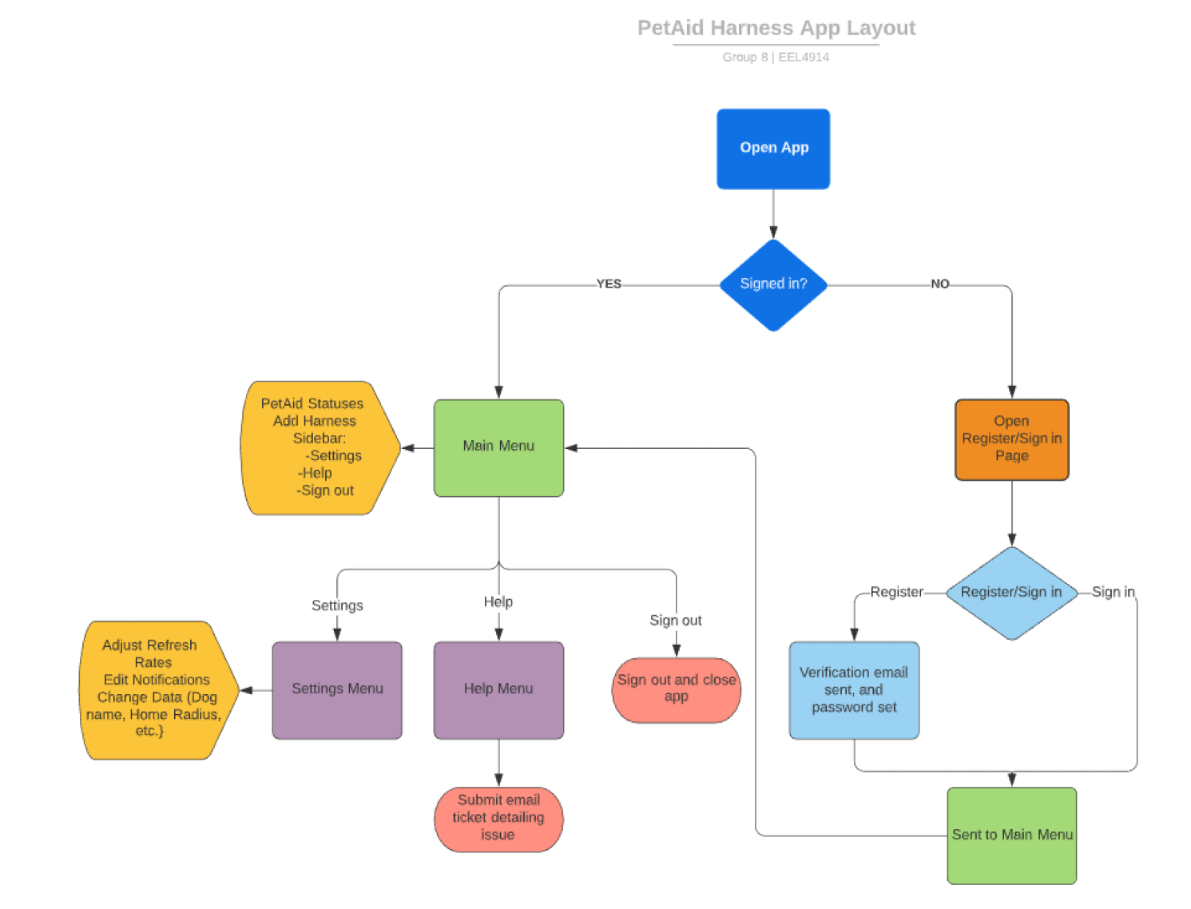
Phone Application Layout (cont.)
Registry uses email address and password
Account is used for harness security and contact
Multiple harnesses can be added and monitored

Slide 27
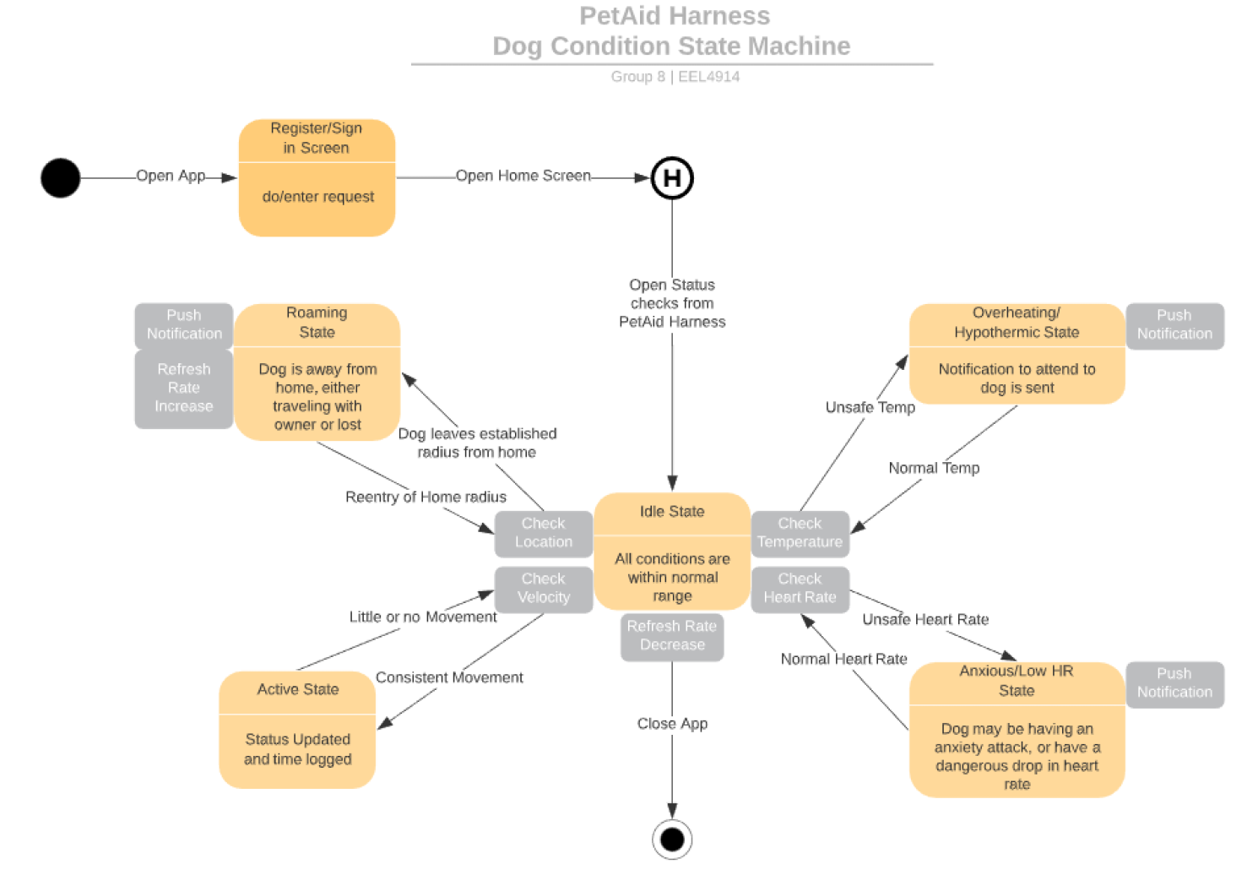
Phone Application Layout (cont.)
Status determined by values given by each biometric peripheral
Notifications given when certain conditions are met
Conditions range in body heat, heart rate, position, and velocity

Slide 28
Project Successes
Acquired all parts needed.
Individual Prototype testing
Solder pin headers onto MMA8451
Solder pin headers onto Logic-Level Converter
Implementation of DS18B20+ and SEN-11574
Gather and Receive all materials
Hardware Test
Brainstorm & Project Plan

Slide 29
Project Difficulties
Ethical difficulties with testing
Difficulty meeting
Other commitments
GPS had not been tested
GSM sending SMS
Heart Rate test w/ECG Simulator app
Placement of peripherals

Slide 30
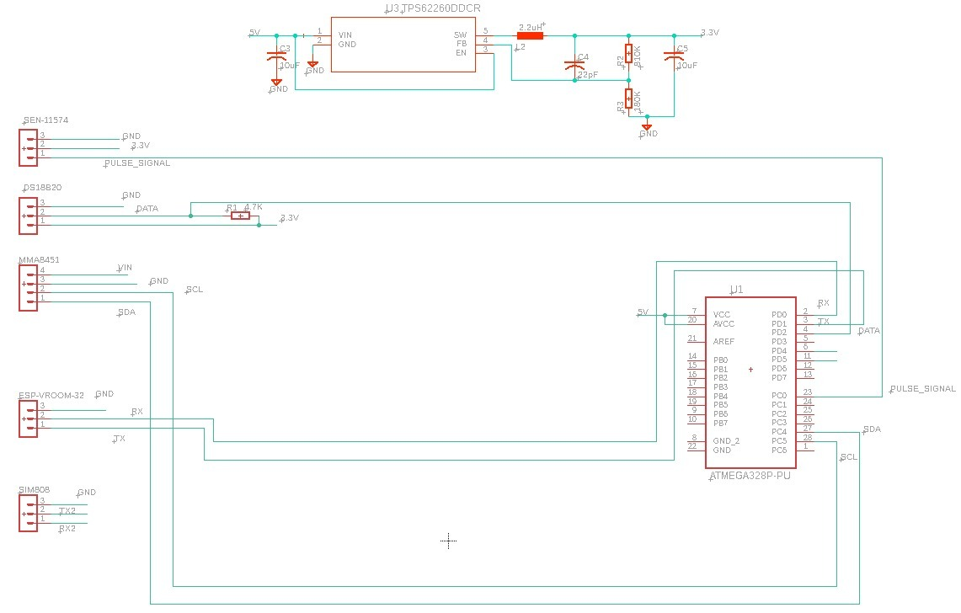
Hardware Schematic

Slide 31
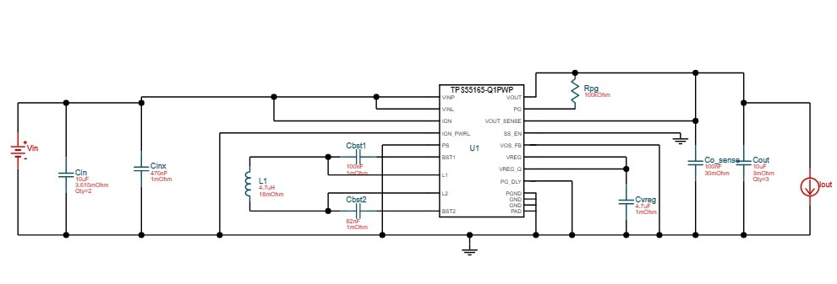
Schematic: Power Supply
Input 6V- Output 5V DC-to-DC Converter

Slide 32
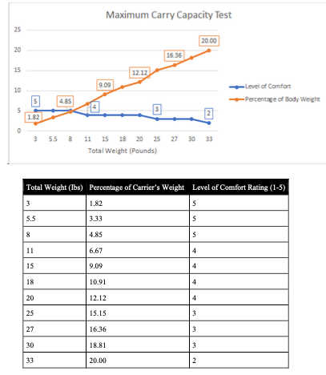
Standards
Development of new pet care standards
Standard PAH-1.1: On carrying capacity of house pets
Standard PAH-1.2: On temperature sensitivity of house pets

Slide 33
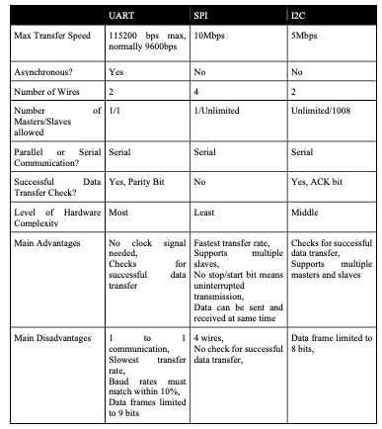
Standards
Microcontroller data communication standards
UART
SPI
I2C

Slide 34
Standards
Alkaline Power Supply Standards
IEEE.org (Standard 1625)
Batterypoweronline.com (ANSI standard C18.2M)
Bluetooth Standards
IEEE 802.15.1

Slide 35
Budget & Finance Cost

Slide 36
Project Progress

