Slide 1
FINAL PRESENTATION
Presented By:
Annette Barboza
Ayanna Ivey
Brandon Kessler
Group 13
Sound Enhancing Autonomous Network
Sponsored By:
July 29th 2019
Notes:
brandon

Slide 2
Special Thanks
Applied Research – Sensor Systems and Technology
Director: Scott Nelson
Mentor: Jonathan Tucker
Notes:
brandon

Slide 3
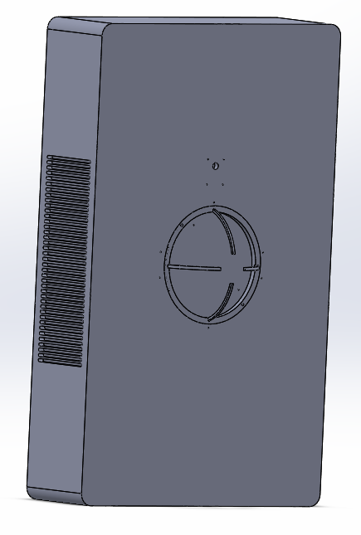
Project Idea
Sound Enhancing Autonomous Network (Sean): Portable device designed to be an improved hearing aid alternative focused on human-to-human conversation.
Enhance the sound of another human’s voice
Utilize multiple microphones to identify the location of signals
Employ camera to determine if and where humans are in the scene
User interacts with system though a phone app
Notes:
annette

Slide 4
Motivation & objectives
Main Motivation:
Current hearing aides do not effectively amplify desired signals and attenuate unwanted noise
Objectives:
Provide a directed sound experience that allows the user to have a seamless conversation with another person and control the level of background noise
Prove that there is value in integrating a visual aspect to a hearing aid
Create a comfortable wearable platform that highlights the utility of a portable system
Be a user-friendly and intuitive product
Stay under budget of $2000
Notes:
annette

Slide 5
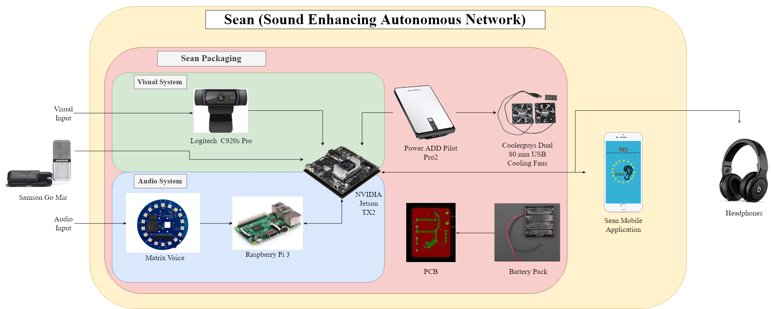
System design
Notes:
Brandon

Slide 6
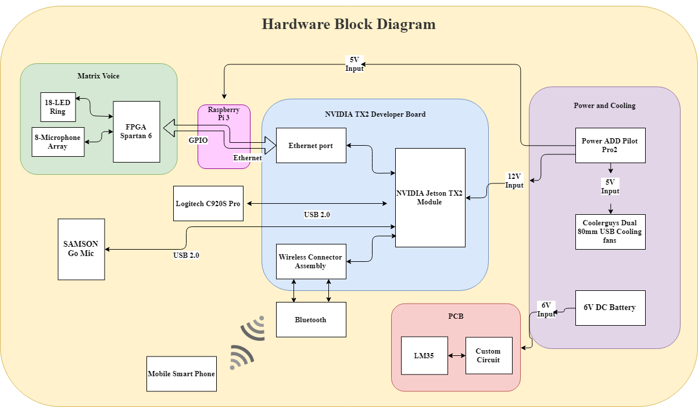
Notes:
Brandon

Slide 7
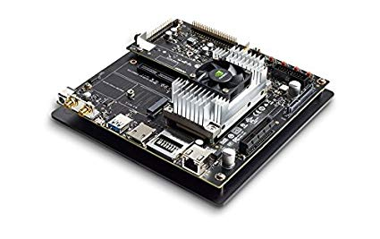
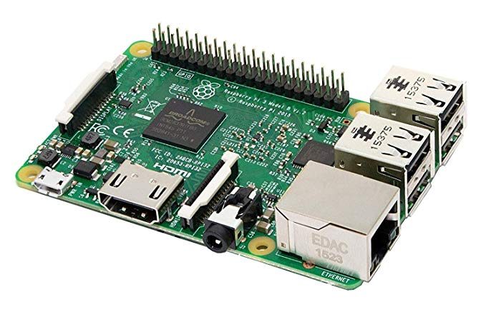
Processors
Processor | GPU | CPU | Wireless Compatibility | Price | Power
Jetson TX2 Developer Kit | 256-core Pascal GPU | 2 Denver 64-bit CPUs + Quad-Core A57 | Bluetooth® 4.1 and WiFi enabled | $600 | 7.5W / 15W
Raspberry Pi 3 | Broadcom VideoCore IV | Quad-Core ARM Cortex-A53 | Bluetooth® 4.2 and WiFi enabled | $35 | 1.2 W
TX2 Functions:
Run deep learning face detection algorithm
Host for Raspberry pi 3
Run algorithm to merge audio and visual outputs
Display face detection live feed
Capture raw audio and outputting processed audio
Raspberry Pi 3 Functions:
Collect information from microphone array
Run Direction of Arrival (DOA) algorithm
Save DOA outputs
Notes:
Brandon

Slide 8
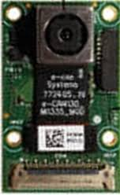
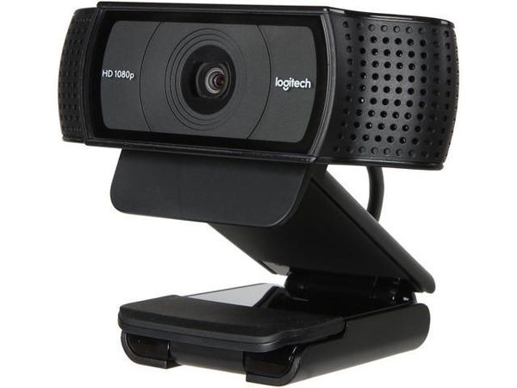
Camera
Camera Module | Resolution | FOV
e-CAM132_TX2 | 13MP (4192 x 3120) | 74.4°(D) 60.2°(H) 46.4°(V)
Logitech C920s Pro | 1920 x 1080 | 78.0°(D) 72.4°(H) 44.7°(V)
Original Camera: e-CAM132_TX2
Optimized for TX2
Achieved 20 – 25 FPS during face detection
Broke during testing; likely due to Electrostatic Discharge
New Camera: Logitech C920s Pro
USB camera with similar FOV
Easy to integrate with existing code
Achieves 15 – 20 FPS during face detection when resizing the image to 640 x 480
Notes:
Brandon

Slide 9
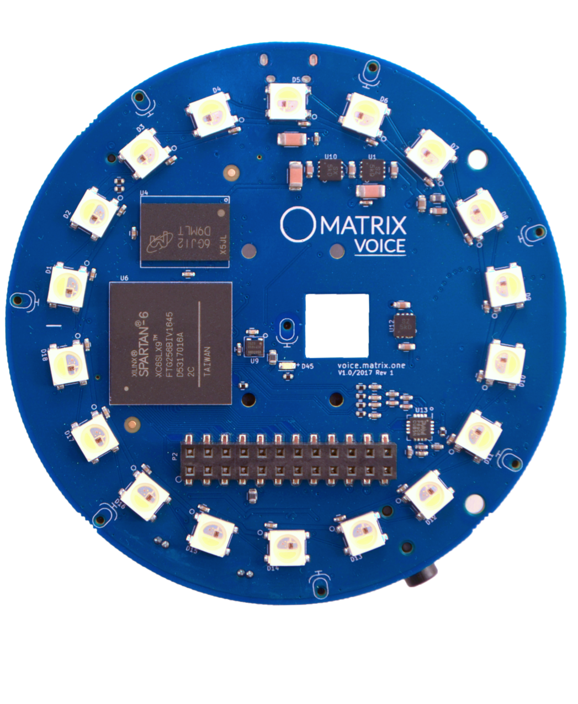
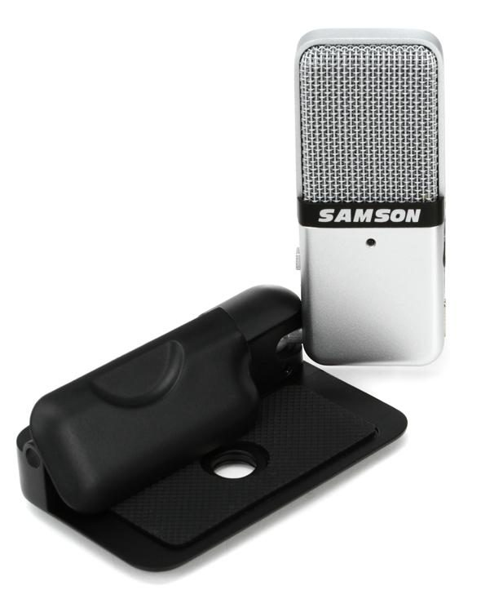
Microphones
Matrix Voice
8 microphones
SNR=62.5 dB
THD
<1% @ 100dBSPL
<5% @ 115dBSPL
Samson Go Microphone
1 microphone
Directionality patterns:
Cardioid
Omnidirectional
16-bit, 44.1kHz resolution
Notes:
Annette

Slide 10
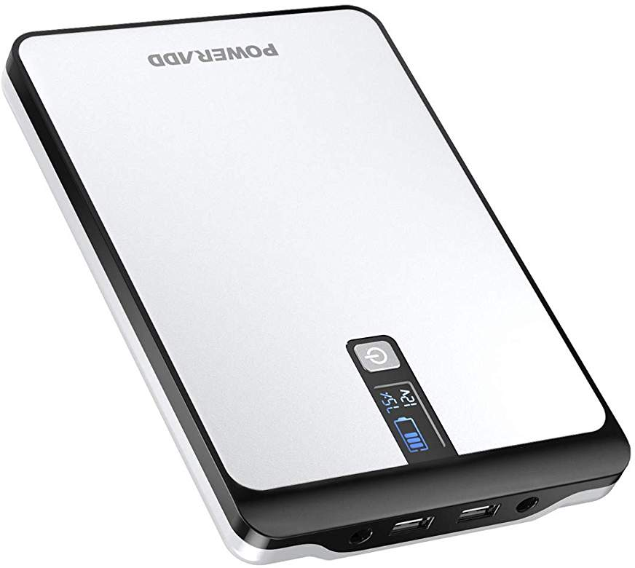
Power Supply
4 x Double A Batteries (6V)
PCB
Pilot Pro
TX2
USB Cooling Fans
Raspberry Pi
Notes:
Ayanna

Slide 11
Wireless communication
Bluetooth
Used to connect to headphones or a speaker within Mobile App
Gstreamer
A pipeline-based framework used for streaming media applications
Compatible with iOS and TX2
Streams over Wi-Fi
Con: Degrades audio quality
Notes:
Ayanna

Slide 12
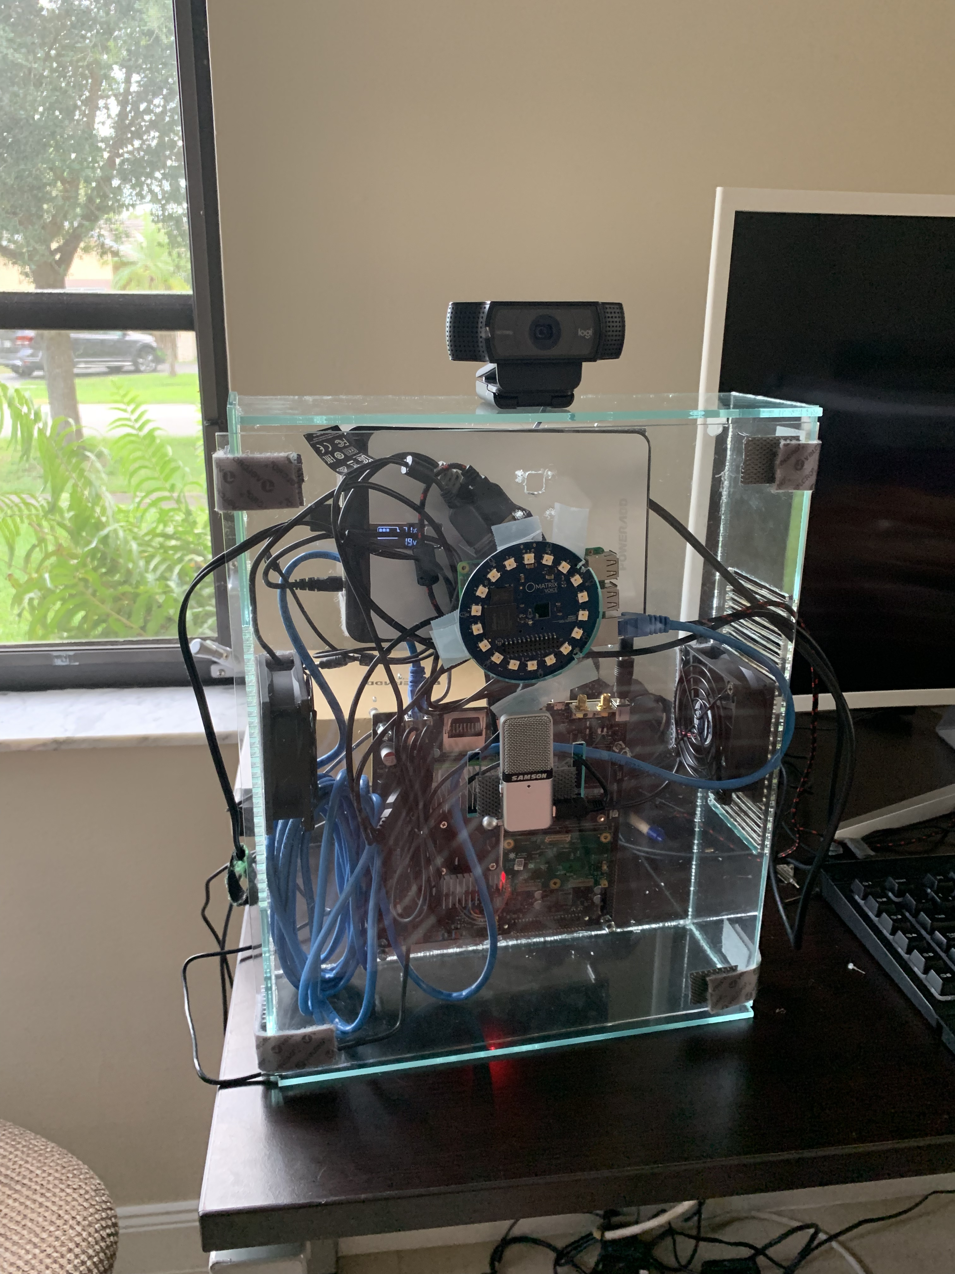
Final Packaging
Laser printing
More sensible for a simple design
Takes less time than 3D printing
Better for larger projects
Acrylic
Durable
Impact Resistant
Notes:
Ayanna

Slide 13
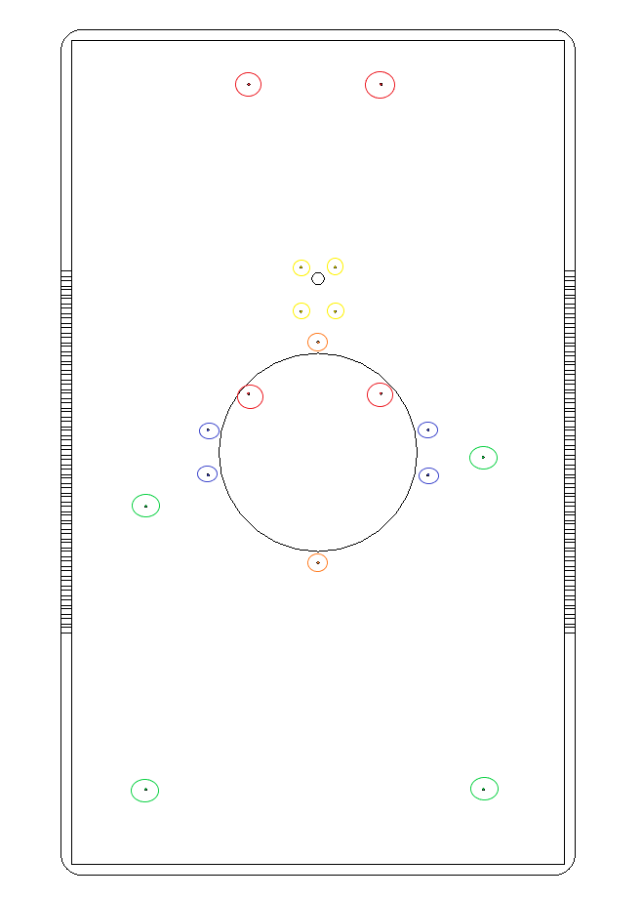
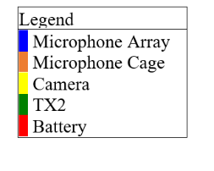
final Packaging design
Table 18 -- Dimensions of Sean Packaging
Component | Part Name | Length (mm) | Width (mm) | Height (mm) | Thickness (mm)
Rectangular casing | Housing for processor, PCB, and battery | 394.46 | 240 | 76.20 | 5
Notes:
Ayanna – annette pit picv

Slide 14
Safety
Notes:
ayanna

Slide 15
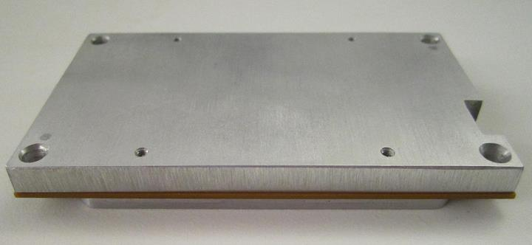
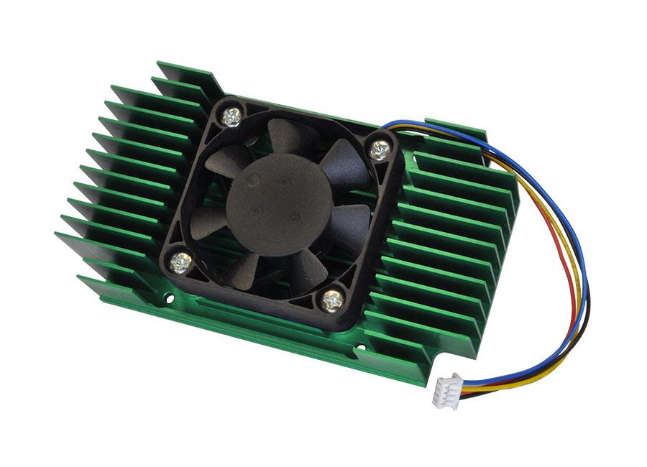
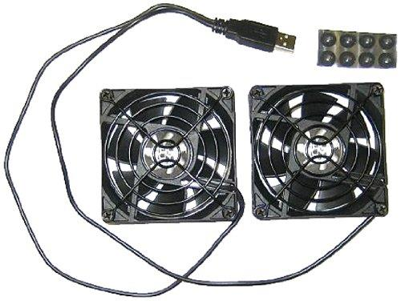
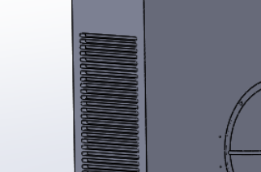
Packaging
TX2 Thermal Cooling Plate
TX2 built in fan
USB Cooling Fan
Cooling
TX2 built in cooling
Vents in packaging
USB Fans
Packaging
Sean Vents
Notes:
Ayanna – put pic pf venting

Slide 16
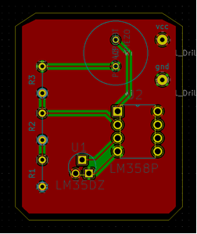
Printed circuit board
Beeps continuously when the temperature in the packaging reaches 43 C and does not cease until temperatures drop below again.
LM358P is used as a comparator to trigger 5V to be supplied to piezoresistive buzzer once the output of the LM35DZ passes reference voltage from the voltage divider circuit
Notes:
Annette - schematic

Slide 17
Software Design Overview
Notes:
aNNETTE

Slide 18
Audio Processing Algorithm
Direction of Arrival (DOA)
Energy is determined by the amplitude and duration of the signal
( Longer and Louder signals = Higher Energy) Lights up LEDs blue or green in the direction of a signal with a high enough "energy level"
Blue: source with high enough energy detected
Green: source that has built up enough energy to be classified as a potential person the user cares about listening to
Angle of direction of the source is measured and sent to cross-reference with the location of any human face detections in the visual algorithm
Notes:
Annette

Slide 19
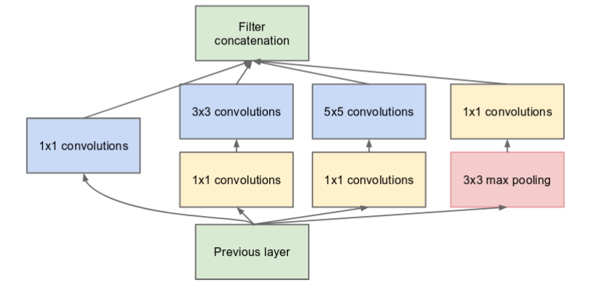
Visual Processing Algorithm
InceptionNet Module
Human Face Detection
Goal: Identify Humans in FOV as likely candidates to be talking to the user
Deep-learning based approach: FaceNet
Convolutional Neural Network using InceptionNet
as base network fine tuned on faces.
Trains on sets of 3 images that are different in size, lighting, and pose
Open source network built with caffe framework
Codebase set up to use any compatible camera
Smooths detection over time
Only considers detections that have been collected 10 frames in a row
Allows detections to persist until there are 10 missed detections in a row
Notes:
Brandon v
Variant of yolo
Video

Slide 20
Merging Audio and Visual SPaces
Camera and microphone array are center aligned
Spaces are divided up into 4 vertical slices
Audio and visual detections correspond to one of the 4 slices
A detection in the audio space occurs when energy from that slice reaches the threshold (light turns green)
Detection in visual space occurs when a human face is detected. (Confidence value > 0.5)
Audio is amplified when detections are found in the same slice in both domains
Microphone Angle Space
72.4°
Camera Angle Space
0°
0
1
2
3
44.7°
Notes:
Brandon
Make ocmments about resolution

Slide 21
Audio Mixing
Environment Based
 | Tier 1 Amplification | Tier 2 Amplification
State | No confirmed human face detection mapped to a voice | Confirmed human face detection mapped to a voice
Gain | 1 | *1.9
High Noise
Ex: Restaurant, lobby
Gain*Y
Medium Noise
Ex: Classroom,
Gain*X
Low Noise (Default)
Ex: Quiet room
Gain*1
NOTE: X>1, Y>X
*1.9 was tested with a participant and was found to be a good level of amplification.
Notes:
Annette

Slide 22
Sean mobile app symbology example
Combining Visual and Audio Detections to Produce Visual Display with Symbology Overlayed
Final Audio Output
Audio is amplified by default 1.9 through Gstreamer. This amplification does result in some distortion.
Final Visual Output
Notes:
Annette (how to remerge) and brandon

Slide 23
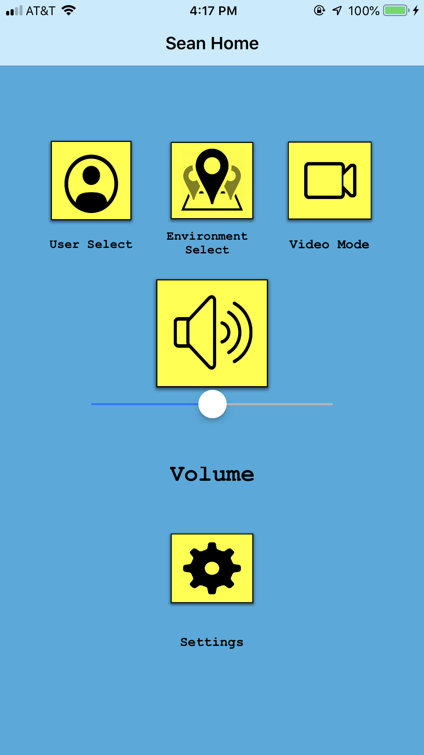
Mobile application - user interface
Notes:
Ayanna

Slide 24
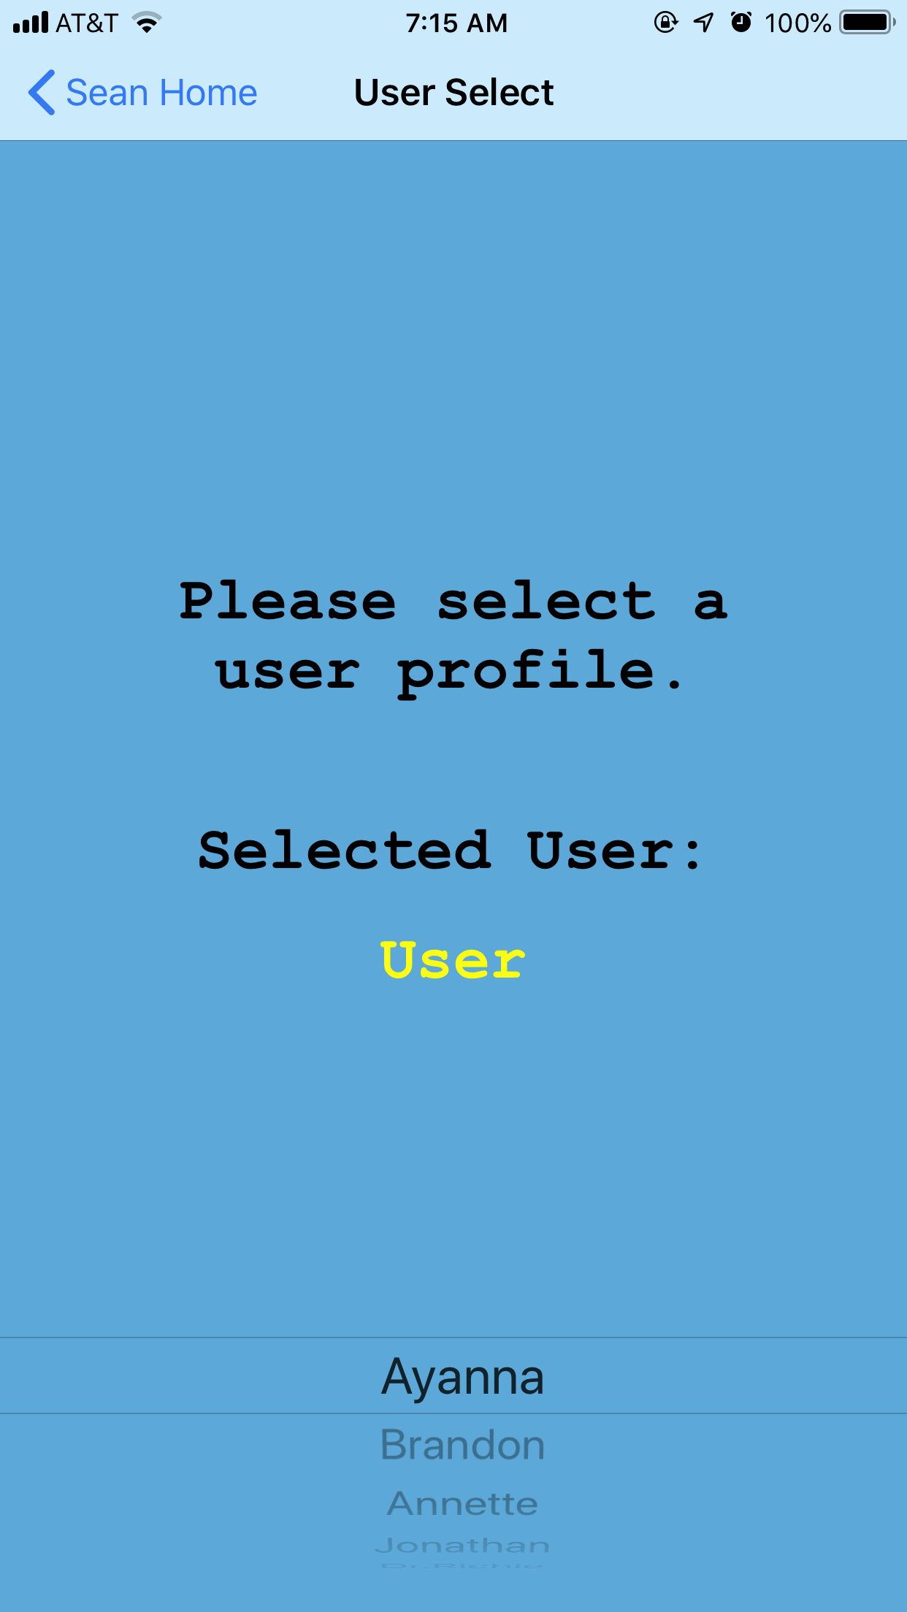
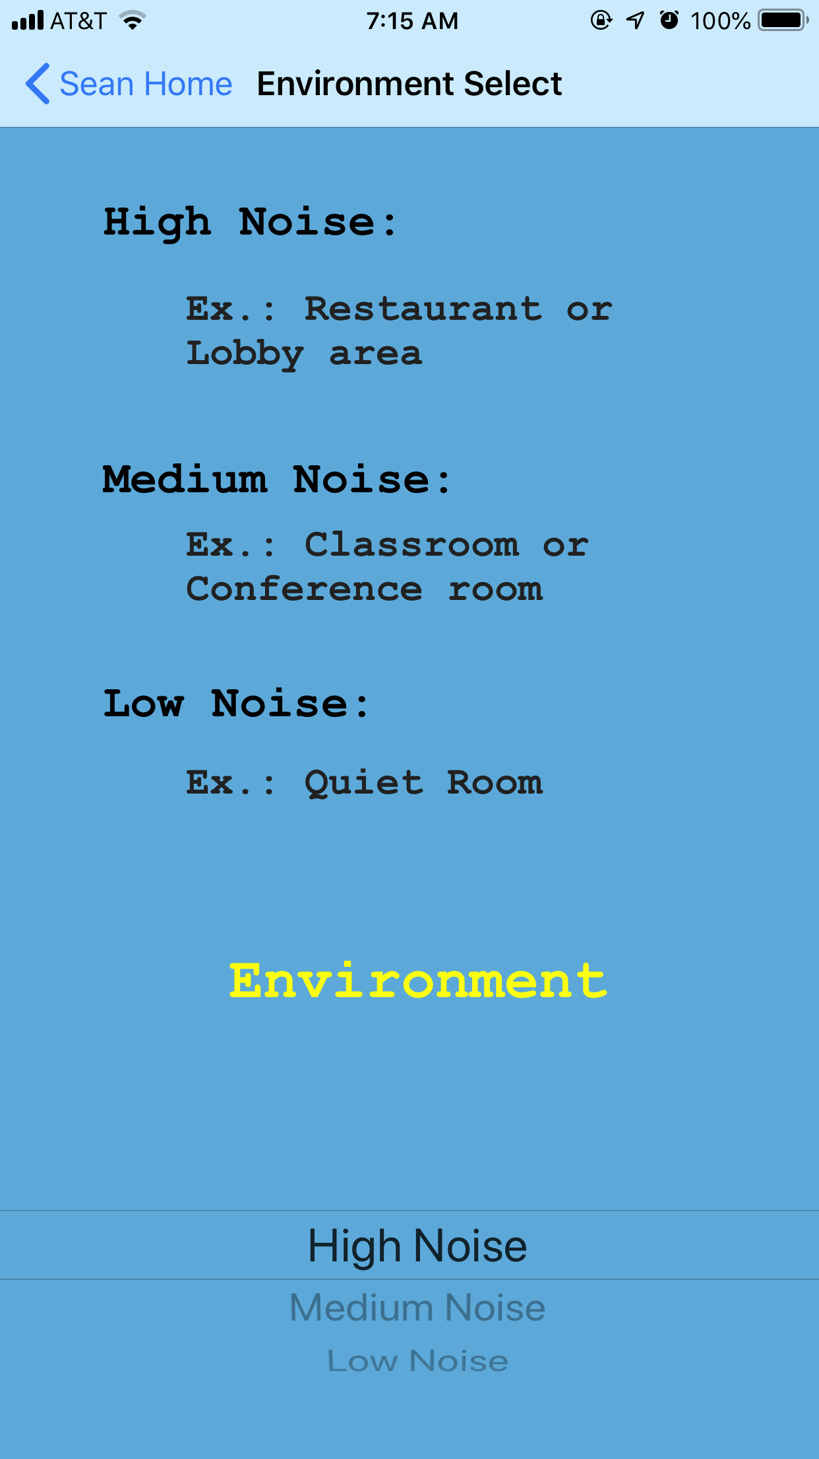
Mobile application - DESIRED FEATURES
User Select
Environment Select
Settings
Video Mode
Notes:
Ayanna

Slide 25
Materials & Budget
Item | Price
Microphone array | $61.05
Double A Batteries and battery holder | $11.72
Camera | $284.00
1st PCB | $27.00
2nd PCB | $26.10
Power Source | $80.00
USB Cooling Fans | $13.95
Processors | $0.00
Microphone array processor | $37.27
RPi Memory | $10.54
Thermal Sensor Circuit | $30.00
Thermal Sensor | $6.35
Op Amp | $9.49
Item | Price
LEDs | $4.99
Wifi Adapter | $8.99
Acrylic (2 sheets) | $80.84
Monitor + Keyboard + Mouse | $141.61
Mounting adhesive stickers | $7.99
1ft ethernet cables | $6.99
Harness | $16.85
Beeper | $8.99
Lowes Screws | $1.37
Home depot screws (1) | $6.98
Michael's mounting supplies | $15.58
Velcro | $19.57
Item | Price
GOMIC USB MICROPHONE | $42.59
LOGITECH C920S PRO HD WEBCAM | $74.54
Screws and Spacers | $11.73
VCE HDMI Male to VGA Female Converter Adapter | $8.99
2nd TX2 | $607.04
Total: | $1647.77
Remaining: | $352.23
Notes:
Ayanna
What to do with extra money

Slide 26
Demo

Slide 27
SEAn mobile app
https://youtu.be/Tukr-ofB_SU

Slide 28
PCB Video
https://youtu.be/zx9sFiW92N0

Slide 29
Demo Test case 1
CASE dESCRIPTION:
User is alone, no other people, no unexpected noise.
Desired result:
“Natural” and clear environment noise.
Notes:
Annette

Slide 30
Demo Test case 2
CASE dESCRIPTION:
User is with one other person (not talking) and noise in the background.
Desired result:
“Natural” and clear environment noise.
Notes:
Annette

Slide 31
Demo Test case 3
CASE dESCRIPTION:
User is with one other person who is in front of the camera talking.
Desired result:
Signal is amplified with Target’s voice.
Notes:
Annette

Slide 32
Demo Test case 4
CASE dESCRIPTION:
Case 3 with another person in the background not talking.
Desired result:
Signal is amplified with Target’s voice.
Notes:
Annette

Slide 33
Demo Test case 5
CASE dESCRIPTION:
User is with two people having their own conversation in the background.
Desired result:
Nothing is amplified. “NATURAL” AND CLEAR ENVIRONMENT NOISE.
Notes:
Annette

Slide 34
Results
Test Results
Case | Results and Feedback
1 | 3, Sound is the same as hearing aid in ideal environment.
2 | 3, Sound is the same as hearing aid in ideal environment.
3 | 4, Voice comes through clear and accurate timing of amplification. Again, consider ideal environment.
4 | 4, Voice comes through clear and accurate timing of amplification. Inconsistent recognition and amplification.
5 | 4, Nothing was amplified as we did not care about that separate conversation.
Proved the value of adding a visual aspect to a hearing aid in order to focus more on human to human interaction
Needs more testing in nonideal environments
Limitations:
User only wants to talk to one person at one time.
User cannot speak.
"On a scale of 1 to 5, please rate how Sean operates in the given situation in reference to the hearing aids you use daily."
1=Totally worse than my current hearing aids
2= Slightly worse than my current hearing aids
3=About the same as my current hearing aids
4=Slightly better than my current hearing aids
5=Totally better than my current hearing aids
Notes:
Annette

Slide 35
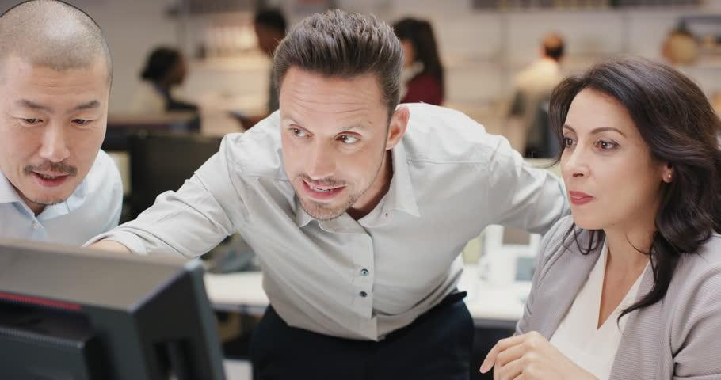
Future work and Considerations
Time was the most valuable and limited resource
More testing with hearing impaired persons
Focus on developing audio algorithms further
Complete what was initially planned
User voice filter
Separation of signals
Confidence based Audio Mixing
Full implementation of Gstreamer within Sean Mobile App
Complete what was initially planned
Path to miniaturization
Reduce weight and size
Human Face Detection Output
Aligned Audio Space Output
- Face Detected
- High-Confident Voice Detection
- Mid-Confident Voice Detection
Final Output
- Face Detected and Voice Signal Amplified
- Face Detected but No Voice Signal
- No Face Detected and Voice Signal Attenuated
Notes:
Everyone

