Slide 1
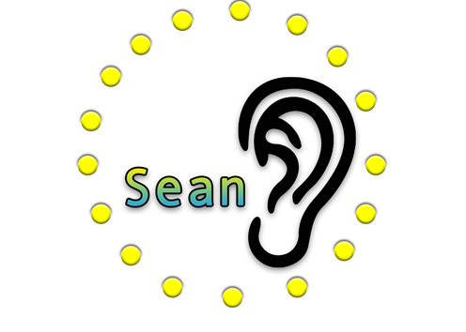
Critical Design Review
Presented By:
Annette Barboza
Ayanna Ivey
Brandon Kessler
Group 13
Sound Enhancement Autonomous Network
Sponsored By:
June 14th 2019
Notes:
Brandon

Slide 2
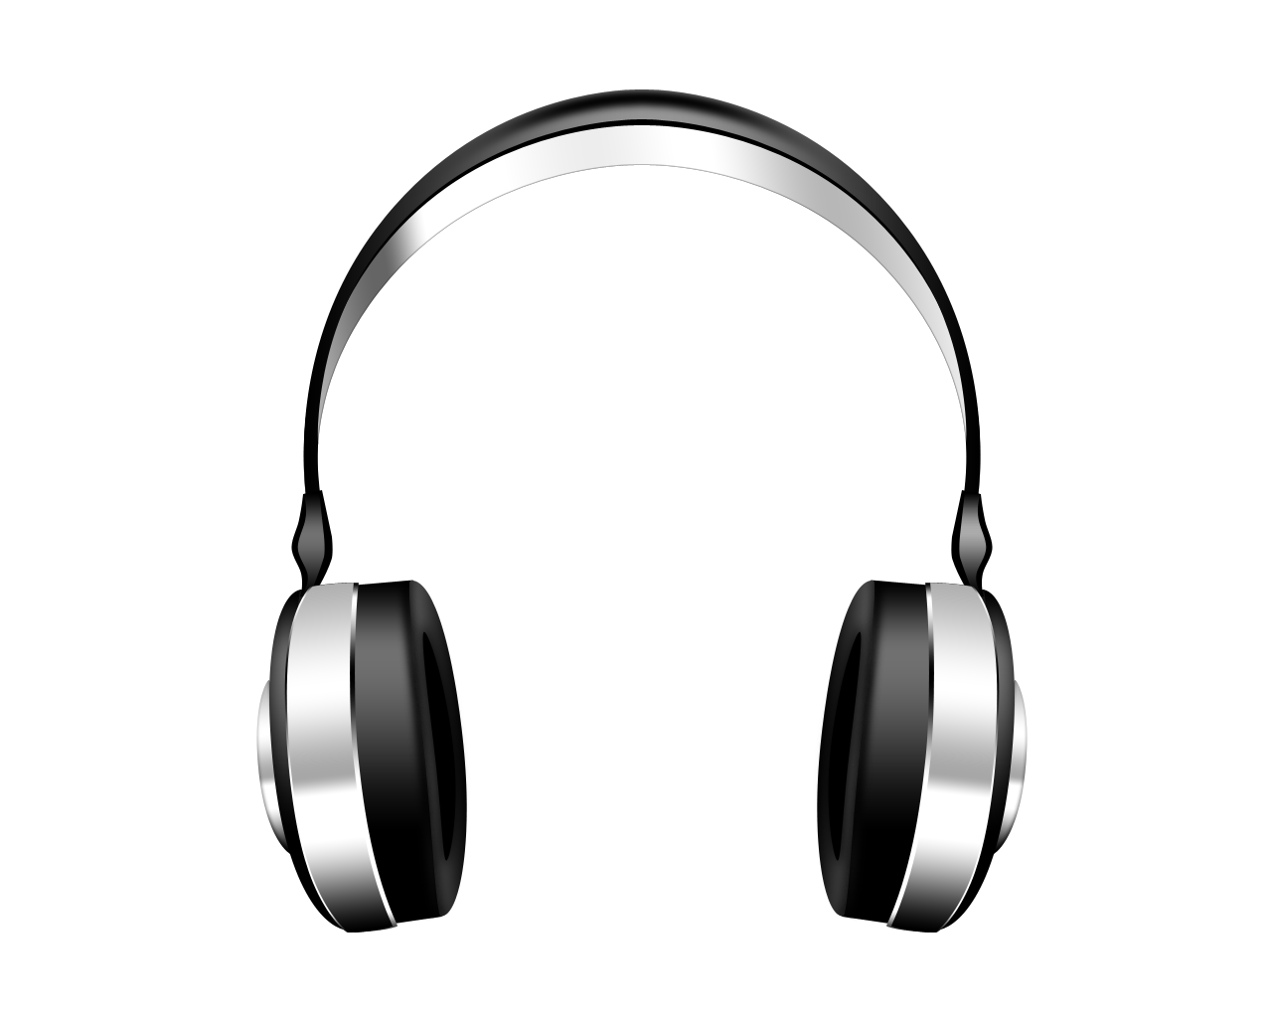
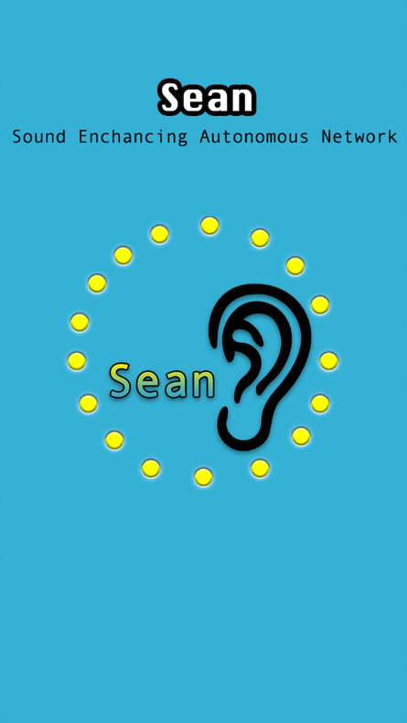
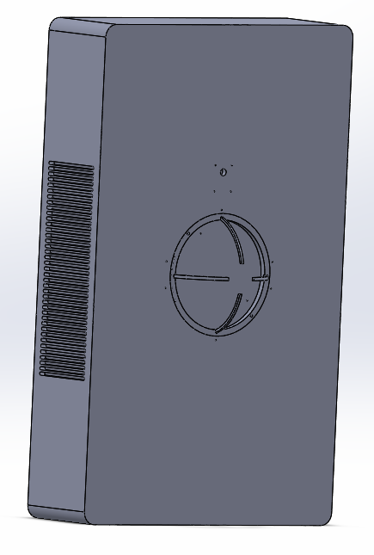
Project Idea
Sound Enhancing Autonomous Network (Sean): Portable device designed to be an improved hearing aid alternative focused on human-to-human conversation.
Enhance the sound of another human’s voice
Filter background noise and attenuate structured background signals
Utilize multiple microphones to identify the location of signals
Employ camera to determine if and where humans are in the scene
User interacts with system though a phone app
Notes:
Brando n

Slide 3
Motivation & objectives
Main Motivation:
Current hearing aides do not effectively amplify desired signals and attenuate unwanted noise
Objectives:
Provide a directed sound experience that allows the user to have a seamless conversation with another person and control the level of background noise
Create a comfortable wearable platform that highlights the utility of a portable system
Be a user-friendly and intuitive product
Stay under budget of $2000
Notes:
Brandon

Slide 4
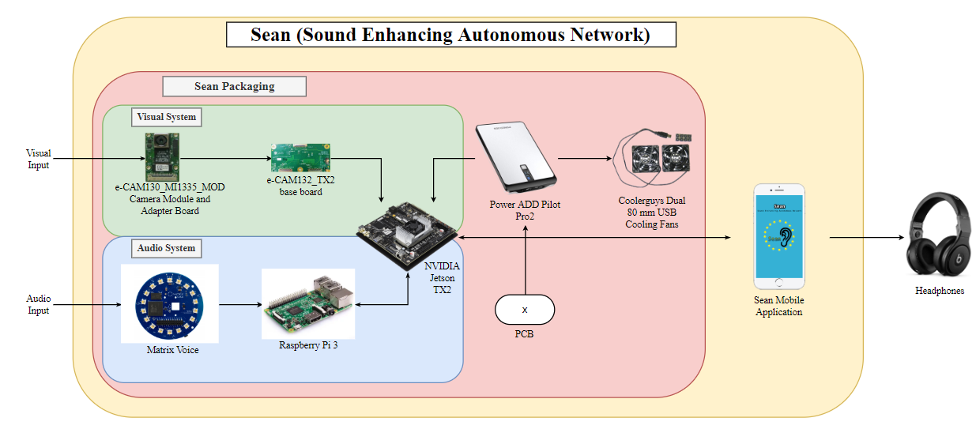
System design
Processors
Camera
Microphone Array
Packaging
Power Supply
Wireless Communication
PCB
Notes:
Ayanna

Slide 5
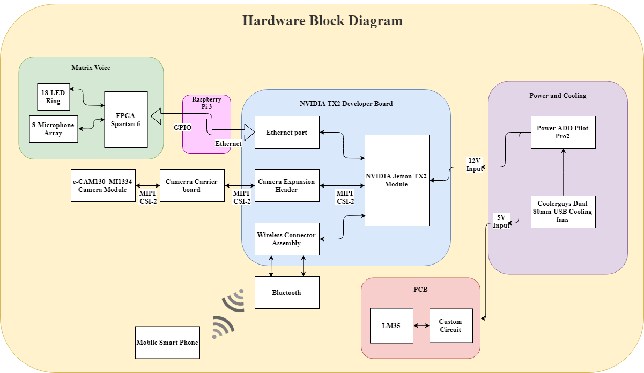
Hardware Design
Notes:
brandon

Slide 6
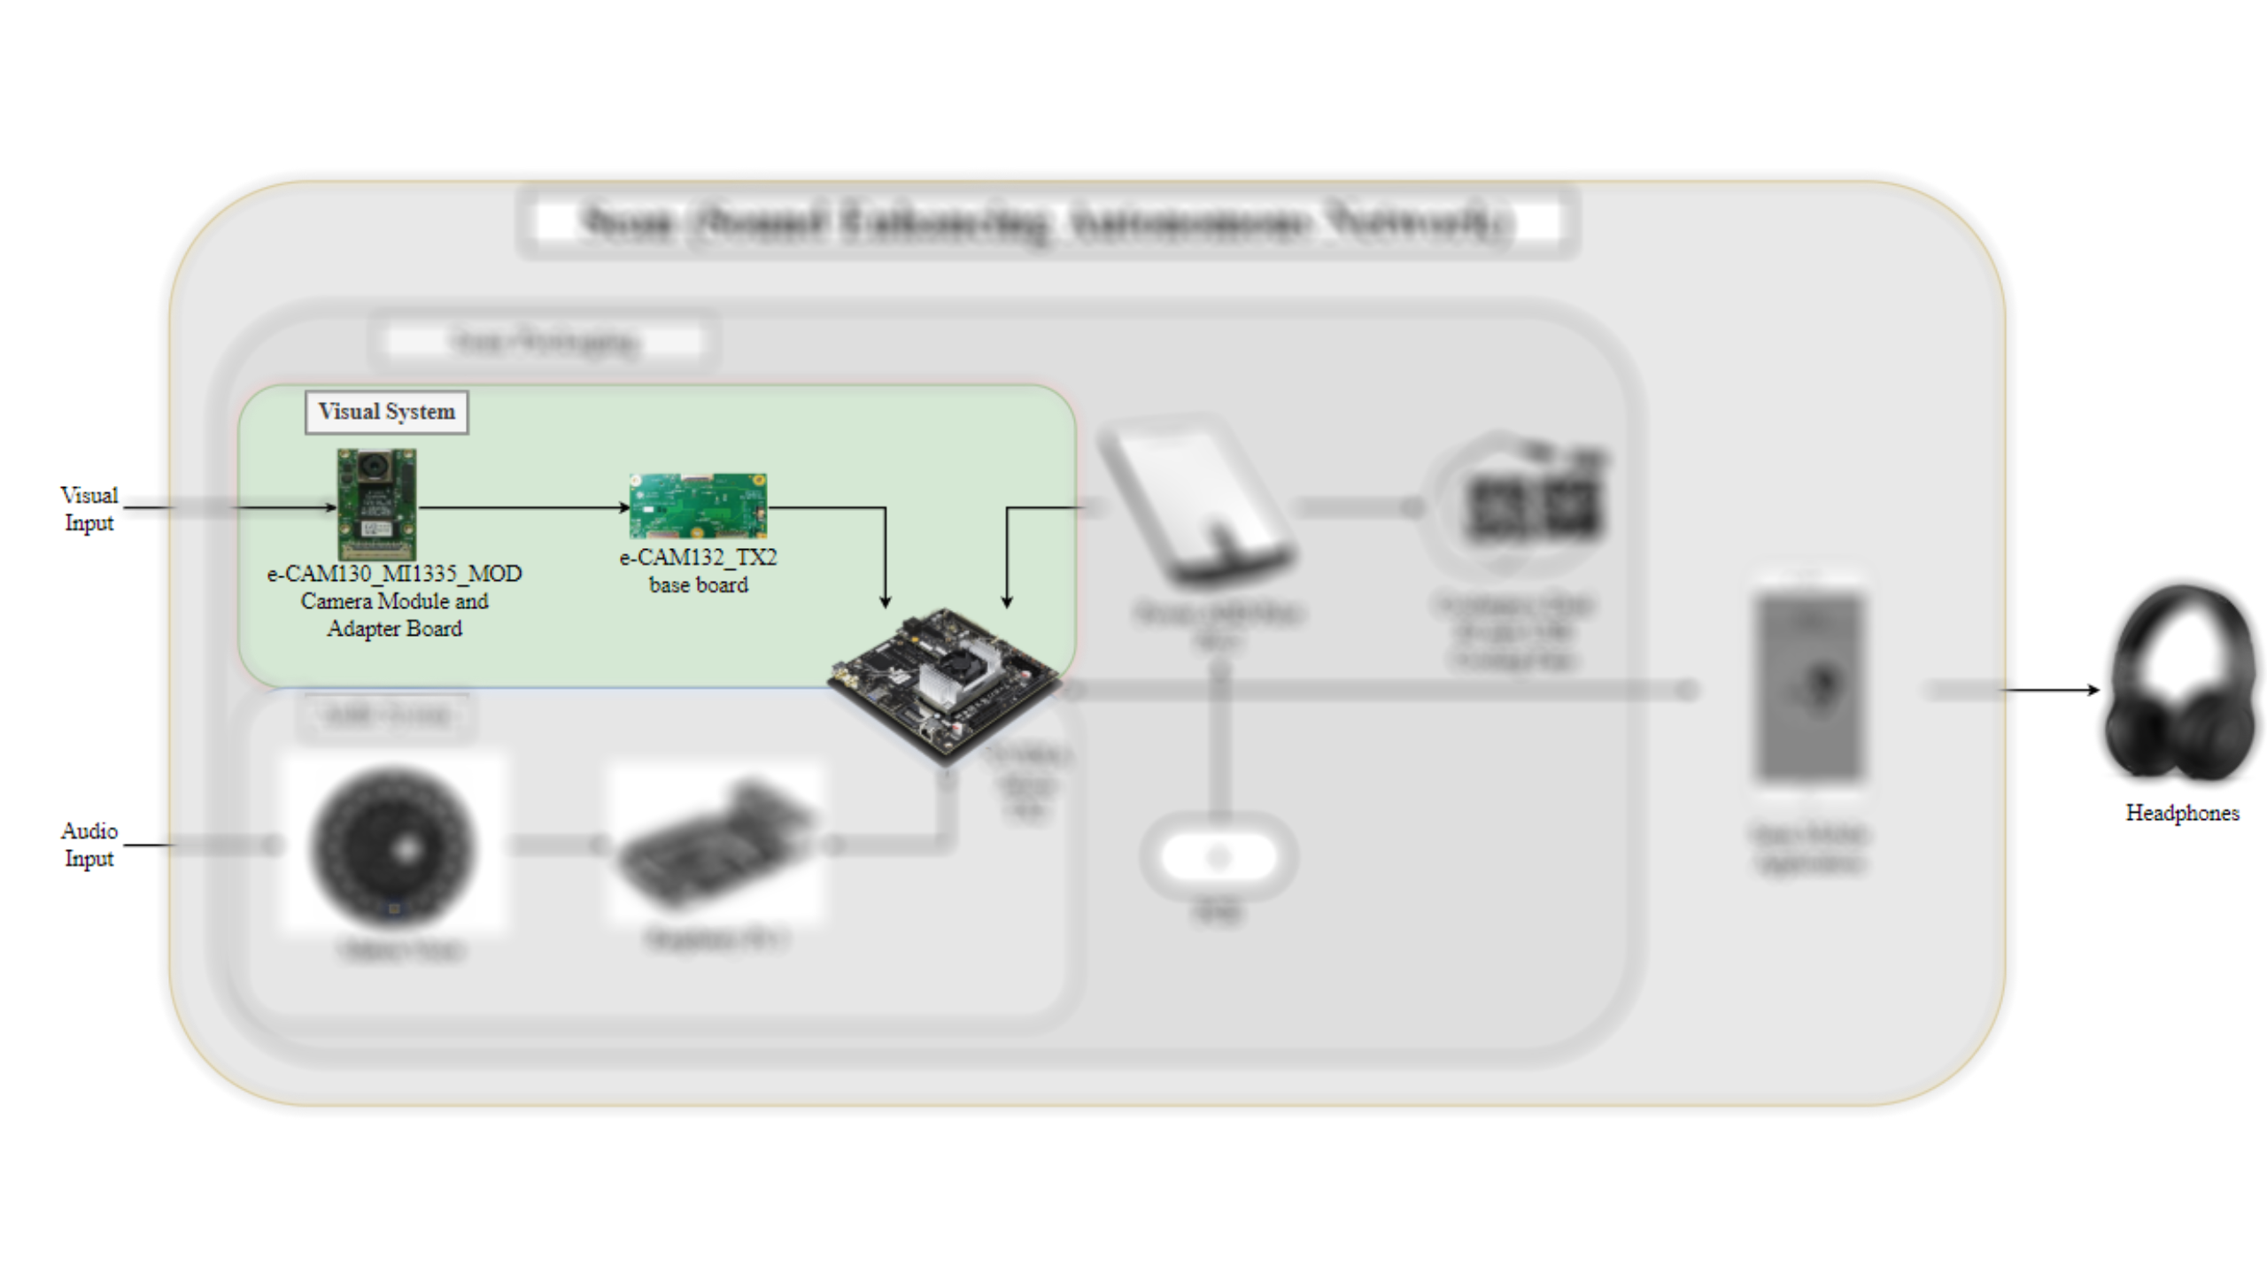

Slide 7
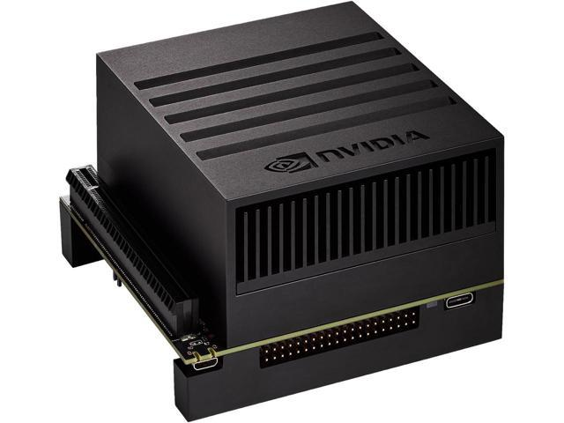
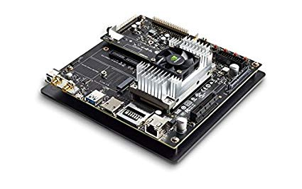
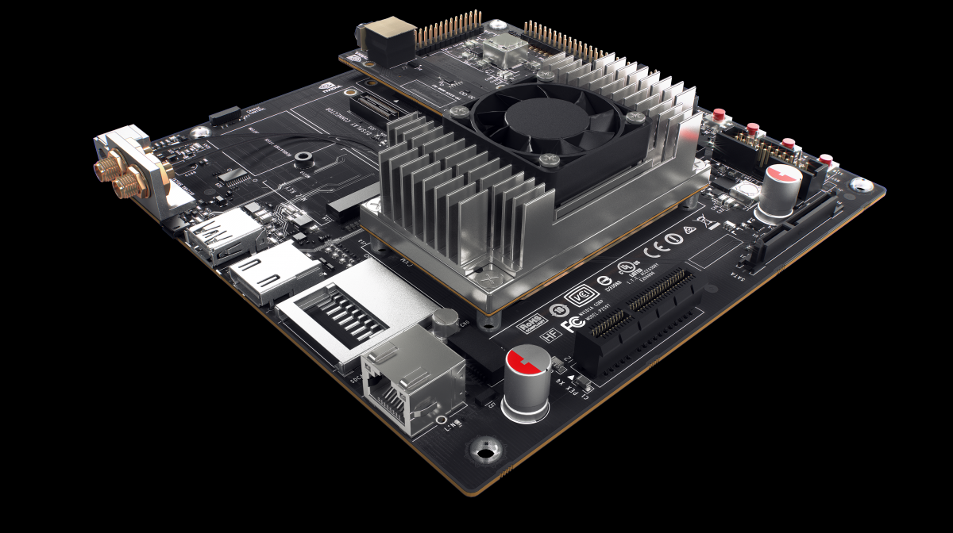
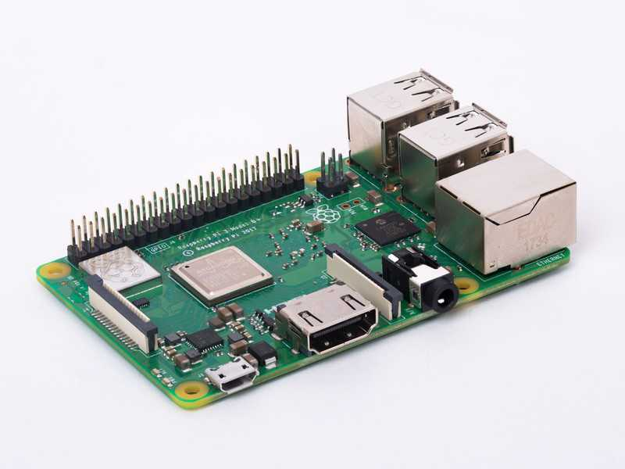
Trade Studies – Processor
Main Processor functions:
Run computer vison algorithms for human face detection
Deep learning vs. traditional machine learning
Host for Raspberry pi 3
Run algorithm to merge audio and visual outputs
Send final outputs via Bluetooth to phone application
Processor | GPU | CPU | Wireless Compatibility | Price | Power
Jetson AGX Xavier Developer Kit | 512-Core Volta GPU | 8-Core ARM 64-bit CPU | Bluetooth® 4.1 and WiFi Sold Separately | $650 | 10W / 15W / 30W
Jetson TX2 Developer Kit | 256-core Pascal GPU | 2 Denver 64-bit CPUs + Quad-Core A57 | Bluetooth® 4.1 and WiFi enabled | $300 | 7.5W / 15W
Jetson TX1 Developer Kit | 256-core Maxwell | Quad-Core ARM Cortex-A57 | Bluetooth® 4.0 and WiFi enabled | $250 | 7.5W / 15W
Raspberry Pi 3 | Broadcom VideoCore IV | Quad-Core ARM Cortex-A53 | Bluetooth® 4.2 and WiFi enabled | $35 | 1.2 W
Notes:
Brandon

Slide 8
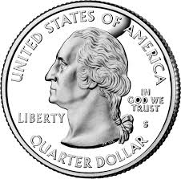
Trade Studies – Processor
7in.
Size comparison
7in.
Notes:
Annette

Slide 9
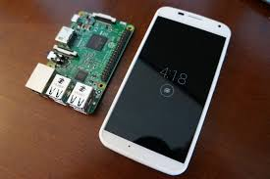
Trade Studies – Processor
Size comparison
Notes:
Annette

Slide 10
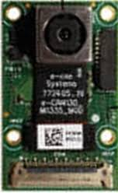
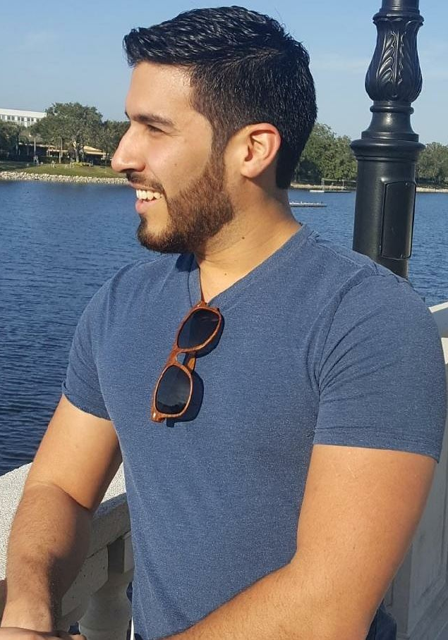
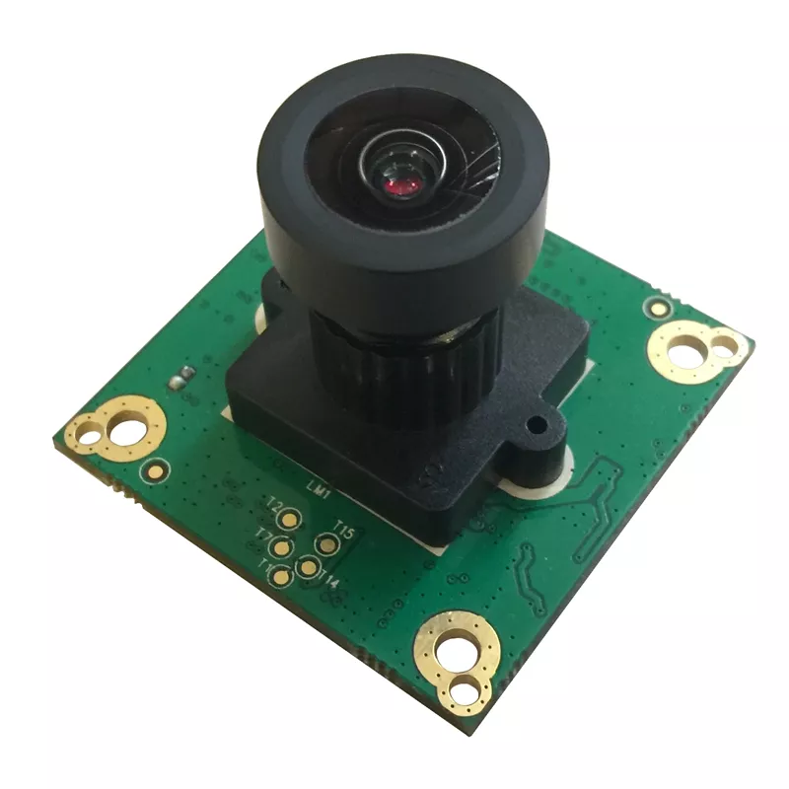
Trade Studies – Camera
Camera Module | Resolution | FOV | Power | Price
e-CAM132_TX2 | 13MP (4192 x 3120) | 74.4°(D) 60.2°(H) 46.4°(V) | Max: 1.22W Min: 0.79W | $284
e-CAM20_CUTX2 | 2MP (1928x1088) | 128°(D) 103°(H) 70°(V) | Max: 0.87W Min: 0.67W | $149
LI-JETSON-KIT-IMX477-X | 12.3MP (4056x3040) | 96.5°(D) 80°(H) 61.5°(V) | Max: 1.76W Min: 1.59W | $399
Vertical FOV of Human
at Shortest Distance Requirement (2 ft.)
Vertical FOV Human
at Longest Distance Requirement (10 ft.)
~ 3600 x 2250
pixels on target
(Based on average human head size)
~ 260 x 220 pixels on target
(Based on average human head size)
46.4°
46.4°
Notes:
Brandon

Slide 11
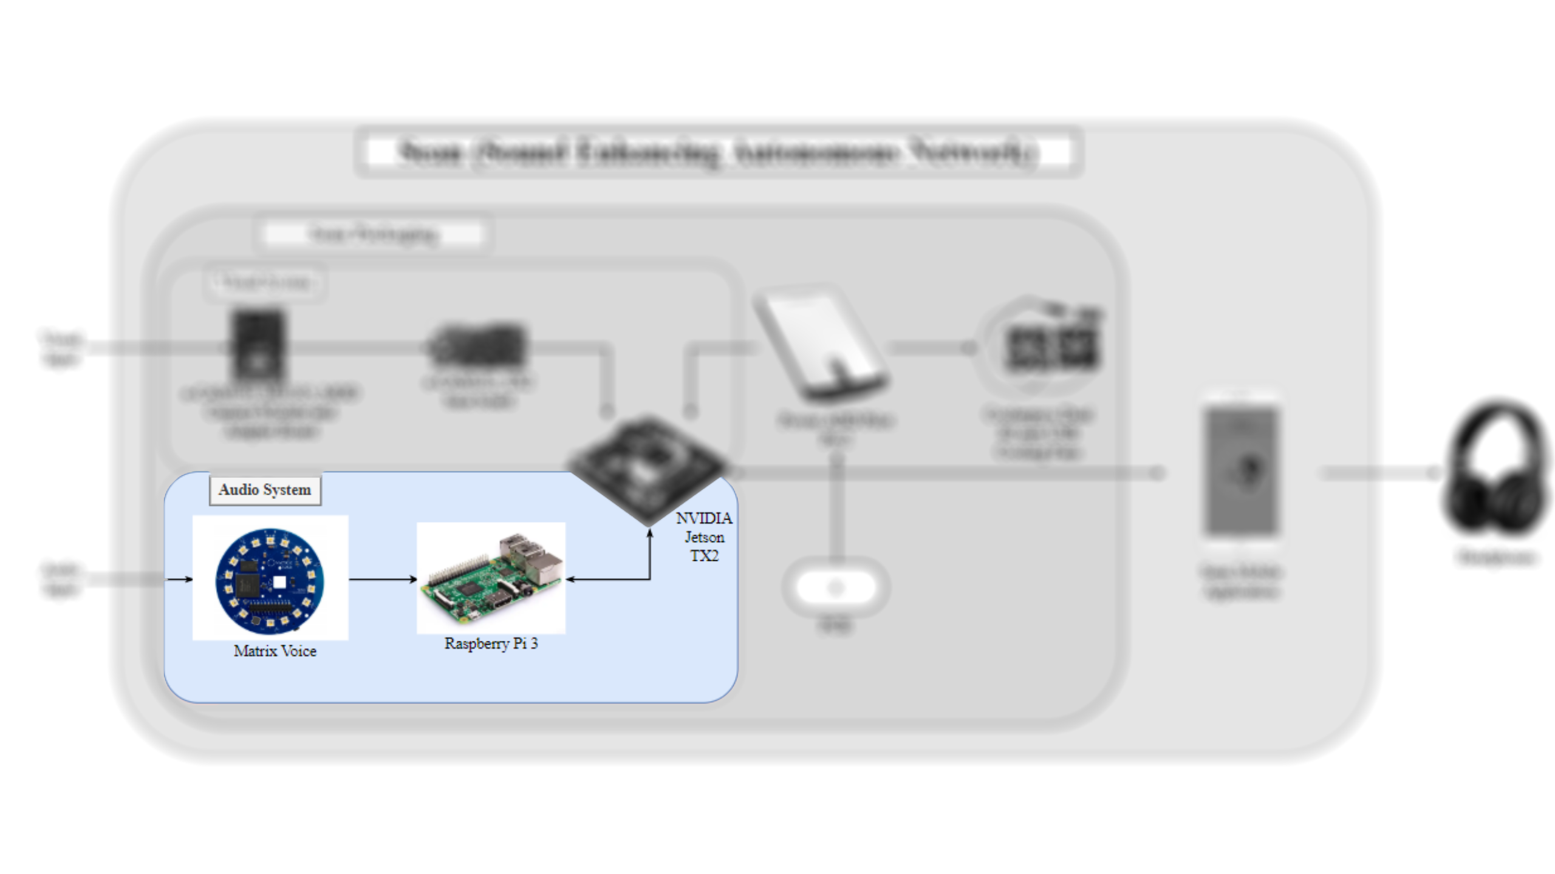
Notes:
annette

Slide 12
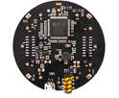
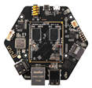
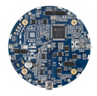
Trade Studies – Microphone array
Chip | # Mics | SNR | THD | Lead Time
MATRIX Voice | 8 | 62.6 dB | <1% @ 100 dBSPL <5% @ 115 dBSPL | 2 days
Respeaker Mic Array v2.0* | 4 | 61 dB | <1% @ 100 dBSPL <2% @ 115 dBSPL <10% @ 120 dBSPL | 20-30 days
Respeaker Core v2.0 | 6 | 55 dB | 0.46% @ 94 dB SPL | 2 days
PS3 Eye | 4 | 90 dB | Unknown | 3-5 days
UMA-8 v2* | 7 | 65 dB | 1.6% @ 120 dB SPL | 20-30 days
Notes:
Annette

Slide 13
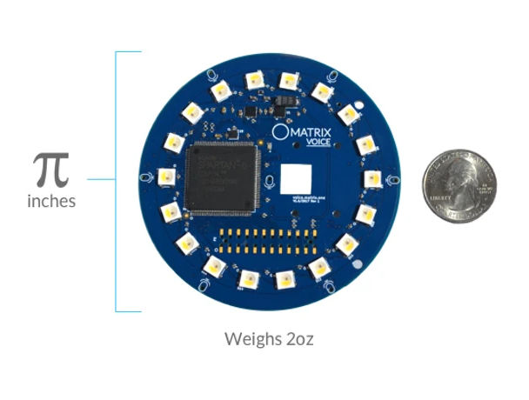
Trade Studies – Microphone array
Size comparison
Notes:
Annette

Slide 14
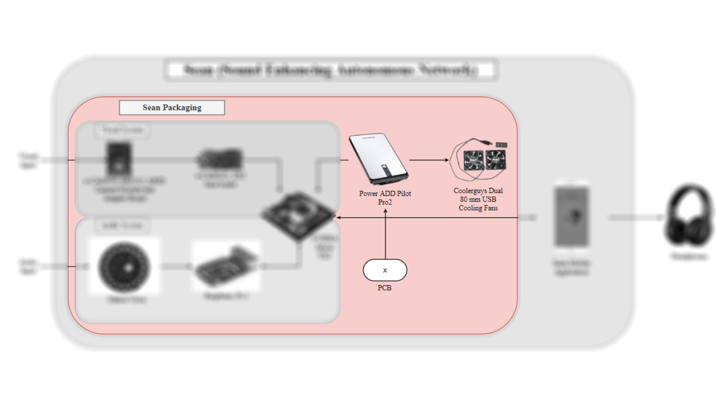

Slide 15
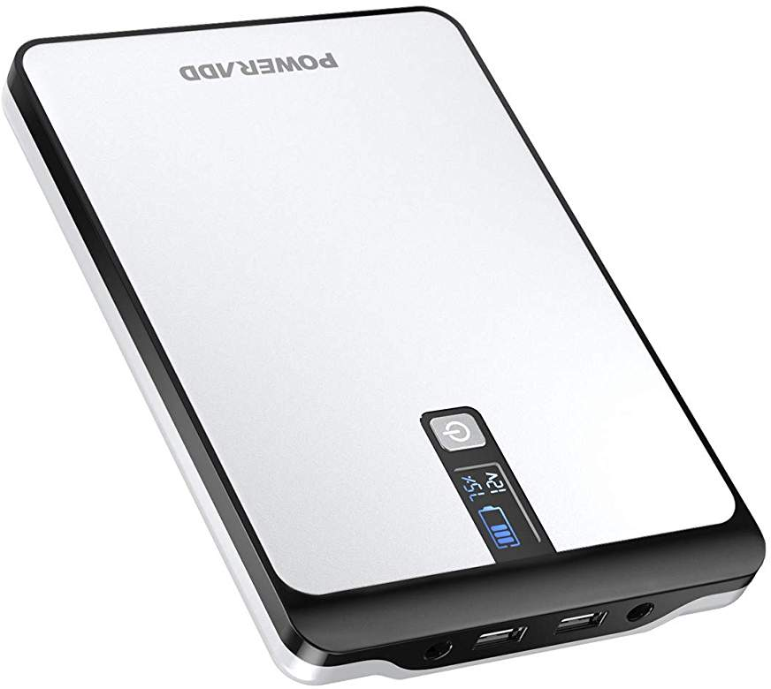
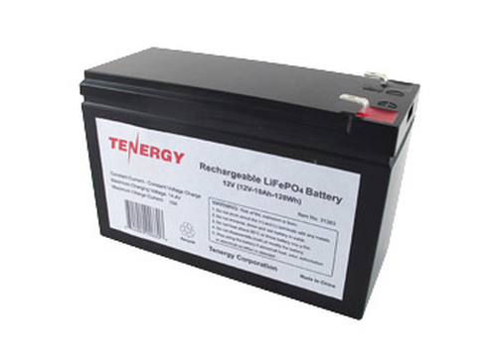
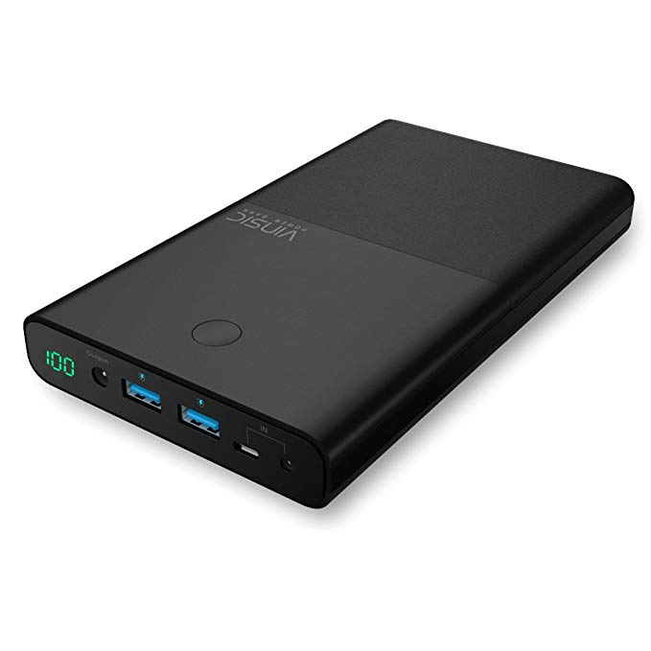
Trade Studies – Power supply
 | Item | Size | Weight | Price | Voltage | # of Outputs | Heat Dissipation | LED Display | Over Voltage & Current Protection
 | PowerAdd Pilot Pro2 | 124mm x 185mm x 19mm | 1.24 lbs | $89.99 | Can select between 5 and 20 | 3 (1 DC, 2 USB) | ✓ | ✓ | ✓
 | Tenergy LiFePO4 Rechargeable Battery | 66mm x 96mm x 152mm | 2.67 lbs | $159.99 | 12 | 1 (DC) |  | ✓
 | VINSIC Power Bank | 103mm x 177mm x 22.1mm | 1.37 lbs | $79.99 | Up to 19 | 3 (1 DC, 2 USB) |  | ✓ | ✓
Notes:
Brandon

Slide 16
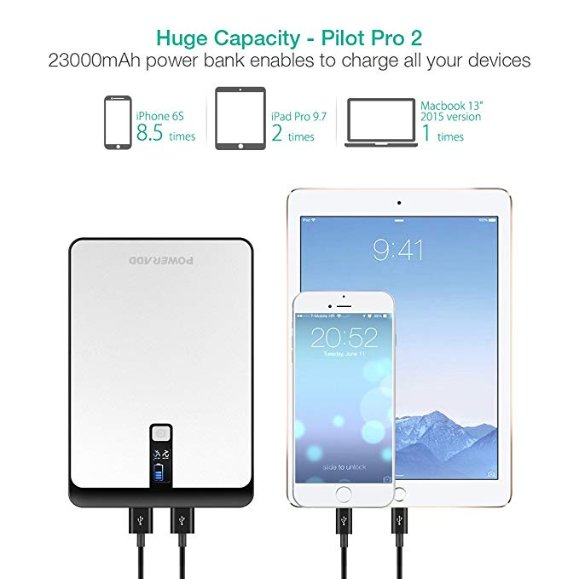
Trade Studies – Power supply
Size comparison
Notes:
Annette

Slide 17
Trade Studies – Wireless Communication
 | Method | Range | Availability | Latency | Compatibility | Low Power
 | Bluetooth (IEEE 802.15.1) | 5-30 meters | ✓ | 200 ms | ✓ | ✓
 | Wi-Fi (IEEE 802.11) | 100+ meters depending on connection |  | 150 ms
Notes:
Ayanna –make bluetooh look better

Slide 18
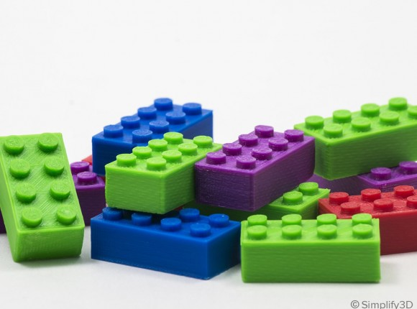
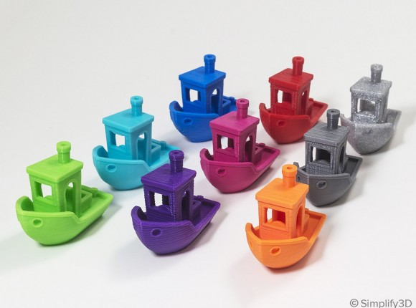
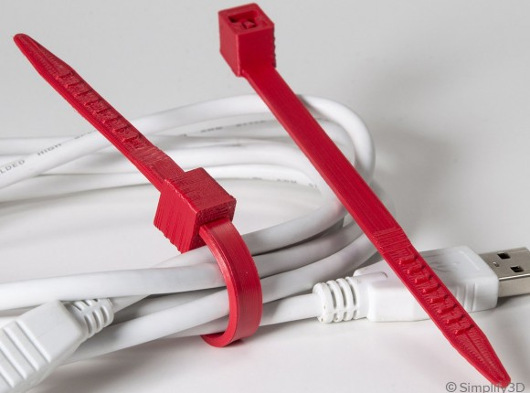
Trade Studies – Packaging
 | Material | Impact Resistant | Heat Resistant | Durable | Cost per kg | High Ultimate Strength
 | Acrylonitrile Butadiene Styrene (ABS) | ✓ | ✓ | ✓ | $10-$40 | 40 MPa
 | Polylactic Acid (PLA) |  |  |  | $10-$40 | 65 MPa
 | Nylon | ✓ | ✓ | ✓ | $25-$65 | 40-85 MPa
Notes:
Ayanna

Slide 19
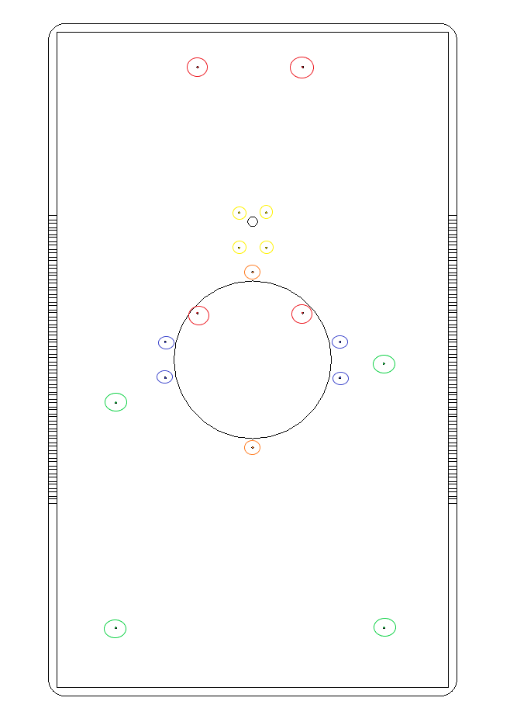
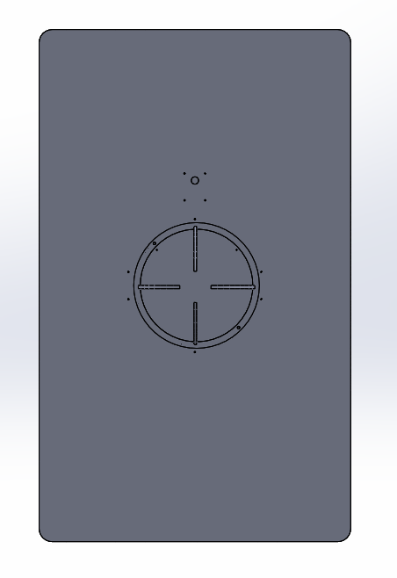
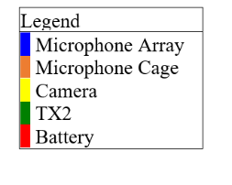
Initial Packaging design
Table 18 -- Dimensions of Sean Packaging
Component | Part Name | Length (mm) | Width (mm) | Height (mm) | Thickness (mm)
Rectangular casing | Housing for processor, PCB, and battery | 394.46 | 240 | 76.20 | 5
Microphone cage | Windscreen cover for microphone array | d=96.78 | - | 17.78 | 2
Notes:
Ayanna – annette pit picv

Slide 20
Safety
Notes:
ayanna

Slide 21
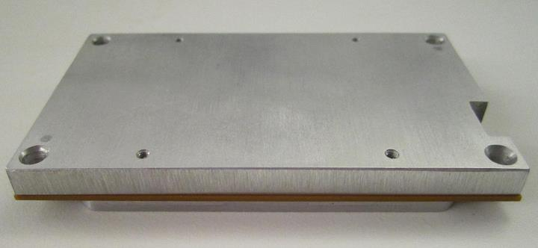
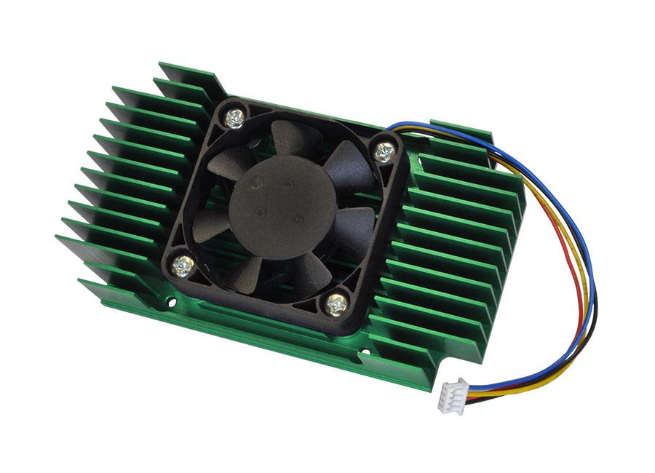
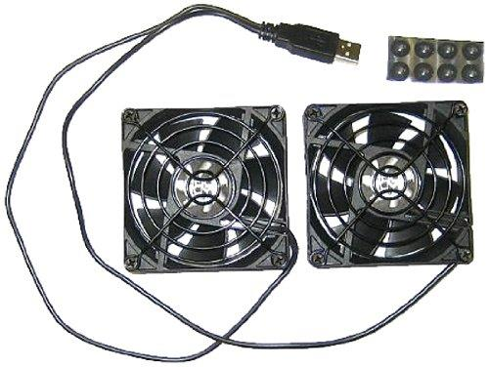
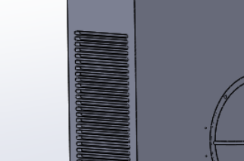
Packaging
TX2 Thermal Cooling Plate
TX2 built in fan
USB Cooling Fan
Cooling
TX2 built in cooling
Vents in packaging
USB Fans
Packaging
Sean Vents
Notes:
Ayanna – put pic pf venting

Slide 22
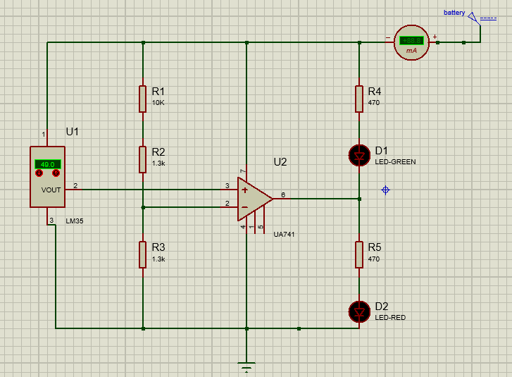
Printed circuit board
Monitors the temperature of the inside of the packaging of Sean.
Green LED on if temperature is below 50C
Red LED on if temperature is above 50C
Notes:
Annette - schematic

Slide 23
Software Design Overview
Notes:
aNNETTE

Slide 24
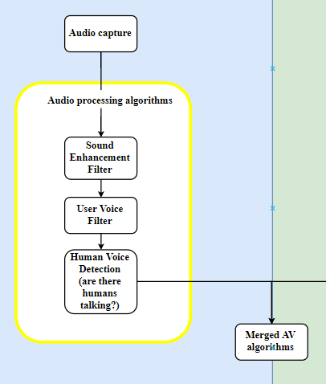
Audio Processing Algorithms
Sound Enhancement Filter
Acoustic Echo Cancellation
Noise Suppression
FIR Filter
User Voice Filter
Filter out user's voice
Distort to make it sound "natural"
Human Voice Detection
Detect human voices
Beamform and separate human voices (up to 3)

Slide 25
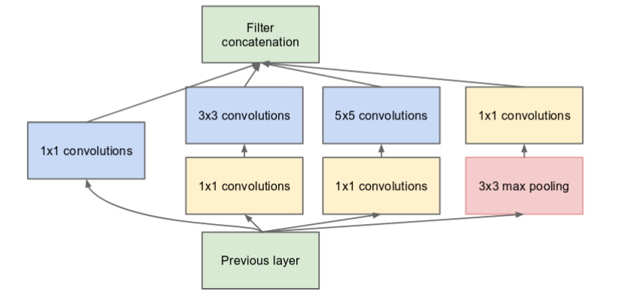
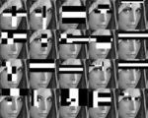
Visual Processing Algorithm
InceptionNet Module
Human Face Detection
Goal: Identify Humans in FOV as likely or not likely candidates to be talking to the user
Deep-learning based approach: FaceNet
(99.63% Accuracy on Labeled Faces In the Wild Dataset)
Convolutional Neural Network using InceptionNet
as base network fine tuned on faces.
Trains on sets of 3 images that are different in size, lighting, and pose
Open source network built with caffe framework
Collecting data from our camera for transfer learning
Traditional machine learning approach: Haar Cascade Classifier
Trained to detect faces from predefined features
Provide baseline timing and performance numbers
Available in openCV
Example of Haar Features
Notes:
Brandon v
Variant of yolo
Video

Slide 26
Merging Audio and Visual SPaces
Currently characterizing FOV of microphone array
Video frame will be IFOV normalized to put pixels in an angle space
Translation alignment will be determined through audio/visual calibration
After spaces are merged a series of tests will be performed to determine level of tolerance
Before Alignment
After Alignment
60.2°
0°
60.2°
0°
Camera Angle Space
Camera Angle Space
Microphone Angle Space
Microphone Angle Space
46.4°
46.4°
Notes:
Brandon
Make ocmments about resolution

Slide 27
Confidence analysis
Audio Confidence Weight Values
 | Voice Activity Detection (VAD) | Distance | Amplitude
Confidence Weight | Most weight, a | Medium weight, b | Least weight, c
Visual Confidence Weight Values
 | Human Face Detection (HFD) | Distance | Look Angle*
Confidence Weight | Most weight, x | Least weight, y | Medium weight, z
Audio Confidence=a*VAD + b*Distance + c*Amplitude, a+b+c=1
Visual Confidence=x*HFD + y*Distance + z*Look Angle, x+y+z=1
Total Confidence=n*Audio Confidence + m*Visual Confidence, n>m
Notes:
Annette and brandon

Slide 28
Audio Mixing
Total Confidence Based
Environment Based
 | Tier 1 | Tier 2 | Tier 3 | Tier 4
What sources go here? | Reserved for Background Noise | Sources below 50% total confidence | Sources above 50% and below 75% total confidence | Source with highest total confidence value above 75%
Gain | Attenuation (< 1.0) |  | 1.0 | Amplification (> 1.0)
High Noise
Ex: Restaurant, lobby
Medium Noise
Ex: Classroom, conference room
Low Noise (Default)
Ex: Quiet room
Notes:
Annette and brandon

Slide 29
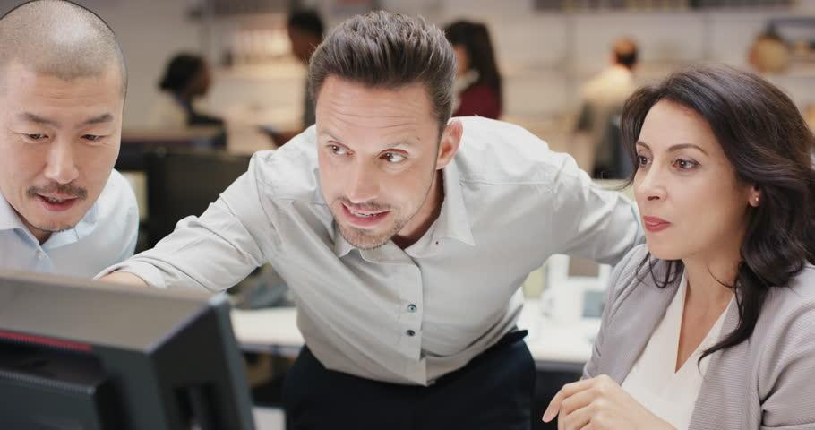
Sean mobile app symbology example
Combining Visual and Audio Detections to Produce Visual Display with Symbology Overlayed
Final Audio Output
*Above image is an example of the addition of signals.
Final Visual Output
Human Face Detection Output
Aligned Audio Space Output
- Face Detected
- High-Confident Voice Detection
- Mid-Confident Voice Detection
Final Output
- Face Detected and Voice Signal Amplified
- Face Detected but No Voice Signal
- No Face Detected and Voice Signal Attenuated
Notes:
Annette (how to remerge) and brandon

Slide 30
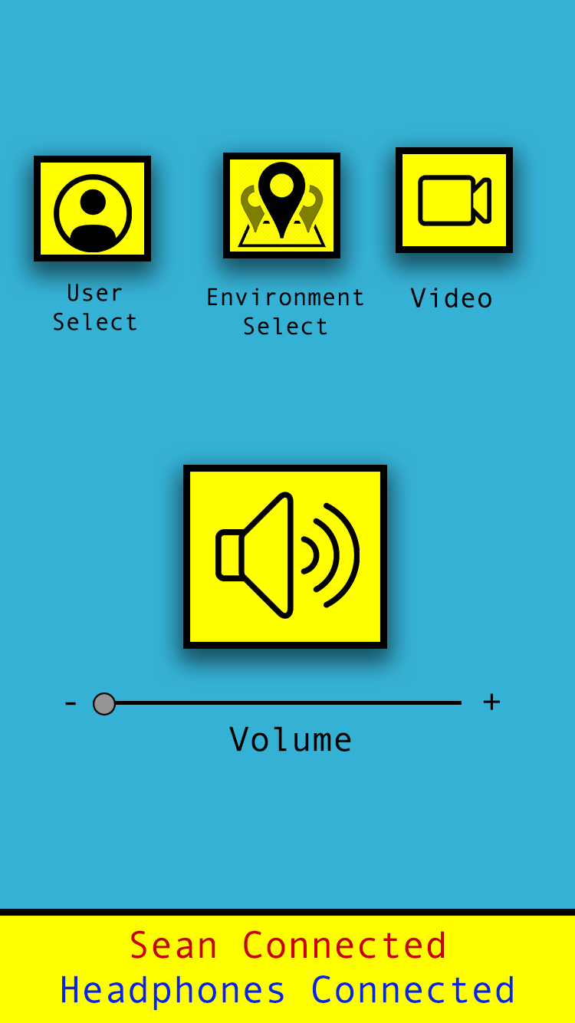
Mobile application - user interface
Notes:
Ayanna

Slide 31
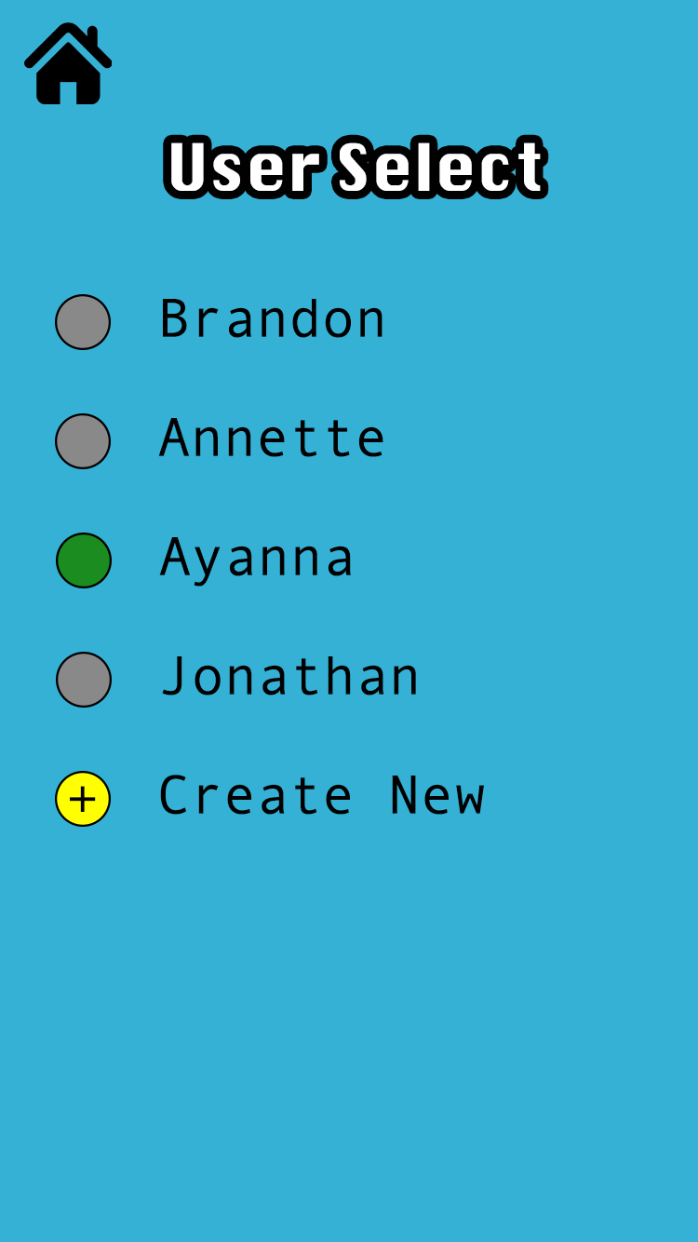
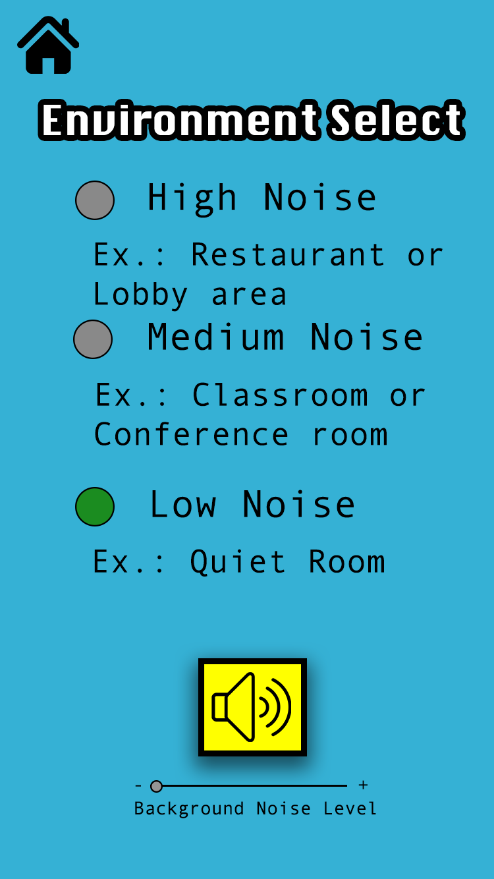
Mobile application - DESIRED FEATURES
User Select
Environment Select
Training Mode
Video Mode
Notes:
Ayanna

Slide 32
Materials & Budget
Item | Price | Obtained?
Microphone Array | $61.05 | ✓
Camera | $284.00 | ✓
PCB | $30
ABS material | $16.99 | ✓
Wearable Item | $10.00
Power Source | $80.00 | ✓
Processor | $0 | ✓
USB Cooling Fans | $13.95 | ✓
Item | Price | Obtained?
Apple Developer Program Fee | $105.93
Raspberry Pi | $10.54 | ✓
Microphone testing device | $37.37 | ✓
Thermal Sensor Circuit | $30.00 | ✓
Thermal Sensor | $5.96 | ✓
Op Amp | $9.49 | ✓
LEDs | $4.99 | ✓
Wifi Adapter | $8.99 | ✓
Total: | $708.15
As Demonstrated Total: | $1008.15 out of $2000
Notes:
Ayanna
What to do with extra money

Slide 33
Project progress
Notes:
Update before thursday

Slide 34
Project Task Distribution
 | Audio System | PCB | Mobile App | Packaging | Power | Visual System
Annette | ✓ | ✓ |  | ✓ |  | ✓
Ayanna |  | ✓ | ✓ | ✓ | ✓
Brandon | ✓ | ✓ |  |  |  | ✓
Notes:
Some kind of random so at least two people on every one

Slide 35
Upcoming milestones
Event | Deadline
Identify separate human faces in an angle space | June 16th
Understand if look angle can be determined | June 16th
Output audio to user's headphones from app | June 18th
Identify and remove user’s voice from raw audio (User Voice Filter) | June 18th
Establish real-time audio and visual streaming between AVIS and Mobile Application | June 21st

Slide 36
Risk Mitigation
Risk | Solution
Components and mounting holes needs adjustments in original packaging design. | Test early and allow for reprinting and redesign.
Audio and visual outputs are not time aligned (latency). | Output audio real time, allow for a visual delay.
Not being able to save/recall data for User Select Setting on mobile app. | Cater to one user and record data directly onto TX2.
Temperature sensor does not accurately measure temperature. | Test early and redesign. Potentially seek outside expertise.
Even with precaution, Sean could combust. | Include flame retardant material on Sean's wearable packaging.

Slide 37
Q & A
?

