Slide 1
Ion
Interactive Robot Assistant
Group 11
Dennis Gebken, CpE
David Jaffie, CpE
Mohammad Rizeq, EE

Slide 2
Motivation
Combat boredom at the desk
Helping to counter this can boost productivity
Can help toddlers learn
Grade-school students study
Business professionals in the workplace
Objective
Produce an all-in-one robotic assistant
Natural movement and conversation
Small, lightweight for portability
Wirelessly utilize the internet to carry out tasks
Meet Peeqo! Made by Abhishek Singh
Source: Management Education Group

Slide 3
Requirements & Specifications
Property | Design Specification
Weight | < 5lb
Size | < 7”x7”x15”
Voice Command Response Time | < 2 seconds
Voice Recognition | 80% of what is spoken
Supported Language | English
Face Recognition | 80% of faces recognized under normal lighting
Power Consumption | < 50W
Cost | < $500

Slide 4
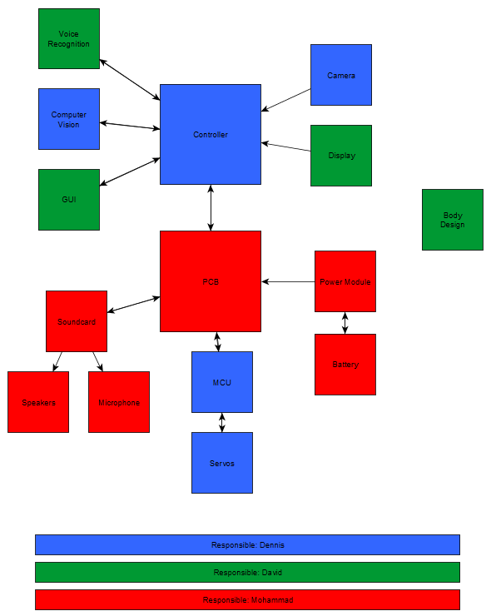
Overall Block Diagram & Tasking
Task | Primary | Secondary
Controller | Dennis | David
Camera & CV | Dennis | David
GUI | David | Dennis
Voice Recognition | David | Dennis
Body Design | David | Dennis
MCU & Servos | Dennis | Mohammad
Power Module & Battery | Mohammad | Dennis
Soundcard, Speakers, & Microphone | Mohammad | Dennis
PCB | Mohammad | Dennis

Slide 5
David’s Responsibilities
Body Design
Display
GUI
Voice Recognition

Slide 6
David’s Responsibilities
Body Design
Display
GUI
Voice Recognition

Slide 7
Body Design
3D-printed skeleton to house components
Designed using Autodesk Fusion 360, a 3D CAD program
ABS filament
Strong, heat-tolerant
Commonly-used for prototyping
Flexible cloth or spandex body to allow for easy, fluid movement

Slide 8
David’s Responsibilities
Body Design
Display
GUI
Voice Recognition

Slide 9
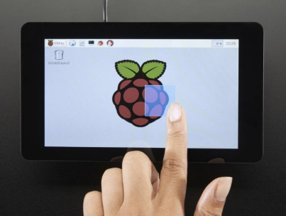
Display
Important factors:
Cost
Touch capability - GUI
Size & Resolution – GUI & multimedia
Built-in adaptor board
Source: Adafruit

Slide 10
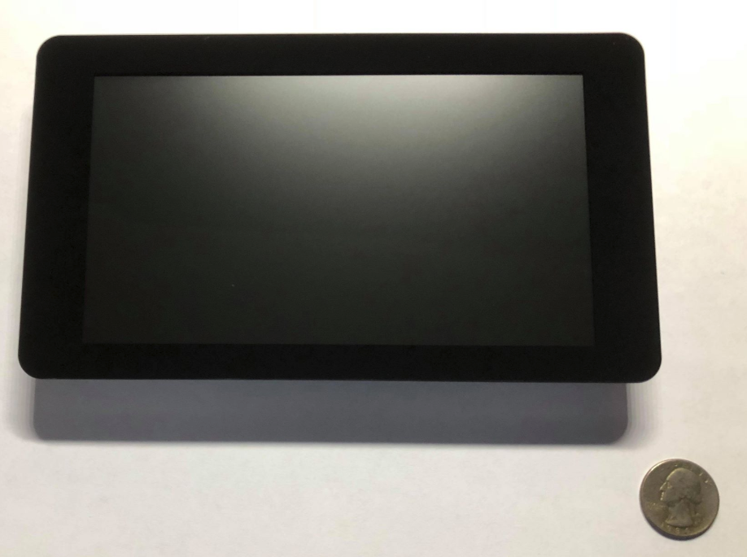
Pi Foundation Display
Size: 7”
Resolution: 800x480
Liquid Crystal Display (LCD)
Cheaper, more energy-efficient compared to TFT
Capacitive touchscreen allowing for multi-touch
Attached driver board that handles power and signal processing
Easily integrates with Raspberry Pi
Cost: $80

Slide 11
David’s Responsibilities
Body Design
Display
GUI
Voice Recognition

Slide 12
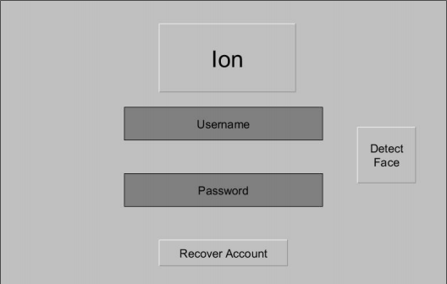
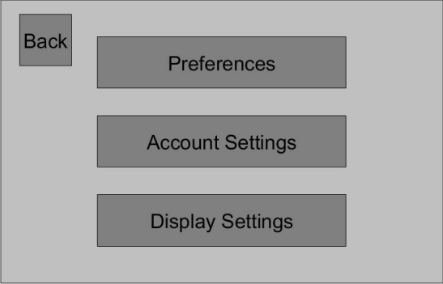
GUI
Secondary means of interaction with the device
Allows the user to login, change settings, and link accounts
Using Python
Included with Raspbian
Event-driven language
Using Kivy
Open-source
Easily integrates with the Raspberry Pi
Great for multi-touch user interfaces and apps

Slide 13
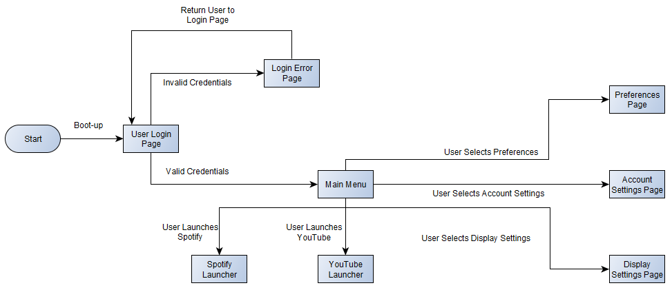
GUI User Flowchart

Slide 14
David’s Responsibilities
Body Design
Display
GUI
Voice Recognition

Slide 15
Voice Recognition
Primary means of interaction with the device
Works the same as Amazon Echo, Siri, etc.
Senses when a command is being given by looking for a ‘wake up’ keyword
Records the command that follows and utilizes Google Speech API to translate it into a command that Ion can recognize

Slide 16
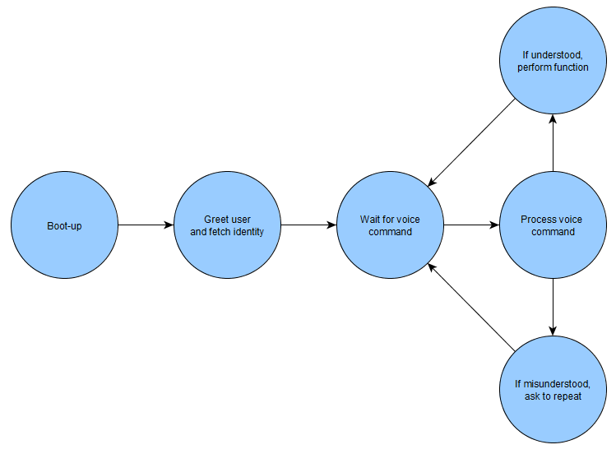
Voice Recognition State Diagram & Flowchart

Slide 17
Dennis’s Responsibilities
Face Detection
Face-the-User System (name TBD)
Facial Recognition
Main Processor selection
Motor Control Unit (MCU)

Slide 18
Dennis’s Responsibilities
Face Detection
Face-the-User System (name TBD)
Facial Recognition
Main Processor selection
Motor Control Unit (MCU)

Slide 19
Face Detection
Purpose:
Detect faces
Return position of face closest to center (x,y)
Feedback for Face-the-User (name TBD) system
Language: Python
Library: OpenCV

Slide 20
Face Detection Algorithm
Reduces capture size
Transforms to grayscale
Blurs
Detects faces
Returns coordinates

Slide 21
Dennis’s Responsibilities
Face Detection
Face-the-User System (name TBD)
Facial Recognition
Main Processor selection
Motor Control Unit (MCU)

Slide 22
Face-the-User System
Camera
Purpose
Turn Ion so the screen faces the user
Capture image
Image is sent to Raspberry Pi
Raspberry Pi
Detects face
Calculates distance vector to center
Instructs MCU to update position
MCU
Changes servo position

Slide 23
Face-the-User System Challenges
Position vector’s magnitude could be off
Too large
Overshoot
Oscillation
Too small
Many minor adjustments
Both are a waste of power and resources
User may move while position is updated

Slide 24
Face-the-User System Solutions
Dynamic feedback
Position change in increments
Variable buffer rectangle
Position updated until face is centered
Target rectangle while adjusting position.
Buffer rectangle. The center of the face needs to cross one of its borders to initiate movement.

Slide 25
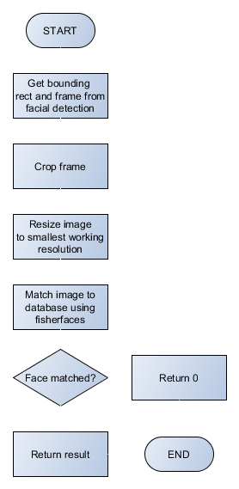
Face-the-User Algorithm
Get position of face from face detection
Determine face distance to center
Turn Ion to center on face
Turn fast if face is far from center
Turn slowly if face is close to center
Once face is in center, only adjust position once face is
outside a certain threshold

Slide 26
Dennis’s Responsibilities
Face Detection
Face-the-User System (name TBD)
Facial Recognition
Main Processor selection
Motor Control Unit (MCU)

Slide 27
Facial Recognition
Purpose:
To identify saved users and load their settings
Not a safety feature
Not accurate enough because of 2D picture
Accuracy vs. Speed
Eigenfaces – fast but unreliable
Fisherfaces – More reliable but slow
Will only run when a face has not been detected for a while

Slide 28
Dennis’s Responsibilities
Face Detection
Face-the-User System (name TBD)
Facial Recognition
Main Processor selection
Motor Control Unit (MCU)

Slide 29
Processor Load
Facial Recognition
Face Detection
GUI & Multimedia
Voice Recognition
OS (Linux)

Slide 30
Single Board Computer (SBC) Choices
Asus Tinkerboard
Beagleboard
Raspberry Pi
Sopine A64

Slide 31
SBC Comparison
 | Raspberry Pi | BeagleBoard | Asus TinkerBoard | Sopine A64
CPU/SOC | 4-core 1.2 GHz | 1-core 1.0 GHz | 4-core 1.8 GHz | 4-core 1.152 Ghz
Memory (RAM) | 1 GB | 512 MB | 2 GB | 2 GB
Price | $35.00 | $49.00 | $55.44 | $35.00
Component Availability | Readily available | Readily available. CPU can be bought directly for $20 | Prototype board available on Amazon. Components for final design not yet found | Readily available
Interfaces | Everything necessary, except 2nd PWM output | All necessary interfaces available | All necessary interfaces available | Everything necessary, except 2nd PWM output
Final Implementation | Connect Raspberry Computer Module 3 via fixed SODIMM connector to PCB | SBC design to be used as reference to add CPU directly to final PCB | Currently not possible because components have not been found | Connect Sopine A64 via fixed SODIMM connector to PCB

Slide 32
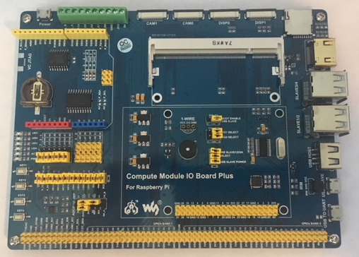
SBC Choice: Raspberry Pi 3 Compute Module Lite
Performance deemed sufficient
Smaller when added to PCB
Lowest cost
Already own development board and SBC (version 3 B)
Abundant information and tutorials online
Most future-proof
Raspberry Pi Compute Module 3 Lite
WaveShare Compute Module IO Board Plus

Slide 33
Dennis’s Responsibilities
Face Detection
Face-the-User System (name TBD)
Facial Recognition
Main Processor selection
Motor Control Unit (MCU)

Slide 34
Motor Control Unit (MCU) Tasks
Rotate servos
Analog to digital conversion (Audio in)
LED control

Slide 35
MCU Main Choices and Comparison
 | Atmel Mega328 | Ti M430
Prototyping Board | Arduino Uno | LaunchPad
Operating Voltage | 1.8-5.5V | 2.0-3.6V
Clock Speed | 20 MHZ @ 4.4+ V | 16 MHz
I/O | 23 GPIO 8 10-bit ADC channels | 15 GPIO 8 10-bit ADC channels
Price | $1.30 | $2.48

Slide 36
MCU Choice: Atmel mega328
Faster
Cheaper
Can be prototyped on breadboard (see picture)
Already own Arduino Uno and Bootloader

Slide 37
Mohammad’s Responsibilities
Audio Processing
WiFi System
Misc.
Power Management
PCB

Slide 38
Mohammad’s Responsibilities
Audio Processing
WiFi System
Misc.
Power Management
PCB

Slide 39
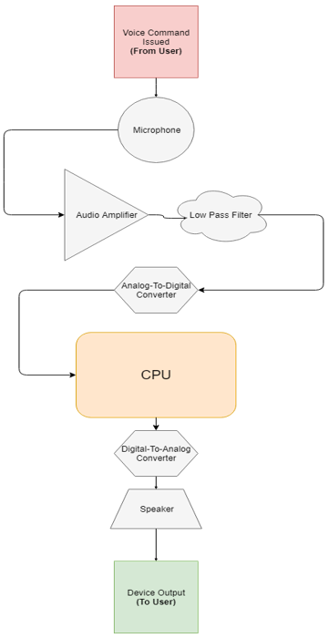
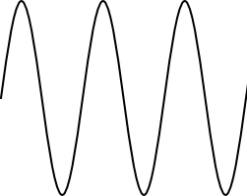
General User-Device Voice Interaction
Audio
Signal
Analog
Signal
User issues the device a command; the device responds.
Example:
User: What is the time right now?
Device: It is 12:30 P.M.
Digital Signal
Digital Signal
Analog
Signal
Audio
Signal

Slide 40
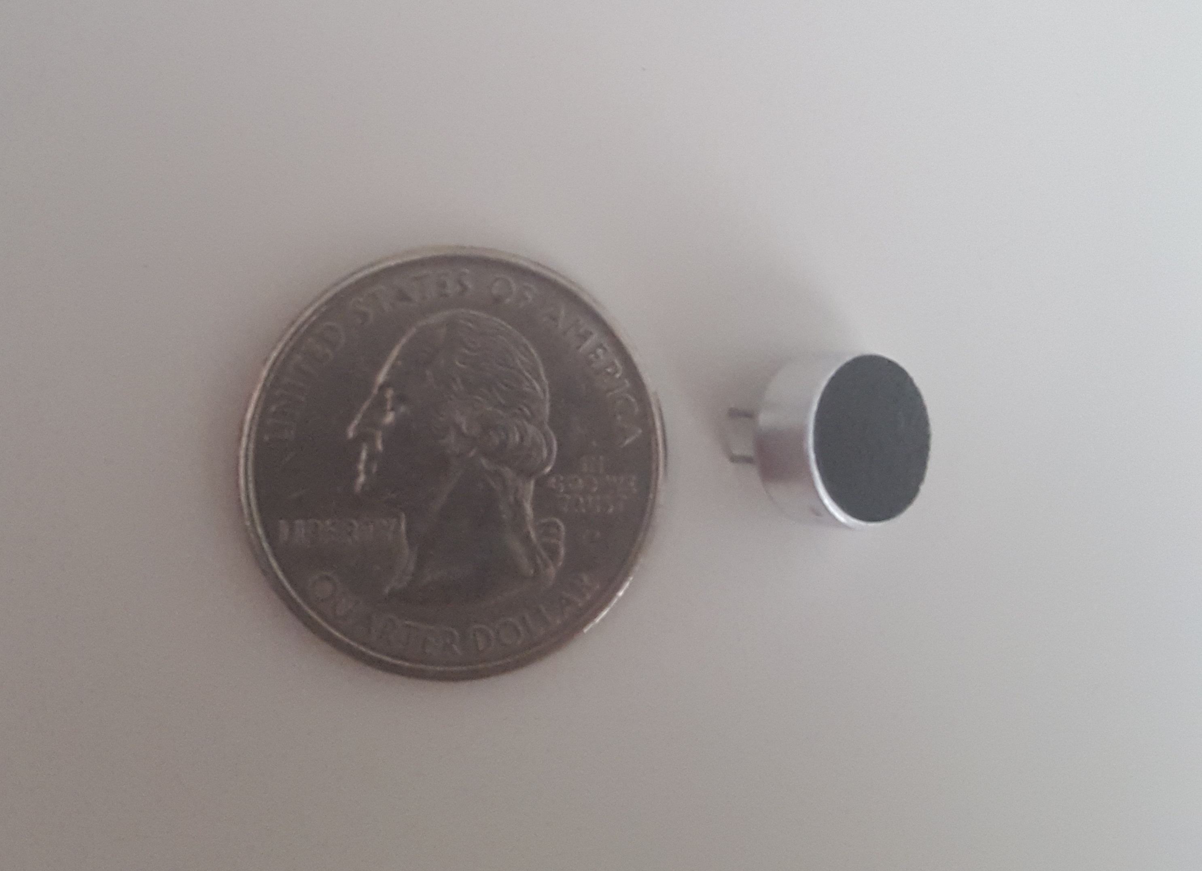
Electret Microphone
Very common in audio projects.
Specs:
-44dB sensitivity
20Hz-20kHz frequency response
Operating voltage range of 1V_{DC}-10V_{DC}
Breadboard-friendly
Downside: Requires filtering and amplifying

Slide 41
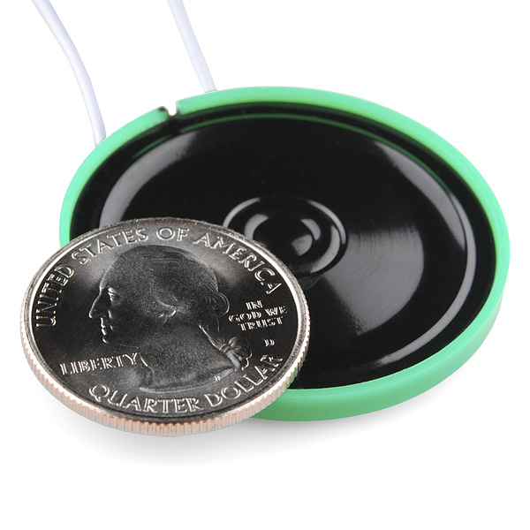
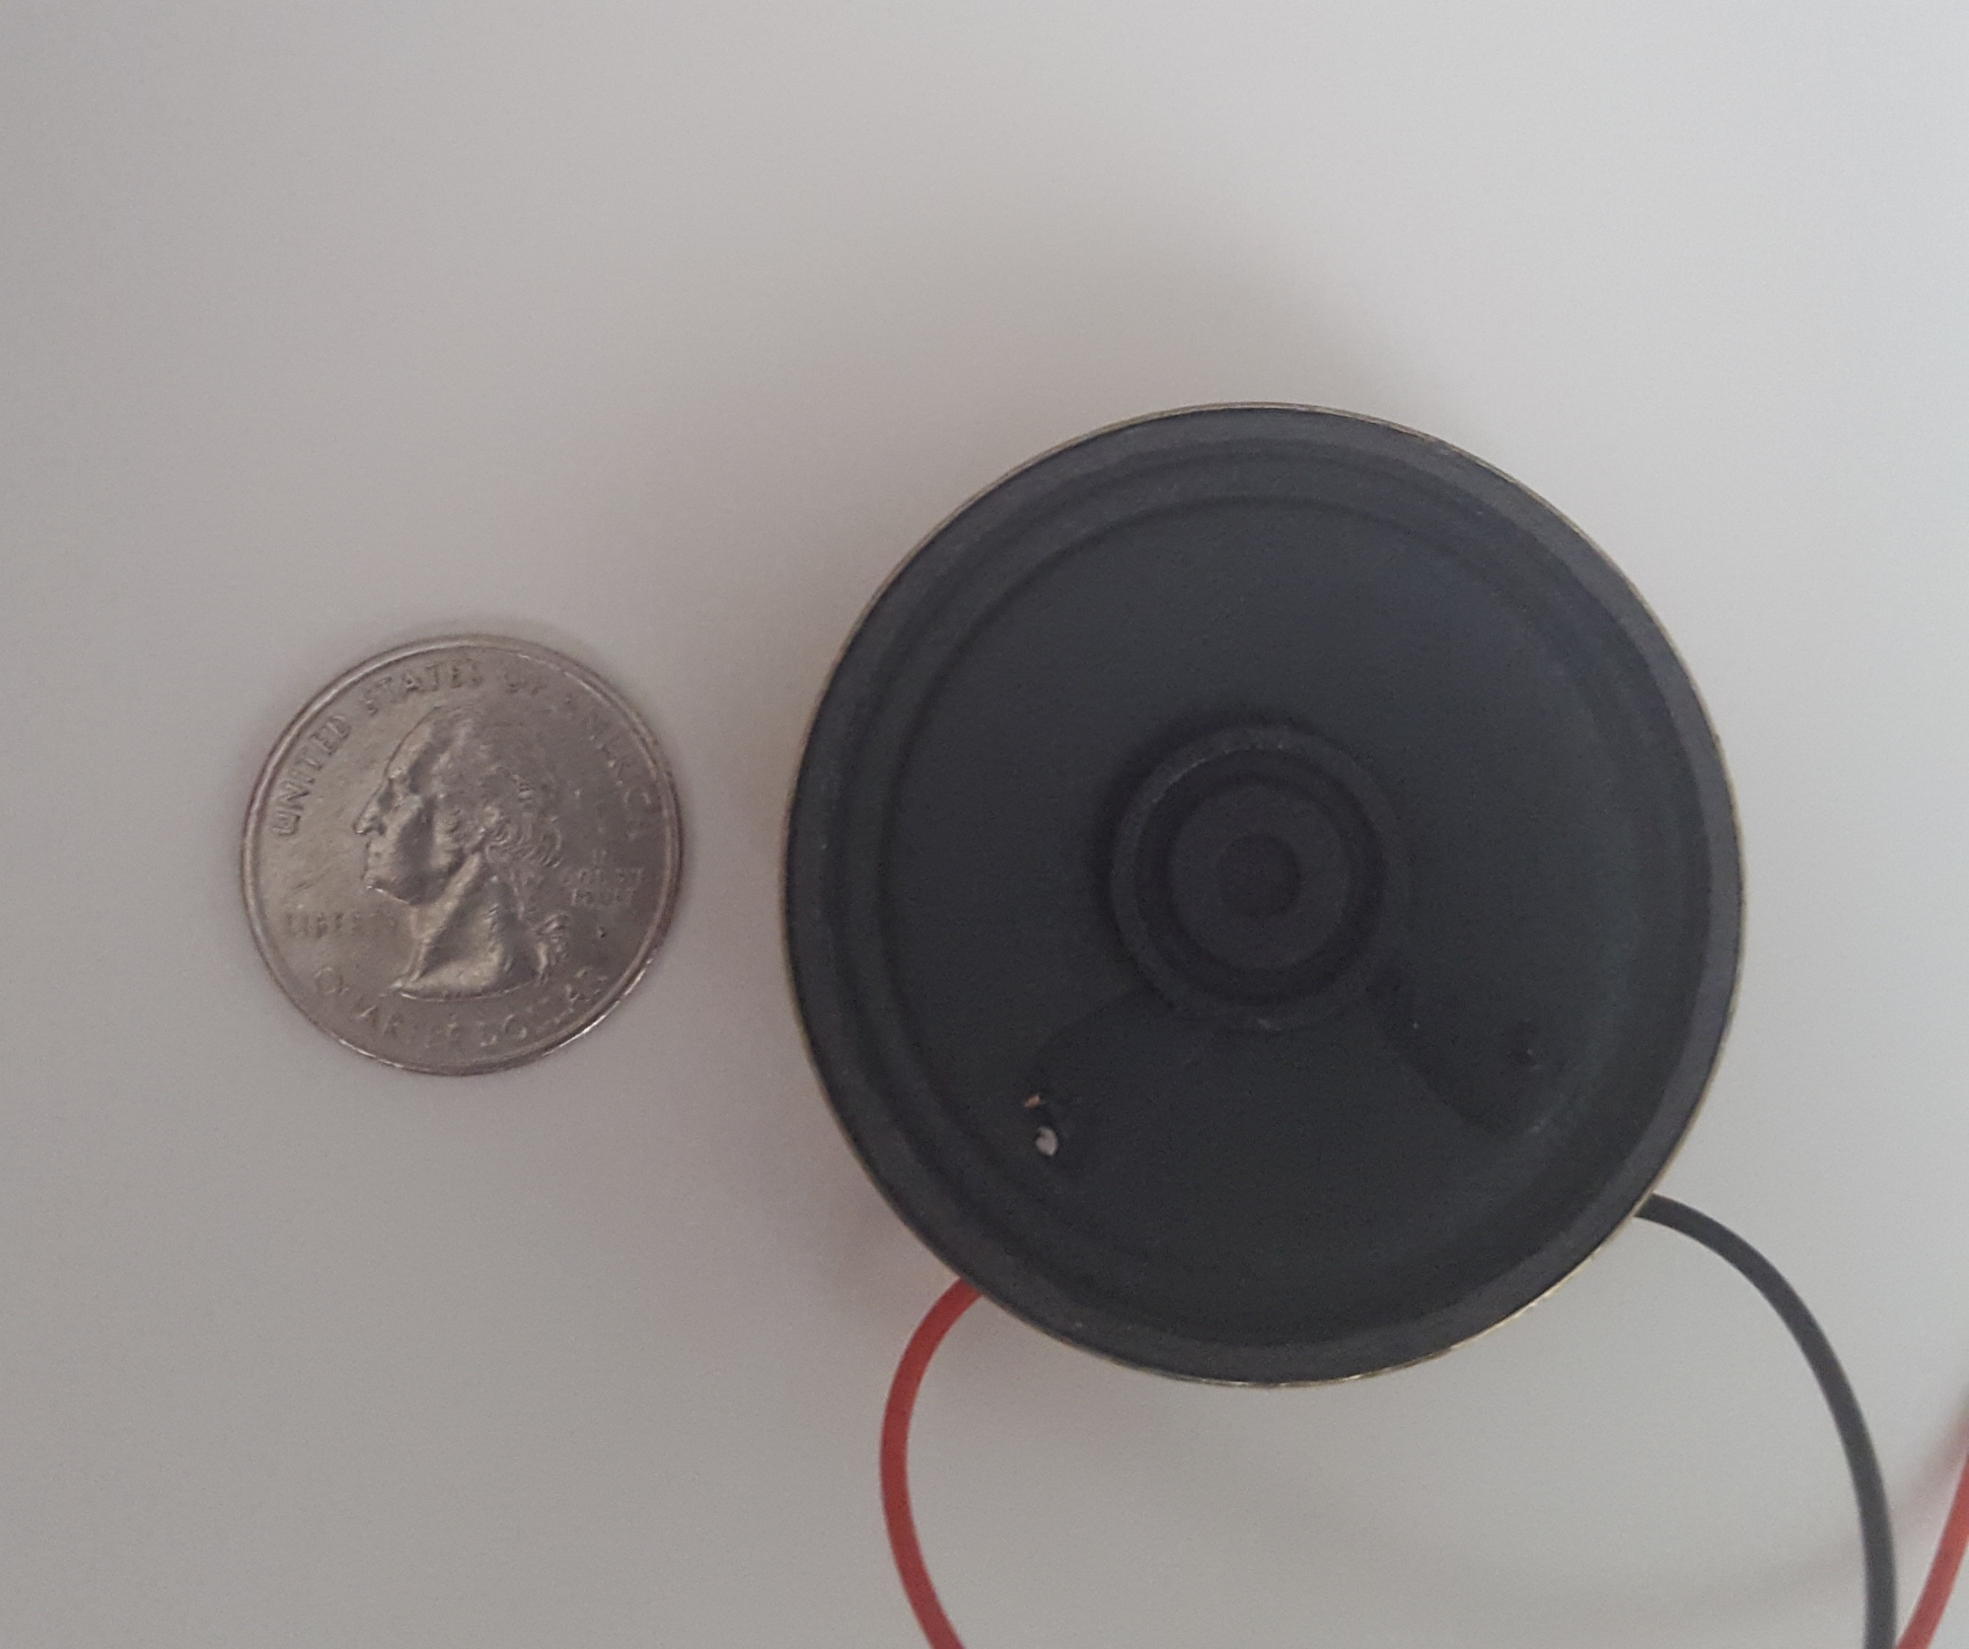
Speakers
Parameter | Regular Speaker | Thin Speaker
Diameter | 50mm | 40mm
Power Rating | 0.5W | 0.25W
Impedance | 8Ω | 8Ω
Price | $1.95 | $0.95
Quality | Much clearer sound | Needs filtering and amplifying
Thin Speaker
Source: SparkFun
Regular Speaker

Slide 42
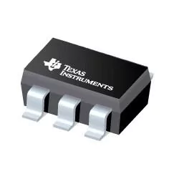
Analog-To-Digital Converter (ADC)
The ATMEGA328-20P chip (MCU) analog input will be used.
Backup component:
ADC081S021CIMF/NOPB
Specs:
8-bit resolution
1 channel
SPI, Serial, 3-Wire interface
Operating voltage of 3.3V-5V
1.3mW power consumption
2.92mm x 1.6mm x 1.02mm
Source: Texas Instruments

Slide 43
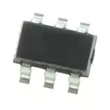
Digital-To-Analog Converter (DAC)
Parameter | MCP4725A3T-E/CH | DAC081S101CIMK/NOPB
Resolution | 12 bit | 8 bit
# of Channels | 1 | 1
Interface | 2-Wire/Serial/I2C | Serial/SPI
Operating Voltage | 3.3V-5V | 2.7V-5.5V
Operating Current | 210µA | 256µA
Price | $1.16 | $1.44
Component Familiarity | More familiar | Never used before
MCP4275
3.1mm x 3.2mm x 1.3mm
Source: Microchip Technology
DAC081
Size dimensions unknown
Source: Microchip Technology

Slide 44
Mohammad’s Responsibilities
Audio Processing
WiFi System
Misc.
Power Management
PCB

Slide 45
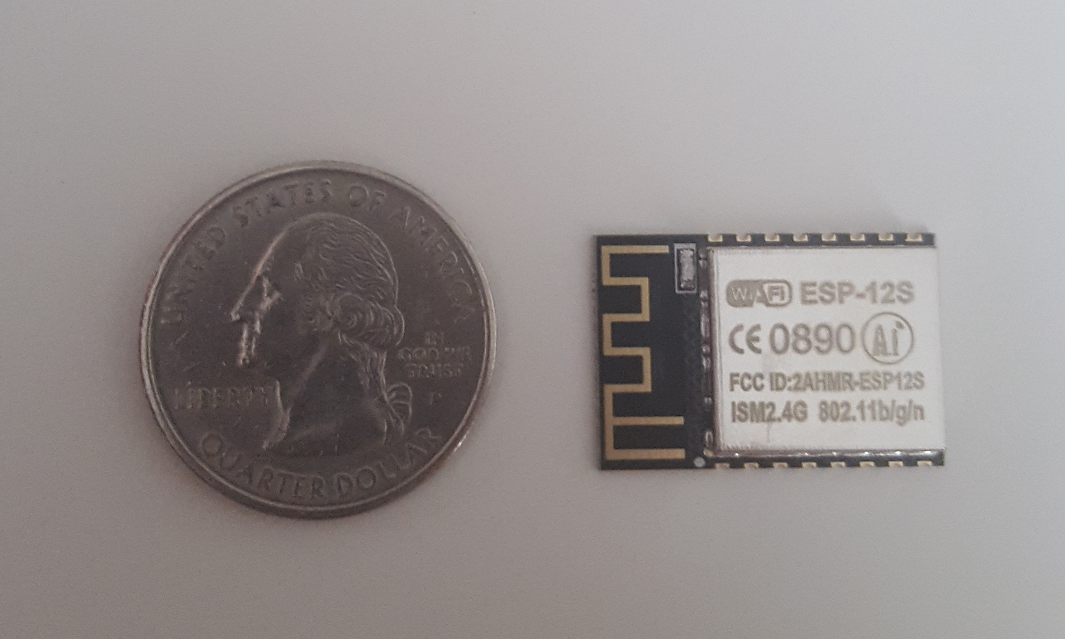
WiFi Chip
Parameter | Xbee S6B | ESP-12S
Standard | 802.11 b/g/n | 802.11 b/g/n
Frequency Band | 2.4GHz | 2.4GHz
Security | WPA/WPA2/WEP | WPA/WPA2/WEP
Interface | SPI/UART | SPI/I2C/UART
Operating Voltage | 3.12V-3.46V | 3.0V-3.6V
Transmit Power | +/- 16 dBm | +/- 20 dBm
Price | $29.00 | $6.95
ESP-12S WiFi Chip

Slide 46
Mohammad’s Responsibilities
Audio Processing
WiFi System
Misc.
Power Management
PCB

Slide 47
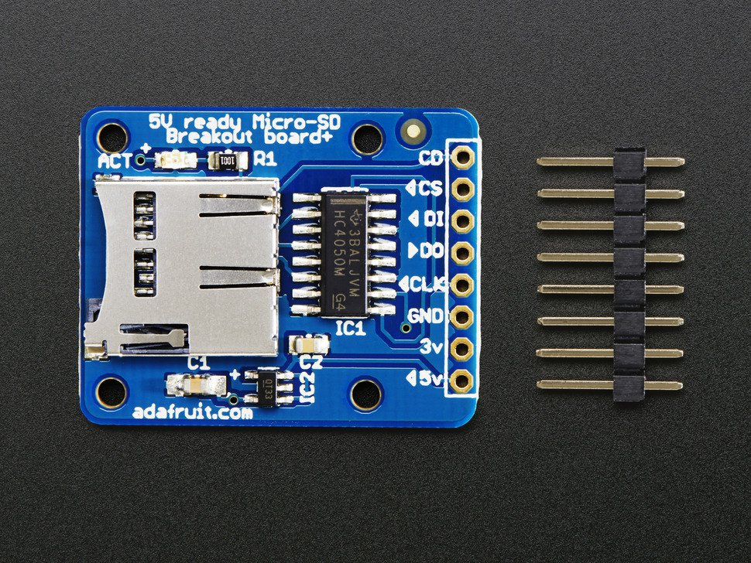
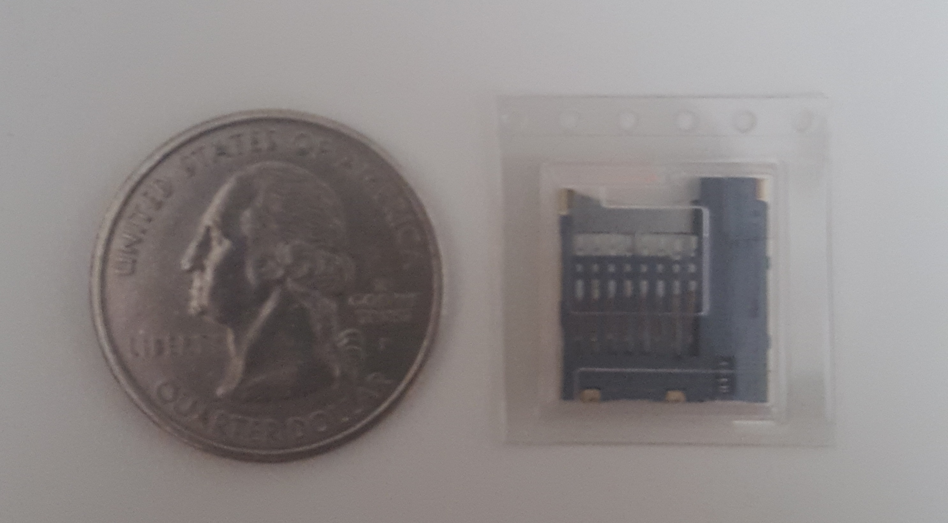
Storage
MicroSD card breakout board+
Source: Adafruit
MicroSD Card Socket

Slide 48
Light Emitting Diodes (LEDs)
 | Single-Color LEDs | RGB Programmable LEDs
Advantages | Desired colors are already programmed Simpler to use Least expensive | Less LEDs are required Many different colors can be used per LED Not too expensive
Disadvantages | A bunch of LEDs will be needed for each color for the project; takes more space | Color programming required
Chosen by the group | No | Yes

Slide 49
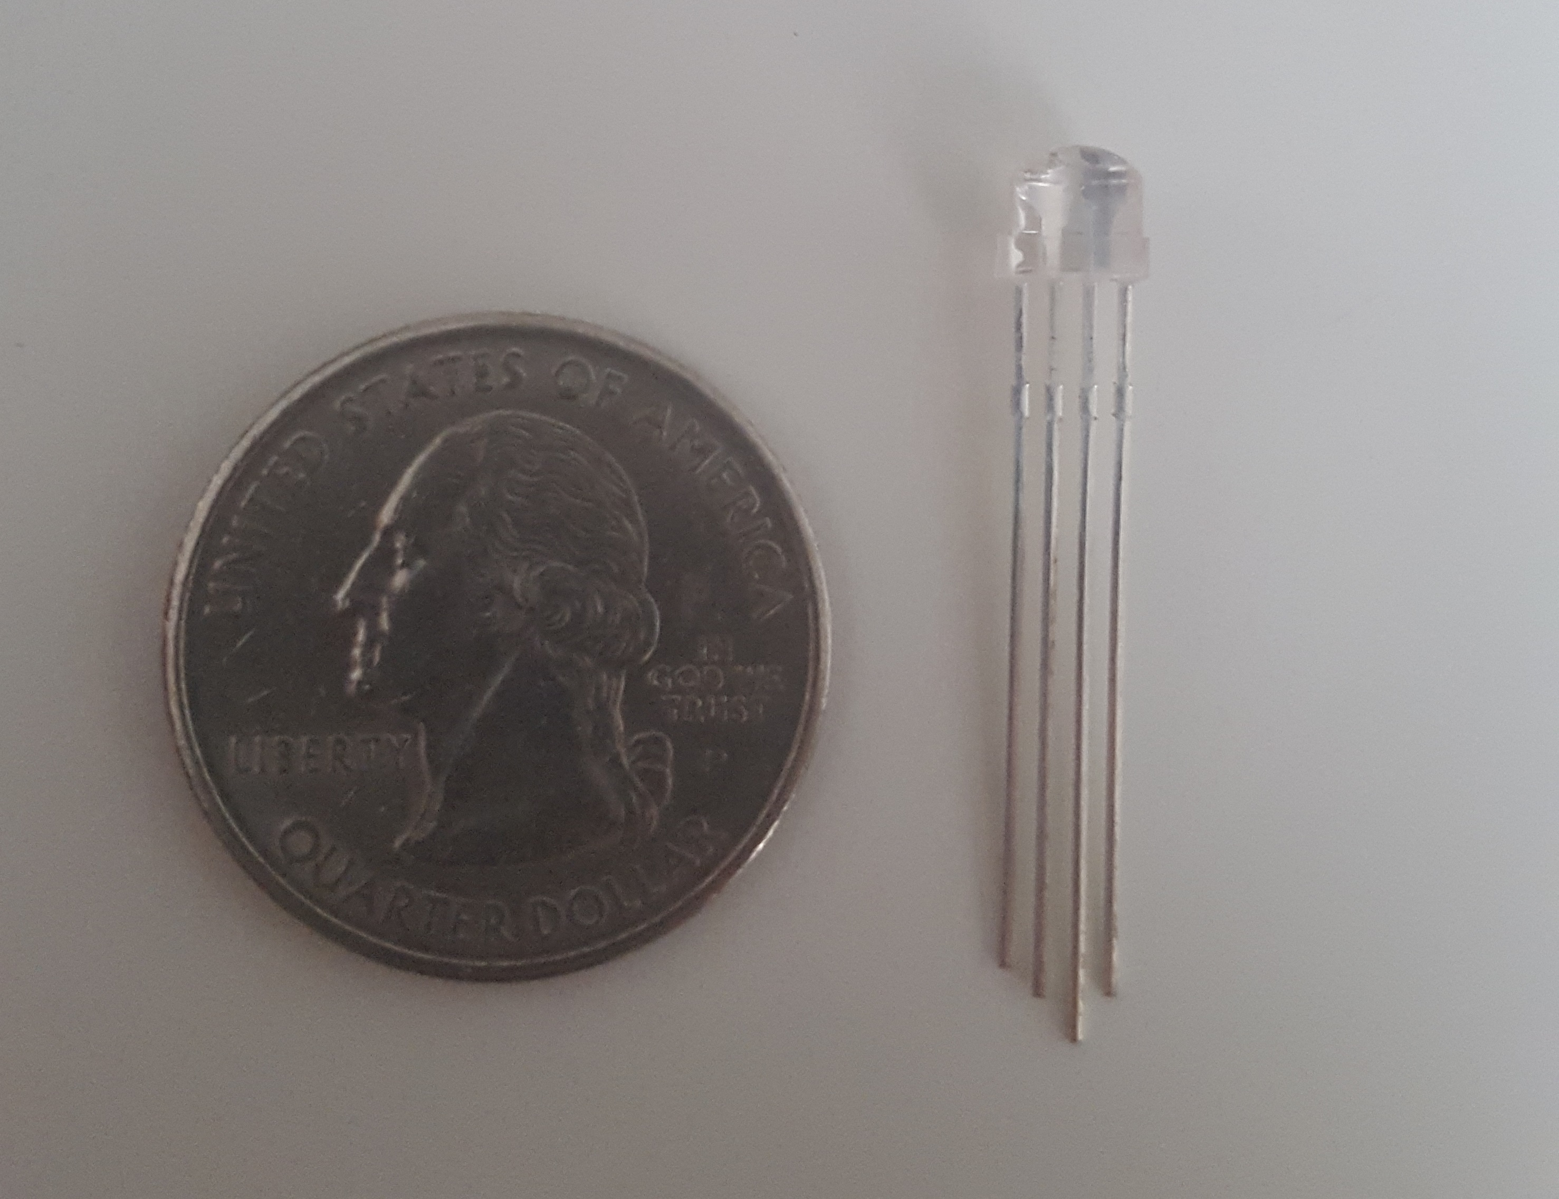
LED Specifications & Functions
Specs:
Single Wire Single Transmission
800kHz internal frequency
Operating voltage range of 4.5V_{DC}-6V_{DC}
Color | Meaning
Blue | Device is ON
Yellow | Device is currently listening to user commands (processing)
Green | Device understood the command
Red | Device did not understand the command
5mm Clear Head RGB LED

Slide 50
Mohammad’s Responsibilities
Audio Processing
WiFi System
Misc.
Power Management
PCB

Slide 51
Power Consumption
Component | Nominal Input Voltage (V) | Nominal Current Draw (mA) | Power Consumed (mW)
Processor | 5 | 16 | 80
LCD | 5 | 2,400 | 12,000
Servo Motors | 5 | 500 | 2,500
Motor Control Unit | 5 | 0.5 | 2.5
WiFi Chip | 3.3 | 80 | 264
Camera | 5 | 250 | 1,250
LEDs | 5 | ~20 | ~100
microSD Card | 3.3 | 100 | 330
DAC | 5 | 0.21 | 1.05
Total: |  | ~3.36A | ~16.5W

Slide 52
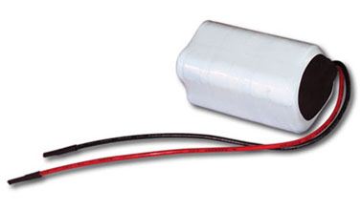
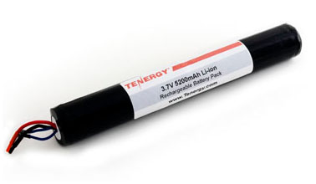
Battery
Parameter | Tenergy Li-Ion 18650 #1 | Tenergy Li-Ion 18650 #2
Nominal Voltage | 7.4V | 3.7V
Nominal Capacity | 4400mAh | 5200mAh
Dimensions | 37mm x 37mm x 70mm | 133mm x 19mm
Weight | 7oz | 3.3oz
Cycle Life | >300 cycles | >300 cycles
Tenergy 18650 #1
Source: Tenergy
Tenergy 18650 #2
Source: Tenergy

Slide 53
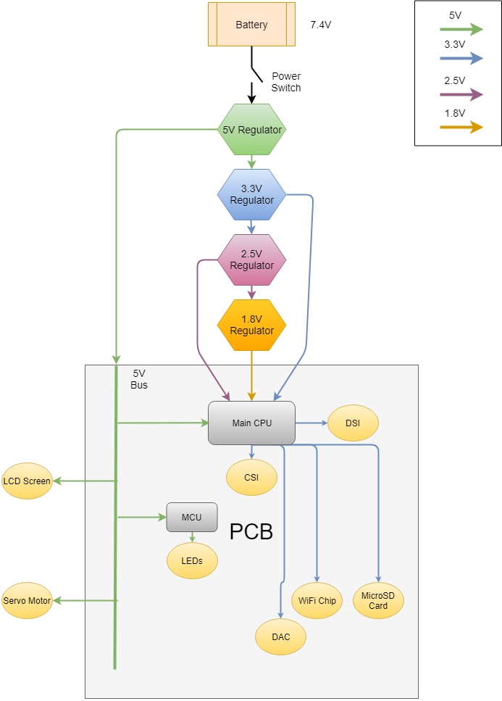
Power Connections
DC-DC Voltage Regulators
7.4V-5V Step Down Regulator
5V-3.3V Step Down Regulator
3.3V-2.5V Step Down Regulator
2.5V-1.8V Step Down Regulator

Slide 54
Mohammad’s Responsibilities
Audio Processing
WiFi System
Misc.
Power Management
PCB

Slide 55
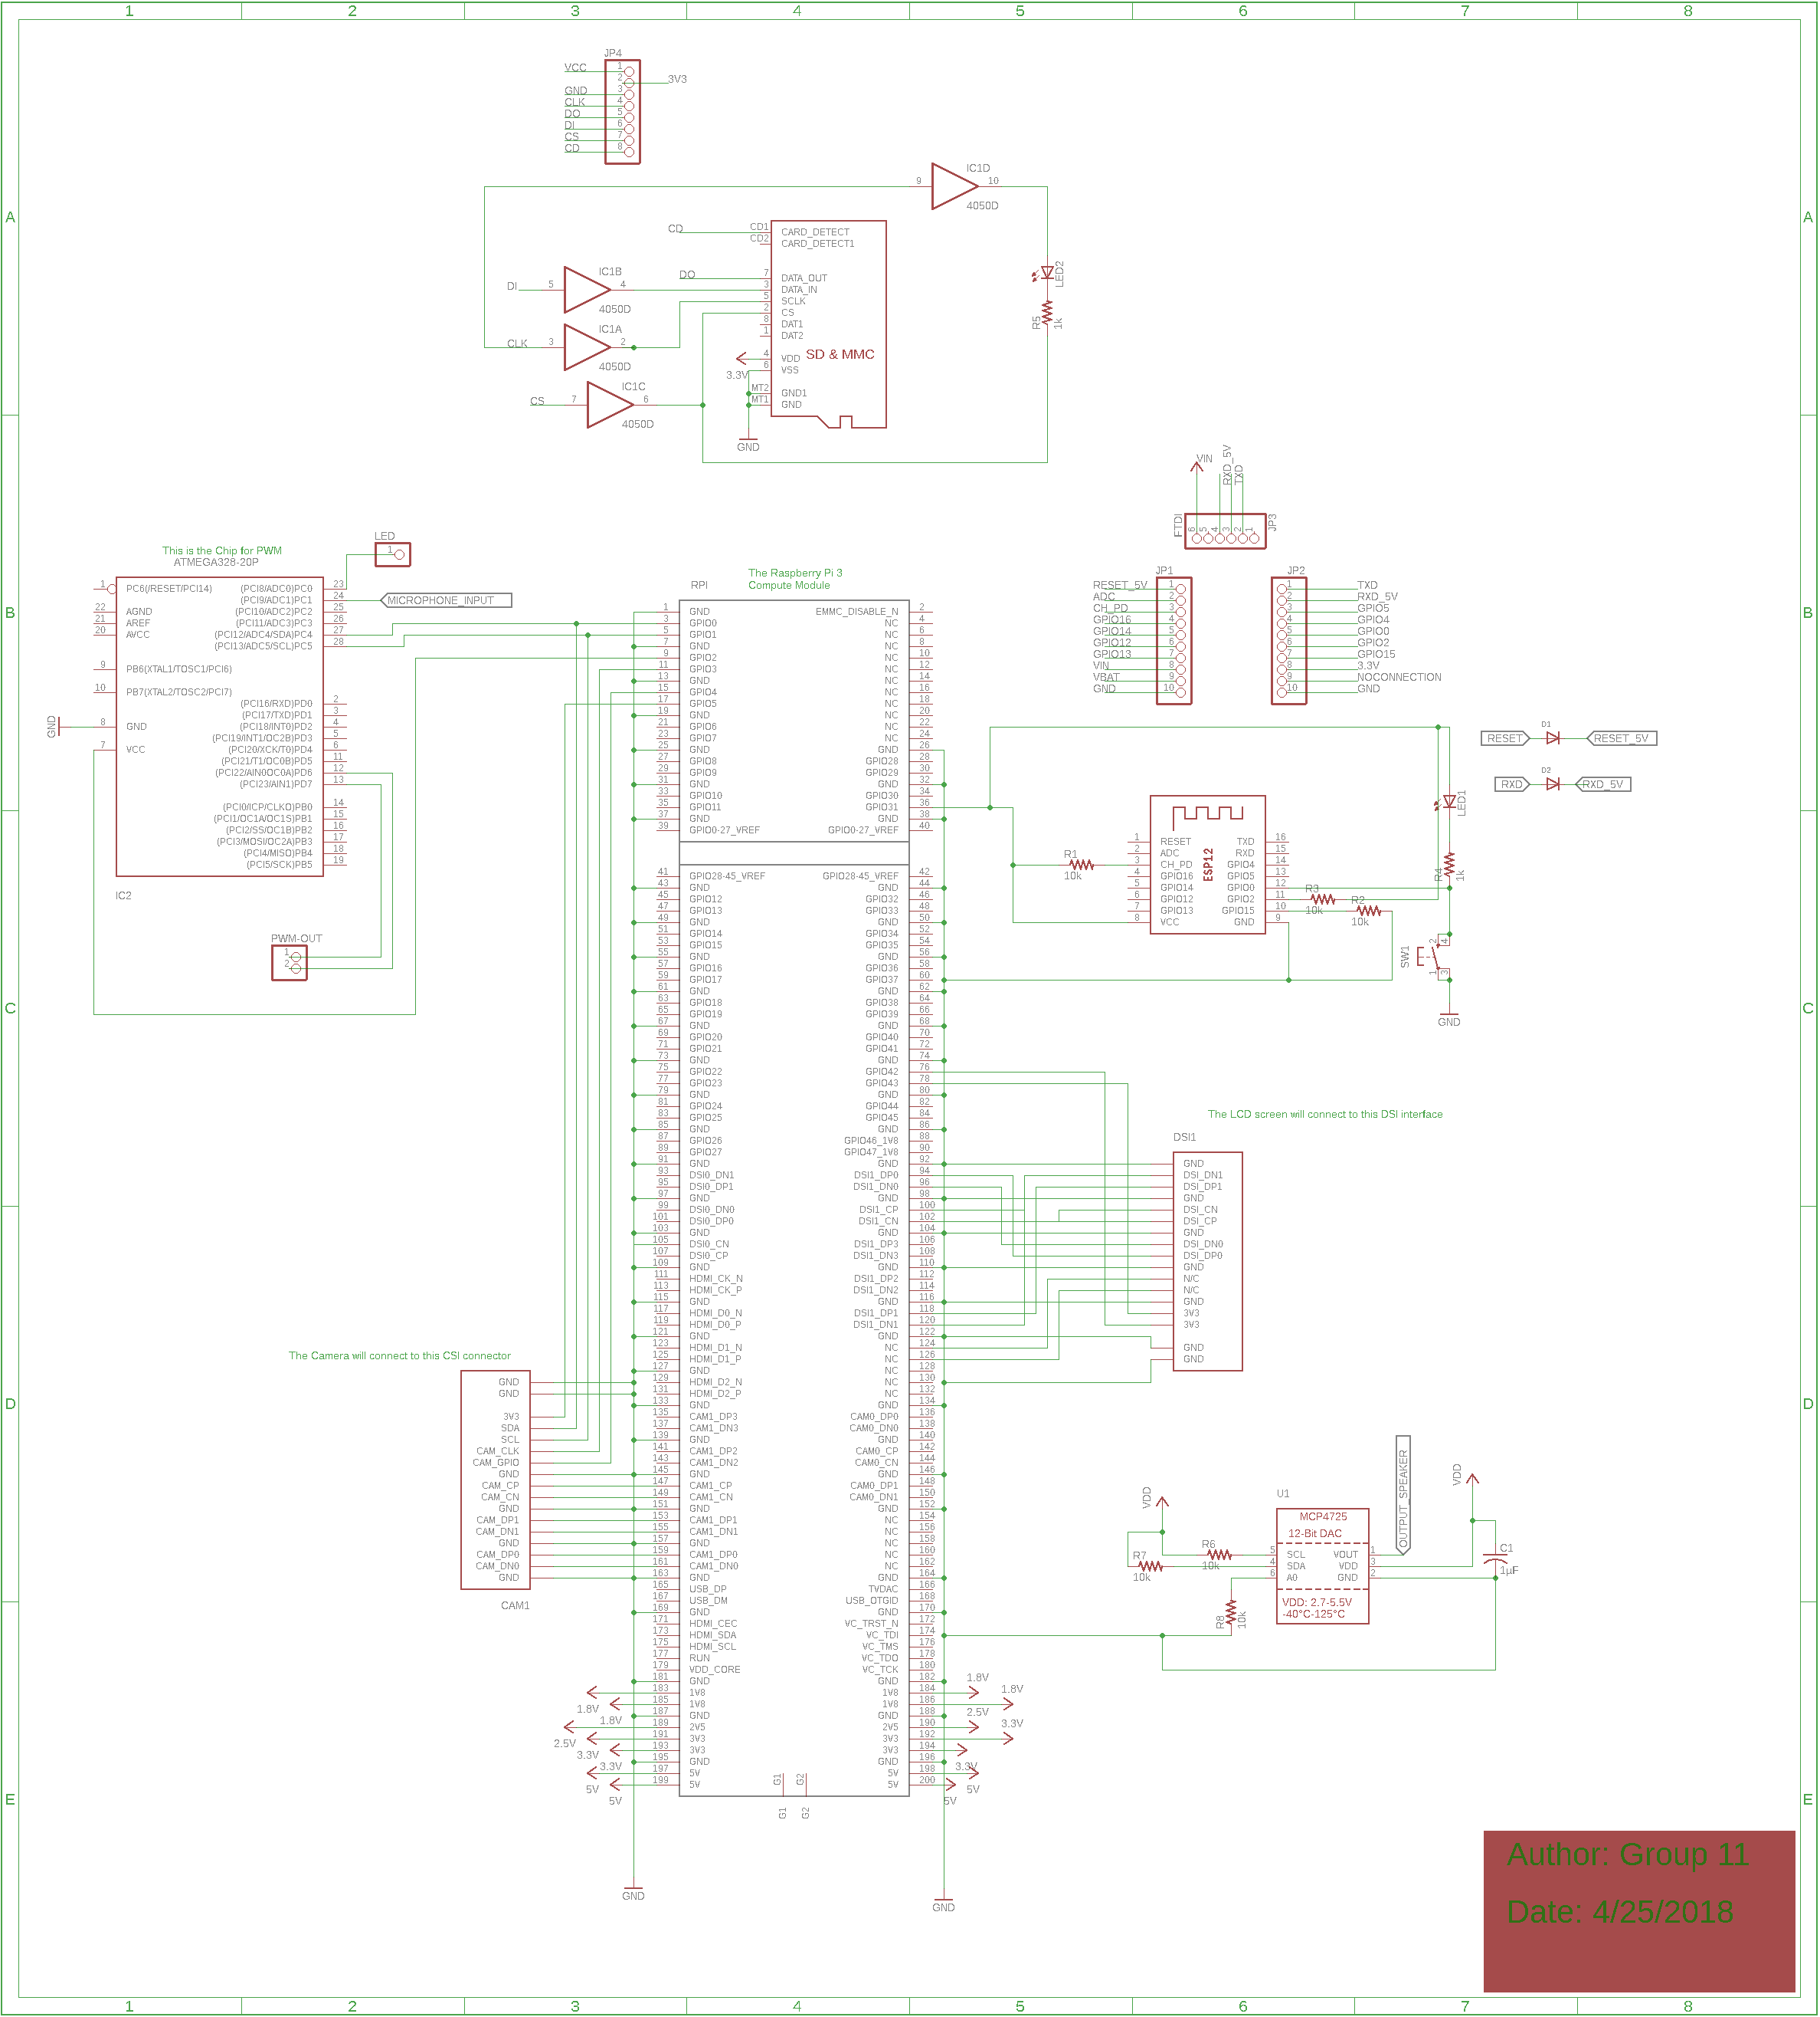
PCB Schematic Overview

Slide 56
Budget
Component | Projected Cost ($) | Actual Cost ($)
Microphones | 3.00 | 1.90
Speakers | 6.00 | 3.90
Display | 60.00 | 80.00
Controller | 35.00 | 26.00
Camera | 15.00 | 10.00
PCB(s) | 50.00 | -
Body | 50.00 | -
Buttons, switches | 10.00 | 1.50
Resistors, capacitors, etc | 10.00 | -
LEDs | 10.00 | 5.90
MCU | 20.00 | 1.30
Servo(s) | 30.00 | -
WiFi Modules | 32.00 | 6.95
Mono Audio Amplifier | 8.00 | 7.95
DAC Breakout Board | 5.00 | 4.95
Battery | 20.00 | -
Voltage Regulators | 15.00 | 10.00
Total | 494.00 | -
Updated Projection: $320.35

Slide 57
Current Progress
To-do:
Get working PCB
Finish up software
Integrate all components together
Test PCB

Slide 58
Issues
Creating a PCB voltage bus and a jack.
Integrating hardware and software together.

Slide 59
Questions?

