Slide 1
Watt You Pay For
GROUP 10
Adam althar
Charles desowitz
Jonathan Killeen
Anders hauge

Slide 2
Motivation
People are becoming more aware of the environmental impact of energy usage.
Monitoring energy usage is still quite difficult for home users and most energy measuring devices do not easily centralize the data from outlets, light switches and home thermostats for users to see.
Giving users a system that can give clear information on their energy usage from a single device and from the entire system can help users make smarter energy decisions.
Create modules that work with new and preexisting home infrastructures.
Team member interest in topic

Slide 3
Home Energy Usage Breakdown
End Use | Share of Total
Space Cooling | 15.4%
Water Heating | 9.5%
Lighting | 9.4%
Refrigeration | 7.2%
Space Heating | 6.2%
Televisions and Related Equipment | 5.9%
Clothes Dryers | 4.1%
Furnace Fans/Boiler Circulation Pumps | 2.3%
Computers and related Equipment | 2.2%
Cooking | 2.2%
Dishwashers | 2.0%
Freezers | 1.6%
Clothes Washers | 0.5%
Other(Small Electronic devices etc.) | 31.3%

Slide 4
Goals and Objectives
Accurately measure real power usage and ignore reactive power.
Centralize energy measurements and upload data onto a server.
Allow easy access to power and energy data from phone or computer.
Show minute by minute, hourly, daily, and monthly power consumption.
Remotely turn off or on outlets and light switches.
Remotely monitor ambient temperature.

Slide 5
Specifications of Energy Monitoring System
Behavior | Value | Unit
Devices shall connect to Wi-Fi in under | 2 | Min
Devices shall send energy data every | 1 | Min
Devices shall withstand and measure current up to | 15 | A
The devices shall be capable of measuring power across lines at | 120 | V rms
The devices shall have a minimum Wi-Fi range of | 10 | m
The devices shall respond to instructions sent from the main server in under | 20 | Sec

Slide 6
Overall Block Diagram

Slide 7
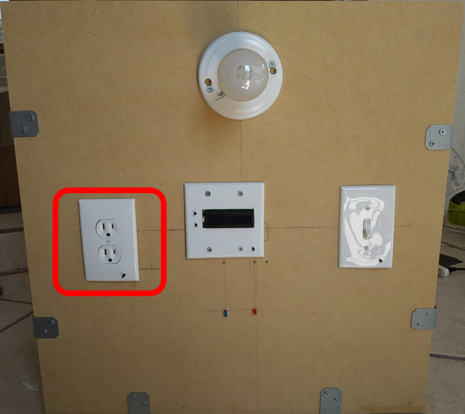
Outlet Control Unit
Devices are plugged into the control unit power outlet
Setup/Connect mode push button is used to switch the control unit between its two operating modes
Outlet is designed to meet housing standards

Slide 8
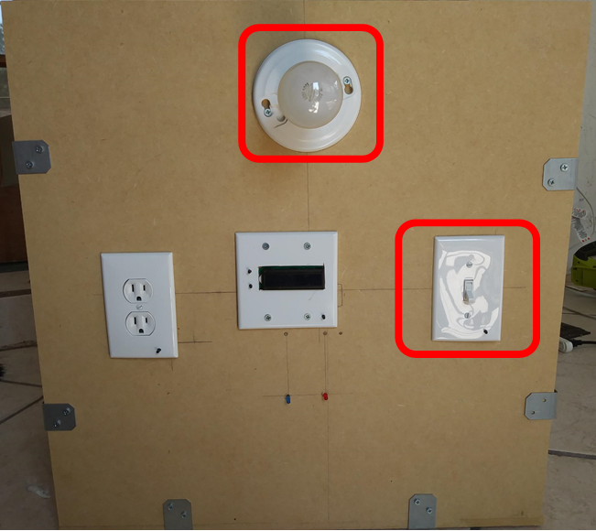
Light Control Unit
Light can be controlled by web interface or conventional light switch
Setup/Connect mode push button is used to switch the control unit between its two operating modes
Light switch is designed to meet housing standards

Slide 9
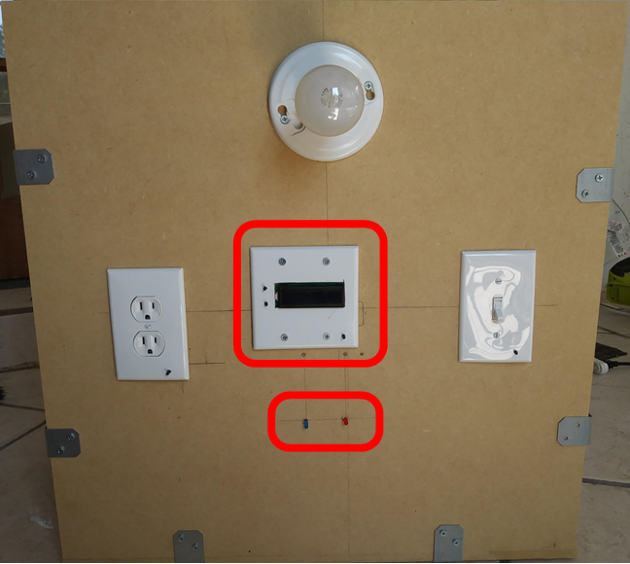
Thermostat
LCD displays ambient and set temperature
Temperature Up/Down buttons
Setup/Connect mode push button is used to switch the control unit between its two operating modes
Heating/Cooling LED indicators

Slide 10


Why Wi-Fi
Wi-Fi is not the only wireless communication protocol
Bluetooth
  Lower-Power Consumption
  Physical Interference
NFC
  Major Range Limitations
ZigBee
  Complex when not interacting exclusively with other XBee devices
Wi-Fi
  Provides built in collision detection and avoidance
  Scalability

Slide 11
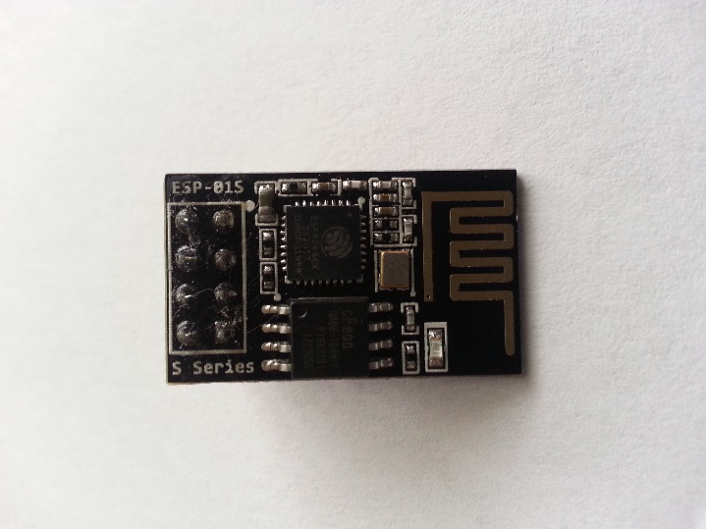
ESP 8266-01S Wi-Fi Module
Purpose:
Connect Mode: To send to and receive data from the main server
Setup Mode: To allow the user to configure the control units settings.
Advantages:
Low idle power consumption
Small form factor
Low cost
Built-in antenna
Well documented
24.7mm
Manufacturer | Makerfocus
Price | $3.25
Operating Voltage | 3.3 V
Flash Memory | 1 MiB
Pin Count | 6
Dimensions | 14.4mm × 24.7mm

Slide 12
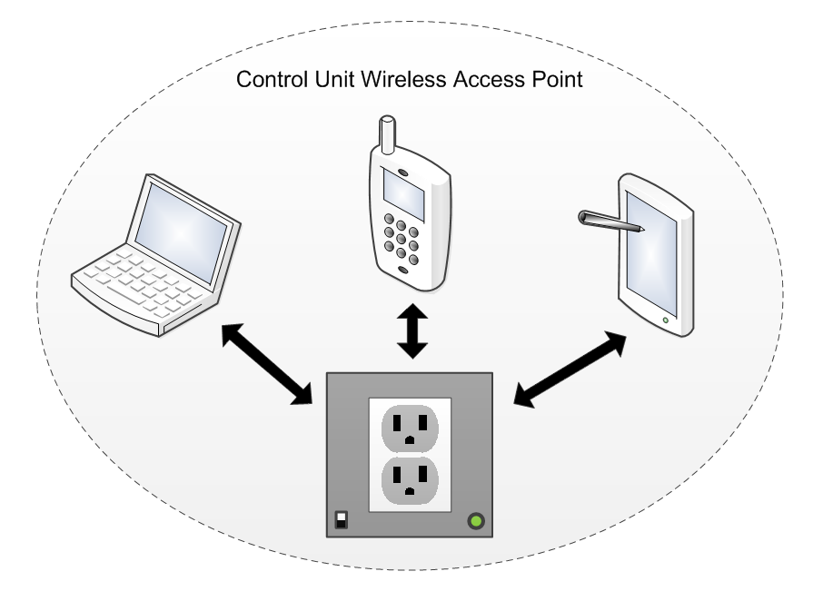
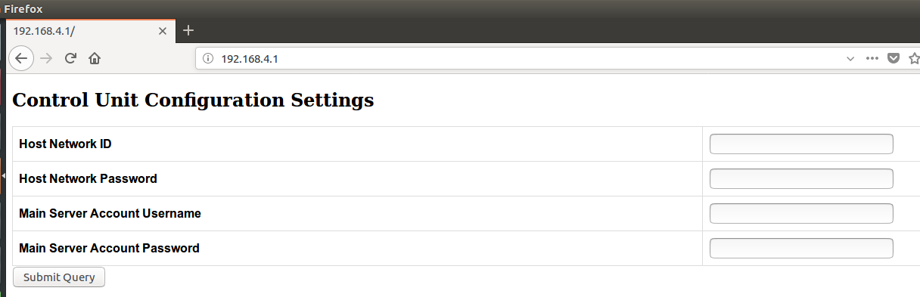
Setup Mode
Control unit sets up a Wi-Fi access point
Wi-Fi enabled devices log onto the control units Wi-Fi network
Devices with browsers can then access the control units configuration page

Slide 13
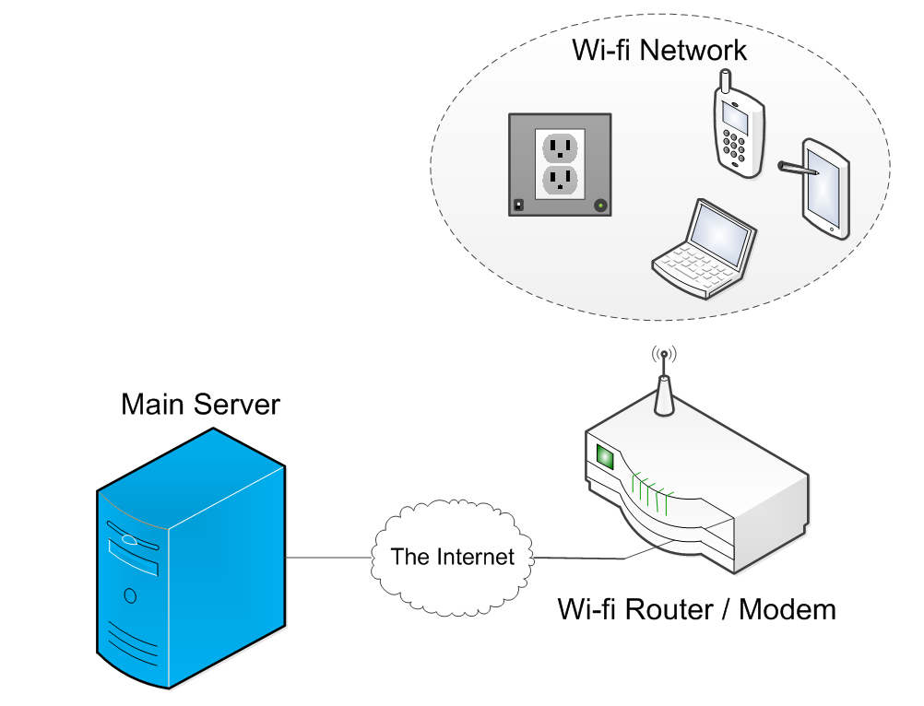
Connect Mode
Control unit connects to the Wi-Fi station specified in its configuration (EEPROM)
Control unit connects to the main server and begins sending power usage data
Control unit can receive commands from the main server

Slide 14
Wi-Fi Module Issues
Problem:
Wi-Fi module operates on 3.3 volts. The ATMega2560 operates on 5 volts. Digital communication between two devices may damage the ESP8266 if a 5 volt signal is sent to it.
First Solution:
Use a bidirectional logic level shifter that can raise the 3.3 volt signal to 5 volts and lower the 5 volt signal to 3.3 volts.
End Solution:
Use a voltage divider for MCU transmit pin.

Slide 15
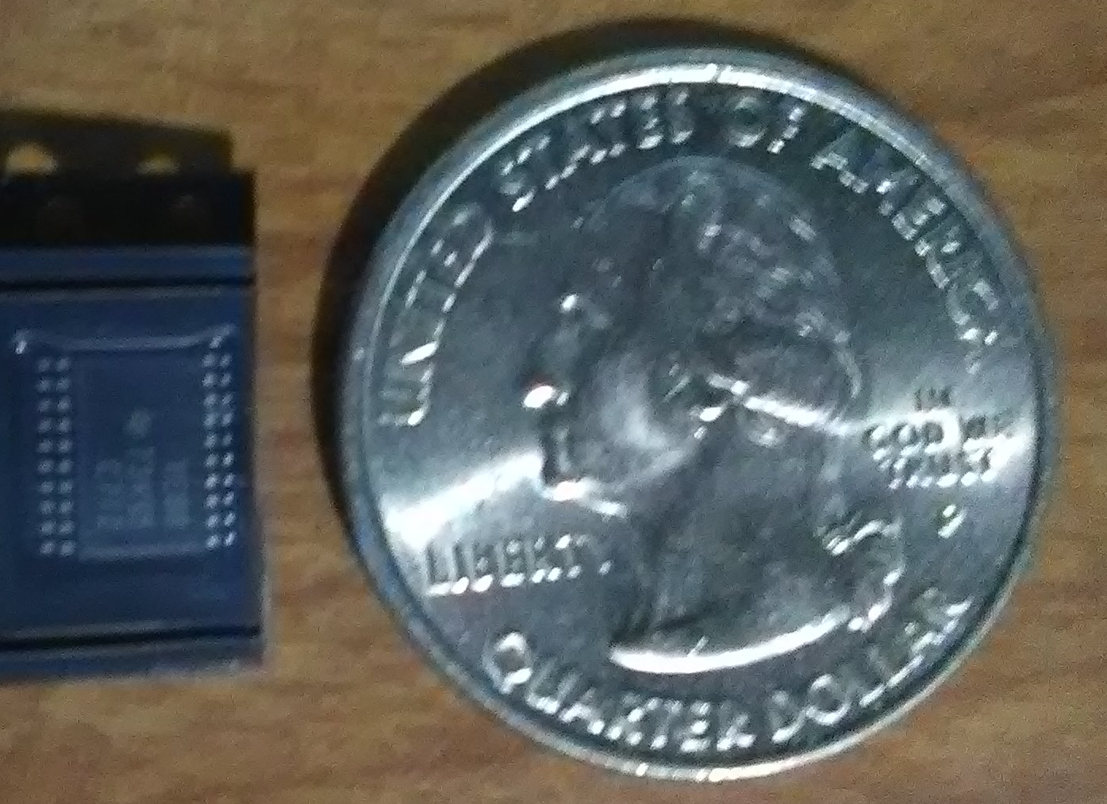
TXB0108 Level Shifter
Purpose:
To safely allow communication between the Wi-Fi module and MCU.
Advantages:
Small package size.
8 logic level shifters.
Wide voltage range
Extremely fast data transmission rate
6.6 mm
Specification | Value
Cost | $1.51
Size | 6.6x6.6 mm
Max Data rate | 100 Mbps
Channel A voltage range | 1.2-3.6 V
Channel B voltage range | 1.65-5.5 V

Slide 16
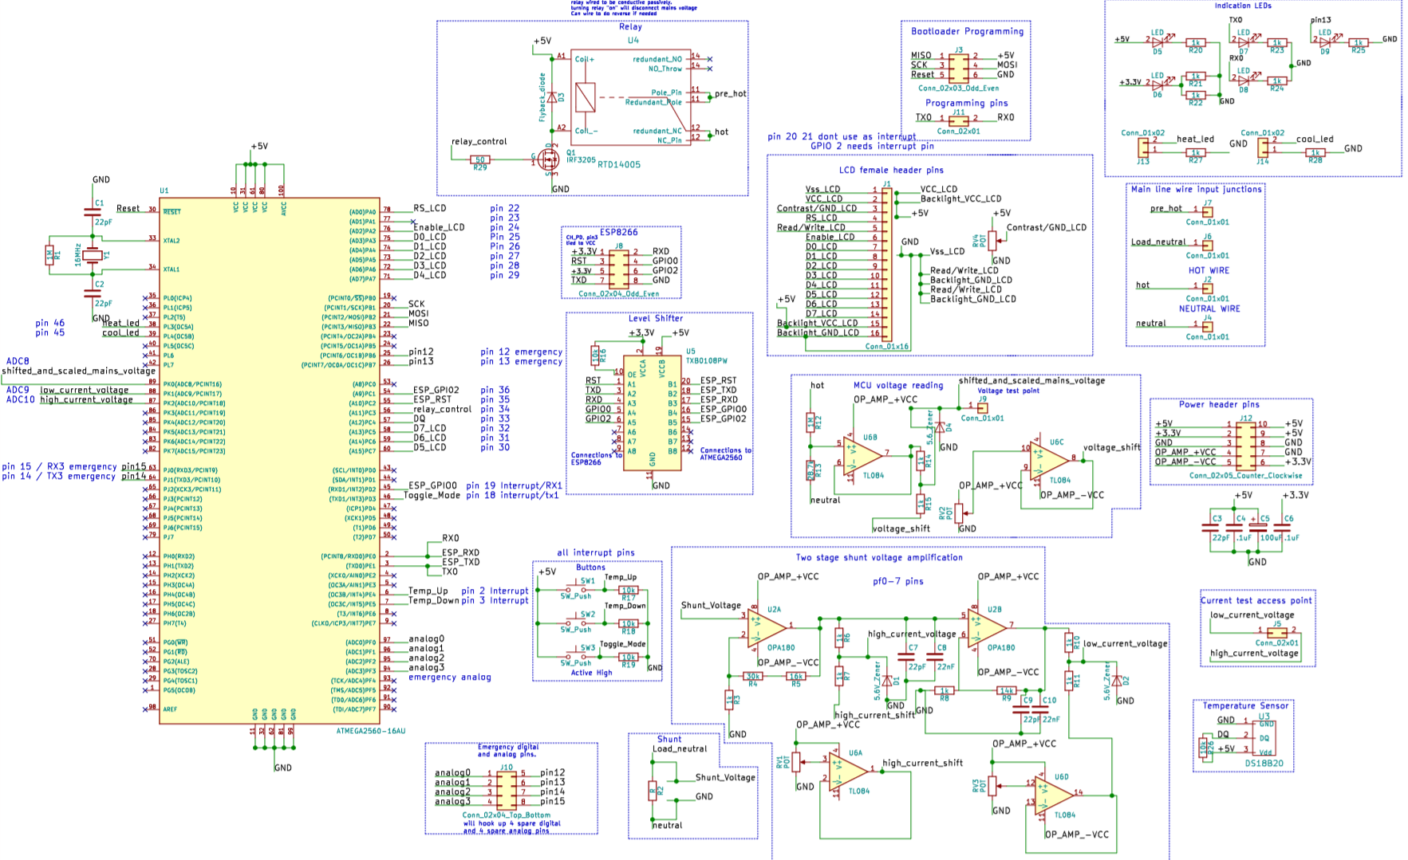
PCB Schematic Design

Slide 17
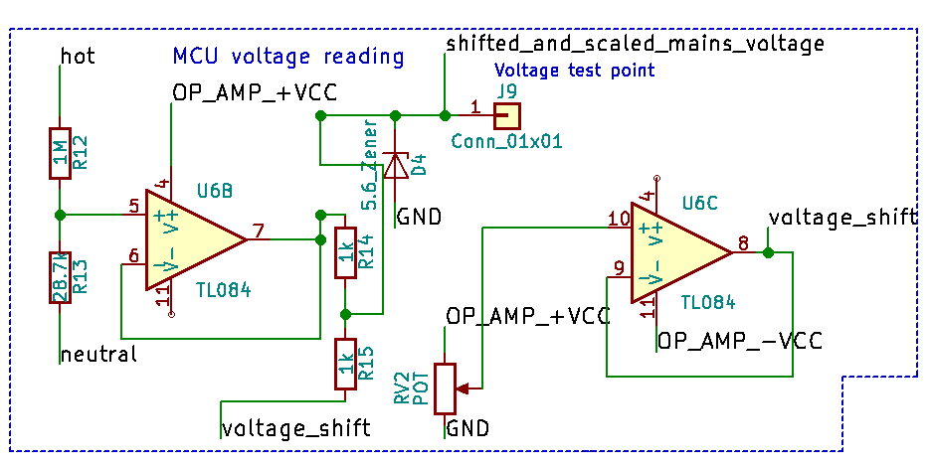
Voltage Measuring
Voltage from the wall is first scaled from an amplitude of 170 volts to 4.75
A unity gain buffer is used before the second voltage divider, which scales the voltage in half and also shifts the waveform up.
The shifted and scaled waveform now has a range between 0 and 5 volts.
A peak voltage lower than 5 volts allows for grid voltage to vary without the ADC reading clipping.
Zener diode protects MCU from voltage spikes.

Slide 18
Current Measuring Difficulties
Problems:
Shunt voltage needs to be small
Significant range will be lost from single amplifier
Solution:
Two stage amplification system

Slide 19
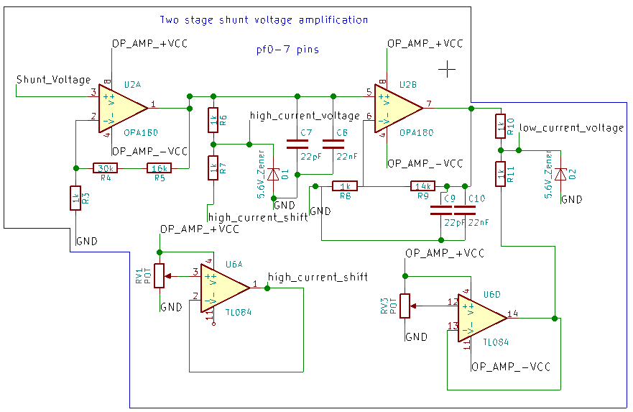
Current Measuring
Two stage non-inverting amplification allows for accurate current measurements for small loads under 1 amp and large loads over 1 amp.
First stage amplifies the shunt voltage by 47 for high current.
Second stage multiplies the shunt voltage by a total of 705 for low current.
Zener protects MCU from overvoltage.

Slide 20
Current Measuring Considerations
Need for two stage current amplification creates complications in reading data
  Which stage do we read from?
Solution: Sample both stages then check values
  If low current reading is >0.1V and <4.9V , use low current reading
  Otherwise use high current reading

Slide 21
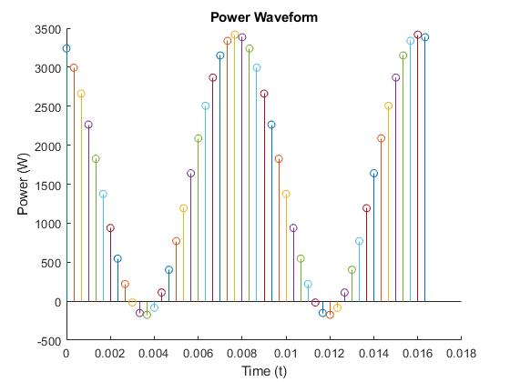
Analog Measurement Philosophy
The more samples taken, the more accurate the data
  This has diminishing returns
Time the MCU spends doing other tasks is time spent not taking samples
Find balance between sampling and other important tasks
  Solution: Periodic high resolution samples
  Can measure non-ideal sinusoidal waveforms

Slide 22
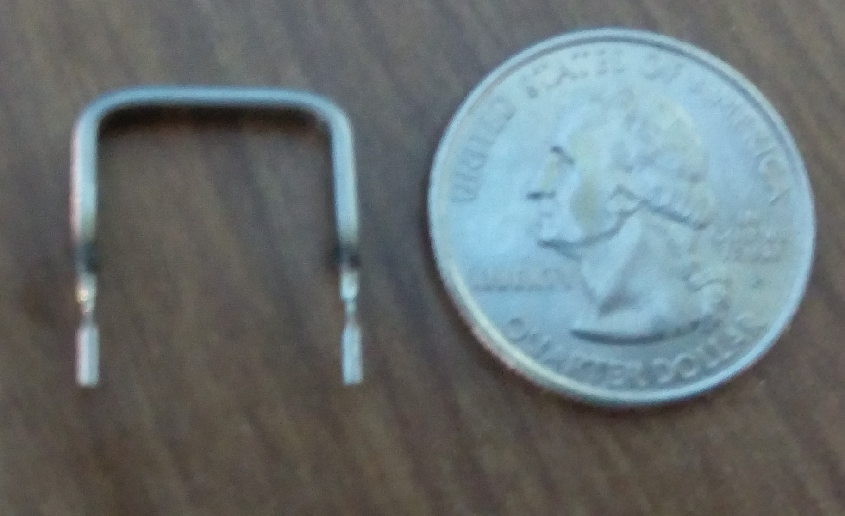
OAR3R005FLF Shunt Resistor
Purpose:
To convert current into a readable voltage.
Advantages:
Low cost.
Easy to use.
Small package size.
Constant resistance
11.43 mm
Specification | Value
Cost | $0.97
Max Current | 16 Amps
Size | 11.43 mm
Resistance | 5 mΩ

Slide 23
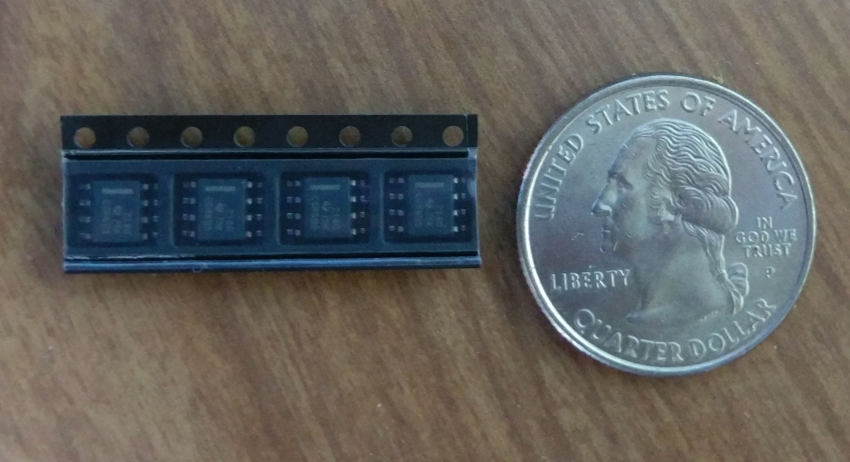
OPA2180IDR Op Amp
Purpose:
To amplify the shunt voltage into a range that the utilizes the full range of the ADC.
Advantages:
Dual Op amp package gives exact amount of high precision amplifiers needed.
Extremely small package size.
Very high accuracy.
5 mm
Specification | Value
Cost | $2.72
Size | 5mmx6.2mm
Voltage range | 36 V
CMRR | 114 dB
Noise | 10nV/Hz^.5

Slide 24
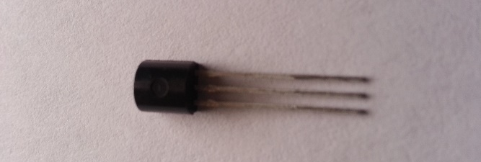
DS18B20 Digital Temperature Sensor
Purpose:
Measure ambient room temperature
Advantages:
Easy to use (only 1 data wire)
Low idle power
High accuracy
Small form factor
Ample documentation
50 mm
Manufacturer | Maxim Integrated
Price | $2.77
Operating Voltage | 3V to 5.5V
Accuracy | +/- 0.5 C
Pin Count | 3
Dimensions | 50mm x 18mm
Temperature Range | -55 to 125°C

Slide 25
LCD vs OLED Display
LCD
  Limited character space
  Large and easy to read
  Easy to use
OLED
  Many colors
  Higher resolution for more possible information
  Very expensive

Slide 26
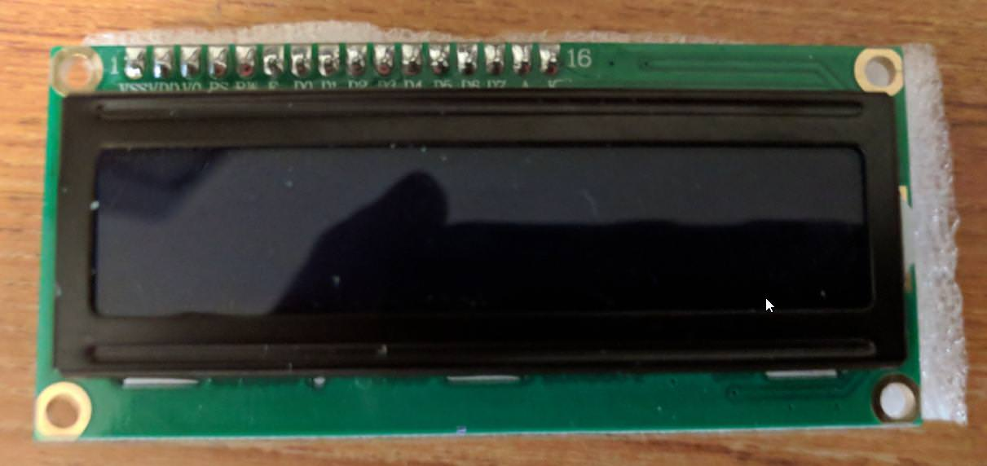
Crystalfontz CFAH1602B-TMIJT
Purpose:
To display set temperature and ambient temperature.
Advantages:
Low cost
Backlit
Library support
Specification | Value
Dimensions | 80 x 36 x 13.5 mm
Cost | $5.97
Maximum characters | 32

Slide 27
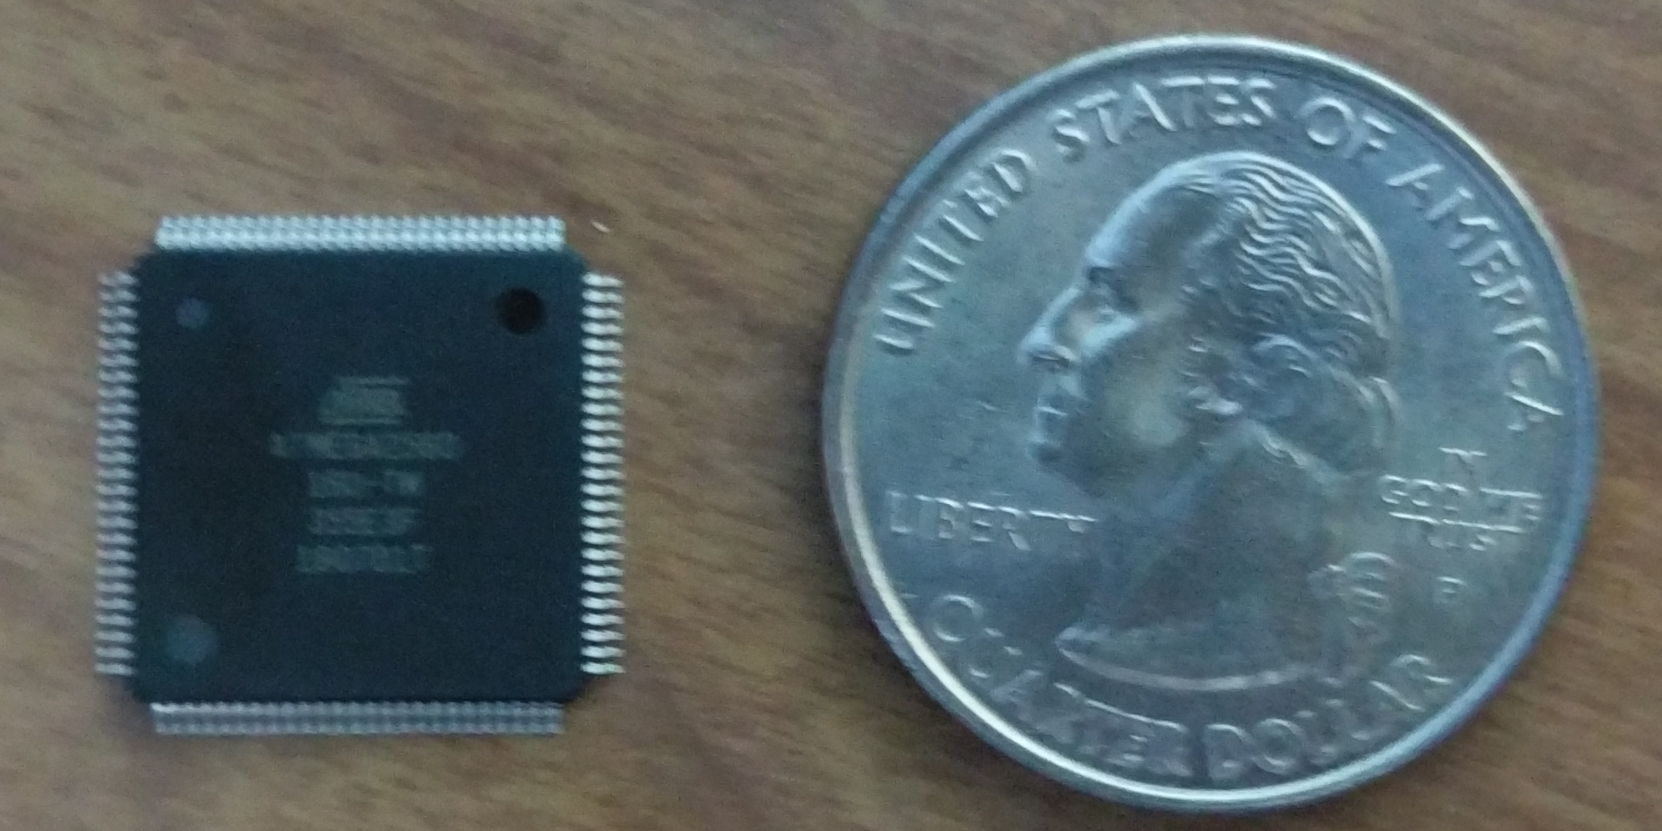
ATMega 2560 Microcontroller
Purpose:
Measure voltage and current inputs
Calculate power consumption
Send and receive data to ESP8266
Send display information and read current temperature
Adjust set temperature based on user input
Advantages:​
256kB memory allows software and library flexibility​
16 analog, 54 digital, 15 PWM, and 4 RX/TX pins allows​ for many peripherals to be attached.​
Gives a large amount of flexibility for prototyping changes.
16 mm
Specification | Value
Cost | $14.22
Memory | 256kB
Clock speed | 16 MHz
I/O pin | 54 digital 16 analog
Size | 16 x 16 mm

Slide 28
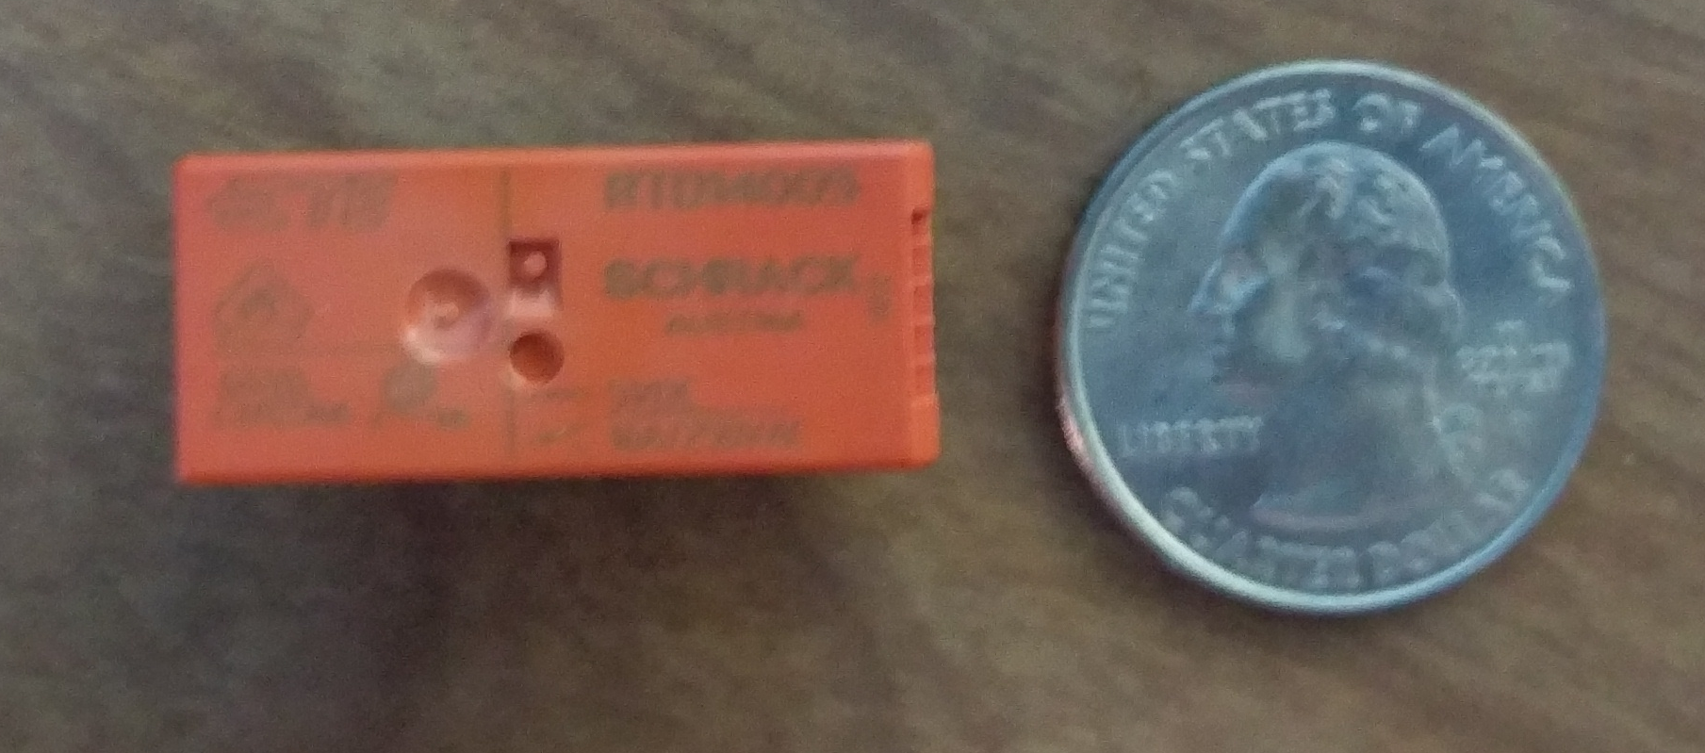
Power Relay
Purpose:
Allows the outlet or switch to be turned off which terminates energy usage from the device.
Advantages:
Relay can be wired to be in normally closed or normally open position.
Low turn on voltage allows it to directly be turned on by microcontroller.
29mm
Specification | Value
Cost | $2.11
Max Current | 16 Amps
Size | 29x12.7 mm
Turn on Energy Consumption | 400mW

Slide 29
Power Relay Considerations
Problem:
The power relay requires 80mA to turn on.
Solution:
Use an n-channel MOSFET as a switch to power the relay.
Problem:
Turning relay off will induce voltage spikes from inductor.
Solution
Use a flyback to remove voltage spikes caused by inductor.

Slide 30
Additional Relay Considerations
Problem:
Relay bounces when switching on or off
Bouncing can cause arcing and EMF interference when power is flowing through the circuit
EMF noise cannot be easily filtered
Circuit design does not allow isolation of mains power
Solution:
Use solid state relay

Slide 31
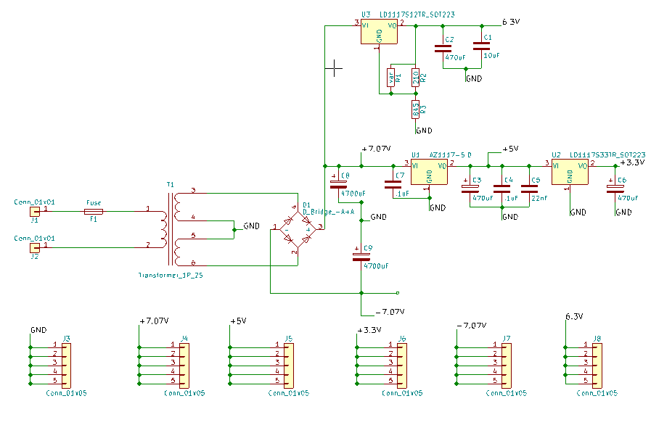
Power Supply
60 Hz transformer steps down 120 volts into two 8 volt windings
Windings connected in series to give positive and negative rail with center tap
Bridge rectifier and capacitors make waveform DC
Voltage regulators used to give necessary voltages

Slide 32
Power Supply Considerations
Problem:
MCU would not reset upon power-up due to slow response time of power supply
Solution:
Plug in the power supply first to give power supply time to charge, then connect devices.

Slide 33
Security
User credentials are stored on a MySQL server
  Passwords are stored as Bcrypt hashes
Secure Sockets Layer (SSL)
  User website uses https to prevent MITM attacks
  Websocket-Main Server communication implements SSL

Slide 34
PCB Considerations
Problem:
No PCB design experience and SMD soldering worries
Solution:
Quickly develop rough prototype to gain experience
Problem:
Non ideal resistances caused the level shifting to be inaccurate.
Solution:
Include potentiometer and op-amp to fine tune shifting voltage.
Problem:
Imprecise Zener caused the waveform to be clipped at 4.8V
Solution:
Use more precise Zener diode.

Slide 35
Additional PCB Consideration
Problem:
Microcontroller could not turn on relay.
Solution:
Use MOSFET as switch to turn on relay.
Problem:
Voltage rail can vary which will cause voltage dividers to change
Solution:
Use a voltage regulator that does not vary when the rail voltage changes

Slide 36
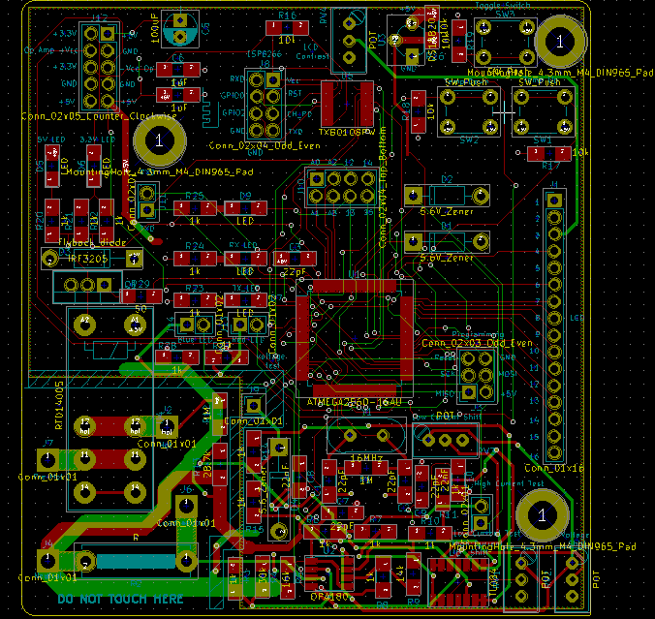
Final PCB

Slide 37
Budget
Component | Total
PCB manufacturing | $153.34
Mouser | $429.20
Amazon | $139.59
Arrow | $48.16
Ebay | $66.24
Home Depot | $64.59
GitHub | $49.00
DigitalOcean Server | $30.00
Total | $980.12

Slide 38
Work Distribution
 | Networking | Embedded Design | Analog Design | PCB Design | Prototype Testing
Adam | S | P |  |  | S
Anders |  |  | P | S | P
Jonathan | P | S |  |  | P
Charles |  | S | S | P | S
Legend
P-Primary Contributor
S-Secondary Contributor

Slide 39
Questions?

