Slide 1
Home Energy Monitoring System
GROUP 10
Adam althar
Charles desowitz
Jonathan Killeen
Anders hauge

Slide 2
Motivation
People are becoming more aware of the environmental impact of energy usage.
Monitoring energy usage is still quite difficult for home users and most energy measuring devices do not easily centralize the data from outlets, light switches and home thermostats for users to see.
Giving users a system that can give clear information on their energy usage from a single device and from the entire system can help users make smarter energy decisions.
Team member interest in topic

Slide 3
Home Energy Usage Breakdown
End Use | Share of Total
Space Cooling | 15%
Water Heating | 10%
Lighting | 9%
Refrigeration | 7%
Space Heating | 6%
Televisions and Related Equipment | 6%
Clothes Dryers | 4%
Furnace Fans/Boiler Circulation Pumps | 2%
Computers and related Equipment | 2%
Cooking | 2%
Dishwashers | 2%
Freezers | 2%
Clothes Washers | 1%
Other(Small Electronic devices etc.) | 34%

Slide 4
Goals and Objectives
Accurately measure real power usage and ignore reactive power consumption.
Centralize power measurements and upload data onto a server.
Allow easy access to power data from phone or computer.
Show minute by minute, hourly, daily, and monthly power consumption.
Remotely turn off or on outlets and light switches.
Measure temperature and give users an interface that can change thermostat temperature and send a signal to turn on or off the air conditioner.
Remotely change thermostat temperature.

Slide 5
Specifications of Energy Monitoring System
Behavior | Value | Unit
Devices shall connect to Wi-Fi in under | 45 | Sec
Devices shall send power data every | 1 | Min
Devices shall withstand and measure current up to | 15 | A
The devices shall be capable of measuring power across lines at | 120 | V rms
The devices shall have a minimum Wi-Fi range of | 30 | m
The devices shall respond to instructions sent from the main server in under | 20 | Sec

Slide 6
Overall Block Diagram

Slide 7
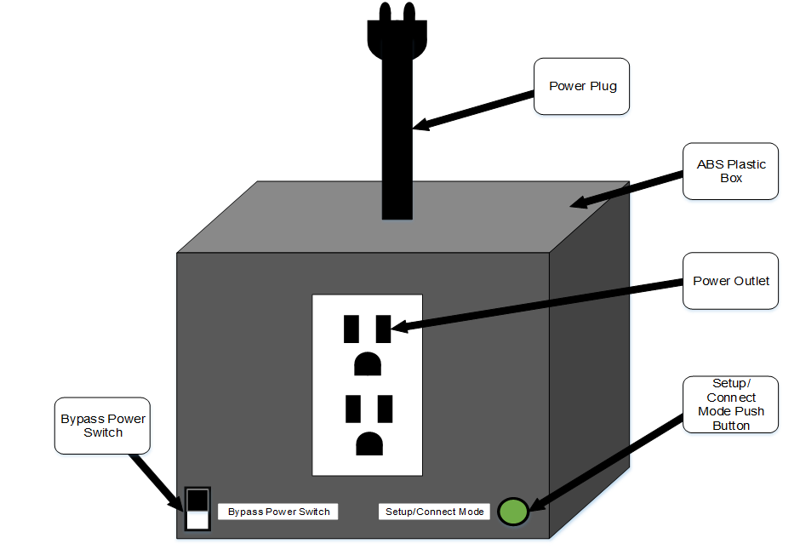
Outlet Control Unit Prototype
Power plug goes into the wall outlet
Devices are plugged into the control unit power outlet
Bypass power switch disconnects/connects power plug from wall outlet
Setup/Connect mode push button is used to switch the control unit between its two operating modes

Slide 8
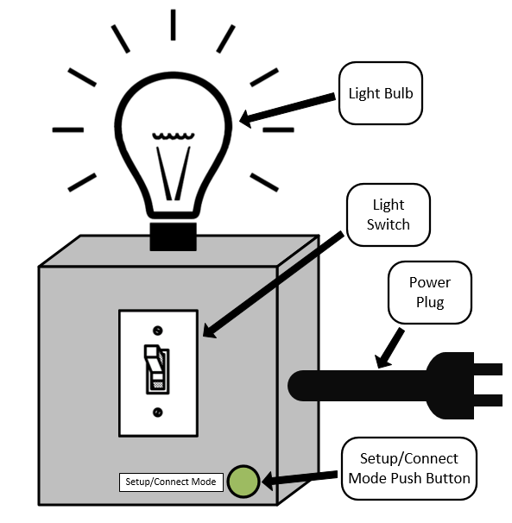
Light Control Unit Prototype
Power plug goes into the wall outlet
Light Switch is connected in series with relay
No Bypass power switch
Setup/Connect mode push button is used to switch the control unit between its two operating modes

Slide 9
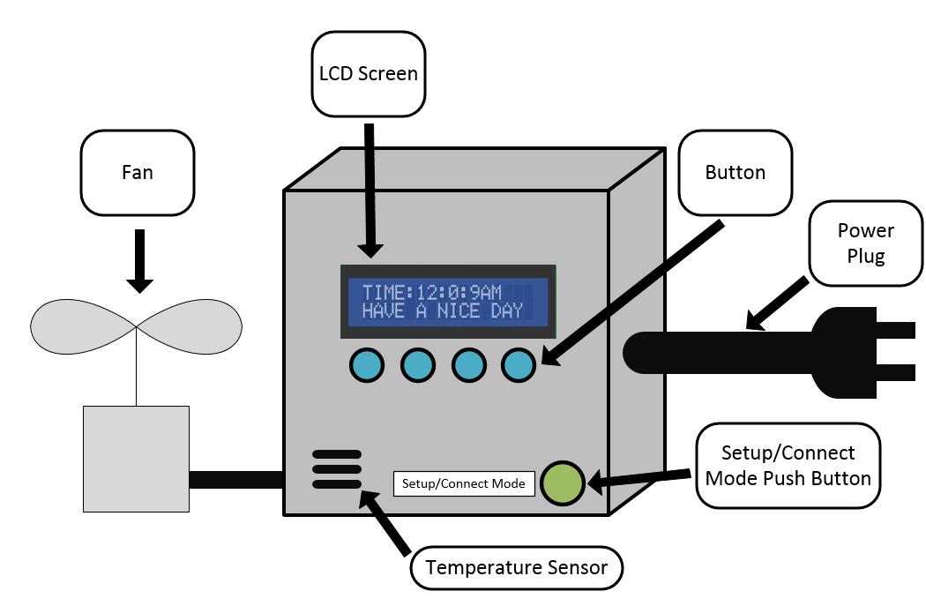
Thermostat Prototype
LCD displays data like current tempreature
Side vent for getting ambient temperature
Push buttons used to control device
Setup/Connect mode push button is used to switch the control unit between its two operating modes
Unit switches on fan based off temperature sensor reading and current temperatures setting

Slide 10


Why Wi-Fi
Wi-Fi not the only wireless communication protocol
Bluetooth
  Lower-Power Consumption
  Physical Interference
NFC
  Major Range Limitations
ZigBee
  Complex when not interacting exclusively with other XBee devices
Wi-Fi
  Provides built in collision detection and avoidance
  Scalability

Slide 11
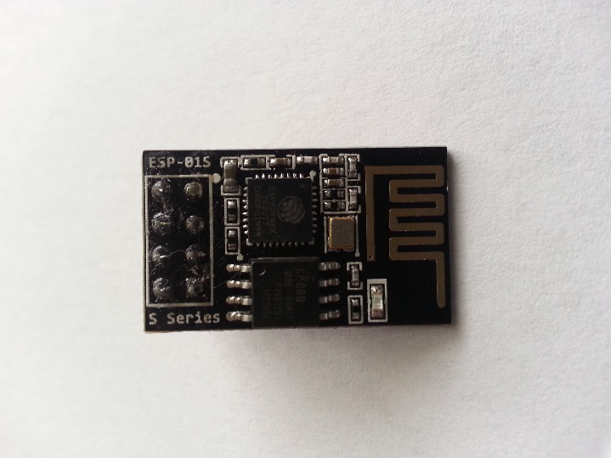
ESP 8266-01S Wi-Fi Module
Purpose:
Connect Mode: To send to and receive data from the main server
Setup Mode: To allow the user to configure the control units settings.
Advantages:
Low idle power consumption
Small form factor
Low cost
Built-in antenna
Well documented
24.7mm
Manufacturer | Makerfocus
Price | $3.25
Operating Voltage | 3.3 V
Flash Memory | 1 MiB
Pin Count | 6
Dimensions | 14.4mm × 24.7mm

Slide 12
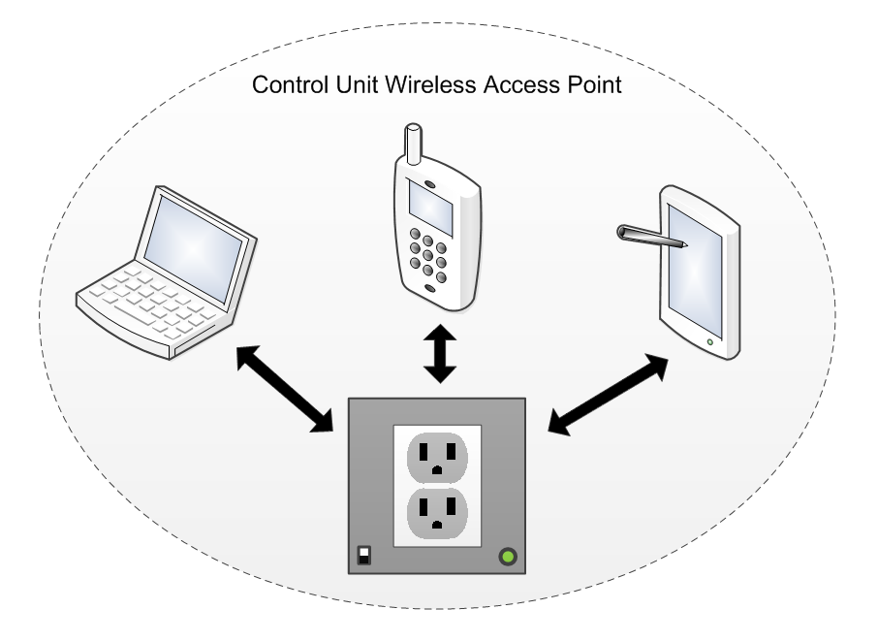
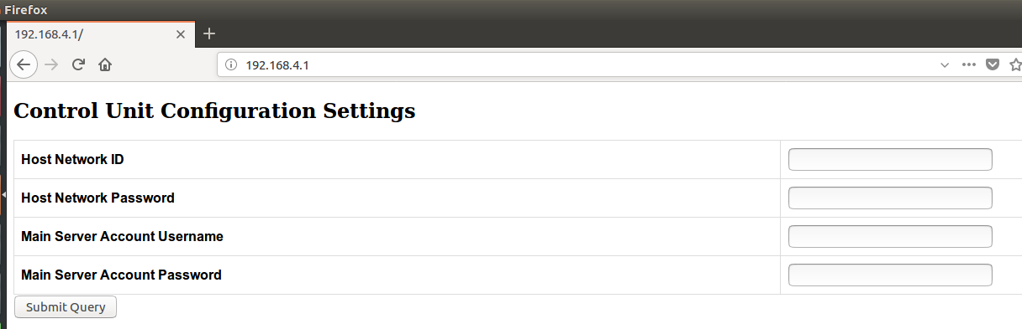
Setup Mode
Control unit sets up a Wi-Fi access point
Wi-Fi enabled devices log onto the control units Wi-Fi network
Devices with browsers can then access the control units configuration page

Slide 13
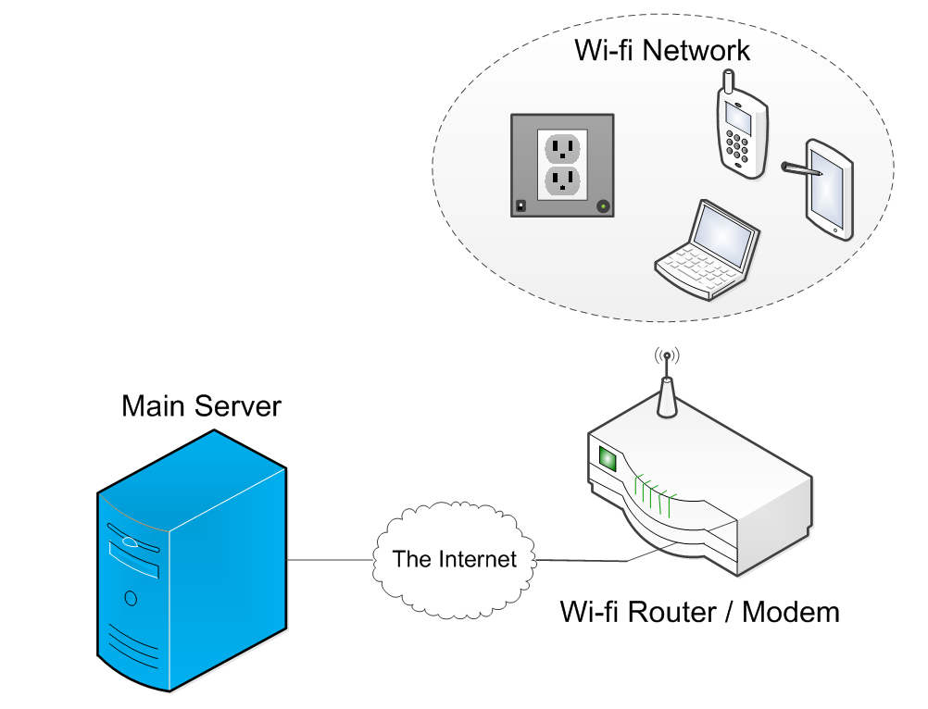
Connect Mode
Control unit connects to the Wi-Fi station specified in its configuration (EEPROM)
Control unit connects to the main server and begins sending power usage data
Control unit can receive commands from the main server

Slide 14
Wi-Fi Module Issues
Problem:
Wi-Fi module operates on 3.3 volts. The ATMega2560 operates on 3.3 volts. Digital communication between two devices may damage the ESP8266 if a 5 volt signal is sent to it.
Solution:
Use a bidirectional logic level shifter that can raise the 3.3 volt signal to 5 volts and lower the 5 volt signal to 3.3 volts.

Slide 15
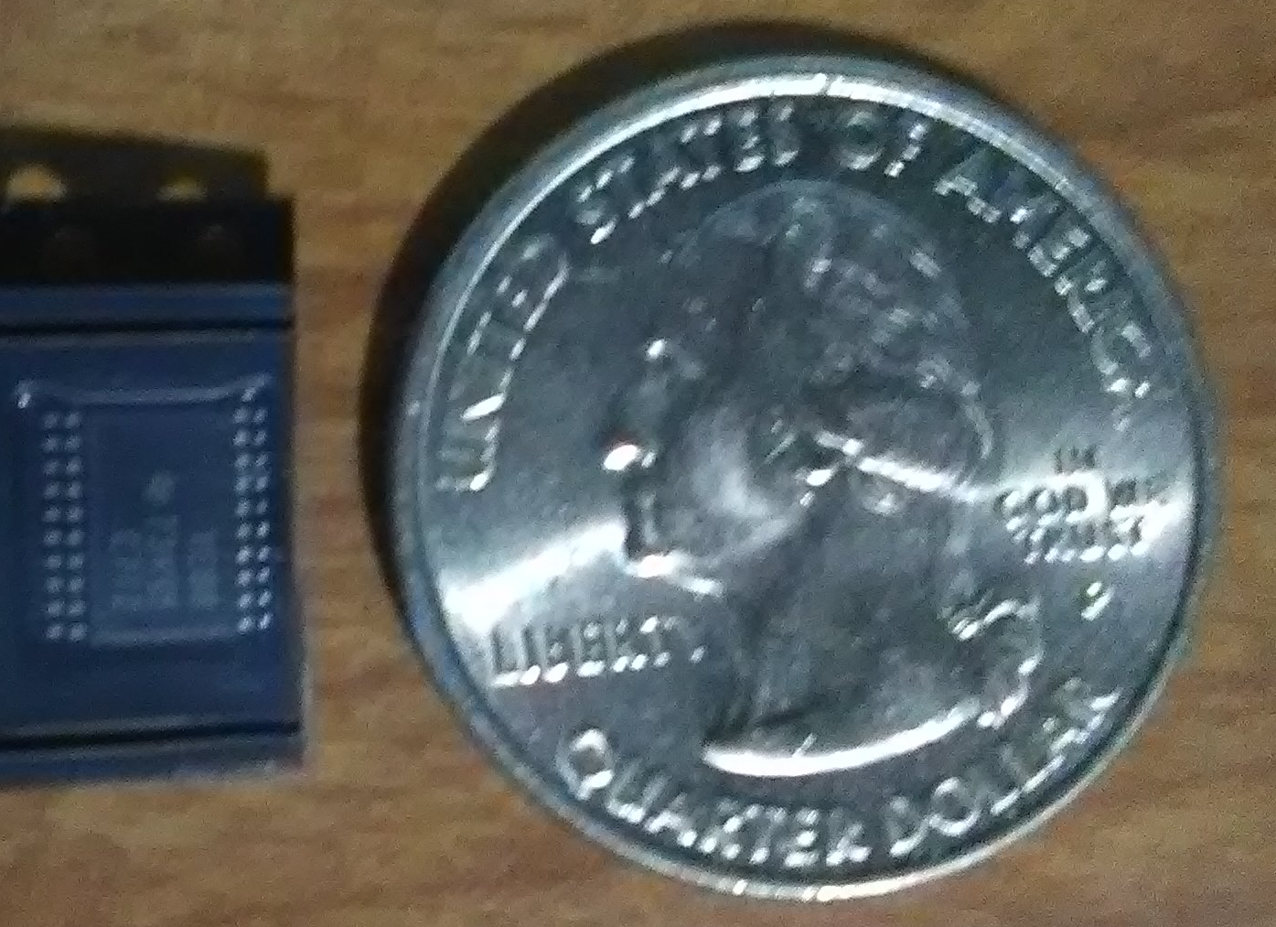
TXB0108 Level Shifter
Purpose:
To safely allow communication between the Wi-Fi module and MCU.
Advantages:
Small package size.
8 logic level shifters.
Wide voltage range
Extremely fast data transmission rate
6.6 mm
Specification | Value
Cost | $1.51
Size | 6.6x6.6 mm
Max Data rate | 100 Mbps
Channel A voltage range | 1.2-3.6 V
Channel B voltage range | 1.65-5.5 V

Slide 16
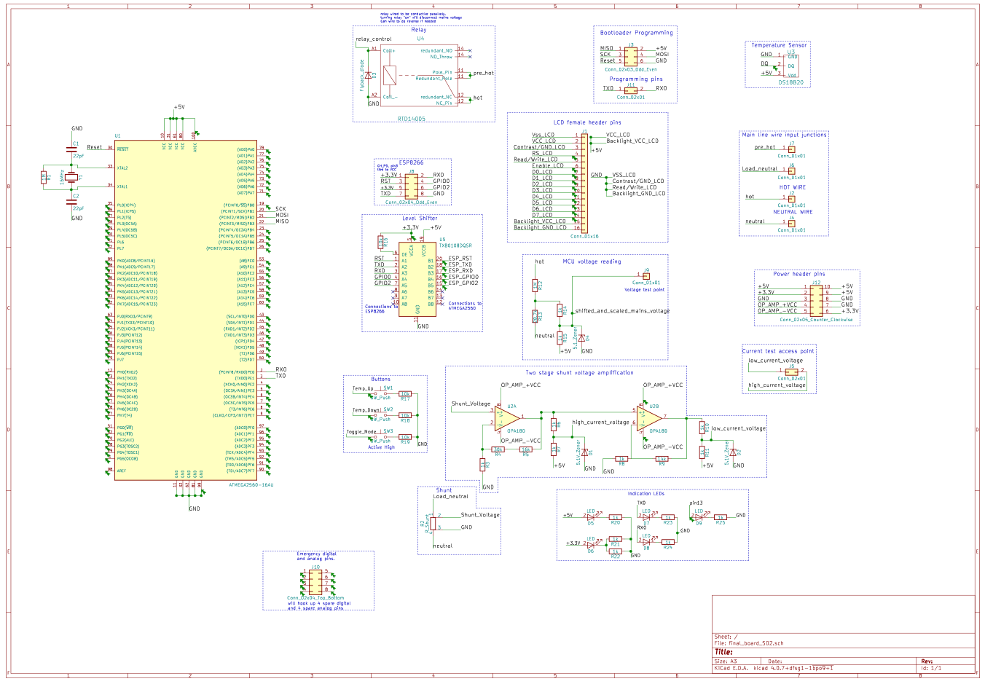
PCB Schematic Design

Slide 17
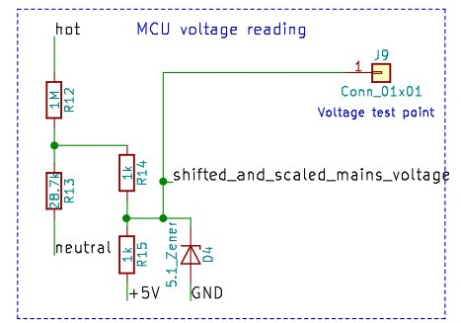
Voltage Measuring
Voltage from the wall is first scaled from an amplitude of 170 volts to 4.75 volts or 9.5 volts peak to peak.
A second voltage divider scales the voltage in half and also shifts the waveform up.
The shifted and scaled waveform now has a range between 0 and 4.75 volts.
A peak voltage lower than 5 volts allows for grid voltage to vary without clipping the max voltage of the ADC.
Zener diode protects MCU from voltage spikes.

Slide 18
Current Measuring Difficulties
Current is typically measured by the voltage across a shunt resister.
Problems:
Shunt voltage needs to be very small to not produce waste energy as heat and to not inhibit the flow of current to the rest of the circuit.
Voltage can be amplified through an Op-Amp, but a significant range will be lost due to the signal being too small when a small amount of current under 1 Amp is used or go out of range of the ADC when a high current is used.
Solution:
Use a two stage amplification system. High currents will produce a large voltage over the shunt which means they do not need much amplification.
Low current will be amplified much higher to get the signal within a range that the ADC can read accurately.

Slide 19
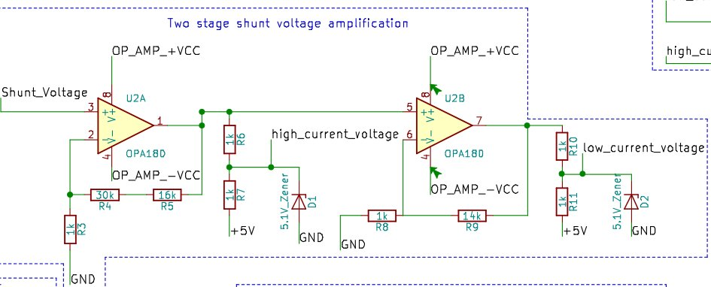
Current Measuring
Two stage non-inverting amplification allows for accurate current measurements for small loads under 1 amp and large loads over 1 amp.
First stage amplfies the shunt voltage by 47 for high current.
Second stage multiplies the shunt voltage by 705 for low current.
Zener protects MCU from overvoltage.

Slide 20
Current Measuring Considerations
Need for two stage current amplification creates complications in reading data
  Which stage do we read from?
Solution: Sample both stages then check values
  If low current reading is <4.9 V and >0.1 , use low current reading
  Otherwise use high current reading

Slide 21
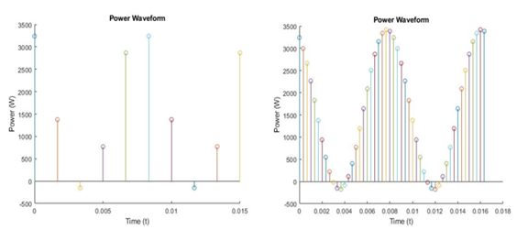
Analog Measurement Philosophy
The more samples taken, the more accurate the data
  This has diminishing returns
Time the MCU spends doing other tasks is time spent not taking samples
  Solution: Use Interrupts
Find balance between sampling and other important tasks

Slide 22
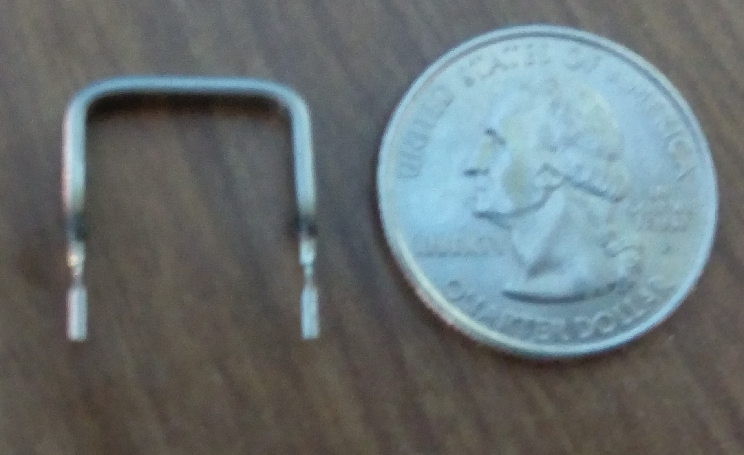
OAR3R005FLF Shunt Resistor
Purpose:
To convert current into a readable voltage.
Advantages:
Low cost.
Easy to use.
Small package size.
Constant resistance
11.43 mm
Specification | Value
Cost | $0.97
Max Current | 16 Amps
Size | 11.43 mm
Resistance | 5 mΩ

Slide 23
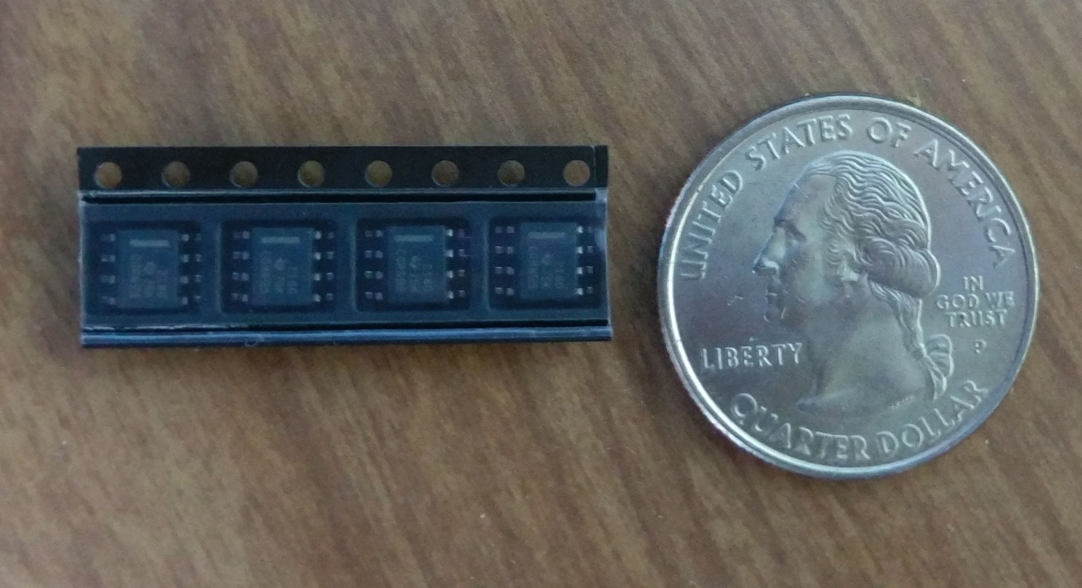
OPA2180IDR Op Amp
Purpose:
To amplify the shunt voltage into a range that the utilizes the full range of the ADC.
Advantages:
Dual Op amp package gives exact amount of amplifiers needed.
Extremely small package size.
Very high accuracy.
5 mm
Specification | Value
Cost | $2.72
Size | 5mmx6.2mm
Voltage range | 36 V
CMRR | 114 dB
Noise | 10nV/Hz^.5

Slide 24
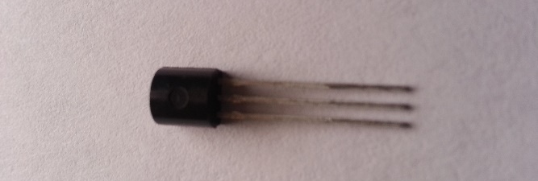
DS18B20 Digital Temperature Sensor
Purpose:
Measure ambient room temperature
Advantages:
Easy to use (only 1 data wire)
Low idle power
High accuracy
Small form factor
Ample documentation
50 mm
Manufacturer | Maxim Integrated
Price | $2.77
Operating Voltage | 3V to 5.5V
Accuracy | +/- 0.5 C
Pin Count | 3
Dimensions | 50mm x 18mm
Temperature Range | -55 to 125°C

Slide 25
LCD vs OLED Display
LCD
  Limited character space
  Large and easy to read
  Easy to use
OLED
  Many colors
  Higher resolution for more possible information
  Very expensive

Slide 26
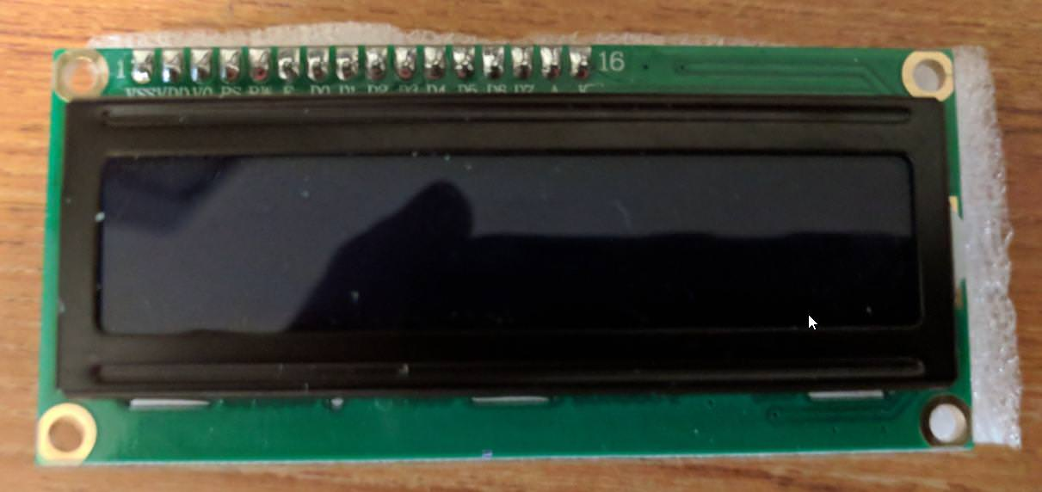
Crystalfontz CFAH1602B-TMIJT
Purpose:
To display set temperature and current temperature.
Advantages:
Low cost
Backlight
Library Supported
Specification | Value
Dimensions | 80 x 36 x 13.5 mm
Cost | $5.97
Maximum characters | 32

Slide 27
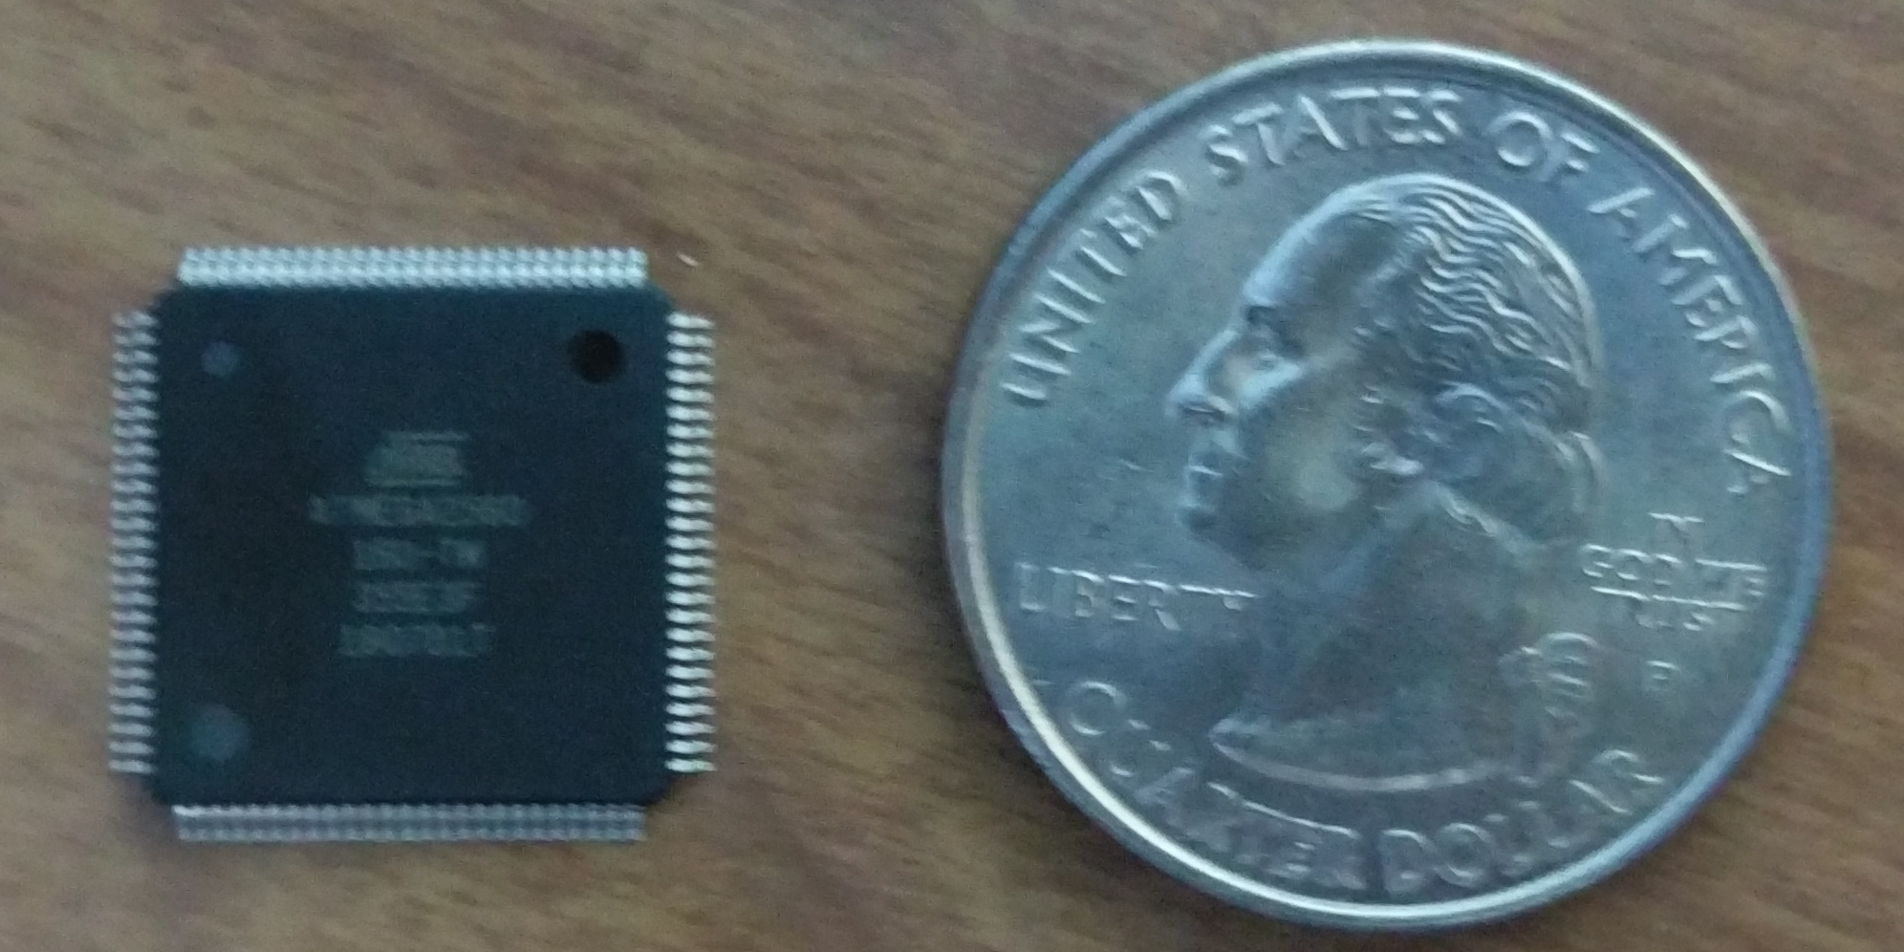
ATMega 2560 Microcontroller
Purpose:
Measure voltage and current inputs
Calculate power consumption
Send and receive data to ESP8266
Send display information and read current temperature
Adjust set temperature based on user input
Advantages:​
256kB memory allows software and library flexibility​
16 analog, 54 digital, 15 pwm, and 4 RX/TX pins allows​
For many peripherals to be attached.​
Gives a large amount of flexibility for prototyping changes.
16 mm
Specification | Value
Cost | $14.22
Memory | 256kB
Clock speed | 16 MHz
I/O pin | 54 digital 16 analog
Size | 16 x 16 mm

Slide 28
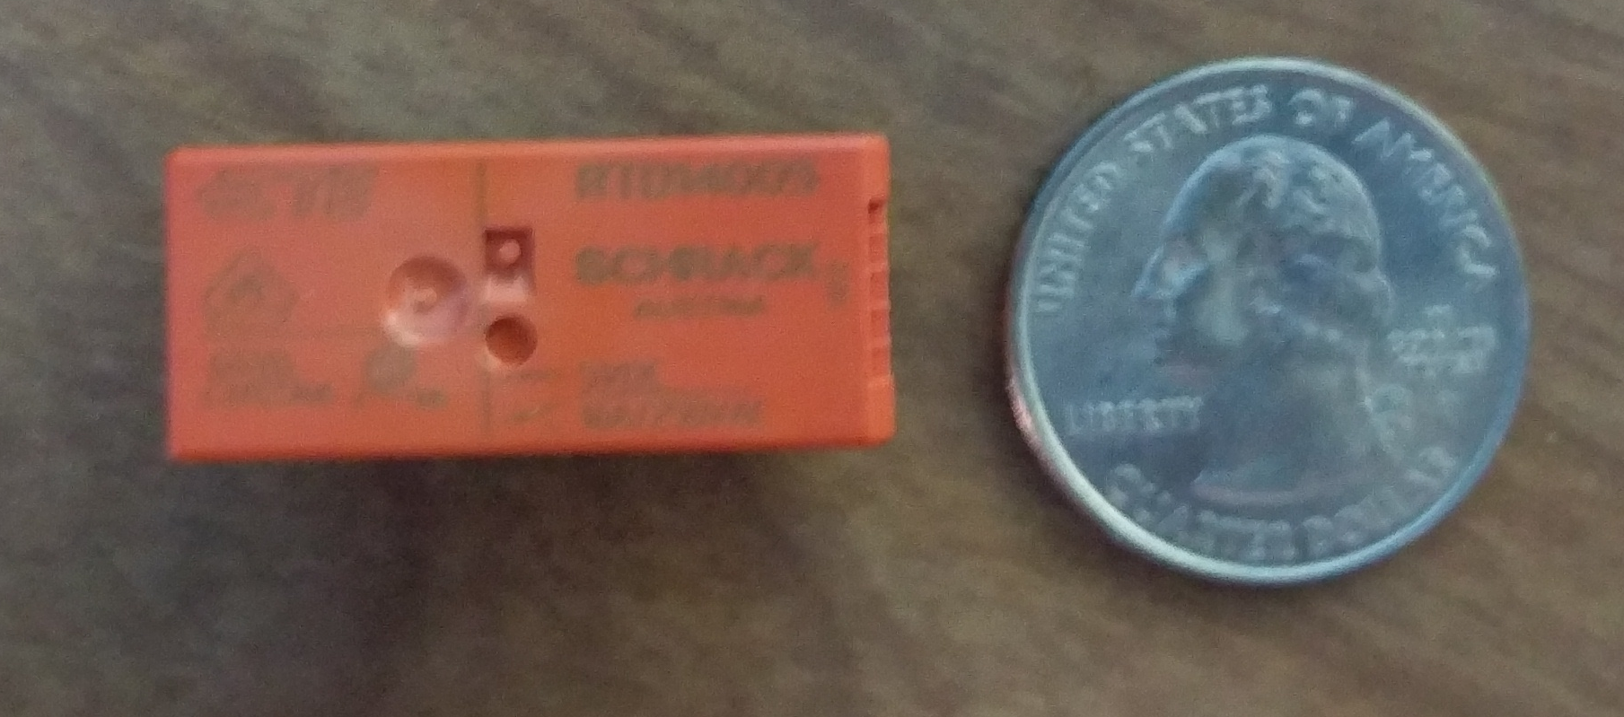
Power Relay
Purpose:
Allows the outlet or switch to be turned off which terminates energy usage from the device.
Advantages:
Relay can be wired to be in normally closed or normally open position
Very low energy usage when relay is turned on.
Low turn on voltage allows it to directly be turned on by microcontroller.
29mm
Specification | Value
Cost | $2.11
Max Current | 16 Amps
Size | 29x12.7 mm
Turn on Energy Consumption | 400mW

Slide 29
Security
User credentials are stored on a mysql server
  Passwords are stored as bcrypt hashes
  All PHP queries are parameterized
Apache mod_evasive used to prevent DDoS and DoS attacks
Secure Sockets Layer (SSL)
  User website uses https to prevent MITM attacks
  Websocket-Main Server communication implements SSL
  Third party CA “Let's Encrypt” used for authenticating certificates

Slide 30
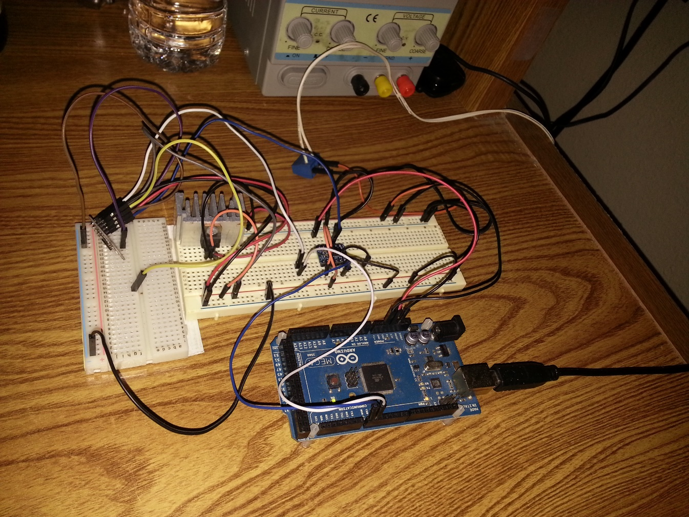
Control Unit Wireless Unit Prototype
Demonstrates all functionality of the wireless software units.
ESP 8266 module interacts with a main server running on a virtual machine while in connect mode.
Laptop is used to interact with the ESP 8266 module while in setup mode.
Bi-directional logic converter used to connect TX/RX pins of the Arduino and the ESP 8266 module

Slide 31
Soldering and PCB Issues.
Problem:
Circuit design requires many surface mount components and many fine pitched ICs. While some have experience with through hole components, nobody has soldered surface mount. Additionally, nobody has PCB design or fabrication process experience.
Solution:
Design a test board that will give experience in soldering and PCB design

Slide 32
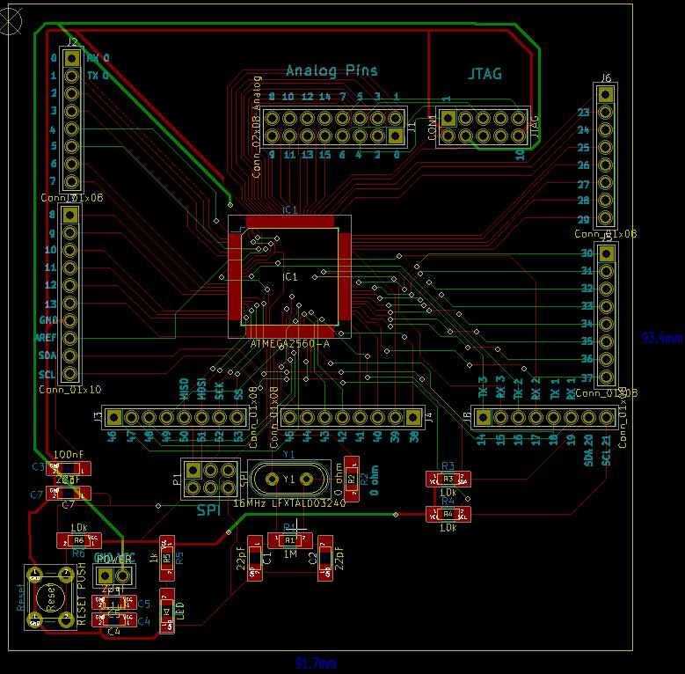
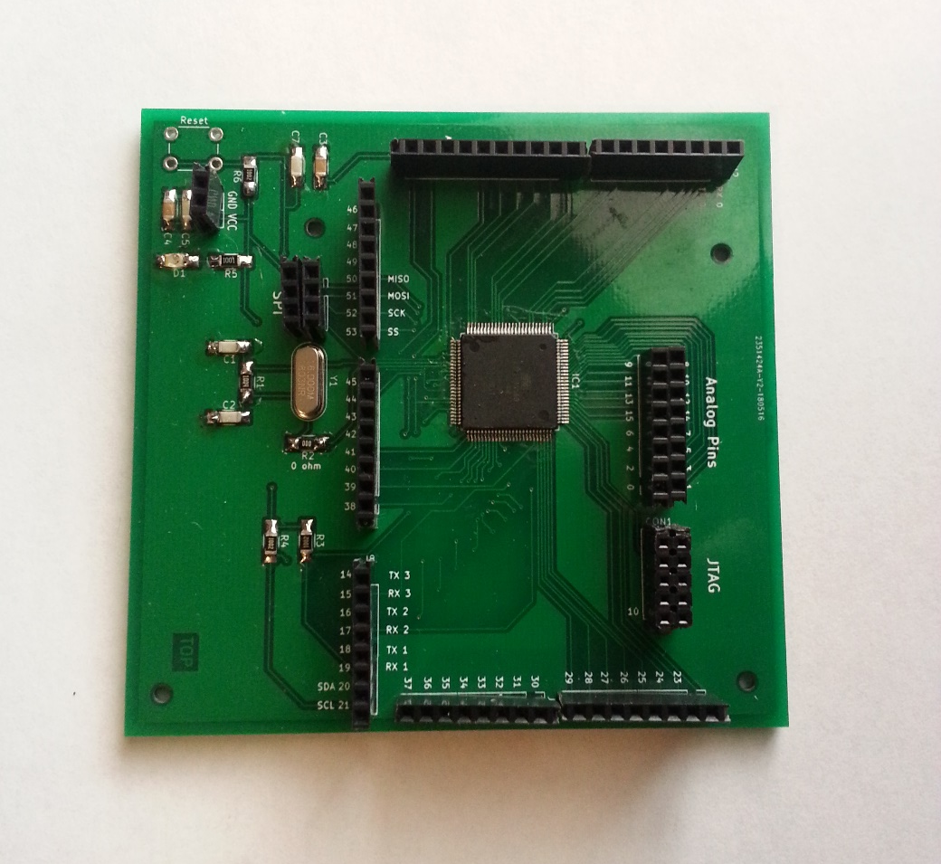
Control Unit Board Prototype
50 mm

Slide 33
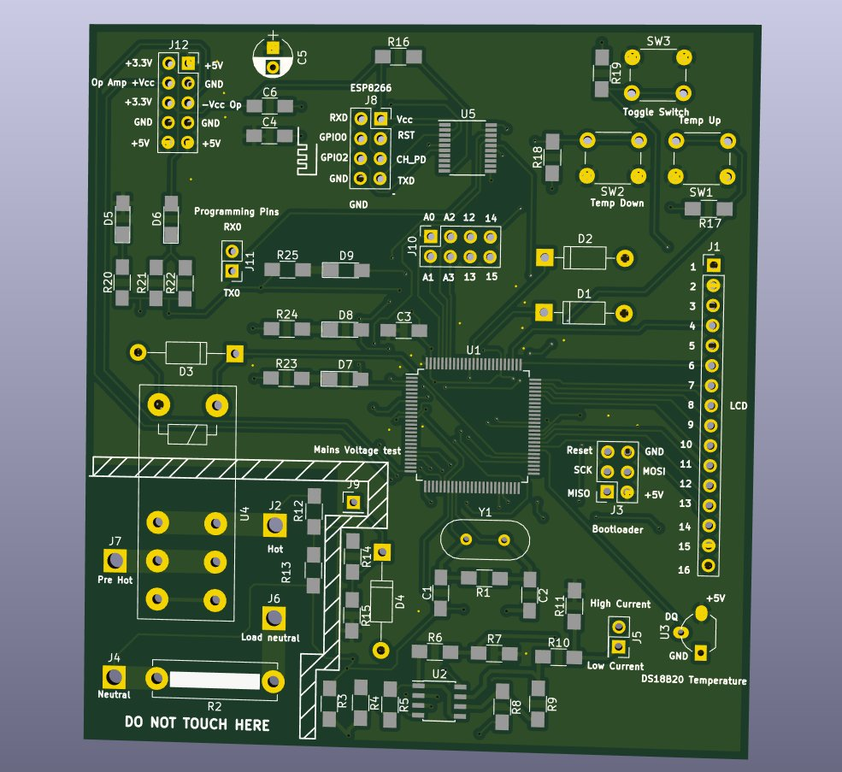
Final Board Revision 1.0
Board currently being tested.
Multiple test points for debugging purposes
Mains voltage isolated from the rest of the board.
Additional unused analog and digital pins added to reduce need of designing additional board in case change is desired.
Universal design will allow same board to work with thermostat, light-switch and outlet.

Slide 34
Budget
Component | Quantity | Cost Per Item | Total
Arduino Boards | 4 | $30 | $120
MCU | 5 | $14 | $55
ESP Module | 5 | $3 | $15
Prototype Items | Varied | Varied | $150
PCBs | 2 Sets | $30 | $60
Voltage Transformer | 3 | $12 | $36
Server Subscription | 7 Months | $5 | $35
5V USB PSU | 3 | $5 | $15
Presentation Materials | Varied | Varied | $50
Total | - | - | $562

Slide 35

Duke Sponsorship
Currently awaiting further information regarding Duke Energy Sponsorship
As our project is based around energy conservation we believe this will be very in line with what Duke is looking for in a project

Slide 36
Overall Progress

Slide 37
Work Distribution
 | Networking | Embedded Design | Analog Design | PCB Design | Prototype Testing
Adam | S | P |  |  | S
Anders |  |  | P | S | P
Jonathan | P | S |  |  | P
Charles |  | S | S | P | S
Legend
P-Primary Contributor
S-Secondary Contributor

Slide 38
Next Steps to Complete Project
Solder and test final board.
Design Power Supply.
Improve User Experience
Integrate Embedded Software Units
Make Senior Design Website

Slide 39
Questions?

