Slide 1
Smart Crib
GROUP 7
COMPUTER ENGINEERING
Phuoc Nguyen
ELECTRICAL ENGINEERING
David Brunat
Thinh Nguyen
COMPUTER SCIENCE
Brian Nguyen

Slide 2
Motivations
AP9101CK6-CQTRG1 | 0ZCJ0035AF2E
Sadie Kay was Born December 26, 2017
Alleviate the stresses of raising young children.
Is the child breathing? Are they gaining weight? Is the child awake?
Postpartum depression.
SIDS prevention.
The Smart Crib system will replace baby monitors, nanny cams, weight scales, and pulse monitoring devices.

Slide 3
Goals
Monitor the temperature of the environment the child is in.
Notify parents when child is crying or in distress.
Transmit data wirelessly to a mobile application.
Measure Biometrics of a child.
Weight tracking
Pulse
Display biometric data on a mobile application.

Slide 4
Specifications
Component | Specification | Design
Sound Sensor | Accuracy and speed | Detects the baby crying within 5 seconds and alert the MCU
Weight Sensor | Accuracy | Average the weight of the baby over 4 weight sensors within +/- 1% accuracy
Temperature Sensor | Accuracy | Reads the ambient temperature of the crib within 0.8 C degrees accuracy
Motion Sensor | Accuracy and Speed | Detects the constant movement of the baby within 2 seconds
Pulse Sensor | Accuracy | Takes pulse readings every 5 seconds
Battery | Battery life | 6 hour lifespan
WiFi Module | Range | 20 meters

Slide 5
Overview

Slide 6
Block Diagram
12V AC TO DC
Battery Charger
WiFi
Module
-12V
Regulator
5V Regulator
3.3V
Regulator
Battery
Regulator
Battery
Sound
Sensor
Main MCU
Cloud Storage
Wearable
MCU
Motion Sensor
Weight Sensor
Pulse Sensor
Mobile Application
Temp
Sensor
Camera

Slide 7
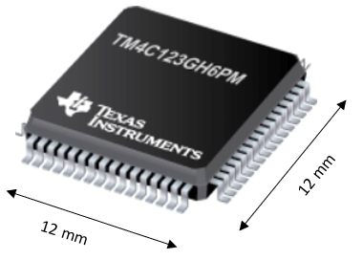
Microcontroller Unit
TM4C123GH6PM (32-bit ARM® Cortex®-M4F)
Accelerometer
 | EK-TM4C123GXL | MSP430G2553
Flash(KB) | 256 | 16
RAM (KB) | 32 | 0.5
ADC Channels | 2 | 2
ADC Resolution(Bits) | 12 | 10
GPIO | 40 | 24
I2C | 4 | 1
SPI | 6 | 2
UART | 8 | 1
Speed(Mhz) | 80 | 16
Hibernation module | Yes | yes
Cost | $10.64 | $2.43

Slide 8
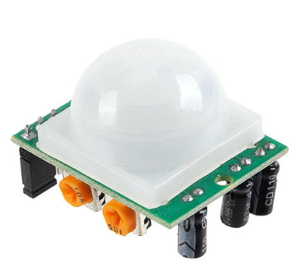
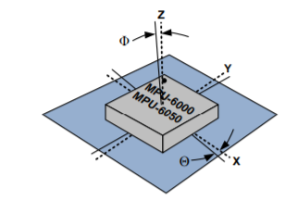
Motion sensor
PIR
Accelerometer

Slide 9
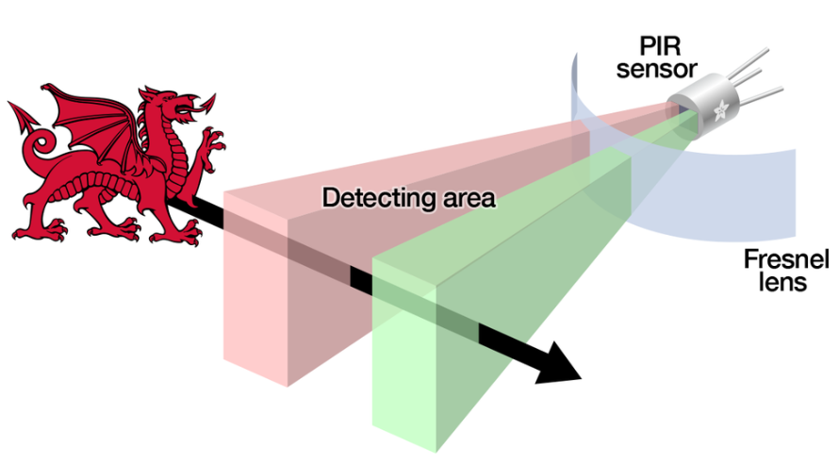
Motion sensor: PIR
Detect the amount of IR

Slide 10
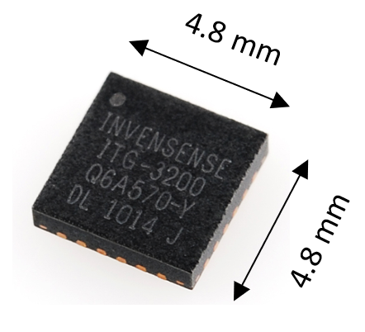
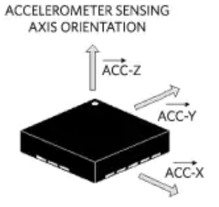
Motion sensor: Accelerometer
When an acceleration is detected in either axis
Specification | MPU6050
Cost | $6.99
Power Consumption | 1.4mA
Angle Sensor | 180 degrees
Operating voltage range | 2.375V-3.46V

Slide 11
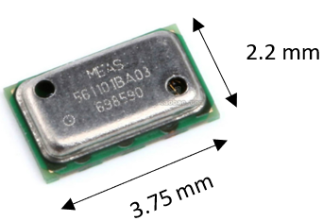
Temperature sensor
Measure ambient temperature
Features | MS5611_01BA03
Cost | $12.48
ADC | 24-bit
Power consumption | 1.0uA
Interface | I2C & SPI
Accuracy | ±0.8C
Supply voltage | 1.8V to 3.6V
Operating Temperature | -40c to +85c

Slide 12
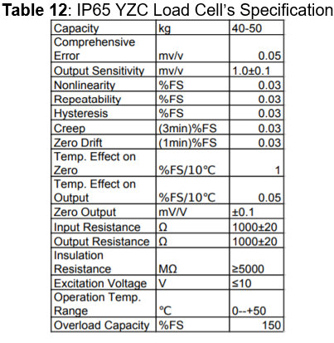
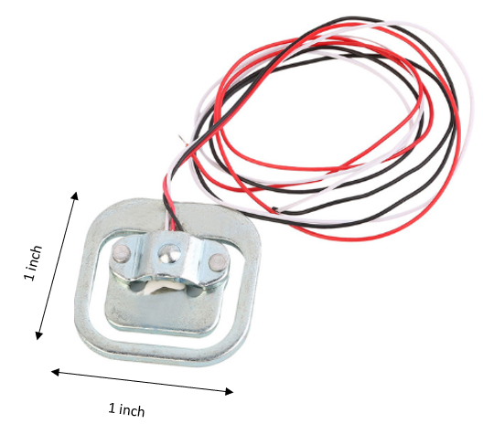
Weight sensor
Keep track of the baby weight over the 2st year of age.
4 x Load Cell

Slide 13
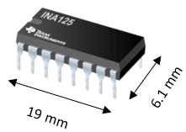
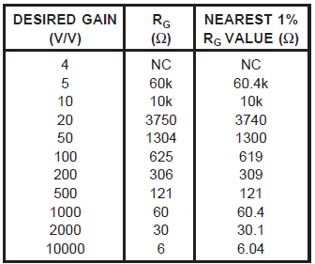
Instrumentation Amplifier
1x Instrumentation Amplifier
INA125 SPECIFICATION
FEATURES
LOW QUIESCENT CURRENT | 460mA
PRECISION VOLTAGE REFERENCE | 1.24V, 2.5V, 5V or 10V
SLEEP MODE | Yes
LOW OFFSET VOLTAGE | 250mV max
LOW OFFSET DRIFT: | 2mV/°C max
LOW INPUT BIAS CURRENT: | 20nA max
HIGH CMR: | 100dB min
LOW NOISE | 38nV/ÖHz at f = 1kHz
INPUT PROTECTION | ±40V
WIDE SUPPLY RANGE | Single Supply: 2.7V to 36V Dual Supply: ±1.35V to ±18V
Gain | 4 to 10000 (v/v)

Slide 14
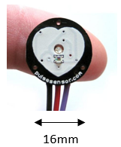
Pulse sensor
Measure Baby Heart-rate
PulseSensor(NOT From PulseSensor.com)
Features | PulseSensor
Cost | $2.04
PCB’s size | small
Accuracy | 12-bit
Data Communication | ADC
Operation Temp | -40C to +85C
Operation Voltage | 3.3V to 5.0V
User Friendly | Yes

Slide 15
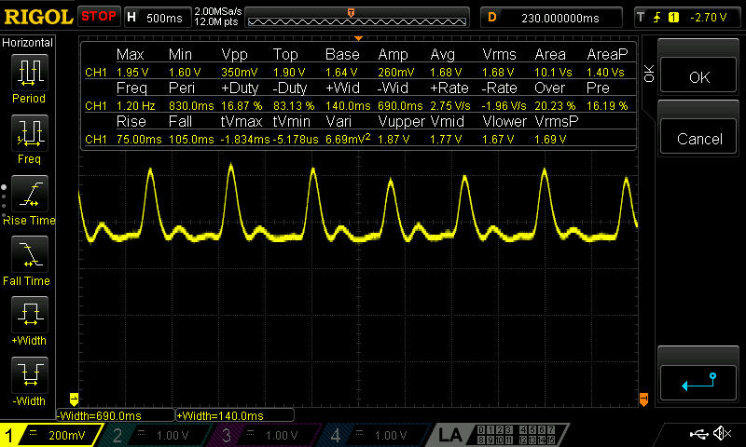
Pulsesensor Flow Diagram

Slide 16
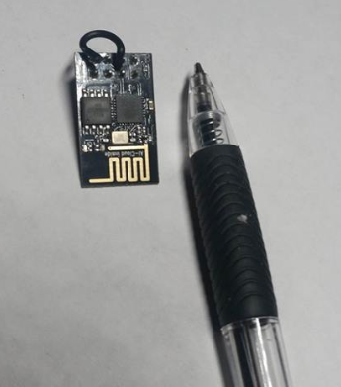
Wifi Module
Transfer sensor’s data to the Database
ESP8266 Wifi Module
Specifications | ESP8266
SPI/I2C/I2S/UART | 2/1/2/2
Working Temperature | -40C ~ 125C
Operating Current | 80mA

Slide 17
ESP8266 Data Flow Diagram

Slide 18
Sound SENSOR
 | High Sensitivity Microphone Sensor | PZM11 LL WR
Input Voltage | 5 V | 12V to 24V
Output Voltage | 0.6 V | 1.25 V
Price | $0.57 | $179
Two different sound sensors were tested for performance.
The High Sensitivity Microphones low level output made amplifying the signal difficult.
The PZM11 LL WR had much higher output signal, which made amplifying and filtering better.
The PZM11 LL WR was also donated.

Slide 19
Cry Detection system
MCU
Sound Sensor
Mobile Application
Motion Sensor
Notification to User
Live Camera
Feed

Slide 20
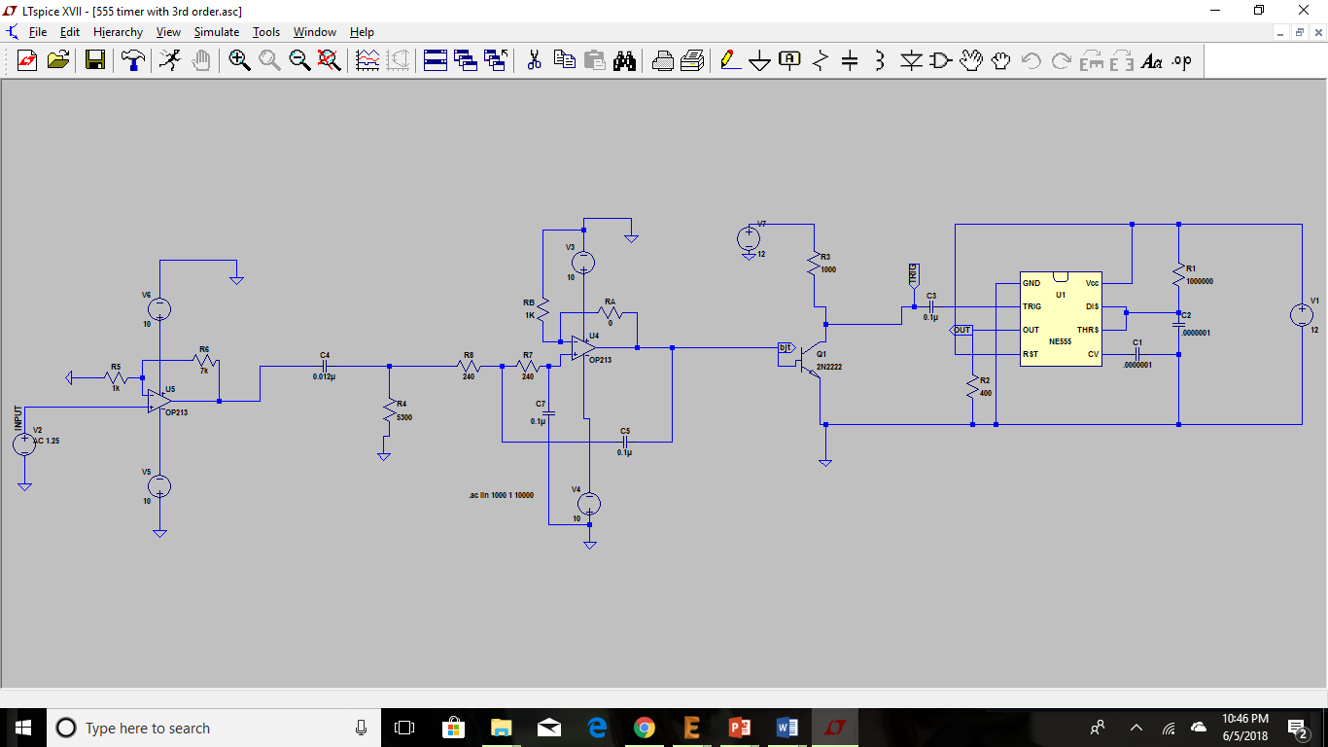
Cry Detection hARDWARE

Slide 21
Cry Detection hARDWARE
555 timer in Monostable mode

Slide 22
Cry Detection hARDWARE
Sound Sensor Input and Amplification of signal by Gain of 8

Slide 23
Cry Detection hARDWARE
3rd Order Bandpass Filter, set to the cry frequency range of a child

Slide 24
Cry Detection hARDWARE
AC signal that passes through the filter turns on the switch, allowing the trigger to discharge.
Trigger
Switch

Slide 25
Mobile Application
Live look-up
Data logging
Intuitive ( in computer terms easy to use and understand)

Slide 26
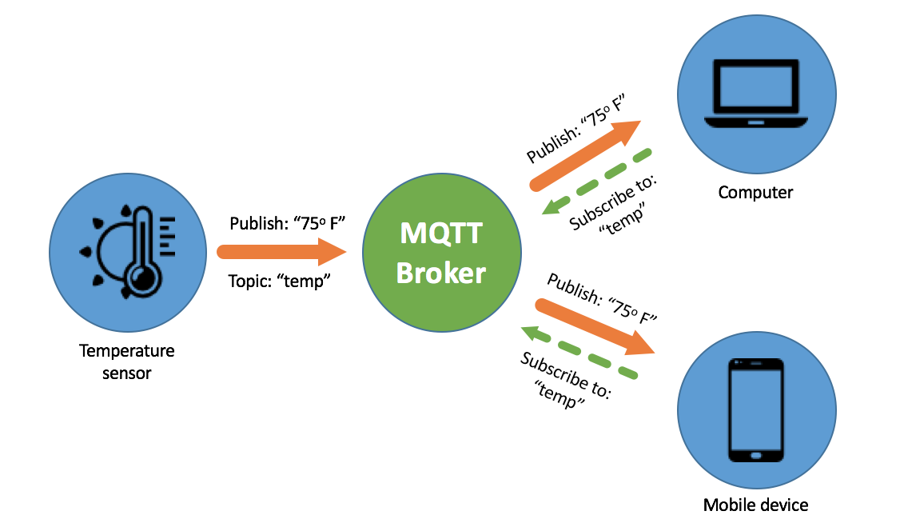
Live Look-up

Slide 27
Database
For this project we have chosen NoSQL database.
Interval of 5 seconds is 6 million entries per sensor.
{
TableName: “Temperature”
Item: {
“id”: “100”,
“value”: “72”,
“timestamp” : “6/8/2018”,
“flag” : “1”,
}
}
 | Relational Database (SQL) | Non-Relational Database (NoSQL)
Data Format | Highly Structured | Highly Unstructured
Data Volatility | Rigid | Versatile
Data Size | Costly | Cheap

Slide 28
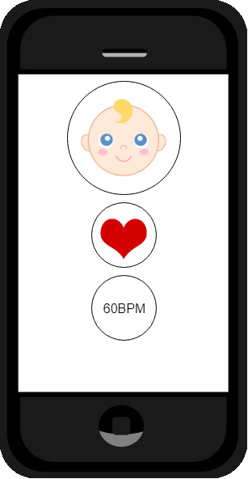
User Interface
Tap – live look-up.
Hold to view more detailed page.
Tap to view baby.

Slide 29
Main Schematic
Power
Headers
Peripherals
MCU

Slide 30
MAIN PCB LAYOUT

Slide 31
Wearable Pcb overview
Power
Headers
Peripherals
MCU
USB B
JTAG
MCU
Header
UART
Debug
Header
JTAG
WiFi
Header
WiFi
Module
Battery
Charger
Pulse Sensor
Header
MCU
Battery
Motion
Sensor
Fuse
PMIC
Voltage
Regulator

Slide 32
Wearable pcb Schematic
Power
Headers
Peripherals
MCU

Slide 33
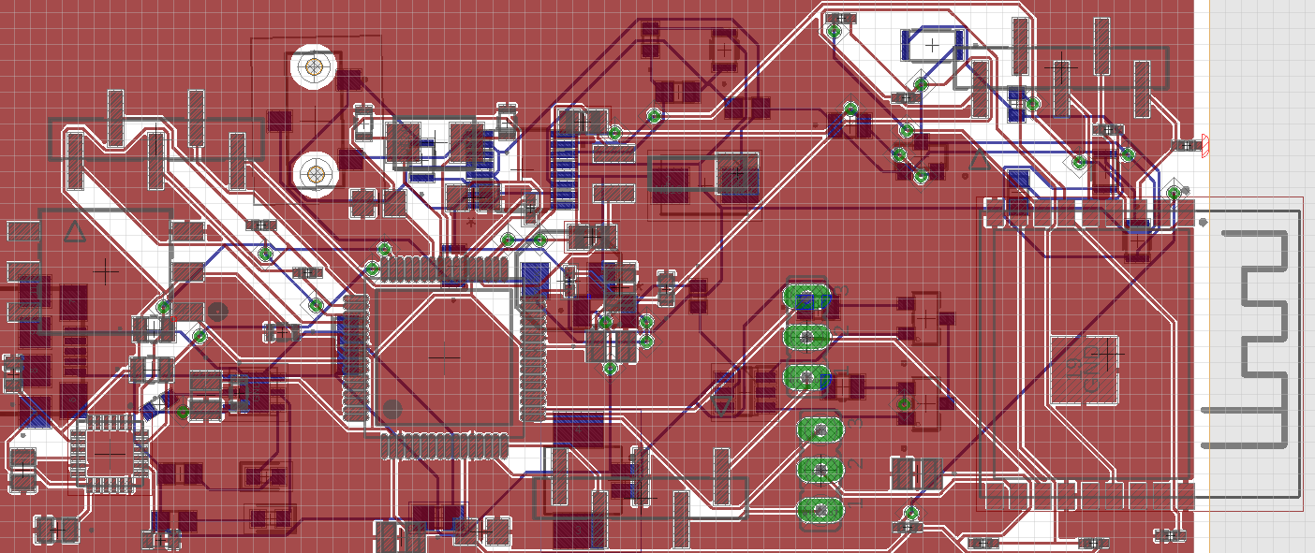
Wearable PCB LAYOUT

Slide 34
Rechargeable BATTERY System
 | Battery | Battery Charger | Power Management IC | Fuse
Part Number | RJD3555HPPV30M | STBC08PMR | AP9101CK6-CQTRG1 | 0ZCJ0035AF2E
High Voltage | 4.28 V | 4.2 V | 4.2 V
Low Voltage | 2.35V |  | 2.8V
Current Capacity | 500 mAh
Charge Current | 250 mA | Programmable By Resistor
Maximum Current | 1 A |  |  | 750 mA
Li-Ion Coin Size Battery was selected
Battery Charger uses Constant Voltage and Constant Current.
Power Management IC has Overvoltage and Undervoltage Protection.
Fuse has implemented for discharge and short circuit protection.

Slide 35
Wearable power distribution
MAX1701EE+
Input Voltage | 2.7V to 5.5V
Output Voltage | 3.3 V
Output Current | 800 mA
Efficiency | Varies as Input Voltage changes
Price | $7.80
Made to work with Li-ion batteries whose input voltages will fluctuate.
Provides an output voltage of 3.3V regardless of voltage from the battery.
Configured to operate as both a step up and step down DC converter.

Slide 36
Work Distribution
 | Wearable PCB | Main PCB | Firmware | Software
David | Primary | Secondary
Thinh | Secondary | Primary
Brian |  |  | Secondary | Primary
Phuoc |  |  | Primary | Secondary

Slide 37
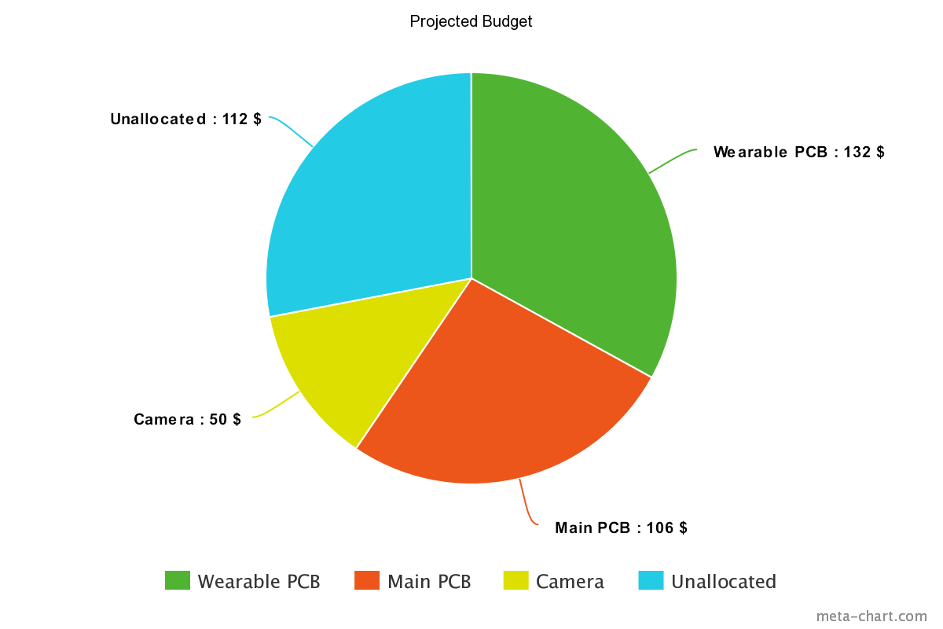
Budget and Financing
Self-funded project. Our group has decided to contribute $100 each for a total of $400 for this Senior Design Project.

Slide 38
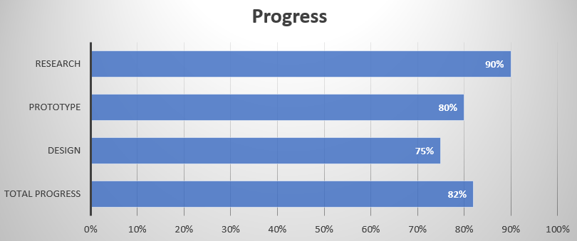
Smart crib progress

Slide 39
Issues
Redesign of the battery charging system to work with one battery instead of two.
Have not solidified the process to implement the camera.
WiFi IC, we had initially designed the traces and spent a lot of time trying to match the impedance and are now using a module instead.
Designing a waterproof housing for the wearable PCB.

Slide 40
Disclaimer
*Currently, no babies were harmed in the testing of this project.

Slide 41
Questions

