Slide 1
Smart Shower
Alex Power, CpE
Andres Huertas, CpE
Luke Gillespie, CpE
Nicholas Stoll, EE

Slide 2
Group Introduction
Alex Power – Software (Database, API, Data Access)
Andres Huertas – Software (Android, Integration)
Nicholas Stoll – Hardware (Power System, PCB design)
Luke Gillespie – Hardware (Embedded Software, Hardware Peripheral Interface)

Slide 3
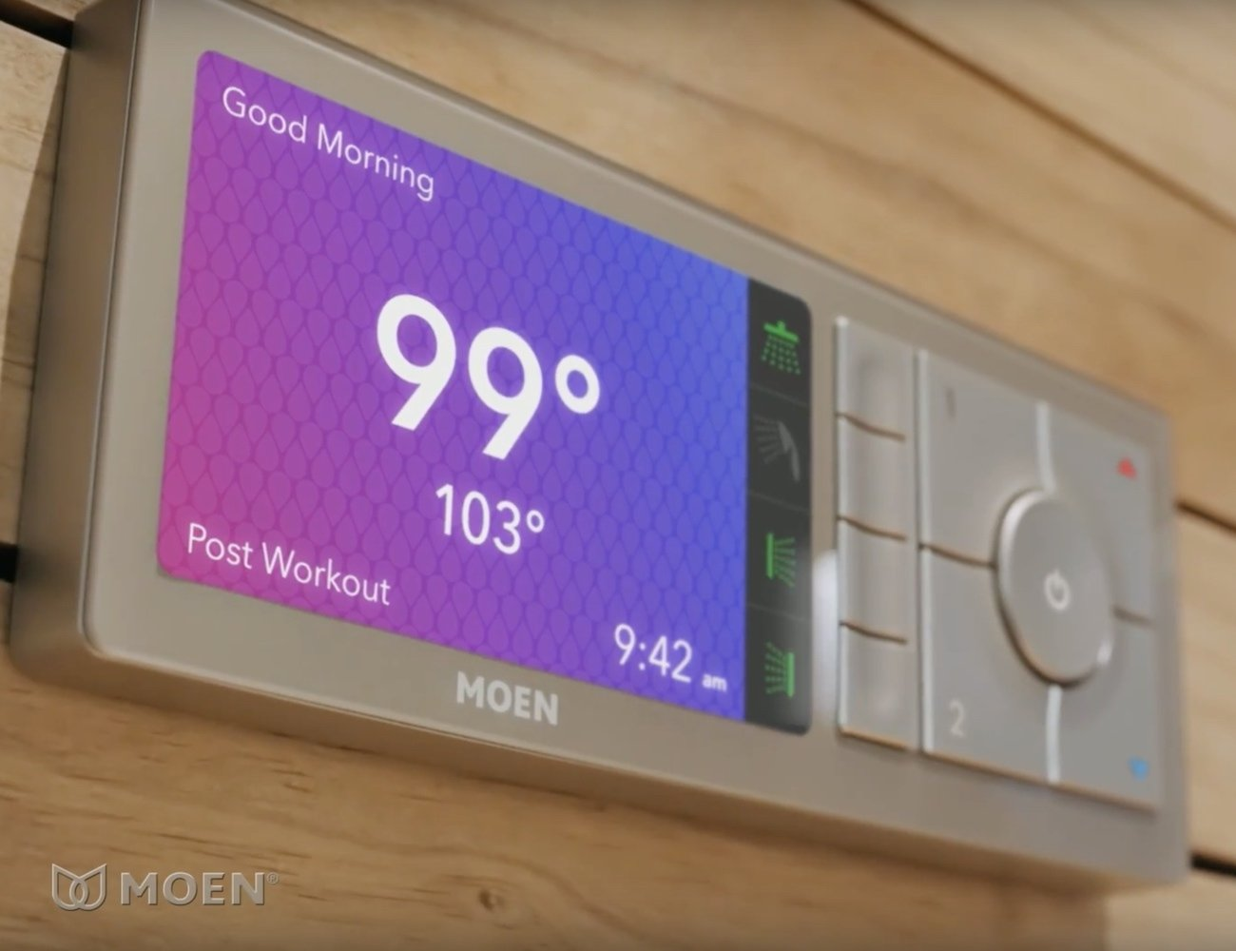
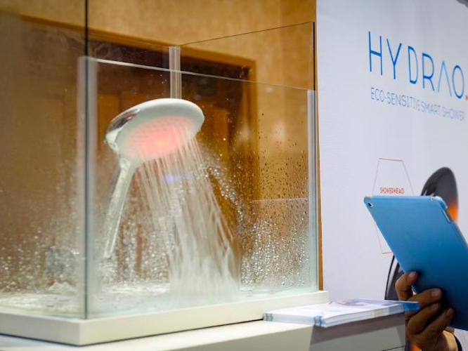
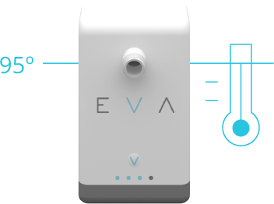
Existing Products/Technology
U by Moen
Hydrao
EvaDrop
Notes:
-Andres

Slide 4
THE SMART SHOWER
Notes:
3 main components ( sensors, mcu/display, and servo interface)

Slide 5
Requirements Specification
Control water flow and temperature
Display water flow and temperature information
Provide local control via an LCD touchscreen interface
Communicate wirelessly to external networks
Maintain ±5º Fahrenheit accuracy
Installable on existing shower hardware
Reach desired temperature within 1 minute (if plumbing allows)
Android Application
Pair with Smart Shower
Turn shower on/off
Control temperature of water
Display water temperature
Control various showers
Display water statistics
Set timer to cut off water flow or change temperature
Shower timed turn-on
Notes:
Nick
Hardware wise there are some key requirements that we are trying to achieve. This includes controlling the flow and temperature of the water as well as displaying that information on a touch screen to the user in a reasonable way that they can easily control. Along with that it needs to be able to communicate wirelessly and be able to maintain a 5 degree accuracy temperature control. And most of all it should be able to be installed on an existing shower.

Slide 6
work flow distribution
Notes:
Nick

Slide 7
Design Methodology
Agile Development Methodology
Extreme Programming
Weekly Meetings
Task Board
Division of labor into discrete modules
Well defined interfaces for decoupling hardware and software modules
Labor Module Assignments:
Alex | Luke | Nick | Andres
Database | Embedded Software | PCB Design | Android UI
Database API | Servo-Shower Interface | Power System | Android HTTP Requests
Android Data Acquisition | Nextion in-shower UI | Mechanical Design | Android/Shower Sync

Slide 8
THE SMART SHOWER
Notes:
3 main components ( sensors, mcu/display, and servo interface)

Slide 9
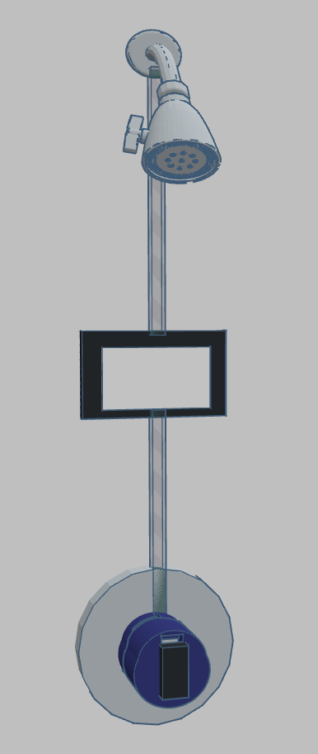
ESP8266
Microcontroller | Operating Frequency | GPIO | Serial Ports | Size | Integrated Communication | Cost
ESP8266 | 80/160 Mhz | 16 | 2 | 5x5 mm | Wireless 802.11 | $2
ESP8285 | 80/160 Mhz | 16 | 2 | 5x5 mm | Wireless 802.11 | $6
ESP32 | Up to 240 Mhz | 36 | 3 | 5x6 mm | Wireless 802.11 , Bluetooth | $12
328P | 20 Mhz | 23 | 2 | 7x7 mm | None | $2
2560 | 20 Mhz | 54 | 2 | 14x14 | None | $5
MSP430 Series | 16 Mhz | Up to 48 | 1 | Varies | None | $1-$20
RaspberryPi Zero W | 1 Ghz | 28 | 1 | 65x30 mm | Wireless 802.11 , Bluetooth | $10
Very powerful
Super cheap
Does everything we need
Notes:
-color3d graphics -> TV while hosting web server… used for many projects already so familiar…. Great SDK and support Arduino

Slide 10
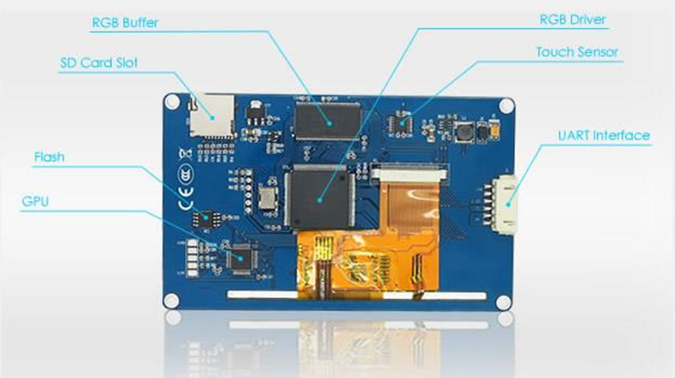
NEXTION DISPLAY
Cost effective
Low overhead
Great design software
Resistive Touch
Notes:
- Serial comm, own cpu/gpu, so much better than pixel banging. And handles touch input…. (resistive touch)

Slide 11
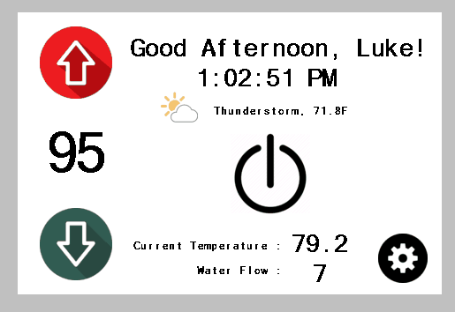
Display INTERFACE
Sensor Information
System Control
Other useful information
Notes:
Pulling weather data from WU, grabbing NTP time, greeting string for user.

Slide 12
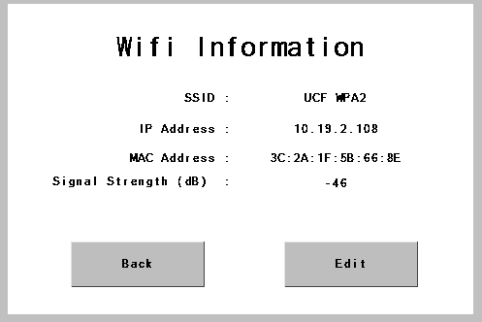
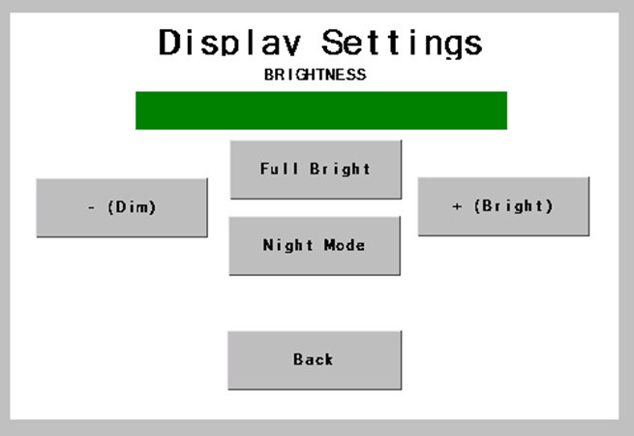
OTHER DISPLAY INTERFACES

Slide 13
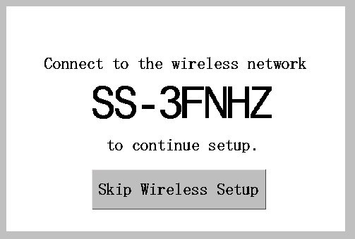
OTHER DISPLAY INTERFACES

Slide 14
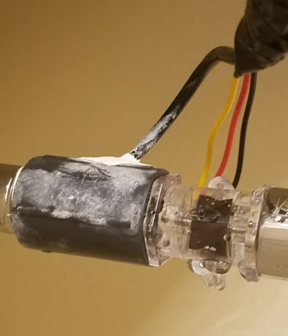
Temperature Sensor Interface
DS18B20 Sensor
Thermal Epoxy
½” Coupler fitting
Model | Accuracy (±°C) | Resolution (Bits) | Operating Temperature(C) | Cost (USD)
DS18B20 | 0.5 | 12 | -55 to 125 | 1.88
DS1822 | 2 | 12 | -55 to 125 | 1.66
DS18S20 | 0.5 | 9 | -55 to 100 | 2.09
DS1825 | 0.5 | 12 | -55 to 125 | 1.86
MAX31820 | 0.5 | 12 | -55 to 85 | 1.12
DS18S20PAR | 0.5 | 12 | -55 to 100 | 2.58
DS18B20PAR | 0.5 | 12 | -55 to 100 | 2.40

Slide 15
Water flow sensing
YF-S201
½” fitting
Water proof connection

Slide 16
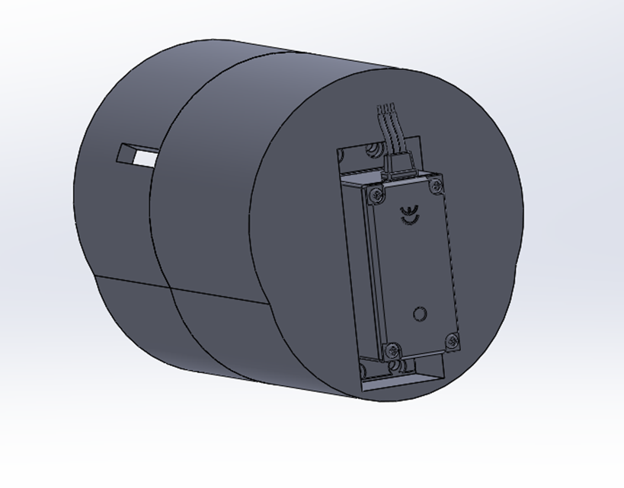
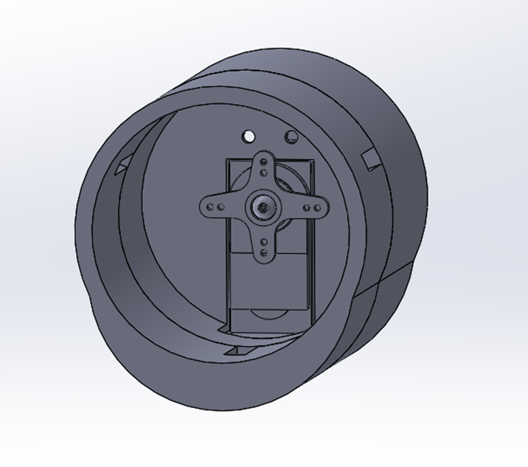
SERVO MOUNT
Solidworks CAD
Notes:
3d printed at TI innovation center, designed to fit most shower valves

Slide 17
SERVO MOUNT cont.

Slide 18
Schematic design

Slide 19
6.5V
3.3V & 5V

Slide 20
ESP8266 - F

Slide 21
Sensor I/O
DC IN

Slide 22
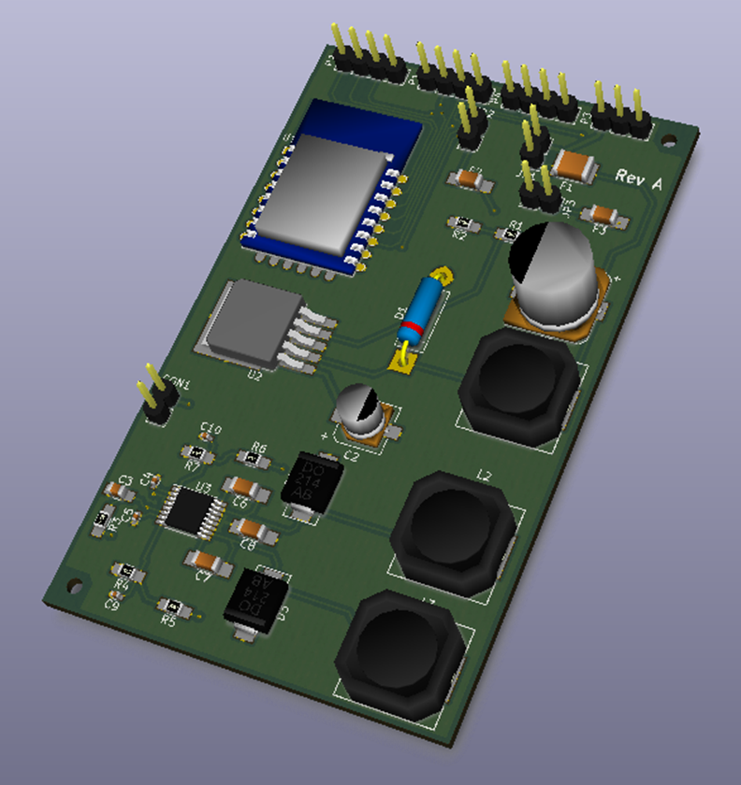
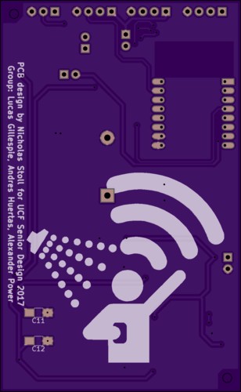
Circuit board design
Designed in KiCAD and modeled
Manufactured by OSH Park on 3oz. FR4 fiberglass board
Assembled by hand with surface mount and through hole components

Slide 23
Software design model
Notes:
-andres

Slide 24
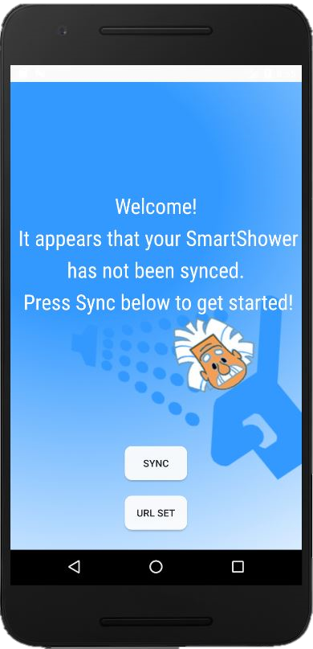
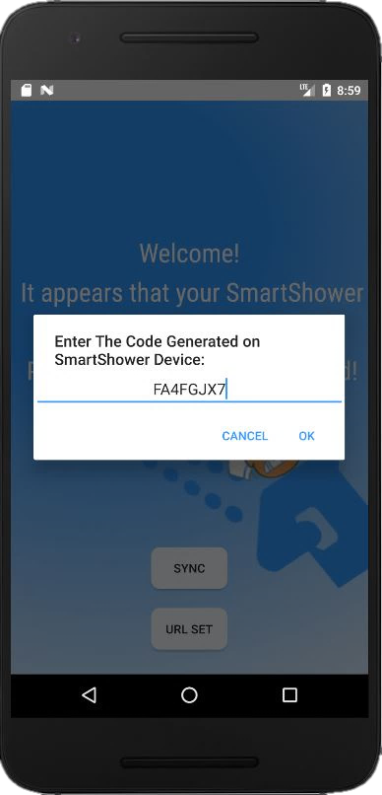
Android Application ui – Splash/Sync
Notes:
-andres

Slide 25
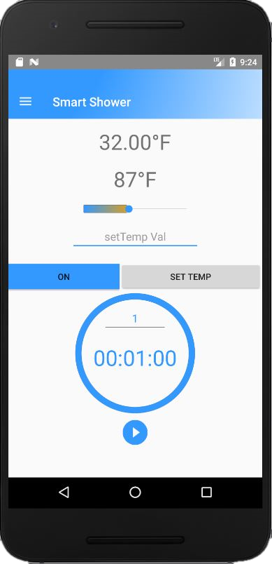
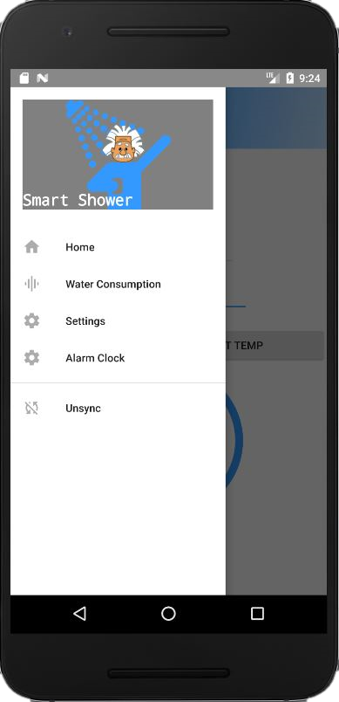
Android Application ui – Home Screen
Notes:
-andres

Slide 26
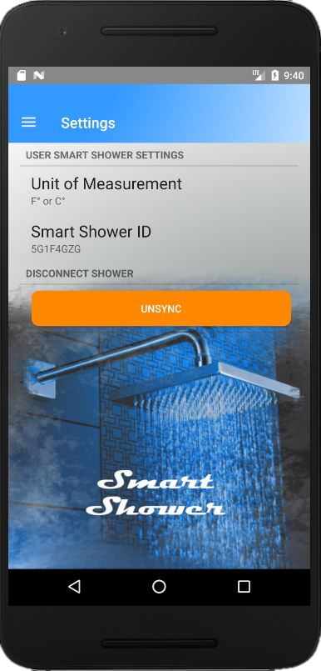
Android Application ui – Settings

Slide 27
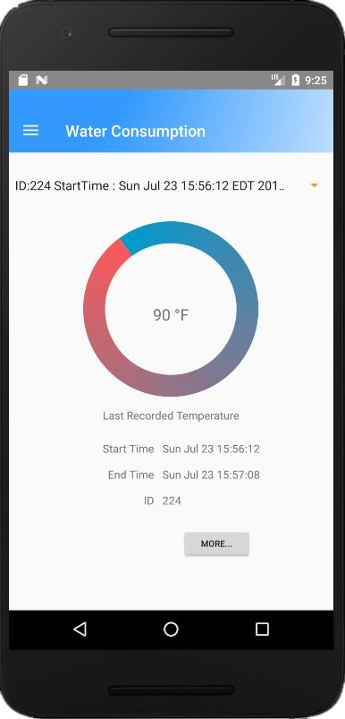
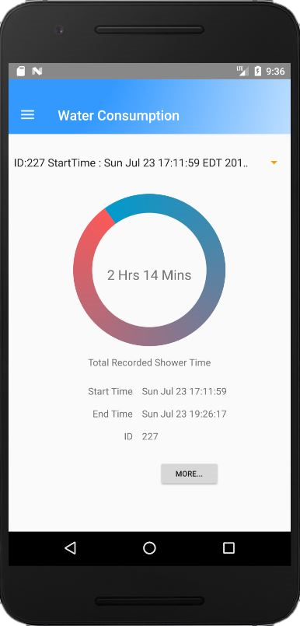
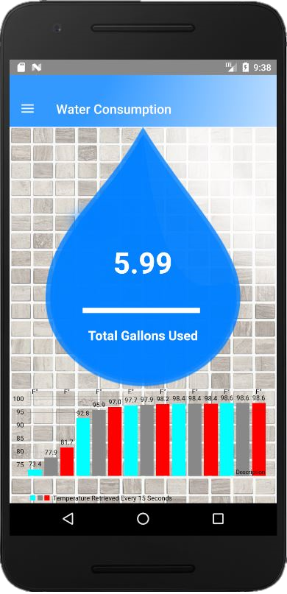
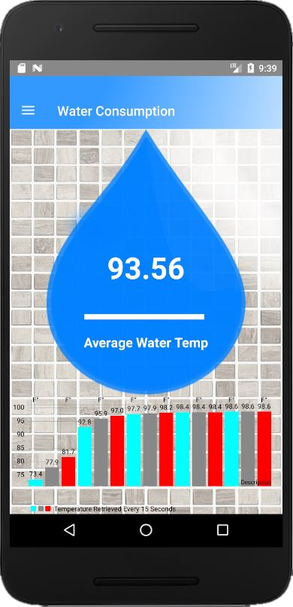
Android Application ui – Water Stats

Slide 28
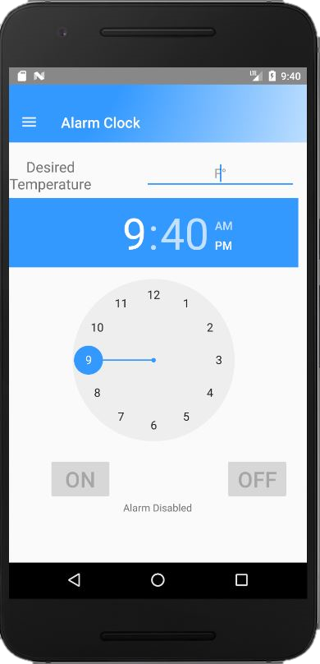
Android Application ui – Alarm Clock

Slide 29
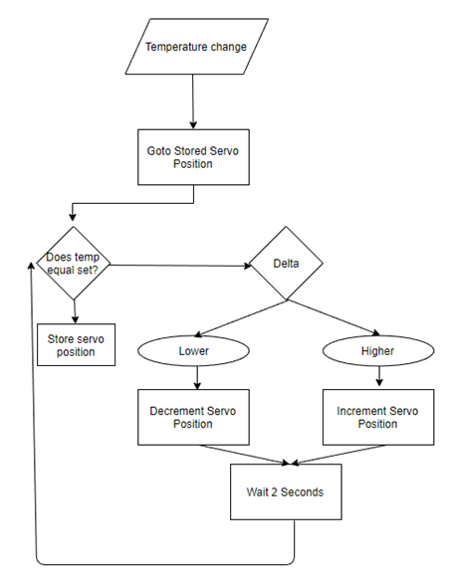
Temperature Control Algorithm
Basic overview
Learns which servo positions produce what temperatures

Slide 30
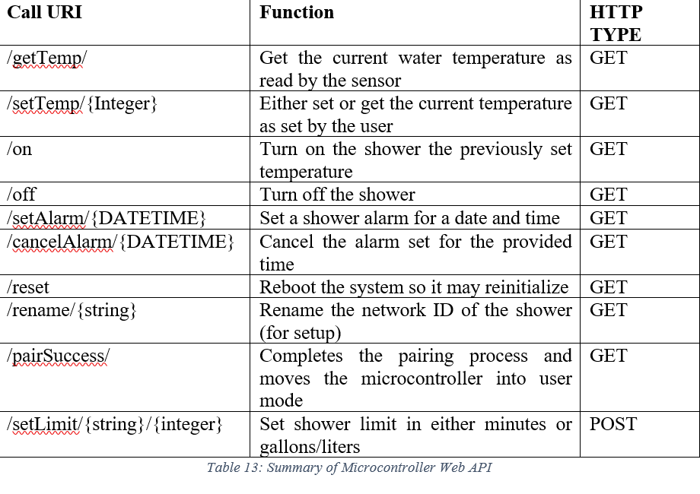
ESP WEB API
Allows communication between MCU and Android + Alexa

Slide 31
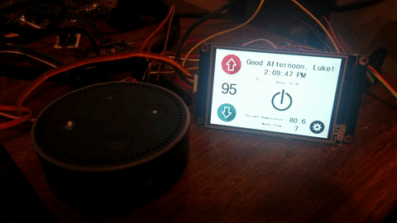
Alexa Integration
Natural Interaction
Most functionality implemented
“Alexa, tell smart shower to change temperature to 104”
Notes:
Faster than pulling out phone

Slide 32
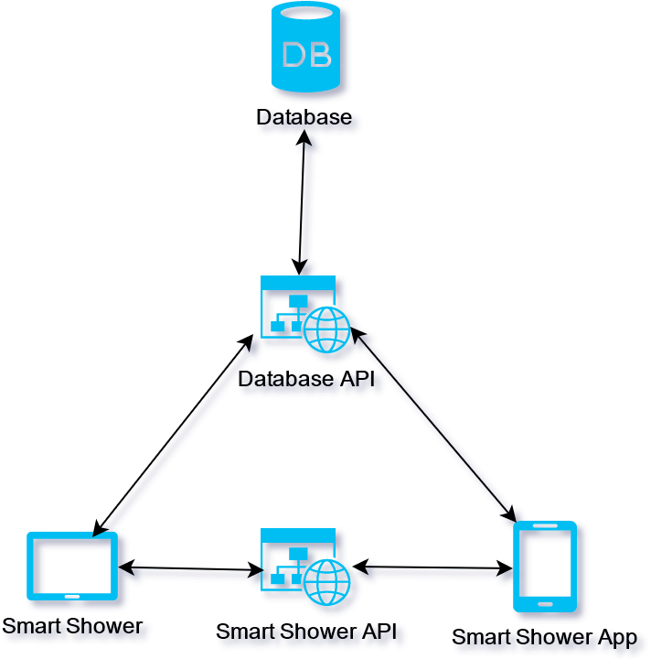
Software Architecture
Client-server architecture
The android application acts as a client
The database is a server
The smart shower acts as both

Slide 33
Database & database API
We will use a database to store the user’s shower use information
The database will be accessed by both the smart shower app and the smart shower through a web API
Microsoft SQL Server 2014
ASP.NET Web API

Slide 34
Database Design
Relational Database Design
Aggregate 1-to-many relationships
Each table represents an object

Slide 35
API Design
The ASP.NET Web API will use HTTP requests to retrieve, update, and insert data in the database
Data insertion and update requires JSON payload using HTTP POST calls
RESTful design
Client-server
Stateless
Cacheable
Uniform Interface
Endpoints for SmartShower and FlowData as well as Shower database tables
URL Endpoint | HTTP Method | CRUD Method | Function
Showers | GET | READ | Get all showers
Showers/ID | GET | READ | Get specific shower
Showers | POST | CREATE | Add a Shower
Showers/ID | PUT | UPDATE | Update a specific shower
Showers/ID | DELETE | DELETE | Delete a specific shower

Slide 36
Budgeting and Finance
Item | Quantity | Date Purchased | Cost | Seller
JX PDI-6221MG 20KG Large Torque Digital Standard Servo 360 Degree x1 | 1 | 2/3/2017 | $1.65 | Banggood(China)
3.5 Inch Nextion Display - NX4832T035 | 2 | 2/3/2017 | $32.66 | DirectVoltage(US)
ESP8266 Dev Boards | 2 | 2/3/2017 | $12.00 | Banggood(China)
Hall Effect Water Flow Sensor YF-S201 x3 | 3 | 2/3/2017 | $13.22 | Banggood(China)
DS3218 20KG Servo 270 Degree x1 | 1 | 2/3/2017 | $10.97 | Banggood(China)
DS3218 20KG Servo 270 Degree x1 | 1 | 4/25/2017 | $10.97 | Banggood(China)
YFS201C | 1 | 04/02/2017 | $4.00 | eBay
PCB components | 3 (sets) | 4/7/2017 | $38.72 | Mouser
Main PCB | 3 | 4/10/17 | $35.45 | OSH Park
Total |  |  | $217.30

Slide 37
Testing
Software
Embedded Software
UI
Servo and Temperature Control
Internet Control
Phone Pairing
Mobile Application
Pairing
Settings
Modifying Temperature
Timer
Water Consumption
Hardware
Power Testing
PCB Testing
Peripheral Testing
Agile methodology has led to Unit Testing
Functional Testing
Acceptance Testing before delivery

Slide 38
Potential Complications
Water Proofing the Main Control Housing
Mechanical strength of the valve components
Wireless signal strength in bathrooms

Slide 39
Future Plans
Smart Shower head with flow control
Bath integration
Hardware PWM servo control
Higher Quality LCD interface

Slide 40
Time Line and milestones
Senior Design 1
Week 8
Week 10
Senior Design 2
Interface sensors with microcontroller
Operate valve servo and LCD via microcontroller
Design valve controller
Week 12
Start development of local user interface and Android app
Week 14
Week 16
Week 18
Week 22
Week 24
Local control system and wireless network integration
Integrate voice control
Design PCB
Electrical hardware testing
Week 20
Design and build LCD interface housing
Full integration testing of device
Final preparations and integration testing
Power circuitry testing
Route cables and connectors
Notes:
Nick
Here is an overview highlighting some of our project milestones, SD 1 consisted of a lot of research and parts acquisition. SD2 is where the bulk of component integration and testing will occur.

Slide 41
PROGRESS

Slide 42
Questions?

Slide 43
Video Demo
https://www.youtube.com/watch?v=vnjjWbLNe3M

