Slide 1
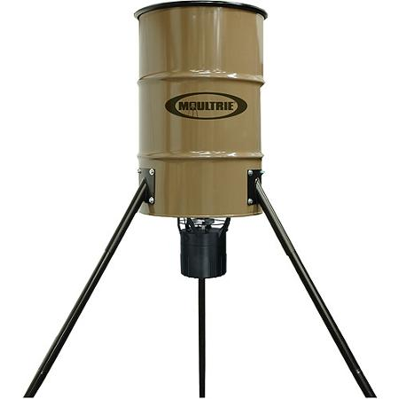
Game Feeder Cam
Group 11
Richard Kelly (EE)
AntHony Crosby (Cpe)
Daniel Guzman (CPE)
Joseph Torres Rosario (EE)

Slide 2
Objective and goals
The objective is to design a standalone system that combines both a game feeder and a game camera
Mobile application
Portability comparable to available existing products
Single rechargeable battery system with solar charging
Ease of assembly / disassembly and programming

Slide 3
Motivations
Desire to improve and simplify the equipment used in scouting game
Simplifying through the combination of a game feeder and camera
Improving by implementation of a user friendly mobile application interface and wireless notifications

Slide 4
Design specifications
Weather proof
Single rechargeable battery with renewable energy source
Bluetooth and GSM communications
Mobile application programming
Camera system activates from motion sensing
Records environmental conditions

Slide 5
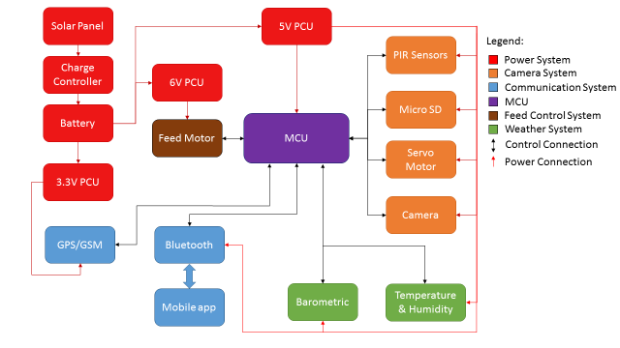
Overall Diagram

Slide 6
MICROCONTROLLER SELECTION
Microcontroller | Raspberry Pi | Arduino Uno | Arduino Mega 2560
Operating Voltage | 5V | 5V | 5V
DC Current per I/O Pin | 16 mA | 20 mA | 20 mA
Digital I/O Pins | 40 | 14 | 54
Analog Input Pins | 0 | 6 | 16

Slide 7
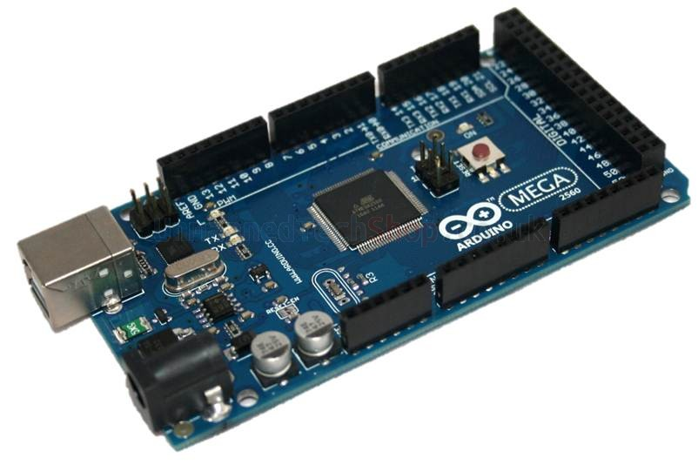
MCU: Arduino Mega 2560
Simple Arduino IDE interface to load and test code
Programmed in C
Code is open source for libraries and test sketches
Many libraries available for various components
Support is widely available

Slide 8
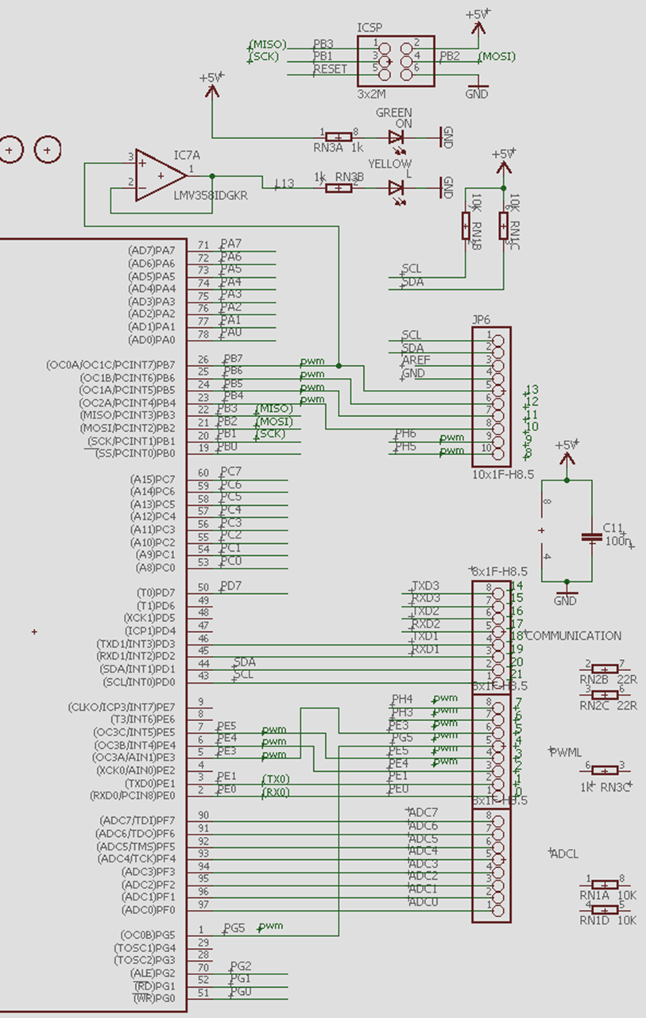
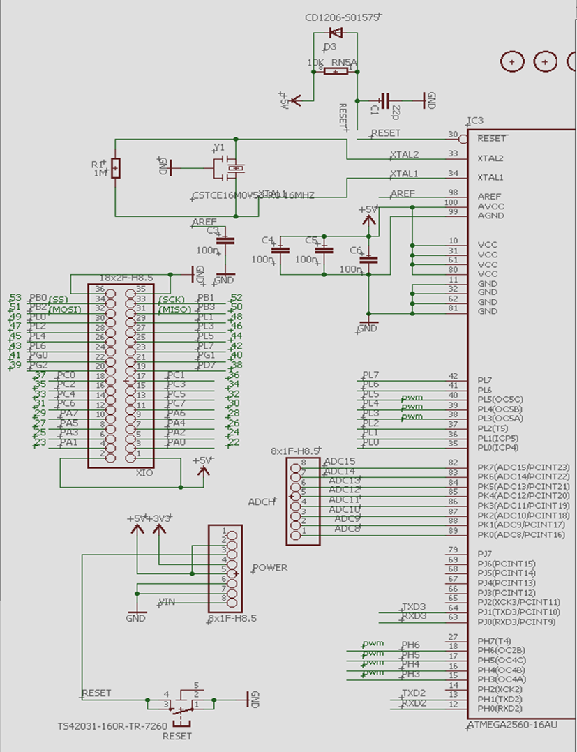
Arduino Mega 2560 Schematic
The DC power system will be removed as well as the ATMEGA16U2-MU chip and its subsystem
The SD card module will also be integrated onto the main MCU PCB

Slide 9
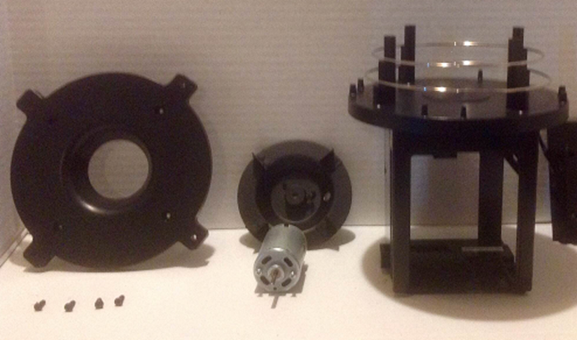
Feed Motor system
Gravity feed funnel
Feed dispersion disk
Six volt DC motor
Motor control PCB

Slide 10
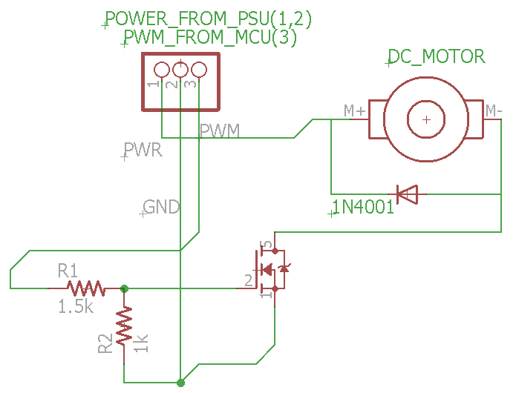
Feed Motor system
Motor Control Schematic
Voltage divider
N-Channel MOSFET
Diode
Screw pin terminal

Slide 11
Camera System
Which Camera is best
Weatherproof TTL Serial JPEG
  Built in Weather proof case.
  IR LED System for Night Pictures
  TTL Serial Link
  Compresses Pictures to JPEG format
  Motion Detection Built in
  Low Cost
  Arduino Compatibility: Compatible
360fly Panasonic 360 ° HD Video Camera
  360 ° Panoramic Pictures
  Bluetooth and WIFI
  Water and Dust Resistance
  High Cost
  Arduino Compatibility: Unknown
The Weatherproof TTL Serial Camera fits best with our project. Choosing this camera meant that a new camera system design was design. Discussion on this design will follow in the next slide.

Slide 12
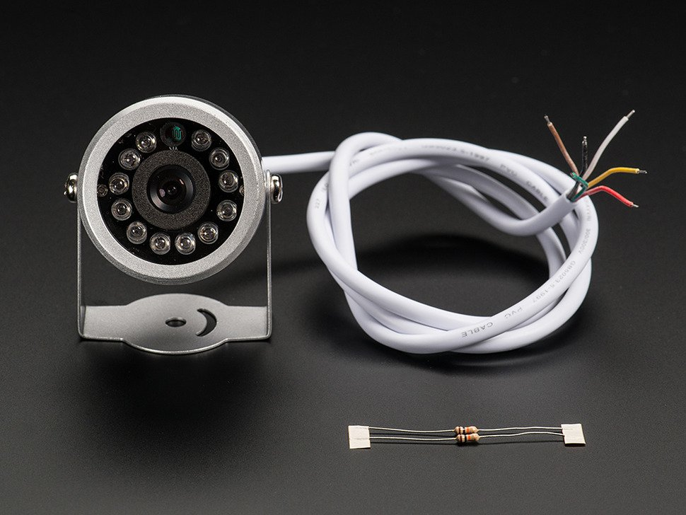
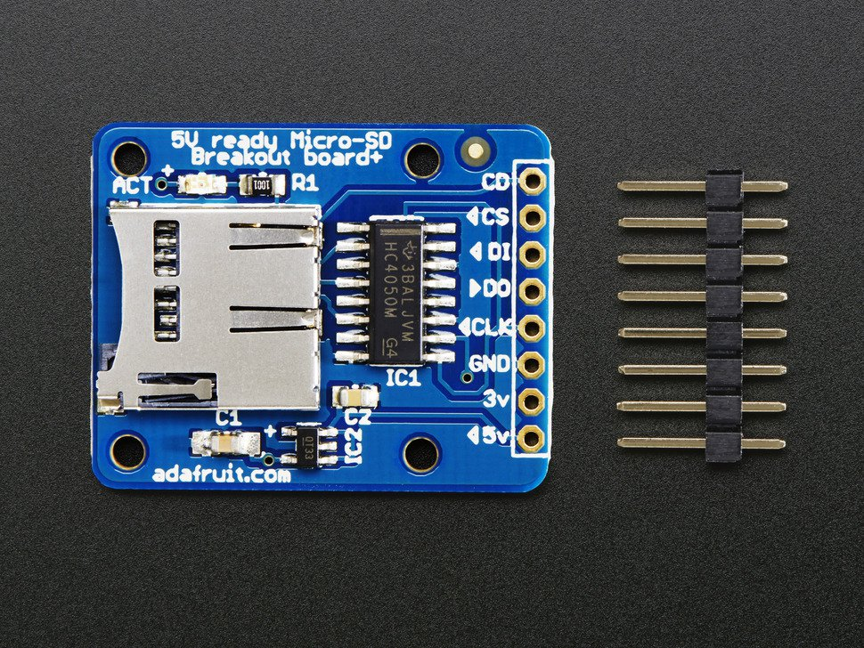
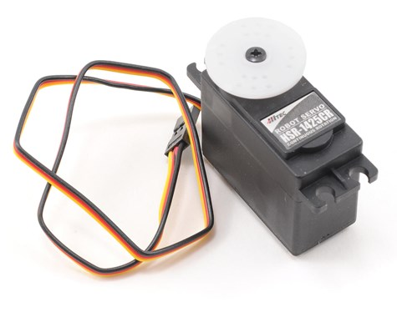
Camera System
Weatherproof TTL Serial JPEG Camera with NTSC Video and IR LEDs
Micro SD Card Breakout Board
Hitec HSR-1425CR Continuous Rotation Robot Servo

Slide 13
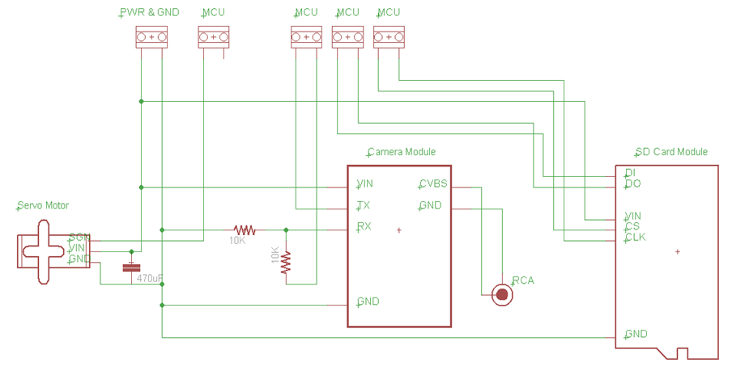
Camera System
Camera System Schematic

Slide 14
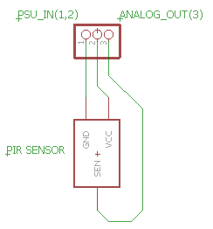
Camera System
Panasonic AMN34112
10m detection
Vertical area 110°
Horizontal area 93°
170μA standby
100μA detection mode

Slide 15
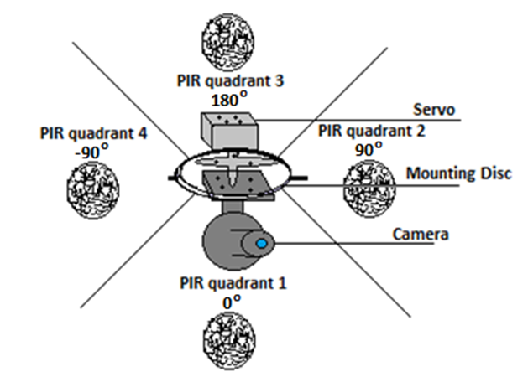
Camera System
Detects motion using PIR sensors
Servo motor points camera to quadrant with activity
Camera takes picture, and is then stored on SD card

Slide 16
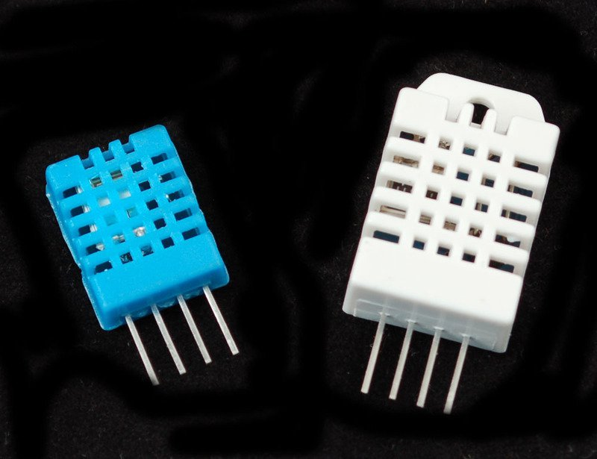
Weather System
Temperature / Humidity Sensor
DHT11
Low cost
3 to 5V power
2.5mA max current
20-80% humidity readings with 5% accuracy
0-50°C temperature readings ±2°C accuracy
DHT22
Low cost
3 to 5V power
2.5mA max current
0-100% humidity readings with 2-5% accuracy
-40 to 125°C temperature readings ±0.5°C accuracy

Slide 17
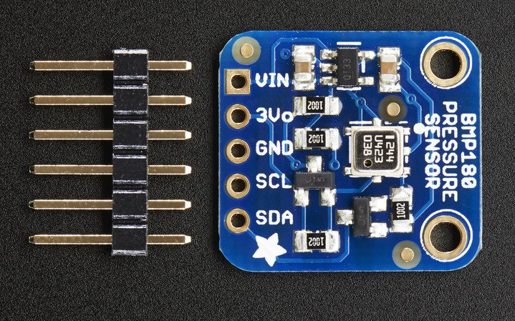
Weather System
Barometric Pressure Sensor
BMP180 Temperature / Barometric Pressure / Altitude
3.3-5V power with onboard voltage regulator
300-1100 hPa (9000m to -500m above sea level) with up to 0.03hPa / 0.25m resolution
-40 to +85°C temperature range with +-2°C accuracy
2-pin i2c analog interface

Slide 18
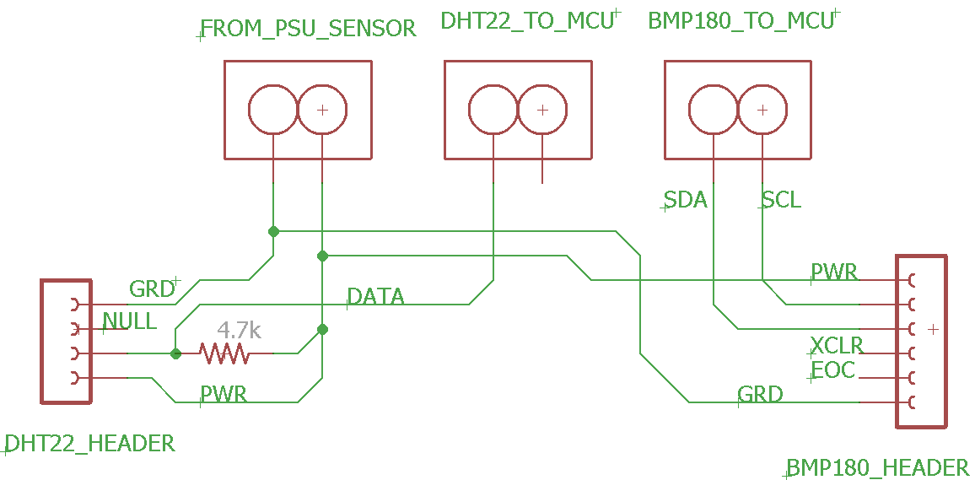
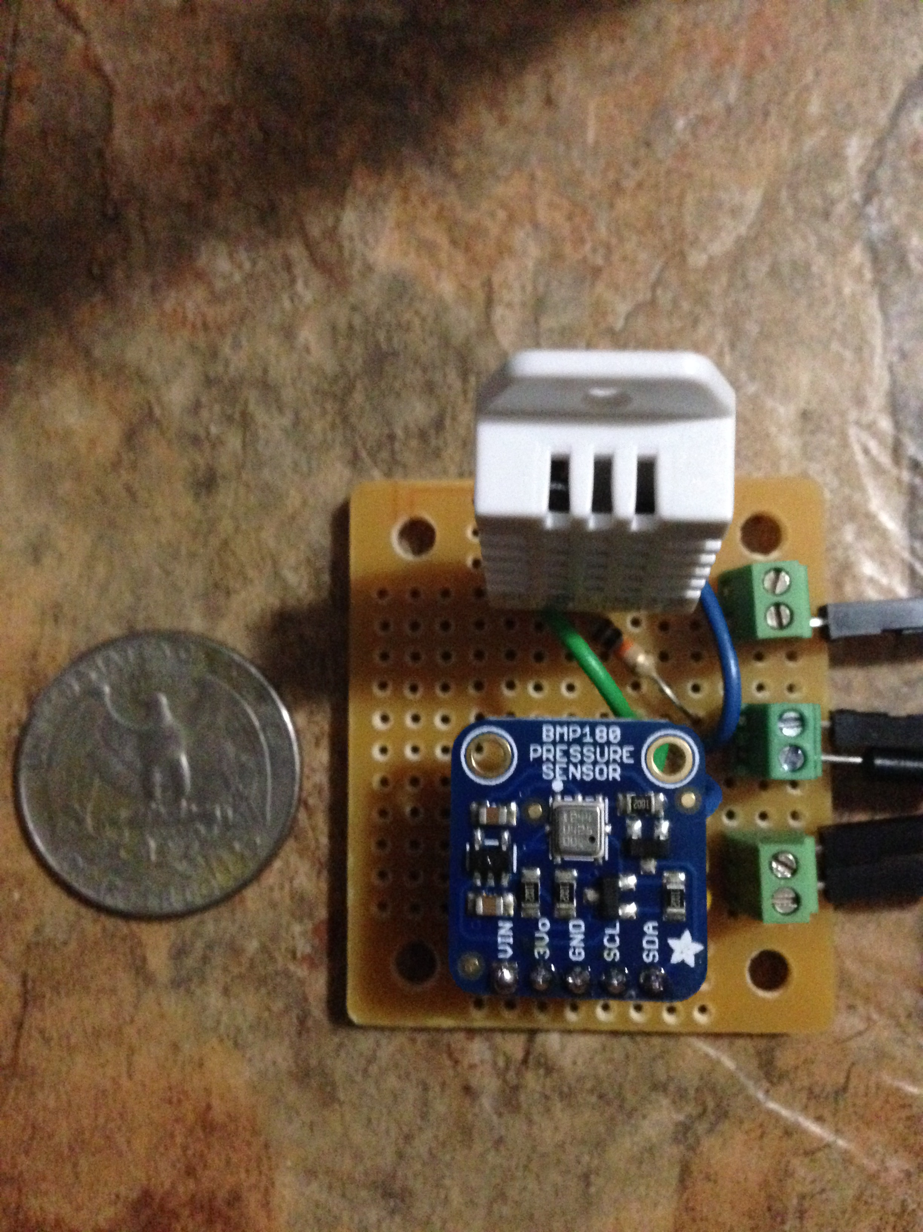
Weather System
Weather Sensor Schematic and Final PCB Design

Slide 19
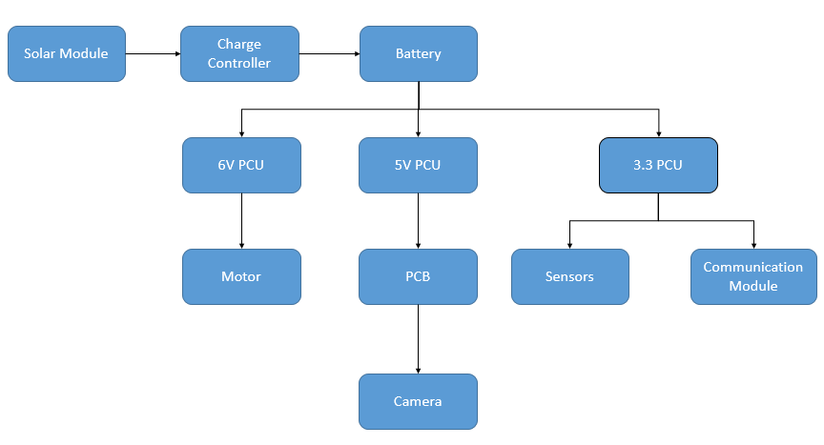
Power System
Power distribution Diagram:

Slide 20
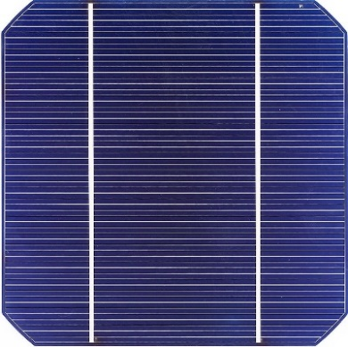
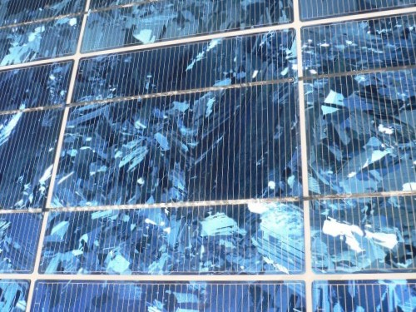
Poly or Mono crystalline?
Mono:
More efficient highest light absorption
Higher cost
Best at low light conditions
Poly:
Comparable efficiency to Monocrystalline
Lower cost

Slide 21
Power system
  Battery Technology: lithium ion or lead acid?
 | Lithium ion | Lead-acid
Cycle Life | 1000 | 300-500 w/ full discharge
Charge Time | 1 hr. or less | 8-12 hrs.
Nominal Voltage (per cell) | 3.6V | 2V
Overcharge Tolerance | low | high
Energy Density (Wh/kg) | 90-190 | 30-50
Self-Discharge per month | 10% | 5%
Charger design complexity | High | Low

Slide 22
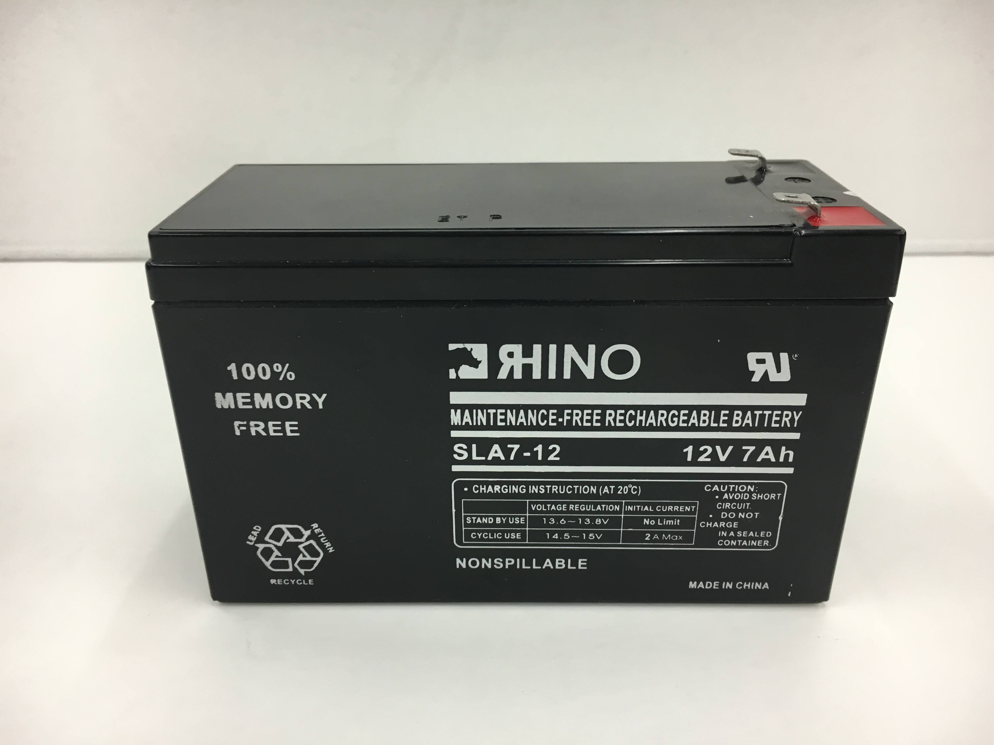
Power system
  Lead acid :
  Simple charge controller design
  Low cost
  High overcharge tolerance
  Better operating temperature range

Slide 23
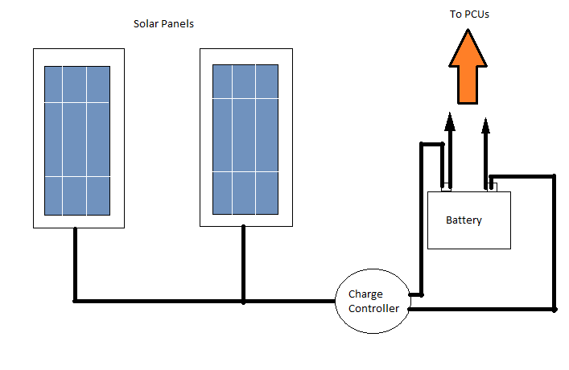
Power system
Sunlight is Unpredictable
  Charge Controller
  Multiple PCU and PCB design

Slide 24
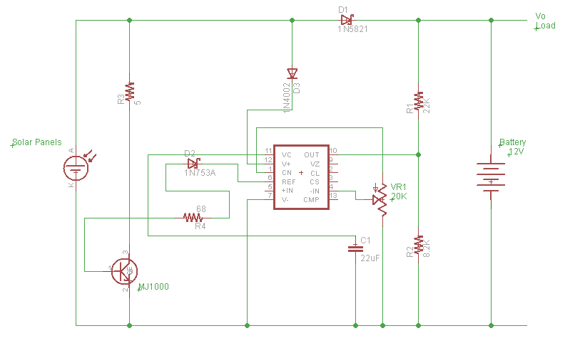
Power System
Diversion Charge Controller Schematic

Slide 25
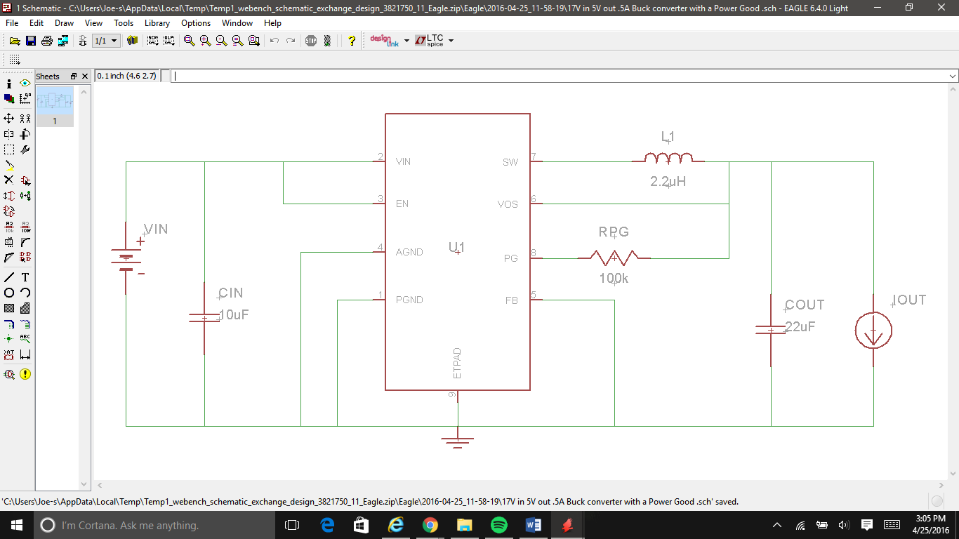
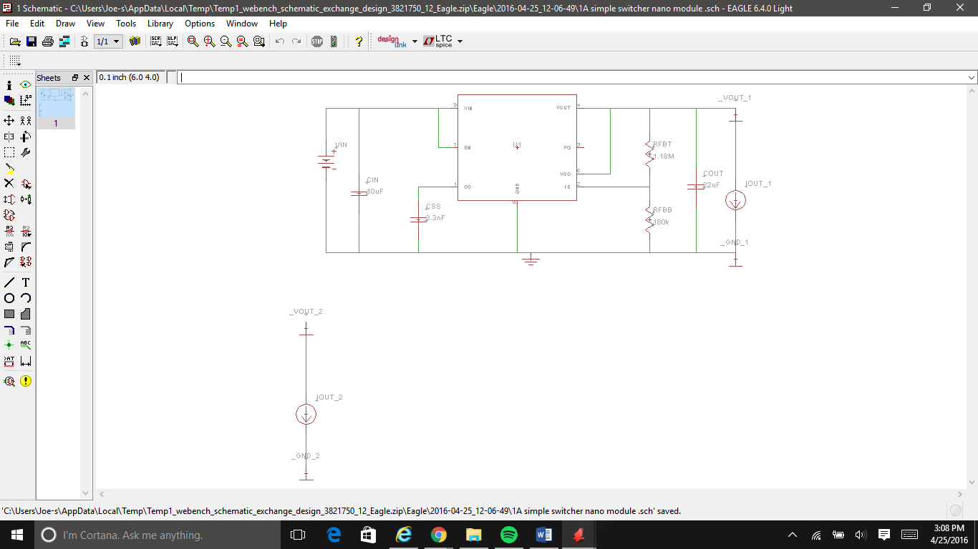
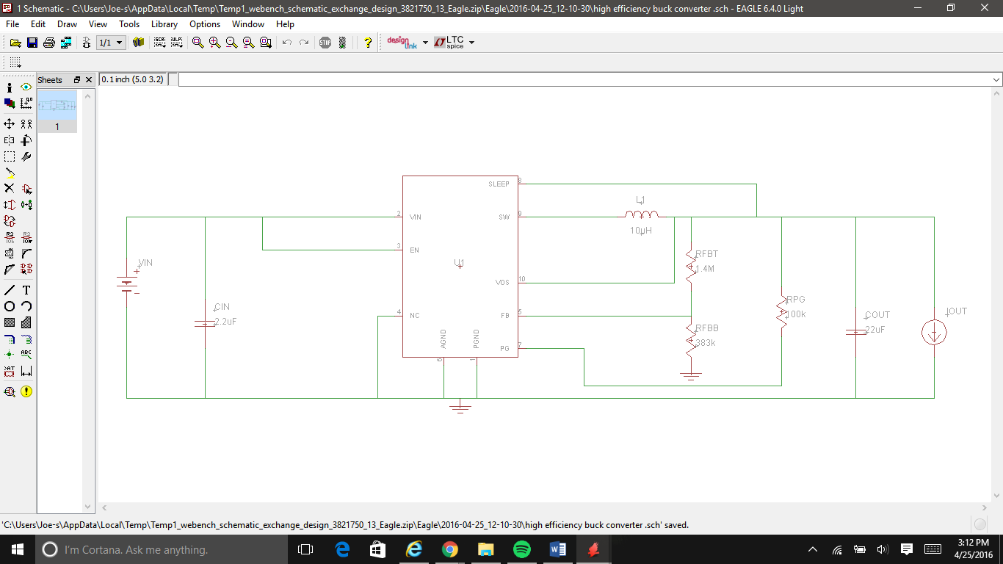
Power system
Power control Unit schematics 5V, 6V, and 3.3V

Slide 26
Communications
Bluetooth or WIFI?
Bluetooth:
  Band: 2.4 GHz
  Range: 100 meters
  Low Cost
  Low Energy
  Easy and Direct Connection
WIFI:
  Band: 2.4GHz or 5GHz
  Range: 32 to 100 meters
  Higher Cost
  Higher Energy Consumption
  More secure connection
Based on the energy and bandwidth requirements of the project the decision was made to choose Bluetooth over WIFI. Bluetooth will provide a direct connection to the GFC when in range.

Slide 27
Communications
GSM
A GSM module will be used for text notifications. Text messages will be sent for the following events:
  Sensor detects movement (Limit to 1 – 3)/hour
  A picture is taken
  Storage is more than 90% used.
  Feeding start/end
  Battery is less than 50% and 20%

Slide 28
Communications
Bluetooth and GSM Module
Bluetooth: Kedsum Arduino Bluetooth
  Band: 2.4 GHz
  Emission Power: <= 4dBm (Class 2)
  Speed : Asynchronous: 2.1Mbps(Max) / 160 kbps, Synchronous: 1Mbps/1Mbps Low Energy
GSM: Adafruit FONA 808 + GPS
  Quad Band: 850/900/ 1800/1900MHz
  Integrated GPS MT3337 Chipset
  Make/Receive Phone Calls
  Send/Receive SMS Messages
  GPRS Data (TCP/IP)

Slide 29
Android Application
IDE: Android Studio
Programming in Java and XML
Application will be used to change the settings of the GFC.
Customizable Settings include:
  DC Motor Speeds and Test
  Notifications
  Camera Test
  Feeding Times
Picture Management will be shown in a picture gallery to manage the pictures stored in the GFC SD card.

Slide 30
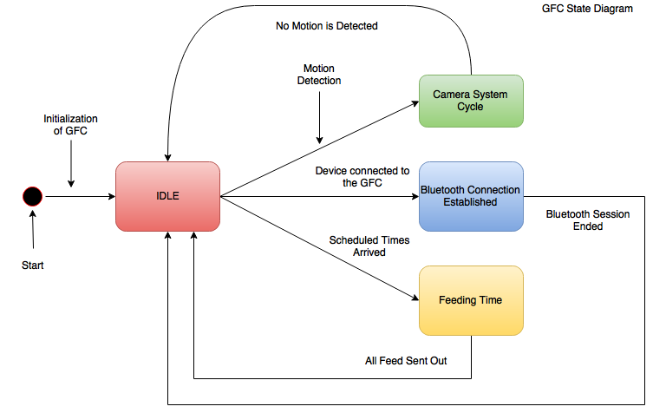
GFC Operating States
Idle:
  The GFC will operate in a low power mode until one of the following events are triggered:
    Sensor detects motion (Go to Camera System State).
    Schedule feeding times arrives (Enter Feeding State).
    A Bluetooth connection is detected (Start Bluetooth State).
  Once no more events are triggered the GFC will return to Idle.
Camera System:
  Atmosphere data is collected, a notification is sent, and a picture is taken.
Feeding:
  Feeder will distribute the food.
Bluetooth, Connection Established:
  Customizable settings of the GFC can be changed via the Android Application.

Slide 31
Integration
Camera System State
Once a sensor is triggered the GFC will go into the Camera System State.
Here the following events are triggered:
  Gather Humidity/Temperature/Pressure
  Take a picture
  Save Picture to SD Card
  Text Notification is Sent
Next Slide shows a diagram of the flow of this state.

Slide 32
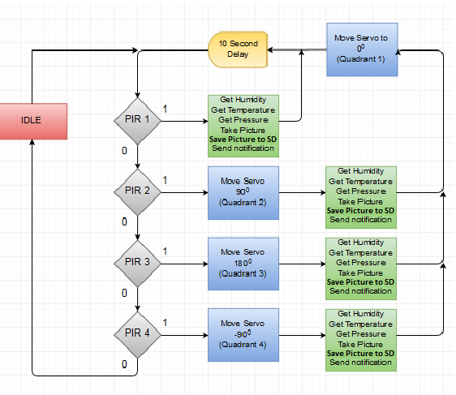
Camera System: Flow Diagram

Slide 33
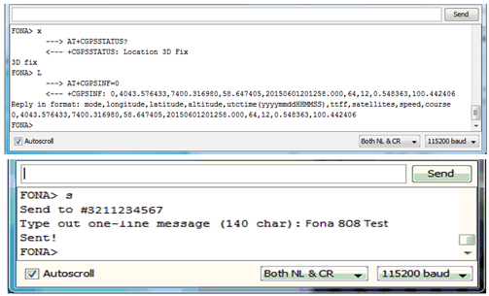
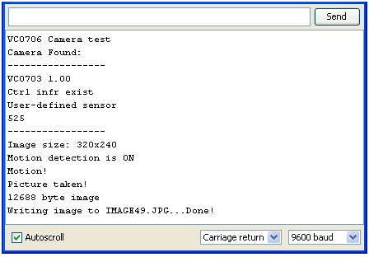
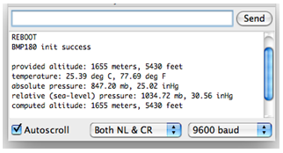
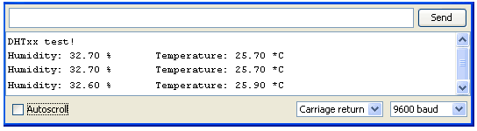
SERIAL TESTING
GSM/GPS
Camera
BMP 180
DHT22

Slide 34
Division of work
Name | Communication | Mobile App | Power | Camera | Weather | Feed
Richard |  |  |  | X | X | X
Antony | X |  |  | X | X
Joseph |  |  | X | X
Daniel | X | X |  | X

Slide 35
Budget
Item | Quantity | Unit Cost | Total (with tax)
Solar panels | 2 | $29.99 | $64.18
PCB Boards | 10 | N/A | $300.00
Motion sensors | 4 | $17.00 | $72.76
HTU21D-F Temperature & Humidity Sensor | 1 | $9.99 | $10.69
MPL3115A2 - I2C Barometric Pressure/Altitude/Temperature Sensor | 1 | $13.20 | $14.12
12 volt Battery | 1 | $19.99 | $21.39
Weatherproof TTL Serial JPEG Camera with IR LEDs | 1 | $54.95 | $58.80
MicroSD Card Breakout Board+ | 1 | $7.50 | $8.03
SanDisk Ultra 32GB Micro SD | 1 | $10.69 | $11.44
Arduino Mega2560 | 1 | $30.99 | $33.16
400-Point Experiment Board | 1 | $5.07 | $5.42
Jumper Wire Package | 1 | $6.87 | $7.35
Adafruit FONA 808 GSM/GPS | 1 | $49.95 | $53.45
JY-MCU Bluetooth Module | 1 | $9.99 | $10.69
Servo Motor | 1 | $15.00 | $16.05
Power Converter | 1
Antennas GPS | 1 | $3.95 | $4.23
Antennas GSM | 1 | $2.95 | $3.16
GSM SIM card | 1 | $9.00 | $9.63
GSM battery | 1 | $9.95 | $10.65
Total |  |  | $693.81
Electronic Components:

Slide 36
Budget
Item | Quantity | Unit Cost | Total (with tax)
55 Gallon Container | 1 | $100.00 | $107.00
Power Systems Housing | 1 | $15.03 | $16.08
Feeder Housing (motor and disc) | 1 | $59.99 | $64.19
Angle Iron ¼”x20’ | 4 | $25.00 | $100.00
Feeder Stand Poles 1”x6’ | 4 | $19.31 | $82.65
Acrylic Adhesive, Bottle, 50mL | 1 | $18.25 | $19.53
1/4-20-Inch x 2-Inch Full Thread Hex Tap Bolts | 100 | $0.16 | $17.18
1/4'” Steel Flat Washer, Plain Finish | 100 | $0.04 | $4.11
Finish Hex Nut, 1/4-Inch by 20-Inch | 100 | $0.07 | $7.48
Silicon | 2 | $4.97 | $10.64
Acrylic sheet 8”x10” | 9 | $2.98 | $28.70
PVC tube ½”x10’ | 3 | $1.65 | $5.30
Total |  |  | $462.86
Materials for Construction Cost:

Slide 37
Progress

Slide 38
Questions?

