Slide 1

Group 7
Adam Kutchak (CPe)
Luis Brum (ee)
Jamie peck (cpe)
Greg Kelso (cpe)

Slide 2
Introduction & Motivation
The Fire Extinguishing Unmanned Aerial Vehicle or FXUAV for short, is a vehicle that seeks autonomously, in a predetermined flight grid, to detect and extinguish fires.
Using an imaging processing algorithm HD camera, a scripted guiding system, and a payload release mechanism, the FXUAV flies a specified path, detects the presence of a flame, and drops a suppressant over the flames.
Facilitate a drive towards reducing the number of fatalities, injuries, and losses
Effectively reduce the number of deaths due to structure collapse and smoke inhalation
Satisfy UCF senior design requirements

Slide 3
Specifications and Requirements
Subsystem | Parameter | Specification
Quadcopter | Thrust | 8 lb
Quadcopter | Flight-time | 10 min
Extinguisher | Weight | 1lb
Camera | Fire Detection/Tracking | 25 sq. meter range

Slide 4
System Overview – Block Diagram

Slide 5
Design Approach and Implementation
  Quadcopter
  Quadcopter
GPS
Fire Detection Module
Fire Detection Module
Fire Extinguishing
Unit
Fire Extinguishing
Unit
Pixhawk Flight Controller
Servo Control

Slide 6
Multirotor Flight Hardware
Flight Controller Unit: 3DR PixHawk
  Power Requirements: 5 Nominal Volts, < 3 Amps
  Manufacture: 3DR
  Price: 199.99
  Pros: Number of Ports, Support, Ease of Use.
  Cons: Price.

Slide 7
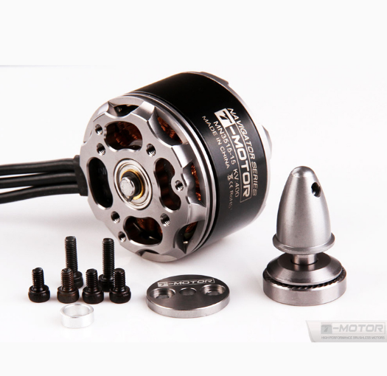
Multirotor Flight Hardware
Motors: T-Motor MT3515 400KV (4 units)
  Power Requirement: 22.2 Nominal Volts, 0-20 Amps
  Price: $49.99 each
  Thrust: 970 grams per motor at 50% throttle
  2460 grams per motor at 100% throttle
  Manufacture: Tiger Motors
  Pros: Thrust, Sturdiness, Efficiency
  Cons: Price, Availability

Slide 8
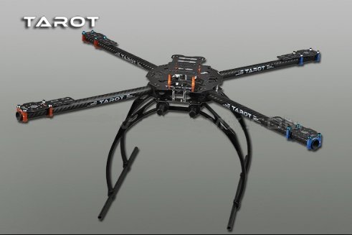
Multirotor Flight Hardware
Frame: Tarot 650
  Material: Carbon Fiber
  Total Weight: 590 grams
  Price: $120.00
  Size: 650 mm
  Pros: Size
  Cons: Structural Integrity

Slide 9
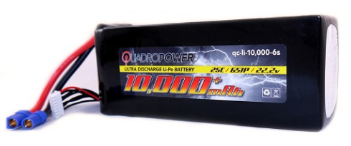
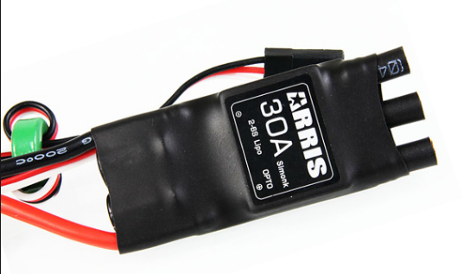
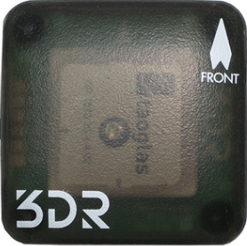
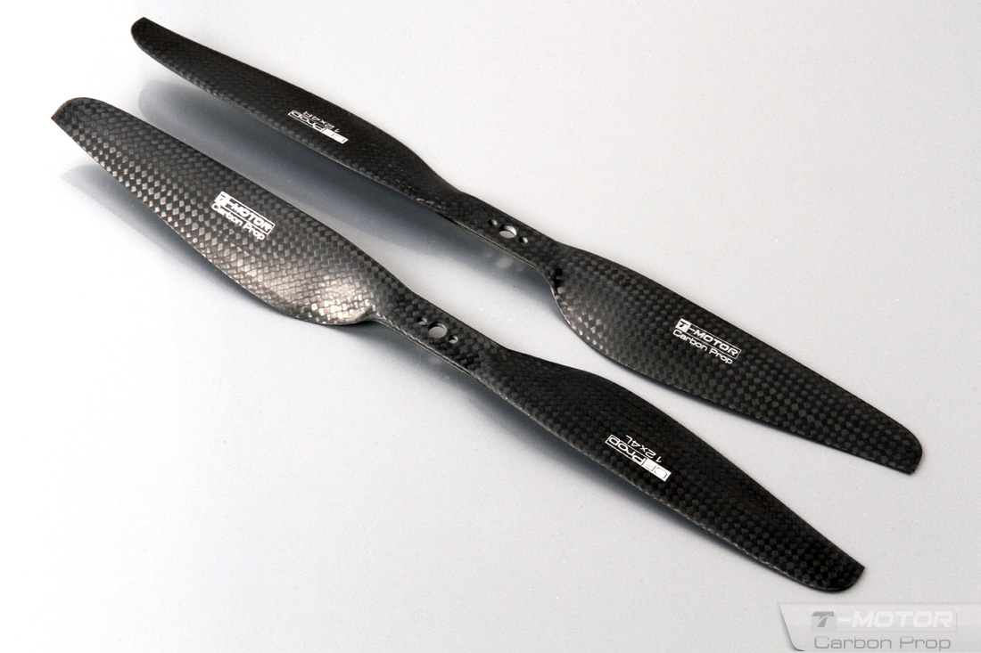
Multirotor Flight Hardware
Electronic Speed Controller: Arris (4 units)
10.8– 22.2 Nominal Volts
0-30 Amps
Price: $ 14.99 each
Battery:
QuadroPower 6s 35C
22.2 Nominal Volts
10,000 mAh
Price: $159.99
GPS System: 3DR uBlox GPS with Compass Kit
Voltage : 3.3V
Current: 21 mA
Price: $89.99
Propellers: 15” Diameter Carbon Fiber

Slide 10
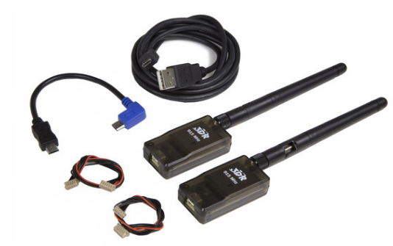
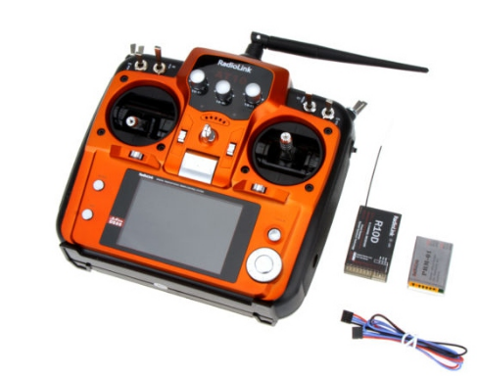
Multirotor Flight Hardware
Telemetry Radio: 3DR RADIO V2
  Transmit Current: 100mA at 30 dBm
  Operating Voltage: 3.7-6 V
  Price: $29.99
Radio Controller: Radiolink AT10 Transmitter w/ Module & 10ch R10D Receiver
  Receiver Operating Voltage 4.5V-6V
  2.4GHz 10 channels PPM
  Frequency Hopping Spread Spectrum technology
  Price: 119.99

Slide 11
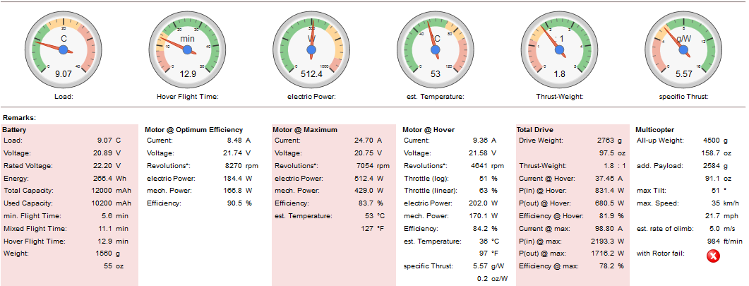
Flight Time Estimation

Slide 12
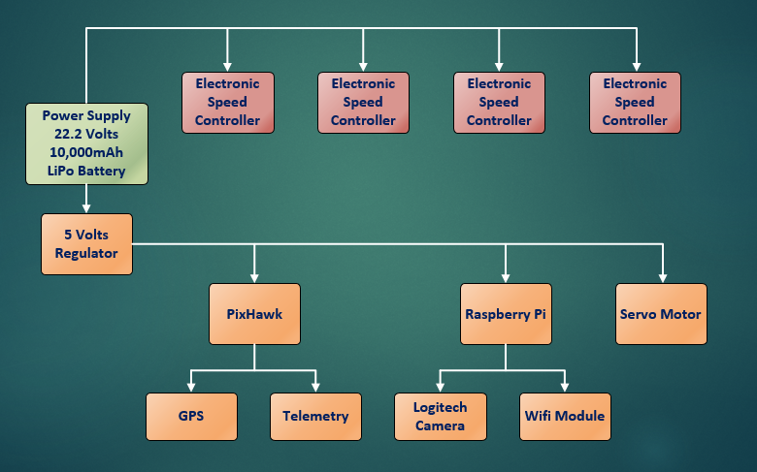
Power Distribution Diagram

Slide 13
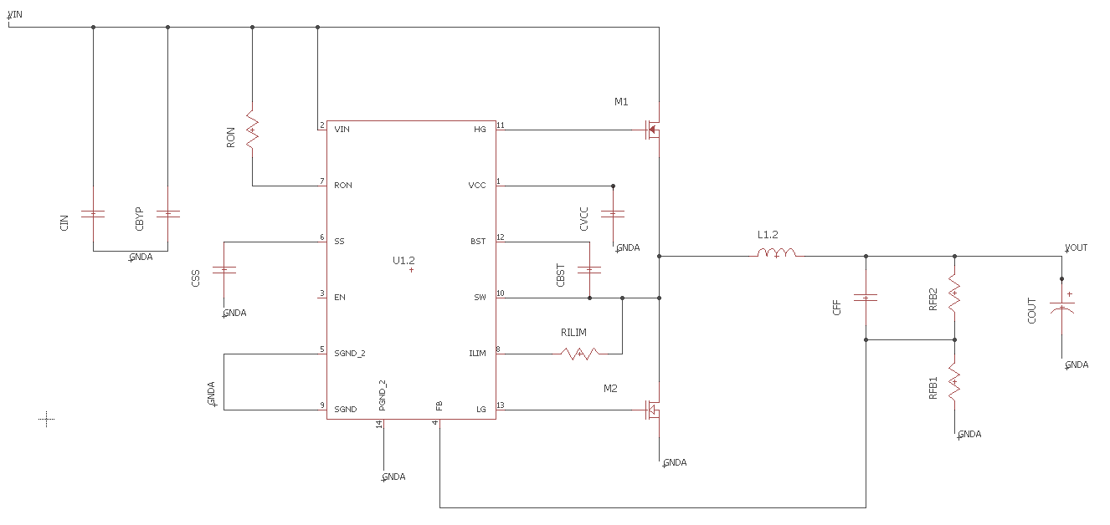
PDB Schematic

Slide 14
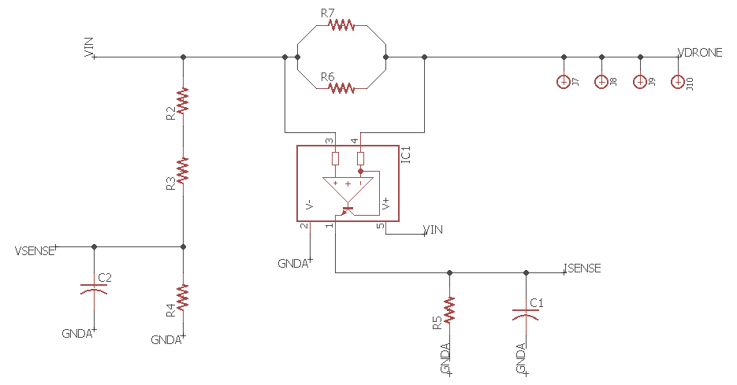
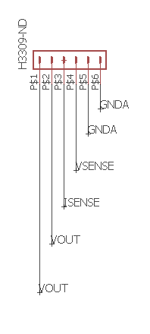
PDB Schematic

Slide 15
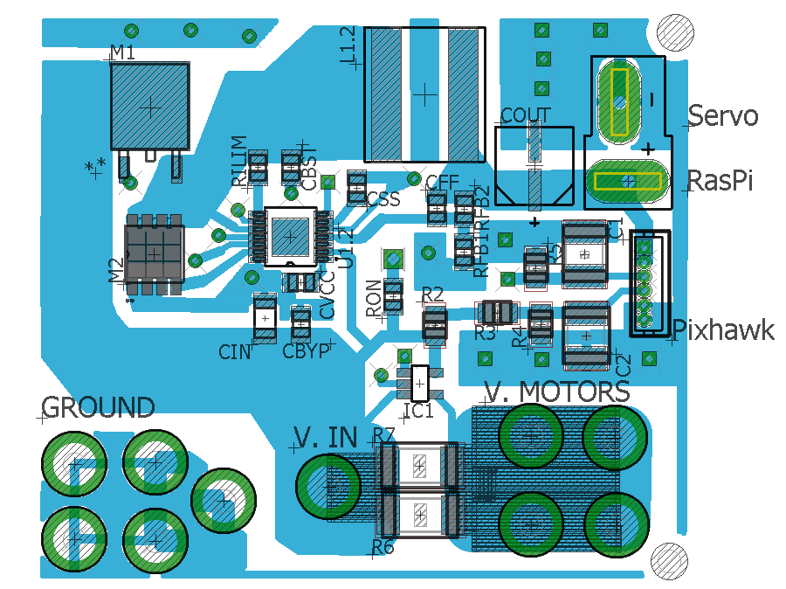
PDB Layout

Slide 16
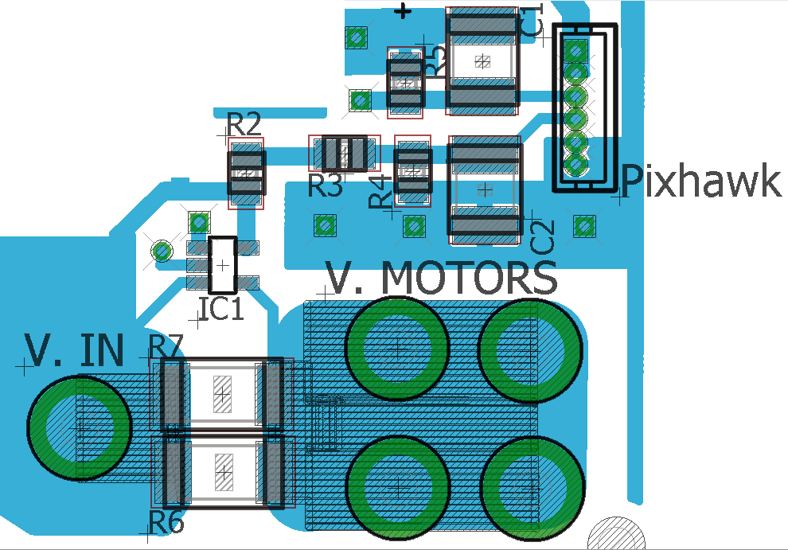
PDB Layout
VOLTAGE SENSE BREAKOUT BOARD
Line | BOARD REF | P/N | VALUE
1 | R2 | RG20P4.7KBCT-ND | RES SMD 4.7K OHM 0.1% 1/8W 0805
2 | R3 | 311-10.0KCRCT-ND | RES SMD 10K OHM 1% 1/8W 0805
3 | R4 | 311-1.00KCRCT-ND | RES SMD 1K OHM 1% 1/8W 0805
4 | R5 | YAG1967CT-ND | RES SMD 73.2K OHM 0.1% 1/8W 0805
5 | R6 | 696-1680-1-ND | RES SMD 0.1 OHM 1% 3W 2512
6 | R7 | 696-1680-1-ND | RES SMD 0.1 OHM 1% 3W 2513
7 | C1 | GRM43DR72J104KW01L | CAP CER 0.1UF 630V X7R 1812
8 | C2 | GRM43DR72J104KW01L | CAP CER 0.1UF 630V X7R 1812
9 | IC1 | INA169NA/250CT-ND | IC CURRENT MONITOR 0.5% SOT23-5
10 | PixHawk | H3309-ND | CONN HEADER 6POS 1.25MM GOLD

Slide 17
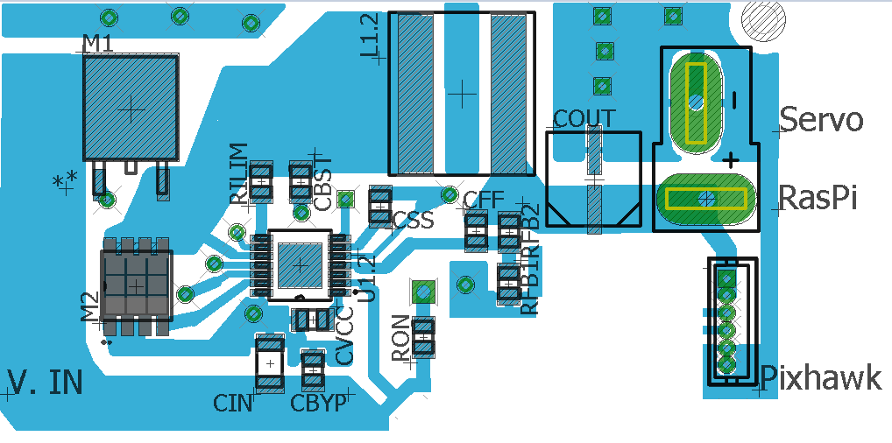
PDB Layout
POWER DISTRIBUTION
Line | BOARD REF | P/N | VALUE
1 | CIN | GRM32ER7YA106KA12L | CAP CER 10UF 35V X7R 1210
2 | CBYP | CC0805KRX7R9BB153 | CAP CER 0.015UF 50V X7R 0805
3 | M1 | FDD8647L | MOSFET N-CH 40V 14A DPAK
4 | M2 | CSD18532Q5B | MOSFET N-CH 60V 23A 8VSON
5 | L1.2 | XAL1010-562MEB | XAL1010 High Current 5.6 uH 20 % 21.2 A
6 | U1.2 | LM3150MH/NOPB | IC REG CTRLR BUCK 14TSSOP
7 | RON | ERJ-6NF2493V | RES SMD 249K OHM 1% 1/8W 0805
8 | CVCC | MK212B7225KG-T | CAP CER 2.2UF 16V X7R 0805
9 | RILIM | ERJ-6ENF1001V | RES SMD 1K OHM 1% 1/8W 0805
10 | CBST | EMK212B7474KD-T | CAP CER 0.47UF 16V X7R 0805
11 | CFF | 08055C122KAT2A | CAP CER 1200PF 50V X7R 0805
12 | RFB2 | ERJ-6ENF7322V | RES SMD 73.2K OHM 1% 1/8W 0805
13 | RFB1 | P10.0KCCT-ND | RES SMD 10K OHM 1% 1/8W 0805
14 | COUT | 6SVPE220M | CAP ALUM POLY 220UF 20% 6.3V SMD
15 | CSS | CC0805KRX7R9BB153 | CAP CER 0.015UF 50V X7R 0805

Slide 18
Software Architecture
Raspberry
Pi
MAVLink via
USB
GPIO Pins
C++/
OpenCV
Fire Detection
Servo
Control
Pixhawk

Slide 19
MavLink
MAVProxy is a command-line ground control station written in Python
MAVLink (Micro Air Vehicle Communication Protocol) is a protocol for communicating to UAVs.
Each MAVLink command sent to the Pixhawk via USB/Serial/Wi-Fi from MAVProxy.
DroneKit-Python is an API that allows developers to create applications that run on single-board computers and communicate with the ArduPilot flight controller.

Slide 20

Structure of a MAVLink Packet
Byte Index | Content | Value | Explanation
0 | Packet start sign | 0xFE | Indicates start of a new packet
1 | Payload length | 0 - 255 | Indicates length of following payload
2 | Packet sequence | 0 -255 | Each component counts up its send sequence. Allows to detect packet loss
3 | System ID | 1 -255 | ID of the SENDING system. Allows to differentiate between MAVs on the same network.
4 | Component ID | 0 - 255 | ID of the SENDING component. Allows to differentiate between different components of the same system (MCU and Autopilot)
5 | Message ID | 0 - 255 | ID of the message – defines what the payload "means" and how it should be decoded
6 to (n+6) | Data | (0 – 255) bytes | Data of the message, depends on the message ID
(n+7) to(n+8) | Checksum (low byte, high byte) | 1..(n+6) bytes | ITU X.25/SAE AS-4 hash

Slide 21
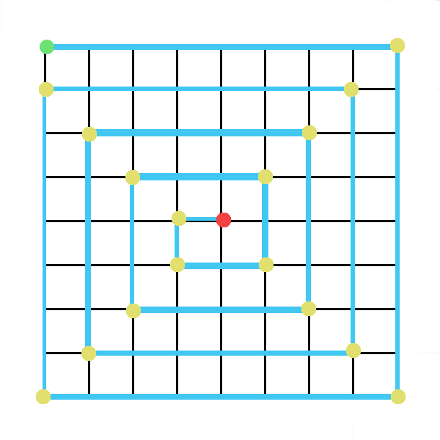
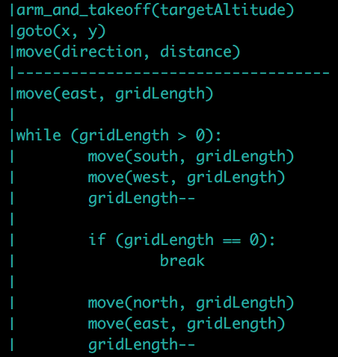
Automated Grid Search

Slide 22
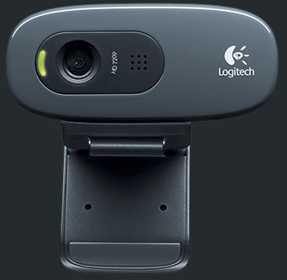
Image Processing Module
The Raspberry Pi will receive video streams from the Logitech C270
Once the object is detected the Raspberry Pi will signal the servo to release the fire suppressant
 | GoPro HERO4 Black | Logitech HD C270
Weight | 5.4oz (152g) | 4.48oz (127g)
Cost | $499.00 | $39.99
Image | 1080 x 720 | 1080 x 720

Slide 23
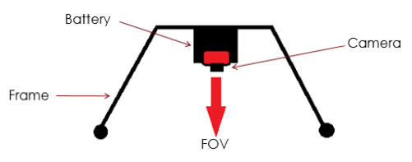
Camera Attachment

Slide 24
Image Processing
findcontours( )
drawcontours( )
The function draws contour outlines of filled contours in the image
check( )
The function searches for contours of red pixels
The function retrieves contours from the image
Useful tool for shape analysis and object detection and recognition
Image Prep
GaussianBlur( )
dilate( )
erode( )
convolves the source image
causes bright regions within an image to “grow”
bright areas of the image get thinner, and dark zones get bigger

Slide 25

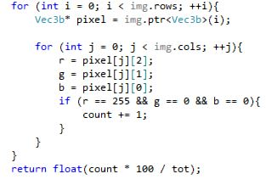

Slide 26
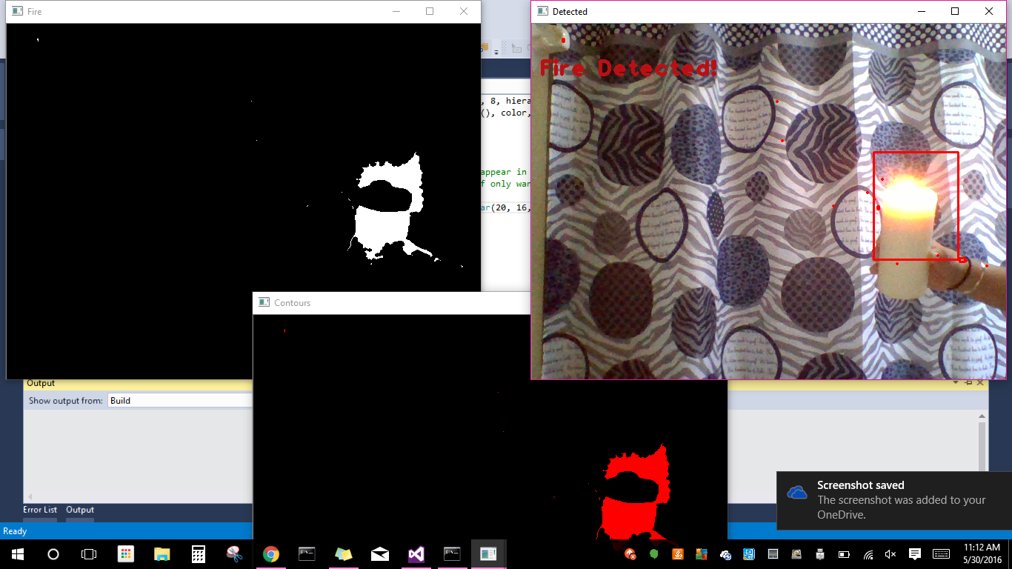
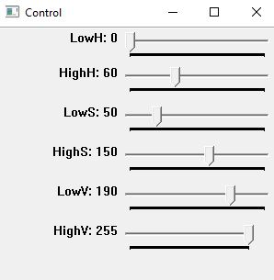

Slide 27
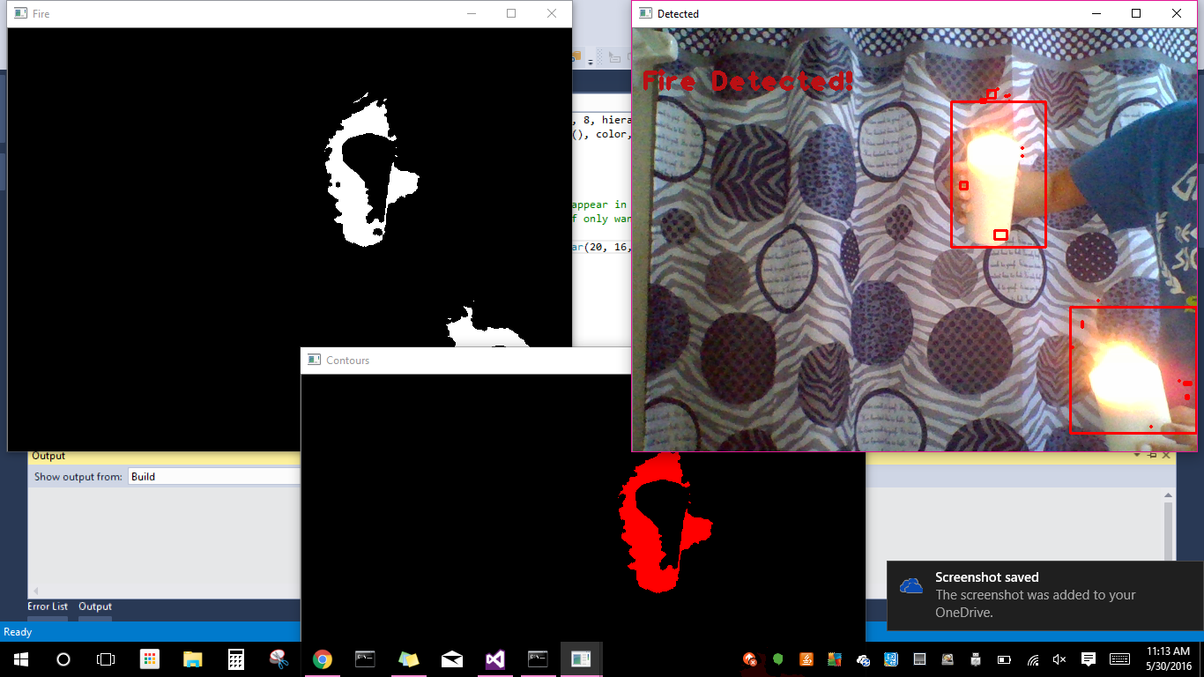

Slide 28
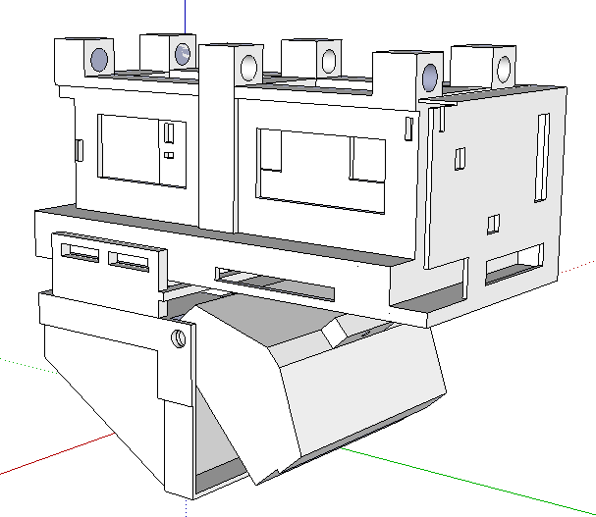
Fire Extinguisher
  Designed on SketchUp.
  3D Printed Battery Section.
  Handmade container section.
  Lid Controlled by Servo Motor.

Slide 29
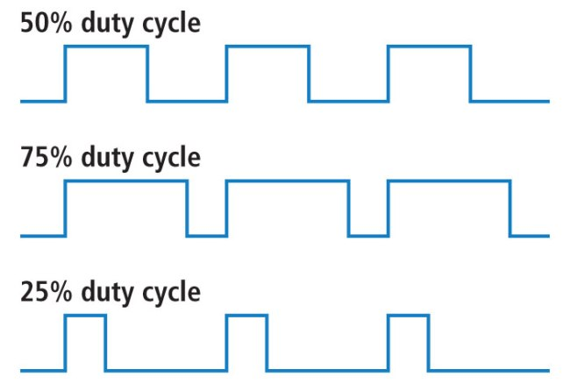
Servo Control
The fire suppression will be made up of a spring loaded door mechanism that is populated with Sodium Bicarbonate (baking soda), something often used in fire extinguishers.
Once the drone has detected a fire, a signal will be sent to release the contents and extinguish the fire.
The servo is controlled by pulse width modulation (PWM).
This allows us to vary the length of time that the signal output is high.
The duty cycle is the percentage of time the digital signal is on.

Slide 30
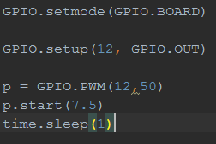
Servo Control
The angle of the rotation is determined by the width of the pulse (not the duty cycle) which is somewhere between 1ms and 2 ms.
For example, setting the signal high for 1.5ms will turn the motor to 90 degrees. (halfway between 0 and 180 degrees, and halfway between 1 and 2 ms).
This is done using the time.sleep() function

Slide 31
Servo Control
Using PWM and a continuously rotating servo, we’re able to effectively rotate to 180 degrees, pause, and then rotate to 0 degrees.
From 0-180 degrees opens the fire extinguishing container.
From 180-0 degrees closes the fire extinguishing container.

Slide 32
Companion Computer
 | Raspberry Pi 2 B | BeagleBone Black | Odroid XU4
Cost | $45.00 | $55.00 | $75
Universal Serial Bus | 4x2.0 | 1x2.0 | 2x3.0
RAM | 1 GB | 512 MB | 2 GB
Speed | 900 MHz | 1 GHz | 2 GHz
Processor | ARM Cortex -A7 | TI Sitara AM3359 ARM Cortex A8 | Samsung Exynos5422 Cortex™-A15 2Ghz and Cortex™-A7 Octa core
GPIO (pwm) | Yes | Yes | No
Serial Comm. To Flight Controller | Yes | No | Yes
Operating System | Android, Linux | Android, Linux, Windows CE, RISC OS | Android, Linux

Slide 33
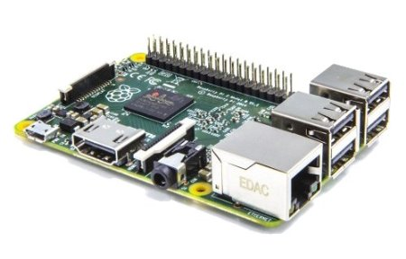
Companion Computer
WINNER:
Accompanying the flight controller will be the Raspberry Pi 2 B
Used to execute flight mission scripts, fire detection, and servo control scripts

Slide 34
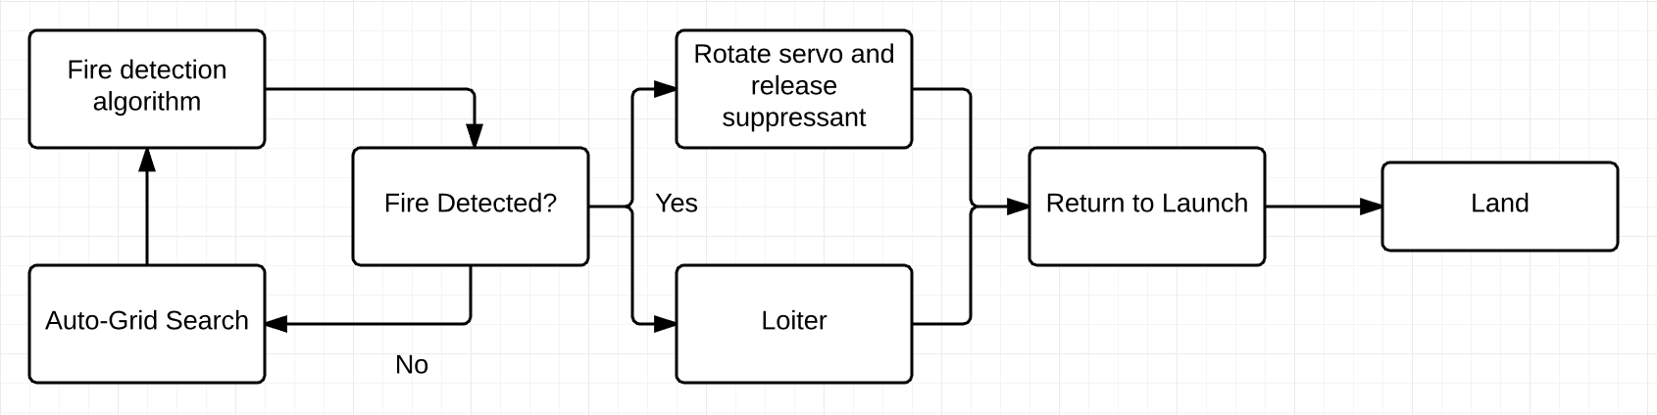
Software Activity Diagram

Slide 35
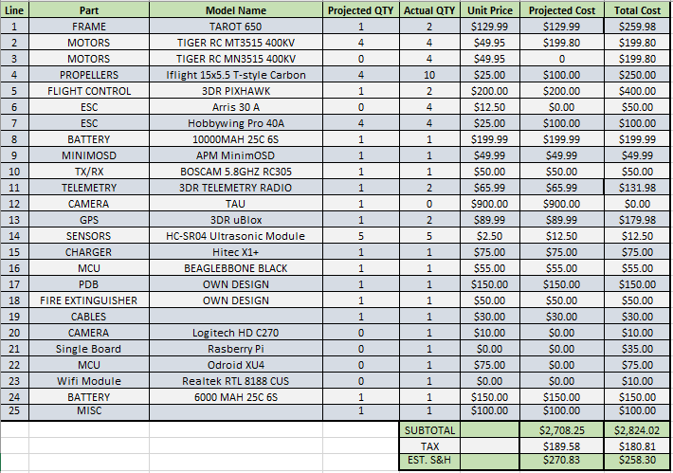
BOM

Slide 36
Work Distribution
 | Adam | Luis | Jamie | Greg
Mission Software
Power Distribution Board
Image Processing
Quadcopter hardware
Primary
Secondary

Slide 37
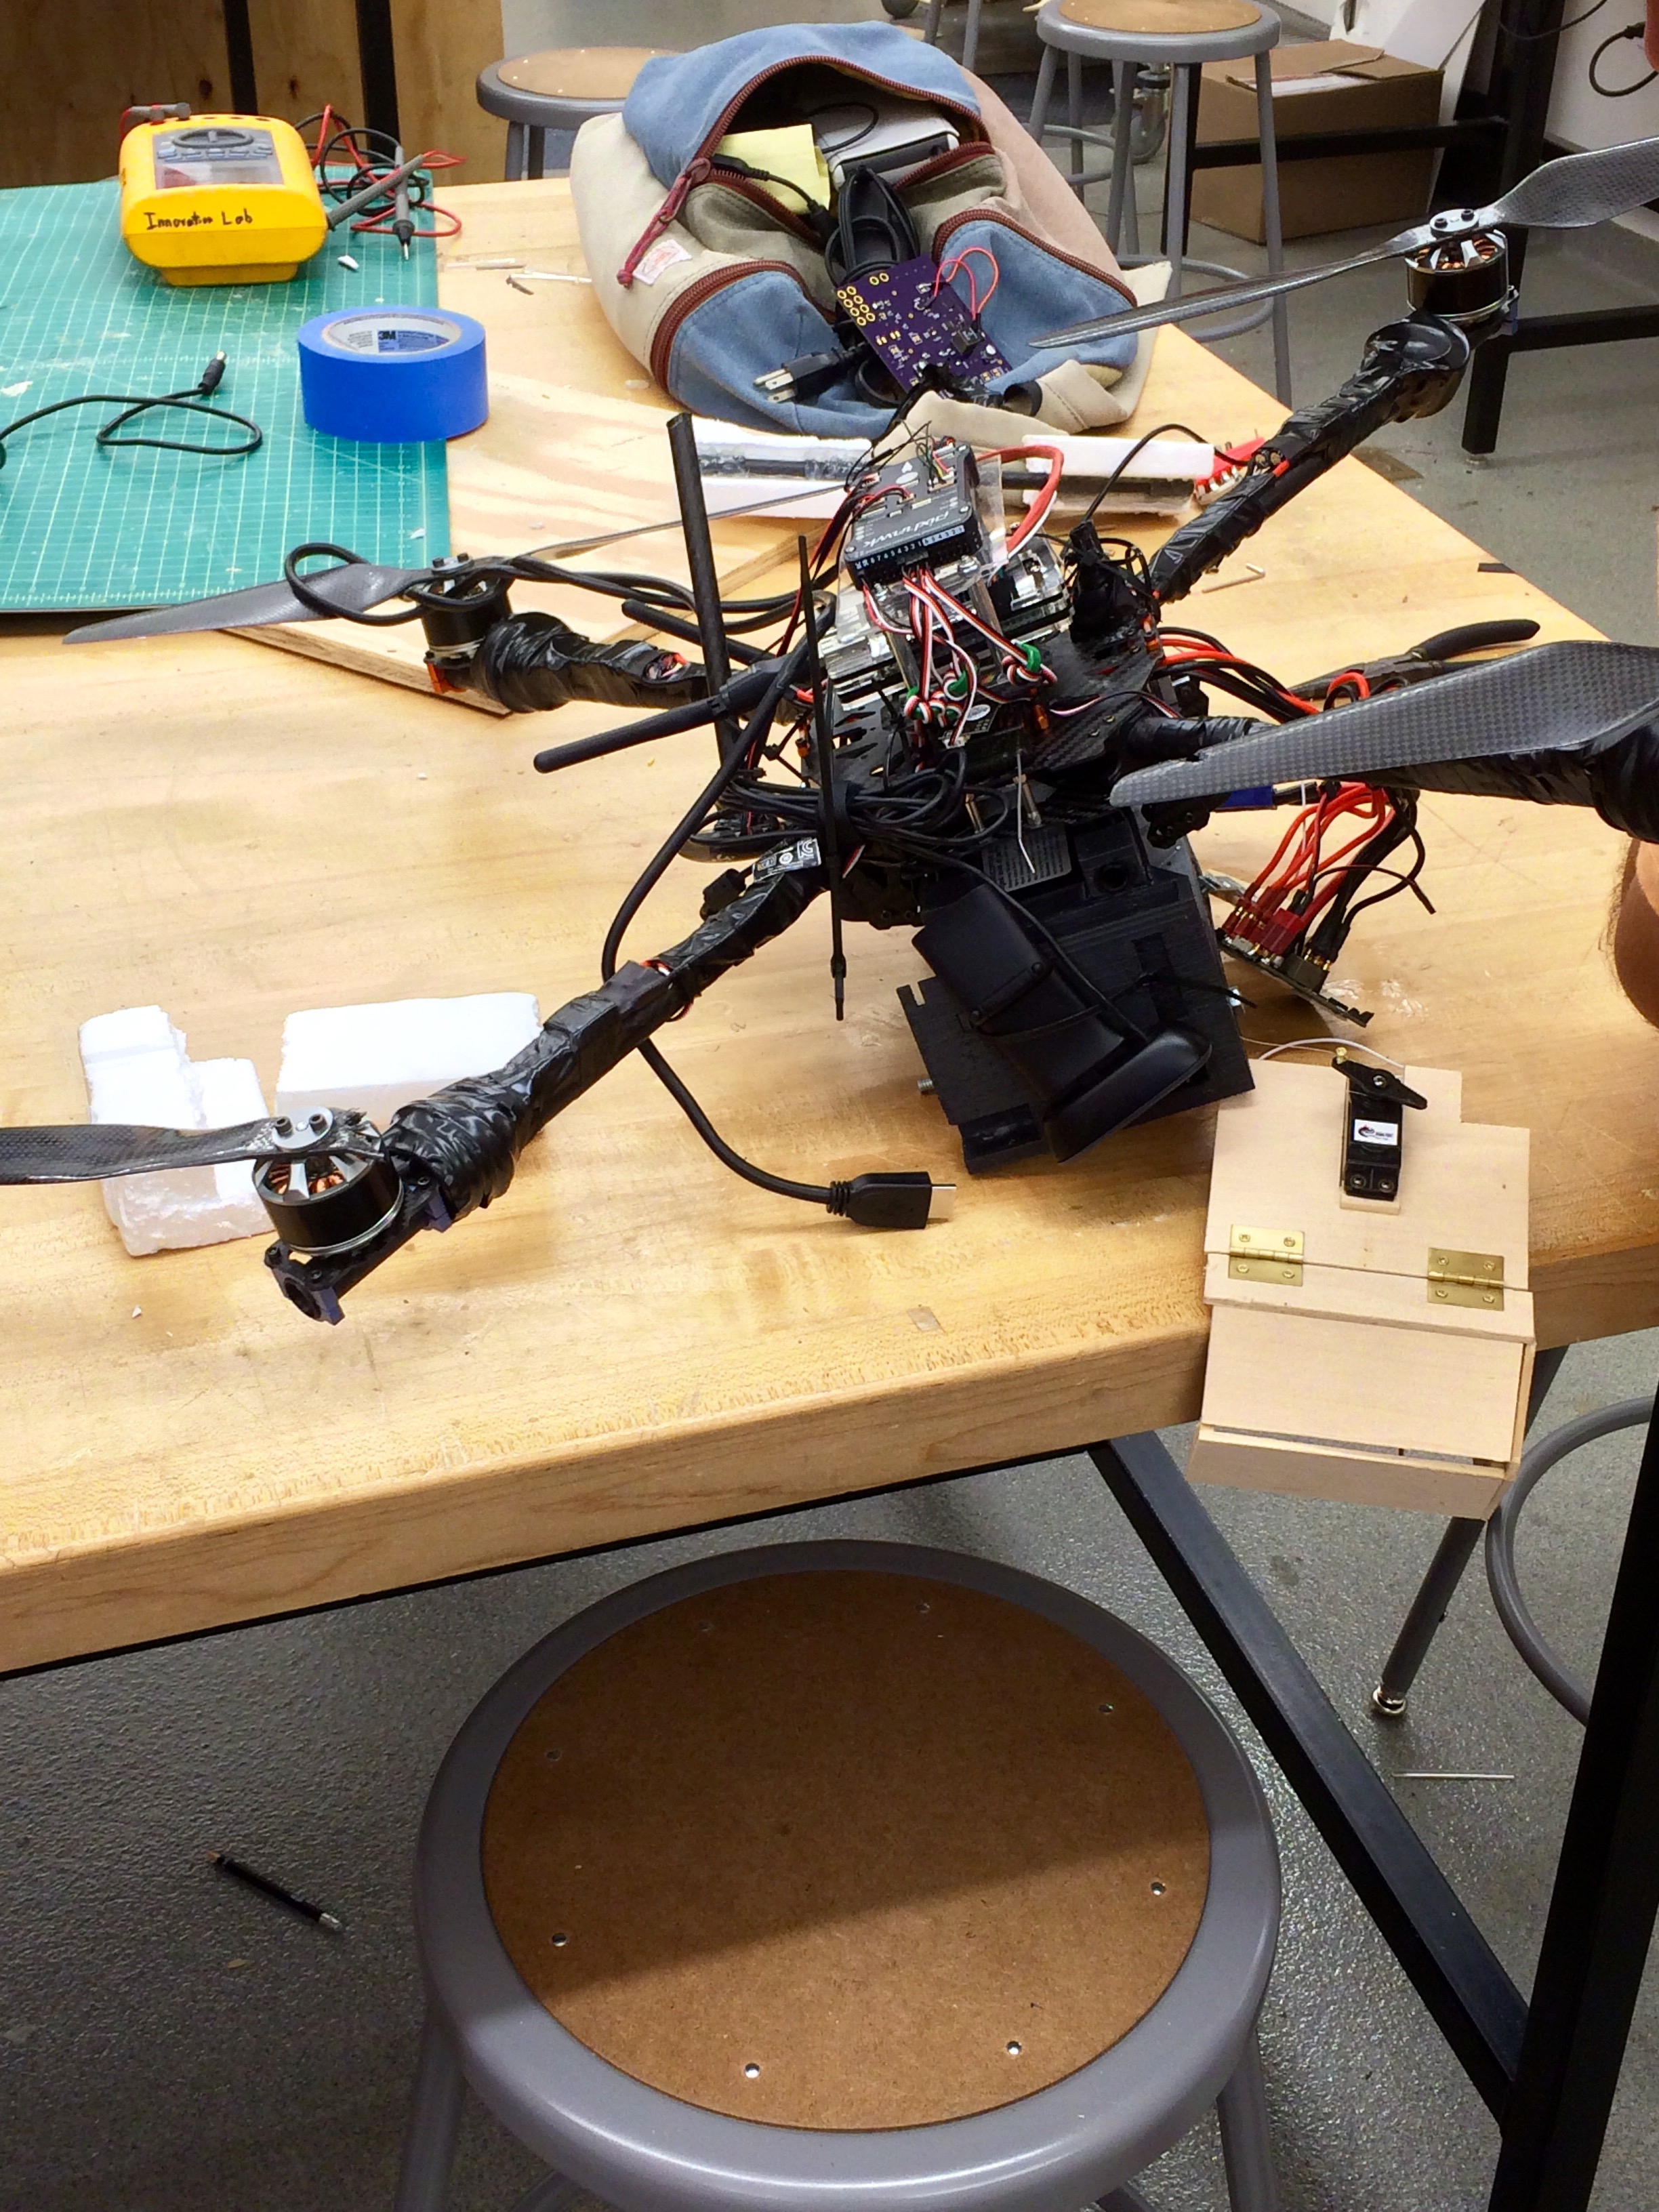
Issues, Failures and Setbacks
PDB blown trace
Odroid doesn't support PWM
Inconsistent serial communication between companion computer and flight controller
3D printer broke
Current spike on PDB
Fix with fly-back diode
FLIR camera was unobtainable due to time and legal constraints (Int'l Traffic in Arms Regulations)
Altitude fluctuation during search mode
Can't test during certain weather conditions

Slide 38
