Slide 1
S LAR POWERED BIKE RACK SYSTEM
Daniel Adarme (E.E)
The Pham (E.E)
Christine Erwin (E.E)
Nha Nguyen (E.E)

Slide 2
Table of Content
Motivation
Goal and objective
Specification
Structural Design
Hardware Design : Power System, DC-AC, locking system, applications
Software Design: Embedded System
Project Budget and Finance
Question

Slide 3
MOTIVATION
Typical bike rack does not fully protect the bike from bad weather
Not safe to walk to the bike rack at NIGHT TIME on campus
BIKE LOCK KEY can be STOLEN or LOST
BIKE can still be STOLEN even if it is locked to the rack
Campus is large and time gap between classes is short
There is a huge demand for charging station for Electric Bikes

Slide 4
Goals and Objectives
Bikes can be fully protected from bad weather by built-in roof
Embedded locking system is added to the rack for easy access
Magnetic Card Reader device is added to locking system to improve security/Identification purpose
Only student with valid ID has the access to the bike station (preventing outside thefts)
LED lights and Security camera being added the system provide more safety at night time
Motion Detection Sensor is added to the system for energy efficient purpose
Bike Sharing System is designed to help students with easy commuting between place to place
The 110V AC outlet is provided to charge electric bikes
Power will be provided 100% by the OFF-GRID Solar Power System

Slide 5
Specifications
Component | Parameter | Design Specification
Power Storage System (Deep Cycle Battery) | Discharging Duration without power provided by solar panel STILL MAINTAIN ABOVE 50% CAPACITY | 12 HOURS
Solar Charge Controller | VOLTAGE RATING and CURRENT RATING | ~12V DC and 5A DC
Solar Charge Controller | Power Efficiency | greater than 75%
Power Distribution System (DC-DC converter) | Power Consumption | Less than 5W
Power Distribution System (DC-DC converter) | Total System Efficiency | Above 95%
DC-AC inverter | Stable AC Power Supply | 110V 60Hz
Microcontroller | Low power, wireless comm. capable | 3.3V max, WiFi
Motion Detection Sensor | Viewing distance/range | 270 degree, 2 meters

Slide 6
Over All Structural Design
Component | Parameter | Desired Value
Over All Structural | Height | 6.0 Feet ~ 7.0 Feet
Structure | Support Force Capability | 60 lbs
Structure | Estimated Cost | $50~$100

Slide 7
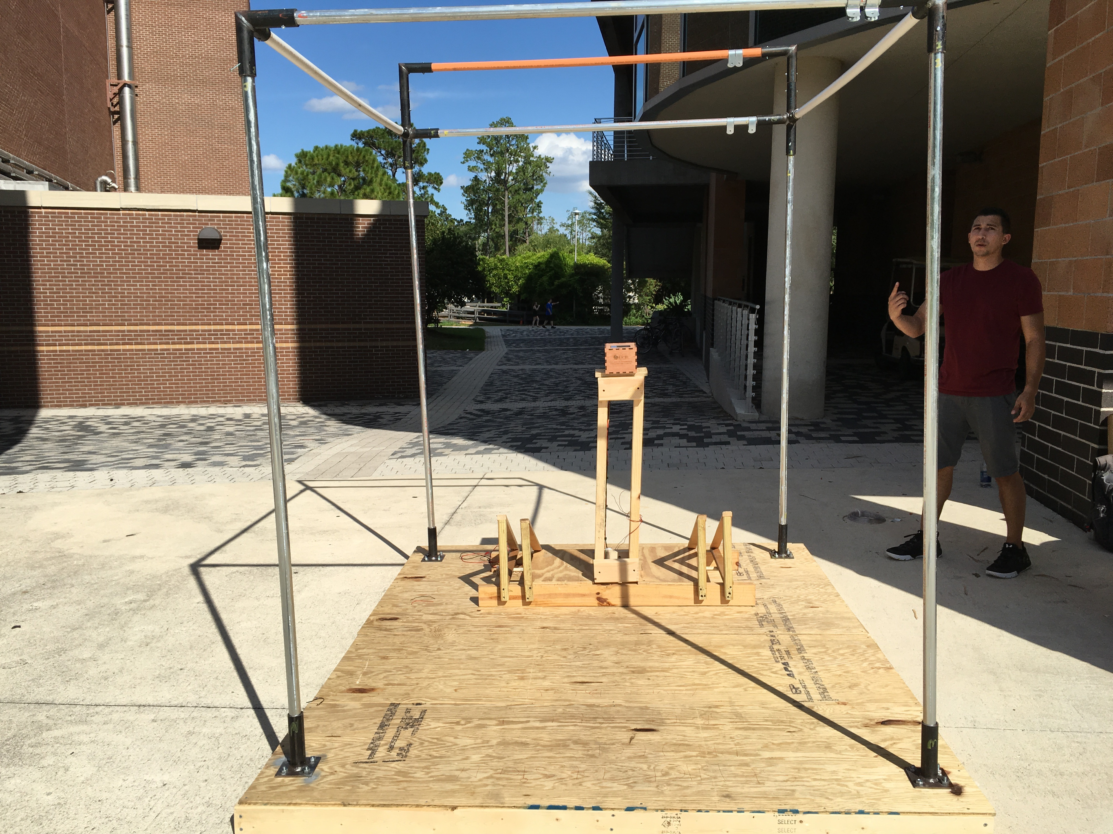
ACTUAL BIKE RACK STRUCTURE SYSTEM

Slide 8
BIKE RACK SYSTEM OVERALL BLOCK DIAGRAM
POWER SYSTEM
EMBEDDED SYSTEM (MCU CONTROL SYSTEM)
APPLICATION SYSTEM (LIGHT, SENSOR, CAMERA)
ELECTRICAL APPLICATION SYSTEM (DC-AC INVERTER, LOCKING SYSTEM)

Slide 9
Changing Decision on POWER SYSTEM
Time and financial constraints affected on initial system design decision
NAME | INITIAL DESIGN | NEW DESIGN | Reason to Change | ADVANTAGE/ DISADVANTAGE
SOLAR PANELS | 200W Polycrystalline 18V rating voltage 10A rating current | 100W Monocrystalline 18V rating voltage 6A rating current | Financial Constraint | Less weight Smaller Dimension Cost Reduced by $80 Taking longer to charge
BATTERIES | Golf Cart Batteries Deep Cycle 430 Ah 12V 5.16 kWh | AGM Deep Cycle 105 Ah 12V 1.26 kW | Financial Constraint Lack of information | Cost reduced by $200 Smaller Size Less power capability
SOLAR CHARGE CONTROLLER | MPPT PMP765 TI CHARGE CONTROLLER REFERENCE DESIGN | SOLID STATE SWITCH CHARGE CONTROLLER | Time Constraint Budget Constraint Required knowledge in coding | No Codes Required Cost reduced by $50 Less Efficiency

Slide 10
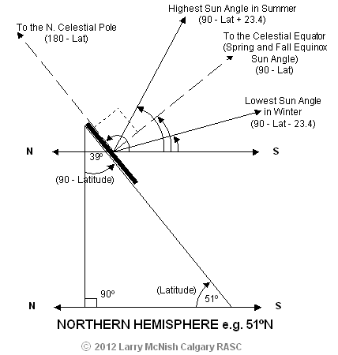
Solar Photovoltaic Devices for the System
Photovoltaic Device Materials Choice: Monocrystalline Technologies
HIGHER POWER EFFICIENCY and SMALLER IN SIZE
Specifications
Quantity | 2 Panels
Optimum Operating Voltage (V_{mp}) | 18.5V
Optimum Operating Current (I_{mp}) | 2.50 A
Total Cost | $180

Slide 11
Power Storage System
AGM (Absorbent Glass Mat) Deep Cycle Battery
Most Safety and Least Maintenance required compared to other types
Specifications
QUANTITY | 3X Battery
CYCLE USE VOLTAGE | 13V~13.5V
TOTAL CAPACITY | 35Ah
TOTAL COST | $68 FOR EACH

Slide 12
POWER SYSTEM BLOCK DIAGRAM
12V 35A Deep Cycle AGM Battery CONNECT IN SERIES
SOLAR PANELS
12V
6A
SOLAR
SSS
CHARGE CONTROLLER
POWER STORAGE SYSTEM
(DEEP CYCLE BATTERY)
POWER DISTRIBUTION SYSTEM
Protection Fuse
SYSTEM LOADS

Slide 13
SOLID STATE SWITCH SOLAR CHARGE CONTROLLER
Low cost construction
Easy to troubleshoot
Requires less power consumption
Requires less maintenance
Light weight and small dimension
No programming code required
Rating Scale
5: Desirable
2-4: Average
1: Not Desirable

Slide 14
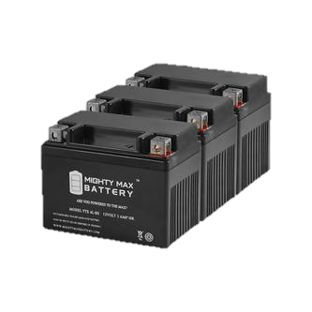
Solid State Switch Charge Controller Block Diagram
Solar Panel Terminal
P Channel MOSFET
18V ~ 20V
Battery Full Charge Voltage is at 14.5V
TI-LM339N
TI-LM317LZ
Voltage Buck Regulator to provide QUAD-Comparator reference voltage value and power clock generator
Four comparator circuits connected as S-R FLIP-FLOP with wire OR output to taking in inputs and driving the MOSFET
50K TrimPot
Lock Oscillator period generate 30mS Pulse every 15s. Its function to set the flip flop so that charging may commence
Adjustable pot feeding desired cut-off voltage to comparator circuit to drive the MOSFET Switch

Slide 15
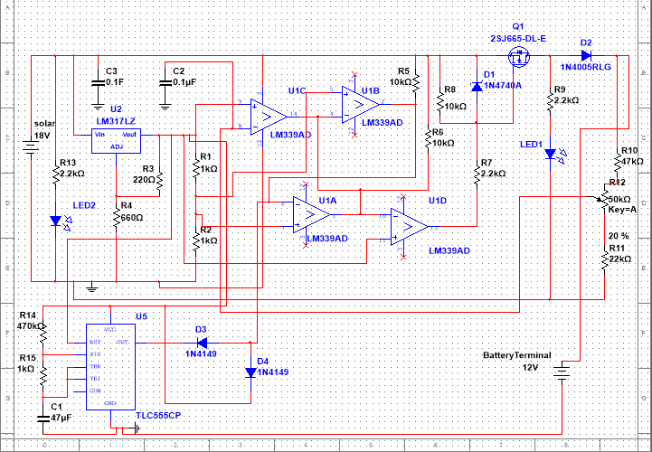
Solar Charge Controller Schematic Design

Slide 16
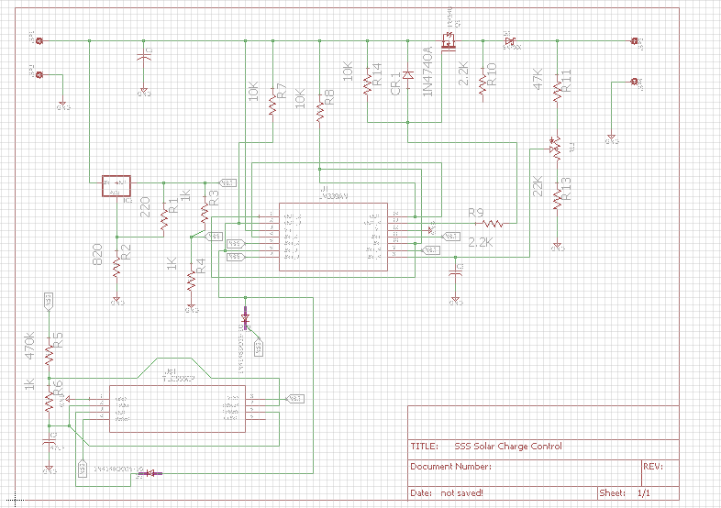
EagleCAD Solar Charge Controller Schematic Design

Slide 17
PCB Board Design and Final Result

Slide 18
Power Distribution System

Slide 19
DC-DC Converter Circuit
12V OUTPUT CIRCUIT
5V OUTPUT CIRCUIT
3.3V OUTPUT CIRCUIT

Slide 20
DC-to-AC Power Converter
Input 12VDC / Output 120VAC 60Hz
Maximum Power 100W
N-channel MOSFET Half-bridge Configuration
Pulse Width Modulator SG3525A
Surge Protection

Slide 21
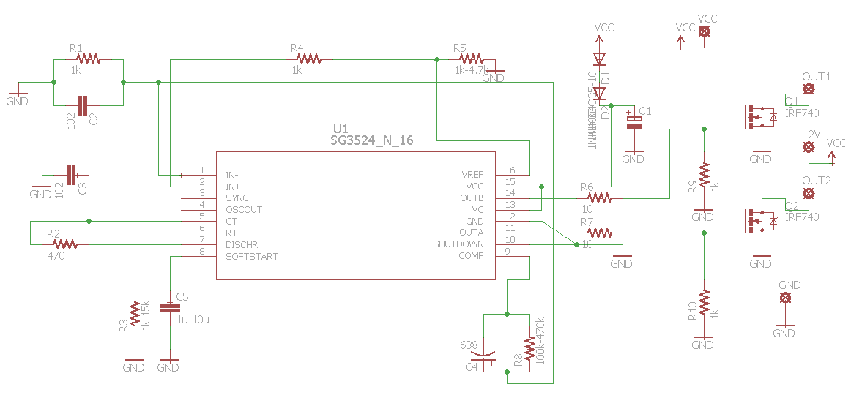
DC-to-AC Power Converter PCB Schematic Design

Slide 22
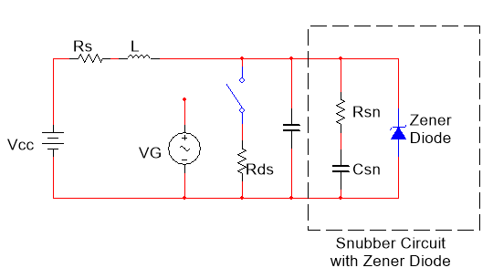
DC-to-AC Power Converter Surge Protection
Current from Inductors flow back to off MOSFETs
Snubber Circuit with Zener Diode is used to damped the surge current
R_{sn}, C_{sn}, and Zener Diode are connected parallel to MOSFETs

Slide 23
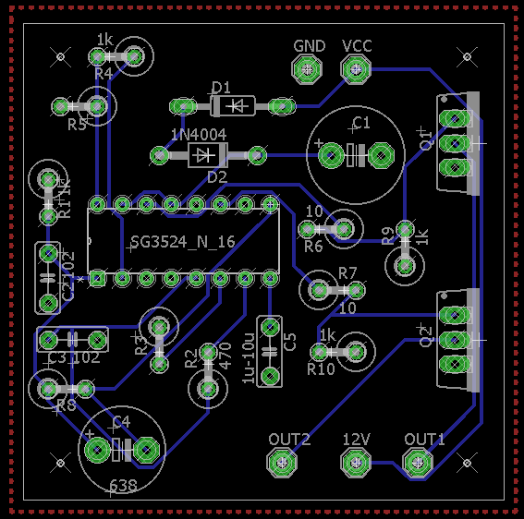
DC-to-AC Power Converter PCB Design
Dimension : 2inch x 2inch
Designed by Software CS EAGLE ver 7.5.0

Slide 24
DC-to-AC Power Converter PCB Implementation
12 VAC fed to
Transformer
12 VDC

Slide 25
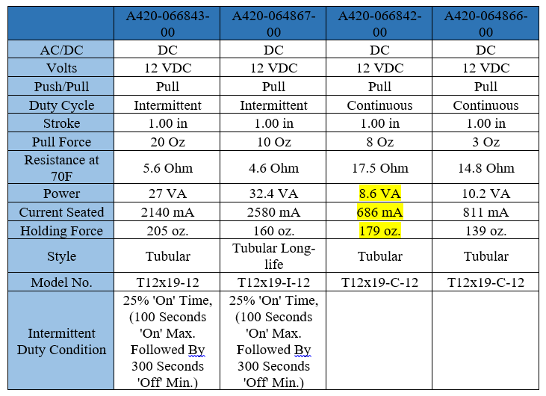
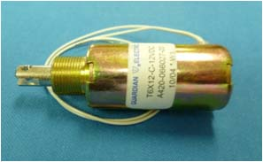
Locking Mechanism – Solenoid Locks
Pull-type Solenoid
Part A#420-066842-00 manufactured by Guardian Electric is used for low power consumption and high achievable pull force

Slide 26
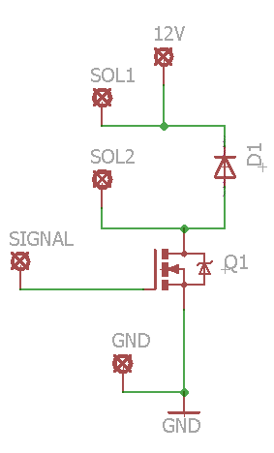
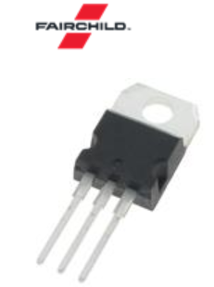
Lock Controller PCB Schematic Design
N-channel MOSFET BUZ11_NR4941 (Fairchild Semiconductor)

Slide 27
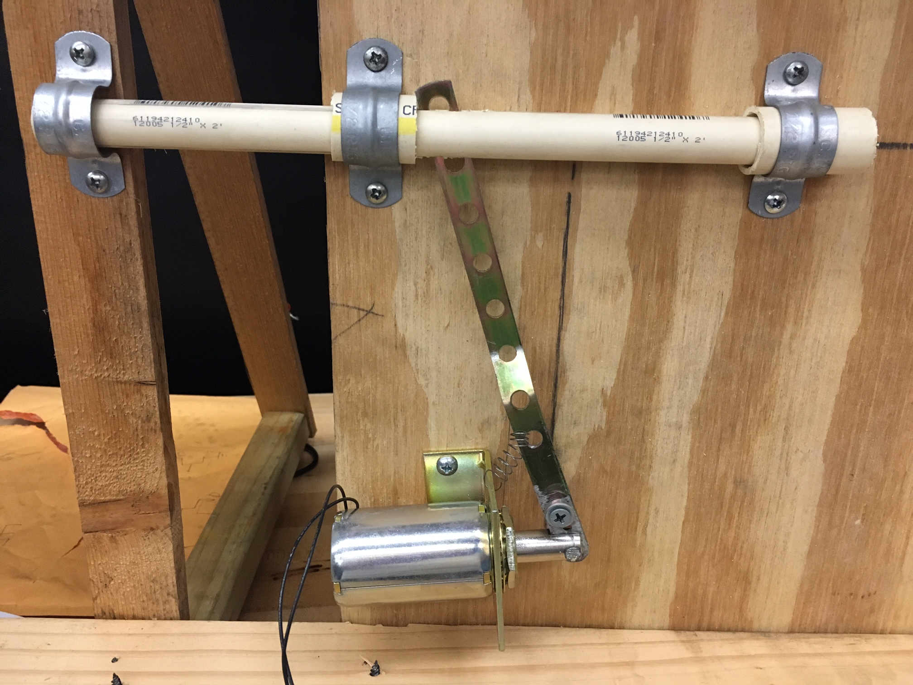
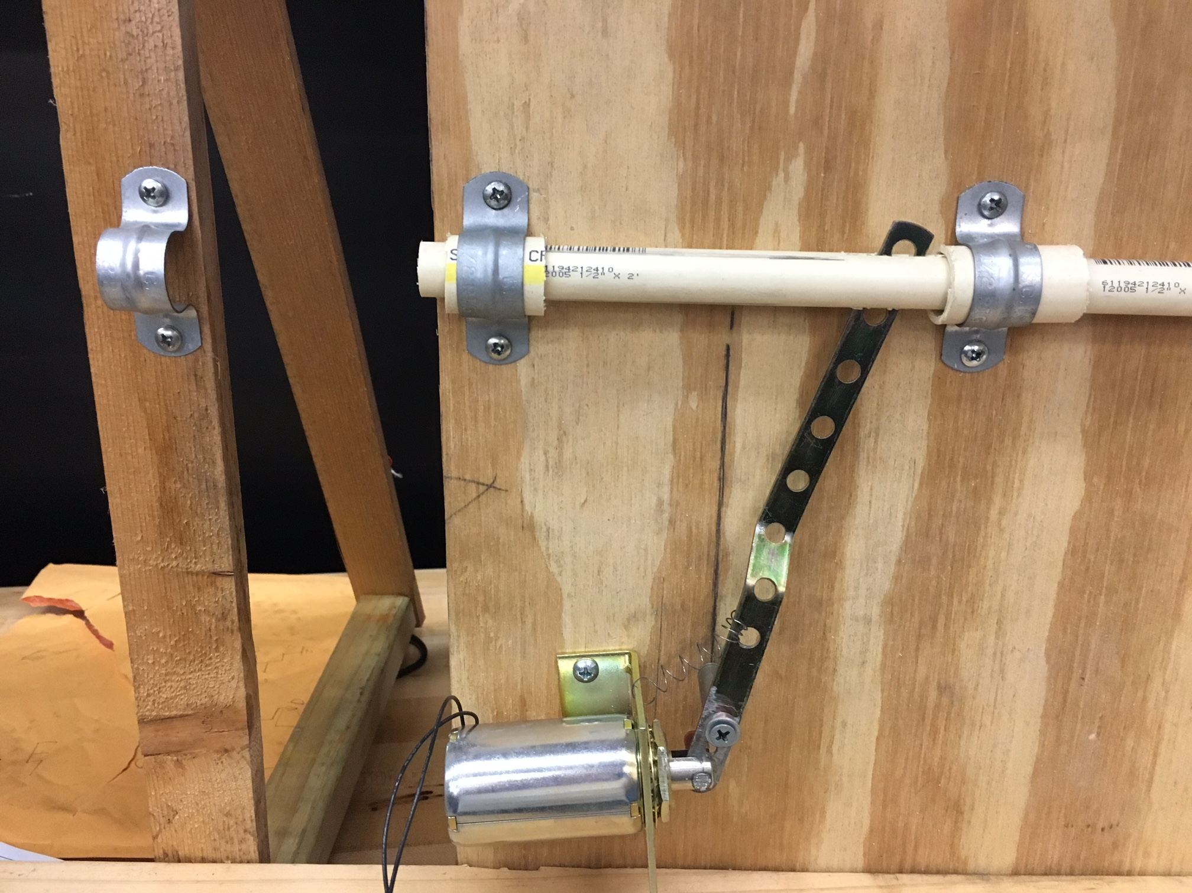
Lock Structure Implementation
Lock Closed
Lock Open
Solenoid Off
Solenoid On (Pull)

Slide 28
3D MODELING DESIGN FOR THE BIKE RACK SYSTEM

Slide 29
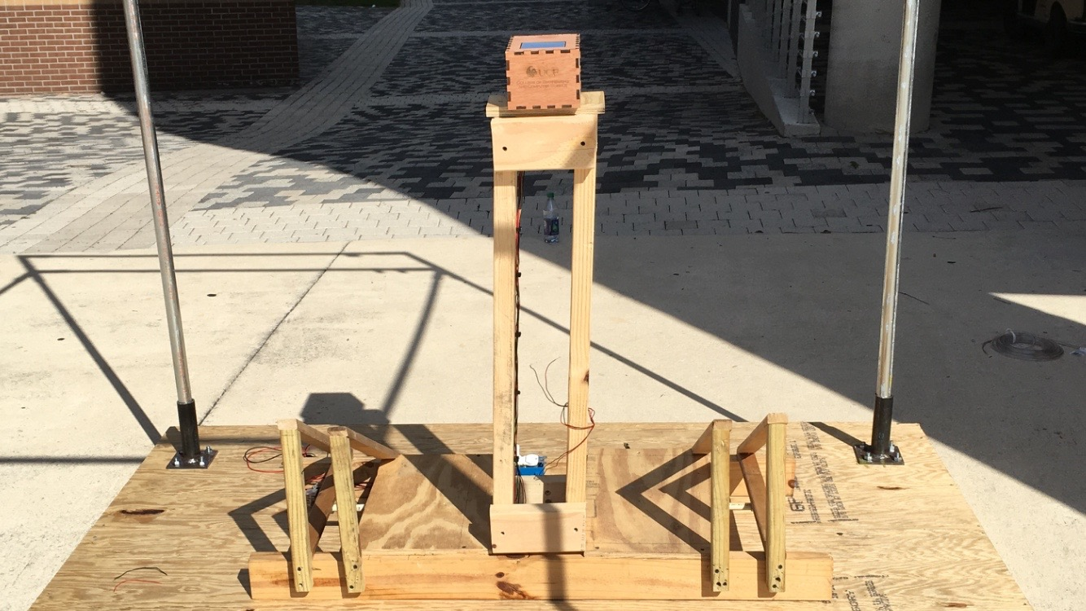
FINAL BIKE RACK DESIGN

Slide 30
Lighting System Features
Activated via PIR motion sensor
Controlled using TI CC3200
Designed for the safety of the user
Circuit switched using 12V coil relay
Flyback diode used to protect against relay spikes

Slide 31
Camera System Features
Saves pictures to SD card
Pictures are intended to be used to retrieve information on stolen bicycles
Surveillance deters theft
Cameras starts taking pictures when internal motion sensor sees movement
Controlled using Arduino Uno

Slide 32
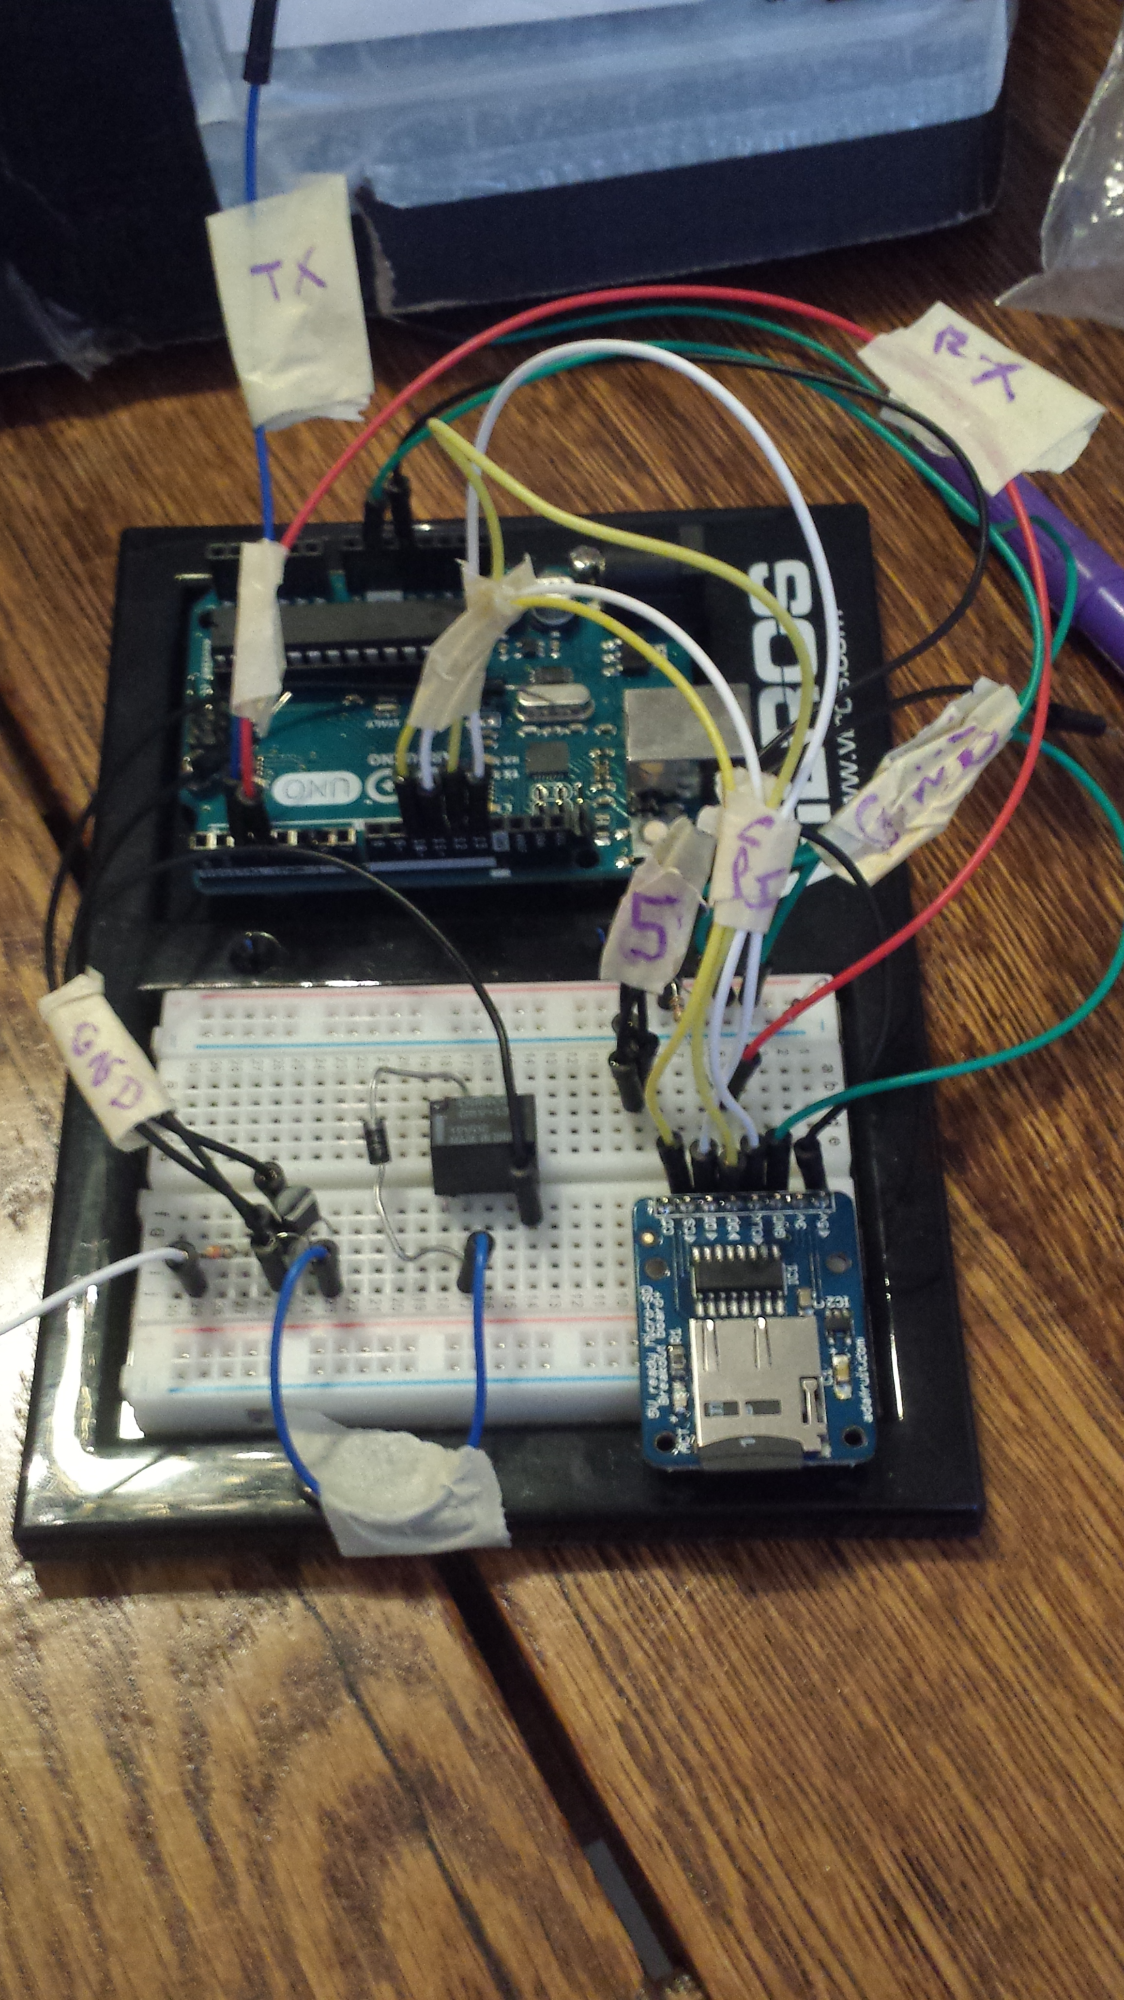
Lighting/Camera Hardware

Slide 33
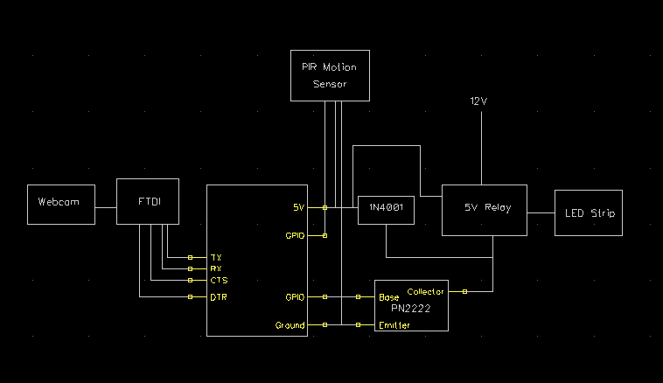
Lighting/Camera System Hardware General Diagram

Slide 34
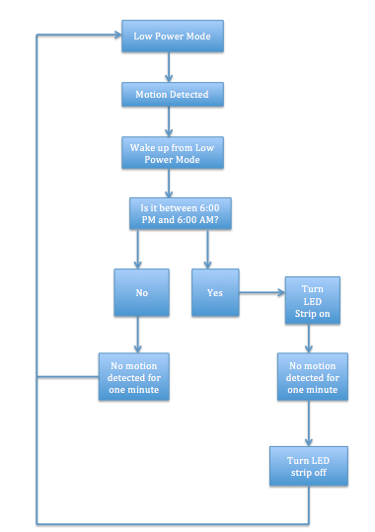
Lighting System Code Block Diagram

Slide 35
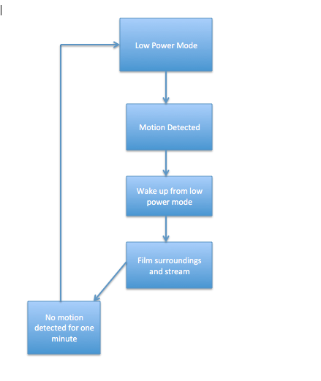
Camera System Code Block Diagram

Slide 36
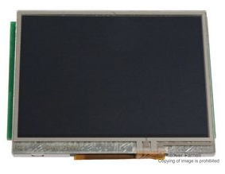
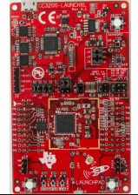
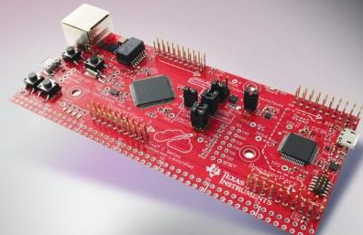
Embedded System
Tiva C Series
SimpleLink CC3200
Kentec LCD Display
Code Composer Studio

Slide 37
GUI

Slide 38
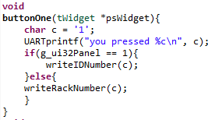
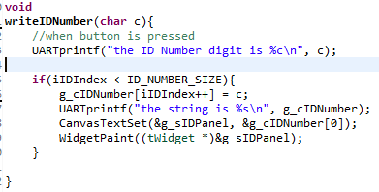
GUI

Slide 39
GUI

Slide 41
Parse

Slide 42
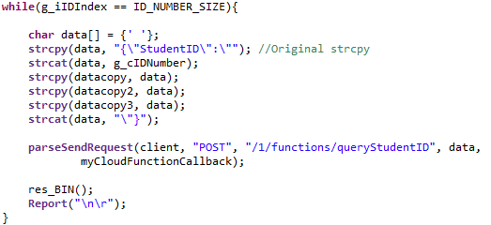
Parse

Slide 43
WORK DISTRIBUTION
Name | Major | Area of interest | Project design
The Pham | Electrical Engineering | Electric Power System and Electronic Device | Solar Power System Structural Design DC-DC Converter
Nha Nguyen | Electrical Engineering | Electronic Device and Integrated Circuit Design | DC-AC Inverter Locking Mechanism Embedded System
Christine Erwin | Electrical Engineering | Electric Power System and Application | SecurityCamera Motion Detection Light Sensor
Daniel Adarme | Electrical Engineering | Embedded system and communication system | Main Embedded system Electric Lock system Structural Design

Slide 44
Financing and Fundraising
The project was not funded by any company
Late in March, fundraising for the project was created on “gofundme.com” site
Goal for Fundraising was set at $1000 and duration of 2 WEEKS
Result: LESS THAN 2 WEEKS, the goal $1000 was reached by the helps from family and friends

Slide 45
Proposed Budget Table
Name | Quantity/Types | Price/unit | Status
Solar Panel | 2x(50 watts offgrid solar panel) | $200 | confirmed
Charge Controller | Charge Controller (Included PCB) | $35 | research
Battery | 2x(215 Ah 6V Golf Cart Battery) | $200 | research
DC-DC inverters | 5 Circuits | $70 | research
DC-AC inverters | 1 | $30 | research
TI CC3200 SimpleLink | 1; sample from TI | $0 | donated
TI CC3200 Launchpad | 1 | $0 | donated
Magnetic card reader | 1/prime eligible | $17.78 | purchased
RFID reader | 1/prime eligible | $12.80 | purchased
TI Stellaris Launchpad | 1 | $13.38 | In Transit
TI Stellaris LCD Module | 1 | $35 | In Transit
FTDI Board | (2) USB 2 I2C | $9.95 | In Transit
Phototransistor | 1 | $5 | research
camera | 1 | $25 | research
Microcontroller for the camera | 1 | $40 | research
LED strip | 1 | $15 | research
External hard drive | 1 | $65 | research
Motion Sensor | 1 | $12 | research
Bike Rack Structure
Others | shipping cost, material cost | $200 | research
 | Total | $985~$1000

Slide 46
PROJECT DEMONSTRATION

Slide 47
THANK YOU FOR YOUR SUPPORTS WE CANNOT MAKE IT HERE WITHOUT YOU

Slide 48
Question

