Slide 1
SEMS (Smart EV Monitoring System)
By: Nathan Rodriguez
Edwin Lomans
Symone Adams

Slide 2
Motivation and Purpose
Low cost smart electric vehicle charger
Secure access for UCF students/faculty only
Power monitoring capabilities
Flexibility for Level 1 and Level 2 Charging

Slide 3
Solution
Low cost smart electric vehicle charger
Multi-annual updates can cost companies up to $600 per charging station software update, anything to lower installation and software cost is a bonus.
Secure access for UCF students/faculty only
Currently anyone from the public can use charging stations in Garage A as well as other locations.
Power monitoring capabilities
Energy can be monitored and broadcasted to parking services where university monitors the use of the EV stations.

Slide 4
Solution
Flexibility for Level 1 and Level 2 Charging
Typical Work day 9-5.
UCF Research work day 8 A.M – who knows….
Case Example:
Volkswagan eGolf (24 kW battery)
Charging (from garage)
Level 1: 120V x 10A = 1.2 kWh
Level 2: 240V x 16A (limitation) = 3.8 kWh
Battery Completely Discharged
Level 1 = 20 Hours
Level 2 = 6.32 Hours
Charging 12 kW only
Level 1 = 10 Hours
Level 2 = 3.16 Hours
Cost Savings
Michigan Public Service Commission
11 A.M – 7 P.M: 13.39 cents per kWh
Otherwise: 4.283 cents per kWh
Notes:
But this allows for one to charge during a long if you arrive late at home, gives you schedule flexibility and less depleting over time

Slide 5
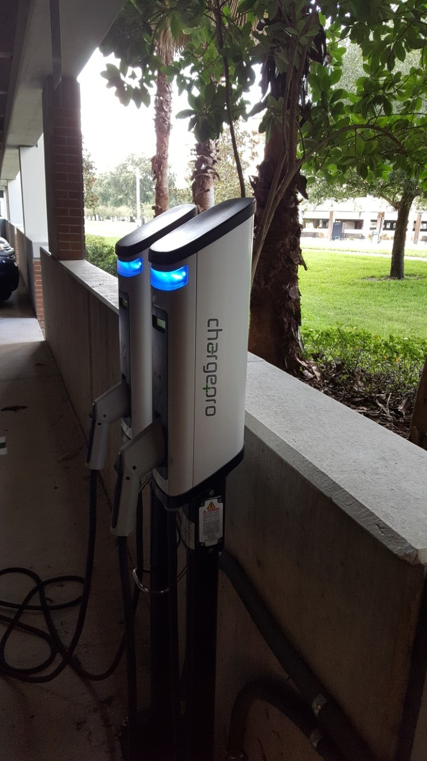
System Requirements
Operating Voltage: 120-240V
Center Frequency: 50-60 Hz
Output Current: 6-32A
Output Power:
Level 1: <2.4 kW
Level 2: <9.6 kW
Weight: 1.5kg/3.3lbs
System Temperature <155°C
Garage A Charging Stations

Slide 6
J-1772

Slide 7
Hardware Design
PCB/Prototype functionalities
Input Power
System Power Distribution
Pilot Signal Generation
Ground Fault Protection
Current Sensing
Relay Check
LED status
Arduino Programming
Design Methodology
Schematic Design
Simulation
Power Dissipation
Part Selection
PCB Routing Techniques
Gerber File Generation

Slide 8
Full PCB System level
Grid
5V
Ground Fault Protection Circuit
12V
Pilot Generation Circuit
5V
Arduino
-12V
Level 2
16MHz Oscillator
LT3502A
LT3502A
LT3502A
Transformer
220V to 30V AC
Full wave bridge rectifier
15.5V min
20-30V to 12V
12V to 5V
5V to 3V
Or Level 1
LT3580
Transformer
120V to 20V AC
12V to -12V
-12V

Slide 9
Power Distribution
12V to -12V
-12V
LT3580
15.5-35V
Input to 12V
12V to 5.5V
5V to 3V
3V
LT3502A
LT3502A
LT3502A
12V input option
USB 5V

Slide 10
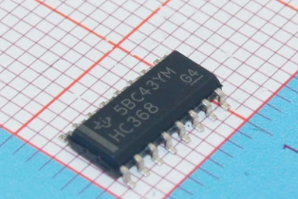
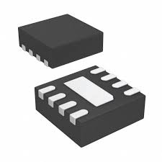
Regulator Information
LT3502A
Short-circuit protection
Integrated Soft-Start function
Internally Compensated
Current Mode control
10-Lead MS10 Package
Linear Technology (now part of Analog Devices)
LT3580
8-Lead MSOP Package
Adjustable switching frequency, Single feedback resistor, inverting converter
Integrated Soft-Start function
Wide-input voltage range (2.5-32)
Linear Technology (now part of Analog Devices)

Slide 11
Regulator part selection
Inductors
Inductance
Higher values for lower frequency, lower values for high frequency
DC current Rating
Main spec related to heating due to resistance in coils
Saturation Current Rating
If this is exceeding the inductance value can drop to 0 and it behaves like a wire
DCR
Indicator of power loss
Core Loss
Loss due to magnetic switching
Saturation Profile
Core dependent
Capacitors
Value
Controls output ripple
Load supporter
DC Voltage Rating
Not choosing aluminum or electrolytic
DC Bias
Consideration in ceramics, determines how much “effective capacitance” will drop.
ESR
Limits voltage in transitions
Limits RMS current
ESL
Limiting factor in transient response
RMS Current Rating
Dielectric Material
Lifetime
Notes:
Switch mode power supplies rely on “Steady-State” Inductor principle. DC current rating is how much current can inductor handle at steady-state? The saturation current is the amount of current when the inductance value drops 30% of its value. Core loss is energy lost due to changing magnetic energy in the core during switching cycle and eddy currents, which are induced in the core material by a time varying flux…During off time the control switch, the capacitor holds up the output voltage as the energy of the inductor decreases, thefore the amount of power supply ripple is directly related to the amount of output capacitace, when the load current or power supply suddenly changes from light load to heavy load, the capacitor must support the extra current while the current ramps up in the inductor. Like when your lights dim briefly when you turn on washer or dryer., ESL tells you how fast current can change in the capacitor, limiting in transient response, ESR determines voltage dip during transition

Slide 12
LT SPICE simulation

Slide 13
LT SPICE simulation Results

Slide 14
Power Distribution Schematic

Slide 15
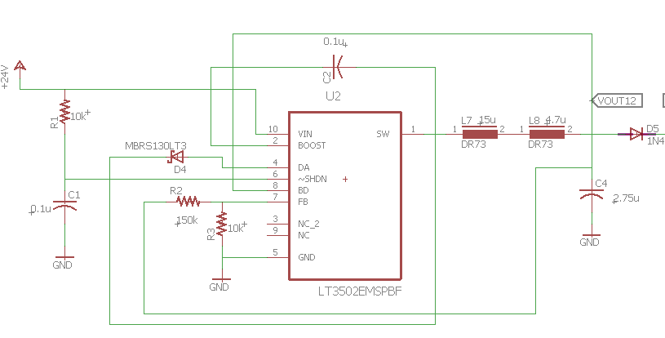
24V to 12V

Slide 16
12V to 5V

Slide 17
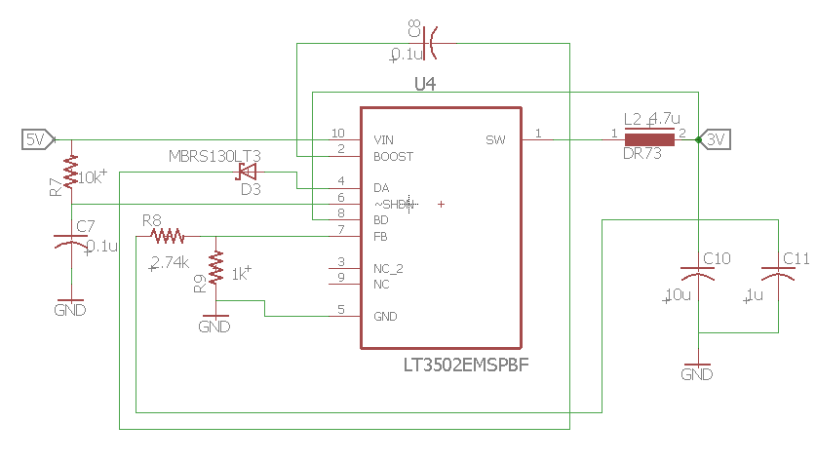
5V to 3V

Slide 18
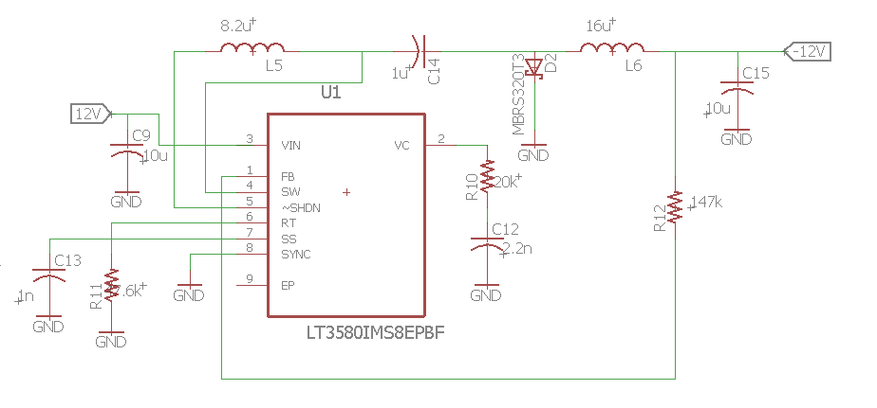
12V to -12V

Slide 19
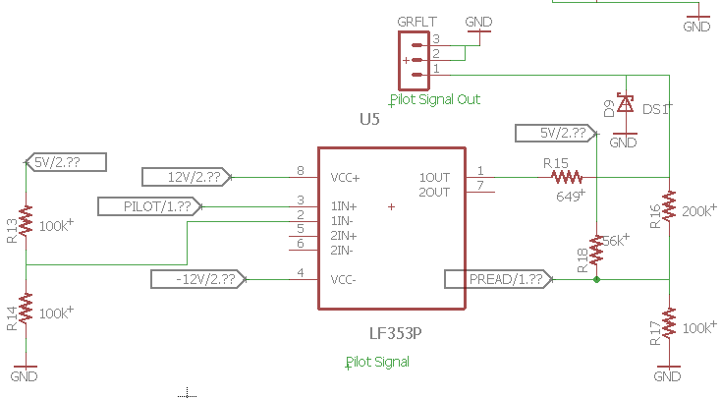
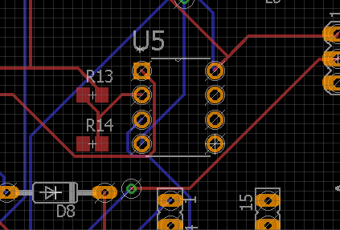
Pilot Signal Generation
Notes:
Make sure to mention that Arduino cannot read negative voltages so that a 5V pull up is necessary so that way at -12V one would read 4.5V

Slide 20
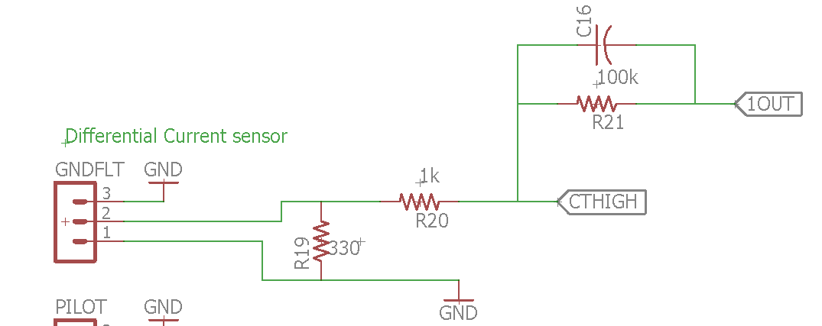
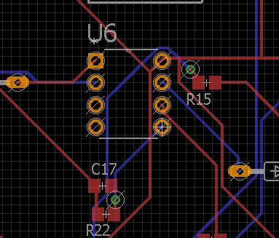
Ground Fault Protection
Notes:
Mention the feedback path

Slide 21
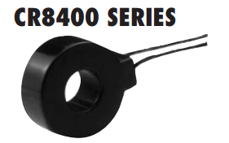
Current Sensing
CR8450-1k-T7QC
From CR Magnetics
Level 1: 10A goes to 312mV
Level 2: 16A goes to 500mV

Slide 22
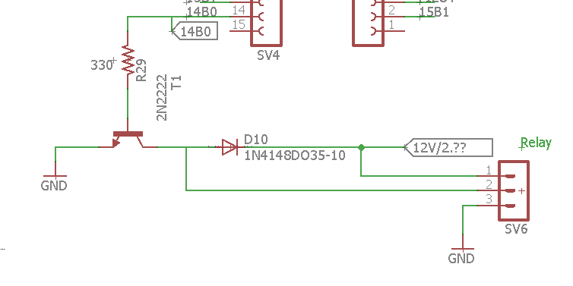
Relay check
Explanation and picture
Explain that one time
Diode shorted out, plans to
Isolated this circuit with
Electrical tape
Other components are
Not drawing current when
Isolated.
This concept is important in system integration
Creating Unstable Ground in prototype when enabled and disabled.
Notes:
Show a picture of it pulling current and mentioned how you eliminated the diode and still a short was detected. ESD sensitive objects

Slide 23
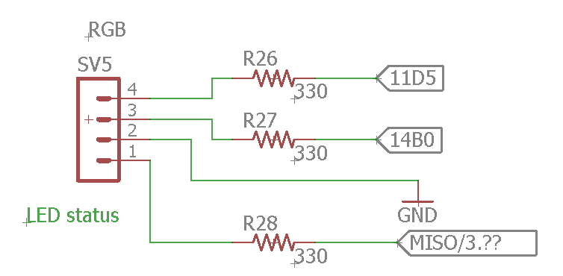
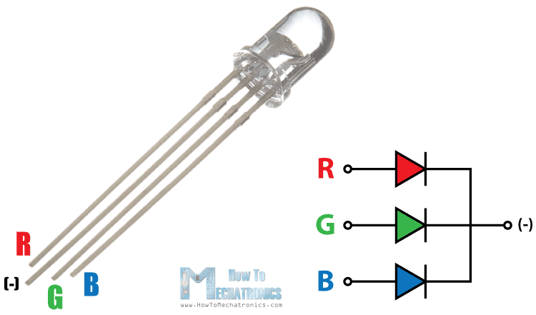
LED Status
Notifies of Arduino is being programmed.
Gives off different colors for different modes of operation
Standard RGB LED from sparkfun

Slide 24
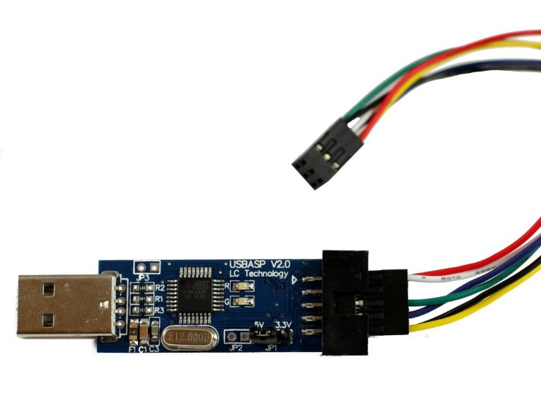
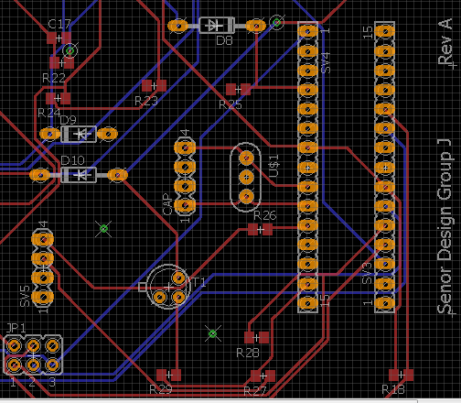
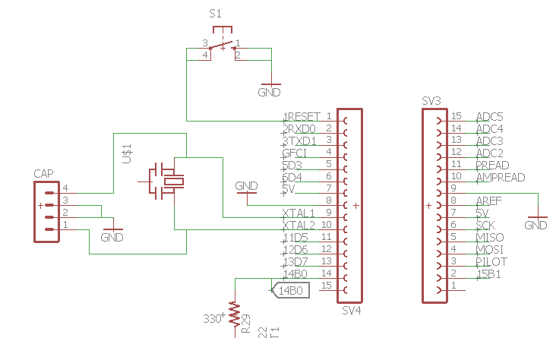
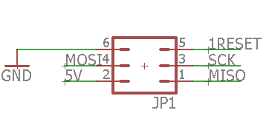
Arduino Programming
Jumpers
Limits to 1 oscillator
Arduino off-programmer jumpers (USB to SPI)
Notes:
Make notes about how Arduino has one oscillator as opposed to two like most normal programming systems such as the CC3100, CC3200 or MSP430

Slide 25
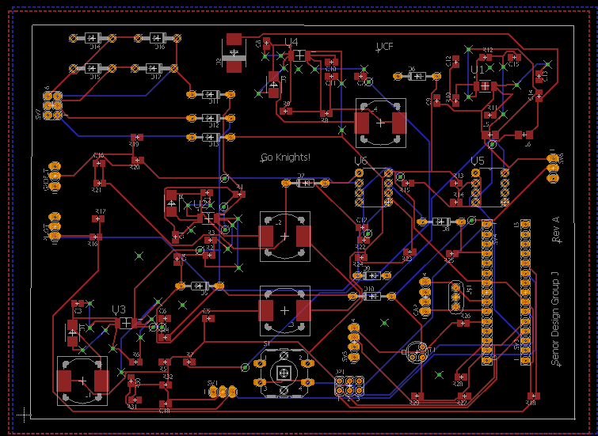
Routing
Separate power and digital areas
For data signals keep traces orthogonal.
Support max current rating to determine trace width
For 1A 10 mils is sufficient

Slide 26
Design Costs
Fast PCB ordering
$729.05
PCB and prototype part acquisition
$250.67
J1772 Cable
$149
Total: $1,128.72

Slide 27
System Diagram
Charging Station
Wi-Fi Board (WFB)
Android Phone Application
Power Processing Board (PPB)
Magnetic Card Reader
Online Database
Keypad
System Power Generation Board (SPGB)
Electric Vehicle
Power Supply
220V AC at 60 Hz
Inlet + Charger + Battery

Slide 28
Previous Design Summary
Excessive Coding requirements
2 MSP430F5529’s
CC3100 Wi-Fi MCU
Application Software
Data base
Hardware requirements
4 PCB Designs layouts
1 RF 4-layer board to support Wi-Fi capabilities

Slide 29
New Design
Configure for single MCU implementation
Eases coding
Saves Space
Hardware reductions
2 prototype boards
1 PCB
Adjusts to late customer change
October 11

Slide 30
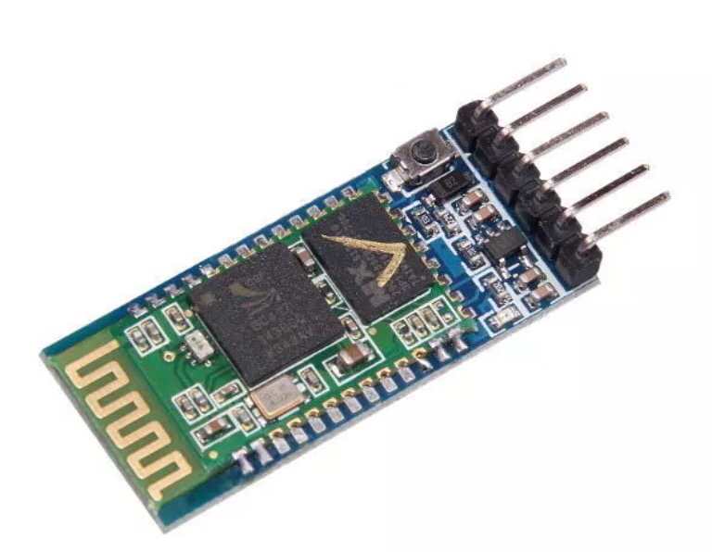
Bluetooth Module

Slide 31
A popular IDE for developing applications on Android devices.
Features include:
Debugging
Android Phone Emulator
Connectivity with real devices through USB
XML files for layout design
Useful APIs (Application Programming Interfaces)
Programming language is Java.
Because of its wide use, there are many resources available.

Slide 32
Main Features of Application
Sign page that is accessible for only UCF students/faculty.
Database to store NID and password information.
Second screen that displays the state of charge.
Connection using Bluetooth to Wireless Module.

Slide 33
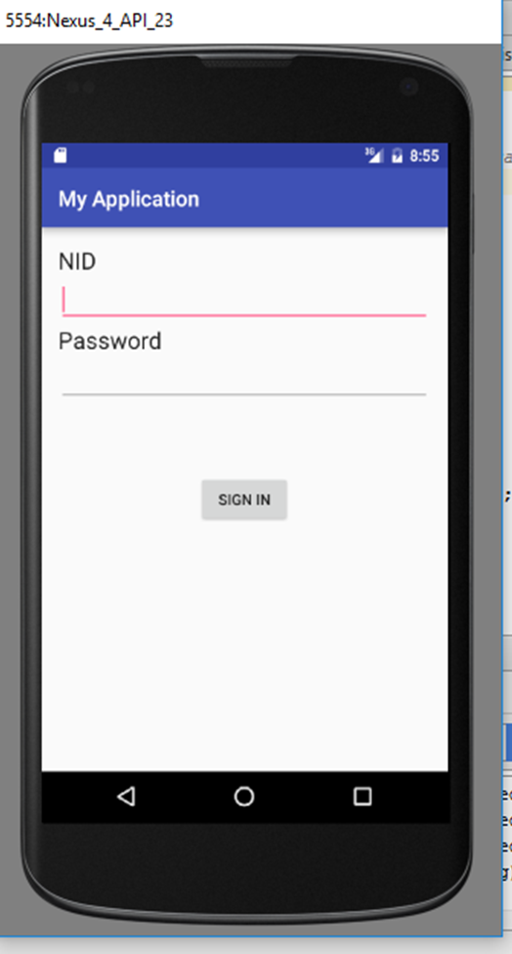
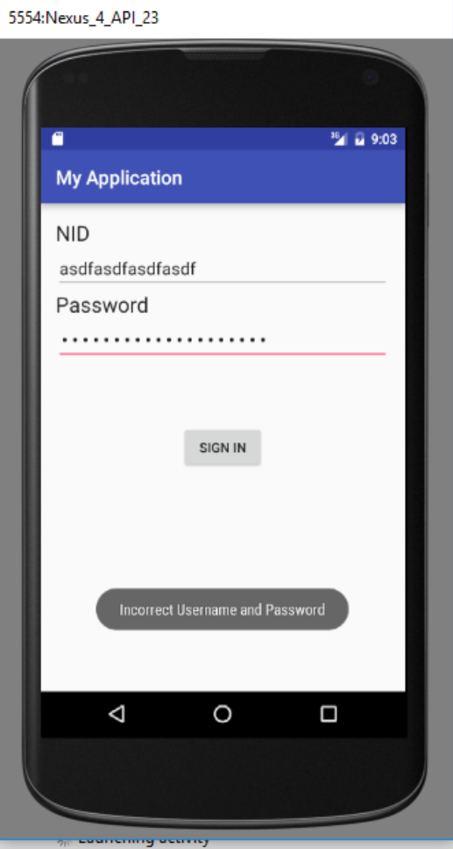
Sign-in Page
Simple NID and password sign in familiar to all UCF students/faculty.
On button click, code will compare input to database and respond according to that input.

Slide 34
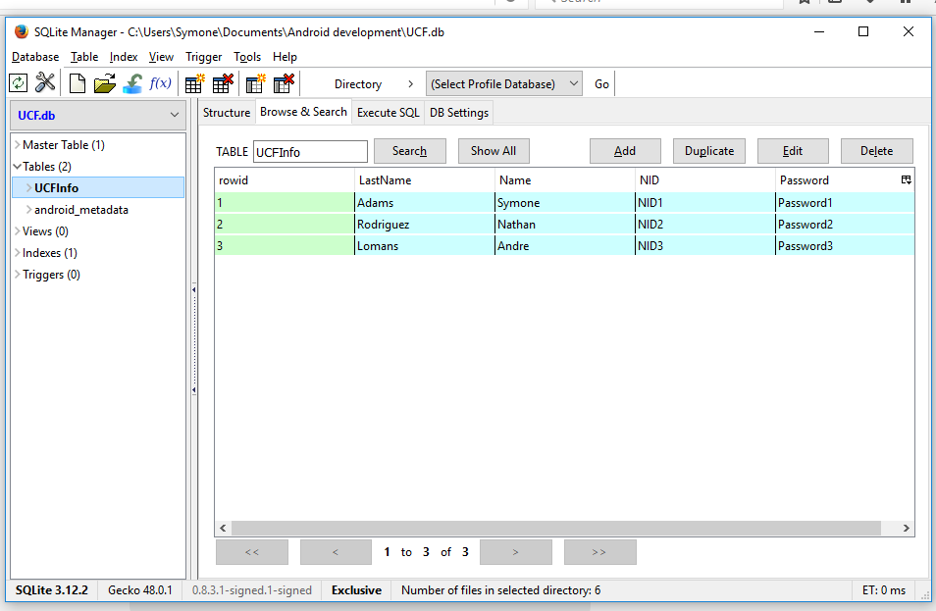
Database
For prototyping purposes, a database was created in Android Studio.
NID is set as a unique constraint; new entries are entered based on this. No one with the same NID can be in place.
SQLite Open Helper: A helper class that connects to the Firefox plugin, SQLite Manager.

Slide 35
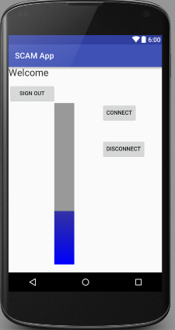
Second Screen
When NID and password are correct
On the connect button click, phone will connect to wireless MCU server to receive information.
Information is displayed as percentage on progress bar.

Slide 36
Bluetooth Set-up
Verification of Bluetooth
Search for Devices
Connection as Client
Broadcast Receiver

Slide 37
Verification Code
The API Bluetooth_Adapter is called to ensure the device can support Bluetooth.
If Bluetooth is supported but not enabled, an intent is called to switch it on.
If already enabled and supported code will continue.

Slide 38
Searching for Devices
Device will connect to Bluetooth module first as a paired device.
The code list the module’s name and address. This verifies that the discovery of new devices is working.

Slide 39
Connections
The APIs BluetoothDevice and BluetoothSocket are used to first make connections with the module. The device creates a socket and connects to the device through the UUID (Universally unique identifier).
The call connect() is called to connect through the socket.
The initial connection happens in a separate thread from the main class.

Slide 40
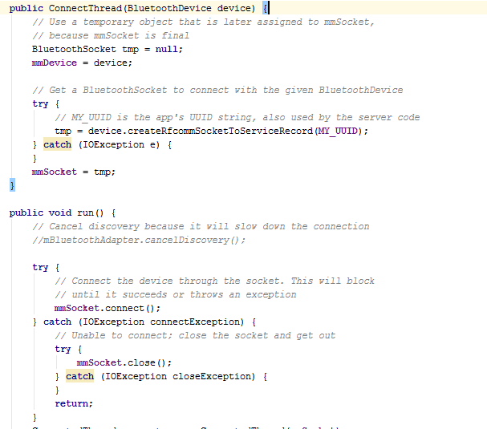
Connections Code

Slide 41
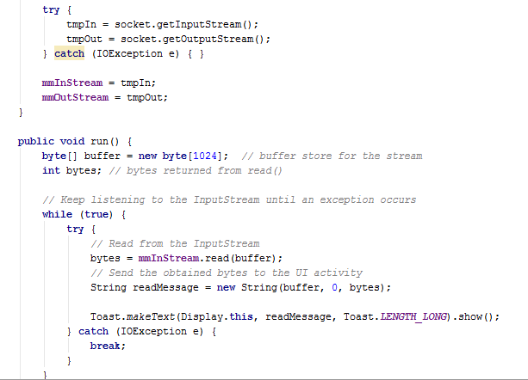
Connections
The next step in connection is receive data from the HC-05 module.
Once a connection is established, the socket passes information to the InputStream where it’s read an transmitted to the User Interface of the application.

Slide 42
Broadcast Receiver
Broadcast Receiver are used for any wireless connectivity.
Intents or operations to be performed are called in the Broadcast Receiver once certain functions in the code are implemented.
For this code, once connection has been established with the device, an intent is called to send a message that Bluetooth is connected.

Slide 43
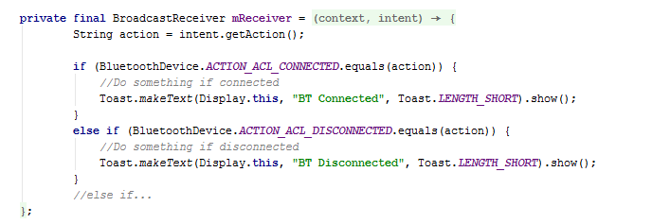
Broadcast Receiver Code

Slide 44
Obstacles
Displaying data
Connection works with Arduino sending serial data.
Code sets up a Handler to deal with user interface activities. Data not displaying.
Narrowed down to: Incorrect Handler code or error in InputStream.

