Slide 1
SCAM:
Smart charging Automobile Monitor
Group J members:
Nathan Rodriguez EE
Andre Lomans EE
Symone Adams EE
Sponsor: Florida Solar Energy Center

Slide 2
Motivation and Purpose
Low cost smart electric vehicle charger
Secure access for UCF students/faculty only
Power monitoring capabilities

Slide 3
Goals and Approach
EV charger will track power
Build a power monitoring circuit at a low cost. Current ones are expensive.
Use products and parts that have simple implementation.
Modern Functionalities
Students/Faculty will track power using a smartphone application.
Limited Accessibility: two verification systems
Magnetic strip card swiper for UCF ID.
Keypad

Slide 4
System Overview
Mobile Application
Database
Grid/Power Outlet
EVSE Monitoring System
Electric Vehicle
Inlet + Charger + Battery

Slide 5
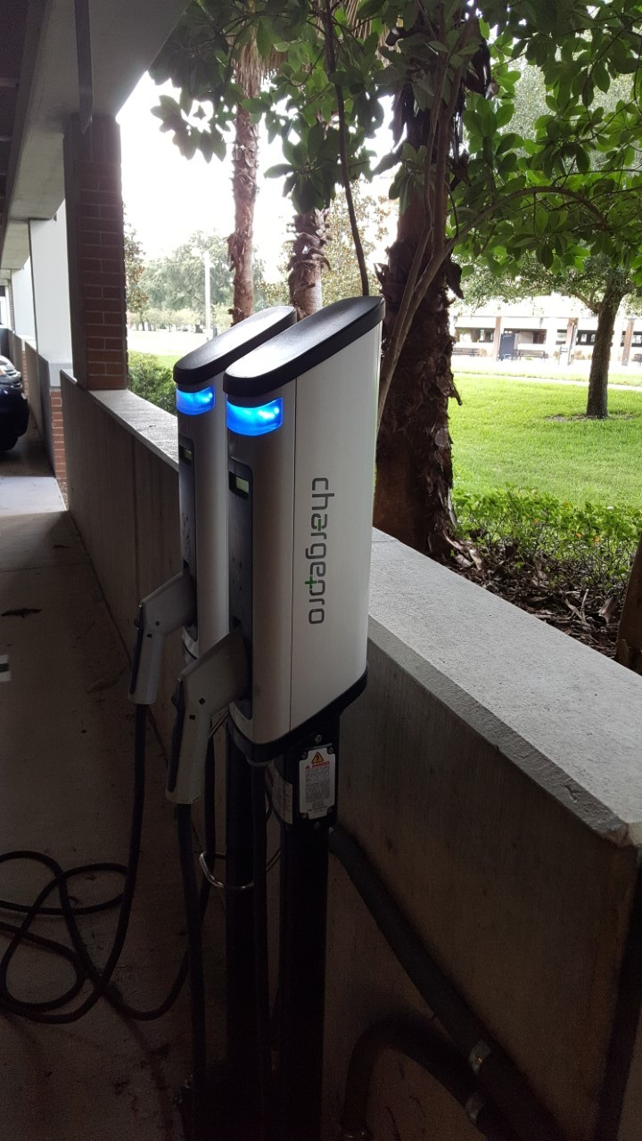
System Requirements
Operating Voltage: 120-240V
Center Frequency: 50-60 Hz
Output Current: 6-32A
Output Power:
Level 1: <2.4 kW
Level 2: <9.6 kW
Weight: 1.5kg/3.3lbs
System Temperature <155°C

Slide 6
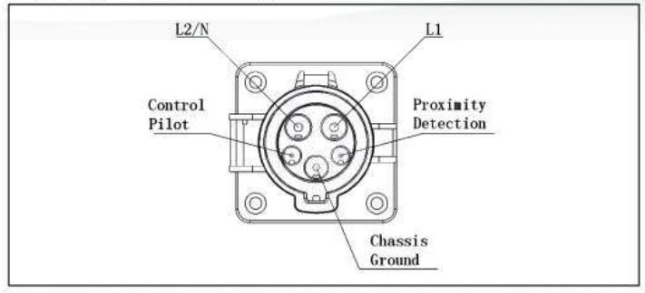
J-1772

Slide 7
SCAM Main Block Diagram
Charging Station
External to the System
Wi-Fi Board
Android Phone Application
Internal to the system
Power Processing Board
User Interface Board
Magnetic Card Reader
Online Database
Keypad
Power Supply
220V AC at 60 Hz
System Power Generation Board
Electric Vehicle
Inlet + Charger + Battery

Slide 8
Wi-Fi Board Hardware

Slide 9
Overall Layout
Power Processing Board
USB 2.0 Connection
3.3V
5.0V
JTAG
SPI
2.5V
Resistor Divider
Multi-
Purpose Buffer
External Flash Memory 8 MB
LTC3561 Switcher
UART
CC3200 Arm-Based Processor chip
3.3V and 1.85V
54 Mb OFDM
50 ohm Co-planar Waveguide
Infrared Temperature sensor
Multi-layer Bandpass Filter
2.54 GHz Antenna Chip
Internal Processor 40-MHz Crystal
4um to 16 um range
SPI
MSP4305529 Central Processor
Accuracy 32-kHz Crystal

Slide 10
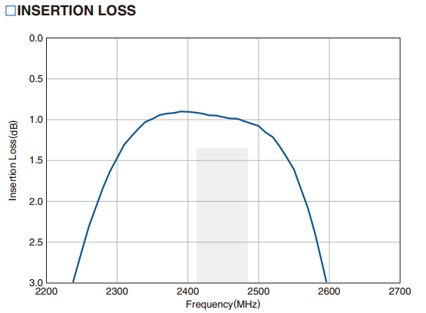
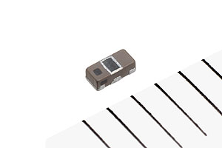
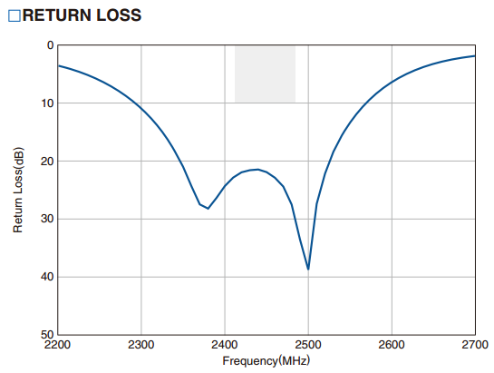
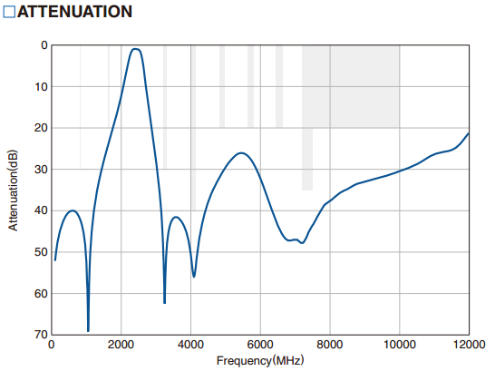
Bandpass Filter

Slide 11
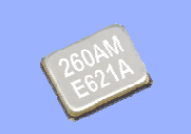
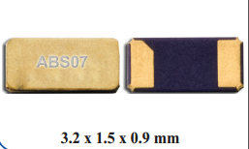
Oscillators
40 MHz Oscillator
Used by internal ARM processor and proprietary WLAN system
32.768 KHz clock
Used for set and rest times, synchronization for phase lock loops, accuracy in timing purposes

Slide 12
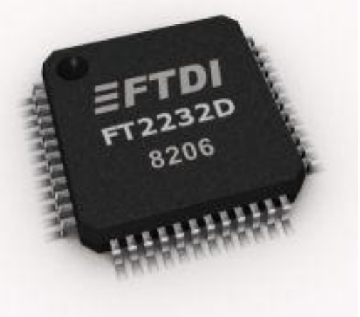
Multipurpose Buffer – FT2232D Dual USB to Serial UART/FIFO IC
Entire USB protocol handled on the chip.
Multi-Protocol Synchronous Serial Engine
USB to JTAG
SPI, I²C, JTAG
On chip clock multiplier
Supporting 6-48MHz operations
Supports full-speed USB 2.0
12Mbit/s

Slide 13
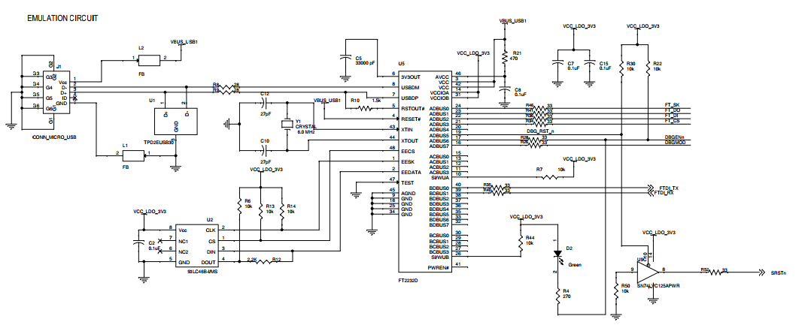
Schematics

Slide 14
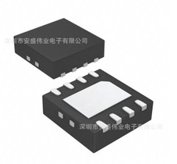
LTC3561 Features
Up to 4 MHz switching operation
High Switching current: 1.4A
Uses current mode control for better
Load response
Line response
High Efficiency up to 95%
Short Circuit protected
Stable with ceramic capacitors

Slide 15
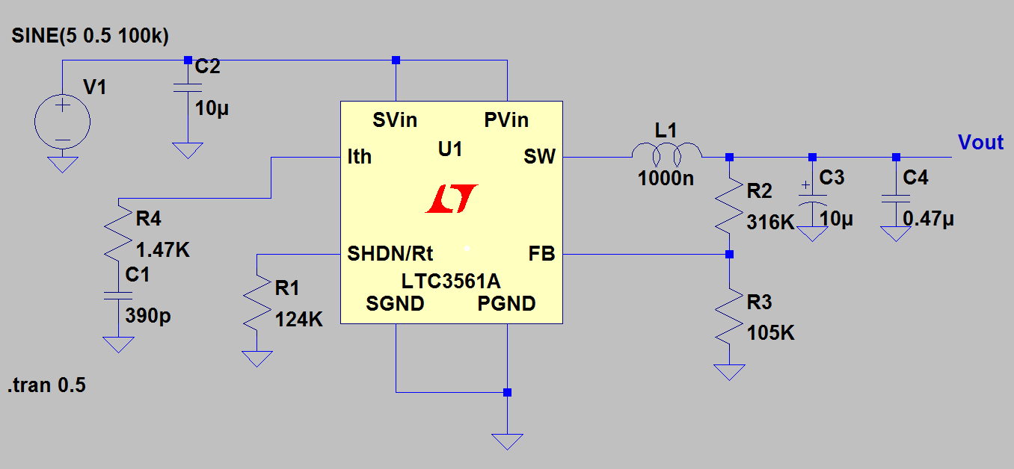
LTC3561

Slide 16
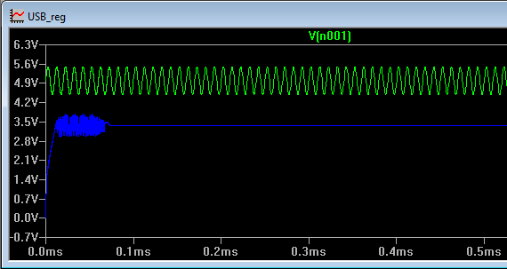
LTC3561 Simulation

Slide 17
Antenna Selection – RFANT5220110A2T
AH316M245001-T
Taiyo Yuden
Can be on edge of PCB
RFANT5220110A2T
Walsim
Needs to be in corner of PCB
Antennas Satisfy
Parameter | Specification
Frequency Bandwidth | 2.4-2.5 GHz
Typical Gain | 1.9 dBi
VSWR | 3
Efficiency | -1.3dB (73%)

Slide 18
Power Processing
Board

Slide 19
Motherboard (Power Processing Board) Layout
USB HUB and Power Supply for Re-programming
Main Electronics and MCU section
TI eZ-lite Emulation Section

Slide 20
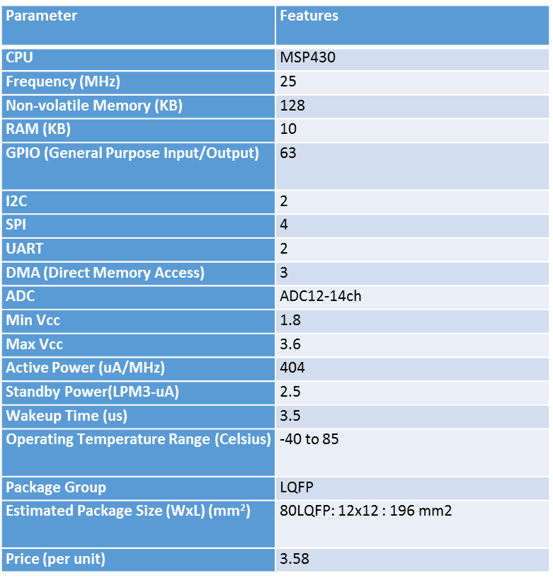
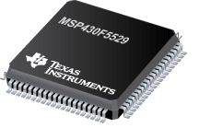
MSP430F5529
Features
Integrated USB and PHY supporting USB 2.0
four 16-bit timers
High-performance 12-bit analog-to-digital converter (ADC)
two universal serial communication interfaces (USCI)
hardware multiplier (32x32),
DMA (Direct Memory Access),
a real-time clock (RTC) module with alarm capabilities
IrDA

Slide 21
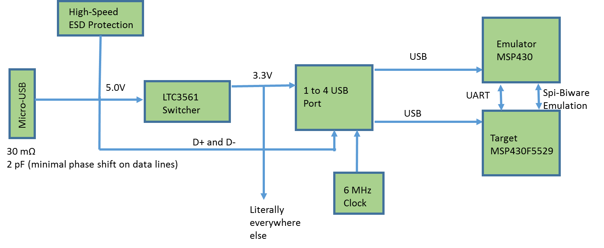
USB-Hub and Power Supply

Slide 22
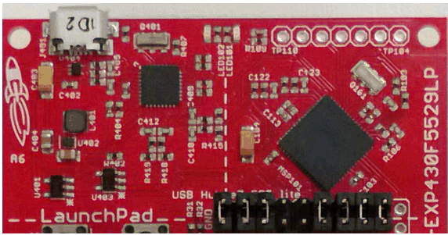
USB-Hub, Power Supply, and Emulation

Slide 23
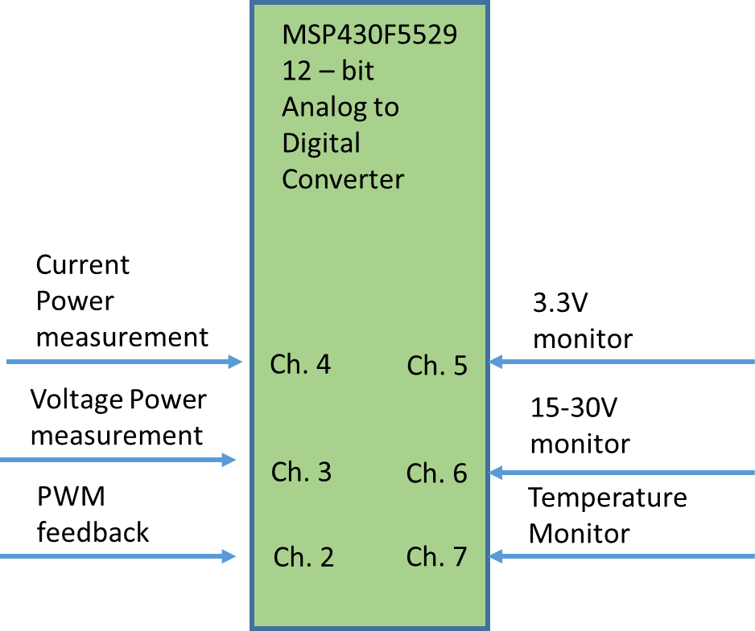
MSP Main Electronics

Slide 24
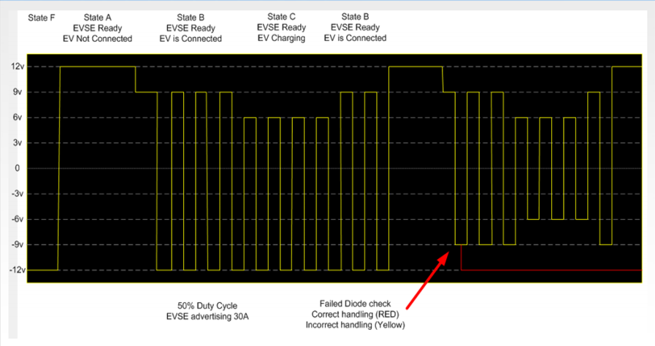
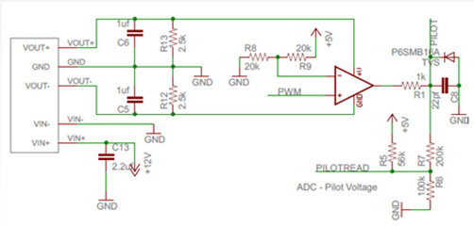
Pilot Signal
1 kHz PWM
Pulse width changes based on current delivered to car.
Duty Cycle = amps/0.6

Slide 25
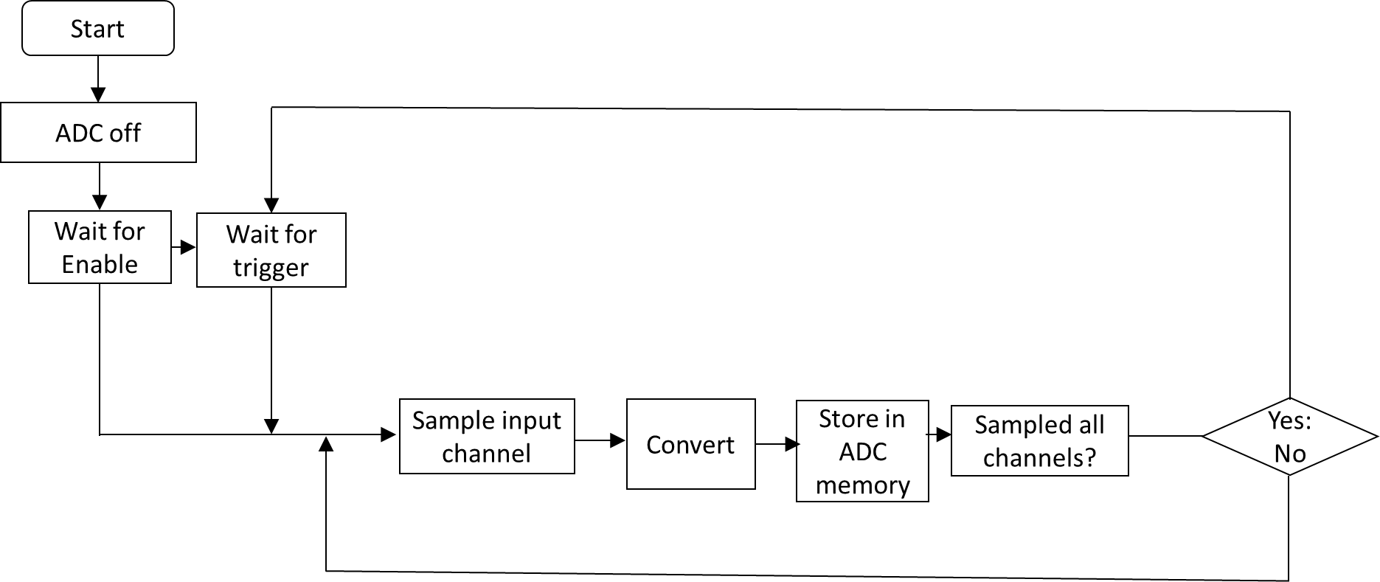
ADC configuration

Slide 26
Wireless Communication

Slide 27
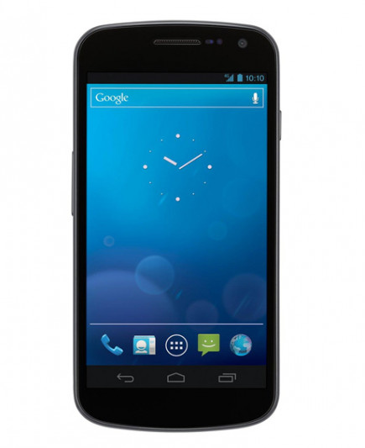
Wi-Fi Communication
Wi-Fi vs. Bluetooth: One of the goals stated was for communication between station and device to be accessed anywhere on campus.
MCU must have WLAN (wireless area network) access point connection capabilities.
Receive state of charge electric vehicle data through SPI from Main MCU.
Send data using TCP sockets to smartphones.

Slide 28
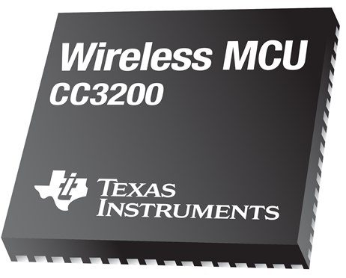
CC3200 Wireless MCU
CC3100 vs. CC3200: CC3200 is a single-chip wireless MCU.
Interface between two TI products simplifies implementation.
Acts as a station that connects to a network.
IoT (Internet of Things) solution.
Specifications
Input Voltage | 3.3 V
Source Current | 2-6 µA
TCP data rate | 13 Mbps
Wi-Fi standard | 802.11b/g/n
External SPI Interface | 8 simultaneous sockets
Body size | 9 mm x 9 mm

Slide 29
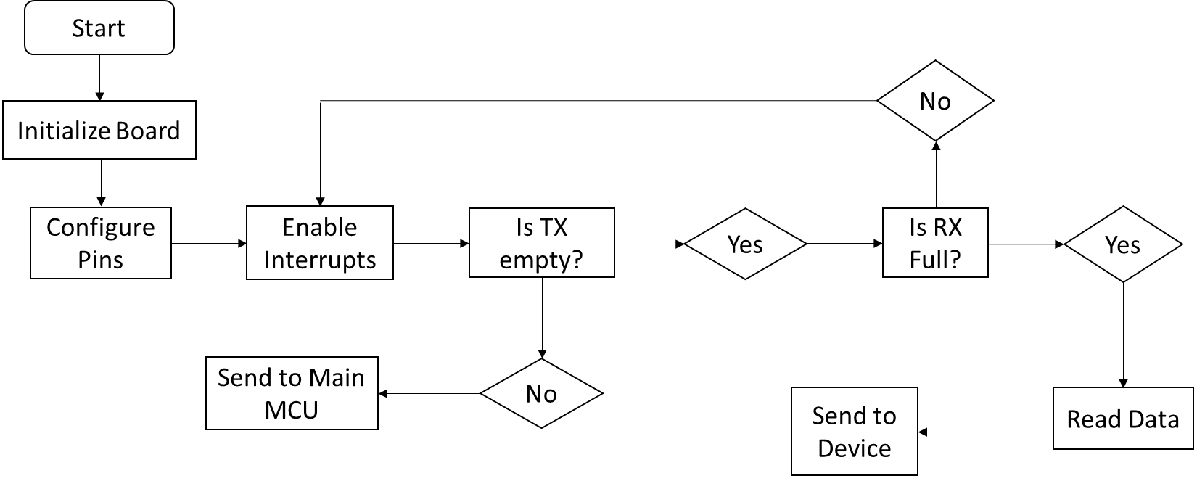
SPI Flow Chart

Slide 30
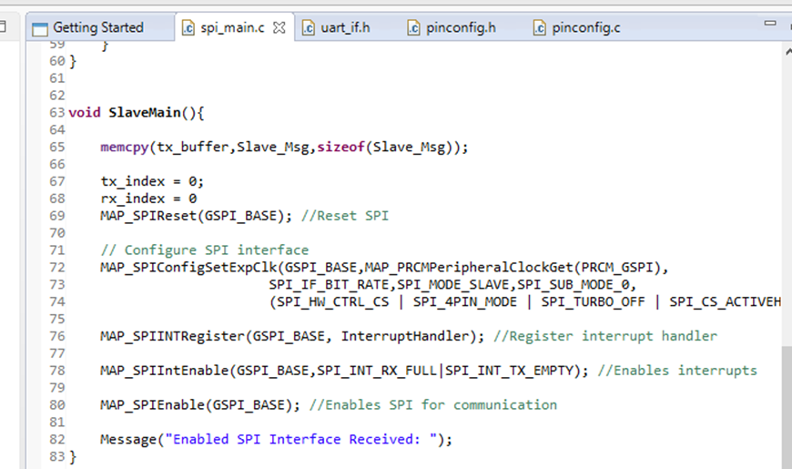
Software: Code Composer Studio
Familiarity with CCS
Compatibility with Texas Instrument products.
C/C++ compiler and debugging applications.
Many resources and references for troubleshooting.

Slide 31
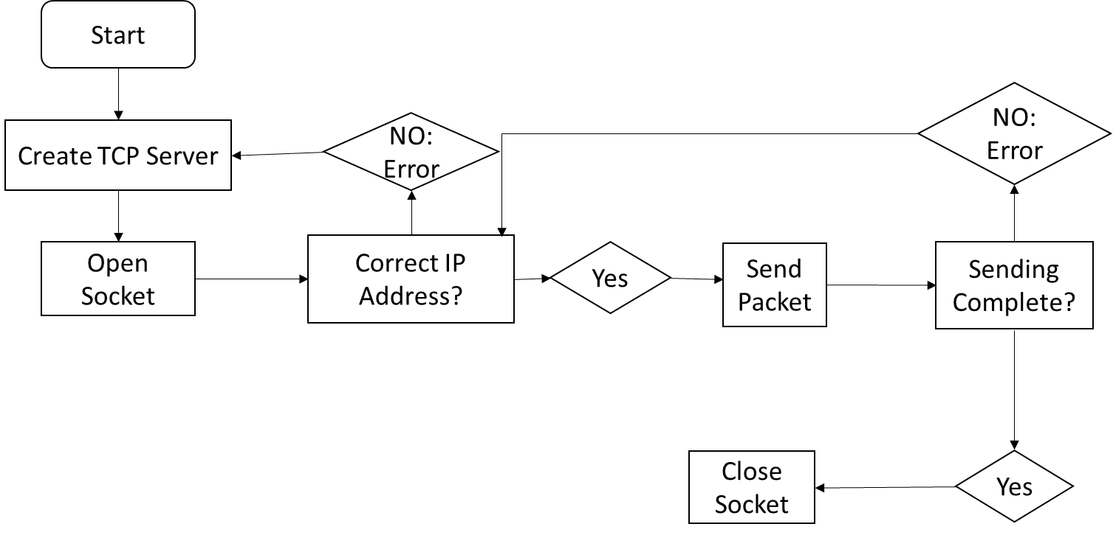
TCP Flow Chart: Server

Slide 32
A popular IDE for developing applications on Android devices.
Features include:
Debugging
Android Phone Emulator
Connectivity with real devices through USB
XML files for layout design
Programming language is Java.
Because of its wide use, there are many resources available.

Slide 33
Main Features of Application
Sign page that is accessible for only UCF students/faculty.
Database to store NID and password information.
Second screen that displays the state of charge.
Connection using TCP to the wireless MCU.

Slide 34
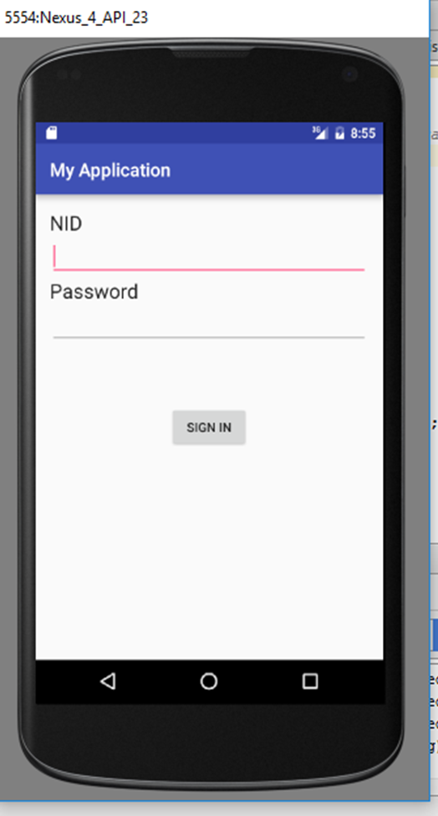
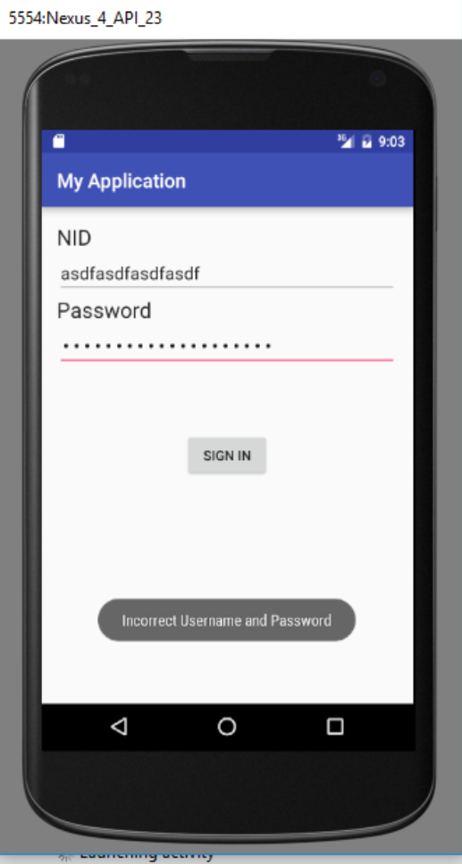
Sign-in Page
Simple NID and password sign in familiar to all UCF students/faculty.
On button click, code will compare input to database and respond according to that input.

Slide 35
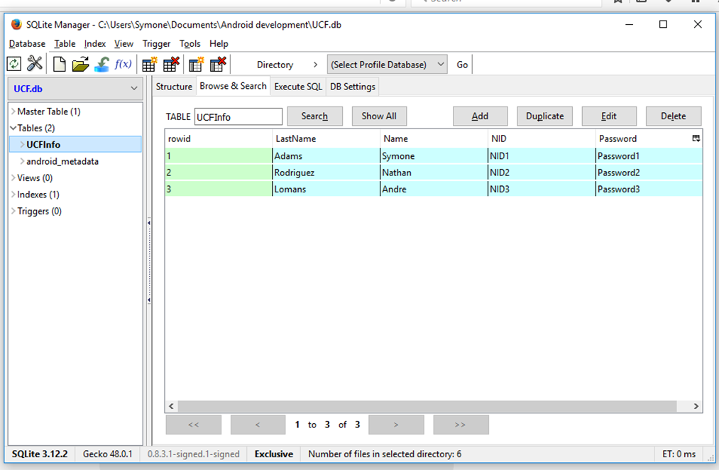
Database
For prototyping purposes, a database was created in Android Studio.
NID is set as a unique constraint; new entries are entered based on this. No one with the same NID can be in place.
SQLite Open Helper: A helper class that connects to the Firefox plugin, SQLite Manager.

Slide 36
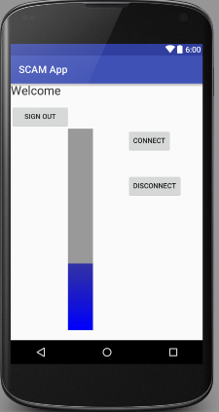
Second Screen
When NID and password are correct
On the connect button click, phone will connect to wireless MCU server to receive information.
Information is displayed as percentage on progress bar.

Slide 37
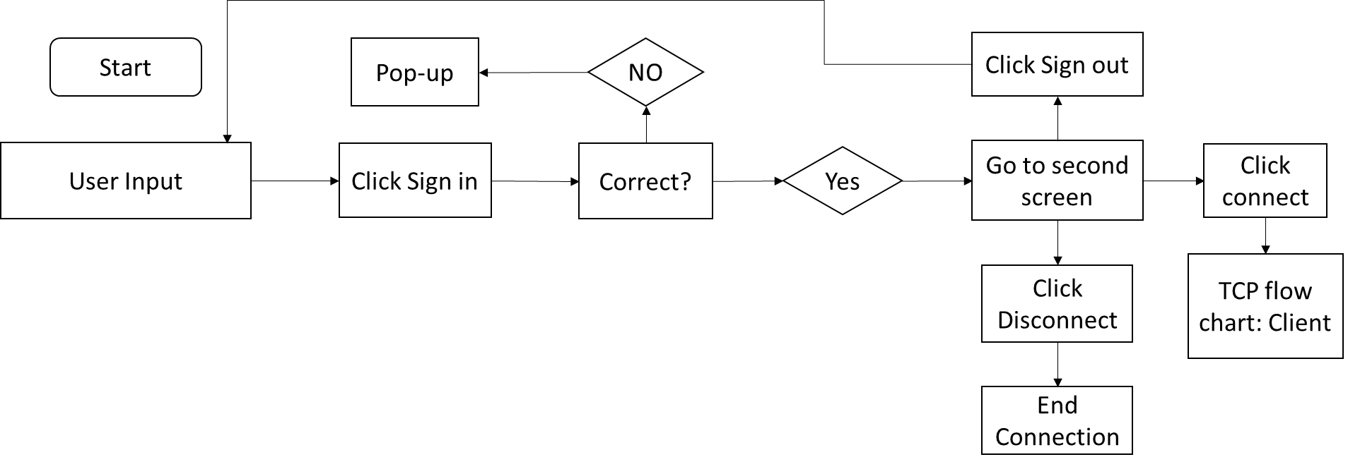
Android Code Flow Chart

Slide 38
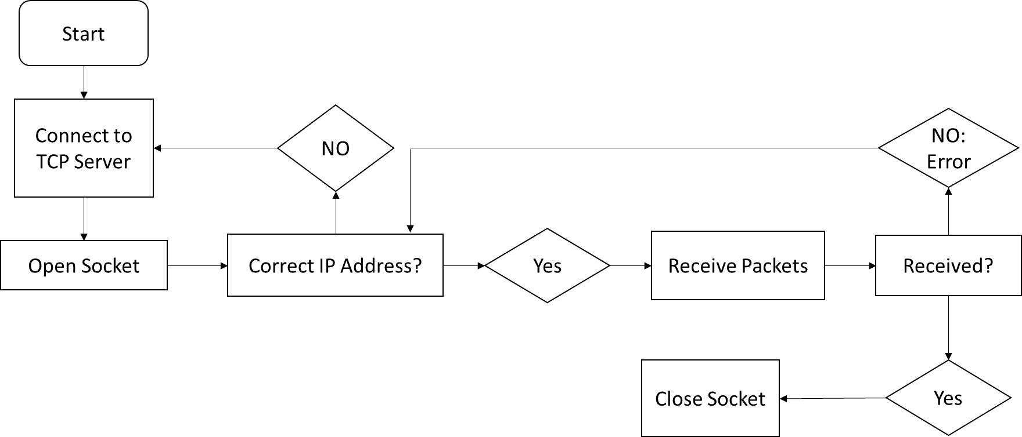
TCP Flow Chart: Client

Slide 39
User Interface

Slide 40
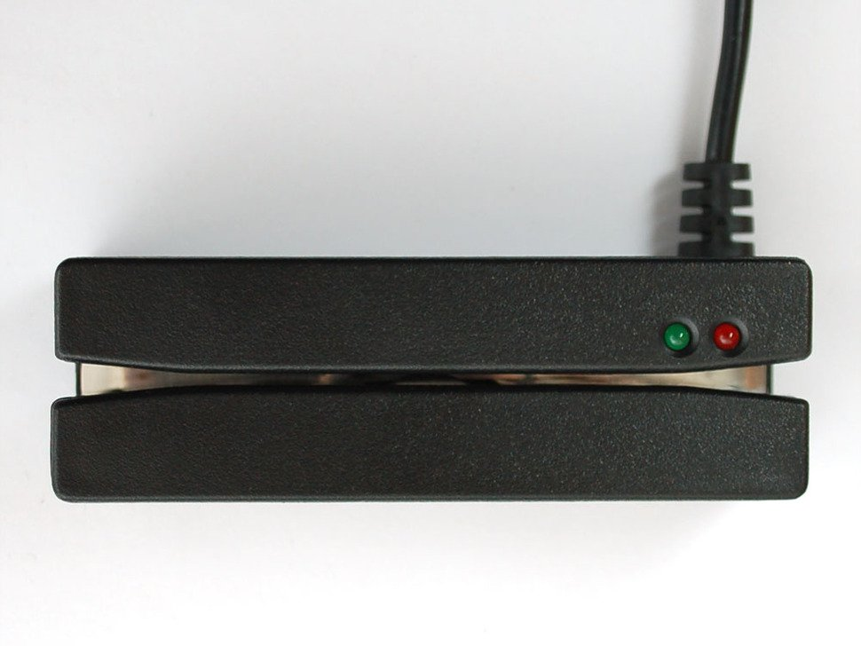
Magstripe
Magstripe Reader Ps/2 Interface
Interfaces directly to MSP430 via Ps/2 wired connector
Provides first line of two verify security system capable of reading 3 tracks. Utilizing 2 track for S.C.A.M

Slide 41
Notes
Chosen for being microcontroller-friendly
Cheap relative to Stripe readers ($59.95)
PS/2 cable allows us to use MSP430 without fabricating USB port most Readers in this price range we're USB operated
Uses a single connector for power and data and two data pins
Bi-directional and outputs data stream in the right order regardless of orientation
Does not write to cards. Operation not needed for S.C.A.M

Slide 42
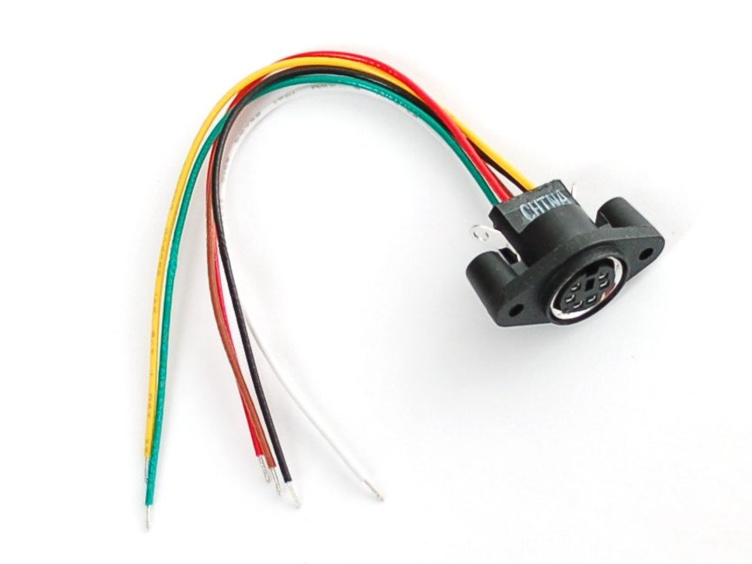
PS/2 Wired Connector
Specifications
Input Voltage | 5V
Source Current | 1-2A Max draw
Operating temperature | -40-85 ℃
Life | 1000 cycles

Slide 43
PS/2 Wired Connector
Additional Specs
Baud rate | 9600bps
Data Bit | 8 bit
Check bit | None
Stop bit | 1 bit

Slide 44
PS/2 Wired Connector
PS/2 Device wiring
Green Wire | +5V
Black Wire | Ground
Brown Wire | Data
Yellow Wire | Clock
White Wire(n/a) | Mouse Data for 2-in-1 spliter cables
Red Wire(n/a) | Mouse clock for 2-in-1 splitter cables

Slide 45
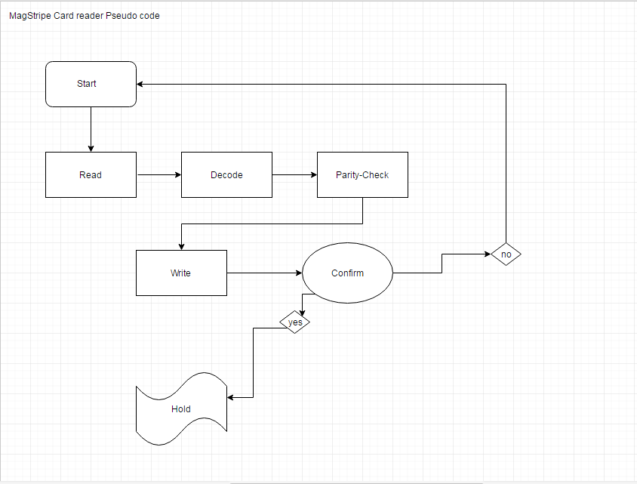

Slide 46
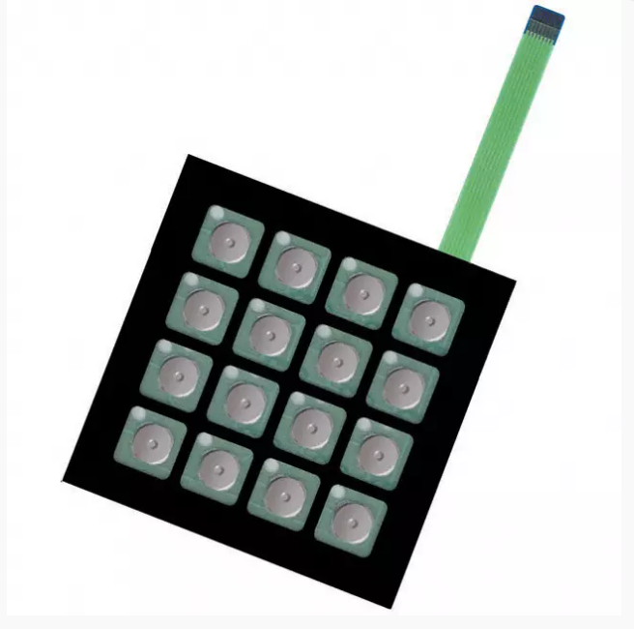
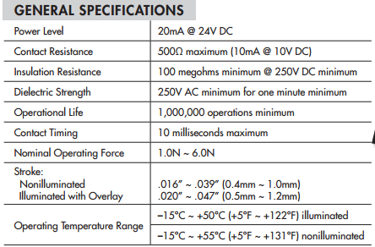
Keypad Switch Circuit

Slide 47
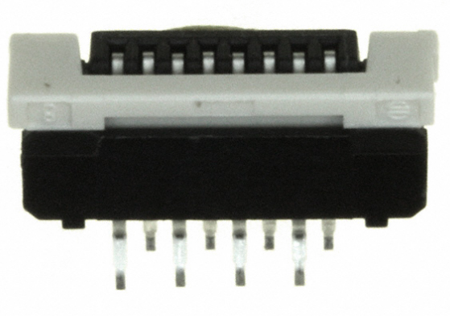
Requirements
FCI Part No. SLW8S-5C7LF
8-Pin connection
24V

Slide 48
Power Management

Slide 49
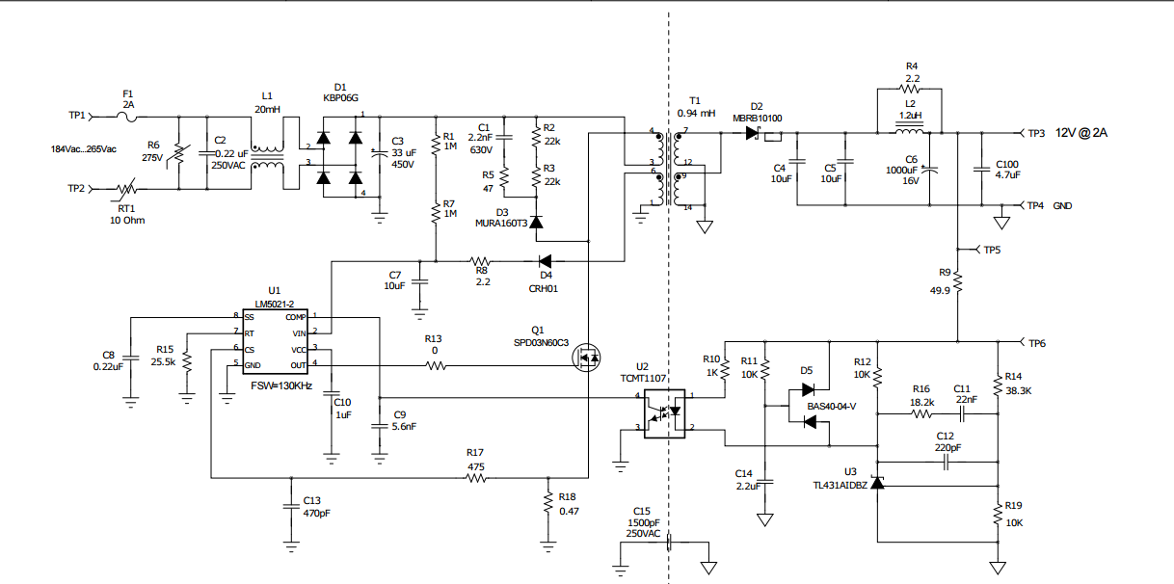
Power Management

Slide 50
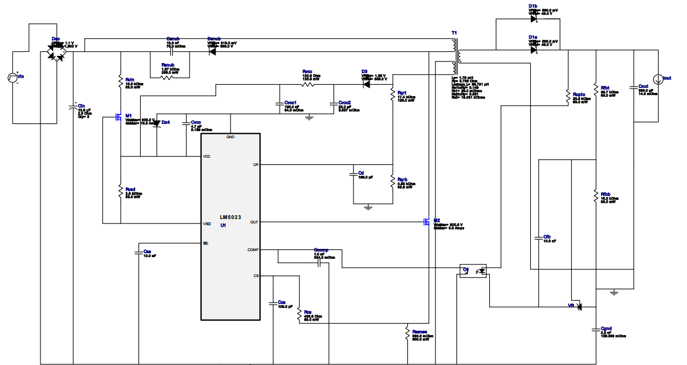

Slide 51
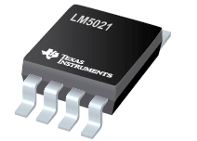
PWM
Specs
Startup Current | 25 µA Max
Max Duty Cycle Limiting | 80%
Vin Voltage | 8Min - 30Max

Slide 52
Budget
Part | Current Cost | Expected Cost
Magstripe | 59.99
Switching Keypad | 25.25
Msp430(6x) |  | 20
CC3200 |  | 12
Regulators |  | 60
PCB layout |  | 300
J-1772 Connector |  | 160
Phone(Prototyping) | 30
Misc |  | 100
 | 115.24 | 652.00

Slide 53
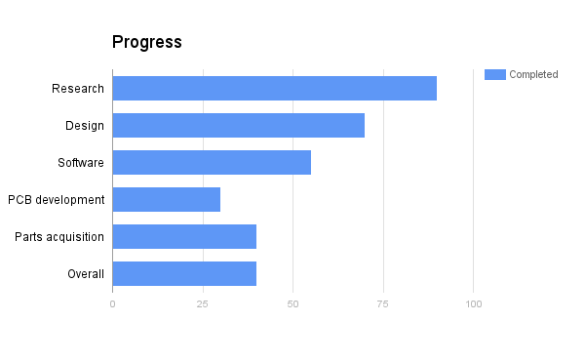

Slide 54
Challenges
Input power
Level of charging
110-120 vs 208-240
Software implementation
Part aquisition
RF design
Not standardized
Japan vs Usa

Slide 55
Work Distribution
 | Hardware | Software | User Interface | Power
Nathan Rodriguez | P | S | S | S
Symone Adams | S | P | S | S
Edwin Lomans | S | S | P | S

Slide 56
Questions?

