Slide 1
Group 4
Mike Amaral, B.S.E.E.
John Brushwood, B.S.E.E.
Reginald Fergerson, B.S.Cp.E.
Zachary Kirby, B.S.Cp.E.

Slide 2
Group Members
Michael Amaral, BSEE
John Brushwood, BSEE
Reginald Fergerson, BSCpE
Zachary Kirby, BSCpE

Slide 3
Why a Drink Vending Machine?
Become the hero of a tailgate party or backyard Bar-B-Que.
We want to be millionaires.
Top 10 percent of American drinkers, 24 million of them, drink 74 drinks per week. **
24 million x 0.5 percent market capture = 120,000 customers
If we sell each unit for $1,000 that equals $120,000,000 in sales. This = $$$$
We want to graduate.
**Statistics are taken from The Washington Post, washingtonpost.com

Slide 4
Goals and Objectives
Portable design.
Designed using low cost pumps.
Controlled by an Android mobile app.
Optional battery powered system.
Build and sell at a lower cost point than the competitors.

Slide 5
Specifications and Requirements
Component | Parameter | Design Specification
Mobile Bluetooth Link | Minimum Range | 3 meters
Liquid Pumps | Accuracy | Dispense +/- 0.5% of recipe
Micro Pressure Switch | Accuracy | Detect an empty bottle
Mobile Application | Usefulness | Intuitive user interface
Power Supply | Efficiency | Achieve at least 90% efficiency
Power Supply | Longevity | Ability to work all day on battery
Vending Unit | Portability | Weigh less than 100 lbs.

Slide 6
Power Supply Circuit
5V
12V
3.3V
Pump
Circuit
MCU
A
Cup
Sensors
MCU
B
Bluetooth Link
Bluetooth
Power Line
Control Line
Android
Tablet
Communication
Breathalyzer
Power Delivery
LCD
Display
MCUs
Liquid Level Circuit
I/Os

Slide 7
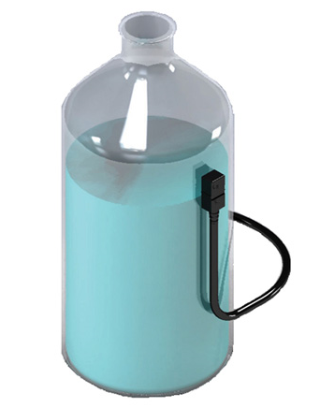
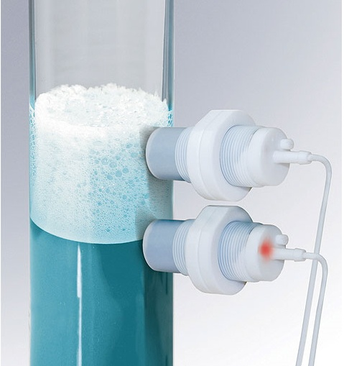
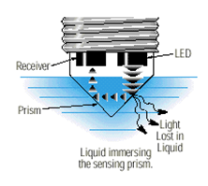
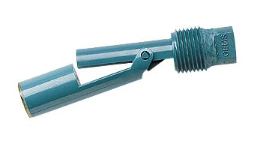
Liquid Level Circuit
Challenges
Actively monitor the amount of liquid inside each container
Allow easy access to bottles while providing monitoring
Prevent contamination by not using sensors that touch any liquid
Provide digital logic signal to interrupt main pump controller
Must be relatively low cost to implement
Float Switch
Electro-optic
Ultrasonic
Capacitive
Photos courtesy of Honeywell, Gemtech, Baluff

Slide 8
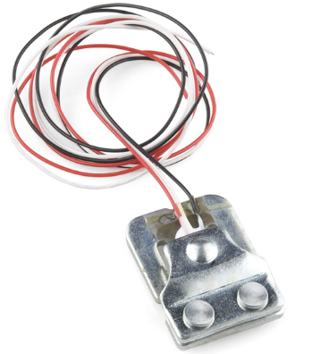
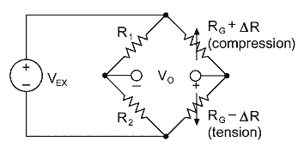
Liquid Level Circuit Continued
1st Approach: 50kg Load Cell
Weigh the contents of each bottle
Amplify the signal using an Op-amp
Photo courtesy of SparkFun
50kg load cell
Wheatstone Bridge
Key Features:
Relatives low cost at about $1.50 each
Half Wheatstone bridge
Approach Downfalls:
Requires additional components
Completed circuit does excessively more than what was needed

Slide 9
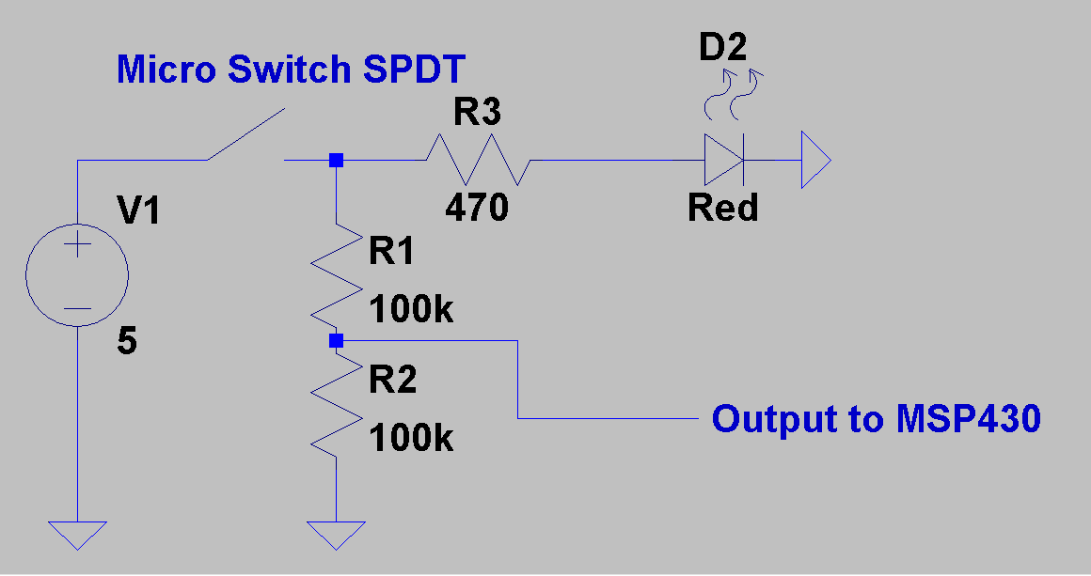
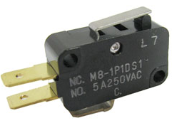
Liquid Level Circuit Continued
2nd Approach: 4N Micro Switch
Bypass amplification circuit
Provides direct logic level signal for MCU
Photo courtesy of Mulon
Mulon M8 Precision Micro Switch
Specs:
SPDT
250VAC
5Amp
NO and NC Contacts
4N Operating Force
$1.50 Each
Basic Theory of operation
Input Pin of MSP430 receiving 0V for open switch
Input Pin of MSP430 receiving approximately 2.5V for closed switch

Slide 10
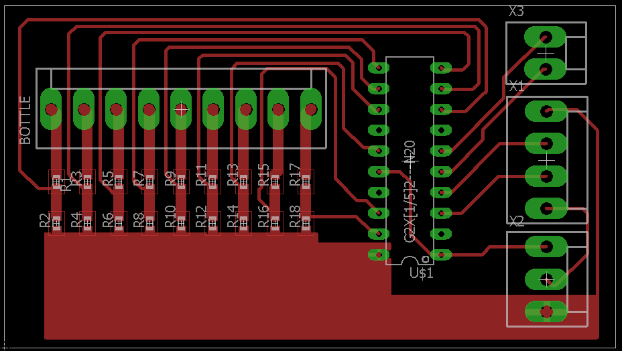
Liquid Level PCB

Slide 11
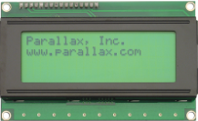
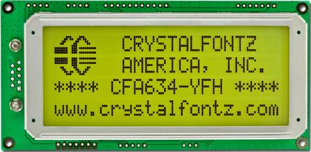
LCD Display
Take RS232 serial data from the MSP430
Display an ASCII string of characters on the screen for the user to see
Must be able to operate on a voltage currently available from our power supply circuit
Should be ideally able to display 4 lines of text
Photo courtesy of Parallax
Photo courtesy of Crystalfontz
2.37”
2.48”
5.12”
3.86”
Specs:
SPI Interface,RS232, I2C
5.0V supply
Yellow Green LED backlight
-20C to 70C operating temperature
$50.26 Each
Specs:
Single Input pin
5.0V supply
Adjustable Contrast Knob
-20C to 70C operating temperature
$42.99 Each

Slide 12
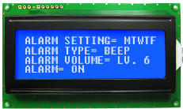
LCD Display
Specs:
RS-232(TTL), SPI, I2C Interface Compatible
5.0V Power Supply
5x8 pixels
Side White LED Backlight
Wide Temperature range
(-20C to +70C)
6 O’clock Viewing Angle
$22.70 for a single display
New Haven 4x20 LCD Serial Display
Photo courtesy of New Haven
2.36”
3.85”

Slide 13
Power Supply Circuit
5V
12V
3.3V
Pump
Circuit
MCU
A
Cup
Sensors
MCU
B
Bluetooth Link
Bluetooth
Power Line
Control Line
Android
Tablet
Communication
Breathalyzer
Power Delivery
LCD
Display
MCUs
Liquid Level Circuit
I/Os

Slide 14
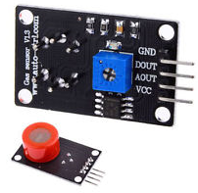
Breathalyzer
Plugs directly into a USB port on the Android Tablet
Powered completely by the USB port
Allows multiple tests to be submitted by many users
Sends a logic level signal to the Tablet to disable or caution the user from ordering another drink
Micro4you Studio MQ-3 Ethanol Sensor
1.57”
Specs:
5V Circuit and Heating Voltage
0.05mg/L to 10mg/L range
Operating Range of 20C
Key Features:
Highly sensitive to Ethanol
Analog and Digital Outputs
Adjustable Threshold Digital Output
0.79”
Photo courtesy of Micro4you

Slide 15
Power Supply Circuit
5V
12V
3.3V
Pump
Circuit
MCU
A
Cup
Sensors
MCU
B
Bluetooth Link
Bluetooth
Power Line
Control Line
Android
Tablet
Breathalyzer
Communication
Power Delivery
LCD
Display
MCUs
Liquid Level Circuit
I/Os

Slide 16
Microcontrollers
 | Texas Instruments MSP430G2553IN20 | Atmel Atmega16 | Microchip Pic24FJ16MC101
Operating Voltage | 1.6 – 3.6 V | 4.5 – 5.5 V | 3.0 – 3.6 V
Current Draw | 230 µA | 1.1 mA | 1 mA
I/O Pins | 16 | 32 | 15
Flash Memory (KB) | 16 | 16 | 16
RAM (B) | 512 | 1024 | 1024
Architecture | 16-bit RISC | 8-bit RISC | 16-bit RISC
Number of General Purpose Registers | 12 | 32 | 16
Operating Temperature (C) | -40 to 85 | -55 to 125 | -40 to 125
Max Voltage at I/O pin | Vcc – 0.3 V | 6 V | 5.6 V
Max Clock Rate | 16 MHz | 16 MHz | 16 MHz
Socket Type | PDIP,QFN, TSSOP | PDIP, TQFP, QFN, MLF | PDIP, SOIC, SSOP
Pin Count | 20 | 40 | 20
Price Per Unit | $2.80 | $7.16 | $2.50

Slide 17
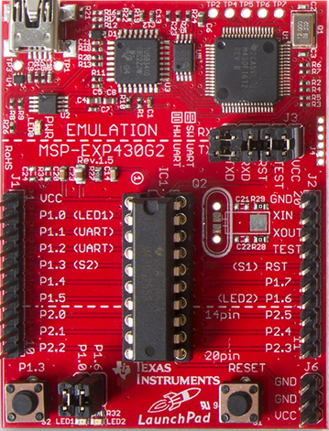
Microcontroller
MSP430G2553 was chosen because we are familiar with it
It is inexpensive and all of us already own the Launchpad to upload the software
16 – bit RISC CPU for easier coding, only 27 core instructions
20 pin PDIP package for easy removal from the PCB and easier soldering using a DIP socket
Manufacturer | Texas Instruments
Part Number | MSP430G2553IN20
Operating voltage (Vcc) | 1.8 – 3.6 Volts
Max Voltage at I/O pin | Vcc – 0.3 Volts
I/O Pins | 16
Price | $2.80
Dimensions | 5 mm x 1 mm
Image Courtesy of Texas Instruments

Slide 18
Power Supply Circuit
5V
12V
3.3V
Pump
Circuit
MCU
A
Cup
Sensors
MCU
B
Bluetooth Link
Bluetooth
Power Line
Control Line
Android
Tablet
Breathalyzer
Communication
Power Delivery
LCD
Display
MCUs
Liquid Level Circuit
I/Os

Slide 19
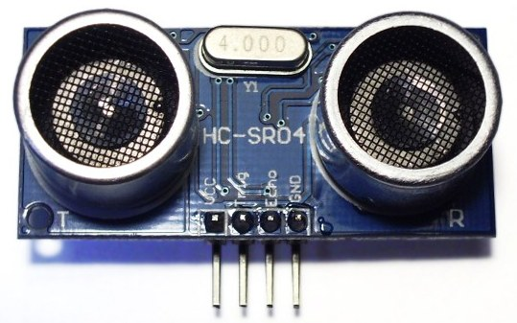
45 mm
Cup Sensors
20 mm
Needed to prevent a possible catastrophic failure
Detect the presence of a standard uniform cup that is used with the DrinkWizard
Detect the level of the liquid that has been dispensed into the standard DrinkWizard cup
Prevents dispensing of a liquid into a cup that has already been filled
Also prevents dispensing of liquid when a cup is not present
Can consist of three ultrasonic sensors to detect the x, y and z – axis
Requires a 5 volt power supply
Output voltage must be reduced when using the MSP430G2553 microcontroller
Image courtesy of MicroPic
Manufacturer | MicroPic
Part No. | HC-SR04
Input Voltage | 5 Volts
Output Level: High | 5 Volts
Low | 0 Volts
Range | 2 cm – 4 m
Price | $1.83

Slide 20
Power Supply Circuit
5V
12V
3.3V
Pump
Circuit
MCU
A
Cup
Sensors
MCU
B
Bluetooth Link
Bluetooth
Power Line
Control Line
Android
Tablet
Breathalyzer
Communication
Power Delivery
LCD
Display
MCUs
Liquid Level Circuit
I/Os

Slide 21
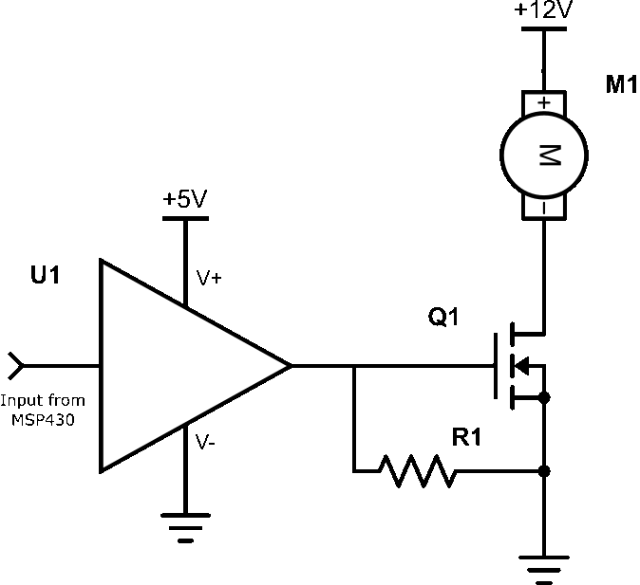
Pump Controller
Used to turn individual pumps off and on
System currently consists of a total of nine pumps
5 pumps for liquor
4 pumps for mixer liquid
Uses a MOSFET as a voltage controlled electrical switch
Also uses a MOSFET driver in order to have the MSP430G2553 control the switching of the MOSFETs
Each pump has its own MOSFET and MOSFET driver circuit to control the cycling off or on
Signal is produced by the MSP430 to control the different pumps.
The pump will remain on for a set amount of time depending on the amount of liquid that it must dispense

Slide 22
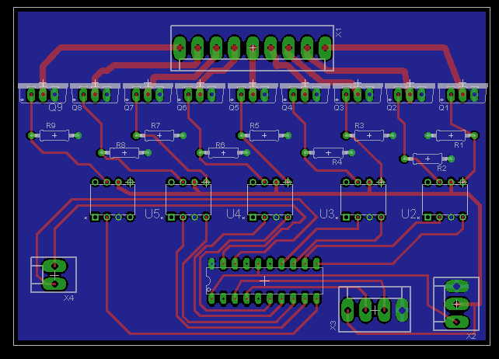
Pump Controller Board Layout
Double Sided PCB
Thicker traces to handle more current draw from the pumps
Connectors for connecting to
Pumps
Bluetooth Module
Power Supply
External Sensors
Will use an IC sockets to mount IC to the board
3 in
4 in

Slide 23
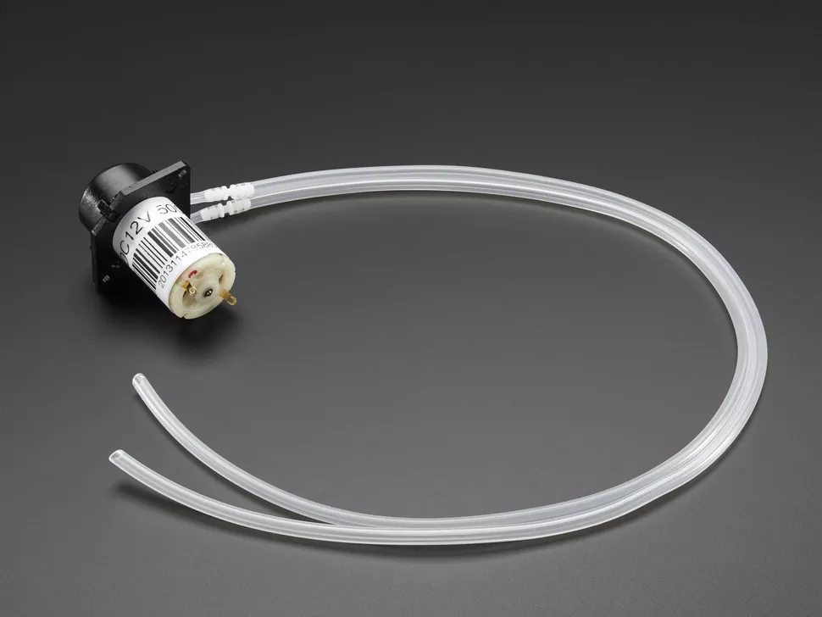
Pumps
Needs to be reliable
Relatively low maintenance compared to other pump types
Flow rate to fill an 8 oz. glass in less than 2.5 minutes
Repeatable accuracy to be within 10 mL
Will not touch the liquid that is to be dispensed
Peristaltic pumps will be used to meet these requirements
Photo Courtesy of Adafruit.com

Slide 24
Power Supply Circuit
5V
12V
3.3V
Pump
Circuit
MCU
A
Cup
Sensors
MCU
B
Bluetooth Link
Bluetooth
Power Line
Control Line
Android
Tablet
Breathalyzer
Communication
Power Delivery
LCD
Display
MCUs
Liquid Level Circuit
I/Os

Slide 25
Wireless Communication
 | Wi-Fi | Bluetooth | ZigBee | Near Field Communication | IR
Range | 32 meters indoors | 5 -30 meters | 100+ meters | 10 centimeters or less | Line of sight up to 5 meters
Bandwidth | 54 Mbps | 800 Kbps | 250 kbps | 424 kbps | 115 kbps
Power Consumption | high | low | low | Very low | Moderate
Ease of use | Complex | Simple | Medium difficulty | Simple | Medium difficulty
Frequency | 2.4 GHz, 3.6 GHz, 5 GHz | 2.4 GHz | 868 MHz, 900 MHz, 2.4 GHz | 13.56 MHz | varies
Price | High | Low | low | Very low | low

Slide 26
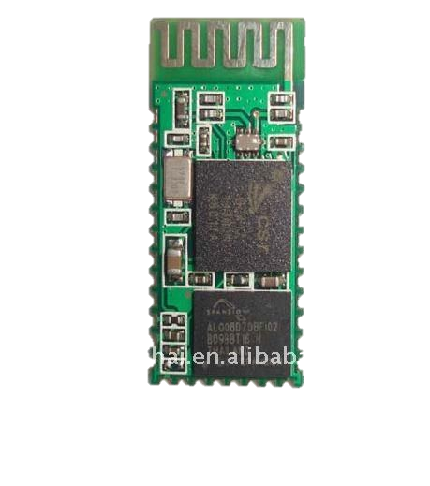
Bluetooth Module
15 mm
Cost less than $5.00
Allows wireless communication between the Android device and the DrinkWizard
Easy integration into the DrinkWizard's systems
Has all the components necessary already on a single board
35 mm

Slide 27
Bluetooth Module
Photo courtesy of Tayda Electronics

Slide 28
Power Supply Circuit
5V
12V
3.3V
Pump
Circuit
MCU
A
Cup
Sensors
MCU
B
Bluetooth Link
Bluetooth
Power Line
Control Line
Android
Tablet
Breathalyzer
Communication
Power Delivery
LCD
Display
MCUs
Liquid Level Circuit
I/Os

Slide 29
User Interface Options
Main requirement was portability
Considered creation of custom controller
Compared Android, iOS, and Windows platforms
Android platform chosen
 | Android | iOS | Windows
IDE | Android Studio | Xcode | Visual Studio
Language | Java | Objective-C | C#, C++
Cost* | Free | Free | Free
* Group members already owned devices necessary to develop for each platform

Slide 30
Android Application
Data sent between the Android device and the mixer
Bluetooth communication with Android application
Application handles user interaction with the mixer:
Handles administrative connection content
Establishes Bluetooth connection with the mixer
Sends and receives drink information
Presents options to user
Details specific ingredients in each drink
Creates and stores custom drinks made by the user
Drink Wizard splash screen

Slide 31
Application Requirements
Bluetooth-enabled Android device
Minimum SDK Version: Android 4.2 (Jelly Bean) – API 17
Compatible with 53.2% of devices registered with Google Play Store
25 MB of storage space
Current version is mostly functional and less than 4 MB
Only breathalyzer remains unimplemented
Full size USB port for breathalyzer (optional)
Application will run on devices without a full size USB port

Slide 32
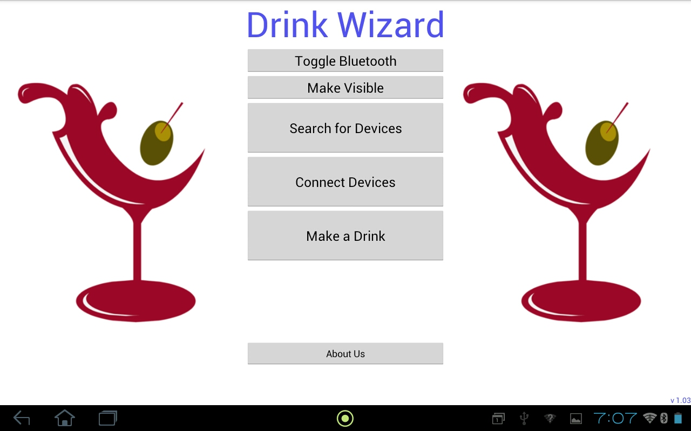
Application Structure – Activities
Bluetooth actions
Start Order Activity
User Interface
Main Activity
Create preset drink list
Set listeners for each drink
Add drinks to SQLite database
Remove drinks from database
Send drink order to mixer
Order Activity
Other Activities:
Paired List Activity – Shows paired devices
Display UI for creating a drink
Capture data for the custom drink
Custom Drink Activity

Slide 33
Bluetooth Connectivity Class Diagram

Slide 34
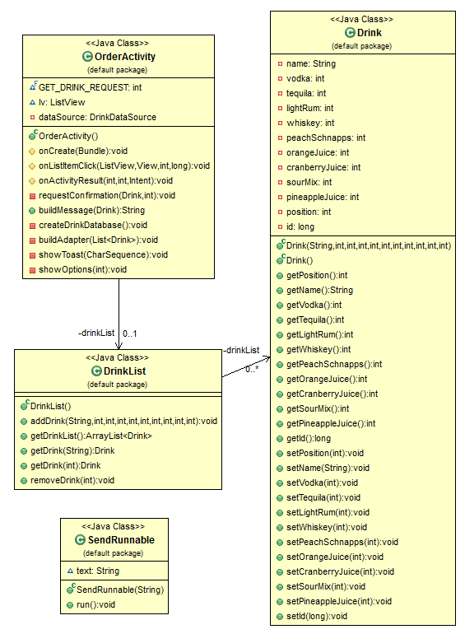
Order Classes
Order Activity - handles ordering
Drink List - holds instance of drink list
Drink - getters and setters
Send Runnable - sends data

Slide 35
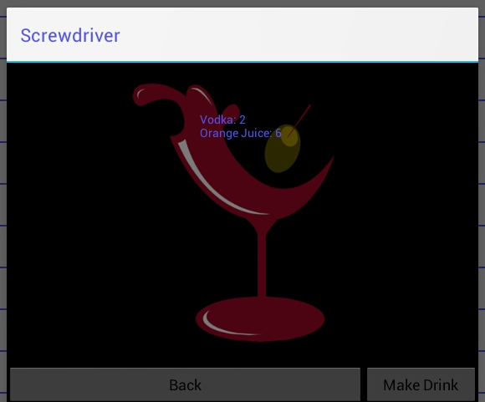
Order Class Diagram

Slide 36
Custom Drink Class Diagram

Slide 37
Power Supply Circuit
5V
12V
3.3V
Pump
Circuit
MCU
A
Cup
Sensors
MCU
B
Bluetooth Link
Bluetooth
Power Line
Control Line
Android
Tablet
Breathalyzer
Communication
Power Delivery
LCD
Display
MCUs
Liquid Level Circuit
I/Os

Slide 38
Power Supply
Have an efficiency of 90% or better
120 volt AC input
Need 12 volt output for liquid pumps
Need 5 volt output for Bluetooth module, LEDs, ultrasonic sensor, and MOSFET drivers.
Need 3.3 volt output for MCUs

Slide 39
Power Supply 12 Volt Supply
12 volt step down transformer drops the 120 volt AC signal down to a 12 volt AC signal.
The 12 volt AC voltage is then passed through a full wave bridge rectifier.
The 12 volt DC voltage is then passed through a series of capacitors to filter any ripple that may occur.

Slide 40
Power Supply 5 V & 3.3 V
Uses the Texas Instrument LM22678 step down buck converter to step down from 12 volts to 5 volts.
5 amp simple switcher
The Texas Instrument LM21215 voltage mode synchronous buck regulator to drop the voltage from 5 volts down to 3.3 volts.
15 amp high efficiency point of load synchronous buck regulator

Slide 41
Responsibilities
Name | Power Supply | Pumps/ Pump Control | Mobile Application | Sensors
John | O | X |  | O
Mike |  | O |  | X
Reggie |  |  | X | O
Zak | X |  | O
X – Primary Task
O – Secondary Task

Slide 42
Budget
Item | Supplier | Price/Unit | # of Units | Total Cost | Our Cost
Liquid Pumps | Adafruit | $11.32 | 9 | $101.88 | $101.88
Bluetooth Module | SparkFun | $4.99 | 1 | $4.99 | $4.99
MCU | Texas Instruments | $2.80 | 2 | $5.60 | Free Sample
Misc. Components |  | - |  | $50.00 | -
Building Supplies | Home Depot | - |  | $150.00 | -
PCB Boards | OSH Park | $59.99 | 5 | $60.00 | Sponsored
LCD Display | New Haven | $22.70 | 1 | $22.70 | $22.70
Micro Switch | Mulon | $1.50 | 9 | $13.50 | $13.50
Ultrasonic Sensor’s | MicroPic | $1.83 | 3 | $5.49 | $5.49
Power Supply | Texas Instruments | $12.53 | 3 | $37.59 | Free Sample
Breathalyzer | SparkFun | $4.95 | 1 | $4.95 | $4.95
 |  |  | Total: | $456.10 | $153.51
*Special thanks to Mtron PTI for sponsoring the PCB board Manufacturing and Batteries

Slide 43
Progress

Slide 44
Troubleshooting/Testing
5-volt power supply was dead.
Had to solder all new components.
Pumps were randomly turning on when power was applied.
Proper pins had to be declared as an input or output. (P1DIR, P2DIR)
Ultrasonic Sensors were not in range with the cup.
Had to constantly move the cup and measure till we found the right measurements from each sensor.
Cup Sensors were staying on after bottle was replaced.
Sensor wiring was shorted out due to staples.

Slide 45
Questions???

