Slide 1
HVAC Smart Control Group 2
Steven Jones
Jerthwin Prospere
Matthew Arcuri
Elroy Ashtian

Slide 2
HVAC
Heating
Ventilation
Air Conditioning
To provide a more energy efficient HVAC system, with enhanced user interface and over all more interactivity and control.

Slide 3
Project Overview
Energy efficiency will allow the user to save money on a monthly basis due to reduced power consumption.
Enhanced User Friendly interface through a wall mount touchscreen thermostat.
Web connectivity- allow settings to be changed via the internet.
Allow user to set a schedule of operation for the units. Specifically temperature.
Restricted access to technician to allow flexible configuration of devices. Adaptive to save user money if they can’t afford all the units.

Slide 4
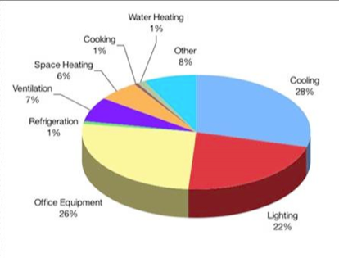
Energy Use
“As much as half of the energy used in your home goes to heating and cooling”. Energystar.gov.
HVAC systems are rated for certain sizes and to deal with certain temperatures. It would be better to make a system that can handle more than one set of ratings for maximum energy efficiency.

Slide 5
Controllable Saving Cost
Zoning houses
Increasing ease and power of scheduling
Smart use of air conditioners
Seer rankings
Split ton units

Slide 6
Goals and Objectives
Accurately read and adjust temperature and relative humidity both inside and outside building.
Internet connectivity
CO2 monitoring for a gauge of air quality
Mood scents
Vent control through zoning
Wireless connectivity to external unit
Enhance user interface
Must be expandable
Determine the most efficient components to use during operation based on the settings of “max comfort” or “max savings”

Slide 7
Specifications
1 CO2 Sensor with accuracy within 100ppm
Wireless transmission of temperature and humidity over a distance of 100 feet
Temperature sensor with accuracy within 1 degree and limits from 0 to 110 F
Humidity sensors with accuracy of 1% and range from 0% - 100%
Ability to be directly installed into existing 24VAC system
Ability to simulate mood scent dispersion
Implementation of scheduler within 5 minute for entire days of 1 week schedule
Overall reasonable cost

Slide 8
Components
Display Unit
Panda Board
TI OMAP 3550
Ease of Wi-Fi connectivity
7 inch LCD Touch Screen
Main Control Unit
Control Relays
PIC24FJ128GA010 (Main microcontroller)
Xbee 802.15 Transceiver
Temp/Relative Hum sensor
CO2 Sensor
Remote Control Unit
PIC24FJ128GA006 (Secondary Microcontroller)
Xbee 802.15 Transceiver
Temp/Relative Humidity Sensor
Solar Panel

Slide 9
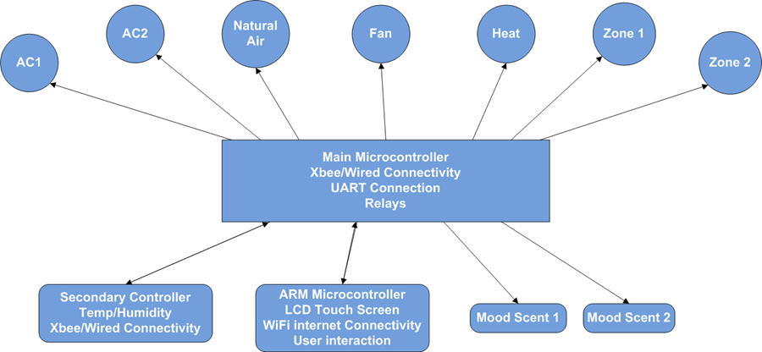
Block Diagram

Slide 10
Power Cost & PCB Design
Steven Jones

Slide 11
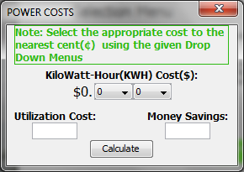
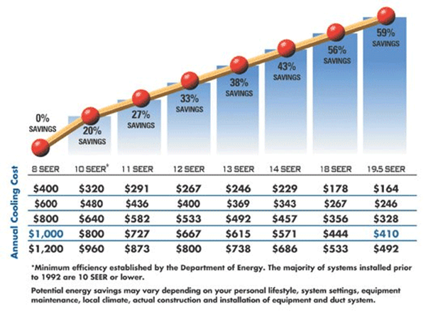
POWER COSTS
There are many factors to power savings with this device.
We choose power savings in relation to a traditional set up with just air conditioner system alone.
SEER rankings.
The following equation is how energy consumption is calculated per unit.
unit size, BTU/h × hours per year, h × energy cost, $/kW·h ÷ SEER, BTU/W·h ÷ 1000 W/kW

Slide 12
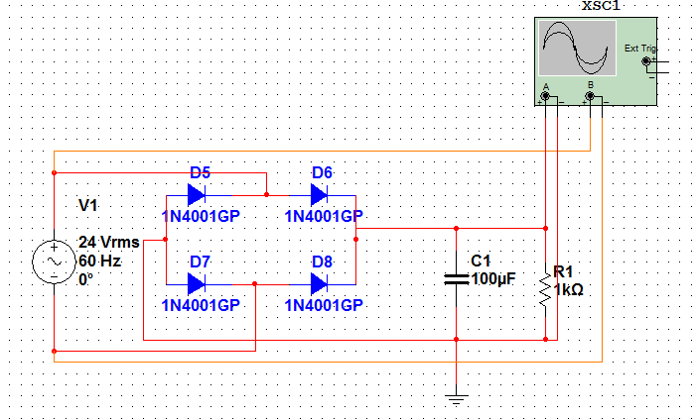
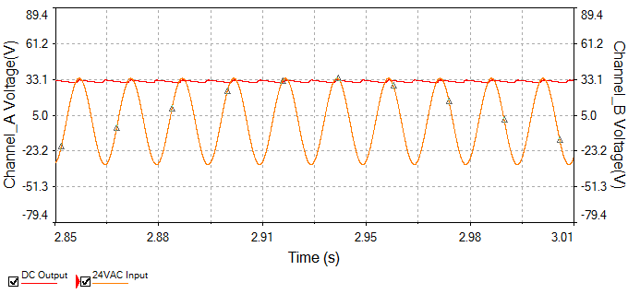
Main Controller Power
Plug in to existing 24VAC supply
Output 24VAC to components
Full wave rectifier Provide adequate current, proper regulators(both linear and switching)
Provides multiple 5V and 3.3V Outputs

Slide 13
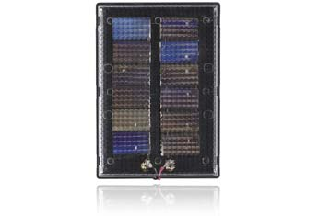
Remote Control Unit Power
Solar Panel 6.0 VDC/40 mA power supply
Battery holder for AA rechargeable battery
Output 3.3V and 5V

Slide 14
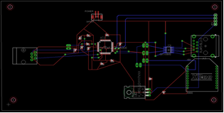
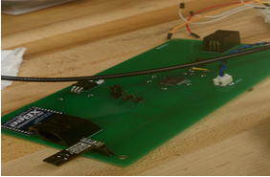
Secondary PCB
Eagle CADSOFT
Schematic
Correct part sizes
PCB routing

Slide 15
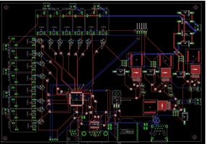
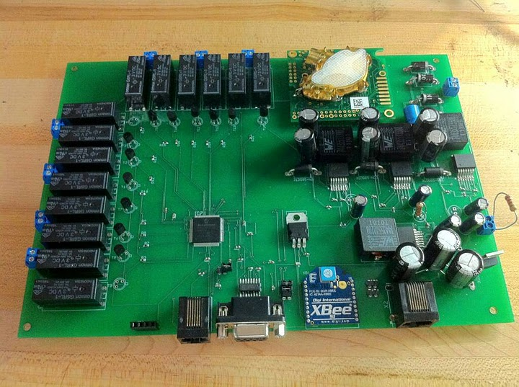
Main PCB
Eagle CADSOFT
Make Parts
PCB Routing
Wire width

Slide 16
PCB Power
Matthew Arcuri

Slide 17
PCB Power
ARM Microcontroller Board
5V @ 4A
PIC 24FJ128GA010 and Xbee Wireless
3.3V
Relays
3.3V @ .1A (x14)
Temperature, Humidity, and CO2
5V

Slide 18
PCB Power
Main Board
Mainly Switching Regulators
Was due to high current requirements on some components
Compared to linear regulators switching regulators are far more efficient when dealing with high current components

Slide 19
PCB Power
Remote Board
Battery powered – 2xAA = 3V
Low Power Use
XBee, Microcontroller, Humidity/Temp.
Used Linear Regulators
3.3V and 5V

Slide 20
National Instruments LM2679
Why this switching regulator?
Available in 3.3V, 5V, 12V and adjustable voltage models
Well documented datasheets
Cost effective for our budget
Free web based simulation software to double check our work

Slide 21
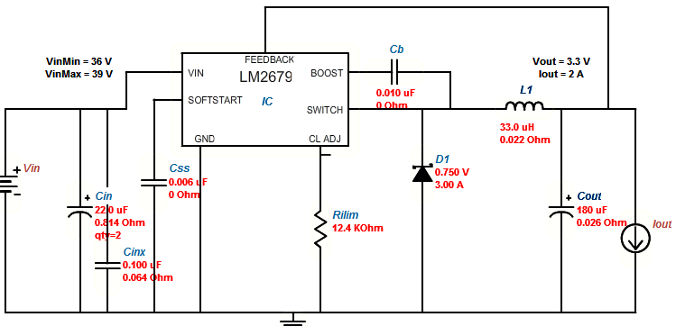
National Semi. LM2679

Slide 22
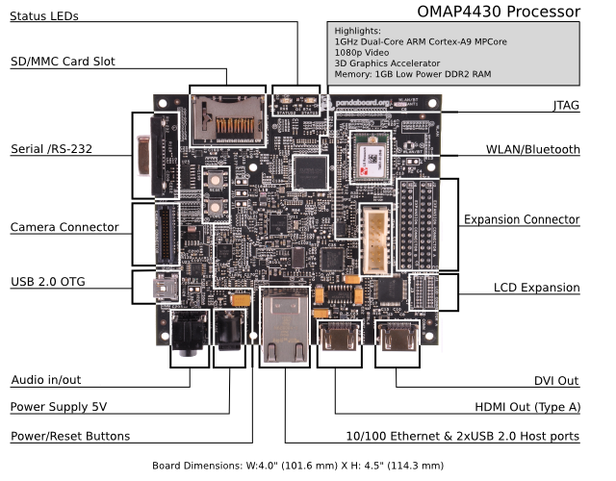
GUI Display
ARM microprocessor
Best price for performance
Low power
Operating System
Flexible
Android, Numerous Linux Distributions
User Interface
Powerful for a Responsive Interface even with additional features

Slide 23
Why did we choose Panda?
 | Pandaboard | Beagleboard | Linksprite | Gumstix
Dedicated RS232 | YES | YES | Yes, 2 | NO
WIFI | Built in | Addon USB Module | Addon USB Module | Addon USB Module
Screen Connectivity | USB and HDMI | USB and HDMI | Ribbon | HDMI, ribbon
Support | Active support Forums, internet mailing list | Forums, phone, internet. | Phone, limited forum | Mail list, forums, phone
Voltage | 5 V | 5 V | 12V | 5V
Cost | $174.00 | $149.00 | $279.00 | $442.00

Slide 24




Operating Environment
Operating System: Ubuntu Linux
Integrated Development Environment(IDE): Oracle JDeveloper
Programming Language: Java

Slide 25
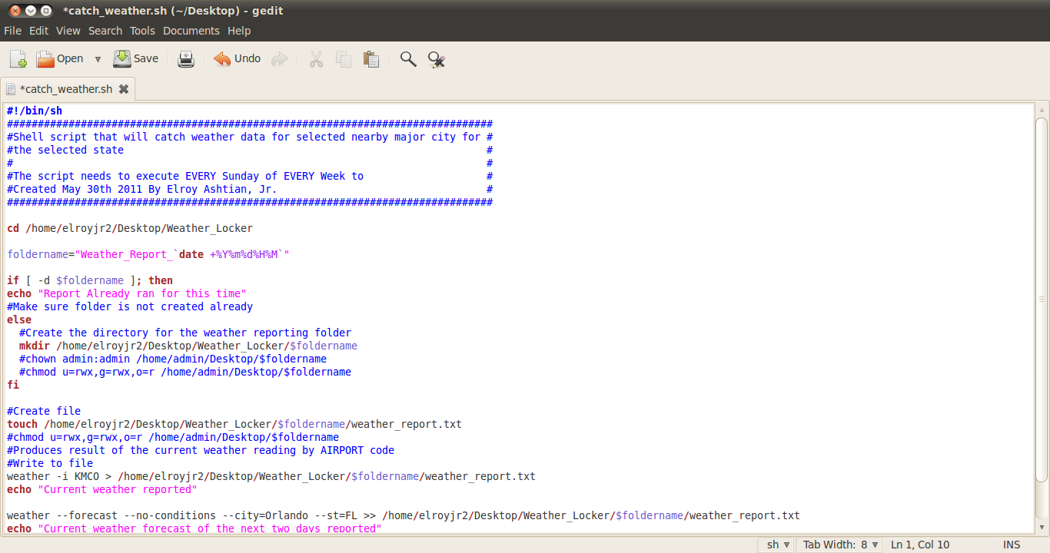
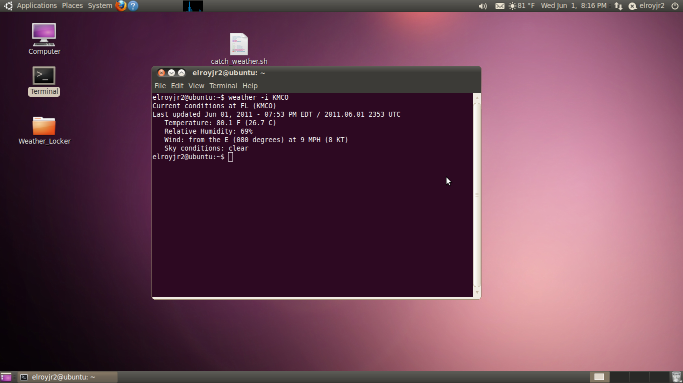
Key Features of Ubuntu on ARM
Kernel support of Wi-Fi drivers for Internet Connectivity
Date/Time
Accuracy
Stable and customizable host environment
Very Powerful Shell Scripting

Slide 26
Remote Access
User should be able to login remotely from any web browser
Features:
Remotely view current status of system and sensors
Similar user interface to the main control unit

Slide 27
Remote Access Website
Apache
Widely used – used by most internet sites currently
Modular in that advanced web site features can be added, such as PHP.
Implemented the PHP in remote access design
Somewhat resource intensive.
Apache was responsive on the ARM processor even with the Java client program

Slide 28
Remote Access Website
PHP reads from CSV file created by Java Program
File is read into an associative array
Values are called as need in HTML code
Updated every 5 seconds

Slide 29
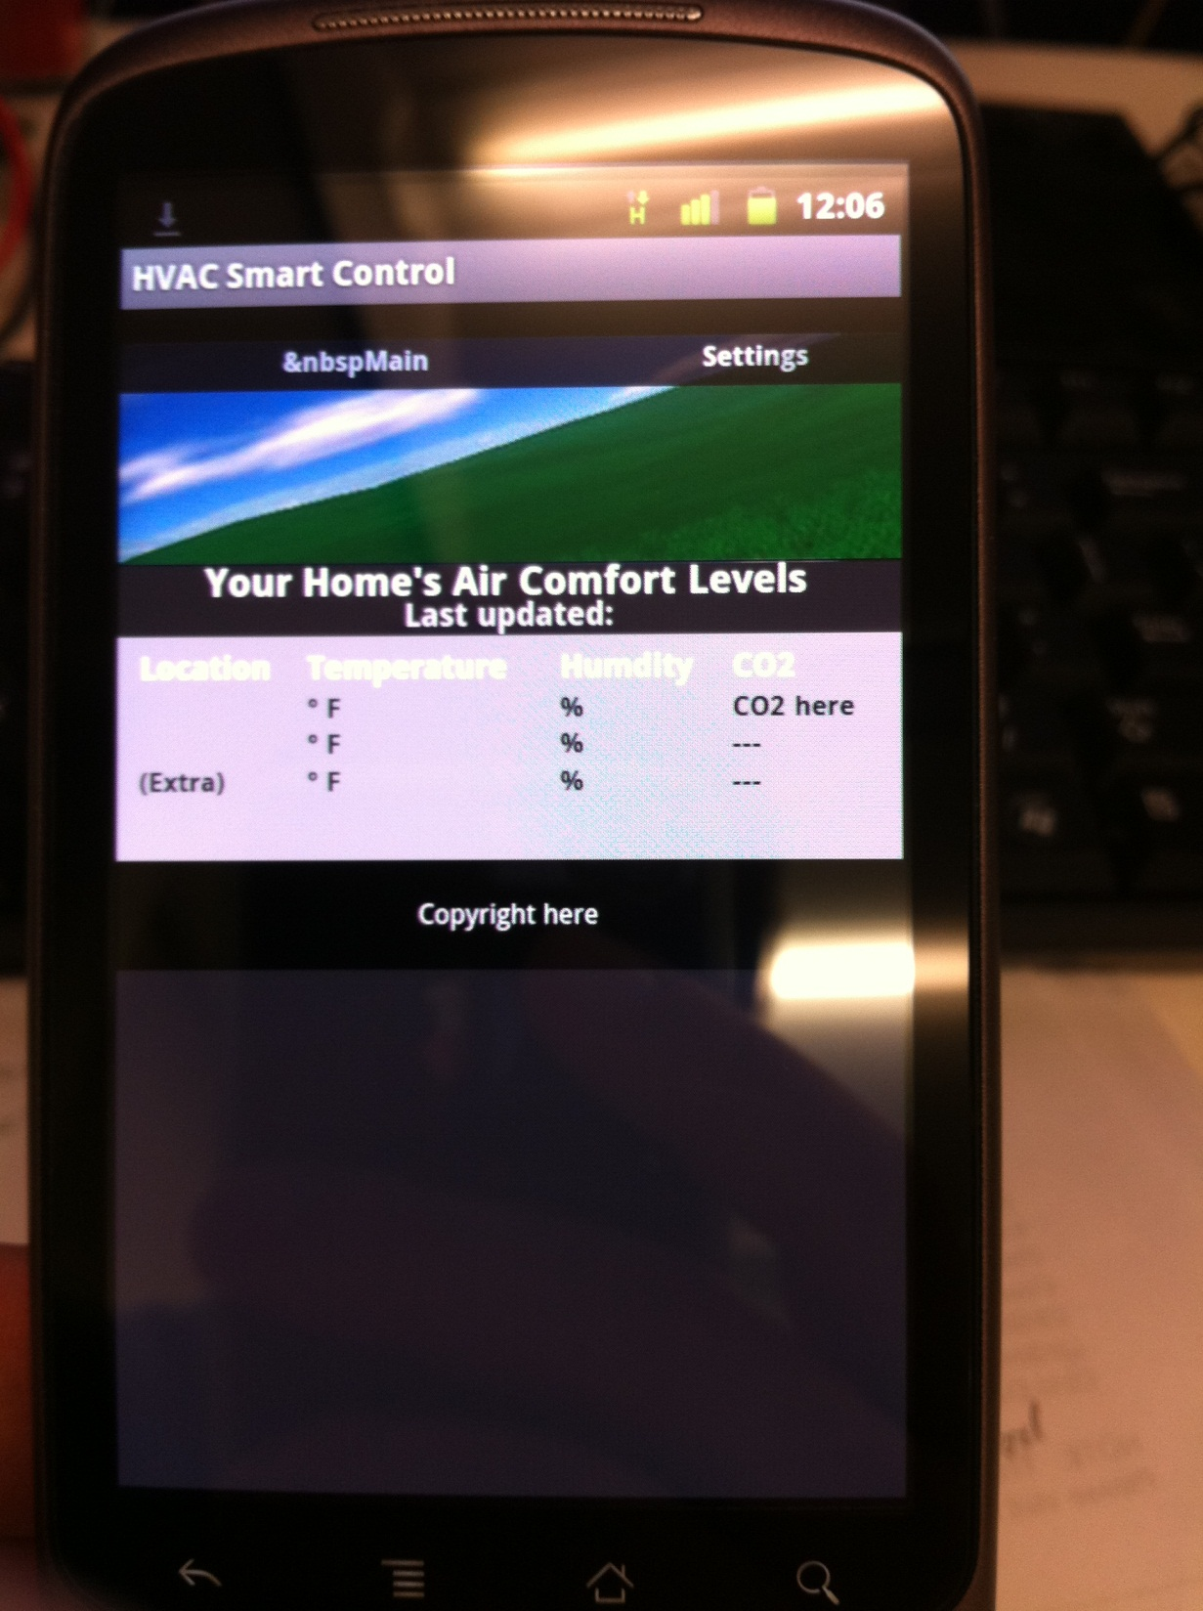
Mobile Website On Smartphone

Slide 30
Remote Update
Implemented using shell script
Order of Operation:
Checks to see if there is an internet connection
Pop up informing the user that there is none
Logins to preconfigured FTP server
Pop up informing user if it can’t connect to the FTP server
Checks version number in file with version number in file on FTP site
If the version number is different: pop up informs the user and it downloads a new version
If the version number is the same: pop up informs user
At the end it reloads the program.

Slide 31
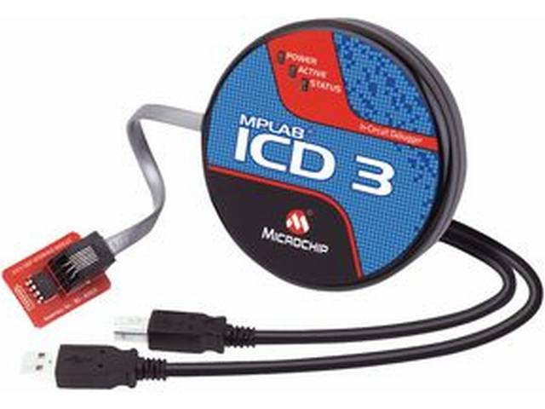
Embedded System
Jerthwin Prospere

Slide 32
Microcontrollers
PIC24FJ128-GA010/GA006
Able to develop using Explorer 16 DEV
Features
C Compiler optimized instruction set
128K bytes of Flash
30K bytes of RAM
85/53 Programmable I/O pins
Supports 2 I2C modules
Supports 2 UART modules

Slide 33
DATA FLOW
CO2 Sensor
Temp/Hum Sensor
PIC24FJ128GA010
Main Microcontroller
XBEE
Control Relays
RS-232
Display Unit

Slide 34
Remote Control Unit
Temperature and Relative Humidity Sensor
PIC24FJ128GA006
Secondary
Microcontroller
XBEE
Main Control Unit

Slide 35
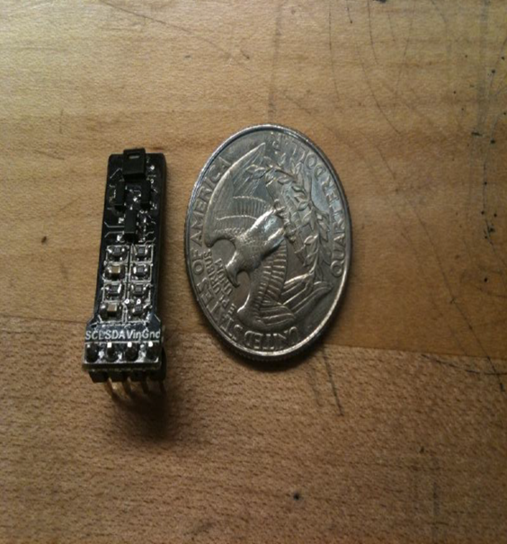
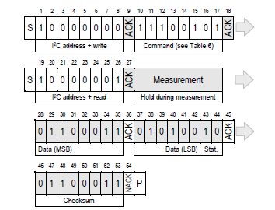
Temperature/Humidity Sensor
I2C Connectivity
Low Power
A/D conversion on board
Min:2.1 V Typ: 3.6V Max: 5V
RH = -6 + 125 * (Srh/2^16) units % RH
T = -46.85 + 175.72 * (St/2^16) units °C

Slide 36
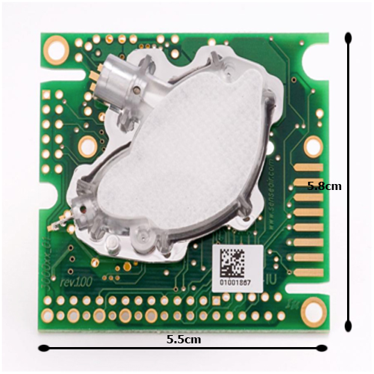
CO2
Sensair’s K30
0-5000PPM +/- 3%
I2C
Built in A/D converter

Slide 37
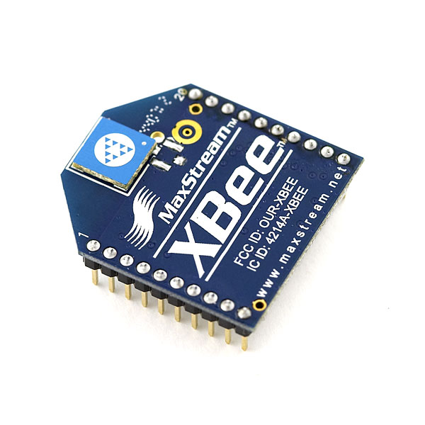
UART
XBEE Wireless Device (802.15)
Chip Antenna
Min: 2.8V Typ: 3V Max: 3.4V
Communication between Main and Remote Unit

Slide 38
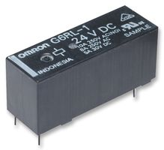
Relays
Outputs from the MCU
Used to control the 24V AC signals: AC1, AC2, Heat1, Heat2, Filter, Fan, Mood 1, Mood 2, NA, NA Dilute, OTH1, OTH2, DH and Zone

Slide 39
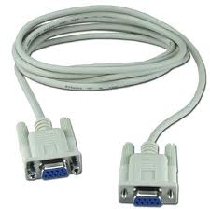
UART- RS232
Communication to Display Unit
Interrupt Service Routines to handle received data
UART Protocol to send inside/outside data to display unit: temperature, humidity and CO2
Indicators: i-t-data or i-c-o-data

Slide 40
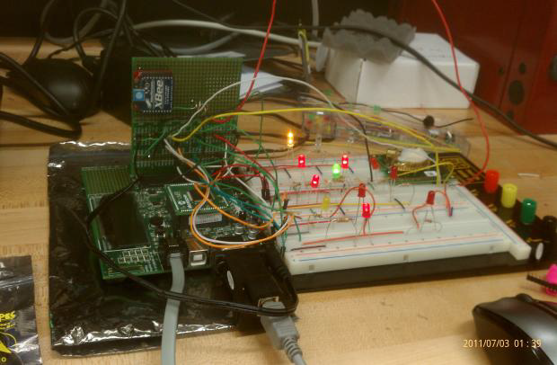
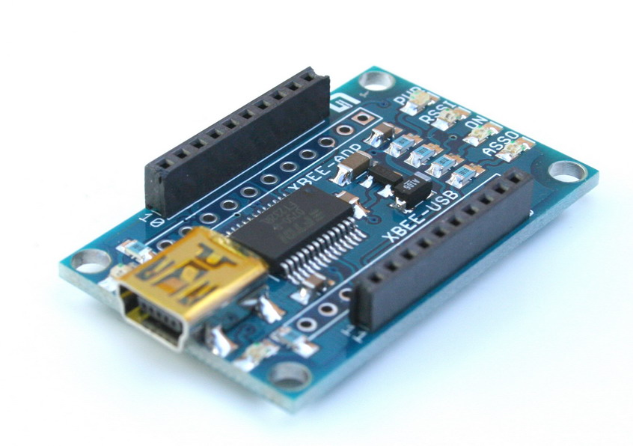
Testing
LEDs used to indicate components
XBEE to USB to simulate Remote Unit
XCTU to receive data from main unit

Slide 41
Software
Elroy Ashtian Jr.

Slide 42
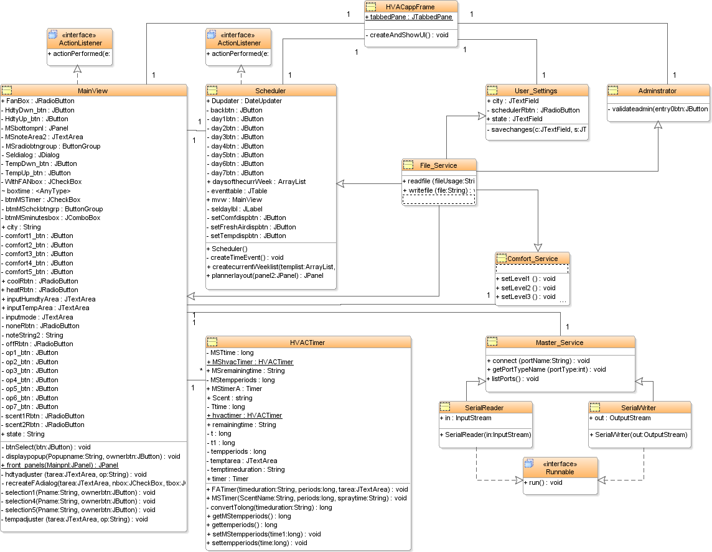
Class Diagram

Slide 43
Use Case Diagram

Slide 44
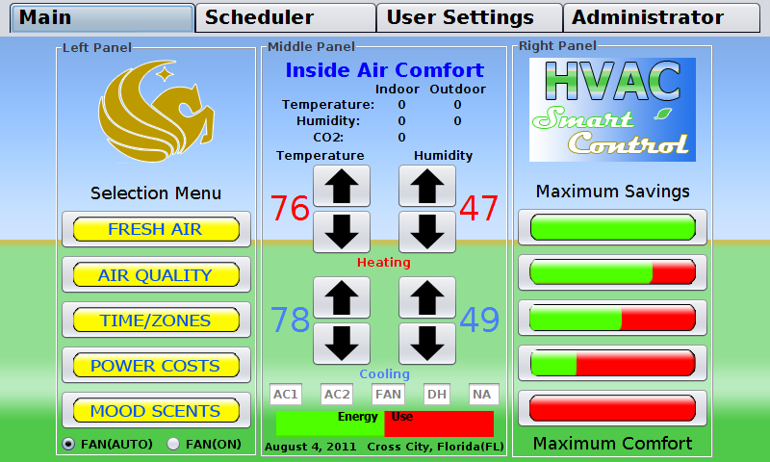
User Interface Main Tab

Slide 45
Selection Menu Options

Slide 46
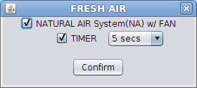
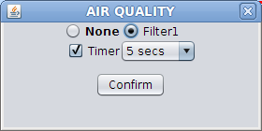
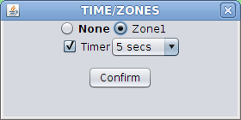
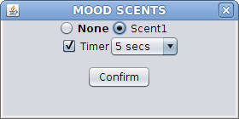
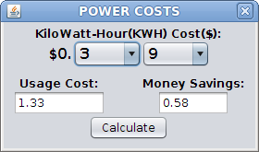
Selection Menu Options
Options:
Timer

Slide 47
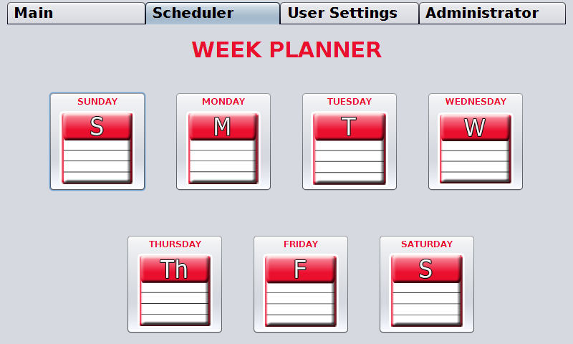
Scheduler Tab

Slide 48
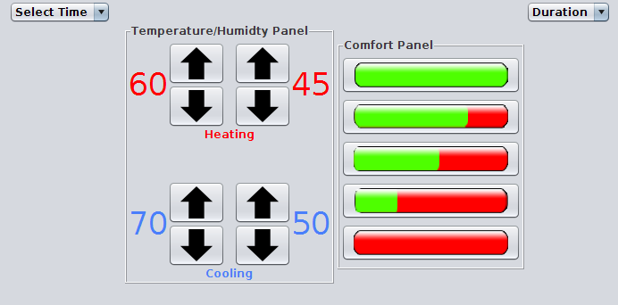
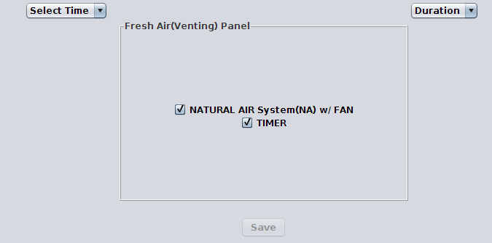
Scheduler Tab Set Temperature / NA

Slide 49
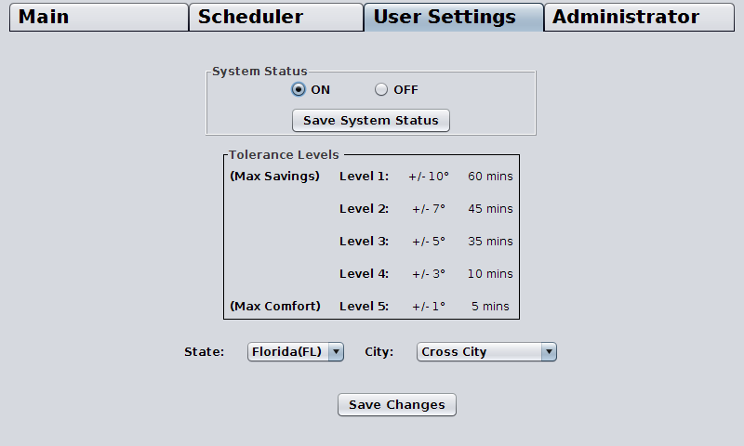
User Settings Tab

Slide 50
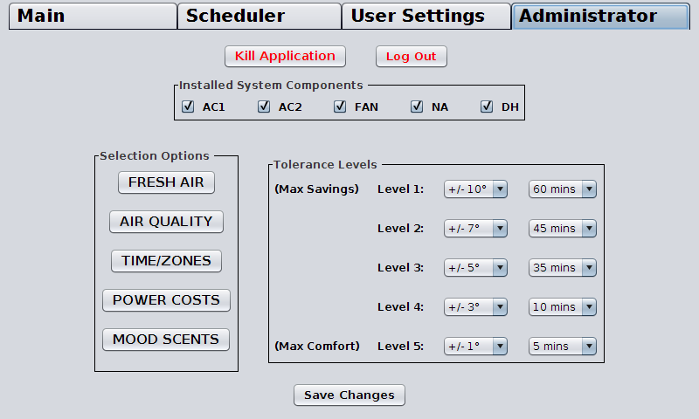
Administrator Tab

Slide 51
Questions?

