Slide 1
HVAC 2011
Steven Jones
Jerthwin Prospere
Matthew Arcuri
Elroy Jenkins

Slide 2
HVAC
Heating
Ventilation
Air Conditioning
To provide a more energy efficient HVAC system, with enhanced user interface and over all more interactivity and control.

Slide 3
Project Overview
Energy efficiency will allow the user to save money on a monthly basis due to reduced power consumption.
Enhanced User Friendly interface through a wall mount touchscreen thermostat.
Web connectivity- allow settings to be changed via the internet.
Allow user to set a schedule of operation for the units. Specifically temperature.
Restricted access to technician to allow flexible configuration of devices. (Adaptive to save user money if they can’t afford all the units.

Slide 4
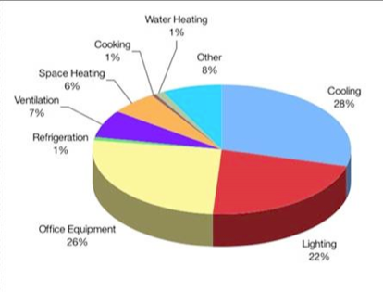
Energy Use
“As much as half of the energy used in your home goes to heating and cooling”. Energystar.gov.
HVAC systems are rated for certain sizes and to deal with certain temperatures. It would be better to make a system that can handle more than one set of ratings for maximum energy efficiency.

Slide 5
Controllable Saving Cost
Zoning houses
Increasing ease and power of scheduling
Smart use of air conditioners
Seer rankings
Split ton units

Slide 6
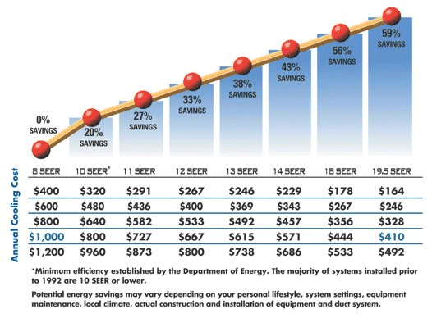
SEER
Seasonal
Energy
Efficiency
Rating
Standard the Air Conditioning, Heating, and Refrigeration Institute standardized to rate the performance of air conditioners.

Slide 7
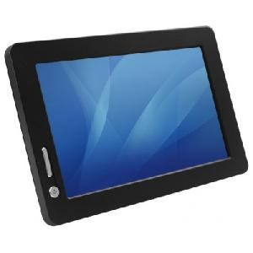
Enhanced user interface
Mood Scents
Vent control
Scheduler
Web applications
Air quality
7” Touch Screen

Slide 8
Goals and Objectives
Accurately read temperature and relative humidity both inside and outside building.
Internet connectivity (User can view and manipulate system settings from a remote location)
CO2 monitoring for a gauge of air quality
Mood scents
Vent control through zoning
Wired/wireless connectivity to external unit
Finish the user interface, including scheduling and more refined display
Must be expandable

Slide 9
Goals and Objective
Allow the user to input their desired temperature and humidity settings.
Determine the most efficient components to use during operation based on the settings of “max comfort or “max savings”
Display the current percentage of total system energy from the system using a scroll.
System must be able to be installable without the hassle of wiring.

Slide 10
Specifications
1 CO2 Sensor with accuracy within 100ppm
Wireless transmission of temperature and humidity over a distance of 100 feet
Temperature sensor with accuracy within 1 degree and limits from 0 to 110 F
Humidity sensors with accuracy of 1% and range from 0% - 100%
Ability to be directly installed into existing 24VAC system
Ability to simulate at least 2 mood scent dispersion
Ability to simulate control of at least 2 zones
Implementation of scheduler within 5 minute for entire days of 1 week schedule
Total cost less than $1500

Slide 11
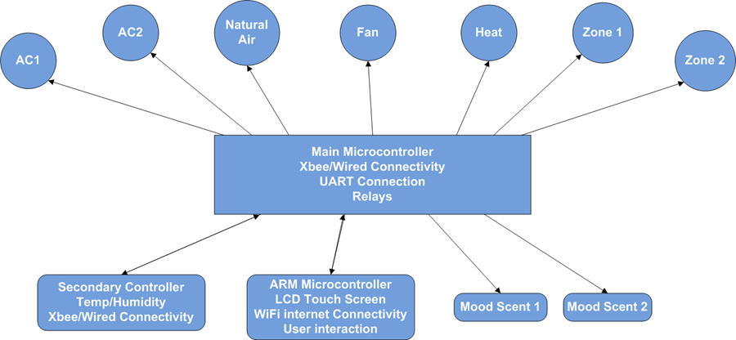
Block Diagram

Slide 12
Components
LCD Display Unit
Panda Board
TI OMAP 3550
Ease of Wifi connectivity
7 inch LCD Touch Screen
Main Control Unit
control relays
dsPIC33F (Main microcontroller)
Xbee 802.15 Transceiver
Temp/Relative Hum sensor
CO2 Sensor

Slide 13
Component Overview
Remote Control Unit
PIC24FJ128GA006 (Secondary Microcontroller)
Xbee 802.15 Transceiver
Temp/Relative Humidity Sensor
Ethernet
Solar Panel

Slide 14
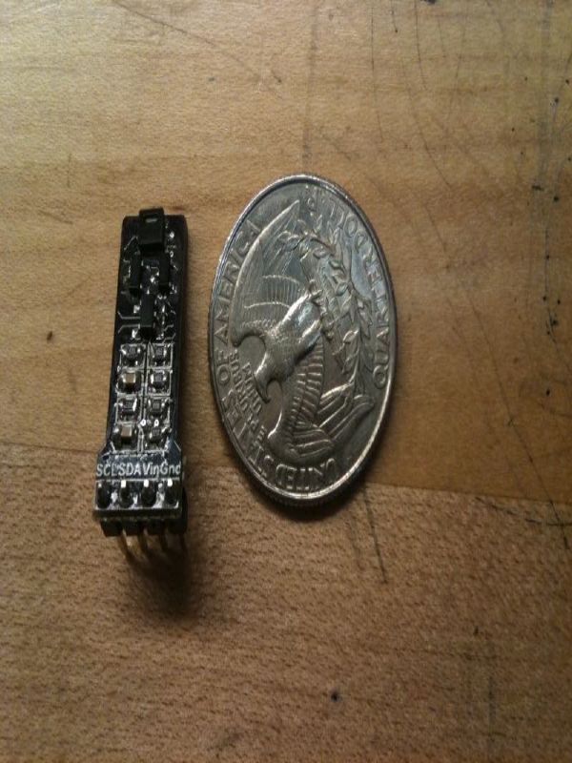
Temperature and Humidity
I2C Connectivity
Low Power
A/D conversion on board

Slide 15
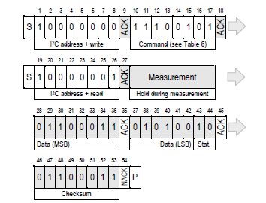
Temperature Sensor I2C
SCL and SDA lines
Formulas for Calculating Temperature and Humidity
RH = -6 + 125 * (Srh/2^16) units % RH
T = -46.85 + 175.72 * (St/2^16) units °C

Slide 16
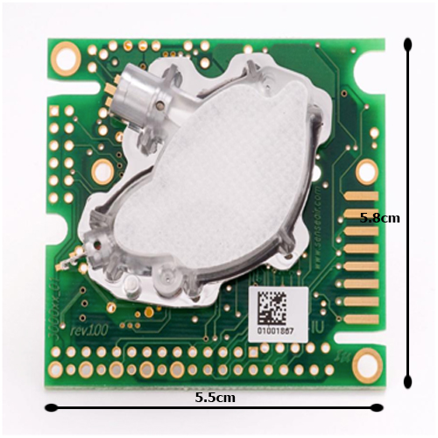
CO2
Sensair’s K30
0-5000PPM +/- 3%
I2C or UART
Built in A/D converter

Slide 17

Relays
Zone Venting
Traditional to power A/C and Heat
Mood scent
24VAC output, controlled by main microcontroller
Protection from relay using BJT or Diode to prevent feedback surge

Slide 18
Problems with old design (Software)
Slow
Used BMP images with C overlay
Lacked full functionality
Unorganized Code

Slide 19
Problems with old Unit (Hardware)
Rectifier (Diodes)
Wifi chip
Blown regulators

Slide 20
Main Control Unit
Components: SHT21 sensor, dsPIC33FJ256GP710A main microntroller, Xbee wireless transceiver
Powered by 24 V AC which is installed for thermostat in the construction of the house
Component | Min Operating Voltage(V) | Typical Operating Voltage(V) | Max Operating Voltage(V)
dsPIC33 | 3 | N/A | 3.6
Xbee | 2.8 | 3 | 3.4
SHT21 | 2.1 | 3 | 3.6

Slide 21
Main Microcontroller
Reasons for Choosing dsPIC33FJ256GP710A
Had the Explorer 16 Development Board already in hand
Proven to be sufficient based on the workability from the previous version
Features
C Compiler optimized instruction set
256K bytes of Flash
30K bytes of RAM
85 Programmable I/O pins
Supports 2 I2C modules
Supports 2 UART modules

Slide 22
Functions of Main Microcontroller
Reads in temperature, relative sensors and carbon dioxide level from sensors
Convert the data
Turn the Relays on and off
Grabs Remote Control Unit data from XBEE
Communicate with Display Unit
Serial Communication: RS232

Slide 23
DATA FLOW
CO2 Sensor
K30
SHT21
Temp/Hum Sensor
I2C Interface
I2C Interface
dsPIC33FJ256GP710A
Main Microntroller
UART Interface
I/O Ports
4214A-Xbee
802.15 Wireless Transceiver
Control Relays
RS-232
7” LCD Touch Screen Display

Slide 24
Remote Control Unit
SHT21
Temperature and Relative Humidity Sensor
PIC24FJ128GA010
Secondary
Microcontroller
XBEE
802.15 Wireless Transceiver
I2C
Main Control Unit

Slide 25
Functions of Secondary Microcontroller
Take input from Temperature and Relative Humidity Sensor (14 bits)
Convert the data from the sensor to temperature and humidity
Send information to Main Control Unit
Wirelessly via XBEE
Wired Ethernet

Slide 26
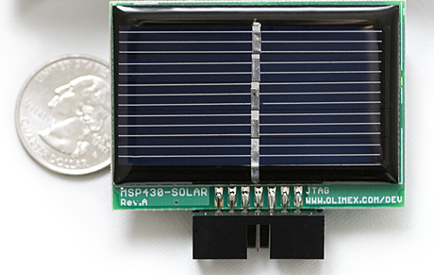
Remote Control Unit Solar Panel
Used to charge the batteries
Solar Panel 2.4 VDC/80 mA power supply
Battery holder for AA rechargeable battery

Slide 27
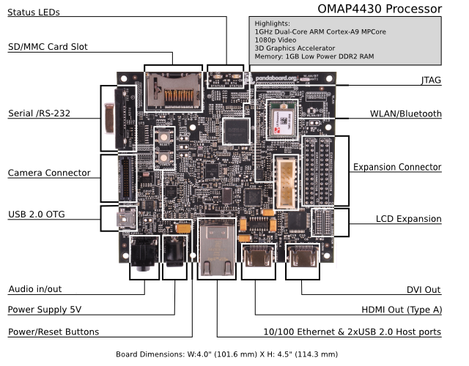
GUI Display
Why ARM?
Which system to use?
Cost?

Slide 28
Why did we choose Panda?
 | Panda | Beagle | Linksprite | Gumstix
RS232 | YES | YES | Yes, 2 | NO
WIFI | Built in | USB Module | USB Module | USB Module
Screen Connectivity | USB and HDMI | USB and HDMI | Ribbon | HDMI, ribbon
Support | Active support Forums, internet, phone | Forums, phone, internet. | Phone, limited forum | Mail list, forums, phone
Voltage | 5 V | 5 V | 12V | 5V
Cost | $174.00 | $149.00 | $279.00 | $442.00

Slide 29




Operating Environment
Operating System: Ubuntu Linux
Integrated Development Environment(IDE): Oracle JDeveloper
Programming Language: Java

Slide 30
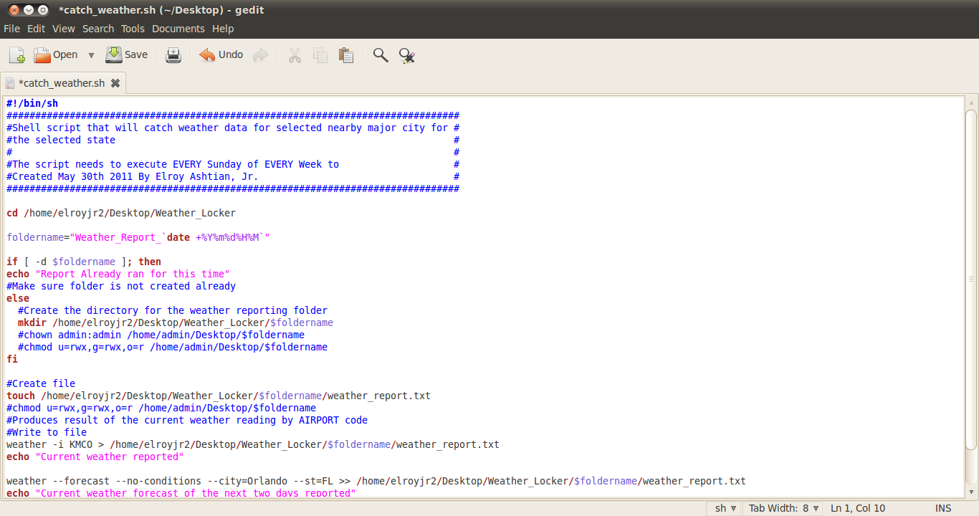
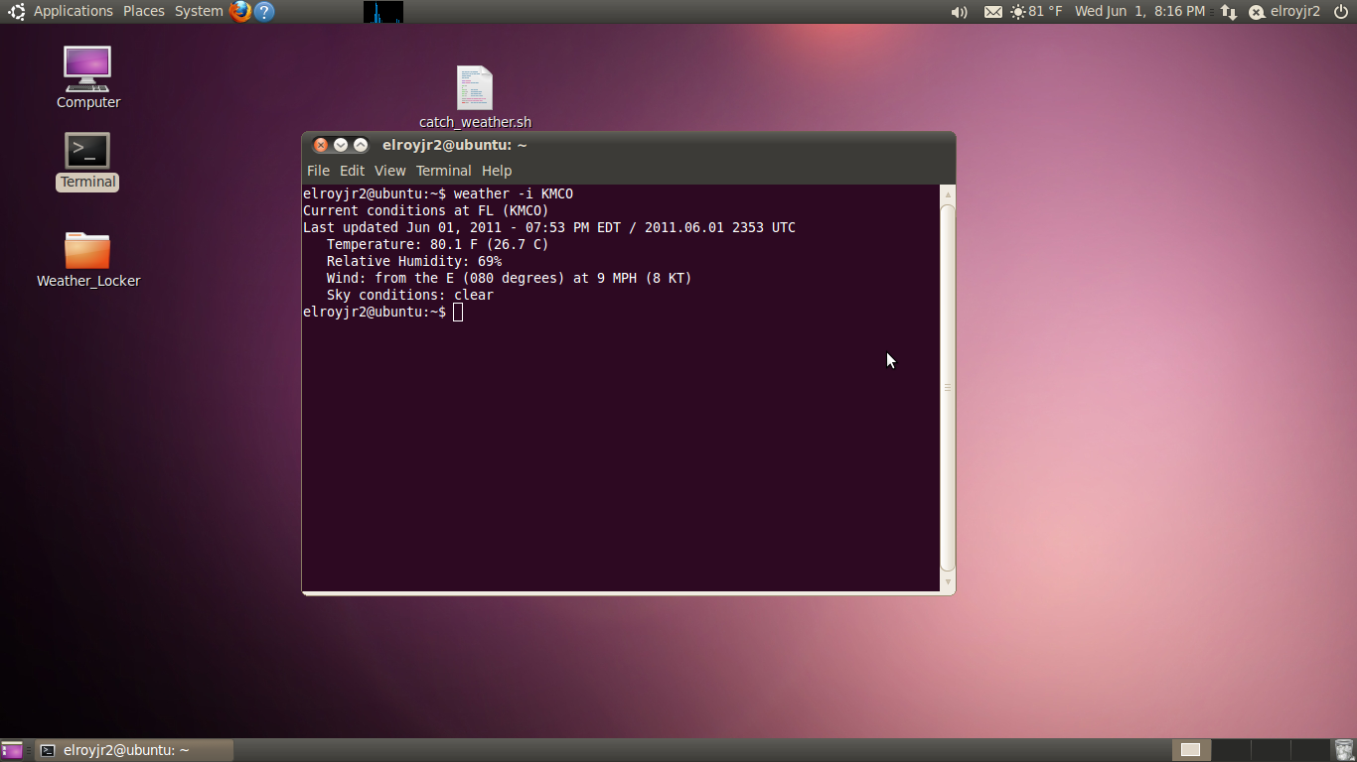
Key Features of Linux
Weather notification
Shell Scripting w/ weather-util
Internet Connectivity
Date/Time
Accuracy
Stable host environment

Slide 31
Remote Access (via HTTP)
User should be able to login remotely from any web browser securely
Features:
Remotely view current status of system and sensors
Similar user interface to the main control unit
Remotely change settings such as increase temperature at which the AC unit will turn on

Slide 32
Remote Access Options
Design remote access within client Java application
Lighttpd – minimal HTTP server for Linux
Thttpd
Apache HTTP server

Slide 33
HTTP Server – Apache
Security in being open source and the larger user base
Apache is used as the backend webserver for a very large portion of the internet and is checked for security issues for each major release
Combination of both Linux and Apache allows for minimal overhead and a responsive system
Modular in that advanced web site features can be added, such as PHP
HTTP standard compliant

Slide 34
Class Diagram

Slide 35
Use Case Diagram

Slide 36
User Interface Main Tab

Slide 37
Selection Menu Options

Slide 38
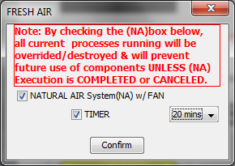
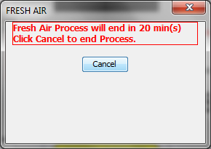
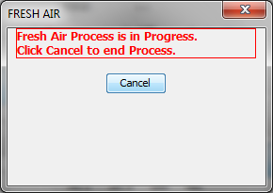
FRESH AIR
Options:
Timer
No Timer

Slide 39
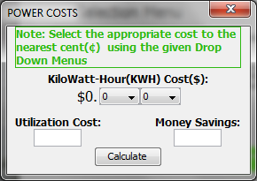
POWER COSTS
There are many factors to power savings with this device.
We choose power savings in relation to a traditional set up with just air conditioner system alone.
The following equation is how energy consumption is calculated per unit.
unit size, BTU/h × hours per year, h × energy cost, $/kW·h ÷ SEER, BTU/W·h ÷ 1000 W/kW

Slide 40
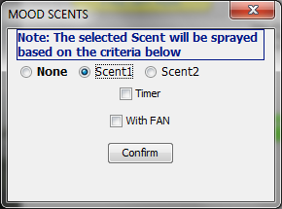
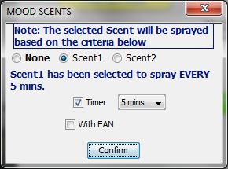
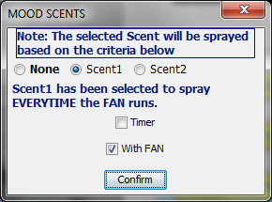
MOOD SCENTS
Options:
Scent Selections
Timer
With FAN

Slide 41
Scheduler Tab

Slide 42
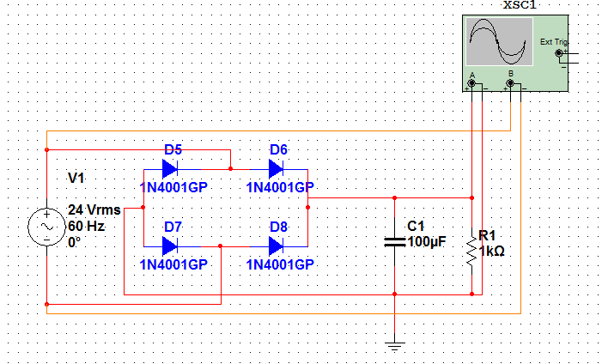
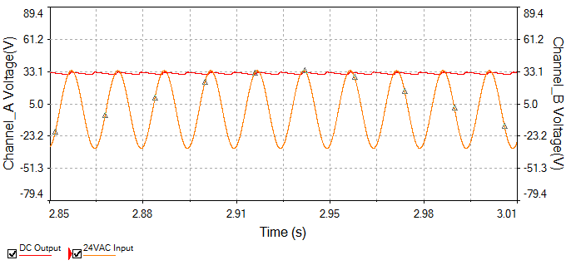
POWER
Plug in to existing 24VAC supply
Output 24VAC to components
Full wave rectifier
Provide adequate current, proper regulators

Slide 43
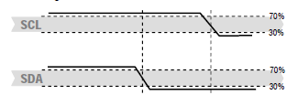
Design Issues
I2C PIC24F16KA102: Master Bus Collision for the first Start Sequence (Silicon Errata)
Bit Banging- Put SDA line low and high while SCL line is held high
Resolution: Change to the PIC24FJ128GA010

Slide 44
Progress

Slide 45
Questions?

