Slide 1

The BearMax Project
Committee
Group 28
Dr. Chung Young Chan
Dr. Joon-Hyuk Park
Dr. Matthew Gerber
Dr. Mark Maddox
Dr. Andrew Steinberg
Bhavani Sivakumaar
Nicholas Buchberg
Raahym Khan
Zachary Larson

Slide 2
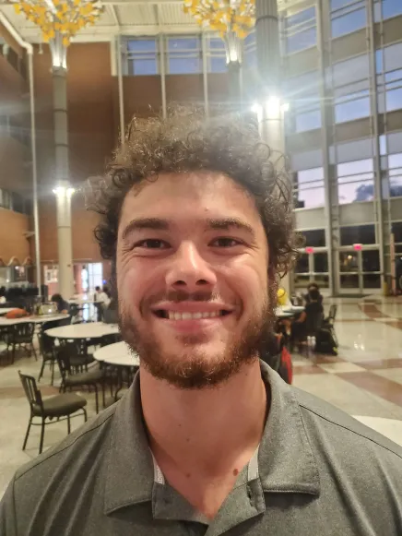


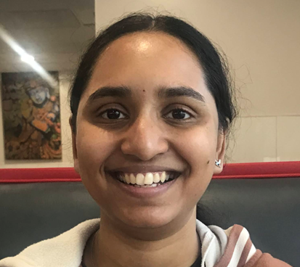
Team Members
Raahym Khan: Computer Engineering
Zachary Larson: Computer Engineering
Bhavani Sivakumaar: Mechanical Engineering
Nicholas Buchberg: Mechanical Engineering

Slide 3

Notes:
Bhavani
Look at the designing the mind of a social robot paper Zach researched of how robots are good with kids with autism bc humans are unpredictable, whereas robots are predictable and a good practice method
Script:
BearMax is a robot designed to help people with Autism Spectrum Disorder to recognize and understand various social situations
Therapy robots are used in the medical field for a variety of different reasons including teaching children with ASD to identify emotions
According to “Designing the Mind of a Social Robot” a research paper in the Applied Sciences Journal, social robots are predictable which is an advantage as people can practice on it and it can be modified many times catering to the user’s specific needs. Sometimes human interactions can be confusing whereas the predictable aspect of social robots allow the user to become comfortable and master different scenarios that can help build confidence in the long run for social interactions.
[17] N. Lazzeri, D. Mazzei, L. Cominelli, A. Cisternino, and D. De Rossi, “Designing the Mind of a Social Robot,” Applied Sciences, vol. 8, no. 2, p. 302, Feb. 2018, doi: 10.3390/app8020302.

Slide 4
What is Bearmax?
Bearmax is a social emotional learning robot designed to be able to detect, analyze, and perform emotions for the purpose of therapy for children on the autism spectrum. The main avenue to achieve this will be through the “emotion game”. Where Bearmax copies a target emotion from the child.
Bearmax is to be capable of performing 8 emotions
Happy, sad, angry, confused, shocked, worried, scared, and disappointed

Slide 5
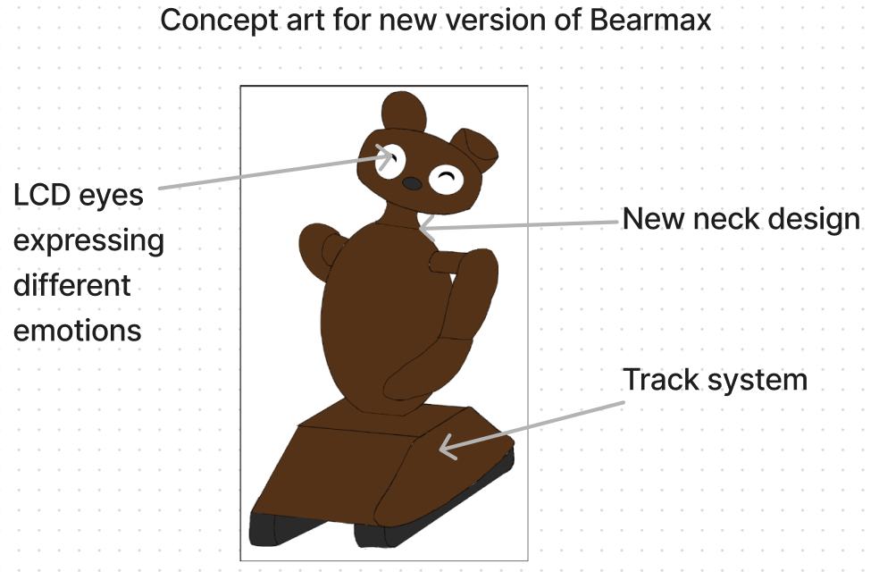
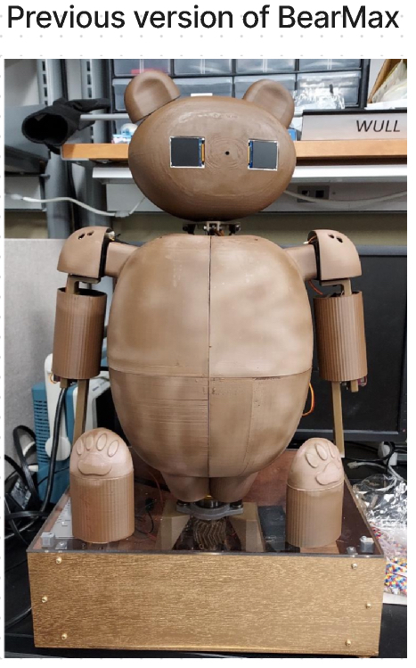
BearMax Concept
Version 1
Version 2 Concept

Slide 6
Goals and Objectives
Improve Version 1 of BearMax
Electrical system upgrade (CE team)
Mobilize BearMax (ME team)
Larger freedom for movement (ME team)
Non-verbal user inclusivity (Collaboration with CS team)
App for users and guardians (Collaboration with CS team)
And more!
Notes:
Bhavani
This is the 2nd iteration of BearMax
One of our main goals is to expand upon the successes of the first version.
Some of our goals include to add more emotions and a larger range of emotions BearMax can express that users can learn and recognize, upgrade the electrical system, mobilize BerMax and collaborate with the Computer Science team to have additional methods for users to communicate with BearMax, either through the app or a touch screen.
Zach and/or Raahym talk about how the first robot used a single breadboard for all electronics and now we can use a PCB thanks to CE’s on the team!

Slide 7
Goals and Objectives
Improve Version 1 of BearMax
Larger freedom for movement (ME)
Non-verbal user inclusivity (Integrate with CS)
App for users and guardians (Integrate with CS)
Version 1 | Version 2
Stationary | Mobile (ME)
Breadboard | PCB (CE)
Basic emotions | Larger range of emotions (ME/CPE)
Notes:
Bhavani
This is the 2nd iteration of BearMax
One of our main goals is to expand upon the successes of the first version.
Some of our goals include to add more emotions and a larger range of emotions BearMax can express that users can learn and recognize, upgrade the electrical system, mobilize BerMax and collaborate with the Computer Science team to have additional methods for users to communicate with BearMax, either through the app or a touch screen.
Zach and/or Raahym talk about how the first robot used a single breadboard for all electronics and now we can use a PCB thanks to CE’s on the team!

Slide 8
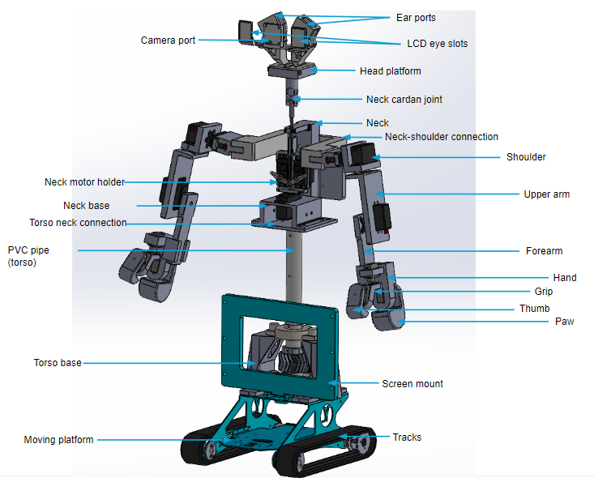
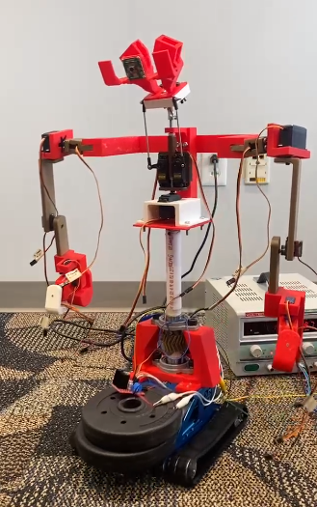
Hardware Design
CAD model of Skeleton
Robot Skeleton

Slide 9
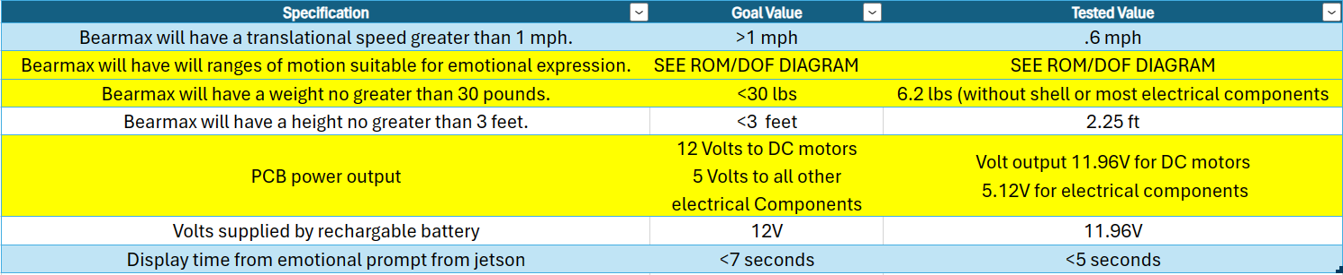
Specifications

Slide 10
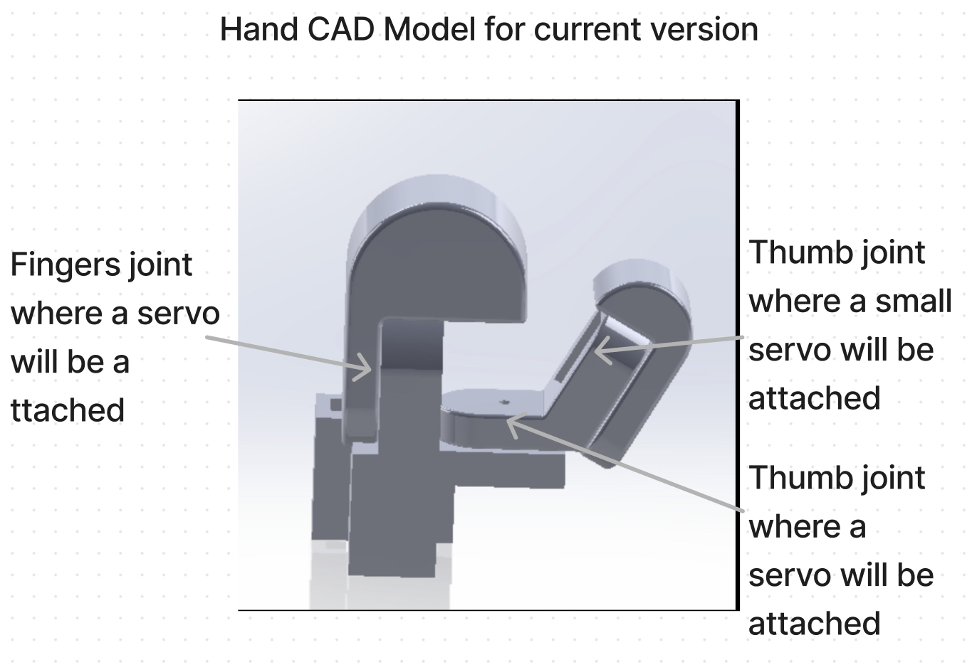
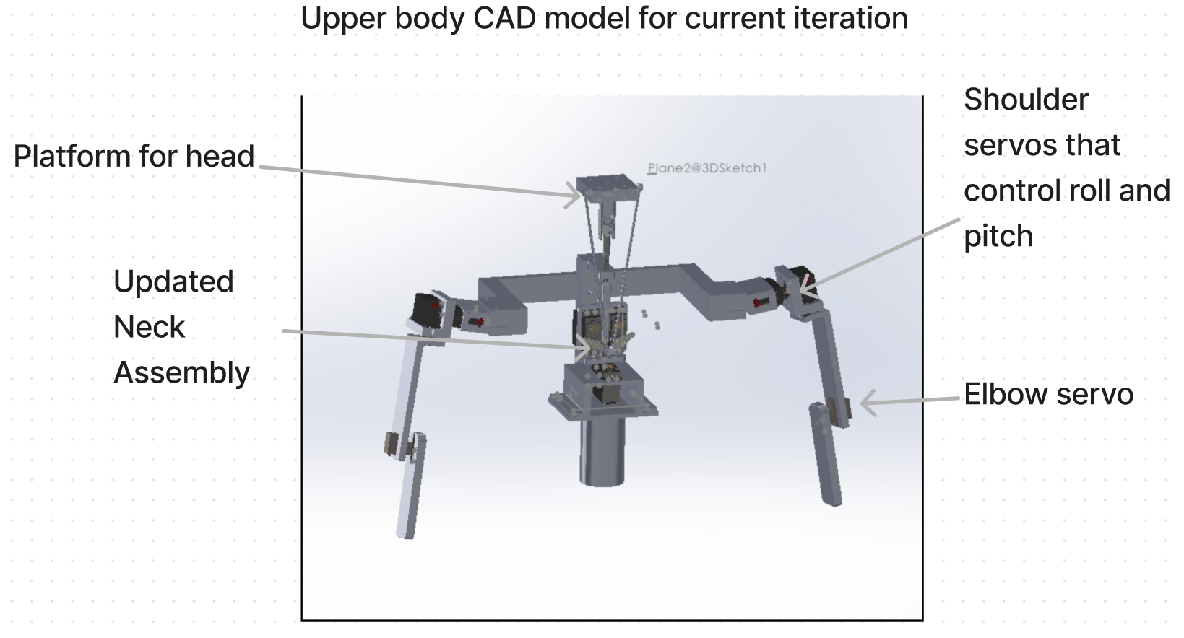
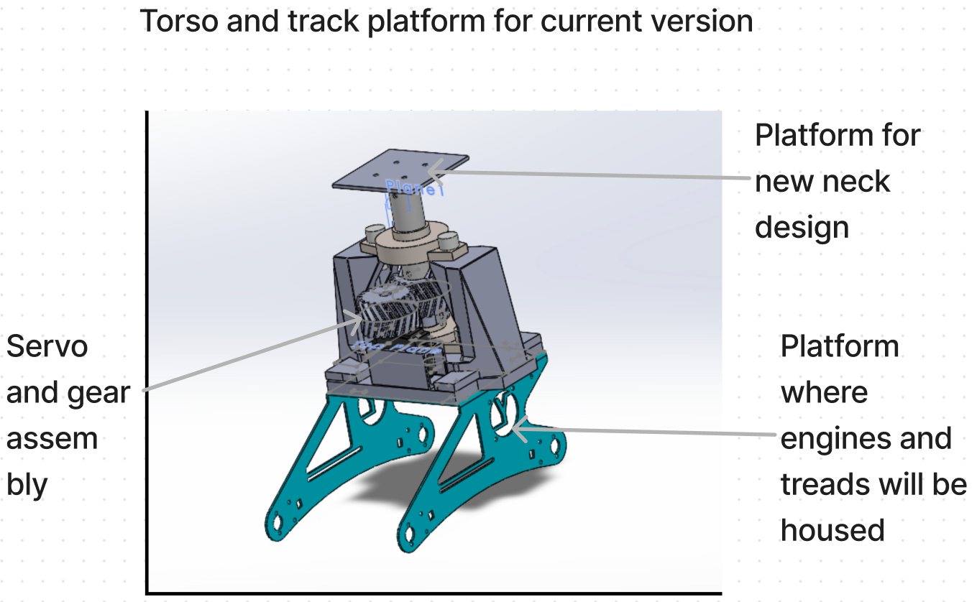
Mechanical Design Diagrams

Slide 11
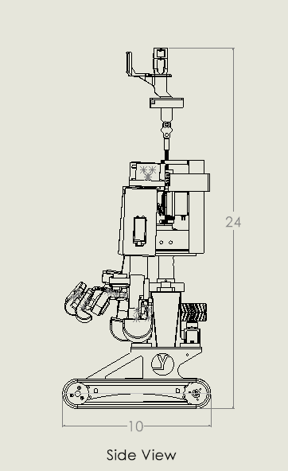
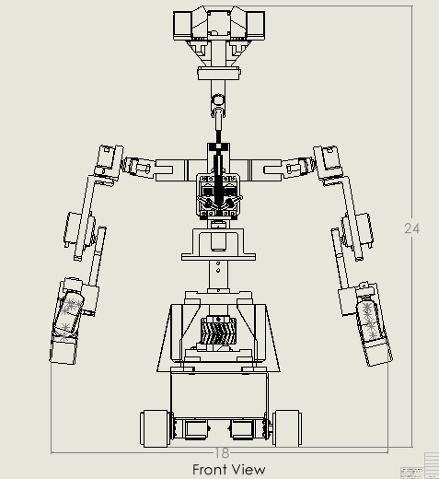
All dimensions are in inches
Notes:
Bearmax’s dimension specifications are as shown in these two images of the side and front view of the skeleton. BearMax’s total length or span is about 1 and a half feet at rest, 10 inches in depth, and approximately 2 feet in height.

Slide 12
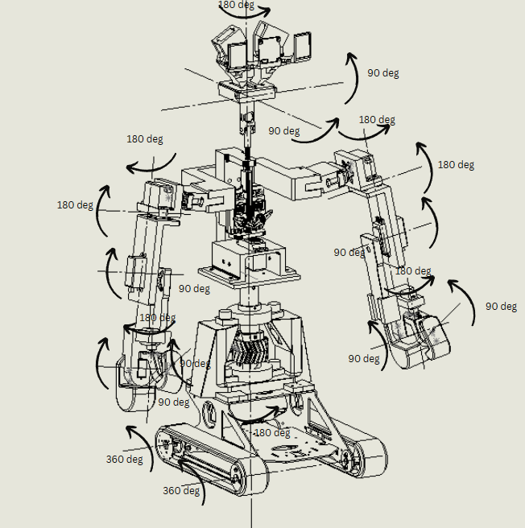
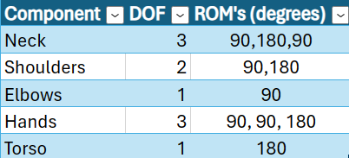
ROM Diagram and DOF chart
ROM’s were tested with servo tester.
All sections met specified angle requirements.

Slide 13
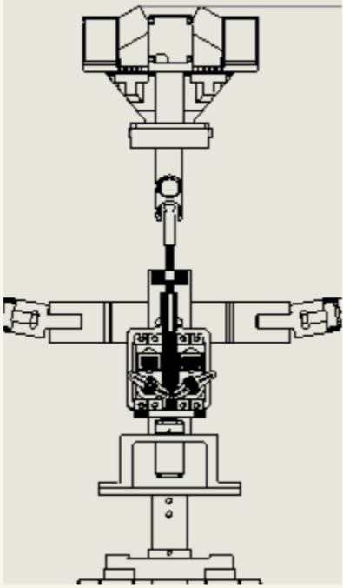
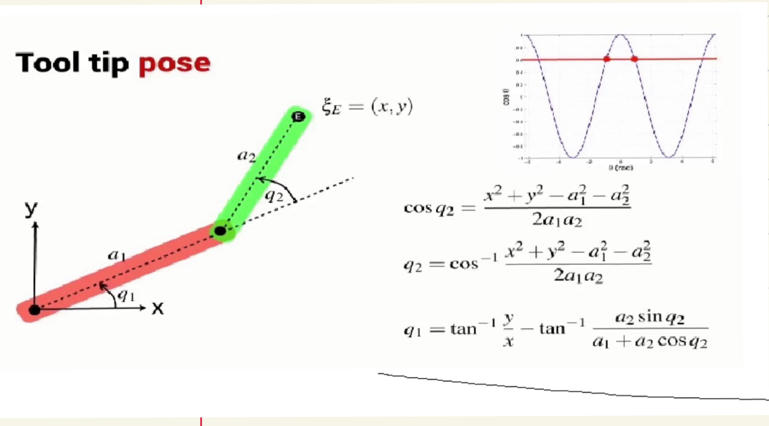
Neck Math
These equations consider the pitch and roll angle of the head. Once recorded, these values were entered into the equations to determine what the angle of each servo should be.
Math equation for each arm
Neck Diagram Sketch

Slide 14
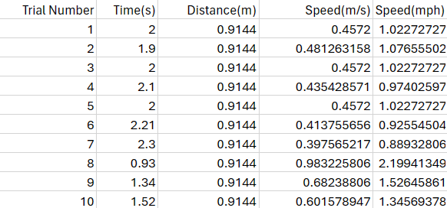
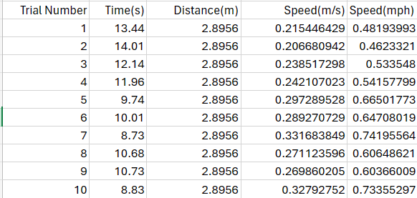
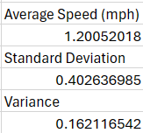
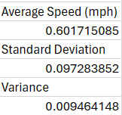
Speed Testing (needs to be updated)
The Speed was recorded over 10 trials based on a set distance and recorded time. The average was below our designed specification needs however still meets the necessary goals of mobility. Therefore we are happy with our results.

Slide 15
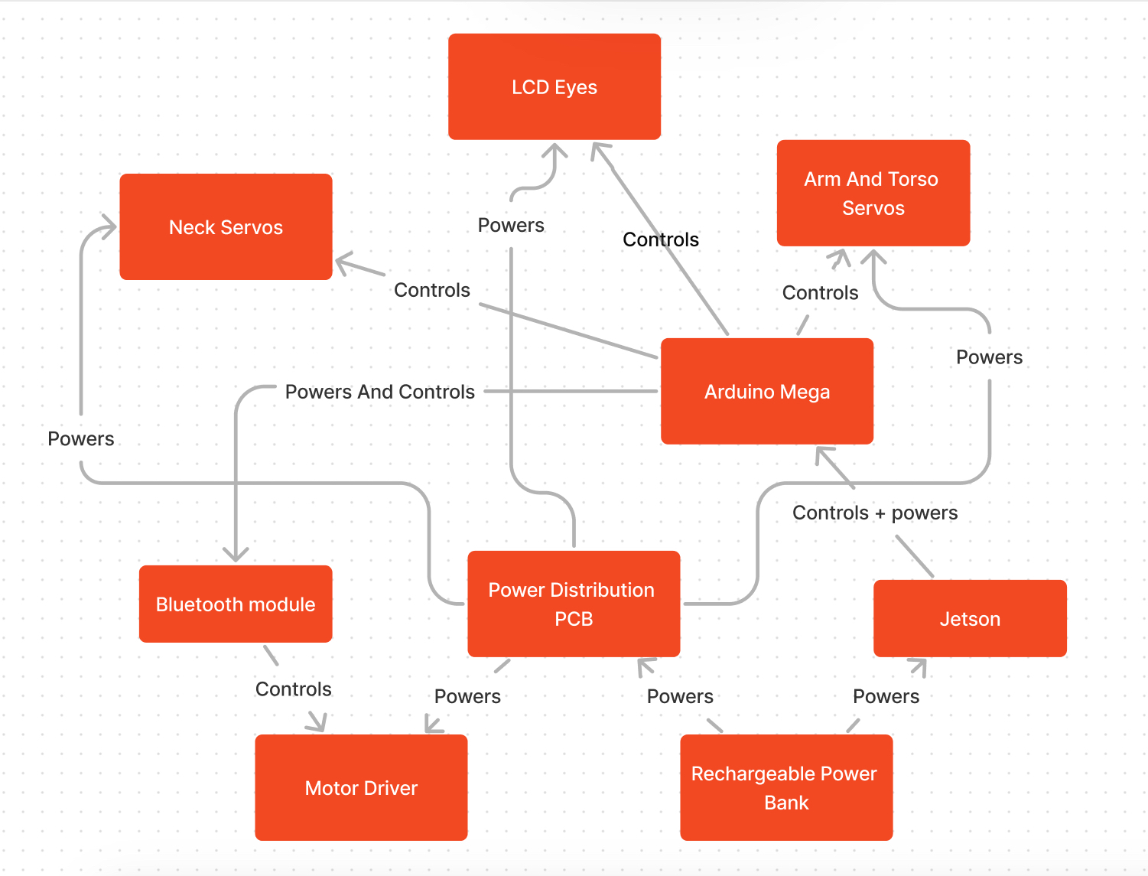
Hardware Block Diagram
Notes:
What Zack will do is explain how each one is powered and connected. The power bank connects to the board by a regular circular plug. This is also how it powers the Jetson. The board connects to the other components (such as the motor controller and the arduinos) using pin headers, which allow wires to be connected easily. The rest of the components are connected through wires or USB cables.

Slide 16
Mechanical Hardware Comparison and Selection
Motor
Part | Cost per motor | Weight | Voltage
DC Motors | $15.00 | 0.75 lbs | 12V, 6V
Stepper Motors | $14.00 | 0.88 lbs | 12V
Servo Motors | $5.00 | 0.45 lbs | 12V, 7.2V, 6V
Why? Cost effective, lightweight, wide range of voltage, precise movement
Notes:
PWD is PCB solderable, so is a stretch goal

Slide 17
Mechanical Hardware Comparison and Selection
Exoskeleton/Shell
Material | Manufacturability | Cost | Tensile Strength
PLA | Minimum difficulty | $35/1kg | 50 MPa
TPU | Minimum difficulty | $21/1kg | 48 MPa
Flexible 80 A resin | Medium difficulty | $200/1L | 8.9 MPa
Foam | Medium difficulty | $20/1yd | 0.2 MPa
Cloth | Medium difficulty | $20/1yd | 27 MPa
Lightweight, minimal restriction, greater options for modeling, aligns with goals
Notes:
PWD is PCB solderable, so is a stretch goal

Slide 18
Hardware Comparison and Selection
Motor Driver
Part | Voltage | Current Output | Price | Form
PWD13F60 | 3.3-15V | 8A | $6.70 | Solderable Chip
PN00218-DME3 Sabertooth | 6-30V | 8A | $124.99 | Dev Board
LN298N | 5-12V | 5A | $10.99 | Simple H-bridge
Notes:
PWD is PCB solderable, so is a stretch goal

Slide 19
Hardware Comparison and Selection
12V Rechargeable Power Supply
Part | Watt-Hours | Weight (g) | Size | Pros | Cons
BiX Power Battery | 100Wh | 621g (1.4lbs) | 7.5” x 4.5” x 0.9” | Long lasting, Multiple output ports | Large footprint, High cost
Talentcell Rechargeable | 96Wh | ~500g (1.1lbs) | 3.1” x 5.4” x 1.5” | Small, Low charge time | Lower capacity
Cabela’s Rechargeable | 94Wh | 2300g (5.0lbs) | 4” x 2.5” x 6” | Large capacity, Leakproof | Massive, No charger included

Slide 20
Hardware Comparison and Selection
Voltage Regulator
Part | Input Voltage | Output Voltage | Max Current Out
TPS54JA20 | 2.7-16V | 0.9-5.5V | 12A
TPS562208 | 4.5-17V | 0.76-7V | 2A
TPS62901-Q1 | 3-18V | 0.6-5.5V | 1A

Slide 21
Hardware Comparison and Selection
Bluetooth Module
Part | Bluetooth Version | Pros | Cons
DSD Tech HM-10 | BLE 4.0 (4-pin) | DSD App, Directly compatible with track, Availability | Less configuration possible
DSD Tech HM-19 | BLE 5.0 (6-pin) | DSD App, Fast transfer rate | BLE 5.0 not compatible with track
HiLetGo AT-09 (HM-10) | BLE 4.0 (6-pin) | HM-10 compatible | Hardware incompatibility

Slide 22
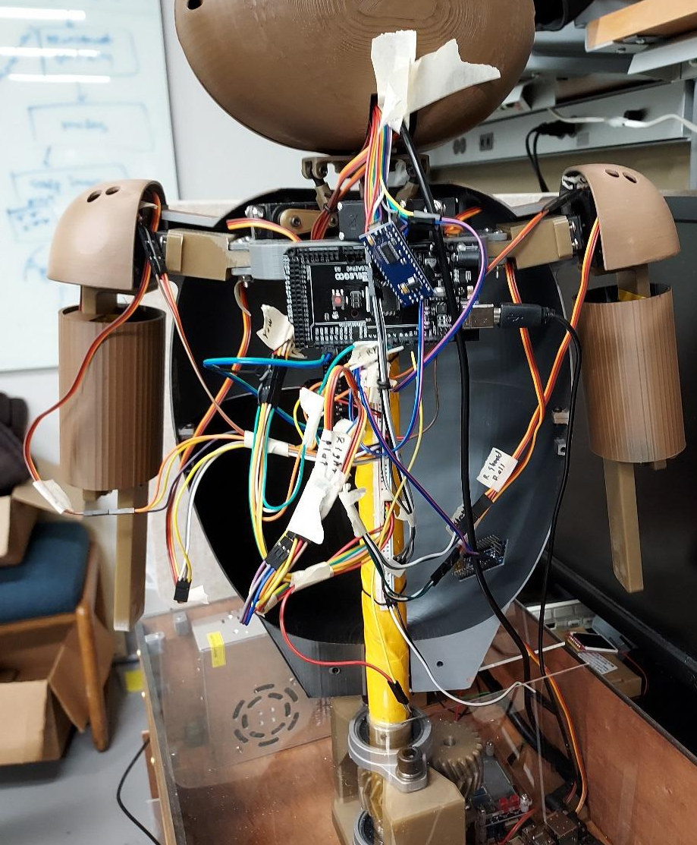
Hardware Comparison and Selection
Reused Parts:
Arduino Mega R3,
NVIDIA Jetson Xavier NX,
TFT LCD Eyes

Slide 23
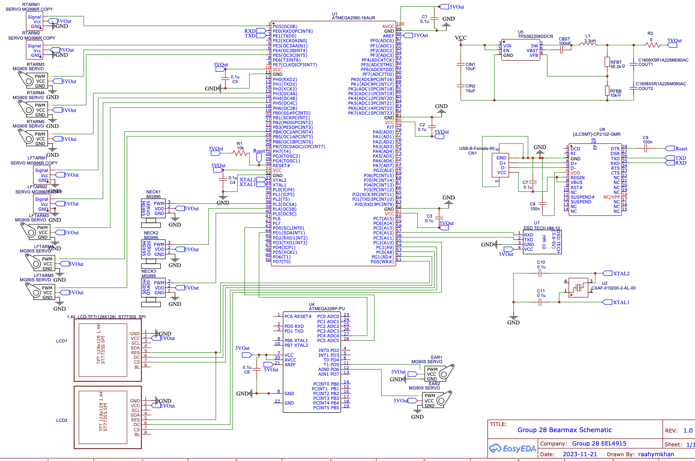
Arduino Connection Schematic

Slide 24
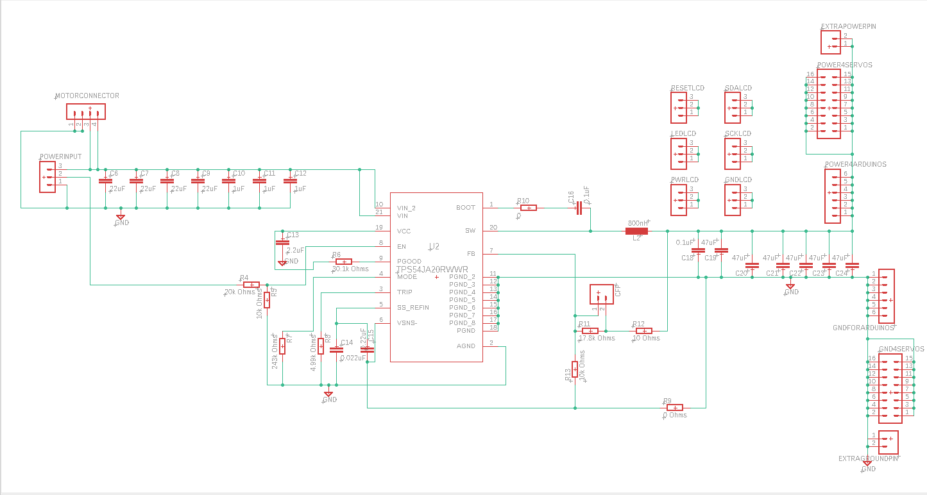
Power Distribution Schematic

Slide 25
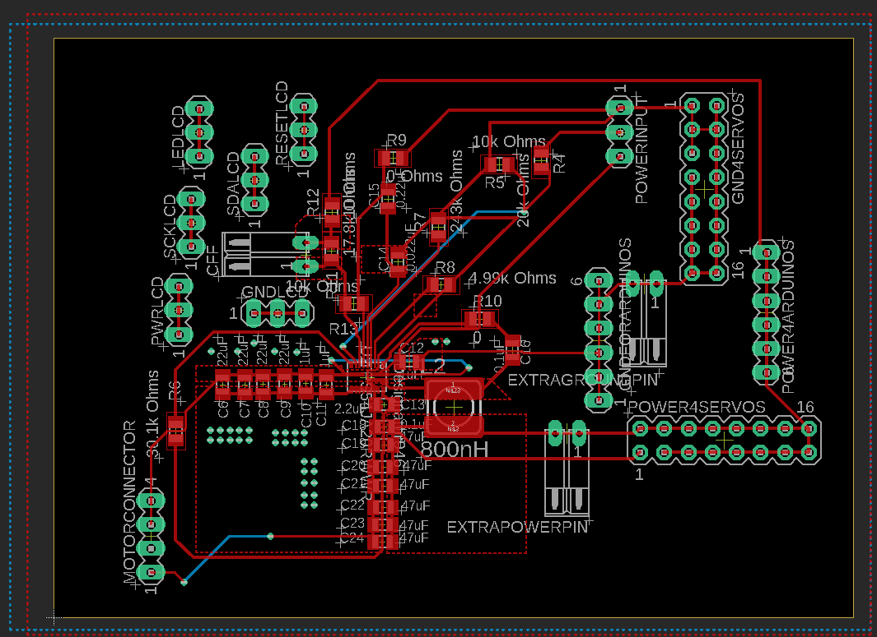
Power Distribution Board Layout

Slide 26
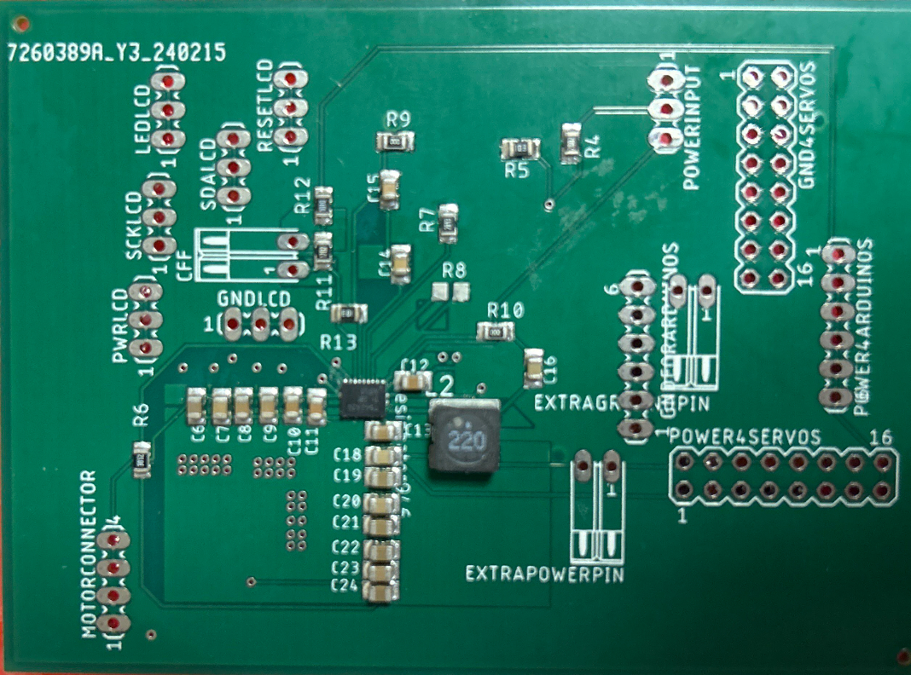
Powerboard PCB Design
Voltage Regulator
Input where 12V Go in
Output for components where 5V comes out
Output for motors where 12V go out

Slide 27
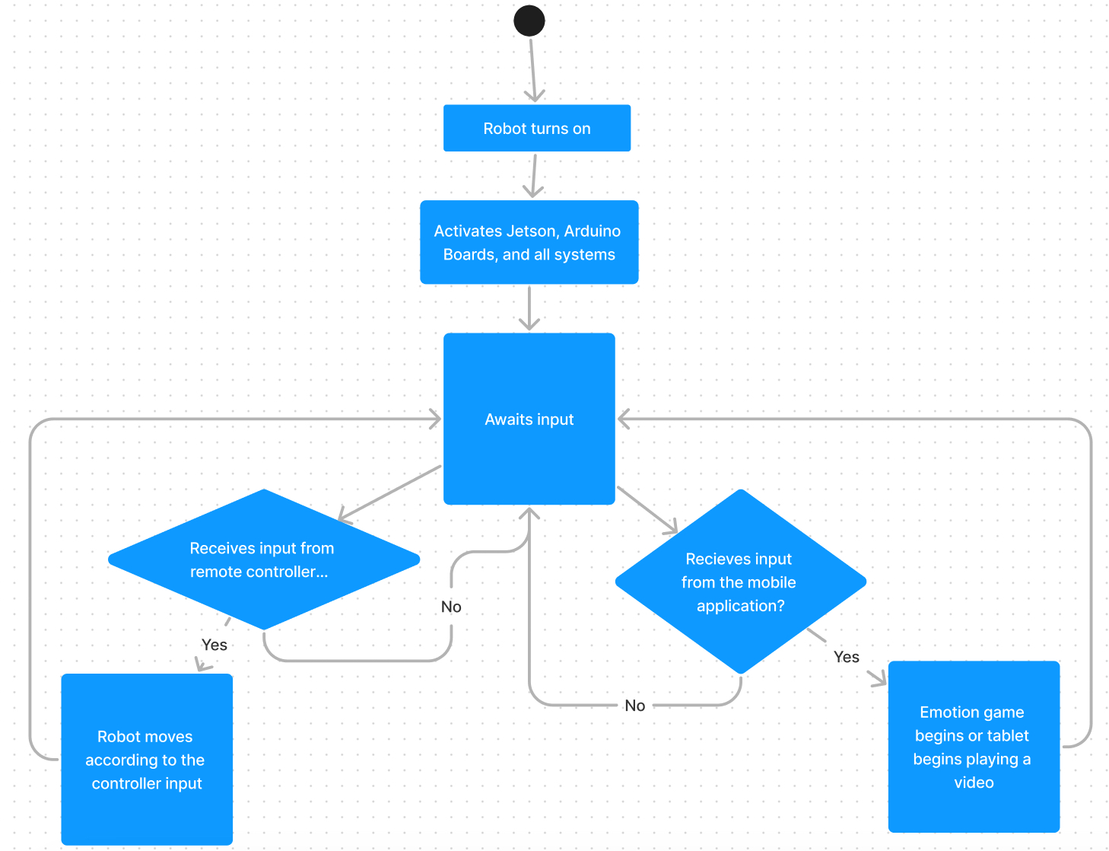
Overall Activity Diagram

Slide 28
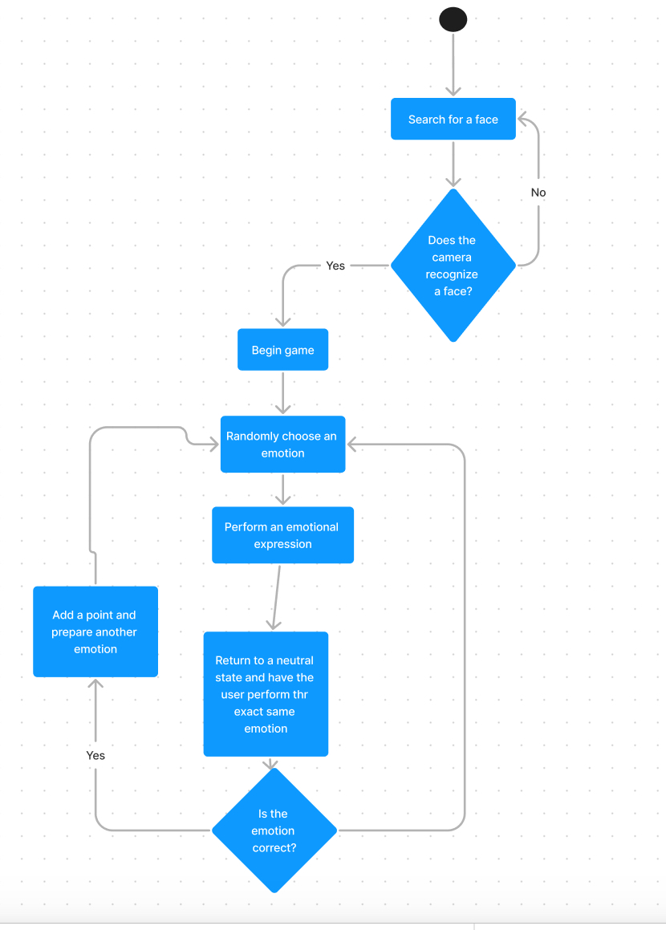
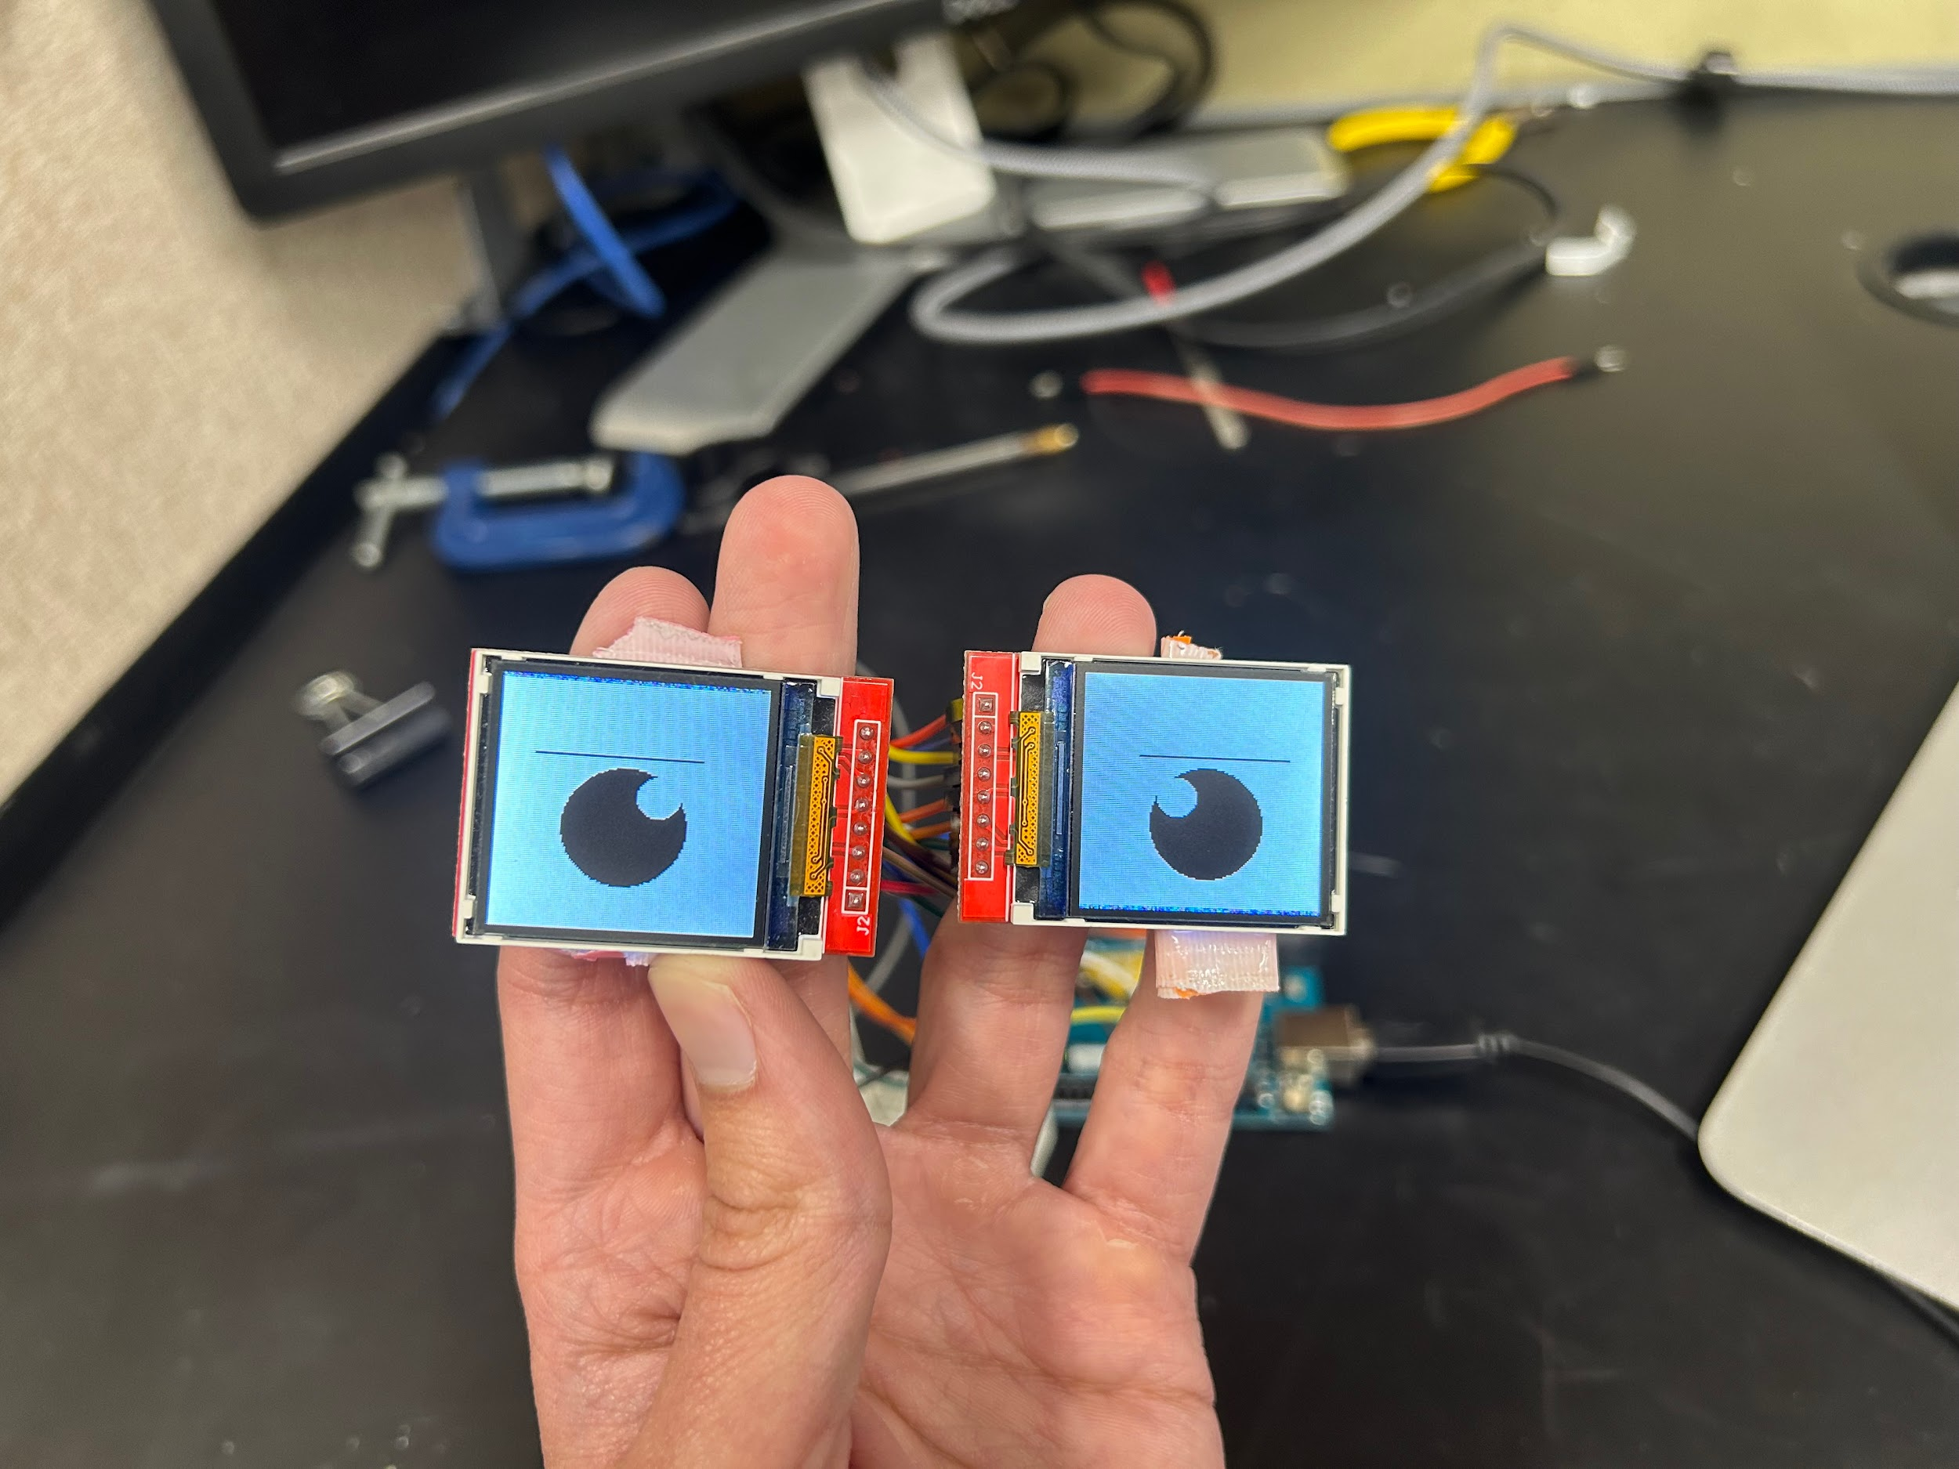
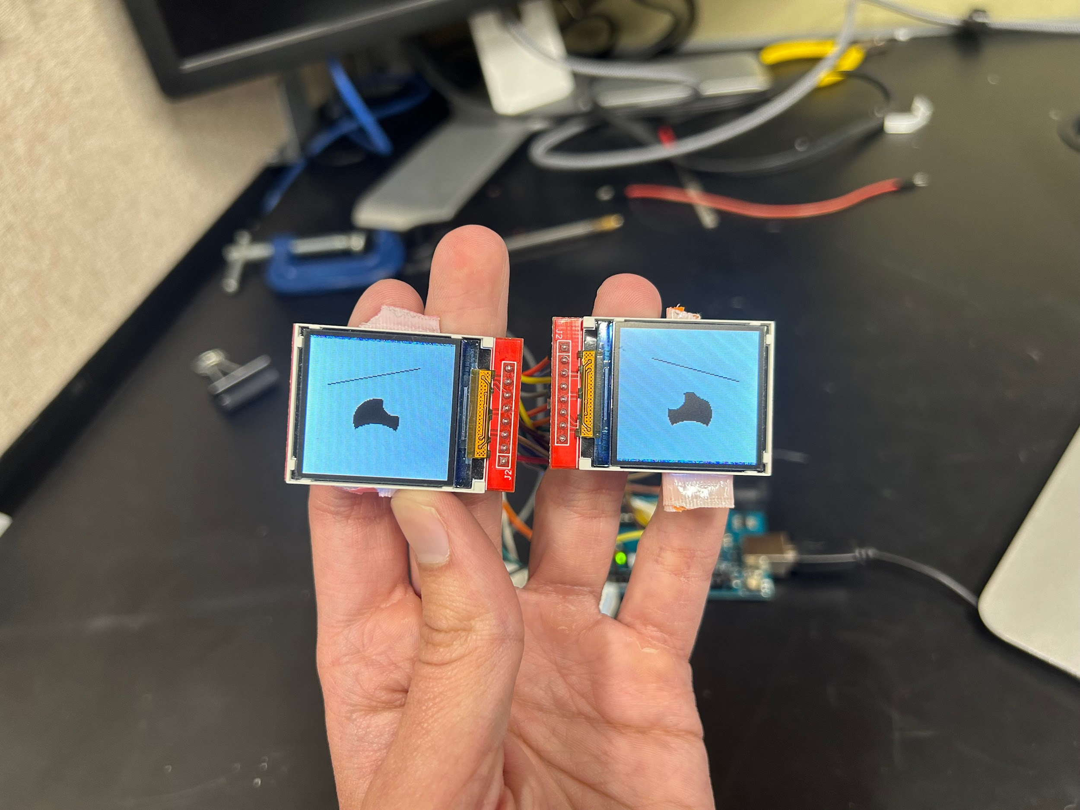
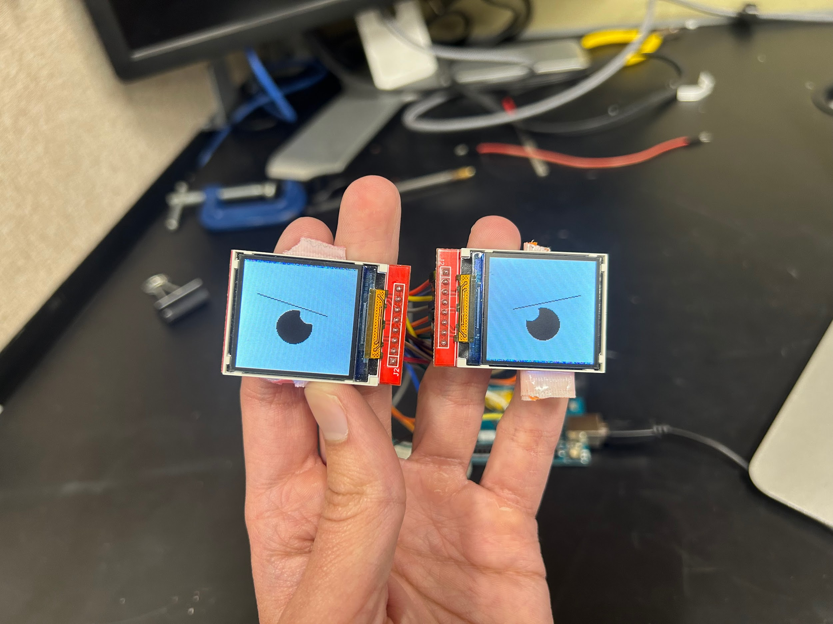
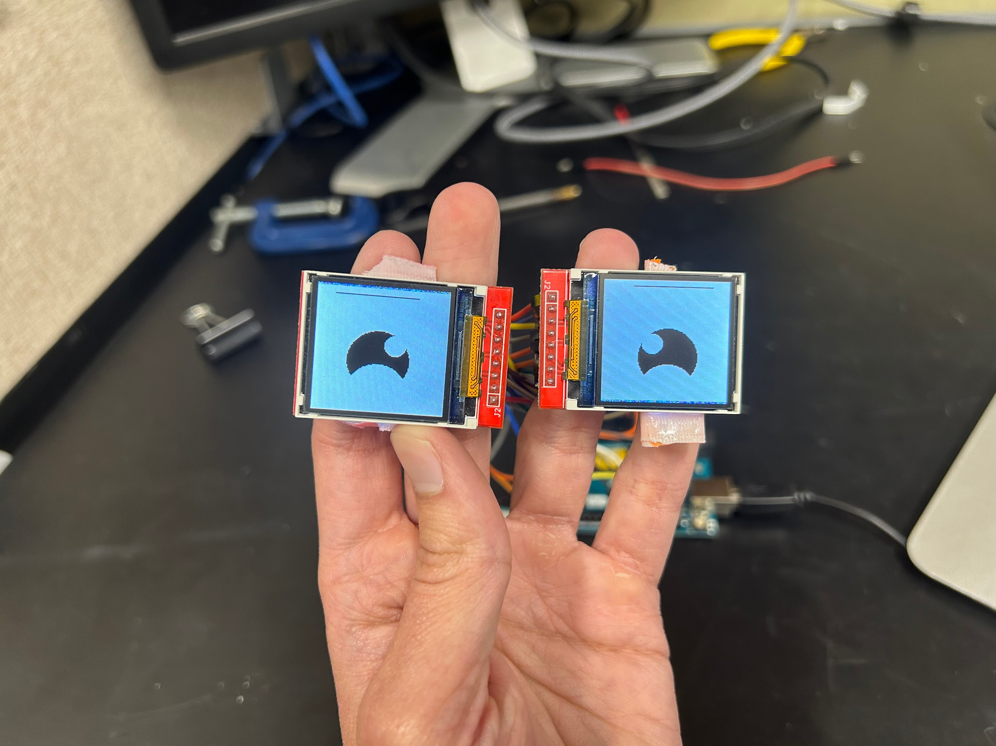
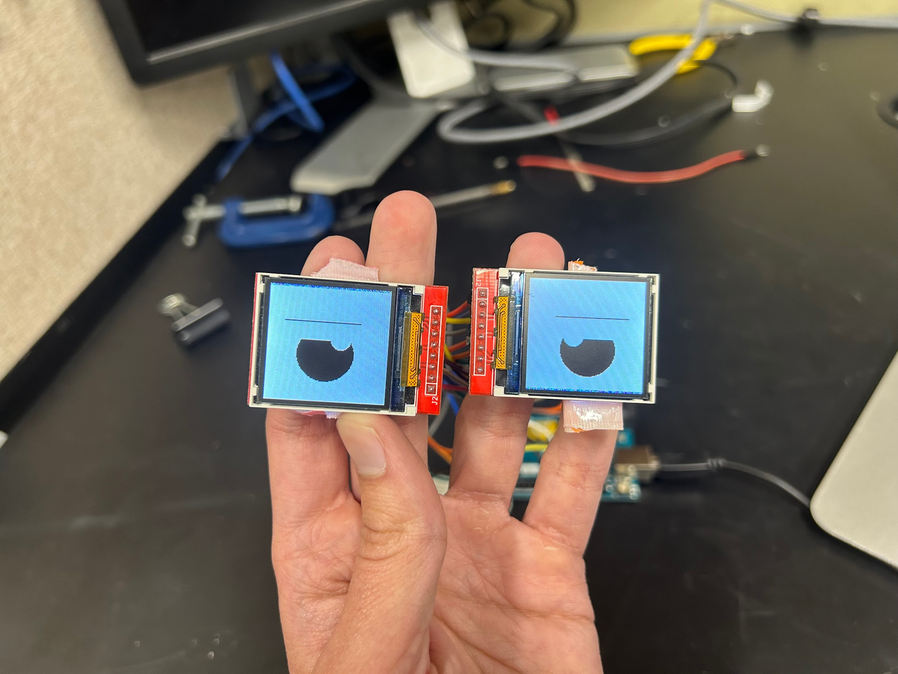
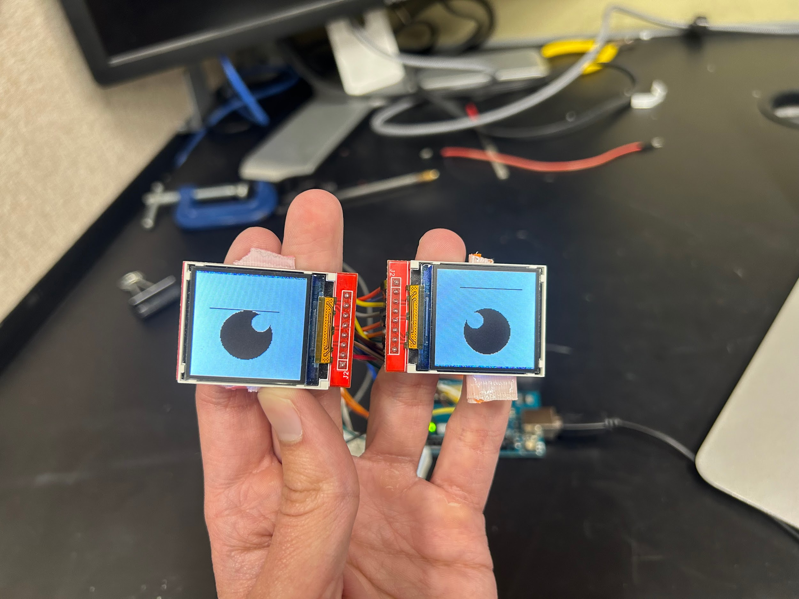
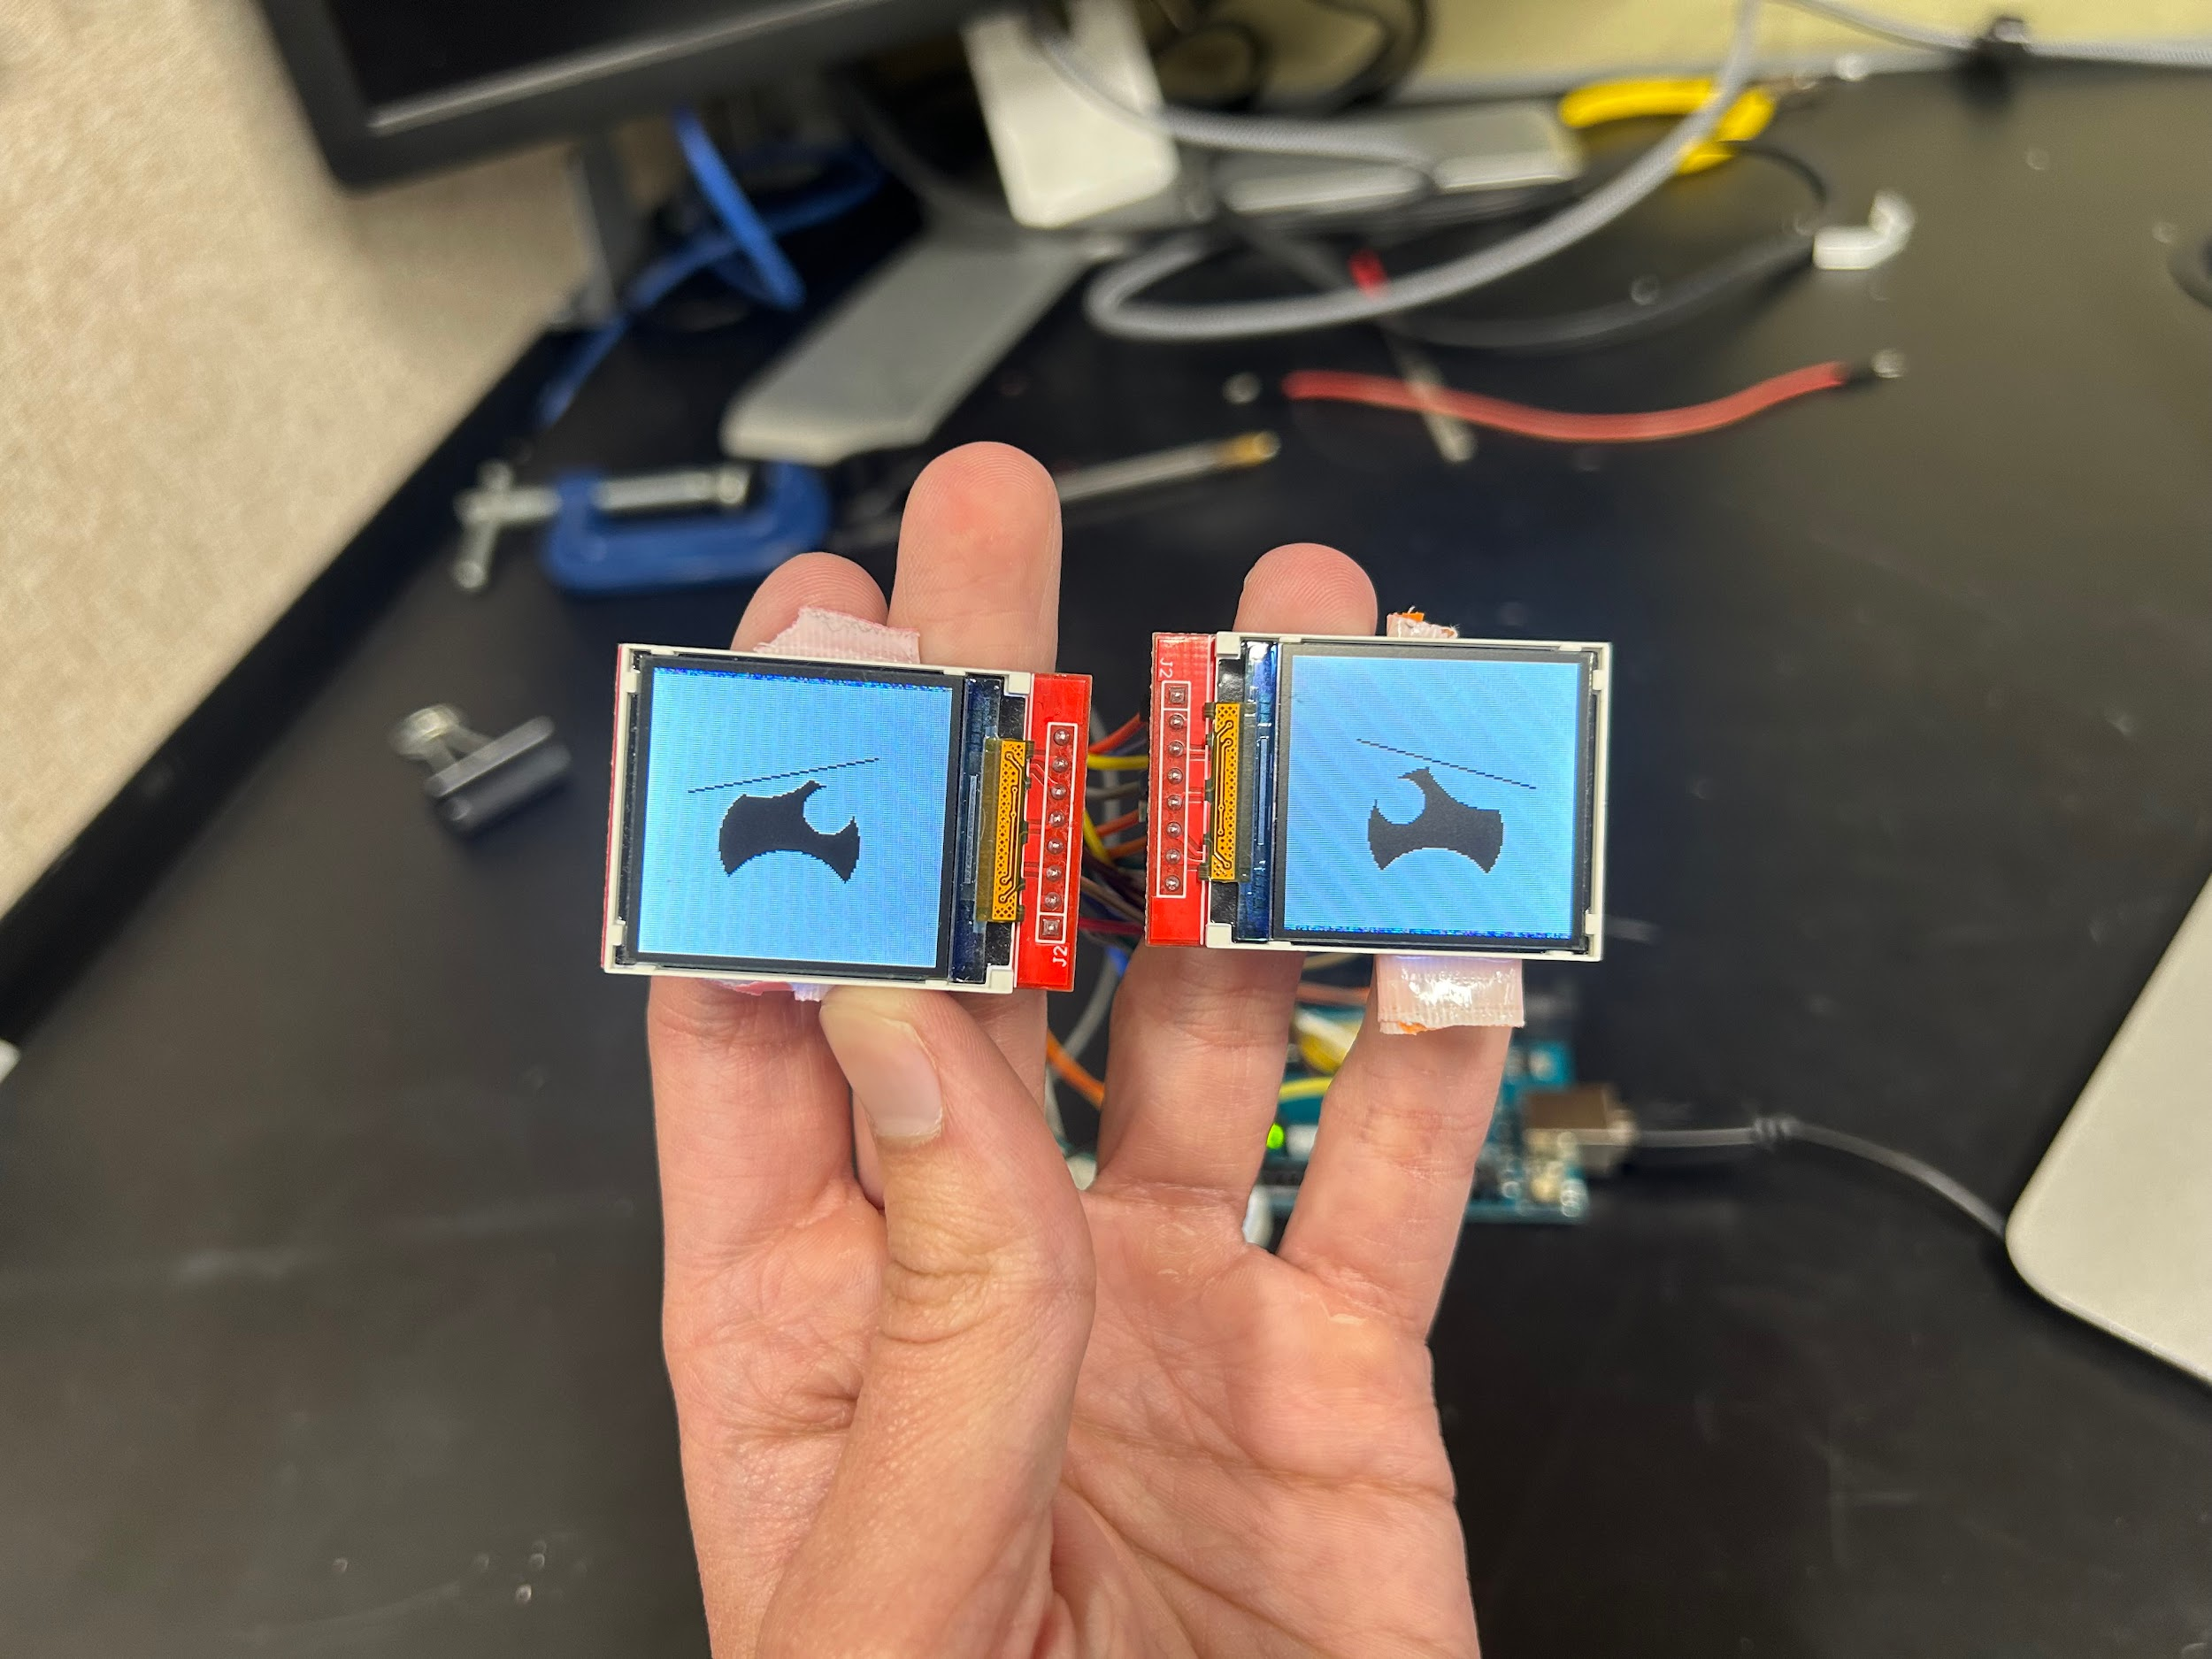

Emotion Recognition game activity diagram
Emotional eye examples
Neutral
Nervous/afraid
Angry
Happy
Disappointed
Confused
Sad
Shocked

Slide 29
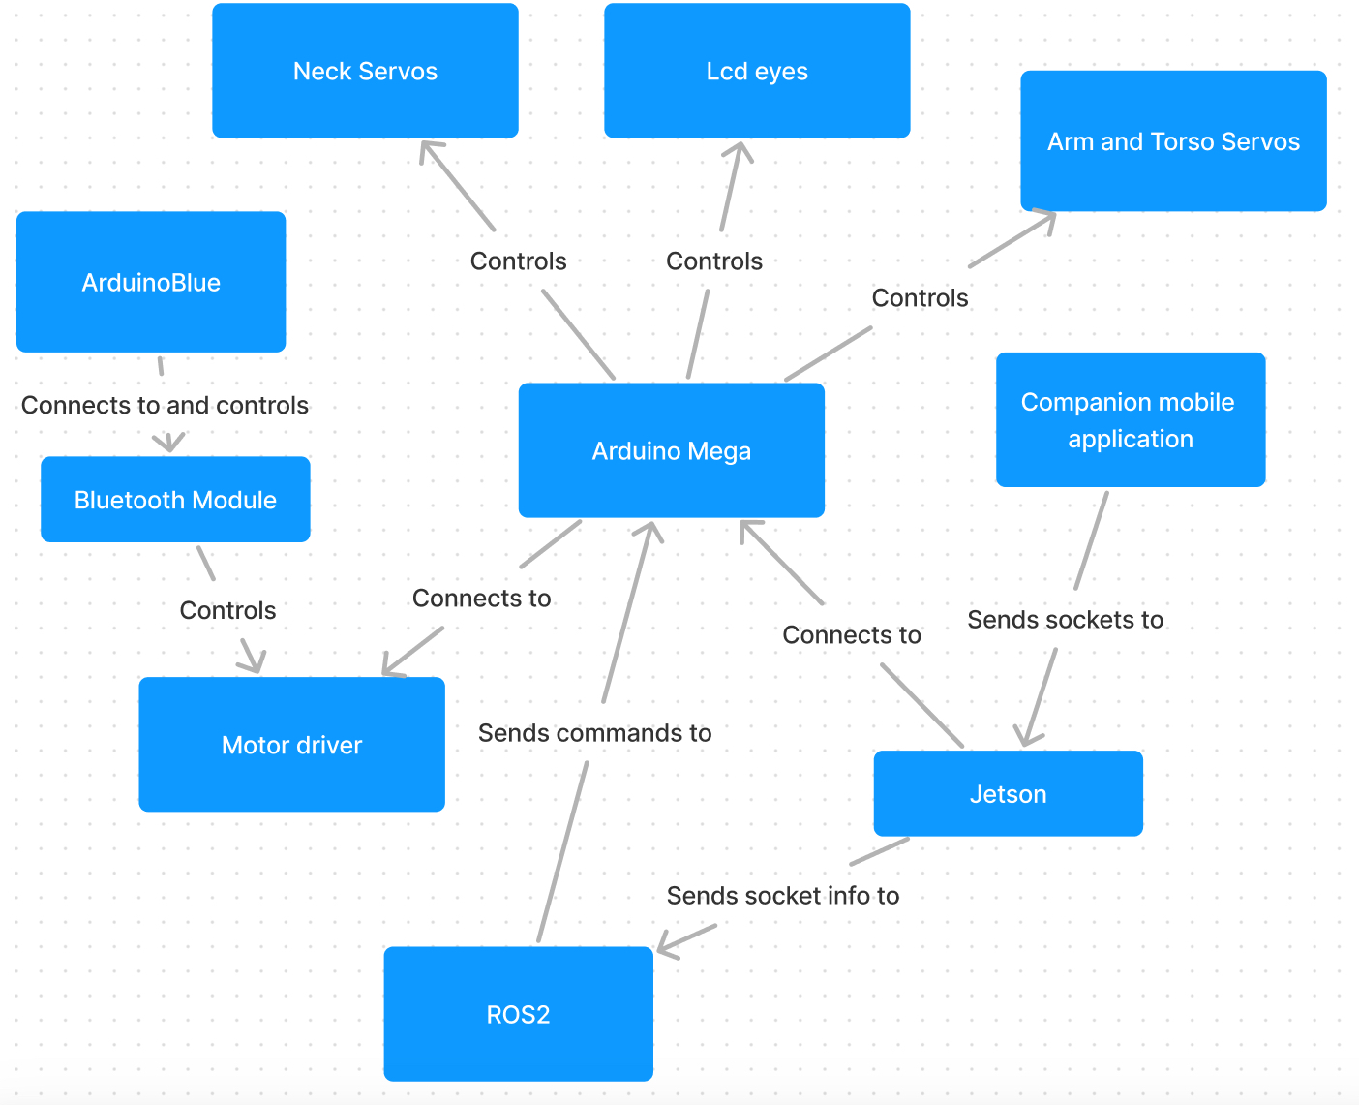
Software Block Diagram

Slide 30
Software Comparison and Selection
Bluetooth App
Part | Cost | Pros | Cons
Arduino Blue | Free | Pairs to DSD parts easily | Limited config
ArduCar | Free | Widely compatible | Android Only
BLExAR | $4 | Good Interface & Tools | Cost

Slide 31
Software Comparison and Selection
Programming Language
Language | Platforms Compatible
C++ | Arduino IDE, ROS lib, Additional drivers
Python | ROS Lib
C | Arduino IDE

Slide 32
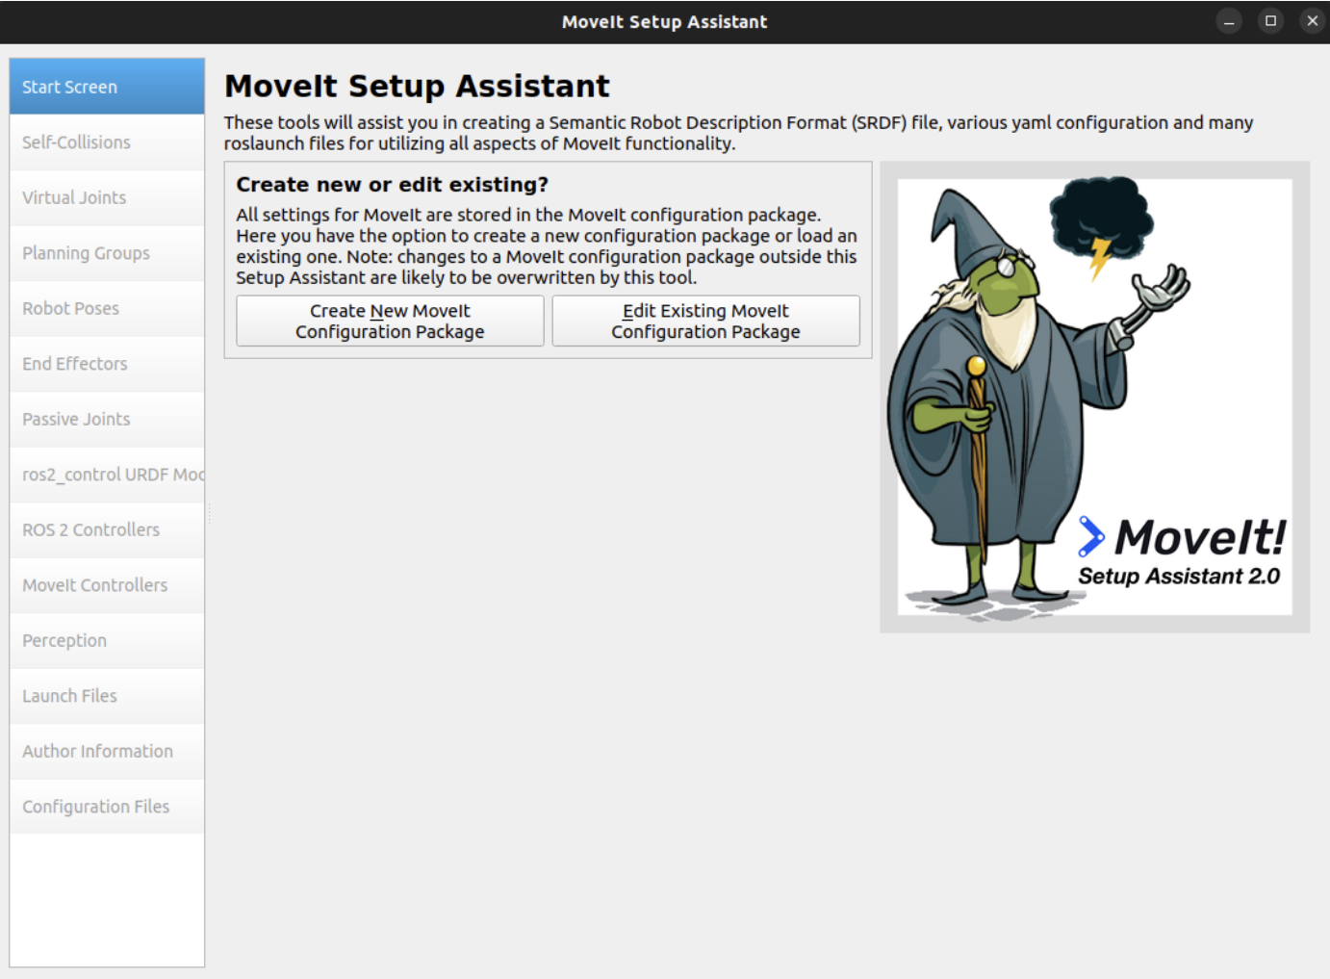
ROS 2 Pose Integration

Slide 33
Bearmax’s Poses
One of the key goals of Bearmax is the robot’s portrayal of the desired emotions. We came up with 8 poses to define the 8 emotions.
Each of the poses has a short description, as well as how the pose could be described to children.
Poses are created by assigning angles to the different joints of Bearmax. All of the angles shown are in radians.

Slide 34
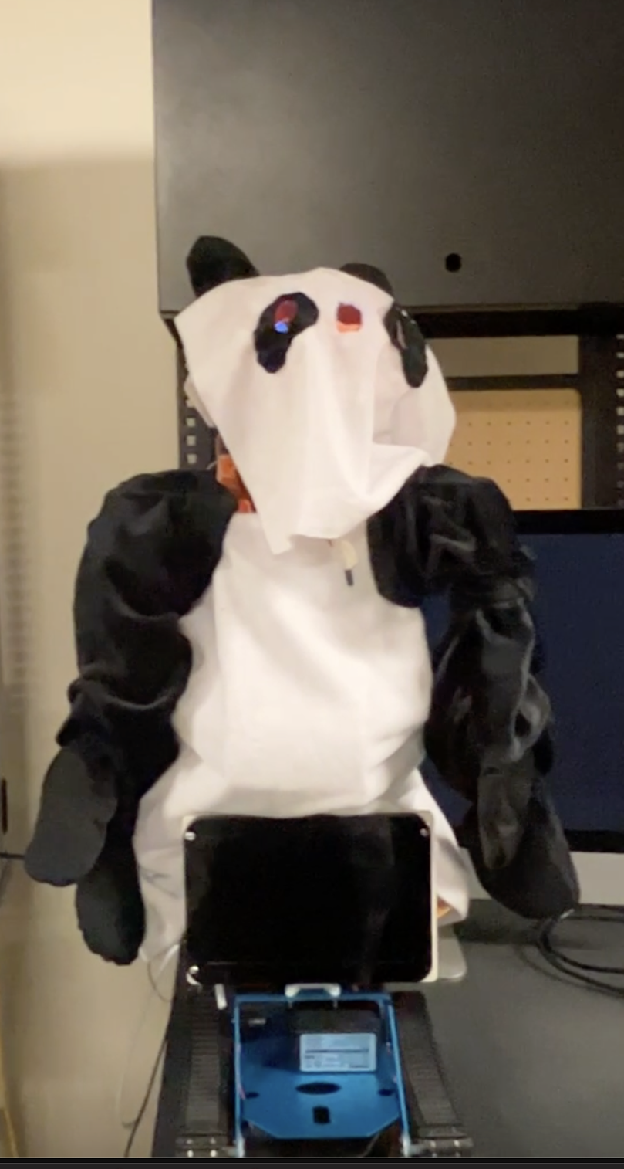
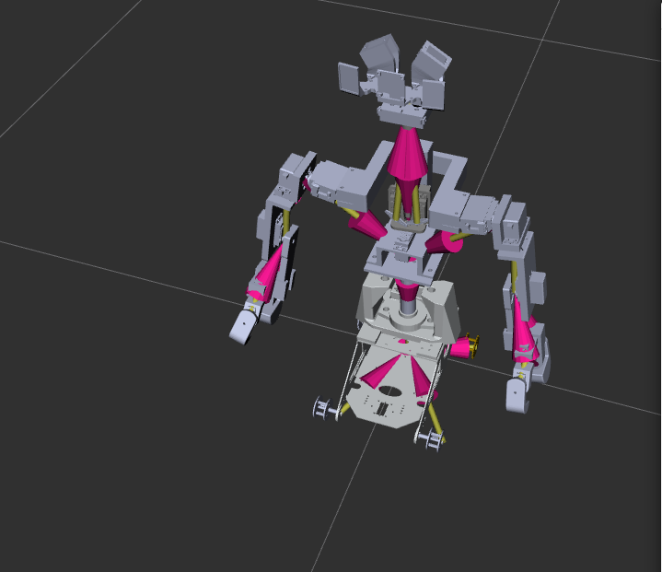
Neutral Pose

Slide 35
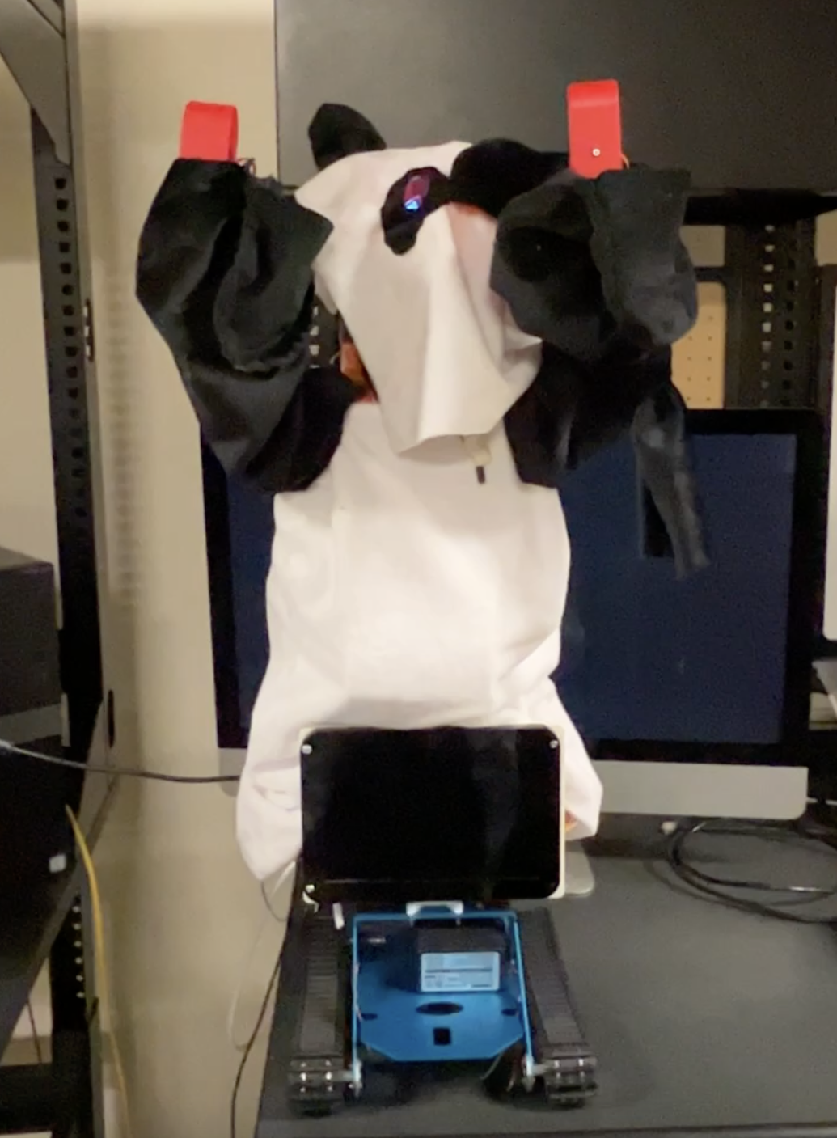
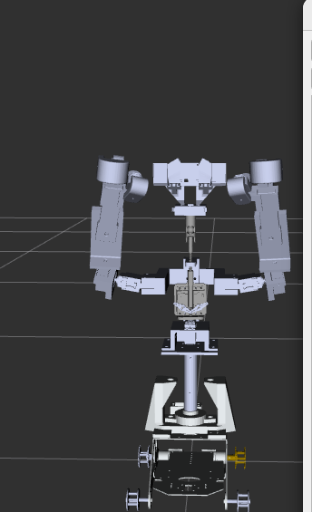
Happy/Cheerful Pose

Slide 36
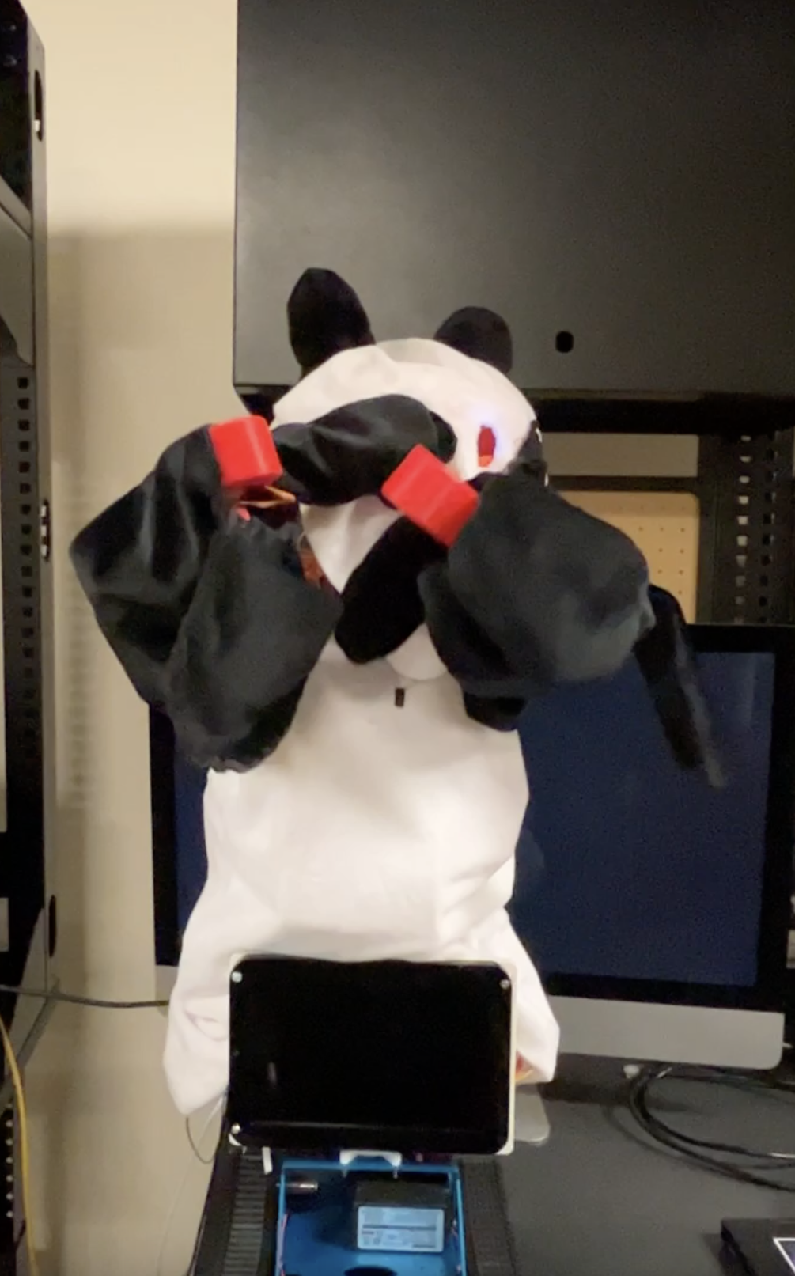
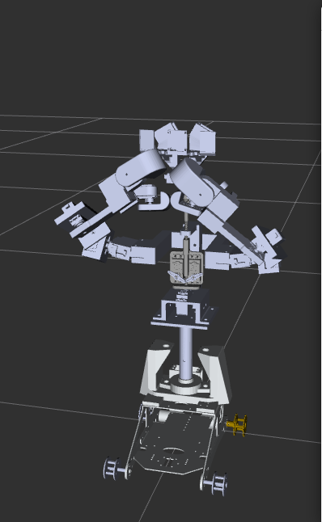
Sad/Crying Pose

Slide 37
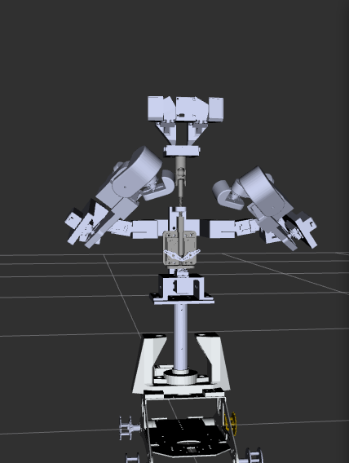
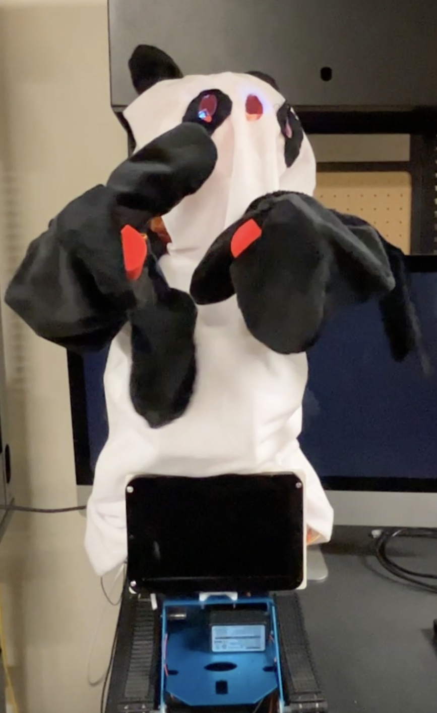
Angry/Mad Pose

Slide 38
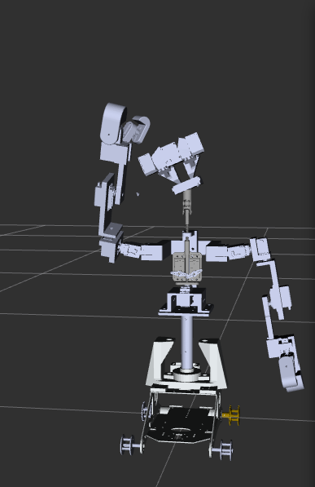
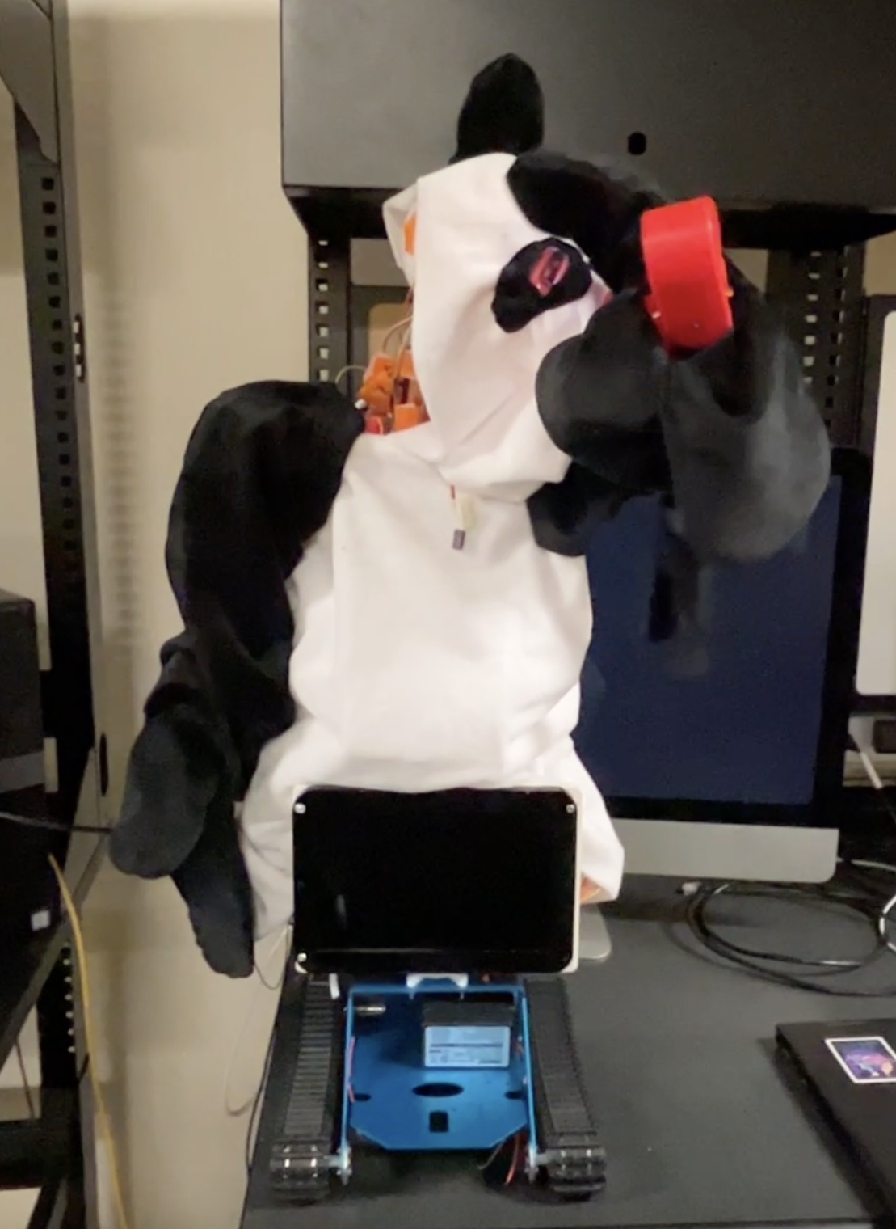
Confused/Perplexed Pose
Bearmax is left handed

Slide 39
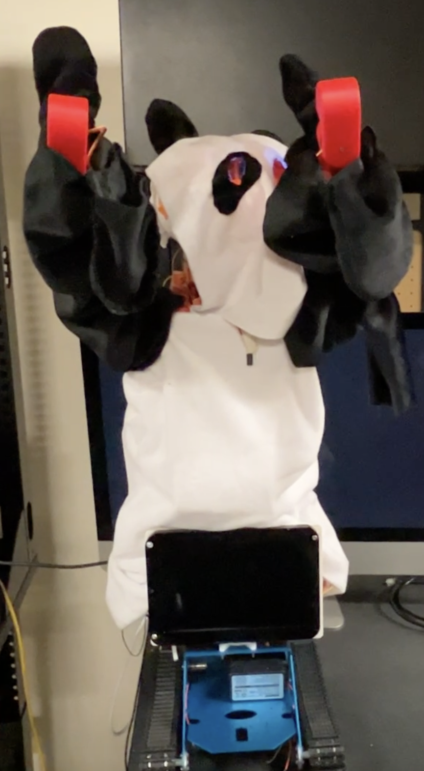
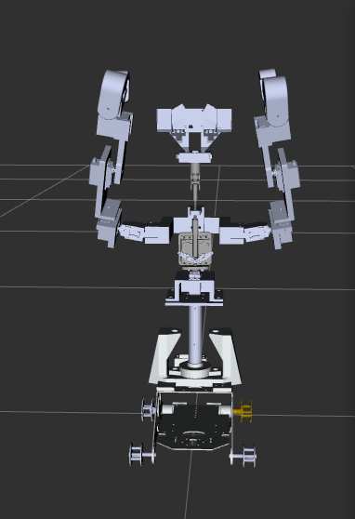
Shocked/Surprised Pose

Slide 40
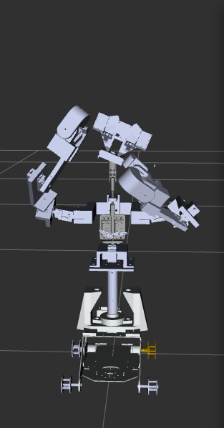

Worried/Concerned Pose

Slide 41


Scared/Shy Pose

Slide 42


Annoyed/Disappointed Pose

Slide 43



Linux Software

Slide 44
CS Team Integration Goals
Display Screen
Remediary Video implemented
Socket connection
Sends information & commands to and from the robot
Can send Pose commands through Website
Emotion Game
Model trained
Pipeline setup

Slide 45
Administrative Content: Budget
Budget: 250 dollars
3D Filament, PCBs, etc
Parts Supplied by WEAR Lab:
Servos, Development Boards, Track Kit, Resin, etc

Slide 46
Administrative Content: Work Distribution
Team Member | Primary Task | Secondary Task
Bhavani Sivakumaar | Model fingers, arms, shoulders, shell | Exoskeleton Build
Nicholas Buchberg | Exoskeleton Build, track platform, head, neck torso | Model shell, shoulders arms
Raahym Khan | Robotics Programming, ROS testing | CS Integration
Zachary Larson | PCB Assembly, Soldering, Testing | Robotics Programming

Slide 47
Challenges
The skeleton has been finished since early march so our main issues mechanically were the shell design and providing mounts for our needed electrical components.
The jetson doesn’t have the needed capacity to run the emotion game so the software demonstration is done partly through an external PC
The resin goal had to be abandoned for a combination of both cloth and foam as it was too heavy.
The PCBs were redesigned and adjusted due to issues distributing needed voltage.
Most of our challenges we were able to overcome and we are proud of the state of BEARMAX 2.0.

