Slide 1
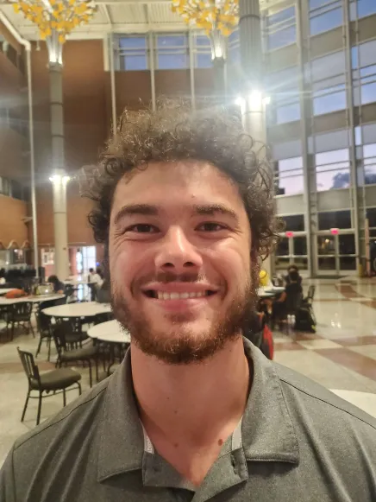
BearMax Critical Design Review
Presentation by Group 28:
Members: Raahym Khan, Bhavani Sivakumaar, Nicholas Buchberg, Zach Larson

Slide 2


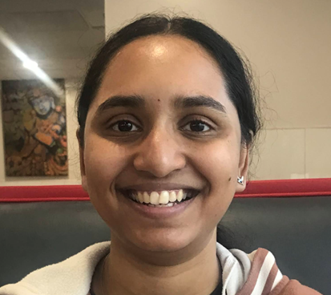
Team Members
Raahym Khan: Computer Engineering
Zachary Larson: Computer Engineering
Bhavani Sivakumaar: Mechanical Engineering
Nicholas Buchberg: Mechanical Engineering

Slide 3

Notes:
Bhavani
Look at the designing the mind of a social robot paper Zach researched of how robots are good with kids with autism bc humans are unpredictable, whereas robots are predictable and a good practice method
Script:
BearMax is a robot designed to help people with Autism Spectrum Disorder to recognize and understand various social situations
Therapy robots are used in the medical field for a variety of different reasons including teaching children with ASD to identify emotions
According to “Designing the Mind of a Social Robot” a research paper in the Applied Sciences Journal, social robots are predictable which is an advantage as people can practice on it and it can be modified many times catering to the user’s specific needs. Sometimes human interactions can be confusing whereas the predictable aspect of social robots allow the user to become comfortable and master different scenarios that can help build confidence in the long run for social interactions.
[17] N. Lazzeri, D. Mazzei, L. Cominelli, A. Cisternino, and D. De Rossi, “Designing the Mind of a Social Robot,” Applied Sciences, vol. 8, no. 2, p. 302, Feb. 2018, doi: 10.3390/app8020302.

Slide 4
Goals and Objectives
Improve Version 1 of BearMax
Electrical system upgrade (CE team)
Mobilize BearMax (ME team)
Larger freedom for movement (ME team)
Non-verbal user inclusivity (Collaboration with CS team)
App for users and guardians (Collaboration with CS team)
And more!
Notes:
Bhavani
This is the 2nd iteration of BearMax
One of our main goals is to expand upon the successes of the first version.
Some of our goals include to add more emotions and a larger range of emotions BearMax can express that users can learn and recognize, upgrade the electrical system, mobilize BerMax and collaborate with the Computer Science team to have additional methods for users to communicate with BearMax, either through the app or a touch screen.
Zach and/or Raahym talk about how the first robot used a single breadboard for all electronics and now we can use a PCB thanks to CE’s on the team!

Slide 5
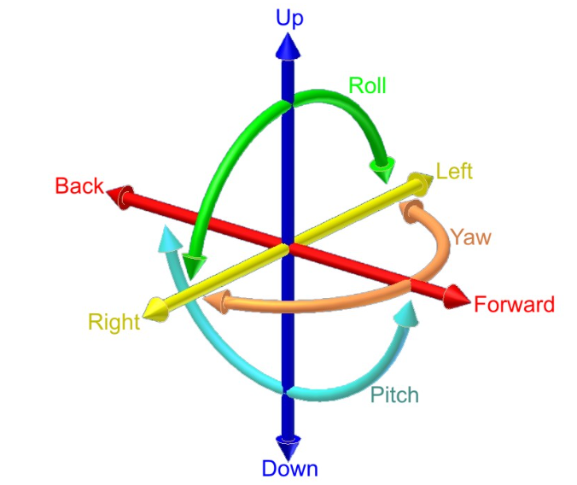
Specifications
Limb | DOF & ROM
Shoulders | 1, 180 degrees
Elbows | 1, 180 degrees
Fingers | 2, 180 degrees & 180 degrees
Neck | 3, 180 degrees, 90 degrees, 90 degrees
Ears | 1, 180 degrees
Platform | N/A but RC capability to move across floor
.
Max Volts | 12 volts
Speed Range | 1-5 mph
Weight limit | 20 pounds
Height Limit | 3 feet
Minimum Response Time | <5 Seconds
Minimum Run Time` | 20 Minutes (Movement/emotions/driving)

Slide 6
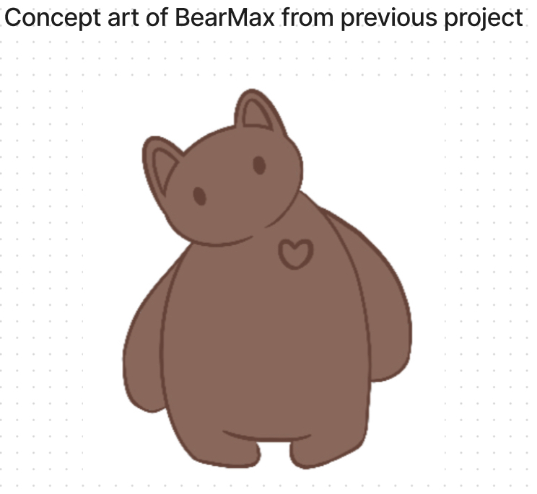
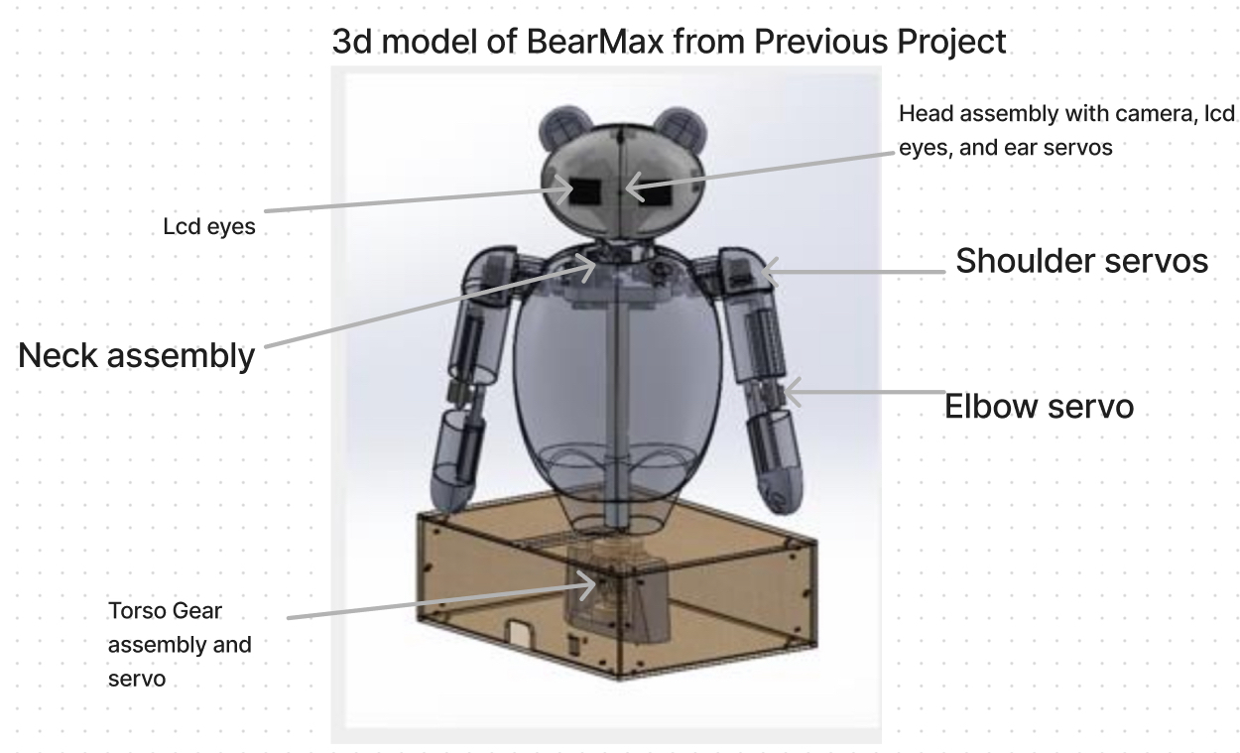
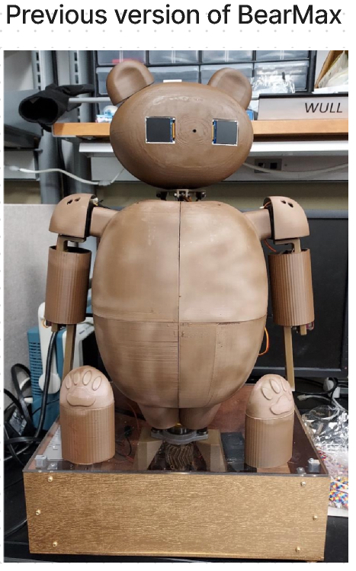
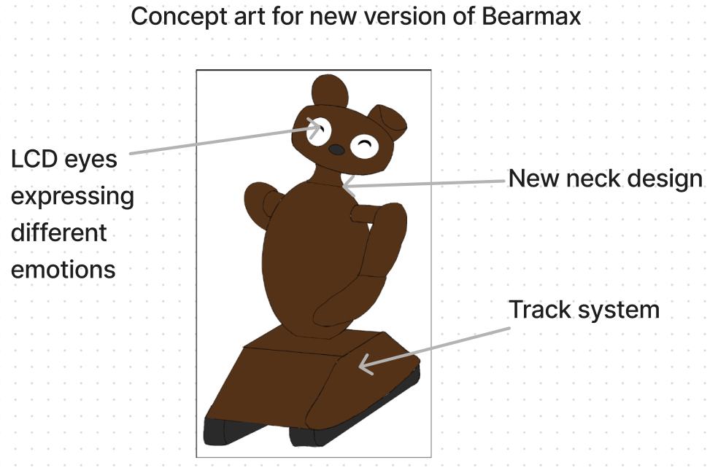
BearMax Concept

Slide 7
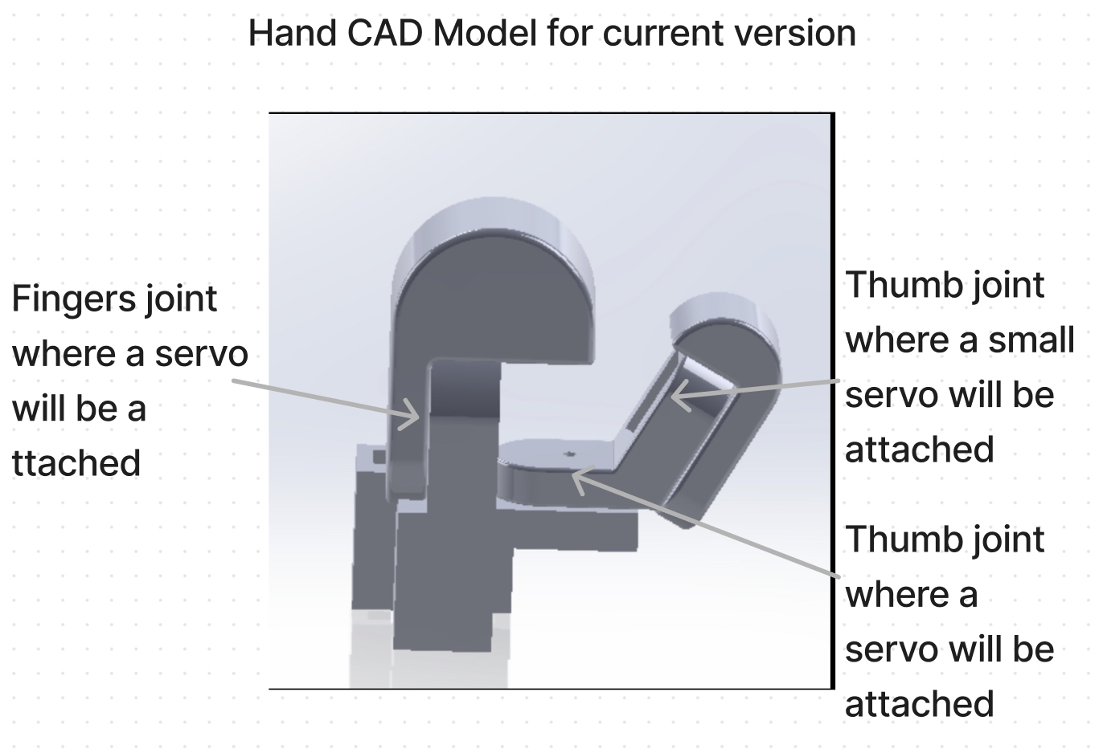
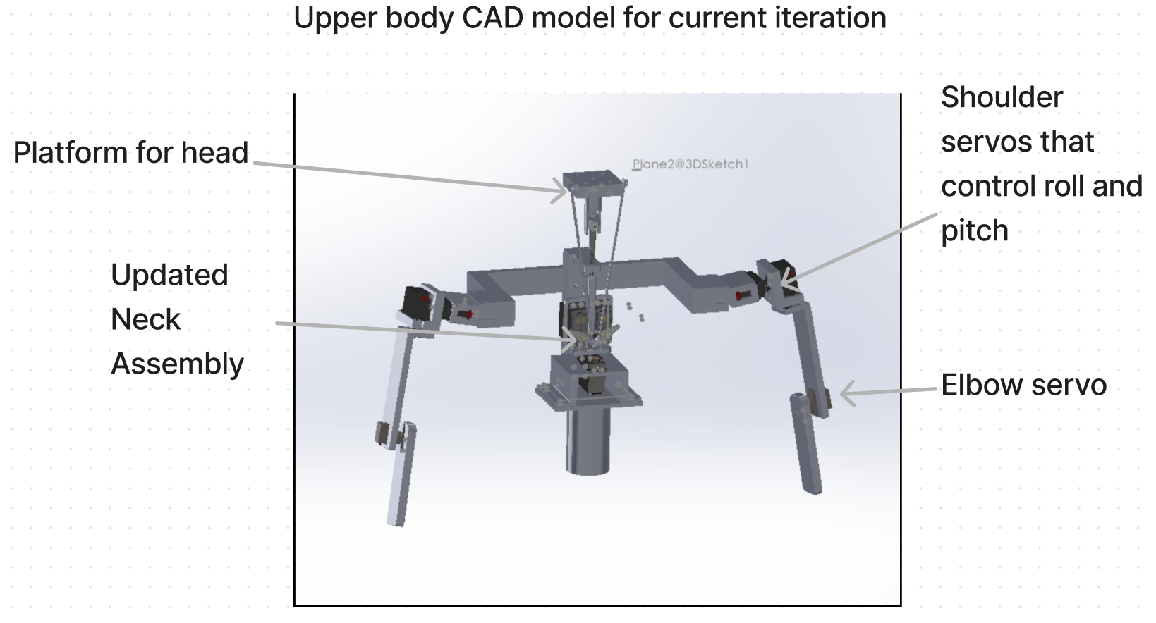
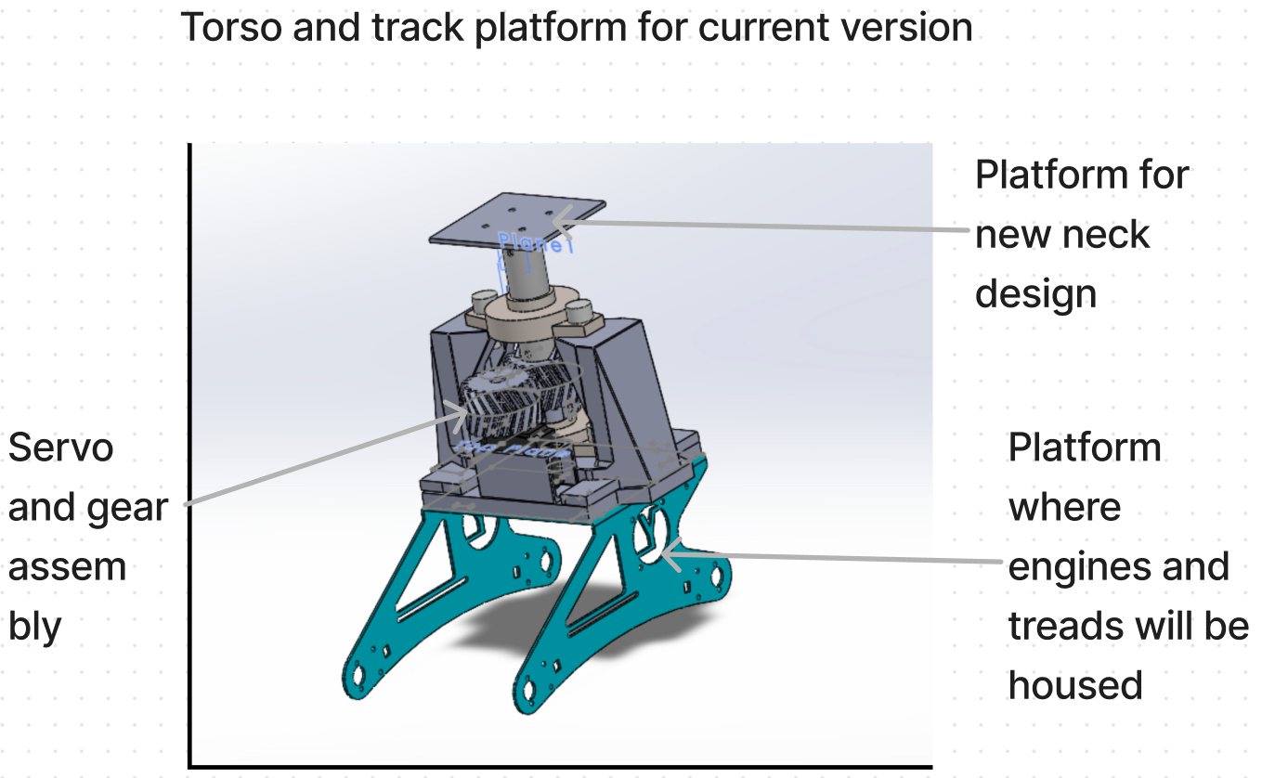
Mechanical Design Diagrams

Slide 8
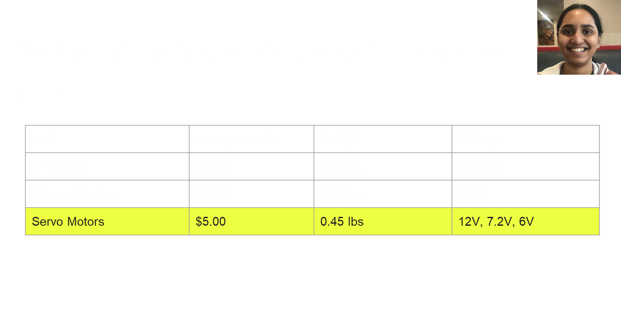
Notes:
https://www.amazon.com/Torque-Permanent-Magnet-DC-Motor/dp/B00NLBFOIS?source=ps-sl-shoppingads-lpcontext&ref_=fplfs&psc=1&smid=A15GNHST7KG47K
https://www.amazon.com/STEPPERONLINE-Stepper-Bipolar-Connector-compatible/dp/B00PNEQKC0?source=ps-sl-shoppingads-lpcontext&ref_=fplfs&psc=1&smid=AWQBCGWISS7BL
https://www.amazon.com/4-Pack-MG996R-Torque-Digital-Helicopter/dp/B07MFK266B/ref=pd_bxgy_d_sccl_1/133-1799409-3658146?pd_rd_w=uEWxU&content-id=amzn1.sym.101c7dca-f8ef-4330-838b-ed6e9ebb9e52&pf_rd_p=101c7dca-f8ef-4330-838b-ed6e9ebb9e52&pf_rd_r=ZJAZNR88TSK37GZVK3P1&pd_rd_wg=yAE4p&pd_rd_r=5cd52828-5998-4396-83bc-ded972b9e762&pd_rd_i=B07MFK266B&th=1

Slide 9
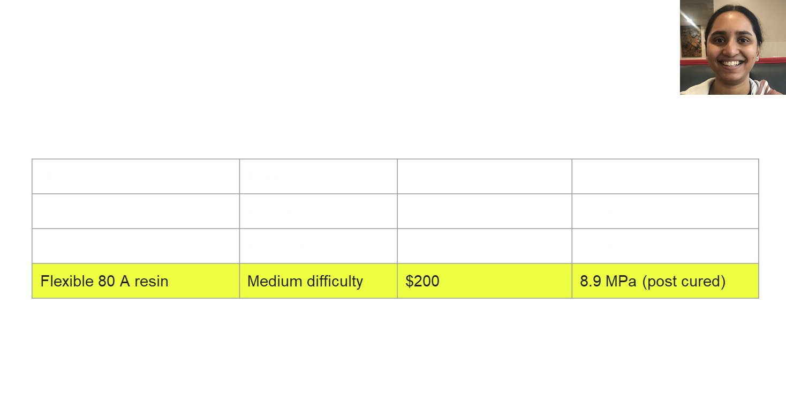
Notes:
https://www.amazon.com/Torque-Permanent-Magnet-DC-Motor/dp/B00NLBFOIS?source=ps-sl-shoppingads-lpcontext&ref_=fplfs&psc=1&smid=A15GNHST7KG47K
https://www.amazon.com/STEPPERONLINE-Stepper-Bipolar-Connector-compatible/dp/B00PNEQKC0?source=ps-sl-shoppingads-lpcontext&ref_=fplfs&psc=1&smid=AWQBCGWISS7BL
https://www.amazon.com/4-Pack-MG996R-Torque-Digital-Helicopter/dp/B07MFK266B/ref=pd_bxgy_d_sccl_1/133-1799409-3658146?pd_rd_w=uEWxU&content-id=amzn1.sym.101c7dca-f8ef-4330-838b-ed6e9ebb9e52&pf_rd_p=101c7dca-f8ef-4330-838b-ed6e9ebb9e52&pf_rd_r=ZJAZNR88TSK37GZVK3P1&pd_rd_wg=yAE4p&pd_rd_r=5cd52828-5998-4396-83bc-ded972b9e762&pd_rd_i=B07MFK266B&th=1

Slide 10
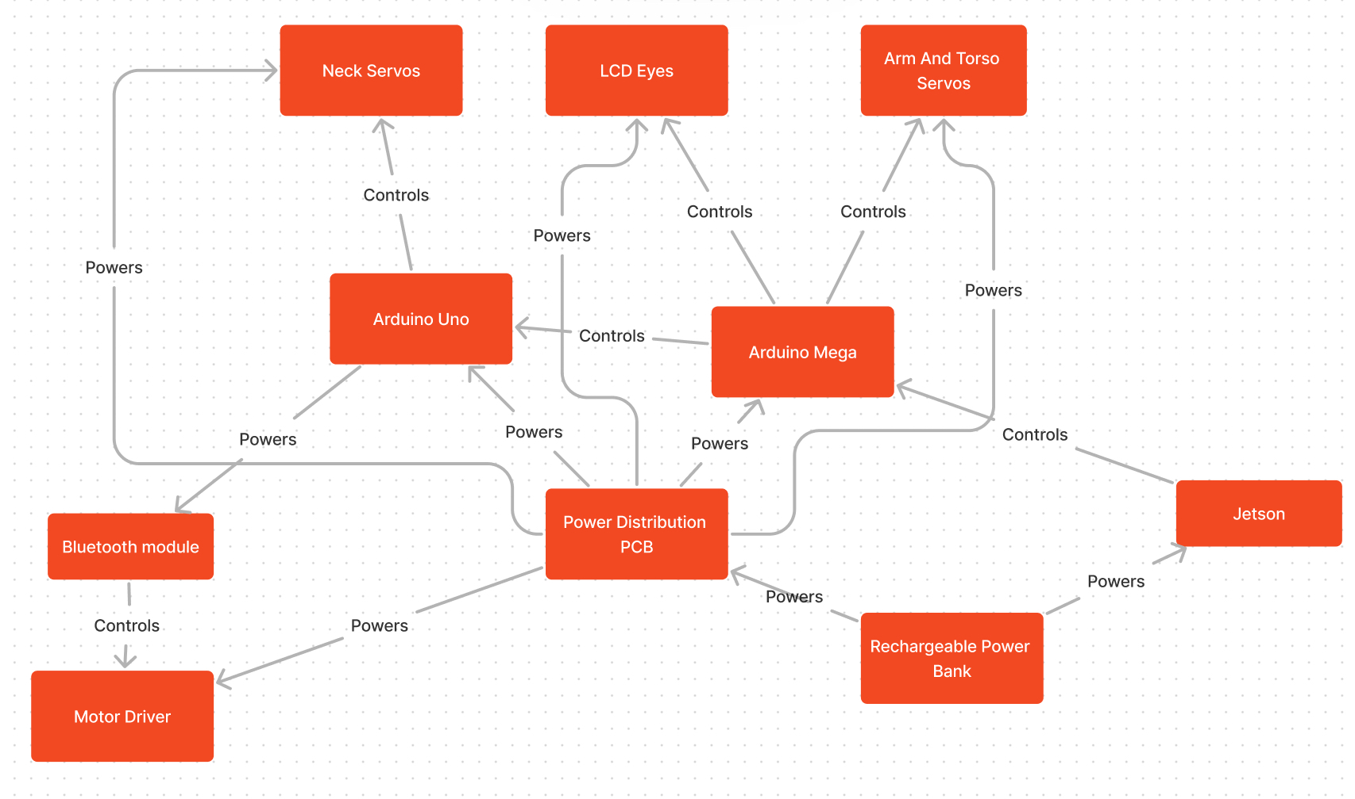
Hardware Design
Notes:
What Zack will do is explain how each one is powered and connected. The power bank connects to the board by a regular circular plug. This is also how it powers the Jetson. The board connects to the other components (such as the motor controller and the arduinos) using pin headers, which allow wires to be connected easily. The rest of the components are connected through wires or USB cables.

Slide 11
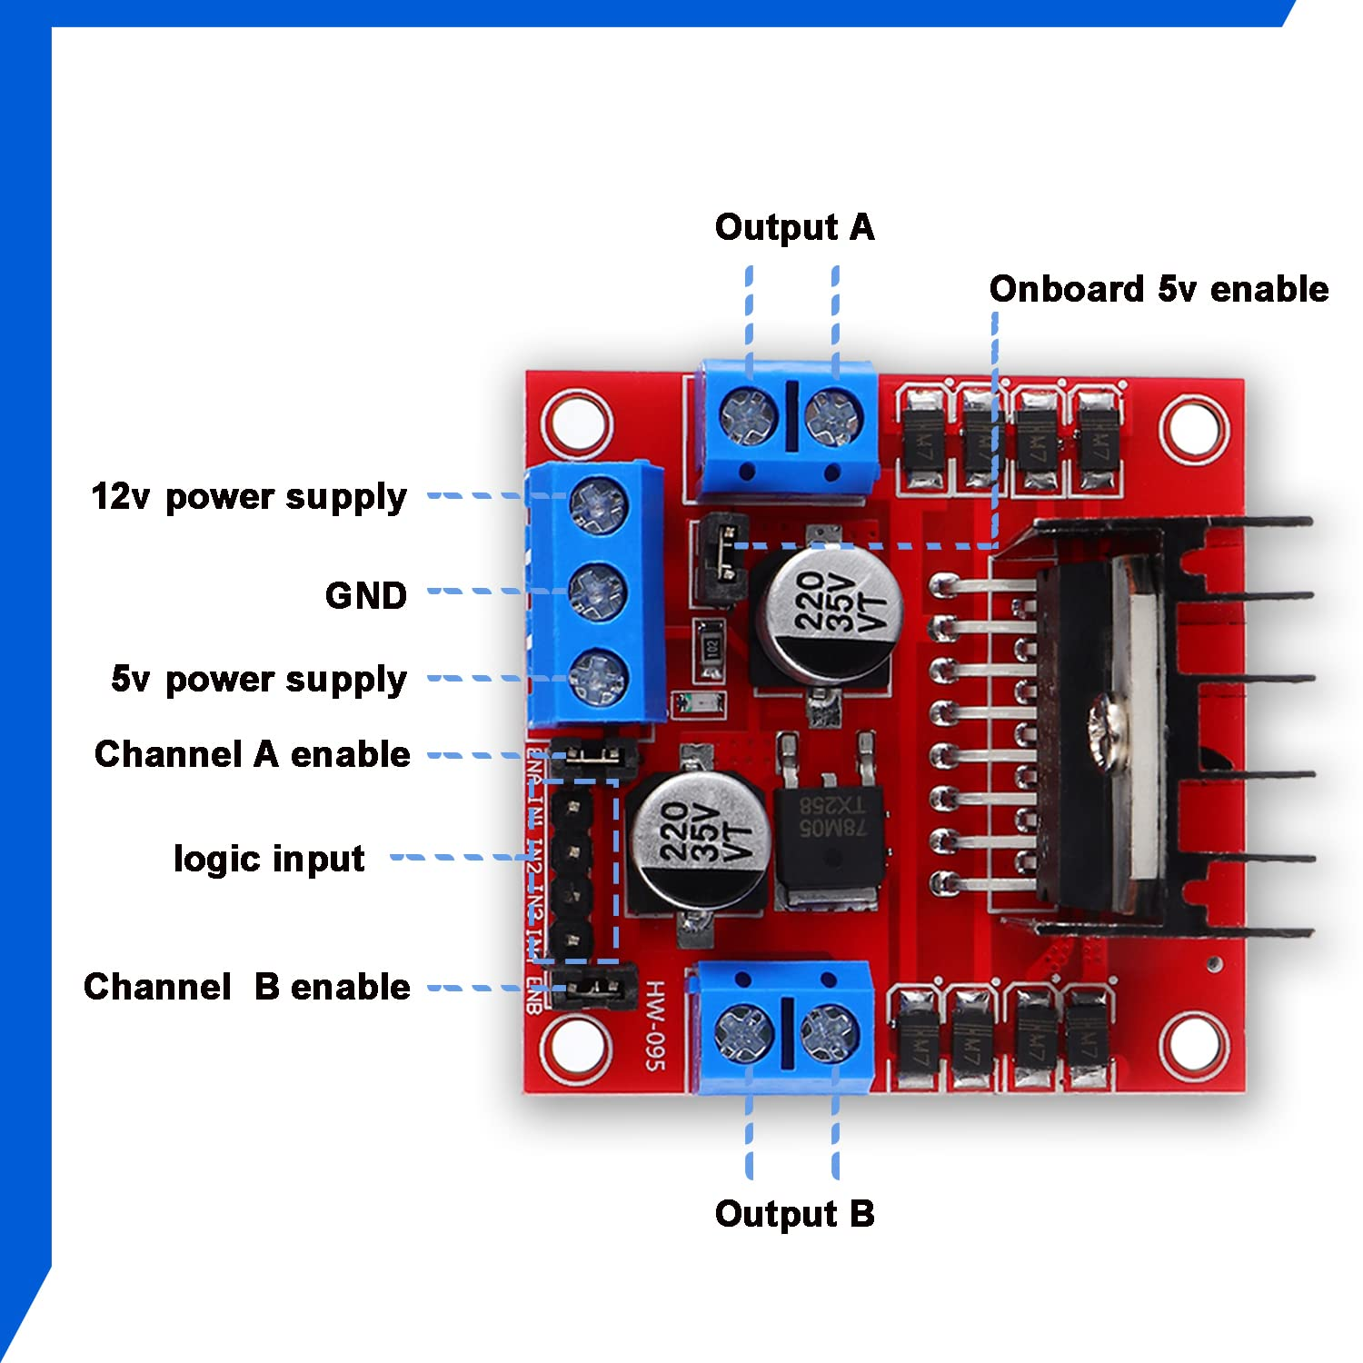
Hardware Comparison and Selection
Motor Driver
Part | Voltage | Current Output | Price | Form
PWD13F60 | 3.3-15V | 8A | $6.70 | Solderable Chip
PN00218-DME3 Sabertooth | 6-30V | 8A | $124.99 | Dev Board
LN298N | 5-12V | 5A | $10.99 | Simple H-bridge
Notes:
PWD is PCB solderable, so is a stretch goal

Slide 12
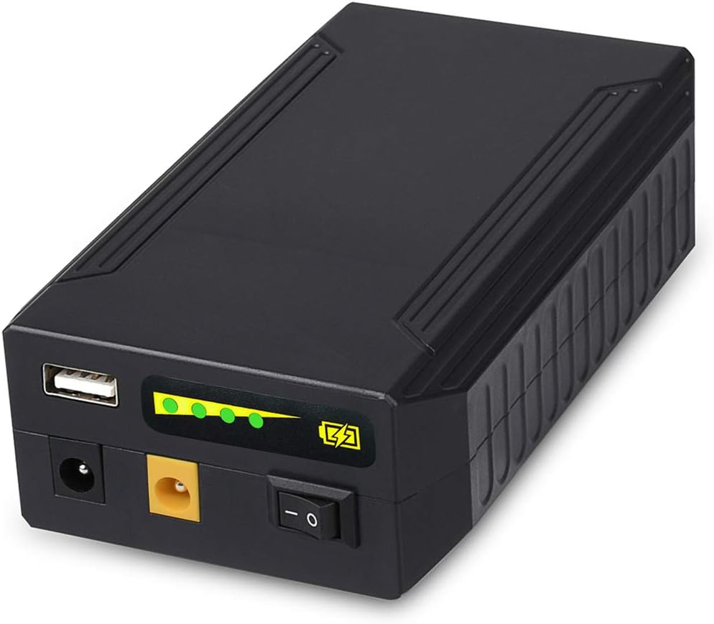
Hardware Comparison and Selection
12V Rechargeable Power Supply
Part | Watt-Hours | Weight (g) | Size | Pros | Cons
BiX Power Battery | 100Wh | 621g (1.4lbs) | 7.5” x 4.5” x 0.9” | Long lasting, Multiple output ports | Large footprint, High cost
Talentcell Rechargeable | 96Wh | ~500g (1.1lbs) | 3.1” x 5.4” x 1.5” | Small, Low charge time | Lower capacity
Cabela’s Rechargeable | 94Wh | 2300g (5.0lbs) | 4” x 2.5” x 6” | Large capacity, Leakproof | Massive, No charger included

Slide 13
Hardware Comparison and Selection
Voltage Regulator
Part | Input Voltage | Output Voltage | Max Current Out
TPS54JA20 | 2.7-16V | 0.9-5.5V | 12A
TPS562208 | 4.5-17V | 0.76-7V | 2A
TPS62901-Q1 | 3-18V | 0.6-5.5V | 1A

Slide 14
Hardware Comparison and Selection
Bluetooth Module
Part | Bluetooth Version | Pros | Cons
DSD Tech HM-10 | BLE 4.0 (4-pin) | DSD App, Directly compatible with track, Availability | Less configuration possible
DSD Tech HM-19 | BLE 5.0 (6-pin) | DSD App, Fast transfer rate | BLE 5.0 not compatible with track
HiLetGo AT-09 (HM-10) | BLE 4.0 (6-pin) | HM-10 compatible | Hardware incompatibility

Slide 15
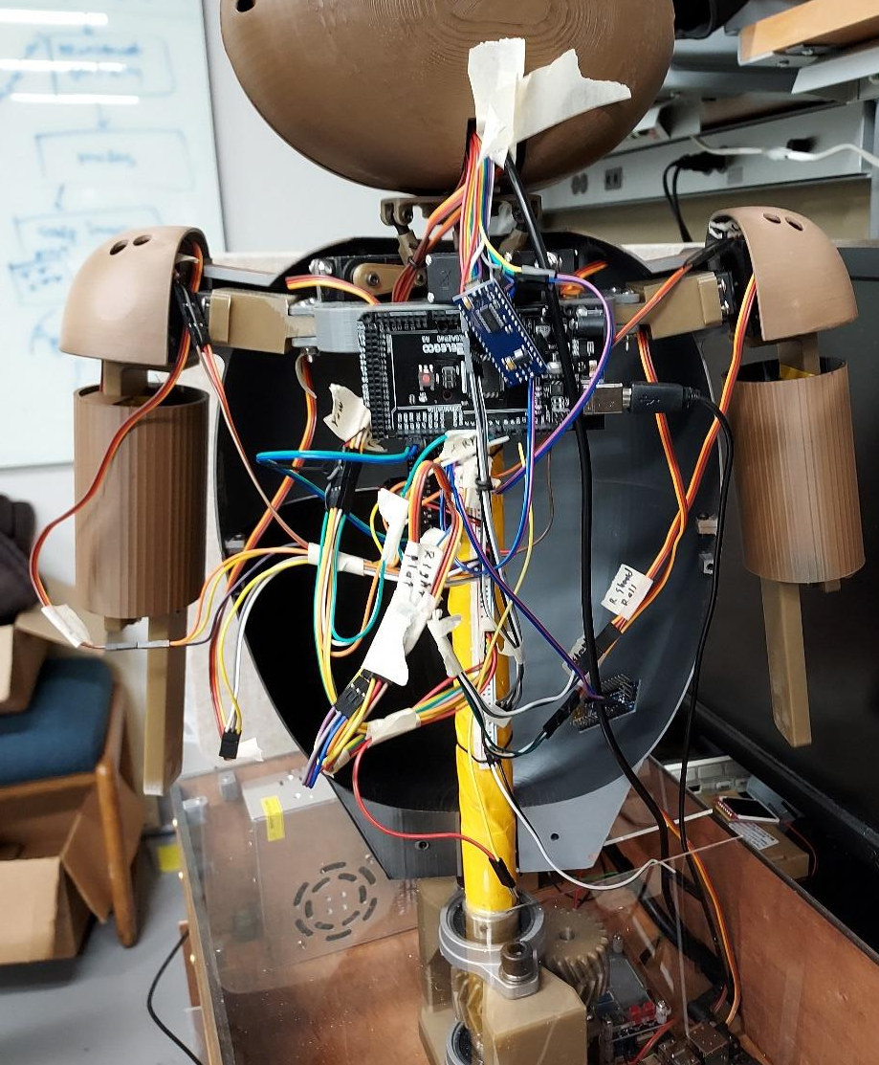
Hardware Comparison and Selection
Reused Parts:
Arduino Mega R3,
Arduino Uno,
NVIDIA Jetson Xavier NX,
TFT LCD Eyes

Slide 16
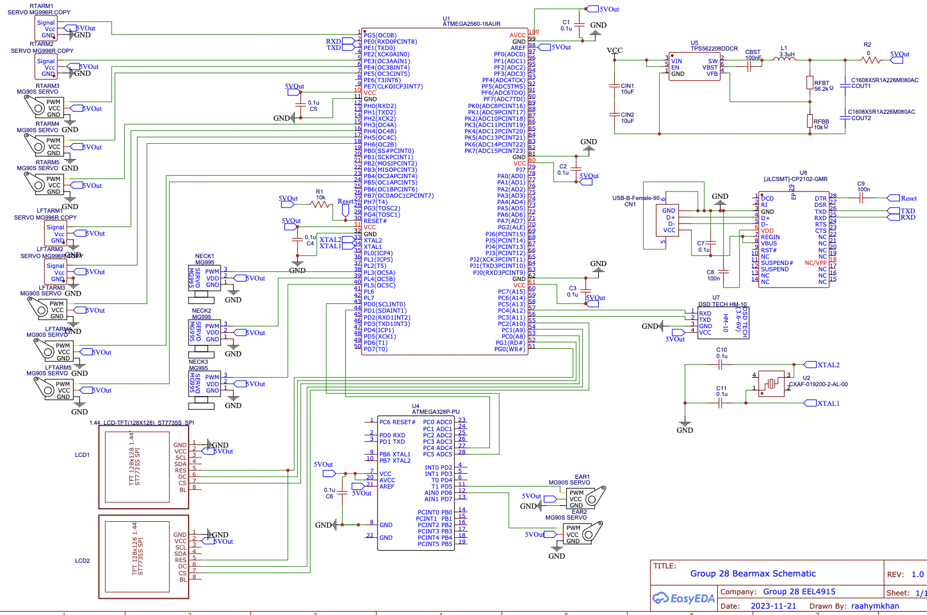
Arduino Connection Schematic

Slide 17
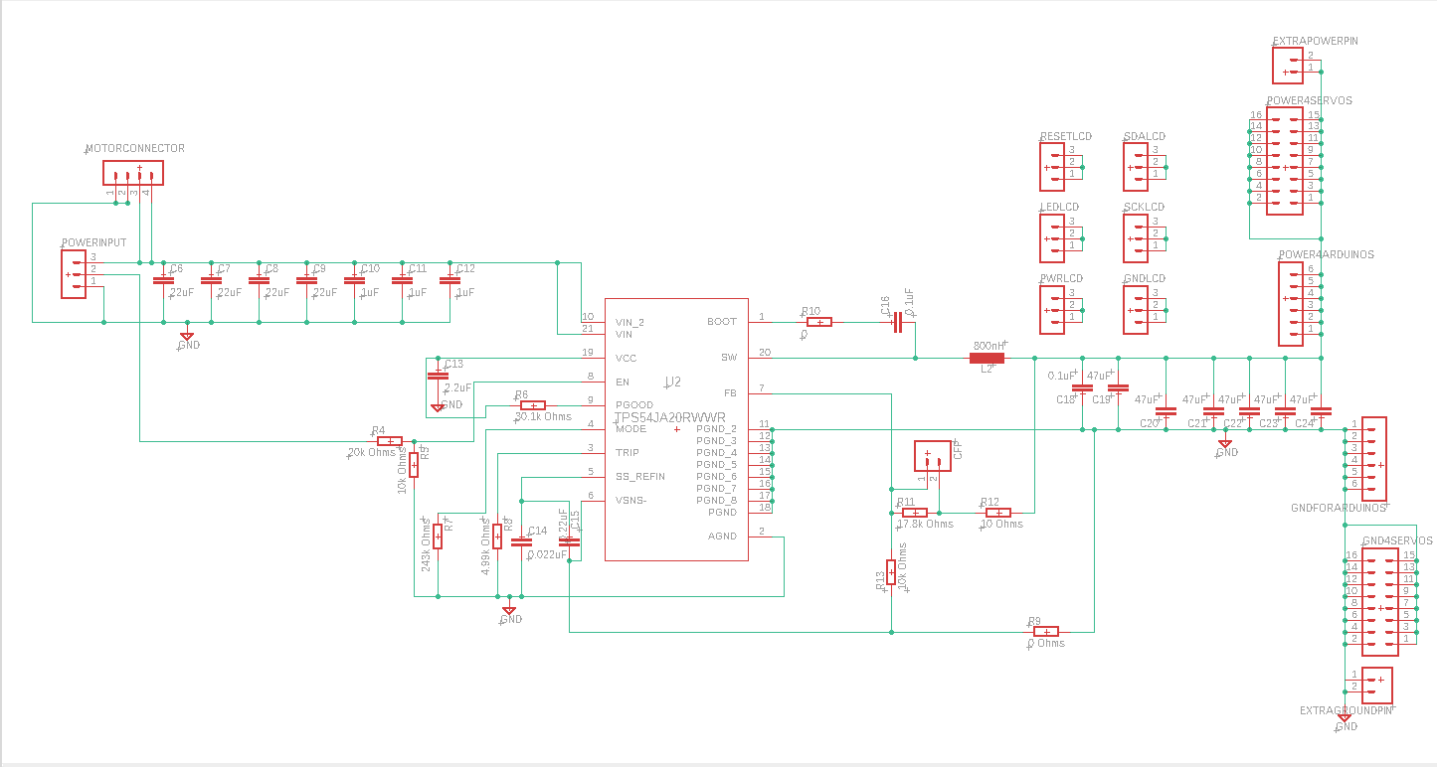
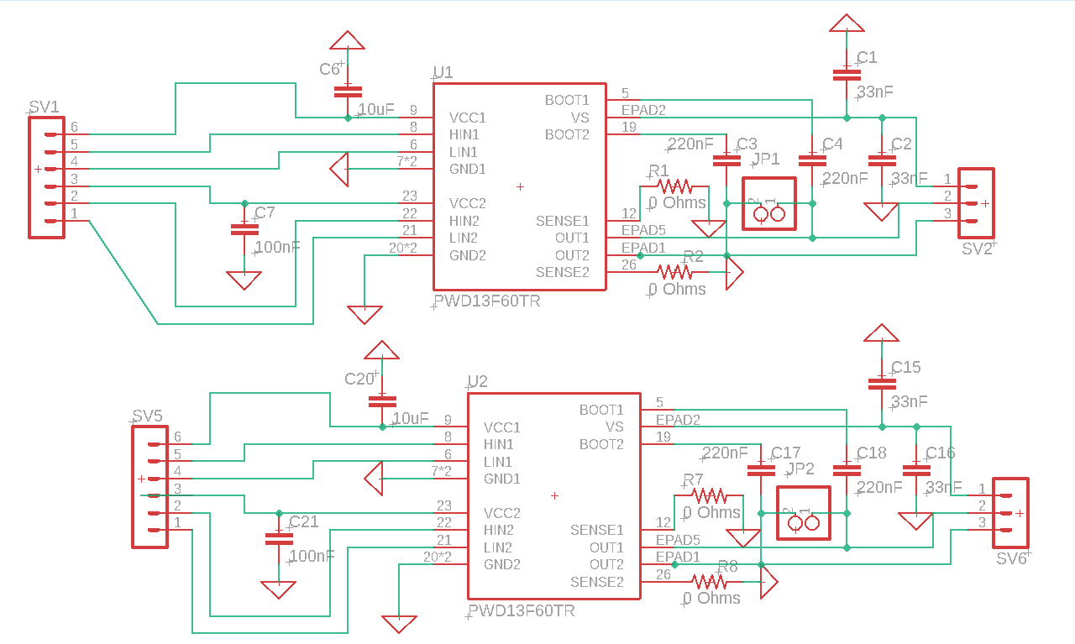
PCB Schematic Design
Power distribution board
Motor Driver board

Slide 18
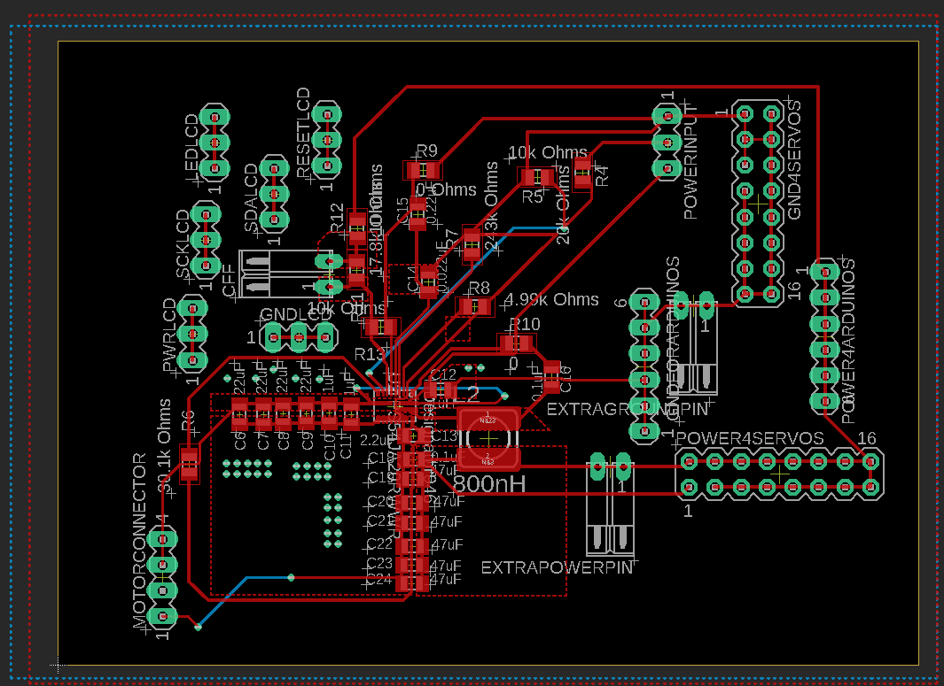
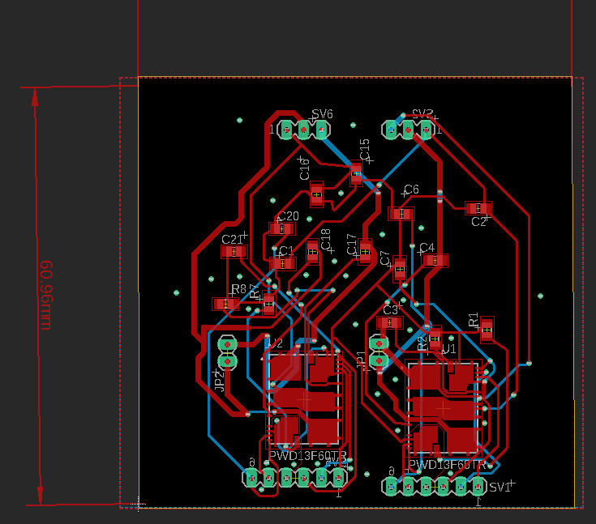
Layouts
Power Distribution Board Layout
Motor Board Layout

Slide 19
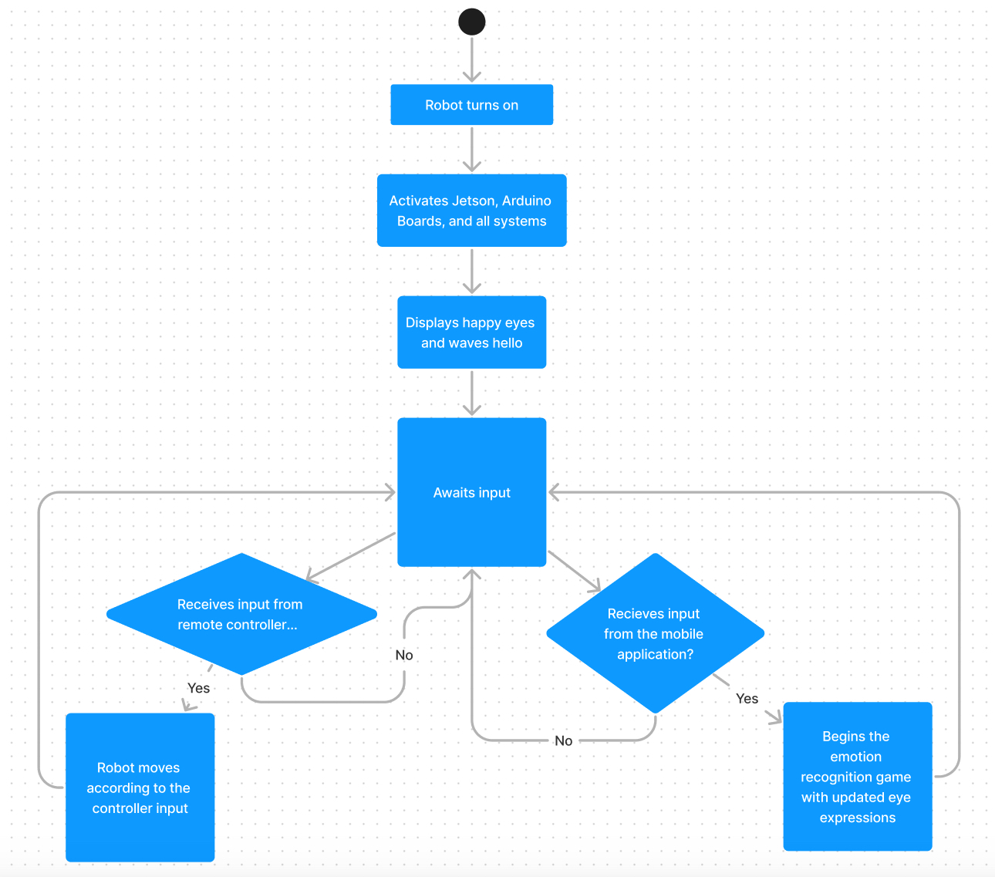
Overall Activity Diagram

Slide 20
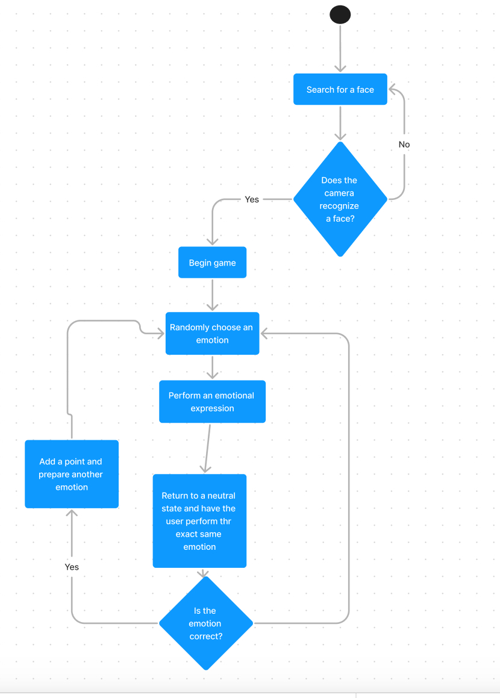
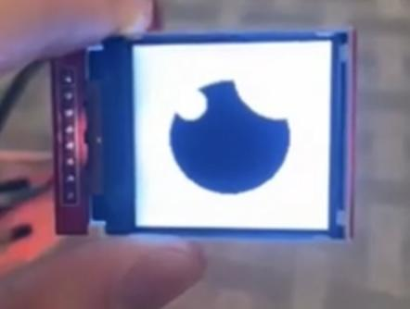
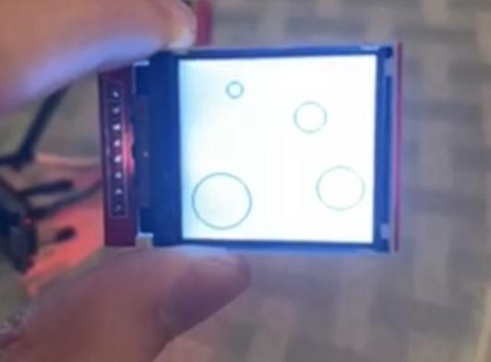
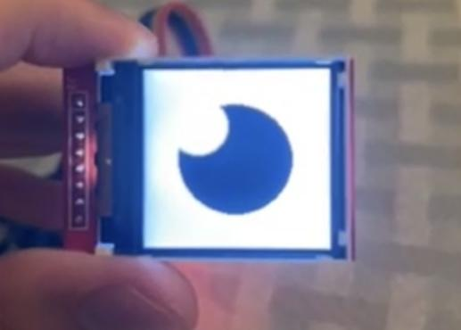
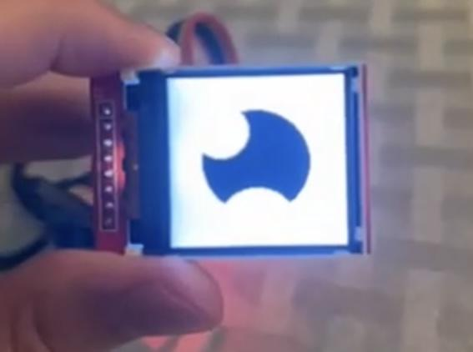
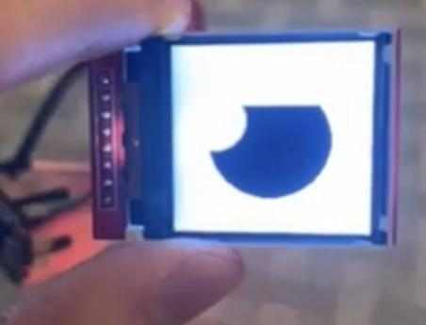
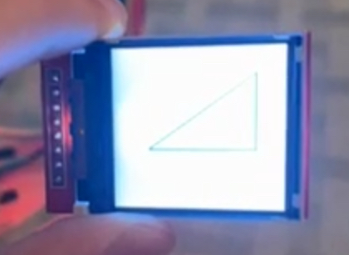
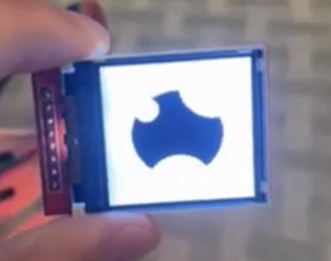
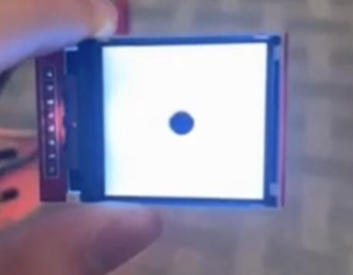
Emotion Recognition game activity diagram
Emotional eye examples
Neutral
Nervous/afraid
Dizzy
Happy
Disappointed
Angry
Sad
Shocked

Slide 21
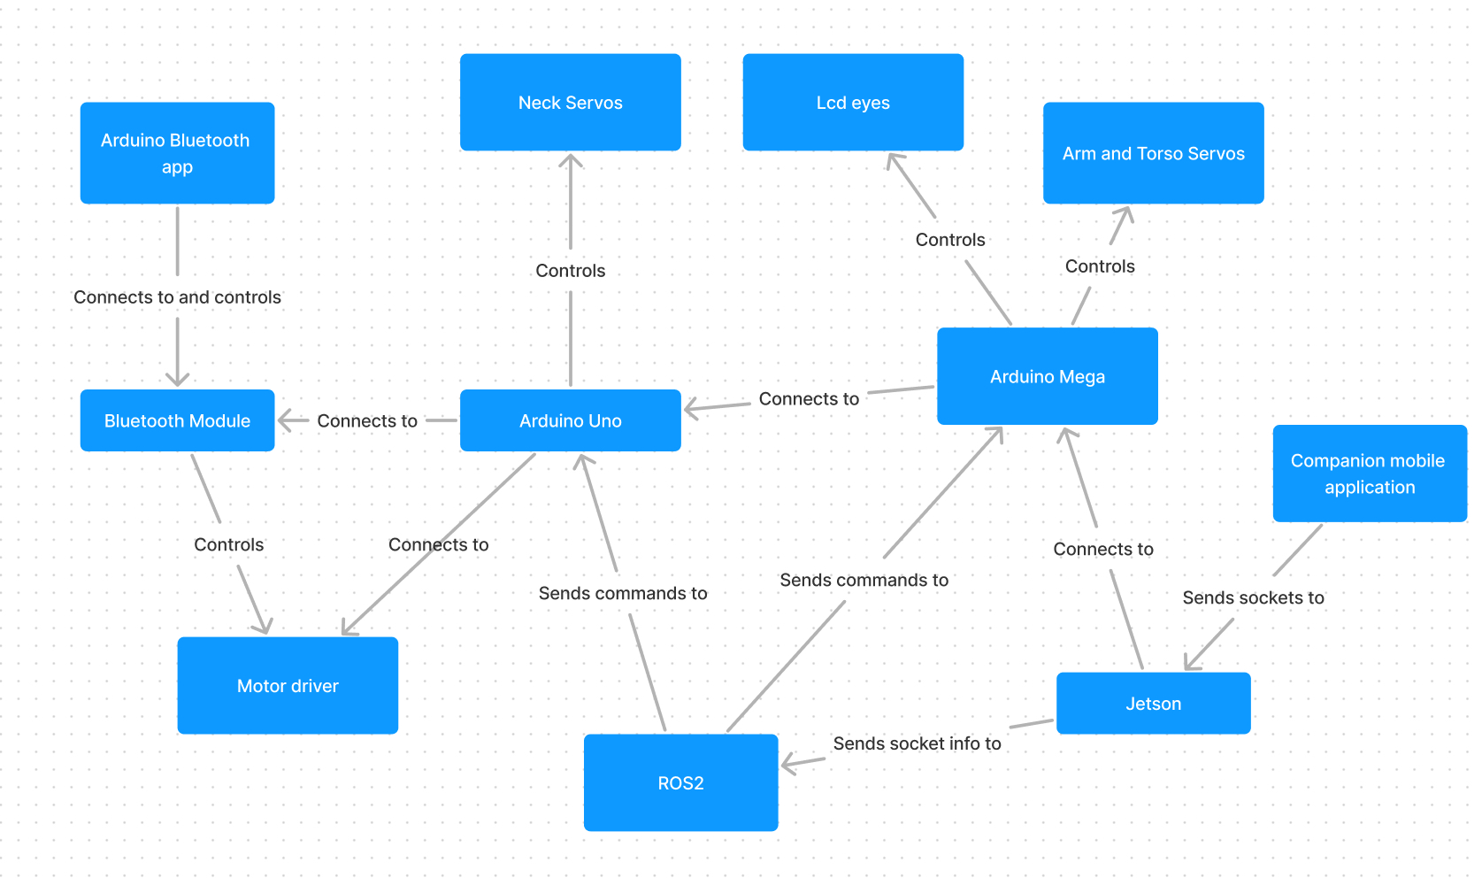
Software Design

Slide 22
Software Comparison and Selection
Bluetooth App
Part | Cost | Pros | Cons
DSD Tech Bluetooth | Free | Pairs to DSD parts like selected | Only works with DSD parts
ArduCar | Free | Widely compatible | Android Only
BLExAR | $4 | Good Interface & Tools | Cost

Slide 23
Software Comparison and Selection
Programming Language
Language | Platforms Compatible
C++ | Arduino IDE, ROS lib, Additional drivers
Python | ROS Lib
C | Arduino IDE

Slide 24


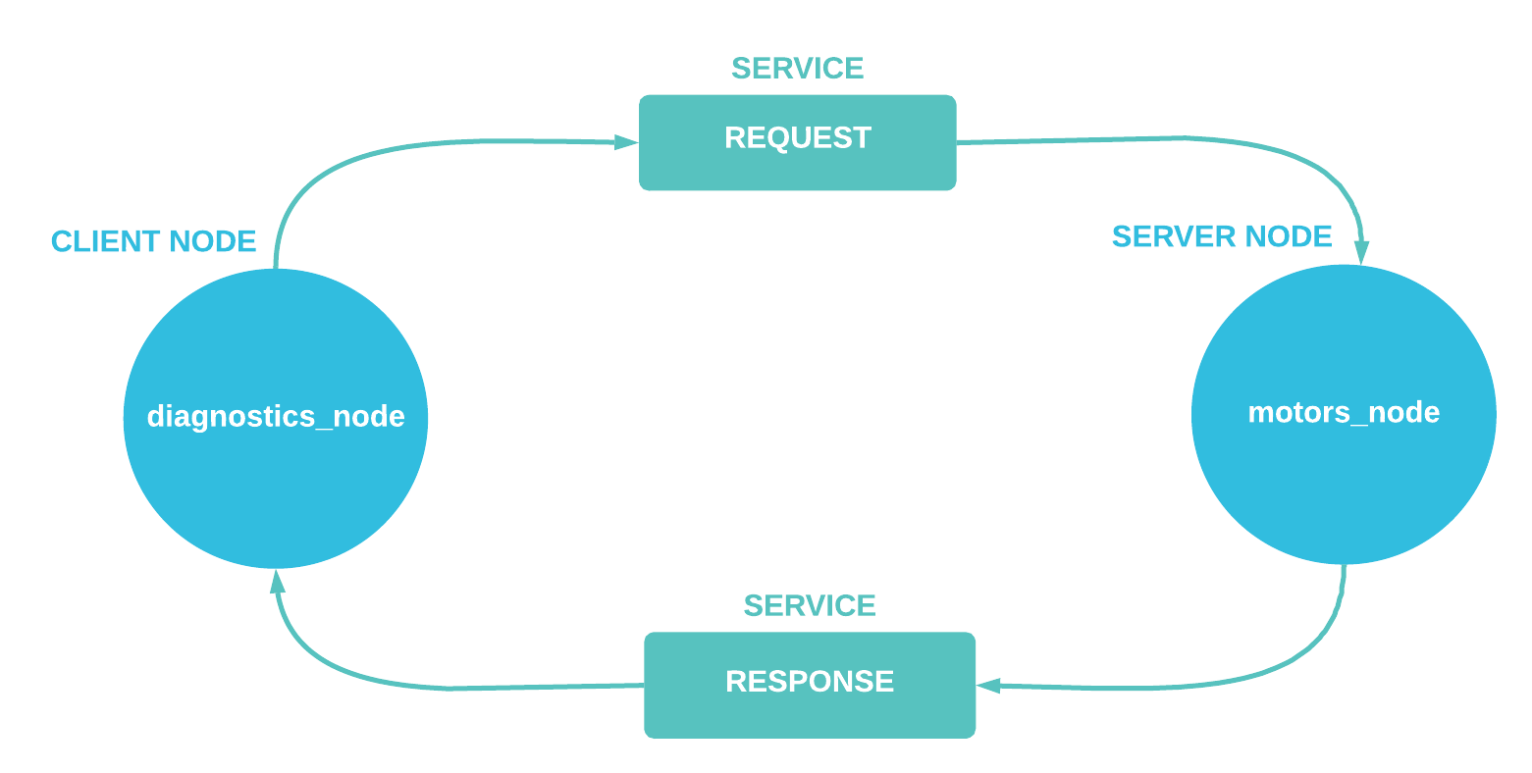

Jetson Xavier NX Software

Slide 25
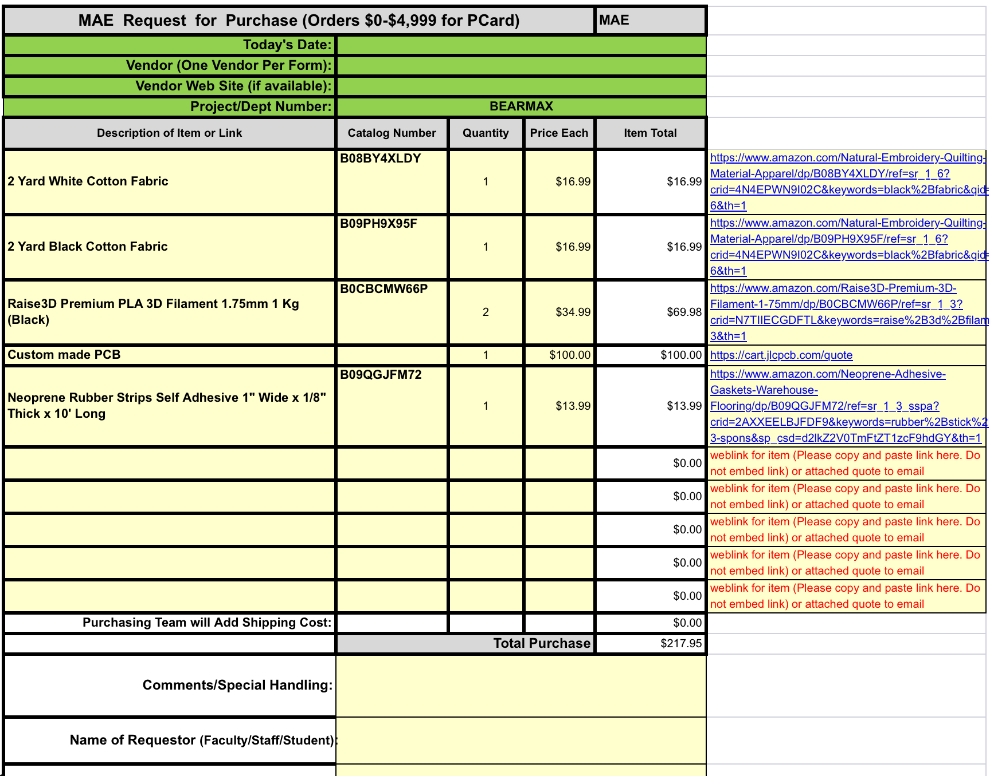
Administrative Content: Budget
Expenses:
Budget: 250 dollars
Parts Supplied by WEAR Lab:
Servos, Development Boards, Track Kit, etc

Slide 26
Administrative Content: Work Distribution
Team Member | Primary Task | Secondary Task
Bhavani Sivakumaar | Model fingers, arms, shoulders, shell | Exoskeleton Build
Nicholas Buchberg | Exoskeleton Build, track platform, head, neck torso | Model shell, shoulders arms
Raahym Khan | Robotics Programming, ROS testing | Jetson Work, CS Integration
Zachary Larson | PCB Assembly, Soldering, Testing | Robotics Programming

Slide 27

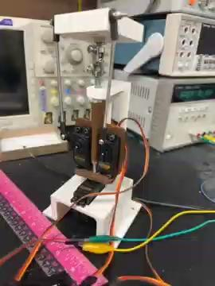
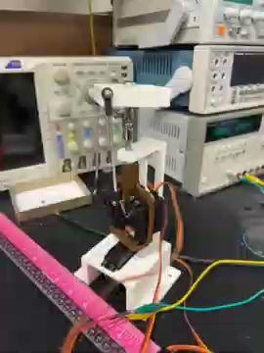

Slide 28
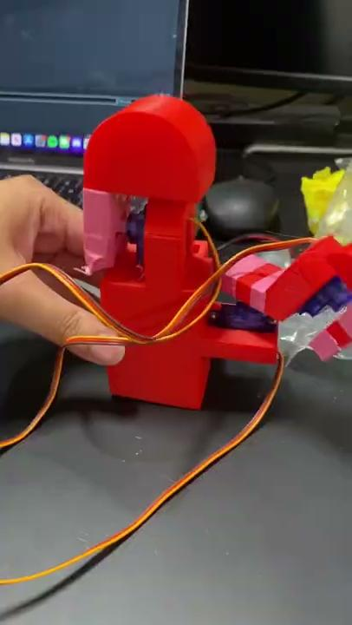

Slide 29
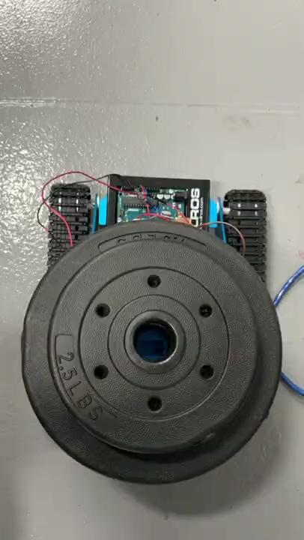
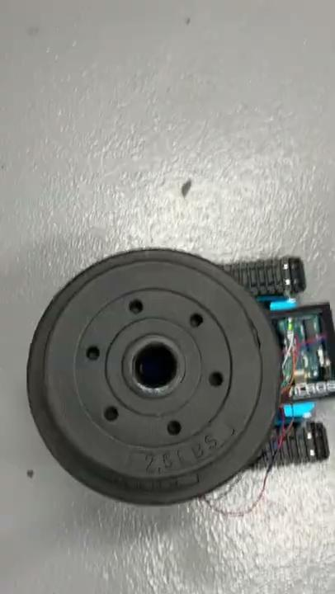

Slide 30
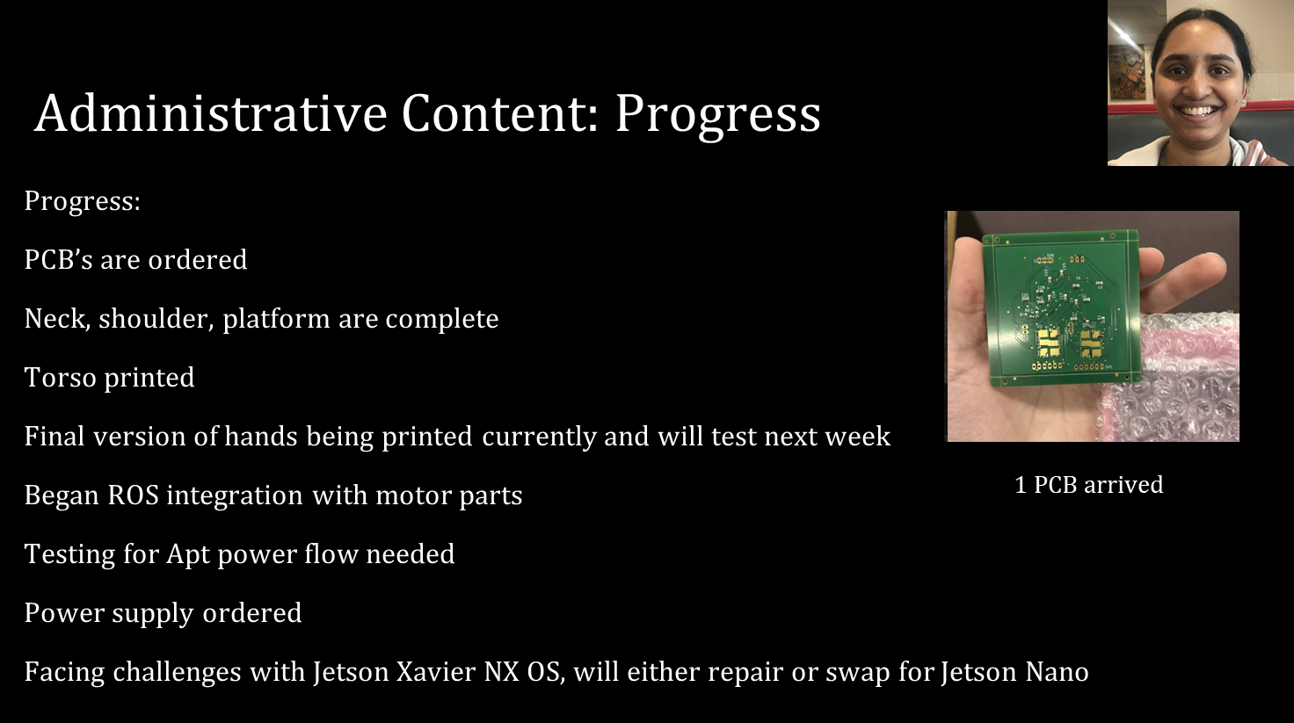

Slide 31

Notes:
Our team has made considerable progress this semester. Some of the most important goals we have are to have functioning components of the robot, such as the hands, head, neck, shoulders, arms, hands, body, and platform of BearMax. We have made and tested the neck which is different from the first version as it has more degrees of freedom or movement. We have also printed and tested the prototype of the hands. Regarding the moving platform, we used a pre made track platform which we have tested using weights and it can support up to 20 pounds which is our highest weight limit. As you can see in these videos, the larger the weight limit, the slower the track moves. Fortunately, for this project speed is not an important consideration because we want BearMax to walk along with a child (look up average walking speed of children age in target demographic for BearMax). Similarly, the hand size is targeted and designed to be similar to the size of a child’s hand. While the hand’s size was changed due to accommodating the size of the motors (restructure paragraph)

Slide 32
Challenges
Designing the hands, Neck, and Torso have been tricky since the team had to go through different designs. We have been able to complete them with guidance from our advisors
Working with the Jetson has proven to be difficult. Fortunately, we have guides to help us and people who can help us
Programming in ROS has proven to be a challenge. Thankfully, we have a previous member who is helping us, we have found guides online, and we have found more people who know about ROS and can help us.
Designing and ordering the PCB has proven to be difficult, but the team has managed to get the PCBs nonetheless

