Slide 1
Study Buddy
Group 33:
Cliff Porter Computer Engineering
Kaiden Duvall Computer Engineering
Denzel Stockhausen Electrical Engineering
Idris Al-Shidhani Electrical Engineering

Slide 2
Motivation
Kaiden Duvall
-Many students find it easy to be distracted from doing their work, especially in the modern day (smartphones, internet access)
-Busy parents need to be able to ensure their child is studying without having to constantly monitor them
-Older students or workers with good self-discipline may desire a small physical separation from distractions

Slide 3
Goals & Objectives
Kaiden Duvall
Goals
Objectives
-Create device with multiple compartments for separate simultaneous uses
-Ability to secure compartments for amount of time chosen by user
-Include several methods of unlocking device outside of timer
-Allow user to configure what methods of access are enabled at any given time
-Detect if the device was forcefully accessed
-Allow short-range monitoring and overriding of main device
-Build locker with three compartments capable of holding a variety of common distractions
-Timer option allowing user to input an amount of time for the device to lock
-Include a keypad, RFID reader, and fingerprint sensor
-Add configuration screen before locking to allow for selecting unlocking methods
-Include lid sensors that alert MCU to tampering
-Create remote that can display locker status and send an unlock override from a short range

Slide 4
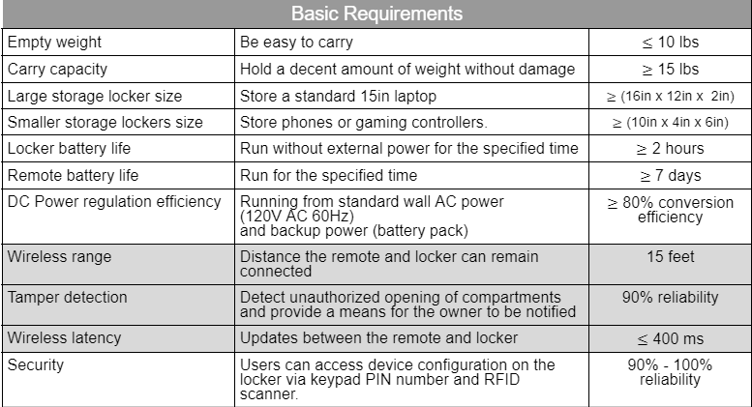
Requirement Specifications
Basic Requirements
Empty weight | Be easy to carry | 10 lbs
Carry capacity | Hold a decent amount of weight without damage | 15 lbs
Large compartment size | Store a standard 15in laptop | (16in x 12in x 2in)
Small compartment size | Store phones or gaming controllers. | (10in x 4in x 6in)
Locker battery life | Run without external power for the specified time | 2 hours
Remote battery life | Run for the specified time | 7 days
DC Power regulation | Running from standard wall AC power (120V AC 60Hz) and backup power (battery pack) | 80% conversion efficiency
Security | Users can access device configuration on the locker via keypad PIN number and RFID scanner. | 90% - 100% reliability
Demonstrable Requirements
Wireless range | Distance the remote and locker can remain connected | 15 feet
Tamper detection | Detect unauthorized opening of compartments and provide a means for the owner to be notified | 90% reliability
Wireless latency | Updates between the remote and locker | 400 ms
Kaiden Duvall
Advanced Requirements
Wireless range | Distance the remote and locker can remain connected | 40 feet
Power for phone chargers | Include 3 USB ports for phone charging | Three 5V 2A USB wires
Advanced security | Users can access device configuration on the locker via fingerprint access. | 80% reliability
Stretch Goal Requirements
Emergency override | Detect when a user might need emergency access to their phone and unlock | 65% reliability
Notes:
important specifications ( mention in presentation ) - large enough to fit common electronics
- long remote battery life
- range 15ft with 40ft as an advanced goal
- reliability of inputs 90-100%
- emergency override stretch goal

Slide 5
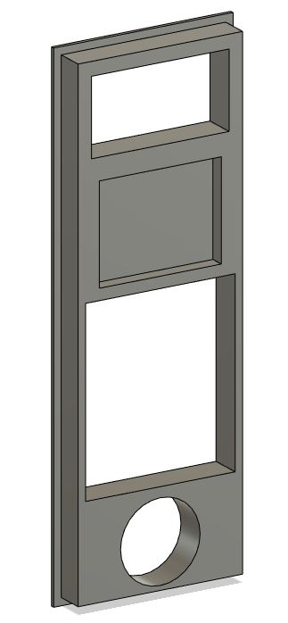
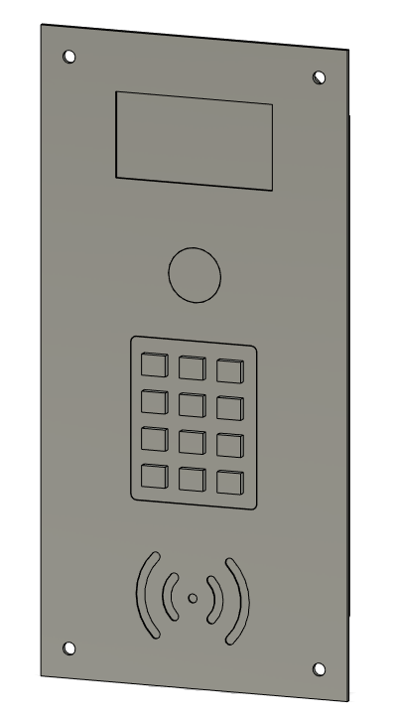
Input Methods (Authentication Factors)
Kaiden Duvall
Timer (Displayed on screen)
Time
Fingerprint sensor
“Something you are”
Keypad (Menu navigation and passcode entry)
“Something you know”
RFID reader module
“Something you have”
Remote override
Location

Slide 6
Technologies Used
Kaiden Duvall

Slide 7
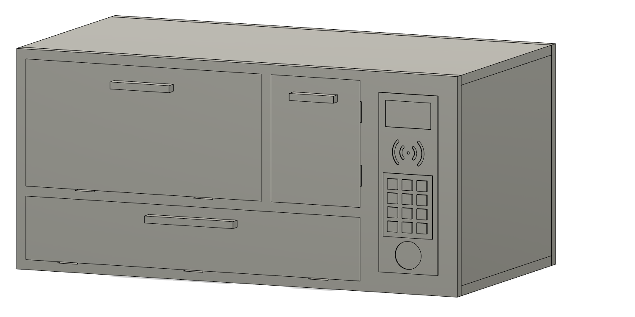
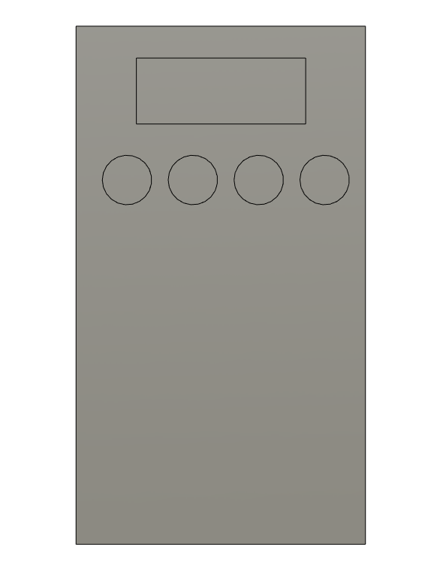
Design Approach and Implementation
Kaiden Duvall
Main locker unit for users to store items in
Mechanism for locking compartments
User interface
Power system with battery backup
Portable remote to wirelessly interact with locker
Low power for long battery life
Intuitive button and screen interface
Displays information and sends commands to the locker

Slide 8
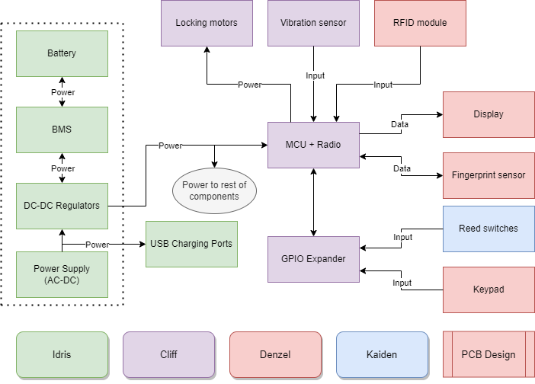
Overall Block Diagrams - Main Locker
Kaiden Duvall

Slide 9
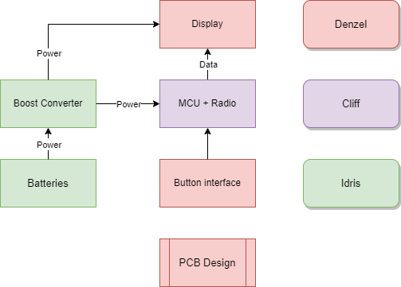
Overall Block Diagrams - Remote
Kaiden Duvall
Notes:
-simple design
-not much to say

Slide 10
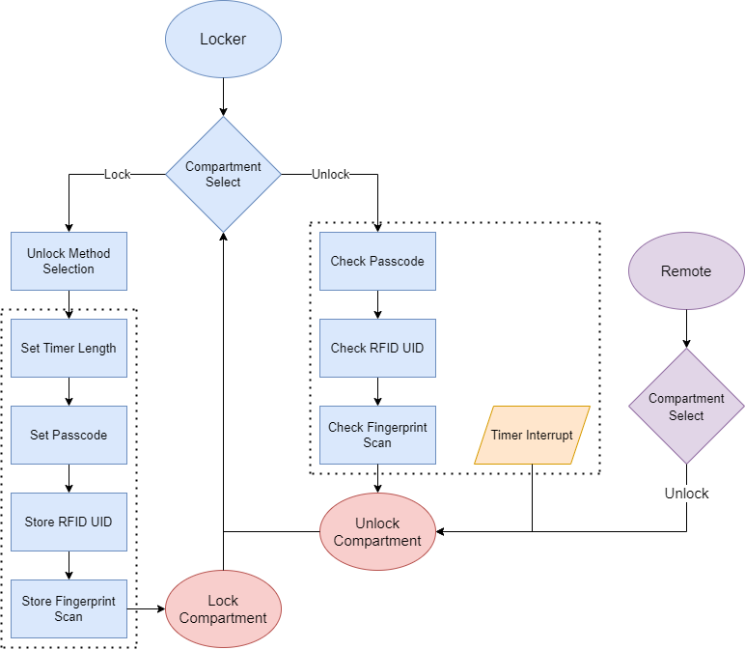
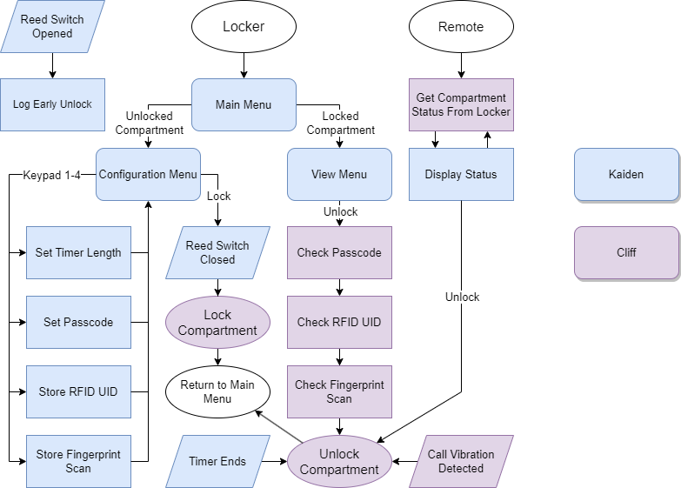
Software Block Diagram
Kaiden Duvall

Slide 11
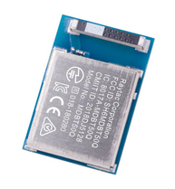
MCU Choice and Wireless Communication
Cliff Porter
 | MSP430FR6989 | RP2040 | ATmega328 | nRF52840
Cost | $12 | $1 | $1-2 | $10
Arduino IDE | No | Mostly | Yes | Mostly
Active current | ~1-5mA | ~9-10mA | 1-10mA | ~0.5-2mA
Wireless support | External radio modules only |  |  | BLE on-chip
Development board schematics | Yes | Yes | Yes | Yes
Currently available? | No | Yes | No | Yes (low availability)
Using the Adafruit ItsyBitsy nRF52840 as our reference design
All in one module
Ultra low power capabilities
Arduino IDE support with Pre-made arduino libraries for UART over Bluetooth Low Energy
Notes:
Cliff
-convenient module with embedded antenna and good availability

Slide 12
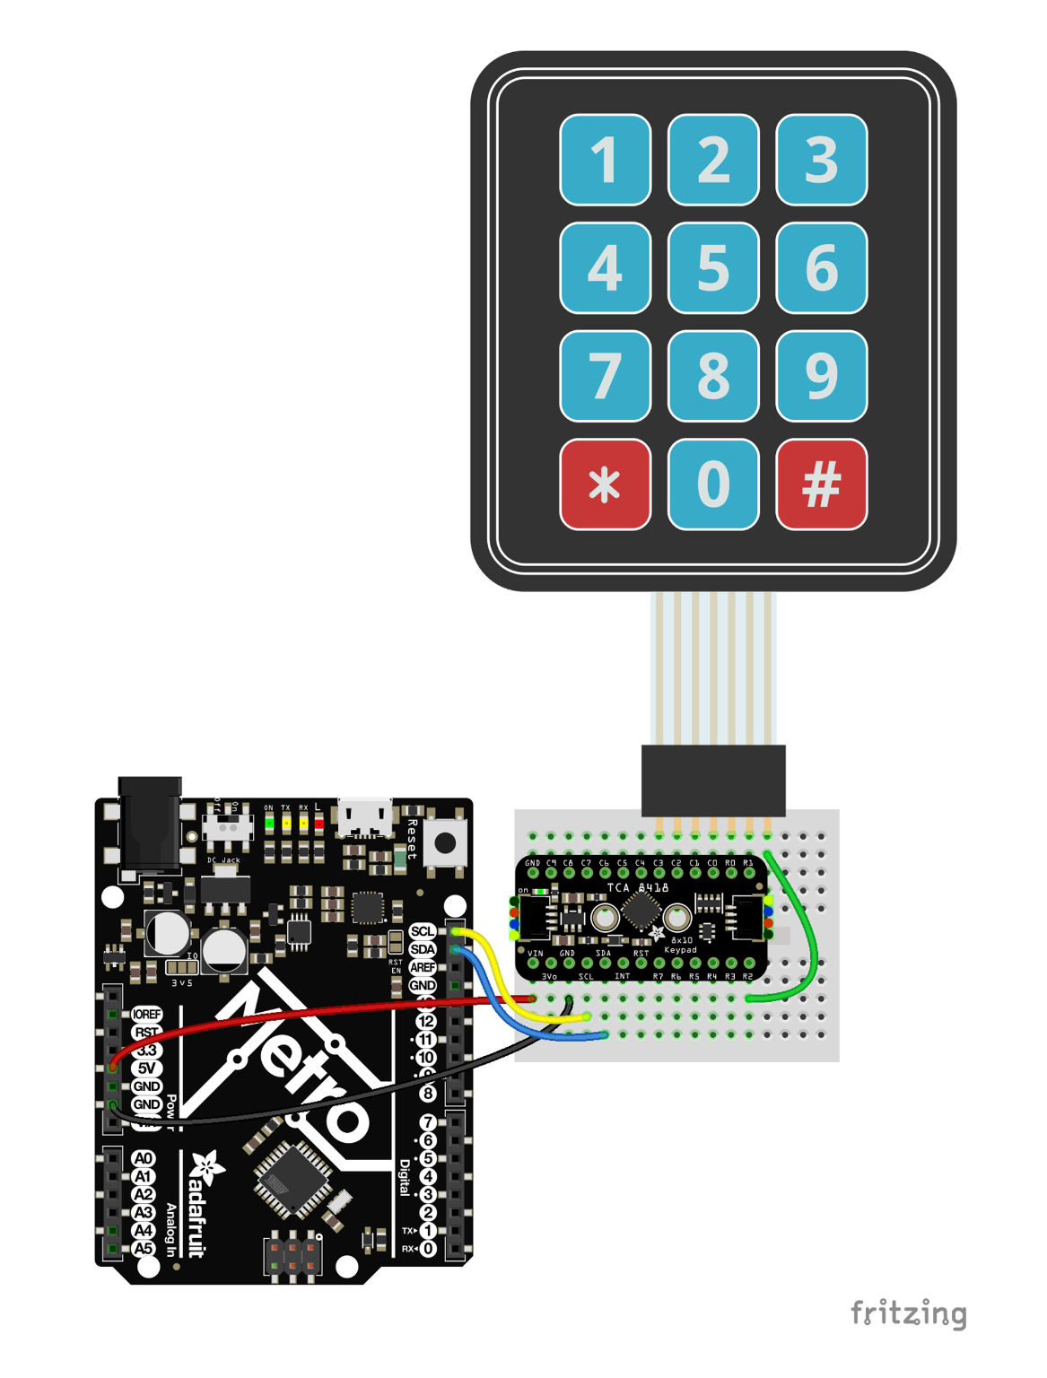
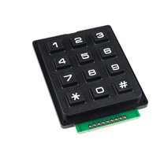
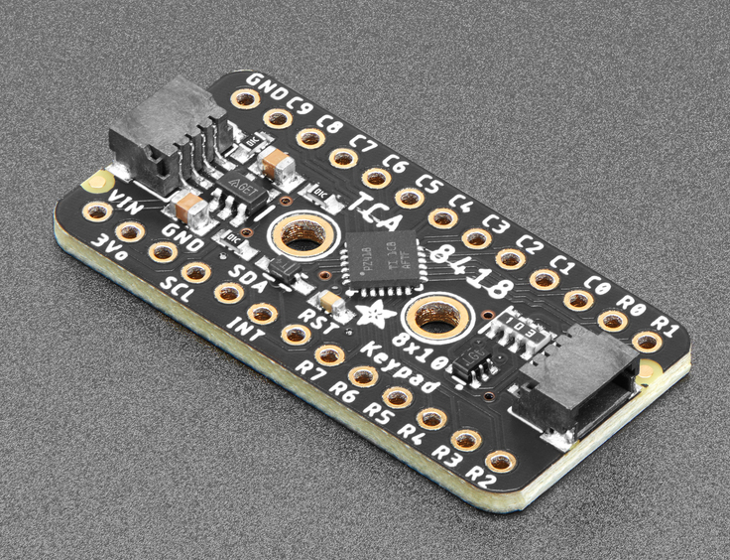
TCA8418 GPIO Expander
Cliff Porter
High number of GPIO pins are required to use all of our peripherals
Moved keypad and reed switches to GPIO expander (saves 10 pins)
Notes:
Cliff

Slide 13
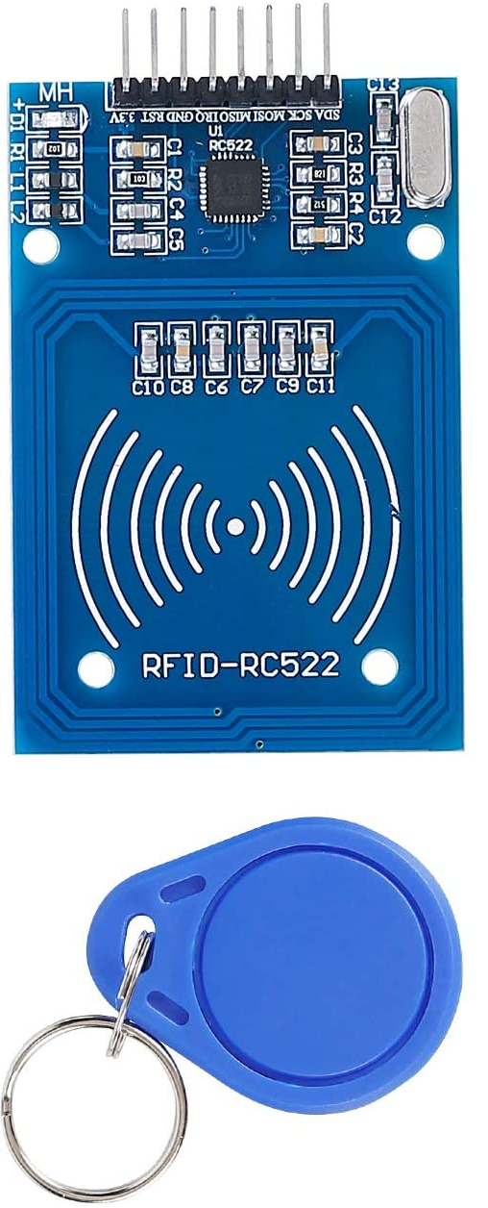
RFID Reader
Denzel
Stockhausen
RC522 RFID Reader Module
-Active reader that works with passive RFID tags
-~3cm read range, farther is unnecessary
-Communicates with MCU via SPI
-Small enough (3.78 x 2.99 x 0.87 inches) to fit in I/O panel
 | RC522 | Adafruit PN532
Operating Frequency | 13.56MHz | 13.56MHz
Communication Protocol | SPI | UART, SPI, I2C
Dimensions | 1.57’’x2.36’’x0.4’’ | 2.1’’x4.7’’x0.425’’
Price | $7.99 | $39.95
Notes:
Denzel
-Simple RFID reader
-Read from a distance (though our IO panel)

Slide 14
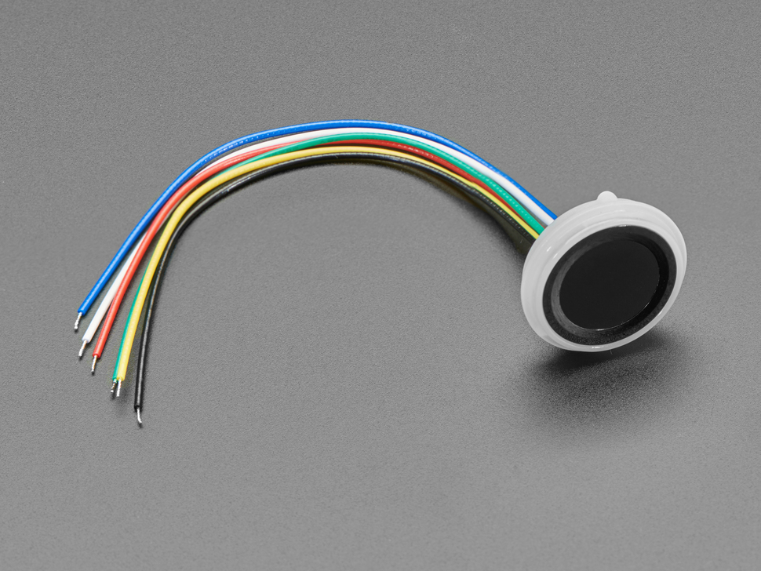
Fingerprint Sensor
Adafruit 4750 Ultra-Slim Fingerprint Sensor
-6 pin connector
-Stores up to 80 fingerprints in onboard memory
-Communicates with MCU via UART
-Enroll/scan library provided by Adafruit
Denzel
Stockhausen
 | Fingerprint Reader Sensor Module DY50 FPM10A Optical Fingerprint Module For Arduino Locks Serial Communication Interface Tools | Capacitive Fingerprint Scanner/Sensor for Arduino
Price | 5.36 | 8.03
Power | Supply voltage: DC 3.6 ~ 6.0V / 3.3V Supplying Supply Current: Current: <120mA Peak current: <140mA | Operating Voltage: 3.3V Operating Current: less than 60mA
Size | 56 x 20 x 21.5mm | diameter 21mm/height 5mm
Scan speed | <1.0 seconds | 300~400ms
Type | Optical | Capacitive
Notes:
Denzel
-simple to use
-pre-made libraries

Slide 15
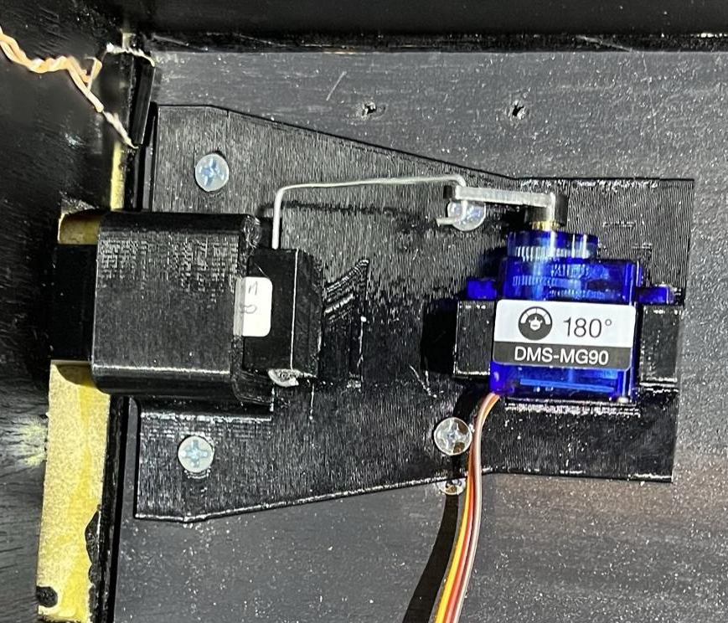
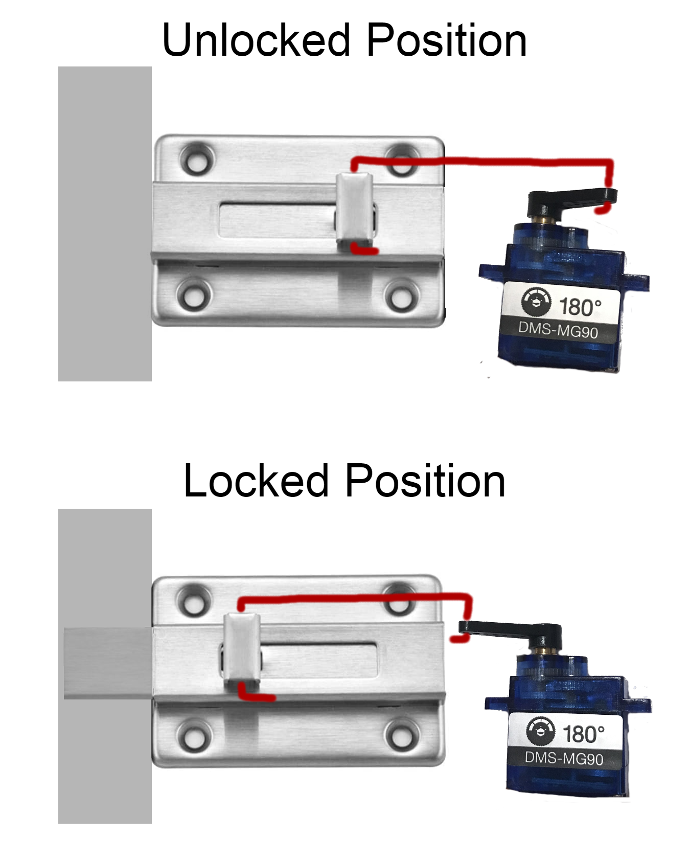
Locking Mechanism
Denzel
Stockhausen
-Using positional DMS-MG90 servo motors
-Each motor connected to a sliding bolt
-Bolt and motor both attached to inside of door
-Prevents force on doors from impacting motors
-Saves space by sliding bolt into locker frame
Notes:
Denzel
Image is a concept

Slide 16
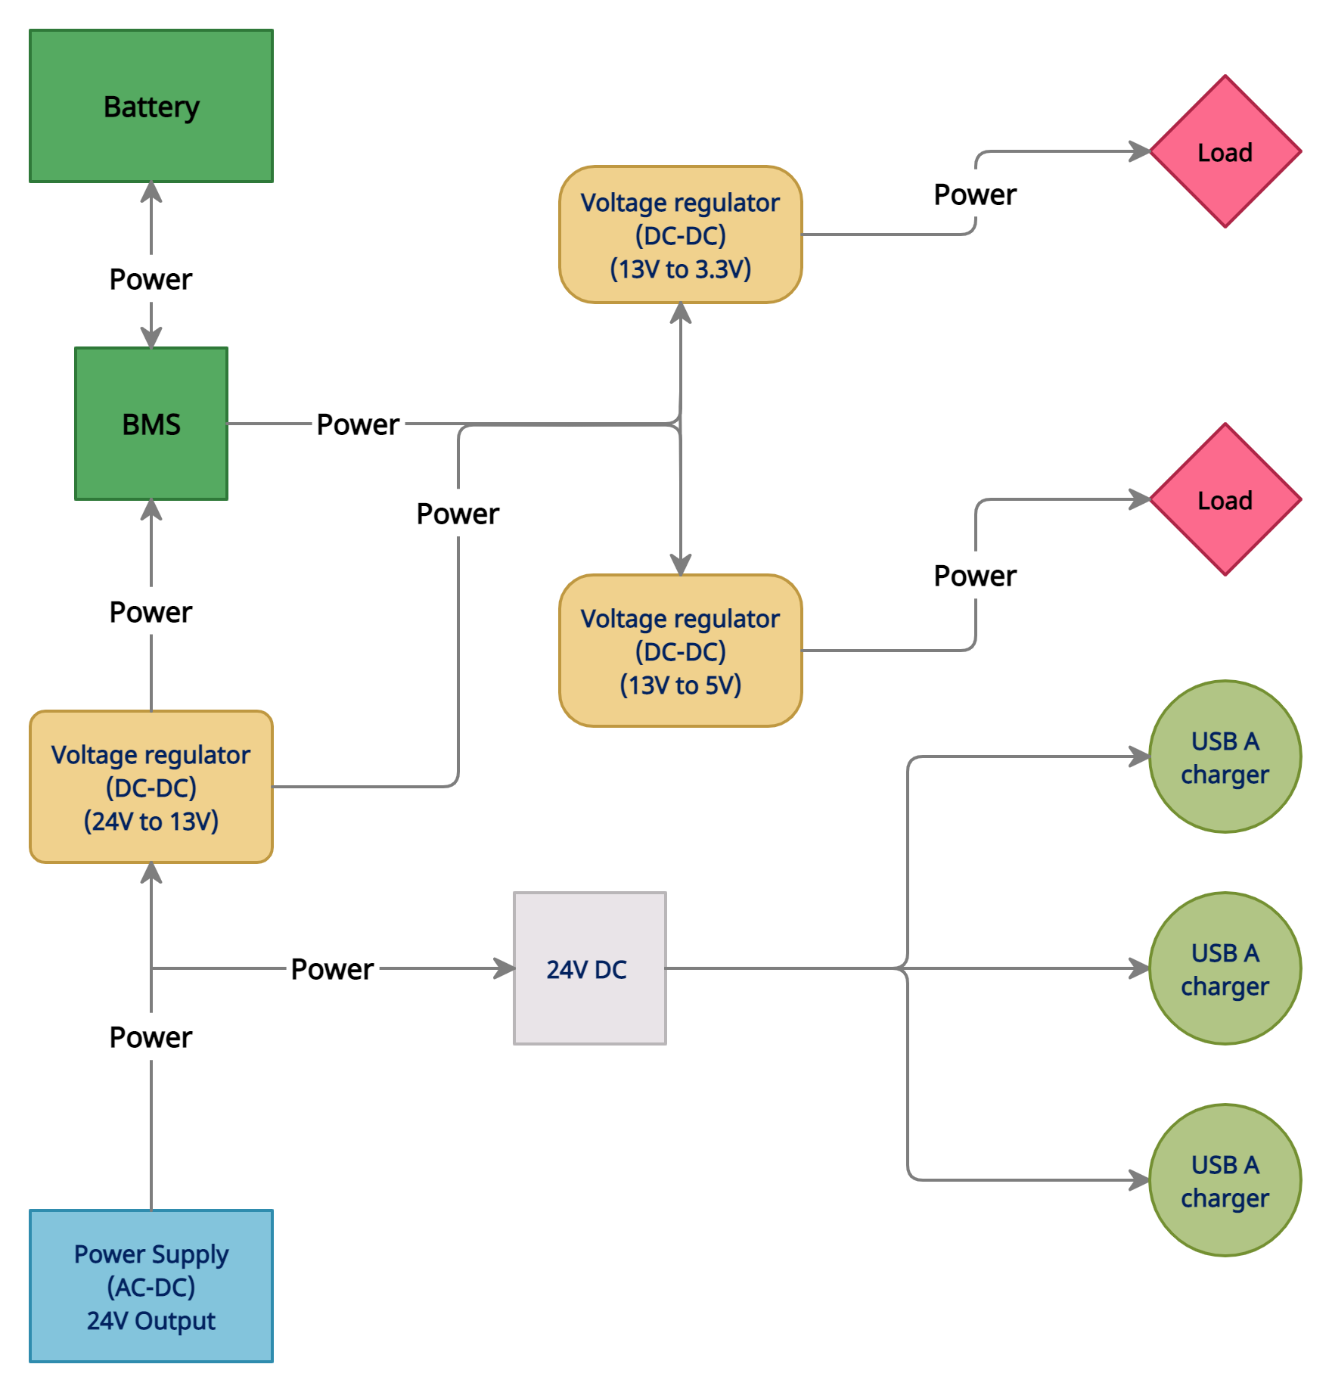
Power System
Four sections:
Power supply
Voltage regulators
Backup power
USB charging
Idris Al-Shidhani
Notes:
Idris
-For the power system of the main body locker, we would have 4 main sections.
-First section is the power supply at the bottom, which is going to provide power for the 13V voltage regulator plus the 3 USB charging circuits.
-Second section is the voltage regulators in yellow, starting by the 13V regulator which is charging the Battery pack and providing power
to the other two regulators of 5V and 3.3V outputs.
- the third section is the (Battery Management System) with the battery pack, and the fourth section is the USB charging ports at bottom right.

Slide 17
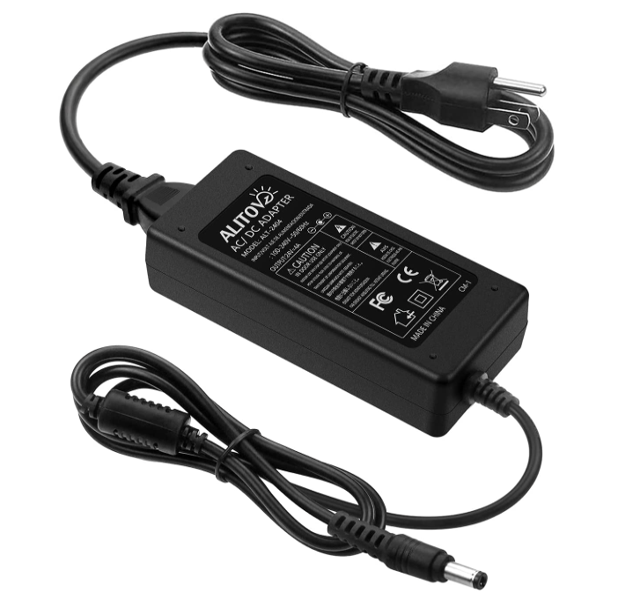
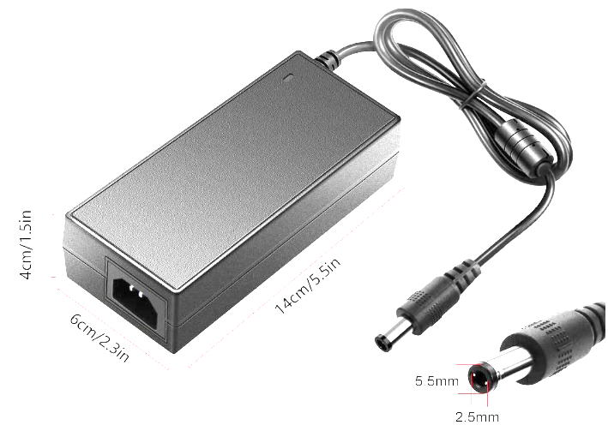
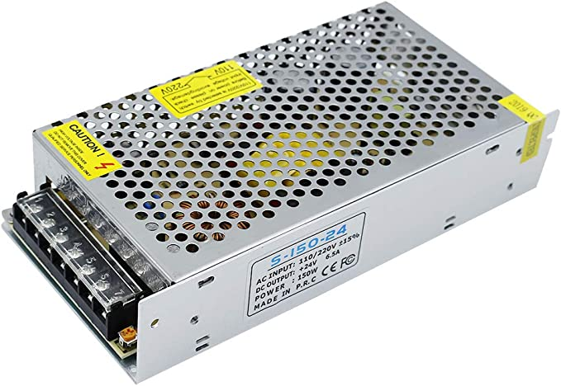
AC to DC Converter
The main power
source of the locker
We chose inShareplus as we already own it.
Can provide up to
150 Watts, and outputs 24V
Uses switching
technology to
maximize the converting
efficiency
Idris Al-Shidhani
Power supply | ALITOVE | SHNITPWR | inShareplus
Maximum load (watts) | 96 watts | 120 watts | 150 watts
Regulating technology | switching | switching | switching
Universal compatibility | (100-240) volts Yes | (100-240) volts Yes | (100-240) volts Yes
Notes:
Idris
-For the power supply, we had many options to choose from, one good option for the needed total watts was the (SHNITPWR), but we also included a bigger power supply that we already owned.
-Both power supplies can be implemented, but to save money we chose the (inShareplus) one that we already own.
-the power supply outputs a constant 24V to power all the locker components.

Slide 18
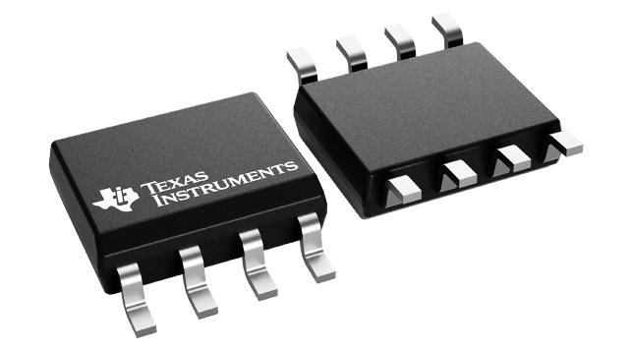
DC to DC Regulators - (13V Output)
Receives Power from AC to DC converter (24V)
The voltage regulator circuit is using the switching IC (TPS5420-Q1) from TI for best efficiency
Delivering Power to:
5V output regulator
3.3V regulator
Battery Management System
Idris Al-Shidhani
Notes:
Idris
-Next section is the voltage regulators, and the first one uses the (TPS5420) IC from Texas Instruments.
-the output of this circuit delivers power to the 5V and 3.3V regulators and also charging the battery pack through the
Battery management system.

Slide 19
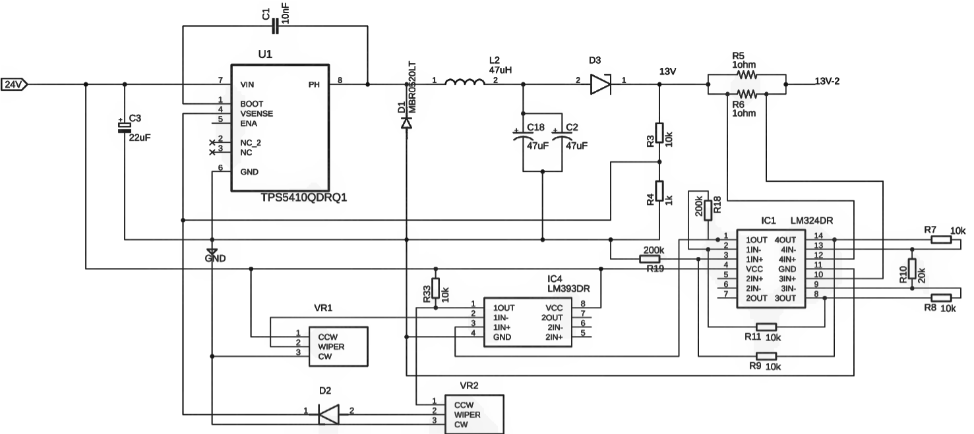
DC to DC Regulators - (13V Output)
The 13V regulator circuit modified to add current control feature.
Current controlling for BMS
Protect both Battery Pack & 13V regulator IC.
Idris Al-Shidhani
Notes:
The circuit of this regulator is designed using help from Webench power designer website to obtain
the most reliable and stable circuit design.
-The obtained webench circuit design has been modified to include a reverse current protection and current
Control feature when charging the battery pack.
-The current control circuit will protect the battery pack from charging too quickly by pulling specific current
Decided by a potentiometer, and also will protect the IC from being damaged.

Slide 20
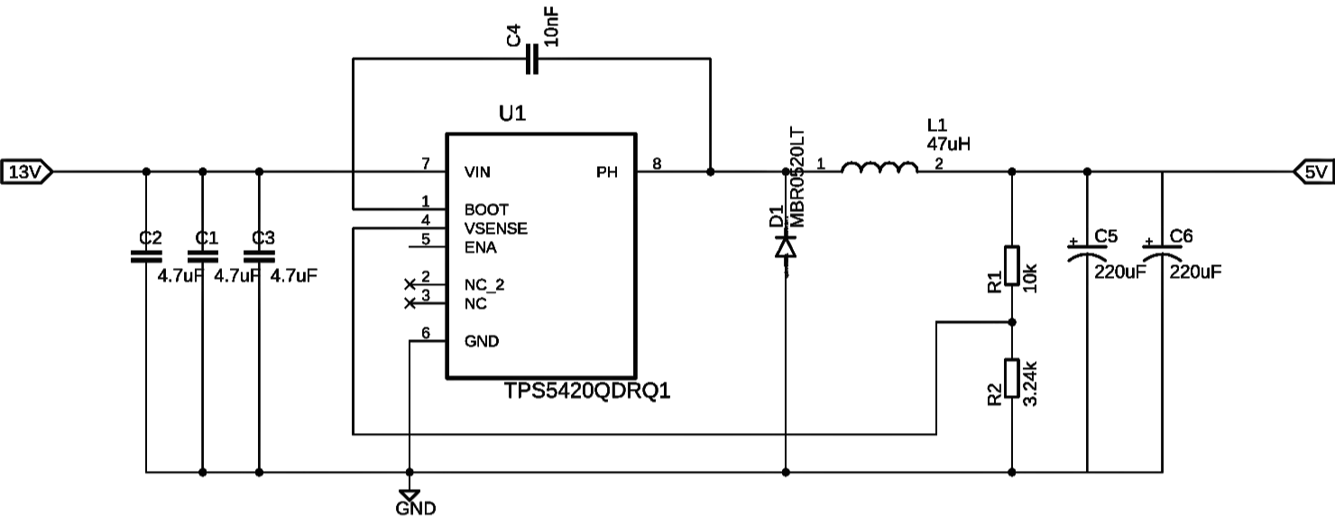
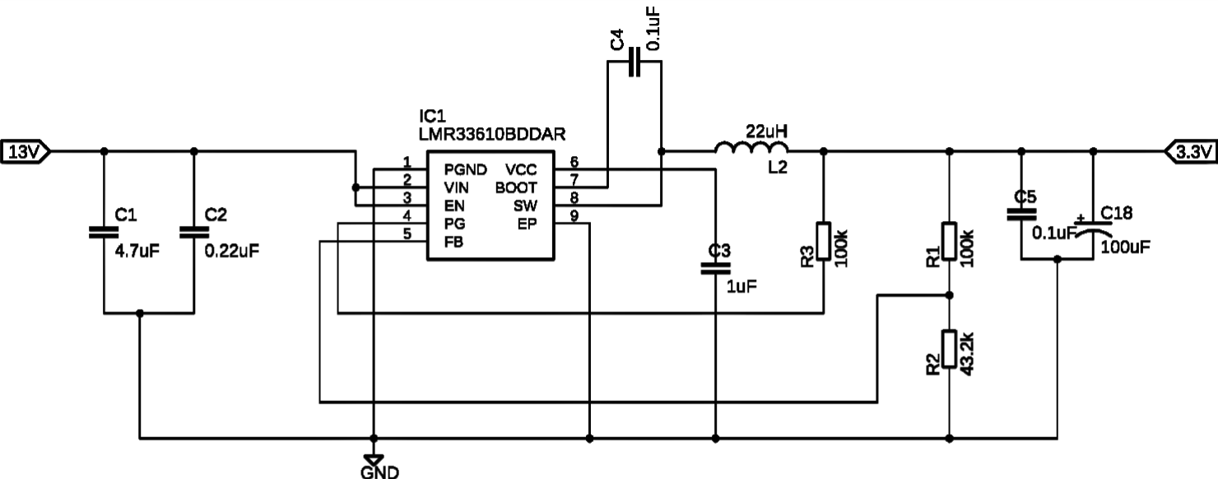
DC to DC Regulators - (5V & 3.3V Outputs)
Idris Al-Shidhani
Receives Power from 13V regulator & from Battery pack when wall power goes out
Delivering Power to:
The MCU and the rest of the
locker components
Notes:
-The other two regulating circuits that are used to output 3.3V for the MCU and other control components of the locker
and 5V to power the servo motors when locking or unlocking a compartment.
-We also used Webench designer to help us choose the best components for
each IC to get the best efficiency and stability of the circuits’ outputs.

Slide 21
Battery Selection
The battery pack is the secondary power source of the locker.
We chose Lithium-ion technology for many reasons:
1) High power capacity.
2) Can supply more instantaneous current to power the Servo motors.
3) Has higher voltage per cell than other battery technologies.
Idris Al-Shidhani
 | Lithium-ion | Nickel Metal Hydride | Zinc-ion
Capacity (e.g.) | (700-15000) mAh | (400-11000) mAh | >700 mAh
Life cycles | 500-1000 | 1000 | 10000
Voltage | 3.7 volts | 1.2 volts | (0.75-1.8) volts
Max discharge current | (5-35) Amps | (0.4-11) Amps | N/A
Cost/pack (average) | 20$ | 13$ | N/A
Notes:
-Moving on to the batteries we considered for building the battery pack, we chose the lithium ion batteries, and specifically the 18650s
Because they are very popular and easy to use than Lithium-polymer ones.
-we primarily did choose lithium-ion over the other types because they have more energy capacity per cell, and also provide more voltage per cell.

Slide 22
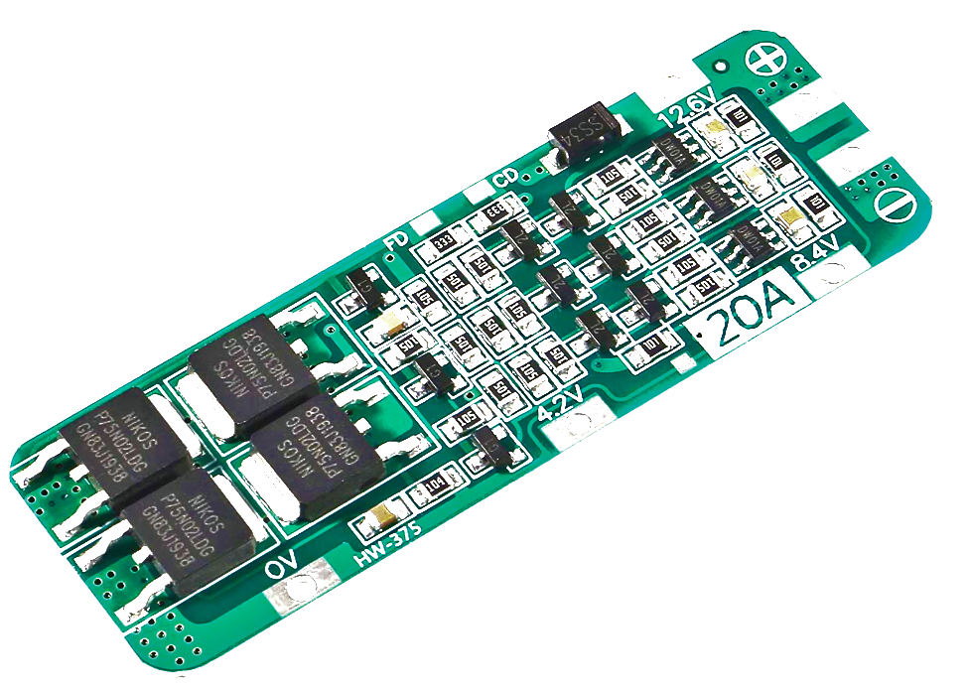
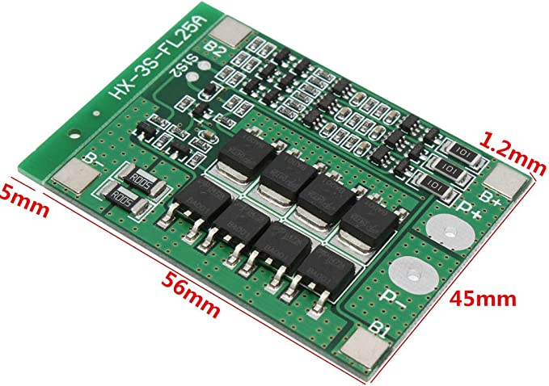
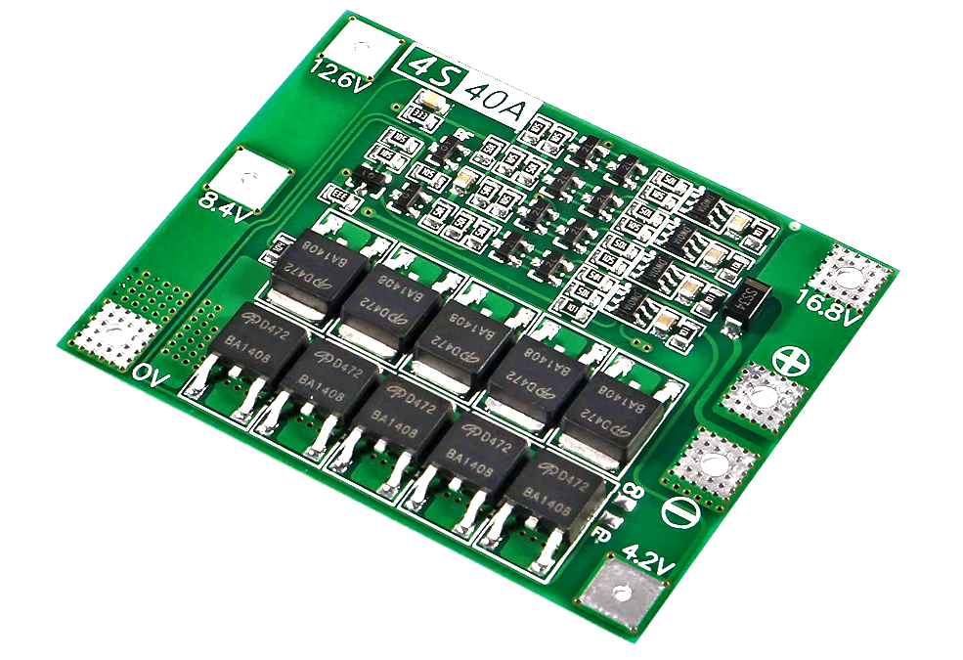
Battery Management System
Idris Al-Shidhani
We chose the (HX-3S-FLxxA) BMS series that is used to manage 18650s battery cells connected in (3S) series configuration
Features included:
Overvoltage protection (4.2±0.05) Volts.
Over Discharge protection (2.5 - 3) Volts.
Maximum total transient current > 25 Amps.
Short circuit protection (with delayed self recovery).
 | ACEIRMC (HW -375) | Daier (HX-3S-FL25A) | Atnsinc (4S 40A)
Batteries orientation | 3 in series (3S) | 3 in series (3S) | 4 in series (4S)
Overvoltage protection | Yes | Yes | Yes
Over Discharge protection | No | Yes | Yes
Short circuit protection | No | Yes | Yes
Terminal Voltage | 11.1V | 11.1V | 14.8V
Notes:
-To manage and protect the battery cells from many destructive factors such as charging overvoltage,
discharging undervoltage, over discharge current, and short circuit, we needed a (Battery Management System) which usually sold as a small independent PCB.
-we chose the Diaer (HX-3S) module as it has most of the features that we considered, and can manage 3 cells in series which is enough for our design.

Slide 23
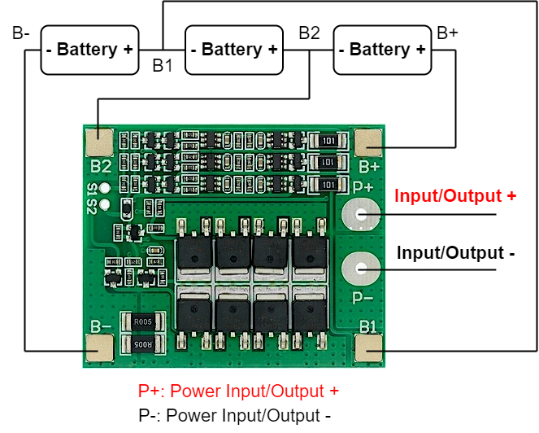
Battery Pack
Idris Al-Shidhani
For a high capacity and voltage output, we chose 18650 cells from Panasonic with 3450mAh for each cell
The battery pack will have three 3.7V rated cells connected in series (3S)
This will give output voltage of 12.6V at full charge & 11.1V at nominal charge
The BMS will manage and protect the battery pack
Notes:
-To build the battery pack we needed it to have a nominal voltage more than 8 volts, so the proper way was to have 3 18650s cells in series,
Which going to have a nominal voltage of 11.1 volts.
-To manage them properly, the picture diagram shows how it should be connected to the (Battery Management system) and how the whole
Backup power source should be connected to the main system.

Slide 24
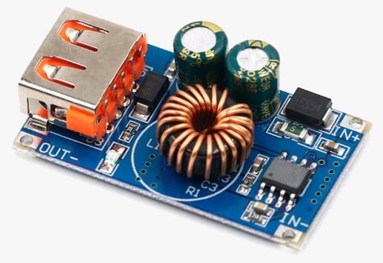
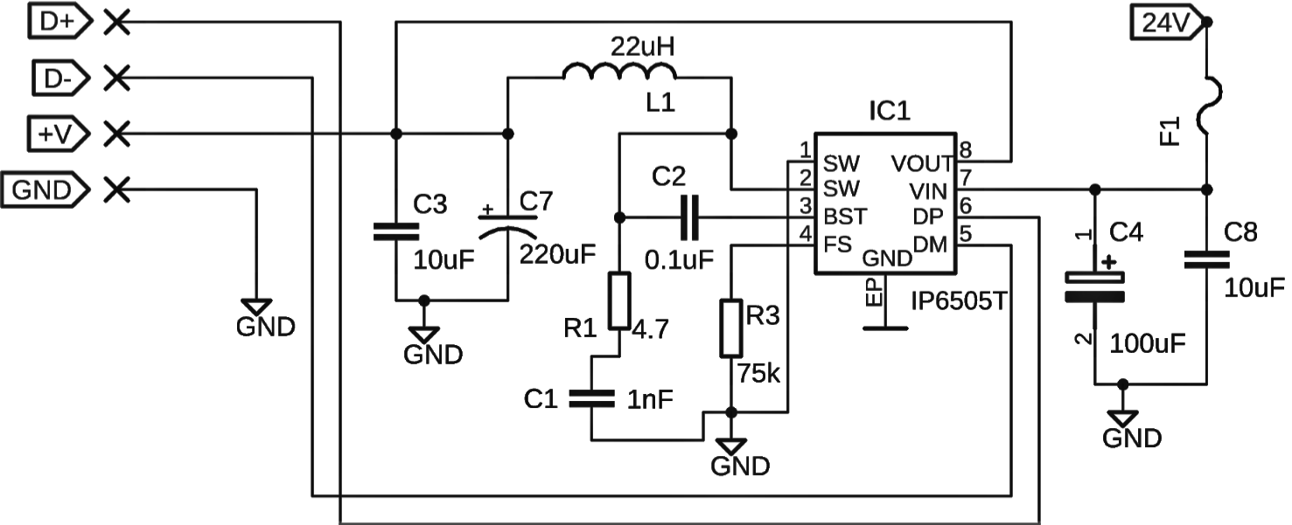
USB Charging Circuit
Idris Al-Shidhani
USB charging gives more convenient locker experience.
One USB charging wire inside each sub locker.
IC chosen is (IP6505) capable of (QC2.0 / QC3.0) for fast charging up to 12V output.
Circuit topology is Buck/Boost , so it can take wide (6 - 32) Volts DC input.
Notes:
Idris
-To make the user experience more convenient, we decided that we should include a USB charging port inside each compartment.
-The design of the charging circuit is based on (IP6505T) chip from Injoinic Technology, which is capable of providing (QC3.0/QC2.0) to the supported devices.
-One nice feature about this IC chip is that it can be used as a buck or boost converter topology, which means it can take a wide input
Voltage of (6 to 32) volts.

Slide 25
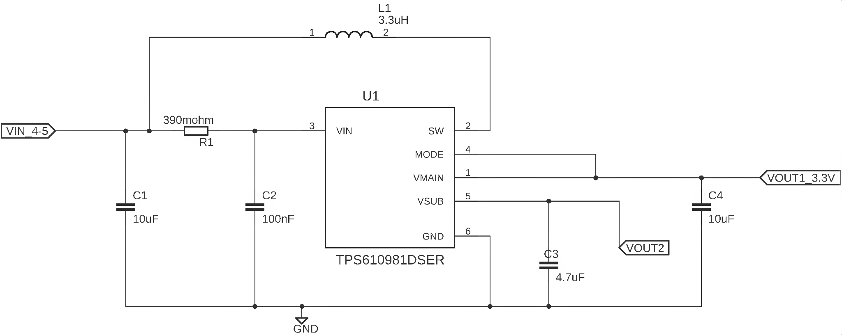
Remote Power System
Idris Al-Shidhani
Remote consumes small amounts of power.
We chose to put two (AA) batteries to achieve running time of more than 168 hours.
Batteries output ranging from (2.6 - 3.1) Volts,
We chose a boost converter with steady state efficiency more than 90%, using (TPS610981) IC from TI.
The boost converter circuit will output (3.3) Volts.
Notes:
-Lastly for the power section, we have the remote power subsystem..
-We chose to have 2 double A batteries as the power source which should last long enough until the user will need to change them.
-We also needed a boost converter to step up the batteries voltage from the maximum 3 volts to the operating voltage of the system of 3.3 volts,
-The boost converter circuit chosen is also designed with the help of webench, as the IC chosen is from TI .
-The overall converter efficiency should be more than 90% which is helping the batteries to last longer.

Slide 26
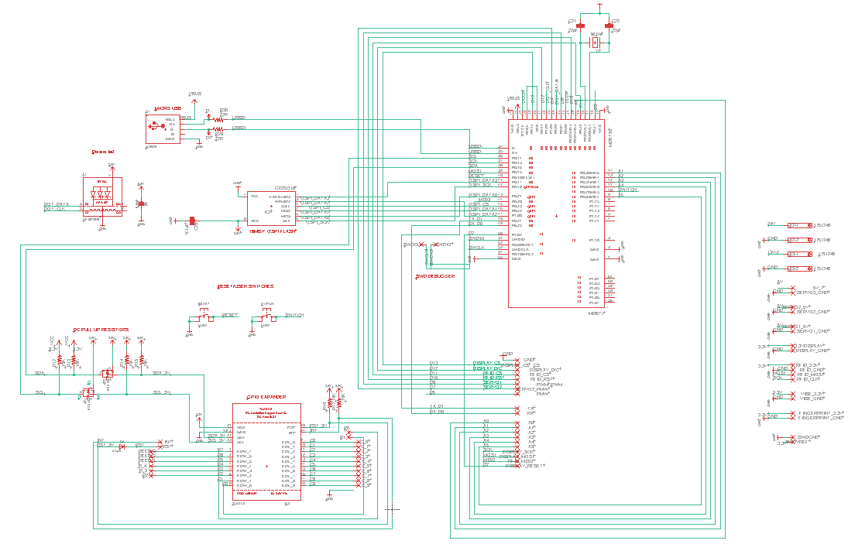
Locker Main PCB Schematic
Denzel
Stockhausen
- Overall design based on Adafruit ItsyBitsy nRF52840 and TCA8418 GPIO Expander
-Needed to include connections for our peripherals
Notes:
Denzel

Slide 27
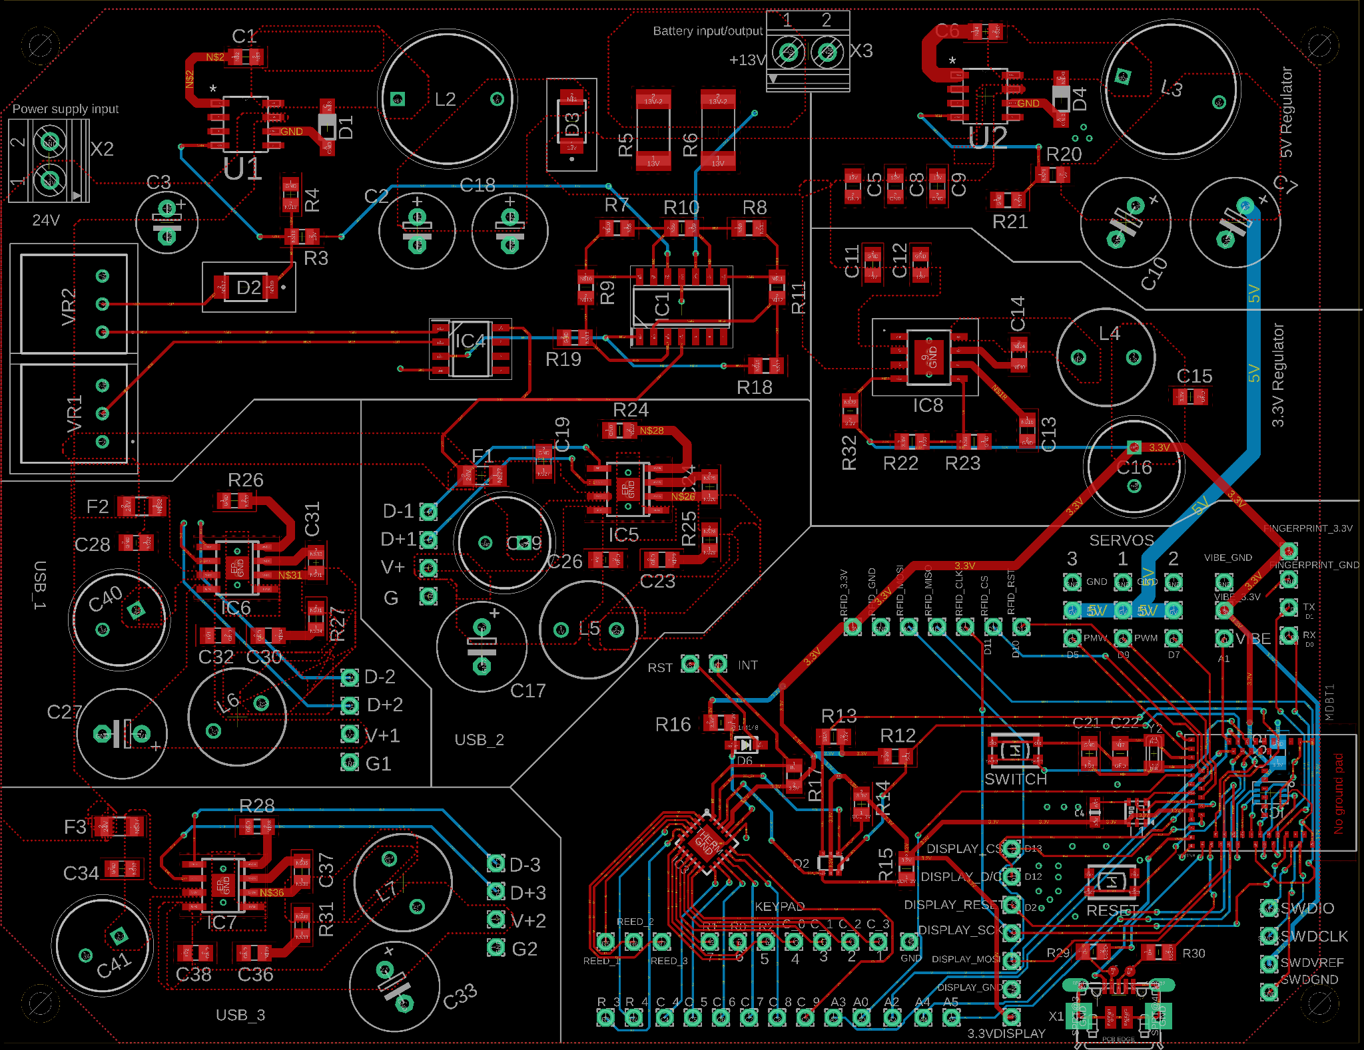
Locker Main PCB Final Design
Denzel
Stockhausen
Ground plane turned off for clarity
Notes:
Denzel

Slide 28
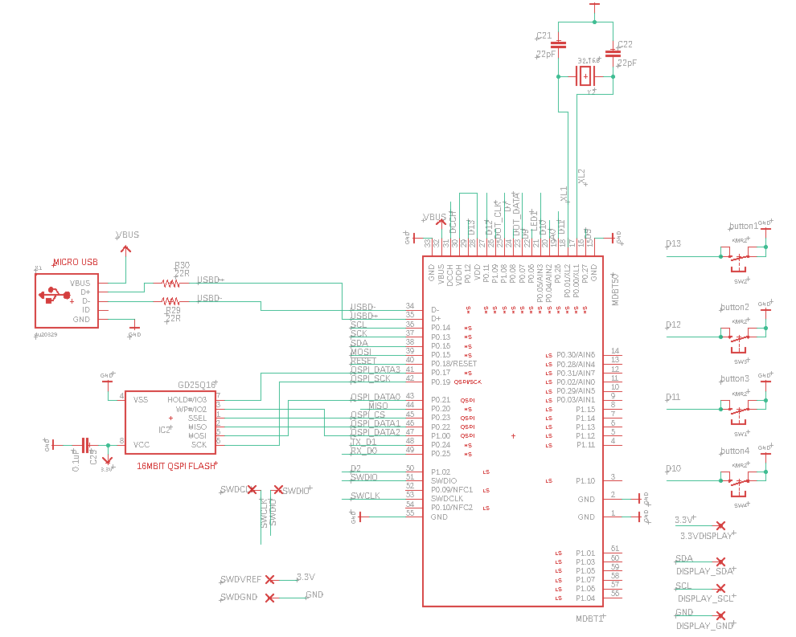
Remote PCB Schematic
Denzel
Stockhausen
Overall design based on Adafruit ItsyBitsy nRF52840
Notes:
Denzel

Slide 29
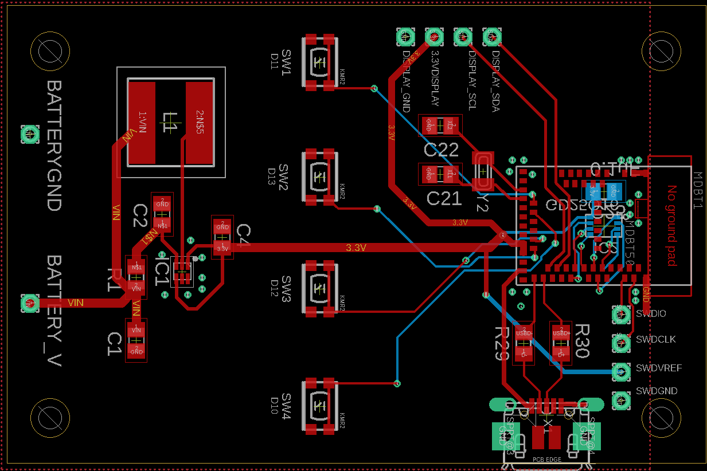
Remote PCB Final Design
Denzel
Stockhausen
Ground plane turned off for clarity
Notes:
Denzel

Slide 30
Software Design
Kaiden Duvall
Code for nRF52840 written in Arduino IDE
Includes libraries for motors, OLED screens, RFID module, and fingerprint sensor
Using nRF52840’s TIMER peripheral for locker timer
Considerations:
System must know when any door is open (reed switches)
Timer should be accurately displayed in real time on the OLED screen
Text instructions on screens should be as legible as possible and utilize full screen
BLE communication between locker and remote
Status of compartments and timers sent from locker to remote
Unlock override command sent from remote to locker
Notes:
Kaiden

Slide 31
Software Libraries
Kaiden Duvall
Adafruit SSD1306
Adafruit GFX
Adafruit TCA8418
Adafruit Fingerprint
Bluefruit
MFRC522
Notes:
Kaiden

Slide 32
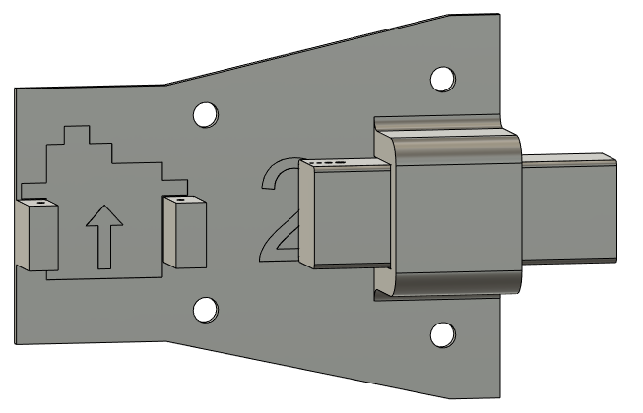
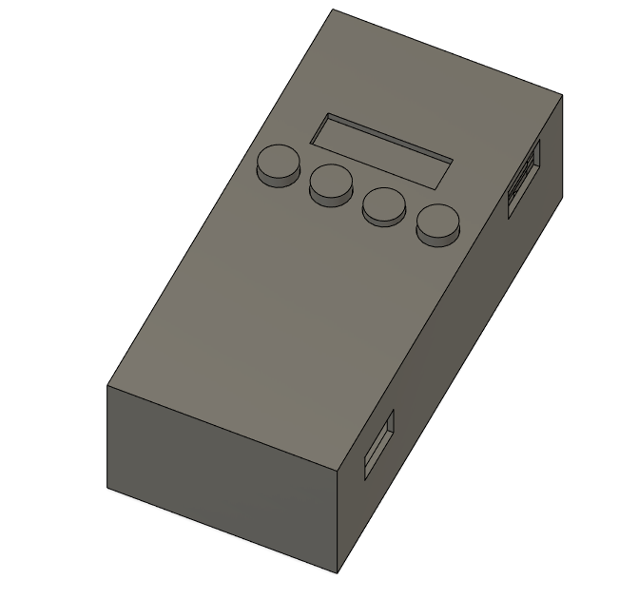
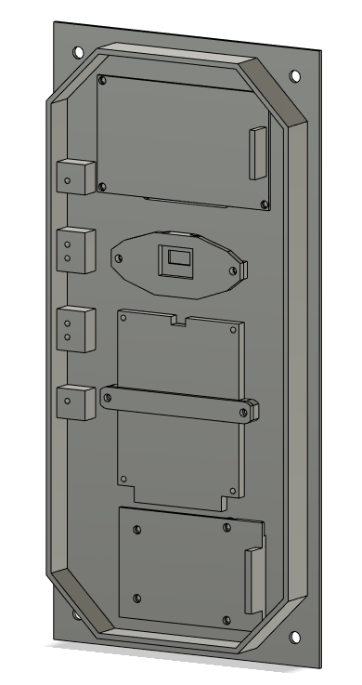
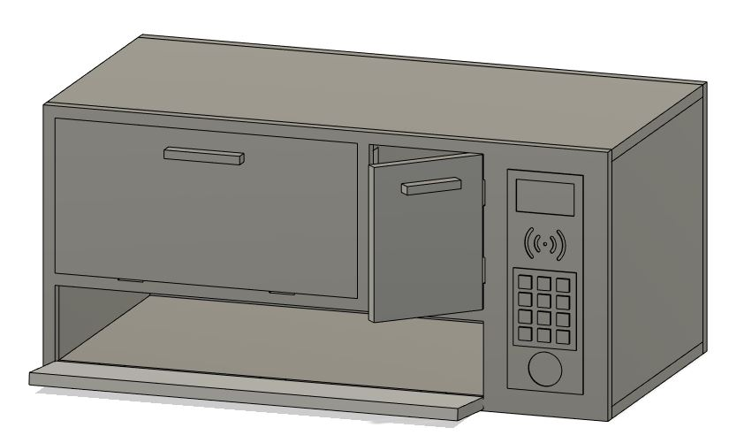
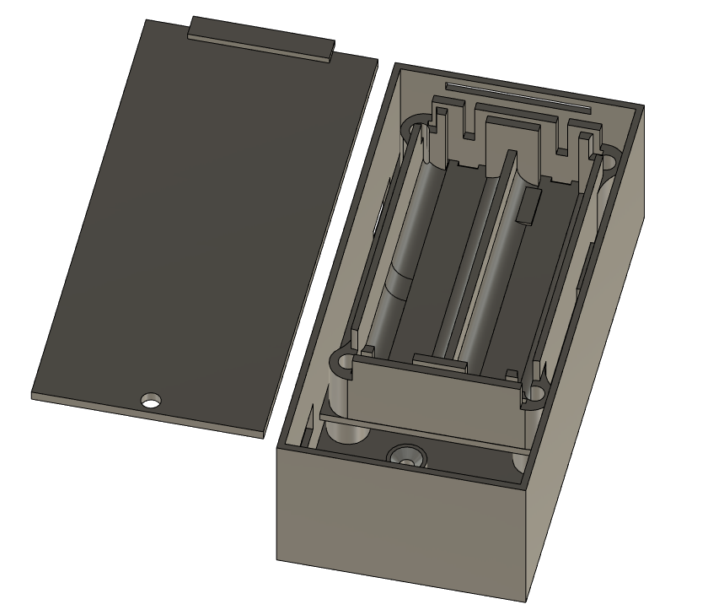
Physical Design and Construction
Cliff Porter
Three different sized compartments
Cut plywood sheets for the body and doors
3D printing for I/O plate, component mounts, remote, and vibration sensor plate
Notes:
Here are some images of our locker design

Slide 33
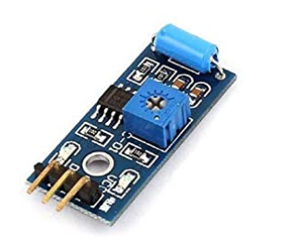
Difficulties and Concerns
Cliff Porter
Cell Phone vibration detection
Loading the arduino compatible bootloader onto blank modules
Multiway power lines for the Battery pack when wall power is removed
PCB design oversights
Soldering practice and communication interference
Notes:
-address some of the difficulties and concerns we had earlier in our project and how we solved them
1. Detecting phone vibrations is easy, but so is detecting bumps or shaking of the device. Put phone on isolated plate to reduce outside vibrations
2. Worked like we thought it should after acquiring a working J-Link
3. Tested with final board and worked great
4. Poor access to traces needed for debugging/programming, forgotten components added after
5. Improperly soldered pads on comm chips, flash chip interfering with USB, dotstar probably fried our chip

Slide 34
Project Constraints
Kaiden Duvall
Time
PCB delivery time
Group schedules
Economic
Prototype cost
Self-funded
Safety
Lithium-ion batteries sensitive to heat, must be charged carefully
Manufacturing
Using two PCBs due to inclusion of the remote

Slide 35
Related Standards
Kaiden Duvall
Power Supply Standards
IEC 60335
Lithium-ion and rechargeable batteries
IEEE 1625
USB Standards
Bluetooth low energy
SPI, I2C, UART

Slide 36
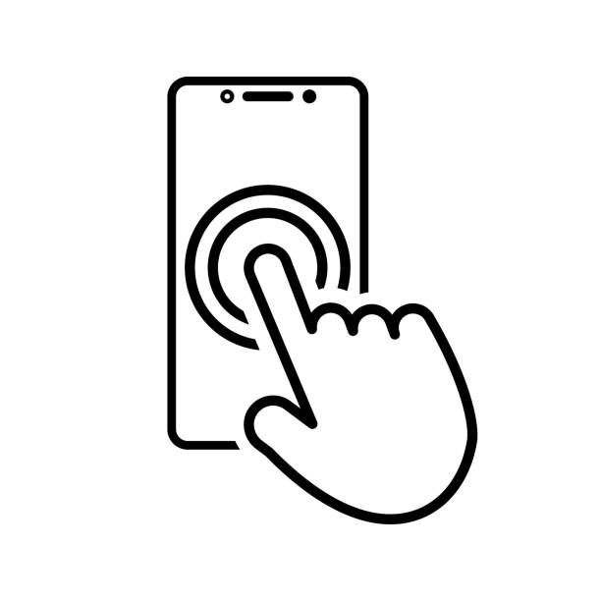
Future Design Plans
Kaiden Duvall
-Refine and improve physical construction
-Create modular system for compartments
-Additional range and functions for remote
-Mobile app
-IoT capabilities
Notes:
Cliff

Slide 37
Work Distribution
Cliff Porter
 | Power Design | Schematic & PCB | Assembly & Testing | Physical Design | Software | Wireless
Cliff |  |  | X | XX | X | XX
Kaiden |  |  | X | X | XX | X
Denzel |  | XX | X
Idris | XX | X | X
XX = Primary X = Secondary
Notes:
Cliff

Slide 38
Budget & Financing
Budget (Estimated Cost)
Cliff Porter
Component | Quantity | Estimated cost
Keypad | 3 | $ 15.00
Large display | 1 | $ 27.00
Small display | 4 | $ 14.00
Fingerprint sensor | 2 | $ 40.00
RFID reader + tags | 3 | $ 24.00
Vibration sensor | 5 | $ 6.00
Rechargeable batteries | 6 | $ 30.00
Remote battery | 2 | $ 6.00
BMS | 2 | $ 10.00
Locks | 3 | $ 13.00
Small motors | 6 | $ 35.00
Reed switches + magnets | 10 | $ 17.00
Radio modules | 10 | $ 14.00
USB charging ports | 4 | $ 12.00
Controller chips (MCU) | 4 | $ 50.00
Push buttons (multi pack) | 1 | $ 13.00
PCB (main) | 1 | $ 15.00
PCB (remote) | 1 | $ 15.00
Construction material | 1 | $ 12.00
Total |  | ~$ 368.00
Notes:
Cliff
Project is self financed

Slide 39
Budget & Financing
Bill of Materials (Actual Cost)
Cliff Porter
Locker
Component | Quantity | Actual cost
Plywood sheets | 2 | $ 49.56
Hinges | 3 | $ 4.92
3D printed material | 273.8g | $ 6.02
Large display | 1 | $ 26.99
Fingerprint sensor | 1 | $ 19.95
Keypad | 1 | $ 4.95
RFID reader + tags | 1 | $ 7.99
Vibration sensor | 1 | $ 1.30
Servo motors | 3 | $ 17.70
Reed switches + magnets | 3 | $ 4.55
BMS | 1 | $ 10.69
Rechargeable batteries | 3 | $ 15.00
USB cables | 3 | $ 5.69
Power supply | 1 | $ 19.99
PCB | 1 | $ 1.60
Controller chips (MCU) | 1 | $ 12.95
PCB components | - | $ 40.48
Total |  | $ 250.33
Remote
Component | Quantity | Actual cost
3D printed material | 38.85g | $ 0.85
Small display | 1 | $ 4.00
AA batteries | 2 | $ 1.16
PCB | 1 | $ 0.40
Controller chips (MCU) | 1 | $ 12.95
PCB components | - | $ 5.26
Total |  | $ 24.62
*Shipping costs not included
Notes:
Cliff
-Project is self financed
-Shipping costs not included.

Slide 40
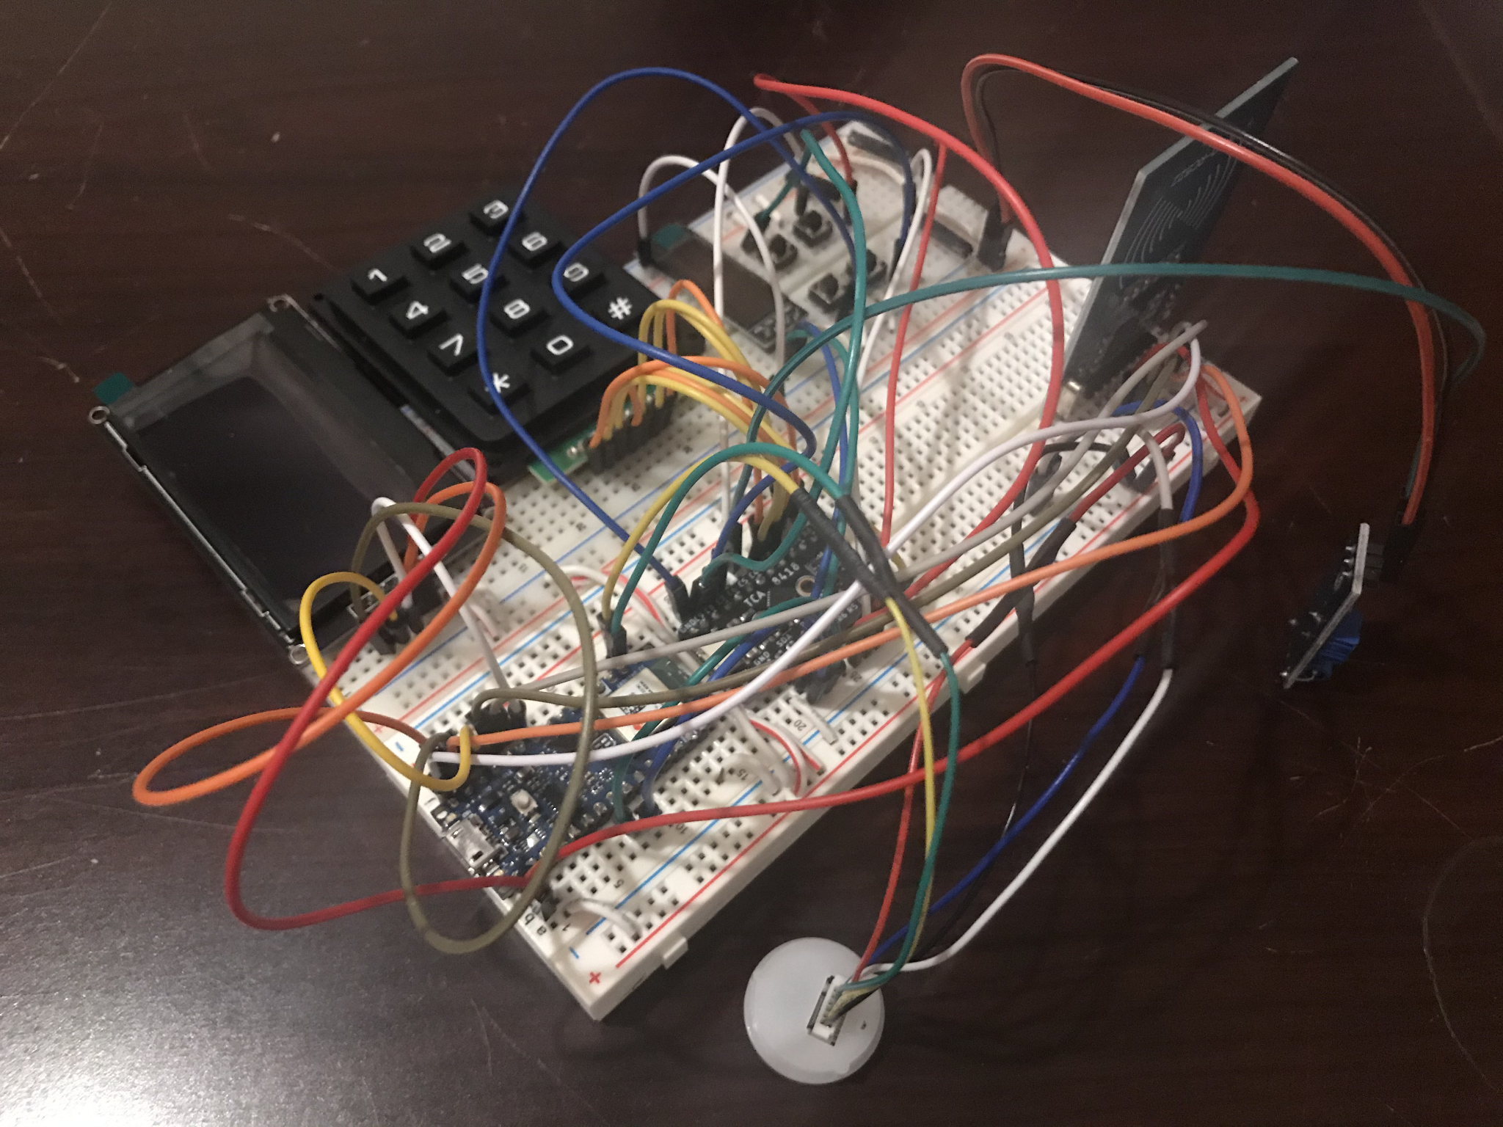
Progress - Breadboard Prototype
Cliff Porter
Notes:
Cliff
What we have done will do next
-do next: build and test pcb, software, physical design

Slide 41
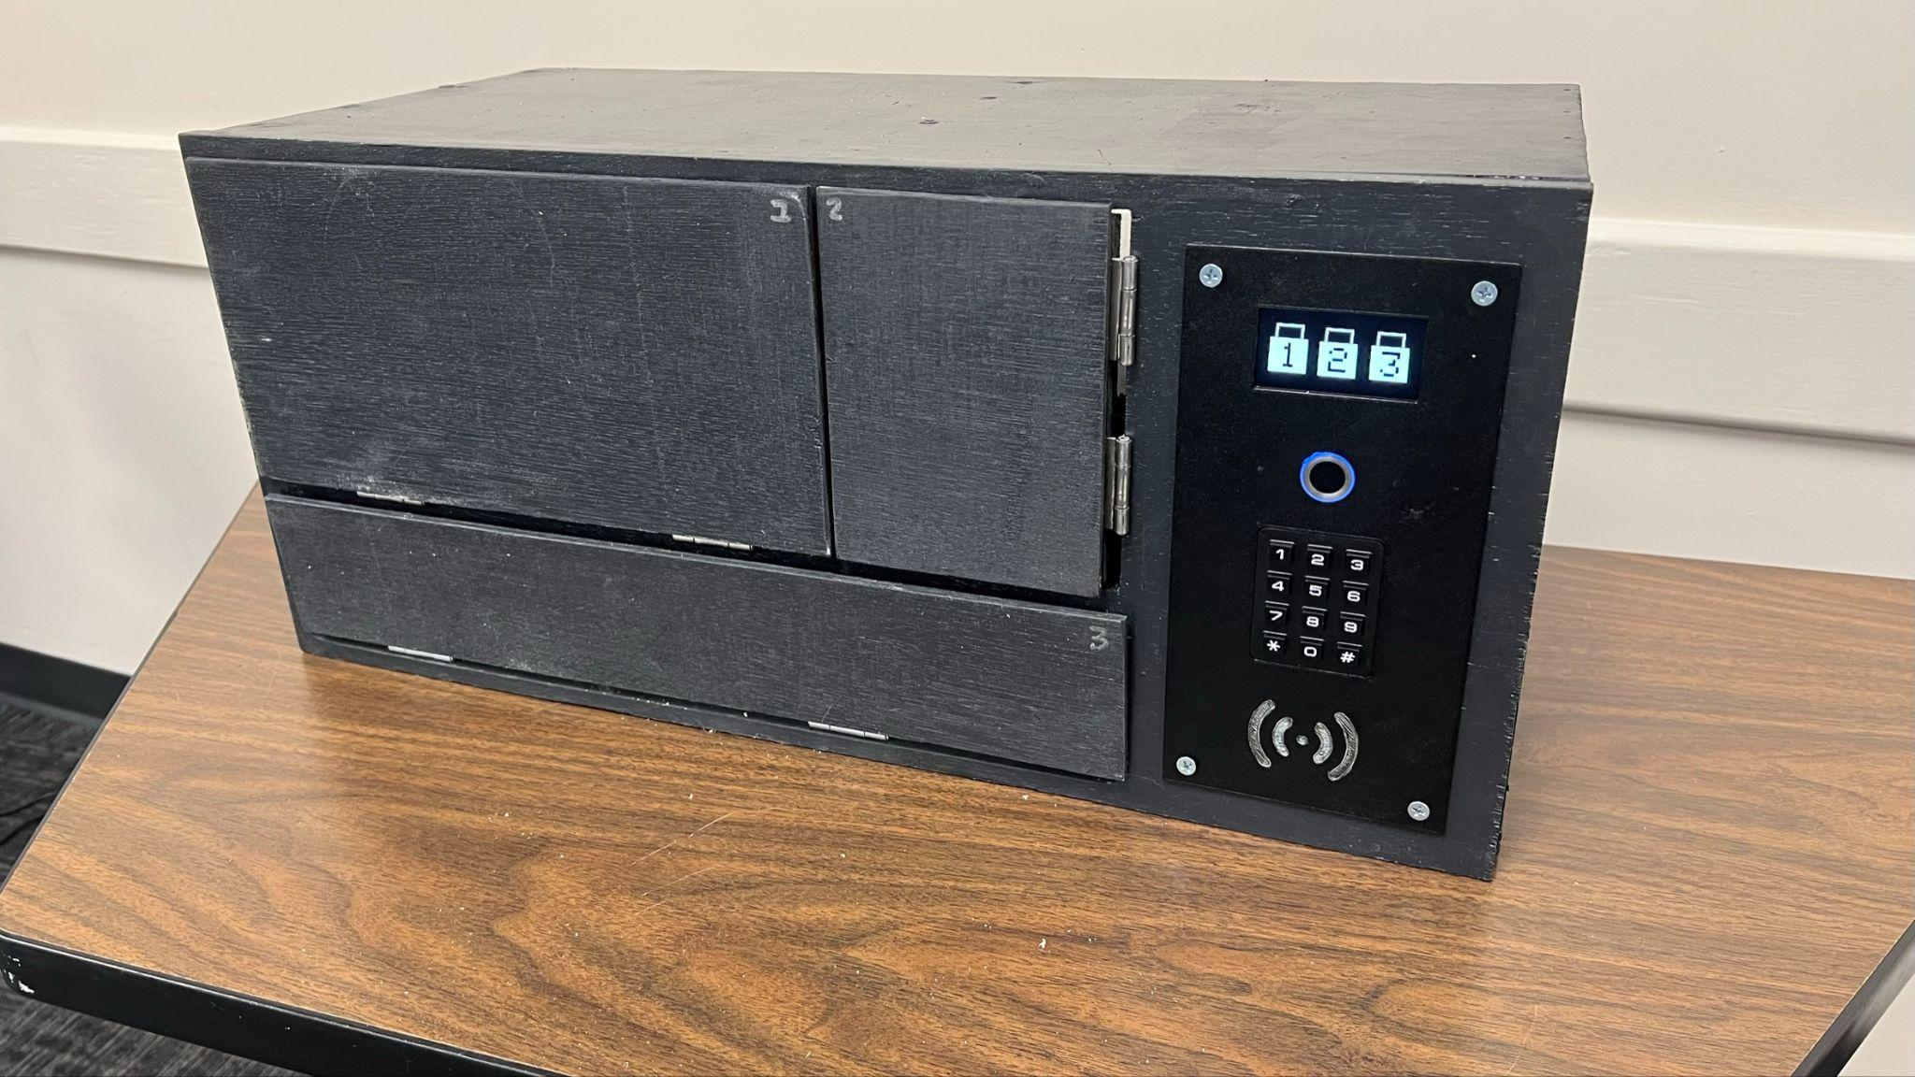
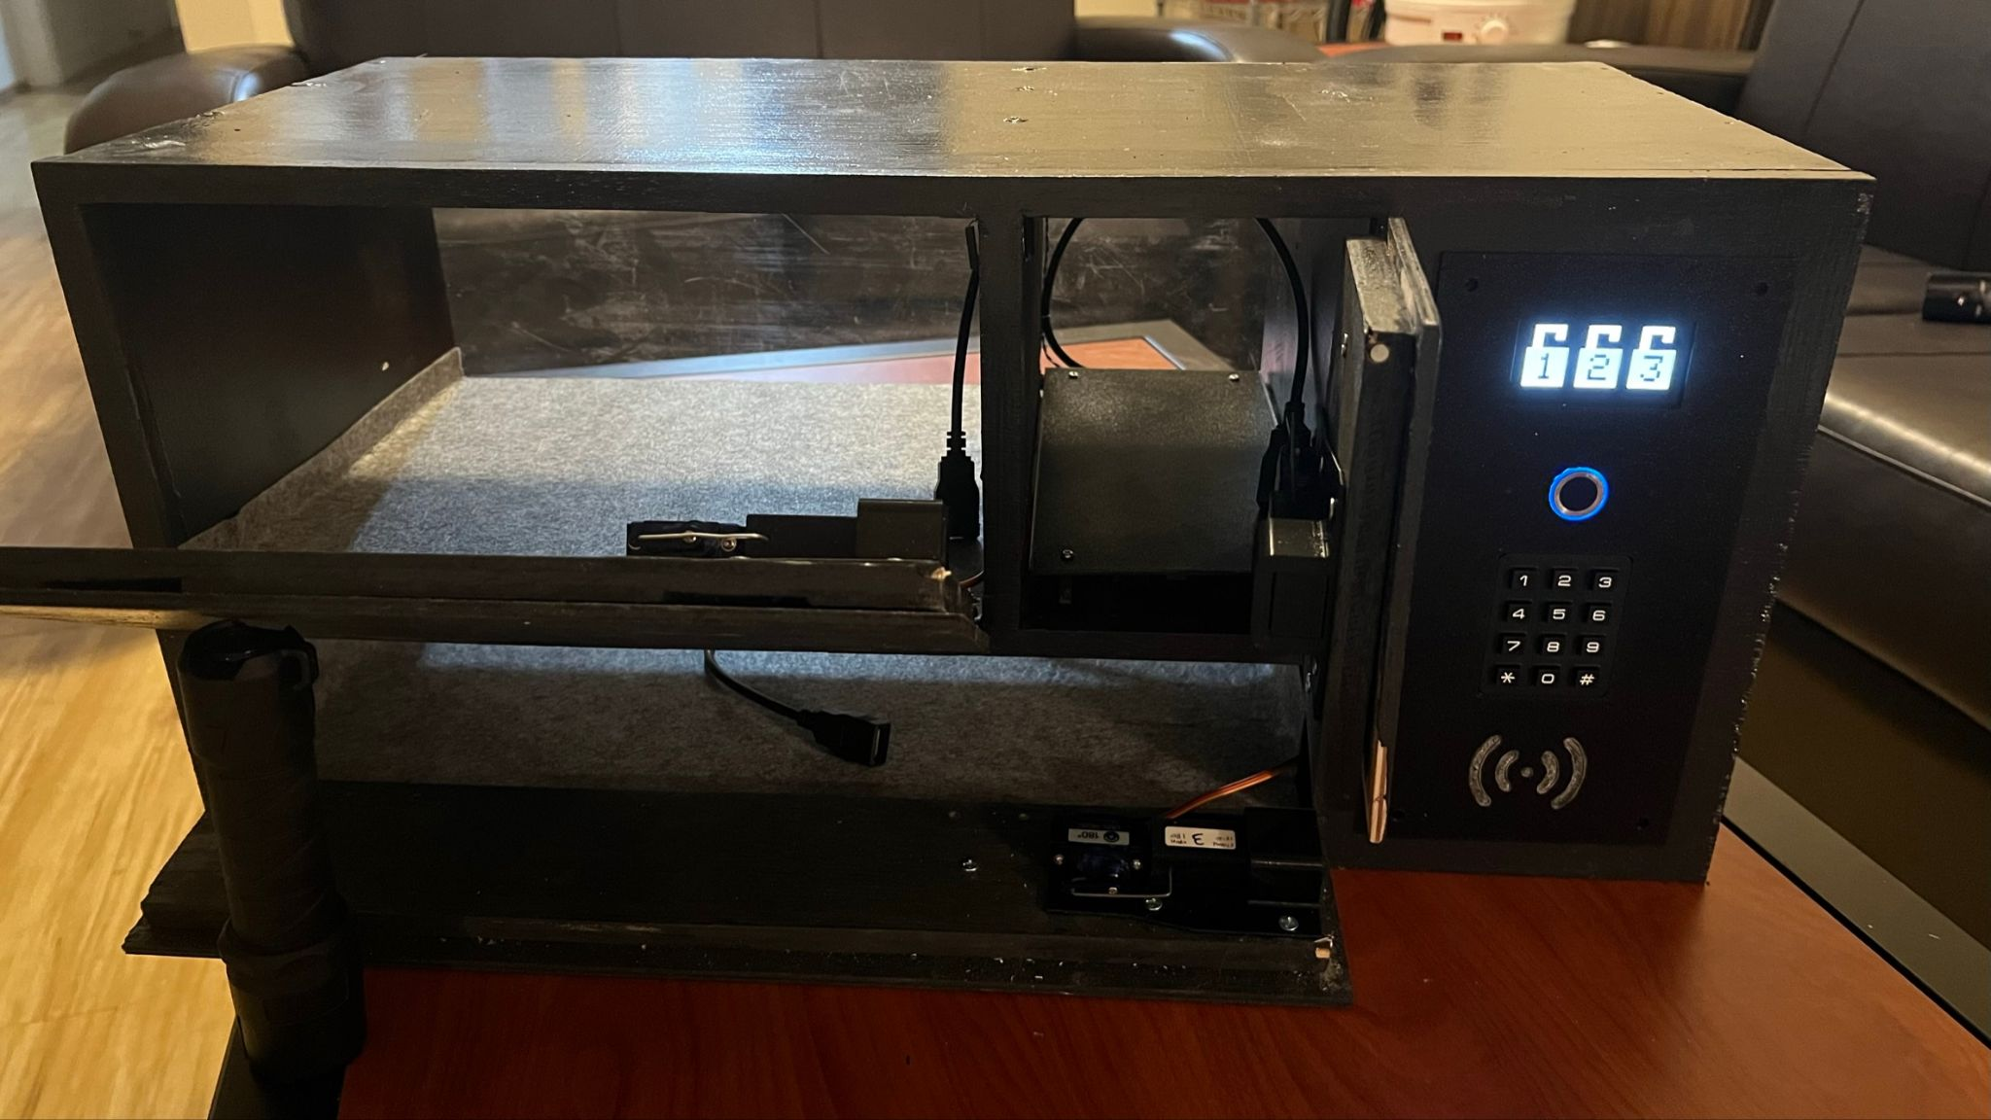
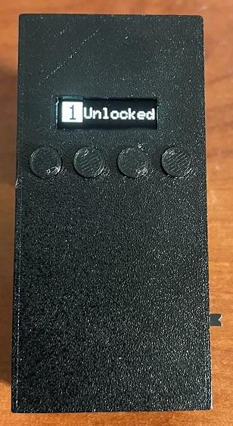
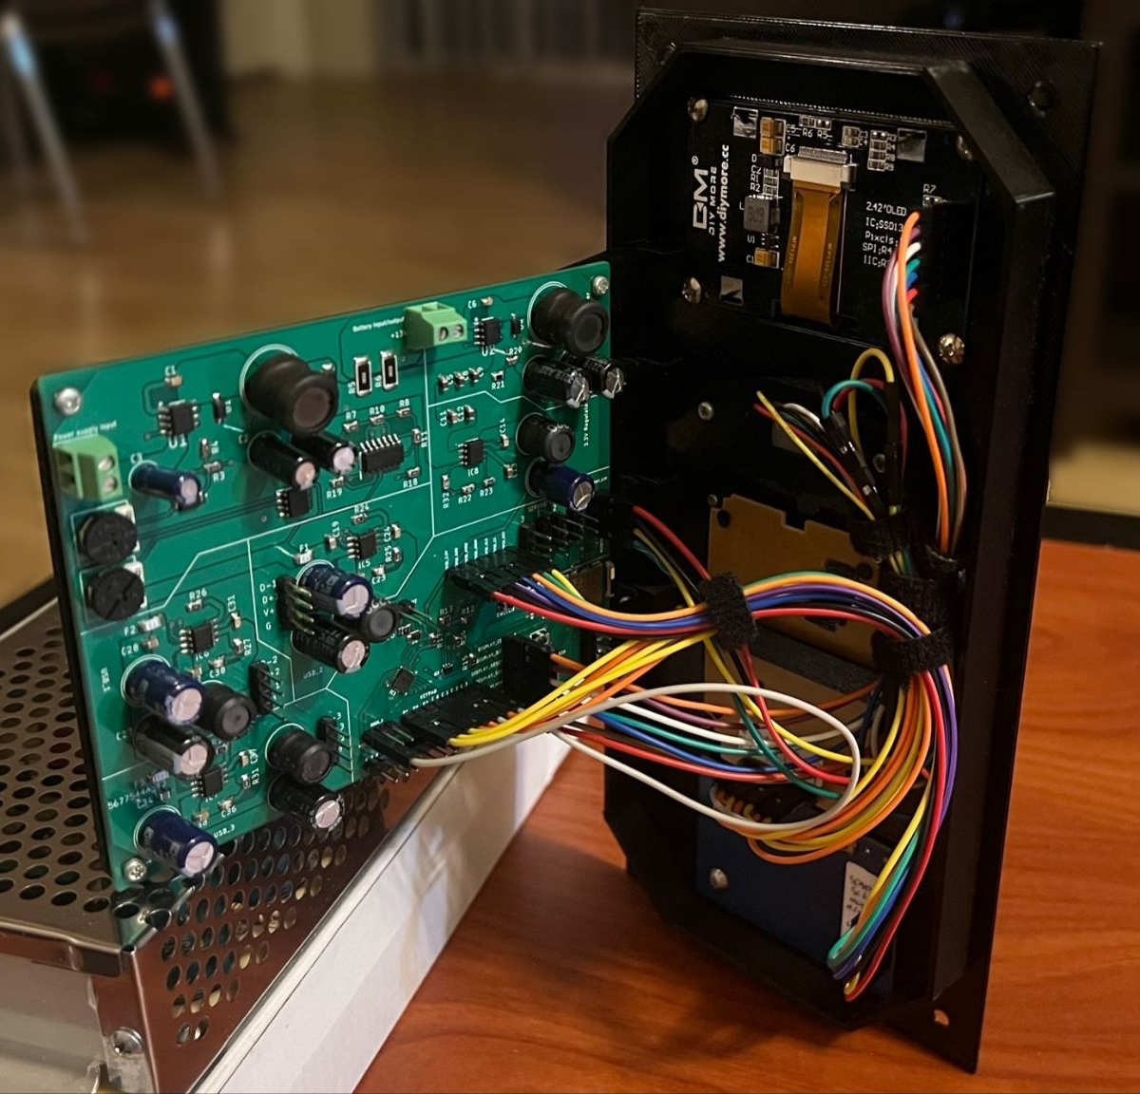
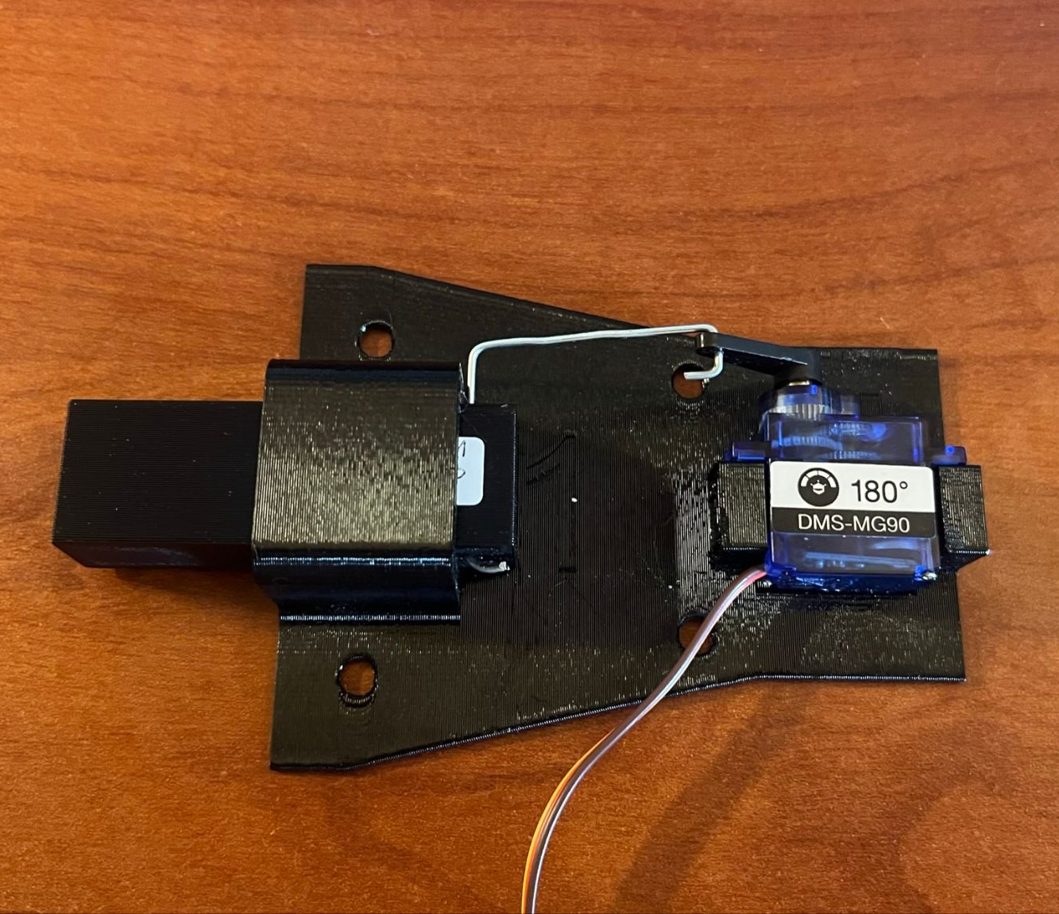
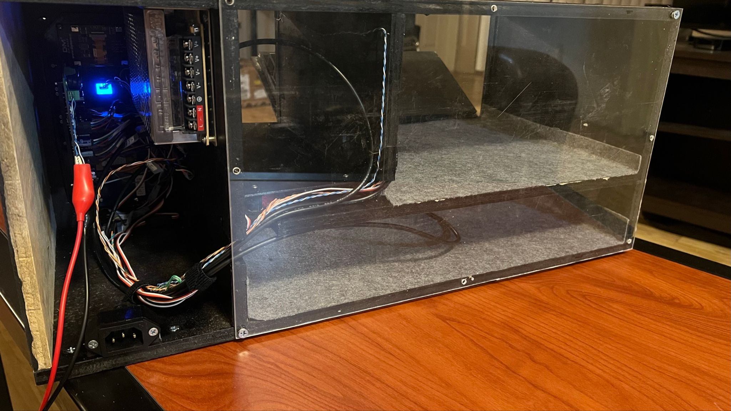
Progress - Final Prototype
Cliff Porter
Notes:
Cliff
What we have done will do next
-do next: build and test pcb, software, physical design

Slide 42
Testing Results
Cliff Porter
Tamper detection reliability: >90% - 90/90 🗸
Basic remote range: 15ft - 150ft 🗸
Adv. remote range: 40ft - 150ft 🗸
Remote latency: <400ms
Ave. = 42ms
Ave. = 58ms
Ave. = 219ms
Notes:
Here are the testing results of the remote’s wireless latency at different ranges. At 15 feet, the average latency is 42 milliseconds, and at 40ft the average latency is about 58 milliseconds. As you can see, up to our advanced goal of 40 feet the latency still has not passed our 400 millisecond specification. At 150 feet, the average latency is 219 milliseconds, but the latency sometimes passes the 400 millisecond threshold. This is the range where the remote begins to occasionally lose connection.

Slide 43
Project Milestones
Milestone | Date
Divide & Conquer Complete | 10/7/22
Testing Components Ordered | 11/8/22
Main Schematic Complete | 12/4/22
SD1 Document Complete | 12/5/22
Breadboard Prototype Complete | 2/1/23
First Locker PCB Design Ordered | 2/11/23
Critical Design Review | 2/24/23
Power System Tested | 3/3/23
Main Software Completed | 3/18/23
Middle Term Demo | 3/20/23
Revised Locker PCB Ordered | 3/27/23
Remote PCB Ordered | 3/27/23
Final PCBs Tested | 4/10/23
Physical Construction Complete | 4/12/23
Final Presentation | 4/19/23
SD2 Final Document Complete | 4/25/23
Cliff Porter

Slide 44
Thank You

