Slide 1
Study Buddy
Group 33:
Cliff Porter Computer Engineering
Kaiden Duvall Computer Engineering
Denzel Stockhausen Electrical Engineering
Idris Al-Shidhani Electrical Engineering

Slide 2
Motivation
Kaiden Duvall
-Many students find it easy to be distracted from doing their work, especially in the modern day (smartphones, internet access)
-Busy parents need to be able to ensure their child is studying without having to constantly monitor them
-Older students with good self-discipline may desire a small physical separation from distractions

Slide 3
Goals
Kaiden Duvall
-Secure device with three compartments capable of holding a variety of common distractions
-Ability to secure compartments for amount of time chosen by user
-Include several methods of unlocking device outside of timer
-Allow user to configure what methods of access are enabled at any given time
-Include method of detecting if the device was forcefully accessed
-Create remote that allows short-range monitoring and overriding of main device

Slide 4
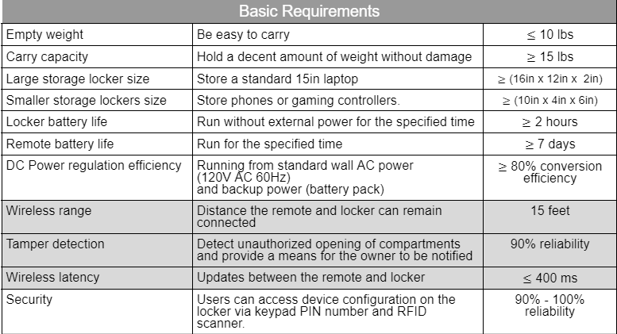
Requirement Specifications
Kaiden Duvall
Notes:
important specifications ( mention in presentation ) - large enough to fit common electronics
- long remote battery life
- range 15ft with 40ft as an advanced goal
- reliability of inputs 90-100%
- emergency override stretch goal

Slide 5
Technologies Used
Kaiden Duvall

Slide 6
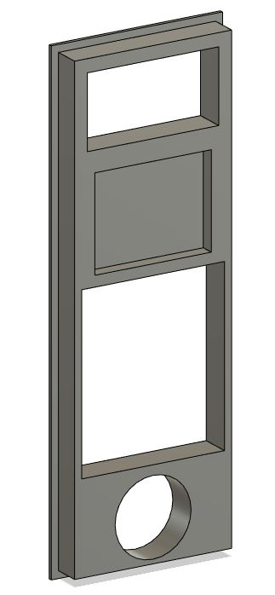
Input Methods (Authentication Factors)
Kaiden Duvall
Timer (Displayed on screen)
Time
RFID reader module
“Something you have”
Keypad (Menu navigation and passcode entry)
“Something you know”
Fingerprint sensor
“Something you are”
Remote override
Location

Slide 7
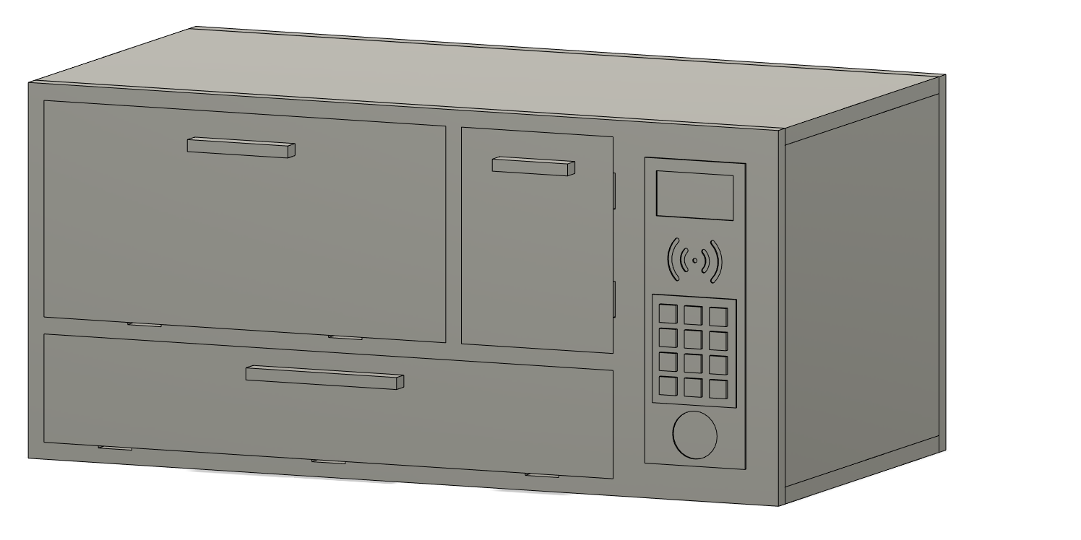
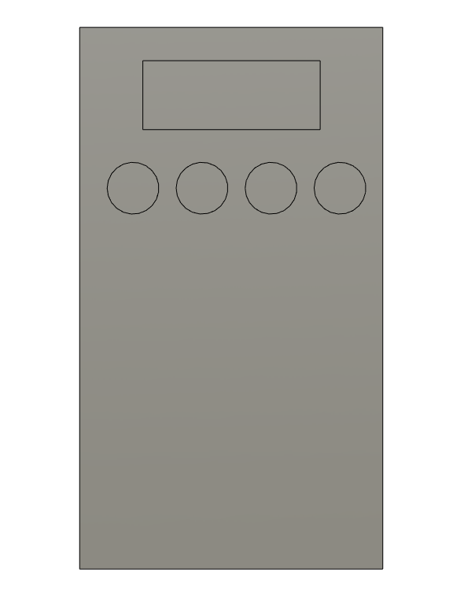
Design Approach and Implementation
Kaiden Duvall
Main locker unit for users to store items in
Mechanism for locking compartments
User interface
Power system with battery backup
Portable remote to wirelessly interact with locker
Low power for long battery life
Intuitive button and screen interface
Displays information and sends commands to the locker

Slide 8
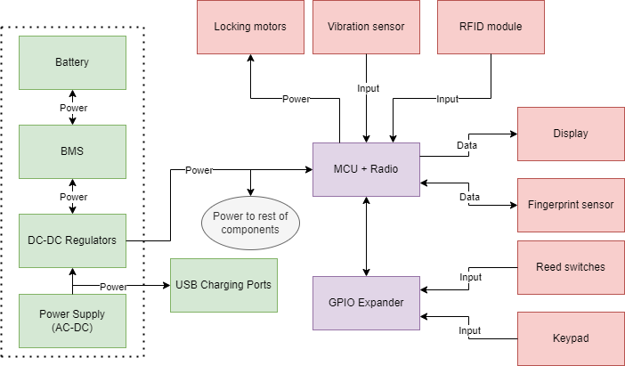
Overall Block Diagrams - Main Locker
Kaiden Duvall

Slide 9
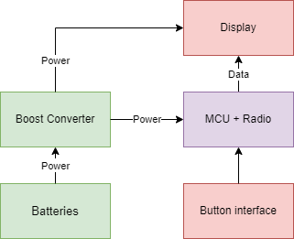
Overall Block Diagrams - Remote
Kaiden Duvall
Notes:
-simple design
-not much to say

Slide 10
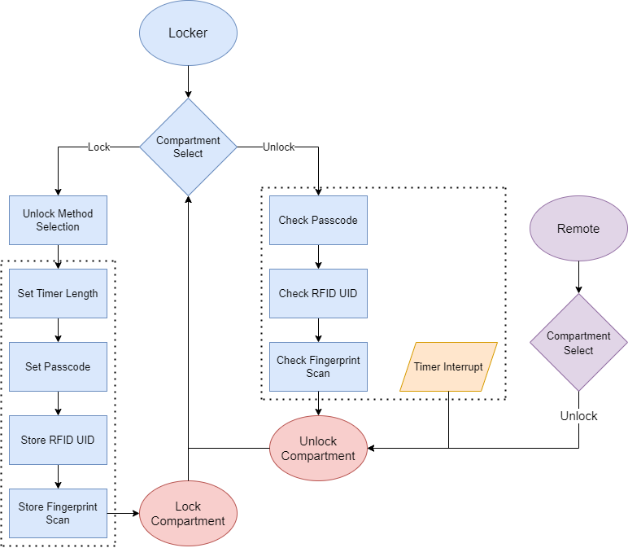
Software Block Diagram
Kaiden Duvall

Slide 11
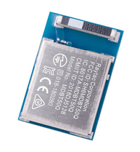
MCU Choice and Wireless Communication
Cliff Porter
Using the Adafruit ItsyBitsy nRF52840 as our reference design
Initially used Arduino nano 33 BLE, but switched to use a more convenient module
Flexible pin assignments
Ultra low power capabilities
Pre-made arduino libraries for UART over Bluetooth Low Energy
Notes:
Cliff
-convenient module with embedded antenna and good availability

Slide 12
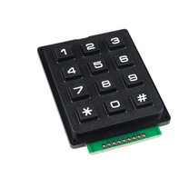
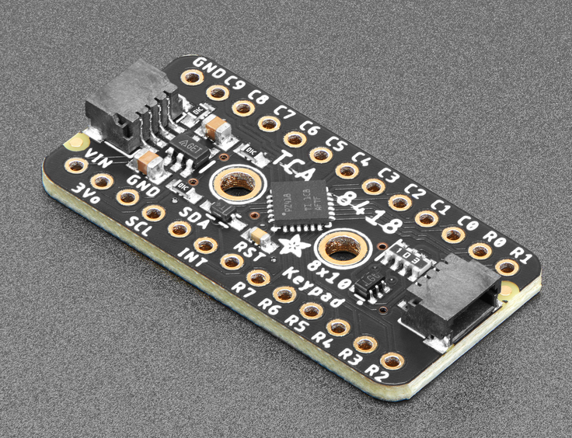
TCA8418 GPIO Expander
Cliff Porter
High number of GPIO pins are required to use all of our peripherals
Moved keypad and reed switches to GPIO expander (saves 10 pins)
Notes:
Cliff

Slide 13
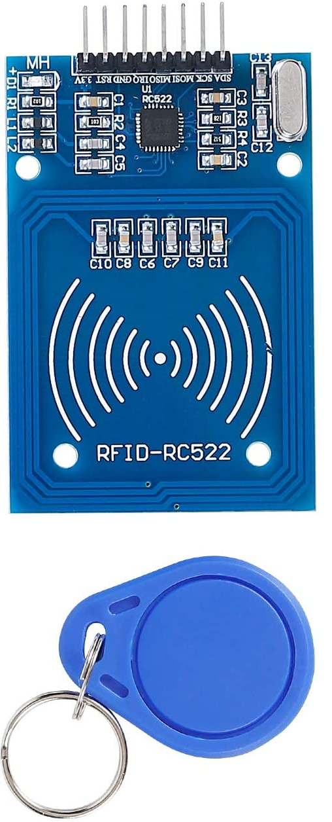
RFID Reader
Denzel Stockhausen
RC522 RFID Reader Module
-Active reader that works with passive RFID tags
-~3cm read range, farther is unnecessary
-Communicates with MCU via SPI
-Small enough (3.78 x 2.99 x 0.87 inches) to fit in I/O panel
Notes:
Denzel
-Simple RFID reader
-Read from a distance (though our IO panel)

Slide 14
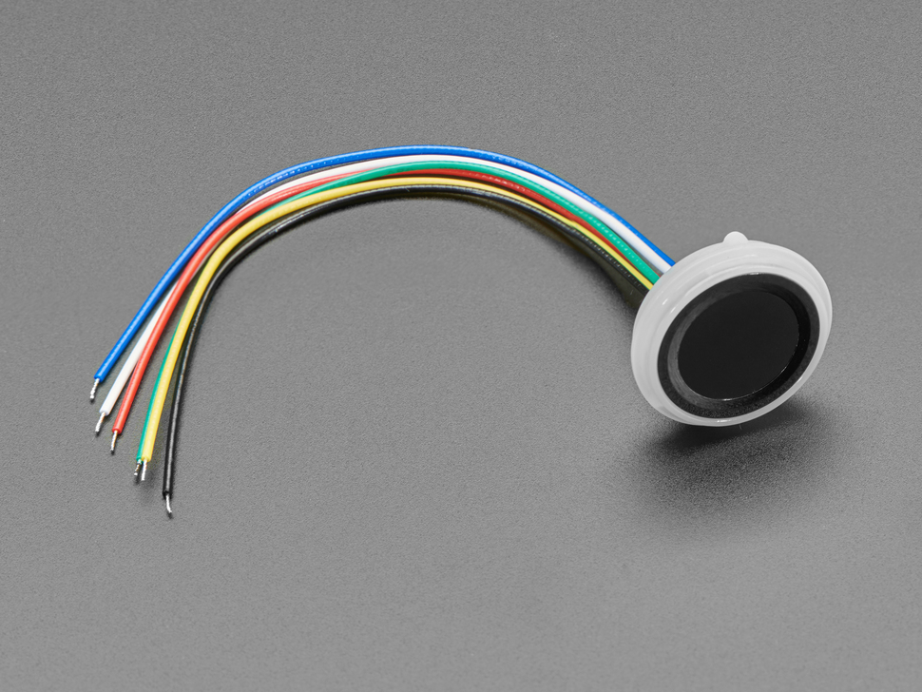
Fingerprint Sensor
Denzel Stockhausen
Adafruit 4750 Ultra-Slim Fingerprint Sensor
-6 pin connector
-Stores up to 80 fingerprints in its memory
-Communicates with MCU via UART
-Enroll/scan library provided by Adafruit
Notes:
Denzel
-simple to use
-pre-made libraries

Slide 15
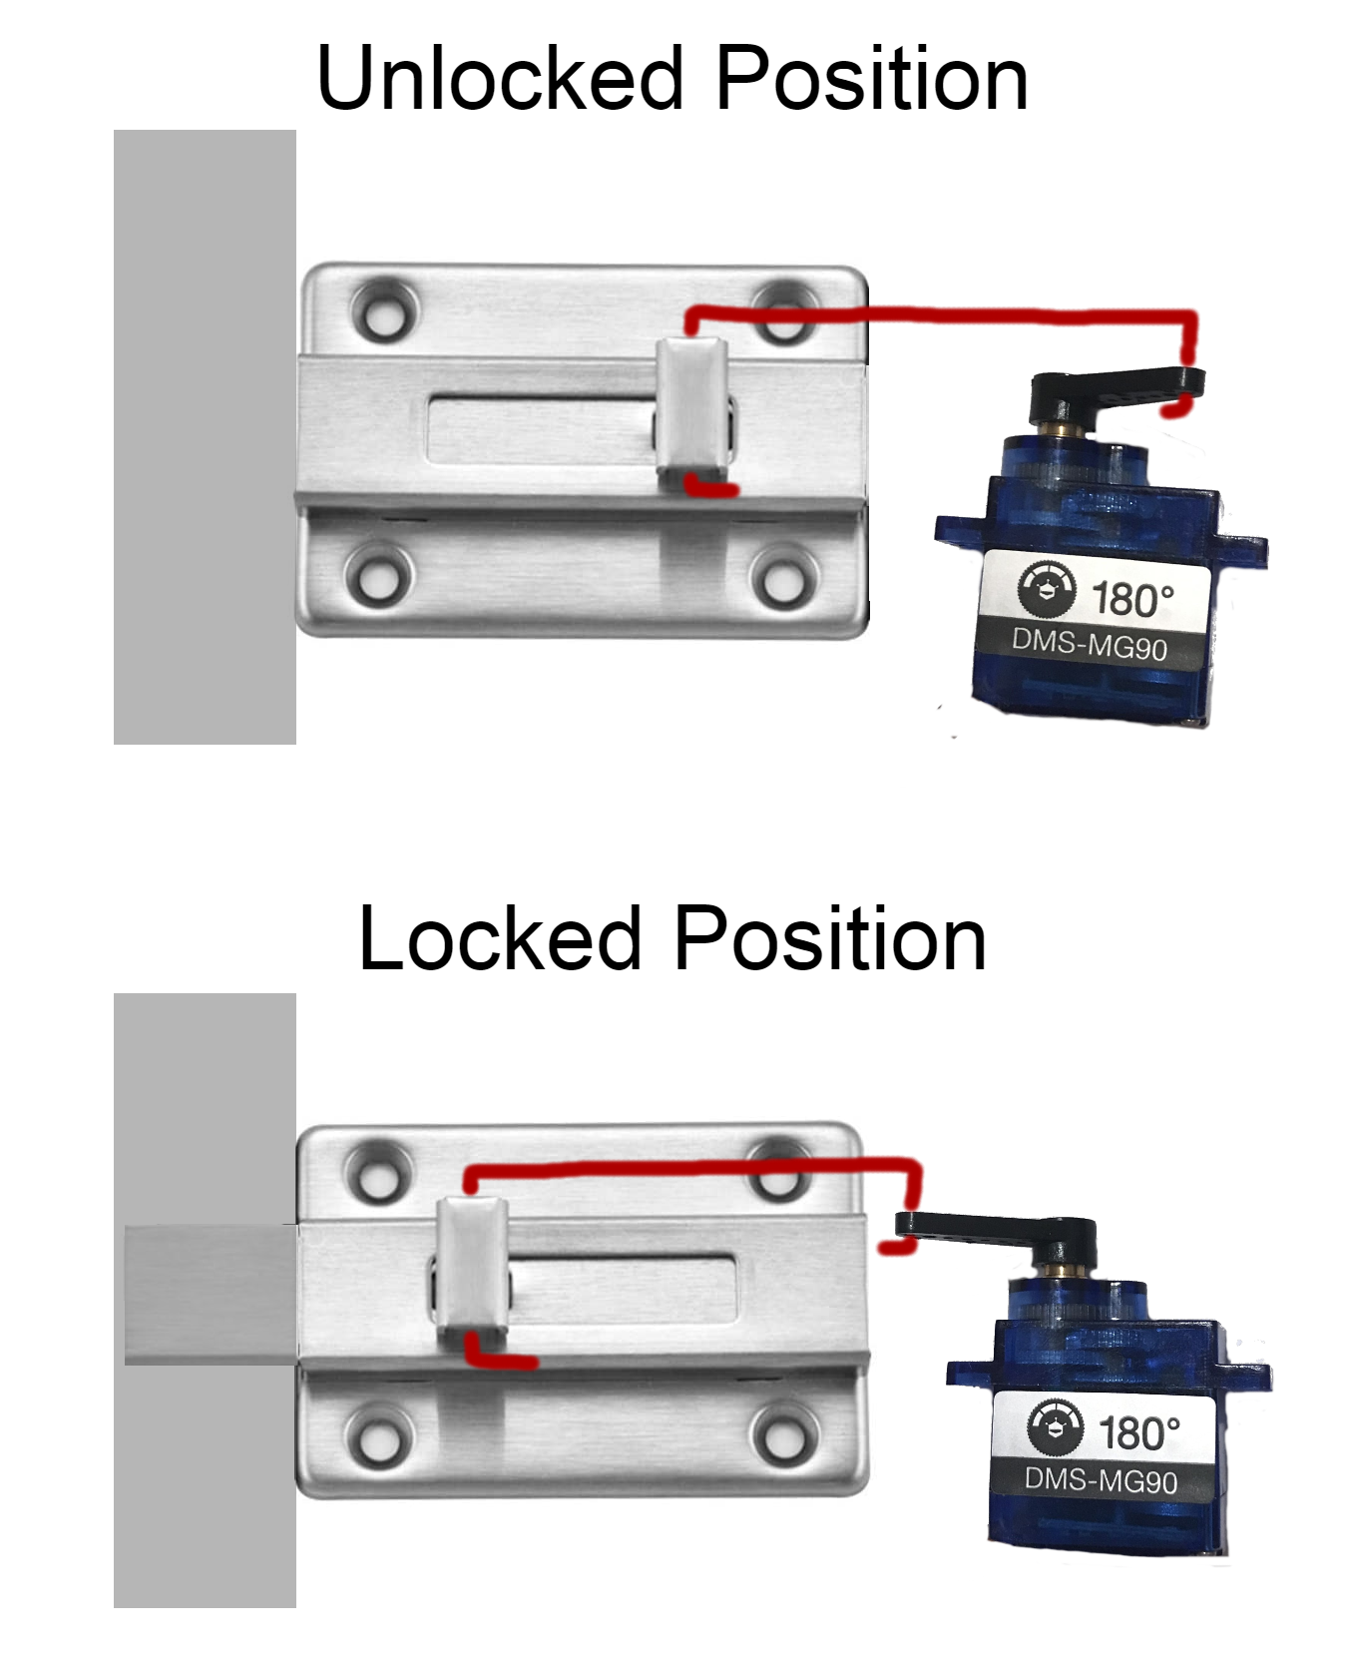
Locking Mechanism
Denzel Stockhausen
-Using positional SER0039 servo motors
-Each motor connected to a sliding bolt
-Bolt and motor both attached to inside of door
-Prevents force on doors from impacting motors
-Saves space by sliding bolt into locker frame
Notes:
Denzel
Image is a concept, haven't started physical design yet

Slide 16
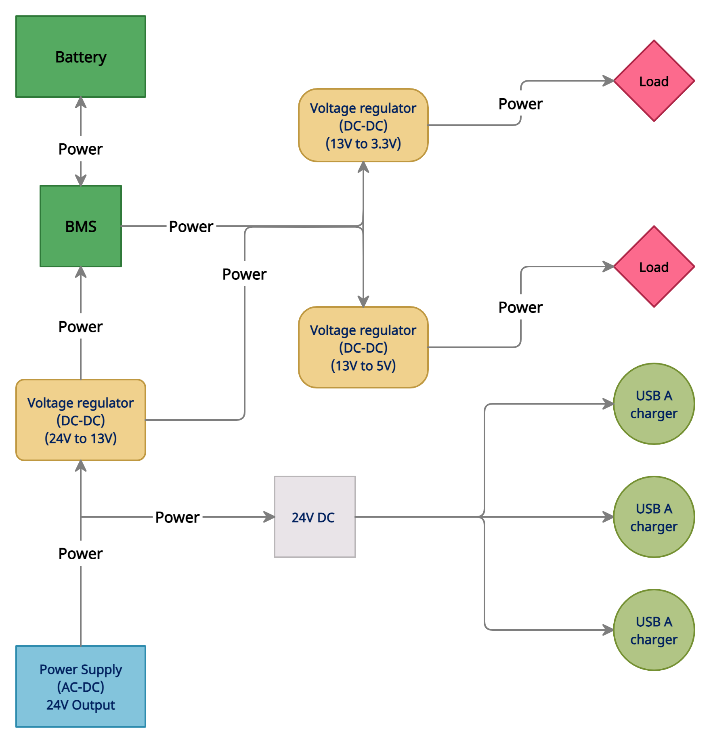
Power Subsystem
Idris Al-Shidhani
Four sections:
Power supply
Voltage regulators
Backup power
USB charging
Notes:
Idris
Power subsystem & block diagram

Slide 17
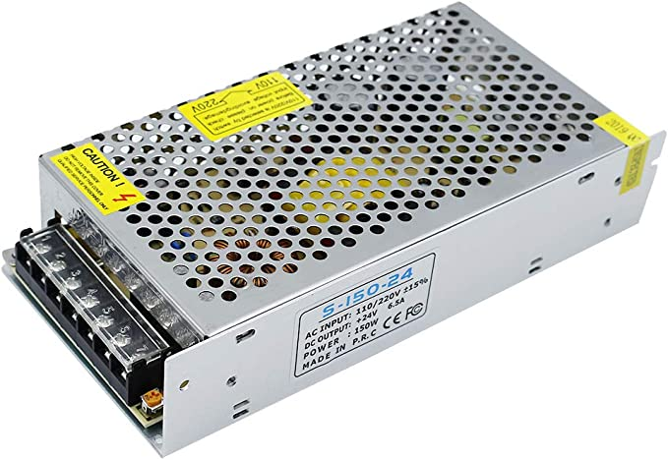
AC to DC Converter
Idris Al-Shidhani
The main power source of the locker
Can provide up to 150 Watts, and outputs 24V
Uses switching technology to maximize the converting efficiency
Notes:
Idris
6.25A @ 24V, our project requires ~4A so this is a good choice for the power supply

Slide 18
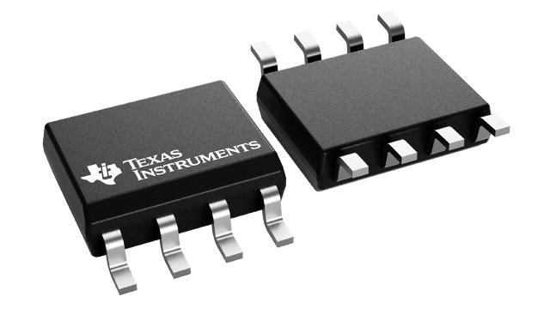
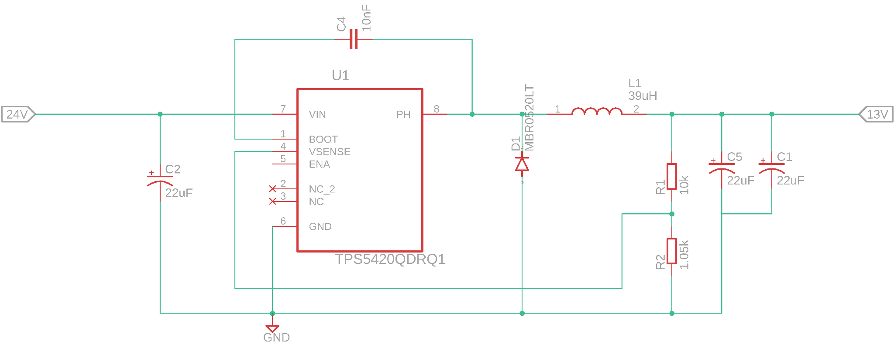
DC to DC Regulators - (13V Output)
Idris Al-Shidhani
Receives Power from AC to DC converter (24V)
All Voltage regulators circuits use switching IC (TPS5420-Q1) from TI for best efficiency
Delivering Power to:
5V output regulator
3.3V regulator
Battery Management
System
Notes:
Idris
We used webench to help us design the regulator circuits using this IC.

Slide 19
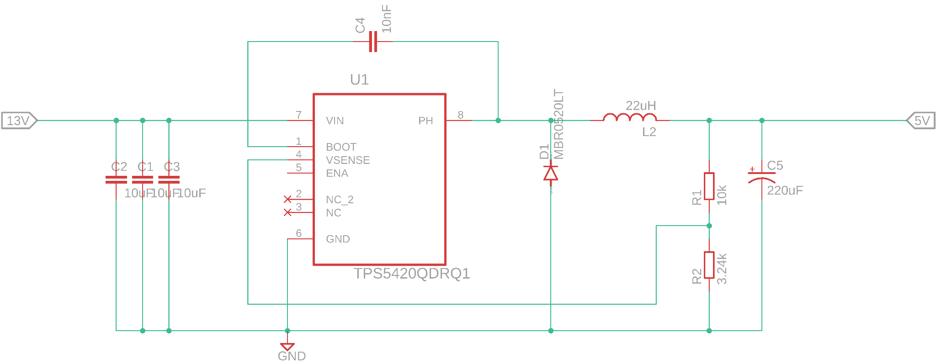
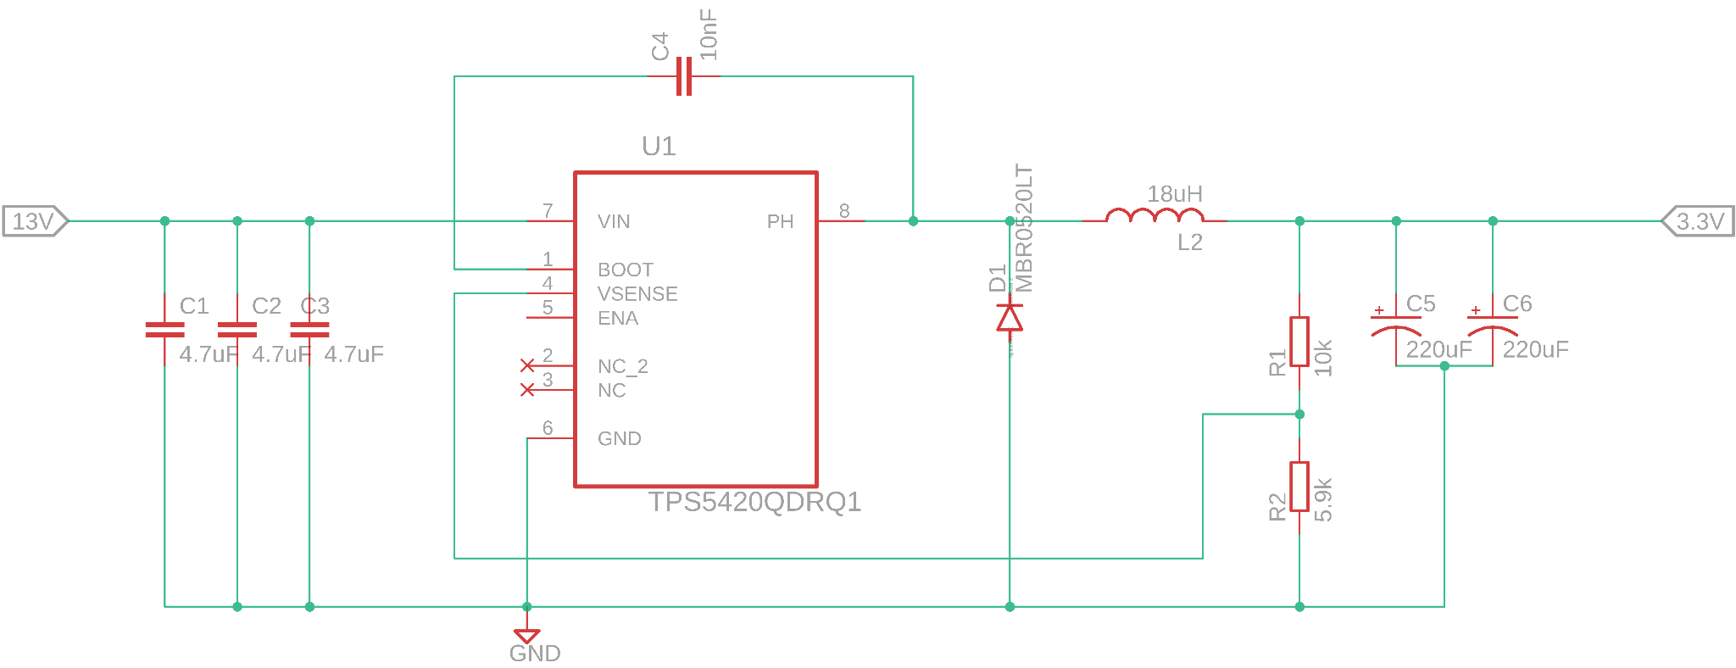
DC to DC Regulators - (5V & 3.3V Outputs)
Idris Al-Shidhani
Receives Power from 13V regulator & from Battery pack when wall power goes out
Delivering Power to:
The MCU and the rest of the
locker components
Notes:
Idris
Taking power from 13V output line.
According to the data sheet of this IC , it can provide a constant 2 Amps of current which is more than enough for our main board power need.
Two regulators are main power providers to the MCU and other locker components.

Slide 20
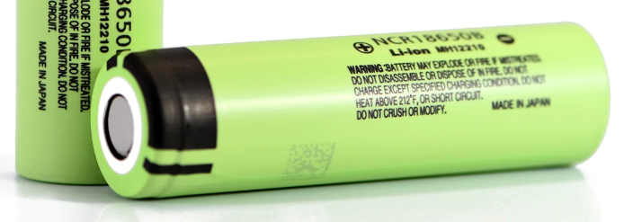
Battery Selection
Idris Al-Shidhani
The battery pack is the secondary power source of the locker.
We chose Lithium-ion technology for many reasons:
1) High power capacity.
2) Can supply more instantaneous current to power the Servo motors.
3) Has higher voltage per cell than other battery technologies.
 | Lithium-ion | Nickel Metal Hydride | Zinc-ion
Capacity (e.g.) | (700-15000) mAh | (400-11000) mAh | >700 mAh
Life cycles | 500-1000 | 1000 | 10000
Voltage | 3.7 volts | 1.2 volts | (0.75-1.8) volts
Max discharge current | (5-35) Amps | (0.4-11) Amps | N/A
Cost/pack (average) | 20$ | 13$ | N/A
Notes:
Idris
We chose to have a battery pack as a backup power source when main power is not available

Slide 21
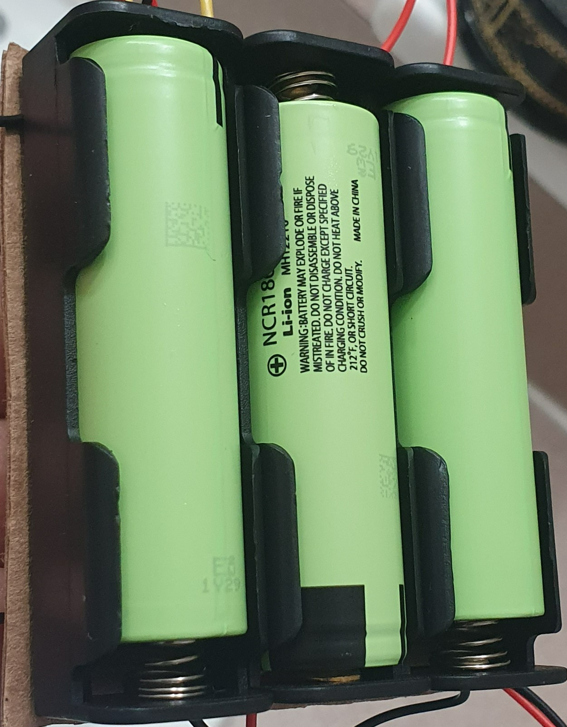
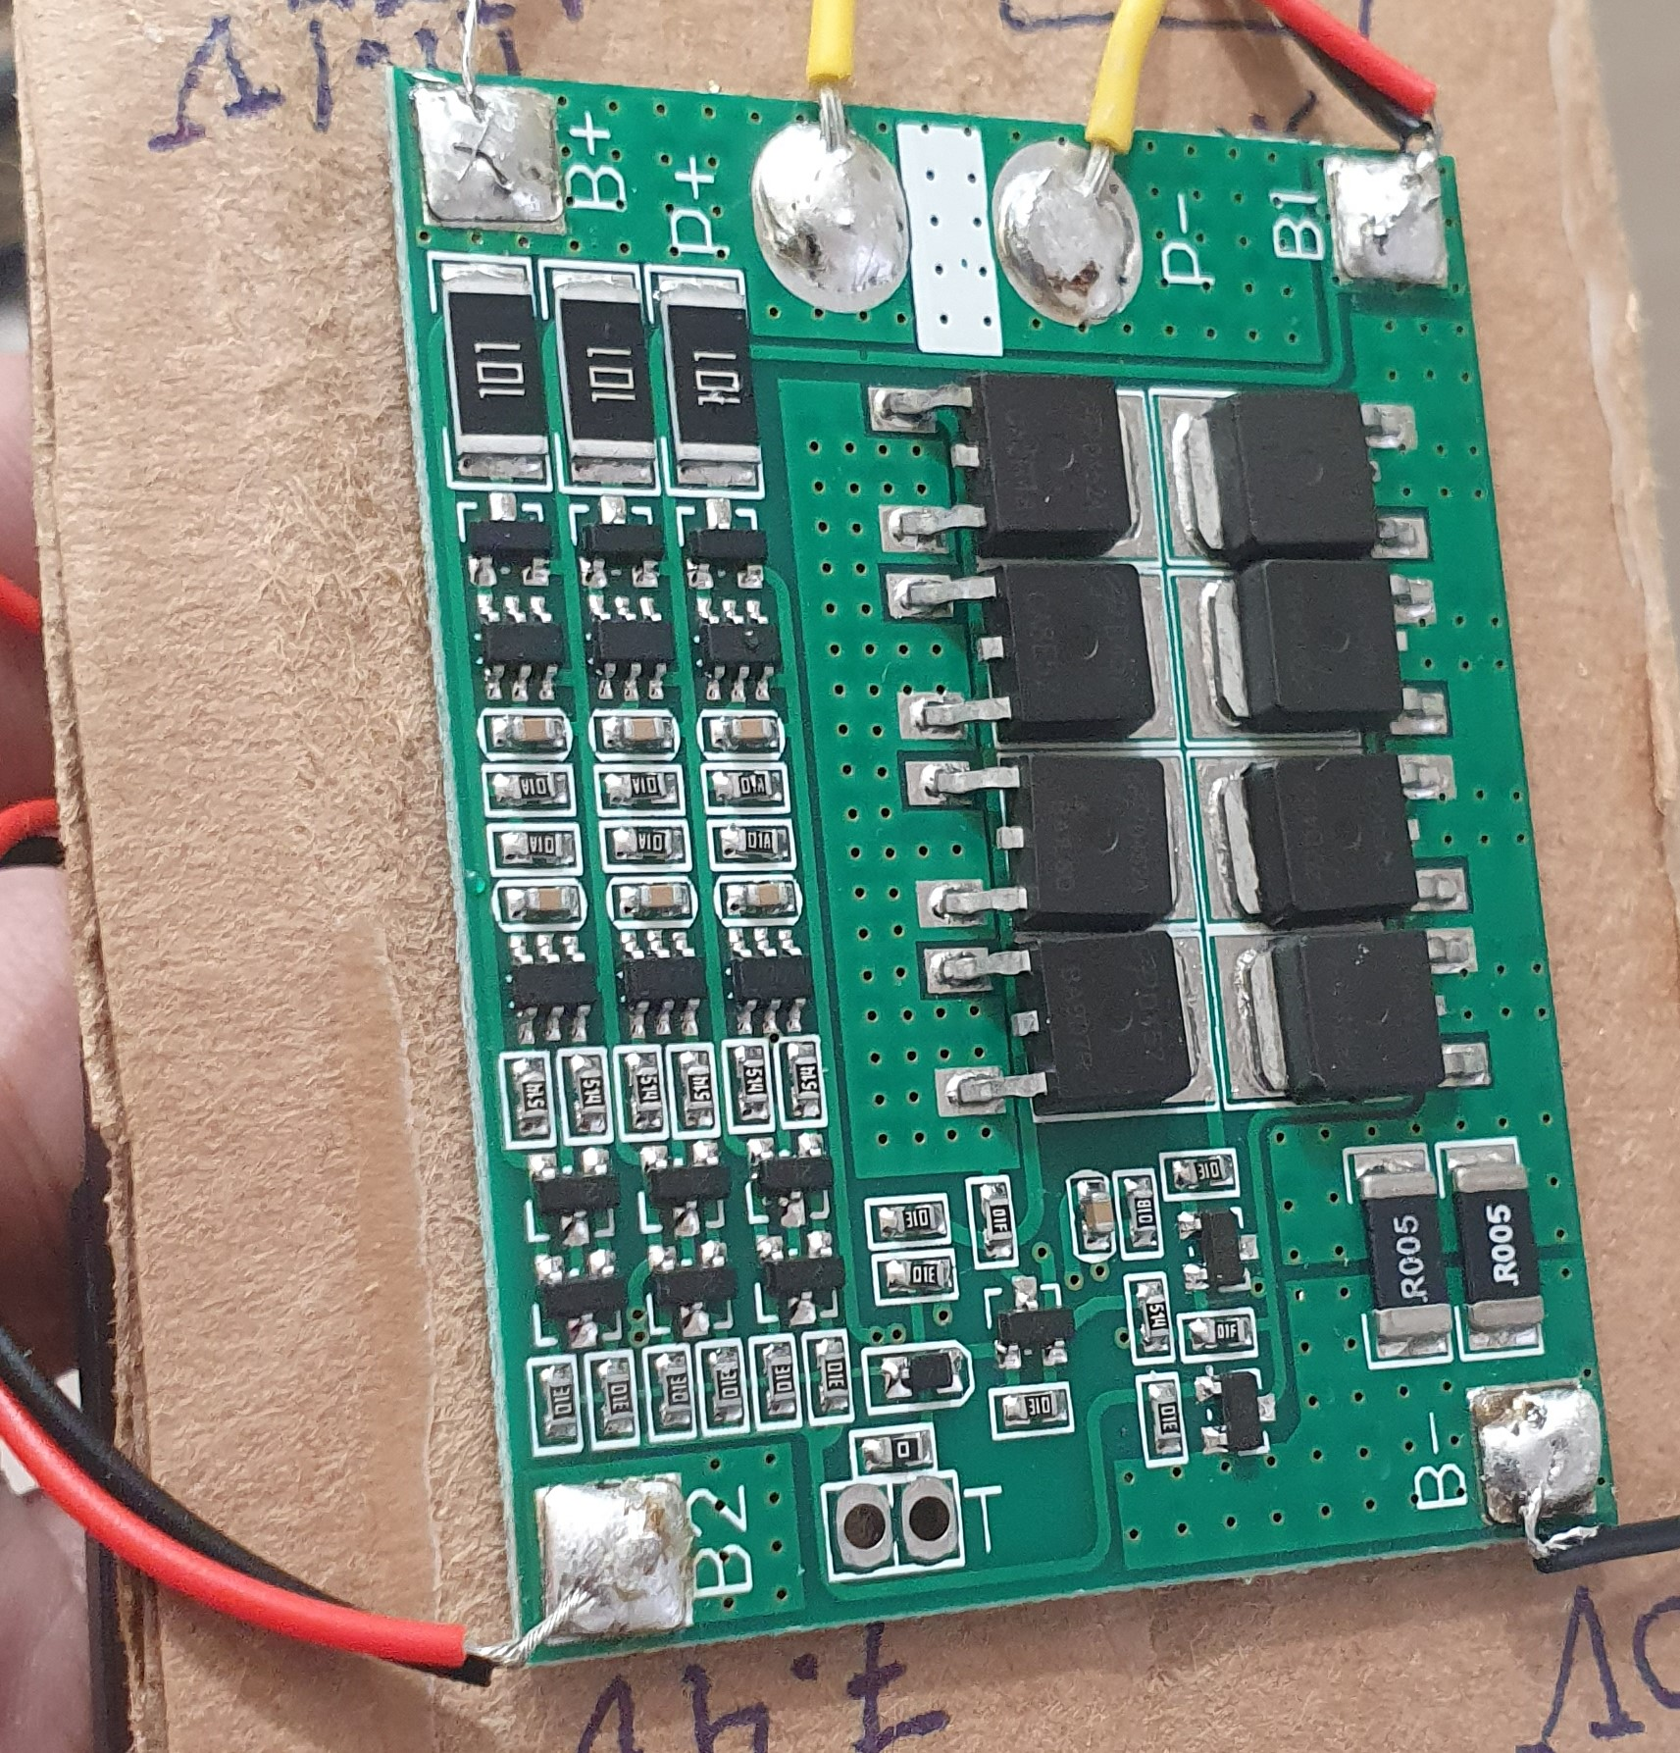
Battery Pack
Idris Al-Shidhani
For a high capacity and voltage output, we chose 18650 cells from Panasonic with 3450mAh for each cell
The battery pack will have three 3.7V rated cells connected in series (3S)
This will give output voltage of 12.6V at full charge & 11.1V at nominal charge
The BMS will manage and protect the battery pack
Bottom
Top
Notes:
Idris

Slide 22
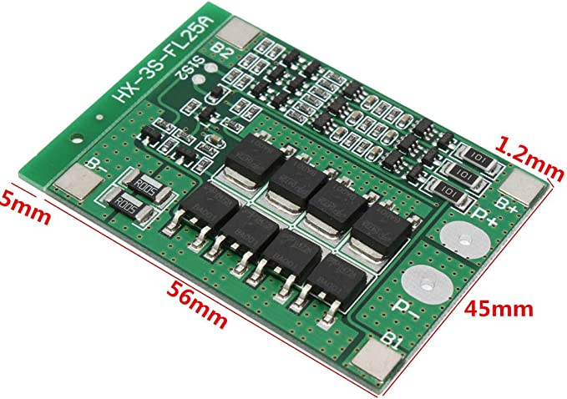
Battery Management System
Idris Al-Shidhani
We chose the (HX-3S-FLxxA) BMS series that is used to manage 18650s battery cells connected in (3S) series configuration
Features included:
Overvoltage protection (4.2±0.05) Volts.
Over Discharge protection (2.5 - 3) Volts.
Maximum total transient current > 30 Amps.
Short circuit protection (with delayed self recovery).
Notes:
Idris

Slide 23
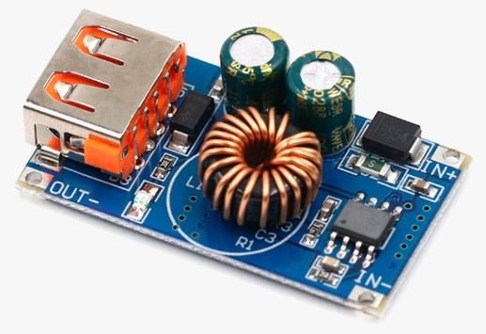
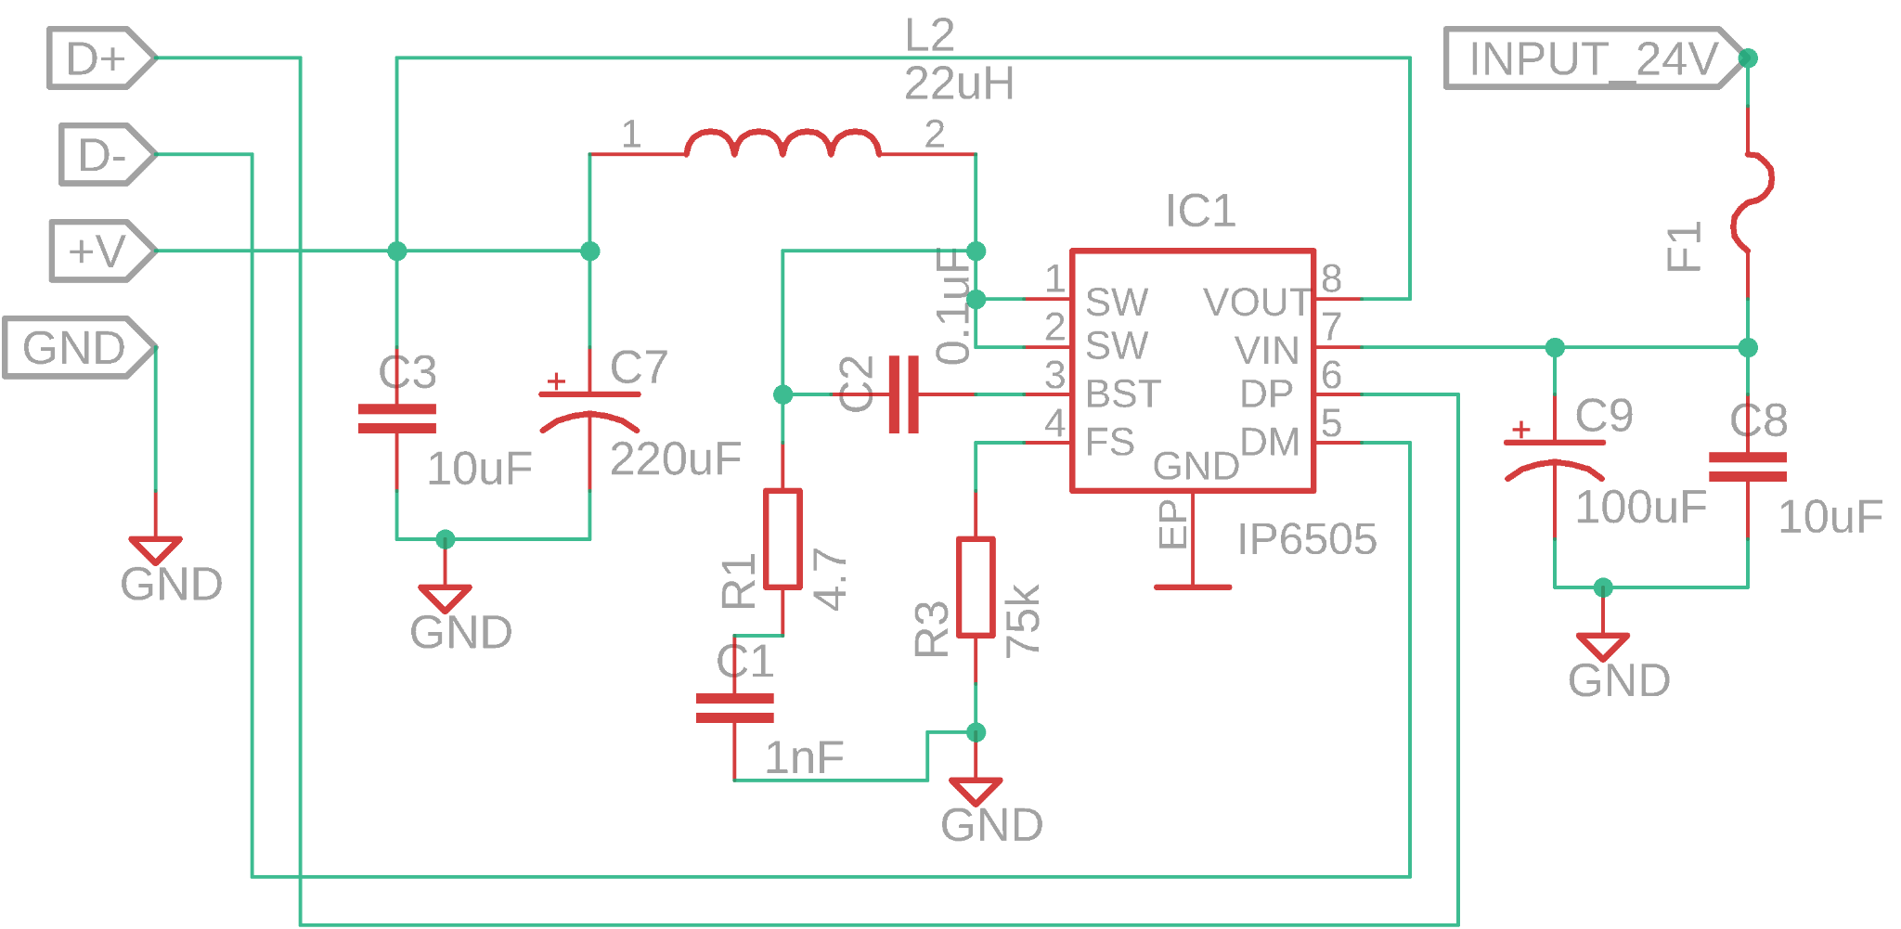
USB Charging Circuit
Idris Al-Shidhani
USB charging gives more convenient locker experience.
One USB charging wire inside each sub locker.
IC chosen is (IP6505) capable of (QC2.0 / QC3.0) for fast charging up to 12V output.
Circuit topology is Buck/Boost , so it can take wide (6 - 32) Volts DC input.
Notes:
Idris
We chose to have USB charging circuits on the locker for a more convenient user experience.
There will be 3 charging circuits each with a wire output to one locker compartment.

Slide 24
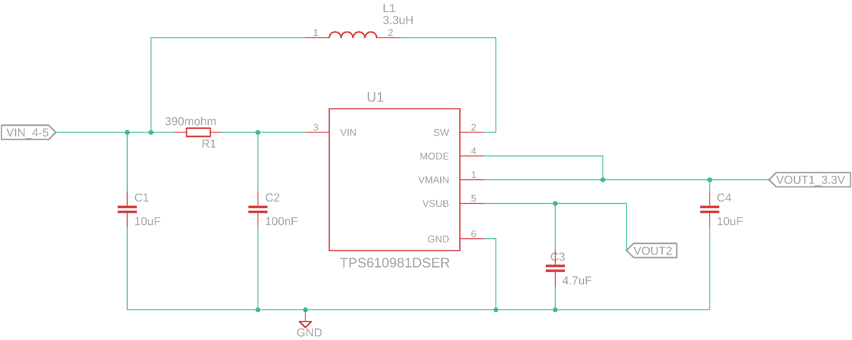
Remote Power system
Idris Al-Shidhani
Remote consume small amounts of power.
We chose to put two (AA) batteries to achieve running time of more than 168 hours.
Batteries output ranging from (2.6 - 3.1) Volts,
We chose a boost converter with steady state efficiency more than 90%, using (TPS610981) IC from TI.
The boost converter circuit will output (3.3) Volts.
Notes:
Idris
The boost converter circuit chosen is also designed with the help of webench, as the IC chosen is from TI .
The overall converter efficiency should be more than 90% which is helping the batteries to last longer.

Slide 25
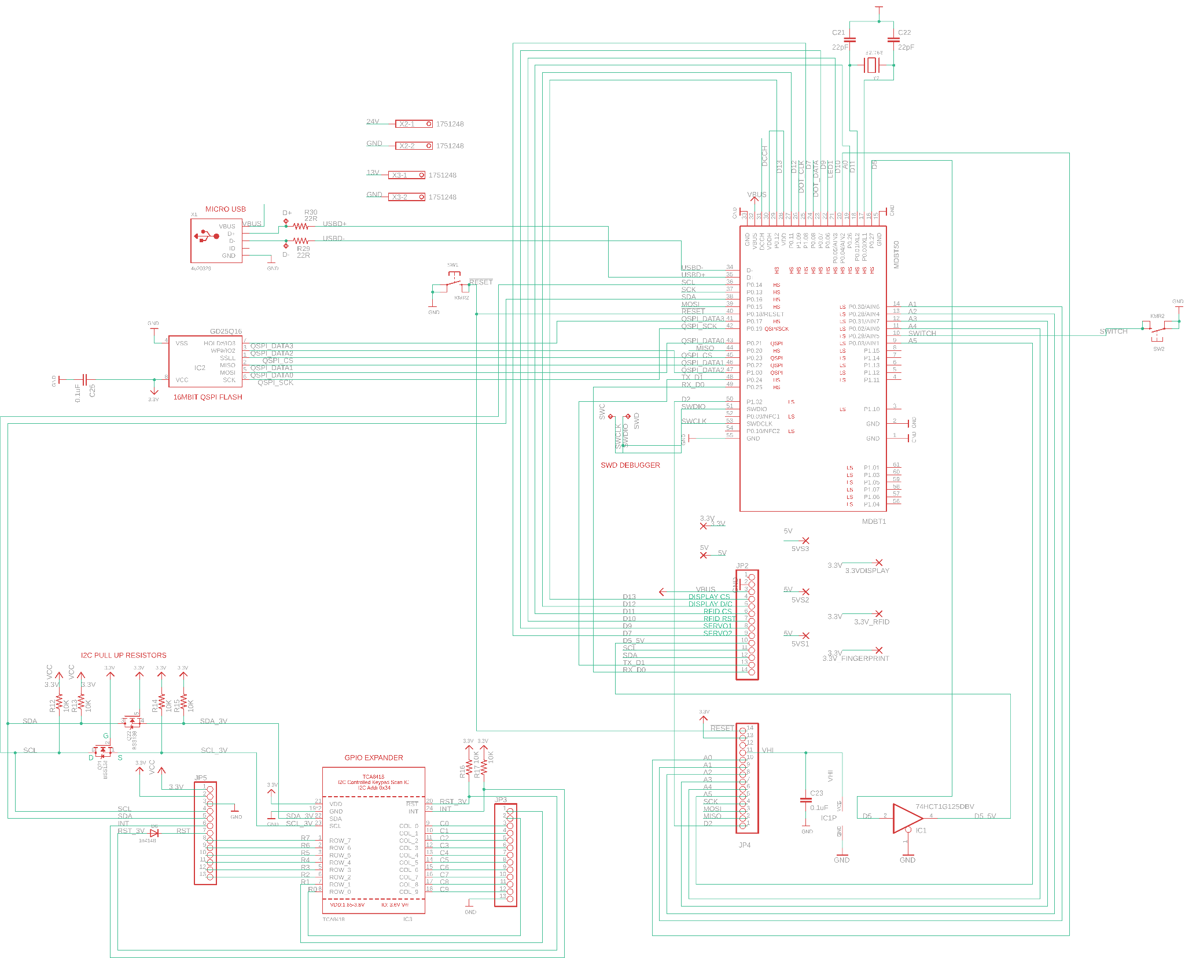
Locker Main PCB
Schematic
Denzel Stockhausen
- Overall design based on Adafruit ItsyBitsy nRF52840 and TCA8418 GPIO Expander
-Needed to include connections for our peripherals
Notes:
Denzel

Slide 26
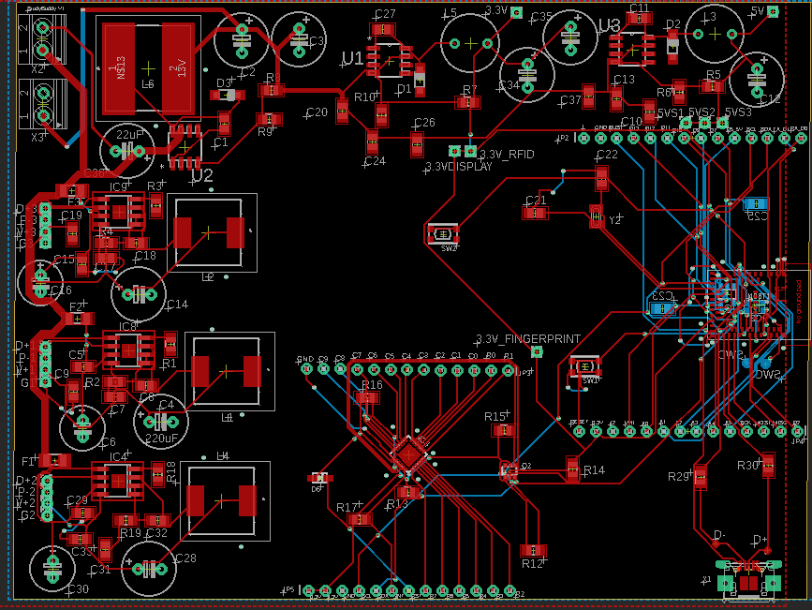
Locker Main PCB Design V1
Denzel Stockhausen
Ground plane turned off for clarity
Notes:
Denzel

Slide 27
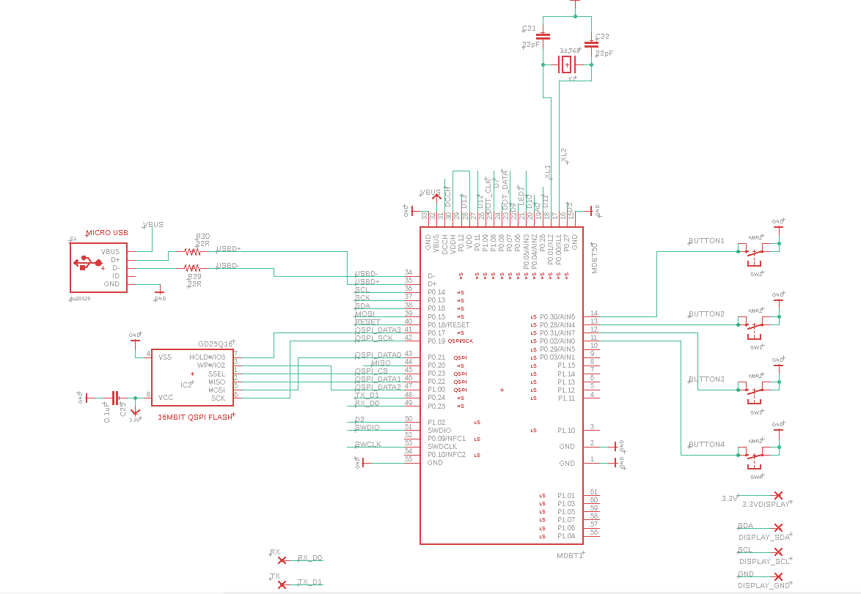
Remote PCB Schematic
Denzel Stockhausen
Overall design based on Adafruit ItsyBitsy nRF52840
Notes:
Denzel

Slide 28
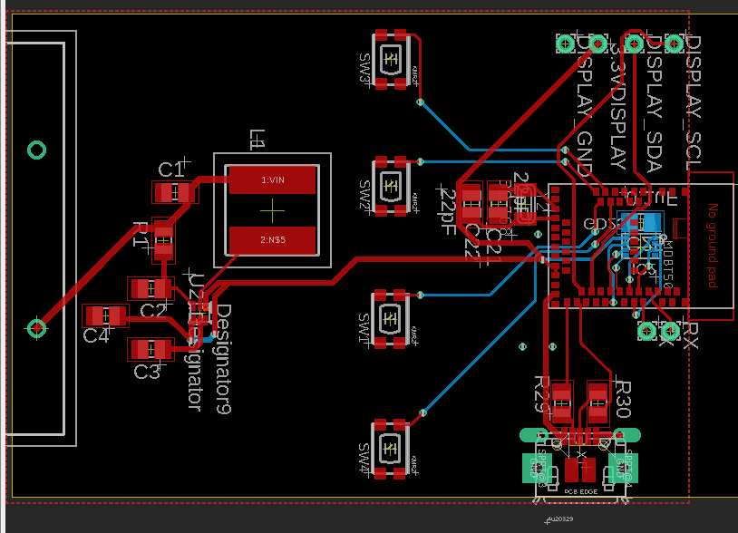
Remote PCB Design V1
Denzel Stockhausen
Ground plane turned off for clarity
Notes:
Denzel

Slide 29
Software Design
Kaiden Duvall
Code for nRF52840 written in Arduino IDE
Includes libraries for motors, OLED screens, RFID module, and fingerprint sensor
Using nRF52840’s TIMER peripheral for locker timer
Considerations:
System must know when any door is open (reed switches)
Timer should be accurately displayed in real time on the OLED screen
Text instructions on screens should be as legible as possible and utilize full screen
BLE communication between locker and remote
Status of compartments and timers sent from locker to remote
Unlock override command sent from remote to locker
Notes:
Kaiden

Slide 30
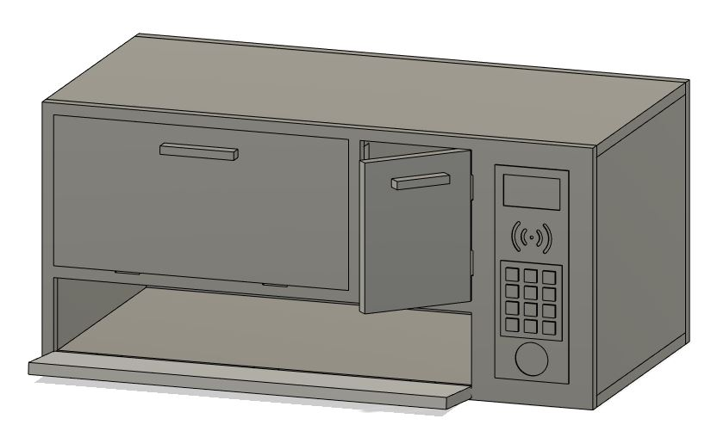
Physical Design and Construction
Cliff Porter
Three different sized lockers
Cut plywood sheets for the body and doors
3D printing for I/O plate and component mounts
Notes:
Cliff

Slide 31
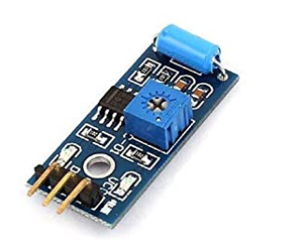
Difficulties and Concerns
Cliff Porter
Cell Phone vibration detection
Loading the arduino compatible bootloader onto blank modules
Multiway power lines for the Battery pack when wall power is out
Notes:
Cliff

Slide 32
Project Constraints
Kaiden Duvall
Time
PCB delivery time
Group schedules
Economic
Prototype cost
Self-funded
Safety
Lithium-ion batteries sensitive to heat, must be charged carefully
Manufacturing
Using two PCBs due to inclusion of the remote
Notes:
Cliff

Slide 33
Related Standards
Kaiden Duvall
Power Supply Standards
IEC 60035
Lithium-ion and rechargeable batteries
IEEE 1625
USB Standards
Bluetooth low energy
SPI, I2C, UART
Notes:
Cliff

Slide 34
Work Distribution
Cliff Porter
 | Power Design | Schematic & PCB | Assembly & Testing | Physical Design | Software | Wireless
Cliff |  |  | X | XX | X | XX
Kaiden |  |  | X | X | XX | X
Denzel |  | XX | X
Idris | XX | X | X
Notes:
Cliff

Slide 35
Budget & Financing
Cliff Porter
Component | Quantity | Estimated cost
Keypad | 3 | $ 15.00
Large display | 1 | $ 27.00
Small display | 4 | $ 14.00
Fingerprint sensor | 2 | $ 40.00
RFID reader + tags | 3 | $ 24.00
Vibration sensor | 5 | $ 6.00
Rechargeable batteries | 6 | $ 30.00
Remote battery | 2 | $ 6.00
BMS | 2 | $ 10.00
Locks | 3 | $ 13.00
Small motors | 6 | $ 35.00
Reed switches + magnets | 10 | $ 17.00
Radio modules | 10 | $ 14.00
USB charging ports | 4 | $ 12.00
Controller chips (MCU) | 4 | $ 50.00
Push buttons (multi pack) | 1 | $ 13.00
PCB (main) | 1 | $ 15.00
PCB (remote) | 1 | $ 15.00
Construction material | 1 | $ 12.00
Total |  | ~$ 368.00
Notes:
Cliff
Project is self financed

Slide 36
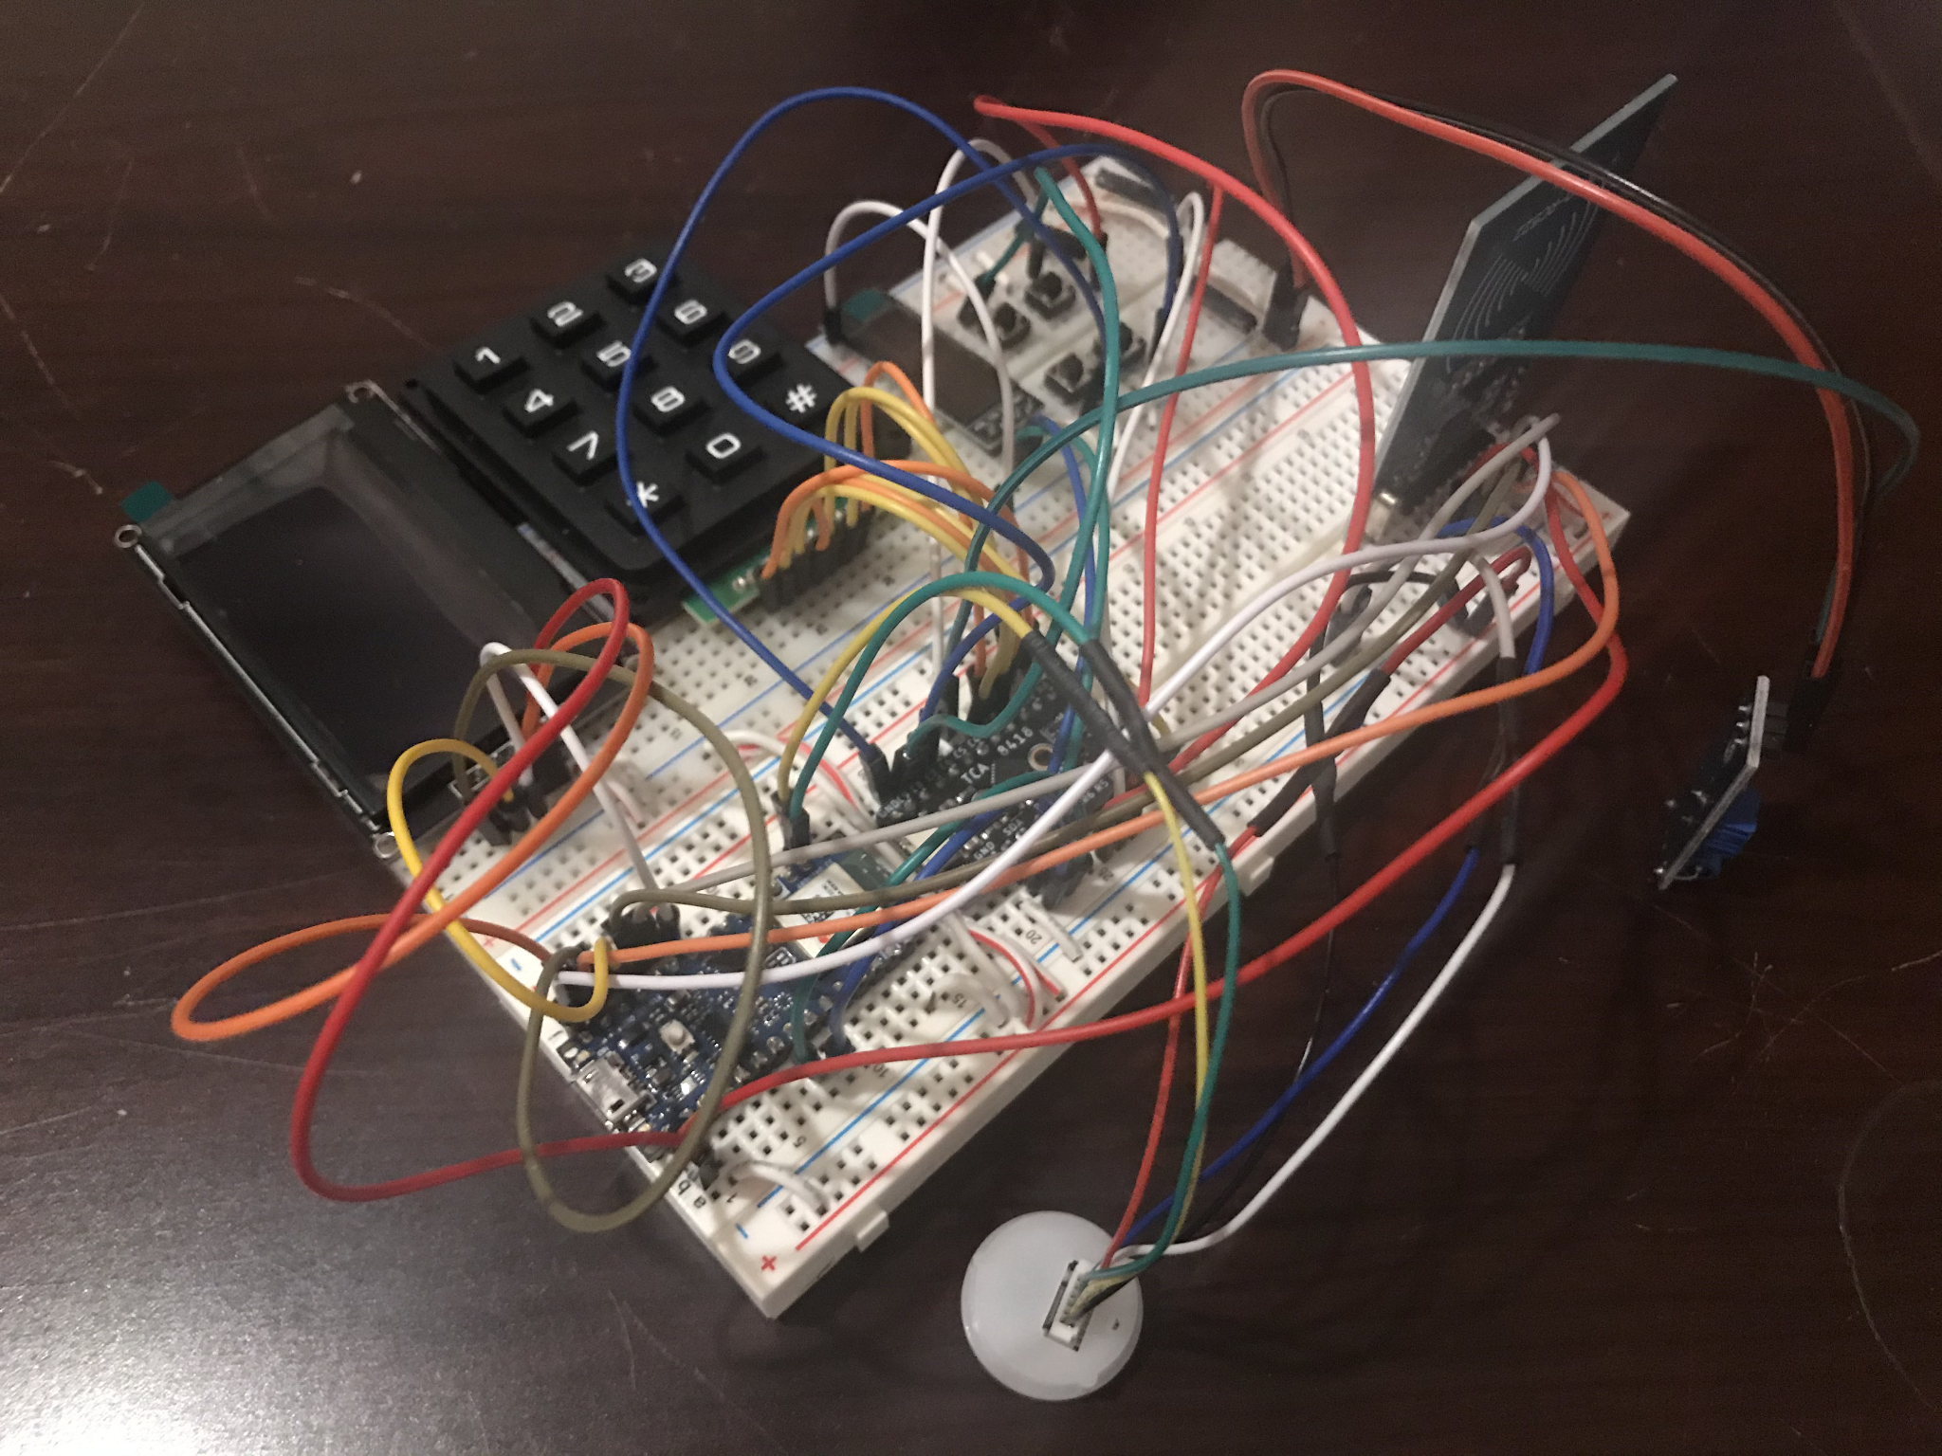
Progress - Breadboard Prototype
Cliff Porter
Notes:
Cliff
What we have done will do next
-do next: build and test pcb, software, physical design

Slide 37
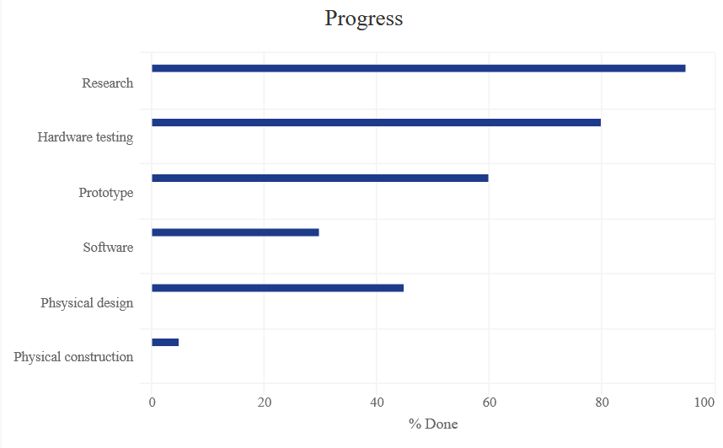
Progress - Overall
Cliff Porter
95%
80%
60%
35%
45%
<5%
Notes:
Cliff
What we have done will do next
-do next: build and test pcb, software, physical design

Slide 38
Questions?

