Slide 1
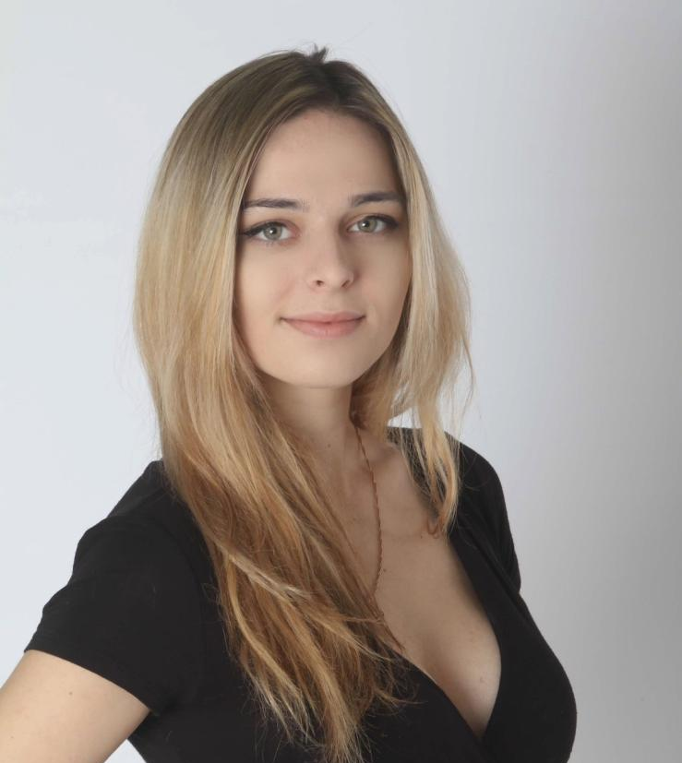
NSynth
Monophonic Hybrid Analog/Digital Synthesizer
Anna Wegener (EE)
Magdalena Dobinda (CpE)
Sebastian Carrion (EE)
Devin Vanzant (CpE)
Notes:
SLIDE 1:
Hi, My name is Magdalena Dobinda and I am talking to you on behalf of Group 27. Our project is "NSynth" which is the hybrid analog/digital monophonic synthesizer
We are a four person group made up of two electrical engineers, seb and anna, and two computer engineers devan vanzant and myself Magdalena Dobinda

Slide 2
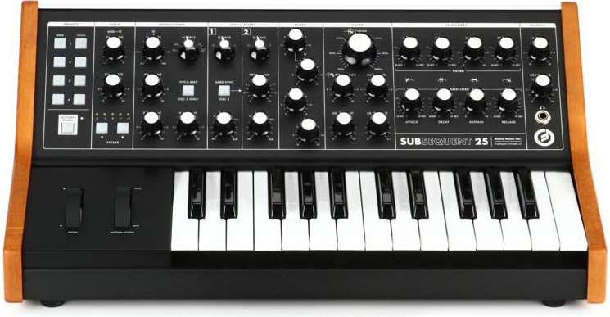
Introduction - What is a synthesizer?
A synthesizer is an electronic hybrid musical instrument that generates audio signals - think of it as a piano that is endlessly configurable to create almost any sound imaginable thanks to its internal analog circuitry. Synthesizers generate different audio signals by generating waveforms. Sounds range from simulating acoustic instruments to weird and wonderful bass, pad, lead, and percussive tones.
Synthesizers allow the user to manipulate the three core elements that define sound: pitch, timbre, and loudness.
Notes:
SLIDE 2:
To explain our motivation we want to reiterate very quick what a synthesizer is.
a synthesizer is a musical instrument that you can use to design your own sounds. Analog synthesizers utilize electrical current to generate sound while digital and software synthesizers use binary code, algorithms, and Digital Signal Processing.
Aside from the many knobs, ports, and cables, the majority of synthesizers utilize a keyboard that makes it much easier to play your sounds - and as a result, you can interact with your sounds across multiple octaves and see where it sounds best.
Synthesizers differ in many ways but all utilize oscillators, ADSR envelopes, LFOs and filters. A signal oscillator generates a signal with a consistent tone, and many synths have multiple oscillators that you can stack on top of one another for a bigger sound.
You can use then use LFOs and envelopes to modulate a plethora of parameters.

Slide 3
Motivation
This project serves as a bridge between engineering, computer science, music production, and performance.
We want to build a vintage-style analog monophonic synthesizer that is playable through its built-in keyboard, or your PC using a MIDI interface.
Through a MIDI to CV converter, our voltage-controlled analog synthesizer will be able to utilize digital MIDI out signals.
The end product will be able to interface with MIDI out with a software/GUI visualizer.
Notes:
SLIDE 3:
As for our motivation for this project, it firstly implements a lot of challenging core concepts we have learned throughout our degree as electrical and computer engineers. It also bridges these concepts with music theory, computer science, and music production.
While this product does exist, it's very challenging to implement this product in a hybrid form and was our main motivation to picking it as our senior design project. We want to bring back the vintage-style analog synthesizer and allow people to use it with modern technology. This can be done by creating a MIDI-to-CV converter as most modern digital synthesizers utilize MIDI signals. Once we have create the hybrid product, we wanted to utilize a GUI visualizer to also allow the user to understand in real time how they are manipulating the sounds and interact with it.

Slide 4
Basic Goals
Advanced Goals
Hardware: The hardware will be able to generate analog waveforms that can be modulated/modified by the other device elements (VCF, VCA, etc). The audio signal created will be audible by the end of the process.
Software: The analog and digital components will interface with a MIDI to CV controller allowing for 1 Volt/Octave tracking. The synthesizer will be MIDI compatible through a USB and will be able to be interfaced to a computer.
Overall: The device will be able to generate audio waveforms that can be transcribed back into audible sounds for the user to perceive as well as letting the user be able to display said waveforms within the computer application through a GUI.
Hardware: The hardware will allow the user to see and hear the effects of their chosen setting parameters reflected on the signal’s waveform.
Software: GUI interface / App Interface will actively read MIDI input from the protocol and show the current waveforms, frequency, pitch, etc. being played. Interface should be able to show the type of waveforms being produced by the synthesizer.
Overall: As we develop the device more, our goal is to enable the user to have more parameters to customize and in turn produce a wider variety of audio waveforms. These parameters will be tracked within the application on the GUI so that the user may see both the parameters affecting the generation of the waveform and the waveform itself.
Notes:
Slide 4: Our base goals for this project is divided into hardware and software goals, for the hardware we want to at minimum have the syntehsizer generate anlog wafeforms that can be modulated and modified by the other main elements of the system. The audio signal must be audible by the end as well. for the software components it is essential that we have a working MIDI to CV converter making the synthesizer MIDI and USB compatible. This can be tested by playing MIDI notes on the keyboard and measuring the voltage output at the CV gate. for our advanced goals we wanted to have a build in GUI and app interface that can read the MIDI data that is being manipulated in real time and shown in a way that the user can understand how the different parameters change the sound.

Slide 5
Stretch Goals
Hardware: The hardware would include a module that would enable the user to connect to the synthesizer via Bluetooth. The synthesizer will be able to recreate previously generated sounds through recalling previous user parameters.
Software: Real time visualization of notes/pitches/etc being played with ability to digitally manipulate. Visualization would include waveforms as well as giving the user artistic expression through customizable visuals that are following the pitch, frequency and beat.
Overall: The long term stretch goals would be real time visualization and playback of previously generated sounds.
Notes:
Some of our stretch goals include including a module in the synthesizer that would allow the user to connect via Bluetooth, as well as advanced features to the GUI previously mentioned.

Slide 6
Requirements Specifications
Subsystem | Requirement Description/Objective | QTY | Unit
VCO (Voltage Controlled Oscillator) | For our current goals the team’s required specification is a dual Voltage Controlled Oscillator 20Hz to 20kHz. Produces saw, square & triangle waves. | 20-20k | Hz
VCA (Voltage Controlled Amplifier) | Used to adjust cut-off frequency through an input controlled voltage with distortion less <5% | <5%
VCF (Voltage Controlled Filter) | Used to adjust cut-off frequency through an input controlled voltage for a frequency range of 20Hz to 20kHz Ability to control cutoff frequency and resonance | 20-20k | Hz
Notes:
For our requirement specifications we wanted to make sure all of our objectives were quantifiable in our research phase to allow clear milestones for this project. The lines highlighted in yellow are the main features we are focusing on for our demonstration at the end of the semester.
VCO: By using two, the versatility of our product doubles and one can get richer and thicker synthesizer tones by slightly detuning the 2nd oscillator—formally the sub-oscillator. It can also be detuned an octave or two lower for sub-bass. **** make sure to mention those highlighted in YELLOW are our demo features ****

Slide 7
Requirement Specifications Continued
Subsystem | Requirement Description | QTY | Unit
Envelope Generator | The Envelope Generator will be used to control four different stages of a sound. Four knobs for each stage of: ADSR (Attack, Decay, Sustain, and Release) | 2
MIDI Inputs | MIDI Inputs USB, Power Supply, VCF, VCO, VCA. MIDI defines 128 notes, ranging from a C two octaves below the lowest C on an 88-note piano, to a G about 1-1/2 octaves above the High C on that same piano. The system will be able to send all 128 notes through to the DAW. MIDI-compliant | 128 | Notes
Notes:
MIDI compliant - through a midi to cv converter our voltage controlled analog synthesizer will be able to utilize and manipulate MIDI out signals
Through a MIDI to CV Through a MIDI to CV converter, our voltage-controlled analog synthesizer will be able to utilize digital MIDI out signals.converter, our voltage-controlled analog synthesizer will be able to utilize digital MIDI out signals.
Through a MIDI to CV converter, our voltage-controlled analog synthesizer will be able to utilize digital MIDI out signals.

Slide 8
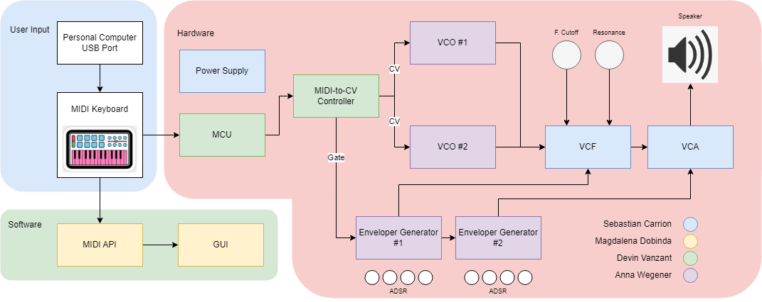
Overall Block Diagram
Notes:
Our synth will take input through a MIDI cable that can either be connected to a MIDI keyboard or PC w/ a USB-MIDI interface. For our project, we decided to use a MIDI keyboard as the main input source.
The MIDI data will be sent over a 5-pin DIN cable to the MCU (ATTiny85) which we have programmed to convert MIDI data into the respective voltages that correspond to the correct notes. The MIDI-to-CV controller outputs this voltage (known as a “control voltage”) to the VCO which controls the pitch of the oscillator. When a key is pressed, the MIDI-to-CV controller also outputs a gate signal of 5V to enable the 2 Envelope Generators– when a key is not pressed, the MIDI-to-CV controller outputs 0V. These Envelope Generators also send a separate “control voltage” to both the VCF and VCA to control the frequency cutoff of the filter and amplitude of the amplifier. The audio output of the VCOs feeds into the VCF to allow the user to control both filter cutoff and resonance. The VCF then sends this audio signal into the VCA where it is then amplified to an audible level.
We also have a goal for a MIDI visualizer built in Java. We chose Java as it is cross-platform and provides all the built-in libraries that our project requires.

Slide 9
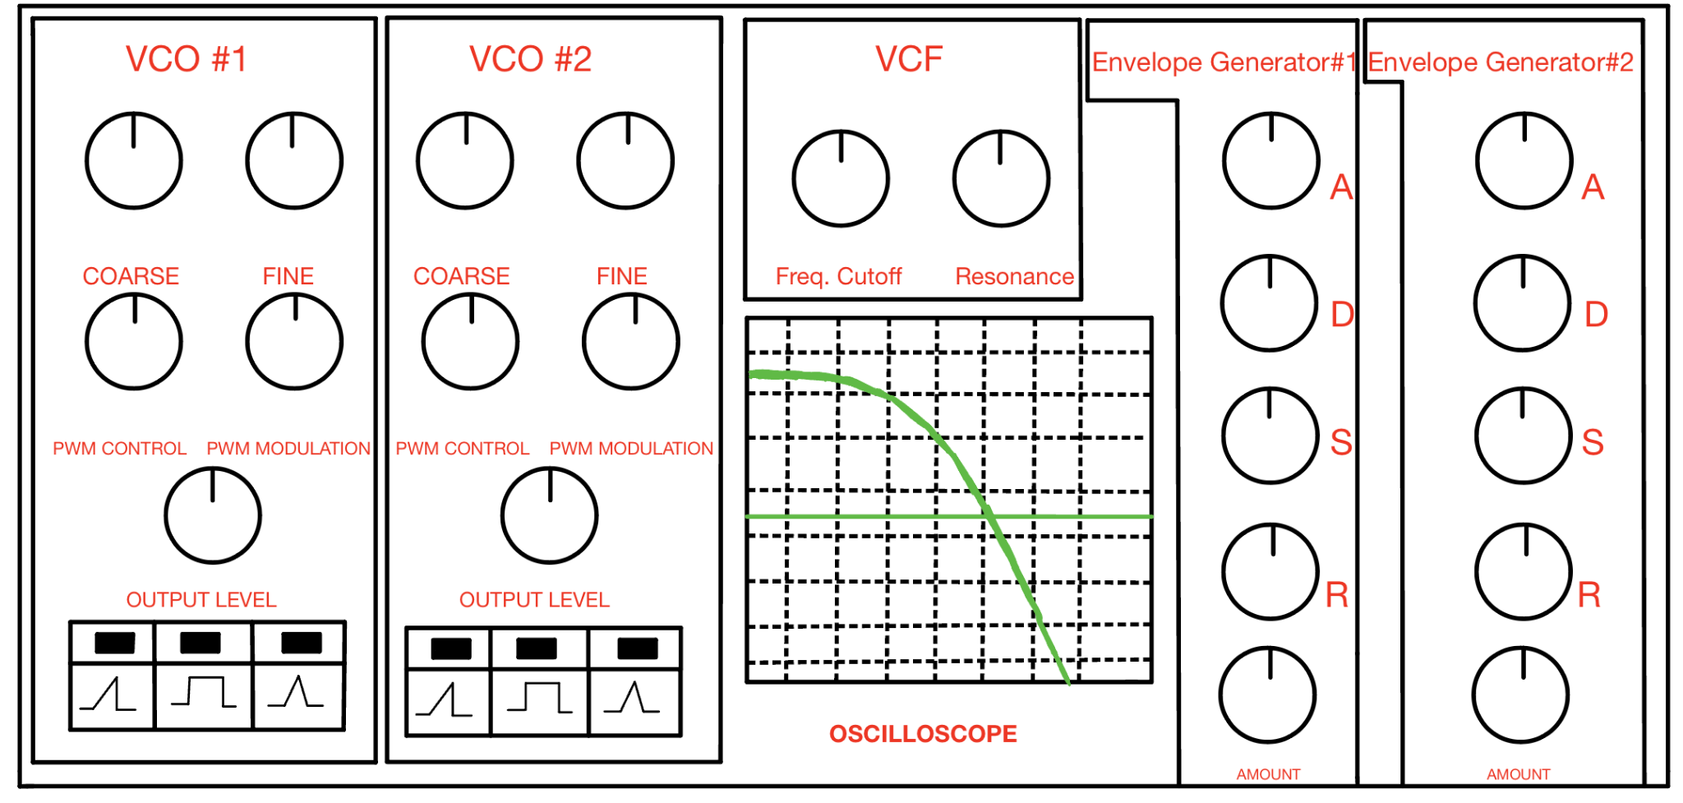
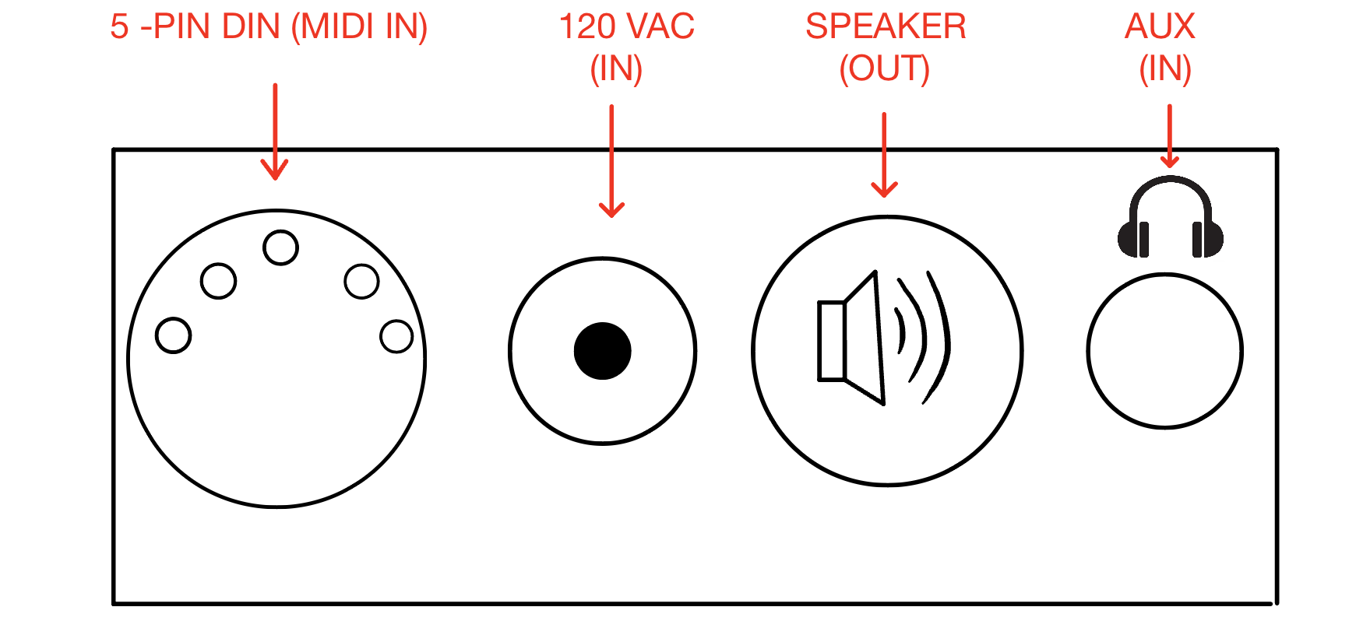
Design Specifications
I/O Ports Enclosure

Slide 10
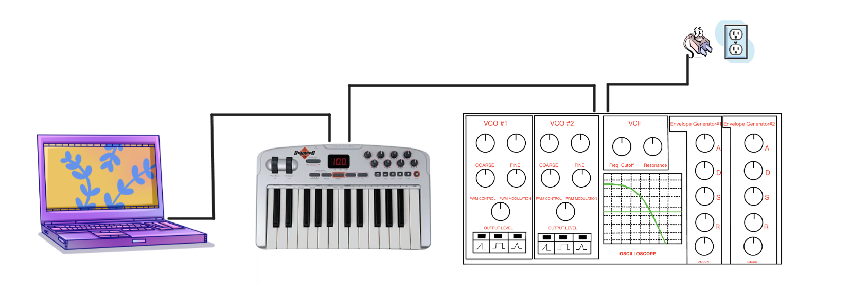
Design Specifications Continued
Overall Setup

Slide 11
PCB Enclosure
For an enclosure roughly of size 10” x 6” x 6”:
Material/Technology | Description & Benefits | Cost (Estimated)
Wood | Wooden enclosure that will need to be assembled part by part that can be done at no cost. | $0 - Free
Prefabricated Plastic | Prefabricated non-metallic enclosure made of ABS plastic. Flame proof | ~$15
3D Printed FDM | Filament printed to exact specifications we create. Alternative printing materials include ABS, ABA, PC, resin. | ~$5
Extruded Aluminum | Prefabricated pressed metal enclosure. Customizable. Online services provide customizing for mounting, holes, etc. | ~$15 - $40 before customization
Store-Bought Metal Electrical Box | Weatherproof metal enclosure with door. Customizable. Requires dremel or other tool capable of making holes in metal. | ~$50
Metal Shielding (EMI) | Mostly for higher end electronics or communications systems to remove electromagnetic interference. | ~$20
Notes:
When designing our analog synthesizer enclosure, we will have to keep several things in mind: the size of the PCB, clearances around I/O ports, and human interface devices. We had to consider several materials and their cost, longevity, and ease of implementation. We decided to go with an off the shelf metal enclosure like one from Hammond Manufacturing. These come with 3D models such that we can ensure the dimensions are sufficient for the size of our PCB, ports, and potentiometers. We will use either a dremel or drill to make the cutouts big enough for each component. The enclosure also needs to be able to be opened to tune the oscillator on occasion. We considered other materials like wood, but this might also absorb moisture in a humid environments and cause our sensitive analog components to drift - however, we may build a wooden prototype before moving onto metal. We also looked into 3d printing but decided against it due to the amount of design and alignment involved around so many potentiometers with a slow print time.

Slide 12
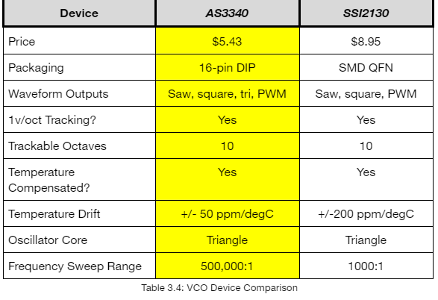
VCO Parts Selection:
Notes:
When considering which IC to use for our VCO, we had to take several factors into account: the most important being price, packaging, waveform outputs, and tracking abilities. I decided to use the AS3340 due to its popularity in the synthesizer DIY community and its lower cost. I was even able to find the chip for a little under $5 and this made it easier to order spares for our prototyping stage so now we have extras for our PCB when that comes in. The AS3340 has been used in many popular historical synths over the years produced by Roland, Moog, and Sequential Circuits. It is popular amongst hobbyist and known as the go-to for the integrated circuit VCO route. It has full temperature compensation making it extremely stable and has an internal zener diode to allow it to operate with our dual +/-12V supply of our synth.

Slide 13
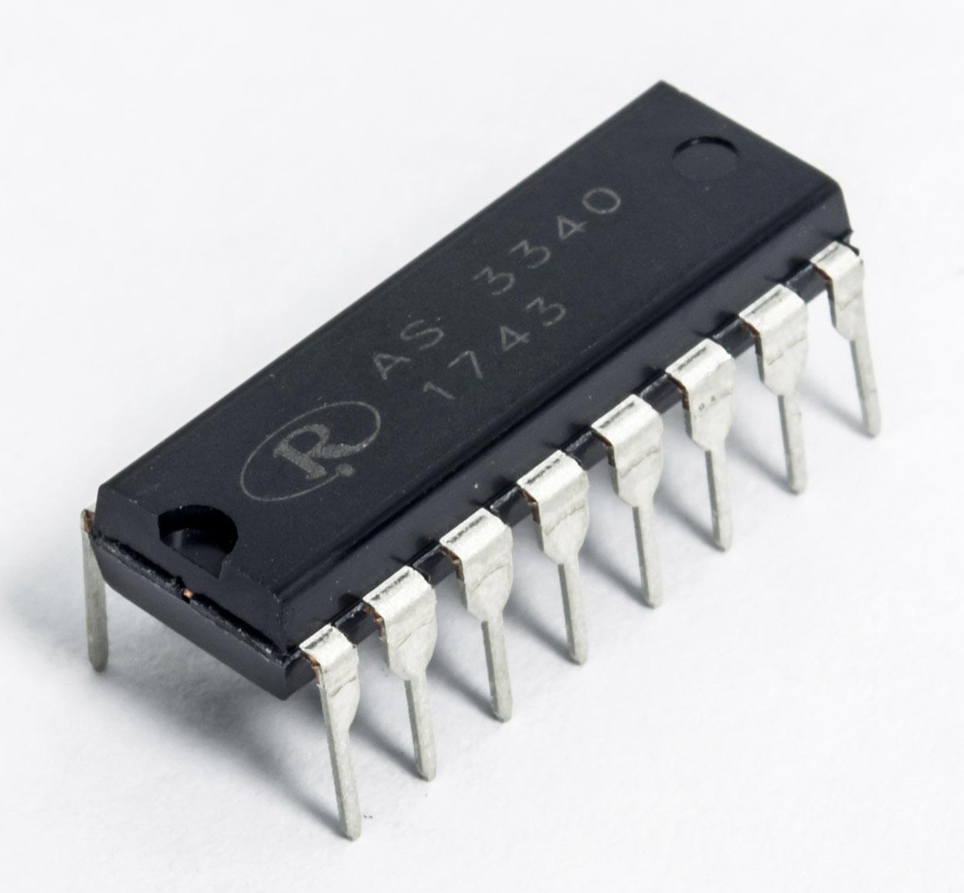
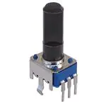
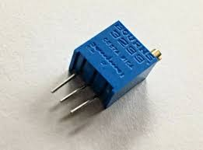
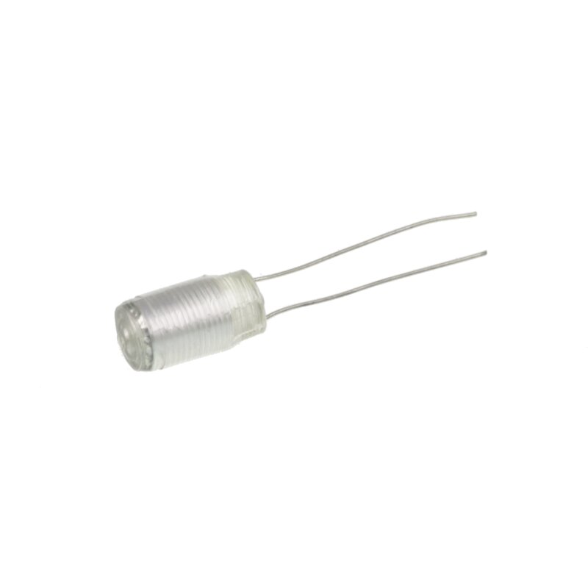
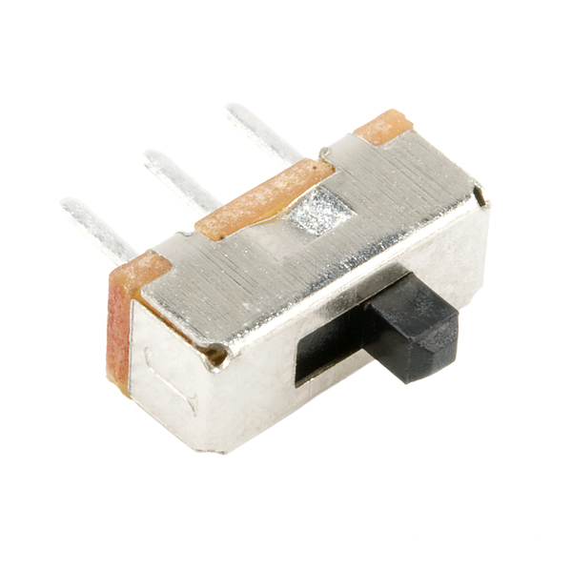
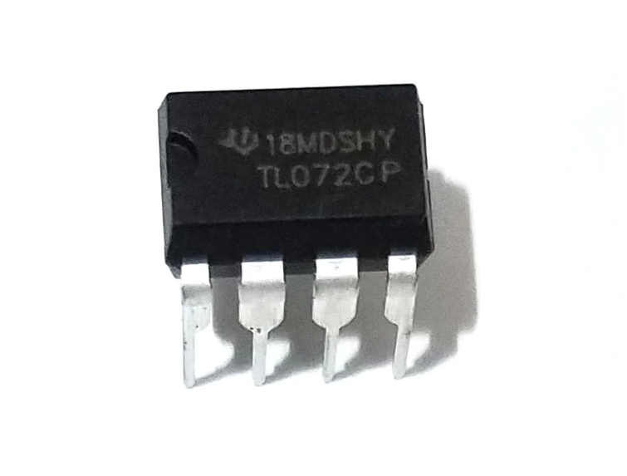
VCO Parts Used
Basic Ramp Wave VCO
AS3340
Breadboard and jumper wire
Various resistors
10K multi-turn trim pot
100K potentiometer
Various ceramic capacitors
1000pF capacitor polystyrene
Components for fine tune control
3.3M resistor
100K potentiometer
Components for pulse width control and modulation
Various resistors
Various ceramic capacitors
100K linear pot x 2
TL072 Op amp
Components for wave forms and output level
Various resistors
Slide switch x 3
100K potentiometer
Notes:
The VCO uses several unique components to the synth. Most importantly being the AS3340, linear potentiometers to control the pitch, and PWM, and switches to switch between different wavetypes. Polystyrene film capacitors were used on Pin 11 for its ideal temperature stability and longevity properties to ensure the VCO stays in-tune as long as possible. Other components involved include various ceramic capacitors, TL072s, and various resistors and capacitors.

Slide 14
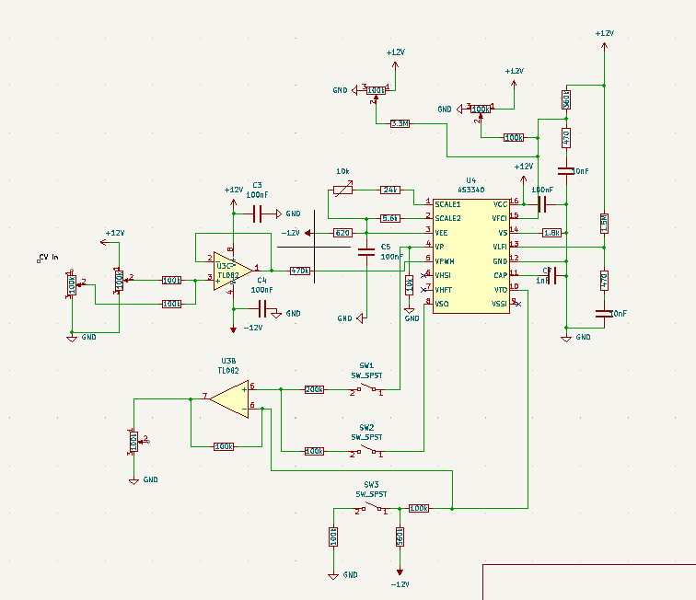
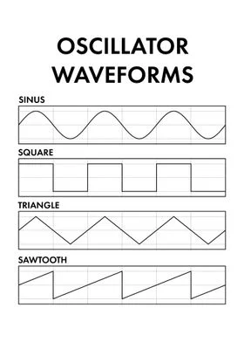
Voltage Controller Oscillator (VCO)
Heart of the analog synthesizer – the noise generator
Always ON and oscillating
Controlled by frequency (pitch), waveform (sawtooth, triangle, square, sine), and modulation (PWM)
Two VCOs
VCO with sawtooth, square, and triangle output
Notes:
The word oscillator itself means “something that goes back and forth.” The Voltage Controlled Oscillator is the heart of the synthesizer that uses incoming Control Voltage to control the pitch at which it oscillates and the user hears as a note. The oscillations speed correlate with a frequency that we as humans hear as an audible pitch and different notes on a piano. The design we have decided on for the VCO is based off of the reference design we mentioned earlier: the Sequential Circuits Prophet One along with studying the AS3340 datasheet connection diagram. Since this is a monophonic synthesizer, we only have one “voice” per IC. We hope to have two VCOs for richer fatter sounds. We have successfully scaled it to the popular 1v/oct standard by Moog such that doubling the frequency will take you up one octave on the scale. After a successful prototyping stage on breadboard, we will also be implementing pulse width modulation (PWM) on pin 5. So right now, this design will give us sawtooth, triangle waves, and square waves. We have switches to enable the user to switch between the three wavetypes and turn multiple on at once.

Slide 15
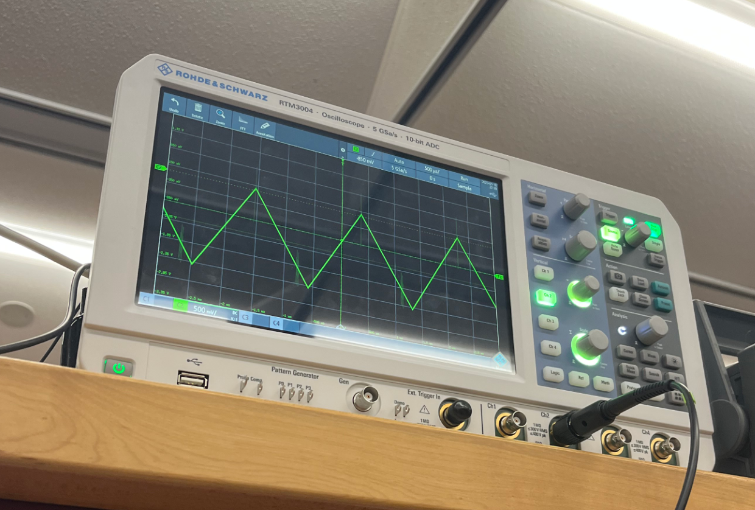
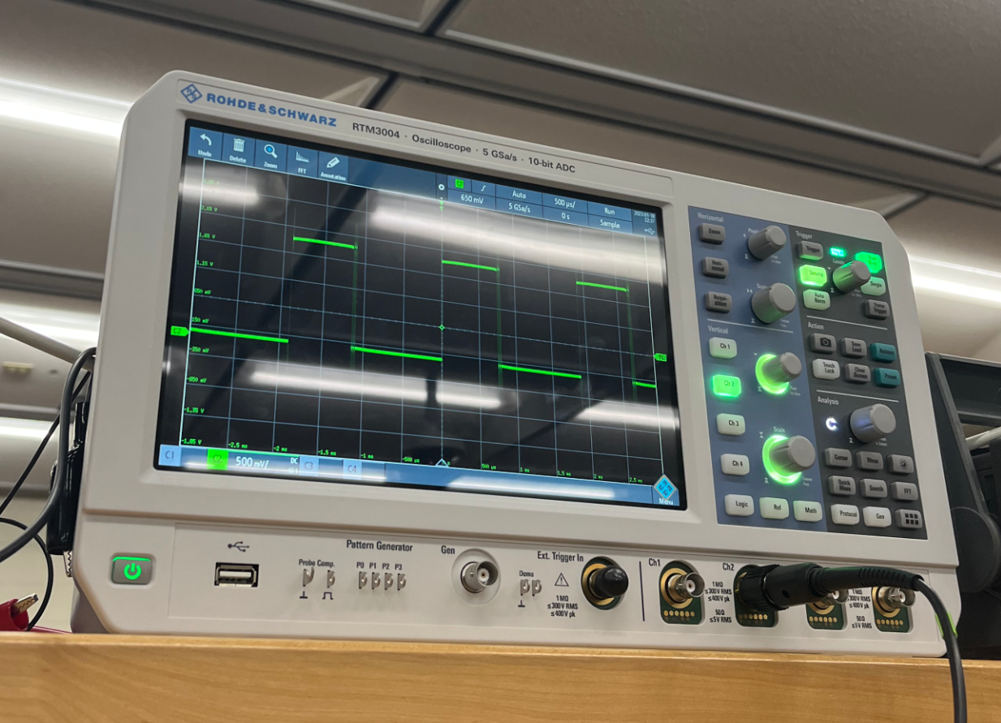
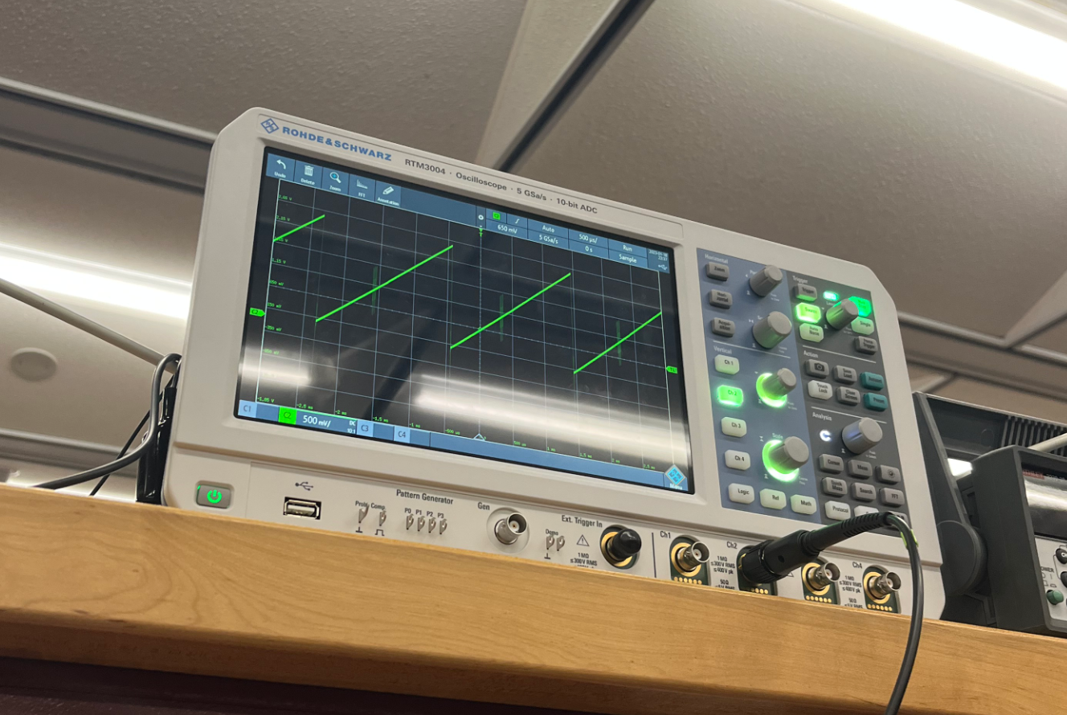
VCO Design Testing
Triangle Square Sawtooth
Notes:
Above you can see our successful testing of the VCO. We were able to achieve triangle, square, and sawtooth waveforms and switch between the wavetypes.

Slide 16
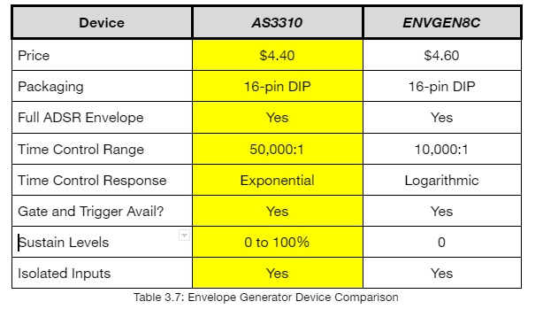
Envelope Generator:
Notes:
When doing research for the envelope generator, we continued comparing against the AS chip family. The SSI family did not offer an envelope generator so the only one we had as a contender for comparison was the ENVGEN8C from electricdruid.com. This is a website that sells electronic components for DIY synthesizers that decided to manufactur their own env gen. After comparing the two, the AS3310 continued to win as we favored its exponential response. We wanted an exponential response for the envelope generator

Slide 17
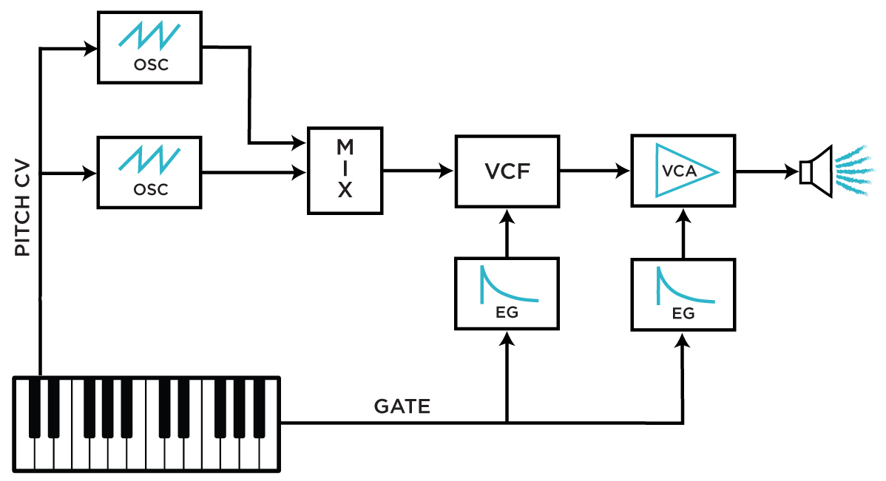
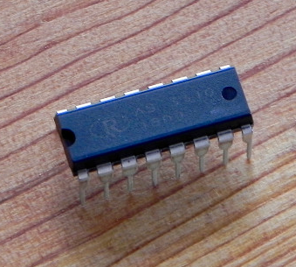
Envelope Generator Parts Used
Envelope Generator
AS3310 x 2
Breadboard and jumper wire
Various resistors
100k potentiometers x 8 (4 for VCA and 4 for VCF)
Notes:
The envelope generator uses less components than other modules. The most prevalent component was linear potentiometers. 8 were needed: 4 to control the VCF and 4 to control the VCA. Applying ADSR to the filter would allow you to exercise control over the cutoff frequency over time – making the sound more or less bright. Applying ADSR to the amplifier allows you to control the volume output generated by the oscillators. This allows the synthesist to create slow/fast attacks and long/short sustains and releases.

Slide 18
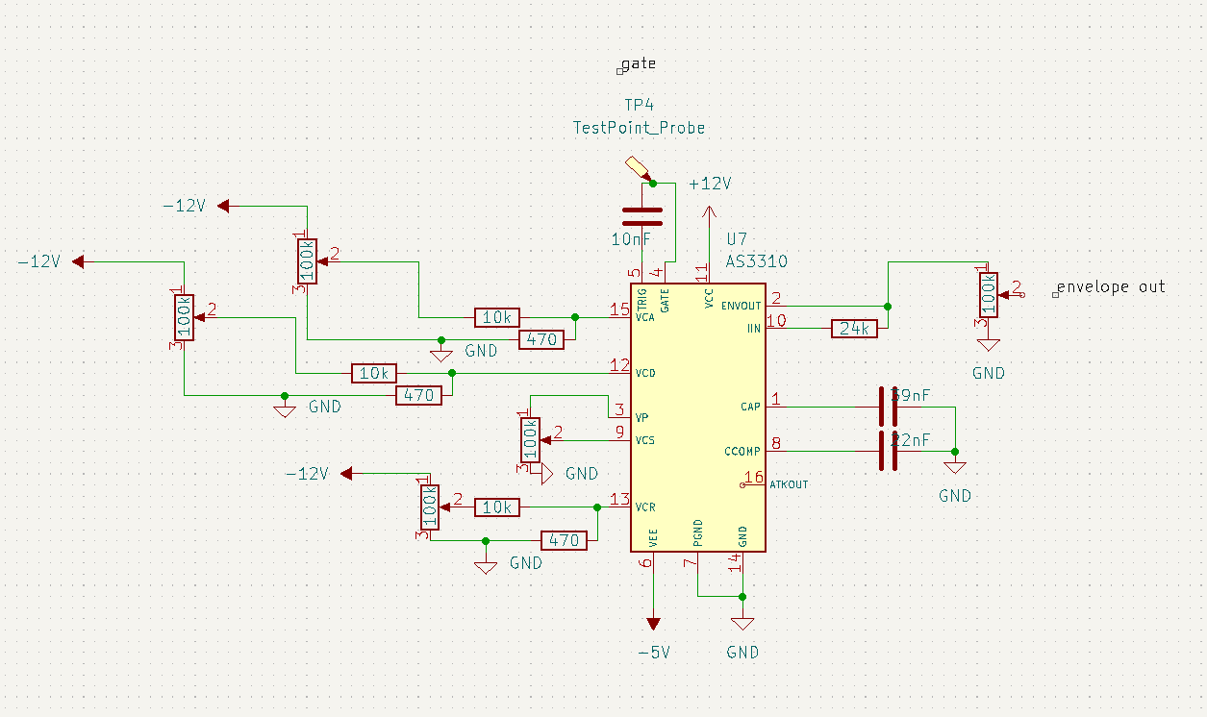
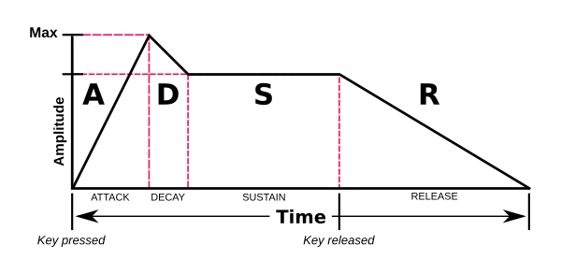
Envelope Generator
Envelope Generator also known as ADSR is a series of knobs providing set of voltages to control the sound envelope of each note
Attack
Decay
Sustain
Release
Notes:
The envelope generator is used for controlling the ADSR (attack sustain decay release) of each note. This allows the user to play and hear the synthesizer as if it were a normal piano – giving the ability to control each note by the amount of force they use when pressing and holding down each note. Attack controls how long it takes for the sound to reach its maximum or peak volume. Decay defines how quickly/slowly sound takes to decrease from its maximum volume to zero. Sustain sets a volume that the decay will drop to as long as the key is held down. Release takes action once the key is released and controls how long it takes the volume of the sound to drop from the sustain level to zero. Applying ADSR to the filter would allow you to exercise control over the cutoff frequency over time – making the sound more or less bright. Applying ADSR to the amplifier allows you to control the volume output generated by the oscillators. This allows the synthesist to create slow/fast attacks and long/short sustains and releases.

Slide 19
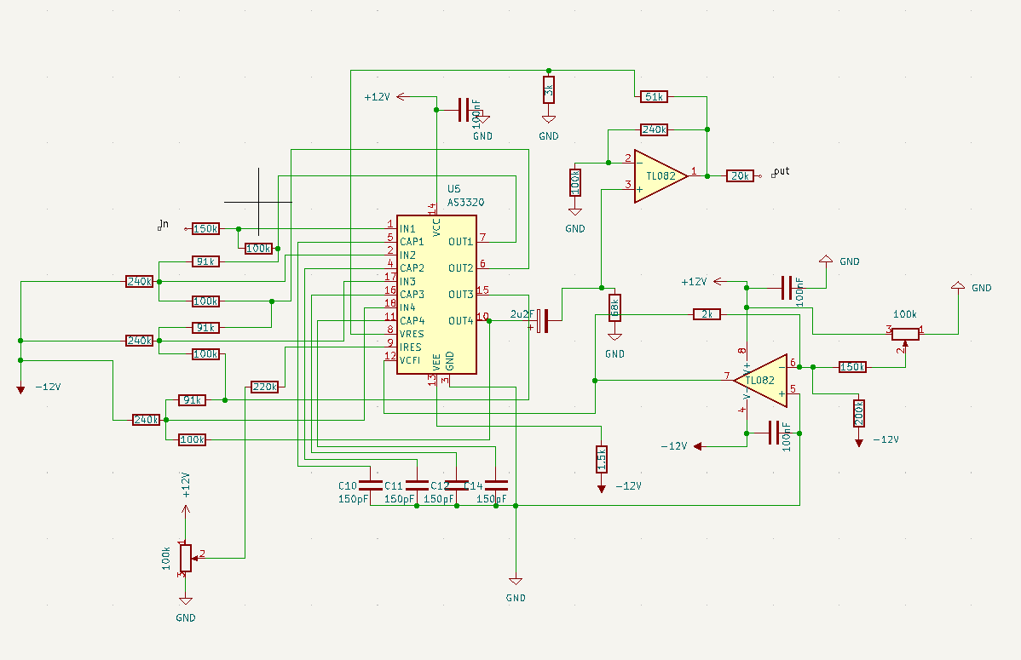
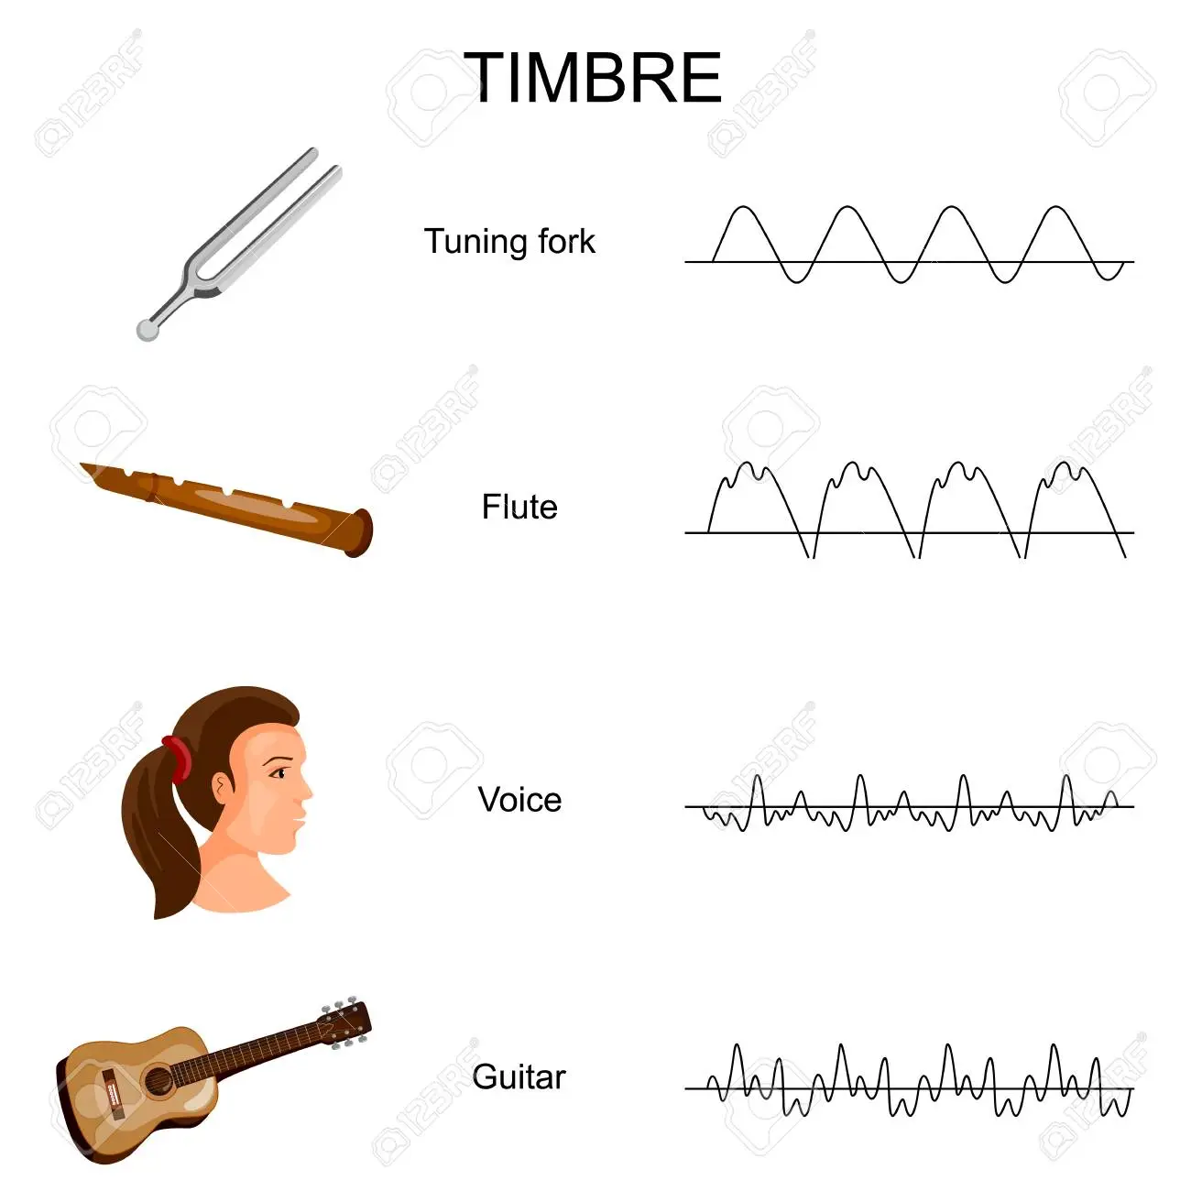
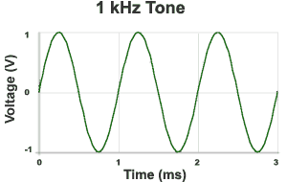
Voltage Controlled Filter (VCF)
The voltage-controlled filter is an essential part of the development of the synthesizer.
The waveform output from the VCO is used as the input for the VCF. Filtering allows the user to shape the waveforms timbre and tone by removing a range of frequency harmonics.
The two main parameters the user interacts with are: 1) Cutoff & 2) Resonance
Notes:
-Considerations such as having the VCO to the right scale, for example 1 volt/octave, is important. Filters are used to alter the harmonic content of signals coming from the VCO.
-Resonance, also known as Q factor, can be controlled to amplify harmonics at cutoff point on the frequency scale to intensify certain timbres.
Number that describes how underdamped an oscillating circuit is. A higher Q value means that the circuit or system has low damping and will ring or resonate for longer
Timbre: the character or quality of a musical sound or voice as distinct from its pitch and intensity.
Tone ~ Frequency

Slide 20
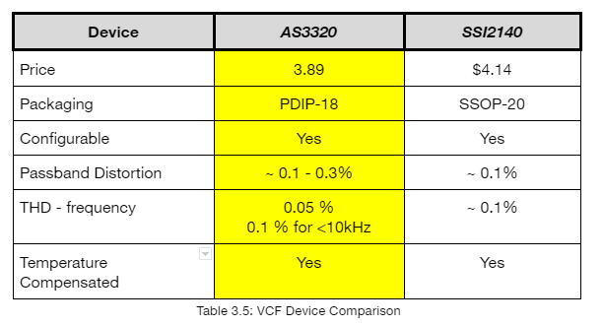
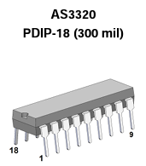
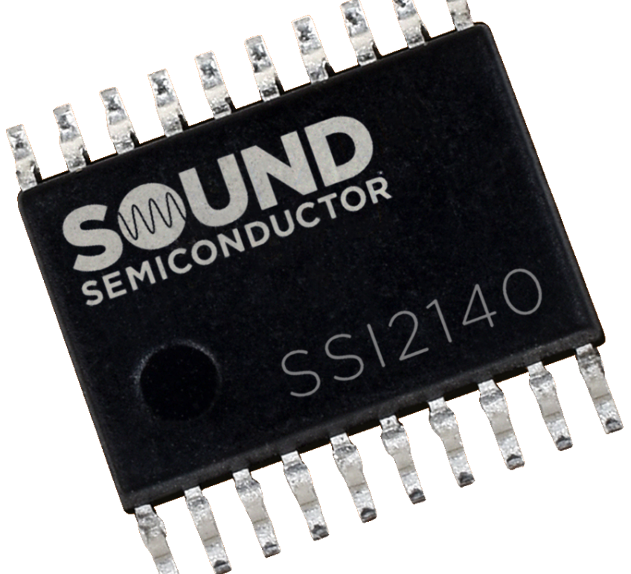
VCF IC Selection
AS3320 was more suitable because more configuration examples are present.
The performance is about the same for both however the pricing for AS3320 is 6% cheaper and comes in different types of packaging.
Notes:
Since the AS3320 presented more straightforward examples it was obvious to pick this since both IC’s share very similar specifications. It also made more sense to pick AS3320 since it comes in through hole IC package unlike the SSI2140 which comes as a surface mount package which needs to be soldered. Since prototyping was done using breadboarding a PDIP package was preferred.

Slide 21
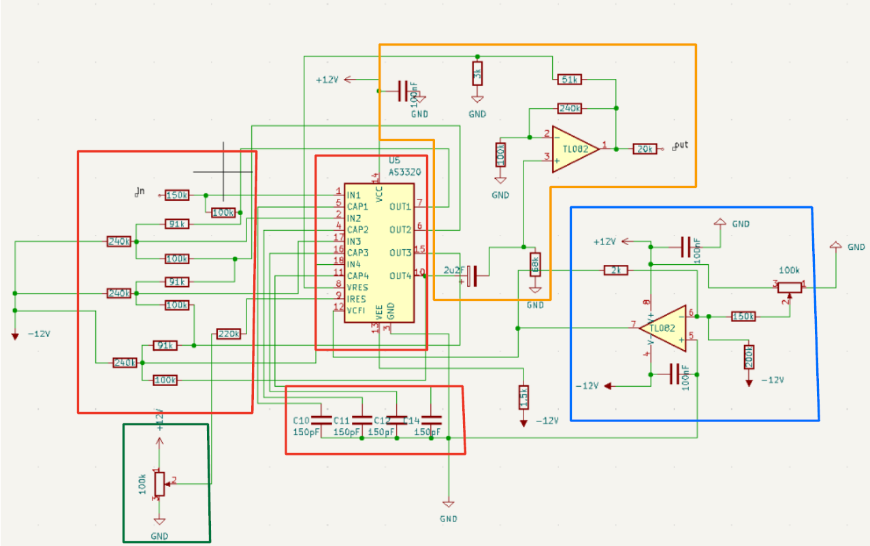
VCF Parts Used
Basic Building Block of VCF
AS3320
Negative & Positive Rails (Power Supply)
1.5k Current Limiting resistor for negative rail
Breadboard & Jumper Wires
240k, 91k, 100k & 150k Resistor
4x 150 pF Capacitors
Components for Cutoff Frequency Stage
1x TL082 Op-Amp
2k Resistor
100k Linear Potentiometer
x2 100nF Capacitors
150k Resistor
200k Resistor
Components of Resonance Control Stage
100k Linear Potentiometer
220k Resistor
Components for Output Stage
1x TL082 Op-Amp
1x 100 nF Capacitor
1x 2.2uF Polarized Capacitor
3k, 51k, 68k,100k, 240k & 20k Resistor
Notes:
The configuration assembled here is a lowpass filter configuration of the AS3320. Active Low Pass Filters are in audio amplifiers, equalizers or speaker systems to direct the lower frequency bass signals to the larger bass speakers or to reduce any high frequency noise or “hiss” type distortion.

Slide 22
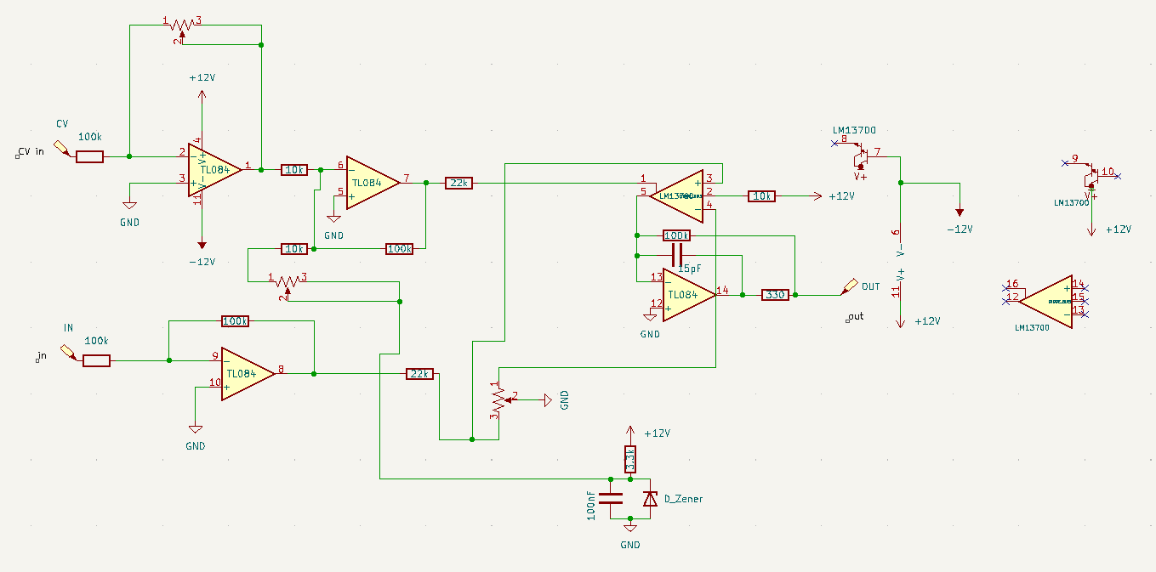
Voltage Controller Amplifier (VCA)
The VCA allows us to control the amplitude of the synthesizer’s signal sources by the means of of a modulating voltage. The modulation source here is of the envelope generator and the VCO.
Notes:
The upper side is the CV circuit and the lower side is for signal that the VCF outputs. These signals get combined in the LM13700
Pin1 of the LM13700 sets the maximum output current of the LM13700 and is used to limit the amplitude of the signal amplified by the LM13700.
Signal amplified by the LM13700 is in pin 3 p
-Amplifiers are what the user controls the loudness of the sound through a volume knob but in this case we decide to use preset potentiometers.
-The higher the input voltage fed through to the amplifier, the more signal can pass through, resulting in a higher volume heard by the listener

Slide 23
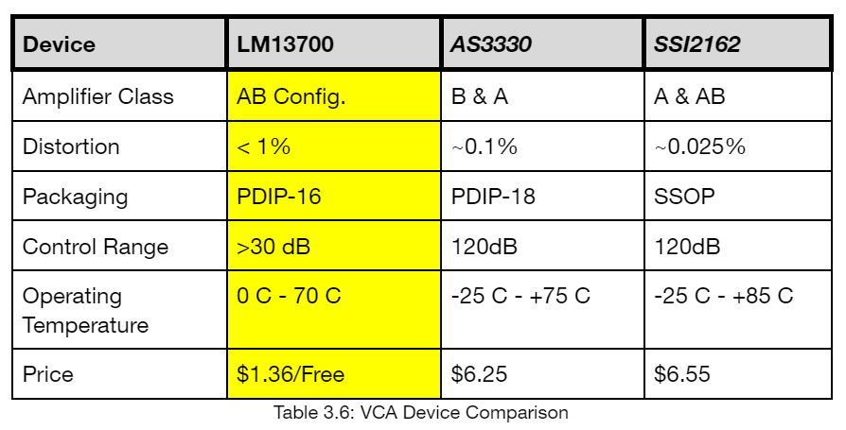
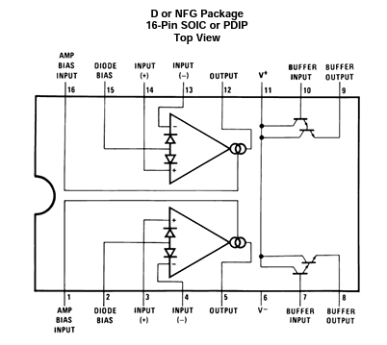
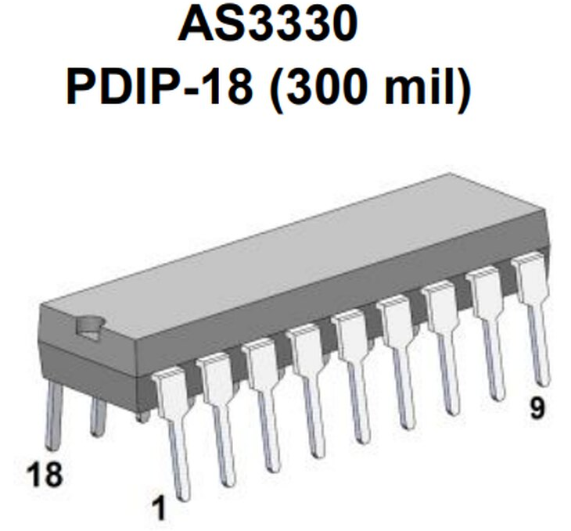
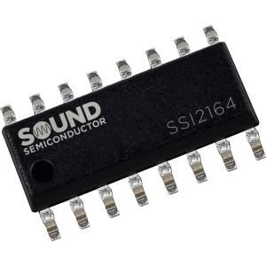
VCA Parts Selection:
Although AS3330 would be the best selection specs wise LM13700 were readily available.
Notes:
Using the LM13700 OTA as a would be consider it as a class AB Amplifier
LM13700 were readily available and even though the AS3330 is better spec wise

Slide 24
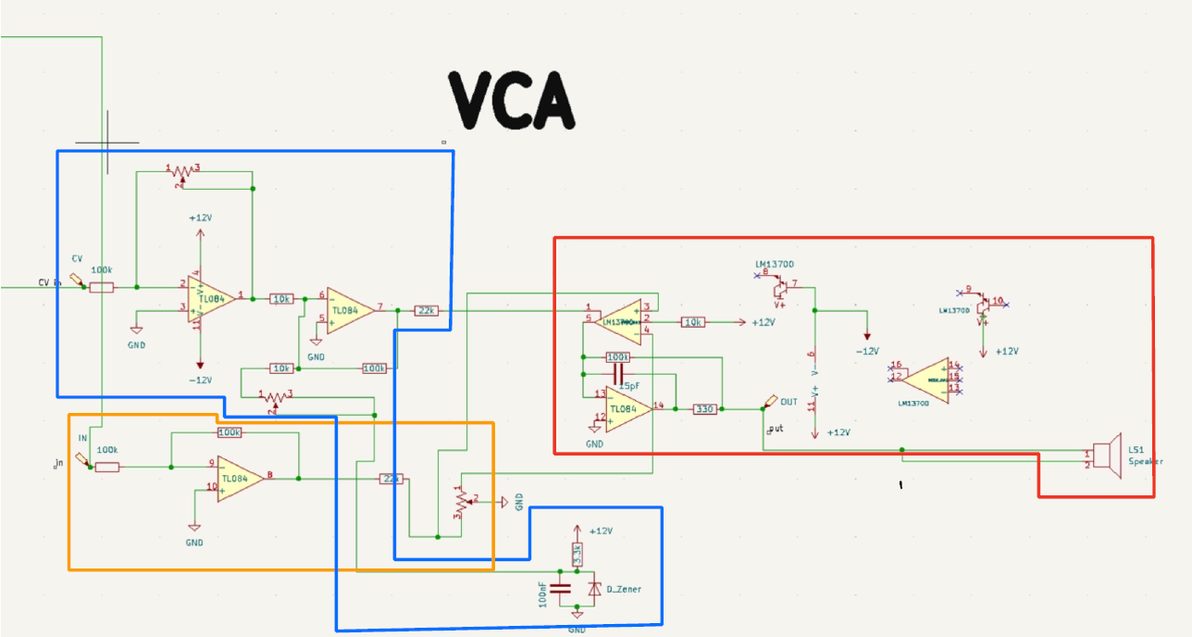
VCA Parts Used
Envelope Generator Stage
2x 100k Resistors
2x TL084 Op Amp
2x 10k Resistors
1x 22k Resistor
2x 50k Potentiometer
1x 3.3k Resistor
1x 100nF Capacitor
1x Zener
Signal Input Stage
2x 100k Resistors
1x TL084 Op Amp
1x 22k Resistor
1x 1k Potentiometer
Output Stage
1x LM13700
1x TL084 Op Amp
1x 10k Resistor
1x 100k Resistor
1x 330 Resistor
Notes:
For the VCA we decided to go with a vintage VCA with the LM13700
Both the envelope generator stage and Singal Input stage are combined at the Lm13700 (OTA)(Operational Transconductance Amplifier) which then is feed to the current to voltage stage which in other words gives an output voltage which depends on the input current and the feedback resistor. This feedback resistor stays the same but say if we were to increase the feedback resistor then we would notice our output voltage go up. It’s similar to the inverting op amp where increase the feedback resistor would increase the gain.

Slide 25
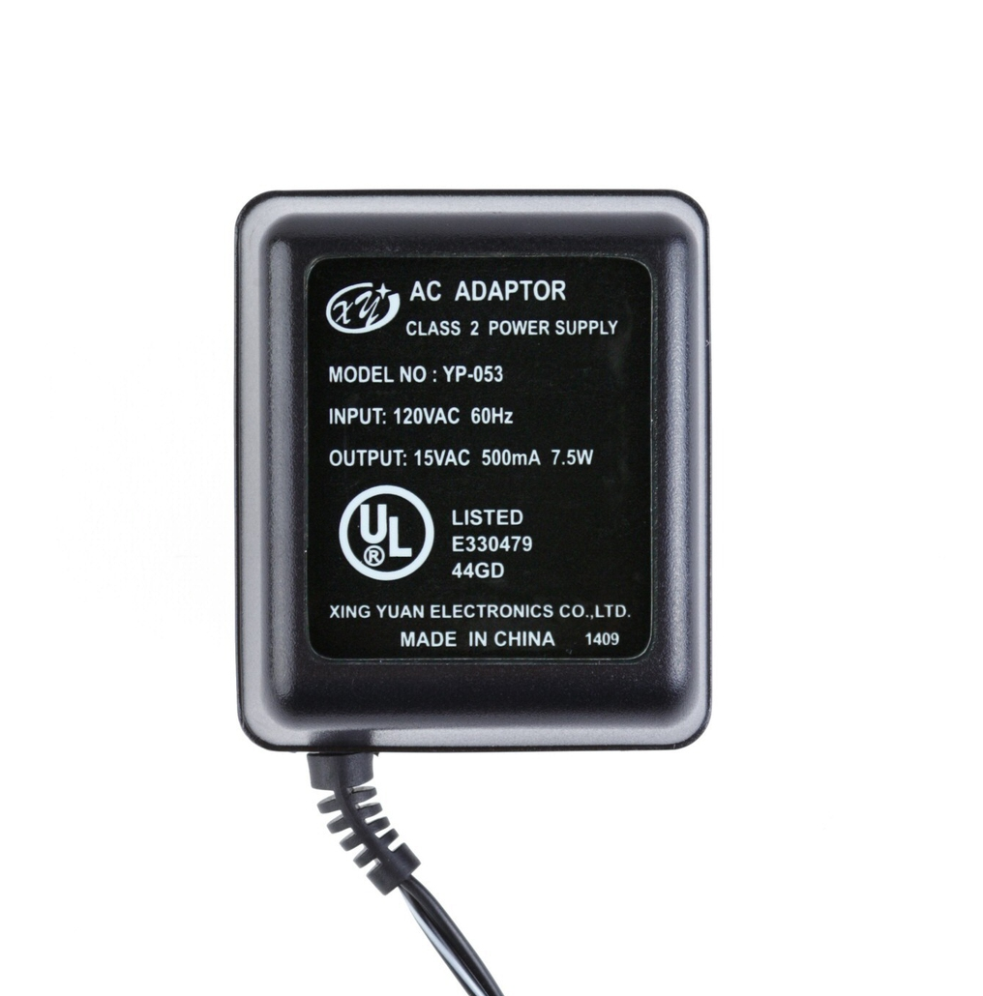
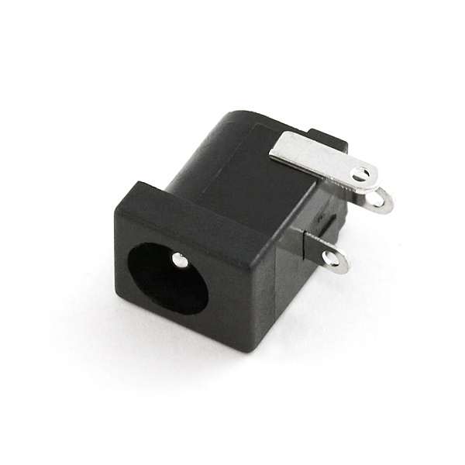
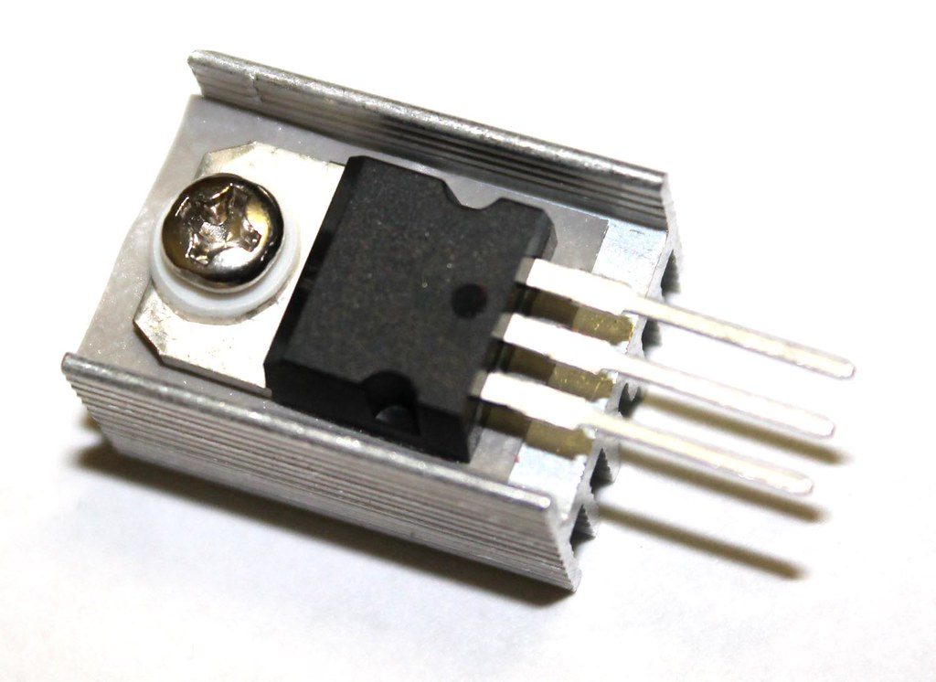
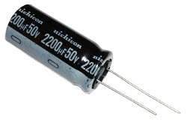
Power Supply Parts Used
Components for AC Input
US (110-120V) 15VAC Power Adapter
DC Power Barrel Jack
Half Wave Rectification
LM317T Voltage Regulator
LM337 Voltage Regulator
Heat syncs
Ceramic capacitors
Various electrolytic capacitors
Various resistors
5k trimmer resistors x 2
1N4007 rectifier diodes
Notes:
We used an AC to AC output to avoid wiring to the mains on a central tap transformer. The one we chose is an AC to AC wall wart designed to take in 120VAC from the wall and step down to 15VAC. The choice for the voltage regulators are the LM317 since it is positively polarized to regulate the positive voltage and LM337 is negatively polarized to regulate the negative voltage. They have the same specifications: voltage ranging from 1.2-37V and 1.5A but just opposite polarities for a dual +/-12V output.

Slide 26
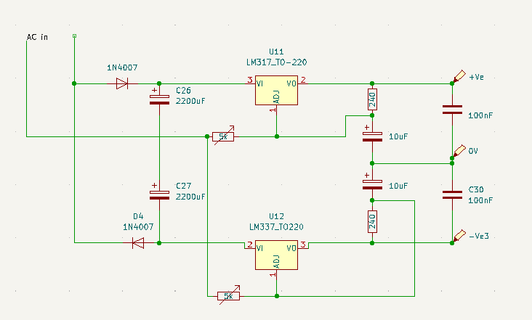
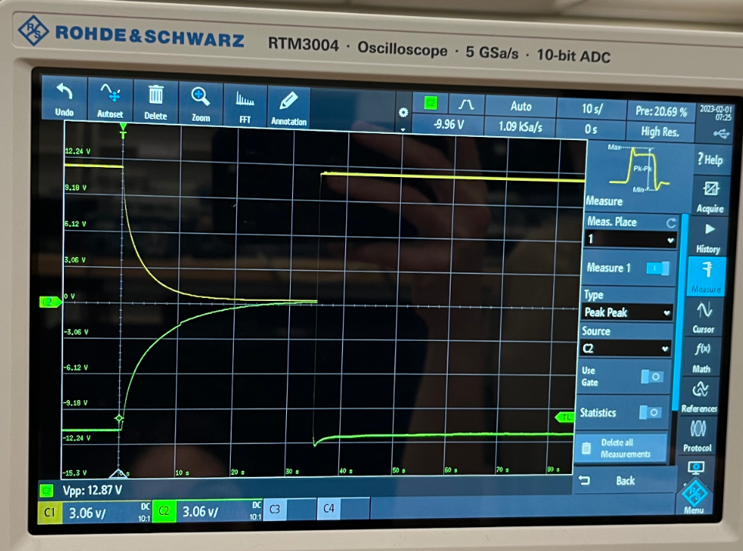
Power Supply
Dual output supply
+/-12V for audio applications and surrounding circuitry
Integrated circuits
Op amps
Notes:
This is our power supply design that takes 120VAC in and steps it down to 15V where it feeds to the rectification diodes help us convert to DC and the ripple is filtered out with the 2200uF electrolytic capacitors and and oppositely polarized linear voltage regulators to regulate our outputs at +/-12V despite our input voltage and this is further adjusted with 2 trimmer resistors to deliver both outputs. A dual linear output power supply is typically used for audio applications since linear regulators have great rejection of AC line ripple and tend to be less noisy than a Switched Mode Power Supply.

Slide 27
MIDI-to-CV Conversion
MIDI is a standardization of digitizing musical instruments.
MIDI works by transmitting a digital signal that represents a sound or a note. This signal contains information about the note such as how loud it is, when it plays, its pitch, among other things.
Control Voltages (CV) are the “opposite” of MIDI, they are analog signals. CVs control voltages sent by adjusting the amount of voltage that is allowed to pass through. These restriction allows CVs to adjust the pitch and amplitude of the signals to adjust their sound.
Notes:
MENTION why a converter is needed, how it works. Being able to convert from a MIDI to analog signal is crucial to being able to use this synthesizer with modern technology.
MIDI - musician instrument digital interface

Slide 28
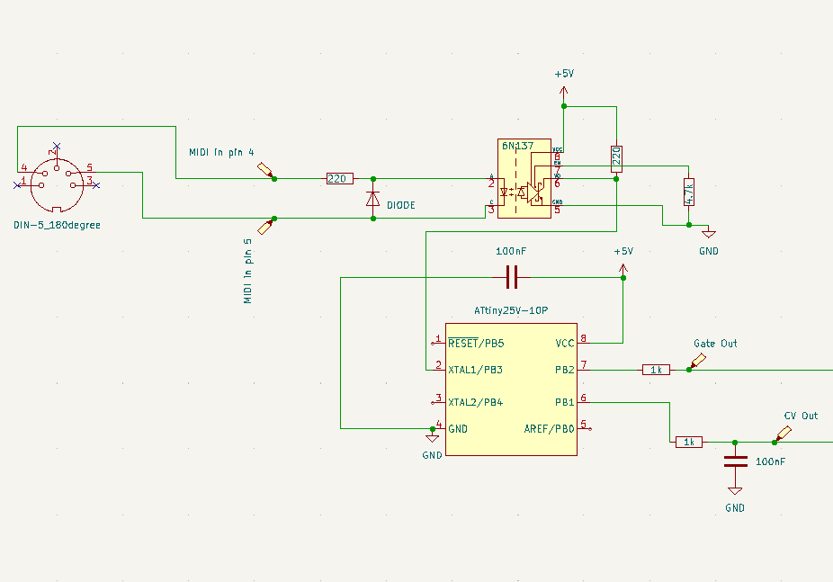
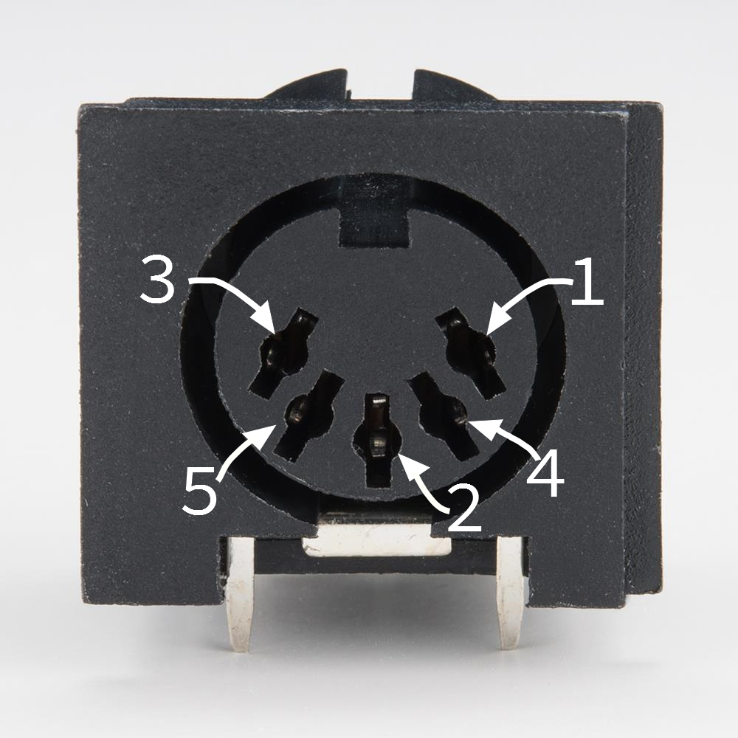
MIDI-to-CV Conversion Schematics + Parts
Parts:
Diode 1N4148
Optocoupler 6N137
ATtiny85 MCU
5-pin DIN socket
Various resistors and capacitors
5-pin DIN
Notes:
MENTION: Why did we choose to use an ATTINY85 over arduino? Cheapest option and very simple to code and use. Reliable and replicability.
Could have purchased pre-fabricated MIDI-to-CV converter, preferred this due to cost

Slide 29
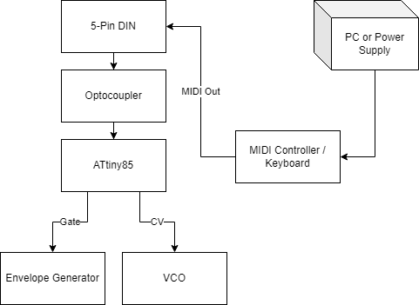
MIDI-to-CV Conversion
The device will accept MIDI messages. It outputs CVs for the synthesizer to use
The device allows the MIDI to control the synthesizer despite not having dedicated MIDI interfaces on the synth
The most basic type of MIDI-CV converter will accept MIDI note on and note off messages, and will then produce two outputs: a control voltage and a gate signal.

Slide 30
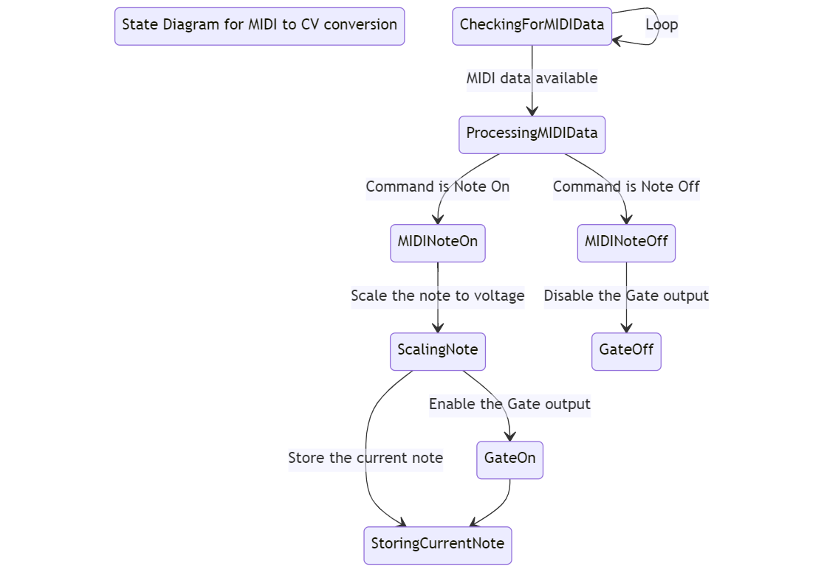
MIDI to CV Software Flow Diagram

Slide 31
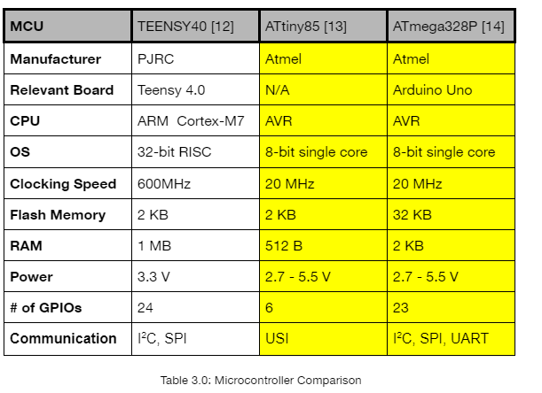
MCU Selection
What is the scope of the instrument?
Simple modular system for simple sounds? Huge polyphonic system for orchestral sounds?
What waveform models do we want to use?
Wavetable? Vintage FM? Additive? The synthesis model we choose will heavily inform the choice of the processor we should use
What additional functional support for I/O do we want?
All formats and outputs should be taken into consideration. Are the communities for these formats and outputs supportive enough or has enough resources such that if we run into an issue we can move forward?

Slide 32
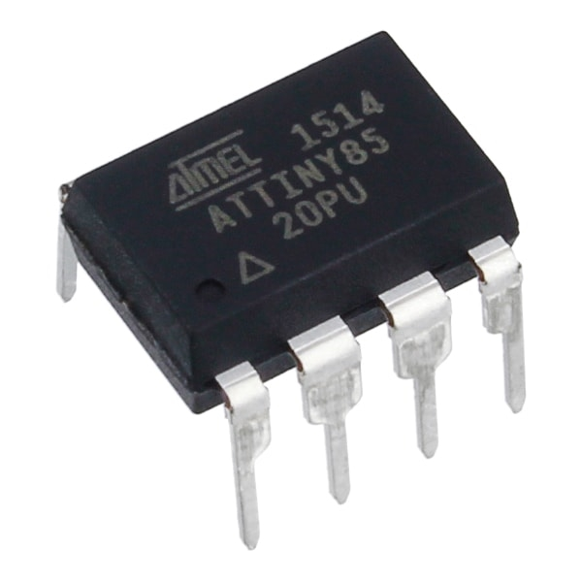
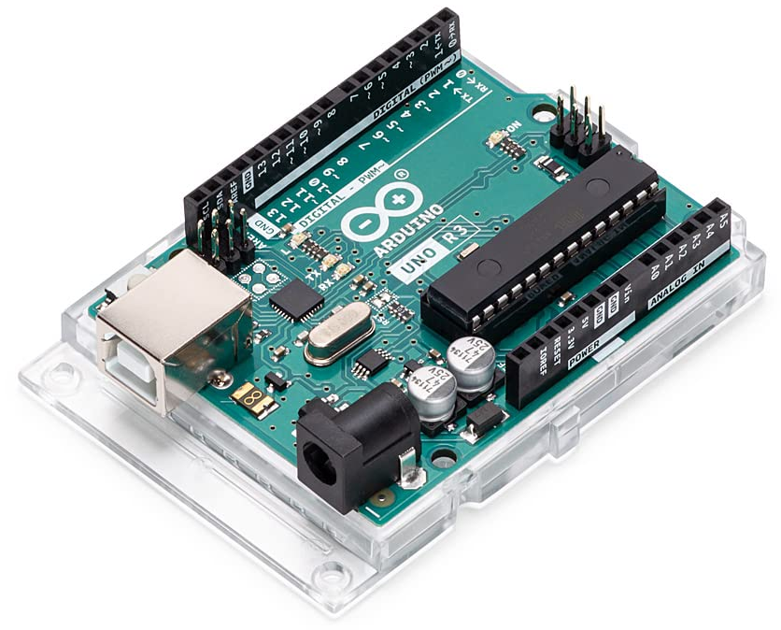
MCU Selection
ATtiny85
Standalone
Programmable with USBasp
Low power (uses 3.3V-5V, overall device will use 5V)
Programmed to recognize MIDI input
ATmega328P
Integrated with Arduino Uno
Helps program ATtiny85
Board comes with extra I/O pins, helpful for breadboard development

Slide 33
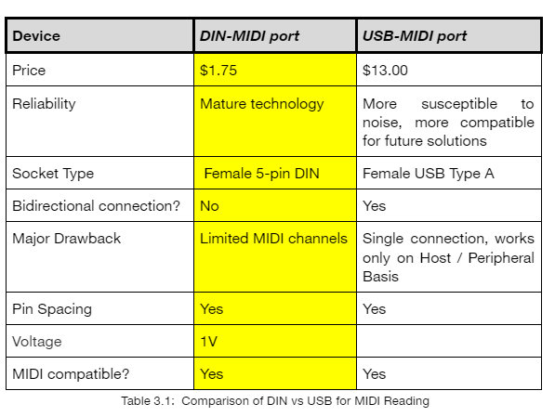
MIDI Port vs 5-pin DIN Connector
MIDI is a universally recognized and used format and 5-pin DINs are capable of reading MIDI input. Thus any MIDI compatible device can interface.
We chose DIN-MIDI because it is the original standard, it is easier to implement, cheaper, and since we only need a unidirectional connection it made the most sense to choose it.

Slide 34
Software Integration
We can read and understand the MIDI data, but how do we view this?
One of our stretch goals was to implement a working display on a graphic user interface (GUI) based on user inputs. This design can be integrated through a simple process using a Java based tech stack and a simple USB connection from our MIDI controller.
Libraries exist within Java for this purpose such as the MIDIx library.
The lines would represent dynamically changing (real-time) parameters such as bpm, pitch, etc.
Notes:
After we finish integrating our project into its hybrid form and can take in digital data, we wanted to take it a step further and intergrate a visual GUI to better immerse the experience for the user. Throughout our research phase we found that Java documentation made room for grabbing MIDI data directly through it’s APIs with a simple USB connection. The entire music library they have integrated will make it much easier for us to grab the specific data we need from our design.

Slide 35
Project Success and Difficulties:
Successes:
VCO testing works
MIDI-to-CV converter works
Full stack team can help out on both electrical and computer engineering issues that rise
Meeting all deadlines so far
Difficulties:
Power supply blowing UP
Parts not coming in on time (“3-day” shipping)
Issues with multiple keyboards

Slide 36
Budget:
Description | Name | Quantity | Price (Est)
Hardware | VCO | 2 | $8.00
Hardware | VCA | 1 | $10.00
Hardware | VCF | 1 | $11.65
Hardware | Power Supply | 1 | $30.00
Hardware | MIDI Converter | 1 | $16.00
Hardware | Keyboard | 2 | $58.00
Travel Expense | Shipping | - | $23.00
Hardware | Custom PCB | 1-3 | $30.00
Hardware | AR envelope generator | 1 | $6.31
Hardware | Enclosure | 1 | $25.00
 | Miscellaneous |  | $22.00
 | Total |  | $240
Notes:
Our initial budget predictions were far higher than what our team ended up spending so far as we decided to build our own MIDI to CV converter from scratch rather than buying one which saved a lot of money. Most of our hardware remained within budget and the main issue we had was reordering parts that blew up, weren’t breadboard mountable, or did not work at predicted. The keyboard was our highest purchase so far and it was necessary to purchase as we couldn’t find any to borrow that still had 5PIN midi out and in ports - they’re made for USB ports only now. We will try to stay within UCF services offered to save on enclosure costs and unexpected fees.

Slide 37
Progress:
Notes:
In this chart you will see our progress so far from the beginning of senior design. Throughout the project we have done a significant amount of research on the best practices and parts to use for a successful project. Our first initiative is nearing an end as almost all prototyping and parts are ordered and tested. Regarding testing and breadboarding most of the subsystems of our synthesizer are coming together and working appropriately, with a lot of trial and error. We are nearing the end of the breadboarding phase and beginning to see the PCB creation come to life. We need to order the PCBs as soon as we can so we can also focus on our enclosure process, demoing and hopefully a few stretch goals. Overall our progress timeline is on track to complete by our deadlines.

Slide 38
Questions/Answers Portion

