Slide 1
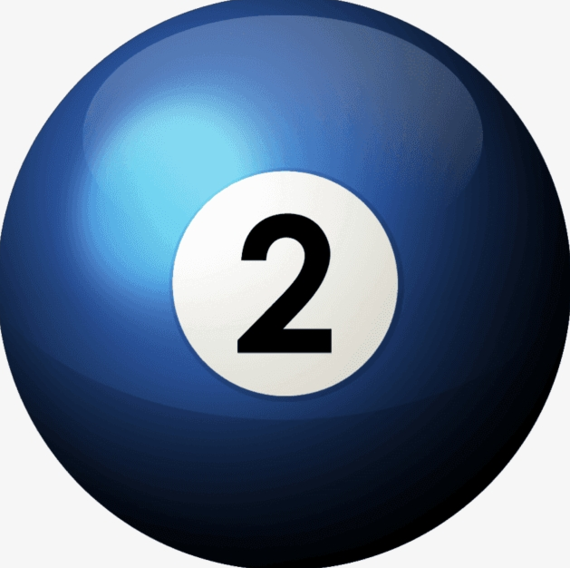
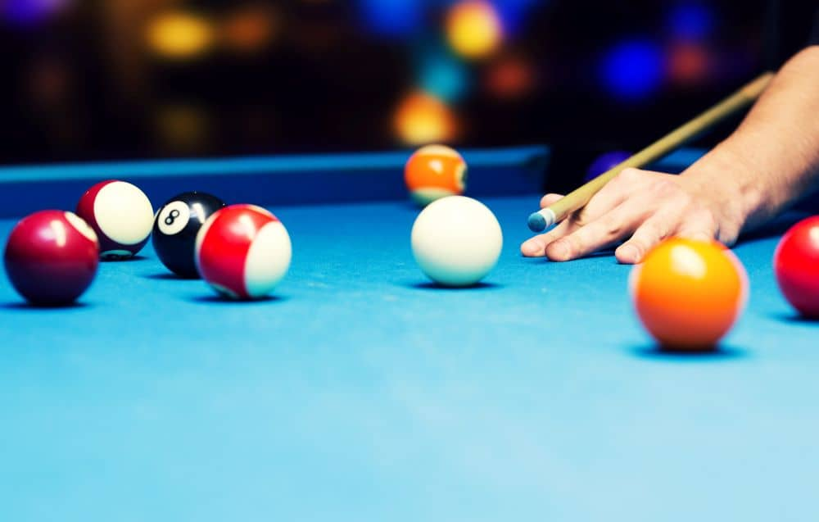


VISION
Visually Impaired Spatially Interactive Orientation Network

Slide 2

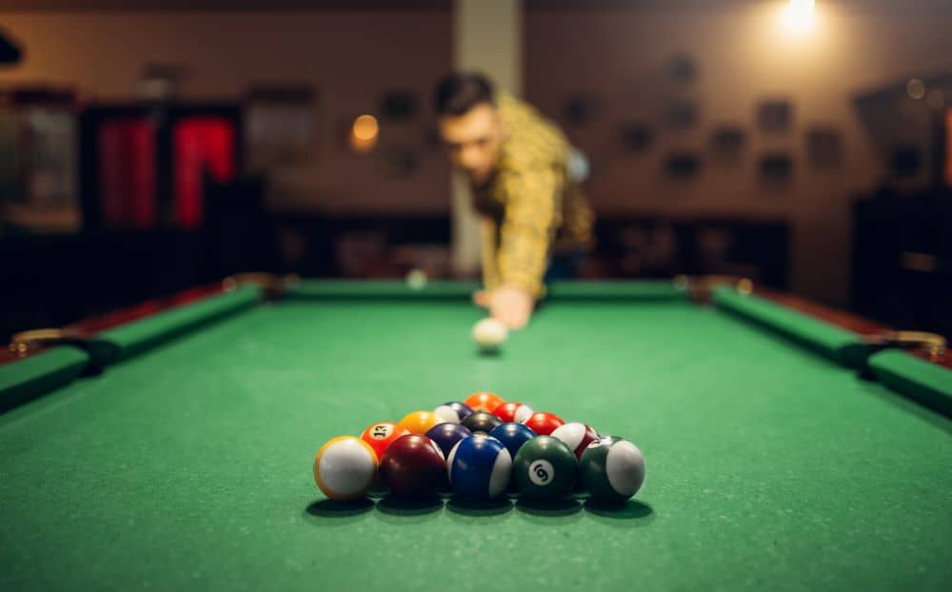

Introduction and Motivation
Bringing the love of billiards to the visually impaired!
POC between VISION and SCRATCH
Inspire future development of assistive technology
Two Senior Design Teams
VISION 🤝 SCRATCH
Table & User teams
Limiting Dependance

Slide 3
VISION
SCRATCH
Table focused
Coarse-grained details
Guide user around the table
Provide completed shot feedback
User focused
Fine-grained details
Execute the shot
Provide feedback after shot completion

Slide 4


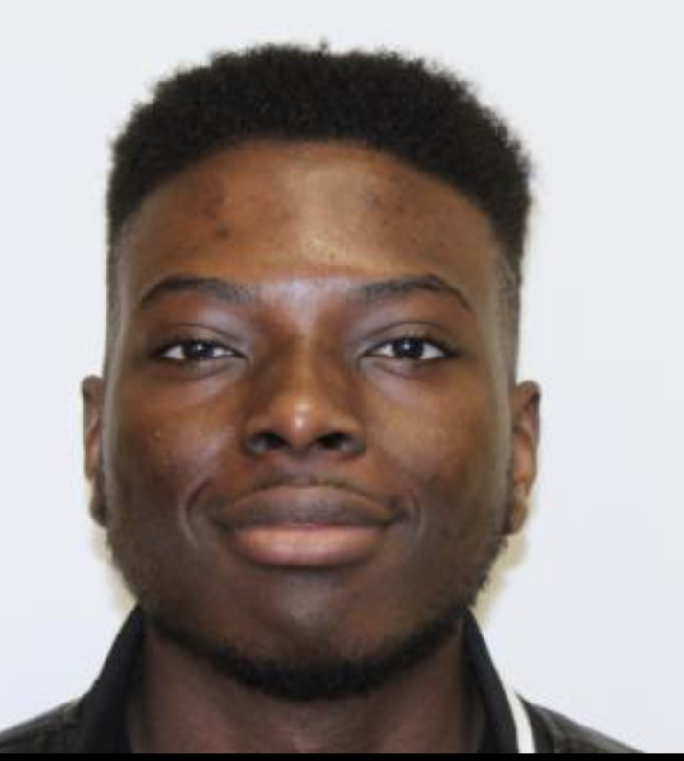

Group Members
E
Noah Harney
Computer Eng
Computer Vision
Aaron Crawford
Computer Eng
Artificial Intelligence
Arsene Landry Tatke
Electrical Eng
User Localization
Alexander Parady
Electrical Eng
User Guidance
Byron
Advisor: Dr. Chan

Slide 5
Goals and Objectives
Computer Vision (CV)
  Goals:
    Detect billiard balls and determine their position and color
    Determine the outcome of a user’s shot
  Objectives:
    Use a camera to capture the table state
    Mount the camera above the table facing downwards
    Keep track of game state to determine shot outcome
Artificial Intelligence (AI)
  Goals:
    Use CV data to model the game in an AI program
    Determine the best shot to take
      Where to stand, where to aim, and with how much force
  Objectives:
    Modify an existing pool AI to fit VISION’s needs
    Produce the (x,y) position of desired position, relative angle, and relative force needed

Slide 6
Goals and Objectives (Continued)
User Localization (Localization)
  Goals:
    Detect a user around the table and within a room
    Communicate location to the central program
  Objectives:
    Use beacons to determine user location
    Track the user with their phone
    Send user position from the phone to the central program with wireless communication
User Guidance (Guidance):
  Goals:
    Guide the user around the table with verbal signals/commands
    Do not overstimulate the player
    Avoid known obstacles for player safety
  Objectives:
    Use a speaker array and commands to guide the user
    Develop a guidance algorithm to avoid obstacles

Slide 7
Standards and Design Constraints
Standards
IEEE 802.11 (Wi-Fi)
IEEE 802.15 (Bluetooth)
UART
C/C++
Python
Computer Vision
Artificial Intelligence
Common Connections (HDMI, USB)
Constraints
User Safety
Cost Effective
Setup Location
Audio Sources
Audio Speed and Loudness

Slide 8
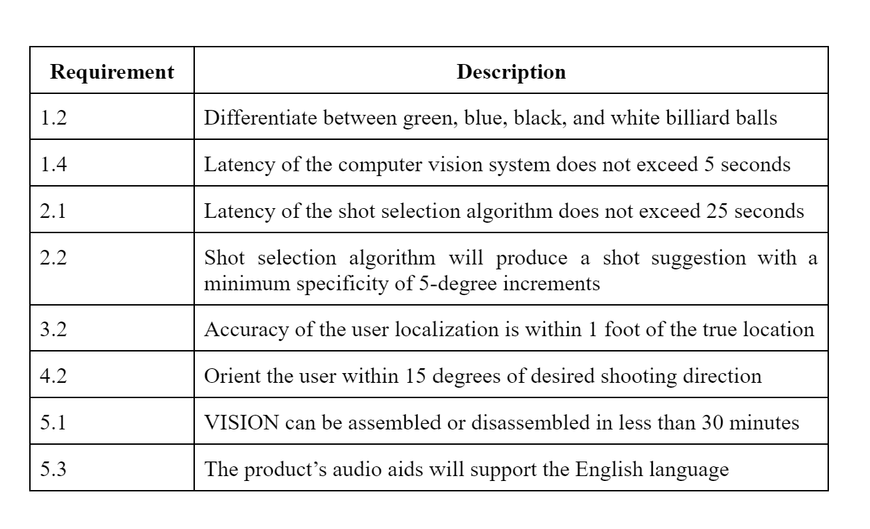
Selected Requirement Specifications

Slide 9
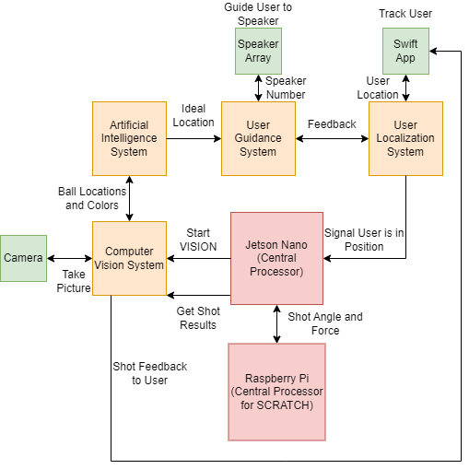
Overall System Diagram

Slide 10
Computer Vision Design and Components
Use a camera to detect the billiard balls on the table
Differentiate between the color of the billiard balls
Localize the billiard ball locations to the billiards table
Determine the outcome of a user’s shot
  Sank a game ball, sank the black ball, scratched, etc.

Slide 11
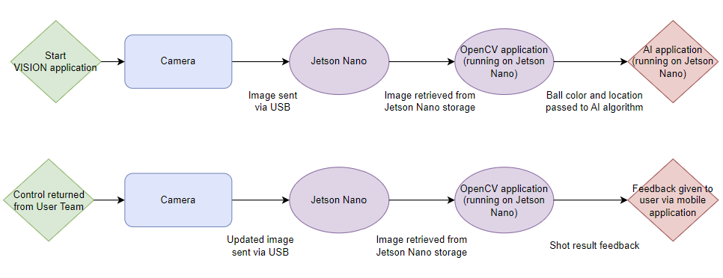
Computer Vision Design and Components
OpenCV for computer vision requirements for simplicity and Python support
  Considered TensorFlow, TensorFlow Lite, Nvidia VPI, YOLOv3, and Keras
Primarily using Hough Circle Transform, image manipulation, and filtering

Slide 12
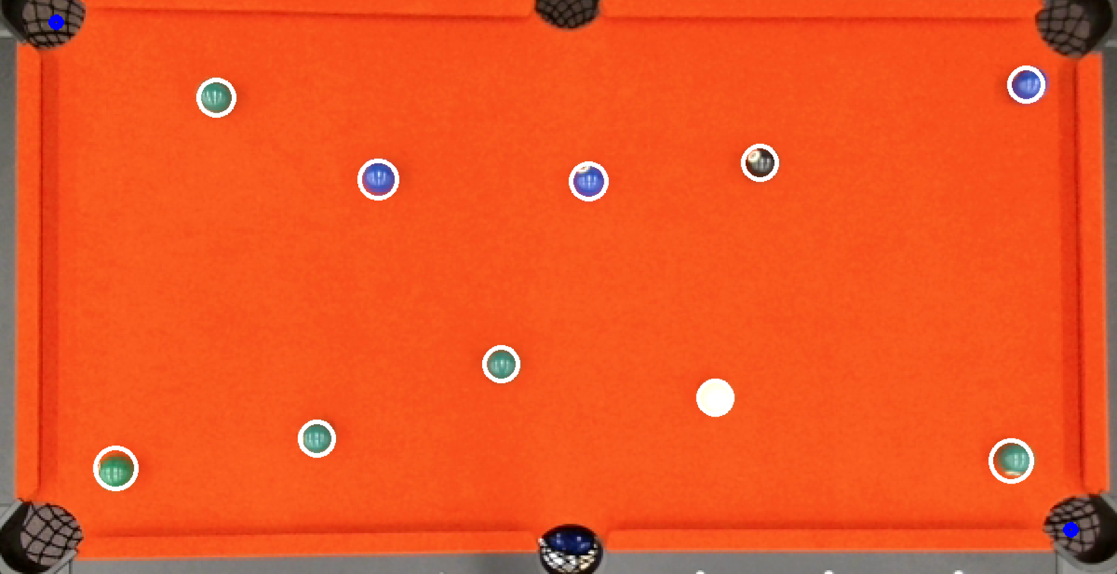
Computer Vision Design and Components

Slide 13
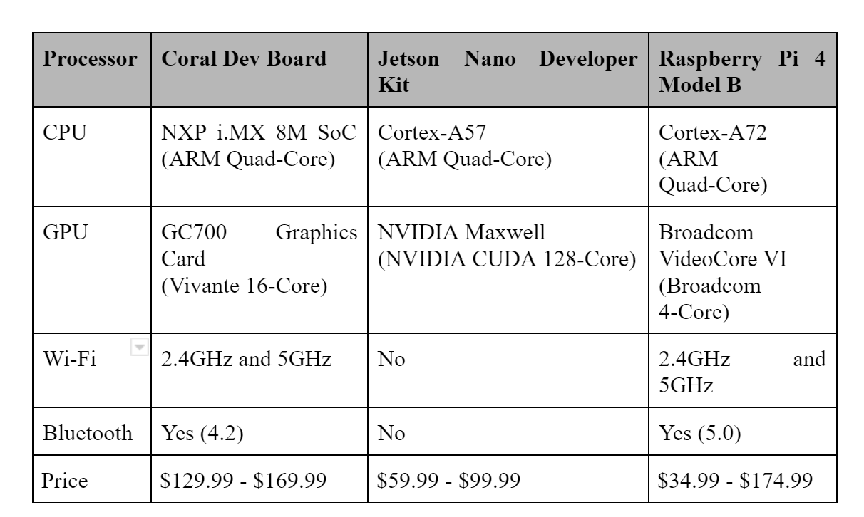
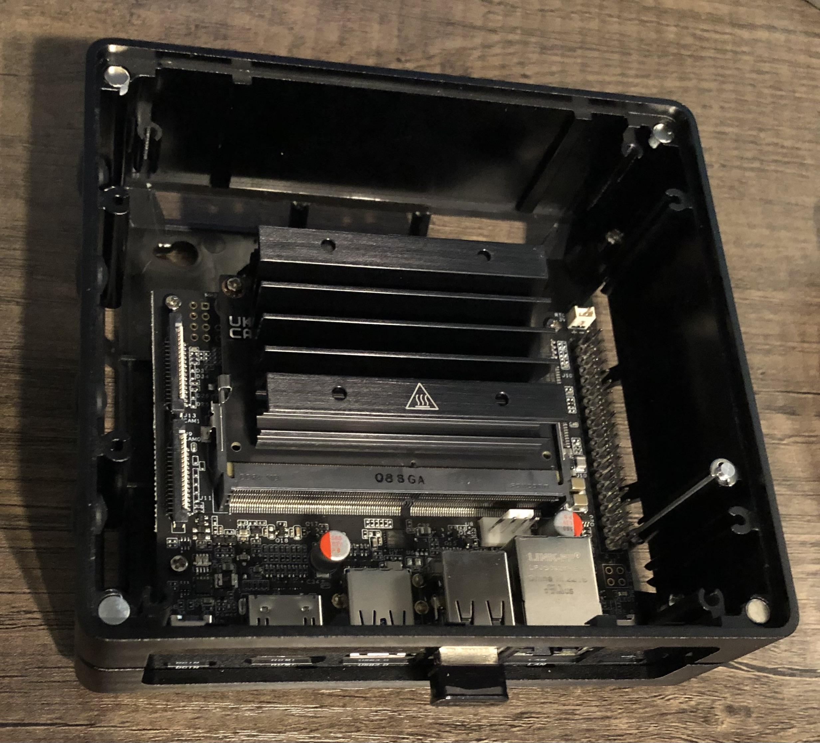
Computer Vision Design and Components
CV and AI require powerful processor
Selection based upon general performance, price, and availability (left table)
  Difficulty securing a Jetson Nano Kit (ordered a 3rd party kit from China) (right image)
  Broken GPIO configuration driver from supplier

Slide 14
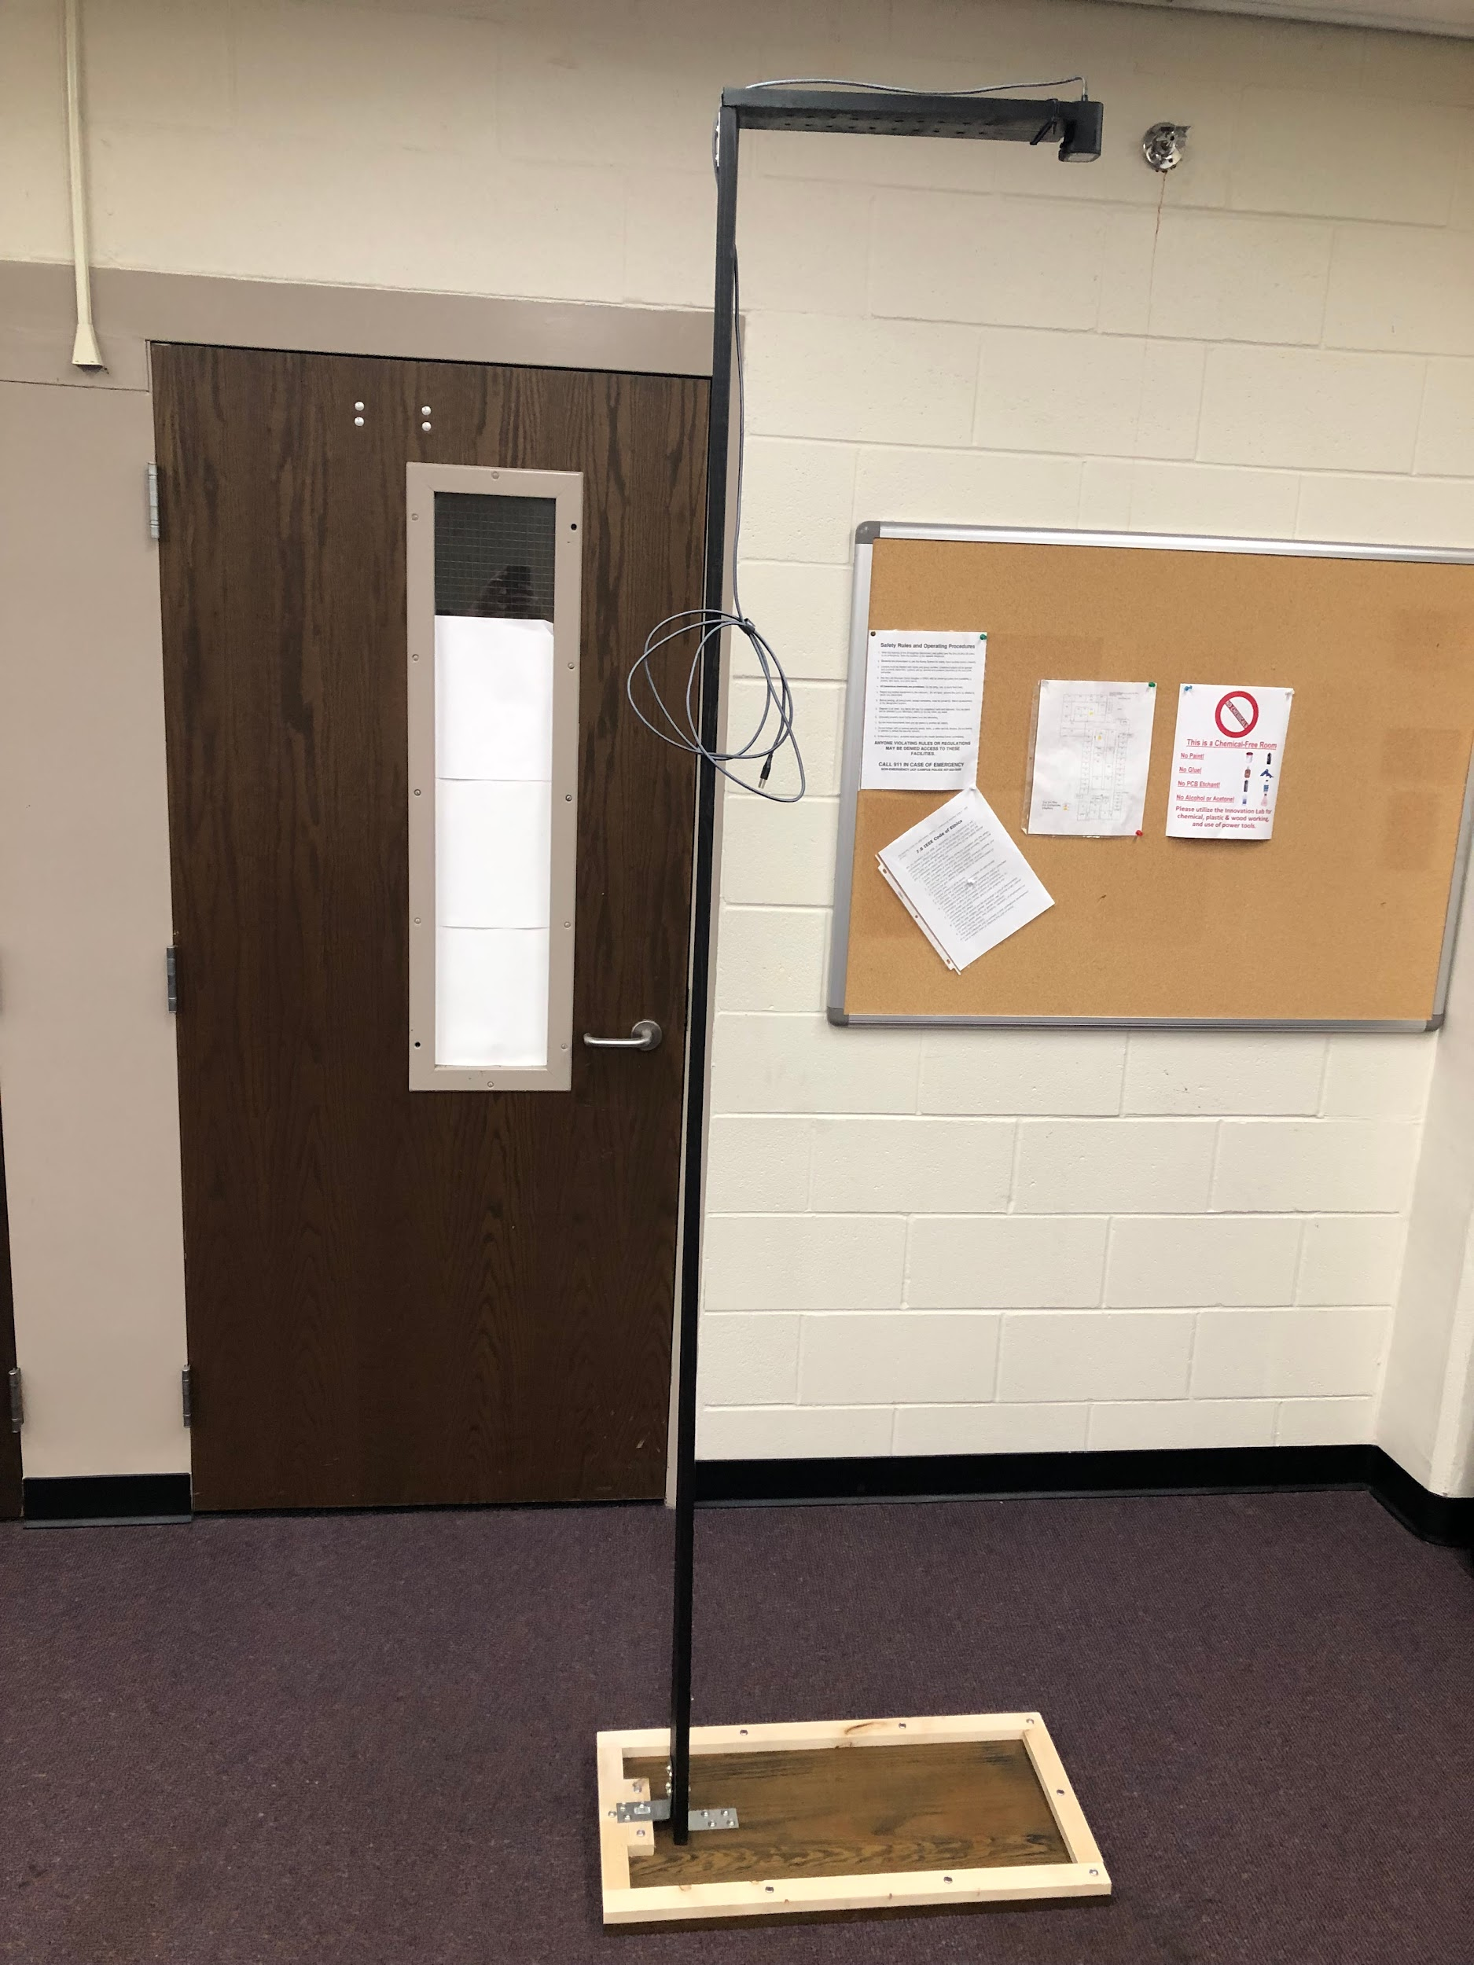
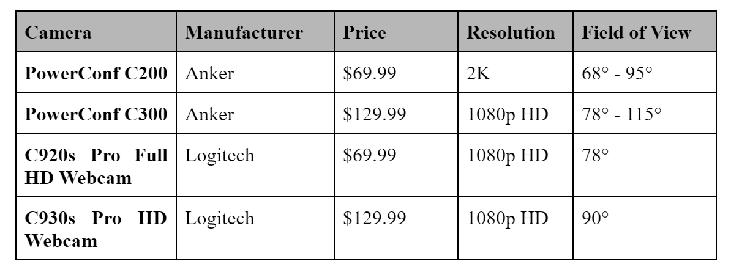
Computer Vision Design and Components
Camera selected based on widest field of view and price (left table)
Camera mounting based on movability (right image)

Slide 15
Computer Vision Design and Components
Hough Circle Transform
  Filter by radius and location and color
    Camera glare is an issue (sample many points)
Determine shot outcome by comparing game state before and after a player’s shot
  Game state consists of billiard balls colors and locations
Successfully locate and determine color of balls reliably
Successfully determine the outcome of a shot given two game states

Slide 16
Shot Selection AI design and components
The goal of this algorithm is determine a realistic shot and output the angle and force to achieve this shot
Input:
  Computer Vision: List of ball coordinates
Output:
  SCRATCH Team: Force and relative angle to hit the cue ball
  Guidance System: Perimeter location and wall number

Slide 17
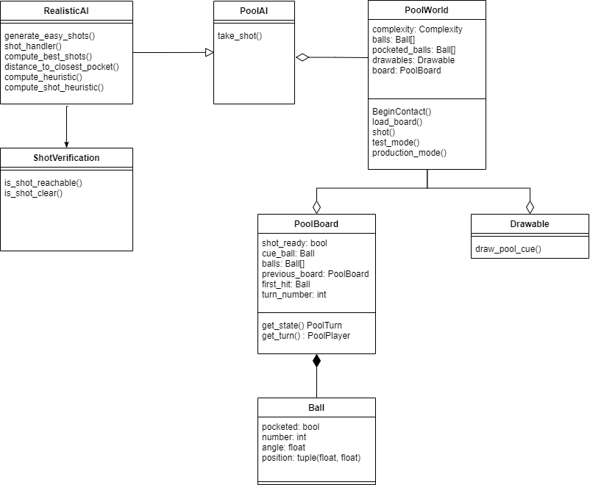
Shot Selection Class Diagram

Slide 18
Shot Selection AI Requirements
Requirements
Algorithm produces output in under 25 seconds
Algorithm produces shots in which the end of a 3 to 4 foot pool cue will not intersect with the dimensions of the table
Ensure that 7.5 degrees in each direction degrees from the shot angle to the table is clear of any balls

Slide 19
Shot Selection AI Design Decisions
Chose a heuristic based AI as opposed to machine learning
Existing project “Pool Genius” was a good base for our AI
Simulates many different shots and assigns each one a score
Shot with the best score is chosen

Slide 20
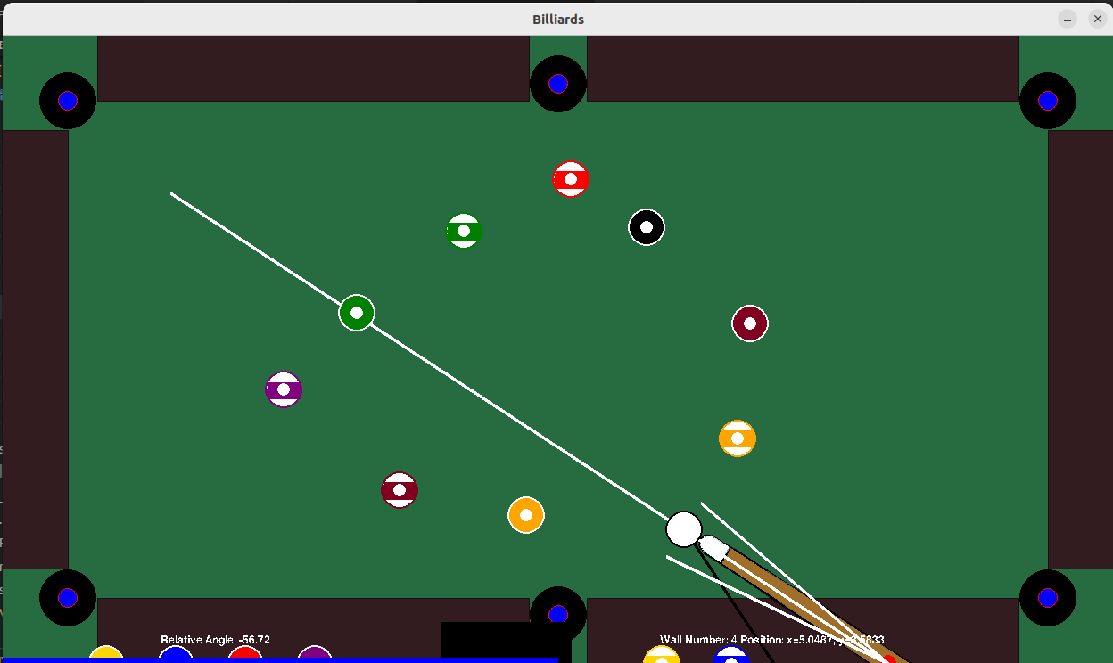
Visual Representation of Shot Selection
Calculates
Relative
angle of shot and force
Wall number and
location along
perimeter
Ensures
User can reach shot
Cue stick has 7.5 degrees of mobility in each direction

Slide 21
Complexity AI
Goal is to limit complexity, lower score is better
Keep track of variables that can measure complexity
A = total collisions
B = distance of cue ball before first contact
C = cue ball collisions with table before first contact
D = list of total collisions per pocketed ball
E = list of total wall collisions per pocketed ball
F = list of total distance traveled per ball
A + B + squared(C) + sum(D) + sum of squares(E) + sum of squares(F)
Each variable also has a weight which it is multiplied by

Slide 22
Additional Heuristic points
Made ball = positive points
Opponents ball made = negative points
Keeping possession = positive points
Scratch = negative points
Far distance of balls to pockets = negative points

Slide 23
Short Circuit and Easy Shots
Short Circuit
  If a certain score threshold is passed in a simulation, that
  shot will be chosen
  Saves on computation time
Easy shot
  Easy shots are shots within 4 degrees of center of one of your game balls
  Extra easy shots are computed as these are the most likely to result in a good shot

Slide 24
Shot Verification
The best shot is not always attainable due to an obstruction
An obstruction can be
  A billiard ball
  The user not being able to reach a shot
  The camera stand

Slide 25
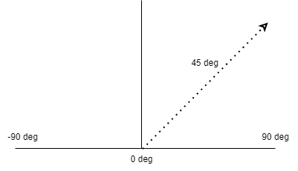
Shot Verification
Calculate relative shot angle
Ensure clear path of pool stick
  Ensure that no ball is in the path of the pool stick through a 7.5 degree
  sweep in each direction

Slide 26
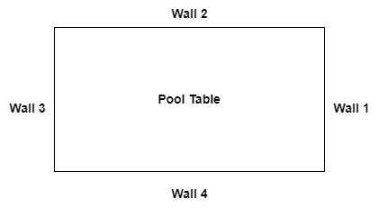
Shot Verification
Determine shot reachability
  Factors in player body position for right handed player
  Length of cue stick
  Position along table
  Ensure that a shot is not blocked by
  camera stand
Determine Position
  Calculates the position along the
  table with raycast
  Finds the wall number of position

Slide 27
User Localization design/components
Goals and requirements
Detect a specific user in real time within a foot of accuracy
Location detection should be done with a specified latency (current 9 to 15s)
Localization aid should be mountable to the pool table to ease deployment and reduce the number of individual subsystems
Localization aid should abide to cost requirements
Full system should be able to communicate with other systems

Slide 28
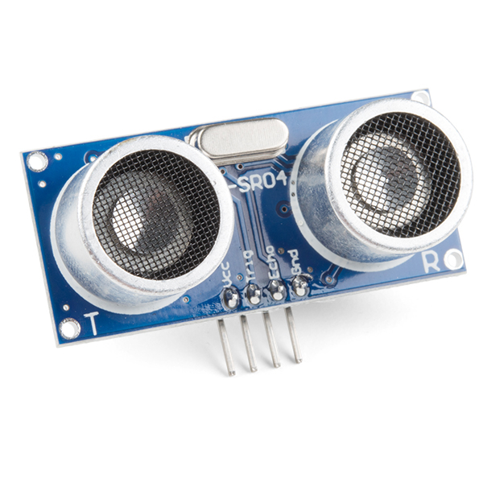

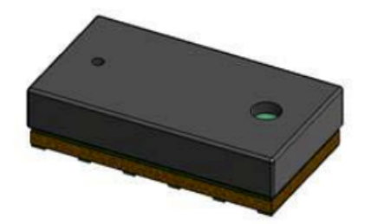
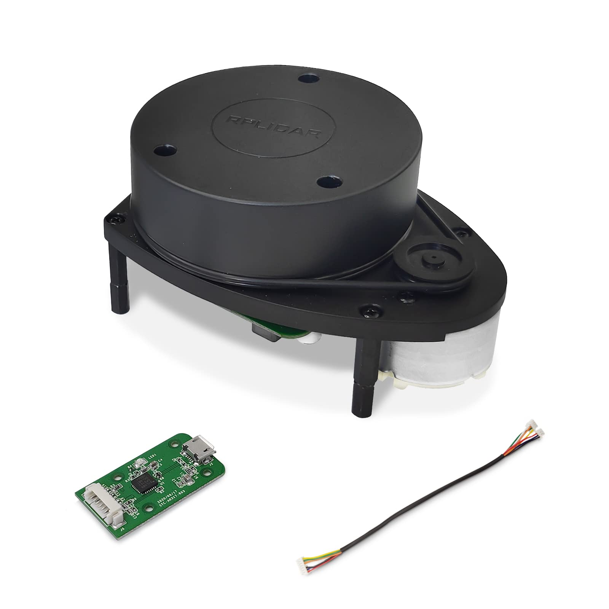
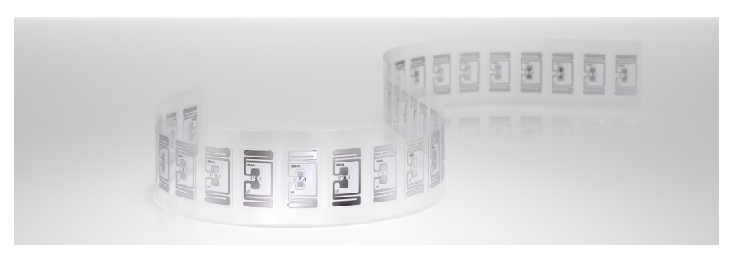
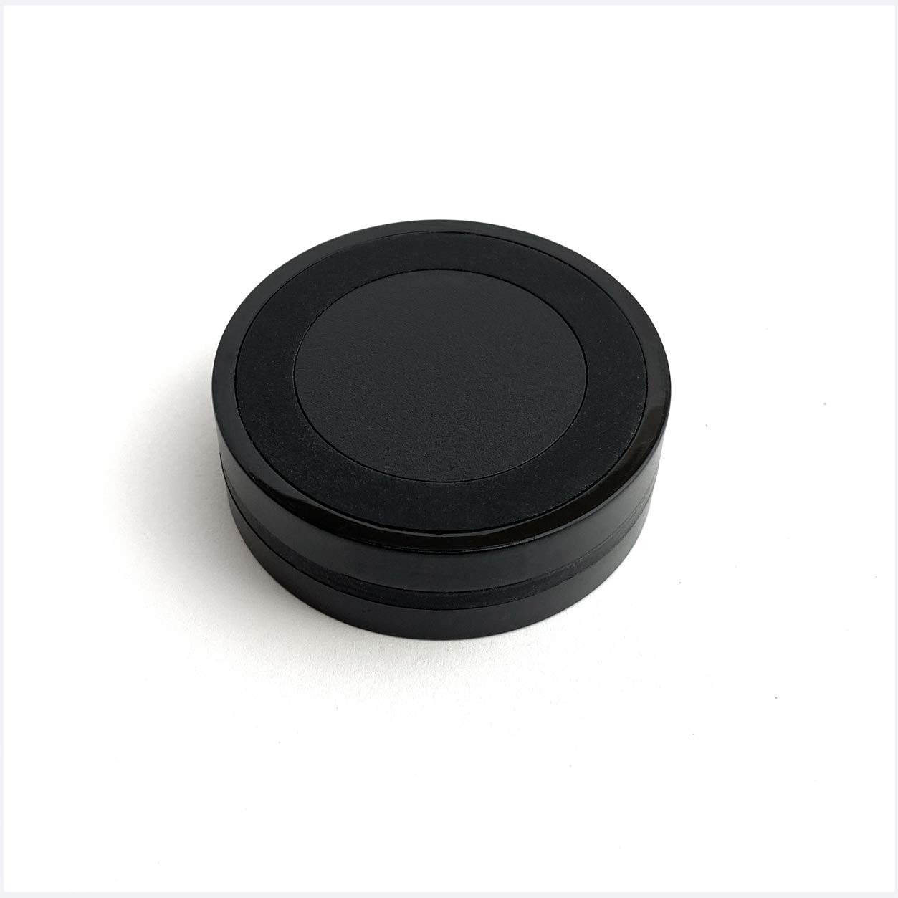
User Localization design/components
Localization Aid Options (Sensors and Technology) - Not Chosen
Ultrasonic sensors
Used for obstacle detection
Need a series of sensors for full coverage
Sensitive to surface absorbing devices
IR sensor
Used for obstacle detection
Need a series of sensors for full coverage
Body heat sensitivity
RADAR/LIDAR
Way too expensive to get good accuracy
RFID
RFID reader too expensive
Not cost effective
BLE beacon
Not accurate at small instances
Multipath fading

Slide 29

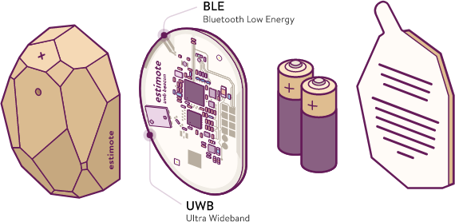
User Localization design/components
Localization Aid Options (Sensors and Technology) - Chosen
UWB Beacons from Estimote
Accurate at small distances within cm
Cost effective (< 100 dollars for full pack)
Availability of SDK for programming purposes
Leading edge technology used in airtags

Slide 30
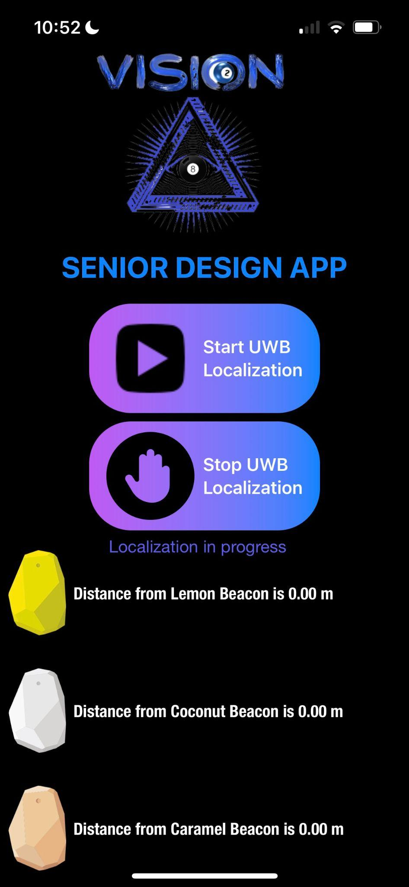
User Localization design/components
Localization Aid - User Side
IOS App Developed on Swift
App exists on an iPhone (Models 13 and above), hence does not require an extra cost to user
App is designed aesthetically to be friendly for visually impaired individuals
Includes sound feedback and vibration response for visually impaired individuals

Slide 31
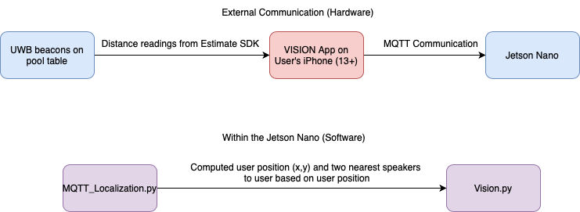
User Localization design/components
Localization Aid - Communication with Jetson (Using MQTT/Python)
Distances from beacons sent every second to Jetson Nano through MQTT subscriptions using free test server from emqx
Two topics are used for communication between App and Jetson Nano
One topic to transfer distances to the Jetson
Second topic sends feedback numbers to the App translated into vocal messages to user

Slide 32
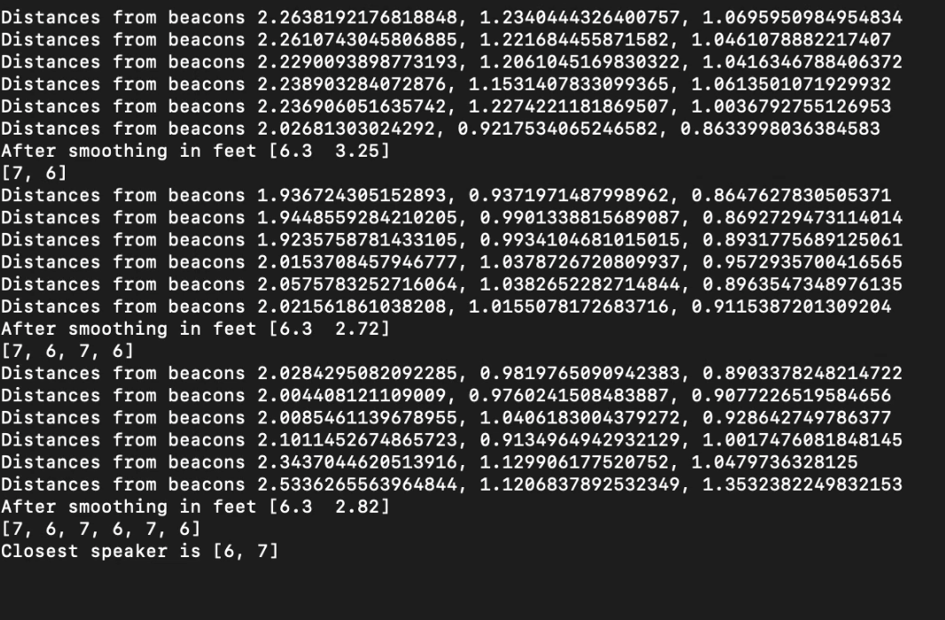
User Localization design/components
Localization Aid - Computation on the Jetson (Using Python)
Beacons are placed at specific positions on the table in chosen coordinate system
Trilateration with beacons positions and distances to user returns an x,y position
Position is smoothed for accuracy, filtered to edges of table, and converted into closest 2 speakers

Slide 33


User Guidance Subsystem Overview
General Audio Guidance for User
Goals & Handoff
Speaker Array
Audio Output
Software Mapping & Feedback
System Integration via PCB

Slide 34
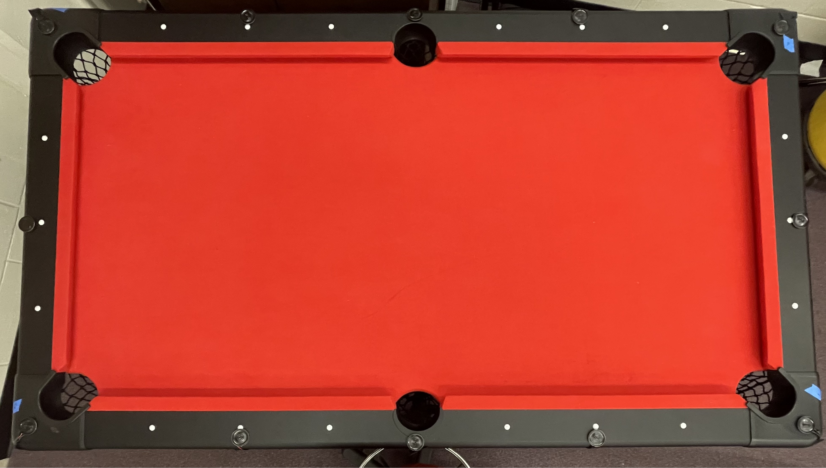
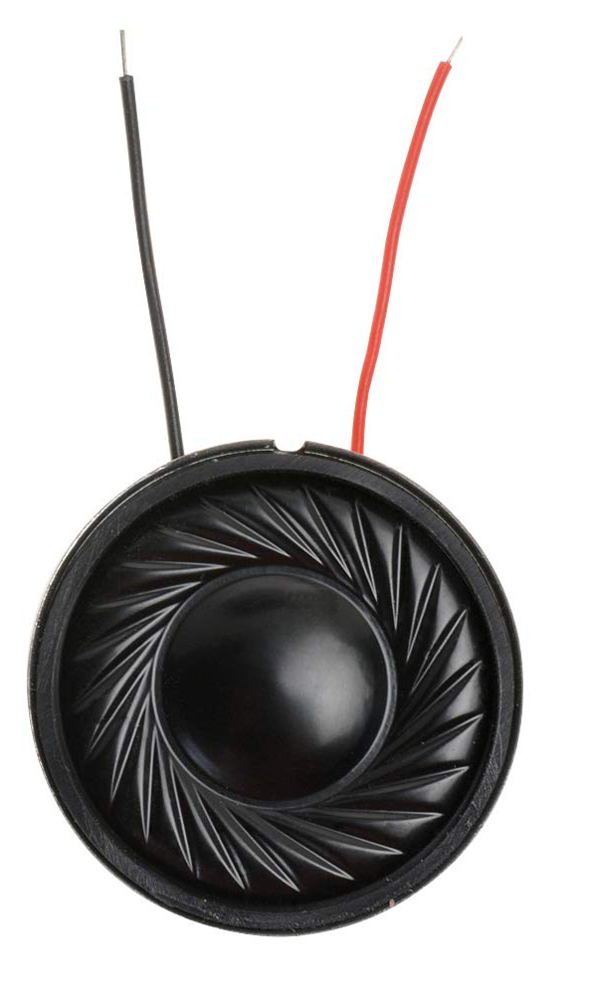
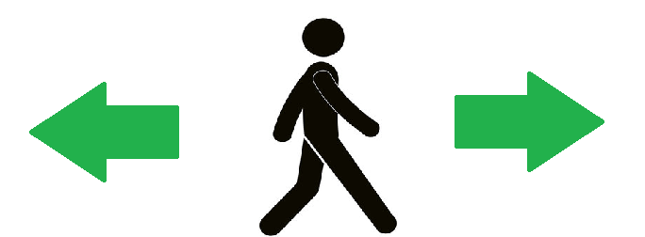
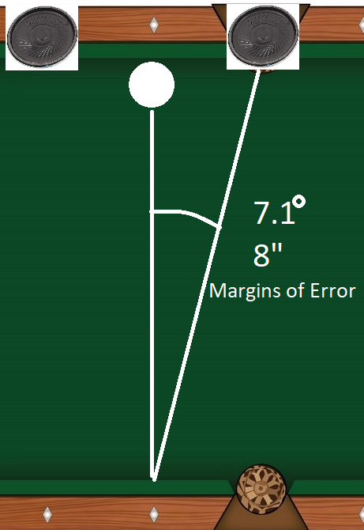
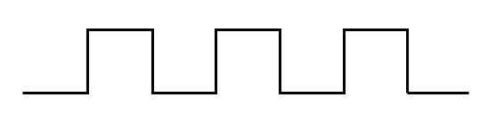
Speaker Array
Guidance Goals
  X Marks the Spot
  SCRATCH Handoff
12 Speaker System
Audio Output
  Square Wave Pulses
Directional Options
  Corner Outputs
Angular Position
  Stretch Goal
  Nonintegral

Slide 35
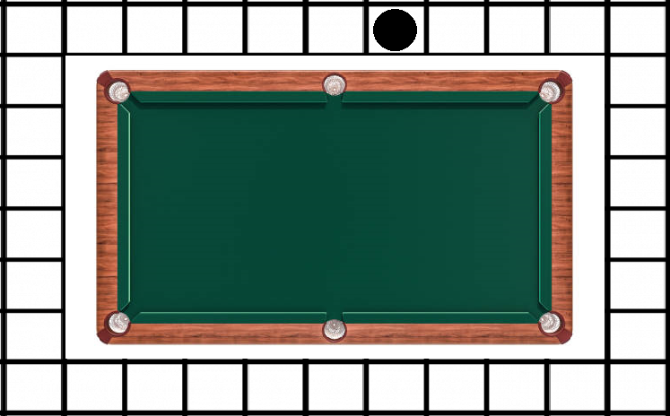
Guidance Software
Communication to Jetson Nano
  Bluetooth Low Energy
State Machine Loop
  Position & Guidance
  Feedback Signals
Localization Array
Guidance Decision
  Corner Speakers
  Selection Away from Stand

Slide 36


Printed Circuit Board Design
PCB Purpose
  Guidance
Integrated Components
  ESP32 with Antenna
  Speaker Headers
  Voltage Regulator
  Push Button Controls
  USB Connection
Schematic Breakdowns
Model Breakdown

Slide 37
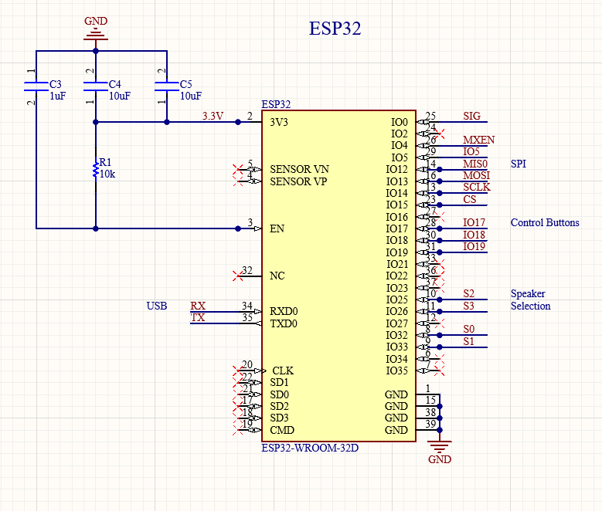
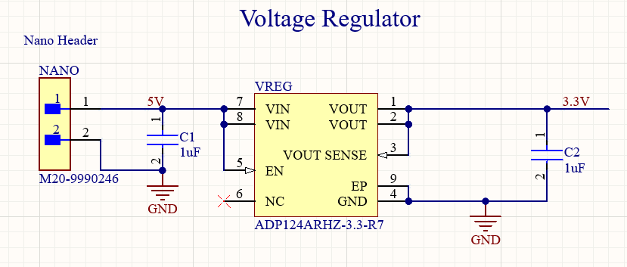
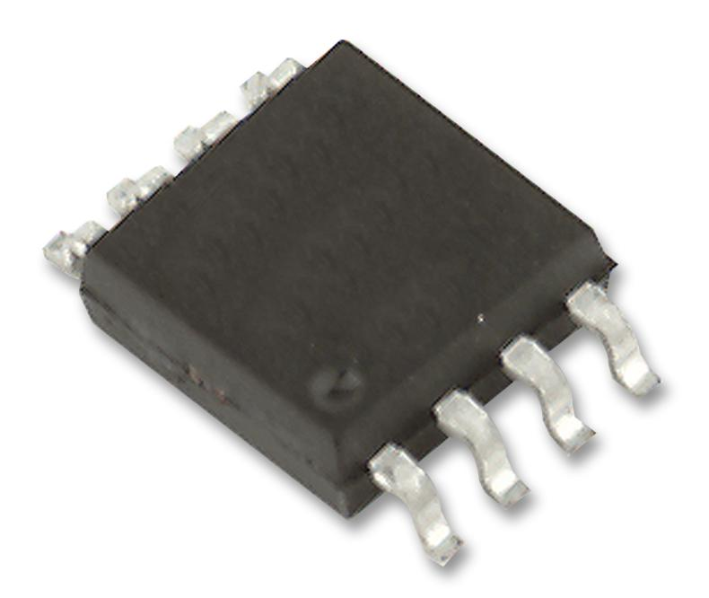
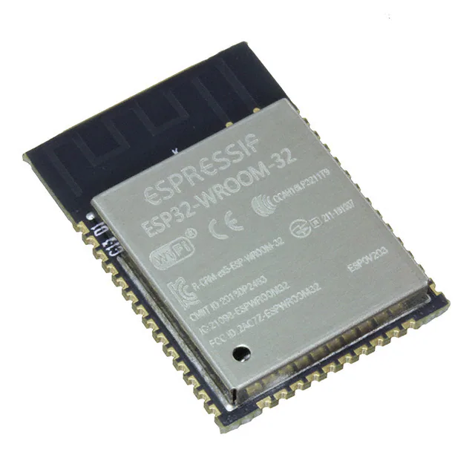
PCB Schematic Breakdown - Central Control
Microcontroller
  ESP32
Power Reg
BLE Comms

Slide 38
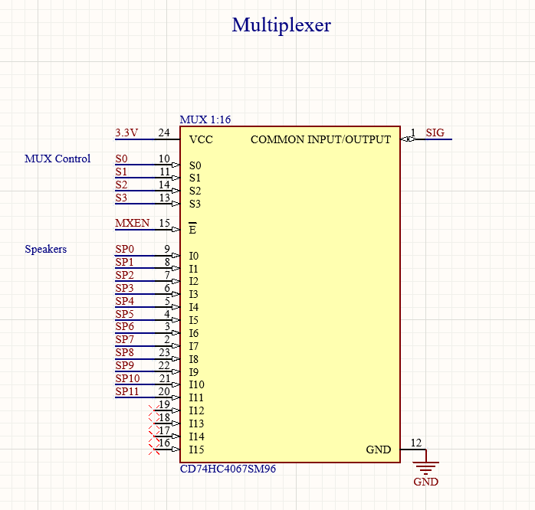
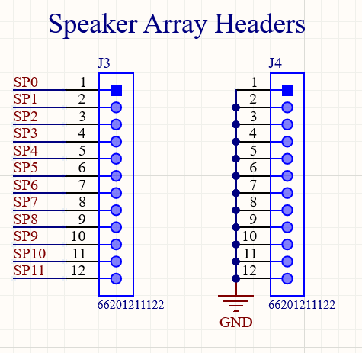
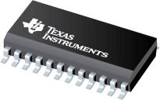
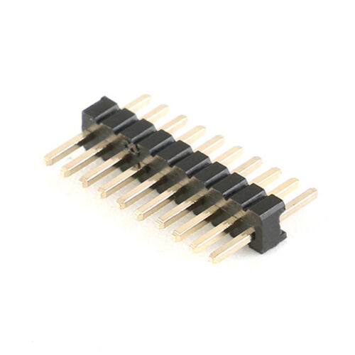
PCB Schematic Breakdown - Speakers
MUX Selection
Speaker Jumpers
Modular Speaker Connections

Slide 39
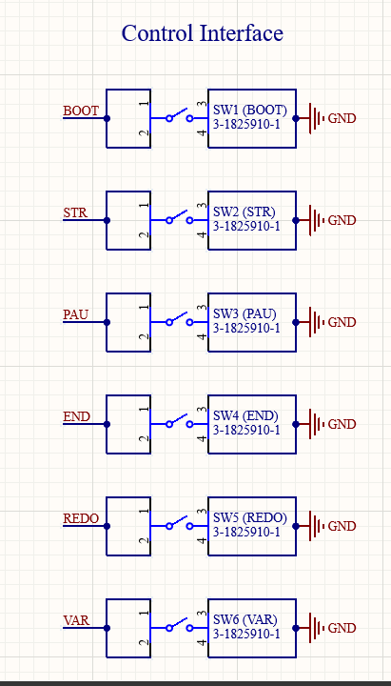
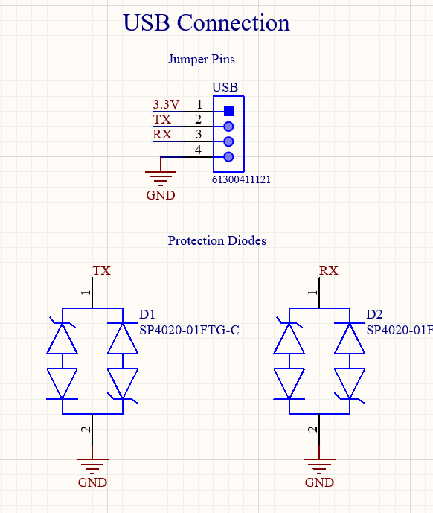
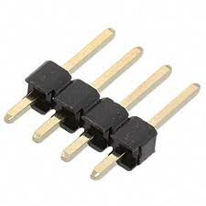
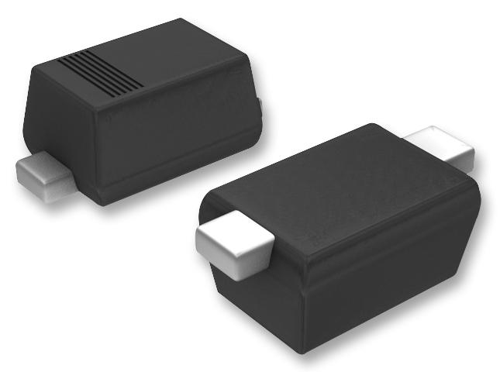
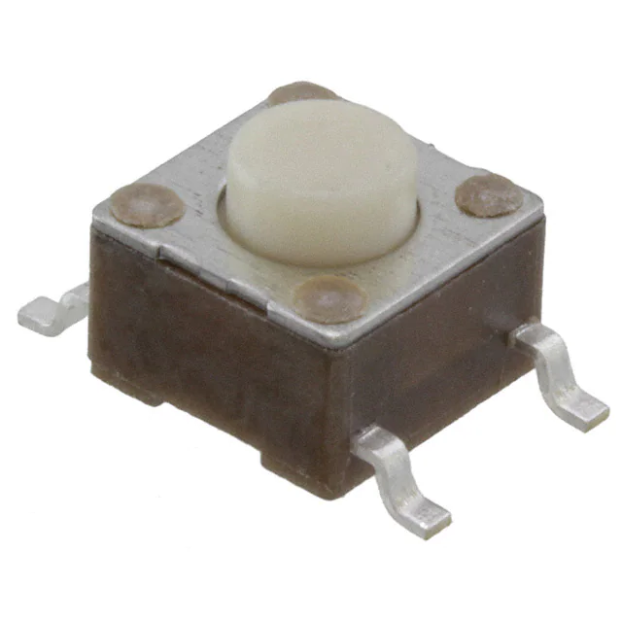
PCB Schematic Breakdown - Peripherals
Push Button Interrupts
  Boot
  Start
  Pause
  End
  Redo
  Variable
USB Programming
  Header
  Protection

Slide 40
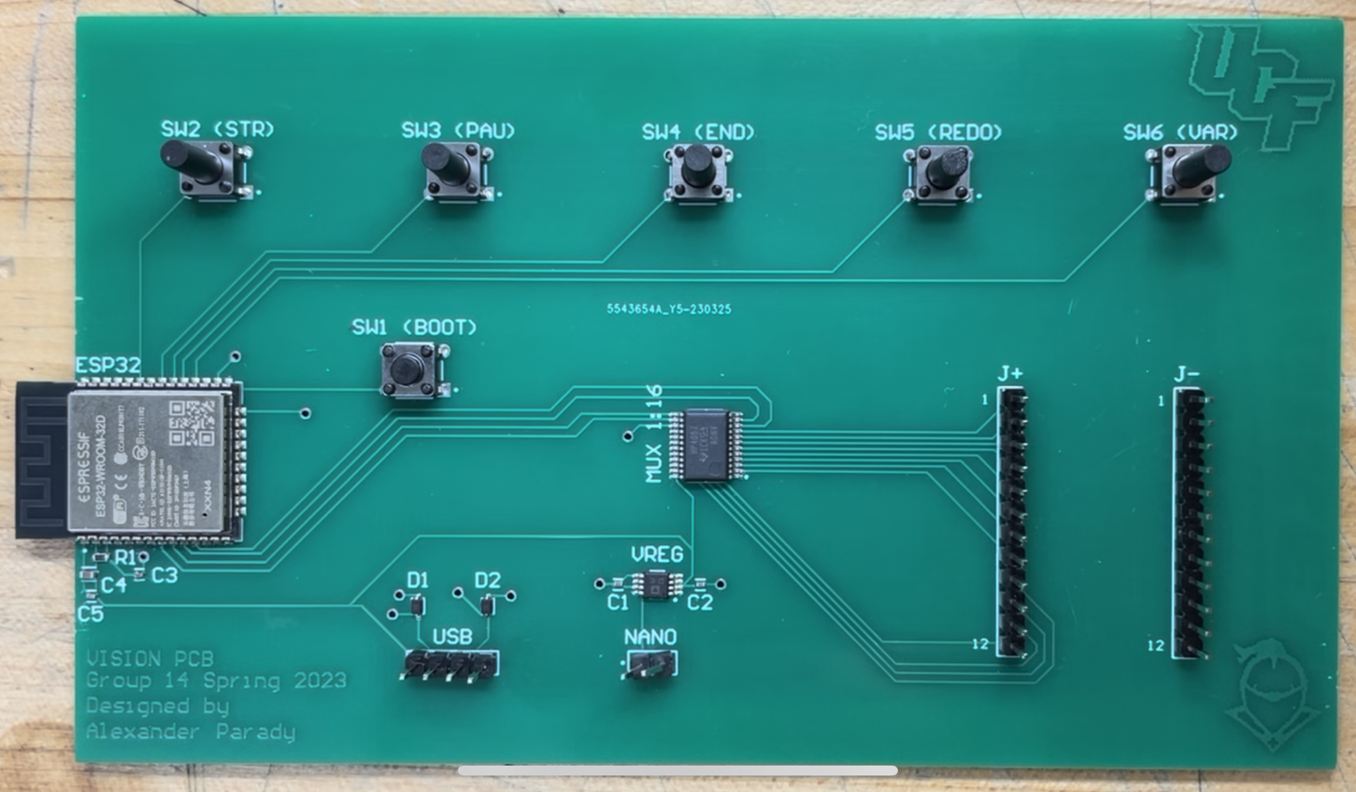
VISION PCB

Slide 41
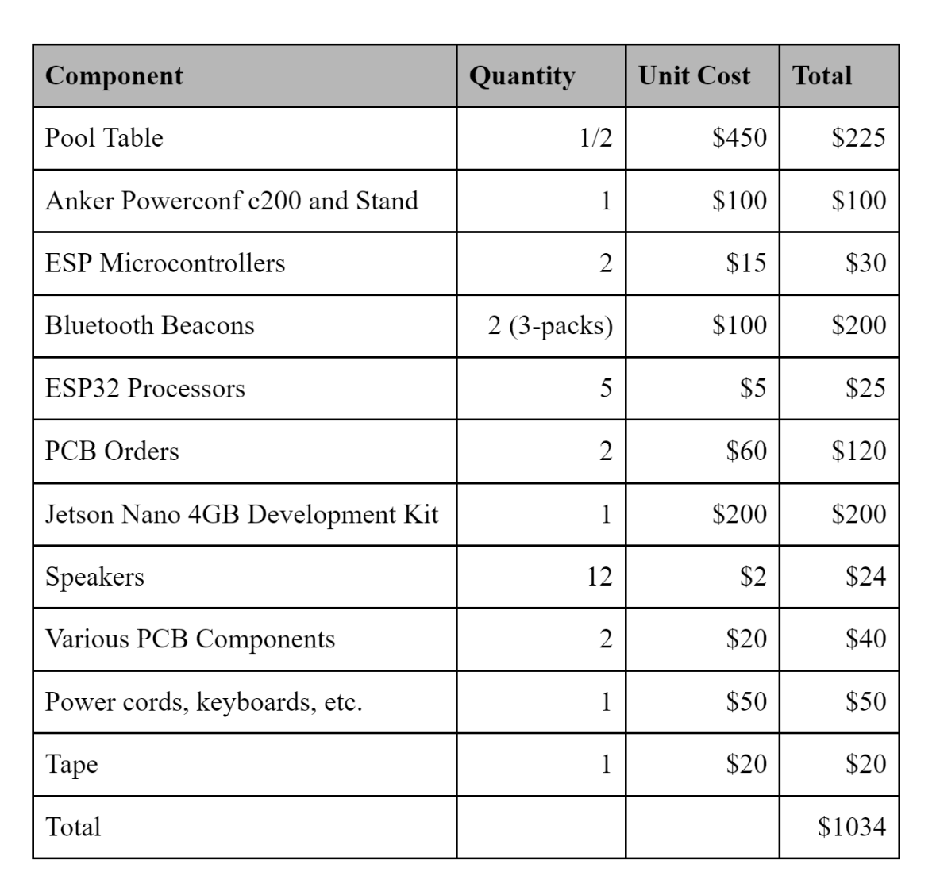
Budget and Financing
Self funded with a contribution of $200 per team member ($800 for Table Team)
Exceeded budget due to PCB version 2 and personal losses
End user can implement VISION much cheaper

Slide 42
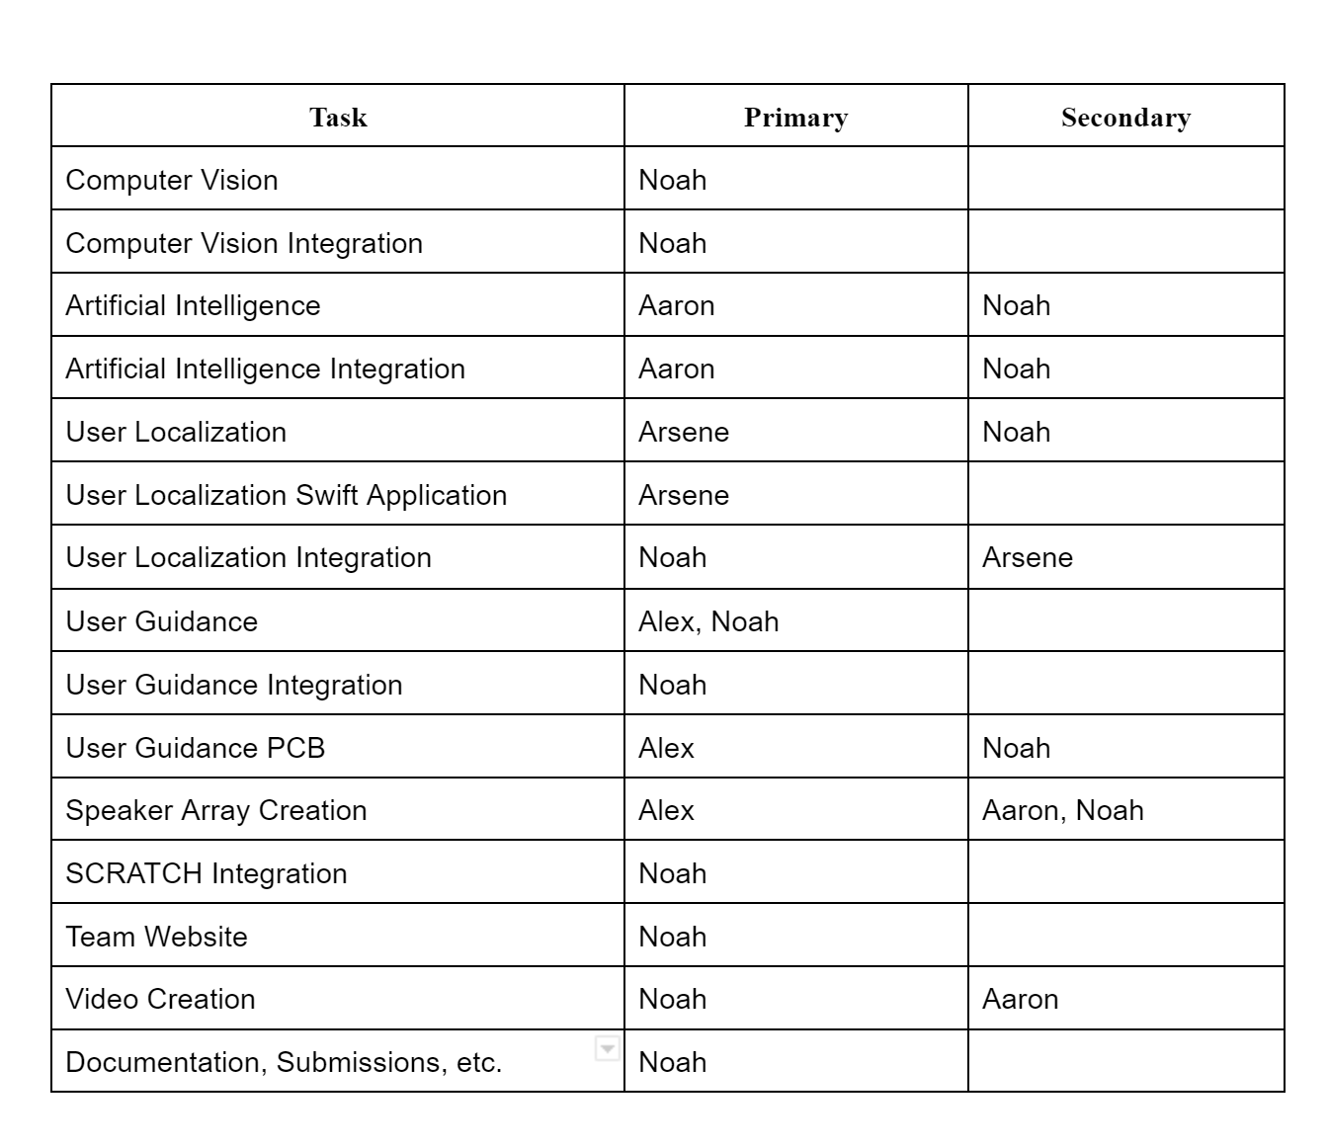
Member Contributions

