Slide 1



Powerpoint Drafting info and extra stuff
Pictures for each person:

Slide 2

Self-Sustaining Hydroponic Greenhouse
with Photovoltaic Power and Optical Sensing
Group 5
Kaleb Morgan – Computer Engineering
GEORGE KIRIAZES – Photonic Sciences
Connor DiMatteo – Photonic Sciences

Slide 3
Motivation
Food insecurity and a lack of sustainable agriculture are becoming growing problems as urban sprawl and food deserts become more prevalent in Florida. To combat this problem, we believe the development of community gardens will provide municipalities with much needed access to healthy organic food for consumption by residents.
There are three major issues inhibiting the development of community gardens: lack of knowledge, lack of people/volunteers, and lack of resources.
Therefore, we have set out to develop a self-sufficient hydroponic greenhouse requiring minimal human contributions with affordable fixed costs and low variable costs.

Slide 4
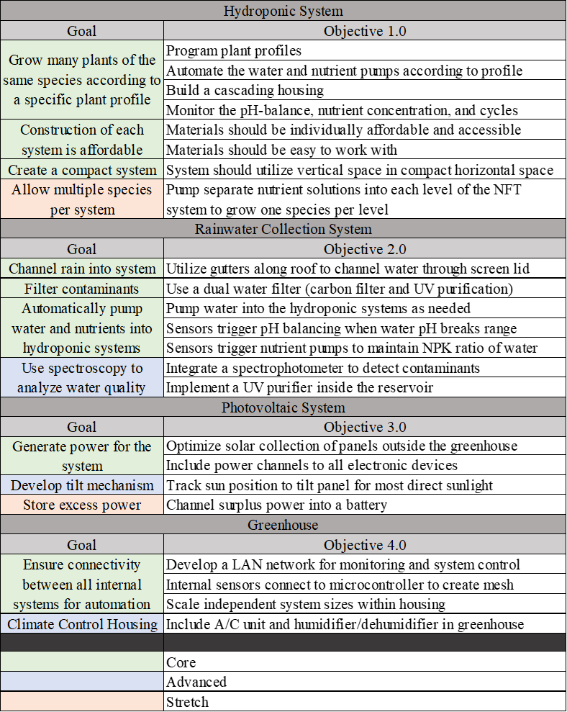
Goals and Objectives

Slide 5
Goals and Objectives (Cont.)

Slide 6
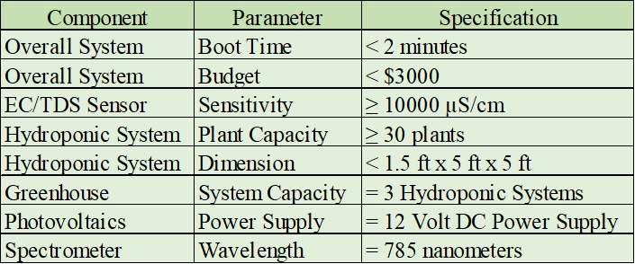
Specifications
Note: The specifications listed here are related to those we will be measuring during our final demonstration.

Slide 7
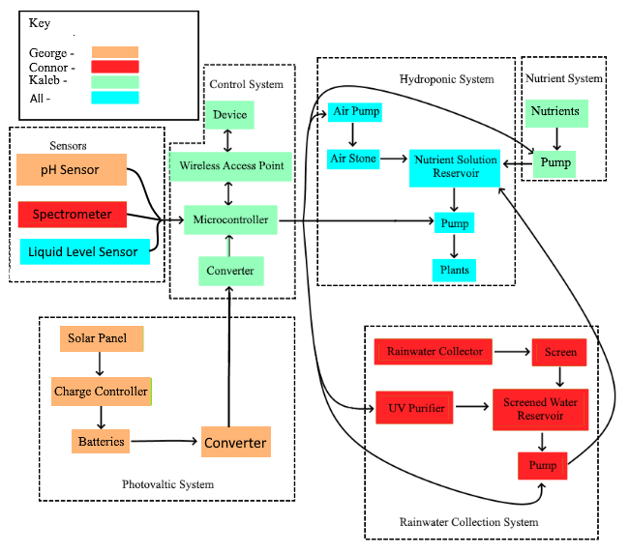
Overall Block Diagram

Slide 8
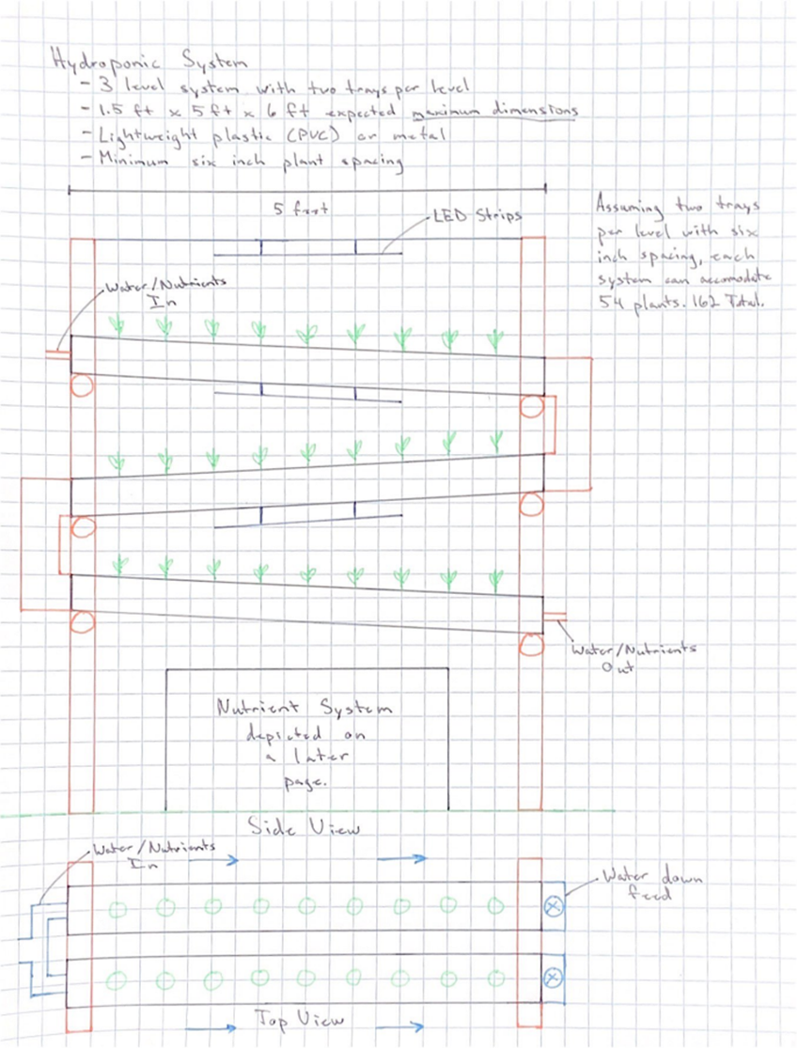
Hydroponic System
Constructed of PVC pipes, connectors, and rectangular channels
Modified version of a NFT system
Utilizes two separate growth trays per level to mitigate competition in growth
Assuming ample time and budget, will make use of LEDs for 24-hour growth of plants
Plant capacity for 3 tiers with two channels is 54 plants per system
Gravity is the main source of motion in trays

Slide 9
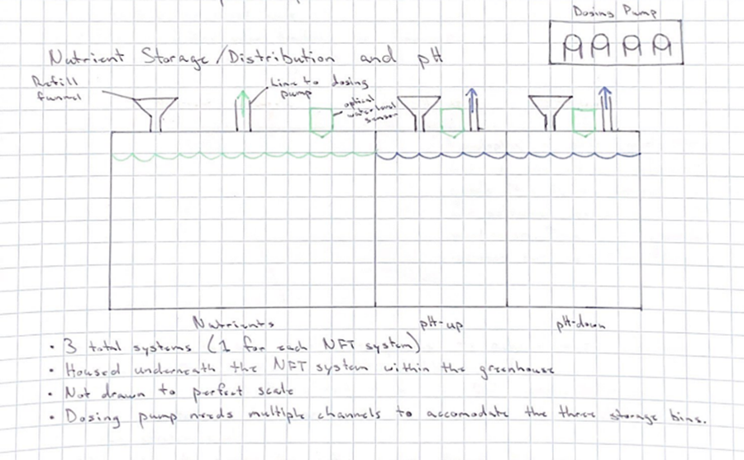
Nutrient and pH Deposition System
Each hydroponic system will have its own nutrient and pH system
Utilizes peristaltic pumps to precisely deposit nutrient/pH solution in the water reservoirs
Will have three separate solution containers to hold system specific nutrient solution, pH up, and pH down
Water level sensors will be used to measure when solutions need to be refilled

Slide 10
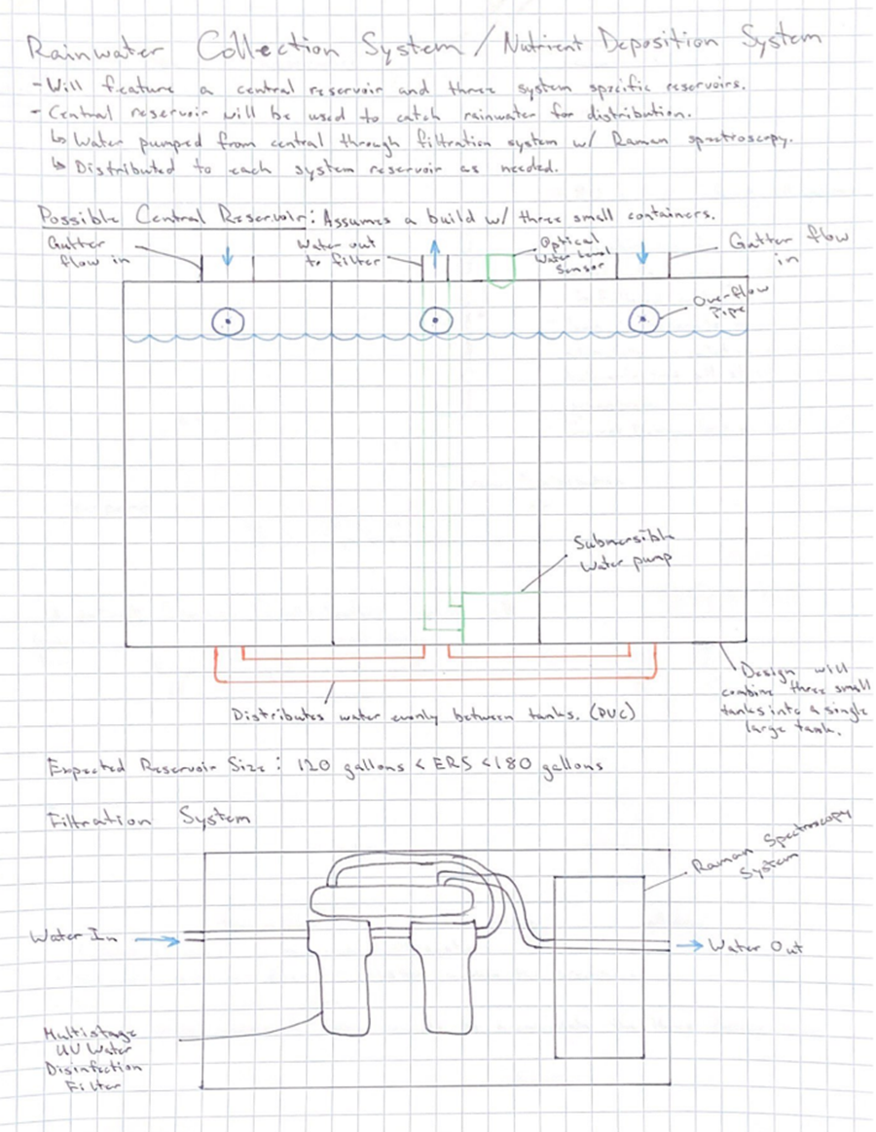
Rainwater Collection System
4 Total water reservoirs will be used
  1 Central, 3 System Specific Reservoirs
Central reservoir will have two inflow channels from the gutters and one outflow
Central reservoir will be comprised of three containers connected at their bases to distribute the water level equally
Middle container will measure water level to notify when levels are too low
Middle container will have a water pump that will pump the water to a water filtration and analysis system
Containers will have overflow valves and mesh toppers for passive collection and purging

Slide 11
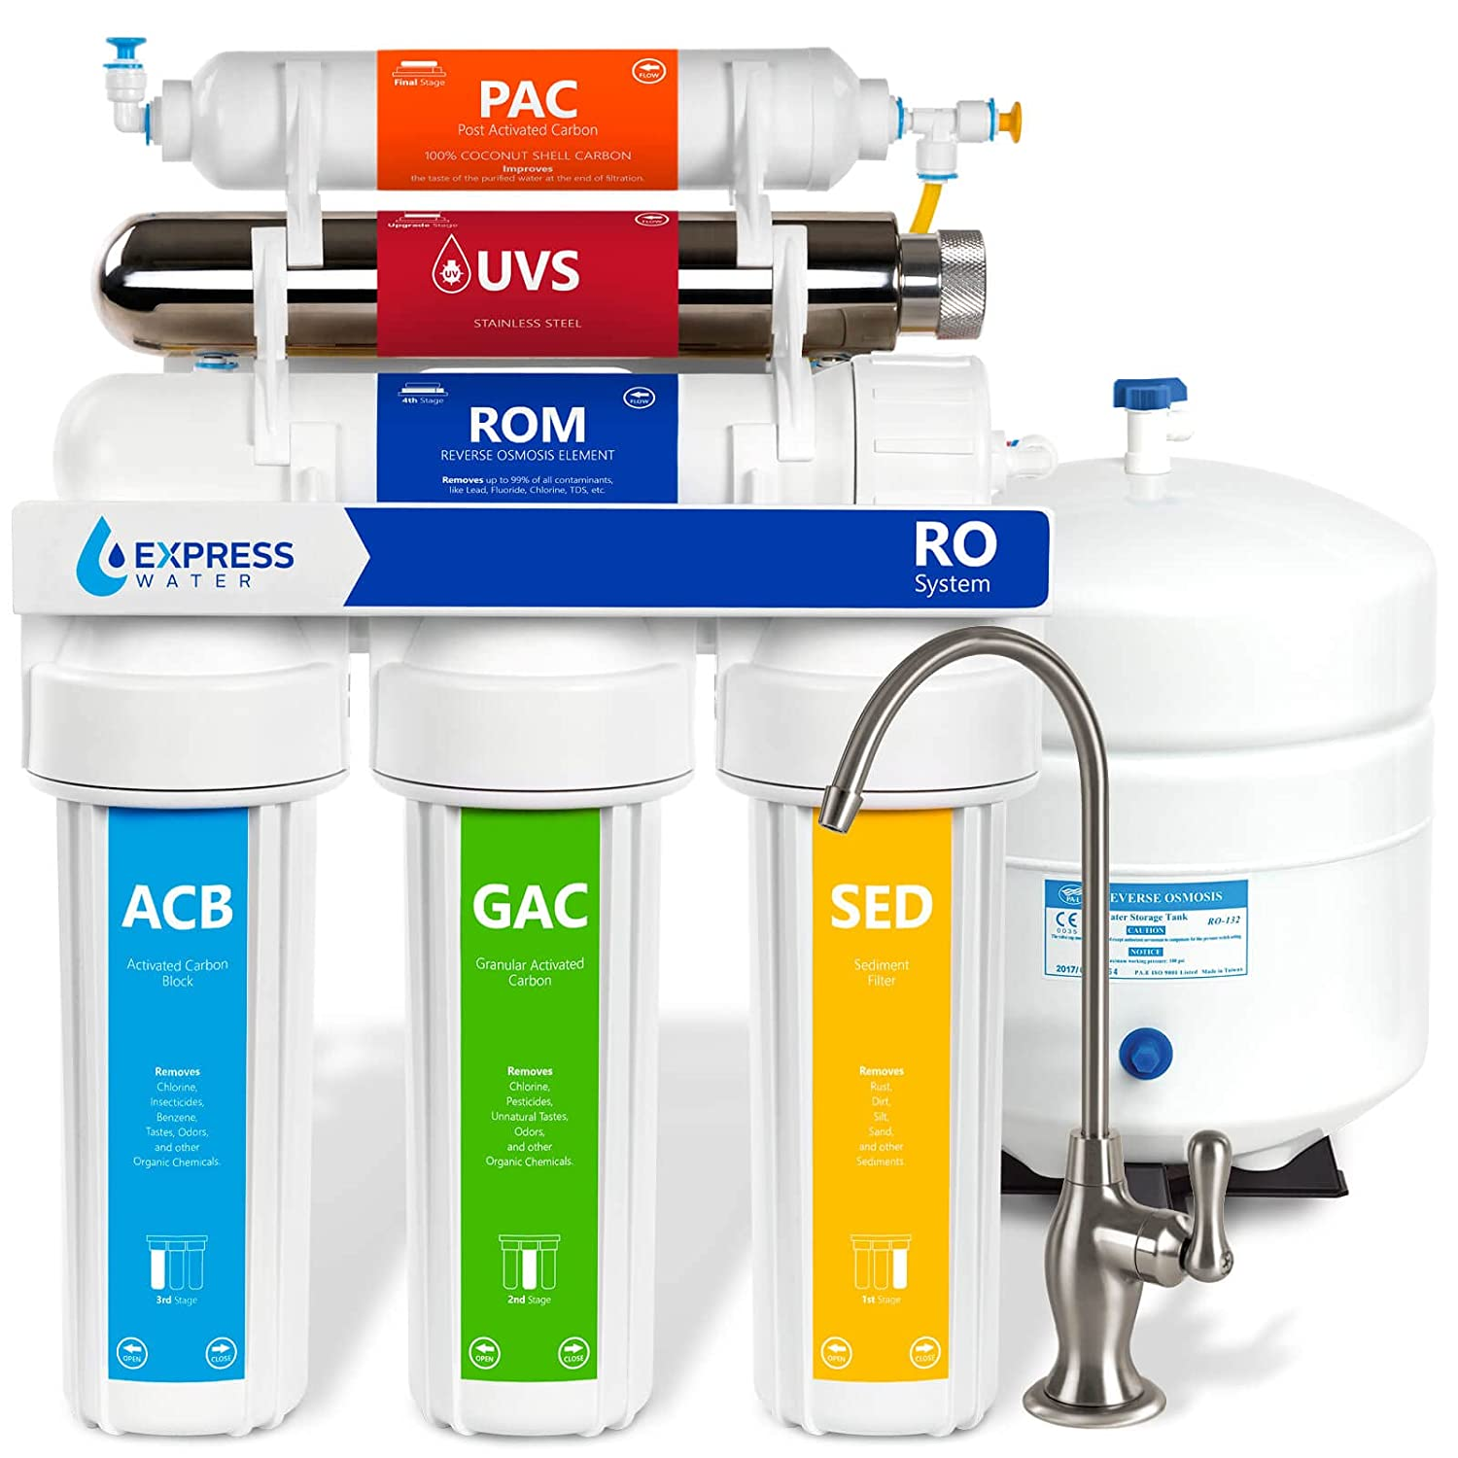
Rainwater Collection System
Water moves from central reservoir into filter
Multistage water filtration system
  6-stage including UV purifier, reverse osmosis, carbon filtration, and sediment filtration
From filter moves through an in-line Raman spectroscopy system
  This is not a digitally integrated system. Can be removed as needed.
Raman spectrometer can be used to measure the quality of the water, ensuring there are not high concentrations of harmful chemicals
Water proceeds into a 3-line valve manifold to be distributed to the system specific reservoirs

Slide 12
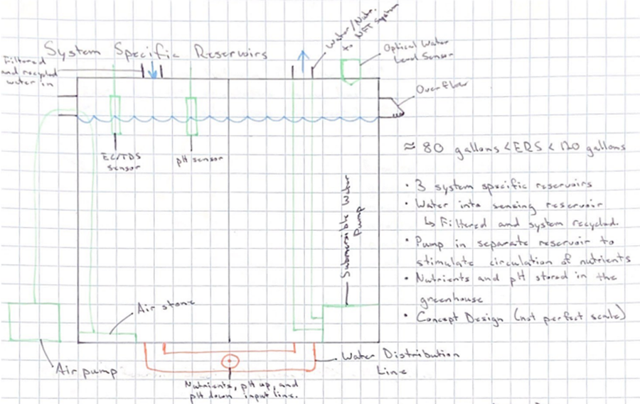
Rainwater Collection System
3 system specific reservoirs
Comprised of two separate containers connected at their bases for equal distribution
New water and recycled solution flow into the left container
Water pumps from right container into the NFT system
An air stone keeps the water oxygenated in the left container
New nutrient solution, pH up, and pH down are deposited in the connecting distribution line for the quickest circulation
Water level is sensed in the right container to trigger water deposition from the central reservoir

Slide 13
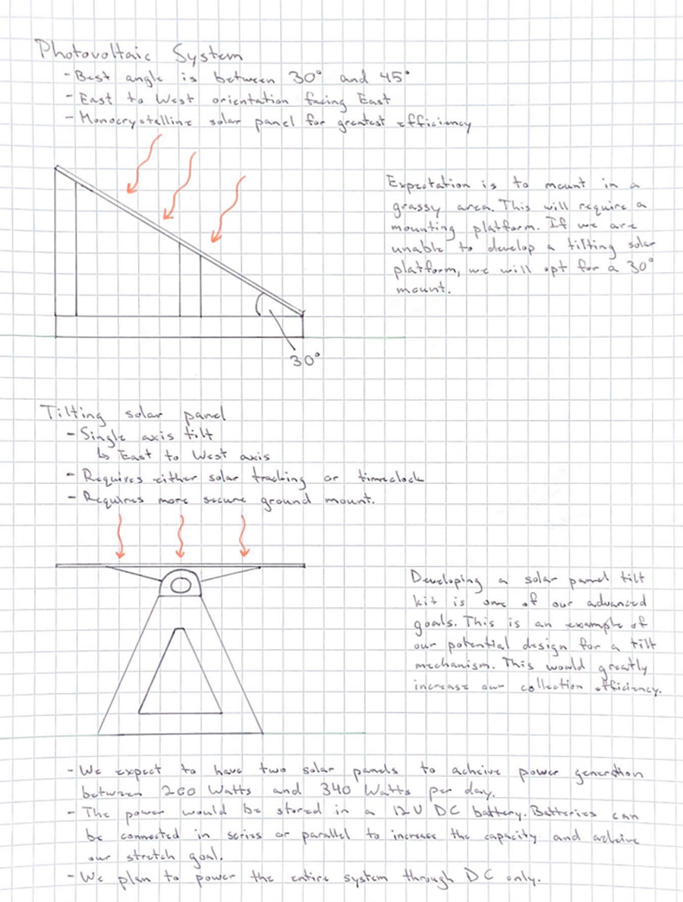
Photovoltaic System
Our system uses two 100-Watt solar panels to power a 12-Volt DC batter
We have two potential designs for how we will mount the solar panels shown below
The left design showcases a stationary mount with a 30-degree angle for collection
The right design showcases a possible tilting panel system to track the sunlight

Slide 14
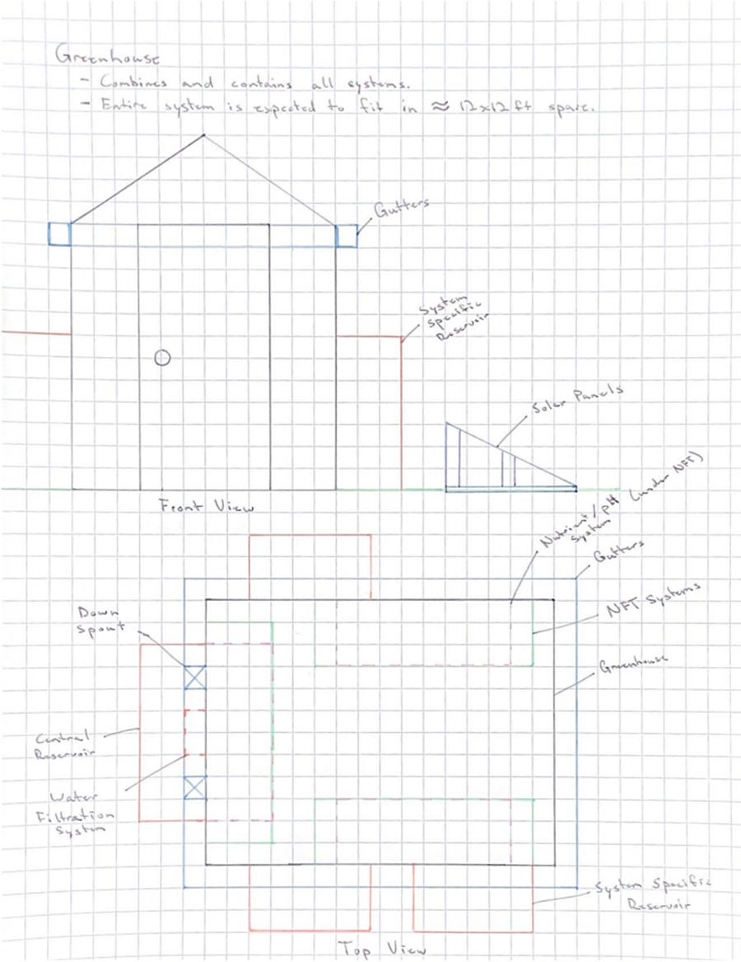
Greenhouse Design and Layout
The two drawings above portray the expected layout of our greenhouse including all its subsystems and design elements.
Some items are not drawn to perfect scale or distance, but this functions as a fairly accurate representation of our expected final concept.

Slide 15
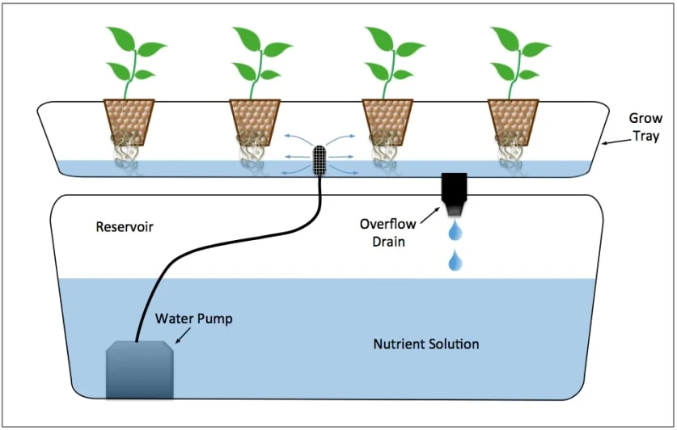
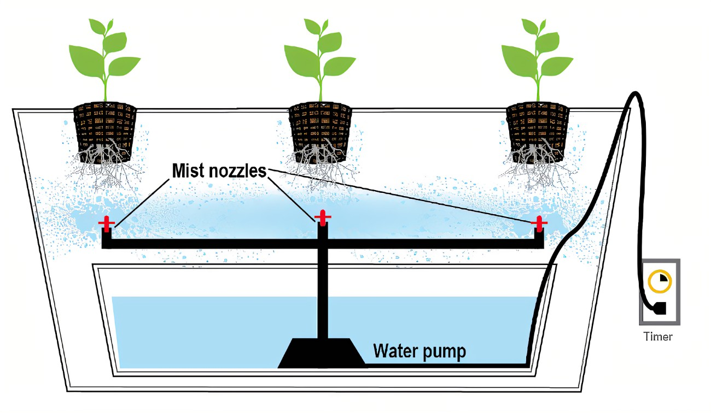
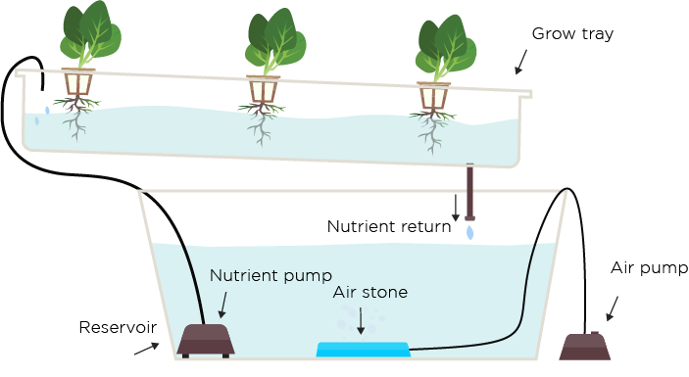
Types of Hydroponic Systems (Selection)
Nutrient Film Technique
Ebb and Flow
Aeroponics
Usable with many plant varieties
Stackable system
Efficient use of resources
Requires more sensors and components
Cost-effective for variety
Usable with many plant varieties
Not a stackable system
Requires large amounts of water at all times
Fewer components needed
Cost-effective for specifics
Lacks capacity and scalability
Not usable with many plant varieties
Capable of vertical gardening
Inefficient deposition of water and resources
Fewer components needed
Not cost-effective

Slide 16
Spectroscopy Water Analysis
Infrared Spectroscopy
Fluorescence Spectroscopy
Raman Spectroscopy
Often used when trying to examine the structure of molecules in a sample
Would absorb to much light for this type of spectroscopy to be efficient
Relies on the excitation of electrons that make matter inside of water fluoresce
Additional chemical dyes introduced into the system
Used to detect mainly fluorescent organic matter
Allows for a specific wavelength to be used to analyze a sample with the wavelength being depended on the excitation source

Slide 17
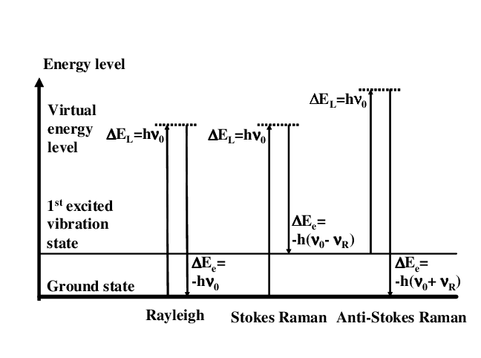
Raman Spectroscopy
When using Raman spectroscopy water also scatters these wavelengths the least making it a prime candidate for investigating organic compounds found in water
Two techniques used in Raman spectroscopy, being stokes and anti-stokes
Stokes: photons from the excitation source collide with molecules which result in some of the energy from the photons transferring to the molecule. This loss in expected energy can be measured which results in seeing a wavelength shift, known as a Stokes shift.
Anti-Stokes: Uses the photons from the excitation source and has them absorb energy from colliding with molecules. This gain of energy results in the wavelength shift in this case.
Notes:
Energy levels for both the Anti-Stokes and the Stokes Raman scattering show that Anti-Stokes occurs at a higher vibration state
Results in the Stokes being much stronger than that of the Anti-Stokes

Slide 18
Excitation Source
Excitation Source | Laser Wavelengths | Applications
Near infrared light source | Solid state Nd-YAG laser (1064 nm) Diode Laser:(785, 830 nm) | Biological samples Polymers General purpose
Visible light source | Ion laser: He-Ne (633 nm), He-Cd (442 nm), Ar+ (488 nm & 514 nm) Solid state laser: Nd-YAG (532 nm) | Organic components Archeology & forensics Semiconductor minerals General Purpose
Ultraviolet light source | Ion laser: He-Cd (325 nm), Ar+ (244 nm & 257 nm) Solid state laser pumped dye laser: Ti-Sapphire | DNA protein Chromophores Wide bandgap semiconductors
Many different excitation sources can be used when performing Raman spectroscopy.
Among them are visible light, ultraviolet light, and near infrared light
  Each of these different common excitation sources for Raman spectroscopy have their benefits for different applications.

Slide 19
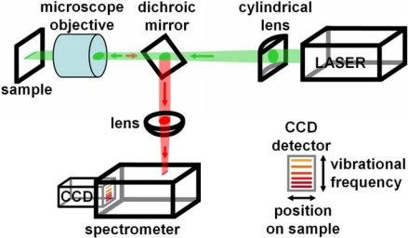
Further Choices
The technique used is also under consideration when looking at the different routes to use for the analysis of water
  Normal Raman, Surface Enhanced Raman, and Fourier Transform Raman are all options for techniques that can be pursued.
  Fourier Transform Raman you have to take into consideration that it requires the use of interferometers to work, making it a complex and less commercially available form of Raman spectroscopy.
  Surface Enhanced Raman spectroscopy is used often due to its efficiency and low concentration detraction making it a great choice however it is a very complicated technique.
  Because of the restraints of both the Surface Enhanced Raman spectroscopy and Surface Enhanced Raman spectroscopy Normal Raman spectroscopy is the best option for our required application.

Slide 20
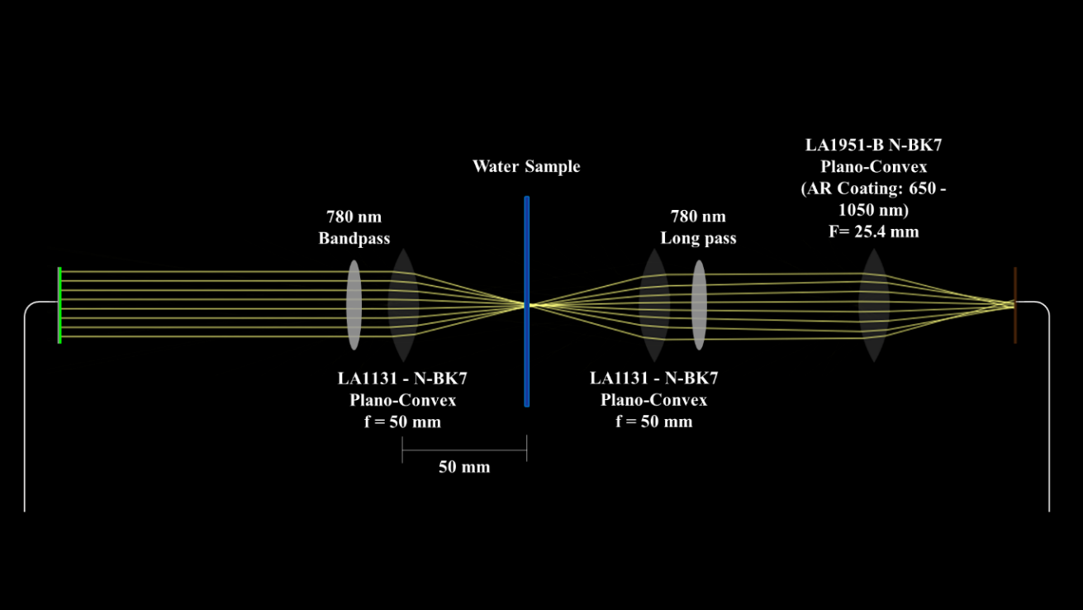
Spectrometer Setup
A lens system had to be put in place to properly guide the rays from the system through the sample and back to the spectrometer.
To be able to have as little outside interference as possible a dark shroud is to be placed around the water analysis system in order to reduce the chance or erroneous reading due to outside interference.

Slide 21
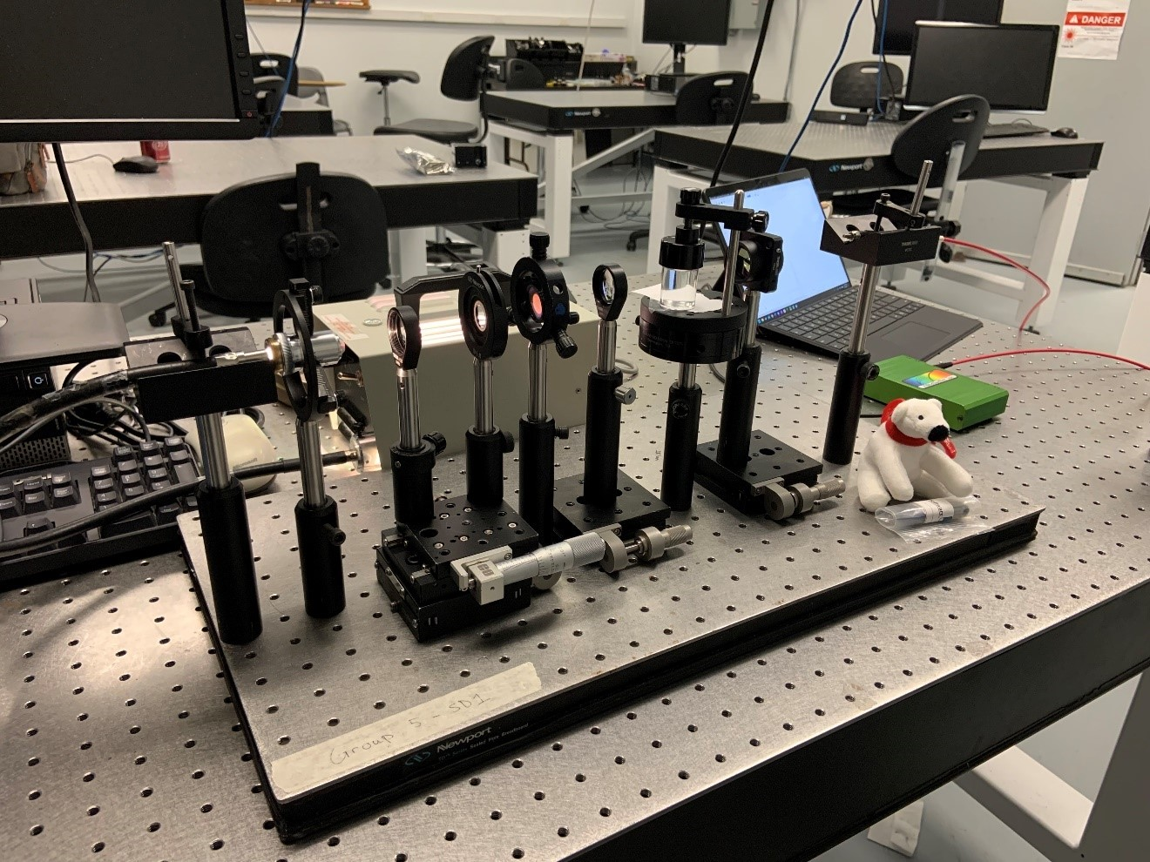
Lens Testing
Performed without the use of our Raman spectrometer
White light source emitter to provide light through the sample sent through a 700 nm bandpass filter to remove the unwanted bandwidth that comes with using a white light source
  700 nm light passing through the filter while not passing the unwanted wavelength of the white light source
After re-collimating the light, it was directed into a SMA fiber which was attached to a StellarNet SpectraWiz spectroscope

Slide 22
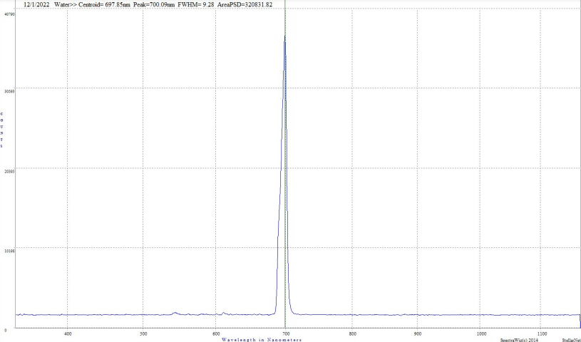
Initial Testing Results
Such a spectrometer would not suffice for the actual design
limitations due to initial testing
spectrum is visible which was the spectrum of light obtained through the water.
  In water: sharp peak at 700.09 nm
  In air: the wavelength was shifted to lower wavelengths

Slide 23
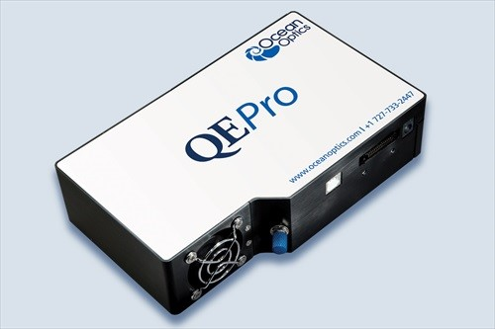
Spectrometer Selection
A previous senior design group “UV Water Analysis System” from 2020 did a spectroscopy-based project on the analysis of water for UV purification to use as drinking water.
  used a Raman spectrometer and the necessary emitter source to go along with the spectrometer.
  Test unit of the QEPro that Ocean Insights
    Connects through USB C and has a SMA fiber connection on the front.
  High-power spectrum stabilized 785 nm light emitter

Slide 24
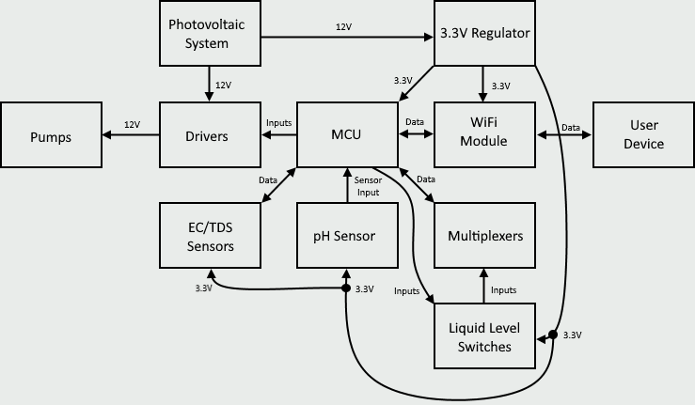
Control System, Sensors and Pumps

Slide 25
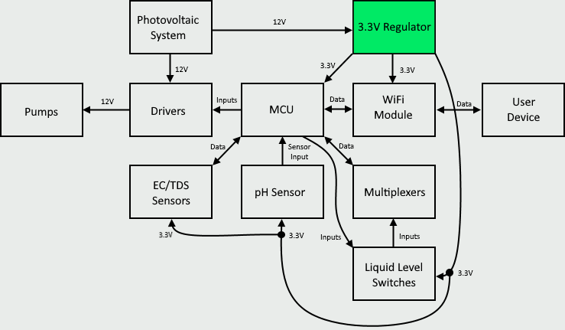
3.3V Regulator

Slide 26
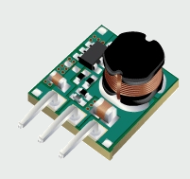
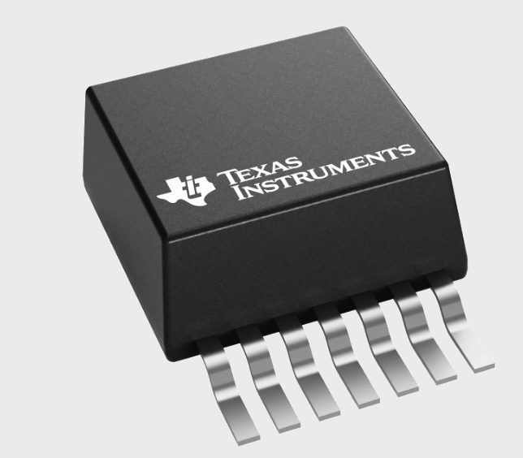
3.3V Regulator
Converts 12V received from photovoltaic system to 3.3V required by the microcontroller, Wi-Fi module, and other peripherals.
The 3.3V supply would need to supply roughly 1 amp if all the 3.3V components were operating at their maximum
Part | TPSM84203EAB | LMZ22003
Input Voltage | 4.5V - 28V | 6V - 20V
Output Voltage | 3.3V | .8V - 6V
Output Current (max) | 1.5A | 3A
Efficiency (max) | 95% | 92%
Price | $8.04 | $13.63

Slide 27
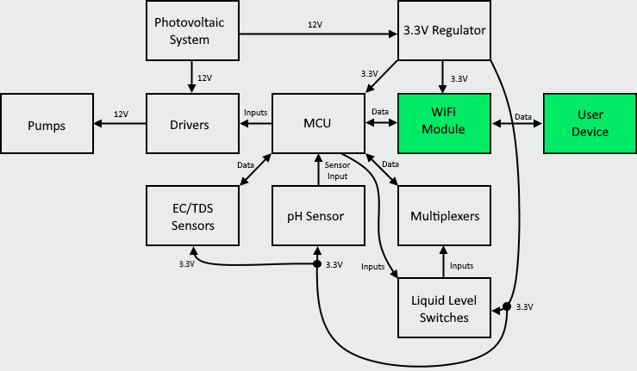
Wireless Communication

Slide 28
Wireless Technology Selection
Wi-Fi is far more popular allowing more people to have access
Wi-Fi has a larger range
Bluetooth uses less power
Technology | Wi-Fi (802.11) | Bluetooth (802.15.1)
Familiarity | High | Low
Access | High | Medium
Range | High | Low
Power Consumption | High | Low
Price | Low | Low

Slide 29
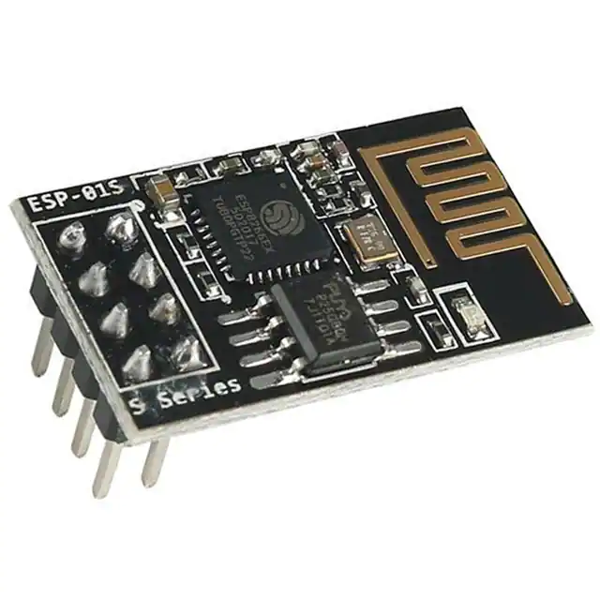
ESP-01S Wi-Fi Module
Communicates data with main microcontroller
Allow user to monitor levels and make changes to the greenhouse using a HTTP
Serves website to user's device browser.
Manufacturer | Ai-Thinker
Power | 3.0V ~ 3.6V
Interface | GPIO/UART/I2C and many more
Current Consumption | 300mA
Size | 24.7mm X 14.4mm
Price | $4.94

Slide 30
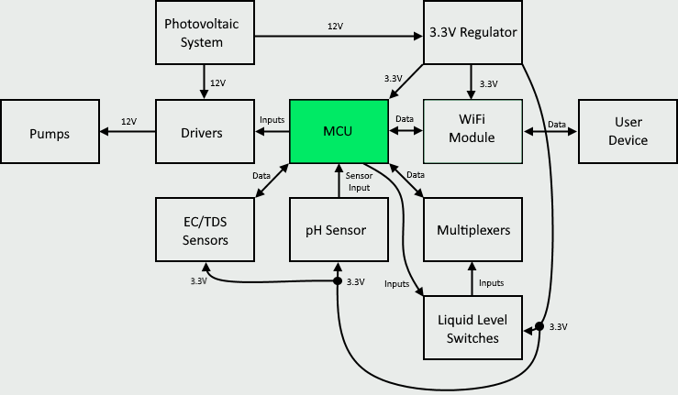
Microcontroller

Slide 31
Microcontroller
Reads EC/TDS, pH, and liquid levels.
Provides output to drivers to control various pumps.
Communicates with ESP-01S to provide sensor data to user's device as well as gather information about plant profiles.
Part | MSP430G2553 | MSP430FR2476 | ATMEGA32A
Non-volatile memory | 16 KB | 64 KB | 32 KB
Random access memory | 0.5 KB | 8 KB | 2 KB
GPIO pins | 24 | 43 | 32
UART | 1 | 2 | 1
I2C | 1 | 2 | 1
Current Consumption (per MHz) | .5uA - 230uA | .6uA - 135uA | 1uA - 600uA
Cost | $0.95 | $3.45 | $5.08

Slide 32
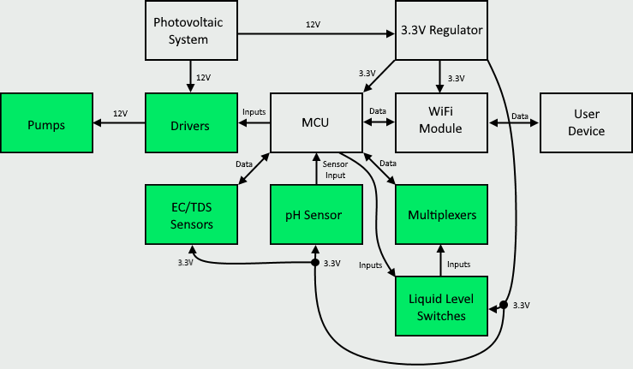
Sensors and Pumps

Slide 33
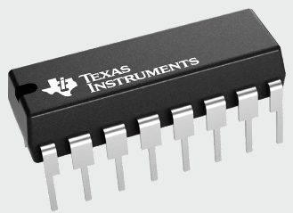
Multiplexers
Allows us to utilize less I/O lines when checking liquid levels.
We require a total of 4 I/O lines from the MCU to utilize a 3 to 8 multiplexer. 3 output selection lines and 1 input data line
Part | SN74HC151N | CD74HC251E
Package | PDIP | PDIP
Selections to Inputs | 3 to 8 | 3 to 8
Supply Current (25°C max) | 8µA | 8µA
Operating temp. range (°C) | -40 to 85 | -55 to 125
Price | $0.60 | $0.99

Slide 34
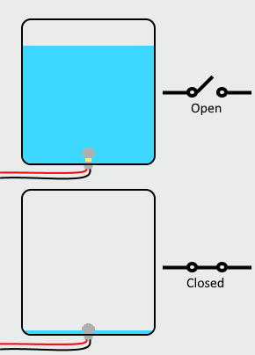
Liquid Level Switches
13 float switches
The switches are open when the water level is high and closed when the water level is low
These switches are connected to two separate 3 to 8 multiplexers requiring an additional output line from the MCU for the anode of the switches.

Slide 35
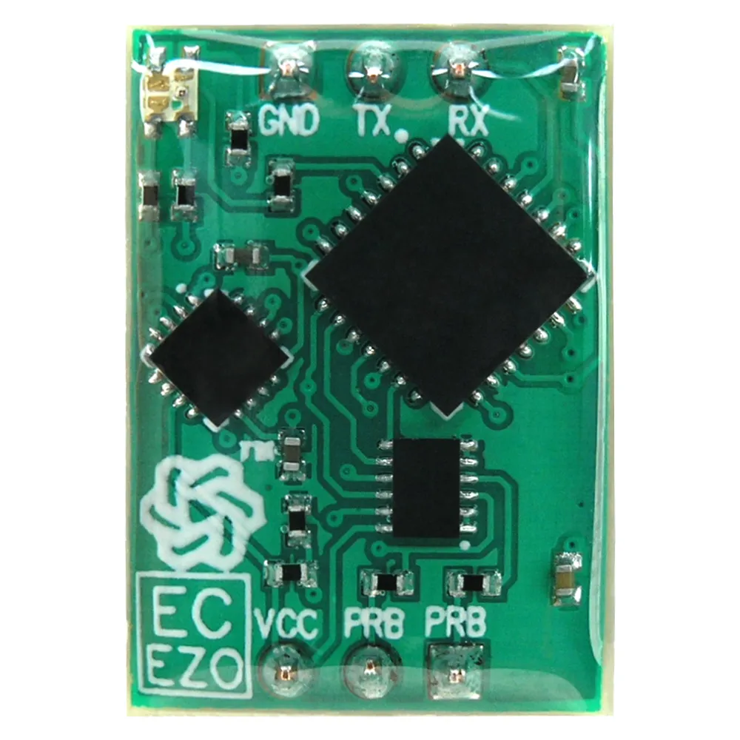
EZO-EC EC/TDS Sensor
Detects dissolved solids in water supply
A probe connected to the sensor is placed at the top of the reservoir. When dissolved solids detected are below the required amount for the plants, pumps must provide the necessary nutrient configuration.
Manufacturer | AtlasScientific | SeeedStudio
Part | EZO-EC | ECTDS10
Power | 3.3V - 5.5V | 3.9V - 30V
Interface | UART/I2C | MODBUS RS485/Analog
Current Consumption | 63 mA | 80mA
Price | $67.99 | $139.00

Slide 36
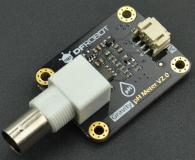
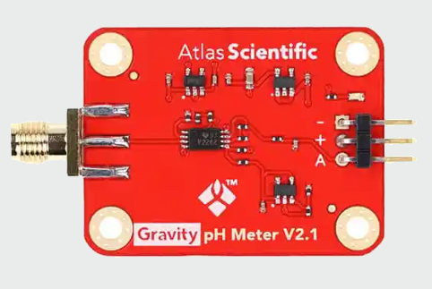
pH Sensor
Monitor pH level of water being sent to plants
Part | DFRobot Gravity: Analog pH Sensor V2 | AtlasScientific Gravity: Analog pH Sensor
Accuracy | ±0.1 | ±0.2
Range | 0 to 14 | 2 to 13
Output | Analog | Analog
Price | $39.50 | $67.99

Slide 37
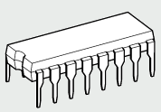
Drivers and Pumps
Pumps run on 12V and require 250mA, far out of the range of our MCU.
These pumps need to be turned on for some time then turned off to supply the specific nutrient configurations as well as stabilize pH resulting in the need for load drivers.
Part | ULQ2003AN | TBD62003APG
Input Voltage (max) | 30V | 30V
Output Voltage (max) | 50V | 50V
Output Current (max) | 500mA | 500mA
Number of drivers | 7 | 7
Price | $0.81 | $1.81

Slide 38
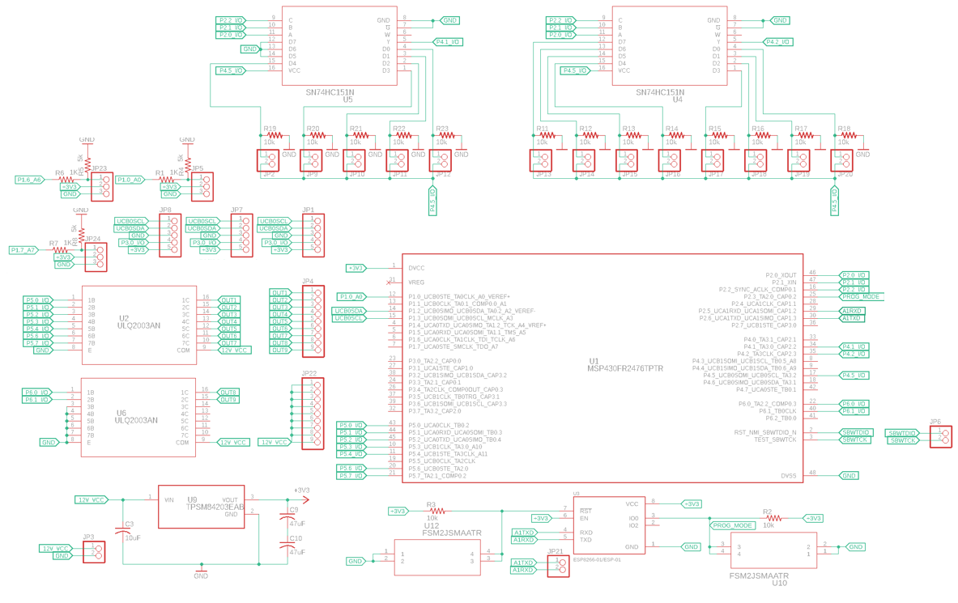
Schematic

Slide 39
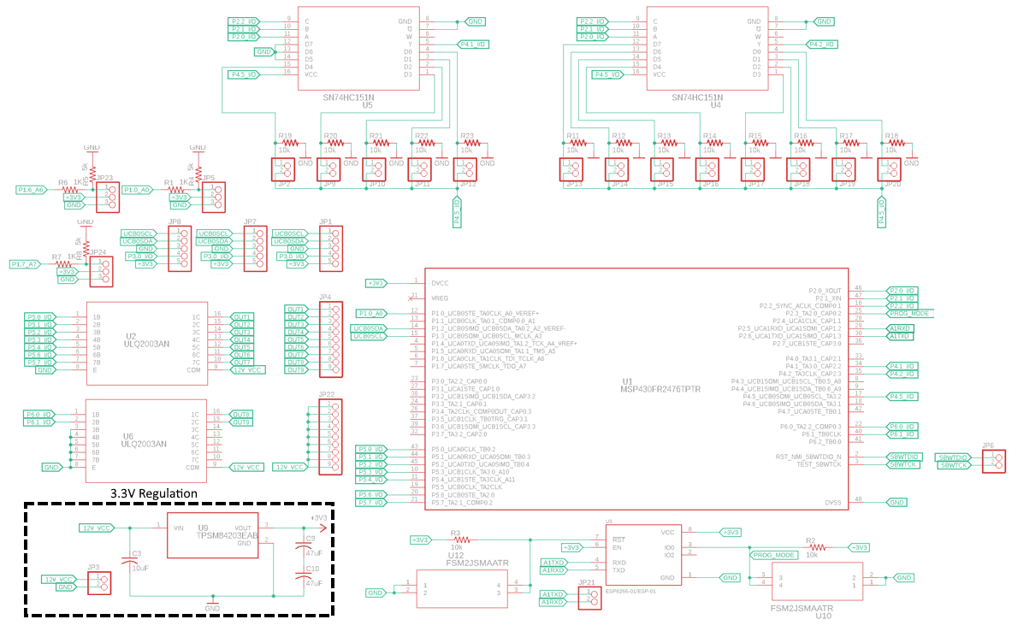
Schematic

Slide 40
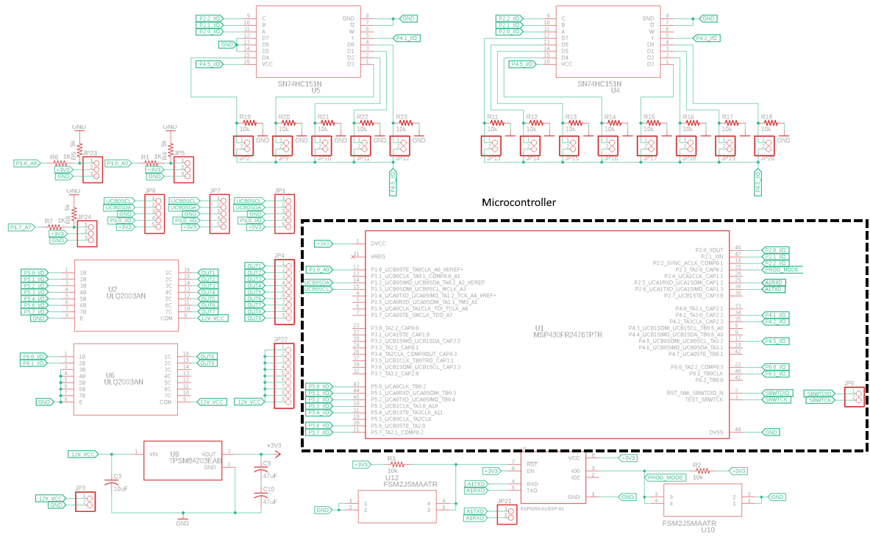
Schematic

Slide 41
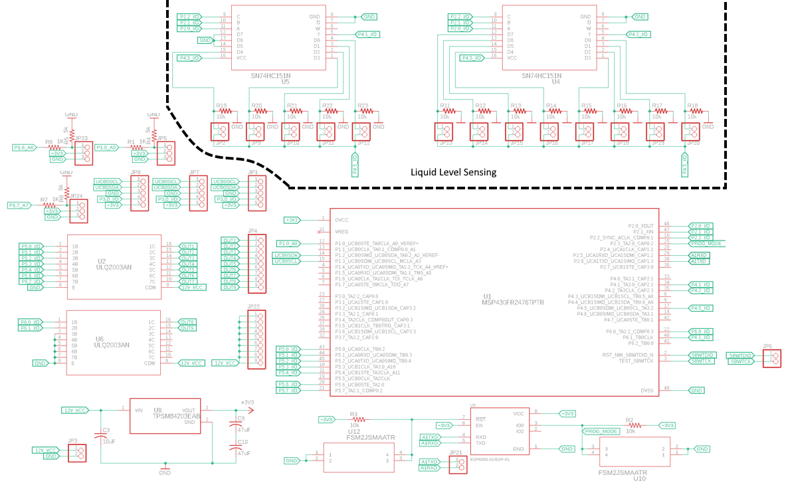
Schematic

Slide 42
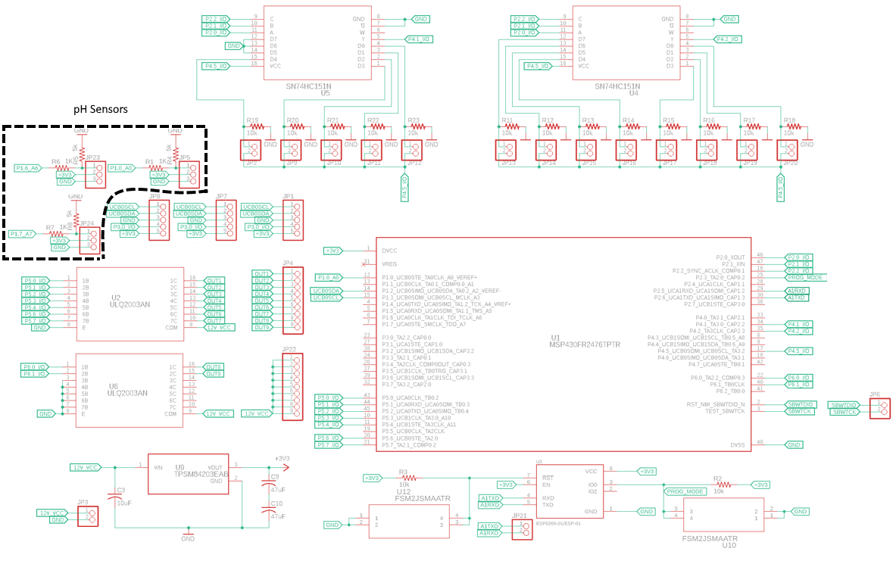
Schematic

Slide 43
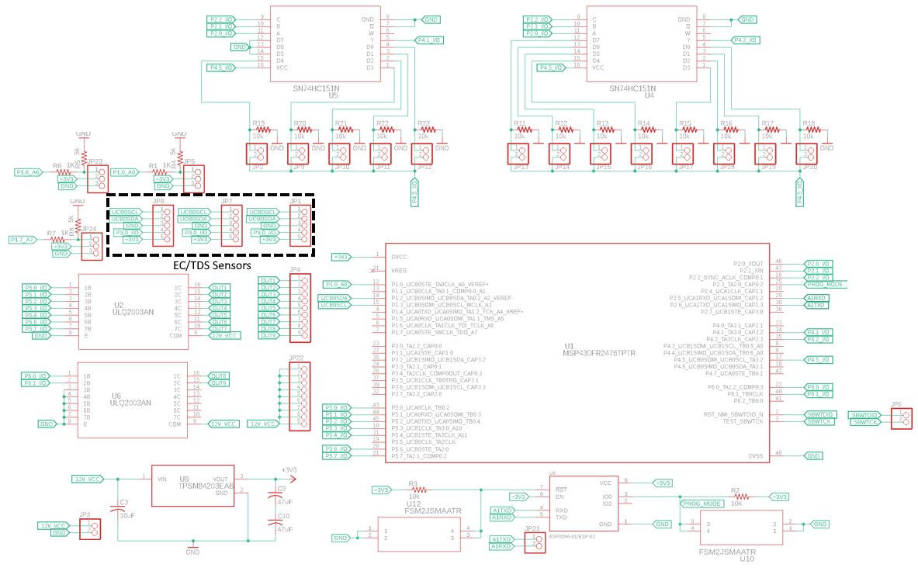
Schematic

Slide 44
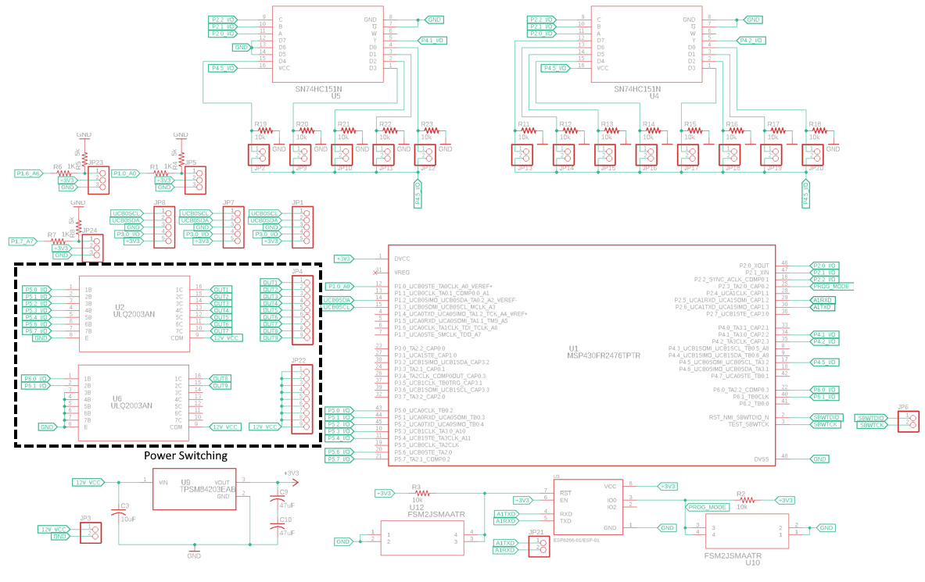
Schematic

Slide 45
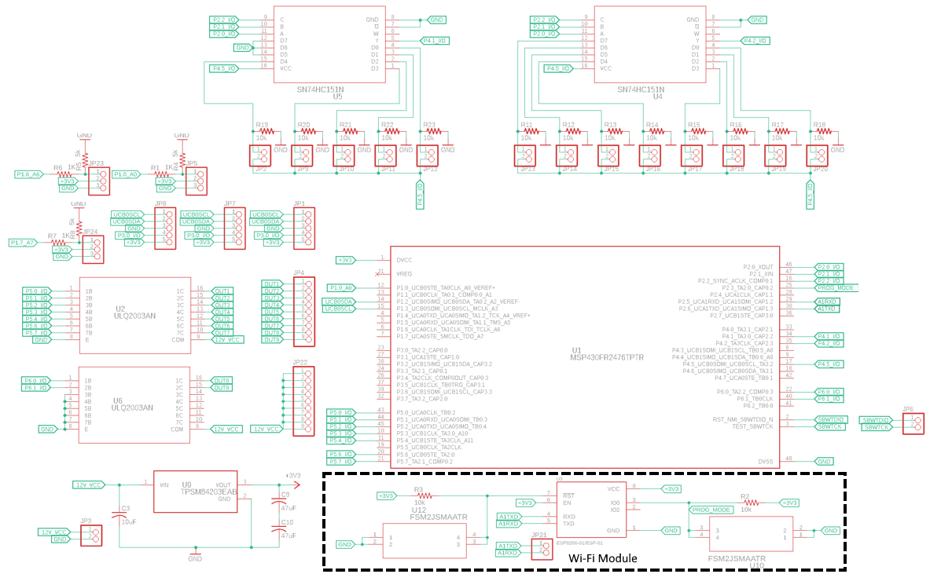
Schematic

Slide 46
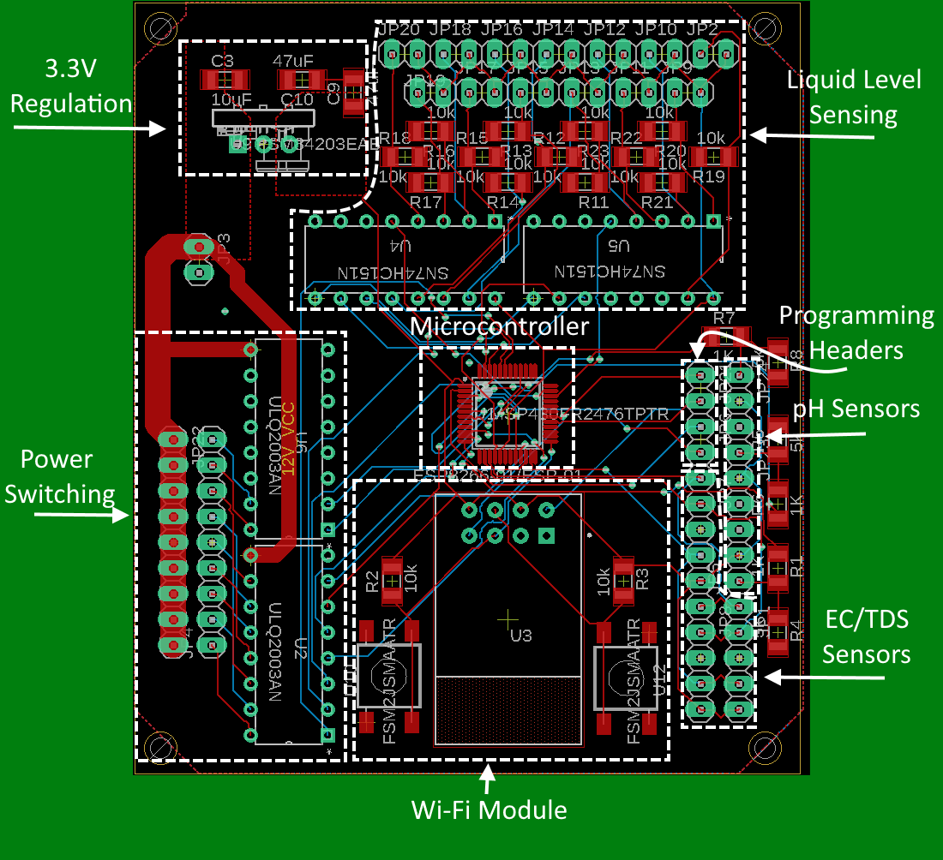
PCB

Slide 47
Software Approach
Both the MS430 MCU and MCU on the Wi-Fi module need software
MSP430FR2476
  Code written in Code Composer Studio
  Interrupt driven
    Timers, UART, ADC
    Facilitates use of low power mode
  Gather sensor data, control pumps, communicate with Wi-Fi module
ESP8266EX (ESP-01S Wi-Fi module)
  Code written in Arduino IDE
  Use HTTP to provide website
  Communicate with MSP430 MCU and user's device
    Information communicated with the MSP430 MCU includes plant profiles, and sensor data

Slide 48
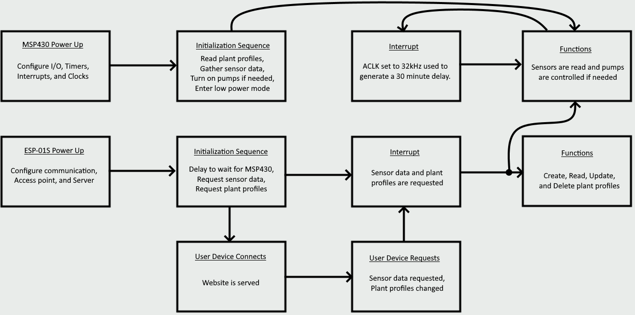
Software

Slide 49
Website
Languages include HTML, CSS, JavaScript, XML
Users can:
Manage sensors
  View time since last check
  View current levels
  Request updated levels
Manage plant profiles
  Create, read, update, and delete plant profiles
  Set current plant profile for the system

Slide 50
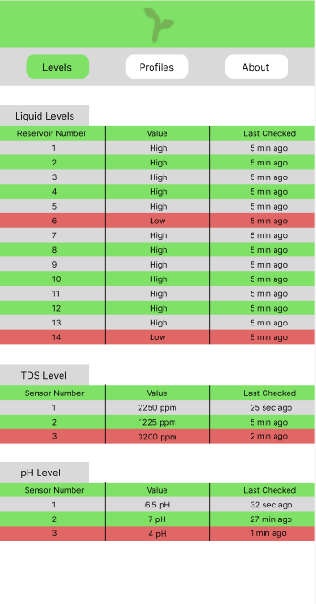


Website – iPhone view

Slide 51
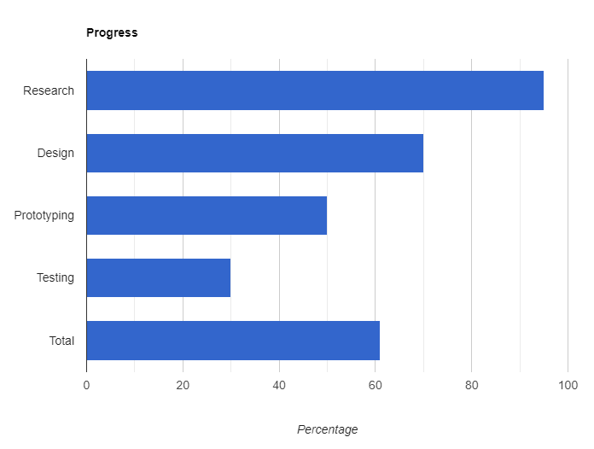
Progress

Slide 52
Budget
Item | Distributor | Price/Unit | # Units | Total Cost
Control System
TPSM84203EAB | Mouser | $8.04 | 1 | $8.04
FSM2JSMAATR | Mouser | $0.32 | 2 | $0.64
GRT31CR61H106KE01L | Mouser | $0.63 | 1 | $0.63
C3216X5R1E476M160AC | Mouser | $0.98 | 2 | $1.96
MSP430FR2476TPTR | Mouser | $3.45 | 1 | $3.45
CR1206-JW-103ELF | Mouser | $0.04 | 15 | $0.60
ULQ2003AN | Mouser | $0.81 | 2 | $1.62
SN74HC151N | Mouser | $0.60 | 2 | $1.20
0022284012 | Mouser | $0.04 | 74 | $2.96
CR1206-JW-102ELF | Mouser | $0.10 | 3 | $0.30
RT1206BRD075KL | Mouser | $0.62 | 3 | $1.86
ESP8266 ESP01S | Amazon | $3.00 | 1 | $3.00
PCB | JLCPCB | $4.98 | 5 | $24.88
Sensors
Liyafy Float Switch | Amazon | $2.00 | 13 | $26
SEN0169-V2 | Mouser | $64.90 | 3 | $194.70
pH Calibration Solution | Amazon | $15.84 | 1 | $15.84
ALAMSCN Dosing Pump | Amazon | $8.00 | 9 | $72
Conductivity K 1.0 Kit | AtlasScientific | $199.99 | 3 | $599.97
Item | Distributor | Price/Unit | # Units | Total Cost
Photovoltaic System
Topsolar Solar Panel Kit | Amazon | $199.99 | 1 | $199.99
Renogy Deep Cycle Battery | Amazon | $189.99 | 1 | $189.99
Voltage Stabilizer, DC 12V | Amazon | $49.99 | 1 | $49.99
Rainwater Collection System
Water Filtration | Amazon | $239.99 | 1 | $239.99
Raman Spectrometer | OceanInsights | $3900 | 1 | $3900
Building Supplies
Greenhouse | Aosom | $537.51 | 1 | $537.51
Manifold | Amazon | $64.97 | 1 | $64.97
Reservoir Bins |  | ~$43 | 7 | ~$300
PVC |  |  |  | ~$300
Additional Costs |  |  |  | ~$300
Project Cost | ~$7,042.09 |  |  | ~$7,042.09

Slide 53

Financing
The Oviedo Historical Society has committed $1500 to the project
A Raman Spectrometer is being borrowed
This drastically reduces the total to $1,642
Additionally, the costs associated with the project include implementing 3 separate hydroponic systems. Focusing on one system will allow us to further reduce the cost to roughly $612 as we can reduce the number of costly sensors as well as building supplies.

