Slide 1
SAFE-T
Secure, Anti-Theft, Flexible, Engineered Taillight
App-Controlled Taillight with Turn Signals for Bicyclists with Theft-detection
Group 34:
Jonathan Diaz (EE)
Jay Kurczy (EE)
Paul Wilson (CpE)
Brandon Therrien (CpE)
Notes:
Hello and welcome to the CDR of SAFE-T
INTRODUCE EVERYONE
Small it of info about how it is not just a taillight anymore

Slide 2
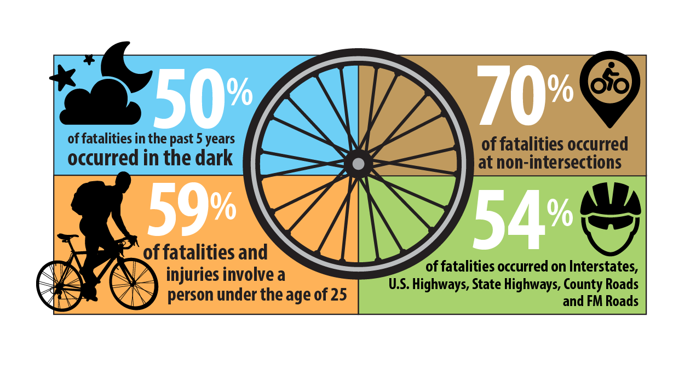
Problem / Motivation
Increase Visibility, Decrease Injury/Death of Bicyclists
Deter Bike Theft
Efficiently Combine Multiple Aspects of Bike Safety
Notes:
Project Motivation is the large number of preventable bicyclists fatalities which occur at nighttime which may be prevented or decreased with the addition of proper lighting which will not only allow the bicyclist to more clearly see their environment but also allow them to be seen by motorists.

Slide 3
Requirements
Software | Hardware
Support iOS And Android (iPhone 8+, Android API 28+) Maximum Size of 1GB Maximum RAM Usage of 512MB | Headlight output of at least 400 - 600 lumens Tail light output of at least 50 lumens Signal light output of at least 50 lumens 2000mAh Rechargeable Battery Recharge within 2 - 4 hours IPX6 Waterproof Alarm at least 100dB Smartphone Enabled

Slide 4
Goals And Objectives
Objectives
Interface with MCU wirelessly Remote control of lights Slider to adjust light brightness Compatible with Android and iOS Lightweight, easy to install Easy to use, very accessible Small and portable Waterproof and environment proof Tamper proof Front and Tail light Turn signal indicators Anti-theft alarm with motion detection
Notes:
The product is designed to be easily affixable

Slide 5
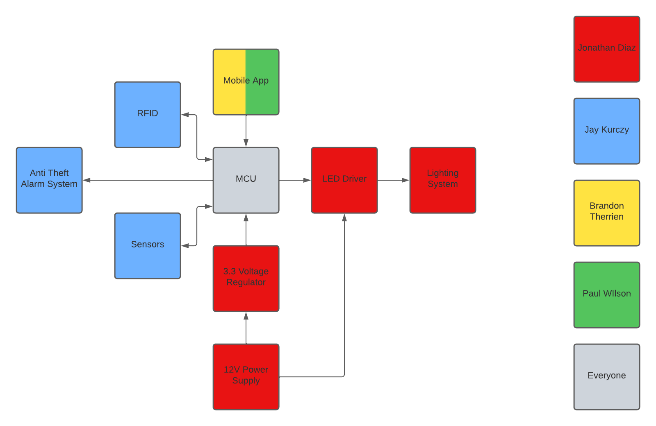
System Diagram

Slide 6
Software Design

Slide 7
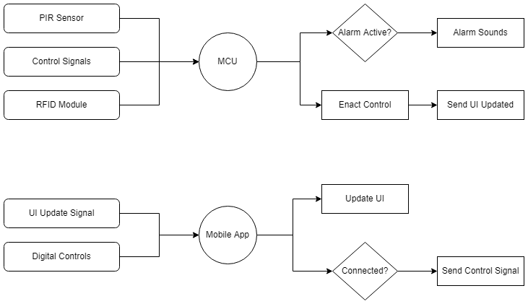
Software Block Diagram

Slide 8
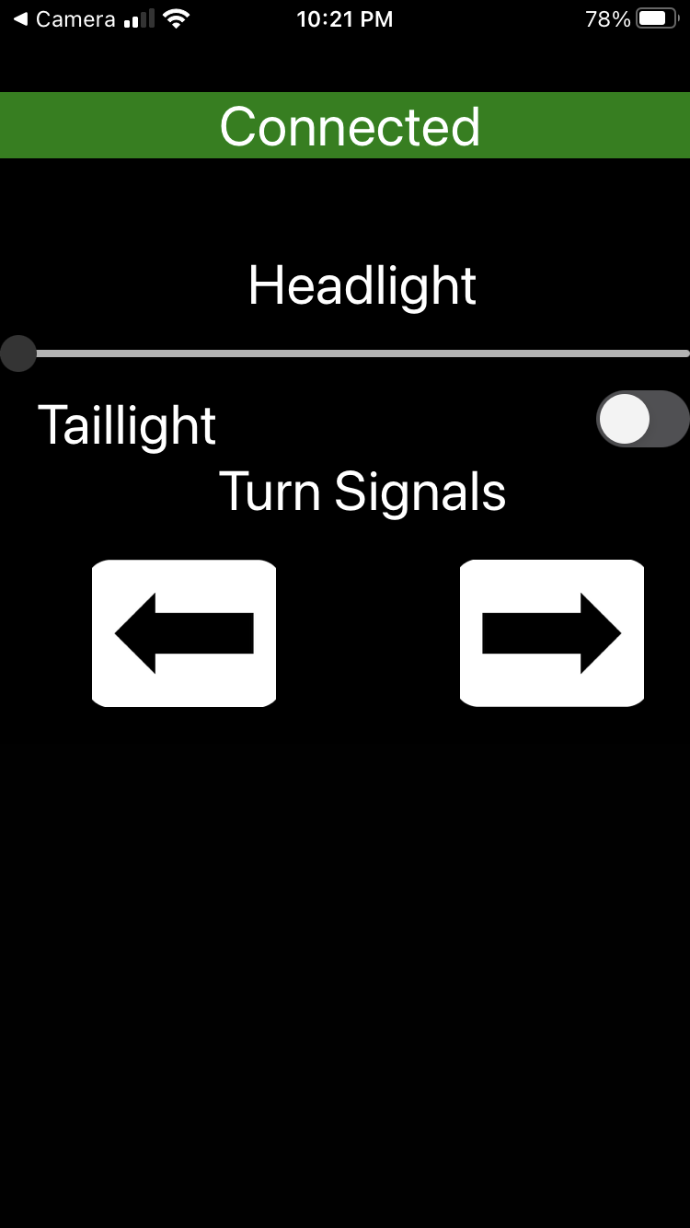
App UI Design
Design with Ease of Use in mind. Simplistic and intuitive controls define the main view screen

Slide 9
Mobile Application
Target Operating System Platforms: iOS and Android
Development Approach | Advantages | Disadvantages
Native Code | Performant Operating system vendor supported Software Development Kit (SDK) | Large in scope for two separate operating systems
Web-App | Easy to get an app up and running | Difficult to work with OS APIs
Cross-Platform Third-Party SDK | Allows for simpler code bases | Restricted in terms of capabilities

Slide 10
Cross-Platform Third-Party SDK Selection
Approach | Advantages | Disadvantages
React Native | Support for JavaScript and its superset TypeScript Works in the Node environment | UI library Requires additional libraries for other software components or at times native code
Flutter | Easy to create application with good UI | Uses Dart and its own development ecosystem
Xamarin | Provides complete application development tools and kits | Lack of experience with XAML/C#

Slide 11
MCU Software for the ESP32
Requirements
Simple, procedural code
Support for concurrency to interact with the optional mobile application
Approach | Advantages | Disadvantages
Custom Firmware | Can be written tailor made for the application in C or C++ | Time-consuming Must write everything from scratch
NodeMCU | Lua can easily be extended with C Widely-used with the chosen chip | Lua is slower for specific operations Interpreted
Arduino | Uses a C++ variant for programming Fast | More difficult to handle errors or crashes
MicroPython | Python programming language | Can be slower for certain operations Interpreted

Slide 12
Wireless Communication and Interface
Network protocols:
Bluetooth
Wi-Fi
Communication protocols:
HTTP(S)
MQTT
Bluetooth requires gateways for TCP/IP, which is used by both HTTP and MQTT, to work

Slide 13
Software Design Challenges
Issues with most third-party libraries
Restricted access to certain parts of the operating system
Relative lack of support
React Native is a UI library
This means either additional libraries or native code are required to interface with the components like Location, Bluetooth on both iOS and Android.
MCU Software Concerns:
Memory restrictions
Available libraries for the firmware

Slide 14
Hardware Design
Notes:
Hello my name is Jonathan Diaz and i am the electrical engineer for this project and i will be covering part of the hardware design

Slide 15
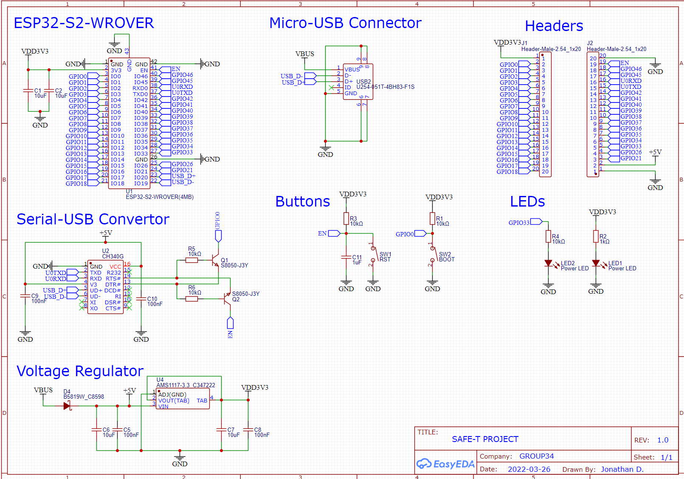
Microcontroller Board Schematic
Notes:
Here is the schematic that was designed for the project. This schematic together is the design of the microcontroller board
At the top left of the schematic is the microcontroller specifically the ESP32 s2 wrover
To the right of the microcontroller is the micro usb connector
Below the microcontroller is the serial usb converter that utilize transistors to create a logic so that the microcontroller can enter flashing mode or reset depending on the buttons pressed
The buttons are to the right of the serial usb converter, one button is the reset while the other is to have the microcontroller enter boot mode
At the bottom is the voltage regulator that will be converting 5V to 3.3V and output a steady current of 0.5A. The reasoning behind the two values is because that is what was specified for the ESP32 in its datasheet
the headers which will be used for easy accessibility of the ESP32 GPIO pins, gnd connections as well as the power pins like the 3.3V and 5V input
Lastly are the led indicators used for easy understanding whether power is being received for gpio33 and across the voltage regulator

Slide 16
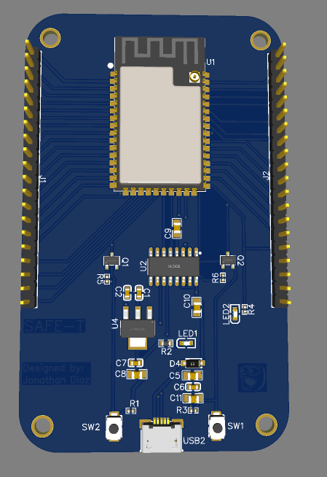
Microcontroller PCB Design
Notes:
Here is our first design for our microcontroller board
Everything was placed accordingly to reduce noise and have easy accessibility

Slide 17
PCB Design: Microcontroller Selection
Microcontroller will be utilized for the following:
LED Brightness Control
Alarm system
Bluetooth Communication
RFID
Microcontroller | ESP32-S2- WROVER | CC2640R2LRGZR
Price | $2.40 | $2.98
Core Speed | 240 MHz | 48 MHz
I/O Pins | 32 | 48
Flash Size | 4 MB | 128 KB
Operating Voltage | 3.3 V | 1.8 - 3.8 V
Notes:
We needed to select a microcontroller that is capable of being used as an LED PWM controller so that LEDs such as the headlights can have brightness options for various outdoor visibility such as night time with no street lights
We also need to be able to use a microcontroller as an alarm system which our project will consist of
This means having simple GPIO connections to communicate with a physical alarm and sensors for theft detection
Bluetooth communication is essential for the mobile app control for LEDs and arming or disarming the alarm
Lastly we will need simple communication with an RFID module to physically arm and disarm the alarm system for those who wish not to use our mobile app or don't carry phones on bicycle rides
The team decided to go with the ESP32-s2-wrover for the cost and flexibility on communication protocols in such that it supports UART, JTAG, I2C, SPI, etc
It also has more than enough GPIO pins for our project needs

Slide 18
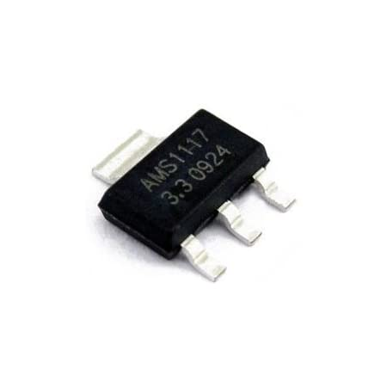
PCB Design: Voltage Regulator Selection
Voltage Regulator needed for the PCB design requires the following:
Capable of supporting input voltage 5V - 12V
Output voltage needs to be 3.3V
Fixed 0.5A output
Small footprint
Voltage Regulator | AMS1117-3.3
Input Voltage | Up to 15 V
Output Voltage | 3.3 V
Max Current | 1 A
Notes:
The voltage regulator selected for the PCB designed needed to be specifics in regards to the input voltage, output voltage, output current, as well as consideration for pcb space meaning small footprint
Specifically the input voltage needs to be able to handle anywhere from 5V to 12V
This is due to usb connections being 5V or so
And 12V is the incoming voltage from our selected power supply which is a rechargeable 12V battery
The output voltage needs to be 3.3V since that is what the MCU, specifically the ESP32-C3, requires based on the datasheet
The output current needs to be 0.5A again due to what the ESP32 C3 datasheet requires
And lastly a small footprint to minimize any spacing issue with our hardware due to wanting the overall project not being a hinder to a bicyclists mobility
Thus we chose the LM2574 3.3
Which as shown in the table can handle voltages up to 40V
It can output voltages 1.23V to 37V
And can output a steady fixed current of 0.5A
There were many other voltage regulators however due to chip shortage we ended with this selection for our voltage regulator

Slide 19
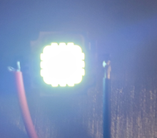
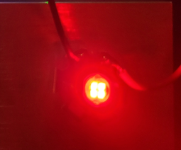
Parts Selection: LEDs for Lighting System
Headlight
Needs to output at least 400 - 600 lumen
Color: white
Tail light
Needs to output at least 50 lumen
Color: red
Signal Lights
Needs to output at least 50 lumen
Color: Yellow
Purpose | Power | Voltage | Current | Lumen
Headlights | 10 W | 9-11 V | 900 - 1100 mA | 900 - 1000 lm
Taillight | 3 W | 2.0-2.2V | 400 - 500 mA | 60 - 70 lm
Signal Lights | 3 W | 2.0-2.2V | 700 mA | 60 - 70 lm
Notes:
The lighting system will consist of headlights, tail light, and signal lights
Headlights will be designed in such that it will output at least 400 - 600 lumens and will be a white color
The tail light will output at least 50 lumens as well as a red color for clear visibility behind the bicyclists
And the signal lights will output at least 50 lumen and a yellow color
The leds chosen are all shown in the table starting with the headlight specification being 30-32 V with 700 mA and can produce 1600-1800 lumens
The tail light requires 2.0-2.2V and 1200 mA and output 115-120 lumens
And lastly the signal lights like the tail light can handle 2.0V to 2.2V but only require 700mA and produce 50-60 lumen
All LEDs chosen accomplish each of the requirements

Slide 20
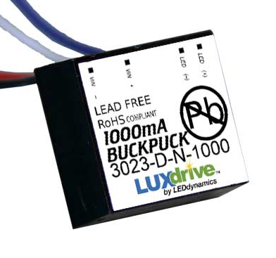
Parts Selection: LED Driver
For Headlights the LED driver will have:
Input voltage range 5-32V
Constant current output of 1000mA
Allows dimming through external control via digital/analog intensity control
For Tail Lights LED driver:
Constant current output of 500mA
ON/OFF can be controlled through 0-5V
For Signal lights LED driver:
Constant current output of 700mA
Notes:
The LED drivers are incredibly crucial for our lighting system in such that they essentially will intake a wide range of voltage and output steady current needed for the LEDs.
Starting with the headlight the team will be using a step up led driver to convert 12 v to 30-32 v with a current of 700 mA. Its also important to note that the led driver will also contain the option of PWM dimming for brightness control. This will be utilized since we want our project to range anywhere from ordinary urban city cyclists that ride at night to Bicyclists that don't have much street lights or live in rural areas.
To the right is the led driver that will be used for the headlight which is the LDH-45A-700W.
Next up is the tail lights which will utilize an LED driver that can step down 12 v to 2 to 2.2 v and output 1200 mA.
Lastly an LED driver for the signal lights with the same input and output voltages but can output 700mA

Slide 21
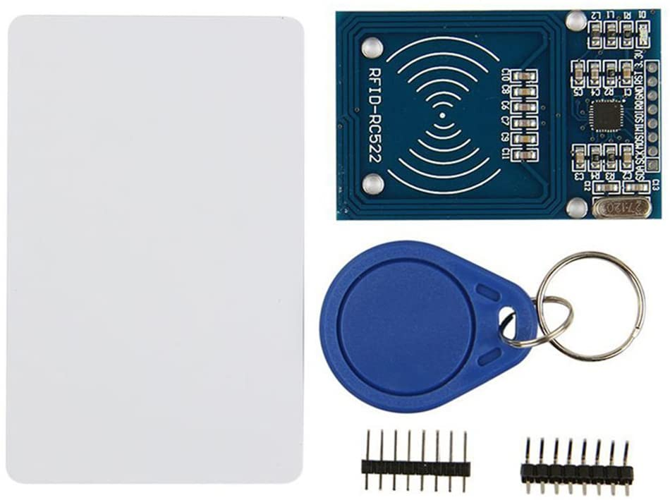
Parts Selection: RFID
HiLetgo RFID Kit
Includes:
Mifare RC522 RF IC Card Sensor Module
S50 Blank Card and Key ring
Low cost: $5.49
Uses SPI interface
Requires 3.3V
Notes:
The selected RFID is the HiLetGo RFID kit
This kit includes a RC522 RF IC card sensor module
It can read and write 13.56MHz contactless communication card
It comes along with Blank cards and a key ring
It was found on Amazon for a cheap price of $5.49, which fits within our project budget for RFID selection
It uses simple SPI interface so the ESP32-C3 can communicate with it easily
Lastly it only requires 3.3V at 13-26mA when active which our battery can handle

Slide 22
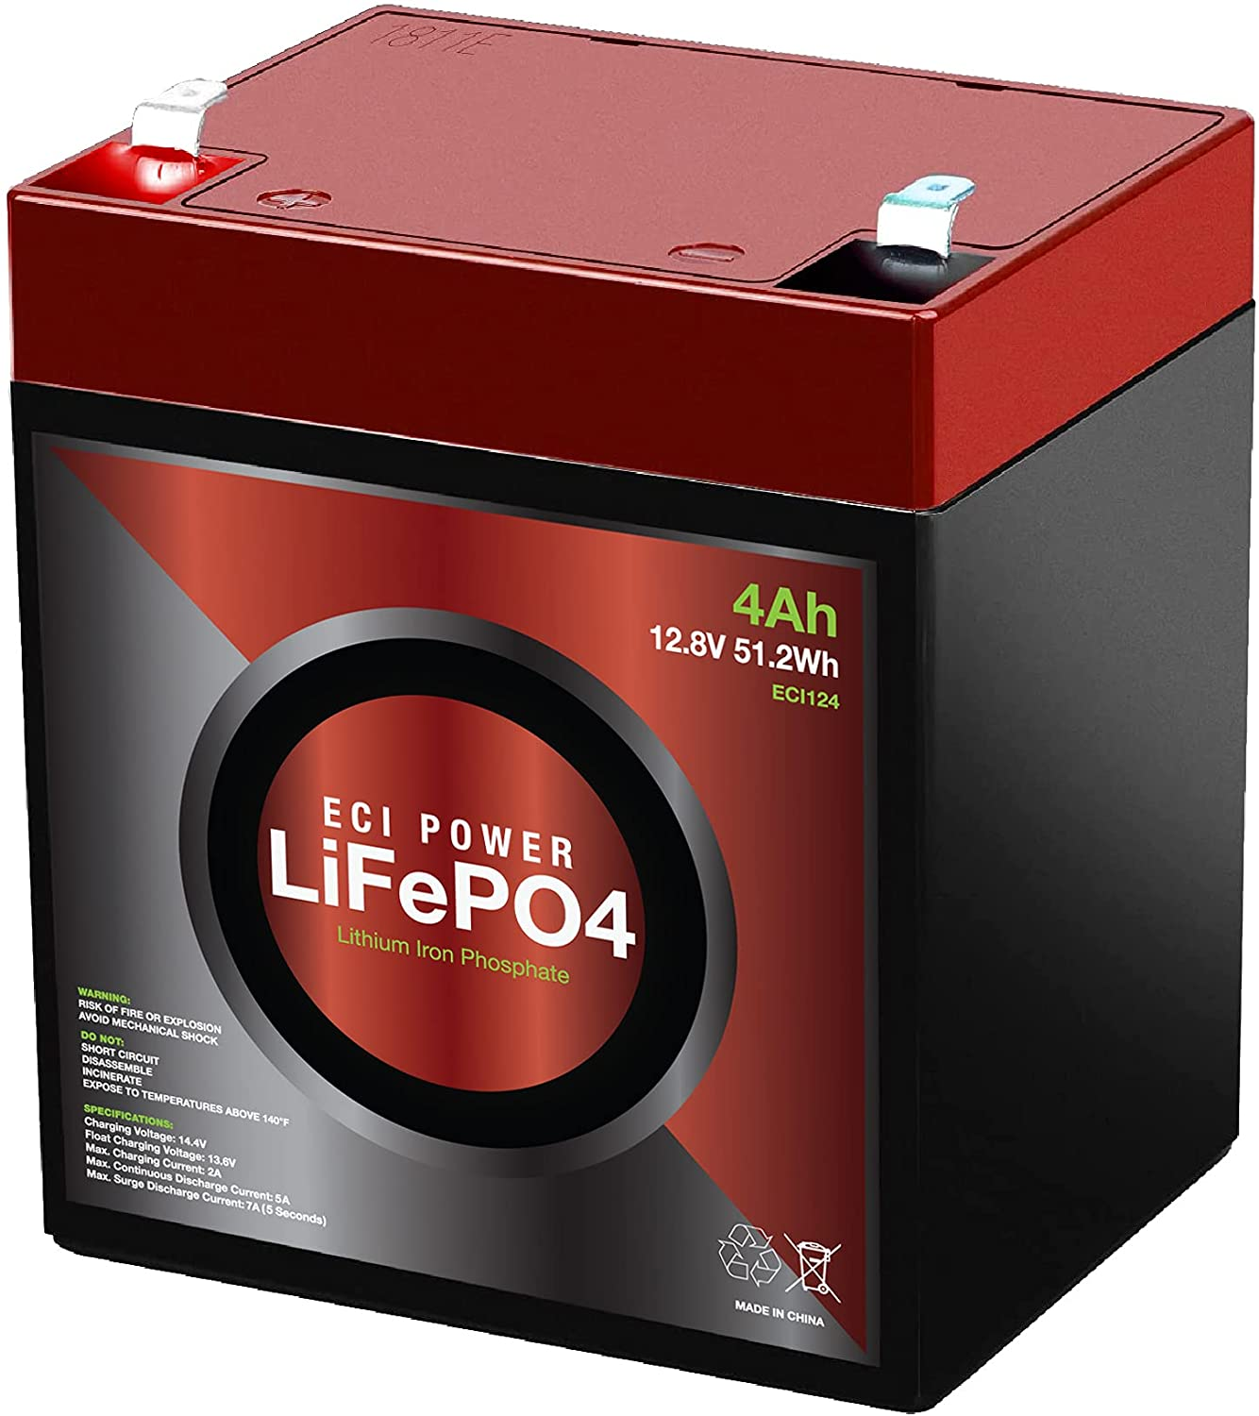
Parts Selection: Battery
Selected ECI Power 12V 4Ah Lithium LiFePO4 due to:
Low cost
Easily Mountable
Long Life (for design) 4 Amp-hours
Simple to charge
Battery | ECI Power 12V 4Ah Lithium LiFePO4 | AmazonBasics AA NiMH
Price | $29.99 | $34.99
Number in Pack/ Per Order | 1 | 24
Capacity | 4Ah | 2400 mAh
Voltage | 12.8 V | 1.2 V
Weight | 1.7 lbs | 1.52 lbs
Net Capacity | 4 Ah | 4800 mAh
Net Voltage | 12.8 V | 12.0 V
Notes:
The power supply for this project will be the ECI 12V 4Ah Lithium LiFePO4 battery
The cost of the battery was $29.99 on Amazon
This battery holds long battery life which 4Ah
Which is very much needed for parts of our project specifically the headlights due to how much power is needed for full brightness
It can be placed inside some form of housing that the team will design to support waterproofing
This housing will also be able to be easily mountable on the bicycle since the battery itself is 1.7lb
It is small and compact which benefits the project’s aim in reducing weight to the bicyclist while also helping the team design proper housing for strong sturdiness during bicycle rides
And it is rechargeable which is great for longer usability
We chose this batter over the amazon basic double A batteries because it's overall cheaper, has easier rechargeability, less complexity in such that the circuitry needed avoids connecting multiple AA batteries in series and parallel
It's also important to note that the battery life is fantastic

Slide 23
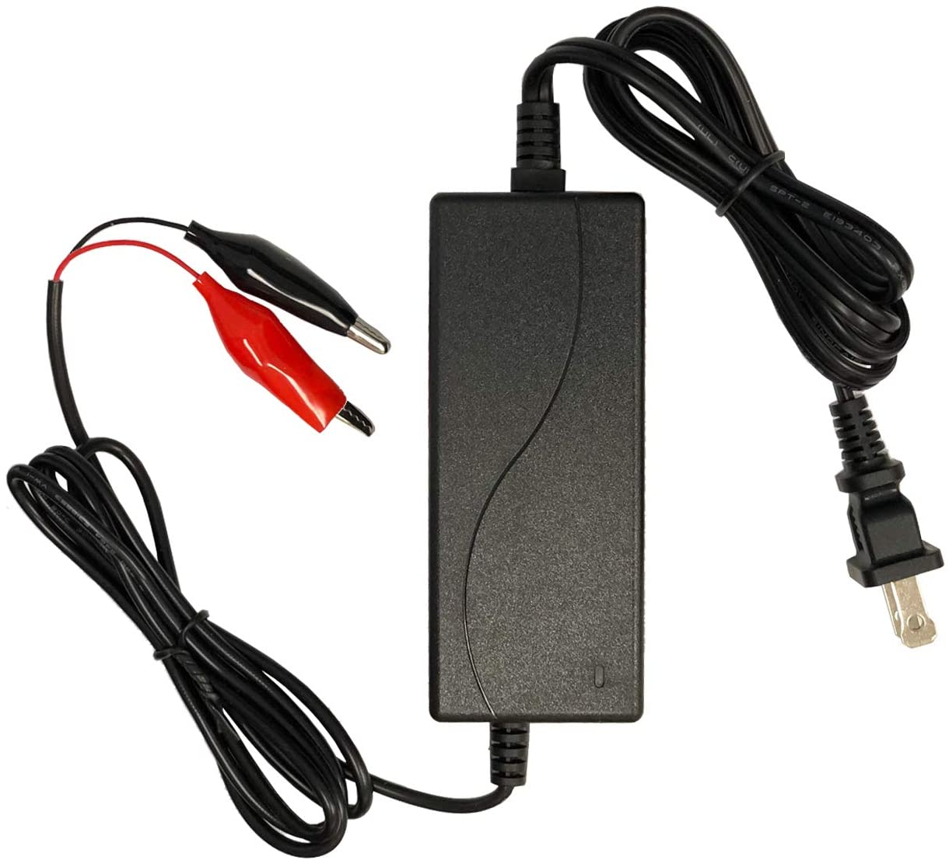
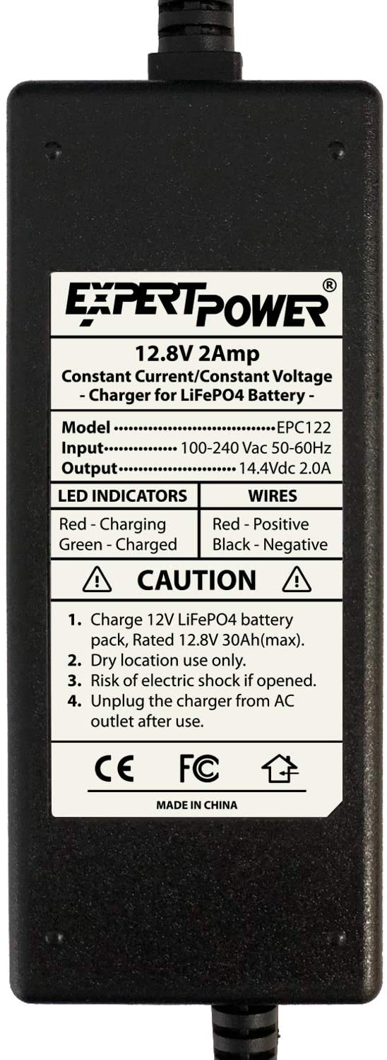
Parts Selection: Battery Charger
Smart Charger for Lithium LiFePO4 Rechargeable Batteries
Designed for 12V LiFePO4 batteries
12V 2A Lithium Charger
Smart LED indicators
Fast charge: 2 hours
Slow charge: 5 hours

Slide 24
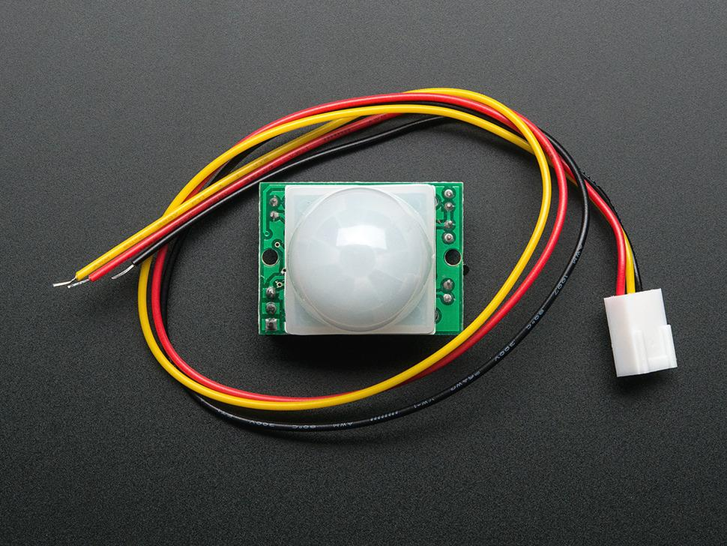
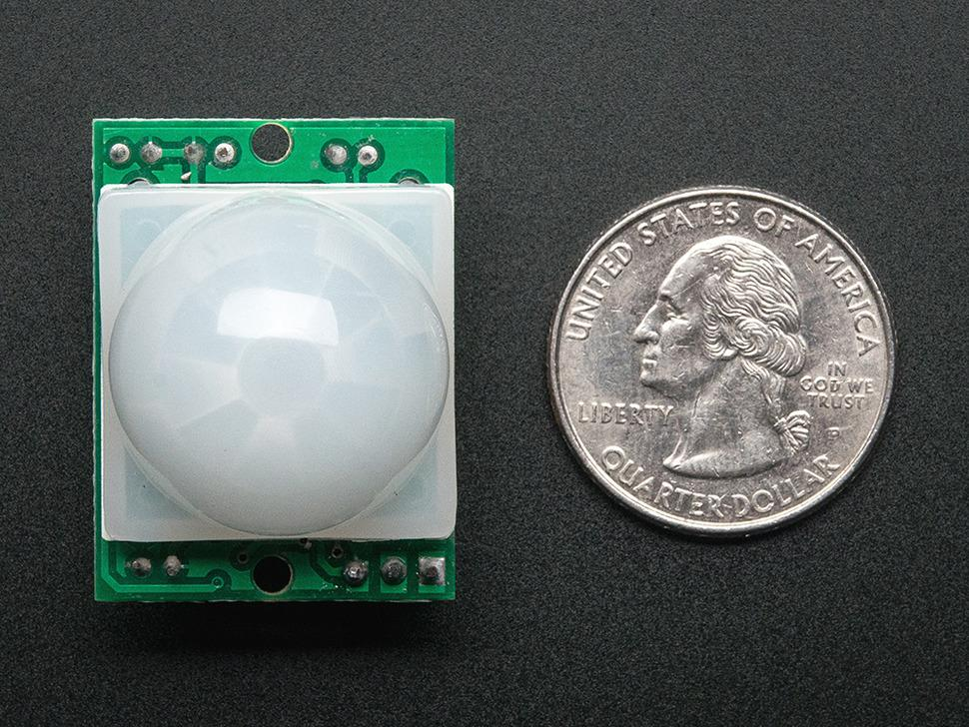
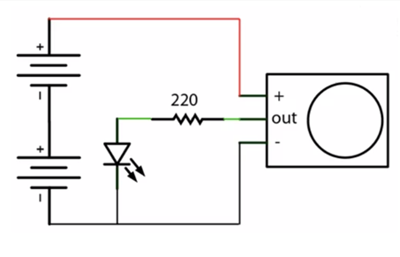
Theft Detection
A PIR (passive infrared sensor) placed on the bike, facing so that someone interfering with the bike will set off an alarm connected to the app.
Low-power, low-complexity device that is used commonly by hobbyists.
A separate IC chip that can be integrated into the other systems.
Low-cost sensor ($10) will be used due to price, availability, and power consumption (5v)
Small enough to be secured wherever needs be with minimal effort

Slide 25
Standards & Constraints
Constraints:
Economic:
Chip shortage: low stock & price increase
Utilizing the UCF labs
Time:
Chip shortage: increasing in shipping time
Standards:
Bluetooth
Lua
Typescript
USB-C
I2C
SPI

Slide 26
Hardware Design Challenges
Challenge | Solution
Global chip shortage | Find alternatives using different websites or other parts
Weight and space of hardware | Design of PCB takes account of space and weight Minimize Battery weight and space through selection
Battery life | Calculate power consumption of all aspects of the project

Slide 27
Administrative Content

Slide 28
Team Responsibilities
Jonathan Diaz EE | Jay Kurczy EE | Paul Wilson CpE | Brandon Therrien CpE
Primary: Hardware Secondary: LED Driver PCB Design | Primary: Hardware Secondary: Anti-Theft System RFID | Primary: MCU Secondary: Mobile App | Primary: Mobile App Secondary: MCU

Slide 29
Budget
Item | Quantity | Price
3D Printed Material Buttons MCU PCBs Main Battery Alarm Headlights Tail Lights Turn Signal Lights RFID Sensor Misc Hardware Bicycle LED Drivers | x Cubic Inches 5 1 x Layers, x Square Inches 1 1 1 10 10 1 2 x 1 4 | $15.00 / Cubic Inch $7.99 $10 $20 $50 < $5 $15 $10 $10 $20 $10 $20 OWNED $50
Total: |  | < ~$243

Slide 30
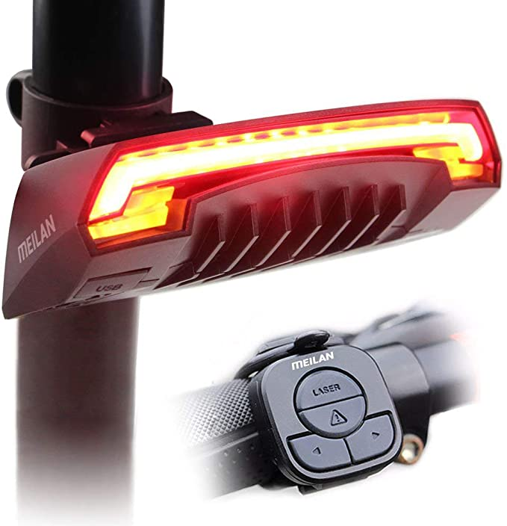
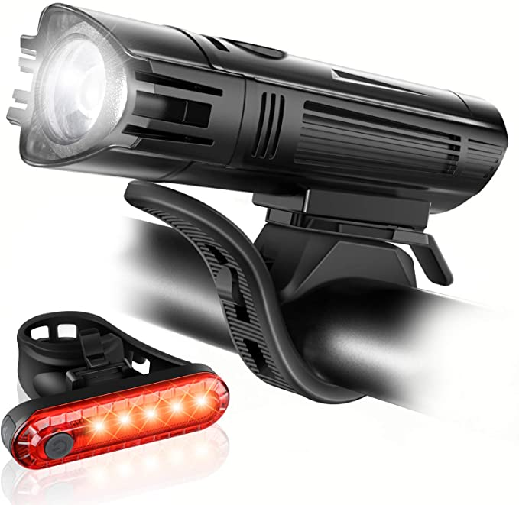
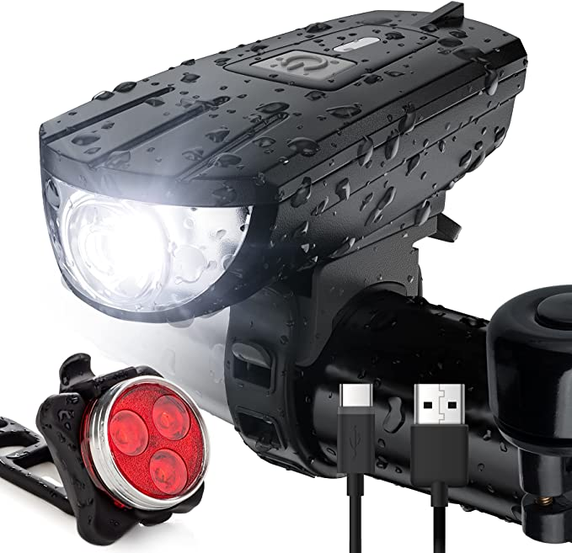
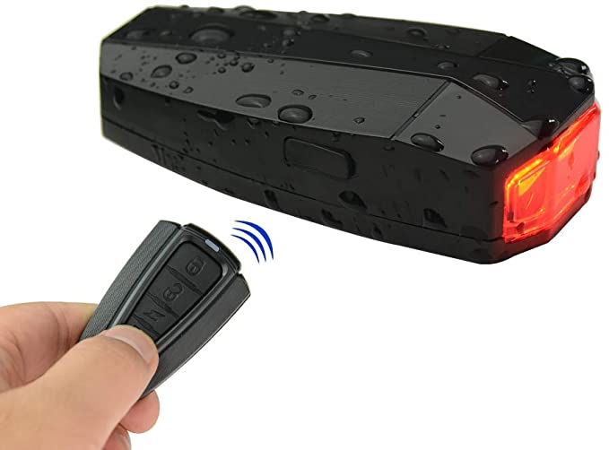
Competitors
Name | MEILAN X5 Smart Bike Tail Light with Turn Signals and Automatic Brake Light | Ascher Ultra Bright USB Rechargeable Bike Light Set | Intelligent Bike Tail Light | Vont Rechargeable Bike Light Set
Price | $36.99* | $18.99* | $22.99 | $17.99*
Functionality | Tail Light and Signals | Head and Tail light | Tail Light and Alarm | Head and Tail Light
Product Link | Link | Link | Link | Link
*Products on sale at time of making this slide

