Slide 1
Chromesthesia Simulation Device Mid-Term Demo
Group 27:
Nick Alban - EE
Wesley Ellery - CpE
Brooke Roeder - EE
Angel Garcia - CpE

Slide 2
Design Objectives
The purpose of our device is to take audio and visual inputs and produce a visual output to simulate the visual experiences a person with chromesthesia would experience.​
The way it will work is by combining audio input devices and an optical capture device on a single platform that can be oriented and pointed in any direction.

Slide 3
Hardware Integration

Slide 4
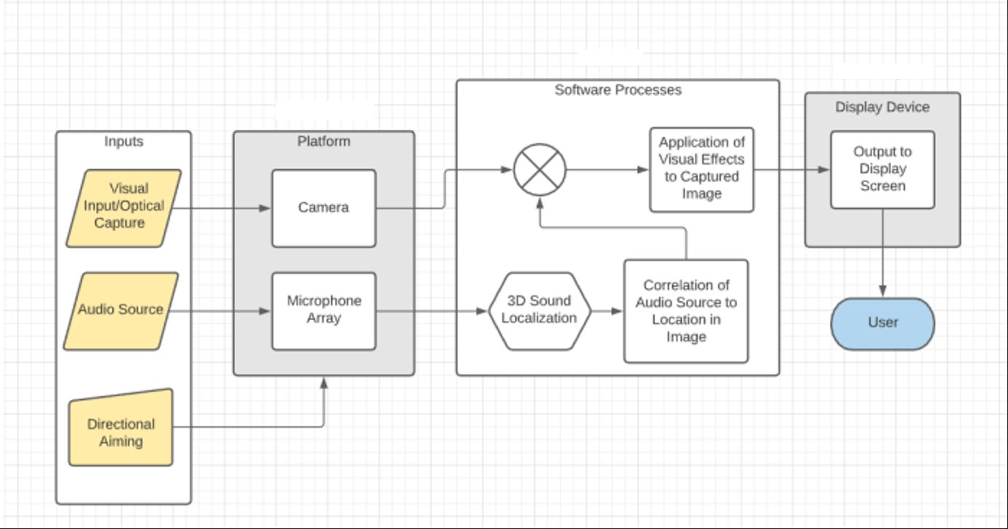
Hardware Block Diagram

Slide 5
Hardware Demonstration

Slide 6
Software Integration

Slide 7
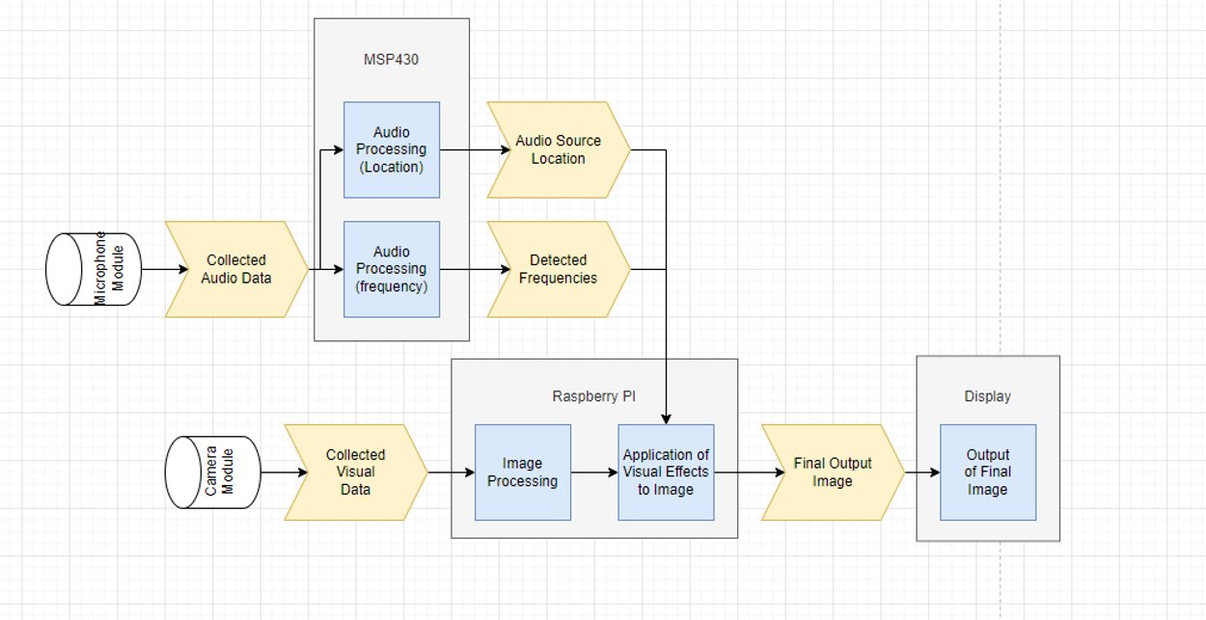
Device Functionality Block Diagram Progress

Slide 8
Device Functionality Block Diagram Progress

Slide 9
Software Used
Thonny - IDE for Raspberry Pi
Python 3
Library for camera module
OpenCV library for image editing and processing
MATLAB:
Testing and Analysis of data
Code Composer Studio (CCS) - IDE for MSP430FR6989
C

Slide 10
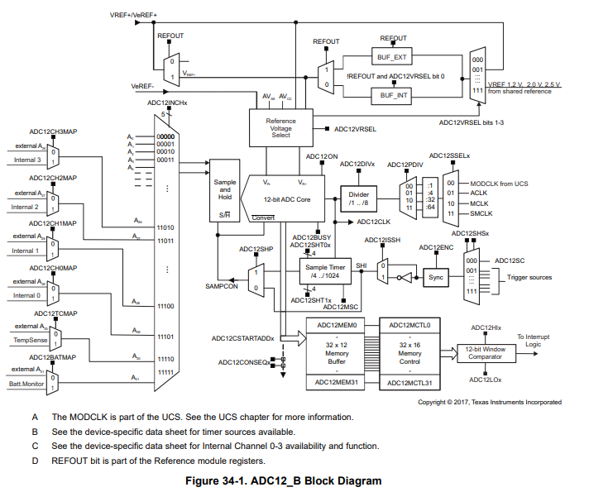
Processing of Analog Signals From the Microphone Using MSP430FR6989
The MSP430 is able to collect the analog output signal of the microphone
Performs ADC on the analog input signal
Can demonstrate reading these values using UART communication to the COM port in the CCS IDE

Slide 11
Fourier Transform to Obtain Frequency Values
Our project uses a Fourier Transform to obtain the frequency
Using C, the Fast Fourier Transform is used to take a sample of values and output a frequency

Slide 12
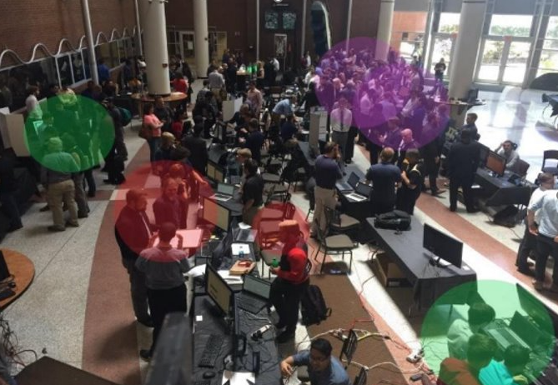
Object Identification
Identify objects and their location on screen using object detection library (currently using coco ssh)
Looking for other libraries with more “sound oriented” objects
Can use this to better estimate location of sound source and location on image to apply effects

Slide 13
Full System Integration - Next Steps
Printed Circuit Board has just been delivered. Still working on full integration into our system and the soldering of the MSP430.
3D Sound Localization
Device Housing
Designing and 3D printing the housing with proper dimensions
Code Tweaking for Efficiency
Cohesive integration

Slide 14
Thank You!

