Slide 1
Interactive Cat Toy
Notes:
Welcome to the Final Presentation for the Interactive Cat Toy project. -Vu

Slide 2
Senior Design Group #25
Aliza Grabowski
Computer Engineering
Embedded Software
Application Software
Joseph Lopez
Computer Engineering
Application Software
Application Connectivity
Vu Nguyen
Electrical Engineering
PCB Design
Power Supply
Embedded Software
Elizabeth Vargas
Electrical Engineering
Power Supply
PCB Design
Structural Design
VN
Notes:
Senior Design Group #25 members are two electrical engineering students including myself Vu Nguyen and Elizabeth Vargas…
… and two Computer Engineering Students: Joseph Lopez and Aliza Grabowski

Slide 3
SPONSOR Le Phan Mechanical Engineer and Author
Notably worked with the mechanical design of the Avatar ride at Walt Disney’s Animal Kingdom
Author of “How to Design Mechanisms that last a Lifetime: Practical Applications of Gruebler’s Count”
YouTube Channel Host https://youtube.com/channel/UCEYqGvJE61nq9rFS-z_2sSA
Notes:
We are extremely thankful to have our Sponsor working with us...
Le Phan is a … who… He recently published a book entitled… and hosts a YT channel where he demonstrates methods from his book.
Le has generously giving his time to take care of the mechanical design and 3-D printing for our project.

Slide 4
Motivation
It is estimated that:
373 million cats around the globe are kept as pets
with approximately 93.5 million pet cats here in the U.S.A.
This provides for a large number of pet owners
looking for toys to entertain their
fun-loving felines
AG

Slide 5
Meeting a Challenge:
Cat toys are a great way to help pet owners have fun and enjoy time with their cats, while helping their beloved felines get well needed exercise.
Finding the right toy to really attract a cat into play;
however, can be a tough challenge!!
Our Senior Design Team decided to meet this challenge by building an Interactive Cat Toy (ICT) that entices cats into playtime using a variety of luring features.
AG

Slide 6
Goals & Objectives:
Design an Interactive Cat Toy that cats can be entertained by and engaged in play with for hours.
Incorporate elements into our toy that are key to domestic cat entertainment.
Work to implement the current standards and the best safety factors that we can.
Design our ICT so that it can withstand rough cat play and last for a reasonable amount of time.
JL
Notes:
For our Senior Design Project, our Goals and Objectives are to…

Slide 7
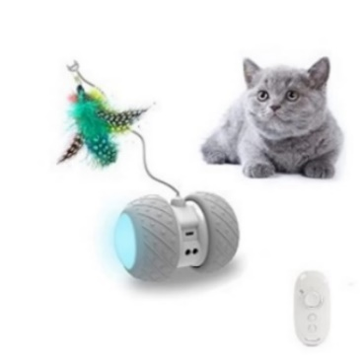
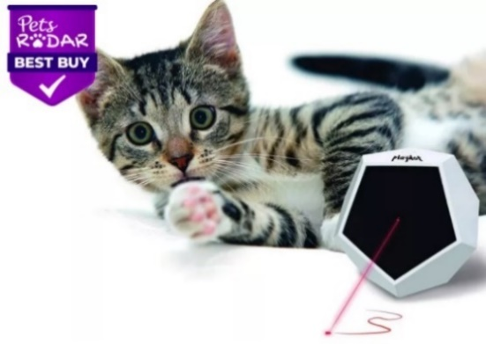
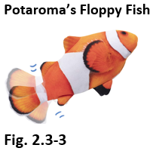
Market & Product Research:
 TOP RATED CAT TOYS 
PetDroid’s Robotic Cat Toy
Potaroma’s
Floppy Fish
Felix & Fido’s Playdot
Key Features
LED light effects
Motion
Interchangeable attachments
Laser light effects
Realistic Animal Design
Motion
Catnip Scented
Notes:
We performed market and product research, to help us plan the design for the Interactive Cat Toy.
This research helped us to identify key features that were proven to entertain cats.

Slide 8
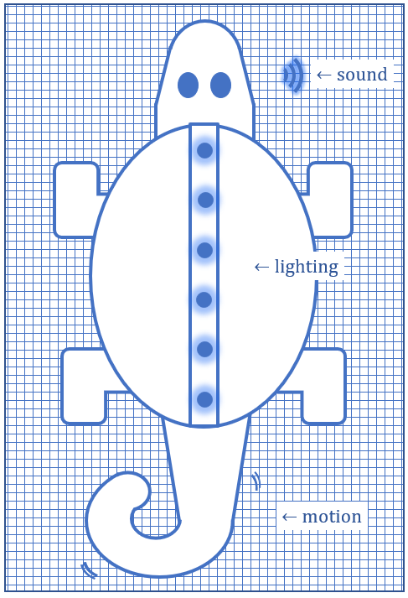
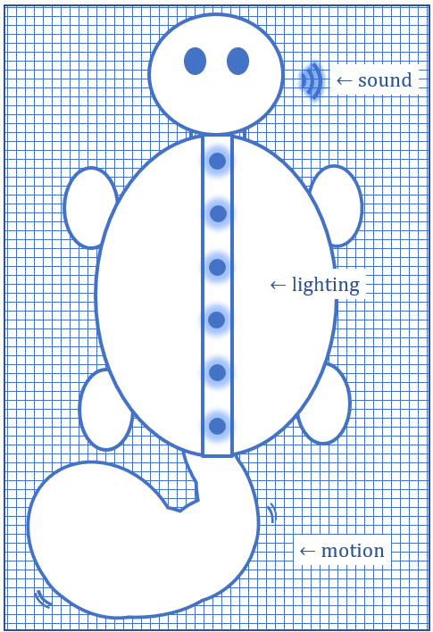
Project Design Overview:
Planned Features
Sound Effects
Lighting Effects
Toy Motion
Catnip Scenting
Interchangeable Skins
 Phone App Control
Notes:
We planned to incorporate all of the key features that we identified into the Interactive Cat Toy…
… and take our toy design further, by adding control of select features to a phone application.

Slide 9
Requirements Specifications:
Component | Parameter | Specification
Battery | Run Time - Full Charge | ≈ 8 hours
Feature Components
Lighting Effect | Light Output | < 10 Lumens
Lighting Effect | Illuminate Yellow Color | $≤$ 5 seconds
Speakers | Volume | $≤$ 60 dB
Motor(s) | Low Noise | $<$ 40 dB
Phone Application | Whole System Delay Time | $<$ 5 seconds
Motion Sensor | Detection Distance | $≤$ 4 feet
Notes:
This table lists some of the ICT’s Requirements Specifications.
Key engineering specifications for the ICT are highlighted in yellow. Vu
We will limit the lighting intensity to under 10 lumens.
Our whole system delay time for our phone application will be less than 5 seconds
Our motion sensor will detect motion within 4 feet.

Slide 10
Design
& Engineering

Slide 11
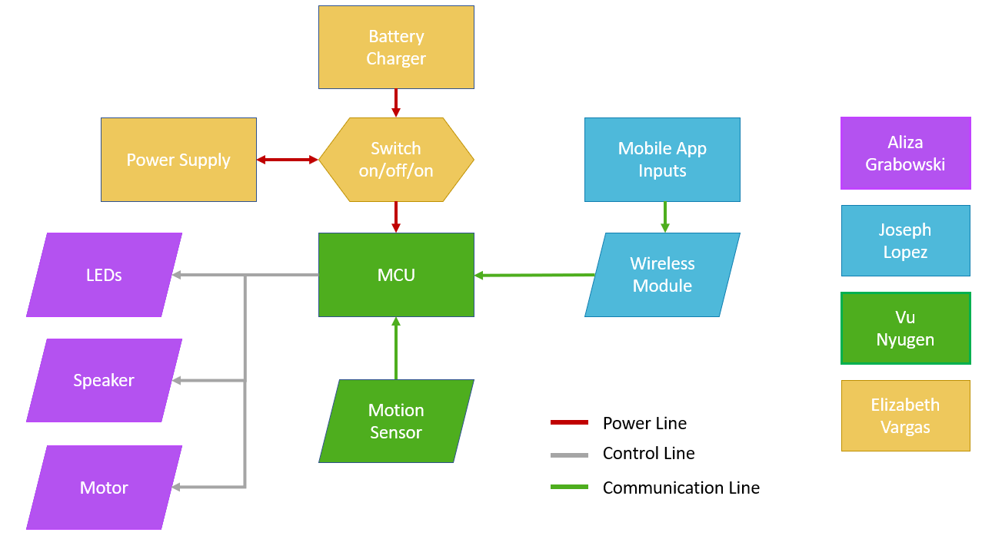
Hardware Block Diagram:
VN
Notes:
This is the Hardware Block Diagram for the ICT.
Central to our Hardware is the MCU on our PCB.
Our power supply is controlled by a switch which transitions between battery charging, being turned off and powering the toy.
The MCU is programmed to control feature component displays.
A motion sensor signals the MCU to activate the ICT from sleep mode.
A Mobile Application communicates to the MCU via a bluetooth module to allow a user to select different component display options.

Slide 12
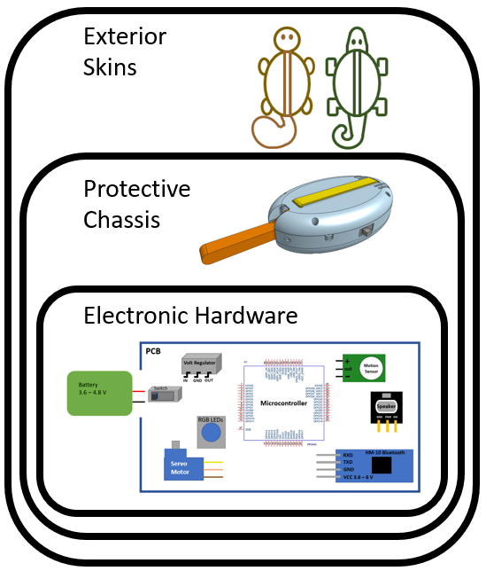
Hardware Design:
Hardware Layers
1. Exterior Skins
2. Protective Chassis
3. Electronics
VN
Notes:
The structural design of our Interactive Cat Toy includes three hardware layers.
Exterior skins will envelop a protective chassis, which will support and enclose all of the ICT’s electronics.

Slide 13
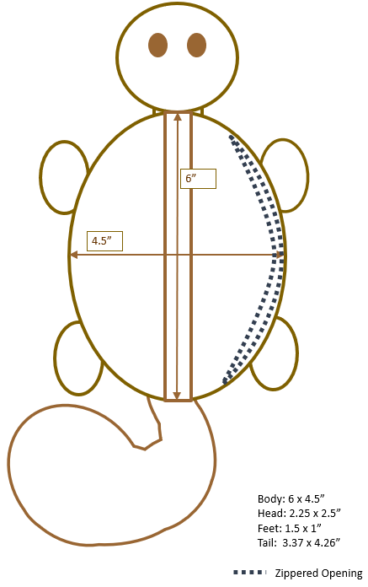
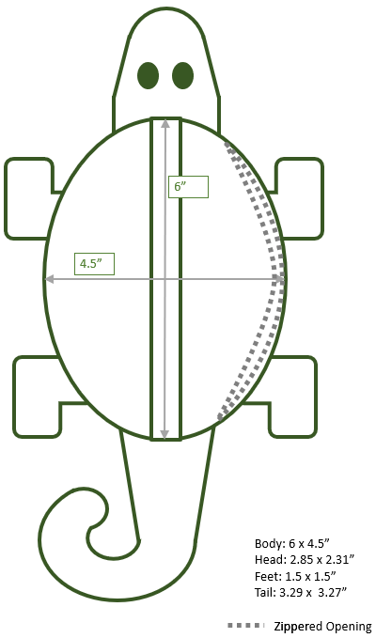
Hardware Level 1: Exterior Skins
Squirrel
Lizard
interchangeable
EV
Notes:
We decided to construct two interchangeable exterior skins for our Interactive Cat Toy.
We believe that this was a significant design decision that will provide valuable benefits to our toy:
The exterior skins are designed with the same measurements and a zippered opening, so that the chassis can be easily switched between them.
The skins are made of robust outdoor fabric to hold up to rough cat play…
… and they are also lined with cushioning to protect the chassis and electronic parts.

Slide 14
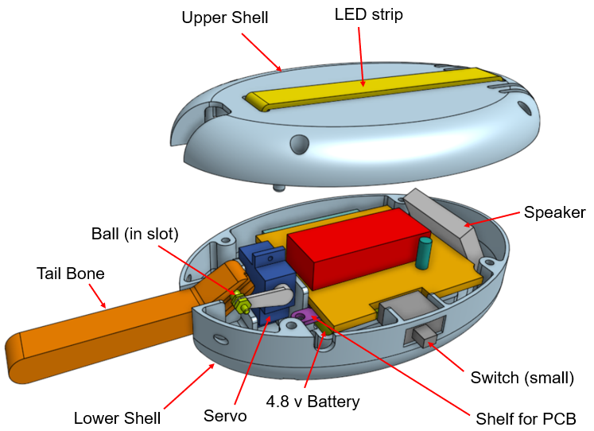
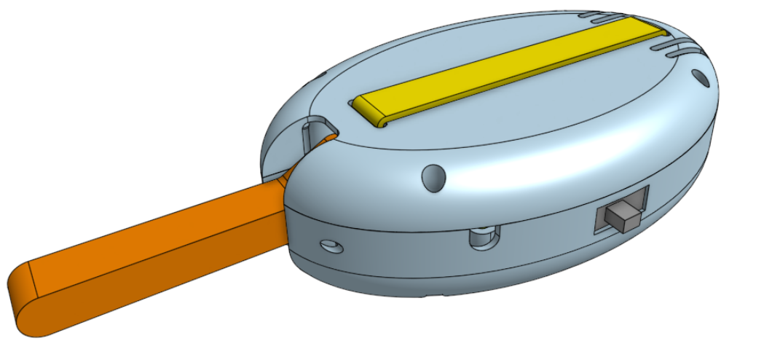
Hardware Level 2: Protective Chassis
Electronics Protection
Feature Support
Easy Fit
Mechanical Design and 3-D Printing Courtesy of our Sponsor, Le Phan
EV
Notes:
The chassis for our toy is designed to protect the electronics of the toy, to support toy features and to be easily switched between the toy’s interchangeable skins.
The mechanical design and 3-D printing of our chassis is being done by our wonderful sponsor, Le Phan.

Slide 15
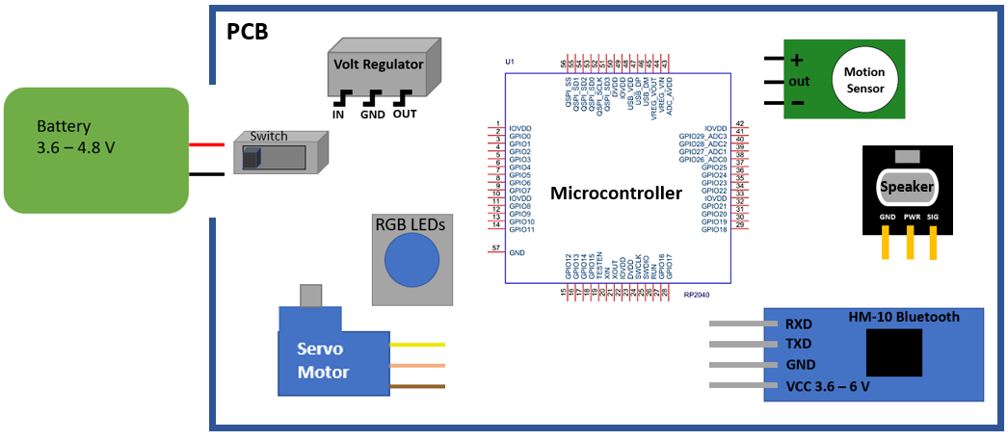
Hardware Level 3: Electronics
Notes:
Electronics for the Interactive Cat Toy include our Microcontroller and electronic feature components.
All feature components for our Interactive Cat Toy are RoHS compliant - ensuring environmentally safe products.

Slide 16
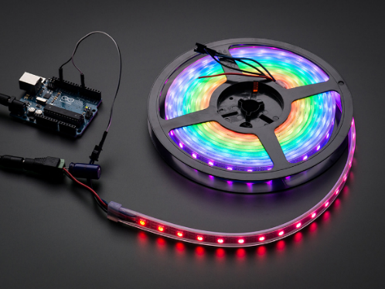
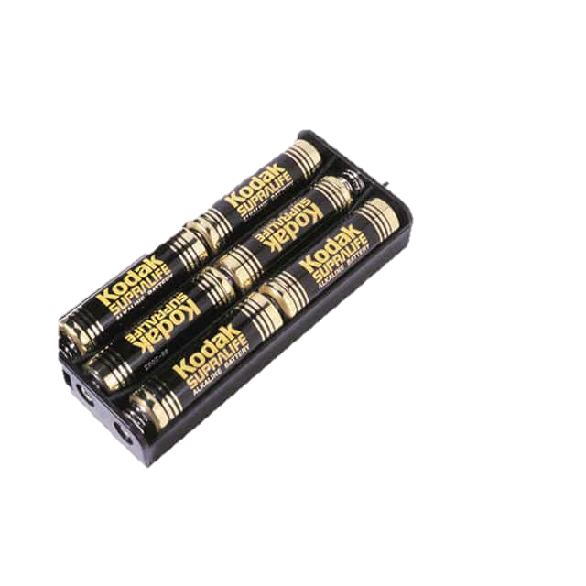
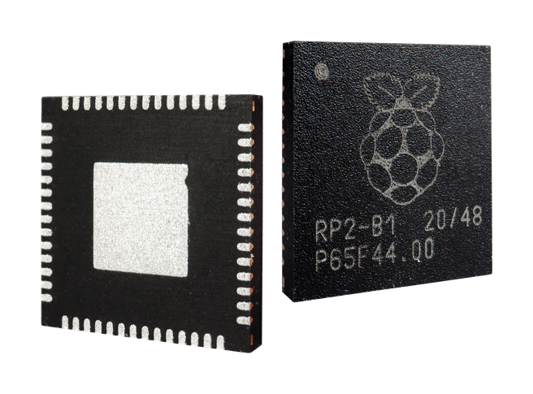
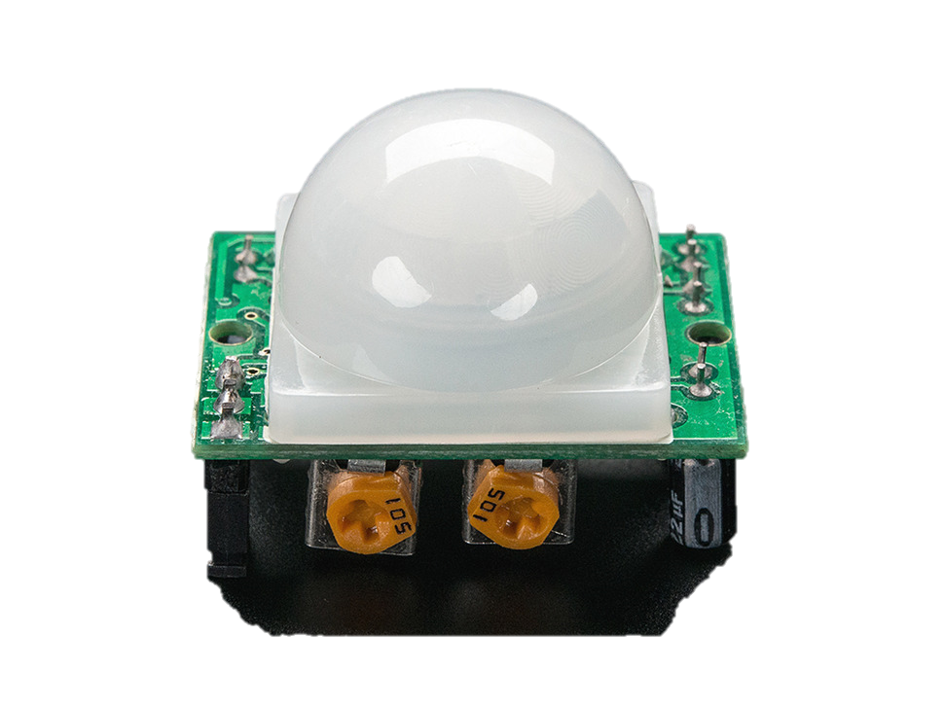
Component Selections:
Part Description | Selected Component | Vendor | ID #
Microcontroller | Raspberry Pi Pico | Digi-Key | 2648-SC0915
Printed Circuit Board | Self Designed PCB | PCB Way | n/a
Wireless Module | HM-10 Bluetooth Module | Amazon | B074VXZ1XZ
Power Source | Blomiky NiMH 4.8V 2200 mAH Battery Pack | Amazon | B0727NJ2MF
Speaker | STEMMA Speaker | Adafruit | 3885
Motor | Micro Servo Motor | Adafruit | 2307
Lighting | NeoPixel RGB LED Strip | Adafruit | 1461
Motion Sensor | PIR Sensor | Adafruit | 189
Chassis - 3D Filament | PLA | Amazon | B014VM9724
Exterior Skins | Outdoor Fabric, Polyester Belting etc. | Various | Various
VN
Notes:
The main hardware components that we selected to build the ICT are listed in this table.

Slide 17
Microcontroller
Product Description | RP-2040 | Trinket M0 | PIC18F16Q40
Vendor/ Manufacturer | Digi-Key / Raspberry Pi | Adafruit | Microchip
Vendor ID # | 2648-SC0915 | -- | --
Processor | Dual-core Arm Cortex M0+ | ATSAMD21E18 32-bit Cortex M0+ | 8-bit PIC
Dimensions | 21 mm × 51 mm | 27 x 15.3 x 2.75 mm | 7.2 x 5.30 x 1.73 mm
Operating Voltage | 1.8–5.5V DC | Up to 16V input | 1.8–5.5V DC
Watts / Amps | @ 5V ≈ 92.8mA | -- | --
Pins | 26 GPIO pins | 5 GPIO pins | 20 pins
Memory size | 264 KB SRAM, 2 MB flash memory | 32 KB RAM, 256 KB flash memory | 64 KB flash memory
Max frequency | 133 MHz | 48 MHz | 64 MHz
Programmable language(s) | C/C++, Python | CircuitPython, Arduino IDE | MPLAB IDE
Cost | $1.00 | $8.95 | $2.24
VN
Notes:
Among microcontrollers, the RP-2040 seemed to be the best option for us to use with the ICT.

Slide 18
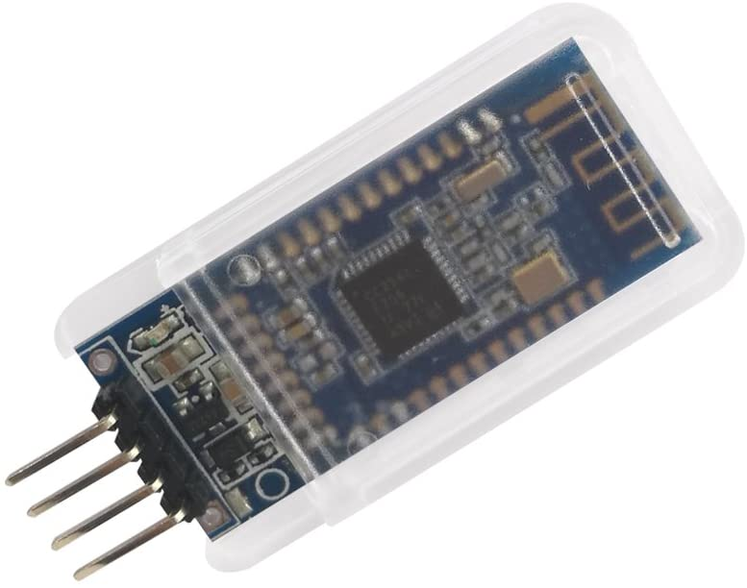
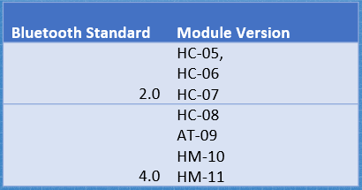
Wireless Communication:
Product Description | HC-05 | HM-10 Bluetooth Module | Bluetooth Low Energy
Vendor/ Manufacturer | Amazon / DSD tech | Amazon / DSD tech | Adafruit
Vendor ID | B01G9KSAF6 | B074VXZ1XZ | 2479
Dimensions | 26.9 x 13 x 2.2 mm | 1.5 x 0.6 x 0.1 in | 21 x 32 x 5 mm / 0.8" x 1.26" x 0.2"
Operating Voltage | 3.6 - 6V | 3.6 - 6V | 5V safe input with 3.3 Voltage regulator
Watts/Amps | 30mA | 30mA | Avg: 1.86 mA Peak: 15.2 mA
Transmission speed | 2.1 Mbps | 2.1Mbps | not listed
Operating frequency | 2.4 GHz | 2.4GHz | not listed
Phone Compatibility | Android | iPhone, Android | iPhone, Andriod
Cost | $9.99 | $11.49 | $17.50
IEEE Standard for
Low-Rate
Wireless Networks
Low Power Consumption
JL
Notes:
Originally we decided to go with the HM-10 Bluetooth Module, but the modules we purchased had connectivity issues.
Though they claimed to have iPhone compatibility, we could not get our iPhones to find the Bluetooth connection.
We settled with selecting the HC-05, compatible only with Android phones.
IEEE Standard for Low-Rate Wireless Networks applies to our project.
Side Note: It is recommended to use HM 4 and above for today’s cell phone compatibilities

Slide 19
Speaker Selection:
 | STEMMA Speaker | Mini Metal Speaker | Dynamic Speaker
Vendor | Adafruit | Adafruit | Digi-Key
Manufacturer | Diodes Inc | AricZhu | Soberton Inc.
Part Number | 3885 | 1890 | SP-1605
Dimensions | 37 x 30.5 x 7.2 mm 1.46” x 1.2” x .28” | Diameter: 28mm 1.1” | Diameter: 16mm .63”
Weight | 7.5g | 8g | N/A
Operating Voltage | 2.0 - 5.5 V | .25 V | .89V
Watts/Amps | 1 Watt | 0.5 Watts | 0.8 Watts
Impedance | 8 Ohm | 8 Ohm | 8 Ohm
Frequency Range | not listed | 600 Hz – 10 KHz | 300 Hz – 8 KHz
Volume Control | Screwdriver adjustable | - | -
PCB Connection | Need additional wire purchase | attached wires | attached wires
Shape | Oval / Stadium | Circle | Circle
Accessories | Class D Amplifier | - | -
Datasheet with EagleCAD File | Yes | No | No
Cost | $5.95 | $1.95 | $1.73
Notes:
For the sound feature of the ICT, we selected to use Adafruit’s Stemma Speaker with it’s included class D Amplifier.

Slide 20
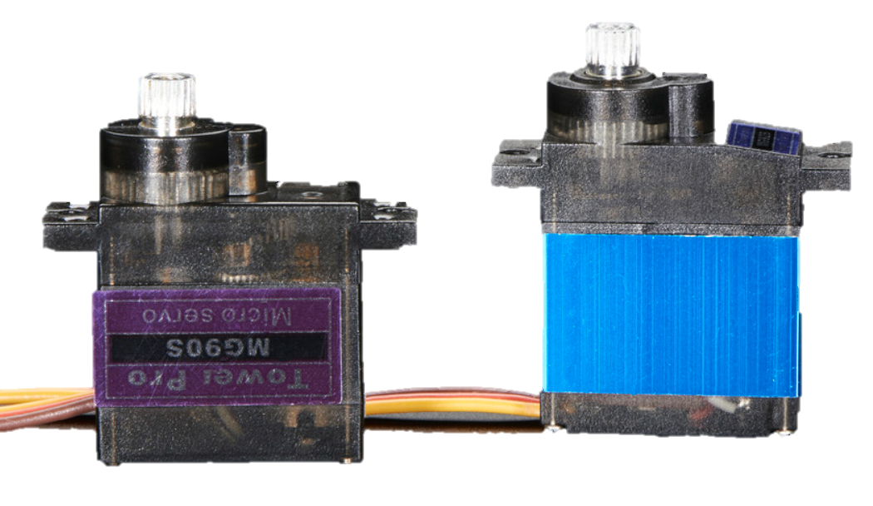
Motor Selection:
PURR-FECT!!!
Product Description | Brushless DC Motor | Micro Servo Motor | Stepper Motor
Vendor/ Manufacturer | BC Robotics | Adafruit/ Tower Pro | Digi-Key / Adafruit
Vendor ID | ROB-211 | #2307 | 1528-1366-ND
Manufacturer ID | A2212/15T | n/a | #858
Dimensions | 40 x 27.5 mm 1.73” x 1.1” length x Diameter | 1.4” x 0.5” x 1.2” | 29 x 28 mm 1.14” x 1.1” length x Diameter
Range of Motion | 360° 930 RPM/Volt | ≈ 180° | 360°
Operating Voltage | 2 - 12 V DC | 5.0 ≈ 6.6 V | 5 V DC
Watts/Amps | 109 W | not given* | not given*
Accessories | motor mount + | 3 Horns included | mounting plate
Cost | $12.95 | $11.95 | $4.95
Notes:
We selected to go with the Tower Pro micro servo motor from Adafruit to facilitate tail motion for our cat toy.
Servo motors allow for embedded code to use PWM to control positioning of the gears, giving us just what we needed to correctly simulate tail motion.
This micro servo motor is ideally sized and has robust metal gears, so it seemed purr-fect for the ICT.

Slide 21
Lighting Selection:
Product Description | NeoPixel RGBW Mini Button LEDs | 5M WS2811 RGB IP68 LEDs | NeoPixel Digital RGB LED Strip
Vendor/ Manufacturer | Adafruit | Banggood | Adafruit
Product ID | 4776 | 1346213 | 1461
Dimensions | 9.1 mm x 9.1 mm x 3.1 mm | 5.0 m | 12.5 mm x 4.0 mm x 16.7 mm
Operating Voltage | 5.0 V | 6.5 V | 5.3 V
Watts/Amps | 70 mA each | 1.0 µA | 21 W / 60 mA each
LED Used | SK6812 | WS2811 | WS2812
LED Count | 10 pack | 50 LEDs | 60 LED/meter
Individual Control / Addressable | yes | no | yes
Weight | 0.3 g | 39 g | n/a
Cost | $4.95 | $22.99 | $24.95

Slide 22
Motion Sensor Selection:
Product Description | PIR & Mini-PIR Sensors | Ultrasonic Distance Sensor | Medium Vibration Sensor Switch
Vendor/ Manufacturer | Adafruit | Adafruit | Adafruit
Product ID | 189 | 4007 | 2384
 | 4871
Dimensions | 24*32*25 mm | 45*20*15mm | 5 mm diameter by 0.2” height
 | 13.8 mm diameter
Operating voltage | 5 -20 V | 5V | none
 | 3 - 12 V
Signal output voltage | 0v –3.3V | -- | na
Current consumption | 65mA | 15mA | none
 | not given
Current when is not active | 50µA | -- | open
 | not given
Sensitivity range | 7 m /120° cone | 2cm-400cm / 15° cone | 0 ft - Tap Sensor
 | 5 m / 100° cone
Delay time | 5sec - 5min | -- | --
 | 2 secs
Working frequency | -- | 40Hz | --
Contact Time | Na | na | 2 - 2.5 ms
Cost | $9.95 | $3.95 | $0.95
 | $3.95
Notes:
For our motion sensor we decided to use a PIR sensor…
… this sensor has an adjustable range and a wide area of detection.

Slide 23
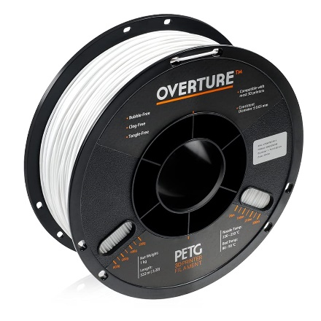
3D Printing Filament:
Product Description | PLA | PETG
Vendor/ Manufacturer | Amazon.com / Hatchbox | Amazon.com / Hatchbox
Vendor ID | ASIN: B00J0GMMP6 | ASIN: B014VM9724
Manufacturer ID | 3D PLA-1KG1.75-WHT | 3D PETG-1KG1.75-WHT
Dimensions | 1.75mm diameter X 1KG (2.2 lb)Spool | 1.75mm diameter X 1KG (2.2 lb)Spool
Color | White | White
Attributes | Sturdy | Flexible
Recommended Nozzle Temperature | 180° - 210° C 356° - 410° F | 230° - 260° C 446° - 500° F
Cost | $22.99 | $23.99
Notes:
Initially we selected PETG to print our chassis, assuming it’s slightly better flexibility would make it more robust for the ICT.
When printing, though, the chassis was too rough and fiberous… so we switched to PLA.
Side Note: PLA is made from edible material; however, processing may make it not safe for consumption. Because our chassis will be within an exterior skin we will not work to make it “Food Grade”. (ok with Dr. Wei)

Slide 24
Power Supply:

Component Power Usage Estimates
Component | Voltage (V, DC) | Current (mA) | Apprx Use min/hr | Fraction of Hour in Use | mAH Needed
Microcontroller | 1.8 – 5.5 | 93 | 60 | 1 | 93
Speaker (animal sounds) | 2 - 5.5 | 30 | 5 | 0.0833 | 2.5
Motor | 3 - 6 | 90 | 10 | 0.1667 | 15
Lighting | 5.3 | 60 | 30 | 0.5 | 30
Motion Detector | 5 - 20 | 65 | 60 | 1 | 65
Blue Tooth | 3.3 - 6 | 30 | 60 | 1 | 30
30% Margin | V + ≈ 1 V | 101 | -- | -- | 62
Total Needed | ≈ 6 - 7 V | 469 | -- | -- | 297
Current for 8 Hours |  |  |  |  | ≈2400 mAH
Battery should operate ICT for 8+ hours when fully charged.
 Enough time to entertain a cat during a typical work day.
EV
Notes:
To determine our needed power supply we added the approximate power usage for each of the toy’s electronic components plus a 30% margin
(as advised by Dr. Wei, to cover leakage current and various voltage drops)
We reasoned that the battery should power the ICT for about 8 hours on a full charge…
…this would allow enough time for entertaining cats during a typical work day.

Slide 25
Power Supply: Battery Selection

Ni-MH Safer for
Kitty Playtime
Rechargeable Battery Comparisons
Nickel Metal Hydride (NiMH) | Lithium-Ion
Large | Small
Heavy | Light
Moderate Volatility - Pop and Burn | High Volatility – Explosive
Less Costly than Li-Ion | More Costly than NiMH
 Rechargeable batteries are standard in most electronic cat toys today.
EV
Notes:
We compared NiMH and Li-Ion rechargeable batteries as a power source for our project…
And selected NiMH due to it’s lower volatility and cost.
We selected a rechargeable battery because that is the standard for most electronic cat toys on the market today.

Slide 26
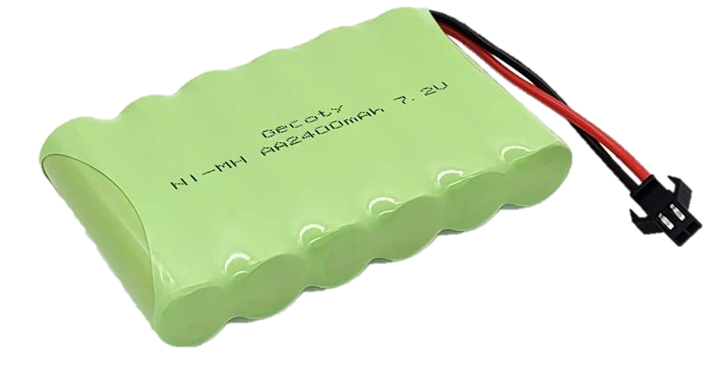
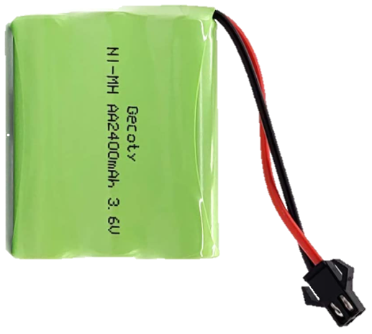
Power Supply: Battery Selection

NiMH Battery Pack Comparison
7.2 V 2400 mAH | 6 V 2200 mAH | 4.8 V 2200 mAH | 3.6 V 2400 mAH
Too Large for ICT | Still Too Large for ICT | Good Fit for ICT | Great Fit for ICT
Too Heavy @ 200 g | Too Heavy @ ≈ 130 g | Acceptable Weight @ 100 g | Very Good Weight ≈ 70 g
Voltage Reg - Buck | Voltage Reg - Buck | Voltage Reg - Boost | Voltage Reg - Boost
Out
of Stock
Other 3.6 V NiMH Battery Packs did not offer more than 1000 mAH
EV
Notes:
For our battery selection we considered 7.2 to 3.6 V battery packs with similar current ratings.
We preferred to go with the 3.6 V pack, however, it was out of stock and other 3.6 V packs did not offer more than 1000 mAH… this would only guarantee powering the ICT for about 3 hrs.
For now we decided to go with the 4.8 V battery pack for our prototype. This pack is a good fit for the ICT with an acceptable weight at just under 100 g.
Side Note: Battery holders were too large. With the holder for even 3 AA cells being as large as the 7.2 V battery pack.

Slide 27
Power Supply: Voltage Regulation

Voltage Regulator - Boosting 3.6 or 4.8V to 5.2 V
Switching Regulator
Higher efficiency than linear regulator.
Reduces need for heat sink.
Efficiency: 95.6%
EV
Notes:
The voltage regulation circuit has been designed to accommodate boosting power from either a 3.6 or a 4.8 V battery pack, in case a 3.6 V pack should become available to us.
We employ a switching regulator because of higher efficiency and the reduction in need for a heat sink.
We boost the voltage to 5.2 V, accounting for possible for voltage loss over the circuit, in order to properly supply enough voltage to power a 5V voltage bus.
Side Notes:
Need for heat sink is reduced with switching regs b/c their transistors operate in saturation and cut-off modes (lin regs operate in active mode)
Voltage loss occurs over circuit and schotky diode between Vsys and Vbus on the PICO. We may be able to conform our features’ embedded programming to work with the direct connect of the 4.8 V battery only -- need further system testing done to determine.

Slide 28
Power Supply: Battery Charger

Design and Build?
Basic NiMH Battery Charging Circuit Components
Regulated AC-to-DC Power Supply
WEBENCH assisted design for the complex circuitry
Flyback Control → Circuit Isolation ✓
Current Control (extra important for NiMH chemistry)
Relatively simple circuit to design and test
Voltage Regulation
Design with WEBENCH
Overcharge and Thermal Protection
Multiple Techniques Require Significant Study
- Timer - Thermal Detection - Neg. Delta Voltage Detection – Trickle Charging
Sensitive monitoring for constant current essential for NiMH batteries
Out of Stock
Components
Almost A Senior Design Project in Itself
EV
Notes:
We considered designing and building a battery charger for our project, however, NiMH battery charging is significantly complex. Basic Charging Circuit Components include: Reg… Current Control… Voltage Regulation and O & TP.
Should we undertake designing and building a charging circuit for our battery, a considerable amount of time would be required to study the various charging techniques used for the process and to perform testing.
Building this circuit would almost be a SD project in itself.
… And currently, dealing with component supply issues, it would be even more difficult to compose such a circuit.

Slide 29
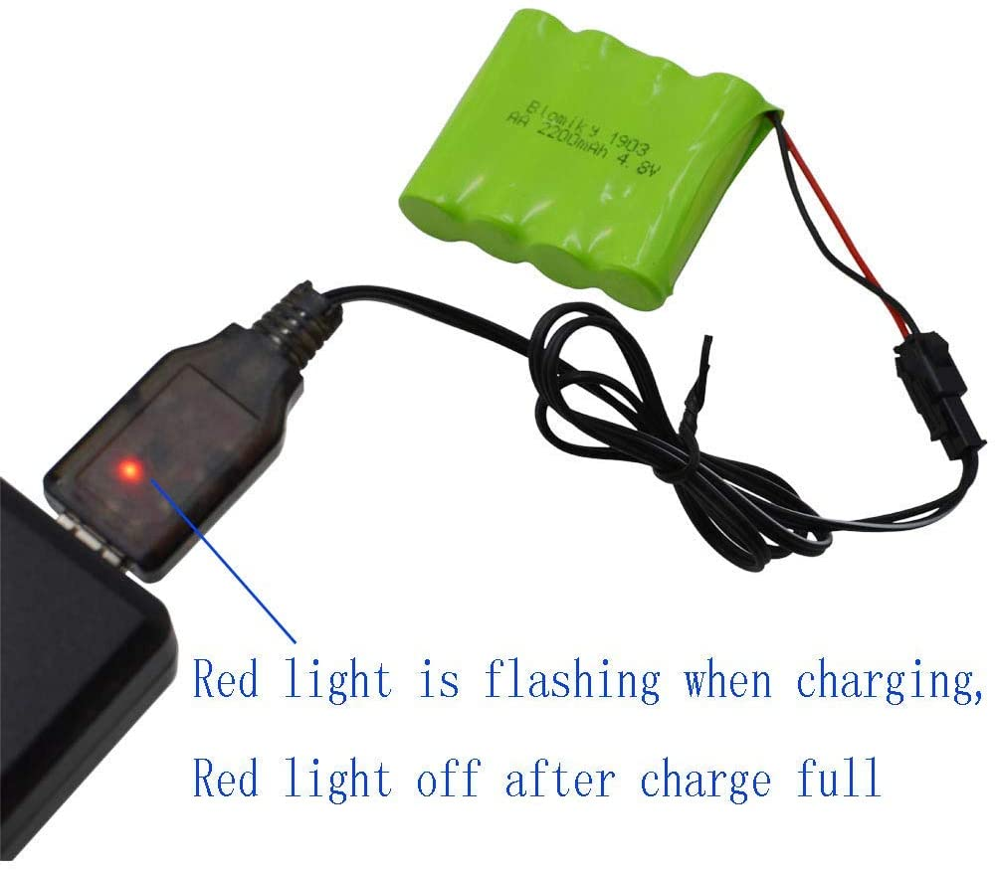
Power Supply: Battery Charger

IN STOCK
!!!
Built-in
Overcharge
Protection
EV
Notes:
Due to the complexity of designing and building an NiMH battery charger we decided to use a pre-fabricated USB charger that is sold with the battery pack we selected. (Ok’d by Dr. Wei)
…with built-in over-charge protection and an indicator light to alert when charging is complete…
…this seemed to us, to be the optimal choice of charging the battery for our project.

Slide 30
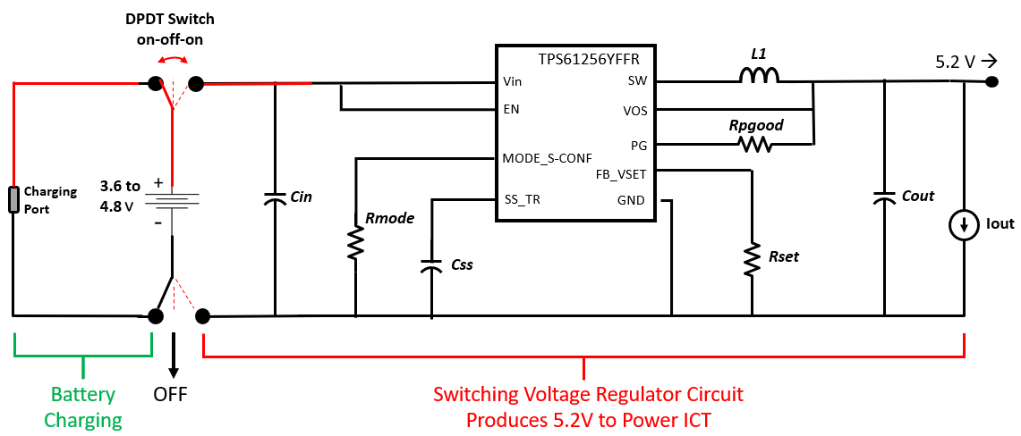
Power Supply: The Circuit

EV
Notes:
Our power supply circuit for our project is designed to be switched between three positions.
The first position allows for battery charging, the second position switches the ICT “Off”…
… and the third position enables powering the toy through a voltage regulator.
Side Note: Can be adjusted to work with 3.6 V

Slide 31
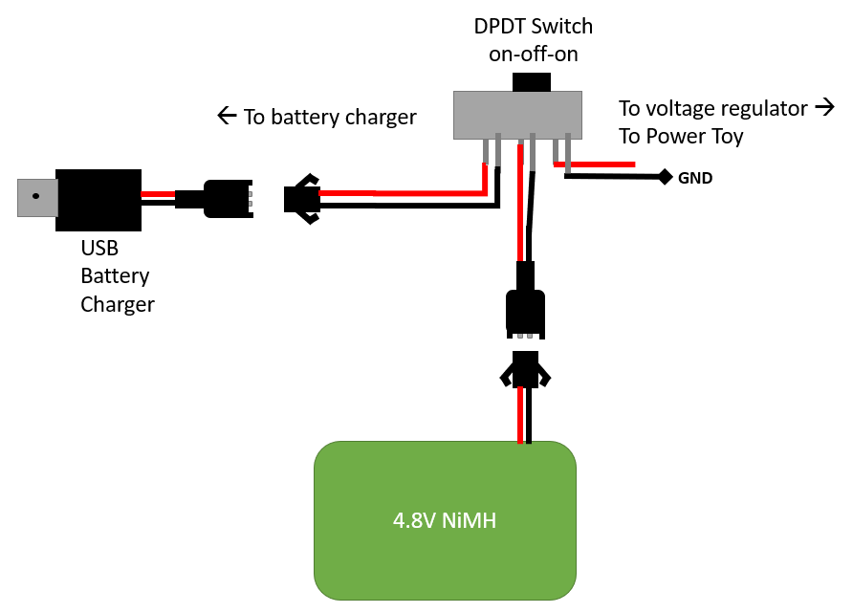
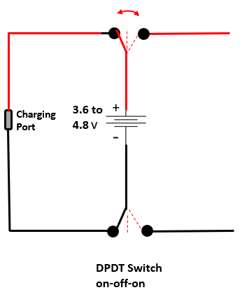
Power Supply: The Switch

EV
Notes:
Switching for our power supply circuit is realizable with a double-pole, double throw switch.
Side-notes:
Our switch has three positions on-off-on. (DPDT – 2P2T means double pole with two “on” positions
Will test to ensure isolation.

Slide 32
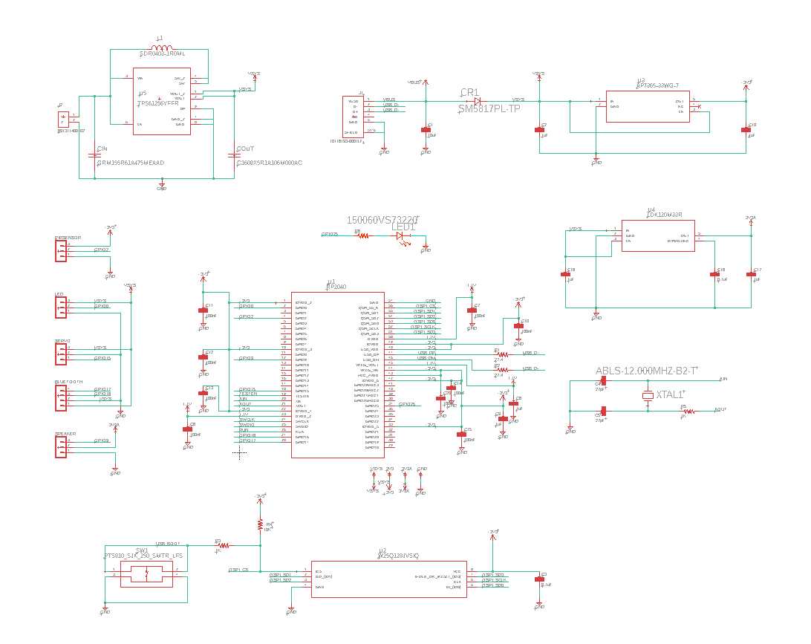
Prototype PCB Circuit:
VN

Slide 33
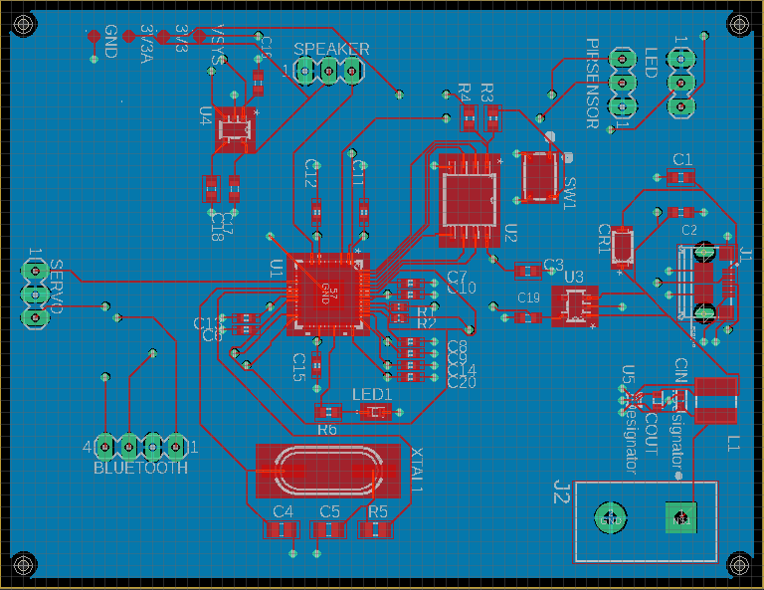
PCB Design:
IPC-2221A - Generic Standard on Printed Board Design
VN

Slide 34
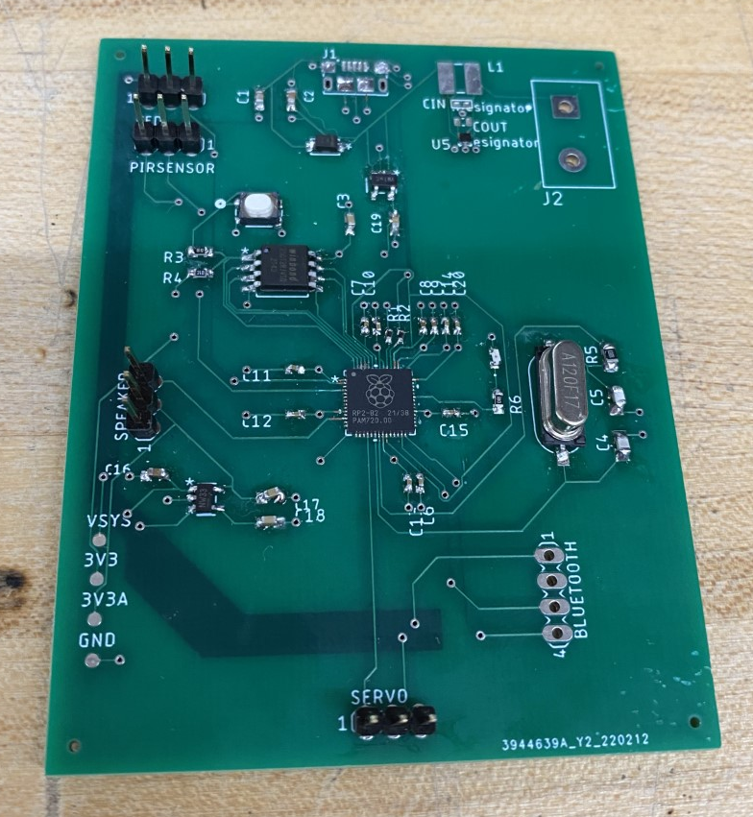
5.
This is the first PCB that we designed to work with the RP2040 MCU.
Significant components include:
The RP2040 Chip
Flash Memory
Crystal Oscillator
Voltage Regulators
Feature Component Pins
Unfortunately our initial PCB design did not successfully work due to mis-configuration of some components.
4.
5.
4.
2.
3.
1.
4.
5.
5.

Slide 35
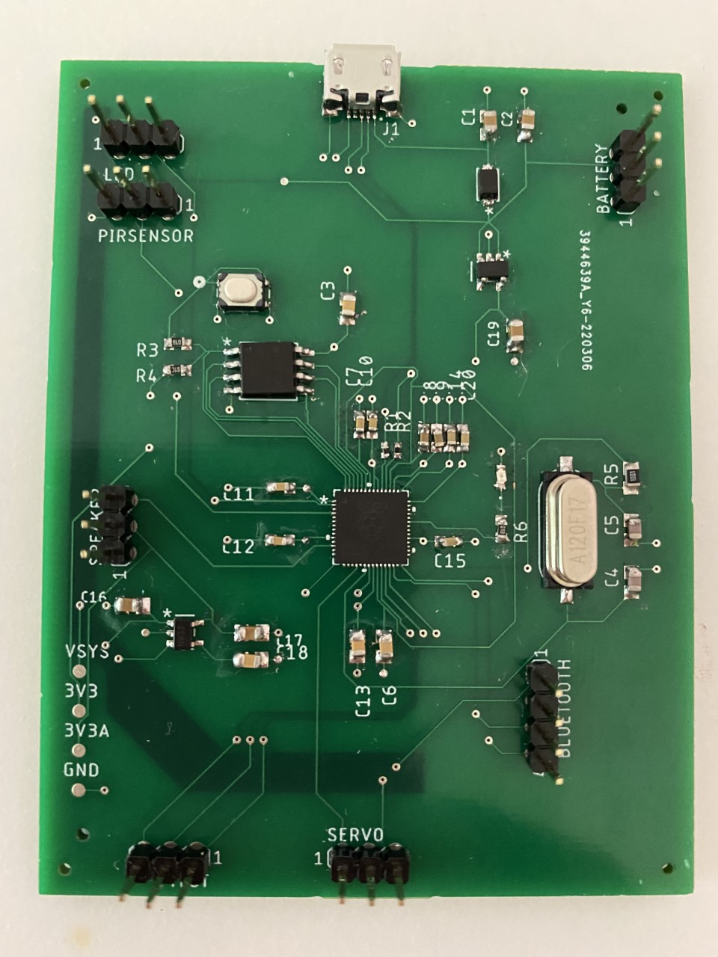
This is the final PCB that we designed to work with the RP2040 MCU.
Significant components include:
The RP2040 Chip
Flash Memory
Crystal Oscillator
Voltage Regulators
Feature Component Pins
Changes Made Included:
Redesigning the battery connection for fitting and replacing out-of-stock components
Changing the orientation of the USB connector to fit the board
5.
4.
5.
4.
2.
3.
5.
1.
4.
5.
5.
Notes:
Vu

Slide 36
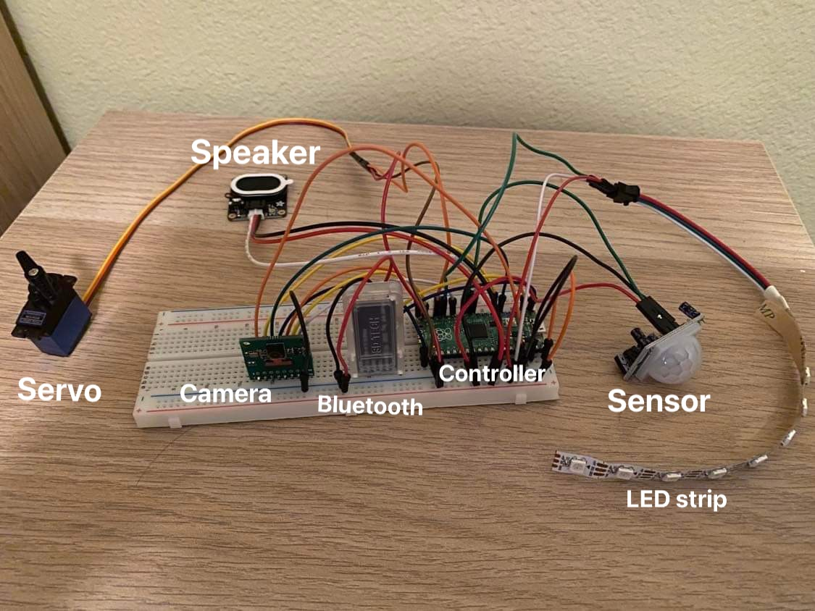
Electronics Breadboard Testing:
VN

Slide 37
Hardware Standards Apply
IPC-2221A - Generic Standard on Printed Board Design
ASTM F963-17 - Standard Consumer Safety Specification for Toy Safety
IEC 60086-1 – Primary Battery Standards
Directive 2011/65/EU - Restriction of Hazardous Substances (RoHS)
VN
Notes:
These are a few standards that apply to the hardware design of our Interactive Cat Toy.

Slide 38
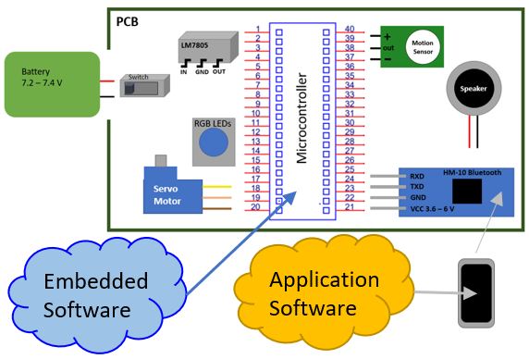
Software Design:
Software Layers
1. Application Software
2. Embedded Software
JL
Notes:
To make our project successful and fully functional we will be using application software and embedded software.

Slide 39
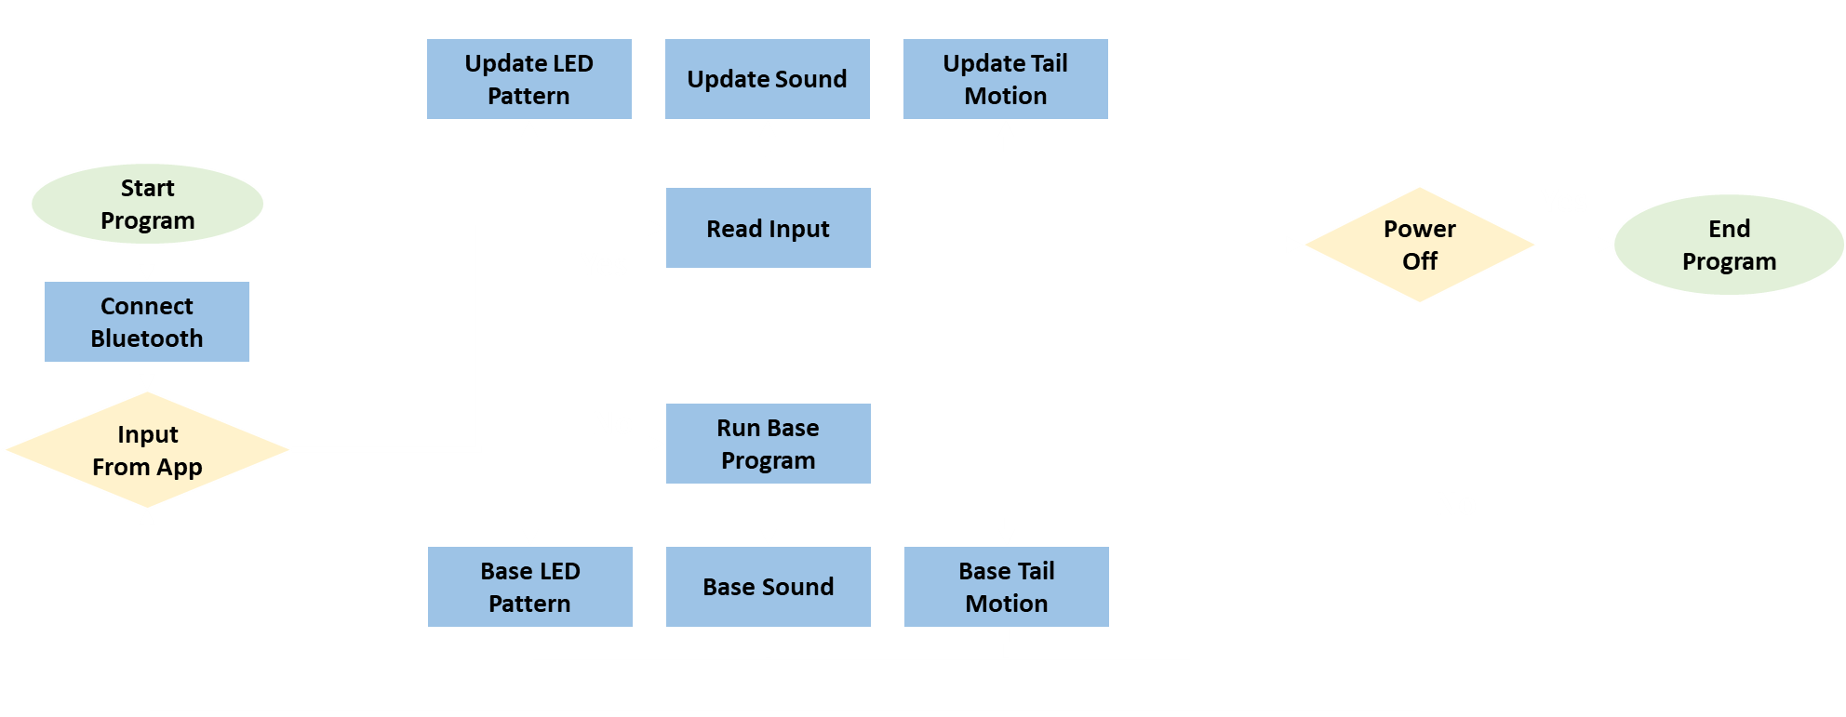
Software Block Diagram:
Symbol Table:
AG
Notes:
Script:
This software block diagram shows when the program begins it starts by connecting to the Bluetooth device.
To then check if it got any input from the mobile application.
If it doesn’t get an input, it runs the base program’s LED pattern, sound, and tail motion
If it does get an input, it updates either the LED pattern, sound or tail motion. Depending on what was selected.
After running the base program or updating the program will check if the device is off or asleep.
If it is not off or asleep it will check if there is an app input again
Otherwise the program will end.

Slide 40
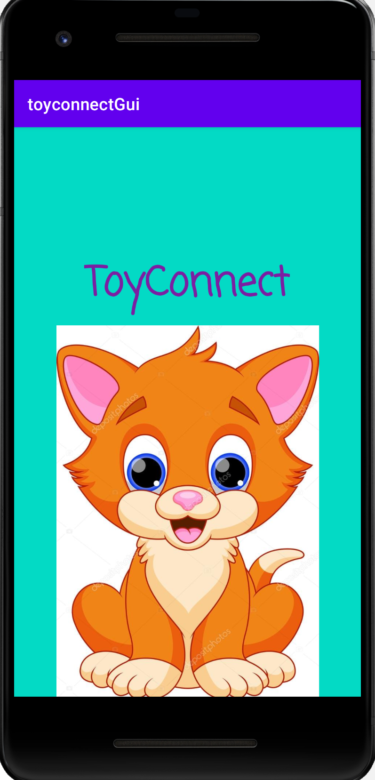
Application Software:
Development
MIT App Inventor
Bluetooth Wireless Connectivity
Switched from Android Studios to MIT App Inventor for convenience of iOS connectivity.
JL
Notes:
For our Application Software we use MIT App Inventor with Bluetooth Wireless Connectivity.
While having difficulty with the connectivity of the HM-10 Bluetooth Module we switched from using the Android Studios App developer to the MIT App Inventor, to attempt to connect with the iOS compatibility. Unfortunately, this did not work. But we found the MIT App Inventor platform to be more optimal (convenient) for building our application and decided to use it to complete our project.

Slide 41
Application GUI:
Main page will present the toy features of lighting, sound, and motion
Selecting a feature will take a user to a feature page
Feature page will offer multiple exhibition options
JL
Notes:
Our Application’s Graphic User Interface begins with a…

Slide 42
Application Capabilities:
Control of Select Features
3 Lighting Display Options
3 Sound Choices
3 Patterns for Tail Motion
JL
Notes:
The capabilities of our phone application includes the control of 3 lighting display options, 3 sound choices and 3 tail motion patterns.

Slide 43
Application Standards:
Android Developers - Core App Quality Guidelines
Java Code Conventions
IEEE 802.15.4-2020 –
IEEE Standard for Low-Rate Wireless Networks
JL
Notes:
These are some of the standards that apply to our application development.

Slide 44
Embedded Software: Lighting Effects
The Interactive Cat Toy (ICT) Will Have WS2812 LEDs, Providing A Wide Range Of RGB Color Choices.
Base Toy LED Effect –
Simple Pattern Of One Color Going Down The LED Strip
Application LED Effect –
Option 1: Three Colors Going Down The LED Strip
Option 2: Rainbow Colors Going Down LED Strip
AG
Notes:
Script:
make an extra technical slide to mention addressability, how colors are coded, signal timing to have uniform use of 60 mA for 50 ohm resistor etc.

Slide 45
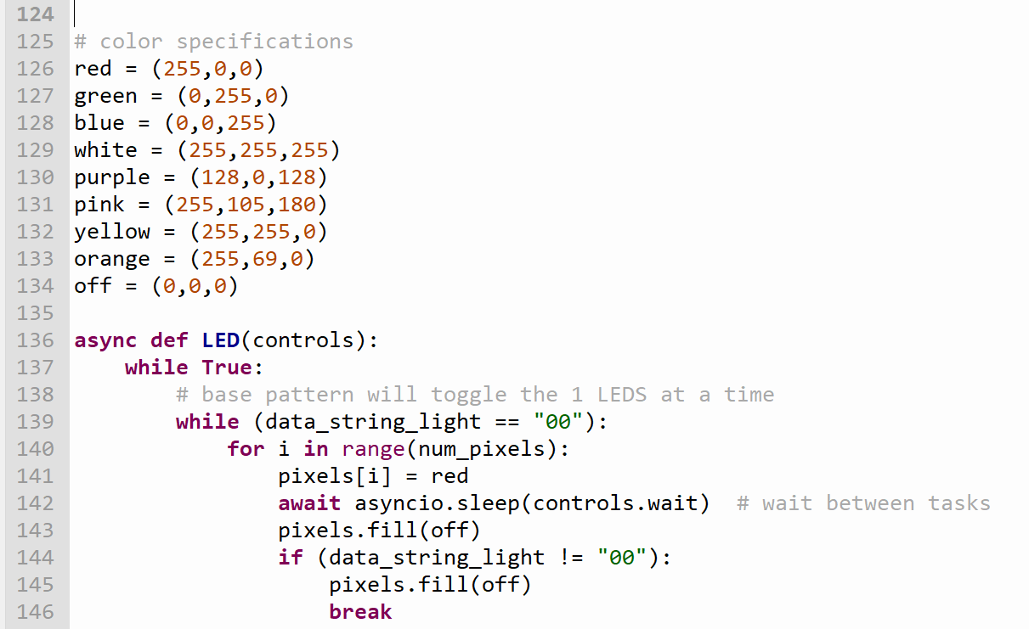
Light Coding Detail:
LEDs require current control so they will not burn out. For this we put a simple 160 Ohm resistor between our MCU and LED strip and use embedded software to limit lighting effects to 60 mA displays.
The Code Presented Describes The Basic Idea Of How We Will Be Programming The LEDs.
Red, Green, Or Blue LED Lighting Uses ≈ 20mA
White LED Lighting Uses ≈ 60 mA
AG
Notes:
Script:
To emit light on the RGB LED it requires some current control, to avoid any LED burn out.
To avoid this, we must simply implement a 160 Ohm resistor between the MCU and the LED strip.
Then using the embedded software, we limit the lighting effects to only use a max of 60 miliamps at a time.
The code to the left shows the basic idea of how the LEDs will be programmed

Slide 46
Embedded Software: Tail Motion
The Interactive Cat Toy (ICT) Will Utilize A Micro Servo Motor To Provide A Tail Wagging Effect
Base Toy Tail Motion –
Simple Pattern Of Moving Up And Down At A Steady Speed
Application Tail Motion –
Option 1: Half Movement Up And Down With Full Movement Up And Down At A Steady Speed
Option 2: Quick Movement Up And Down
- Added Benefit - Motion will Help Send The Aroma Of Catnip In The Air
AG
Notes:
Script:

Slide 47
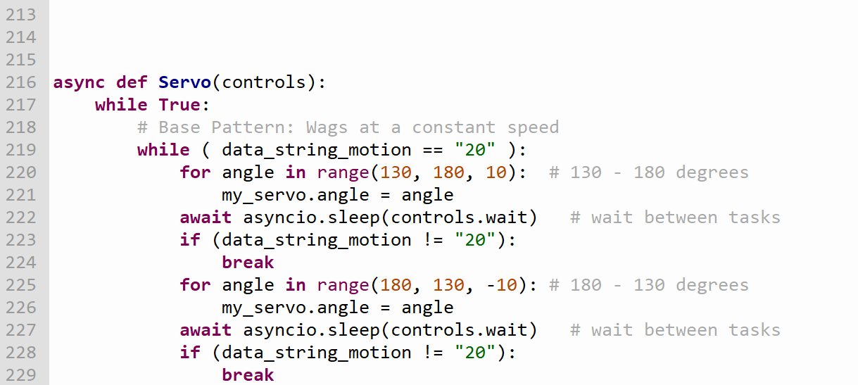
Motion Coding Detail:
In CircuitPython The Servo Motor We Will Have Its Position Grabbed Using The Degrees Method, This Will Allow For A Wagging Effect. In Between Each Motioned “Wag” It Will Allow For Another Task To Run In The Code.
The Code Presented Describes The Basic Idea Of How The Function On How The Tail Will Be Moved.
AG
Notes:
Script:
The position of the servo motor will be grabbed using the degree method, allowing us to create a wagging like effect.
In between each Wag the code will pause to allow another function to run.
The circuitpython code to the left shows the basic idea of how our code will look.

Slide 48
Embedded Software: Sound Effects
With the Stemma Speaker The Interactive Cat Toy (ICT) Will Be Able To Make Many Sounds That Entice A Cat
Base Sound–
Simple Sound Of A Small Animal Chattering
Application Sound–
Option 1: Sound Of A Bell
Option 2: Sound Of Walking in Hay
Adafruit STEMMA Speaker
AG
Notes:
Script:

Slide 49
Sound Coding Detail:
To Get Sound Emitted From The Speaker The Code Must First Decode The mp3 File. Which Is Just A Static Array Of Numbers.
The Code Presented Describes The Basic Idea Of How The Function On How The Music Will Played.
AG
Notes:
Script:
For CircuitPython to be able to emit sound from the speaker.
We have to decode the mp3 file into a static array of numbers.
After the mp3 file is decoded, we can play the sound through the speaker endlessly through a infinite while loop.

Slide 50
Embedded Software: Sensor
A Sensor Will Establish The Ability For “Sleep” Mode. This Will Allow the Battery Life To Last Longer.
With No Interaction From A Cat For A Short While The Interactive Cat Toy (ICT) Will Switch To A “Sleep” Mode.
When The Cat Triggers The Sensor, The Sensor Will Send A Message To The Program To “Wake Up” And Continue the Base Toy LED Pattern, Tail Motion, And Sound Effects.
!
Z
Z
Z
Z
AG
Notes:
Script:

Slide 51
Administration
Business and paperwork

Slide 52
Work Distribution:
Team Member | Structural Design | PCB Design | Power Supply | Application | Embedded Software
Aliza Grabowski |  |  |  | S | P
Joseph Lopez |  |  |  | P | S
Vu Nguyen | S | P | S
Elizabeth Vargas | P | S | P
P = Primary S = Secondary
EV
Notes:
Our Work Distribution Table represents how work for our project was shared among our group members.
P distinguishes the Primary and S the secondary members who are responsible for an area of work within our project.

Slide 53
Budget & Financing:
Bill of Materials, BOM
Part # | Part Description | Vendor | ID # | Cost
1 | Microcontroller | Digi-Key | 2648-SC0915 | 4.00
2 | PCB | PCB Way | n/a | 10.00
3 | Gecoty NiMH 4.8V Battery Pack | Amazon | B07FXVHT32 | 15.00
4 | STEMMA Speaker | Adafruit | 3885 | 6.00
5 | Micro Servo Motor | Adafruit | 2307 | 12.00
6 | NeoPixel RGB LED Strip | Adafruit | 1461 | 25.00
7 | Squirrel & Lizard Skins | Various | n/a | 40.00
8 | PLA 3D Printer Filament | Amazon | B07PGZNM34 | 24.00
9 | HC-05 Bluetooth Module | Amazon |  | 10.00
10 | PIR Sensor | Adafruit | 189 | 10.00
Total Cost |  | 156.00
EV
Notes:
The cost to build the Interactive Cat Toy came in at about $150.
The project is fully funded by our group members…
…with each student agreeing to pay one-fourth of the costs.

Slide 54
End of Semester Progress:
EV
Notes:
Our progress at the end of our Senior Design II class semester has brought us to very close to being at 100% of where we would like to see the Interactive Cat Toy Project to be.
In the process of completing our prototype, issues arose that left us considering ideal alternative designs.

Slide 55
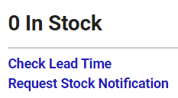
Ideal Alternative Project Design Plans
Structural Design – better placement for motion sensor
PCB Design – smaller and more robust connections – include optimal parts (minus supply chain issues)
Embedded Software – Code better syncing with Bluetooth and feature expressions… lower delay time
App Design – Include switch off option for features
Prototyping - Build smaller and lighter prototype (not able to do while components including a smaller power source was unavailable during our project build due to Covid-19 supply chain outages)

Slide 56
Valuable Experience Gained:
During Senior Design Project we learned many lessons…
Designing and building an electronic device, from just an idea, has been a fascinating and valuable experience.
We will be able to take this great experience forward with us into our Engineering careers.

Slide 57
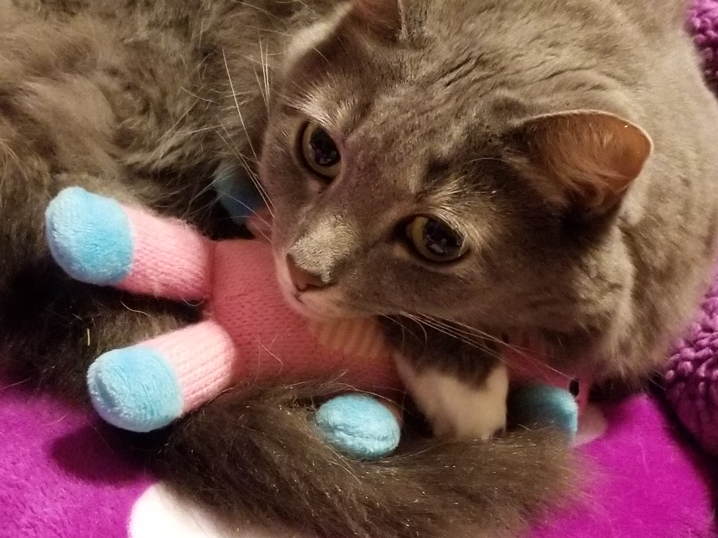
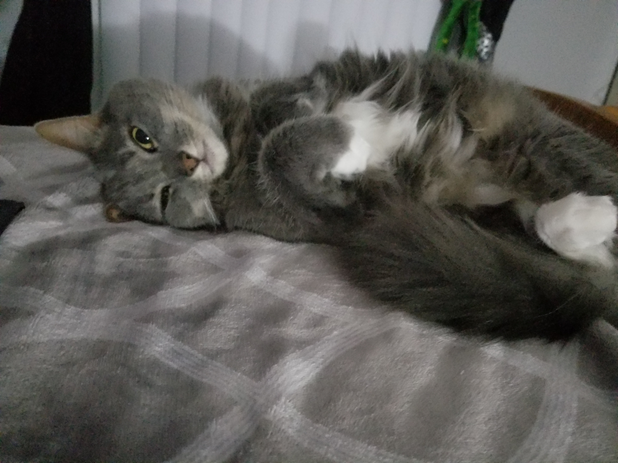
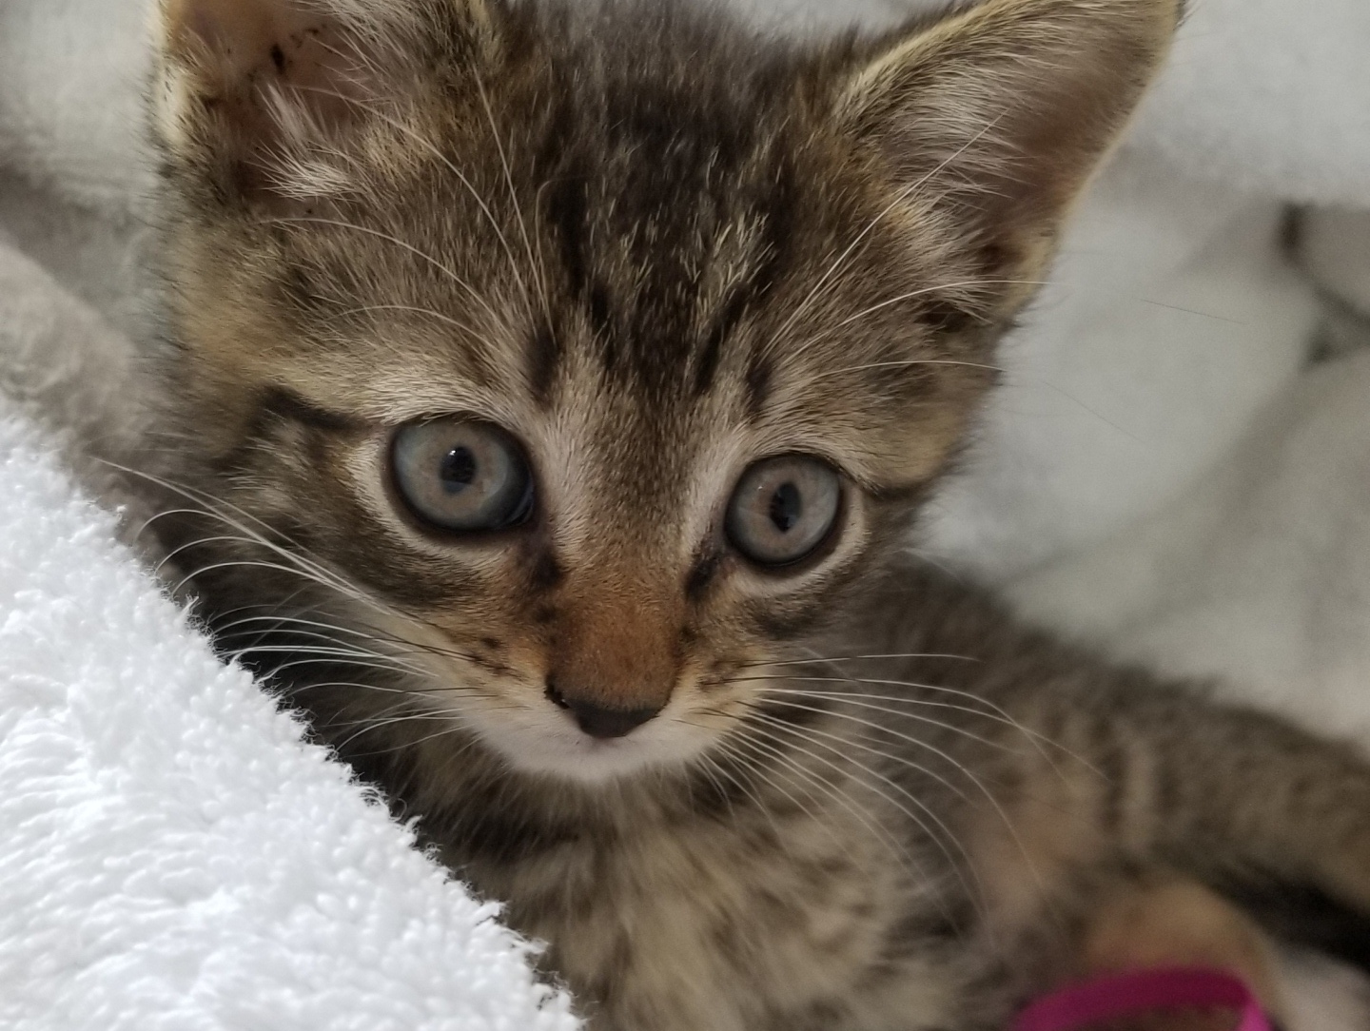
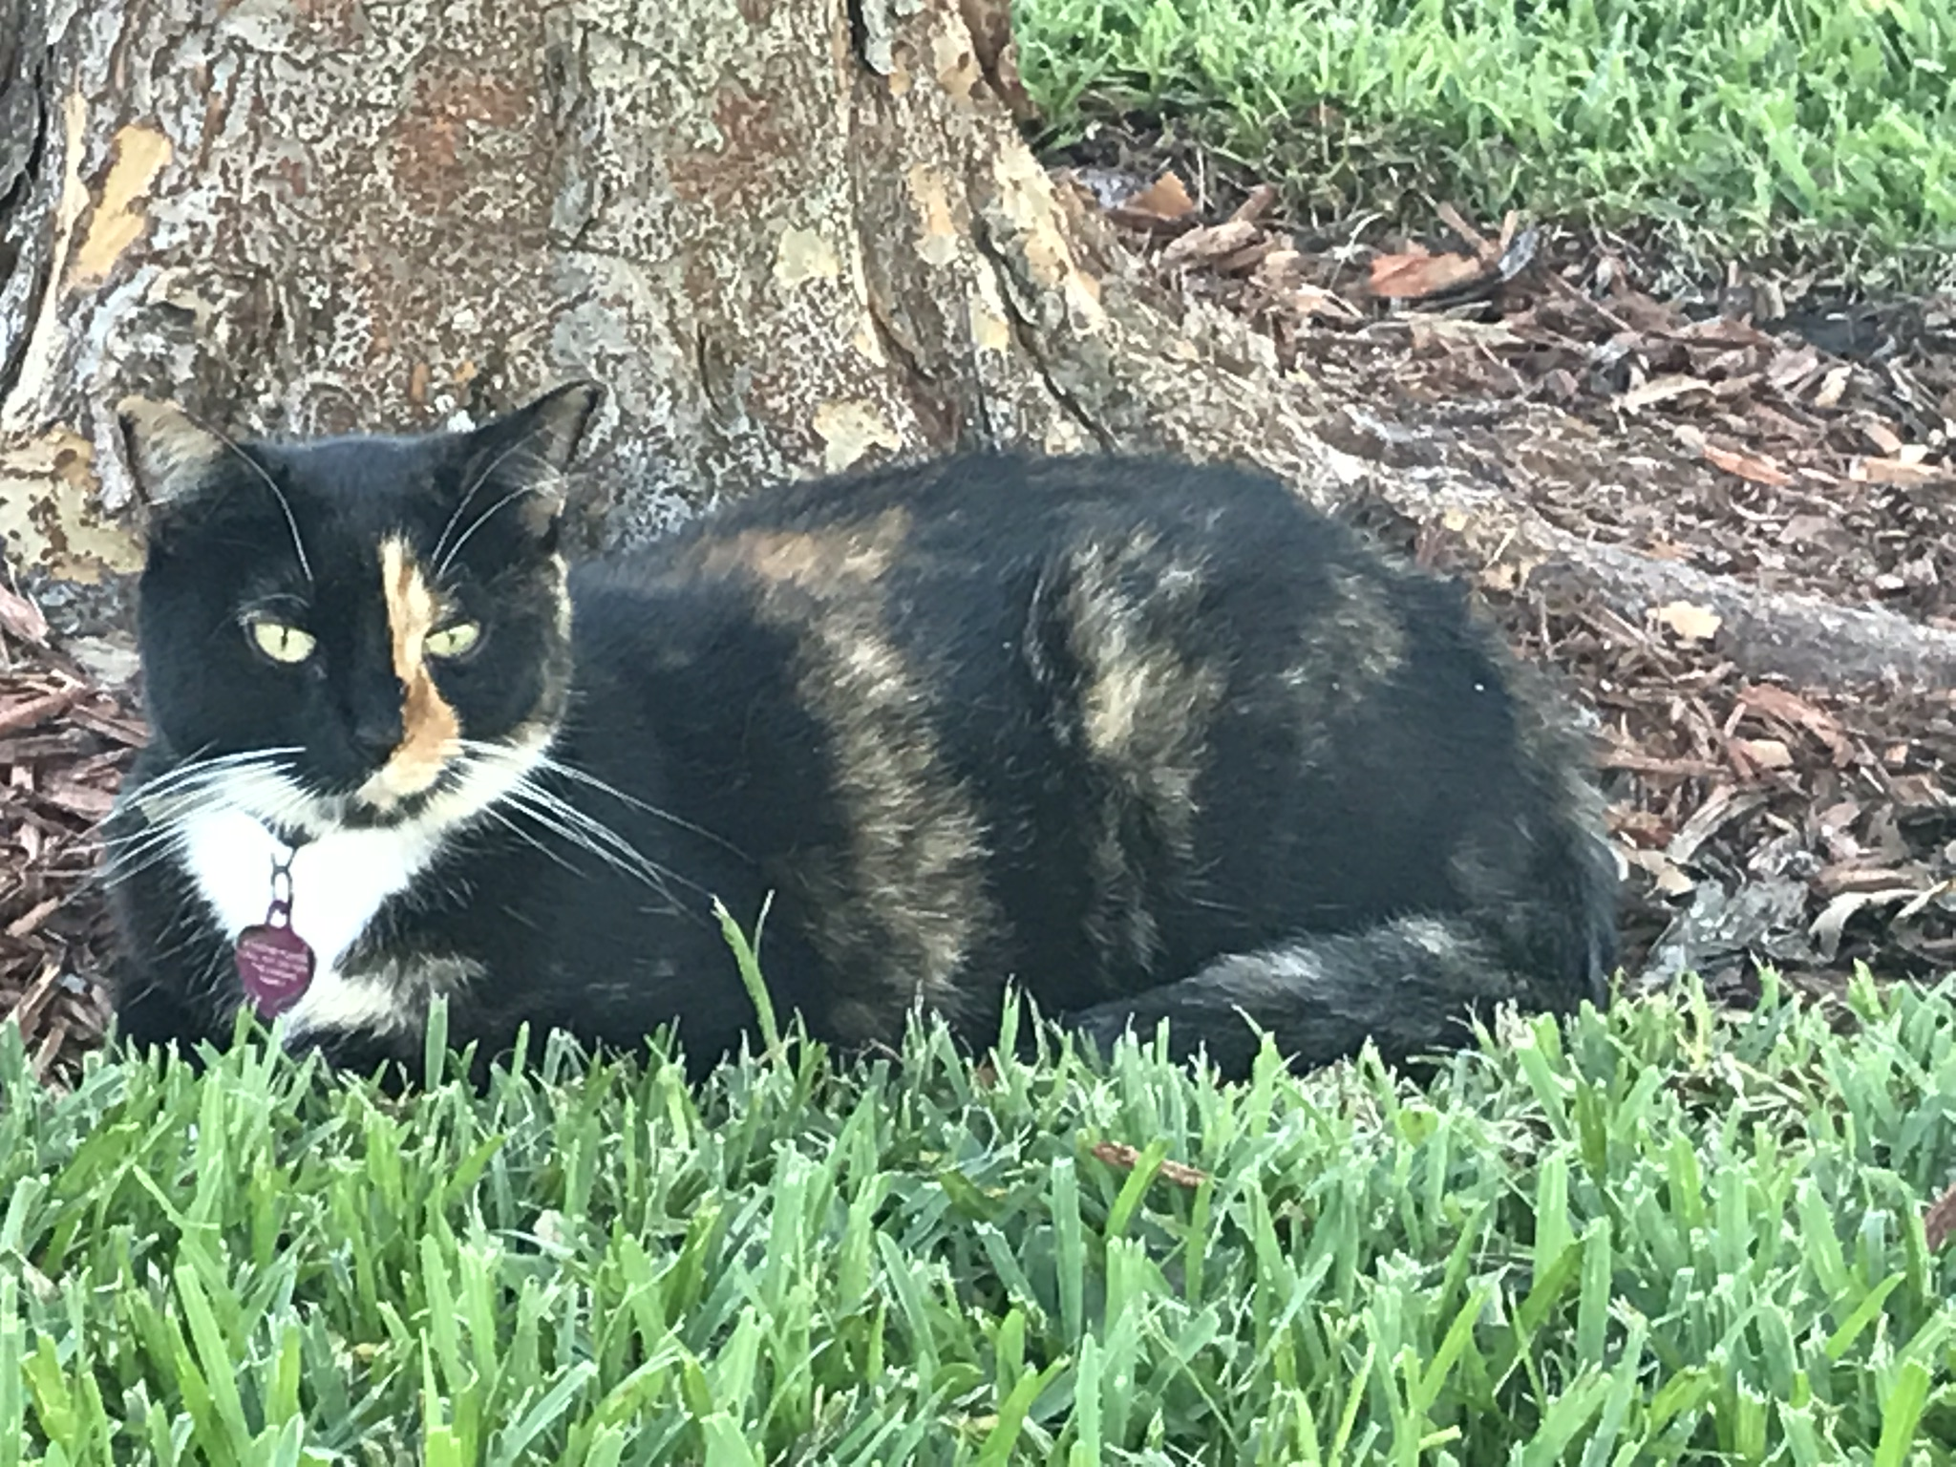
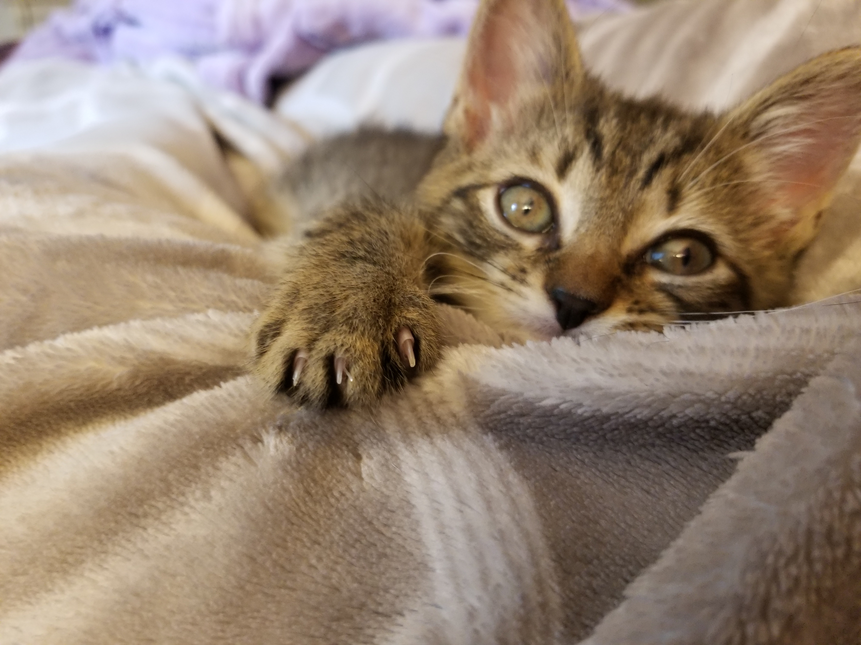
For Our Kitty Friends

Slide 58
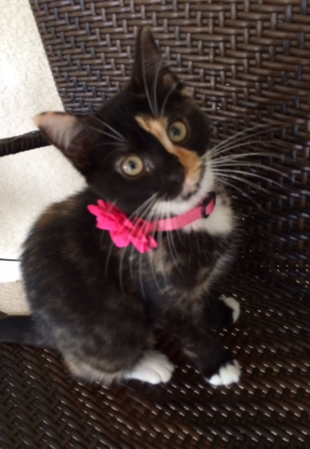
In Loving Memory of Aaliyah
September 2013 – November 2020

Slide 61
Special thanks to:
Dr. Wei and Dr. Richie
Our Sponsor Le Phan
Bob Meizlik, Electrical Design Advisor
Our Seamstress, Grandma Sonja

Slide 62
Thanks for Watching !
We hope you enjoyed the Final Presentation
for the
Interactive Cat Toy (ICT)
Notes:
This concludes our presentation… we appreciate you taking your time to watch! Thank you!!!

