Slide 1
Wirelessly Connected Laser Shooting Gallery
Group 22
Jamauri Balzourt – Electrical Engineering
Rachel Goodman – Electrical Engineering
Thomas Stoeckert – Computer Engineering
Anna Malaj – Computer Engineering
Notes:
Thomas Stoeckert
Hello. We are Group 22, and our project is the “Wirelessly Connected Laser Shooting Gallery.” Our members are Jamauri Balzourt, Rachel Goodman, Thomas Stoeckert, and Anna Malaj.

Slide 2
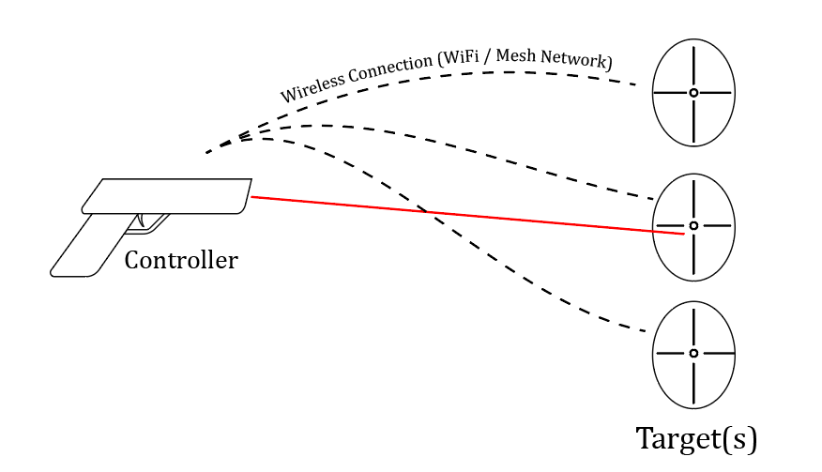
Objective
Create a portable and expandable laser shooting gallery
Composed of two hardware platforms
Wireless targets
Laser gun (“Controller”)
Embedded software suite for choosing and configuring game modes
Notes:
Thomas Stoeckert
The objective for this project is to create a portable and expandable wirelessly networked laser shooting gallery, composed of two types of devices – a single controller and an array of targets, which all connect in a WiFi-based mesh network to coordinate game events. The controller also hosts a user interface and software suite for configuring game modes and device settings.

Slide 3
Motivation
Most standard shooting galleries have limited reconfigurability
Targets are typically fixed, hard-wired points that can only be set up in expensive, permanent installations
Larger-scale shooting galleries are expensive
Specialized, niche hardware is required
We can create wireless targets that can be set up in many different positions and environments
This increases the configurability of the system, thus increasing user convenience, creating a better gameplay experience, and expanding market reach
Notes:
Thomas Stoeckert
When planning this project, we were motivated by a few factors:
Most standard shooting galleries have limited reconfigurability. Targets are fixed or installed in place, resulting in static systems that require dedicated, permanent space to function and be displayed
Larger-scale shooting galleries tend to expensive, requiring niche, specialized hardware. This limits the use of such games to places with both the budget and space to permanently install a custom system.
We believe that with the recent explosion in low-power and low-cost computing, we can create wireless targets that don’t require such static, expensive measures, allowing the system to be dynamic, cheaper, and more flexible.

Slide 4
Goals
Improve the user experience for laser shooting galleries
Expandability: support easy addition of multiple targets and controllers
Reconfigurability: allow the user to customize their gameplay, both physically and in software
Convenience: allow the user to play after minimal setup time and little frustration
Notes:
Thomas Stoeckert
We boiled our plan down into three goals:
Expandability – Users should be able to add targets and controllers to the system dynamically.
Reconfigurability – Users should be able to adjust their gameplay by moving targets around in the real-world and by adjusting game settings in the digital.
Convenience – The system should be intuitive to use with little effort required to setup devices.

Slide 5
Design and Implementation
Notes:
Thomas Stoeckert
Design and Implementation.

Slide 6
Requirements Specifications
Number | Purpose | Description | Requirement
 | Performance | The controller should have a high active uptime | ≥ 3 hours
 | Performance | Each target should have a high active uptime | ≥ 6 hours
 | Performance | The time between pulling the trigger and the target’s visual response should be small | ≤ 0.1 seconds
 | Performance | The system should have a quick startup time | ≤ 25 seconds
 | Performance | Target pairing should be completed in minimal clicks | ≤ 4 clicks
 | Energy | The controller should be energy efficient, consuming a small amount of current | ≤ 3000 mA/4 hours
 | Usability | The controller should achieve a low maximum weight | ≤ 10 lbs
 | Usability | The target should achieve a low maximum weight | ≤ 5 lbs
 | Usability | The system should be in “ready to play” state within a short period after startup | ≤ 2 minutes
Notes:
This slide will detail our Requirements Specifications for our project.
We pushed for an aggressive approach towards our specifications. Such as having a minimum of 3 hours playtime for the laser controller.
The laser targets are at 6 hours based on predicted operation from the user. The Targets will only be activated when they are interacted with by the user.
The moment the trigger is depressed on the gun controller the user should see visual feedback of a successful hit through an LED indicator within .1s.
With the goal of seamless operation by any user, the necessary start time and pairing steps are to be reduced as much as possible.
In this case start time should be no more than 25 seconds and pairing a target should be completed within 4 clicks of the menu buttons.
The energy efficiency specifications states that the battery capacity should not be drained within 4 hours of continuous usage by the user.
The Usability specifications of the system were given a wider tolerance range earlier in senior design 1 due to the unpredictable supply chain for the battery and the enclosure which was still under consideration at that time. In general, the Usability specifications outlined should not impede the user when operating the system.
Keep in mind These requirements specifications were tuned based on power estimation analysis of the system by averaging the power usage of critical components, where applicable in this table.

Slide 7
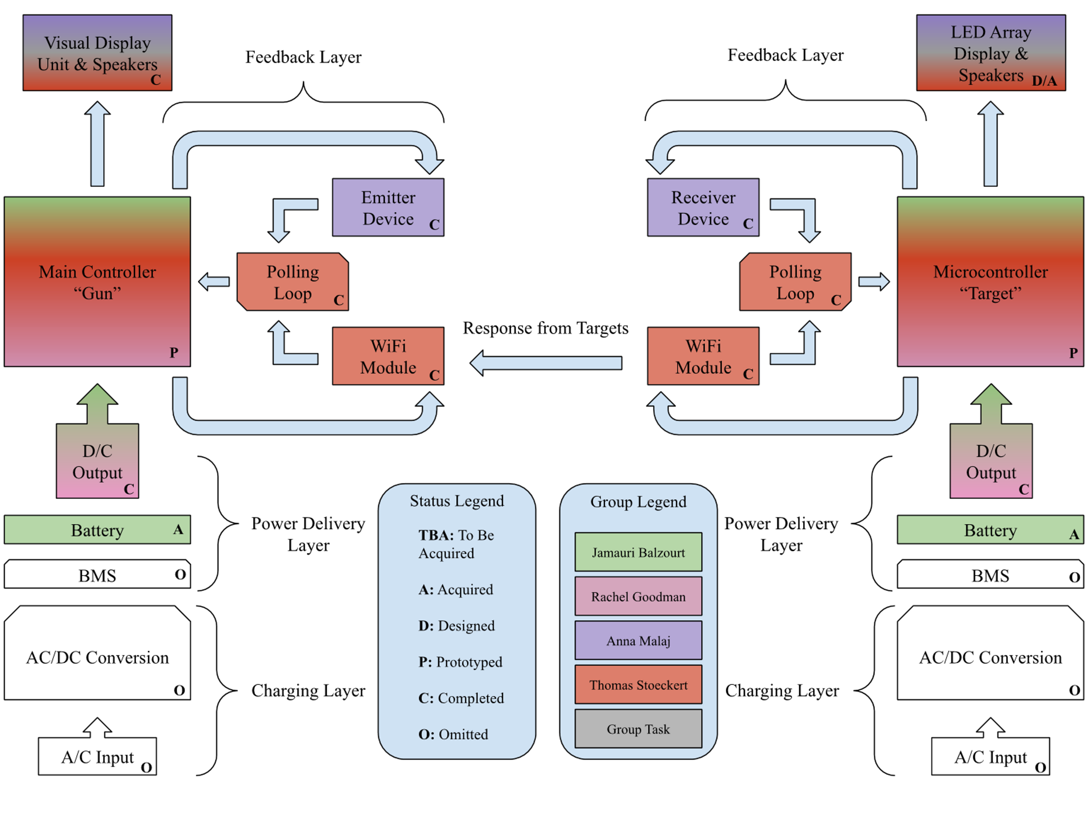
Hardware Block Diagram
Notes:
Rachel Goodman
This is our hardware block diagram, which gives a basic overview of all hardware aspects of this project and how they interact with each other. It’s an updated version of our original block diagram from the beginning of senior design 1, with changes made to reflect the current statuses and ownership of all blocks.

Slide 8
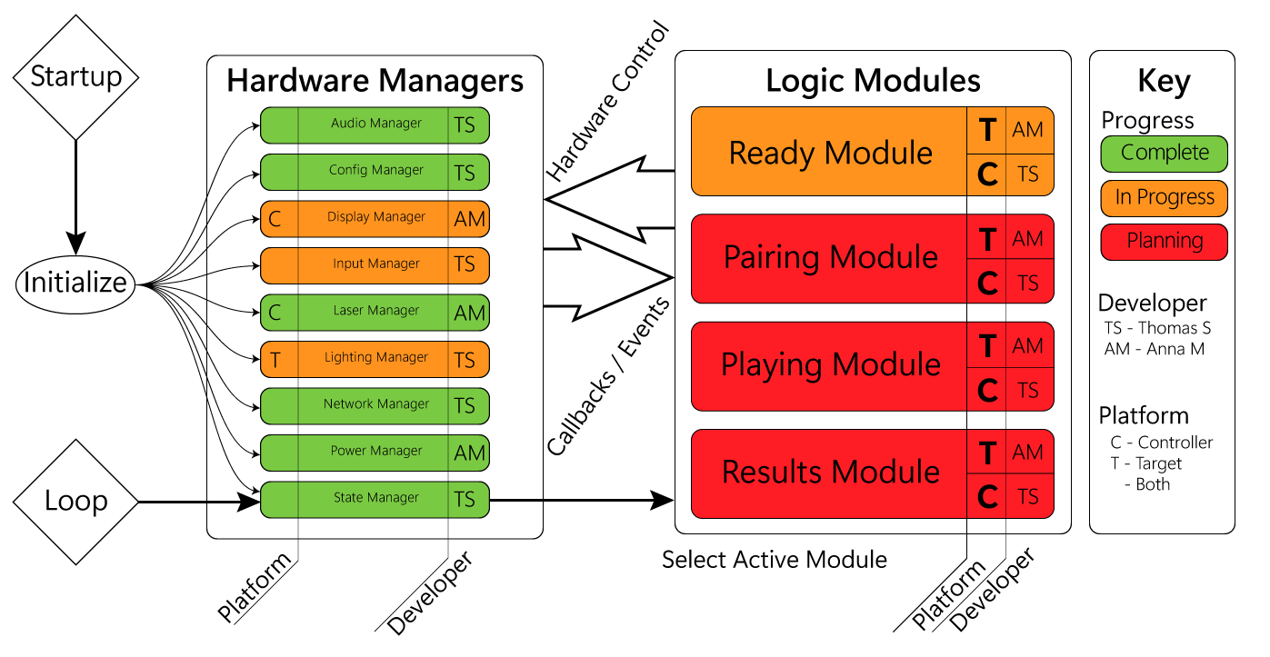
Software Block Diagram
Notes:
Thomas Stoeckert
Here is our Software Block Diagram. You can see our two columns of objects - Hardware Managers and our Logic Modules. You can see that when the system starts, all of the hardware managers are given a chance to initialize. Once they’re done, the system enters its primary loop, which provides the appropriate logic module the opportunity to operate, depending on the current state of the system.
Our hardware managers are mostly shared between platforms, though there are a few exceptions to this. Our logic modules are unique per-platform, so they’re denoted twice in their boxes – once for the Target platform, and once for the Controller platform.

Slide 9
Shared Platform Design Approach and Implementation
System is composed of two hardware platforms that share some functionality
Maximizing the similarities between platforms critical – reduces system complexity, reduces the number of unique parts, saves design time.
Extra functionality can be added per platform as needed
Shared Systems:
Microcontroller
Power Subsystem
Audio Subsystem
Notes:
Thomas Stoeckert
Our system is composed of two similar – but distinct – hardware platforms. We can take advantage of that, by designing around their similarities, to reduce the amount of work and minimize complexity.
The systems that both platforms share are the main microcontroller, the power subsystem, and the audio subsystem – which is present on all devices, to allow for audio playback in a spatial environment.

Slide 10
Controller Design Approach and Implementation
Controller serves as the main interface for users
Also serves as “coordinator” for the system
Tracks score, tells targets to turn on, manages game state
Additional Subsystems:
OLED Display
Three button inputs (Menu / Trigger)
Laser Diode
Notes:
Thomas Stoeckert
The “Controller” device in our system acts as the primary user interface – users configure settings, pair devices, and actually play the game with this device in their hands. As such, ergonomics, user experience, and user interface design are important while designing this device. On top of the human-interface role it plays, it also serves as the coordinator for the entire system. It tracks the players score, tells targets to enable / disable, play lighting or audio effects, and manages overall system state.
The additional subsystems that are required for this device are the OLED display, three additional buttons (left/right menu buttons, and trigger), and the laser diode.

Slide 11
Target Design Approach and Implementation
Targets are slightly more passive elements
Mostly responds to game coordination commands from Controller
Additional Subsystems
Pairing Button
Phototransistor / Laser Detection
NeoPixel RGB LED Array
Notes:
Thomas Stoeckert
Targets in the system act in a more passive role – they simply listen for either network messages or the excitation of a laser, then act upon that. Because of this, they aren’t as computationally active and are somewhat simpler in their design.
They do have some additional subsystems, however – a button to shift them into a “pairing mode,” the phototransistor array for laser detection, and a NeoPixel RGB LED array to serve as a visual indicator during gameplay.

Slide 12
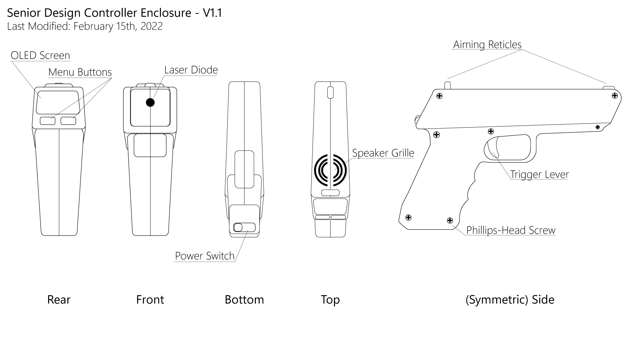
Controller Enclosure Design Approach and Implementation
Enclosure Design is the field we have the least experience in
CAD work is planned to be done in Fusion360, as it is where we have the most experience
All parts are currently planned to be 3D-printed
Notes:
Thomas Stoeckert
Each of these platforms will require unique hardware enclosures – a field we as a team have little experience in but are taking steps to ensure the process is as smooth as possbile. Our CAD work is planned to be done in Fusion360, and we plan to manufacture our parts ourselves using a 3D printer we own.
You can see here our current planned design for the controller’s enclosure – the OLED screen and menu buttons facing the user on the rear of the device, a power switch on bottom, and laser diode out the front.

Slide 13
Target Enclosure Design Approach and Implementation
Notes:
Thomas Stoeckert
The target’s enclosure is comparatively simpler. The most notable aspect of it is the standard hanging hole, like you’d find on picture frames, on the rear of the device.

Slide 14
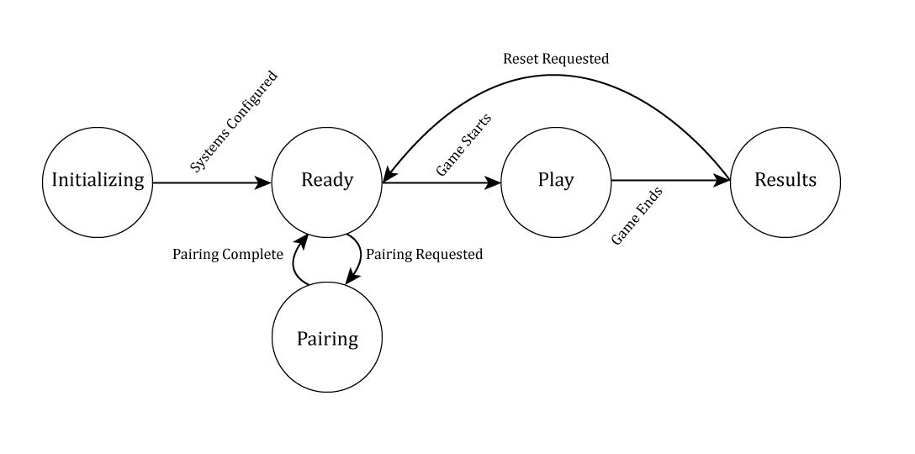
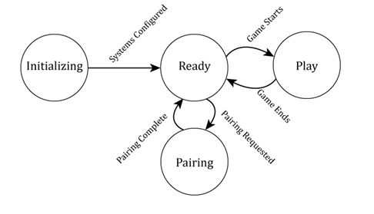
Software Architecture
The system will be event-based, using a Real-Time Scheduler
Transition between multiple states depending on the user’s input and various internal logic
Controller State Diagram
Target State Diagram
Notes:
Anna Malaj

Slide 15
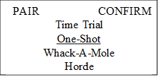
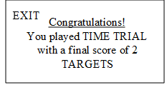
Software UI Design
The user can interact with a left button, right button, and gun trigger to pair targets and select from four different game modes
Game options and results will be displayed to the user on an OLED screen
Notes:
Anna Malaj

Slide 16
Software Design Approach and Implementation
Two hardware platforms -> Two software packages
To simplify development, share as much code and structure as possible between the platforms
Two Software Layers:
Hardware Managers – abstract control of peripheral devices into static classes
Mostly the same between platforms – just include as necessary
Ex: InputManager, AudioManager, NetworkManager
Logic Modules – Define how the system behaves depending on system state
Differs greatly between platforms – but we can reuse everything else. Libraries, development environment
Has callbacks & fixed-frequency update loops to perform any logic required
Critical Libraries: painlessMesh, TaskScheduler
Notes:
Anna Malaj

Slide 17
Networking Considerations
painlessMesh allows for the sending of messages across a dynamic “mesh” of nodes
Uses chipID (32-bit unsigned int) as addresses, Strings as payloads.
Custom Network Messaging Protocol:
Format: `<timestamp>;<tag>|<data>`
timestamp – unsigned long, network time when message created
tag – string, describes what is inside the message
data – string, arbitrary information
Devices “pair” together during a process where they learn the ID of their controller or the IDs of their targets
Notes:
Anna Malaj

Slide 18
Software Development Tools / Organization
Development is done using PlatformIO for VSCode
Embedded Development Platform, C/C++
Provides tools / libraries / support for many devices, including ESP32
Using the Arduino development framework, but can also use ESP-IDF
Software Development is tracked via Git/GitHub
A primary branch for core/shared functionality, one branch for each target platform
A wiki on GitHub is used to help document modules / managers
Tasks are created as issues, then developers self-assign tasks that they want to tackle
Notes:
Anna Malaj

Slide 19
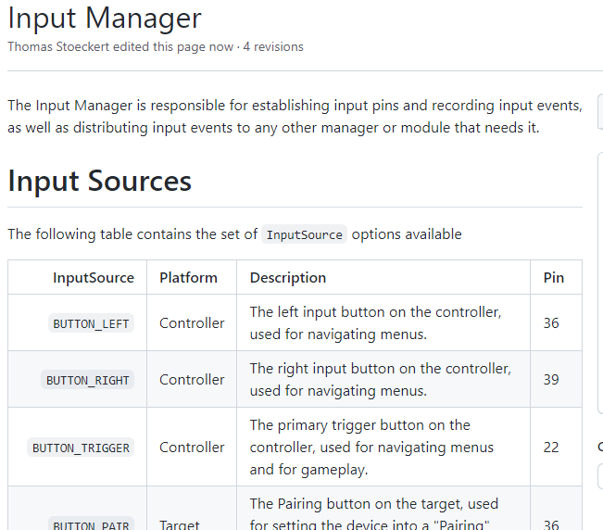
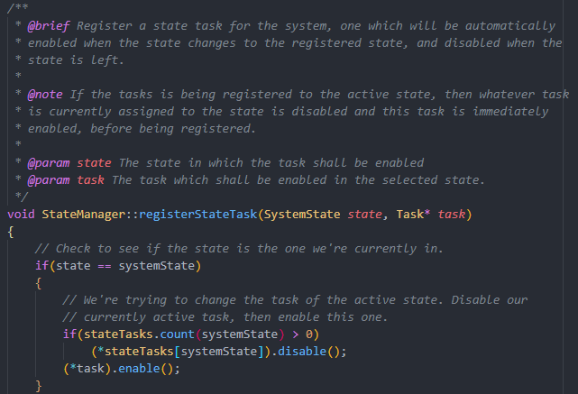
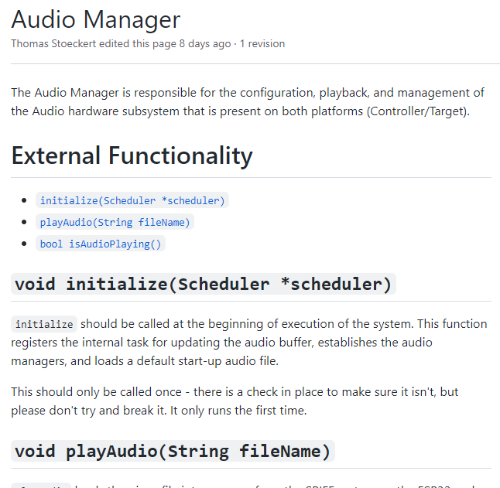
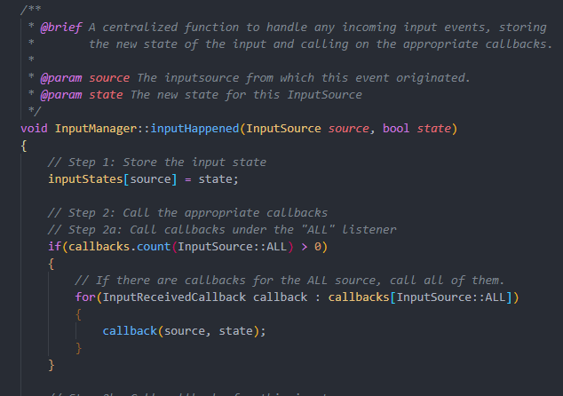
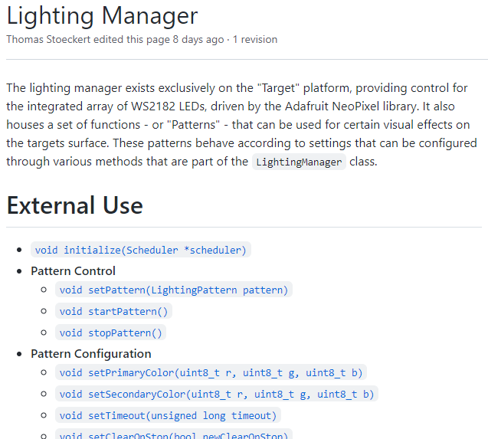
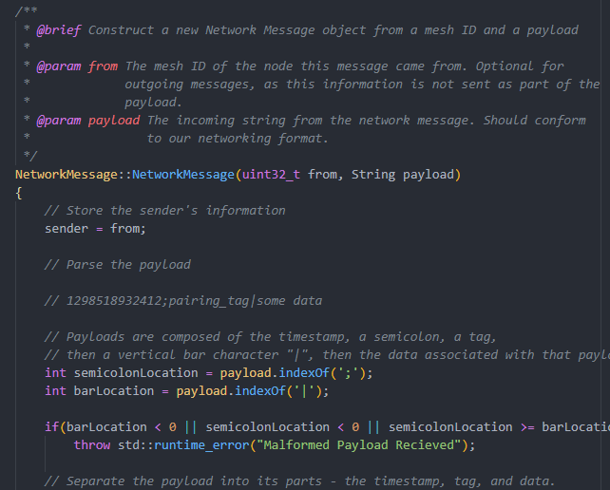
Software Development Documentation
Notes:
Anna Malaj

Slide 20
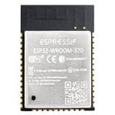
Microcontroller Selection
Model | ATmega640 | MSP430FR6989 | ESP8266 | ESP32D-WROOM
Clock Speed | 16MHz | 16MHz | 80MHz | 240 MHz
V_{supply} (V) | 1.8-5.5 | 1.8-3.6 | 1.8-3.6 | 3.0-3.6
I_{draw} (mA) | ~0.5-14 | ~1.6 (Controller) | ~170 (Controller + RF) | ~500 (Full Load)
Storage | 4KB EEPROM | Unified /w RAM | 4 - 16MB SPI Flash | 4 - 16MB SPI Flash
RAM | 8KB | 128KB | ~50KB | 520KB
Wi-Fi/BT | N/N | N/N | Y/N | Y/Y
GPIO | 86-pins | 10-Pins | 17-Pins | 34-Pins
ADC/DAC | 10-bit/N | 12-Bit/12-Bit | 10-Bit/N | 12-Bit/2x8-Bit
RTC/WDT | N/Y | Y/Y | Y/N | Y/Y
Framework | Arduino | Arduino/TI | Arduino/ESP-IDF | Arduino/ESP-IDF
Notes:
Thomas Stoeckert
We looked at a few microcontrollers for this project, but quickly narrowed down our search. Wireless functionality was critical to the core design of our system, and while we could use an external module for wireless connectivity, that was an added complexity we did not want to involve. That narrowed our search down to two popular controllers – the ESP8226 and ESP32-WROOM. While features like Bluetooth support and watchdog timers were less critical to our decision, the amount of processing that the “Controller” device platform requires – alongside the number of functional GPIO pins – left us the ESP32 as our clear choice for the project. We decided to use the ESP32 on both platforms in order to reduce overall complexity.
Additionally, the ESP32-Wroom can output a maximum of 40mA, enabling us to directly drivee the laser from the Microcontroller.

Slide 21
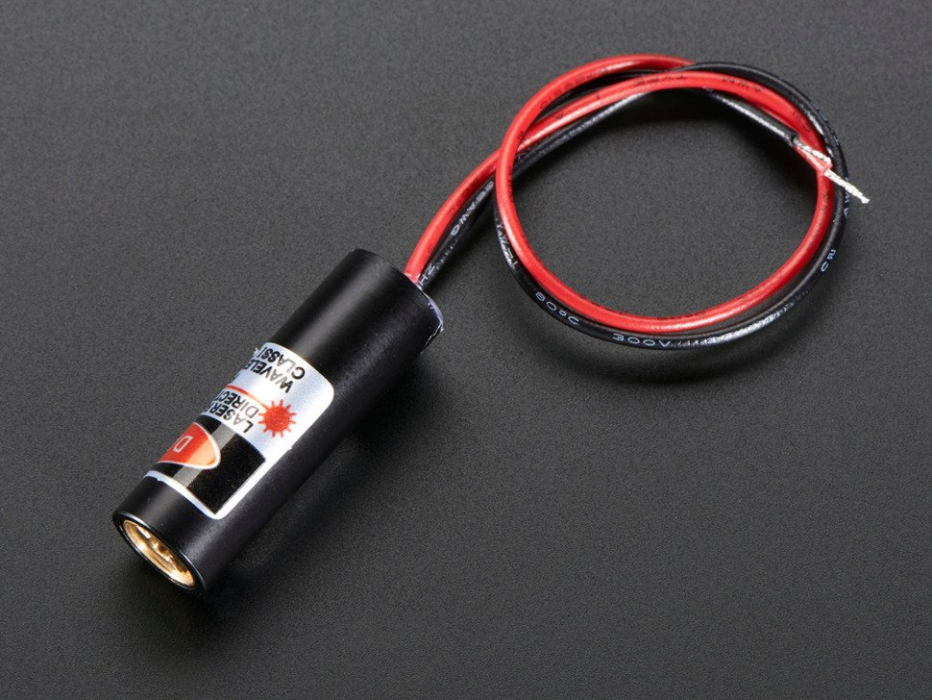
Laser Diode Selection
Opted for visible laser over IR – more satisfying for gameplay
Investigated FDA laser classes – went for class IIIa
Most abundant color was red
Decided on Adafruit’s Laser Diode - 5mW 650nm Red
Cheaper than other options considered ($5.95 instead of $20)
Notes:
Jamauri Balzourt
For our laser diode, we initially considered the pros and cons of both visible and infrared lasers. We ultimately decided to use a visible laser to provide a more satisfying user experience when operating the device.
That way, the user can see exactly where they are aiming,
and will know right away if they have hit the target.
When choosing the exact laser diode to use, we researched laser classes, which the FDA has created to rank lasers by output power and danger to people.
We went with a class 3a laser, which is limited to no more than a 5mW output and is the same class as your typical laser pointer, which can only be harmful if pointed directly at your eyes extended periods.
As a result of this decision the most abundant color on offer was red, so that was what we settled on. After comparing numerous laser diodes and testing a few, we decided to use this one from Adafruit, which was $5.95, much cheaper than most we could find on other sites such as Digi & Mouser, which were all around $20.

Slide 22
Laser Diode Characteristics/Compatibility
Laser Diode availability limited
650nm laser beam pattern distorted at long ranges
Factoring Distortion, Pricing, Spectral Sensitivity, and Supply Chain Checks
Reduces compatible phototransistor options to 1/10 of available market choices
Usable excitation region decreases to ~70%
Laser Diode Light Pattern at 37ft
Notes:
Jamauri Balzourt
Selecting the Adafruit laser diode came with a few limitations:
Because we chose 650nm this constrains the light sensor to that same wavelength spectrum
Additionally, the beam pattern at long distances became distorted resulting in a 30% reduction of usable light

Slide 23
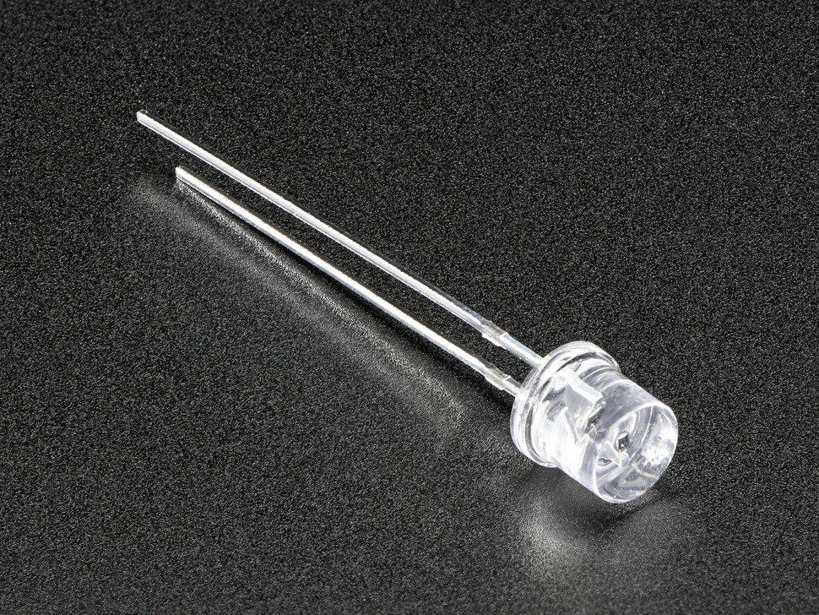
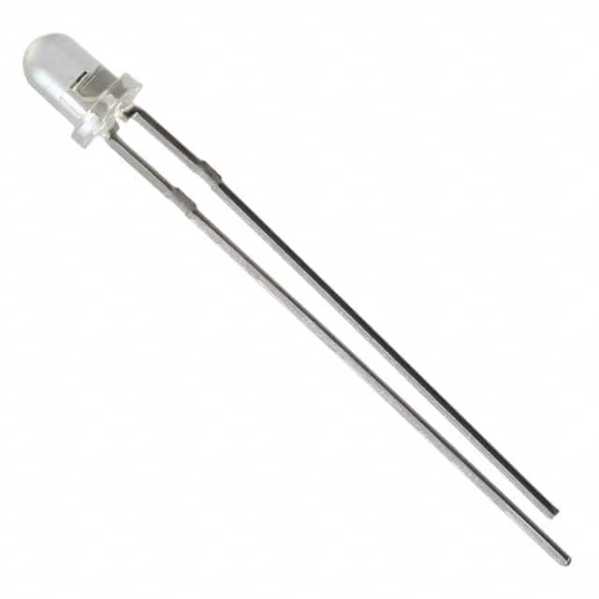
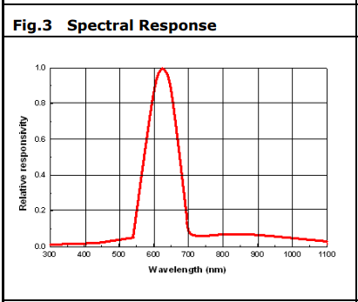
Light Sensor Selection - Phototransistors
This decision is still in progress as testing is carried out, but we have narrowed it down to two through-hole candidates, which will be easy to swap out
The HW5P-1 from Adafruit
Good availability & fast shipping
Cheap price ($0.95) per phototransistor
Larger clear “lamp” on top – easier to aim at
No peak spectral sensitivity wavelength specified in datasheet
The ALS-PT204-6C/L177 from Digi-Key
Also has good availability & fast shipping
Cheaper price ($0.50) per phototransistor
Smaller “lamp” – harder to aim at, but still possible
Peak spectral sensitivity wavelength of 630nm, closest we could find to 650nm (the wavelength of a red laser)
HW5P-1
ALS-PT204-6C/L177
Notes:
Jamauri Balzourt
For the target’s light sensor, which will pick up the laser beam output by the controller, we decided to use phototransistors. We have narrowed down the exact models to the two shown on this slide.
The model from Adafruit is larger and easier to aim at, but its spectral response is not given in its datasheet.
The model from Digi-Key however, is smaller, but its spectral response is given in its datasheet with a peak at 630nm, which is as close as we could find to the laser diode selected in the previous section.
Both lights sensors are good candidates that performed well in initial testing, and both are through-hole components, making them easily swappable. The final decision for which model to use will be made once we perform more in-depth testing of the whole system.
Data Acquired: ALS-PT204 has almost a 310% gain over the HW5P-1.

Slide 24
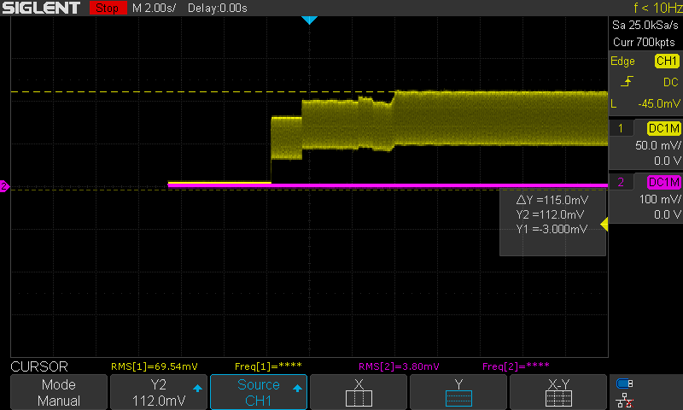
Adafruit Phototransistor Performance
Ambient Lighting
Long-Range Test (12V Supply, SNR)
Increased Ambient Lighting
Max SNR of .71V
Max. Ambient Lighting
Phototransistor Output Across Varied Ambient Light Levels
Max ambient noise floor of .1V
Notes:
Jamauri Balzourt
The graphs on the slide detail the performance characteristics of the Adafruit Light Sensor.
The graph on the left is a long-range test of the light sensor from a given noise floor. Upon excitation from the laser diode, The resulting SNR is approximately 700mV. This is more than enough to detect a “Hit” from the laser diode.
The graph on the right is the noise floor along with various ambient light levels to characterize the light sensors. The maximum Noise measured is around 100mV. This test confirms the selected light sensor is suitable for the target system.
Data Acquired: ALS-PT204 has almost a 310% gain over the HW5P-1 in the far range test.

Slide 25
Battery Selection
NiMH and NiCad battery packs were eliminated from consideration
High cost
Lack of BMS protections
Supply chain issues, including delayed shipping times
The Efest 18650 4S1P 14.8V 2600mAh battery pack was chosen
4 free battery packs were provided to the team by Smart Charging Technologies LLC (SCT)
High voltage means boost voltage converters won’t be necessary, avoiding efficiency penalties
BMS features include: OVP, OCP and Over Discharge/Charge protections,
Notes:
Jamauri Balzourt
Eliminated due to economy of scale. In addition, stock updates & communications with vendors slowed made these batteries an unfavorable choice for our project.
Had to contact manufacturer or request stock updates through digi-key/mouser, etc.
Since our project is mobile, energy density and space limitations was prioritized over all other factors when selecting batteries.
NiMH while cheaper than Li-Ion frequently did not contain an internal BMS requiring some development resources for a suitable BMS chip. Due to economy of scaling NiCad had terrible price to performance compared to Li-Ion or NiMH.
SCT generously sponsored Four Li-Ion Batteries with a ^^^^.
BMs features:
The choice for 14.8V allows for a simpler & efficient voltage buck design at the expense of capacity

Slide 26
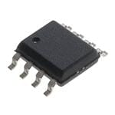
Voltage Regulator Selection
The MC34063ADR was eliminated due to issues with simulation
The BD9227F was selected instead, as it meets all voltage rail input-output requirements with sufficient efficiency (≥90%) at 300mA
Model # | Stock | Price ($) | Selection Order
BD9227F-E2 | 660 | 1.37 | #1
MC34063ADR | 45,665 | 0.78 | ELIMINATED
LM2736XMK/NOPB | 12,676 | 2.60 | #2
LM2576SX-3.3/NOPB | 1,357 | 4.06 | #3
Notes:
Jamauri Balzourt
For our voltage regulator selection, our main choice was the MC34 IC since it was the cheapest along with a maximum output of 1.5A. It also featured an adjustable output so we only needed to use one chip for all our voltage rails.
However, we had difficulty properly simulating the MC34 IC and as a result swapped to the BD9 IC. It featured identical performance but a reduced maximum output of 1A.
Additional Features of the BD9 IC allows Phase Margin Adjustments, giving us the ability to increase system stability by acquiring a larger Positive Phase Margin if we are approaching critically stable behavior. [STOPPED HERE RECORDING]
I would also like to mention that the BD9 IC allows for PWM output tuning. By setting the output to X amount of voltage you can Buck the voltage down to 0V by a ratio set by your system.
Example:
MC34063ADR has current output of 1.5A max
LM2736 750mA output max adjustable
LM2576 3A output FIXED 3.3 -> Boost Voltages -> Efficiency penalties vs Bucking.

Slide 27
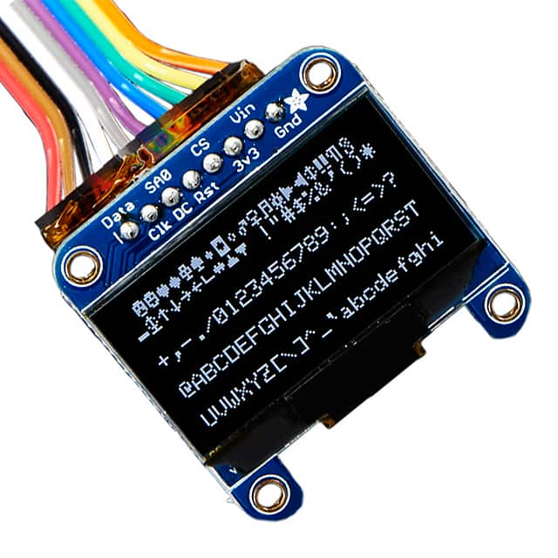
Gun Controls and Display Selection
Tactile buttons were chosen over a touchscreen as the main input devices
Buttons are more intuitive, provide better user feedback, and do not require calibration. User comfort was the highest priority in this decision
OLED was chosen over LED or LCD as the display type
Additional cost of OLED was worth it for weight, brightness, power consumption, and field of view advantages
Final display choice: Monochrome 1.3" 128x64 OLED Graphic Display from Adafruit
Met all the above design decisions
Reliable and high-quality display
Notes:
Rachel Goodman
For menu selections and other inputs on the controller, we opted for tactile buttons rather than a touchscreen. Buttons are more intuitive, provide better user feedback, and do not require calibration. They should provide a more satisfying user experience.
For the screen on the controller, we opted for this small OLED display from Adafruit.

Slide 28
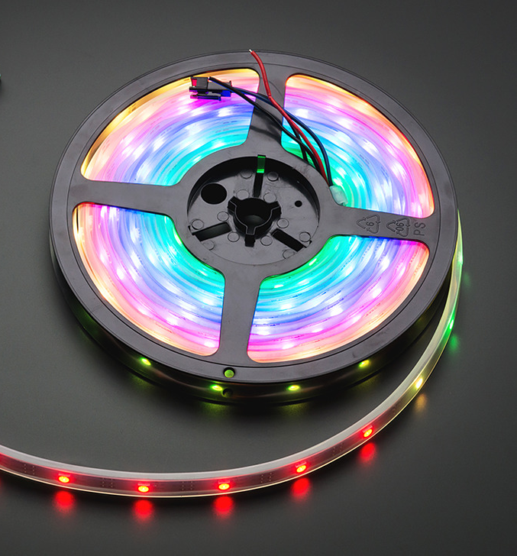
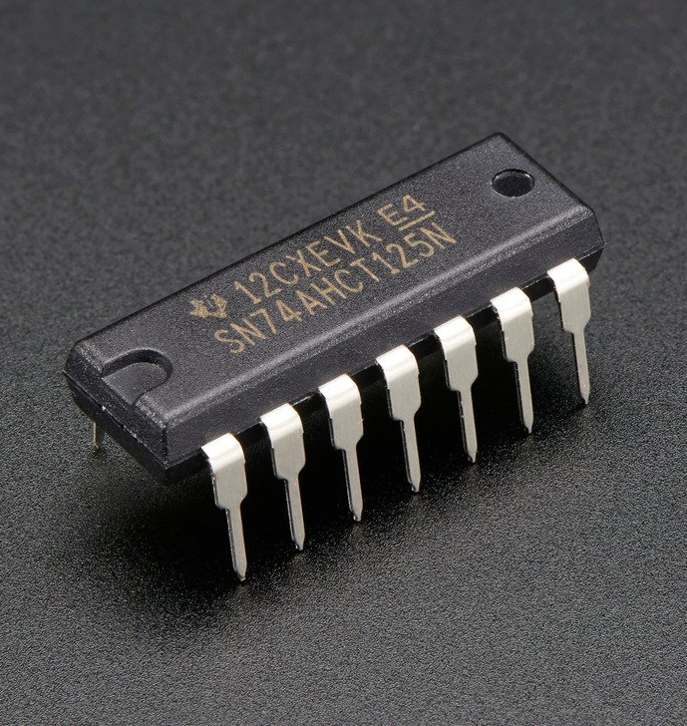
Target LED Strip Selection
NeoPixel Digital RGB LED Strip
Relatively cheap
Low power consumption
Convenient for prototype testing
Easily expanded
Level Shifter - 74AHCT125
LED strip requires a 5V data signal
ESP32 only outputs 3V
Quad Level-Shifter (3V to 5V) bought from Adafruit
Notes:
Rachel Goodman
For the lighting display on our targets, we have decided to go with this NeoPixel Digital RGB LED Strip from Adafruit. They are relatively cheap, coming in at about $17 per meter, do not consume much power compared to something like an LED matrix, and they are super easy to hook up and test.
After selecting the LED strip, we realized that it requires a 5V data signal, and the ESP32 only outputs 3V signals, so we added this 3V to 5V level-shifter from Adafruit to our design.

Slide 29
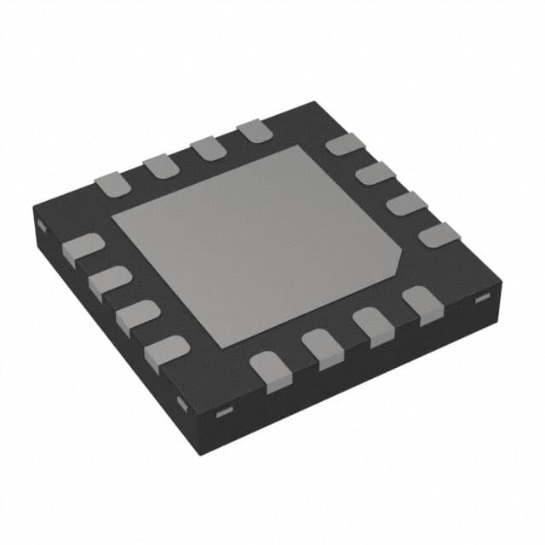
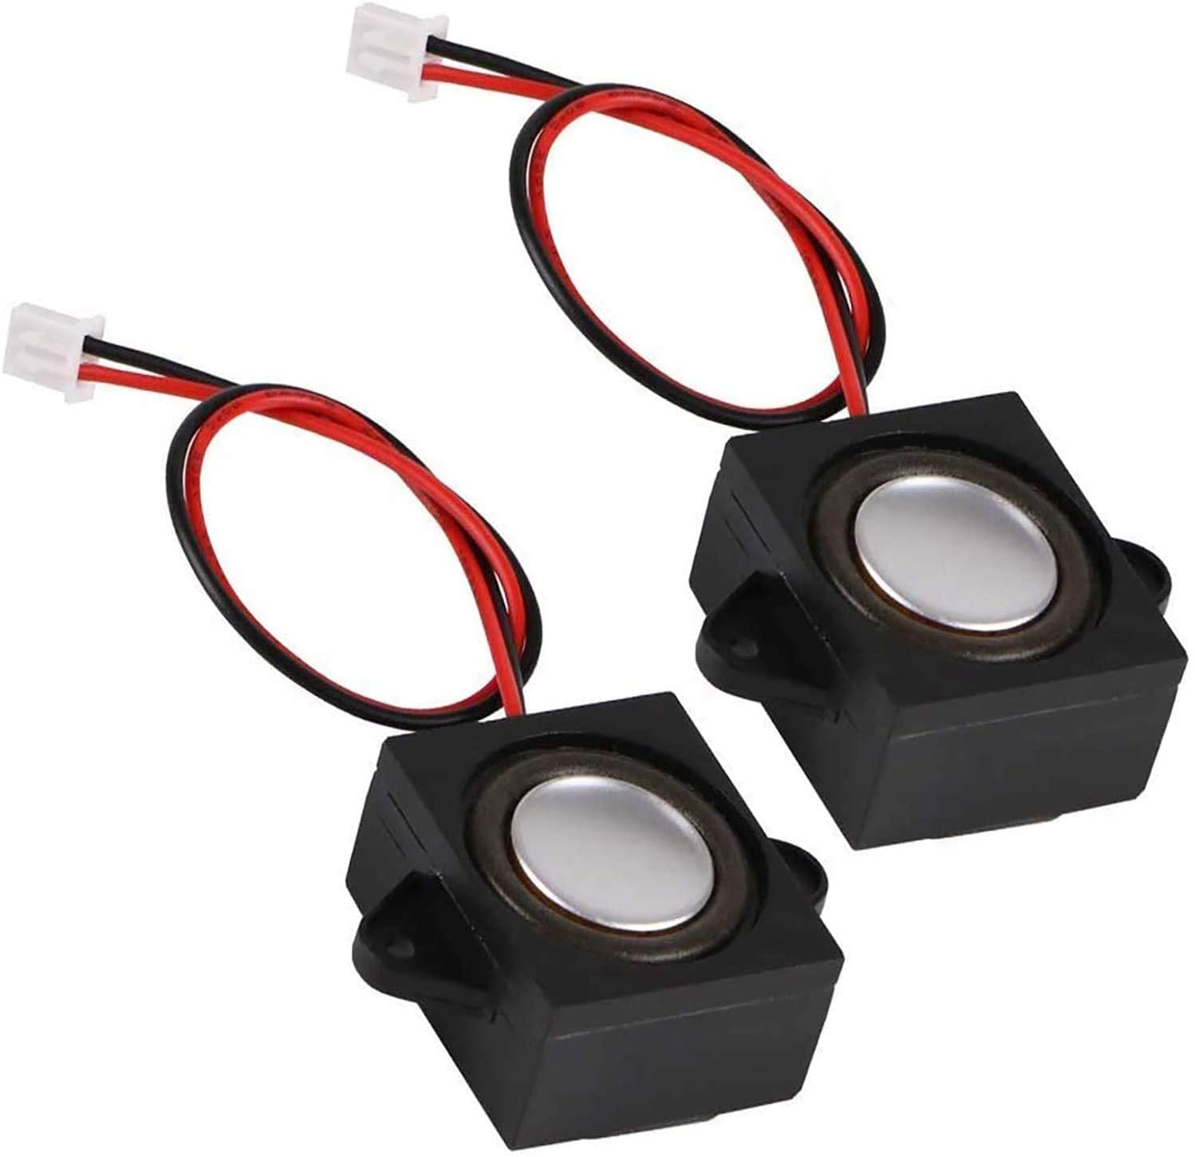
Audio Component Selection
Audio Amplifier Chip
The SparkFun I2S Audio Breakout – MAX98357A board was used for preliminary audio testing due to its high availability, low cost, and few required pin connections.
Preliminary testing proved the chip to be successful, so the MAX98357AETE+T chip was integrated into our PCB design.
Speakers
Required maximum rated power of 3.2W and rated impedance of 4Ω to work with the selected amplifier chip
The MakerHawk 2PCS 4 Ohm 3-Watt Speaker was chosen to fit these requirements
Preliminary testing provided clear, understandable audio
Notes:
Rachel Goodman
For audio on both the controller and the targets, we selected the amplifier chip and speakers shown here. We tested this entire audio system during Senior Design 1 with the chip on a breakout board from SparkFun. For Senior Design 2, we have removed the need for the breakout board by integrating only the parts that we need into our PCBs.

Slide 30
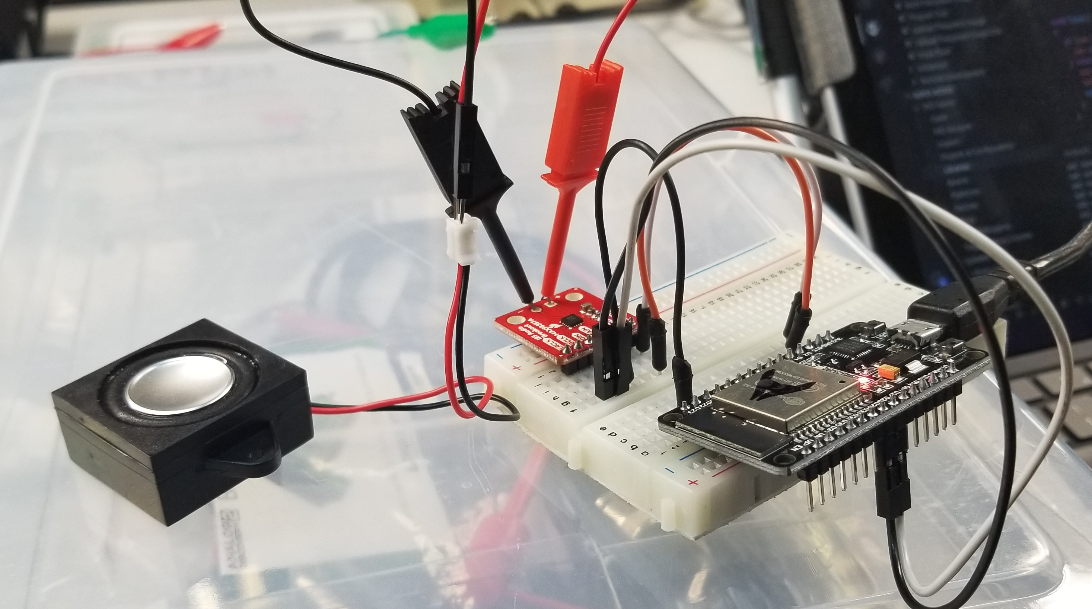
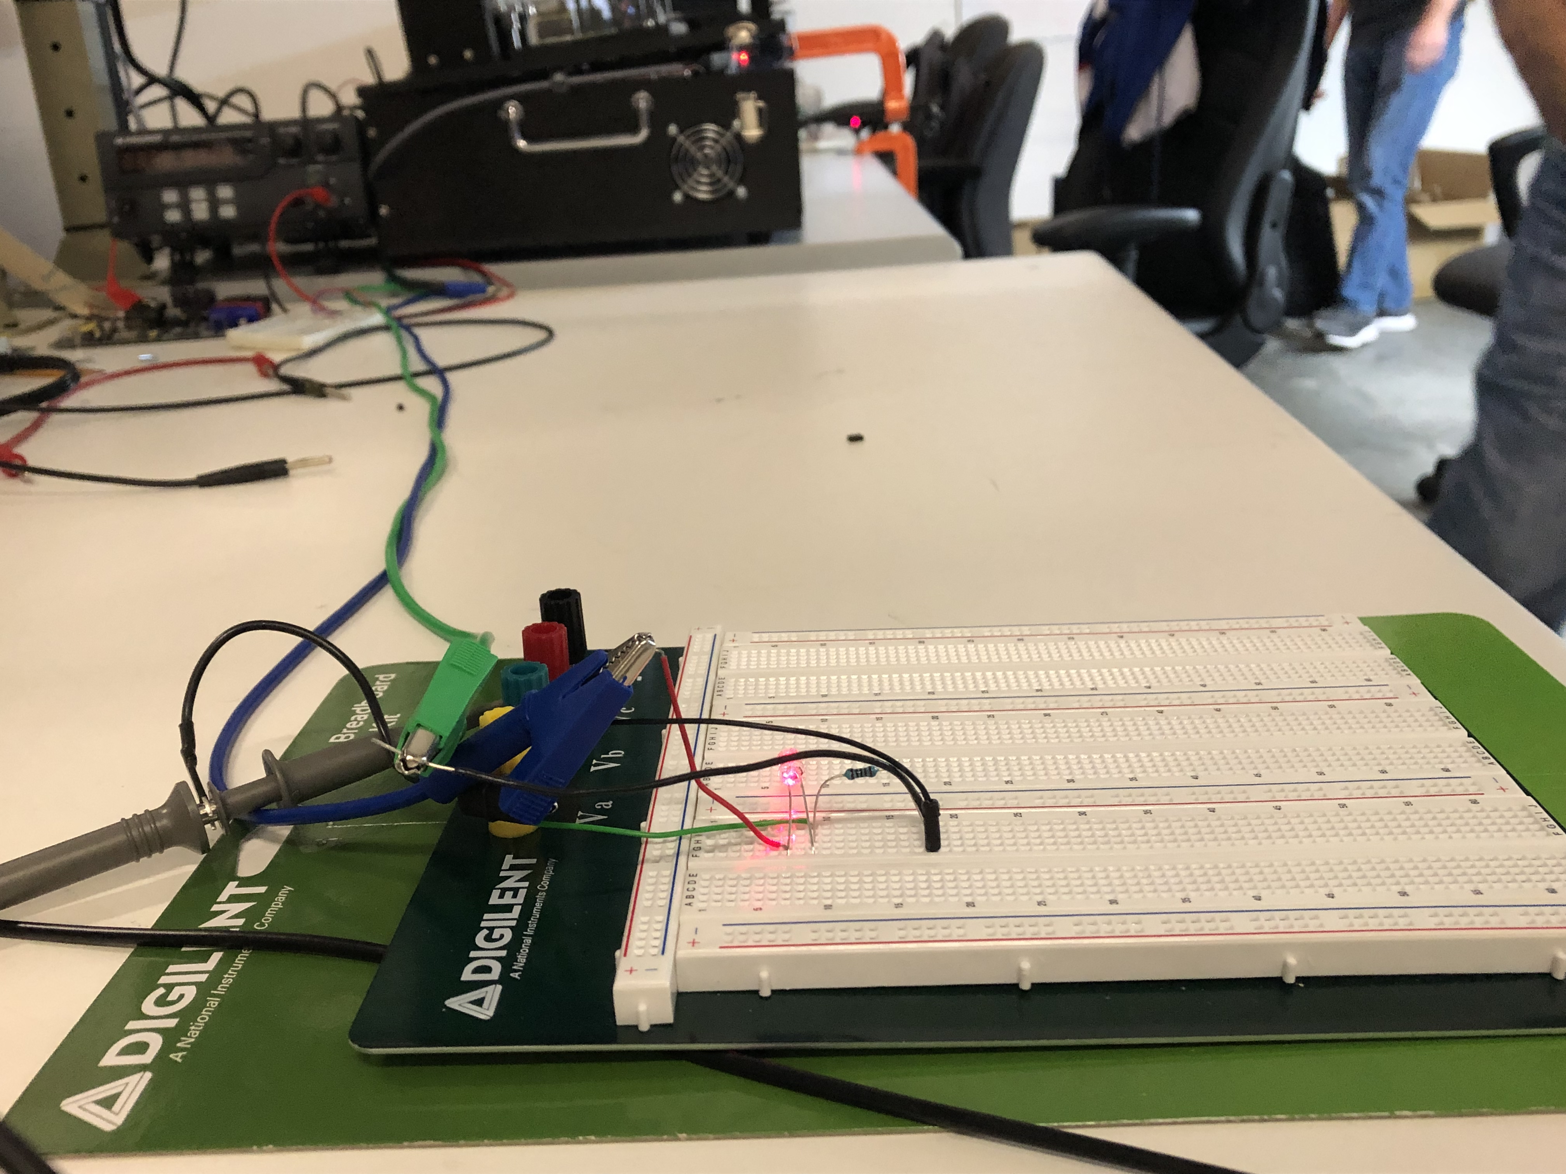
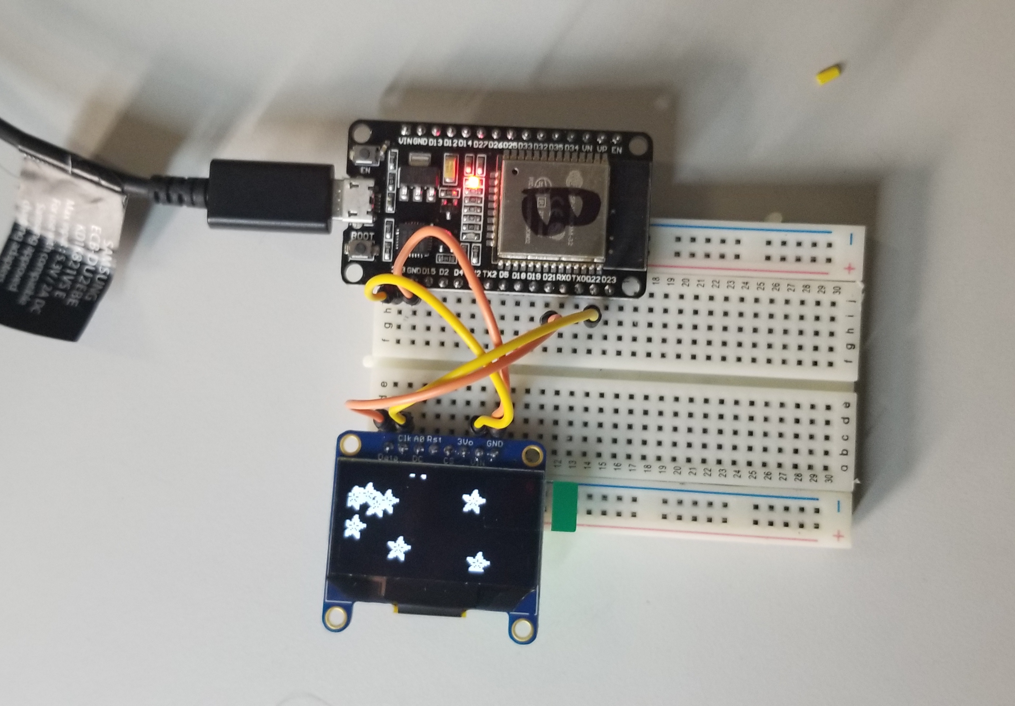
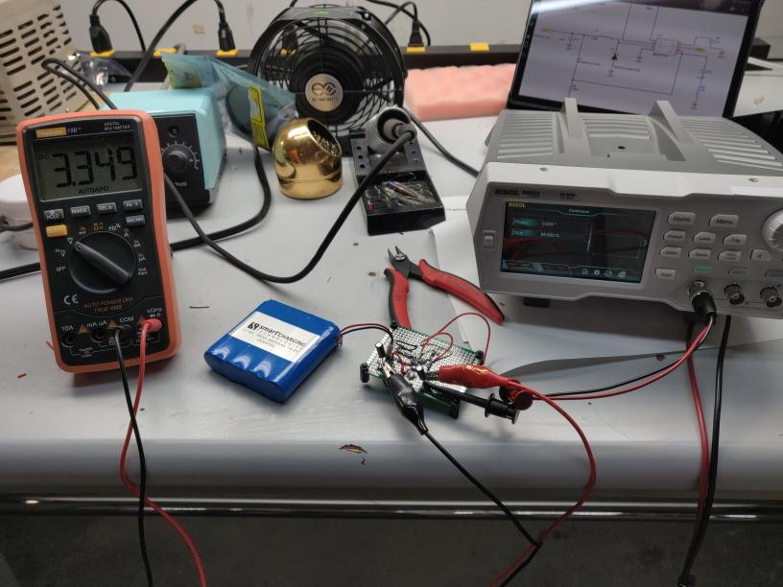
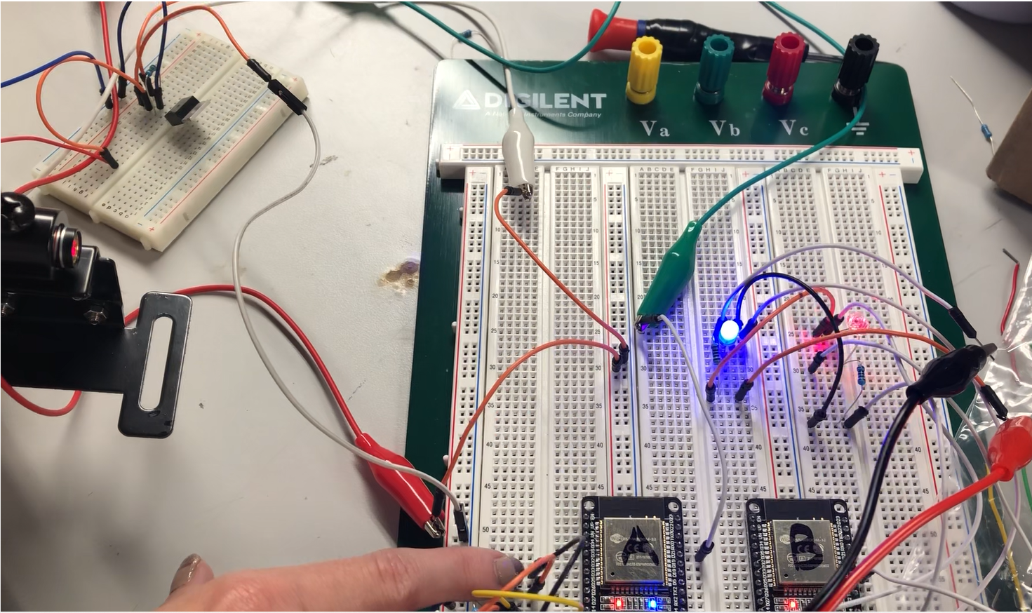
Testing
Laser Diode
Phototransistor
Speaker & Audio Chip Test
Long-Range Laser Test (approx. 7ft)
OLED Display Test
Voltage Regulator Test
Basic System Test – Laser + WiFi + Buttons
Notes:
Rachel Goodman
We have performed breadboard tests on every major subsystem of our hardware design. We ensured that our audio and display components worked properly, we tested our voltage regulator with our battery, we tested the phototransistor’s ability to sense the laser beam from several feet away, and we also performed a basic system test that integrated the laser (which was triggered by a button), the phototransistor, and the wifi communication between both microcontrollers.

Slide 31
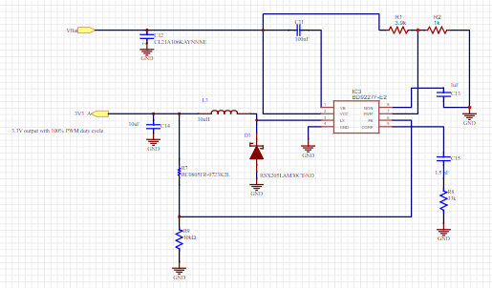
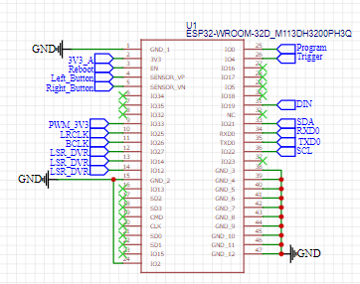
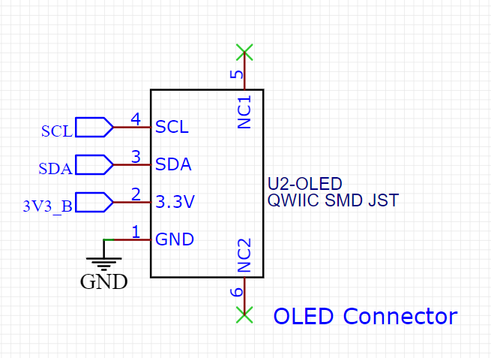
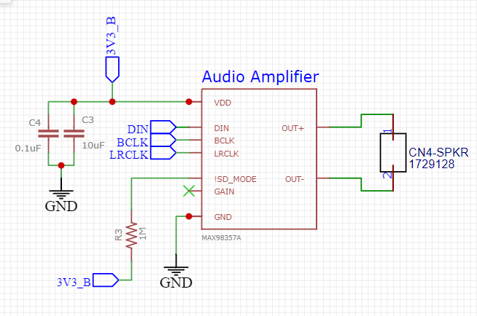
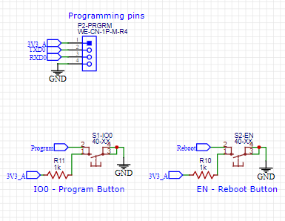
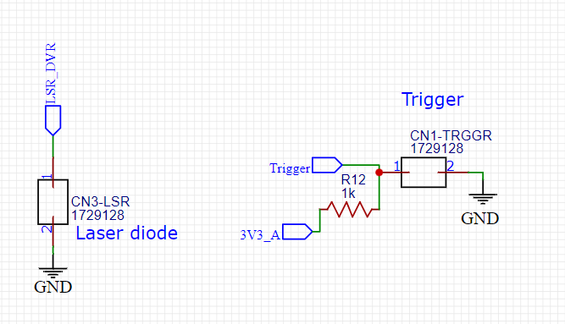
Controller Schematics
3.3V Regulator (x2)
ESP32 w/Connections
OLED Display Connections
Audio Chip
Programming Buttons/Pins
Laser & Trigger
Notes:
Rachel Goodman
This is an overview of all our schematics for the controller. We’ve got the ESP32 and all its connections including its programming pins and buttons, we’ve got the audio chip, the OLED display connections, the connections to the laser and the trigger, and two 3.3V regulators. One of the regulators exclusively gives 3.3V to the microcontroller, and the other gives 3.3V to all the other components. We did this to avoid overloading a single voltage regulator.

Slide 32
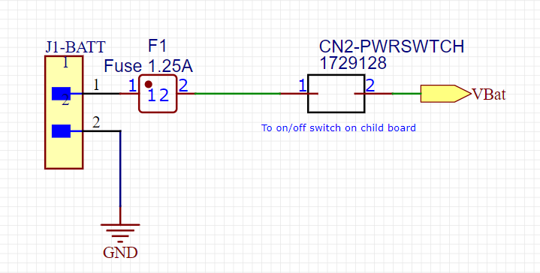
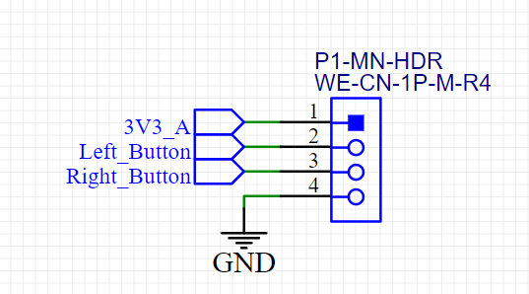
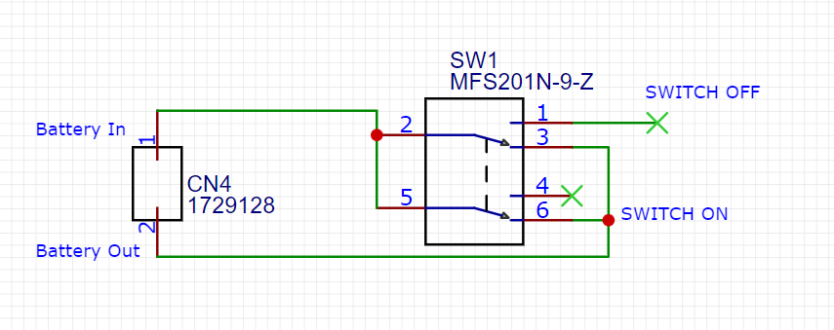
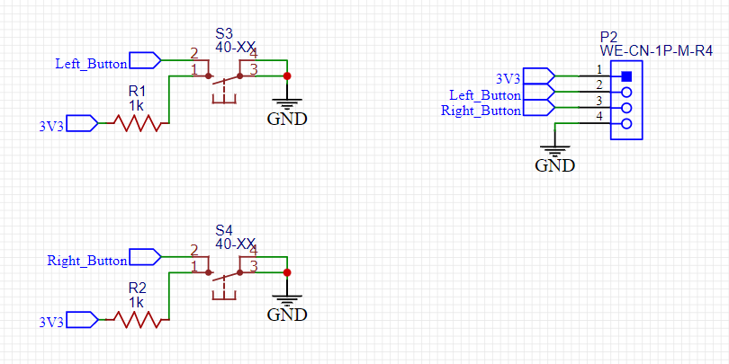
Controller Child Boards – On/Off & Menu Buttons
On/Off Switch
Menu Buttons
Main Board
Child Boards
Completed Boards
Notes:
Rachel Goodman
As part of the controller design, we wanted its menu buttons and on/off switch to be separate from the main PCB. In order to do this, we created two child boards which are shown here. One contains only the on/off switch, and the other contains the left and right menu buttons.

Slide 33
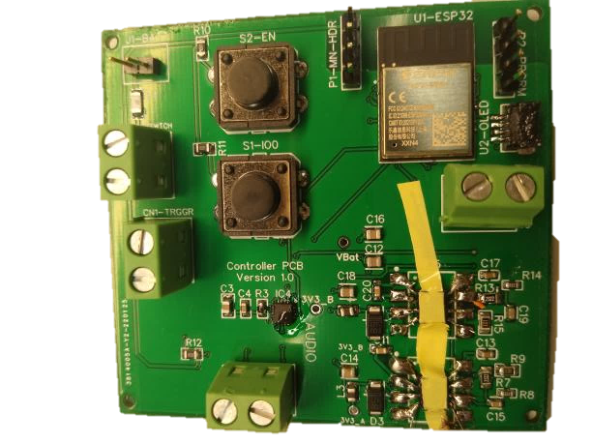
Controller PCB
Revision 2.0
(Currently Shipping)
Revision 1.0
Notes:
Rachel Goodman
A couple of weeks ago, we received and assembled our first round of PCBs. You can see our revision 1 PCB on the left. We discovered a few issues right away which we have addressed in our revision 2 designs, which you can see in the 3D model on the right. These have been shipped out and should arrive this week or early next week.

Slide 34
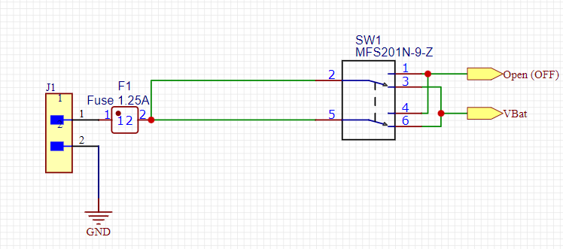
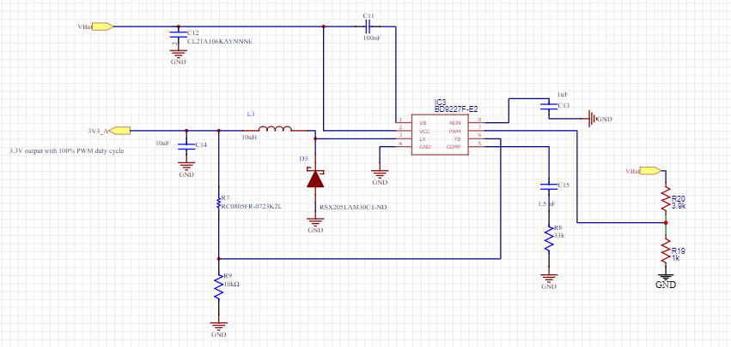
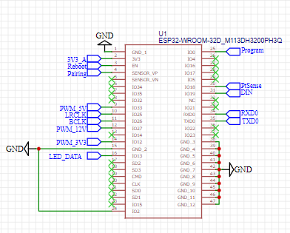
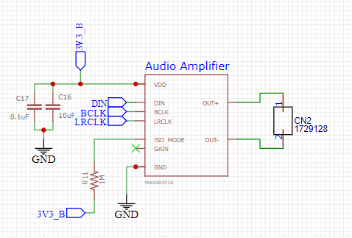
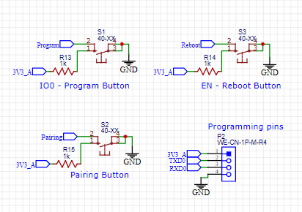
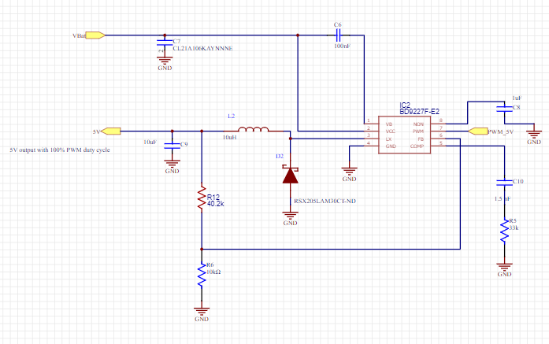
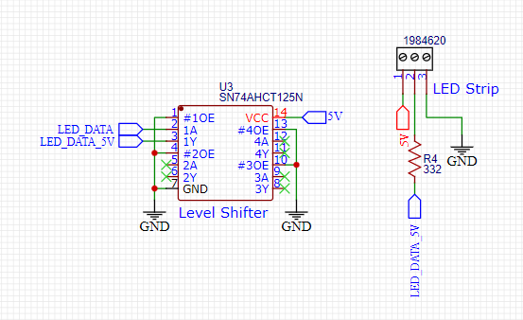
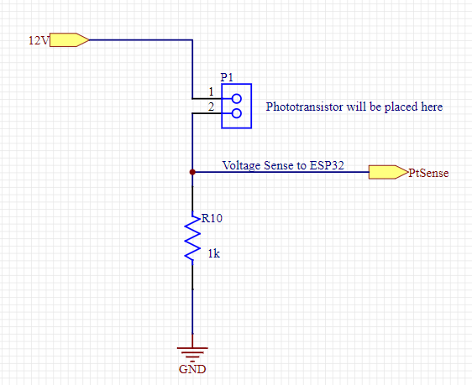
Target Schematics
On/Off Switch
3.3V Regulator (x2)
Audio Chip
Programming Buttons/Pins
ESP32 w/Connections
5V Regulator
Voltage Level Shifter & LED Strip Connection
Phototransistor(s) Connection
12V Regulator (adjustable)
Notes:
Rachel Goodman
Here we have an overview of all the schematics for the target PCB. Just like the controller, it has the ESP32, the audio chip, two 3.3V regulators, programming pins and buttons, and the on/off switch. Parts unique to the target are the phototransistor, the level shifter, the connection to the LED strip, and the 5V and 12V regulators. The 12V regulator is marked as adjustable in case we decide to use the backup phototransistor, in which case it can be changed easily to 6V by swapping out a single resistor.

Slide 35
Target PCB
Revision 1.0
Revision 2.0
(Currently Shipping)
Notes:
The status of the target PCB is the same as that of the controller PCB. Because they share so many aspects of their hardware design, we encountered the same issues with revision 1 of the target that we did with revision 1 of the controller. These issues have been addressed in revision 2, which is currently being shipped to us.

Slide 36
Revision 2.0 Adjustments
Corrected Footprint for Voltage Regulators
Added Turn-On Signal for Voltage Regulators
Exchanged ESP32-Mini for a full-size ESP32 for more reliable soldering
Communicated with Quality Manufacturing Services about getting ESP32 and audio chip professionally mounted
Assorted layout optimizations / improvements
Notes:
This is a list of the corrections we have made in our revision 2 designs to fix the problems with our revision 1 designs.
First, we found the correct footprint for our voltage regulators. You may have noticed in our assembled boards that the footprints were larger than the actual component, which we accidentally overlooked when checking footprints.
We also realized that the voltage regulator that we chose requires a turn-on signal, which the ESP32 cannot provide if the voltage regulator is not turned on to power it, thus creating a problem. We solved this by making sure that the voltage regulator that powers the ESP32 receives its turn-on signal directly from the battery when the device is powered on.
For our revision 1 PCBs, we went with the Mini version of the ESP32. The problem with the mini is that it is ridiculously small, all of its pins are underneath it, and they are impossible to access once it is soldered in place. This meant that when we had trouble communicating with it, we were unable to see if it was a soldering problem, and we were unable to probe any of the pins to troubleshoot. For revision 2, we went with a full-size ESP32, which will be much easier to both solder and troubleshoot.
We have also communicated with Quality Manufacturing Services about getting the microcontroller and audio chips professionally mounted for our revision 2 boards, because they are a bit too small for us to reliably solder by hand.
And lastly, any other changes made in revision 2 were mostly cosmetic, including various silkscreen updates and assorted layout improvements.

Slide 37
Budget and Financing

Slide 38
Financing Plan
All costs will be split equally among the four members of the group
No firm budget restrictions
Early estimates put the final cost at around $500-$800

Slide 39
Budget (Including Testing & Surplus Parts)
Item Type | Item Name | Bought From | Individual Price | Quantity | Total Cost
Microcontroller | ESP32-WROOM-32D | Mouser | $4.00 | 10 | $40.00
Laser Diode | 5mW 650nm Red | Adafruit | $5.95 | 3 | $17.85
Phototransistor Backup Phototransistor | HW5P-1 ALS-PT204-6C/L177 | Adafruit Digi-Key | $0.95 $0.50 | 5 3 | $4.75 $1.50
Battery | Efest Li-Ion 14.8V 2600mAh | SCT | FREE | 4 | $0.00
Voltage Regulator | BD9227F-E2 | Mouser | $1.35 | 50 | $67.50
Controller Display | Monochrome 1.3" 128x64 OLED Graphic Display | Adafruit | $19.95 | 2 | $39.90
Target LED Array | NeoPixel Digital RGB LED Strip | Adafruit | $16.95 | 2 | $33.90
Audio Amplifier | MAX98357AETE+T | Digi-Key | $2.68 | 10 | $26.80
Speakers | MakerHawk 2PCS 4 Ohm 3-Watt | Amazon | $10.99 | 2 | $21.98
3V to 5V Level Shifter | 74AHCT125 | Adafruit | $1.50 | 5 | $7.50
Misc. Passive Components | Misc. | Misc. | Varies | N/A | $75.00
PCB & Stencil Manufacturing + Shipping | 1st & 2nd Controller & Target PCB Orders | JLCPCB | $81.57 (1st) $74.57 (2nd) | 2 | $156.14
Misc. Testing Parts (not in final design) | Misc. | Misc. | Varies | N/A | $50.00
Total |  |  |  |  | $542.82
Notes:
Here we have our project budget, which encompasses all spending so far. This consists mainly of parts used in the actual project design, but also includes parts used only for testing, such as breakout boards and temporary laser diode mounts. Additionally, it includes the surpluses of some parts that we have ordered as backups and to account for supply chain issues. For example, you will notice that we have ordered a whole lot of voltage regulators, and that is because we need two of them for every controller PCB and four of them for every target PCB, and there were only a few hundred in stock anywhere we could find them online.
As previously mentioned, during Senior Design 1, we estimated a range of five hundred to eight hundred dollars for this project, and as you can see right now, we are currently at $542.82 spent. We believe that any remaining expenditures such as the system enclosures and a third round of PCB ordering should keep us within the original estimate.

Slide 40
Current Progress and Future Plans

Slide 41
Milestones
Task | Assigned To | Progress
Hardware
Finish Controller Hardware / PCB | Jamauri, Rachel | IN PROGRESS
Finish Target Hardware / PCB | Jamauri, Rachel | IN PROGRESS
Finish Enclosure Design | Jamauri, Rachel, Thomas | IN PROGRESS
Complete Hardware Testing | Jamauri, Rachel | TO DO
Software
Complete Hardware Managers | Thomas, Anna | IN PROGRESS
Complete Logic Modules | Thomas, Anna | IN PROGRESS
Complete Additional Target-Specific Software | Thomas, Anna | IN PROGRESS
Complete Additional Controller-Specific Software | Thomas, Anna | IN PROGRESS
Complete Software Testing | Thomas, Anna | TO DO
Administrative
CDR Presentation | All | DONE
Choose Faculty Reviewers | All | DONE
Write Conference Paper | All | TO DO
Create Website | All | TO DO
Final Presentation | All | TO DO

Slide 42
Progress To Date

Slide 43
Next Steps
Hardware
Begin final layout for PCBs to fit inside final enclosures
Software
Complete hardware managers
Continue development on logic modules
Thoroughly test software on each individual hardware component and as a complete system
Enclosure
Begin prototyping hardware enclosures

Slide 44
Acknowledgements

Slide 45
Thank You To SCT!
We would like to thank Smart Charging Technologies LLC for sponsoring the batteries that will be used for this project and dedicating a workspace for the team to develop the project
Notes:
Optional Remove to save 15s put on title screen.

