Slide 1
SOLAR CHARGER UCF SENIOR PROJECT
JOHN DICKMAN (EE) TYLER MAIGNAN (EE) LUIS NICACIO (EE) LESLIE RECENDIZ (CE)

Slide 2
Motivation
Being able to use renewable energy. It decreases pollution while also being very user-friendly
The ability to wirelessly charge a phone/headphones/smart watch
Wanted to have a portable way to charge a device without being connected to a power source

Slide 3
Goals & Objectives
Use the solar panel as main source of energy to charge a mobile device when using it outdoors.
Be able to switch to battery if solar panel doesn’t provide enough energy.
Display the output voltage using LCD

Slide 4
Specifications
Specification | Target
Solar Panel Output | 6 V
Battery Charger Output | 3.7 V
Output Voltage Booster | 5.0 - 5.2 V
Output Voltage Booster (with load) | 4.7 - 4.9 V
Low power mode MCU | when Voltage > 5.1
Battery Capacity | 10,000 mAh

Slide 5
Block Diagram
Voltage Booster
Bread Board
USB Port
Wireless Charger
Solar Panel
Battery Charger
Arduino
Bread Board
LCD Panel
Module
Additional Components
Battery
DC to DC Adapter
JST Cable
Jumper Wires
USB-A to USB-B Cable
USB-A to Micro-B USB Cable

Slide 6
Work Distribution
 | MCU code | PCB Design | AutoCad | General Hardware | Battery/Qi charger | Soldering
Luis |  |  |  | S | S | S
John(Conner) |  | P | S | P | P
Tyler | S |  | P | S | S | P
Leslie | P | S | P | S | S
P – Primary
S - Secondary

Slide 7
Component Overview
Microcontroller
Solar Panel
Lithium-Ion Battery
Voltage Booster
Qi Charger
3D Printed Housing

Slide 8
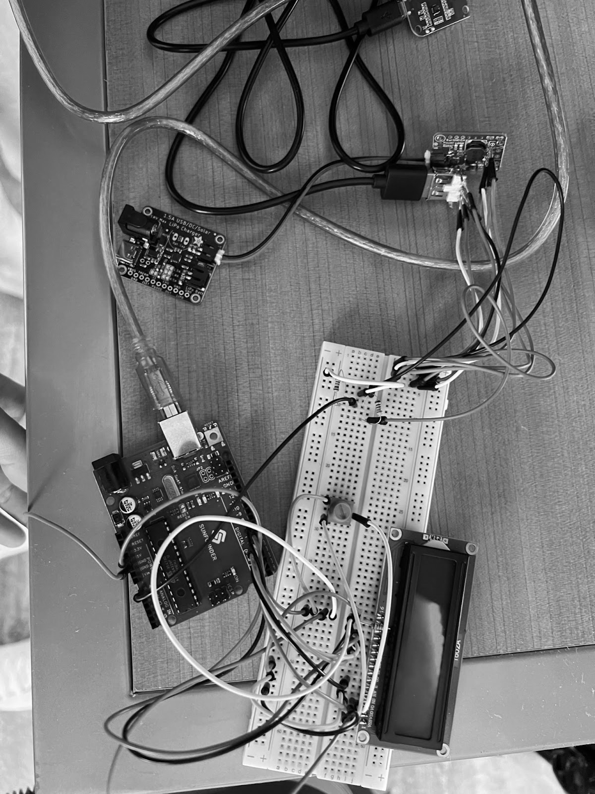
Microcontroller

Slide 9
Microcontroller
Technical Details Comparison
 | Arduino Uno R3 | Seeeduino V4.2
Microcontroller | ATmega328P | ATmega328P
Input voltage | 7-12 V | 3.3 V
Digital I/O pins | 14 | 14
DC current per I/O pin | 20 mA | 40 mA
Clock speed | 16 MHz | 16 MHz
Size | 2.7 in x 2.1 in | 4.5 in x 3.1 in x 0.98 in

Slide 10
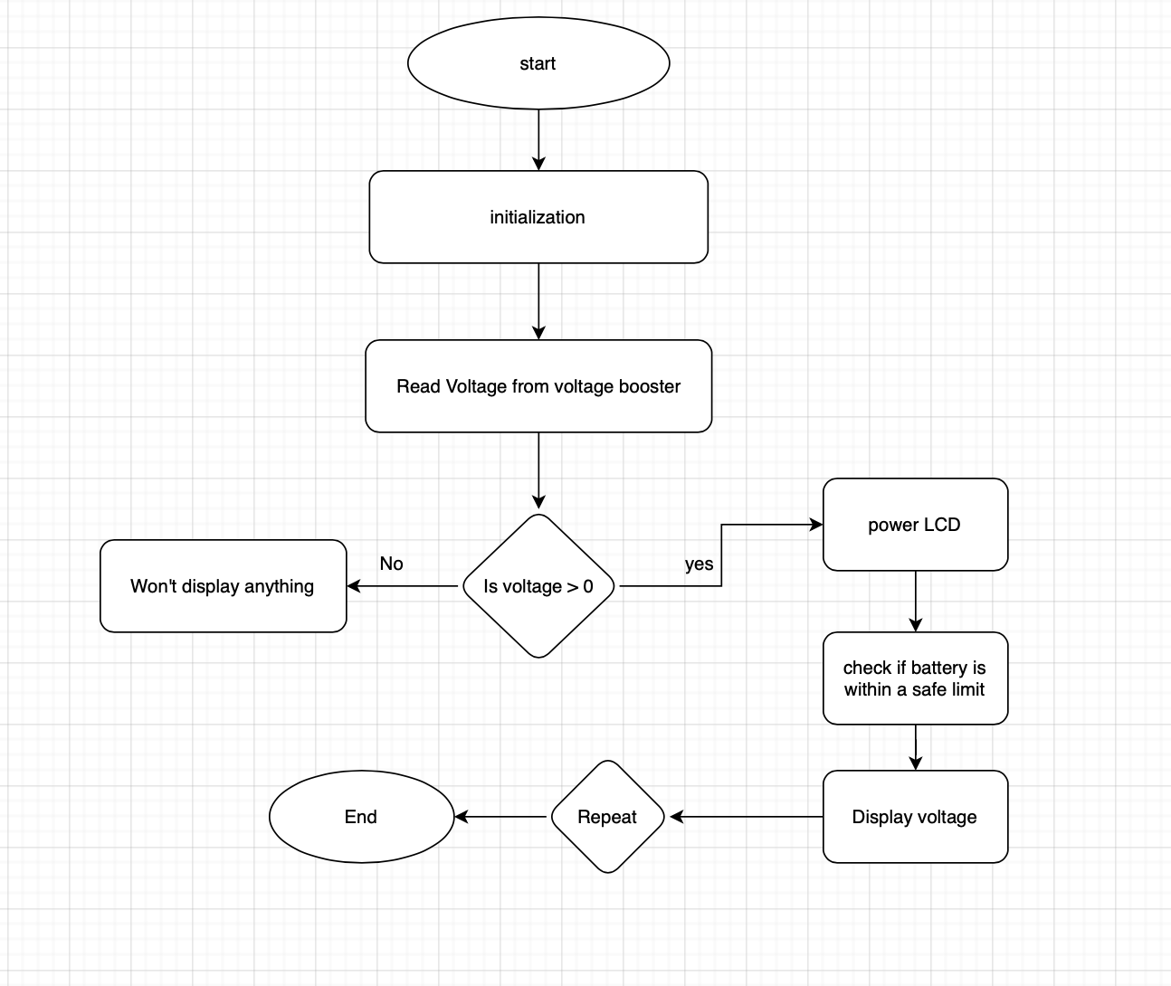
MCU Code
It will work as a voltmeter to calculate the output voltage after the voltage booster
The MCU will communicate with the LCD screen to display voltage change
MCU will also turn on a green LED when charging and red LED when not charging

Slide 11
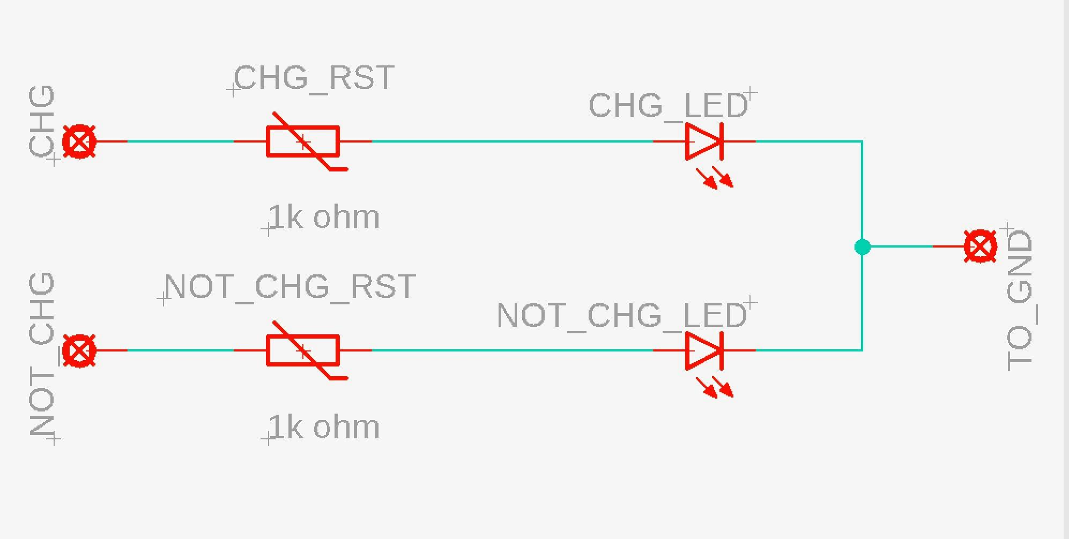
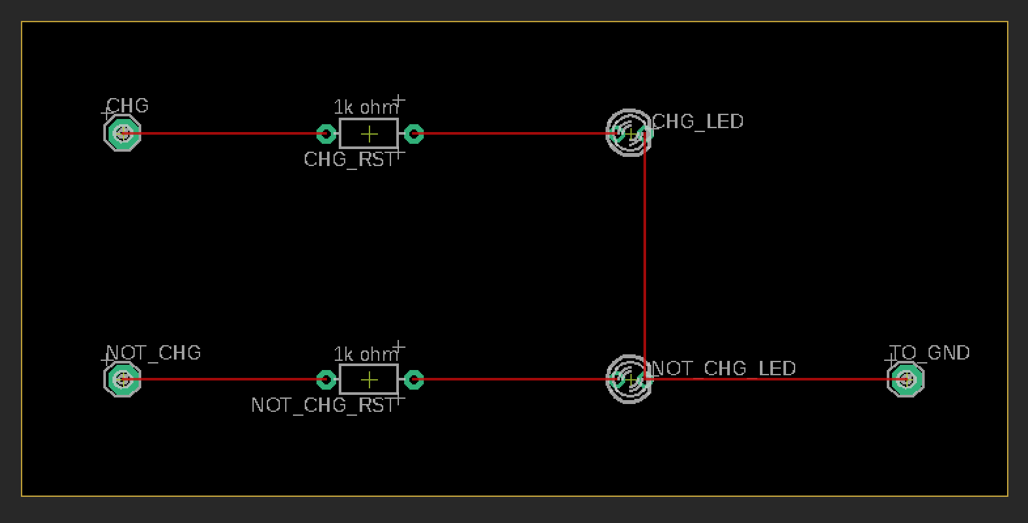
PCB Design

Slide 12
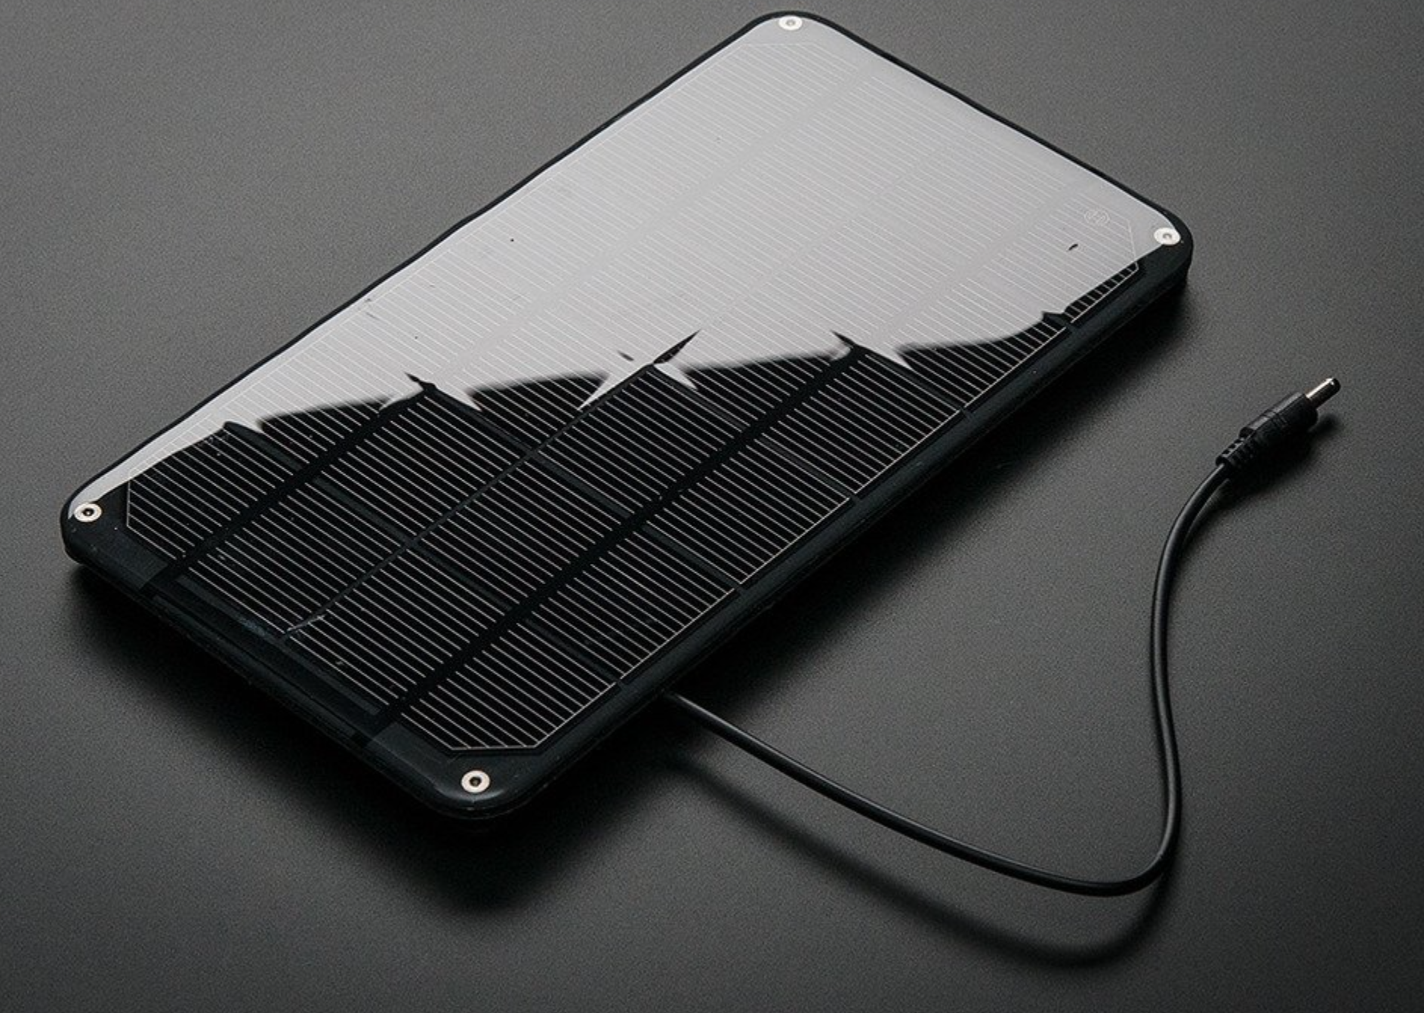
Solar Panel
Notes:
leslie

Slide 13
Adafruit Solar Panel
Model | SLP190S-24 Silver Monocrystalline | Amerisolar AS-6P 340W Polycrystalline | AdaFruit Monocrystalline
Size | 62.2×31.8×1.38 in | 77 × 39.1 × 2 in | 8.3" x 4.4" x 0.2"
Cost | $245.00 | $212.00 | $45
Weight | 41.9 lbs | 50.7 lbs | 140g
Power Output | 190W | 340W | 3.5W
Current | 5.16A | 9.07A | 530 mA
Temperature Constraints | -(0.5±0.05)%/ °C | -0.41%/K | n/a
Annual output | 267 kWh/Year | 478 kWh/Year | n/a
Efficiency | n/a | 17.52% | 19%
Voltage | 24VDC | 37.5VDC | 6V
Notes:
Power output: 3.5 W
Voltage: 6V
19% efficiency
Waterproof, scratch resistant, and UV resistant.
Monocrystalline cells

Slide 14
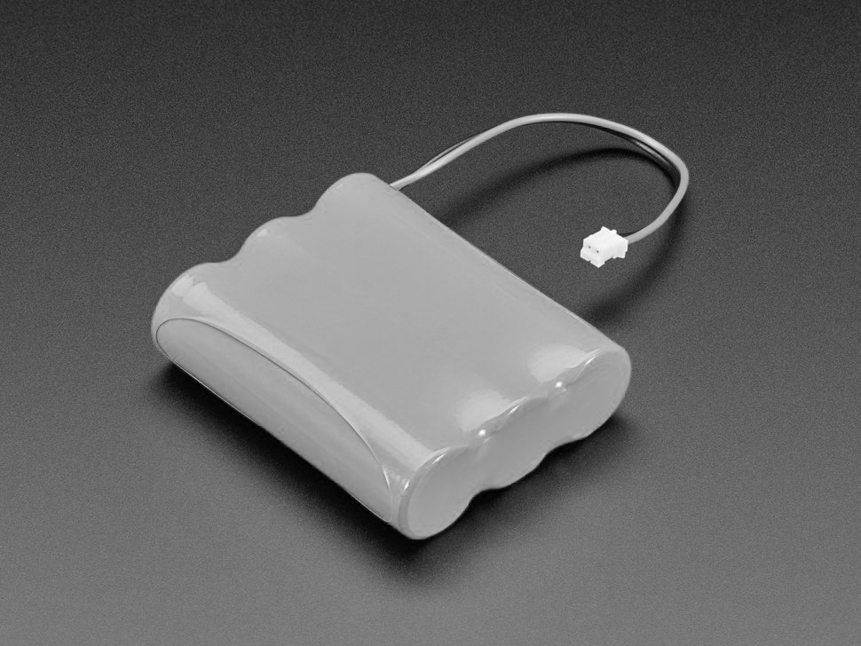
Battery

Slide 15
Lithium-Ion Battery
Voltage: 3.7V
Pre-attached with a 2-pin JST-PH connector.
Standard charging time: 8 hrs

Slide 16
Battery Comparison
Lithium cobalt oxide battery | The lithium cobalt oxide battery has a stable capacity, great thermal stability, but at elevated temperatures its decomposition generates oxygen, which is dangerous because its an exothermic reaction
Lithium-ion ternary battery | The ternary lithium battery has high energy density, charge, and discharge efficiency, but is not resistant to high temperatures
Lithium-ion manganese oxide battery | The lithium manganese oxide battery has long-term reliability, therefore it’s used in electric cars and other devices. It has a very high temperature tolerance, and has stable discharge capability.
Lithium ion battery | The lithium ion battery has a very high energy density, meaning it packs a high energy capacity in a small size. This battery has a low self-discharge rate, and outputs constant full power throughout the discharge.

Slide 17
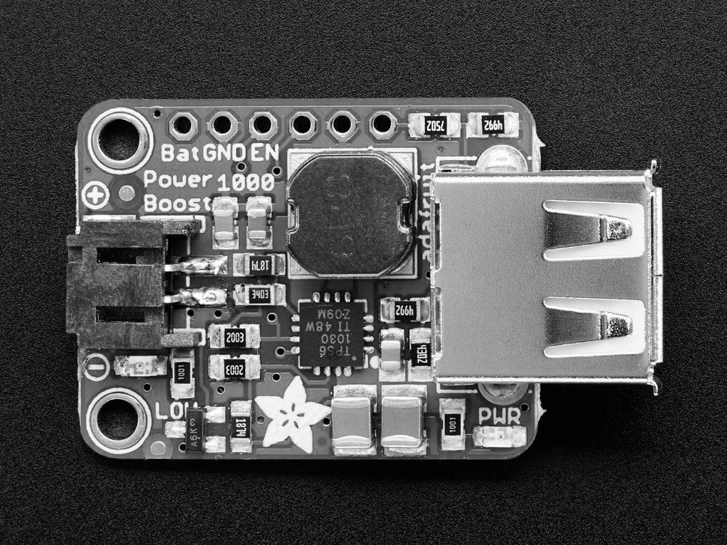
Voltage Booster

Slide 18
Voltage Booster
The USB connector includes is a 5V power pin
Boosts voltage to 5.2V
It will range from 3.0 V when it is pretty close to being dead, to 4.2V when fully charged
Input voltage: 1.8V

Slide 19
Voltage Booster Comparison
PowerBoost 1000 Basic - 5V USB Boost @ 1000mA from 1.8V+ | This voltage booster was the best option for the project. As our project only needed 5V, this voltage booster provides up to 5.2V in the event of undervoltage. Has necessary LED indicators, operates at 90% operating efficiency, weighing at 6 grams and sized at 29 mm x 23 mm x 2mm.
VERTER 5V USB Buck-Boost - 500mA from 3V-5V / 1000ma from 5V-12V | When it came to this voltage booster, it provides some of the same features as the voltage booster above, but when it came to size, it was too small. At 19mm x 32mm x 5mm, it is way too compact for this project. Also, this voltage booster sags to 4.8V, where we need a minimum of 5V.
PowerBoost 1000 Charger - Rechargeable 5V Lipo USB Boost @ 1A - 1000C | This voltage booster also provides the boost of 5.2V, but due to the size of the booster being smaller, at 23mm, 45mm x 10mm. Also, this voltage booster can be used with tablets and provide higher power, where this project is only intended to be used with mobile phones.
PowerBoost 500 Basic - 5V USB Boost @ 500mA from 1.8V+ | While looking at this option for a voltage booster, this one is identical to the one chosen above but did not provide enough current. This voltage booster provides 500mA and the one chosen above is 1000mA.

Slide 20
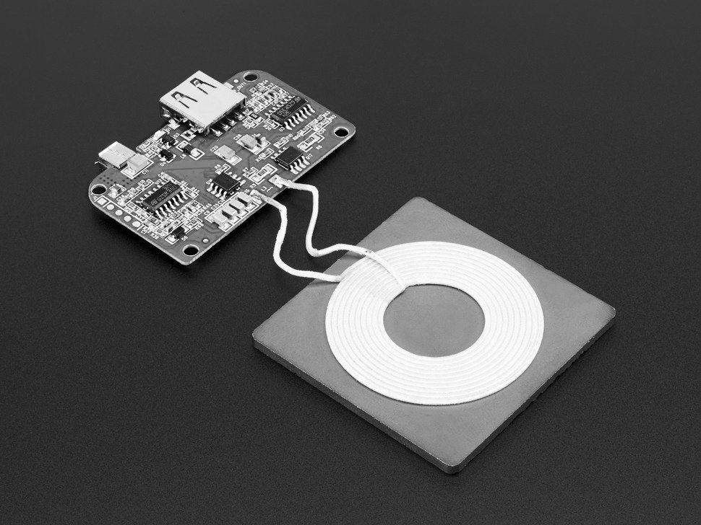
Qi Charger

Slide 21
Wireless Charger
Input voltage: 5V
Charging distance: 0.078 in - 0.3149in
It detects the presence of foreign metal objects in the vicinity of the wireless charging system and disables wireless power transfer when energy leakage exceeds a specified threshold.

Slide 22
Table Comparison
Technical Details | Adafruit Qi Wireless Charger | Gikfun Qi Wireless Charger
Input Voltage (V) | 5V | 5V
Input Current (A) | 2A | 2A
Maximum Output Power (W) | 5 | 5
Operating Frequency (kHz) | 100 - 200 | NA
Charging Distance | 0.078 in - 0.3149in | 0.078 in - 0.3149in
Charging Plate Dimensions | 2.1 x 2.1 x 0.2 | 4.25” x 3” x 1
PCB Dimensions w/ Components | 2.2 x 1.5 x 0.2 in | NA
Weight | 1.6 oz | .81 oz
Price | $26.95 | $15
Needs to be soldered | No | Yes

Slide 23
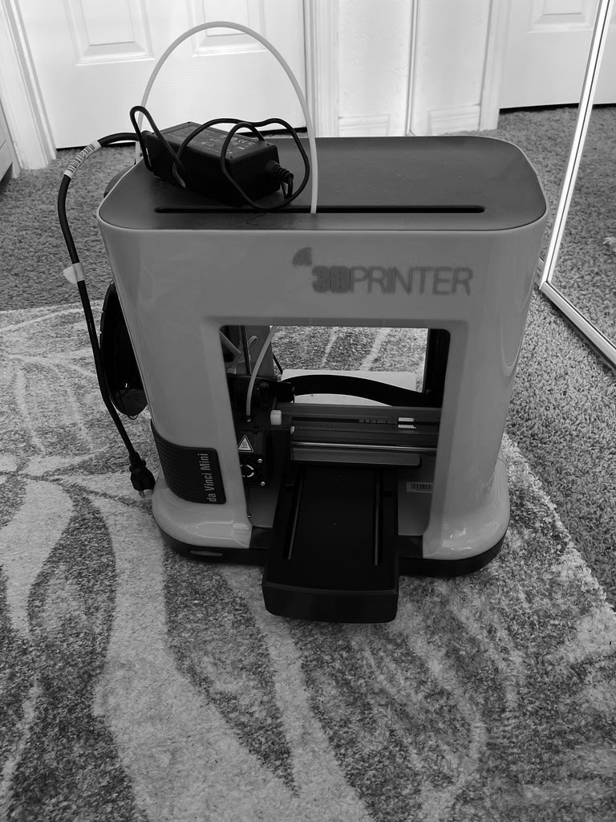
3D Printed Frame

Slide 24
3D Printed Frame
We are using PLA Filament because it is the only filament the printer will support
PLA Filament is made from bio-compostable materials, coming in a $22.95 for 600g
We will be using the software AutoCad to build the 3D model of the charger case
Our 3D printer is from XYZprinting, a new company specializing in small scale affordable printers

Slide 25
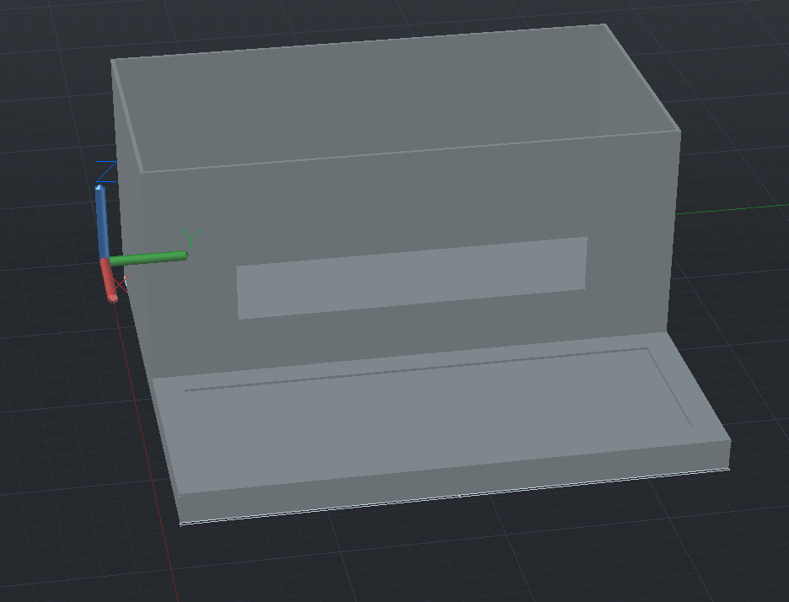
3D Model

Slide 26
Testing Phase
HARDWARE
SOFTWARE
We used a voltmeter to evaluate the voltage output of the solar panel, battery charger, etc.
Components must be able to communicate with each other
LCD must be able to print to screen
Software must be able to detect the power output from voltage booster and display the change.

Slide 27
Budget
Item | Quantity | Price
Lithium Polymer Battery | 1 | $29.95
Universal Qi charger | 1 | $26.95
PowerBoost 1000 | 1 | $14.95
Solar Panel 6V | 1 | $45
Adafruit Universal USB / DC / Solar Lithium Ion/Polymer charge | 1 | $9.95
DC Jack adapter | 1 | $30
3D Printer and filament | 1 | Owned
PCB | 2 | $22
Total Price | $156.8

Slide 28
Design Constraints
Economic
Self-funded by the group
Manufacturability
Availability of parts
Time
Length of the semester
Wait time for shipping delivery for parts

Slide 29
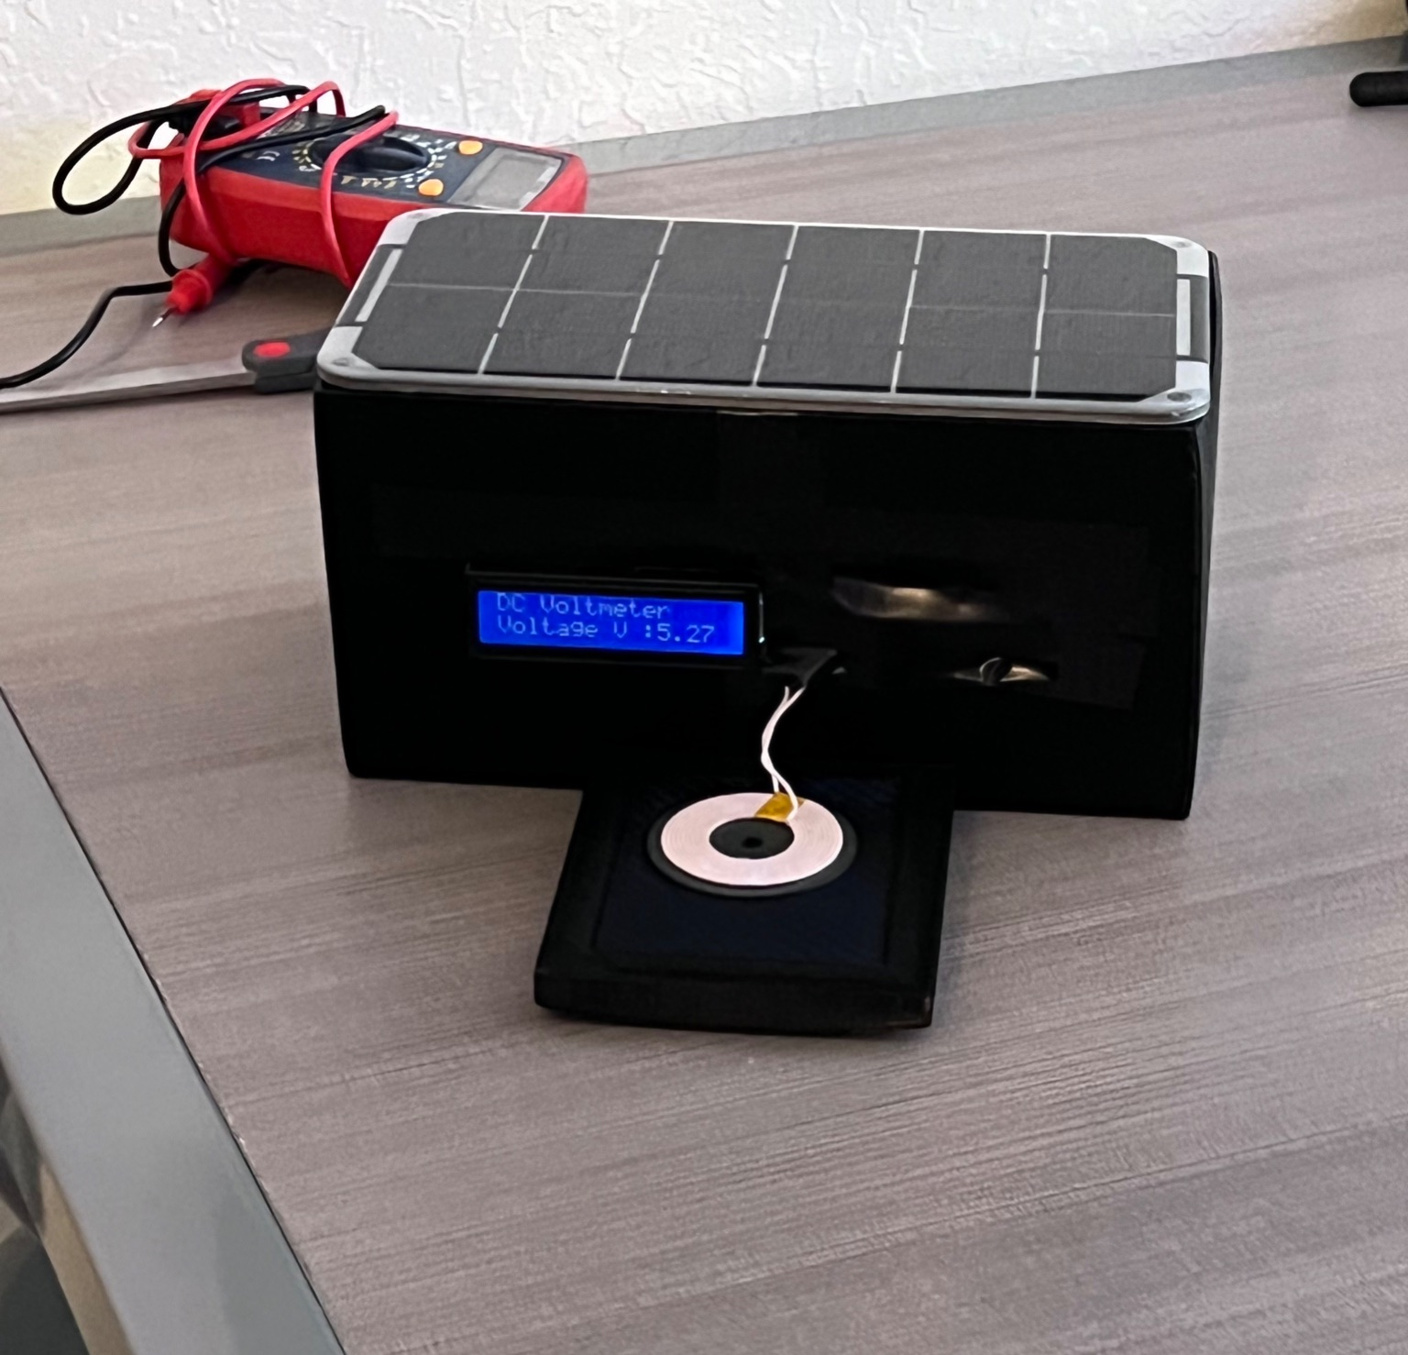
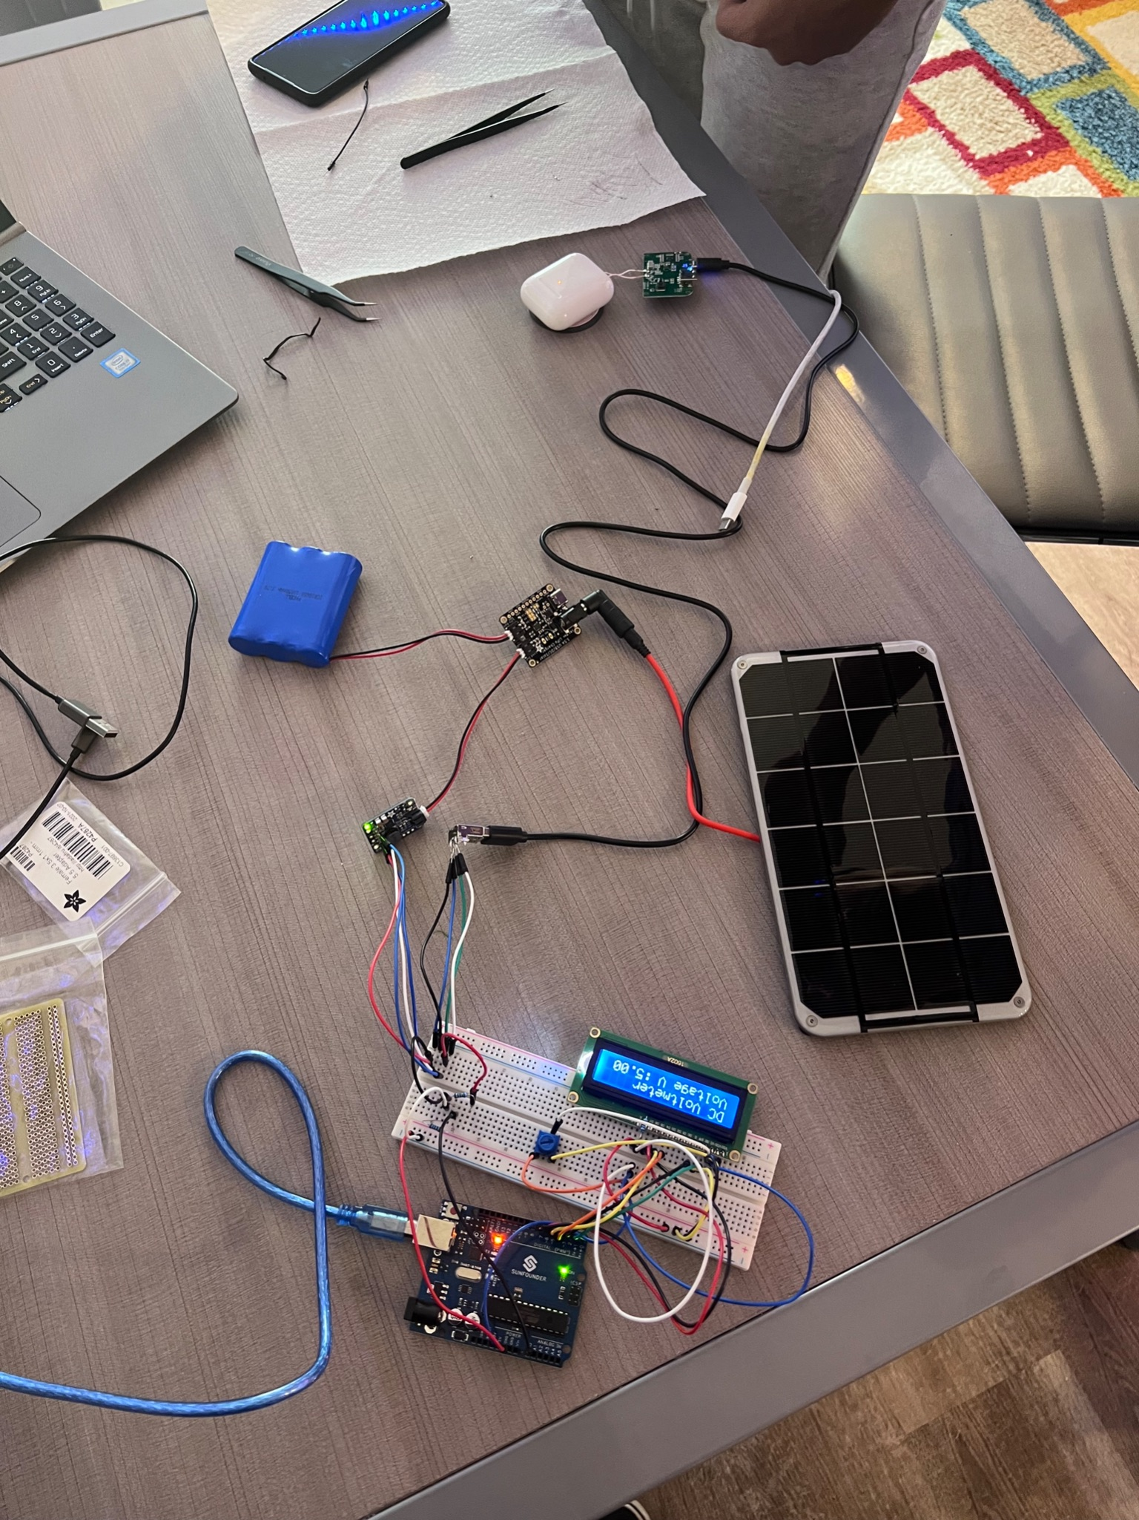
Final Design

Slide 30
Questions?

