Slide 1
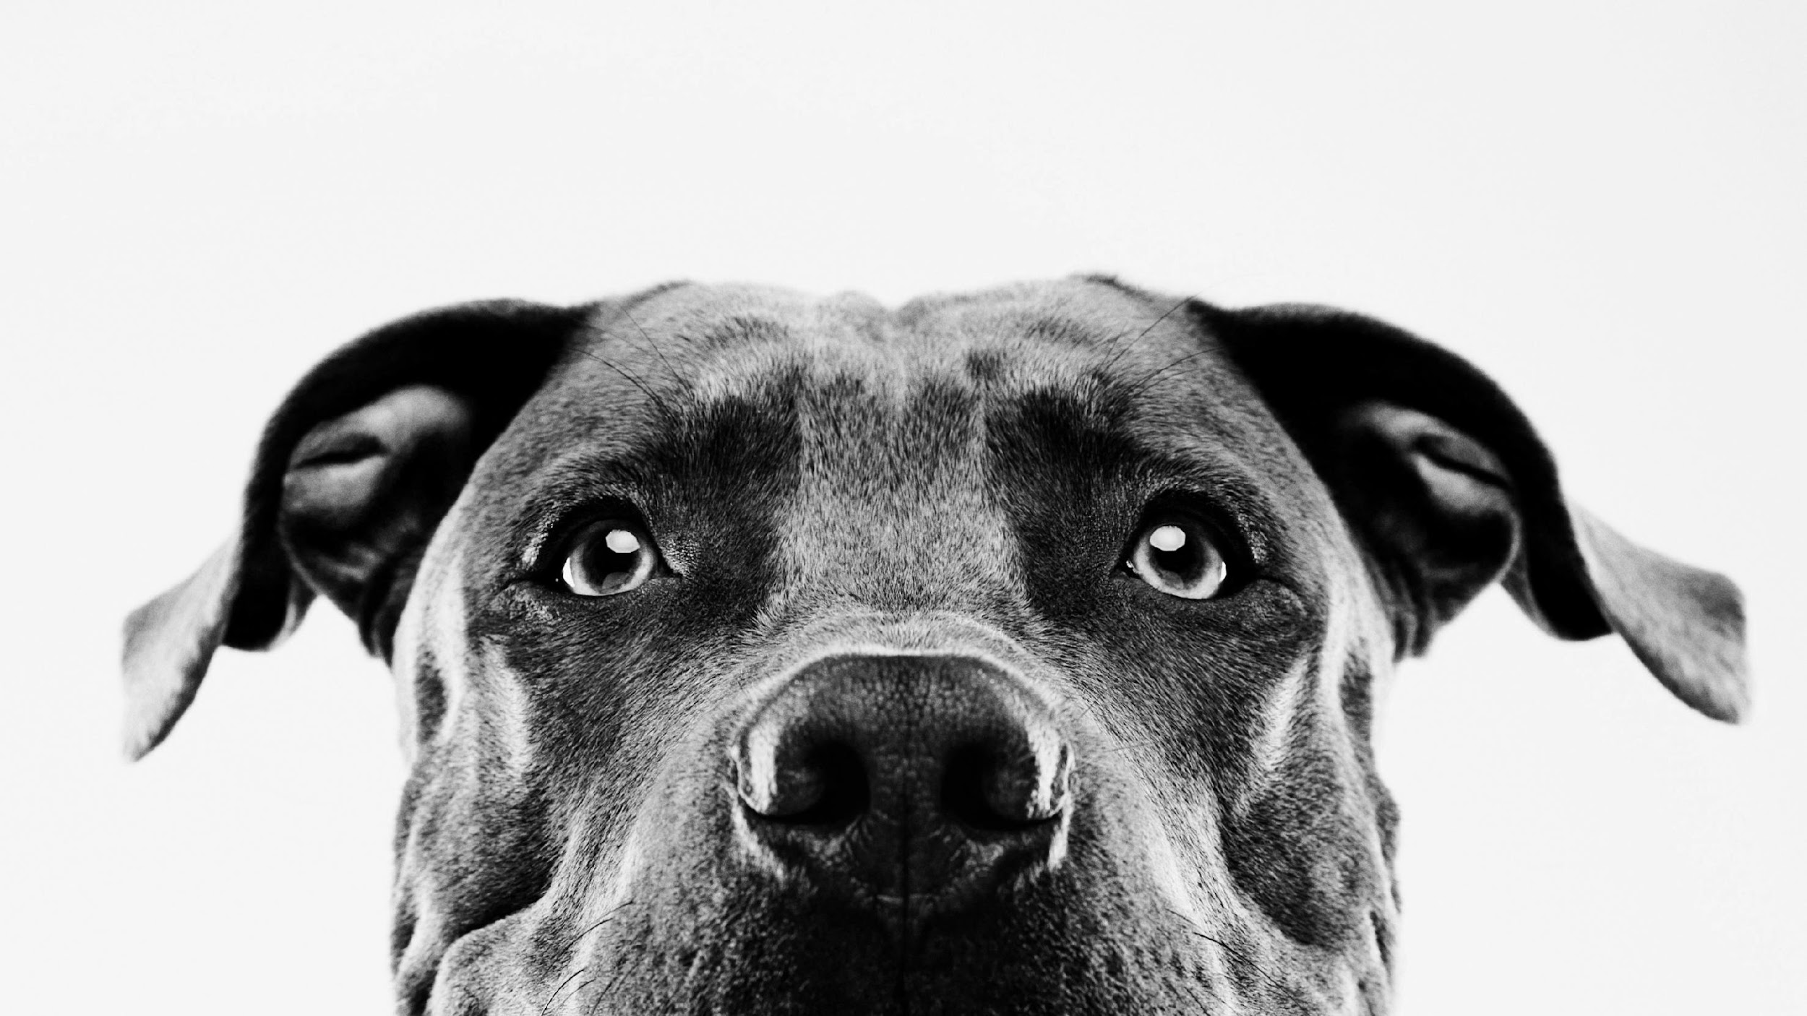
OPTO-SMART PET FEEDER
JACOB HAAS (EE)
TYLER KNIGHT (CREOL)
GROUP 9
CASSIDY COLL (CREOL)
RICKY EGAWA (CPE)
Notes:
Hello! This is group 9, and we are building the OptoSmart Pet Feeder. This is a presentation summarizing the purpose of our design and how we plan to implement it.

Slide 2
What is the Opto-Smart Pet Feeder?
An autonomous feeding device for pets that utilizes optical and photonic technology to ensure that the user’s pets are being routinely fed without needing the owner of the pet to be physically present with them
Notes:
The OptoSmart Pet feeder is an automatic feeding device that ensures that your pet is fed on a routine schedule even youre not present

Slide 3
Project Motivation
Routines are good for pets
Pets thrive getting their food at the same time each day
Chance of pets getting stressed waiting for food
Other pets can steal food from other dog bowls
Pets going hungry
People have busy lifestyles and can sometimes forget to feed their pets
Overfeeding can occur when pets are fed manually
Room in the Market
No other pet feeder on the market incorporates optics and electronics similar to our design
Notes:
The motivation behind the OptoSmart pet feeder was the knowledge that many pet owners have very busy lives that keeps them away from home. This device would ensure a constant feeding schedule for the pet, improving their quality of life through a routine.
This device also aims at ensuring that pet owners with multiple pets can breathe easy knowing that no food stealing is taking place since the lid will only open when it is that pets turn to eat.

Slide 4
Project Goals
Minimize the users time with easy to use software allowing for simple and routine pet feeding
Simple to use app with programmable dates and times
Automatic pet identification
Safe for pets to use
Quickly dispenses food
keep other pets from stealing other pets food using an automatic lid
Notes:
The goals for this project are to deliver a quality product that is simple to set up for your average pet owner, easy for the pet to get the food and robust enough to withstand the pet's daily feeding rituals. all while being completely safe for the pet to use.

Slide 5
PROJECT OBJECTIVES
TAKE THE STRESS OUT OF FEEDING YOUR PET
RECOGNIZES IF A PET IS AT ITS BOWL
THIS DEVICE CAN TELL THE DIFFERENCE BETWEEN PETS
ENSURE PETS ARE FED EVEN WHEN THE OWNER IS NOT HOME
PREVENTS OVEREATING
DISPENSE APPROPRIATE AMOUNT OF FOOD
CREATE A FEEDING ROUTINE FOR THE PET
DISPENSE FOOD AT THE CORRECT TIME
Notes:
Here is a list of the objectives for this The OptoSmart Pet Feeder, which are
*elminating stress from feeding your pet
*the ability to recognise if the pet is present
*To tell the difference between pets
*ensure that pets are fed
*Dispense food at the correct time
*Prevent the pets from overeating
*Dispense the right amount of food each time
*Create a feeding routine for the pet

Slide 6
Engineering Requirements
Engineering Requirement | Specification
Camera detection range | ≥ 5 feet
Motor power | < 100 watts
Photodiode response time | < 10 seconds
Food Dispensing time | < 60 seconds
Collar tag battery life | ≥ 2 hours
Dispenser lid closing time | 30 seconds 士 10 seconds
Pet food dispensed | 士 10% of designated amount
Demonstratable Specifications
Notes:
T: Here you see the engineering requirements for the Opto-Smart pet feeder
Highlighted in purple we have our demonstratable requirements, shown here our camera detection, photodiode response time and the dispenser lid closing time are the main requirements our project is focused towards satisfying

Slide 7
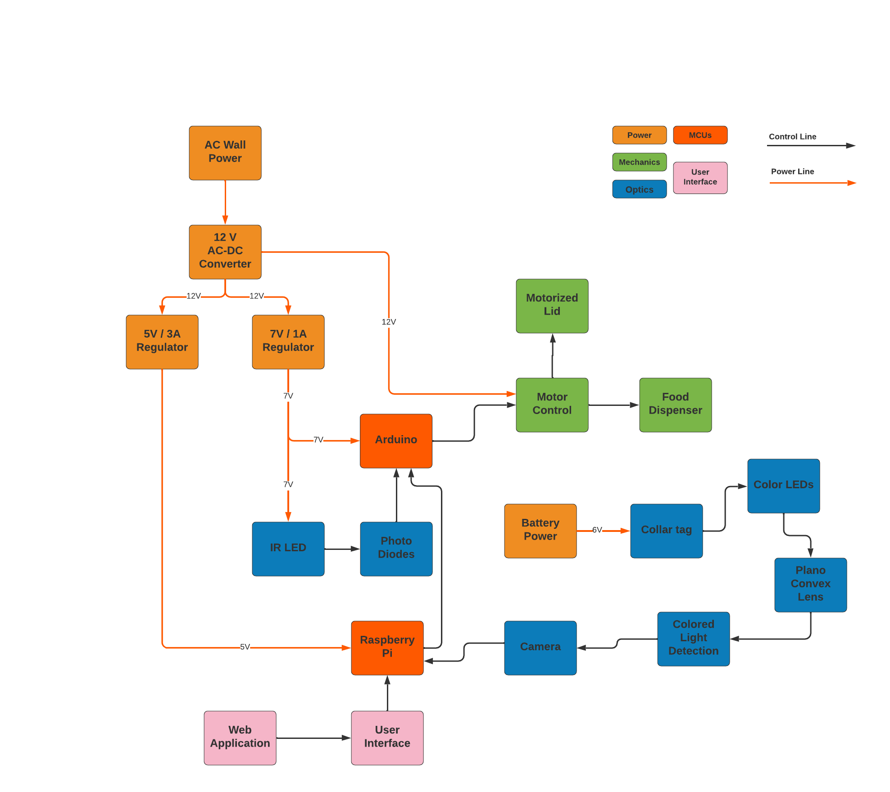
Overall Block Diagram
Member assigned to block
Tyler Knight –
IR Detection
Cassidy Coll - Camera/ Collar Tag
Ricky Egawa - software / Web App Development
Jacob Haas - Power/ MCU
Notes:
This is the overall block diagram of the OptoSmart pet feeder system. This diagram lists the many different systems of the design. which include power, mechanics, optical, the MCUs and the user interface. power lines are denoted in red while control lines are black.
The system takes AC wall power, which is then converted to 12v DC which powers the dispenser and the lid motors. Then the power is regulated to 5V/ 3A which powers the Raspberry Pi, there is also the 7v/1A regulator that powers the arduino and the IR LEDs. We then have the MCUs that are responsible for controlling the optical system and the motor system. An external user interface that changes system parameters will interface with the raspberry pi.

Slide 8
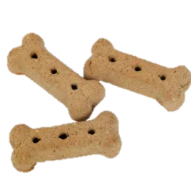
PET FEEDER FEATURES
Food is delivered to bowl using gravity and a motor spinning a 3D printed dispenser
Different pets are identified using an onboard camera built into the feeder. Camera will detect what color LED is on the pet collar and detect the right pet
Once the pet is Identified the device will respond by dispensing a specific amount of food tailored to that pet.
Photodiodes will detect if the animal is at the bowl and will close once it walks away.
Notes:
This slide highlights the features of the pet feeding system
**Read list

Slide 9
CORE FEATURES
Identification collar tag that will open corresponding Opto-smart pet feeder lid
Camera will identify LED color on the pet's collar
Lid will automatically close once pet walks away from opto-smart pet feeder bowl
ADVANCED FEATURES
User configurable settings to adjust for pet size and time of feedings
STRETCH FEATURES
Multiple pet bowls to be used by different pets
Using a webcam for owners to watch pets while owners are out and about
Notes:
This slide illustrates the features of the project. The core features thet were integral into the design of the such as the identification collar tag, a camera system that

Slide 10
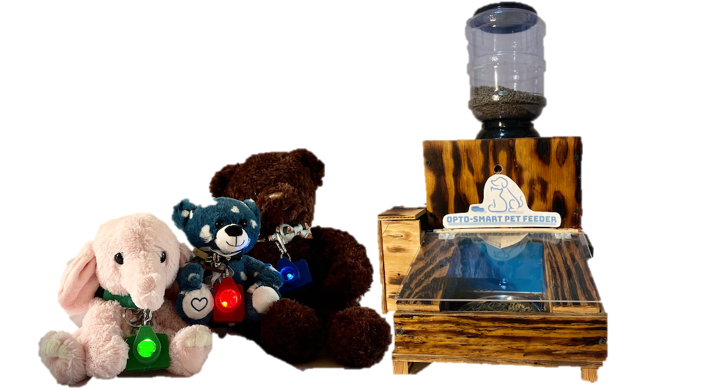
PET FEEDER DESIGN
Notes:
Here is model of what the finished product will look like showing off the food holder, lid system optical system and the collar tag that each pet will wear.

Slide 11
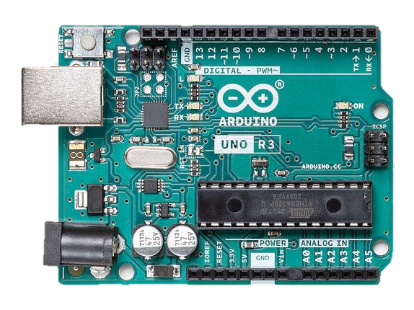
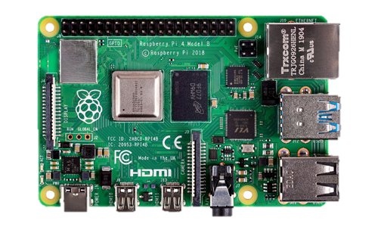
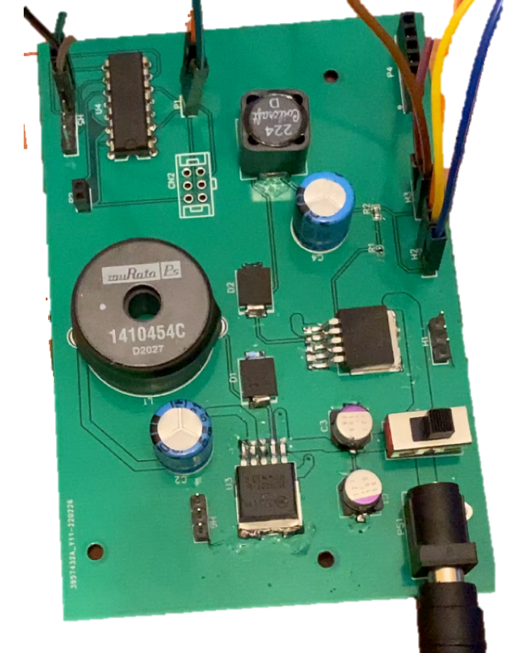
Main Electrical Components
Notes:
Within this section we will cover the reasoning and selection criteria behind the electrical components of the Opto-Smart Pet Feeder as well as discuss the development of the PCBs needed for our device.

Slide 12
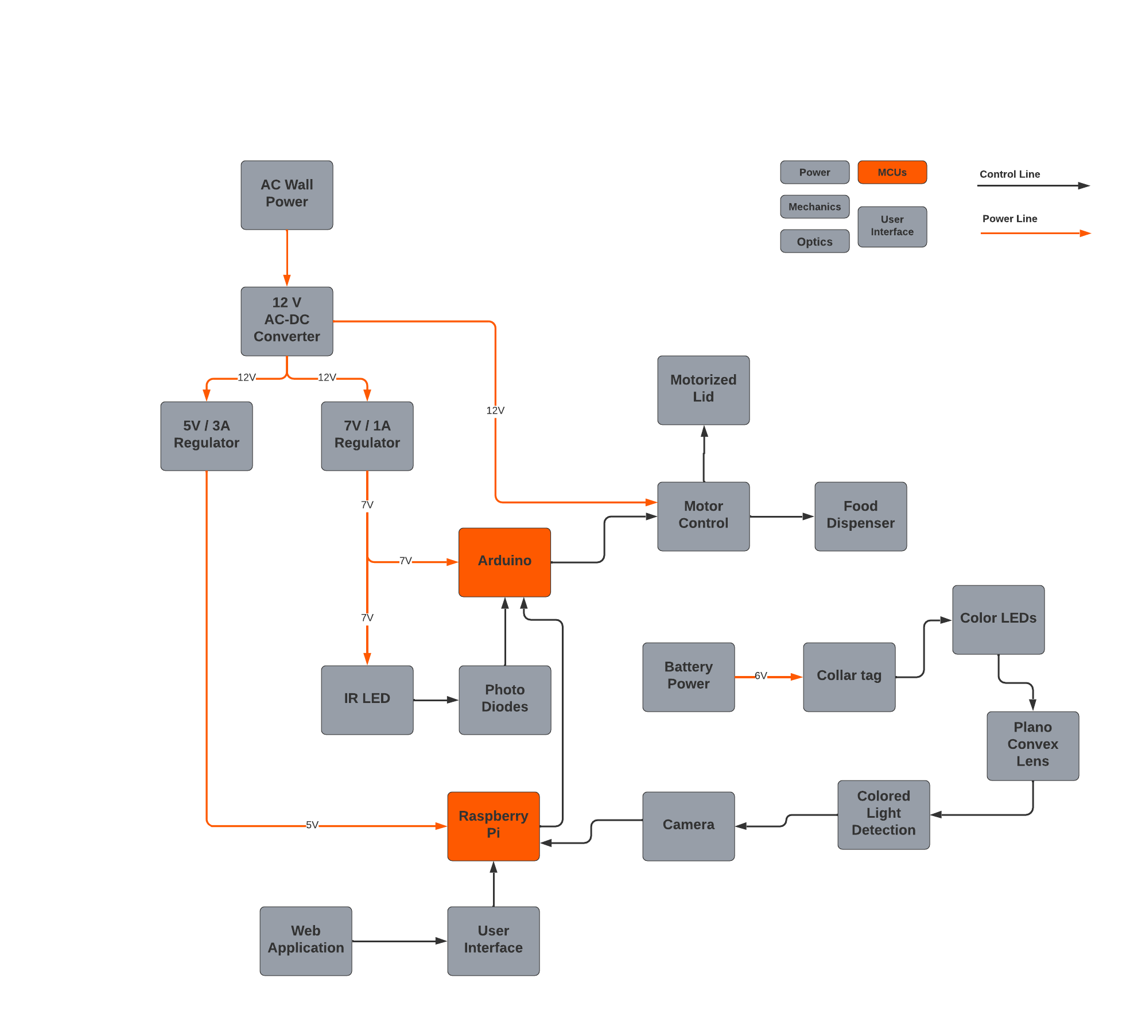
Microcontroller/Microprocessor
Notes:
Displayed here are the main processing and control systems that will be implemented into our design.
The Arduino microcontroller will be utilized for the lower level control of the hardware such as motor control and interpreting voltage readings from the photo-diodes
On the other hand, the raspberry pi microprocessor will be used to process all of the image data as well as run the software written for our web application

Slide 13
Microprocessor (Raspberry Pi 4)
Purpose:
To process the image data presented from the pet collar LEDs and deliver the data to the Arduino for motor control. Additionally, provide the processing power necessary for the web application.
Camera Input
Arduino Uno
Model | Raspberry Pi 4 (Model B) | Nvidia Jetson Nano | BeagleBone Black
Price (for kit) | ≈$70.00 (for standalone) $127.79 (for kit) | ≈$99.99 (Extremely Low stock) | ≈$70.00
Cores | 4 | 4 | 1
Clock Speed | 1.5 GHz | 1.43 GHz | 1 GHz
GPIO | 40 Pins | 40 Pins | Max of 69 Pins
Memory | 4 GB | 4 GB | 4 GB
Chosen Component
85.6mm
56.5mm
Ease of interfacing with camera module (made for Raspberry Pi)
Can communicate serially with microcontroller
CPU can process image data as well as run the developed web application
Web Software
Notes:
The microprocessor chosen for the design of the Opto-Smart Pet Feeder was the Raspberry Pi 4. This device is needed to be able to process image data from various colored LEDs and send that data easily to the Arduino for further control of the system. Using the Raspberry Pi’s onboard wifi will also be necessary for the development of our user application. Although both the Nvidia Jetson nano and BeagleBone Black contain similar features, the main reason for the selection of the raspberry pi was due to its availability, familiarity, and ability to be interfaced directly with the camera module and the Arduino without the need for any extra hardware. Responsive serial communication can also be used to directly communicate data to the Arduino.

Slide 14
Microcontroller Board (Arduino Uno Rev3)
Purpose:
Read input data from Raspberry Pi and Photodiodes to control when each of the lid or dispenser motors should be activated.
Selection Criteria:
Ease of communication with Raspberry Pi
ADC with 10 bit resolution to convert analog voltages to digital signals
Ease of programming motor control in response to data from Raspberry Pi/photodiode voltages
No need for extra power from the TI or ESP chips
Raspberry Pi 4
Motors
68.6mm
Microcontroller | Arduino Uno (ATmega328P) | TI(MSP430FR6989) | ESP32-S3-WROOM-1
Price | $23.00 (Previously obtained) | $20.00 (Previously obtained) | $15.00
Clock Speed | 16 MHz | 16 MHz | 240 MHz
Memory | 32 KB | 128 KB | 8 MB
Digital I/O | 14 Lines | 40 Lines | 45 Lines
Analog Inputs | 6 Inputs | 16 Inputs | 18 Inputs
Chosen Component
53.4mm
Photodiodes
Notes:
Displayed here is the Arduino uno which will be receiving data from both the Raspberry pi and external photodiodes in order to control motor timing and movement.
This microcontroller board was chosen specifically for its ability to easily interface and communicate with the raspberry pi using USB, in addition to its familiar software environment that allows for motor control to be programmed simply.
The many features of the ESP32 would not be utilized in this system, since we already incorporated the Raspberry Pi into our design. The MSP430 board was not selected because it accomplishes the same task as the Arduino with a more complex setup environment.
The Arduino uno is also equipped with a 10-bit ADC that provides a great enough resolution to distinguish the voltage drop across the photodiodes when the pet is blocking the IR LEDs

Slide 15
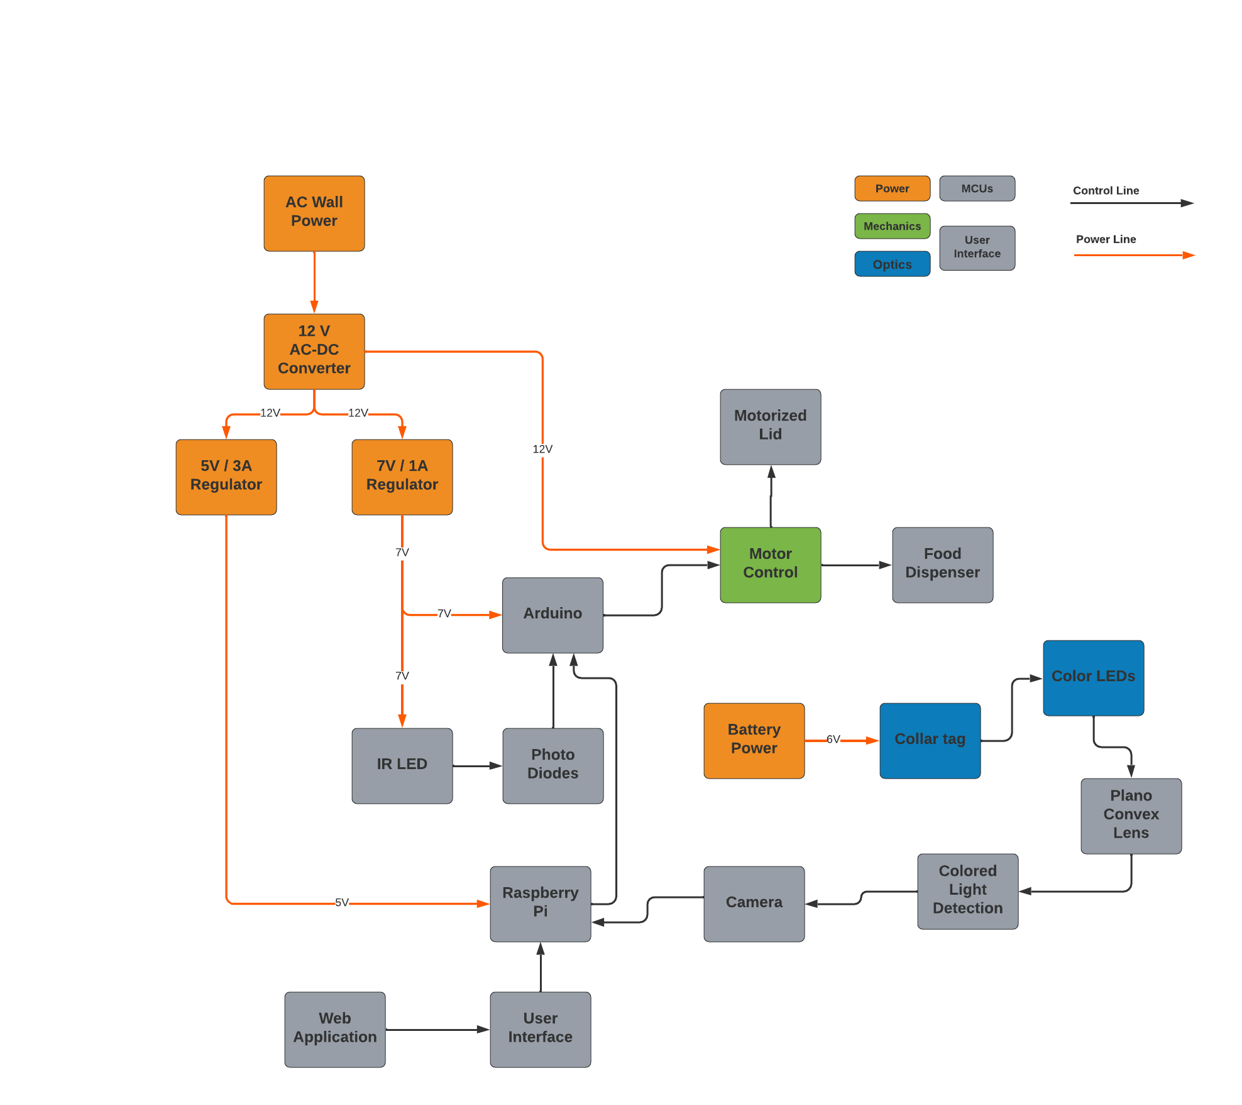
Power and Motor Control
Notes:
We will now discuss the design and development of the power regulation and motor control that will be incorporated into our device’s PCB.

Slide 16
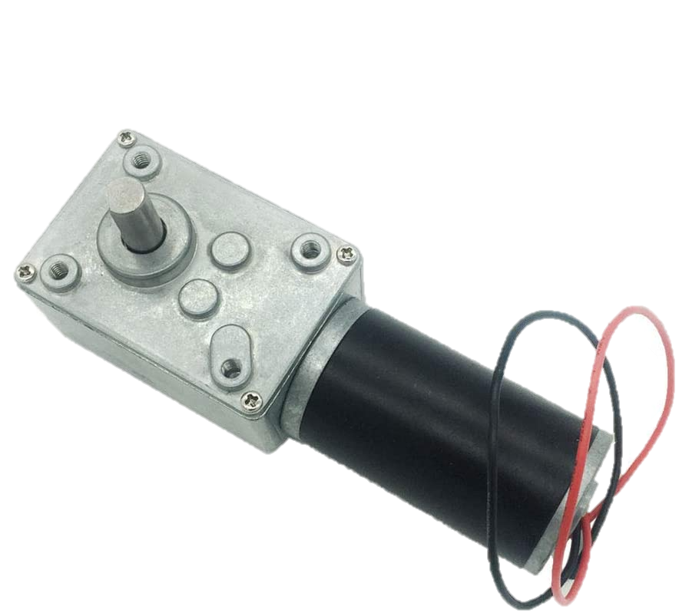
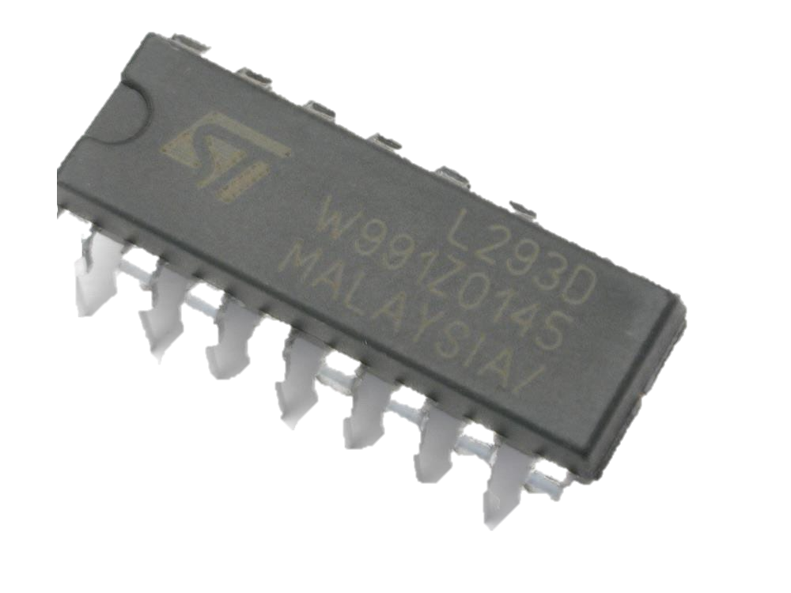
DC Motors(Hugwit 12V 40rpm)
Purpose:
To open and close the lid of the bowl as well as allow food to be dispensed by spinning the metal disk with cutouts
Selection Criteria:
DC motors chosen due to simplicity and no need for precise increments of movement
Works with a 12 V power source
Has enough torque to be able to lift the lid and spin metal plate
133.1mm
Manufacturer | Hugwit | Greartisan DC
Part Number | A58SW31ZY | B071XCX1LH
Price | $29.99 | $14.99
Torque | 3.92 Nm | 0.706 Nm
Motor Voltage | 12V DC | 12V DC
No load speed | 40 rpm | 50 rpm
Chosen Component
Notes:
The motors chosen for the Opto-Smart Pet Feeder were two of the Hugwit 12V 40 rpm DC motors. This motor was chosen over the Greartisan DC motor due to its much greater torque, allowing for the dispenser to be turned even with the weight of the pet food pushing against it.
DC motors were chosen over stepper motors since precise incremental movements are not needed when spinning the dispenser or moving the lid up and down. Servo motors also would not suffice for this design since their rotation is limited to 180 degrees.
This motor meets all of the required criteria that both the lid and dispensing systems need to function properly. With a specified operating voltage of 12V and a torque of 3.92 nm, there will not be any issues with compatibility, and we will not be limited by the motors torque output.
These DC motors can be also be mounted in a variety of positions, making it versatile enough to use with a spinning dispenser and a vertical opening lid

Slide 17
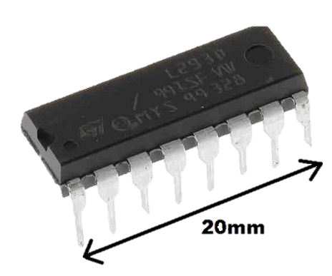
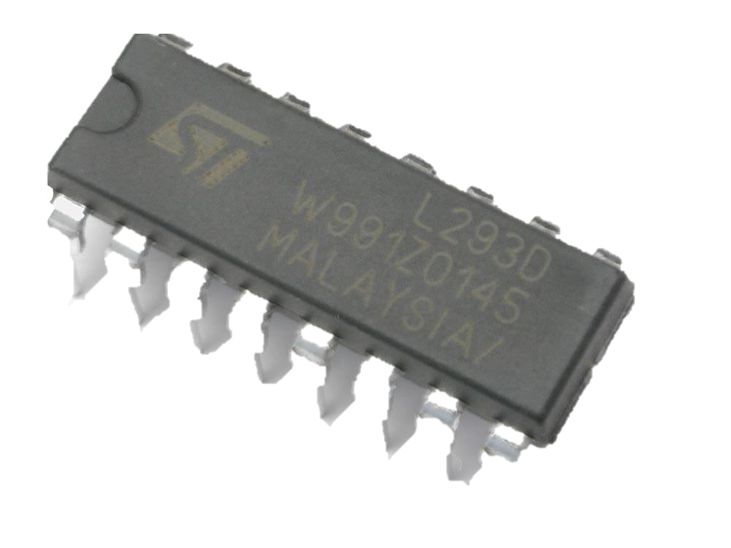
Motor Driver
Purpose:
Allow for separate control of the lid opening motor and the food dispensing motor.
Selection Criteria:
Ease of interfacing with Arduino digital IO
Controls two motors with a single IC
Can interface with both DC and stepper motors
Form factor is able to be mounted easily to PCB
Motor Driver IC | L293D | L298N | TB6612FNG
Manufacturer | TI | STM | Toshiba
Price | $4.50 (previously obtained) | $8.58 | $9.95
Logic Voltage | 5V | 4.5-7V | 2.7V-5.5V
Motor Voltage | 4.5V-36V | 2.5V-46V | 2.5V-13.5V
Peak Output Current | 1.2A | 3A | 3A
Chosen Component
Notes:
The L293D, L298N, and TB6612FNG chips would all accomplish the task of driving both of the systems motors. However, the L293D chip was selected for our design due to its lower cost and on hand availability for prototype testing. The lower peak output current from the L293D was not an issue since only one motor would be spinning at a time.
We decided to utilize a motor driver chip rather than the use of MOSFETs, since MOSFETs can only drive the motor in a single direction and would take up more space on the PCB.
The L293D motor driver chip will provide power to the motors as well as allow data to be transferred between the Arduino and the motors.
The Arduino also contains enough IO pins to be able to handle dual motors.

Slide 18
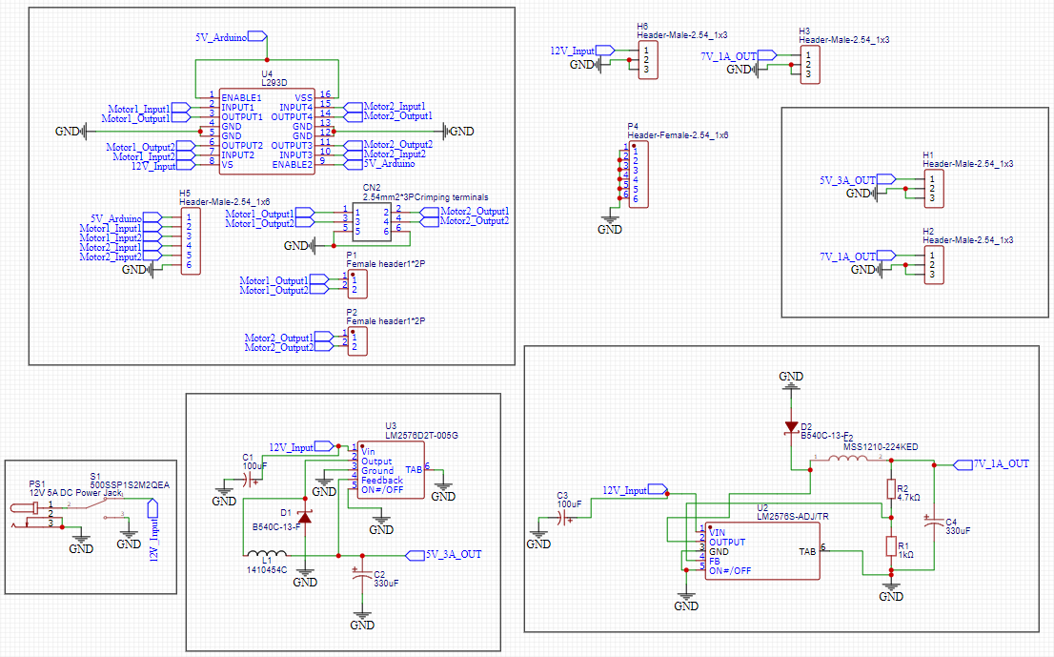
Main PCB Schematic
Notes:
Shown here is the PCB schematic for the power regulation and motor control systems to be implemented in our design. All schematics and PCB layouts were created with the EasyEDA electrical design software.

Slide 19
Main PCB Schematic
Motor Control
Notes:
The motor control section of our PCB includes the use of the L293D chip connected to multiple pin headers that will allow the motors and Arduino to be directly connected to this IC.
The pair of two pin headers are used to connect the leads from both of the motors to the motor driver, while the 6 pin header is used to provide all of the digital input and logic power connections from the Arduino to the L293 chip
Additionally, 12V DC power will be delivered directly to the L293D in order to provide adequate power for both of the motors.

Slide 20
Main PCB Schematic
Power Delivery
Power Regulation
Notes:
The power regulation section of our PCB was designed to make use of two separate regulators.
Each regulator circuit was designed with TI WEBENCH power designer, making use of the LM2576 switching voltage regulator, which delivers increased efficiency over a linear regulator.
Both regulator circuits receive an input of 12 V and one will output a constant 5V at 3A while the other outputs 7 V at 1 A
The 5V/3A output will be used to power the raspberry pi since its specifications require this exact power delivery in order to be powered from its GPIO pins
The 7V/1A output will be used to power the Arduino as its input voltage pin can be provided with a voltage between 6 and 12 V.

Slide 21
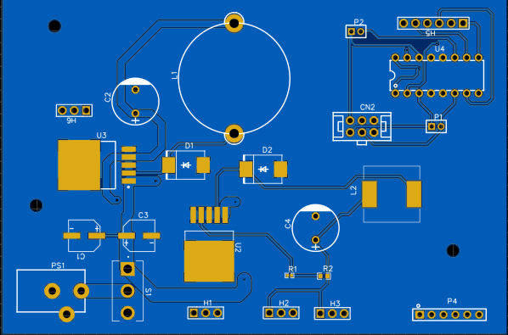
Main PCB Layout
72.39mm
107.82mm
Notes:
Shown here is the PCB board layout created from the previous schematic.
Both of the regulator circuits were placed close the power supply in order to avoid as much signal loss as possible.
And all of the pin headers were positioned to provide enough room for all connections to be made between them and the other components that will be placed on the board
Traces were also implemented on both the top and bottom layers to allow for more efficient routing of the connections, and ground planes were placed on both layers of the board to reduce any noise present.

Slide 22
Main PCB Layout
Notes:
Shown here is the completed physical PCB layout.
All of the components were securely soldered to the board and tested before use.
This PCB will also be able to easily fit inside the optosmart Pet Feeder with its compact design that is no longer than 4.5 inches on its longest side

Slide 23
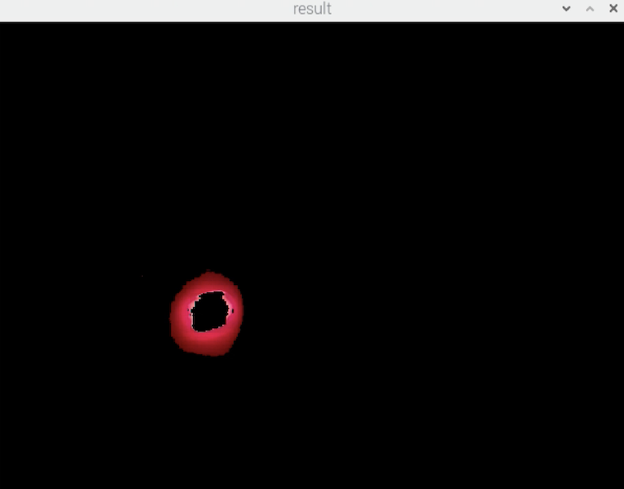
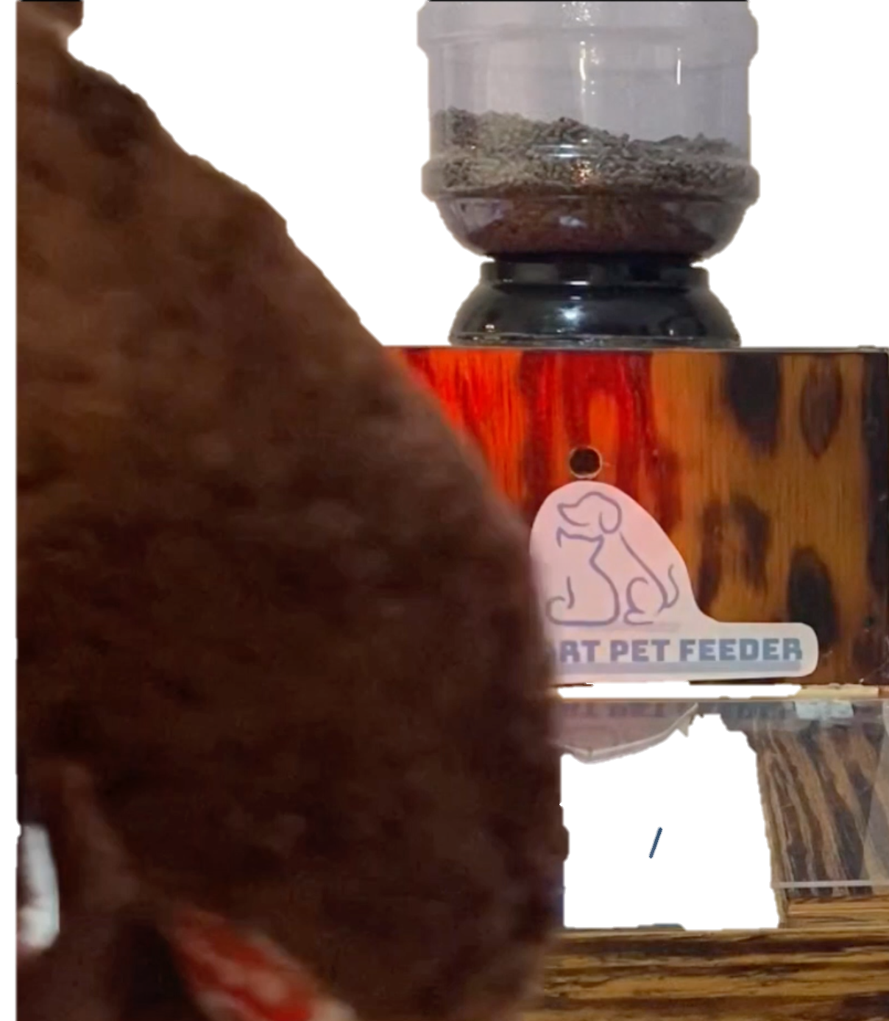
Color Detection
Notes:
In this section, we will focus on how color detection is implemented into the OptoSmart Pet Feeder

Slide 24
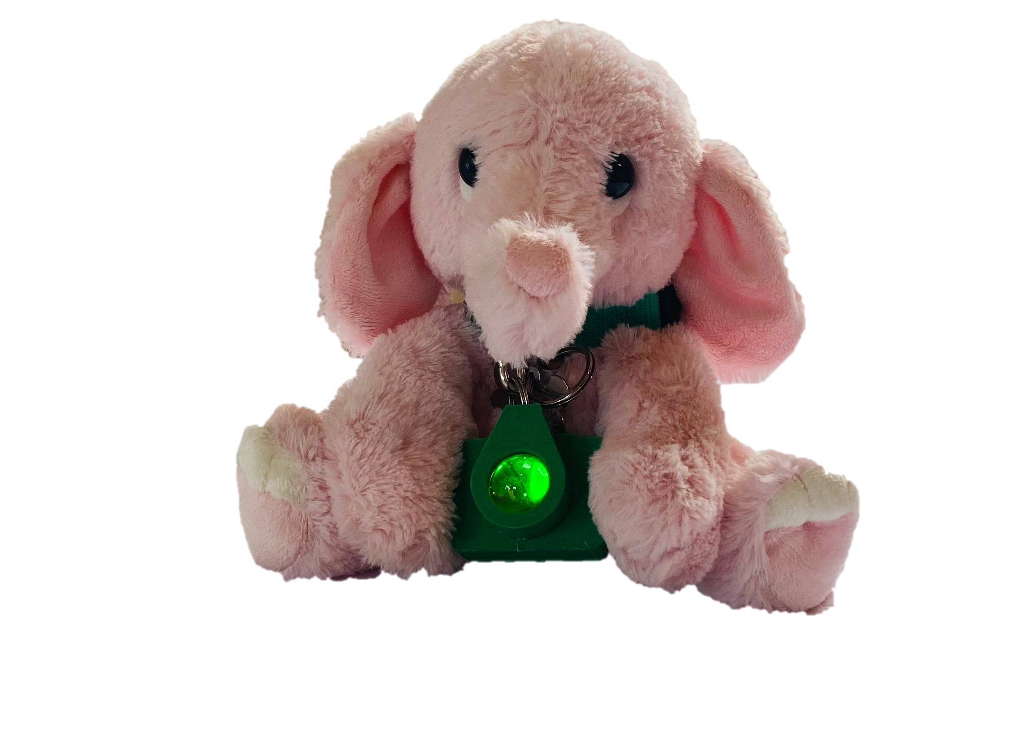
Color Detection
Each collar will be equipped with either a Red, Blue, or Green LED
The camera interfaced in the dog bowl will see the color
Our system will be able to interpret which pet collar color the camera sees
If the color detected is the one programmed into that feeder, it will open the lid
Notes:
Each of the collar tags will be equipped with a different LED that is red, blue or green. Each of these colors have been chosen due to their intensity and how responsive they are when interfacing with the camera system.
The camera system will be interfaced within the dog bowl in order to allow it to see the pet collar LED color as it approaches
Our system will them interpret which color collar is approaching. If it is the color assigned to the bowl it will open the lid and allow the pet to eat from it. If it is the incorrect color the system will not activate and the food will be safe from any other pets trying to sneak in. This will ensure that a pet is only eating out of their own bowl preventing them from over or under eating

Slide 25
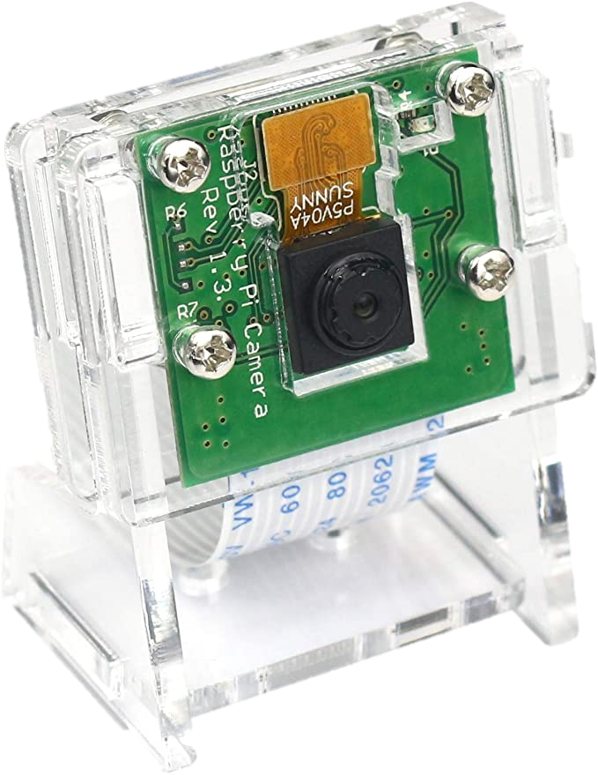
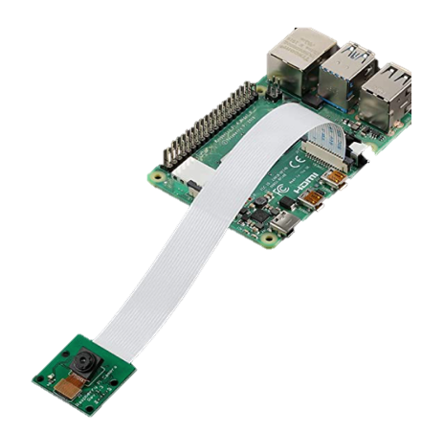
Color Detection technology comparisons
What we need:
A camera system that will be constantly monitoring in front of the pet feeder
Ability to detect RGB values
Able to interface with a raspberry pi
Options Under Consideration
Selected
Raspberry Pi Camera v2
First device considered
Made by the company that makes the Raspberry pi
8 megapixels with a resolution of 3280 x 2464 ppi
Small, only 25mm x 23mm x 9mm
Jun-Electron 5 MP, 1080P Video Camera Module
Comes with a case
Compatible with Raspberry Pi 4 Model B
5 Megapixels sensor with OV5647 webcam sensor in a fixed-focus lens
Compact size of ‎3.15 x 2.76 x 1.1 inches
BBTO OV5647 Mini Camera Module
2 pack sold on Amazon
Compatible with Raspberry Pi
5 megapixels 2592 x 1944 ppi
Compact size of 25mm x 24mm x 9 mm
Notes:
when choosing a camera sytems we needed one that could consistently monitor the souranding area. We needed enough ewaolution to be able to detect the red green or blue colors and an interface that would be able to interface to the ras

Slide 26
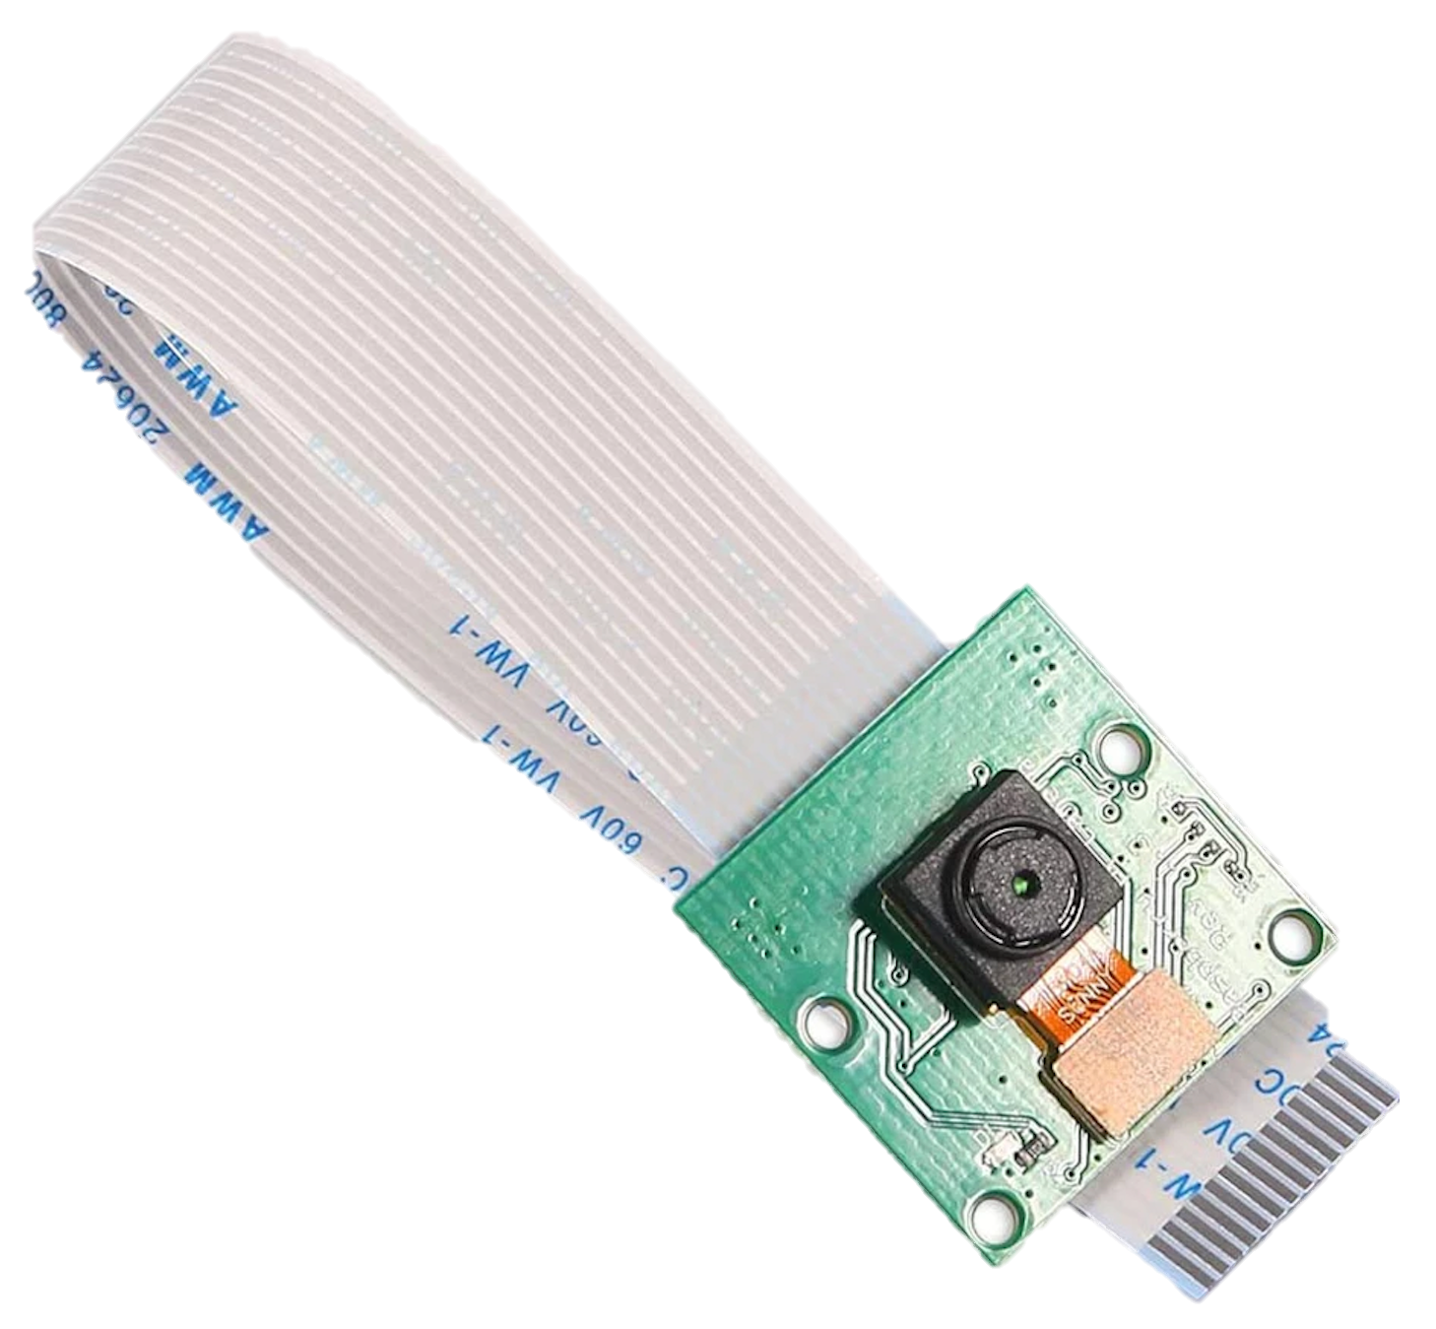
Selected Color Detection Camera (Jun-Electron 5 MP)
Purpose:
To take high-resolution photographs, along with full HD 1080p video, and can be fully controlled programmatically through the raspberry pi 4.
High resolution Image
Raspberry Pi 4
Model | 8541612991
Price | $12.99
Port Type | CSI
Resolution | 1080p
2.76 in
3.15 in
Compatible with Raspberry Pi 4 Model B
5 Megapixels sensor with OV5647 webcam sensor in a fixed-focus lens

Slide 27
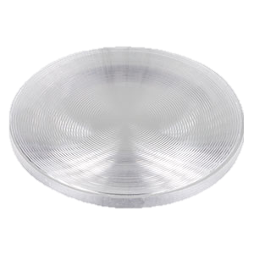
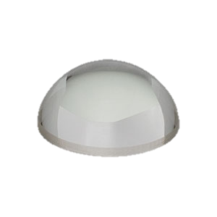
Color Detection technology comparisons
Lens for LED Collar tags
Selected
LA 1951 – N-BK7 Planoconvex Lens
25mm focal length 1” diameter
$25.14 / lens – we require 3
Great light dispersion at the wavelengths we are using
FRP125 – Fresnel Lens
25mm focal length 1” diameter
$23.85 / lens – we require 3
Great light dispersion with blue and green, very poor with red

Slide 28
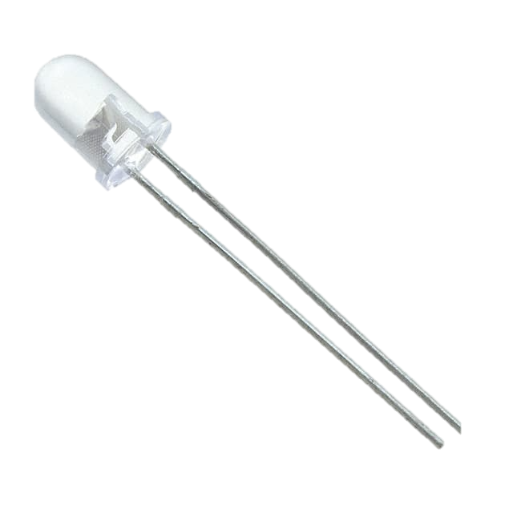
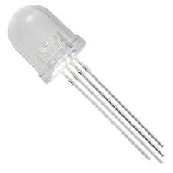
Color Detection technology comparisons
Single Color LED vs multi color led
 | RL5 – R8030 | ALMD-CM3E-Y1002 | C503B-BCS-CV0Z0461 | NTE30159
Type | Single | Single | Single | Multi
Wavelength (nm) | 630 | 525 | 470 | 625 | 525 | 465
Intensity (mcd) | 8000 | 9300 | 4800 | 9000 | 7000 | 6500
Viewing Angle (deg) | 30 | 30 | 30 | 30 | 30 | 30
Forward Voltage | 2.2 | 3.2 | 3.2 | 2.1 | 3 | 3
Operating Current (mA) | 20 | 30 | 20 | 20 | 20 | 20
Cost ($) | $0.28 | $1.47 | $0.21 | $0.80
Selected
Notes:
when choosing our collar tag LED we were deciding between using 3 single color LEDs or 1 multi color LED. We ended up using the 3 Single LEDs for simplicity

Slide 29
LED Safety
IEC62471 recommends that detailed measurements are not required for sources having a luminance of less than 10⁴cd/m² Our light sources are dispersed using a lens and the viewer is never in direct line of sight of the LEDs.

Slide 30
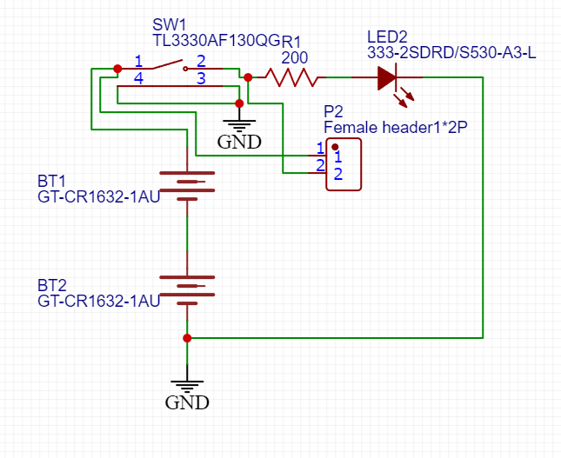
Collar PCB Schematic
PCB inside the collar tag housing that will power a colored LED.
Can be turned on and off with a switch.
Three variations of this circuit will be used with a different LED color for each one.
Notes:
In addition to the main PCB for the Opto-Smart Pet Feeder, three separate, smaller PCBs will be made to fit inside the pet’s collar tag. These PCBs contain a battery powered circuit that turns on and off a colored LED with the use of a manual switch. Each one of the three PCBs will contain a different colored LED to allow for multiple different pets to utilize the same feeding system.

Slide 31
Collar PCB Schematic
Color LED
Battery Power
Notes:
This PCB will be powered by two CR1632 coin batteries in series. Each battery is rated for 3V, and the limiting resistor values were calculated individually based on the operating current of each of the three different color LEDs that were used. In the case of the red LED, the limiting resistor of approximately 195 Ohms will provide the adequate operating current of 20 mA.

Slide 32
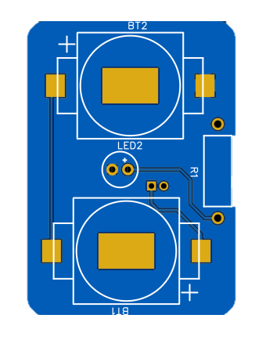
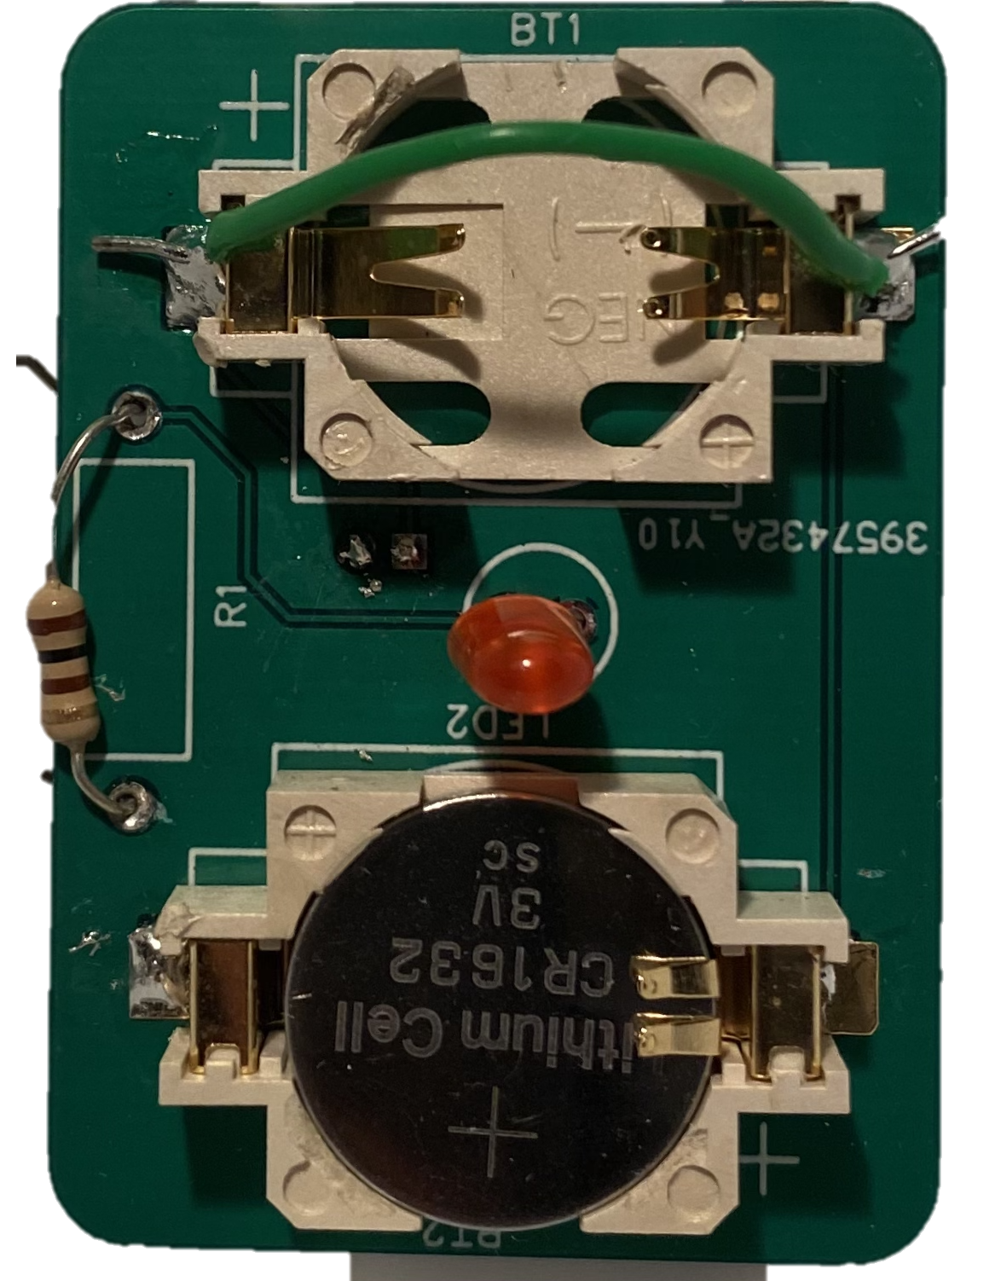
Collar PCB Layout
Slight changes had to be made to physical PCB design for proper function.
48.26mm
34.42mm
Notes:
Shown here is the PCB board layout for the collar tag’s internal PCB. The LED was placed within the center of the board in order to properly align with the lens that will be placed on the outside of the collar housing. The switch for the LED is also placed on the opposite side of the PCB to help prevent the pet from turning off the LED on its collar. Once the PCBs arrived, there were some changes that had to be made during testing in order to optimize the functionality of the circuit. It was found that a single 3V battery provided enough power for the single LED to remain on, so a jumper was placed across the other battery terminal. The type of switch placed on the back of the pcb was also changed to a toggle switch.

Slide 33
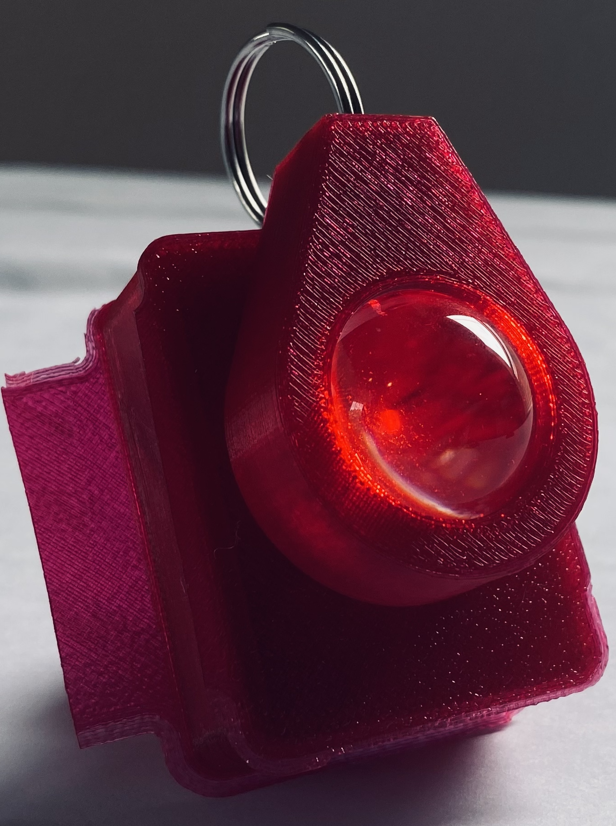
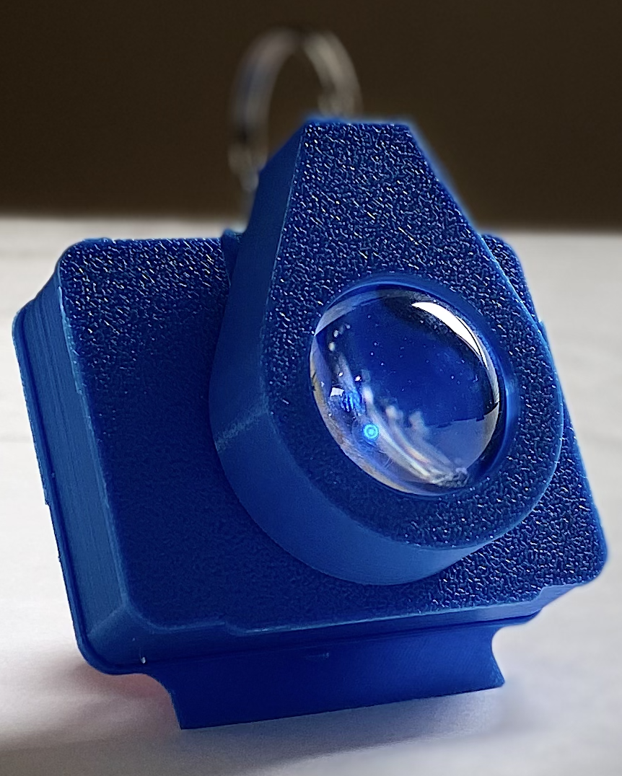
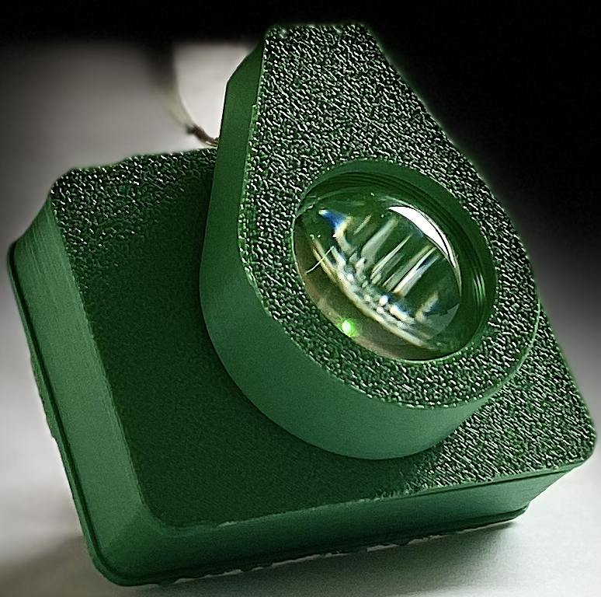
Pet Collar Tag Structural Design
Collar tag enclosures were printed using the Lockheed Martin Innovation Lab 3-D Printers
Lens holder fixed onto PCB housing and then can be attached to pet’s collar
Molded plastic allows for a sturdy lightweight design
Notes:
Our LED collar PCB and lens housings were printed using the Lockheed Martin Innovation Lab 3-D printers.
Our lens holder is fixed upon the collar PCB housing and then was attached to the pet’s collar. The collar PCB housing is designed as two pieces that can tightly fit together, which creates a sturdy housing for our PCB, while also allowing us to open the lid if needed to access the PCB. Using a 3-D printer, allowed us to keep our design lightweight, while also allowing for easy updates and tweaks to our design throughout the engineering process.

Slide 34
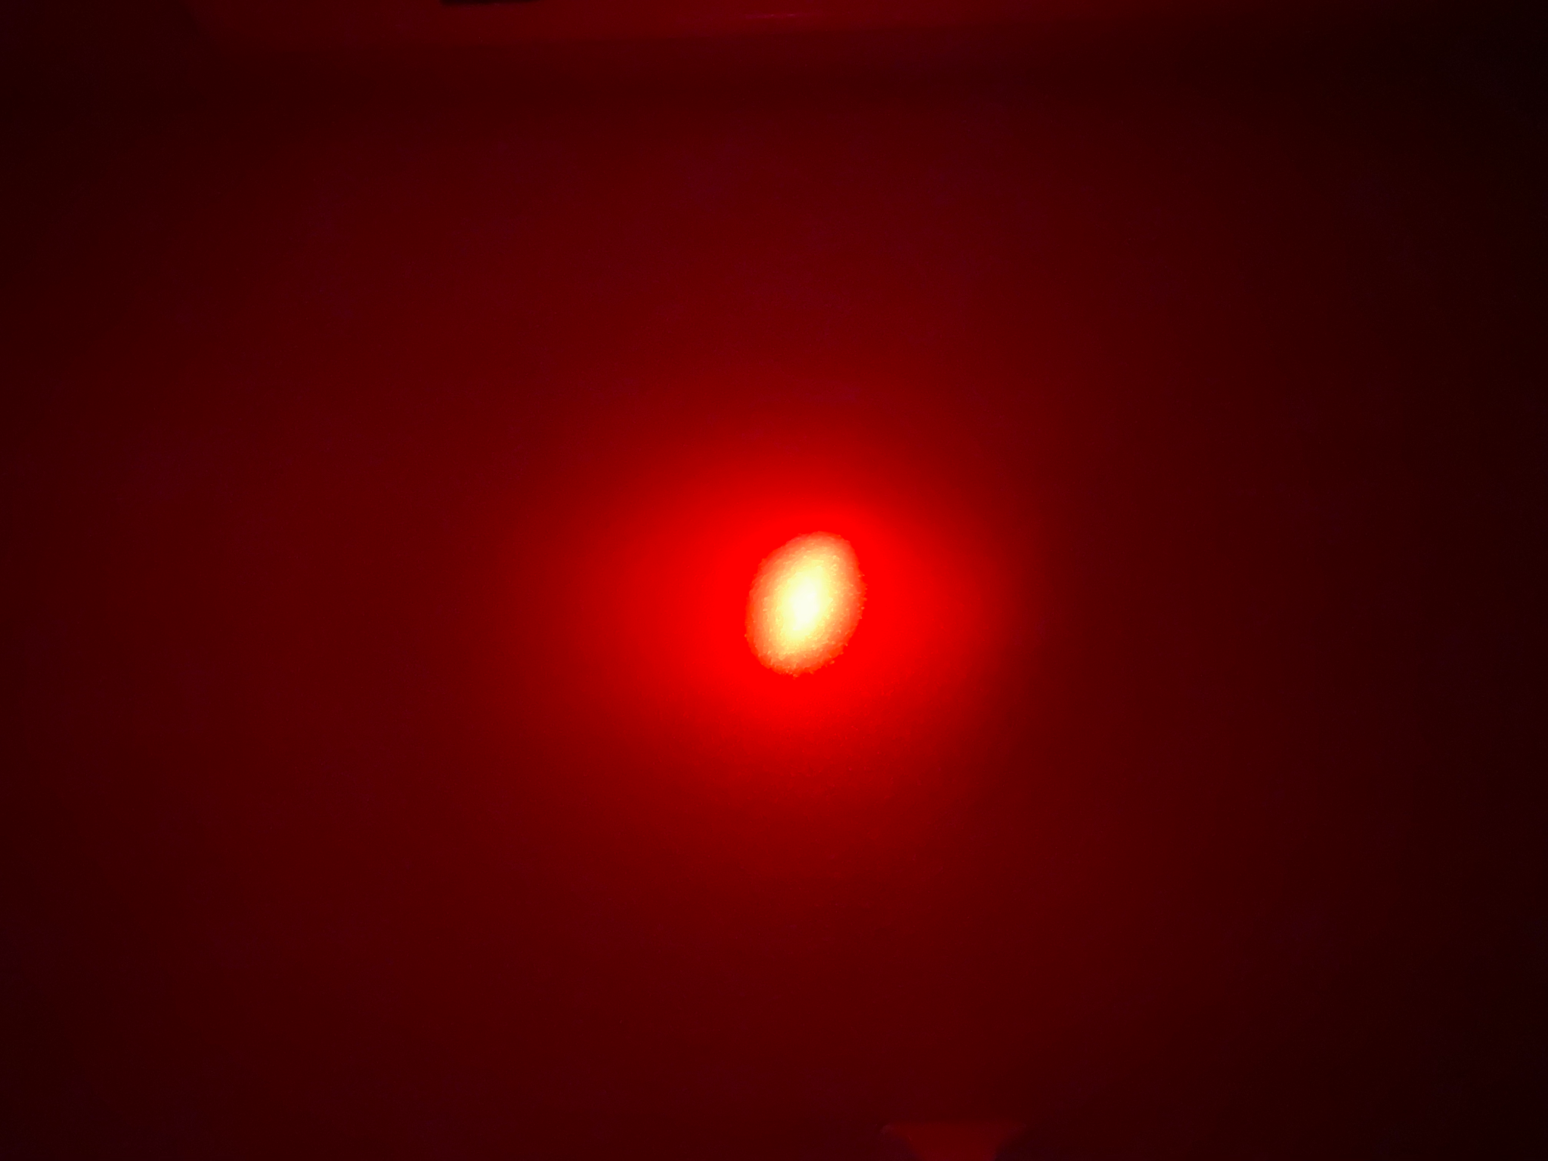
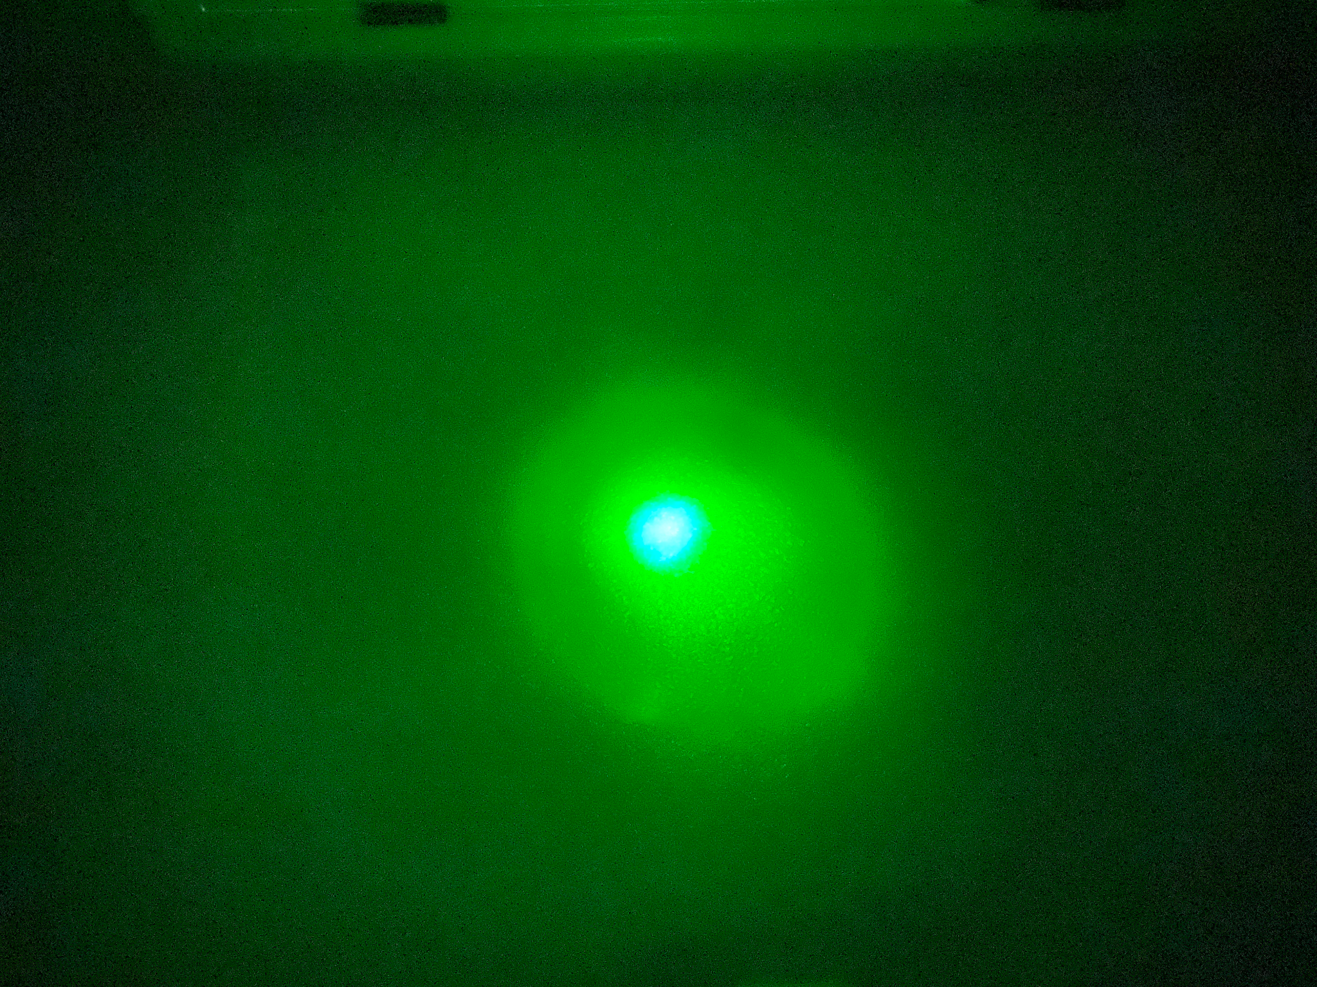
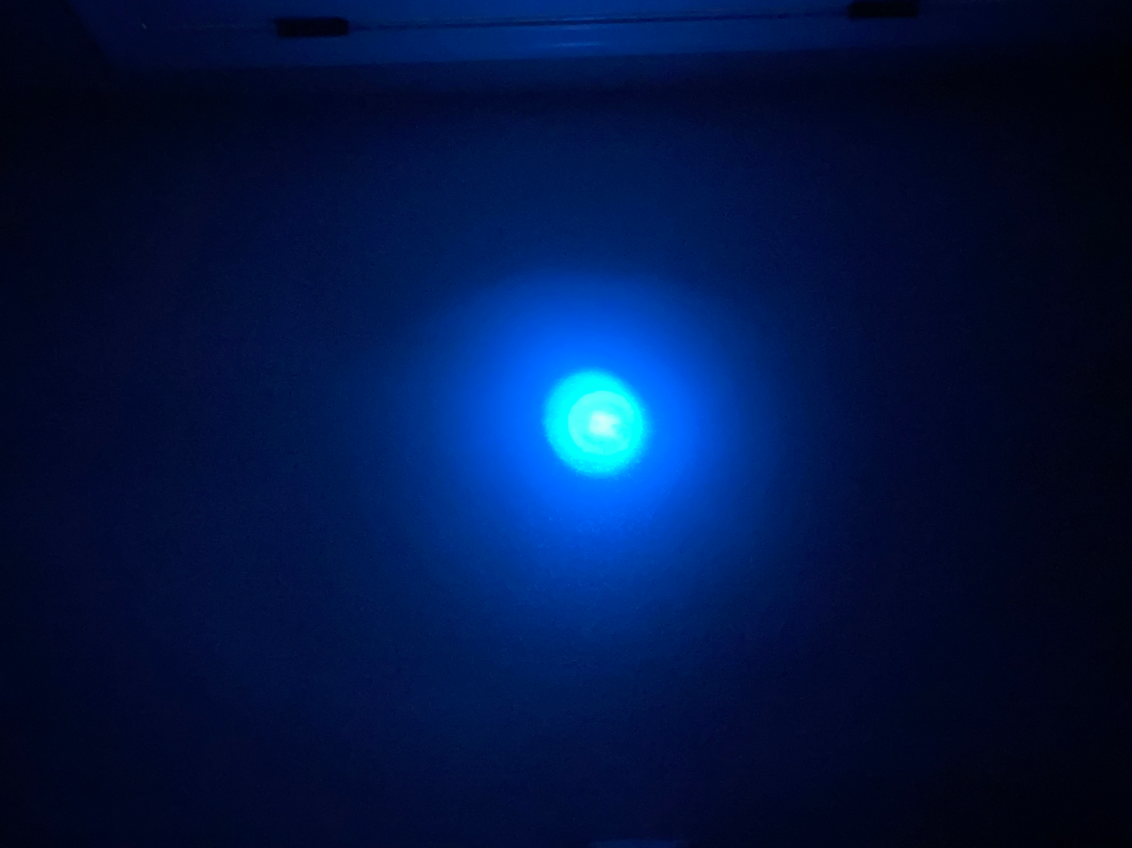
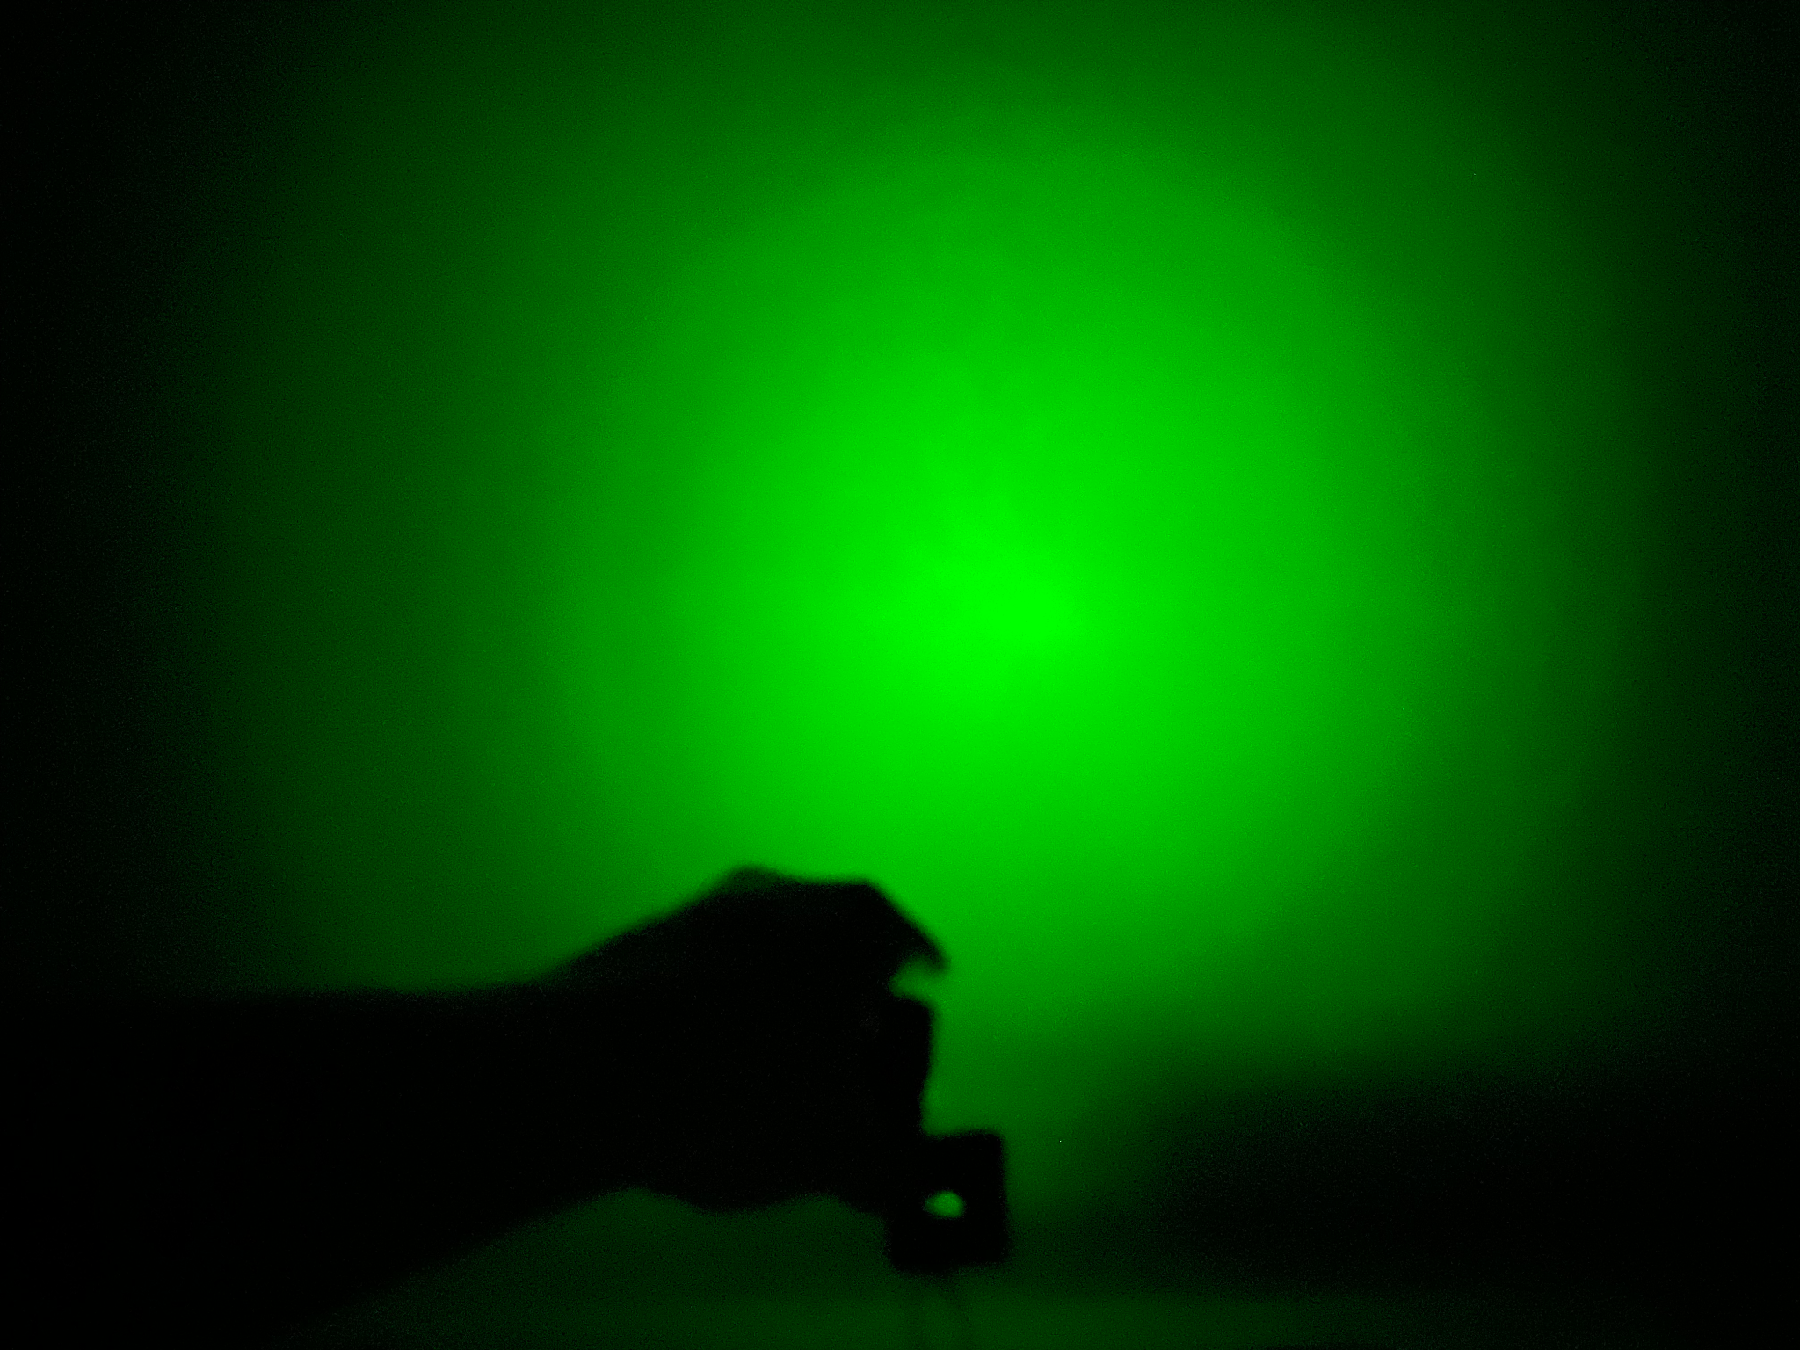
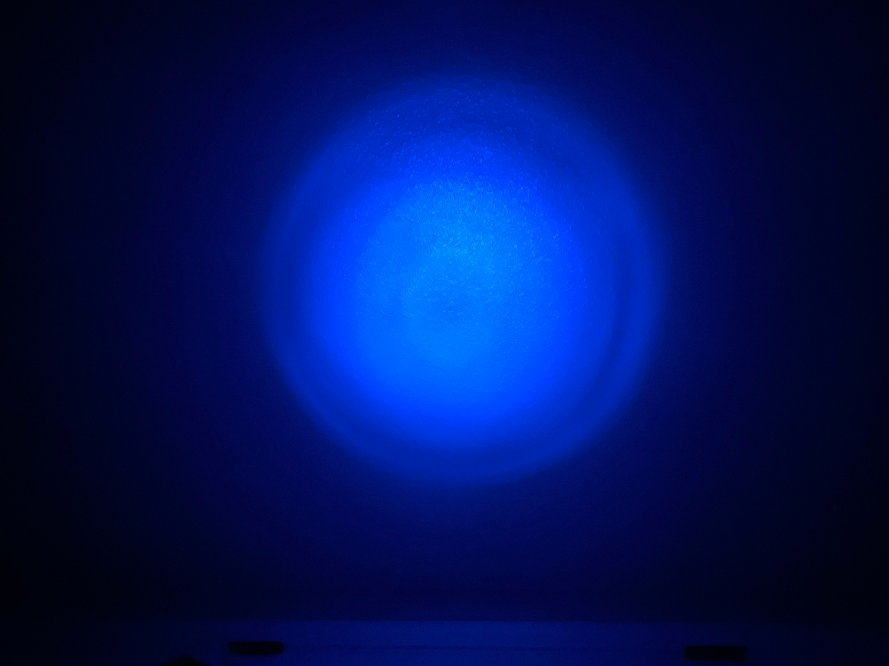
Notes:
C: Here you can see the spot sizes for our LED. The top row is with our Lens, and the bottom row is without a lens. As you can see the lens causes the light to be strong in the area of the lens.

Slide 35
Color Detection Software Overview
The color detection software will be run on the Raspberry Pi 4
The color detection software was developed using the Visual Studio Code.
Python was used for the writing of the software programs for the Raspberry Pi 4 device
Description
The color detection software allows for the camera to detect the LED light attached to the collar of the pet to further determine whether the color of the LED light attached to the pet is correct. Once the correct LED color has been detected, the code will activate the Arduino microcontroller and its uploaded code to power the attached motors to ultimately open the lid for the pet to eat the food.

Slide 36
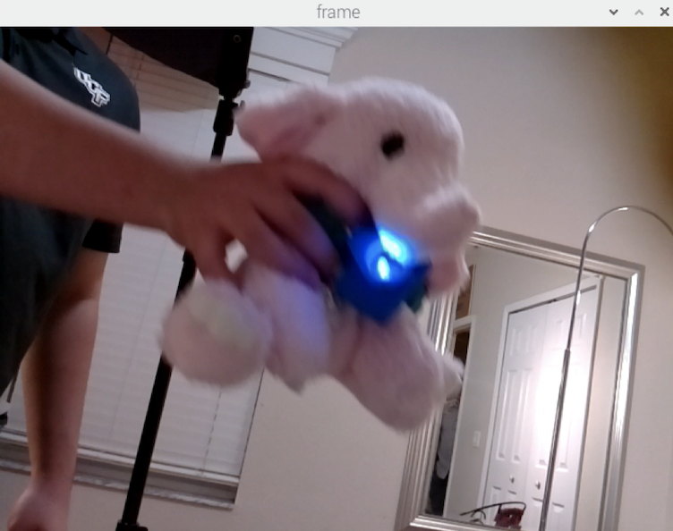
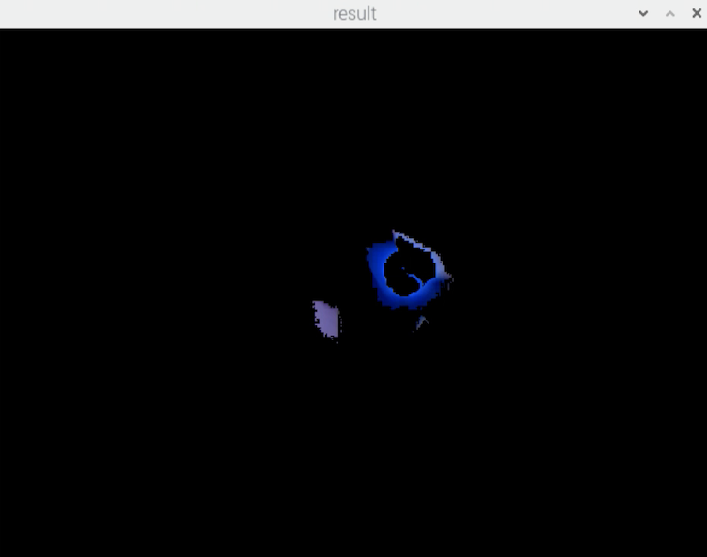
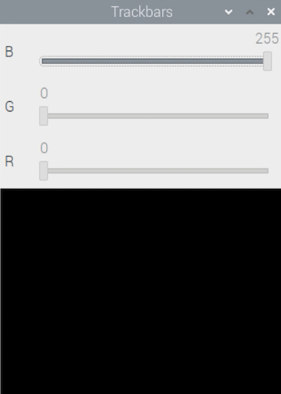
Color Detection Software Demo : Blue LED Detection
Notes:
Our color detection software demo was able to demonstrate that we can process an image and recognize if there is either red, green, or blue LED light present. As shown in these pictures we were able to detect the LED light and recognize it as blue. We also tested out the functionality of adding the lens as shown on the image on the right and it significantly increased the visibility of the light.

Slide 37
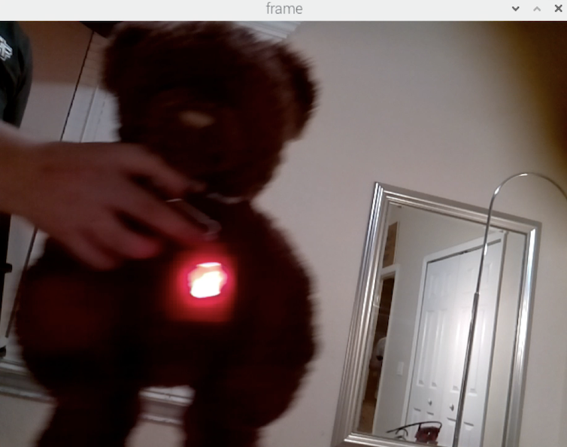
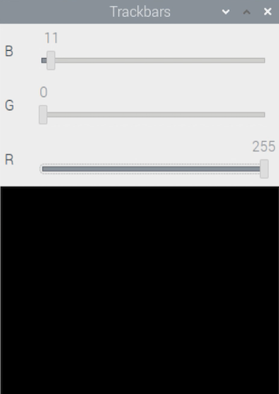
Color Detection Software Demo : Red LED Detection
Notes:
Here we have our demonstration of the Red LED light being detected by our color detection software.

Slide 38
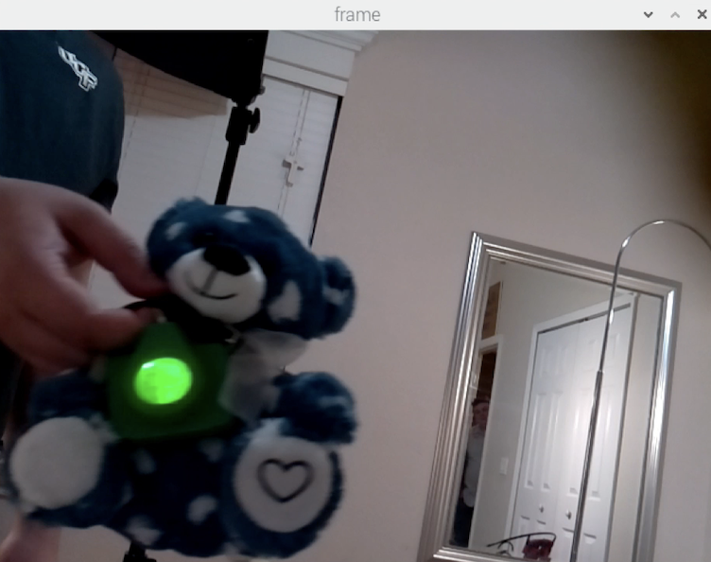
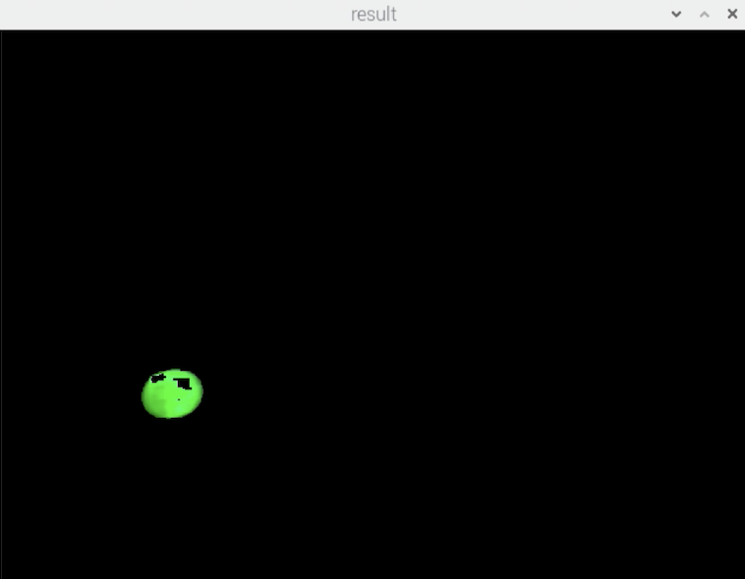
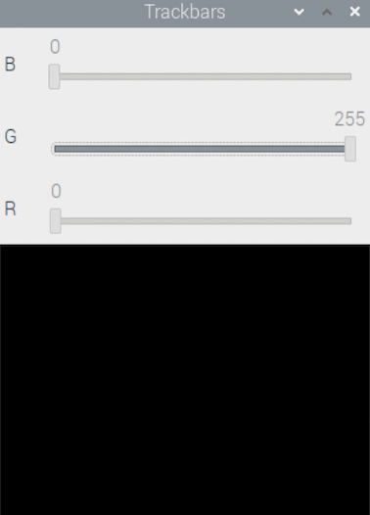
Color Detection Software Demo : Green LED Detection
Notes:
Here we have our demonstration of the Green LED light being detected by our color detection software.
For our green LED demonstration we similarly were able to sort the light based off of its color and saw a greater area of detection when using the lens.

Slide 39
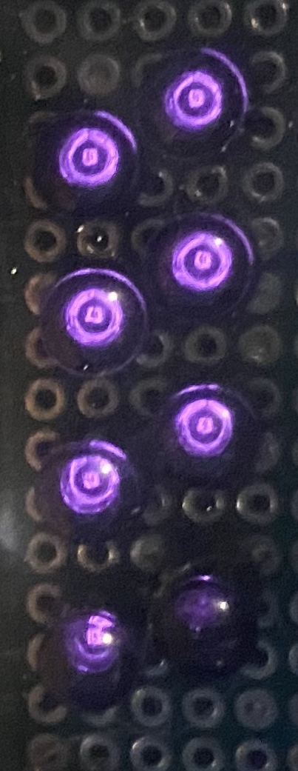
IR LED Detection
Notes:
In this section, we will focus on how color detection is implemented into the OptoSmart Pet Feeder

Slide 40
IR Light Detection
IR LEDs are positioned above the bowl to detect the presence of the pet
When the camera system detects the pet the lid will rise, and the IR LEDS will turn on
Photodiodes peak detection wavelength matching the wavelength of the LEDs, reducing system noise
Photodiode voltage is measured by the Arduino
When a voltage drop is detected, the system knows that the pet is present
When voltage rises the pet is no longer present and a countdown is triggered
If no voltage drop is detected, then the lid is lowered.
Notes:
When the camera system detects the correct colored LED the infrared LEDs will turn on, food is dispensed and the lid is raised.
These IR LEDs will be placed above the food bowl that are aligned with photodiodes to measure a voltage difference. This detects the presence of a pet
The photodiodes have been chosen to match the wavelength of the IR leds which in turn reduces system noise.
The photodiode voltage is measured by the arduino and an average on value is recorded by the system
when a voltage drop is detected the system is put into a countdown loop and holds until the the voltage returns to its original "on" value, this means the pet is at the food bowl
when the voltage rises again, a user programmiable countdown is then triggered, and if the system dosent see a drop in voltage, the lid is then lowered
In the event a voltage drop is detected, then the countdown is reset, and the lid stays raised until a rise in voltage is detected again.

Slide 41
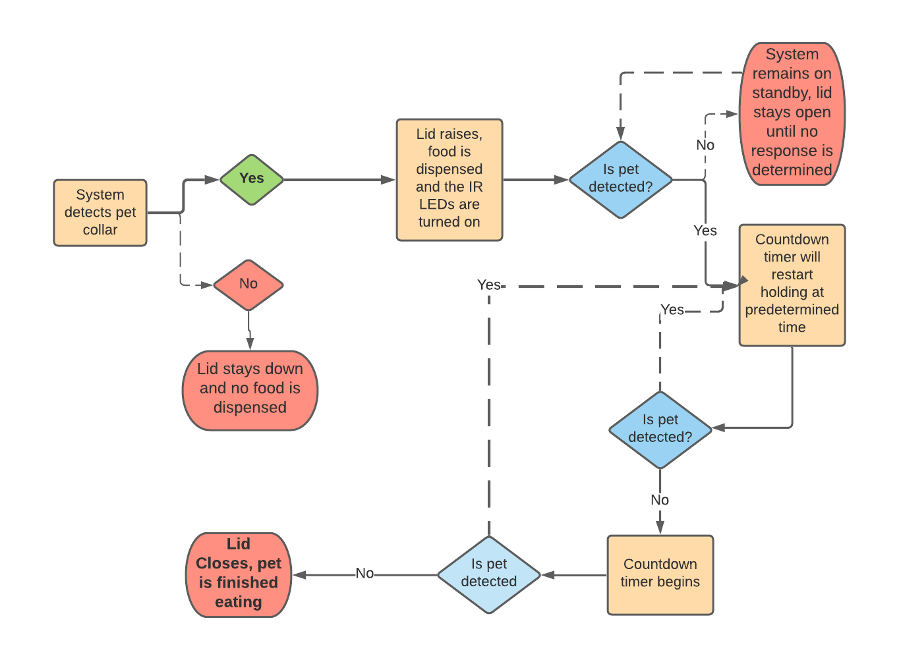
IR Light Detection Flowchart
IR Light Detection Flowchart
Notes:
Here is a flowchart of the IR light detection system highlighting the process that was discussed in the previous slide.
The process starts with the camera system detecting the correct color on the pet tag, which then activates the detection system, where the proper amount of food is dispensed, and the lid raises.
from there, the system will remain on standby until a drop in voltage is detected, where the system will go into a loop where the lid will close only when the pet is finished eating.
When the pet is finished, the lid will close and the detection system will turn off.

Slide 42
IR Detection technology comparisons
LED Comparison
 | NTE30048 | SFH 4546 -AWBW | MTE9460N5
Wavelength (nm) | 950 | 950 | 950
Operating Current (mA) | 50 | 100 | 100
Forward Voltage (V) | 1.4 | 1.4 | 1.3
Viewing Angle (deg) | 40 | 40 | 20
Cost | $0.71 | $0.87 | $6.21
Chosen Component
Notes:
Object detection is one of the most crucial features for the opto smart pet feeder since it ensures that the lid to our feeder will close properly. Care had to be taken when selecting LEDs. The wavelength that was selected was due to the abundance of 950nm LEDs in the market. 950nm light is also easier to detect with standard cameras, compared to longer wavelength light. This made troubleshooting easier. After a great length of time researching the optimal component, we narrowed down the list of LEDs to 3 that emit 950nm light. The deciding factor that won us over is the higher operating current and the wider viewing angle of the SFH 4546-AWBW compared to the NTE30048 or the MTE9460N5

Slide 43
Photodiode Detection
Photodiodes must be operated with a reversed bias
Improves quantum efficiency
Improves response time (better response = safer device)
Equations used when determining the perfect photodiode
$I_{ph}= { η}_{Overall}\frac{Q P_{opt}}{h f}$
(Photocurrent – higher the better)
$R = \frac{I_{ph}}{P_{opt}}$ (A/W)
(Responsivity – higher the better)
Notes:
These are the equations we used when deciding what photodiode we needed to use in our design. We knew that we needed to operate our photodiodes with a reverse bias to improve their quantum efficiency and to improve their response time. In our design, we needed a reasonably high photocurrent in order to achieve a decent responsivity, or how sensitive our photodiode is to light. We chose to negate any attenuation due to our light source and the detector being most sensitive at 950nm, creating a narrow bandpass filter. With an improved responsivity, our device can better detect the photovoltage coming from the photodiode. We determined that we needed at least 50 micro amps of photocurrent per 10 micro watts with a responsivity of .5 amps/watt.

Slide 44
IR Detection technology comparisons
Photodiode Detection
 | S2386-5K | BPV23FL | BPW82
Peak Wavelength Sensitivity (nm) | 960 | 950 | 950
Dark Current (nA) | 0.005 | 2 | 2
Reverse Voltage (V) | 30 | 60 | 60
Rise Time (ns) | 1.8 | 70 | 100
Fall Time (ns) | - | 70 | 100
Photo current (uA) | 4.4 | 63 | 45
Responsivity (A/W) | 0.6 | 0.6 | 0.000209
Cost ($) | $13.98 | $1.03 | $1.07
Chosen Component
Notes:
We compared three different photodiodes together to see what would best fit for our project. Photocurrent and responsivity were most important when deciding which component to use. In the end, we went with the BPV23FL due to its reasonably high photocurrent and its responsivity fitting the criteria for the detection system. An added bonus for this device is that it was the cheapest out of the three as well

Slide 45
Optical Design Demo : IR Light Detection
 |  | Average
LED/Photodiode | Voltage Drop (per LED/Photodiode) | 0.103 V
Photodiodes | Response time | 1.588 seconds
Lid Motor | Activation Time | 30.714 seconds
Notes:
Here is the data from testing the IR Light detection system.
In this test, we supplied power to a single IR LED and aligned it with a single photodiode.
In each trial of interrupting the voltage we saw the voltage difference averaged 100mV between the un-interruped and interrupted voltages.
Even though this is a detectable difference, we used several photodiodes and LEDs in the final design to increase the difference between the two voltage states.

Slide 46
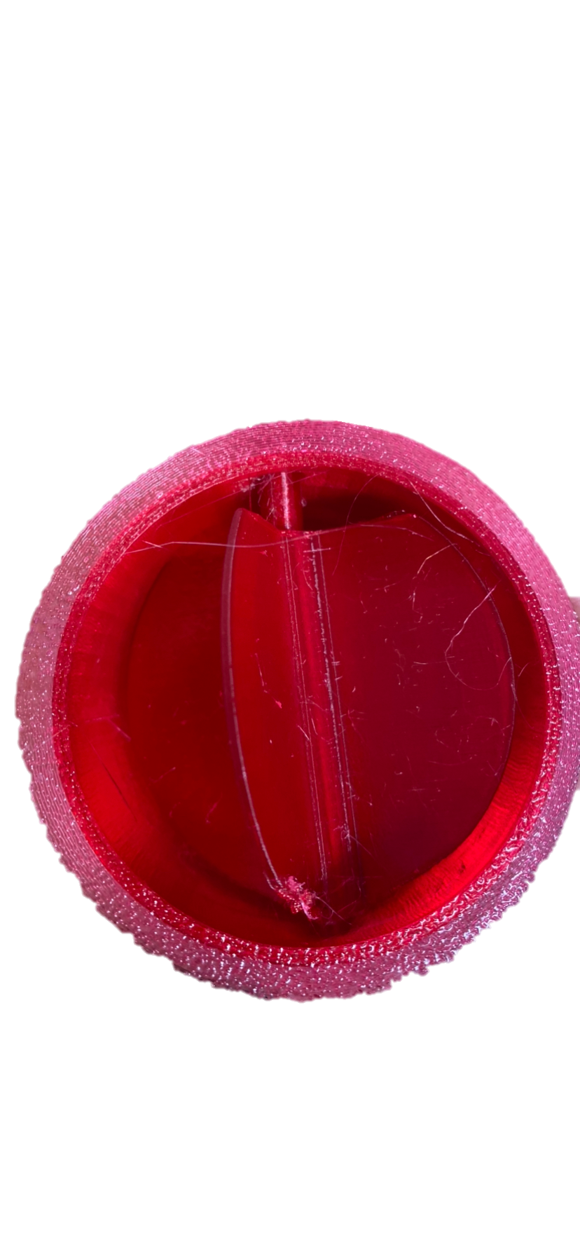
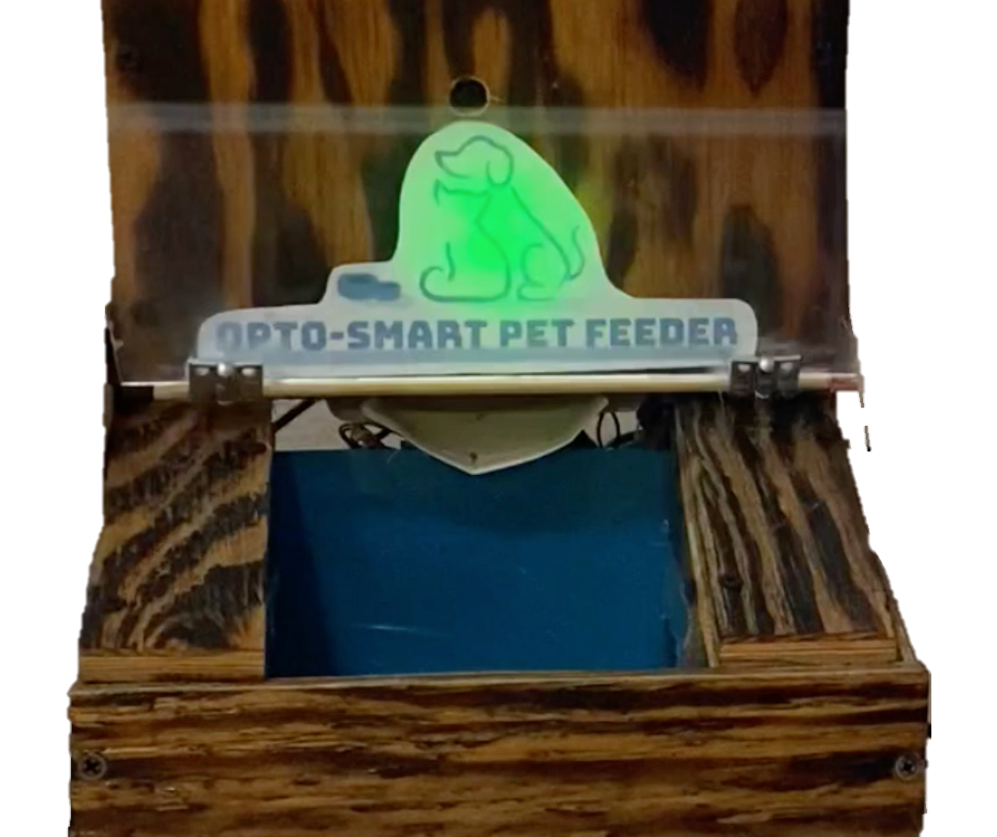
Lid / Dispenser
Notes:
In this section, we will focus on how color detection is implemented into the OptoSmart Pet Feeder

Slide 47
Lid System Software Overview
The lid system software will be run on the Arduino Uno Rev 3
The software to control the lid system was developed using the Arduino IDE.
C/C++ languages were all integrally used for the writing of the software programs for the Arduino device
Description
The software first opens the lid once the Raspberry Pi sends a communication to the Arduino that indicates the correct color LED was detected. While the lid is open, the Arduino will continually check if there is a pet blocking the IR LED signal from reaching the photodiodes. When a blockage is sensed, the lid motor will wait 30 seconds after the pet leaves the bowl to turn the lid closed. If the system does not have a pet interrupt the IR LED signal during the 30 seconds, the lid motor will activate and close.

Slide 48
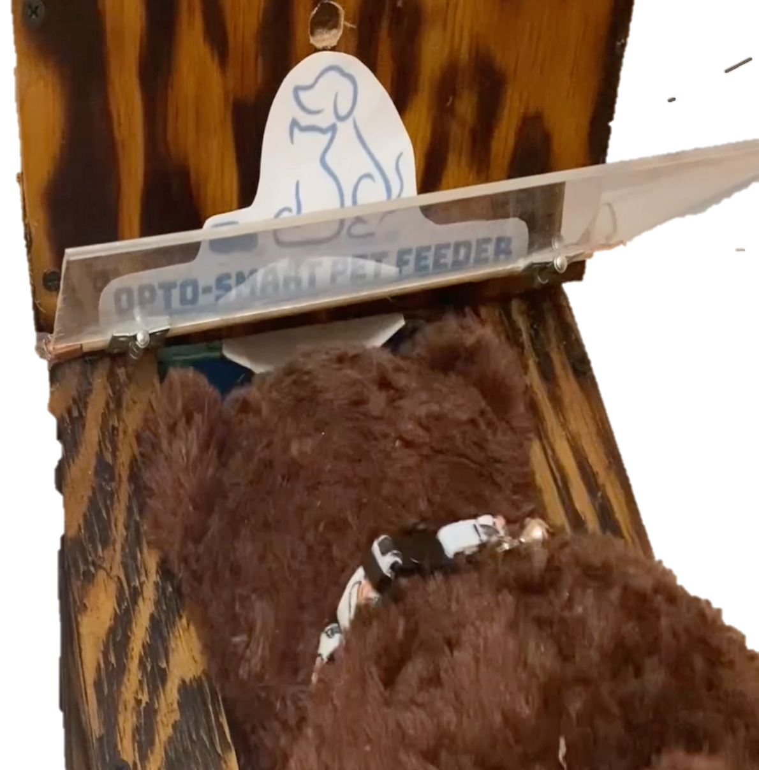
Lid System Software implementing Safety
In order to protect the pet’s head from being injured by the lid’s closing action, If the lid system does detect a pet interrupting the IR LED signal during the 30 second feeding period, the lid motor will not close until the blockage that was previously detected has disappeared. Once the blockage has completely disappeared, the system will activate and close the lid.

Slide 49
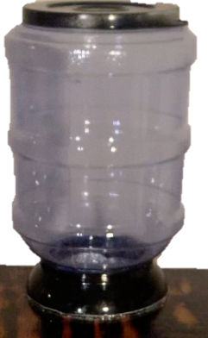
Food Dispenser
The Food Dispenser tube and rotating plate were both printed using the Lockheed Martin Innovation Lab 3-D Printers
Outputs the correct amount of food in at most 60 seconds as the plastic blades on the rotating plate allowing the food to flow from the container down a tube and into the bowl with the help of gravity.
The exact amount of food released per wheel rotation can be determined to calculate and program the time it takes to fully dispense a complete meal (using the wheel rpm)

Slide 50
Web Application
Notes:
In this section, we will discuss the selection and implementation to meet a specific criteria in every software component of the Opto-Smart Pet Feeder as well as to discuss the process of our advanced development of the software programs needed for our smart device.

Slide 51
Web Application Development Overview
This Web application is hosted by the raspberry pi 4 system
Python, HTML, CSS, and database files was all used in creating the web application
Description
Users will be able to create a secure profile and login remotely via Wi-Fi into our web application
Once signed in, users will be able to remotely view, add, edit, and remove food dispensing actions and times done by the system on our webpage
Once the user is done using the website, they can logout using the log out button to safely exit out of the program.

Slide 52
Use Case Diagram
Edit
Notes:
Here is our use case diagram for our web application, starting from the far left, you have a user either being a new user or an pre-existing user, if you are a new user, they must register for our service using their sign up credentials which will be stored inside our secure database. Once sign up, the user may login using their log in credentials to be directed to the home page. Inside the home page, the user may add a dispensing time which will be stored into the database and either view, or remove the dispensing time that they added. ]The user may also select to communicate to the device to dispense the pet food immidiatley, and view the history of the dispensing times inside the home page, once the user is done, they may log out saftely to end their use of our web application service.

Slide 53
Entity Relationship Diagram (ERD)
Notes:
An ERD illustrates how “entities” such as objects or concepts relate to each other within a system. Many input

Slide 54
Web Application Sign in Page

Slide 55
Web Application Sign up Page

Slide 56
Web Application Homepage
Notes:
Here is our web application homepage where users can command specific dispensing actions once signed in. starting from the top, Users can either dispense food immediately with the feed now button, schedule a one-time feeding for the pet by choosing a proper date and time to dispense the food and clicking the “schedule one-time feed” button , or users can schedule a daily dispensing of the food by again choosing the desired date and time to dispense and clicking “schedule repeating daily feed”. After the user is done using the website, they can logout using the log out button to safely exit out of the program.

Slide 57
Web Application History page
Notes:
Once clicking on the history button in the home page, users will be directed to a list of the full history of every dispensing activity done by the pet feeder since the account’s creation to view the times the pet food was dispensed and through which method.

Slide 58
Opto-Smart Pet Feeder Planning
Notes:
In this section, we will focus on some of the Planning Aspects of the opto smart pet feeder.

Slide 59
Work Distribution
Project Characteristic | Tyler | Cassidy | Ricky | Jacob
Collar Tag | Secondary | Primary | - | -
IR LED Detection | Primary | - | - | Secondary
Camera System | - | Primary | Secondary
PCB Design | Secondary | - | - | Primary
Web Application | - | Secondary | Primary | -
Software Design | - | - | Primary | Secondary
Enclosure Design | Primary | Secondary | - | -
Electrical System Testing/Design | - | - | Secondary | Primary
Notes:
The work distribution for our project is illustrated in the table above, indicating primary and secondary roles. Tyler’s primary roles involved the IR Detection system and enclosure design. Cassidy’s primary roles consisted of the collar tag and camera system design. Rickys two primary roles were development of the web application and software design. And Jacob’s primary roles were the design of the pcbs and electrical systems.

Slide 60
Finance and Budget
$500 supplied from CREOL fund
Remaining cost will be split evenly among group members
Notes:
The optosmart pet feeder budget is shown here. We have approximately $196 allocated to the optical components and $350 allocated to the non-optical components bringing the cost to an estimated grand total of 546$. We have purchased many of the parts already, there is a column in this table indicating what has and has not been purchased already. We will receive $500 donated from the CREOL fund to fund our project. The rest of the cost will be split evenly among group members.

Slide 61
Design Constraints
Economics and Time | Our pet bowl will be more expensive than others on the market due to high-tech features Limited two semester time limit for research and development of product
Environmental | Design sourced from off the shelf components Product must last lifetime of pet
Social | Ongoing pandemic may push potential sales down due to many people working from home and not needing an automated pet feeder
Political | Not relevant towards project
Ethical | Care must be taken when working with animals Product must be 100% safe and tested (no exposed motors, gears, electronics must be shielded, etc.)
Health and Safety | Materials must be safe for food contact.
Manufacturability | Ongoing pandemic may cause material shortages, must plan ahead.
Sustainability | Product must last years before material degradation.
Notes:
Many design constraints played a role in the design of our opto smart pet feeder:

Slide 62
Related Standards
Animal Health and Safety Requirements
The Animal Welfare Act, 7 U.S.C. § 2131 et seq.
Soldering Standards
Lead soldering safety
Guidelines for soldering
C Language Programming Standards
ISO/IEC 9899:2011
PCB Standards
IPC-221A
Notes:
Some standards were a key part in our design process

Slide 63
Demonstrated Design Requirement
Component | Parameter | Design Specification | Demo Results Mean | Demo Results Variance
Camera | Detection range | > 5 Feet | 12 Feet (Approx.) | N/A
Photodiodes | Response time | < 10 seconds | 1.588 seconds | 0.0658 seconds
Lid Motor | Activation Time | 30 seconds ± 10 seconds | 30.714 seconds | 0.0563 seconds
Notes:
were able to test 3 of the design requirements of our project. We were able to test the Camera detection range. photo diode response time the lid motor activation time and the cameras color detection.
After 10 tests, the cameras mean detection range was approximately 12 feet. This is above our requirement of 5 feet.
Next, we tested the photodiode response time. After 10 tests, the average response time was 1.588 seconds with a variance of 0.0658 seconds. This meets our requirement of less than 10 seconds.
Third, we tested the lid motor closing time by seeing how long it would take for the motor to activate from the time the IR LEDs detect an object. After 10 trials the average was 30.714 seconds with a variance of 0.0563 seconds. this meets our requirements of 30 seconds +- 10 seconds
Finally, we were also able to show that our color detection meets our design specification since we can detect the 3 colors: red, green, and blue.

