Slide 1
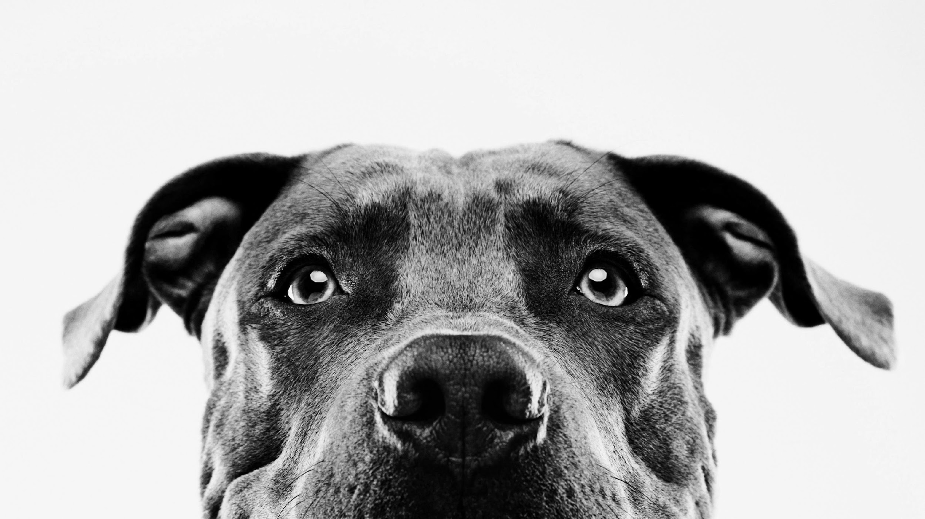
OPTO-SMART PET FEEDER
GROUP 9
TYLER KNIGHT (CREOL)
CASSIDY COLL (CREOL)
RICKY EGAWA (CPE)
JACOB HAAS (EE)
Notes:
Hello! This is group 9, and we are building the OptoSmart Pet Feeder. This is a presentation summarizing the purpose of our design and how we plan to implement it.

Slide 2
What is the Opto-Smart Pet Feeder?
An autonomous feeding device for pets that utilizes optical and photonic technology to ensure that the user’s pets are being routinely fed without needing the owner of the pet to be physically present with them
Notes:
The OptoSmart Pet feeder is an automatic feeding device that ensures that your pet is fed on a routine schedule even when the owner is not present

Slide 3
Motivation
In the US many families work long hours and are away from home for long periods of the day
Hectic schedules can lead to pets being over or underfed at sporadic times of the day
This project aims to improve the quality of life for the pet.
Puts the pet on a routine feeding schedule
Lid design allows pets to only eat out of their specific bowl, preventing sibling food thieves
If an animal is taking medicine, our design ensures they are the only ones with access to it
Notes:
The motivation behind the OptoSmart pet feeder was the knowledge that many pet owners have very busy lives that keeps them away from home. This device would ensure a constant feeding schedule for the pet, improving their quality of life through a routine.
This device also aims at ensuring that pet owners with multiple pets can breathe easy knowing that no food stealing is taking place since the lid will only open when it is that pets turn to eat.

Slide 4
PROJECT GOALS
Deliver a high-quality product that is easy to use for busy pet owners.
Ensure the device can feed pets in a safe and efficient manner
Notes:
The goals for this project are to deliver a quality product that is simple to set up for your average pet owner, easy for the pet to get the food and robust enough to withstand the pet's daily feeding rituals. all while being completely safe for the pet to use.

Slide 5
PROJECT OBJECTIVES
TAKE THE STRESS OUT OF FEEDING YOUR PET
RECOGNIZES IF A PET IS AT ITS BOWL
THIS DEVICE CAN TELL THE DIFFERENCE BETWEEN PETS
ENSURE PETS ARE FED EVEN WHEN THE OWNER IS NOT HOME
DISPENSE FOOD AT THE CORRECT TIME
PREVENTS OVEREATING
DISPENSE APPROPRIATE AMOUNT OF FOOD
CREATE A FEEDING ROUTINE FOR THE PET
Notes:
Here is a list of the objectives for this The OptoSmart Pet Feeder, which are
*elminating stress from feeding your pet
*the ability to recognise if the pet is present
*To tell the difference between pets
*ensure that pets are fed
*Dispense food at the correct time
*Prevent the pets from overeating
*Dispense the right amount of food each time
*Create a feeding routine for the pet

Slide 6
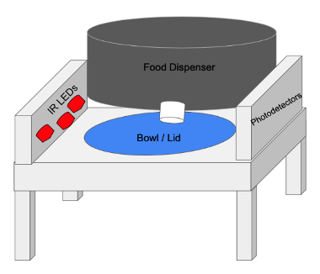
Specifications and Requirements
Component | Parameter | Design Specification
Camera | Color detection | 3
Camera | Detection range | > 5 Feet
Motors | Power | < 100 Watts
Photo diodes | Response time | < 10 seconds
Dispenser | Dispense time | < 60 seconds
Collar tag | Durability | > 60 seconds of a light water mist
Lid | Closing time | 60 seconds ± 10 seconds
Pet food | Accuracy | ± 10% of User Inputted Amount
Notes:
Here we have the design specification for the Optosmart Pet feeder
**Read list**

Slide 7
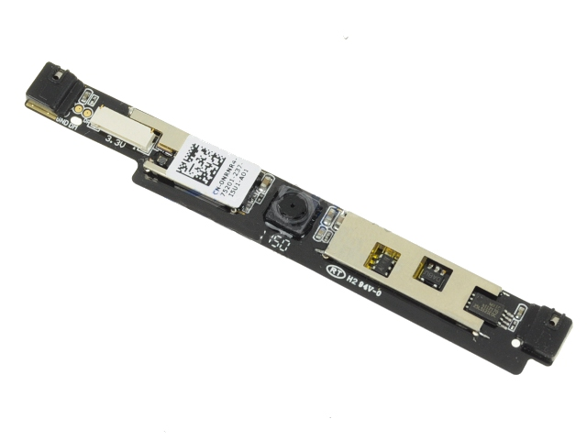
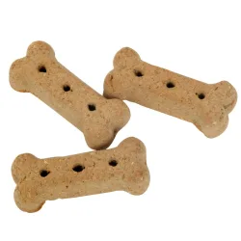
PET FEEDER FEATURES
Food is delivered to bowl using gravity and a motor spinning a thick metal disk with holes that can be adjusted (like a gumball machine, though this method is still being researched)
Each pet will have a collar tag that will emit red, blue or green light.
Different pets are identified using an onboard camera built into the feeder. Camera will detect what color LED is on the pet collar and detect the right pet
Once the pet is Identified the device will respond by dispensing a specific amount of food tailored to that pet.
Photodiodes will detect if the animal is at the bowl and will close once it walks away.
Notes:
This slide highlights the features of the pet feeding sysrtem
**Read list

Slide 8
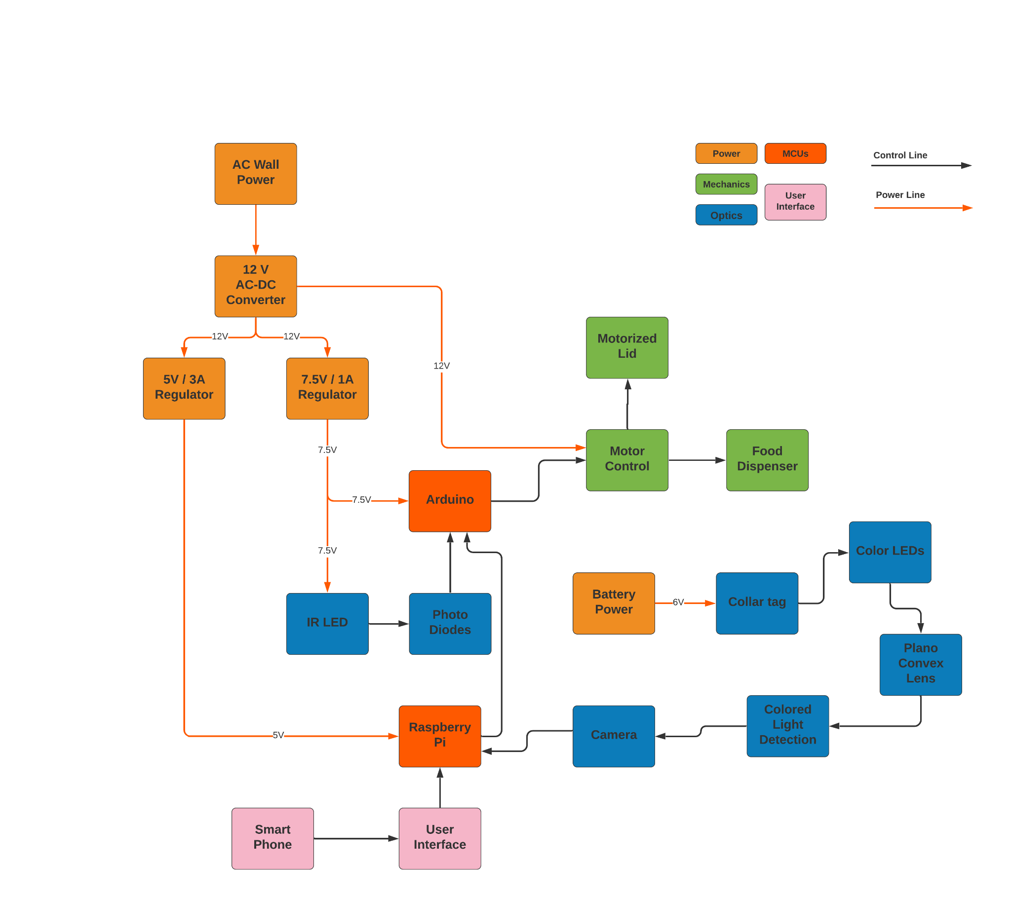
Overall Block Diagram
Notes:
This is the overall block diagram of the OptoSmart pet feeder system. This diagram lists the many different systems of the design. which include power, mechanics, optical, the MCUs and the user interface. power lines are denoted in red while control lines are black.
The system takes AC wall power, which is then converted to 12v DC which powers the dispenser and the lid motors. Then the power is regulated to 5V/ 3A which powers the Raspberry Pi, there is also the 7.5v/1A regulator that powers the arduino and the IR LEDs. We then have the MCUs that are responsible for controlling the optical system and the motor system. An external user interface that changes system parameters will interface with the raspberry pi.

Slide 9
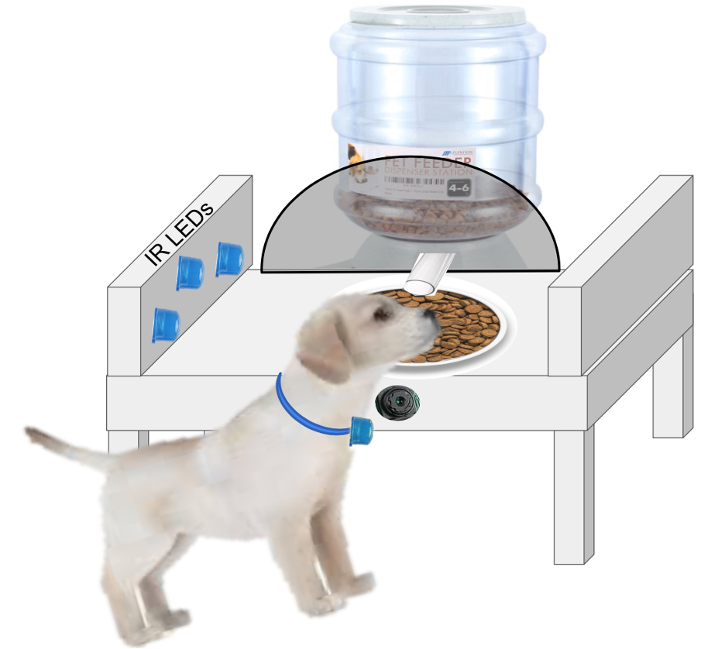
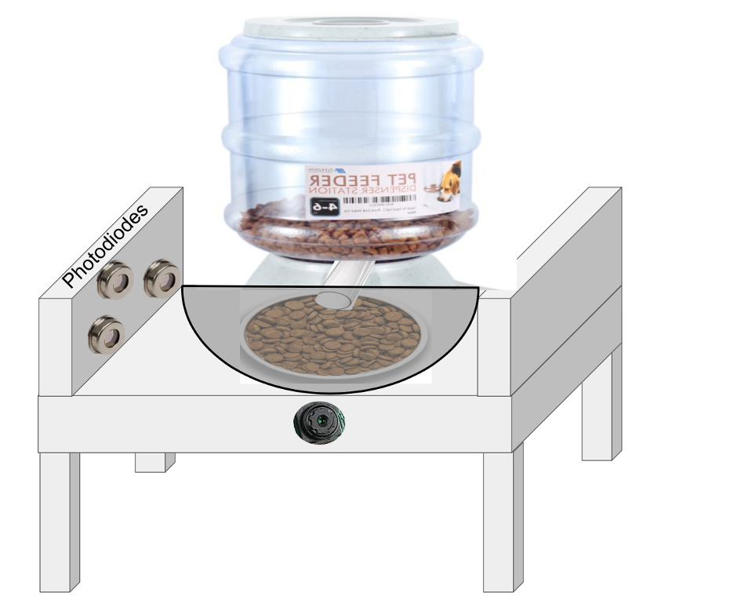
PET FEEDER DESIGN
Notes:
This slide shows a model of what the finished product will look like showing off the food holder, lid system optical system and the collar tag that each pet will wear.

Slide 10
Color Detection
Notes:
In this section, we will focus on how color detection is implemented into the OptoSmart Pet Feeder

Slide 11
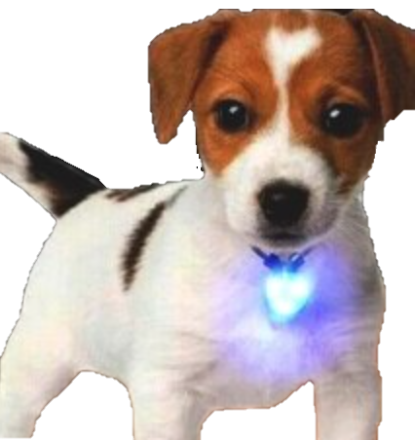
Color Detection
Each collar will be equipped with either a Red, Blue, or Green LED
The camera interfaced in the dog bowl will see the color
Our system will be able to interpret which pet collar color the camera sees
If the color detected is the one programmed into that feeder, it will open the lid
Notes:
Each of the collar tags will be equipped with a different LED that is red, blue or green. Each of these colors have been chosen due to their intensity and how responsive they are when interfacing with the camera system.
The camera system will be interfaced within the dog bowl in order to allow it to see the pet collar LED color as it approaches
Our system will them interpret which color collar is approaching. If it is the color assigned to the bowl it will open the lid and allow the pet to eat from it. If it is the incorrect color the system will not activate and the food will be safe from any other pets trying to sneak in. This will ensure that a pet is only eating out of their own bowl preventing them from over or under eating

Slide 12
OPTICS BEHIND CAMERA SYSTEM
Camera system
LED
Lens
Collar
Notes:
This is a visual demonstration of the optics within our camera system. Each collar will come equipped with a specific LED color. A lens will then be placed infront of it to help diffuse the light, making it brighter. This will allow the camera system to more easily detect the collar from a farther distance.

Slide 13
Optical Design Demo : Blue Light Detection
Without Lens
With Lens
Notes:
Our optical design demo was able to demonstrate that we are able to process an image and recognize if there is either red, green, or blue light present. As shown in these pictures we were able to detect the light and recognize it as blue. We also tested out the functionality of adding the lens as shown on the image on the right and it significantly increased the visibility of the light.

Slide 14
Optical Design Demo : Red Light Detection
Without Lens
With Lens
Notes:
Here we have our demonstration of the Red LED light. Our system was able to accurately sort the red light and the Lens significantly increased the brightness

Slide 15
Optical Design Demo : Green Light Detection
Without Lens
With Lens
Notes:
For our green LED demonstration we similarly were able to sort the light based off of its color and saw a greater area of detection when using the lens.

Slide 16
Optical Design Demo : Color LED Detection
Notes:
When all three LED colors were imaged together we were still able to accurately sort the light colors. This shows that when the system is searching for one color to activate it, It will not detect the other colors if they come into the area of the camera

Slide 17
IR Light Detection
Notes:
In this section we will discuss the design behind the IR light detection for the pet feeder

Slide 18
IR Light Detection
IR LEDs are positioned above the bowl to detect the presence of the pet
When the camera system detects the pet the lid will rise and the IR LEDS will turn on
Photodiodes peak detection wavelength matches the wavelength of the LEDs, reducing system noise
Photodiode voltage is measured by the Arduino
When a voltage drop is detected, the system knows that the pet is present
When voltage rises the pet is no longer present and a countdown is triggered
If no voltage drop is detected, then the lid is lowered.
Notes:
When the camera system detects the correct colored LED the infrared LEDs will turn on, food is dispensed and the lid is raised.
These IR LEDs will be placed above the food bowl that are aligned with photodiodes to measure a voltage difference. This detects the presence of a pet
The photodiodes have been chosen to match the wavelength of the IR leds which in turn reduces system noise.
The photodiode voltage is measured by the arduino and an average on value is recorded by the system
when a voltage drop is detected the system is put into a countdown loop and holds until the the voltage returns to its original "on" value, this means the pet is at the food bowl
when the voltage rises again, a user programmiable countdown is then triggered, and if the system dosent see a drop in voltage, the lid is then lowered
In the event a voltage drop is detected, then the countdown is reset, and the lid stays raised until a rise in voltage is detected again.

Slide 19
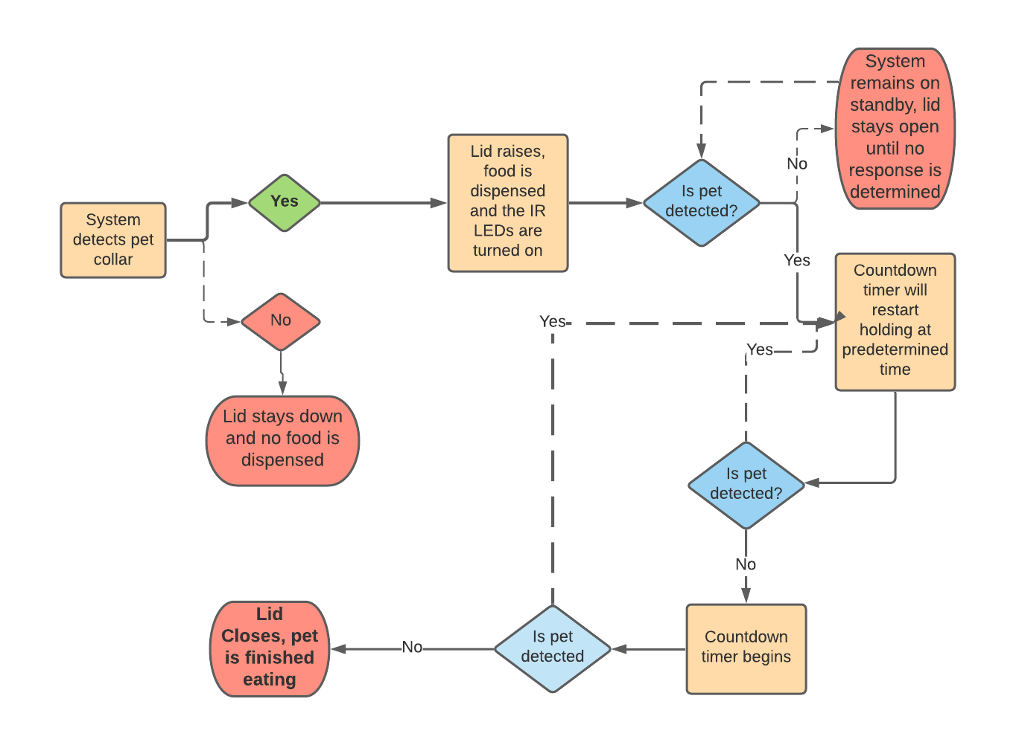
IR Light Detection Flowchart
IR Light Detection Flowchart
Notes:
Here is a flowchart of the IR light detection system highlighting the process that was discussed in the previous slide.
The process starts with the camera system detecting the correct color on the pet tag, which then activates the detection system, where the proper amount of food is dispensed, and the lid raises.
from there, the system will remain on standby until a drop in voltage is detected, where the system will go into a loop where the lid will close only when the pet is finished eating.
When the pet is finished, the lid will close and the detection system will turn off.

Slide 20
OPTICS BEHIND SELF CLOSING LID
Power Detector
IR LEDs
Lid Down
Pet Bowl
Photodiodes
Notes:
Here is a graphical representation of the IR Detection system. This is what the system will look like in the moments after a pet is detected. You can see that the lid is still shut but the IR light detection system has been activated, and the arduino is already gathering "on"averages from the photodiode voltages. while this is happening, the dispensing system is dispensing the pet food into the bowl

Slide 21
OPTICS BEHIND SELF CLOSING LID
Lid
Drop in power detected: system waits for increase in power to start countdown
Power Detector
Open
Pet Bowl
IR LEDs
Pet Snout
Photodiodes
Notes:
He we see the lid open, and there is a drop in voltage coming from the photodiodes due to the light being blocked from the animal's snout. the system will wait until the voltage rises to begin the user configured countdown.

Slide 22
OPTICS BEHIND SELF CLOSING LID
Power Detector
IR LEDs
Lid Closing
Photodiodes
Power returned to normal, countdown starts. Countdown will stop if power drops again, and process will repeat
Pet Bowl
Notes:
Once the pet is finished eating and the countdown goes to 0, the lid closes and the IR light detection system will turn off.

Slide 23
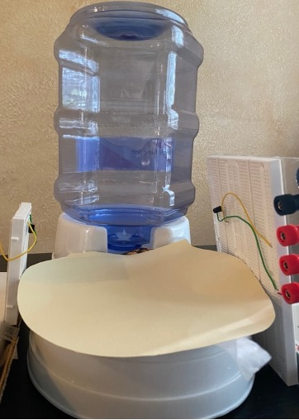
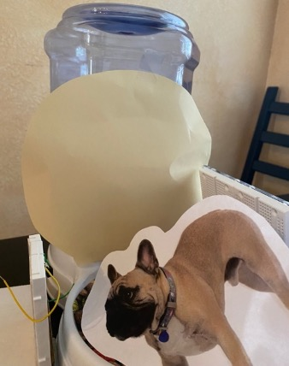
Optical Design Demo : IR Light Detection
 | Uninterrupted Voltage | Interrupted Voltage | Voltage Difference
Trial 1 | 0.395 V | 0.285 V | 0.111 V
Trial 2 | 0.409 V | 0.308 V | 0.101 V
Trial 3 | 0.399 V | 0.302 V | 0.097 V
Trial 4 | 0.402 V | 0.299 V | 0.103 V
Average | 0.401 V | 0.298 V | 0.103 V
Notes:
Here is the data from testing the IR Light detection system.
In this test, we supplied power to a single IR LED and aligned it with a single photodiode.
In each trial of interrupting the voltage we saw the voltage difference averaged 100mV between the un-interruped and interrupted voltages.
Even though this is a detectable difference, we will be using several photodiodes and LEDs in the final design to increase the difference between the two voltage states.

Slide 24
Electrical Design
Notes:
Within this section we will cover the reasoning and selection criteria behind the electrical components of the Opto-Smart Pet Feeder as well as discuss the development of the PCBs needed for our device.

Slide 25
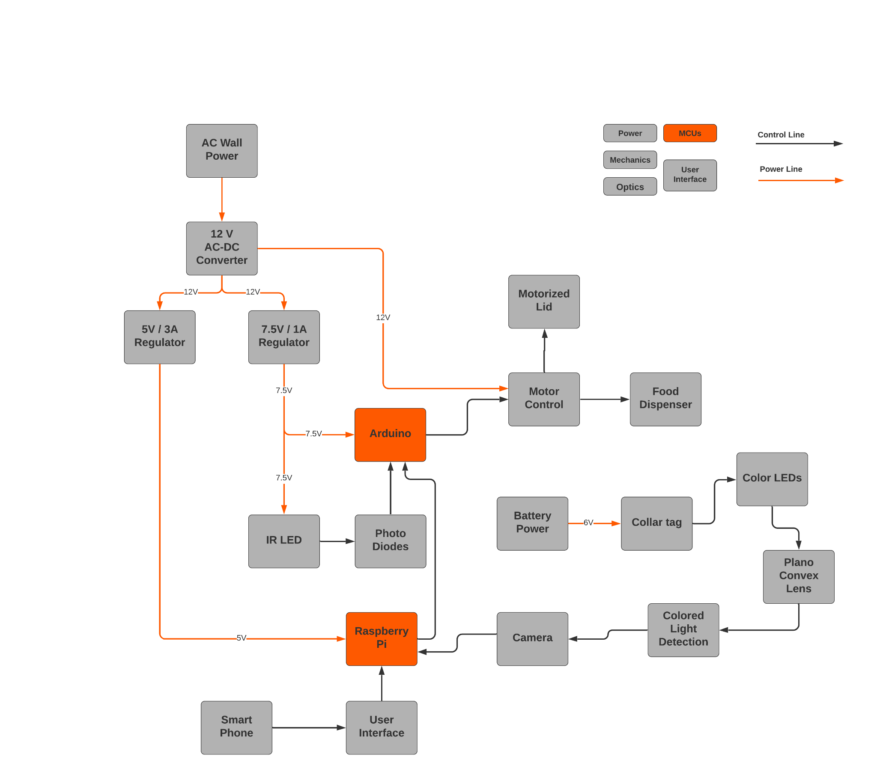
Microcontroller/Microprocessor
Notes:
Displayed here are the main processing and control systems that will be implemented into our design.
The Arduino microcontroller will be utilized for the lower level control of the hardware such as motor control and interpreting voltage readings from the photo-diodes
On the other hand, the raspberry pi microprocessor will be used to process all of the image data as well as run the software written for our web or mobile application

Slide 26
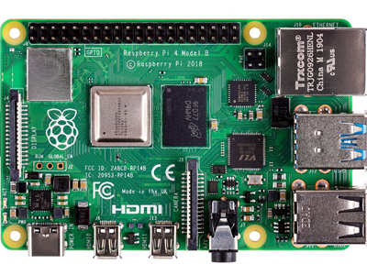
Microprocessor (Raspberry Pi 4)
Purpose:
To process the image data presented from the pet collar LEDs and deliver the data to the arduino for motor control. Additionally, provide the processing power necessary for the web application.
Camera Input
Arduino Uno
85.6mm
Model | Raspberry Pi 4 (Model B)
Price (for kit) | $127.79
Cores | 4
Clock Speed | 1.5 GHz
GPIO | 40 Pins
Memory | 4 GB
56.5mm
Ease of interfacing with camera module (made for Raspberry Pi)
Can communicate serially with microcontroller
CPU can process image data as well as run the developed web application
Web Software
Notes:
The microprocessor chosen for the design of the Opto-Smart Pet Feeder was the Raspberry Pi 4. This device is needed to be able to process image data from various colored LEDs and send that data easily to the Arduino for further control of the system. Using the Raspberry Pi’s onboard wifi and Bluetooth features will also be necessary for the development of our user application. The main reason for the selection of this microprocessor was due to the 4 core processor and 4GB of memory that can handle active image processing as well as running a separate application for users to interact with. Additionally, the raspberry pi can be interfaced directly with the camera module and the Arduino without the need for any extra hardware. serial communication can also be used to directly deliver image data to the Arduino.

Slide 27
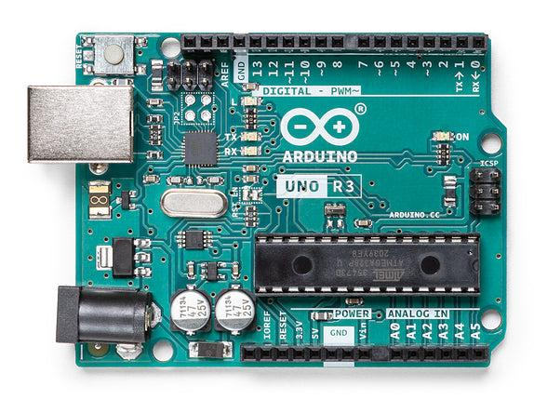
Microcontroller Board (Arduino Uno Rev3)
Purpose:
Read input data from Raspberry Pi and Photodiodes to control when each of the lid or dispenser motors should be activated.
Selection Criteria:
Ease of communication with Raspberry Pi
ADC with 10 bit resolution to convert analog voltages to digital signals
Ease of programming motor control in response to data from Raspberry Pi/photodiode voltages
Raspberry Pi 4
Motors
68.6mm
53.4mm
Microcontroller | ATmega328P
Price | $23.00
Clock Speed | 16 MHz
Memory | 32 KB
Digital I/O | 14 Lines
Analog Inputs | 6 Pins
Photodiodes
Notes:
Here is the Arduino uno which will be receiving data from both the Raspberry pi and external photodiodes in order to control motor timing and movement.
This mircrontroller board was chosen specifically for its ability to easily interface and communicate with the raspberry pi in addition to its software environment that allows for motor control to be programmed simply.
This Arduino uno is also equipped with a 10-bit ADC that provides a great enough resolution to distinguish the voltage drop across the photodiodes when the pet is blocking the IR LEDs

Slide 28
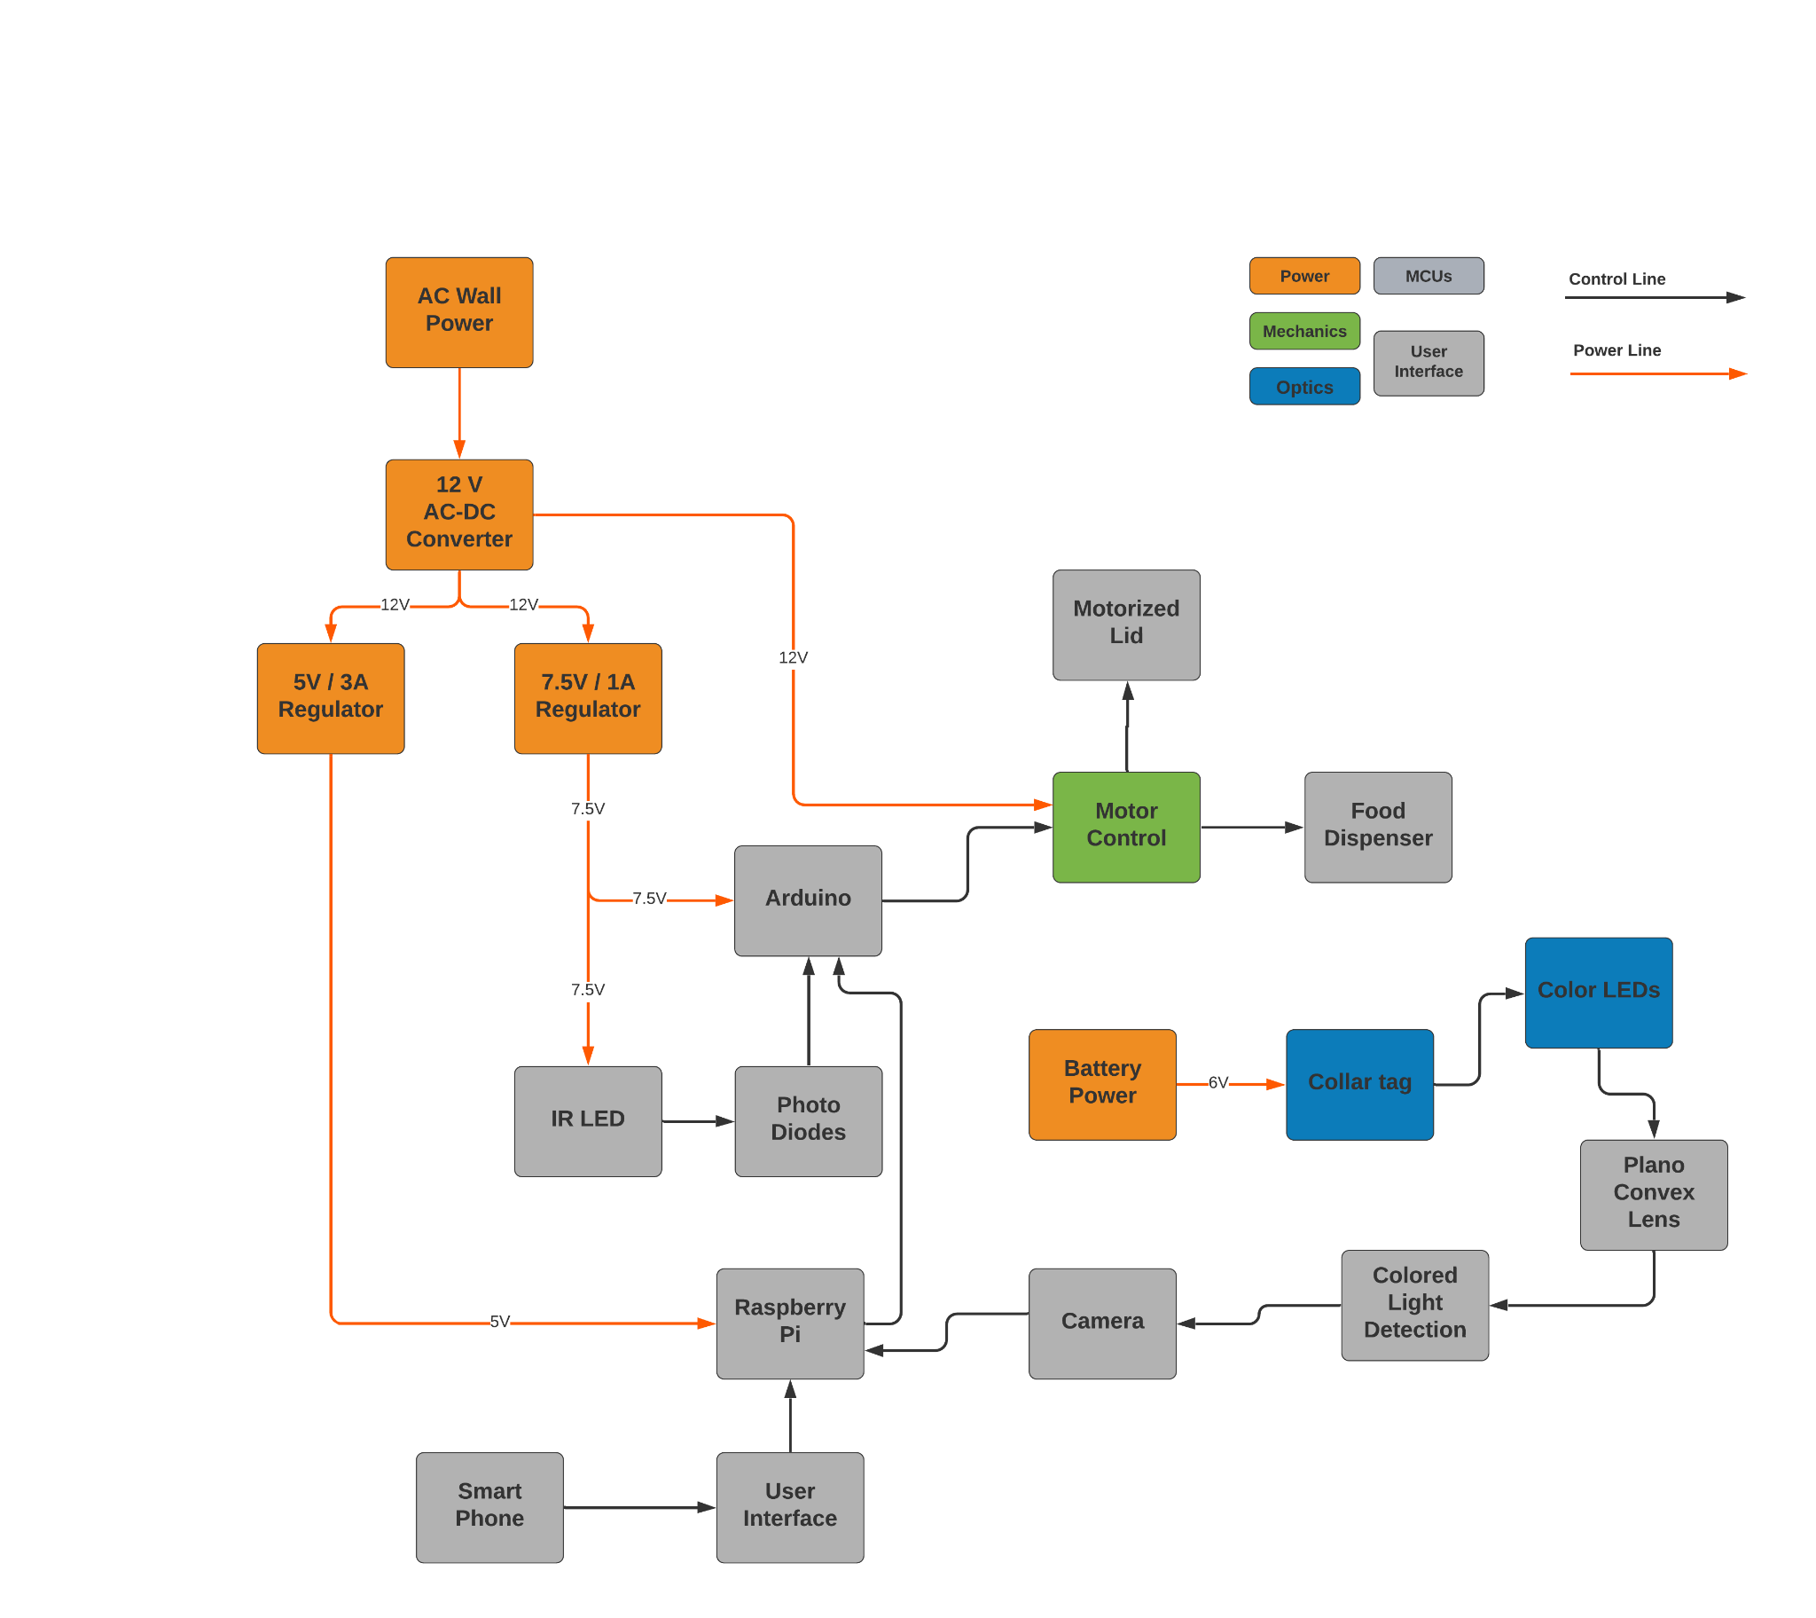
Power and Motor Control
Notes:
We will now discuss the design and development of the power regulation and motor control that will be incorporated into our device’s PCB.

Slide 29
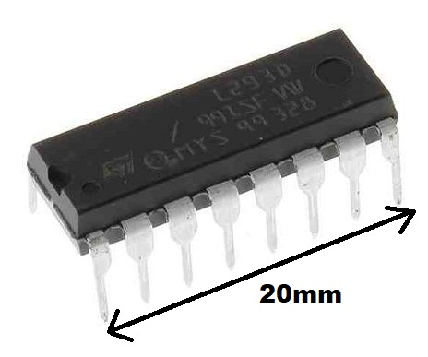
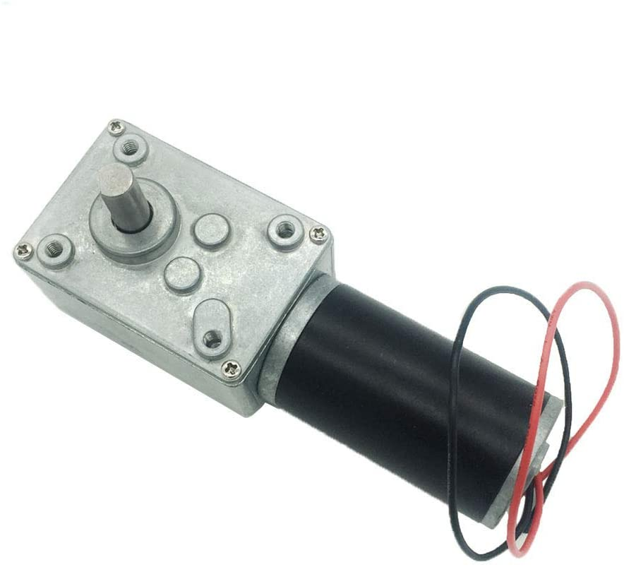
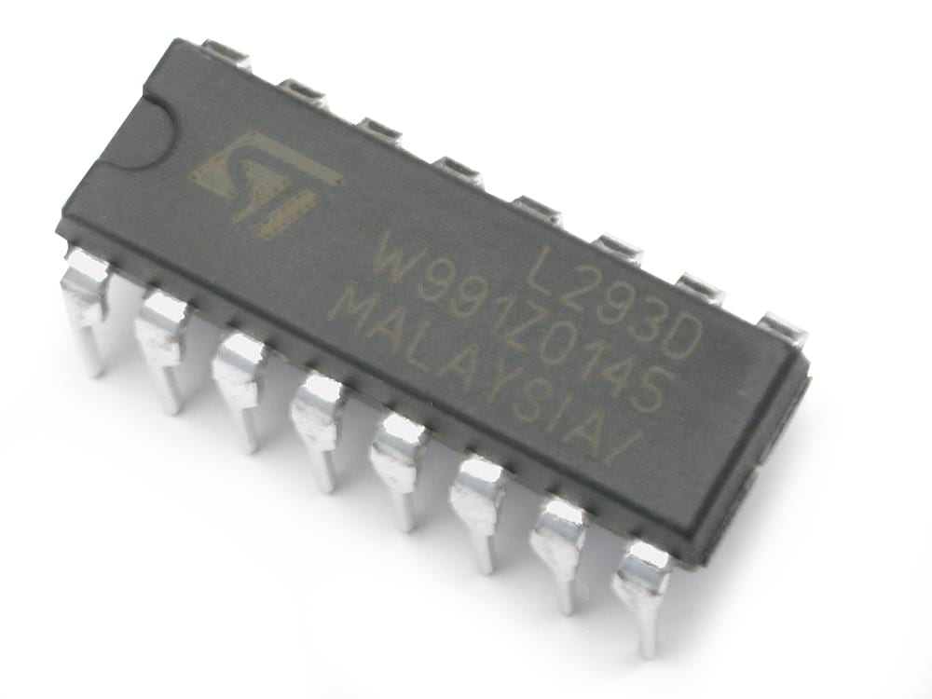
Motor Driver (L293D)
Purpose:
Allow for separate control of the lid opening motor and the food dispensing motor.
Selection Criteria:
Ease of interfacing with Arduino digital IO
Controls two motors with a single IC
Can interface with both DC and stepper motors
Form factor is able to be mounted easily to PCB
Manufacturer | TI
Price | $4.50
Logic Voltage | 5V
Motor Voltage | 4.5V-36V
DC Motor Control | Up to 2 Motors
Notes:
The l293D motor driver chip will provide power to the motors as well as allow data to be transferred between the Arduino and the motors.
This chip was selected for our design due to its ability to interface with and control two separate DC motors at once while being able to be mounted into our PCB without much difficulty. The price of this chip was also relatively low
Being able to control two motors at once was a crucial point in our decision process, since the Opto-Smart Pet Feeder will contain a motor for opening and closing the lid as well as dispensing the food.
The Arduino also contains enough IO pins to be able to handle dual motors.

Slide 30
DC Motors(Hugwit 12V 40rpm)
Purpose:
To open and close the lid of the bowl as well as allow food to be dispensed by spinning the metal disk with cutouts
Selection Criteria:
Can be mounted in multiple orientations
Works with a 12 V power source
Has enough torque to be able to lift the lid and spin metal plate
133.1mm
Manufacturer | Hugwit
Part Number | A58SW31ZY
Price | $29.99
Torque | 3.92 Nm
Motor Voltage | 12V DC
No load speed | 40 rpm
Notes:
The motors chosen for the Opto-Smart Pet Feeder were two of the Hugwit 12V 40 rpm DC motors.
This motor meets all of the required criteria that both the lid and dispensing systems need to function properly. With a specified operating voltage of 12V and a torque of 3.92 nm, there will not be any issues with compatibility, and we will not be limited by the motors torque output.
These DC motors can be also be mounted in a variety of positions, making it versatile enough to use with a horizontal spinning disk and a vertical opening lid
The fact that the motor has a speed of 40 rpm does not hinder the feeding system, since there is no need for fast moving parts in our device.

Slide 31
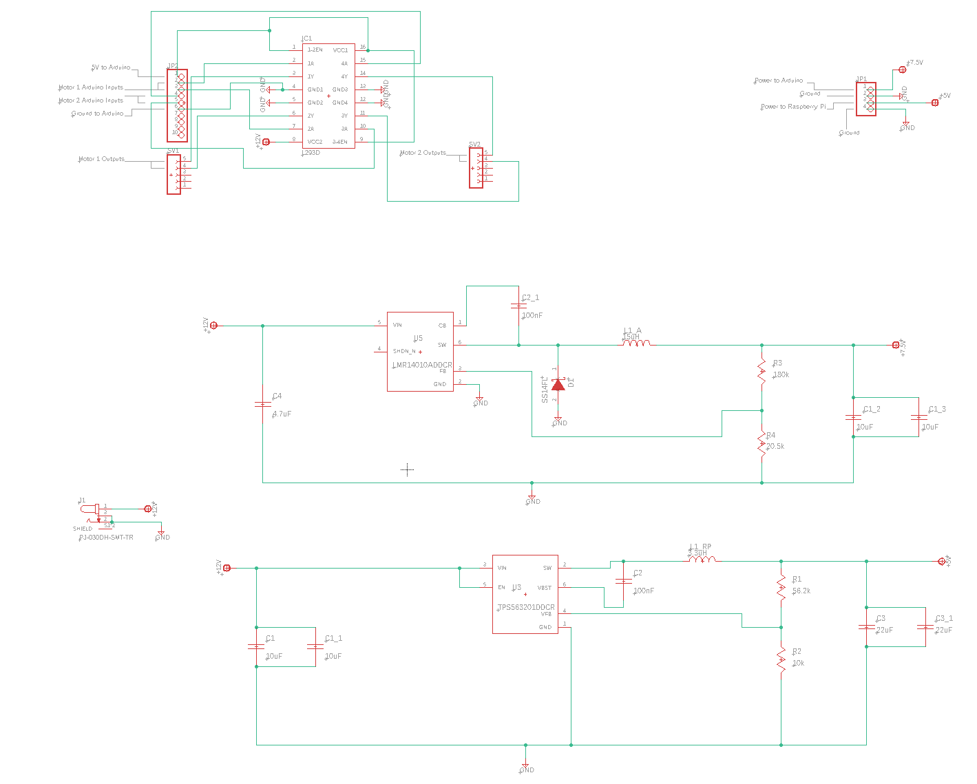
Main PCB Schematic
Notes:
Shown here is the PCB schematic for the power regulation and motor control systems to be implemented in our design.

Slide 32
Main PCB Schematic
Motor Control
Notes:
The motor control section of our PCB includes the use of the L293D chip connected to multiple pin headers that will allow the motors and Arduino to be directly connected to this IC.
The two 5 pin headers are used to connect the leads from both of the motors to the motor driver, while the 10 pin header is used to provide all of the connections from the Arduino to the L293 chip
Additionally 12V DC power will be delivered directly to the L293D in order to provide adequate power for both of the motors.

Slide 33
Main PCB Schematic
Power Delivery
Power Regulation
Notes:
The power regulation section of our PCB was designed to make use of two separate regulators.
Each regulator circuit will take the 12V DC power as input while one circuit will output a constant 5V at 3A and the other will output 7.5 V at 1 A
The 5V/3A output will be used to power the raspberry pi since its specifications require this exact power delivery in order to be powered from its GPIO pins
The 7.5V/1A output will be used to power the Arduino as its input voltage pin can be provided with a voltage between 6 and 12 V.

Slide 34
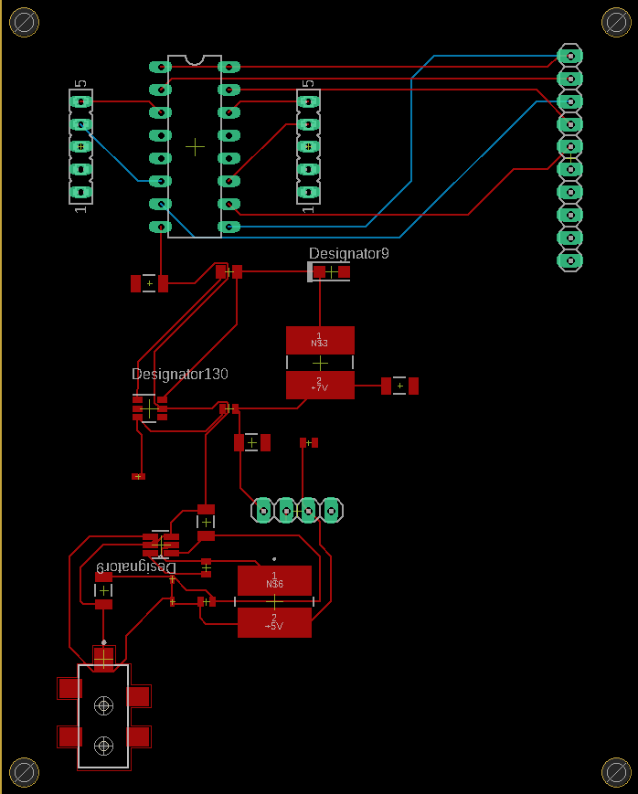
Main PCB Layout
Notes:
Here is the PCB board layout created from the previous schematic.
Both of the regulator circuits were placed close the power supply in order to avoid as much loss as possible.
And all of the pin headers were positioned to provide enough room for all connections to be made between them and the other components that will be placed on the board
Traces were implemented on both the top and bottom layers to allow for more efficient routing of the connections

Slide 35
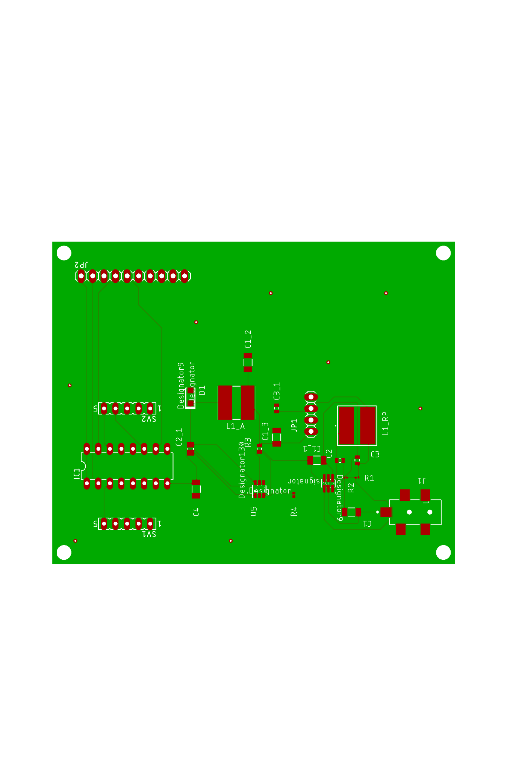
Main PCB Layout
71.12mm
88.90mm
Notes:
Shown here is a more accurate representation of the finished PCB layout.
A ground pour was used on both the top and bottom layers to ensure that all separate ground connections were properly grounded.
The vias were also placed around the board to connect the traces of the top and bottom layers
This PCB will also be able to easily fit inside the optosmart Pet Feeder with its compact design that is no longer than 3.5 inches on its longest side

Slide 36
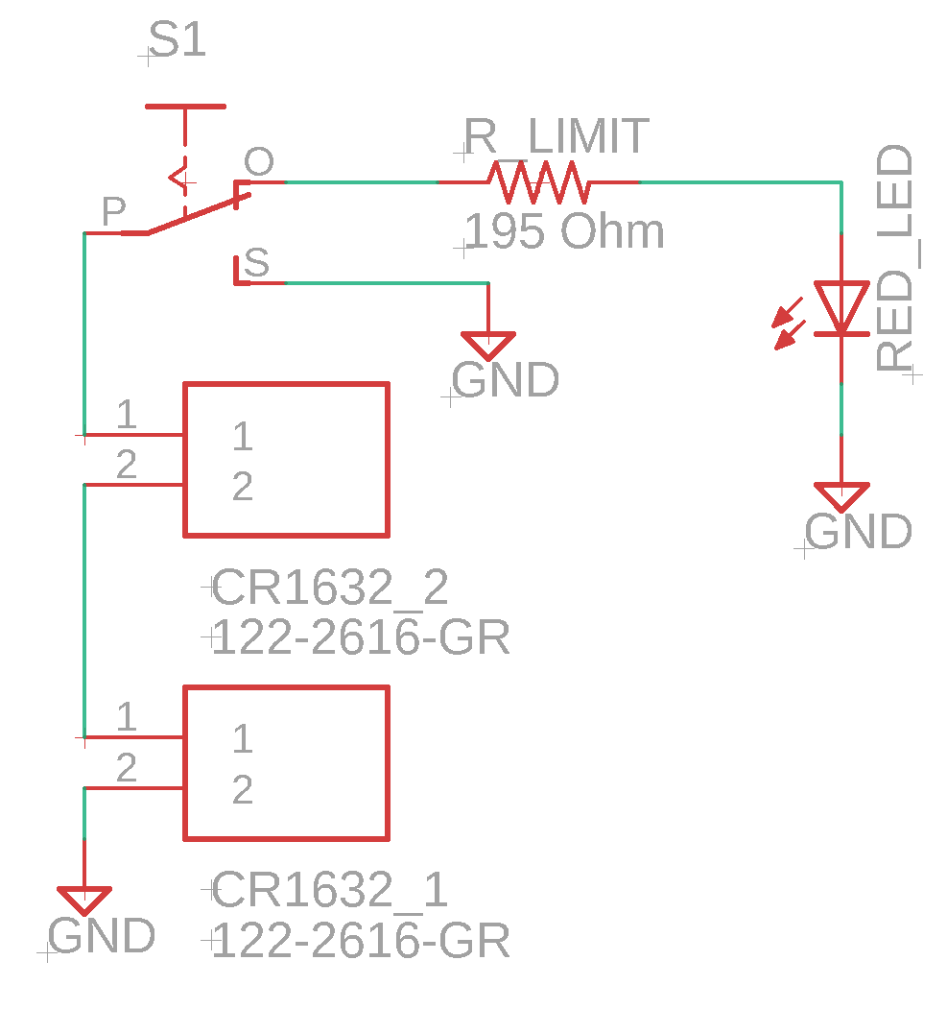
Collar PCB Schematic
PCB inside the collar tag housing that will power a colored LED.
Can be turned on and off with a switch.
Three variations of this circuit will be used with a different LED color for each one.
Notes:
In addition to the main PCB for the Opto-Smart Pet Feeder, three separate, smaller PCBs will be made to fit inside the pet’s collar tag. These PCBs contain a battery powered circuit that turns on and off a colored LED with the use of a manual switch. Each one of the three PCBs will contain a different colored LED to allow for multiple different pets to utilize the same feeding system.

Slide 37
Collar PCB Schematic
Color LED
Battery Power
Notes:
This PCB will be powered by two CR1632 coin batteries in series. Each battery is rated for 3V, and the limiting resistor values were calculated individually based on the operating current of each of the three different color LEDs that were used. In the case of the red LED, the limiting resistor of 195 Ohms will provide the adequate operating current of 20 mA.

Slide 38
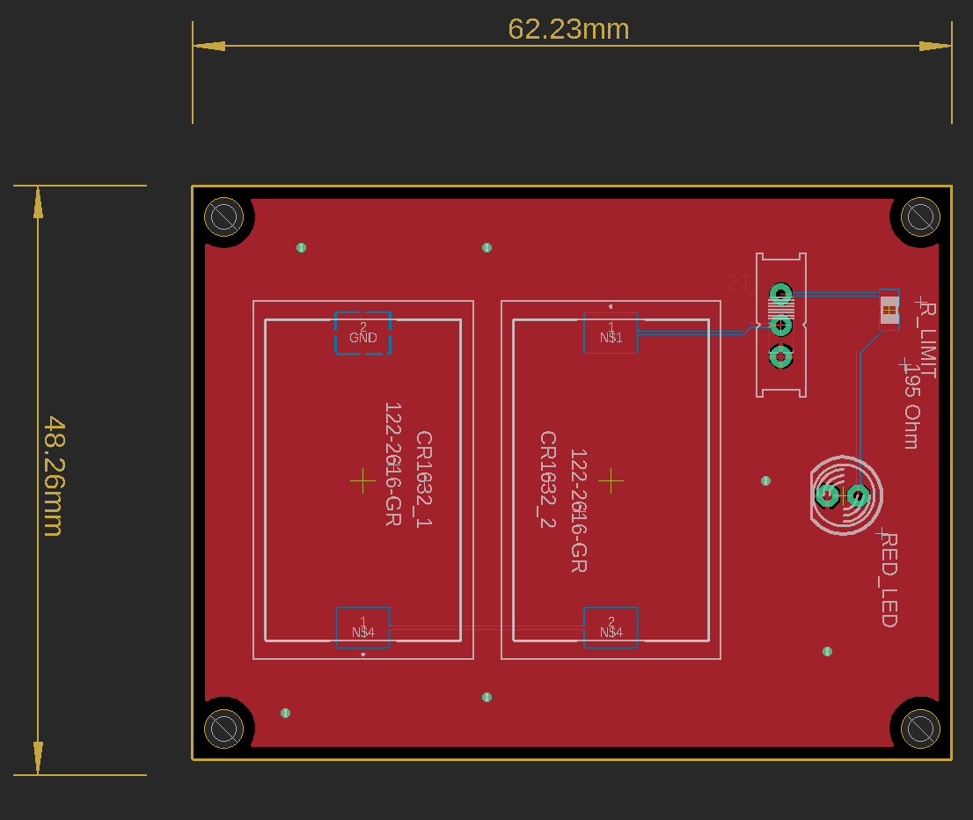
Collar PCB Layout
Notes:
Shown here is the PCB board layout for the collar tag’s internal PCB. The LED was placed within the center of the board in order to properly align with the lens that will be placed on the outside of the collar housing. The switch for the LED is also placed on the opposite side of the PCB to help prevent the pet from turning off the LED on its collar.

Slide 39
Software Design
Notes:
In this section, we will discuss the selection and implementation to meet a specific criteria in every software component of the Opto-Smart Pet Feeder as well as to discuss the process of our advanced development of the software programs needed for our smart device.

Slide 40
Software Overview
Python, Java, and C/C++ languages were all integrally used for the writing of the software programs for the device
The software program created will detect the color of the LED light that is on the pet’s collar
The software program will be used to activate the attached motors to mechanically open the bowl’s lid for the pet to be able to reach to its food
Once the software program detects a drop in the photo diodes voltage a countdown will initiate, and if there is no voltage drop within the time allowed, then the motors will be activated once again to close the lid of the bowl.
The software program will also activate the attached motors to initiate the release of the pet’s food at the specific times decided by the user

Slide 41
LED color detection MATLAB demo code
clear all;
clc;
while(1);
imaqreset
info= imaqhwinfo;
%macvideo works with mac, would need to change if used on a windows computer
Cam= videoinput('macvideo');
set(Cam, 'FramesPerTrigger', Inf);
set(Cam, 'ReturnedColorSpace', 'rgb')
Cam.FrameGrabInterval = 5 ;
start(Cam);
preview(Cam);
while(Cam.FramesAcquired<=600)
Mac_Vid = getsnapshot(Cam);
sgtitle('Colors Detected')
% Blue
Red=Mac_Vid(:,:,1); Green=Mac_Vid(:,:,2); Blue=Mac_Vid(:,:,3);
blue_to_gray=imsubtract(Blue,rgb2gray(Mac_Vid));
blue_filter=medfilt2(blue_to_gray,[3 3]);
blue_gray_to_BW=imbinarize(blue_filter,0.4);
blue_det=bwareaopen(blue_gray_to_BW,500);
B=sum(blue_det(:));
bb=immultiply(blue_det,Blue);
rb=Red.*0;
gb=Green.*0;
blue_detected=cat(3,rb,gb,bb);
subplot(3,1,3);
imshow(blue_detected);
title('Blue Detected');
end
choice = menu('Continue?','Yes','No');
if choice==2 | choice==0
break;
end
end
stop(Cam);
delete(Cam);
clear;

Slide 42
Web/Mobile Application Overview
Users will be able to create a secure profile and login remotely via wifi
Users will be able to remotely view, add, edit, and remove food dispensing times, and the amount of food being dispensed on the corresponding pet’s LED collar
React will be used in creating the web application
VSCode & Atom will be used for code authoring
Firebase will be used for secure data storage
Heroku will be used for hosting the web application
Flutter will be used for the creation of the mobile application
Ubuntu will be used for the OS distribution linux based system

Slide 43
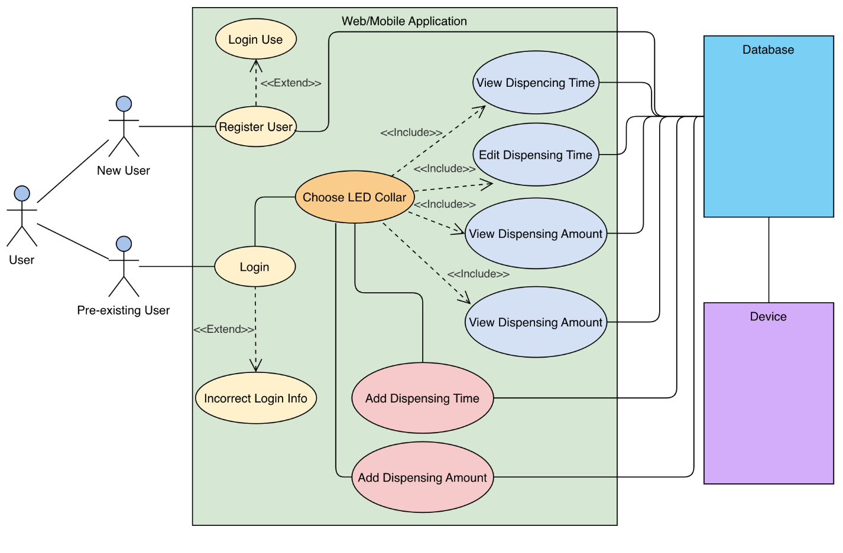
Use Case Diagram
Edit

Slide 44
Entity Relationship Diagram (ERD)

Slide 45
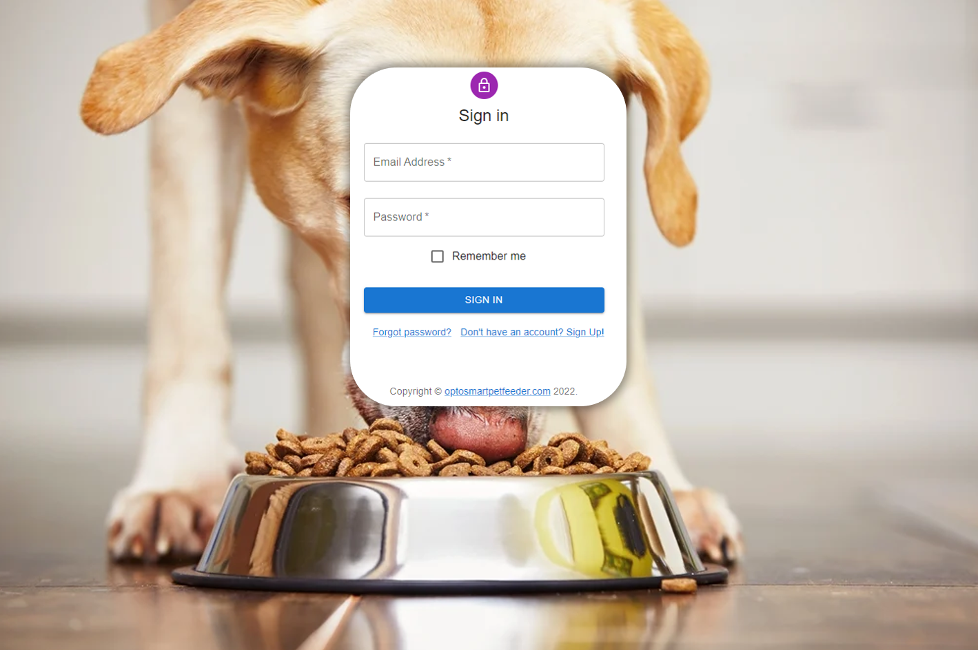
Web/Mobile Application Login Page

Slide 46
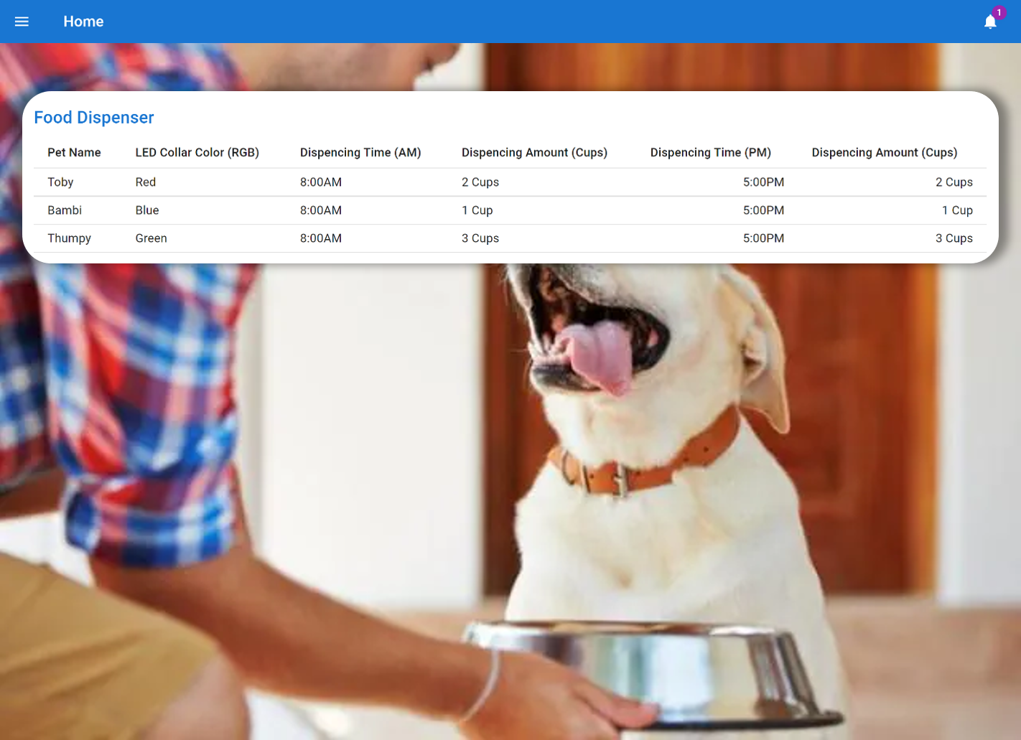
Web/Mobile Application Homepage

Slide 47
OptoSmart
Pet Feeder
Planning
Notes:
In this section, we will focus on some of the Planning Aspects of the opto smart pet feeder.

Slide 48
Finance and Budget
Item | Cost | Quantity | Purchased? | Total
Camera | $11.07 | 1 | √ | $11.07
FRP125 Lens | $38.11 | 3 | √ | $114.33
RL5-R8030 (Red LED) | $0.28 | 25 | √ | $7.00
Green LED (25 pk) | $8.00 | 1 | √ | $8.00
Blue LED | $8.00 | 1 | √ | $8.00
Photodiode | $1.03 | 25 | √ | $25.75
IR LED | $0.87 | 25 | √ | $21.75
Optical Component Cost |  |  | √ | $195.90
Raspberry Pi Kit | $127.79 | 1 | √ | $127.79
Soldering station | $41.59 | 1 | √ | $41.59
Pet collar battery (CR1632) | $5.99 | 1 | X | $5.99
PLA 3D Printer Filament (Black) | $20.49 | 1 | X | $20.49
Stainless steel large dish | $13.57 | 1 | X | $13.57
Adjustable dispensing wheel | $19.99 | 1 | X | $19.99
11/32 in. or 3/8 in. x 4 ft. x 8 ft. BC Sanded Pine Plywood | $28.00 | 1 | X | $28.00
PCB Board (Set 5) | $34.99 | 1 | X | $34.99
9 V Power Adapter | $19.99 | 1 | X | $19.99
Arduino | $19.95 | 1 | X | $19.95
Switch and Battery Case | $4.99 | 1 | X | $4.99
Lead Free Solder | $12.99 | 1 | √ | $12.99
Non-Optical Cost |  |  |  | $350.33
Total |  |  |  | $546.23
$500 supplied from CREOL fund
Remaining cost will be split evenly among group members
Notes:
The optosmart pet feeder budget is shown here. cost to an estimated grand total of 546$. We have purchased many of the parts already, there is a column in this table indicating what has and has not been purchased already. We will receive $500 donated from the CREOL fund to fund our project. The rest of the cost will be split evenly among group members.

Slide 49
Design Constraints
Economics and Time | Our pet bowl will be more expensive than others on the market due to high-tech features Limited two semester time limit for research and development of product
Environmental | Design sourced from off the shelf components Product must last lifetime of pet
Social | Ongoing pandemic may push potential sales down due to many people working from home and not needing an automated pet feeder
Political | Not relevant towards project
Ethical | Care must be taken when working with animals Product must be 100% safe and tested (no exposed motors, gears, electronics must be shielded, etc.)
Health and Safety | Materials must be safe for food contact.
Manufacturability | Ongoing pandemic may cause material shortages, must plan ahead.
Sustainability | Product must last years before material degradation.
Notes:
Many design constraints played a role in the design of our opto smart pet feeder:

Slide 50
Related Standards
Animal Health and Safety Requirements
The Animal Welfare Act, 7 U.S.C. § 2131 et seq.
Soldering Standards
Lead soldering safety
Guidelines for soldering
C Language Programming Standards
ISO/IEC 9899:2011
PCB Standards
IPC-221A
Notes:
Some standards were a key part in our design process

Slide 51
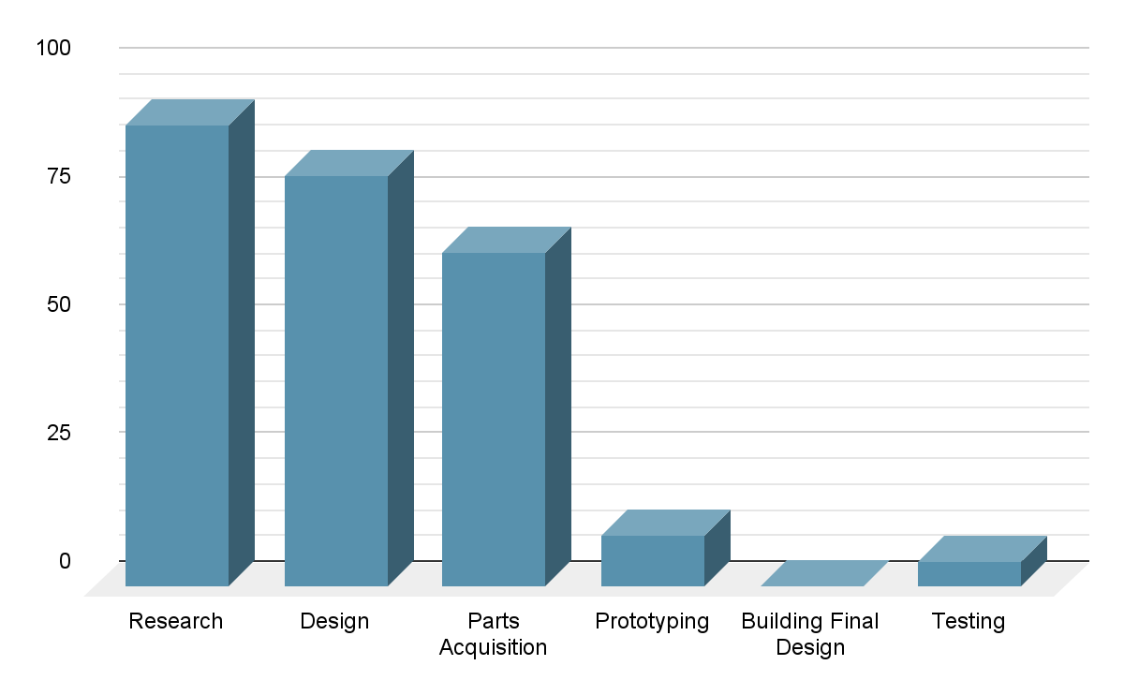
Project Progress

Slide 52
Plans for the Future
 | 2/4/2022 | 2/10/2022 | 2/15/2022 | 2/29/2022 | 3/21/2022 | 4/8/2022 | 4/15/2022 | 4/17/2022 | 4/26/2022
CDR
Finish up Electro-Mechanical Design : Lid, Motors, Dispenser
Purchase and acquire all needed parts
Pairing Raspberry Pie, cameras, Arduino, and motors
Prepare Demonstration
8 Page Conference Paper and Committee Form
Project Showcase
Final Presentation
Final Documentation

Slide 53
Successes and Difficulties
Successes
Successful color detection during optical design demonstration
Voltage drop across photodiodes detected when IR LEDs were blocked by pet
Difficulties
Power consumption from the entire system
Notes:
Throughout the testing of our device, we were able to develop code that allows the camera to detect the correct color being displayed from the LED. We were also able to perceive a significant drop in voltage across the photodiodes when the IR LEDs were being blocked by an object. The total power consumed by the entire opto-smart pet feeder has not been determined yet, since more testing will be required as we further assemble our project. The motors will be the main source of power consumption, and we will analyze the total power draw of the system once additional, more detailed testing is incorporated.

Slide 54
Questions?

