Slide 1
BikeSystem Critical Design Review
Group 21 Keegan Van Wyk – EE Daniel Birath – EE Benjamin Tamayo – EE Sandhya Singh – CpE

Slide 2
Motivation
Alternative to expensive bikes
Make locking a bike more convenient
Provide useful metrics to the user
Appeal to a niche in the market
Notes:
Keegan

Slide 3
Goals & Objectives
Basic Goals | Advanced Goals | Stretch Goals
RFID module as the main locking/unlocking method | Fingerprint locking/unlocking methods as failsafe | Generate power/charge from the bicycle itself instead of replaceable batteries
Lights added to frame as safety measure | Temperature Sensor added to measure ambient temperature | Creating of the mobile to connect via Bluetooth
Mounted LCD on handlebars | - | GPS tracking module for location purposes
Sensors attached to wheels to measure distance and speed | - | -
Alternate mechanical locking/unlocking | - | -
Notes:
Ben

Slide 4
Specifications
Inclusive bike locking system that can be attached to a pre-existing bike frame
Main marketed method of locking/unlocking via RFID module
Failsafe method of locking/unlocking via fingerprint
Alternate unlocking mechanism in the case of low power
Measure revolutions of wheel and tire assembly
Notes:
Danny

Slide 5
Specifications Cont’d
Additional lights mounted on bicycle frame as a safety measure
GPS module added to Bike System to help locate bike in event of theft
A DC power generator with drive pulley will be fixed to the frame of the bike to charge the battery
Creation of a mobile app to save the metrics (health data, ambient temperature, distance, and average speed) from each trip
Notes:
Danny

Slide 6
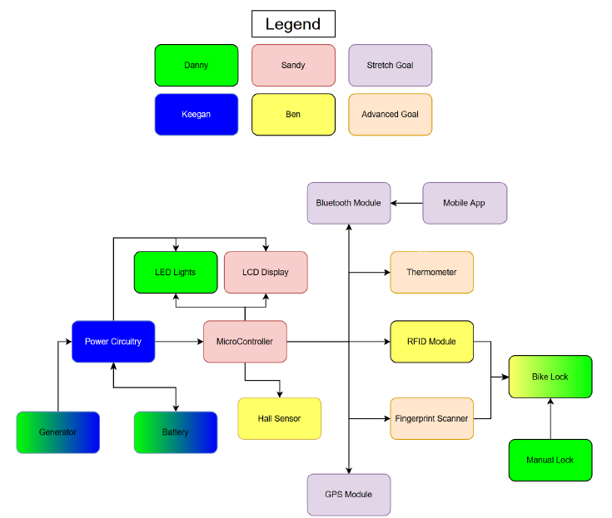
Block Diagram
Notes:
Keegan

Slide 7
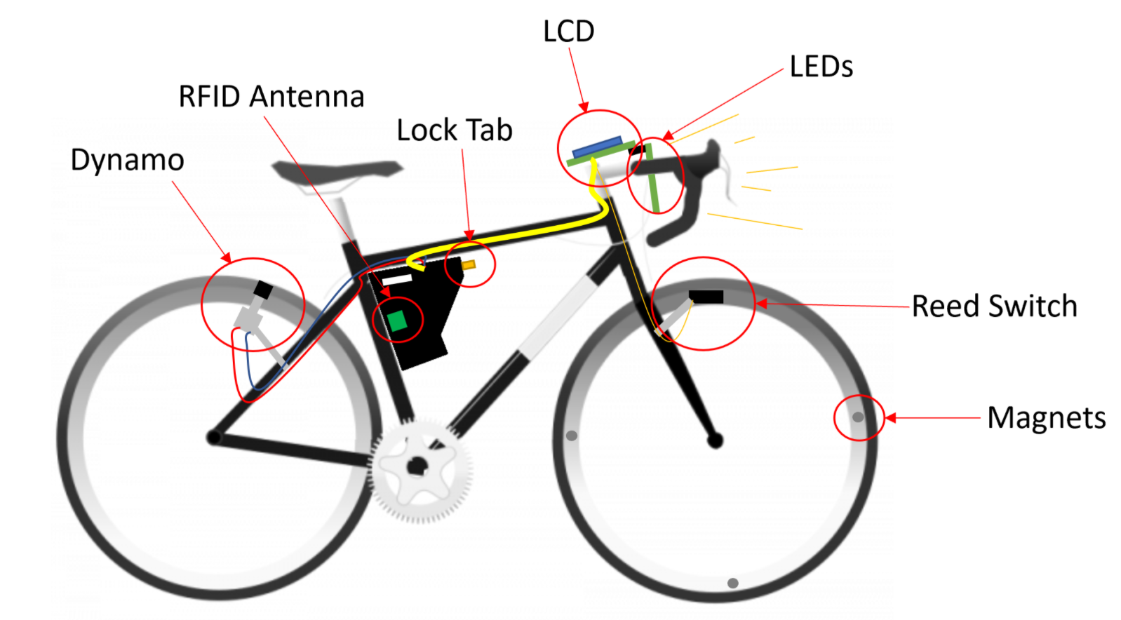
BikeSystem

Slide 8
Related Standards & Constraints
JESB8C.01 3.3V Standard
ISO/IEC/IEEE 29119 – Life Cycle of Software Development
ISO/IEC standard 18000-3:2008
OSHA standard 1915.82 General Requirements for Lighting
Notes:
Keegan/Sandy/Ben/Danny

Slide 9
Constraints
Economic
Lack of funding – the BikeSystem is entirely self-funded
Microcontroller and relating sensors were confined to the power design (3.3V)
Time
Shipping and manufacturing delays due to the pandemic
Notes:
Danny

Slide 10
Power Subsystem
Power provided by battery and dynamo
Rectifies and regulates power generated by dynamo
Switches between sourcing power from dynamo and battery
Automatic switching between power sources
Indicates when battery is in use
Charges the battery when the battery is not in use
Regulates selected source to 3.3V output
Notes:
Keegan

Slide 11
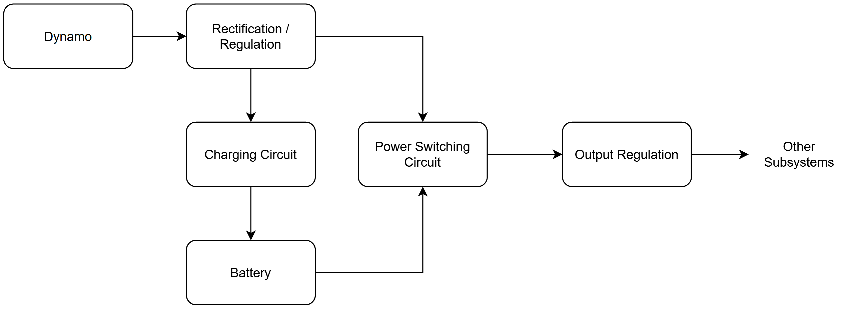
Power Subsystem Block Diagram
Notes:
Keegan

Slide 12
Input Rectification and Regulation
Rectification and Filtering
Voltage Regulation IC
Dynamo Input
Notes:
Keegan

Slide 13
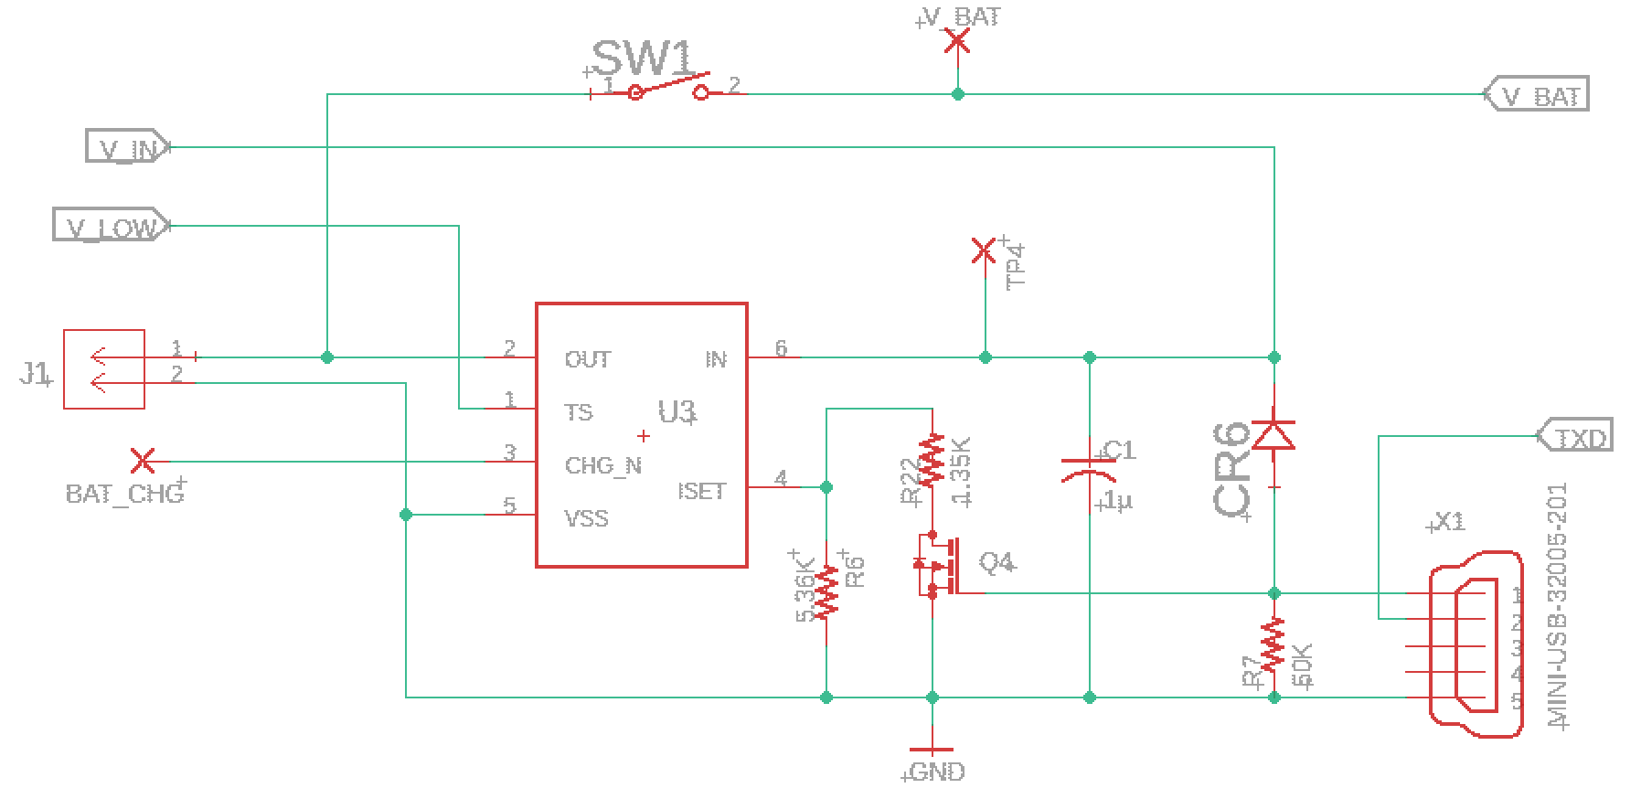
Battery and Charging Circuit
Charging IC
Battery Connection
For External Charging
Notes:
Keegan

Slide 14
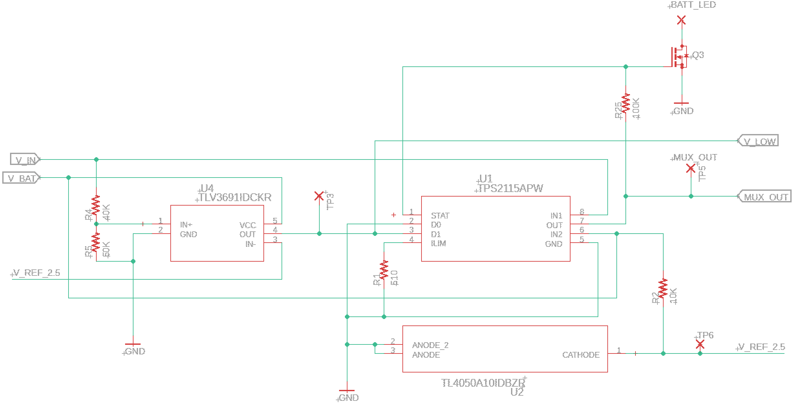
Power Circuit Switch
Power Switching IC
Comparator
Voltage Reference
Notes:
Keegan

Slide 15
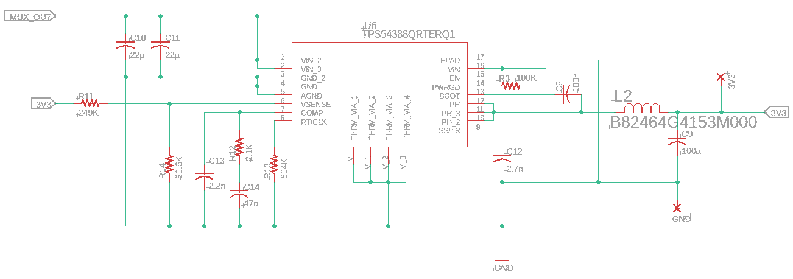
Output Regulation
Voltage Regulation IC
Notes:
Keegan

Slide 16
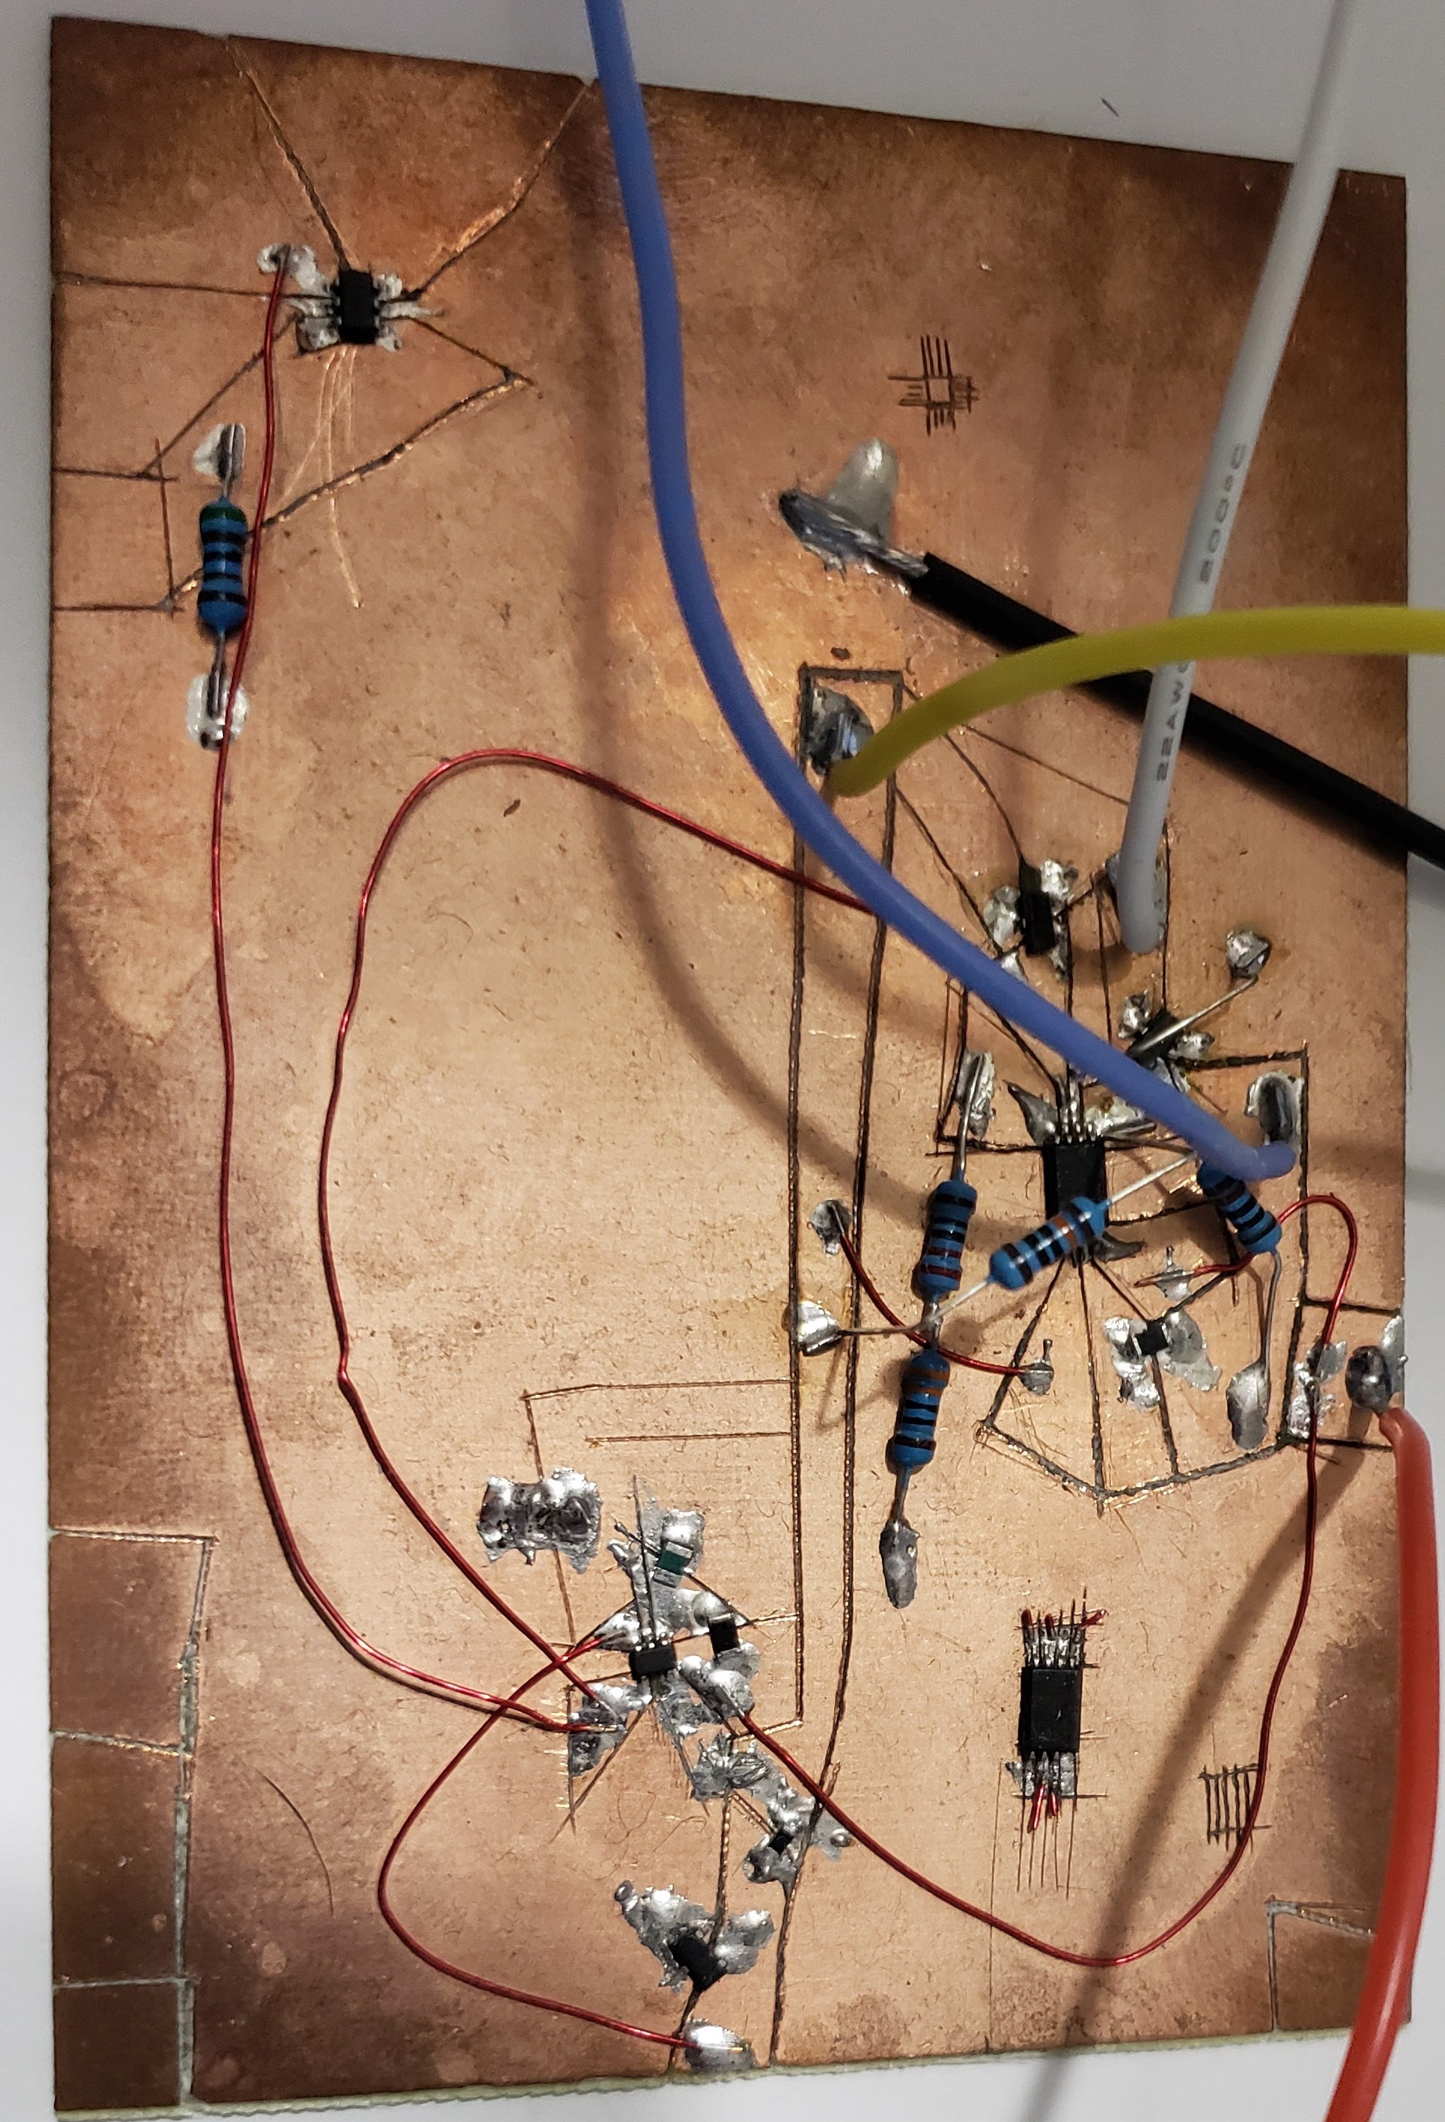
Initial Circuit Testing
Hand cut traces and lands on bare copper PCB
Hand soldered components to test board
Red jumper wires used to interconnect components
Large wires used to connect to breadboarded components (not shown)
Notes:
Keegan

Slide 17
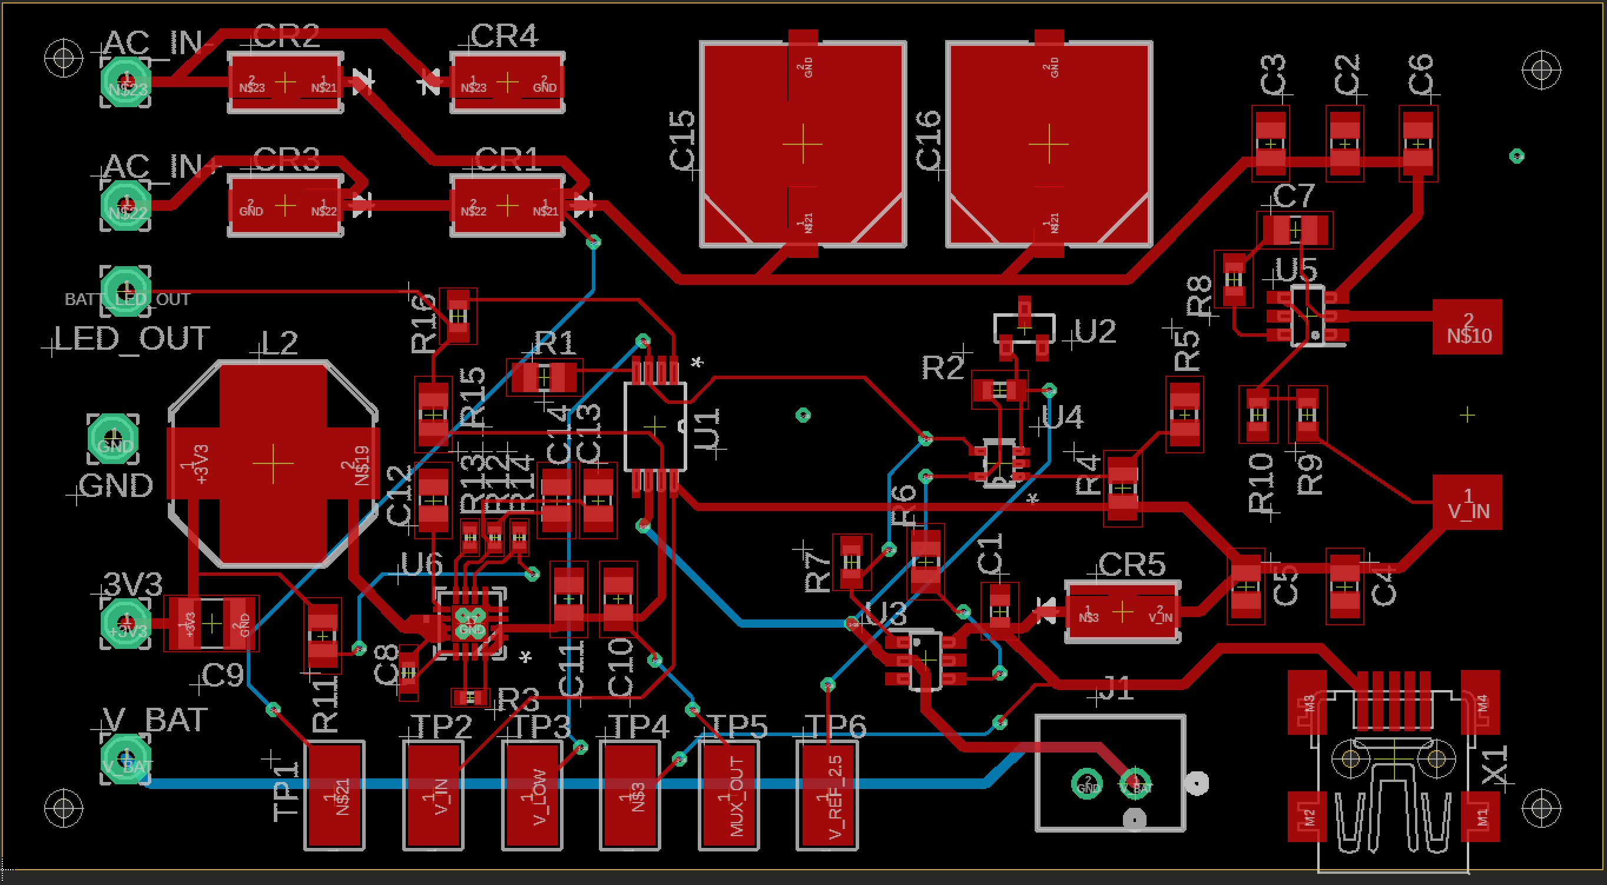
Layout
Notes:
Keegan

Slide 18
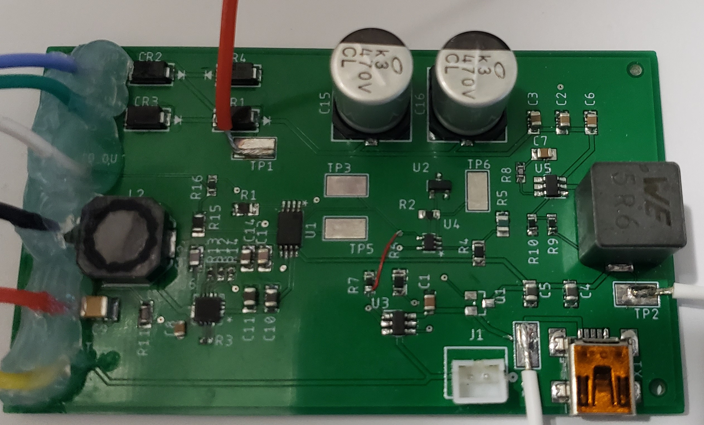
Full Circuit Testing
All components hand soldered
External wires used for power connections and to connect instruments to test points (TPs)
Notes:
Keegan

Slide 19
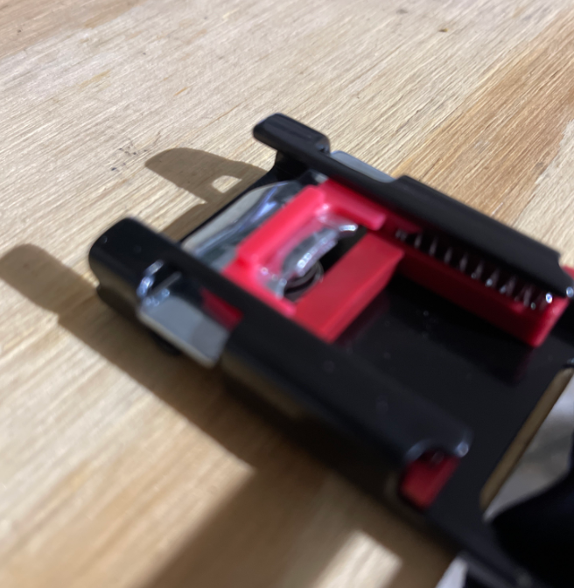
Locking Mechanism
Provide user with a better alternative to traditional bike locks
Convenience
Efficiency
Notes:
Danny

Slide 20
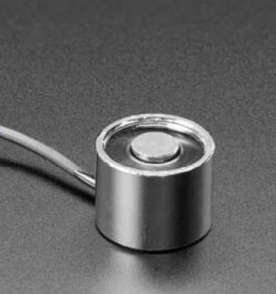
Locking Mechanism Features
Inertial reel assembly
Plug and play locking system
Magnets
Currently being tested
Notes:
Danny

Slide 21
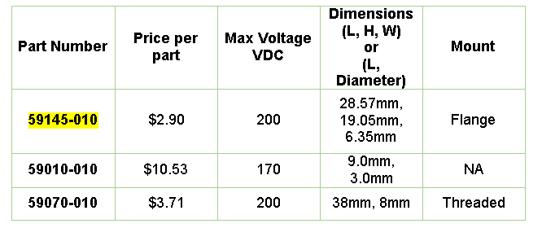
Reed Sensor
Reed Sensor is basically a switch that is actuated by an electromagnetic field.
Output of reed sensor will be used to calculate speed and distance traveled by the system.
Notes:
Ben

Slide 22
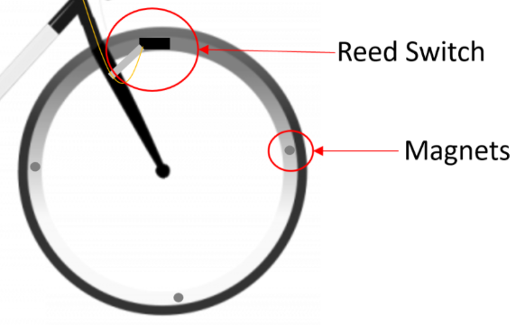
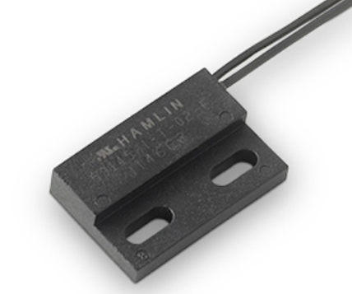
Reed Sensor
The Littelfuse 59145 Reed Sensor was chosen because of its mounting style and sensitivity.
Normally-open configuration will be used.
Notes:
Ben

Slide 23
Magnet for Reed Sensor Actuation
Magnet needs to be able to actuate the Reed Sensor from at least 0.5 inches away.
D81AD-P magnet was chosen, although it was the most expensive per part of all magnets considered, because it has the highest magnetic field strength when considered from 0.5 inches away.
D81AP-P also comes with adhesive pad, which will be needed to secure magnets to the rim of the bicycle tire.
Notes:
Ben

Slide 24
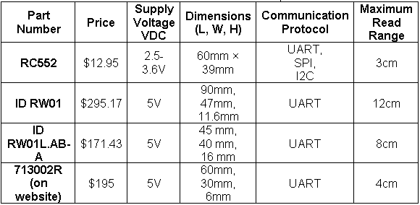
RFID Module
Only complete RFID modules were considered.
RC522 was chosen because of stark difference in price and freedom of communication protocol.
Notes:
Ben

Slide 25
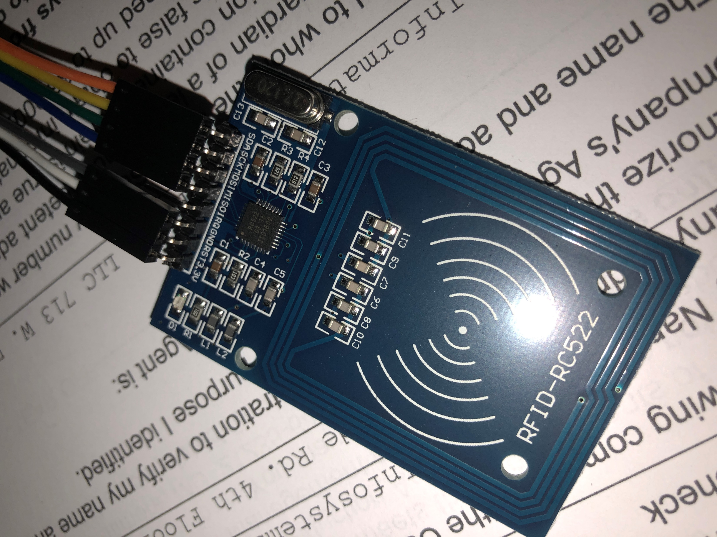
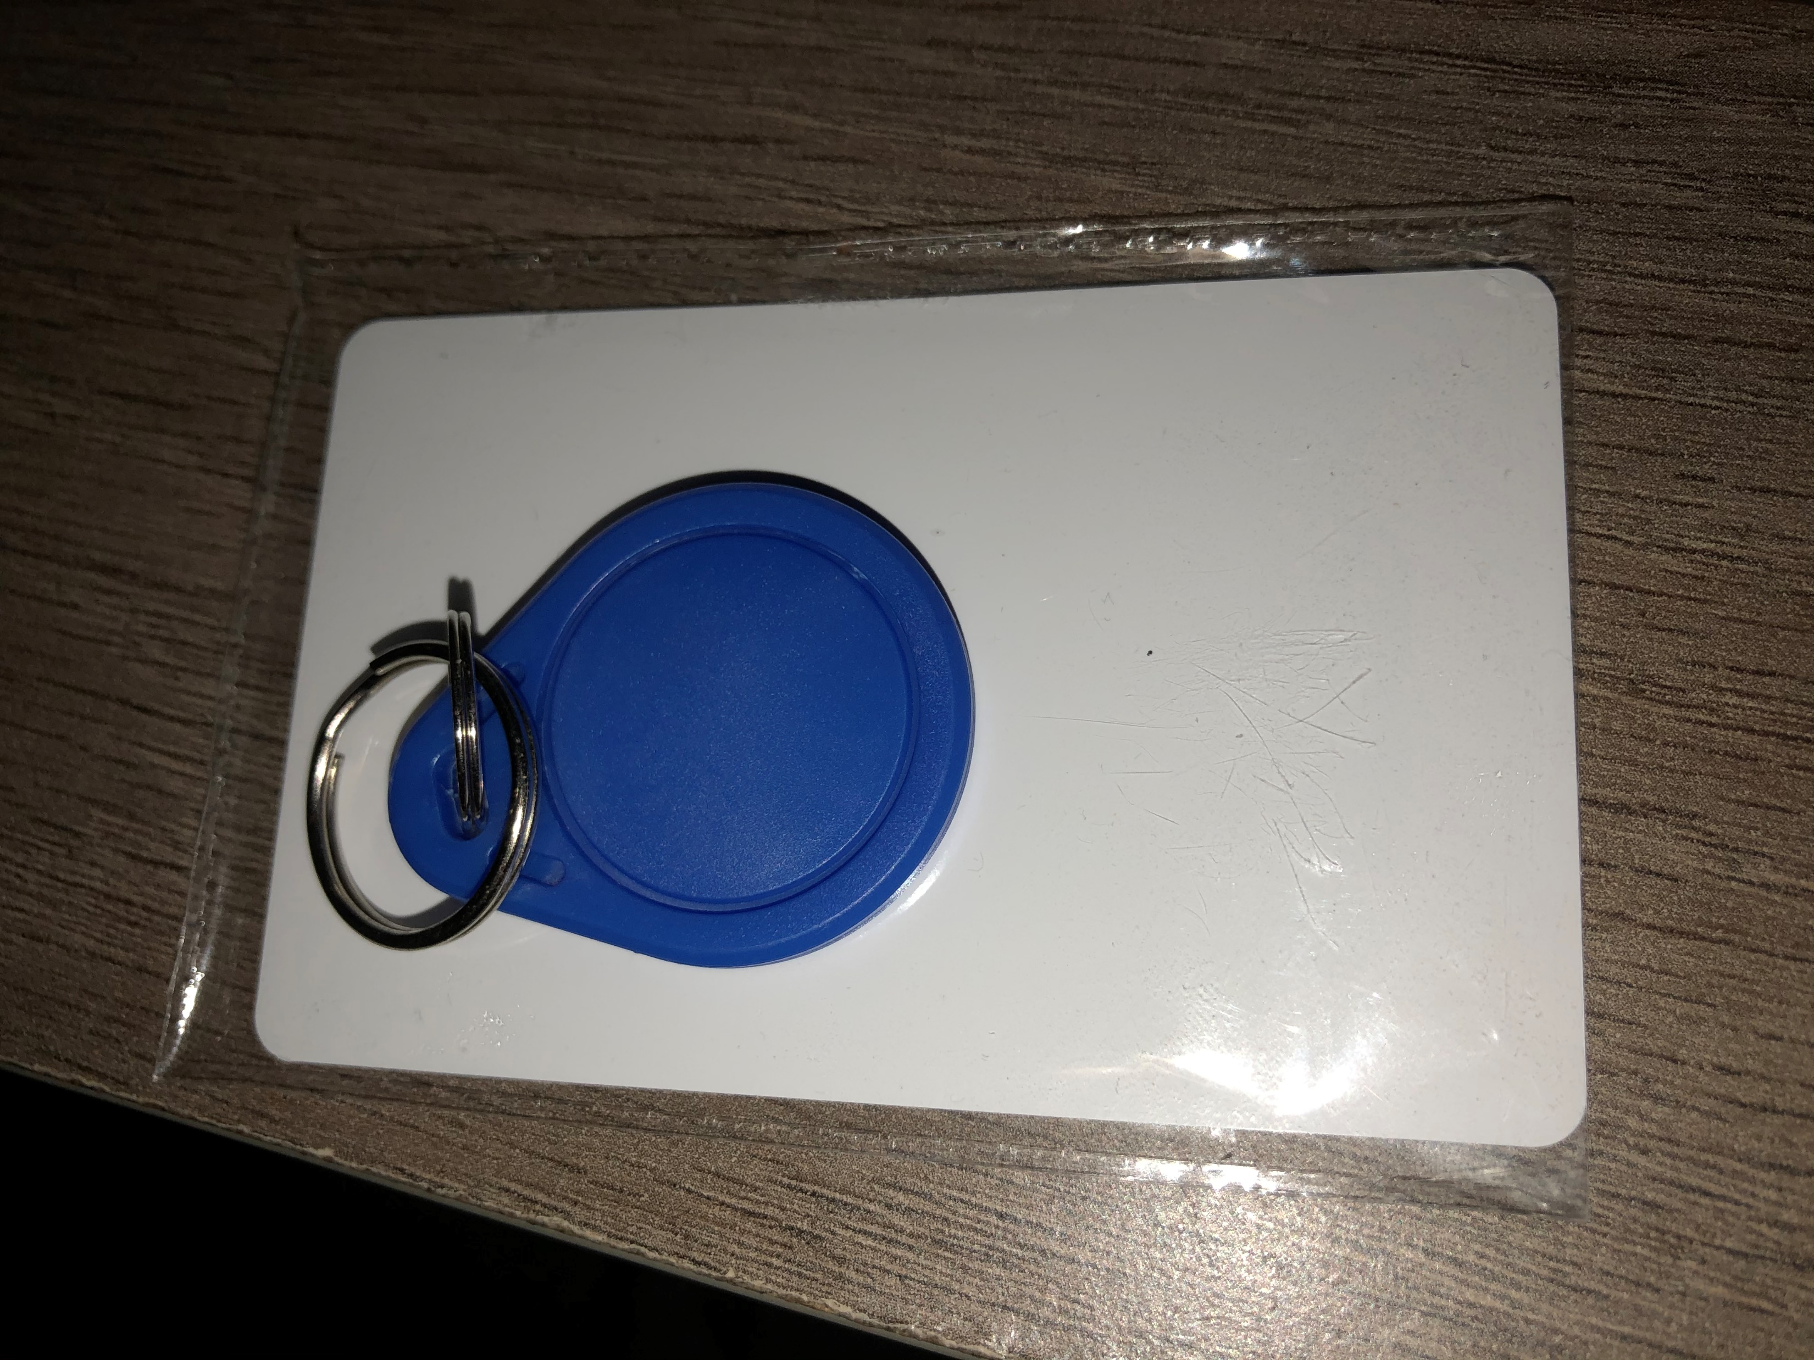
RFID Module
Benefits to using the RC522 RFID module include:
Proof of concept and code with an existing embedded antenna and impedance matching network.
Proof of schematic for specific communication standard (SPI).
Notes:
Ben

Slide 26
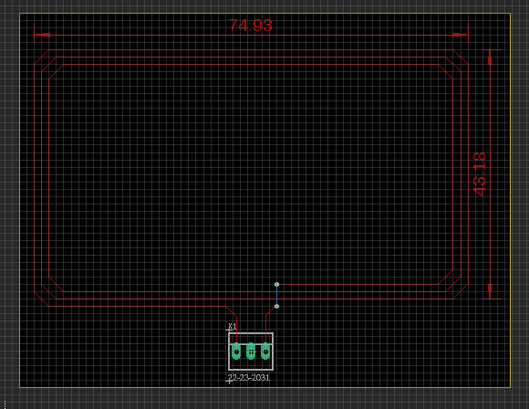
Integrating RFID Module
The IC that drives the RC522 RFID module is called the MFRC522 IC. This IC is responsible for communicating with the chosen microcontroller and RFID card.
The two primary steps to integrate the RFID module into the final PCB is to design an antenna with a known inductance and then design an impedance matching network that connects the antenna to the MFRC522.
Notes:
Ben

Slide 27
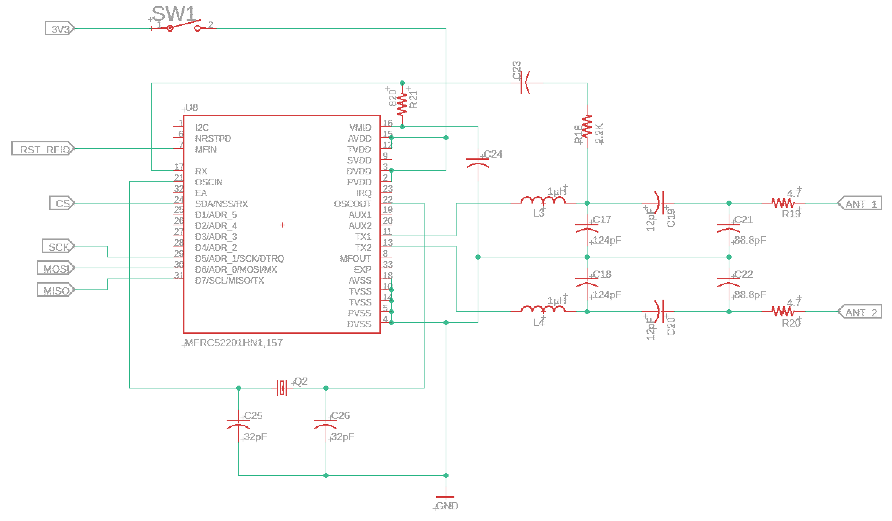
RFID Impedance Matching Network
Notes:
Ben

Slide 28
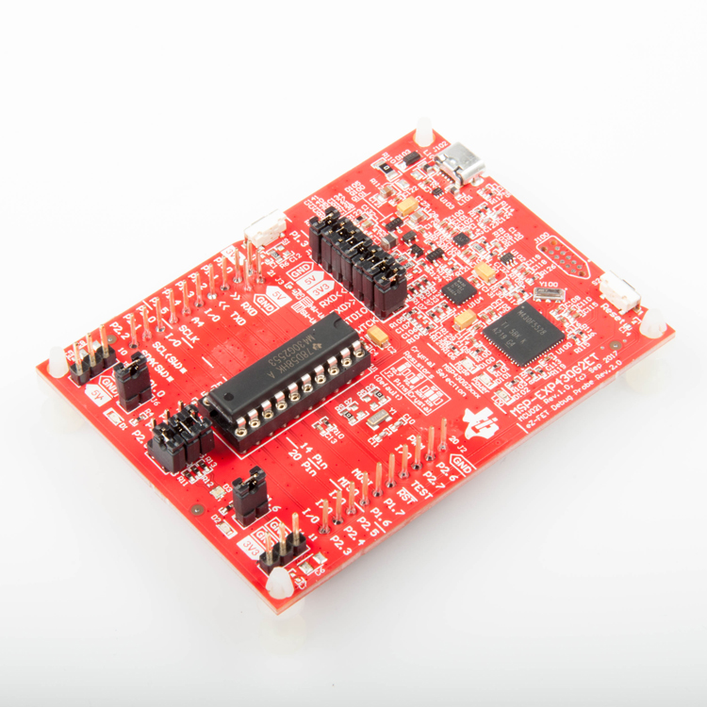
Microcontroller
MSP430G2553
3.3 v
Low power consumption
Notes:
Sandy

Slide 29
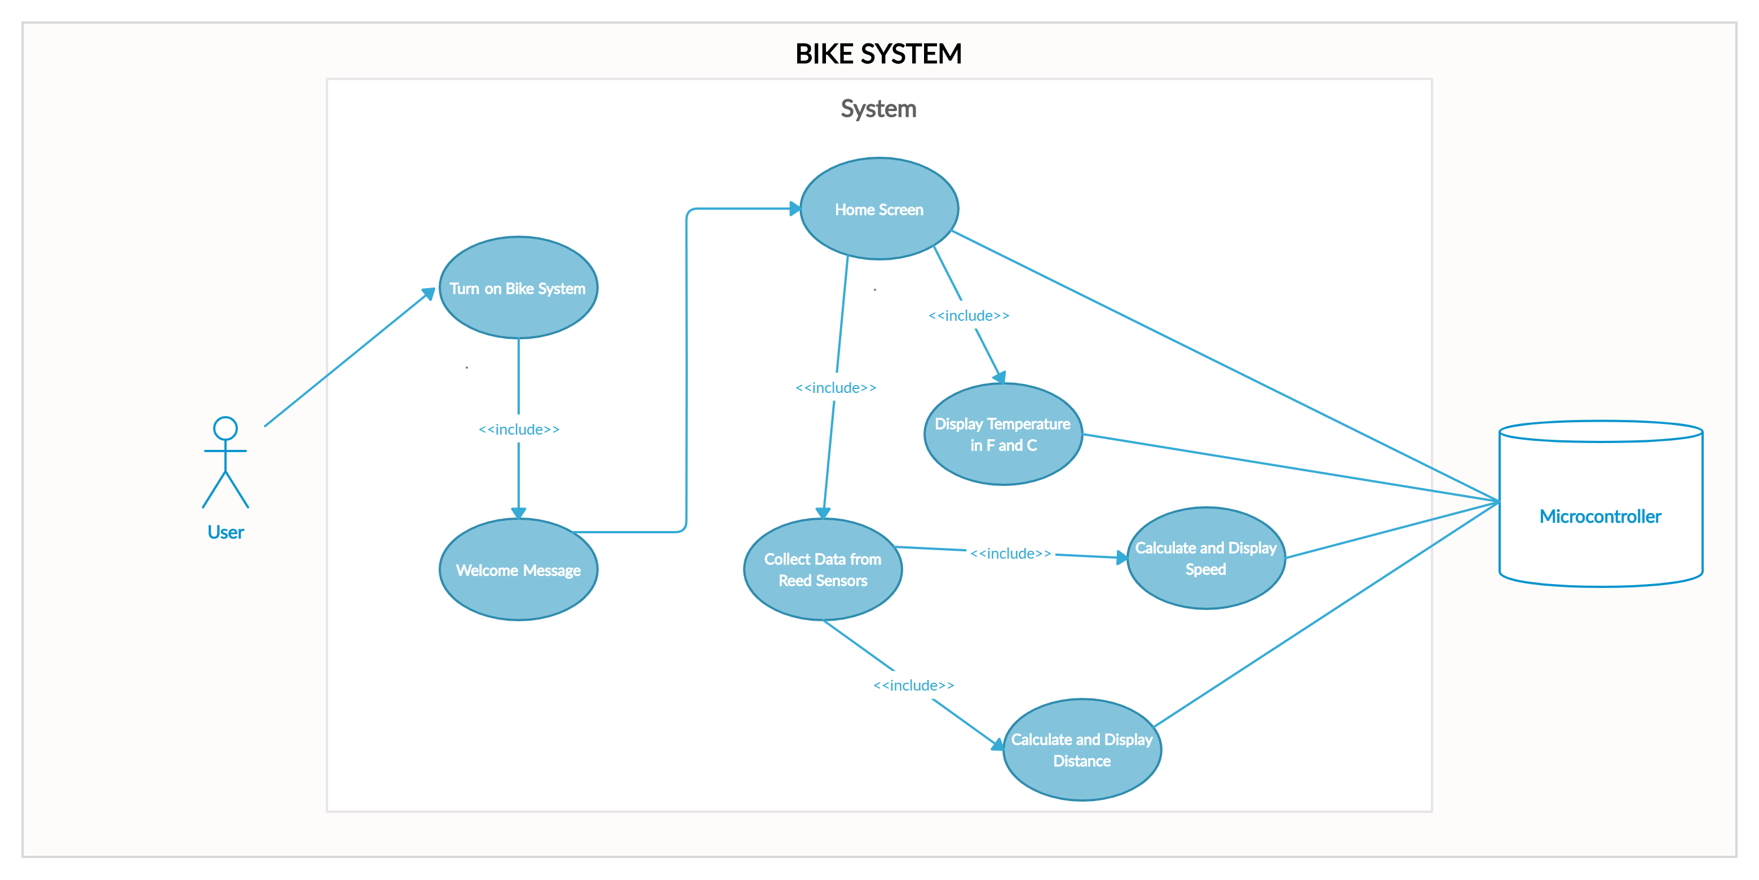
Use Case Diagram
Notes:
Sandy

Slide 30
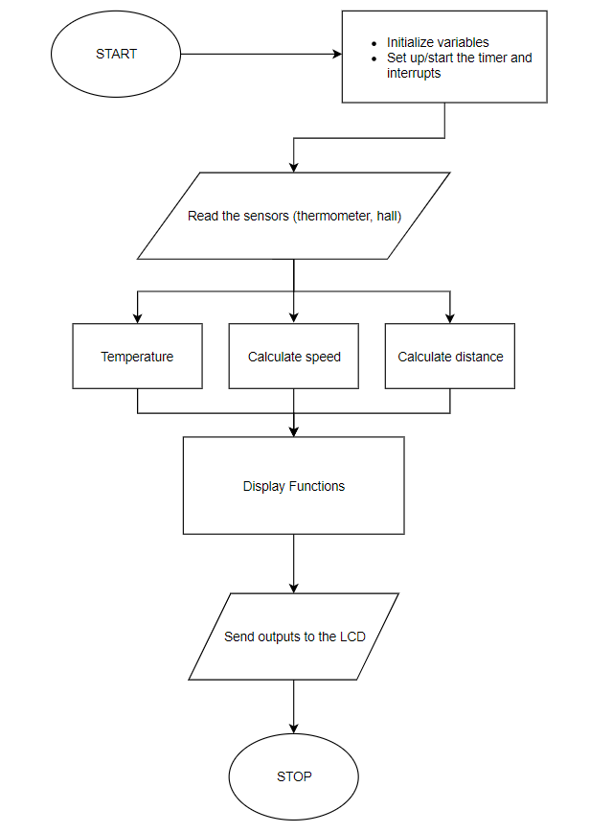
Software Functionality
Input from:
Reed Sensor
TMP 235 Temperature Sensor
RFID Module
Lights
Code written in the C language
Developed and tested within Code Composter Studio (CCS) environment
Notes:
Sandy

Slide 31
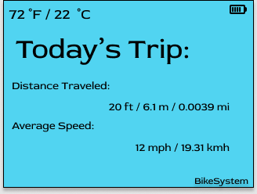
User Interface Prototype
Simple design to avoid user/rider distraction
Metrics such as the temperature, current trip distance and current trip average speed are constantly updated and displayed on the LCD
Final user interface will be similar to this, not exactly what is shown
Notes:
Sandy

Slide 32
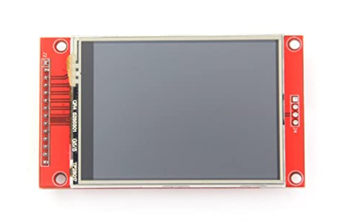
LCD
HiLetGo IL19341
3.3 V operating voltage
Resolution: 240 x 320
Dimensions: 43.2 mm x 57.6 mm
Notes:
Sandy

Slide 33
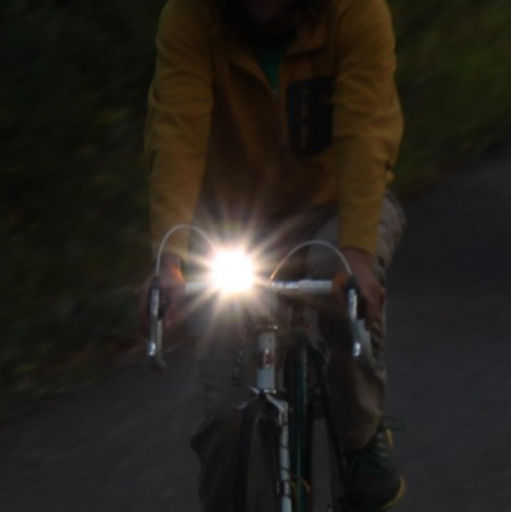
LED Lights
Provide a deterrent from motor vehicles
Provide light for the rider
Efficiently use power resources
Currently being tested
Notes:
Danny

Slide 34
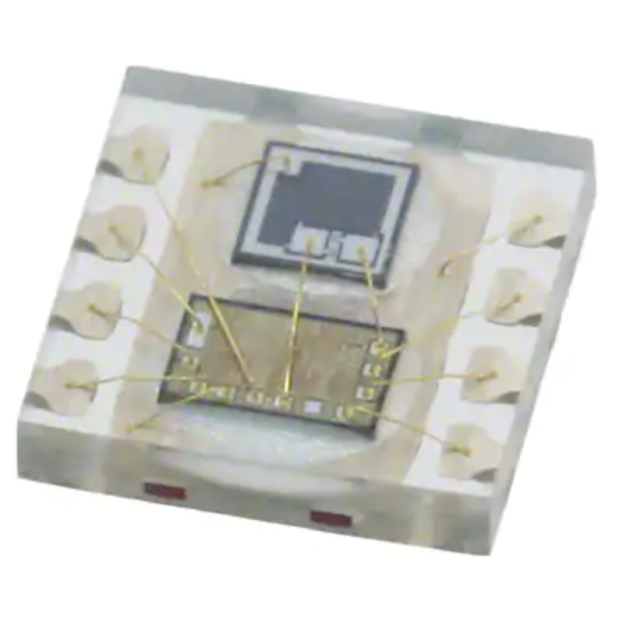
LED Lights Features
Ambient light detection
Auto dimming
Driver for LED’s
Manual On/Off switch
Notes:
Danny

Slide 35
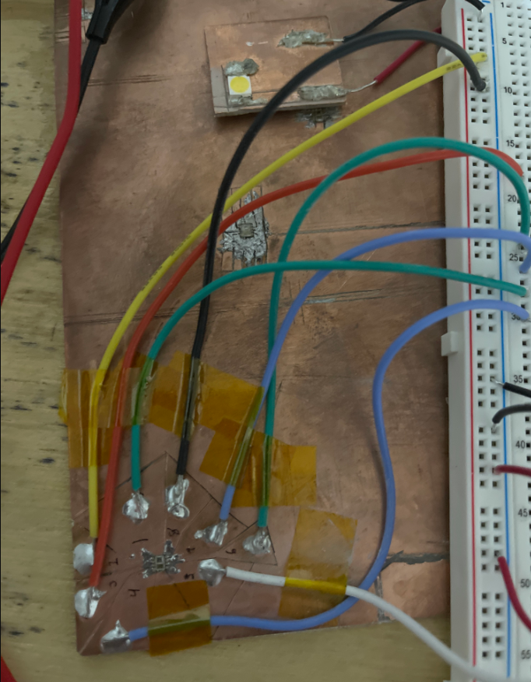
LED Lights Testing
Notes:
Danny

Slide 36
Administrative Content

Slide 37
Work Distribution
Group Member | Power Circuitry | Locking Mechanism | Temperature Sensor | Code | UI Design | RFID | Reed Sensor | Lighting | PCB Schematics
Keegan | Primary |  |  |  |  |  | Secondary |  | Primary
Daniel |  | Primary |  | Primary |  |  |  | Primary | Secondary
Benjamin |  | Secondary |  | Secondary |  | Primary | Primary |  | Secondary
Sandhya |  |  | Primary | Primary | Primary | Secondary
Notes:
Sandy

Slide 38
Budget
Item | Price/Unit | Quantity | Total Price
Bicycle | N/A | 1 | Already Acquired
Microcontroller | $9.99 | 1 | $9.99
Hall Sensor | $0.75 | 10 | $7.49
Reed Sensor | $2.90 | 3 | $8.70
Dynamo | $20.24 | 1 | $20.24
LCD | $13.99 | 2 | $27.98
LED Lights | $15.92 | 2 | $31.84
Safety Harness | $10.99 | 1 | $10.99
Seat Belt Assembly | $20.00 | 1 | $20.00
Temperature Sensor | $31.13 | 1 | $31.13
Alternate Temperature Sensor | $1.81 | 6 | $10.88
Lithium-Ion Battery | $21.49 | 1 | $21.49
Housing Lock | $25.66 | 1 | $25.66
Housing Fabrication | $15.00 | 1 | $15.00
Final PCB w/ Integrated Circuit | $16.80 | 1 | $16.80
RFID Module | $12.79 | 1 | $12.79
Circuit Components | N/A | N/A | $111.12
Magnets | $2.95 | 10 | $29.53
Antenna Prototype | N/A | 5 | $26.00
Arduino Kit | $17.98 | 1 | $17.98
SunFounder RFID Kit | $6.99 | 1 | $6.99
5V Electromagnet | $15.64 | 1 | $15.64
Ambient Light Sensor | $18.17 | 1 | $18.17
TOTAL |  |  | $496.41
Notes:
Sandy

Slide 39
Current Project Progress
Notes:
Sandy

Slide 40
Next Steps
Issues
Plans for Success
Lack of access to proper equipment and experience in characterizing antenna parameters
Switch programming languages to accommodate existing libraries
Meet with advisor(s) for guidance
Continuation on finishing the code
Notes:
Ben/Sandy

Slide 41
Thank you

