Slide 1



Power Systems Knowledge Hub
Senior Design - Spring 2021
Group 19
Ivelisse Rivera - EE
Christopher Marks - EE
Hector Collazo - CpE
Christy Wilhite - CpE
Sponsored by:

Slide 2
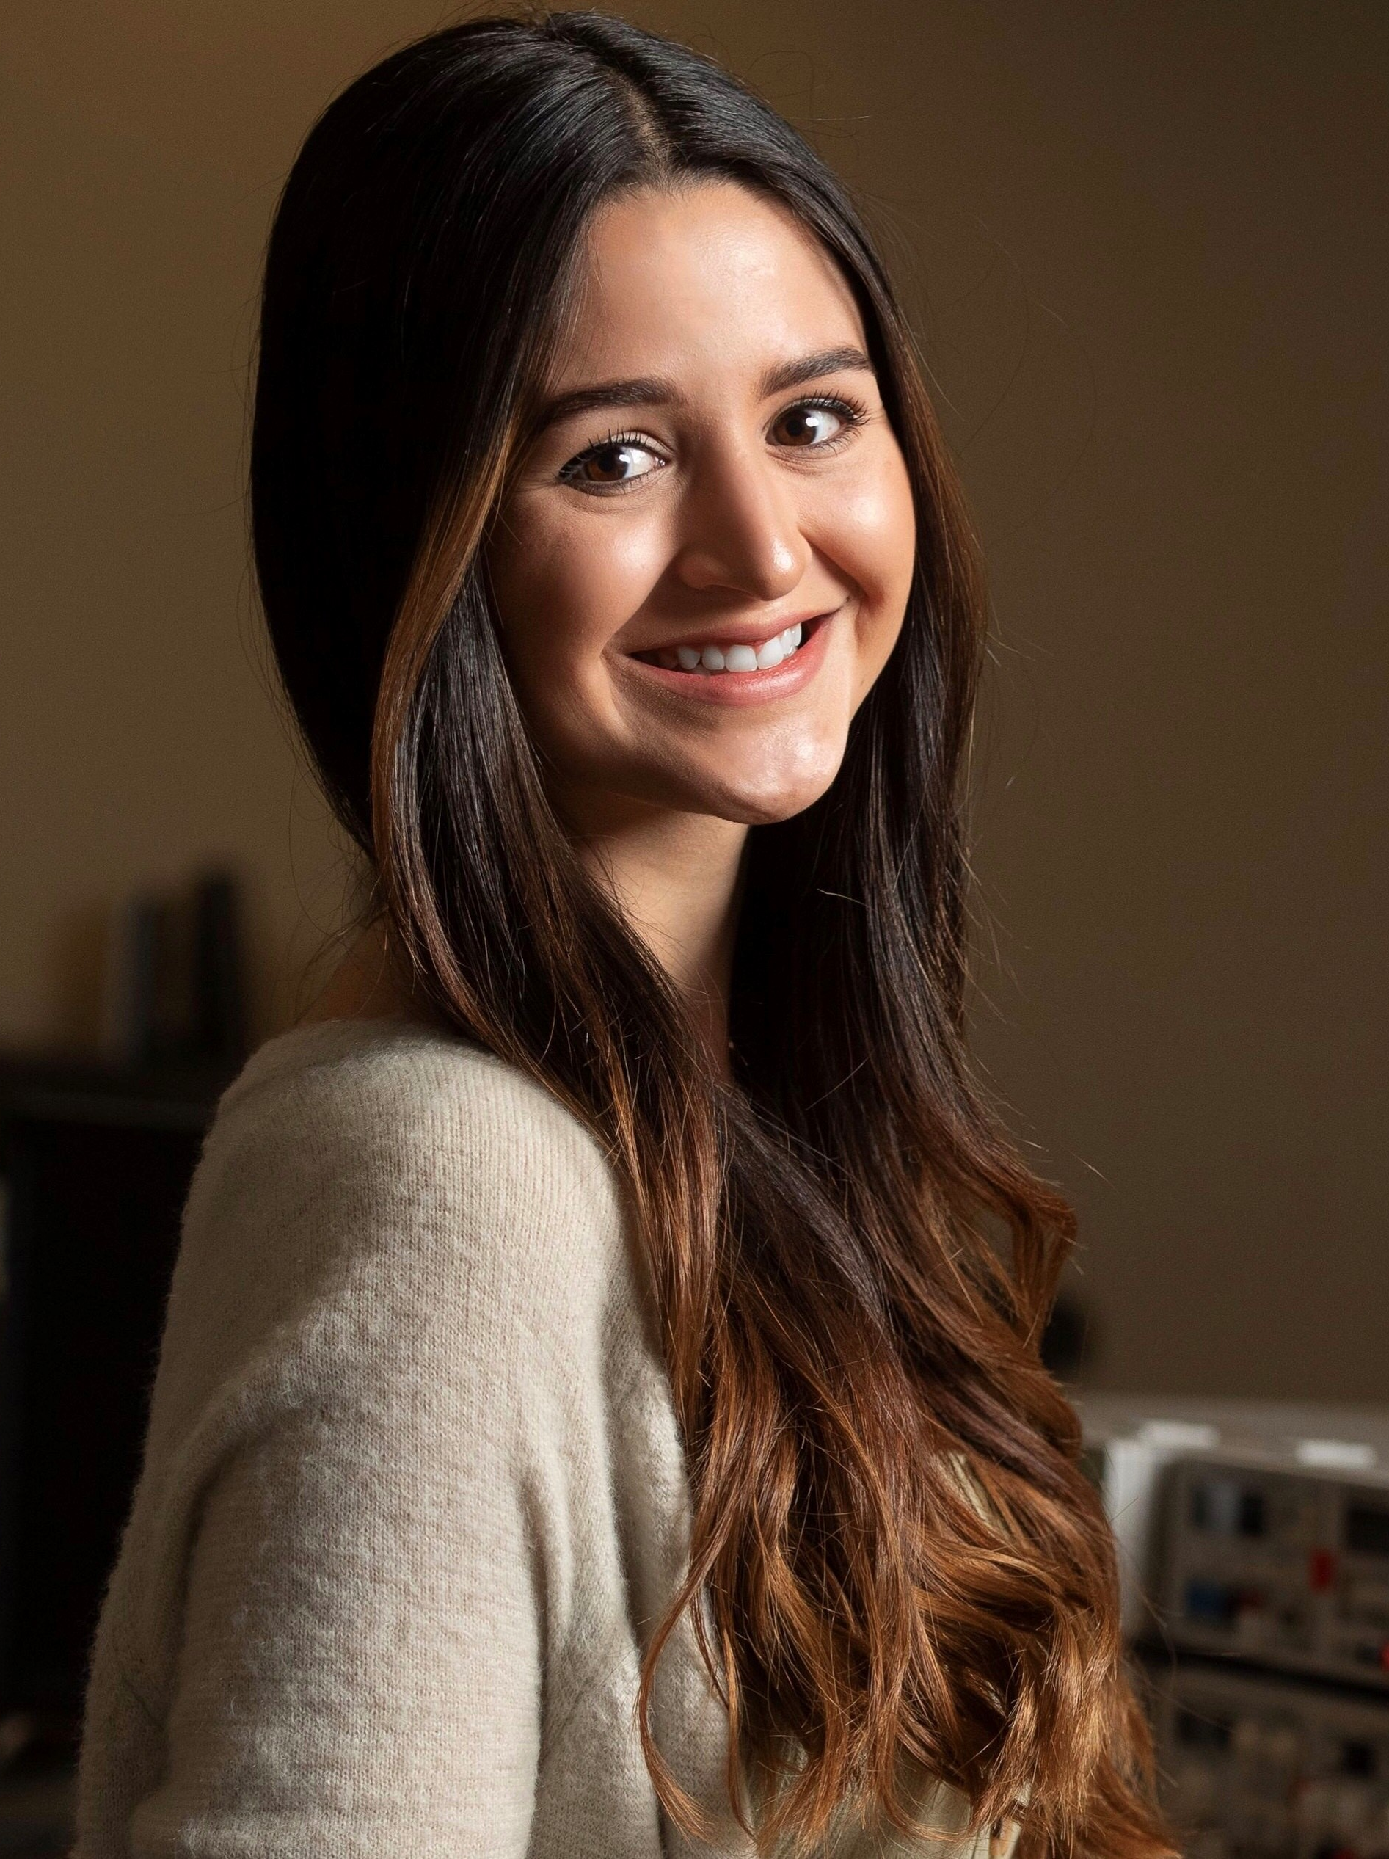


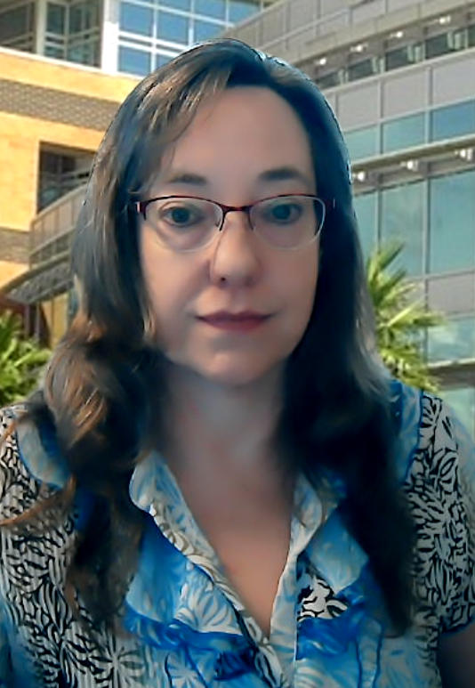
Our Team
Ivelisse Rivera - EE
Christopher Marks - EE
Hector Collazo - CpE
Christy Wilhite - CpE

Slide 3
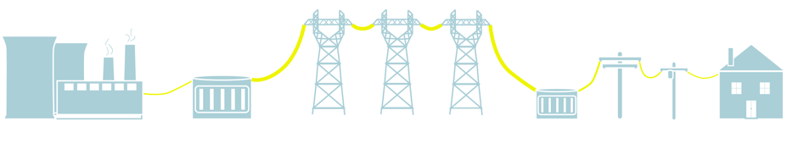
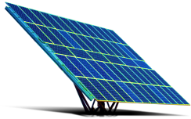
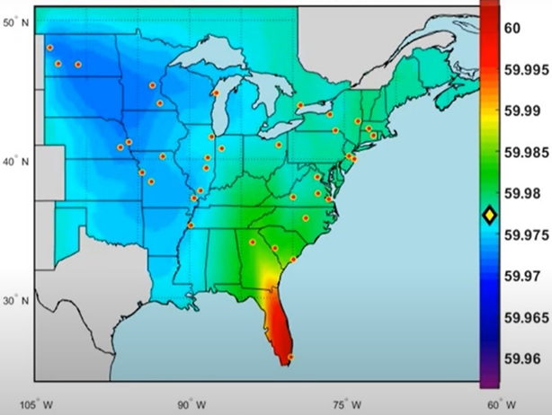
Motivation
The grid-of-the-future is becoming increasingly complex to manage
Development of methods that will enable better monitoring and management of the grid are needed
On January 11th, 2019 there was a frequency event on the eastern interconnect
WAMS (Wide Area Management System)
There has been a decline in the number of students graduating with degrees that specialize in power systems
More interactive learning methods about power systems are necessary
Generation
Transmission
Distribution

Slide 4
Goals and Objectives
Promote interest in power systems related engineering education
Emphasize the importance of increasing situational awareness in the distribution grid
Goal Type | Description
Basic | Interactive touch table that allows users to change the angle of the solar panel and see how that affects its power output. The table will also display educational material about power systems.
Advanced | Interactive touch table displays a simulation of a real-time distribution system with the use of OPAL-RT.
Stretch | User initiates a disturbance in the simulated distribution system and WAMS (Wide Area Management System) algorithm analyzes the data and determines the type of disturbance and its location.
Notes:
This project will consist of an interactive touch table where users can learn about the power grid by interacting with a real-time simulated distribution system and a solar panel.
SOLUTION!!!

Slide 5
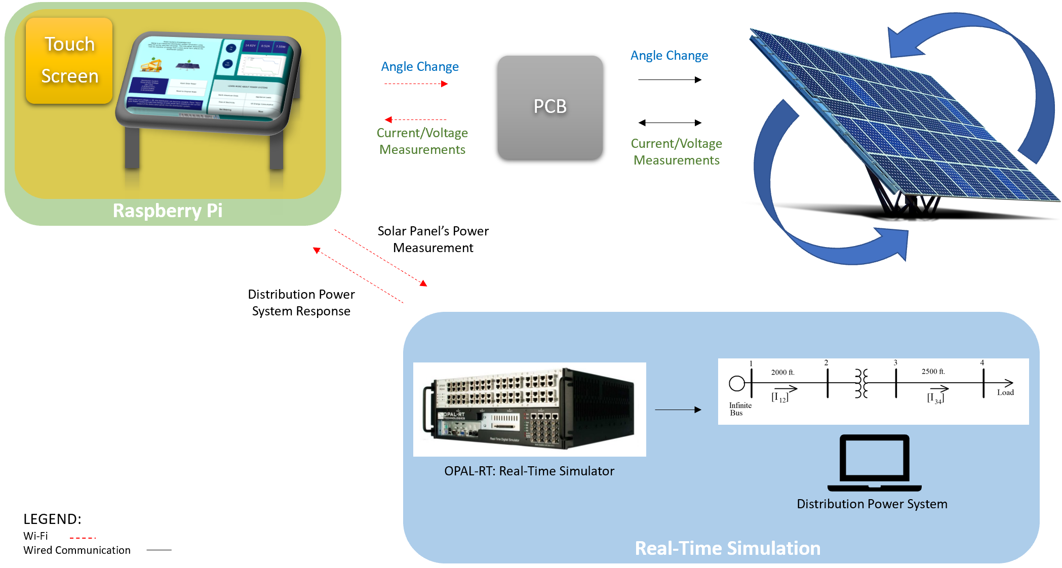
Project Overview

Slide 6
Engineering Requirements and Specifications
Parameter | Specifications
Current and Voltage measurement accuracy | <5% error
PCB Current Input Capacity Support up to 6 A | PCB Current Input Capacity Support up to 6 A
PCB Voltage Input Capacity | 0- to 18-V input voltage support for PVs
Wireless functionality | Ability to transfer data wirelessly in UCF’s 2.4 GHz network
Angle change response time | <12s

Slide 7
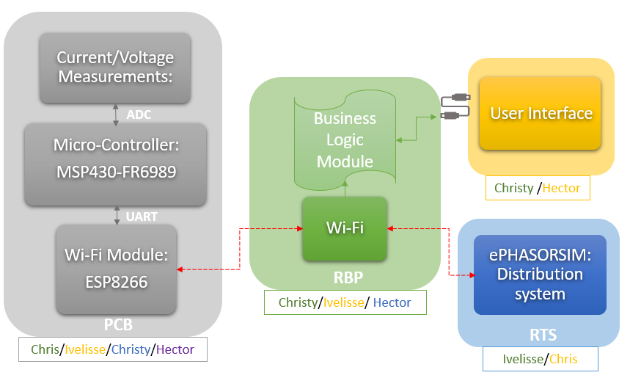
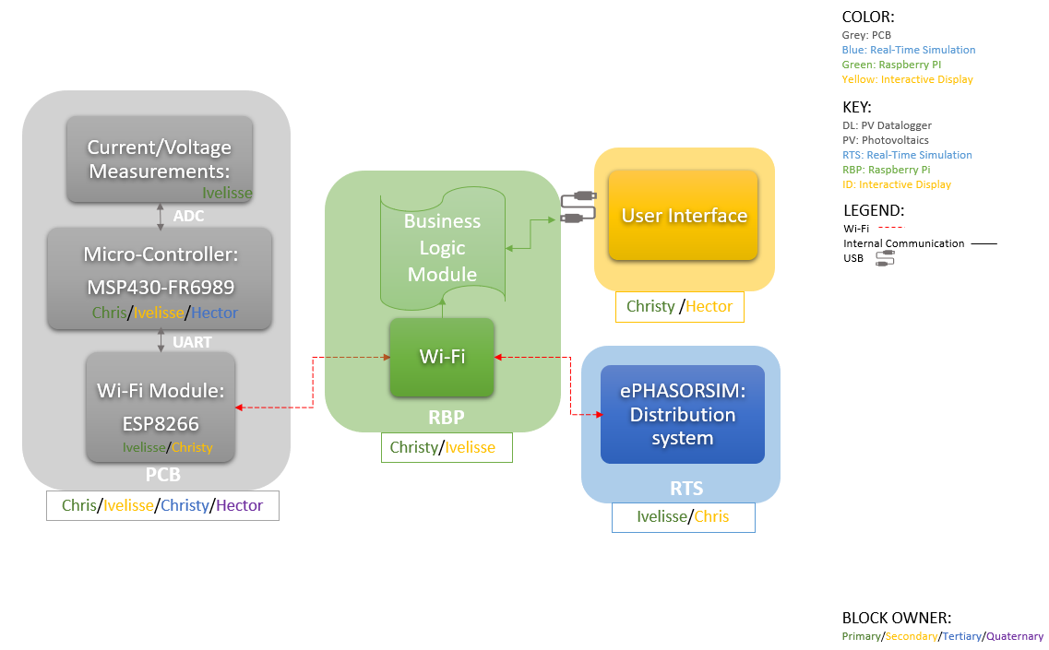
System Architecture
BLOCK OWNER:
Primary/Secondary/Tertiary/Quaternary

Slide 8
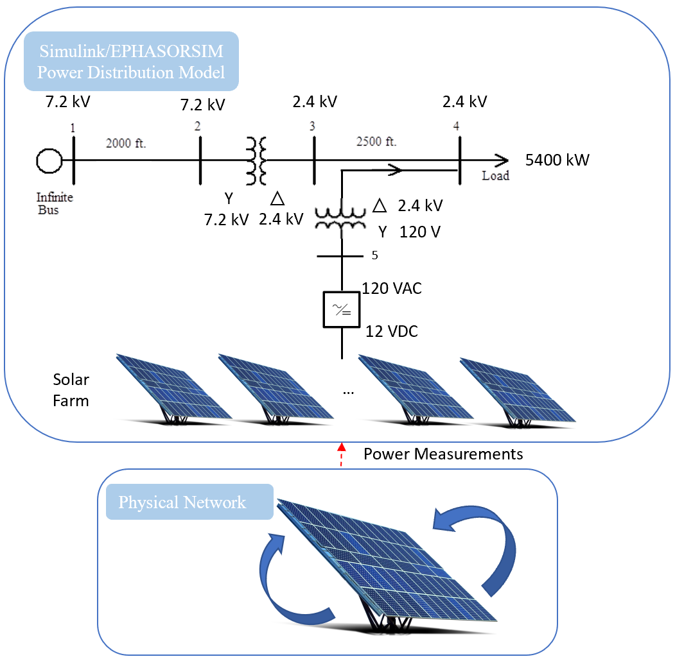
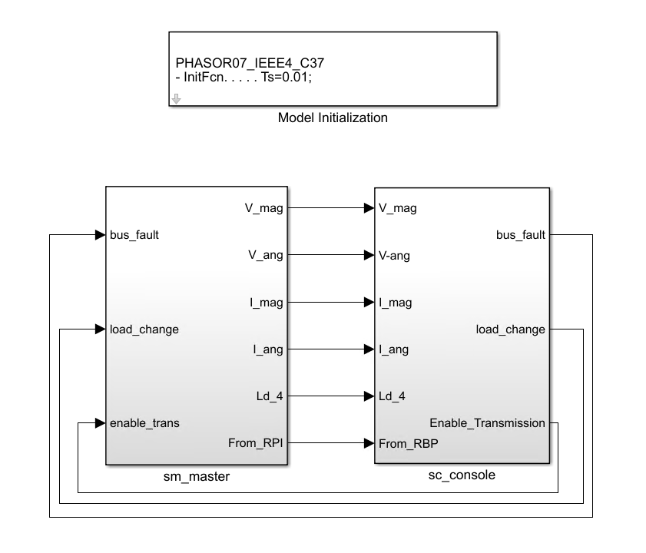
Distribution System Design
BLOCK OWNER:
Primary/Secondary/Tertiary/Quaternary
Notes:
L-N values

Slide 9
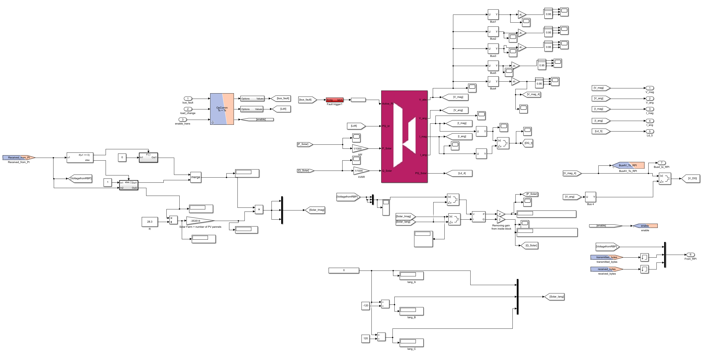
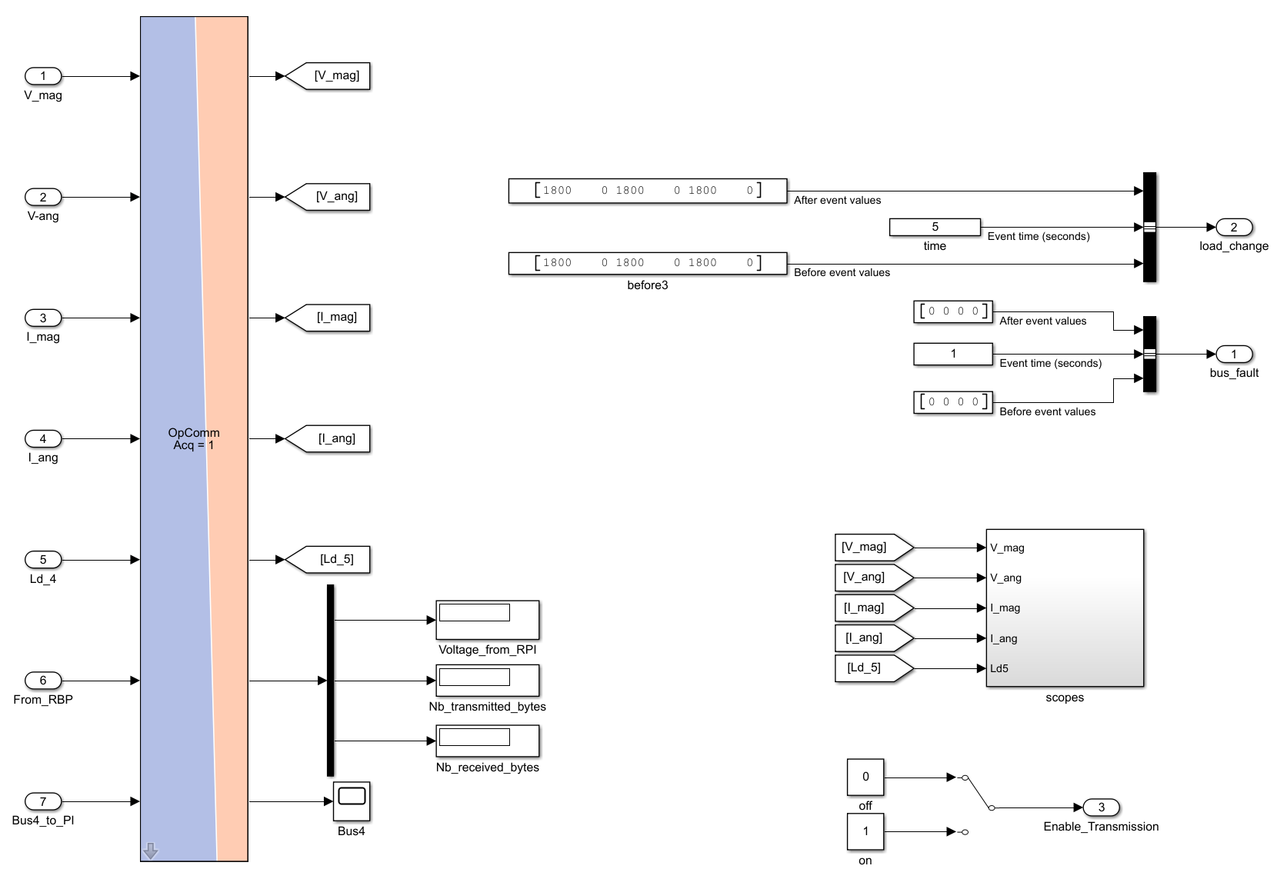
Real-Time Simulation
SM Master Subsystem
SC Console Subsystem
Distribution System
Power Measurements from RBP
Measurements sent
to RBP
DC-AC

Slide 10
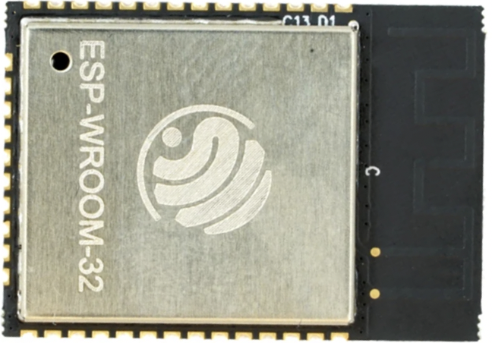
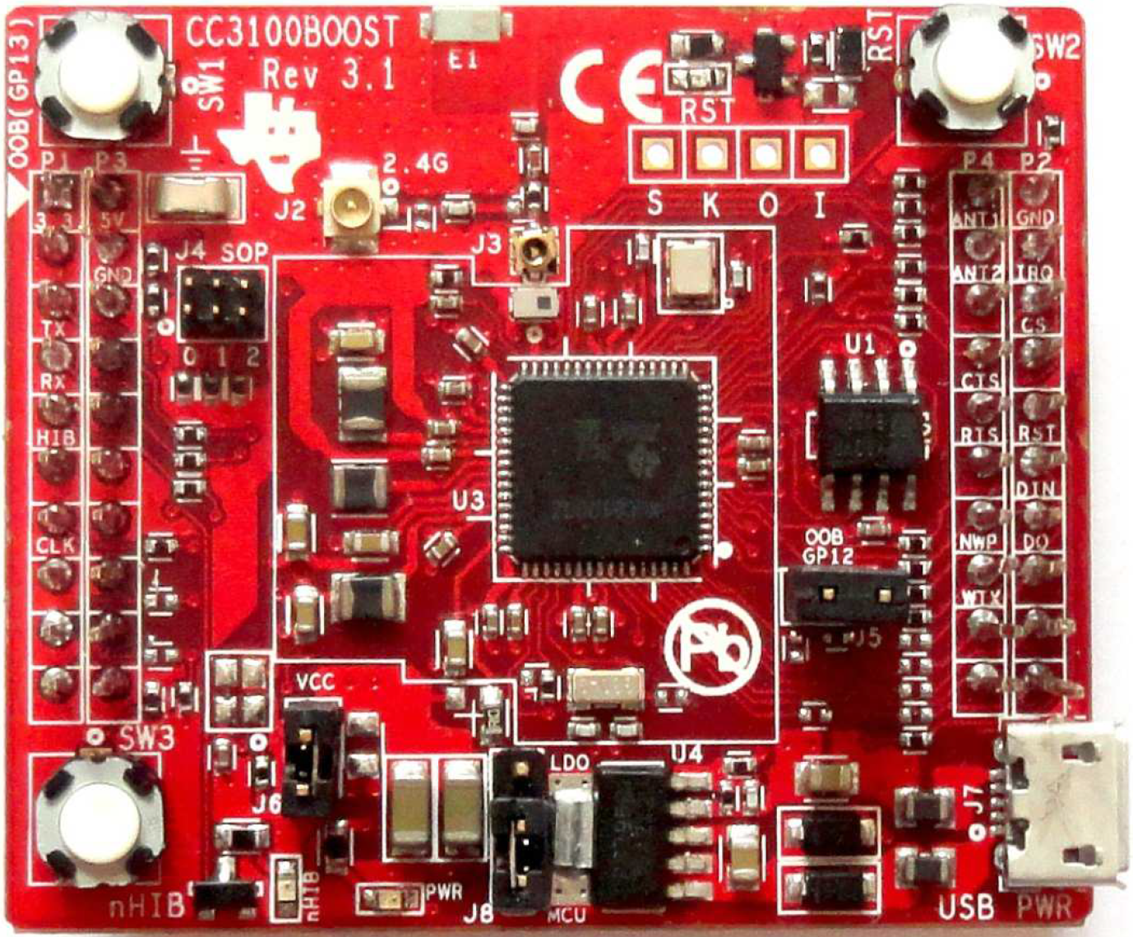
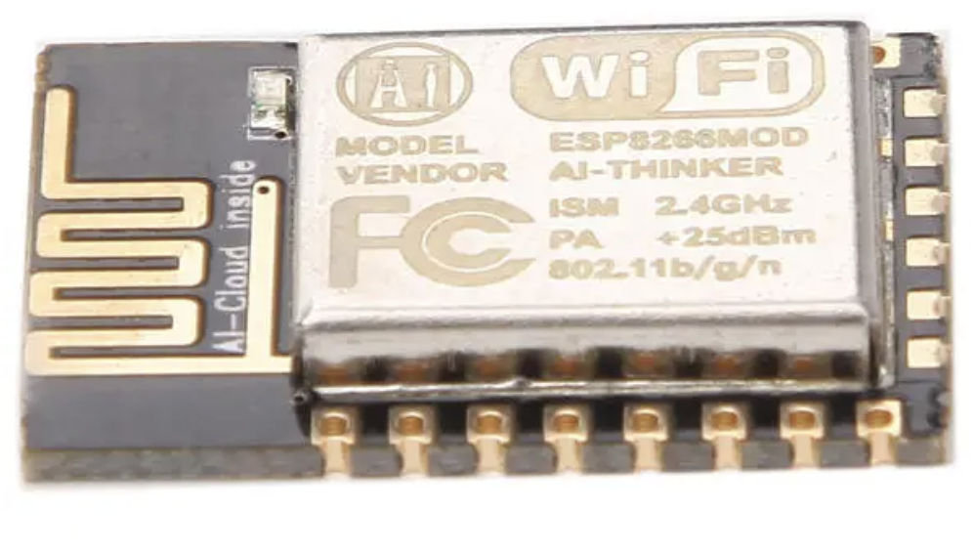

Parts Consideration: Wi-Fi
 | CC3100 | ESP8266-12E | ESP32
Feature | Wi-Fi | Wi-Fi | Wi-Fi, Bluetooth, Ethernet
Throughput | 16 Mbps/13 Mbps | 54 Mbps | 150 Mbps
Power Consumption | 4 uA – 272 mA | 10 uA - 170 mA | 5 uA - 240 mA
Op. Temperature | - 40C ~ 85C | - 40C ~ 85C | - 40C ~ 125C
Programming method/IDE | C/Code Composer Studio (CCS) | C/Arduino/Energia | C/Arduino/Energia
Cost | $23.99* | $7.66 | $4.50 - $5.20
* BosterPack price

Slide 11
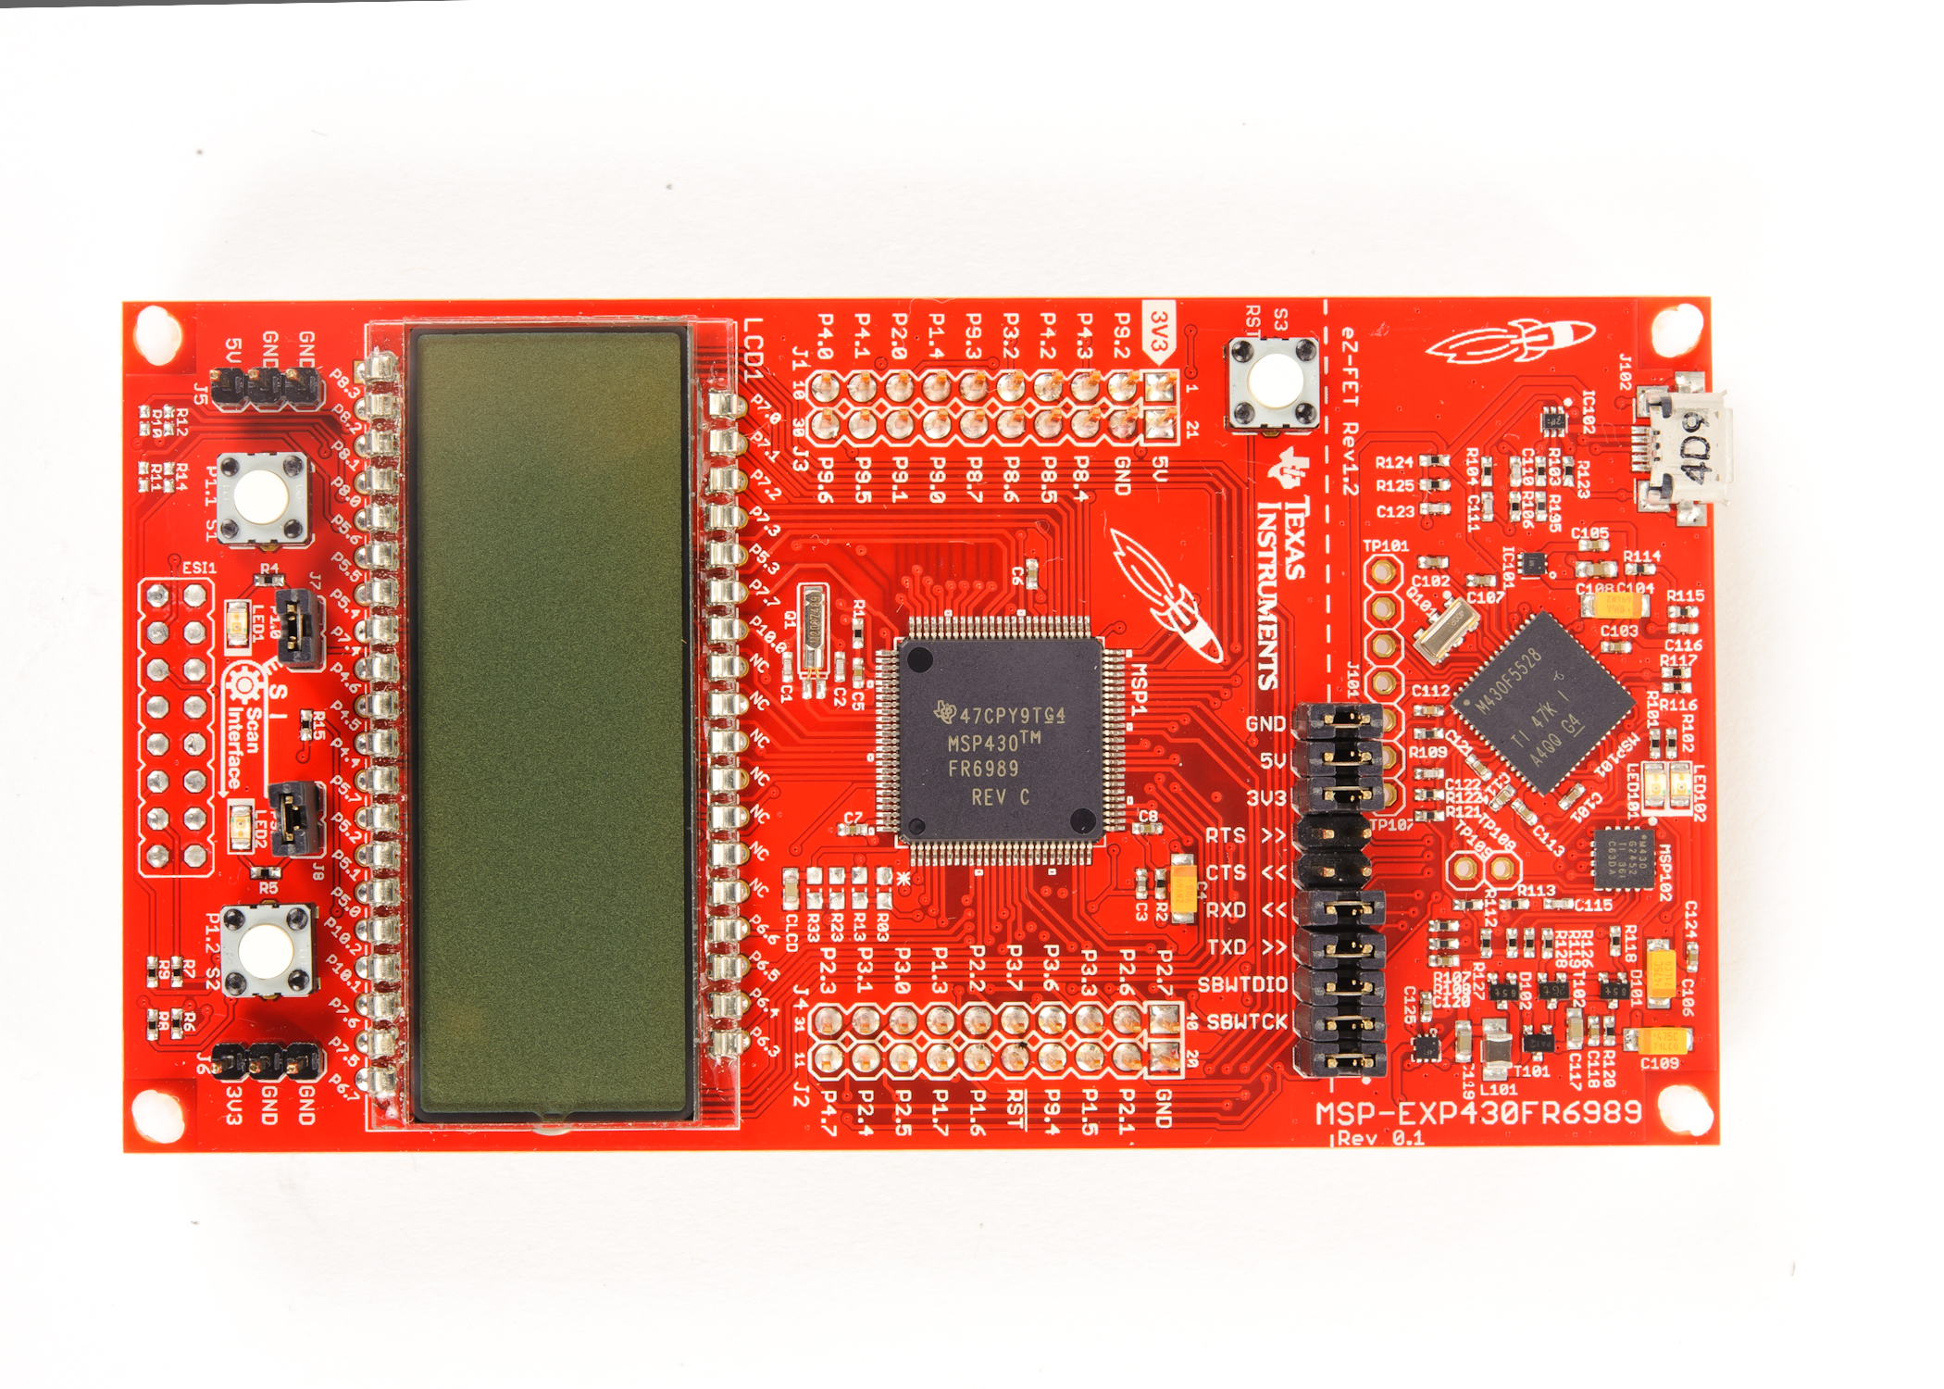
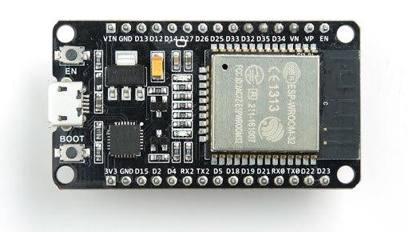
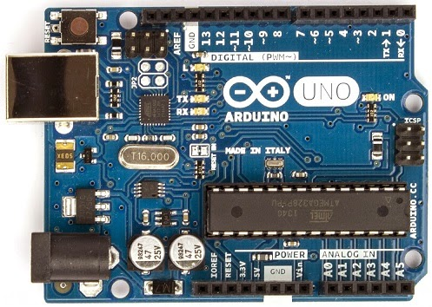
Parts Consideration: Microcontroller
 | MSP430FR6989 | ESP32 | ATMEGA328P
Power Modes | Yes (7) | Yes (6) | Yes (6)
FLASH | 128 KB | 0 - 4 MB | 4 - 32 KB
Programming/IDE | C/CCS | C/Arduino/Energia | C/Arduino/Energia
Op. Voltage | 1.8 V – 3.6 V | 2.3 V – 3.6 V | 1.8 V - 5.5 V
Power consumption | ~100 uA/MHz | 5 uA - 240 mA | 0.1 uA - ~200 uA
Cost | $9.46 | $4.50 - $5.20 | $6.99
Op. Temperature | -40 ~ 85C | -40 ~ 105C | -55C – 125C
MSP430FR6989 LaunchPad (LP)
ESP32 LP
Atmega328P LP

Slide 12
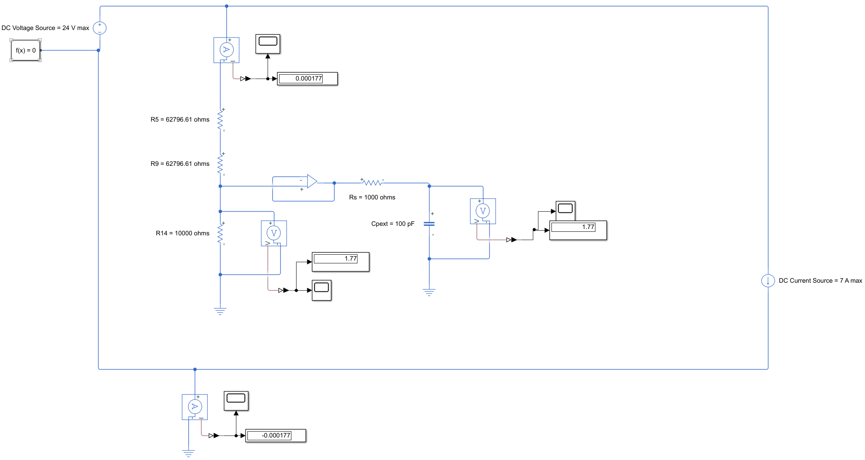
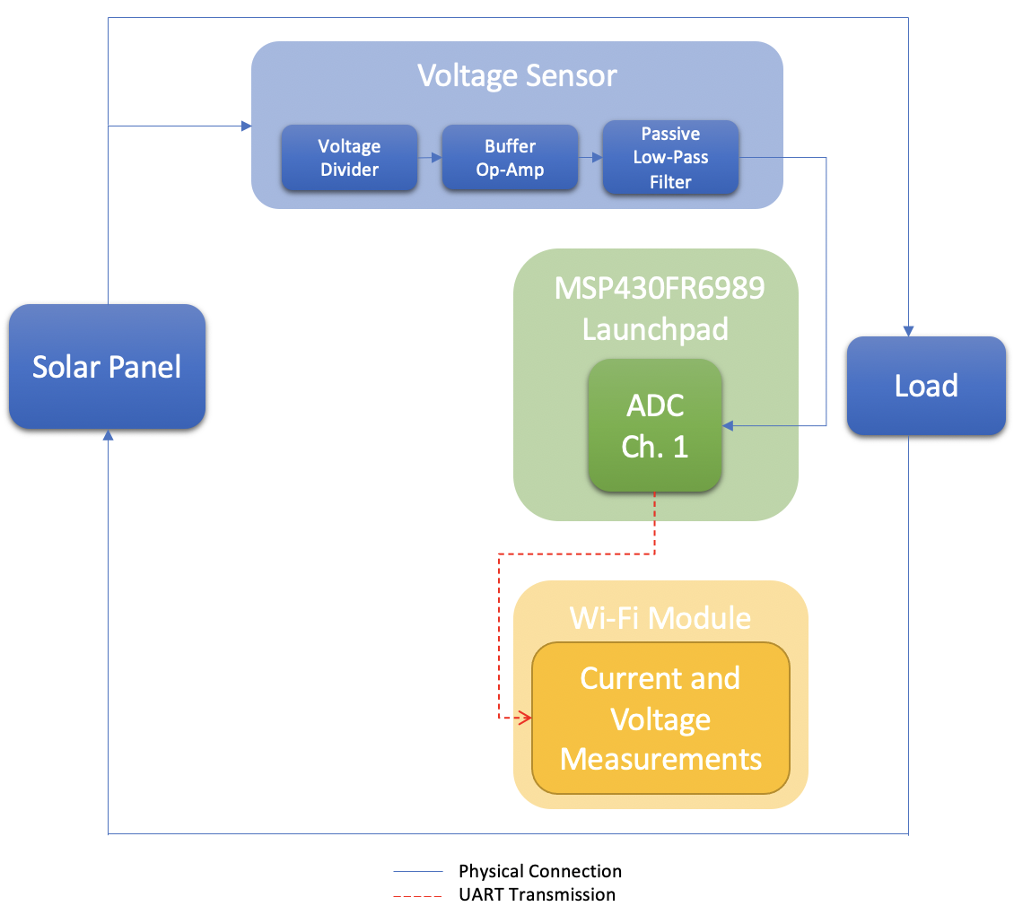
Measurement module: Current/Voltage
MATLAB Simulink Voltage Measurement Simulation
Block Diagram

Slide 13
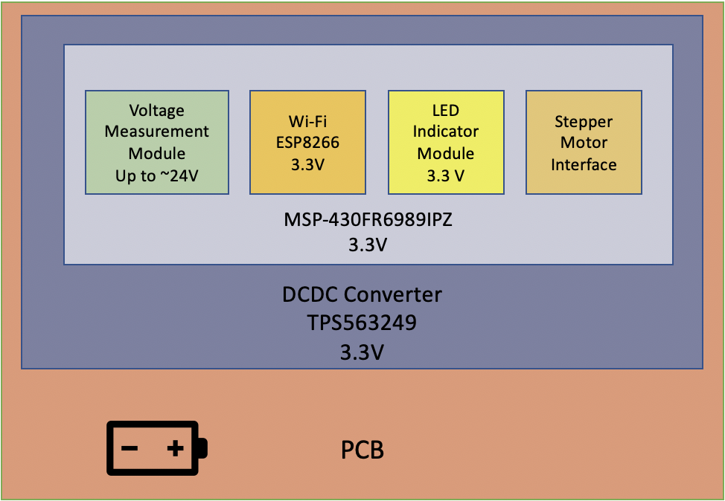
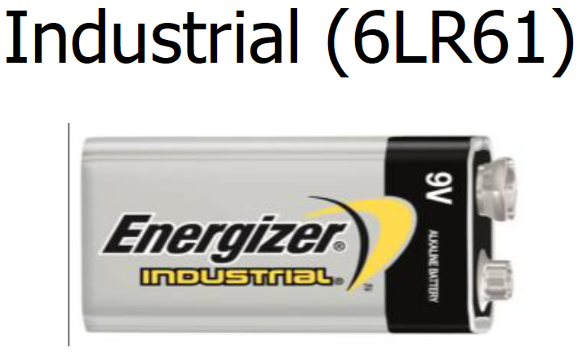
Power Consideration
Onboard Battery Source to power PCB
Went with a 9 V Alkaline Battery due to its energy density
Supplied all modules with enough current
All modules worked per specifications
Operate over wide temperature range: -18ºC to 55ºC

Slide 14
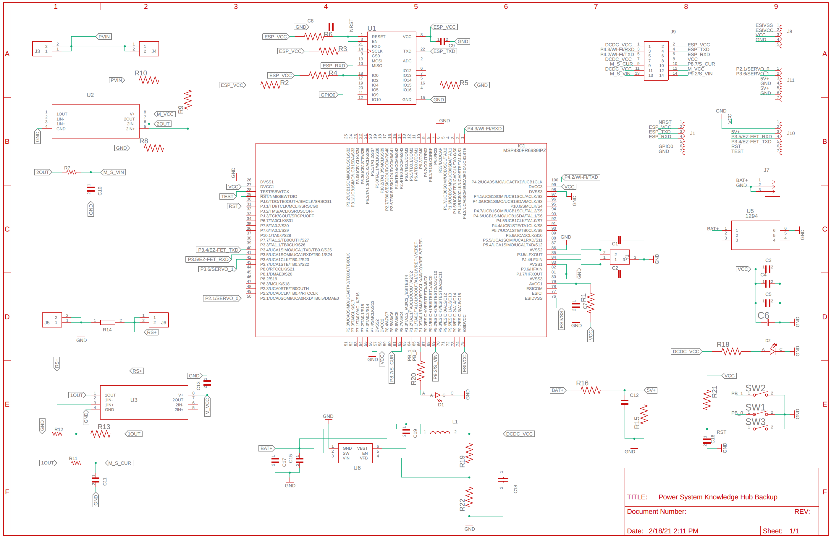

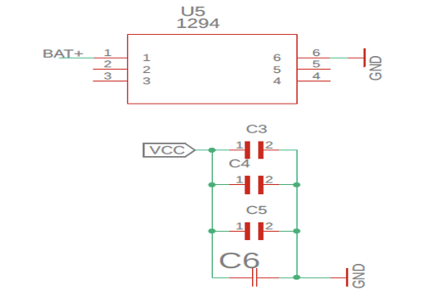
Schematic
Voltage Circuit
Wi-Fi: ESP8266 Circuit
Jumper Circuits
MCU Circuit
LED and Switches
DCDC Circuit

Slide 15
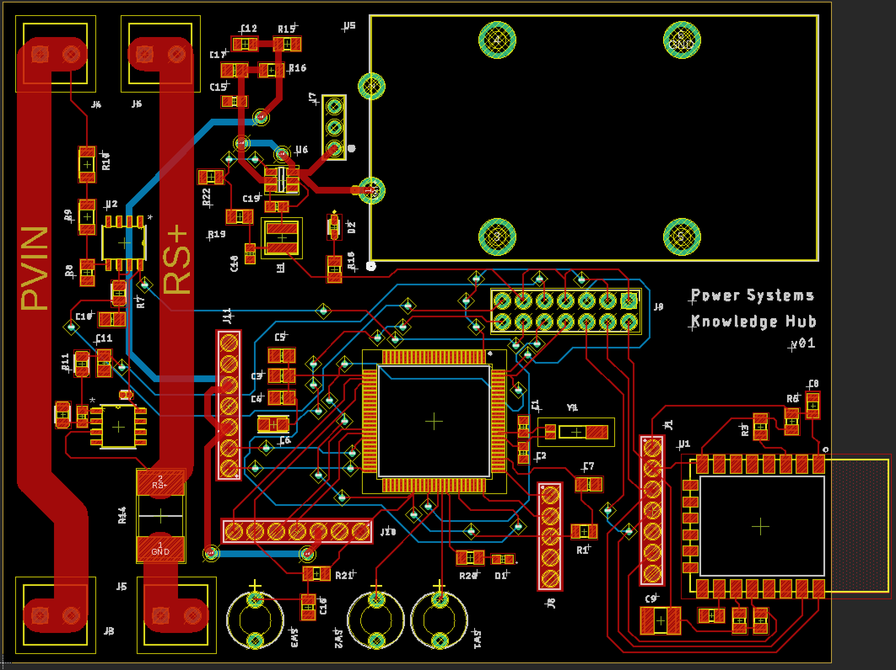
PCB (Printed Circuit Board)
Developed with Eagle
  Validate Design Rules
  Trace sizes
  Board dimension

Slide 16
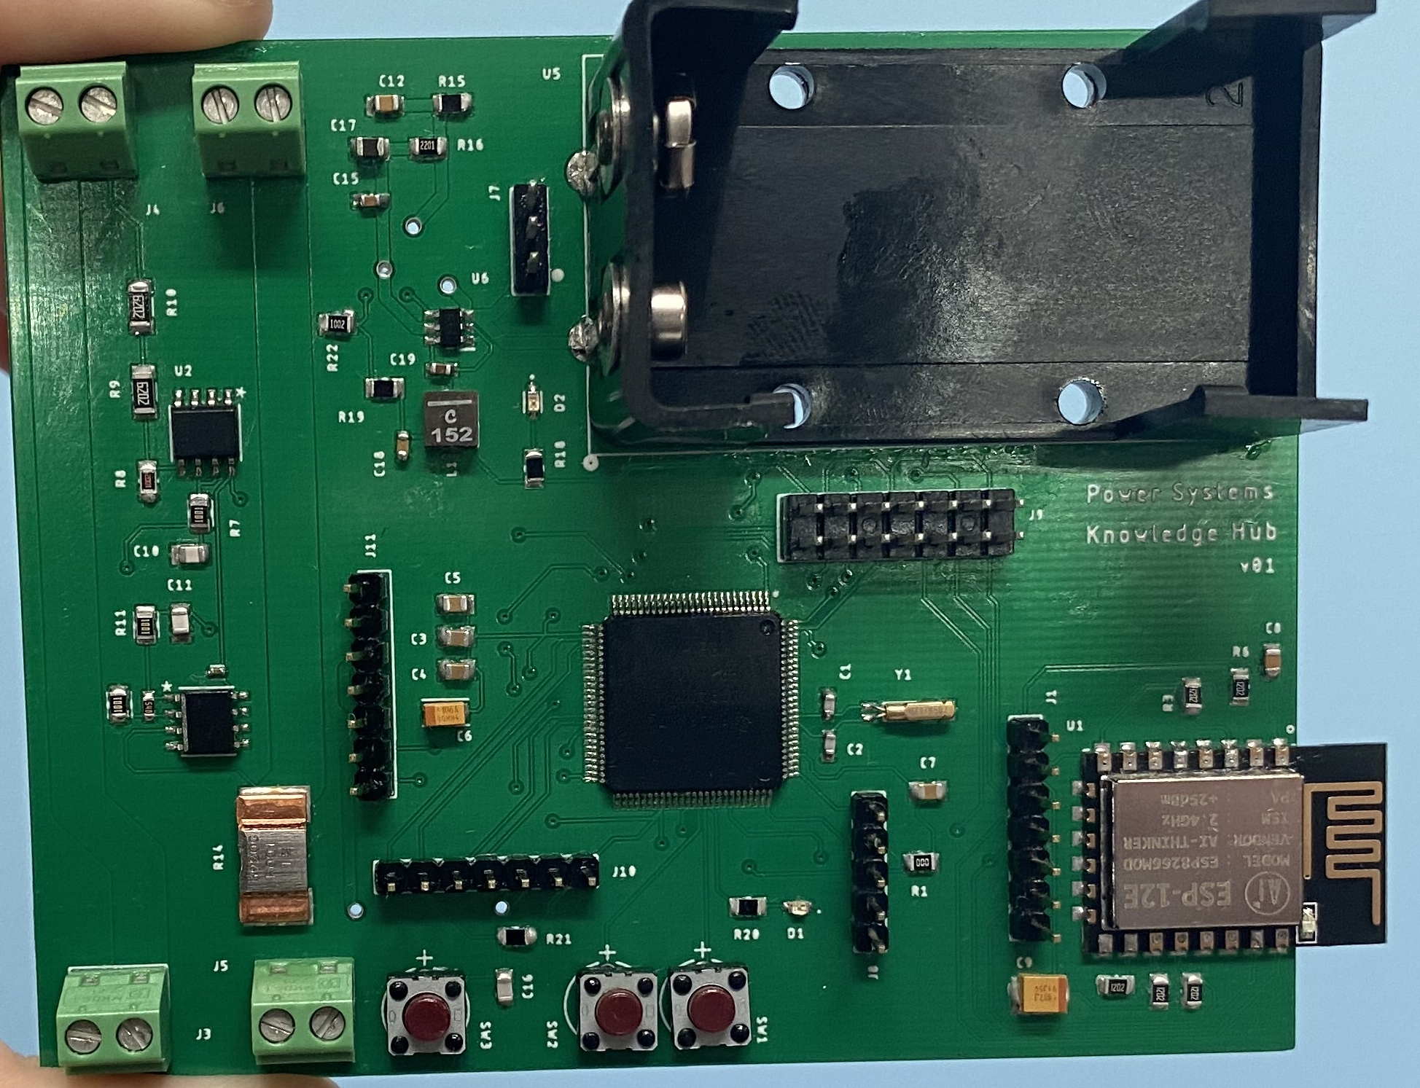
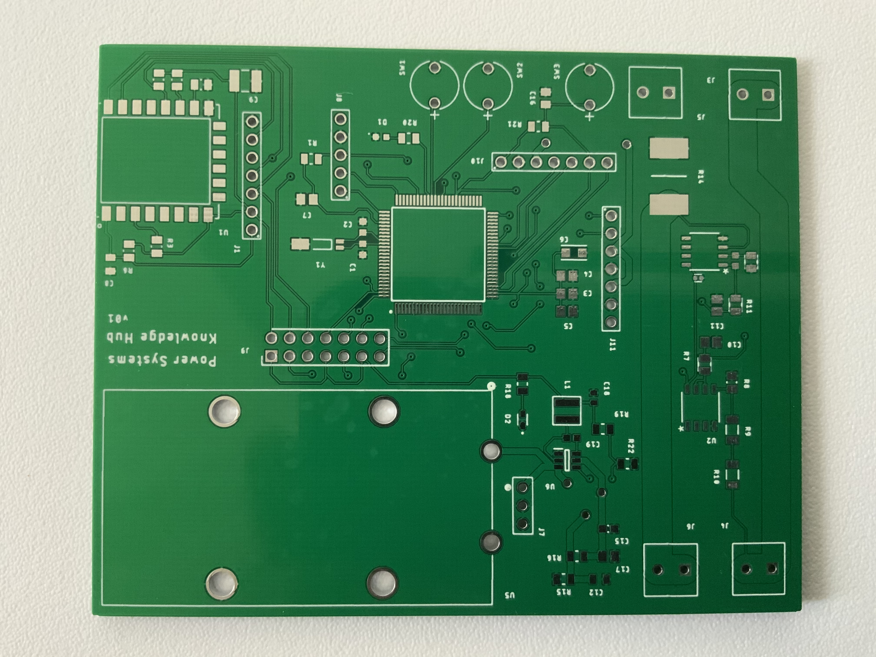
Manufactured PCB
Completed PCB
  Ordered via JLCPCB
Quality Manufacturing
  Contracted for soldering sensitive and small footprint components

Slide 17
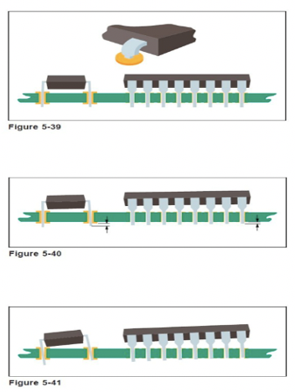
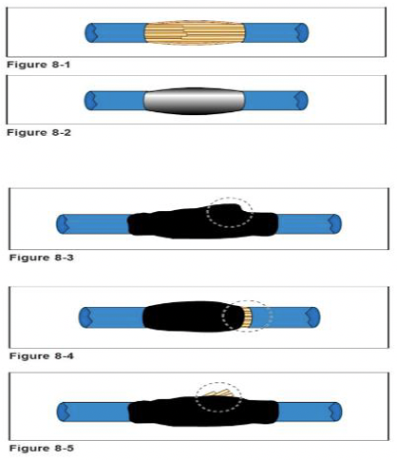
Standards
PCB Standards
  IPC-A-610
  IPC J-STD-001G
  JLCPCB
  JEDEC
    JEP155
    JEP157
  ANSI
    G30-88
Wi-Fi: IEEE 802.11b/g/n
Hi-Definition MMI: CTA-861-G
Serial (I2C, UART, SPI)
IEEE C37.118.2011
Ethernet: IEEE 802.3
Software Development
Mounting – Dual In-Line (DIP)/Single In-line (SIL) Pins & Sockets
Soldered Splices - Mesh

Slide 18
Constraints
Constraint | Description
Cost | Project must be cost effective
Hardware (Weather) | Selected parts must be able to perform at full capacity outdoors in variable temperatures
Time | Limited meeting time due to safety protocols of Covid-19 Pandemic
Resources | Some selected parts have limited data regarding use and integration
Quality | Quality of selected parts is essential for correct measurements and data collection
Notes:
Like every project we are facing a set of constraints that create boundaries around what we want to accomplish. Looking over some of the constraints we face as a team in the development of this project we see cost (try to execute our plans using the least amount of money as possible), hardware (which entails that all of the selected parts we use for our project must be able to perform in the irregular Florida weather and temperatures), time (which is a big constraint knowing that our opportunities to meet up and all work together are extremely limited due to the ongoing global pandemic), resources (which revolves more on the fact that documentation is limited for the collaborative use of some of our parts rather than the availability and accessibility of them), and quality (as we require as precise of data collection, data transfer, and movement as possible).

Slide 19
Parts Consideration: Motor Type
Motor | Advantages | Disadvantages
Stepper | Excellent Low Speed Torque Repeatability Overload Safe Good Choice for Applications Requiring Low Speed with High Precision | Torque Declines Rapidly with Speed Low Accuracy No Feedback is Used to Indicate Potential Missed Steps
Servo | High output power relative to motor size and weight High efficiency Encoder utilization provides higher accuracy and resolution with closed-loop control High torque to inertia ratio | requires tuning to stabilize the feedback loop unpredictable when something breaks Gear boxes are often required to deliver power at higher speeds can be damaged by sustained overload
Notes:
For our motor selection, we were drawn to two types of motors that would best perform for our intended use that provided the torque and precision needed to accomplish the task at hand. Here we have a table highlighting the key advantages and disadvantages that each motor type present. After initially choosing to use the servo motors, we ran into problems concerning the motors actual strength and what was needed to rotate the solar panel over a single axis. Thanks to Dr. Kurt Stresau from the Mechanical and Aerospace Engineering department on campus, we managed to perform an experimental measurement to exactly know the correct amount of torque required to move the solar panel from an angle of -40 degrees to 40 degrees utilizing the weight of objects and gravity to act as our applied force. Unlike servo motors, stepper motors provide continuous rotation giving us a wider range of structural designs to complete the task at hand. Based on this analysis and the tests made, we decided to move forward using the stepper motor.
We quickly noticed that even though the stepper motor allowed us repeatability and excellent torque, it’s low efficiency and low accuracy played against our quality constraint. On the other side, the servo motors disadvantages can actually be corrected utilizing some mechanical components such as gear boxes or pulley systems. Having that option of limiting the disadvantages along with high output, high efficiency and an integrated encoder for more precision turning were the key reasons of selecting a servo motor over a stepper motor.

Slide 20
Parts Consideration: Stepper Motor
 | Specifications
Type | Nema 23 | Nema 17
Operating Temperature | -10°C～50°C | -10°C～50°C
Rated Voltage | 3.78V | 2.8V
Rated Current | 4.2A | 1.68A
Step Angle | 1.8 ̊ | 1.8 ̊
Step Accuracy | +/-5.00% | +/-5.00%
Holding Torque | 30.5 kg/cm | 20.3 kg/cm
Notes:
When it came down to selecting a stepper motor, Dr. Kurt Stresau provided us the necessary information and the best two options he had available to lend us in order to carry out our project. These two options are depicted here: the nema 23 and the nema 17. Clearly, we can see a big difference in the holding torque, which is our biggest factor when selecting motors, where the nema 23 is almost 1.5 tims stronger than the nema 17. This made our option to move forward with the nema 23 much easier.

Slide 21
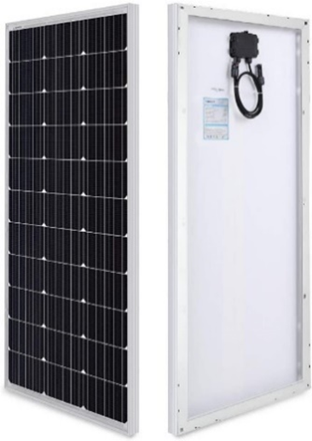
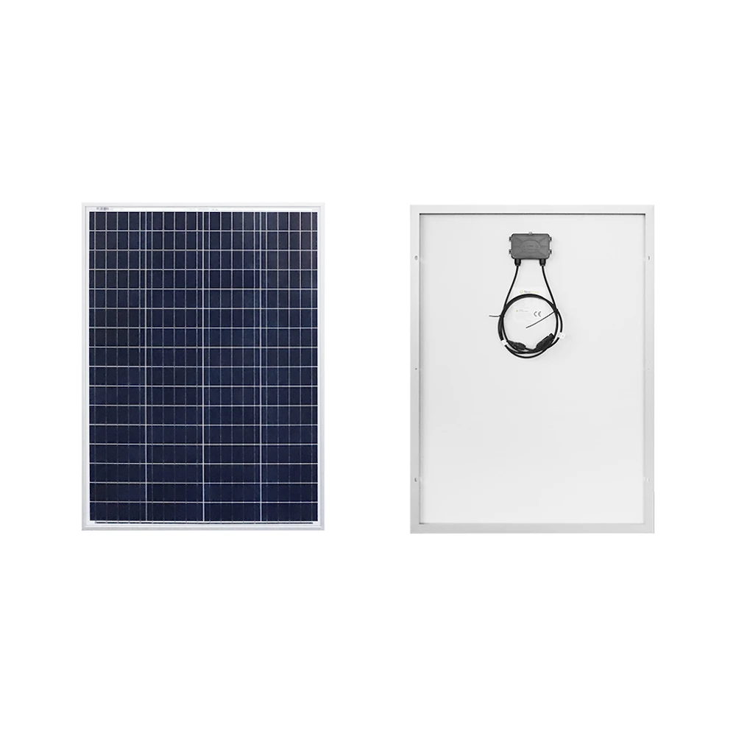
Parts Consideration: Solar Panel
 | Specifications
Type | Renogy | NewPowa
Price | $101.73 | $75.00
Maximum Power | 100 W | 100 W
Optimum Operating Voltage | 17.9V | 17.2V
Optimum Operating Current | 5.72A | 5.81A
Operating Temperature | -40°F to 176°F | -40°F to 185°F
Solar Cell Type | Monocrystalline | Polycrystalline
Weight | 14.3 lbs (6.5 kg) | 15.43 lbs (7 kg)
Dimensions | 42.2 x 19.6 x 1.38in | 35.83 x 26.57 x 1.18in
 | (1074 x 498 x 35mm) | (910 x 675 x 30mm)
Cell Efficiency | 21% | Class A High Efficiency
Renogy NewPowa
Notes:
Now let’s talk about our solar panel. We highlight on this table the two best options we found on the market. As we can see here, there is a slightly bigger difference in price with the renogy being the more expensive option, however after further research into their cell types, we noticed a big difference in performance and efficiency. Monocrystalline offers higher efficiency and longer lifespan over polycrystalline. Taking this into account along with the lighter model we decided to utilize the renogy monocrystalline solar panel for our project.

Slide 22
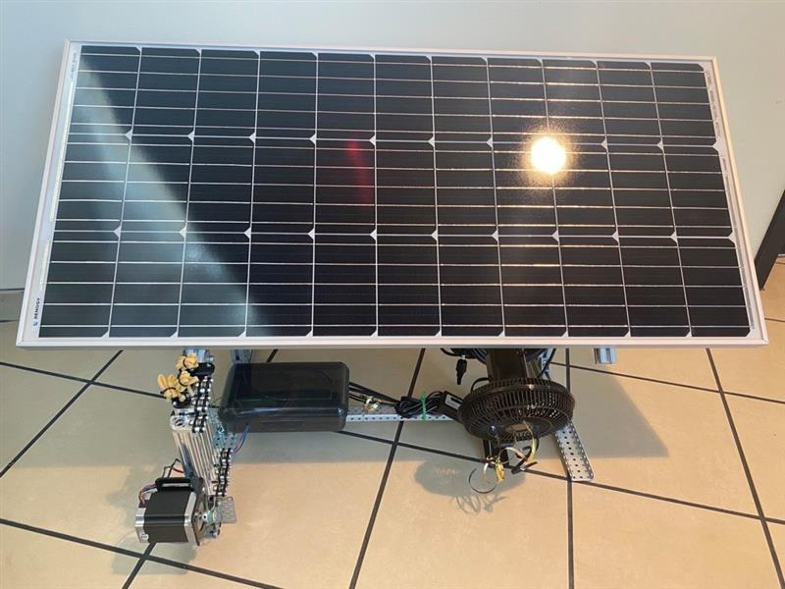
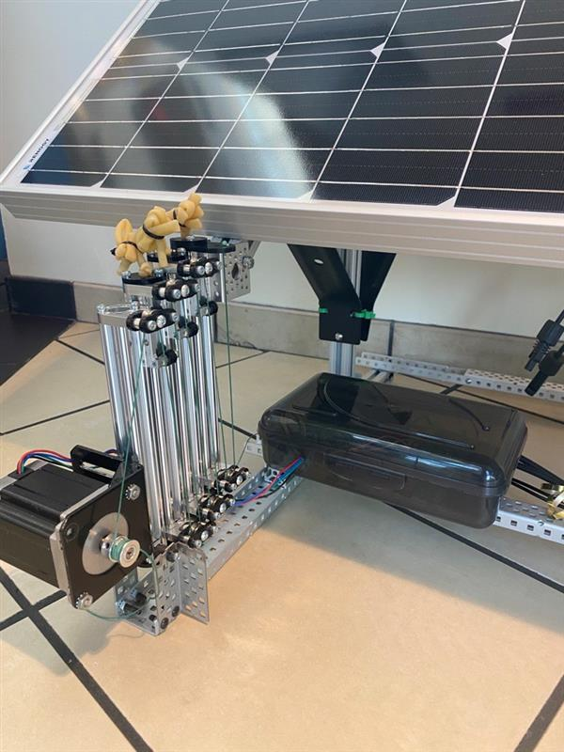
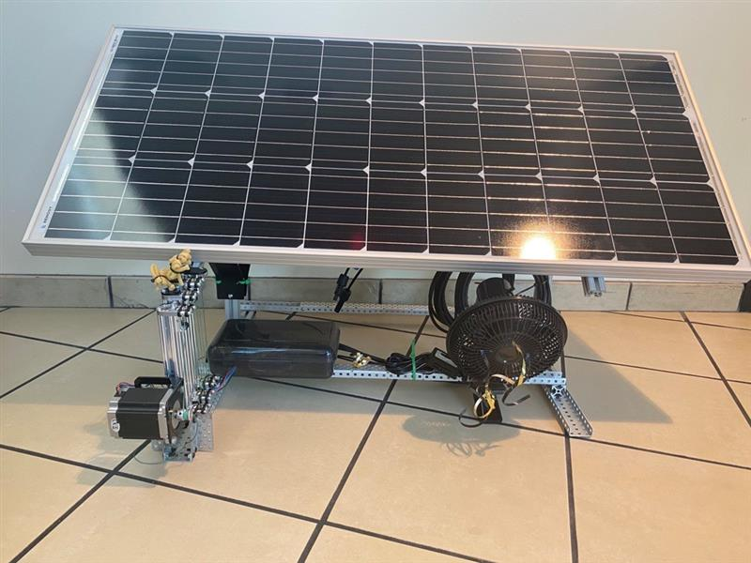
Solar Panel Mount Design
Final Design
Design Details
Mount utilizes 80/20 aluminum extrusions and aluminum C-Channels as main support
Motor located at base of cascade pulley system
Cascade pulley system acts as linear actuator to push and pull solar panel
Limits of cascade pulley system and metal braces provide passive mechanical stop at extreme points
Notes:
For our solar panel mount design, we wanted to go with a simple approach with a structure similar to that of a drafting table. This design utilizes 80/20 aluminum extrusions and aluminum C-Channels utilized in VEX Robotics as the primary support pieces of the mount which could easily hold the weight of the solar panel. We placed the motor on the base of the cascade pulley system. The pulley system, depicted better on the right most picture here, was constructed using small 80/20 aluminum extrusions. The design works as a linear actuator pushing and pull the solar panel by a single point on the bottom left hand side. This is made possible by winding and unwinding a string attached to the bottom part of the first extrusion making its way back to the motor. By winding the string the aluminum extrusions slide up pushing the solar panel. The pattern the string goes through each of the extrusions allows it to distribute the weight evenly making it easier for the motor to move the solar panel even if the motor itself is not strong enough to do so. This pulley system provides a 1:4 ratio to provide more torque while sacrificing speed. The solar panel was also elevated only a foot from the ground for a low center of mass to provide a sturdier base.

Slide 23
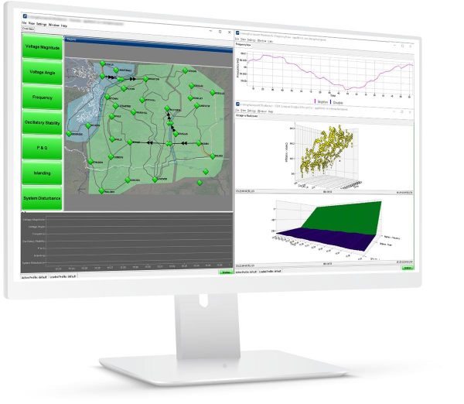
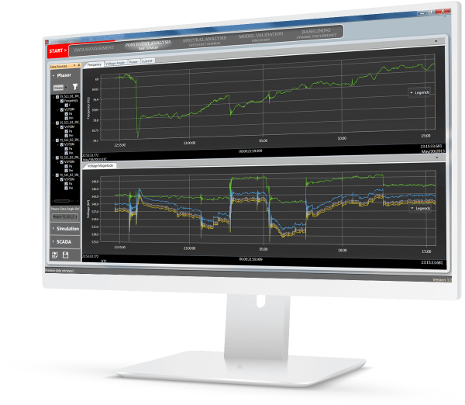
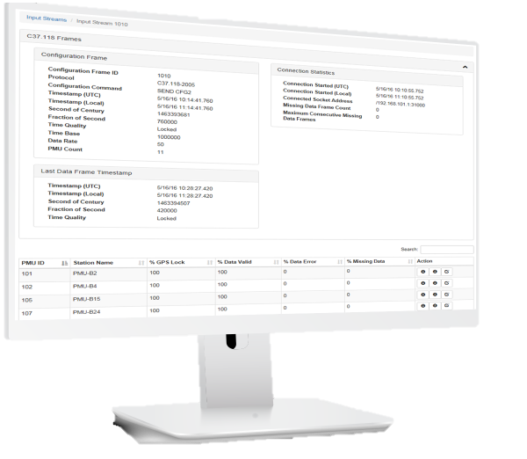
Wide Area Management System (WAMS)
Manages power system stability and responds to system disturbances
Delivers the power system visibility and insights required to optimize and safeguard stability
Notes:
As previously stated, one of our stretch goals is to implement the use of the wide area management system or WAMS. WAMS provides Effective system management through enhanced situational awareness using Real-time synchrophasor based measurement and monitoring. Utilizing two WAMS algorithms, we would be able to detect when and where a fault or a drop may occur in a power distribution system giving us the opportunity to review and repair it as quickly and effectively as possible. These two algorithms are known as the Event detection algorithm (focuses on monitoring the system and notifying if there is a large fluctuation of power) and the ESLI algorithm (focuses on detecting where exactly the event previously detected took place)

Slide 24

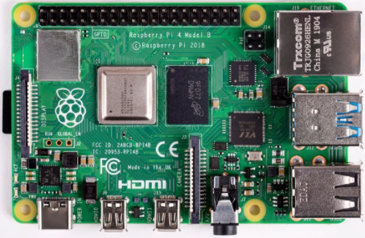
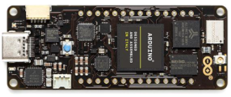
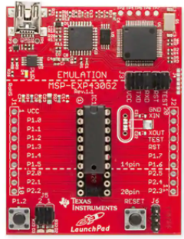
Stand-alone MCU
 | Raspberry Pi 4 Model B (8GB) | Arduino Portenta H7 | MSP430G2ET LaunchPad
Price | $88.50 (board only) | $103.40 | $23.40
Processor | Broadcom BCM2711 Quad core Cortex-A72 (ARM v8) 64-bit SoC @ 1.5 GHz | STM32H747XI dual Cortex®-M7+M4 32bit low power ARM MCU @480 MHz | MSP430G2x32 (single core)
Memory | 8GB LPDDR4 | 8MB SDRAM | 256B
Storage | MicroSD card slot available | Interface for SD Card connector (through expansion port only) | 8KB flash
Wi-Fi Module | 2.4 GHz and 5.0 GHz IEEE 802.11ac wireless | 2.4 GHz Murata 1DX dual WiFi 802.11b/g/n | Not included
Power Consumption | 500mA maximum | 2.95 μA in Standby mode | 250µA/MIPS when active (ultralow)
Operating System | Raspberry Pi OS (based on Debian Linux) | None except the SYS/BIOS | None except the SYS/BIOS
Raspberry Pi 4 Model B
Arduino Portenta H7
MSP430G2 Launchpad

Slide 25
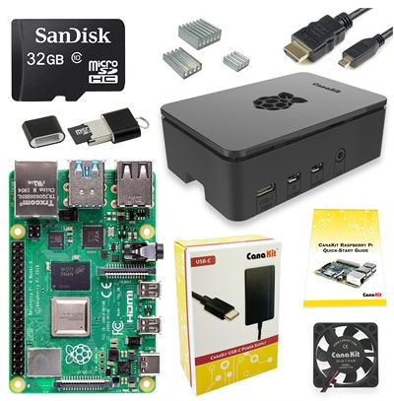
Raspberry Pi 4 Model B CanaKit
Price: $119.99
Raspberry Pi CanaKit includes:
Case
microHDMI to HDMI cable
Heat sinks
Cooling fan
32GB microSD card with Noobs preinstalled
USB Card Reader
5V/3.5A USB-C power supply

Slide 26
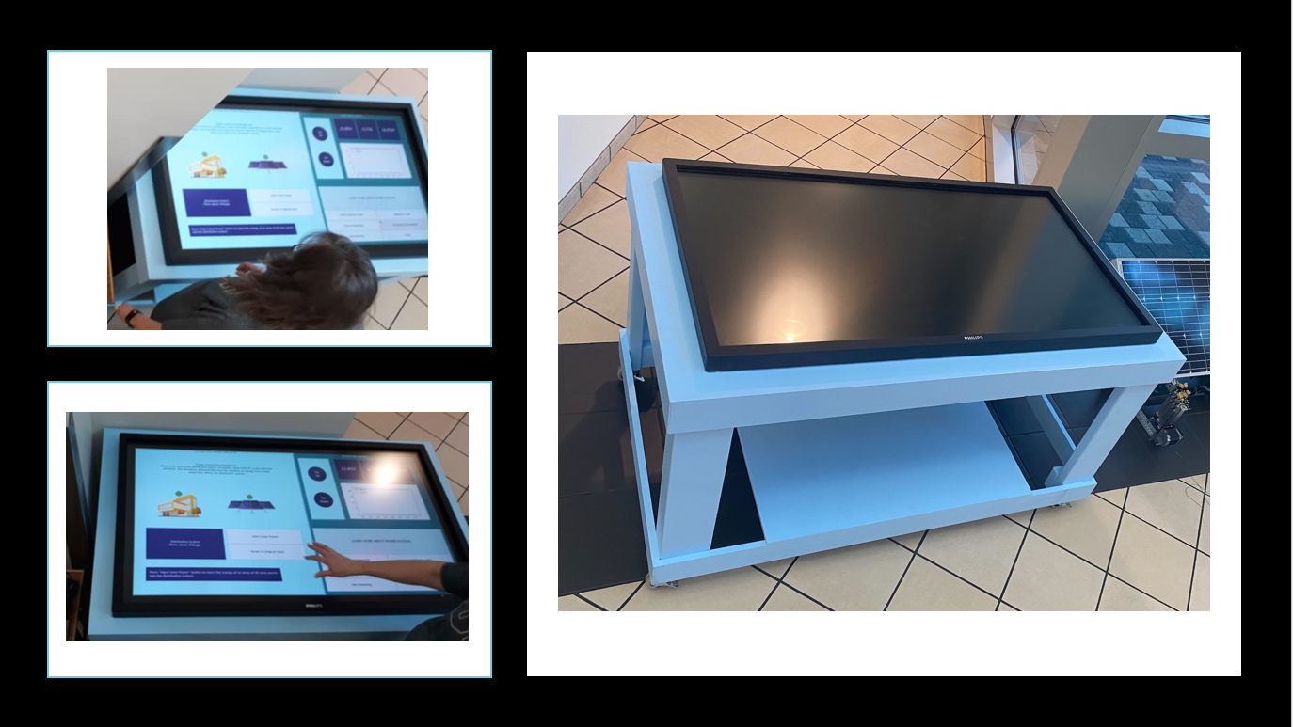
Touch Table
Building our own touch table was cost effective
Table supports at least 500lb to hold the monitor and the weight of students who may lean on it

Slide 27
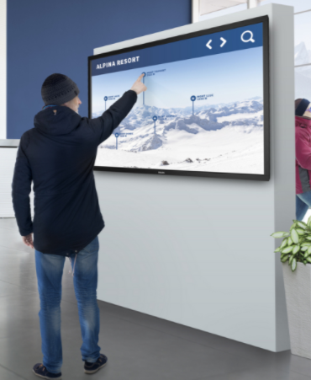
Touch Screen
 | Phillips 55BDL4051T | Samsung PM49H | LG 49TA3E-B TA3E Series | LG 43TA3E-B TA3E Series
Total Price | $1,678.00 | $2,387.23 | $1,910.71 | $1,806.15
Diagonal Size | 55 inch | 49 inch | 49 inch | 43 inch
Dimensions | (1271.0 x 741.7 x 91.4) mm (50.04 x 29.20 x 3.60) in | (1096.9 x 629.1 x 30.5) mm (43.2 x 24.8 x 1.2) in | (1,142.2 x 672.4 x 71.4) mm (45 x 26.5 x 2.8) in | (1,009.6 x 597.8 x 71.4) mm (39.7 x 23.5 x 2.8) in
I/O Connections | DP 1.2, USB-A, USB-B, HDMI(2), DVI-D, VGA, | HDMI 2.0(2), HDCP 2.2, USB 2.0(2) | HDMI (2), DVI-D, USB 3.0 | HDMI (2), DVI-D, USB 3.0
Response Time | 12ms | 8ms | 12ms | 12ms
Storage | 16GB | 8GB (3.75GB Occupied by O/S, 4.25GB Available) | not specified | not specified
Weight | 18.0 kg 39.68 lbs | 13.17 kg 29.04 lbs | 22.3 kg 49.2 lbs | 17.1 kg 37.7 lbs
Power Consumption | 76 W/h | 47 W/h | 60W/h | 55W/h

Slide 28
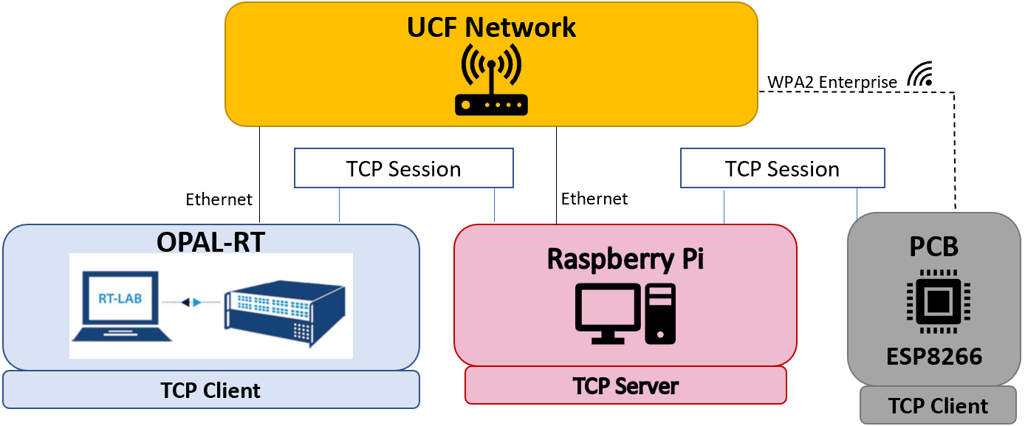
System Communication
Raspberry Pi connects via ethernet to UCF network
OPAL-RT is connected to the UCF network via ethernet and communicates with the Raspberry Pi through the ethernet using MobaXterm to implement TCP socket connections.
Raspberry Pi acts as a server and receives incoming TCP socket connection
ESP8266 connects with the UCF WPA2 Enterprise network and initiates a TCP socket with the Raspberry Pi

Slide 29
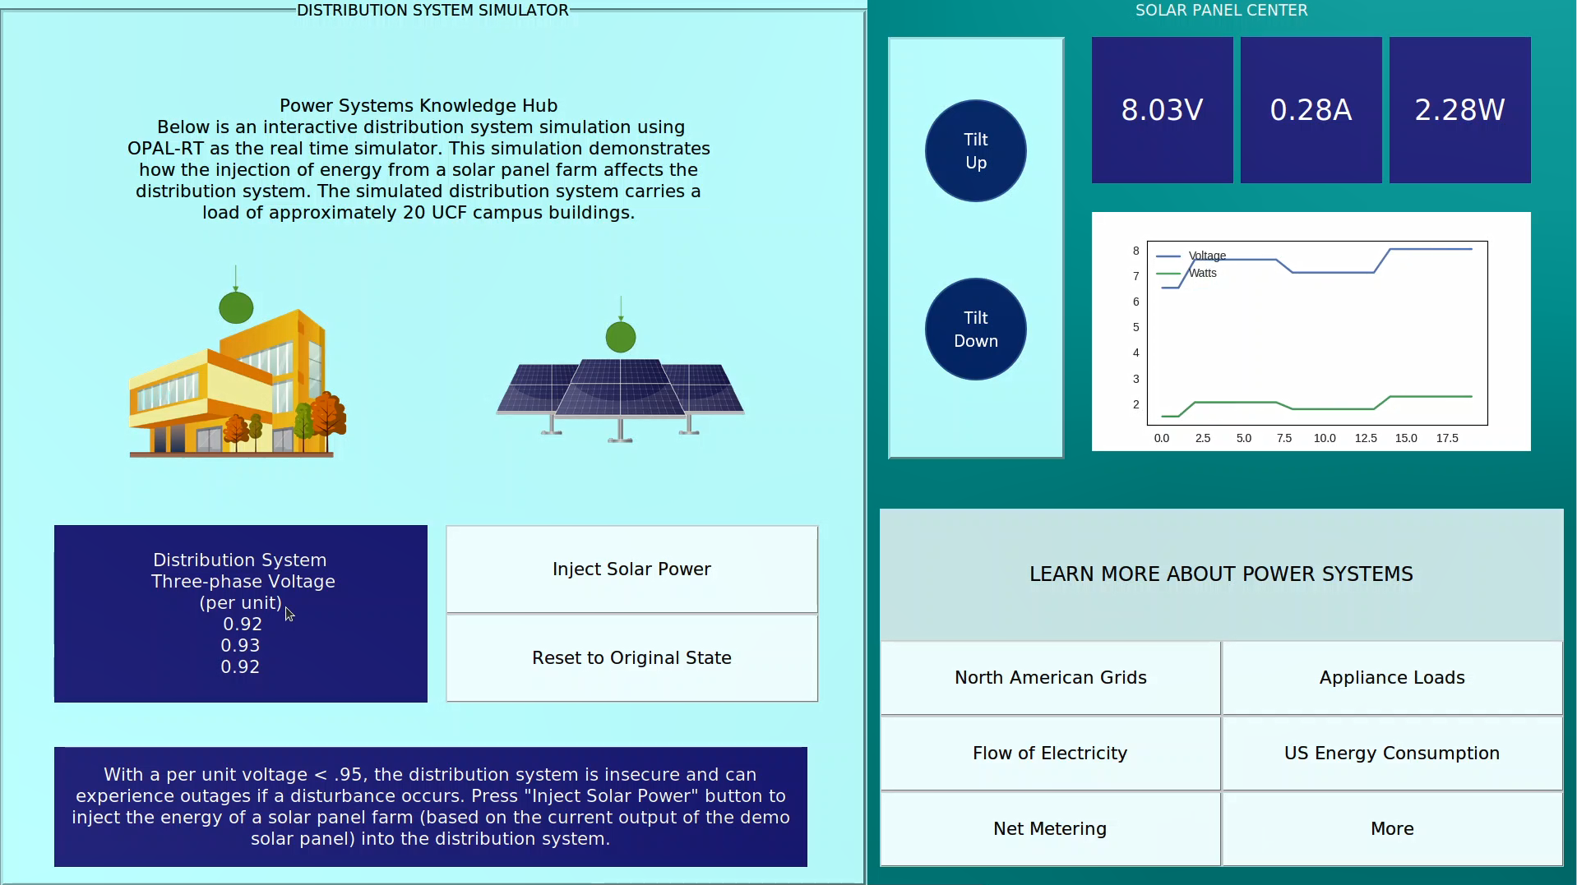
User Interface
All Raspberry Pi code in Python, and GUI was built using Tkinter
GUI includes:
Solar Panel controls and readings
Access to education information
Interactive distribution system simulation

Slide 30



Work Distribution
 | PCB Design & Coding | PCB Design & Coding |  |  | Software/Coding |  | OPAL RT & Modeling | Mechanical Design
 | Design | Micro-controller | Wi-Fi Module | Power Readings | Business Logic & GUI | WAMS | ePHASOR-SIM/Model | Power PV Frame | Touch Table Frame
Ivelisse
Chris
Hector
Christy
Level of Responsibility: Primary/Secondary /

Slide 31
Progress

Slide 32
Budget
Item | Price | Qty. | Total Estimated Cost | Total Spent to Date
OP5600 | $0.00 | 1 | $0.00 | $0.00
Solar Panel | $96.73 | 1 | $96.73 | $96.73
Inverter | $23.48 | 1 | $23.48 | $23.48
Motor | $34.99 | 2 | $69.98 | $69.98
Touch Screen | $1678.00 | 1 | $1,678.00 | $1,678.00
Raspberry Pi CanaKit | $119.99 | 1 | $119.99 | $119.99
PCB (board and all parts/modules) | $100.00 | 2 | $200.00 | $132.00
Table Parts | $230.00 | 1 | $230.00 | $245.94
Fan | $29.67 | 1 | $29.67 | $13.81
Totals: |  |  | $2,447.85 | $2,379.93

Slide 33

Questions?

