Slide 1
All Wheel Find

Slide 2
Team Presentation
Elias Jucevicius Computer Engineer
Assisted with PCB design, hardware implementation, enclosure design, obstacle avoidance algorithm, debugging and calibration.
Luiz Rocco Computer Engineer
Responsible for object detection algorithm, assisted with PCB design and soldering, object avoidance and search algorithm.
Adriana McCabe Computer Engineer
Assisted with search algorithm, return home algorithm, debugging and calibration.

Slide 3
Background
1

Slide 4
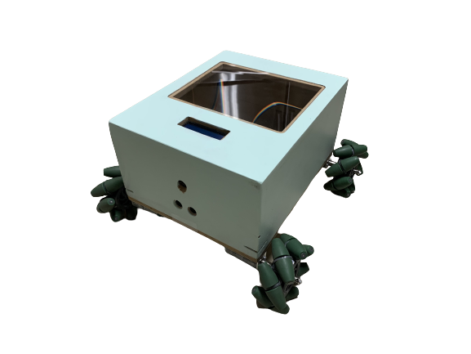
Our Project
Robotic vehicle
Can search through a given unknown search area
Avoids obstacles it encounters without losing position in search area
Identifies target and pins location in map
Uses mapped area to find its way back to its original starting location

Slide 5
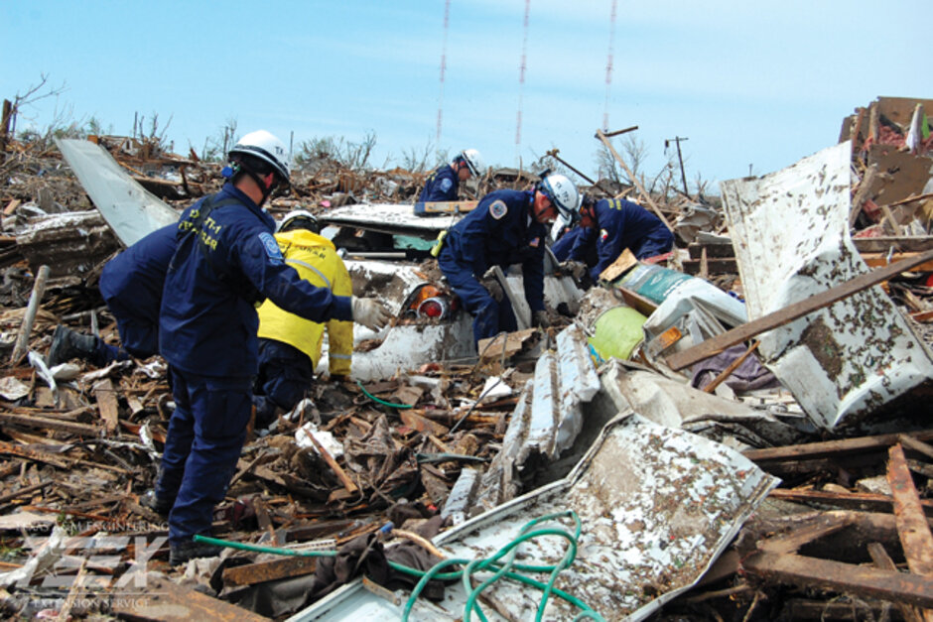
Motivation
Wanted something versatile
Military
Search and Rescue
Recreational
Research
Search and rescue
Can be used by search and rescue teams
Help identify location of people
Map an unknown search area into a known search area

Slide 6
Goals and Objectives
The robotic system is equipped with a search algorithm to autonomously travel an area to find a specific target object
The robotic system is equipped with a machine learning algorithm to efficiently identify a specific object with a 90% confidence rate
Obstacle avoidance to dodge 90% of present obstacles
Ability to travel through various terrains
After locating the object, the robot will return back to its starting position and display whether the object was found and where
Manual override feature in the event that the robotic vehicle gets stuck

Slide 7
Engineering Specifications
Up to 200 m² search area
90% or more accuracy at the object detection task
90% success rate at obstacle avoidance

Slide 8
Project Design : Hardware
2

Slide 9
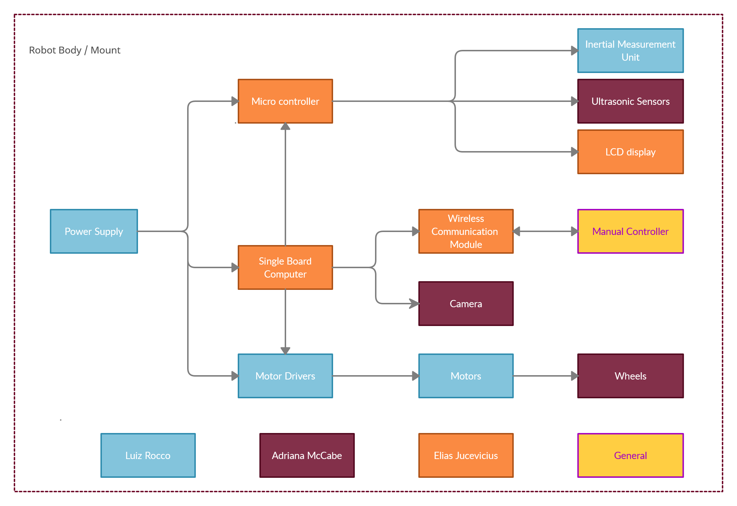
Hardware Block Diagram

Slide 10
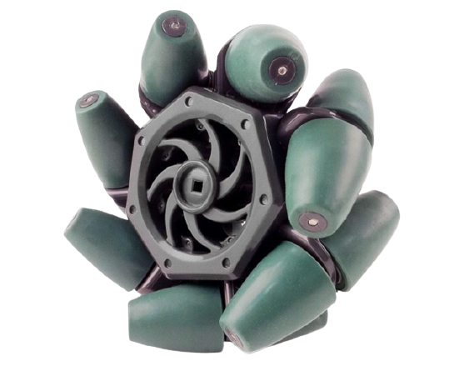
Mecanum Wheels
Mecanum wheels are an omnidirectional wheel design that allows for movement in any direction
Widely used in robotics to eliminate the need of turning of the wheels

Slide 11
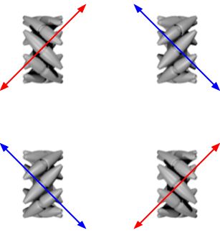
Mecanum Wheels
Each wheel contributes movement at a 45 degree angle
The vector sum of all moving wheels determines final direction of movement
Allows for rotation in place

Slide 12
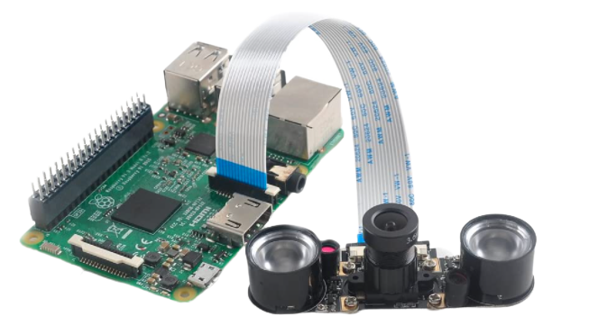
Camera
MakerFocus Pi Camera
Raspberry Pi 4 compatible
Used in conjunction with robotic vision algorithm
Adjustable Focus
Resolution: up to 1080p
Supports night vision

Slide 13
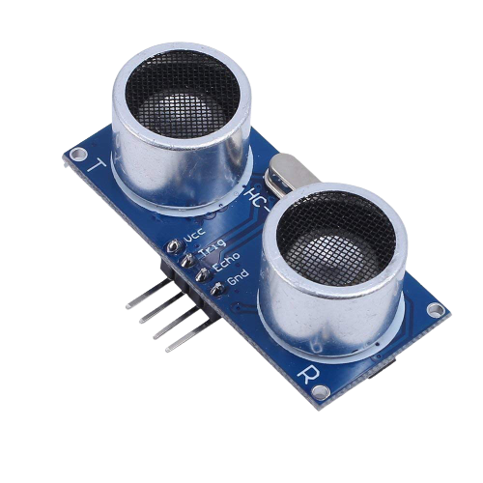
Ultrasonic Sensor
Used in conjunction with Find Target Algorithm
Accuracy, Detection range, and Cost best fit the needs of our system
1 Ultrasonic sensor

Slide 14
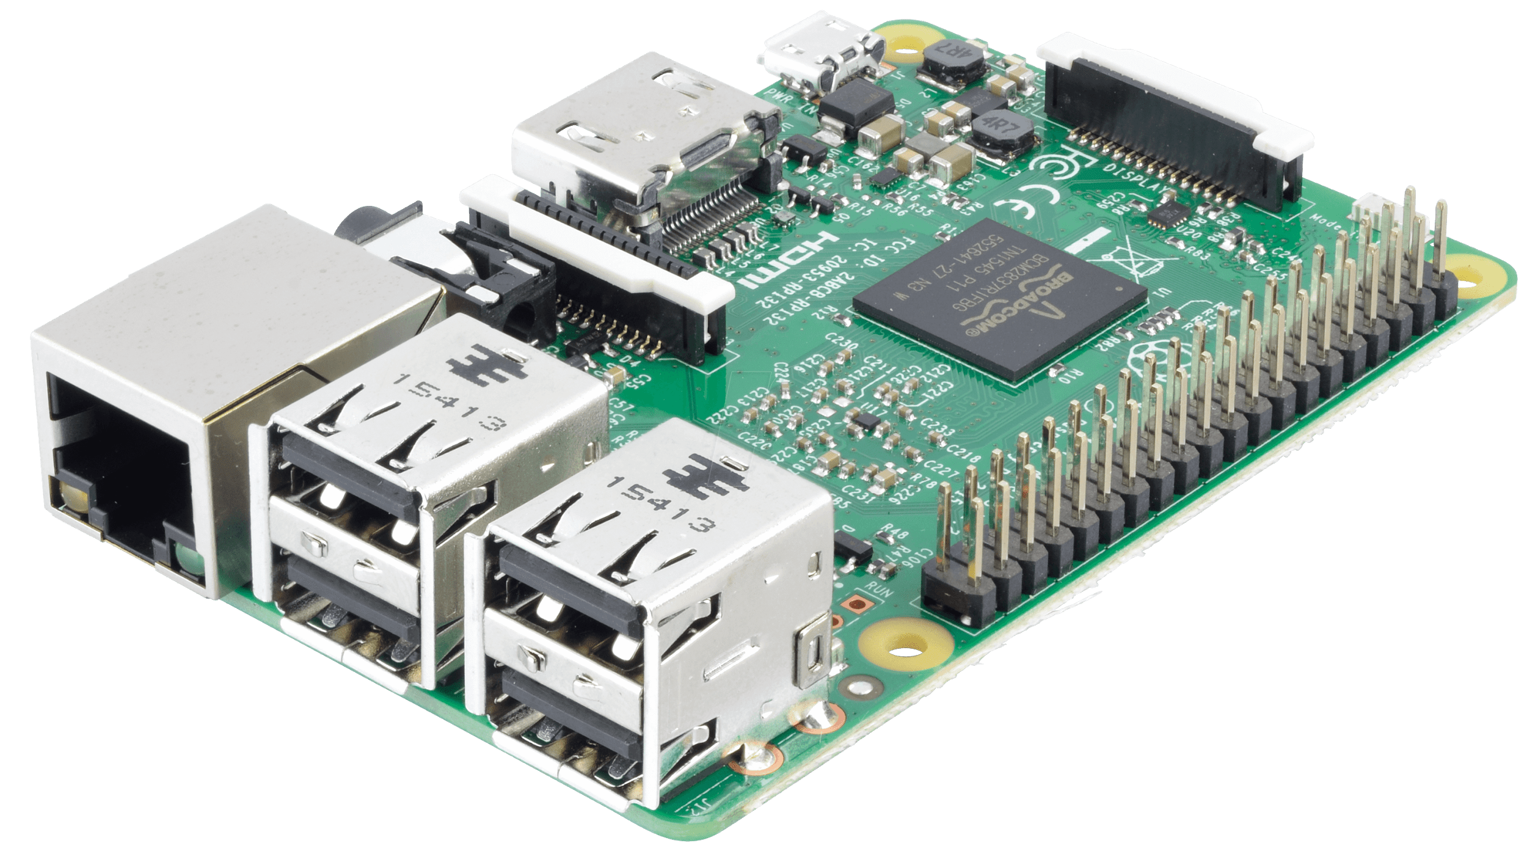
Raspberry Pi 4
The choice of microcomputer was the Raspberry Pi 4 because the project needed a powerful enough board to be able to perform object detection using YOLO framework on live videos

Slide 15
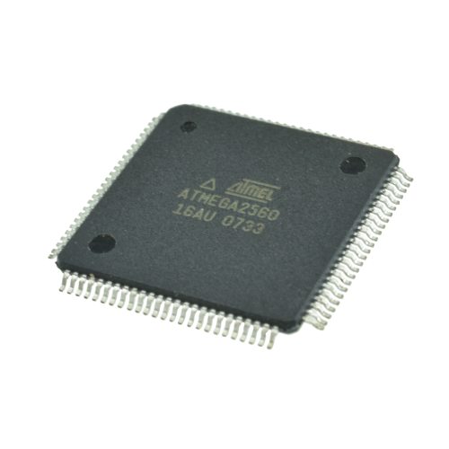
ATmega2560
The ATmega2560 was chosen because it is one of the more powerful models from the ATmega family of microprocessors, which is needed to handle the communication received from the microcomputer and it is cheap due to its high supply in the market since it is used in many development boards such as the Arduino boards

Slide 16
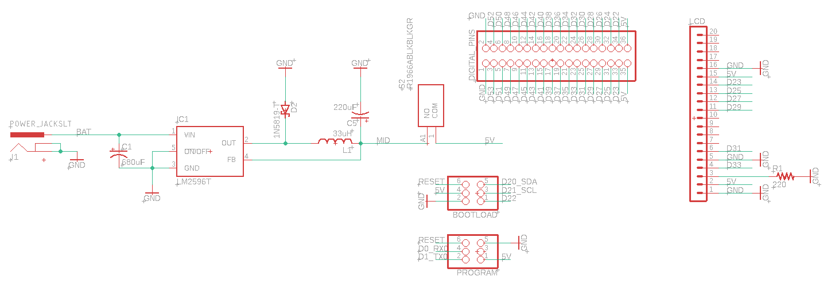
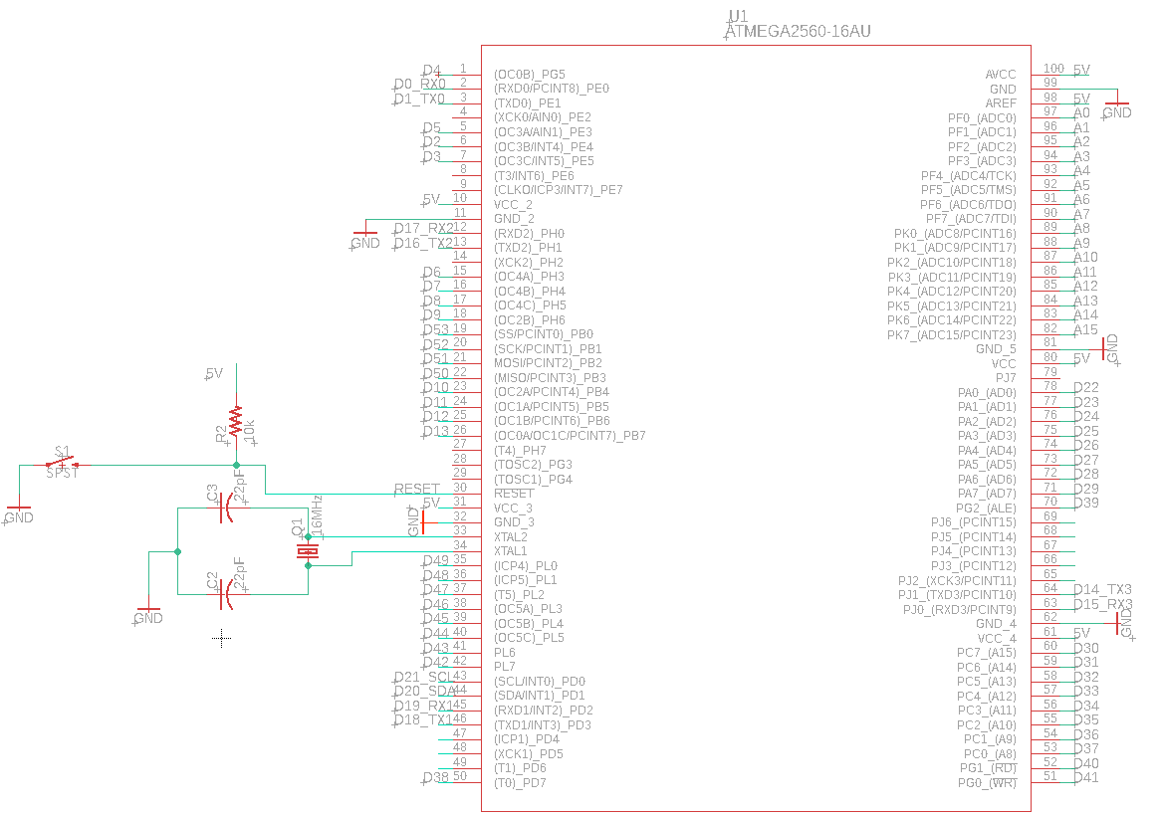
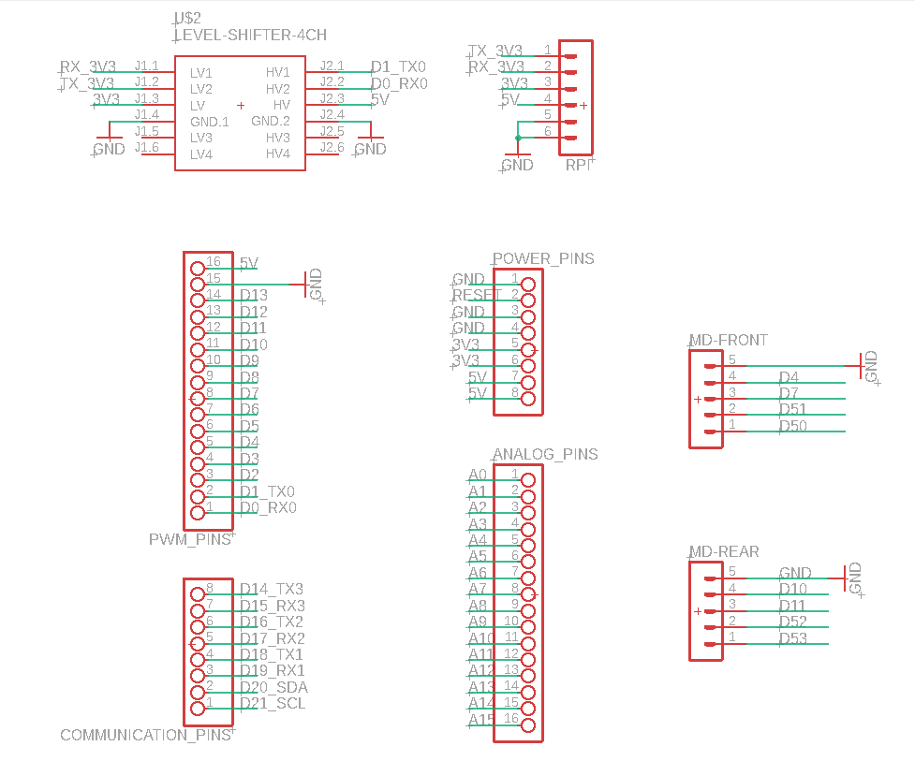
PCB Schematic

Slide 17
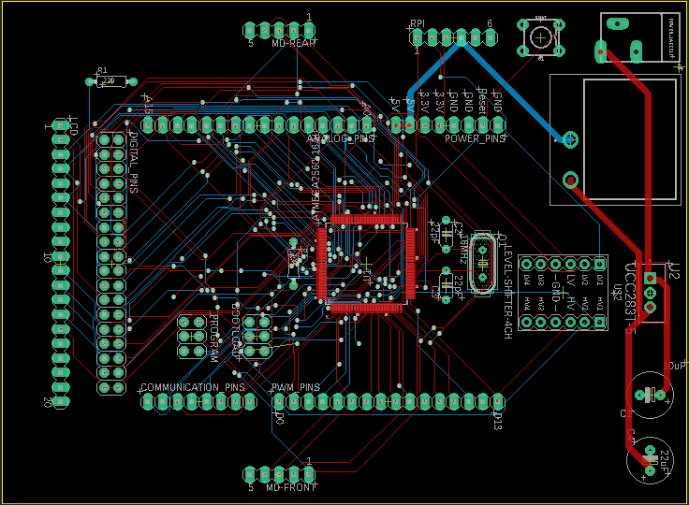
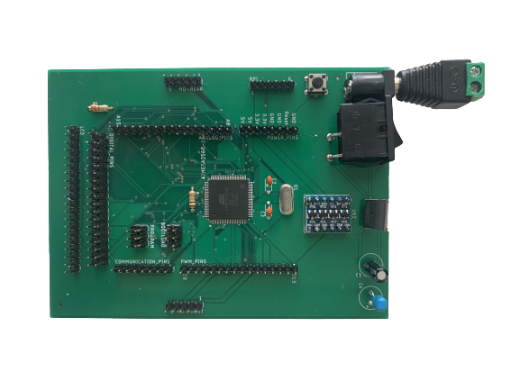
PCB Layout
PCB design sent to production
PCB
Final product

Slide 18
Project Design : Software
3

Slide 19
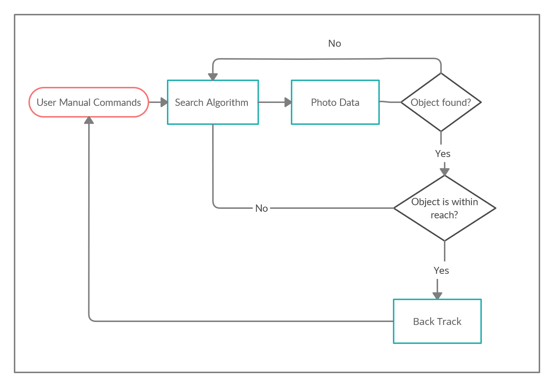
Software Block Diagram

Slide 20
4 Main Algorithms:
Computer Vision Algorithm
Identify the target
Find Target Algorithm
Search algorithm to efficiently search the given unknown area
Go Back Home Algorithm
To return back to the original starting point of the robot and quickly as possible
Obstacle Avoidance Algorithm
Ability to dodge 90% of present obstacles

Slide 21
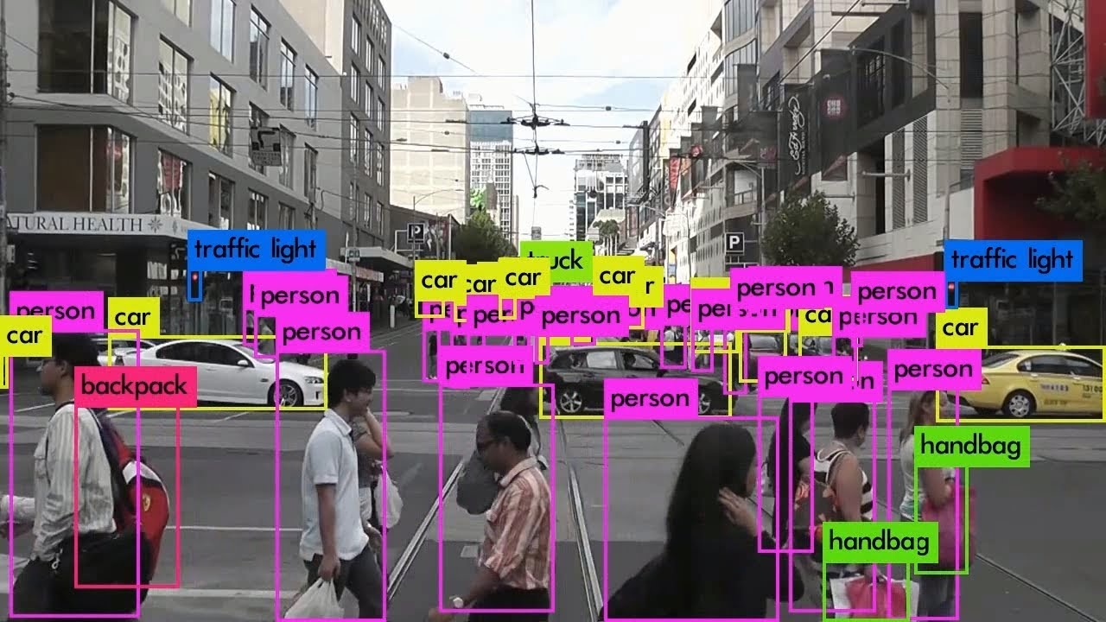
Computer Vision Algorithm
YOLO framework used to recognize a target ball
Training target is generalizable, which includes but is not limited to missing people in natural disasters, stray dog, etc
YOLO is a model architecture that can be implemented using the TensorFlow library distributed by Google in the Python language

Slide 22
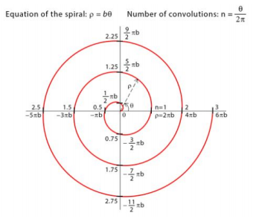
Find Target Algorithm
Distance between each successive spiral is 50 cm, and the search area is increased by 50 cm with each additional spiral
Archimedean Spiral
Our Modified Spiral

Slide 23
Go Back
Home
Algorithm
(-3,3) ↓ | (-2,3) ← | (-1,3) ← | (0,3) ← | (1,3) ← | (2,3) ←
(-3,2) ↓ | (-2,2) ↓ | (-1,2) ← | (0,2) ← | (1,2) ← | (2,2) ↑
(-3,1) ↓ | (-2,1) ↓ | (-1,1) ↓ | (0,1) ← | (1,1) ↑ | (2,1) ↑
(-3,0) ↓ | (-2,0) ↓ | (-1,0) ↓ | (0,0) ↑ | (1,0) ↑ | (2,0) ↑
(-3,-1) ↓ | (-2,-1) ↓ | (-1,-1) → | (0,-1) → | (1,-1) ↑ | (2,-1) ↑
(-3,-2) ↓ | (-2,-2) → | (-1,-2) → | (0,-2) → | (1,-2) → | (2,-2) ↑
Quadrant II
Quadrant I
Quadrant IV
Quadrant III

Slide 24
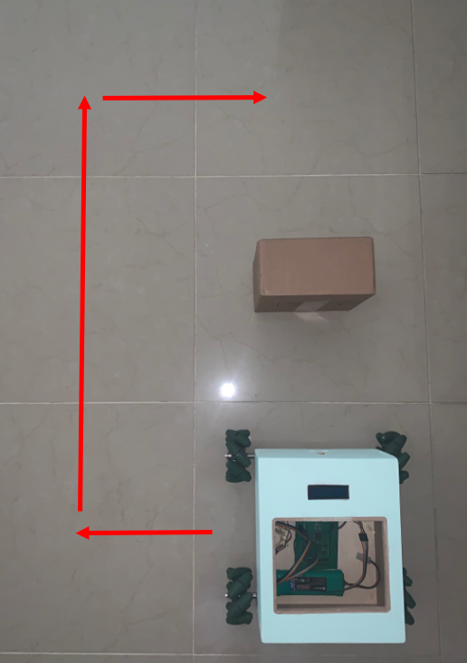
Obstacle Avoidance Algorithm
Ability to dodge 90% of present obstacles during the course of the search algorithm
Algorithm executes when objects are within 50 cm of robot
Robot will move to the left of obstacle, to avoid going outside of the defined search area
After dodging obstacle, return back on correct path

Slide 25
Website
Flask was used to build an API to serve button inputs displayed on the website
Basic HTML, CSS and Javascript used in the frontend to construct the buttons for user interaction

Slide 26
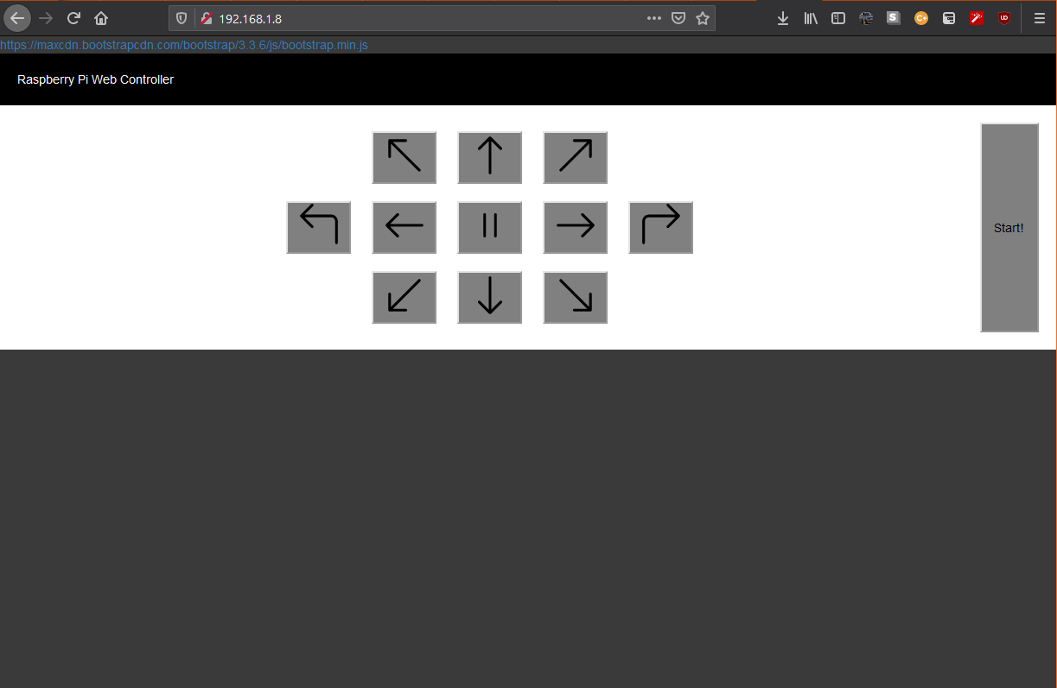
Website
Press and hold buttons that control the robot’s movement over a wifi connection
Start the search algorithm wirelessly and take over manual control if necessary

Slide 27
Design Constraints
Manufacturability & Sustainability
Simple, easy to manufacture design
Weatherproof design
Economic & Time
Lack of Funding
Two semester time frame
Ethical
Spying
Could limit search area or require a license for use
Health & Safety
Accuracy rate of 90%
Weatherproof structure

Slide 28
Budget
ITEM | Qty. | TOTAL PRICE
Raspberry Pi 4 | 1 | $60
Smart Vision Camera | 1 | $60
Robot Chassis | 1 | $100
Ultrasonic Sensor | 1 | $10
PCB | 5 | $50
LCD Display | 1 | $10
6-Cell NiMH Battery Packs | 2 | $36
Motors | 4 | $140
Motor Drivers | 2 | $40
Mecanum Wheels | 4 | $35
Misc. Parts | - | $100
Self-funded project
Budgeted $700 for our system
Achieved $641 final cost through careful parts selection

Slide 29
Standards
IEEE STD 1872-2015
Standard Ontologies for Robotics and Automation
IPC-A-600
Acceptability of Printed Boards
IPC J-STD-001E-2010
Requirements for Soldered Electrical & Electronic Assemblies
ANSI/IEEE STD 1008
Standard for Software Unit Testing

Slide 30
Work Distribution
 | PCB | Website | Computer Vision Algorithm | Enclosure Design | Obstacle Avoidance Algorithm | Search Algorithm | Go-Back-Home Algorithm | Hardware Implementation
Elias Jucevicius | ✓ |  | ✓ | ✓ | ✓ | ✓ |  | ✓
Adriana McCabe |  |  |  |  | ✓ | ✓ | ✓ | ✓
Luiz Rocco | ✓ | ✓ | ✓ |  | ✓ | ✓ | ✓ | ✓

Slide 31
Progression Gantt Chart
 | January |  |  |  | February |  |  |  | March |  |  |  | April
 | 1 | 2 | 3 | 4 | 1 | 2 | 3 | 4 | 1 | 2 | 3 | 4 | 1 | 2 | 3 | 4
Hardware Assembly |  |  |  |  |  | ◆
Computer Vision |  |  |  |  |  |  |  |  |  | ◆
Search Algorithm |  |  |  |  |  |  |  |  |  |  |  |  |  | ◆
Go Back Home Algorithm |  |  |  |  |  |  |  |  |  |  |  |  |  |  | ◆
PCB |  |  |  |  |  |  |  |  |  |  |  | ◆
Presentation |  |  |  |  |  |  |  |  |  |  |  |  |  |  | ◆

Slide 32
Thanks!
Any questions?

