Slide 1
Lunar Exploration using Augmented Reality (LEAR)
Group 6:
Teo Malendevych Photonic Engineering
Sammy Lee Photonic Engineering
David Brown Computer Engineering
Yongsheng Xu Electrical Engineering
Sponsored By:
George Jackson Foundation
NASA Florida Space Grant Consortium
Notes:
Good Morning, today we will talking about the LEAR senior design project, Lunar Exploration using Augmented Reality. My name is Teo Malendevych, a Photonic Engineer onboard the team. I am joined by Sammy Lee, another Photonic Engineer, David Brown, a Computer Engineer, and Yongsheng Xu out of electrical Engineering. I would also like to recognize and thank our sponsors, the George Jackson Foundation and the NASA Florida Space Grant Consortium.

Slide 2
Project Overview

Slide 3
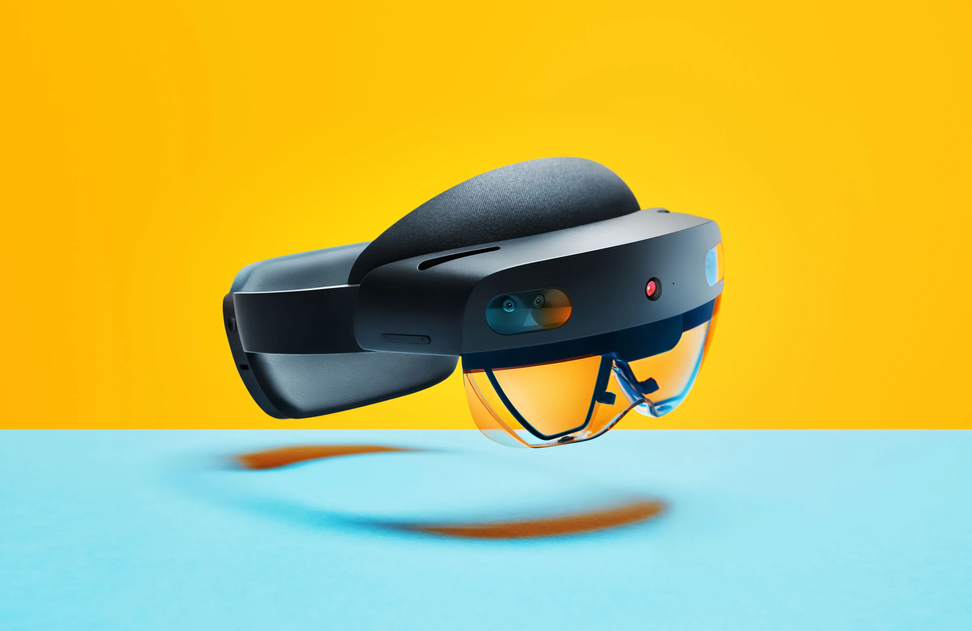
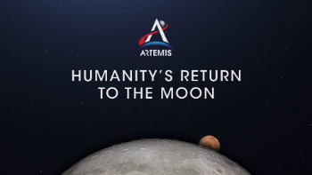
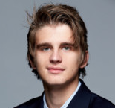
Inspiration
Teo
Notes:
The inspiration for this project starts with the NASA SUITS Challenge. As NASA pursues future Artemis missions that will land American astronauts on the moon by 2024, the agency is interested in enabling these astronauts with more assistance from modern technologies. Displays like augmented reality headsets (AR) will be implemented in future Extravehicular Activity Mobility Unit (xEMU) spacesuits to enable interfacing with lunar payloads, support science work, visualize consumables, streamline crew-to-crew communication, bolster Mission Control Center (MCC) interaction methods and navigate terrain. We are taking on the challenge. We will be utilizing a Microsoft Hololens II and all of its capabilities to aid the astronauts in navigation, tasks, and monitoring their vitals.

Slide 4
Goals and Objectives
General:
Display of Extravehicular activity (EVA) tasks
Communication with Mission Control
System Tutorial
Navigation and Task Assistance:
Guidance from point A to point B
Location of points of interest, lander, partners
Available notes and directions for tasks
Ability to capture video and images
Assistance with high-contrast areas on the moon
Peripheral Devices:
Wrist-mounted optical heart rate monitor and pulse oximeter
Outside temperature sensor
Wireless communication with headset
Teo
Notes:
In terms of our goals and objectives, our project is designed with the astronaut in mind. We are creating a User Interface for displaying extravehicular activity or EVA tasks, and communication with mission control. A system tutorial will be implemented for training new users. The Headset will guide the astronauts to and from designated locations such as the lander, geological sites, points of interest, as well as their partners on the moon. For task management, we will provide the astronaut with non-obstructive directions on tasks as well as the ability to capture video and images. Due to the Artemis Mission’s landing point on the Lunar south pole of the moon, NASA anticipates issues with lighting. Long shadows as well as over-illumination will cause problems for recognizing obstacles and terrain. Therefore, we will apply image processing techniques in the headset to aid the astronaut in these high-contrast conditions. We are also implementing a vitals subsystem outside the Hololens to measure outside temperature, the heart rate and oxygen saturation of the astronaut. This data will be wirelessly transmitted to the headset and Mission control for vitals monitoring.

Slide 5
Requirements and Specifications
Guide user in real-time to any marked coordinates of interest within a range of 2 kilometers from starting position.
Monitor suit vitals (O2, H2O, etc) and alert user if values are abnormal or approach dangerous levels.
Provide a method for taking images and videos
Monitor user pulse and alert if value approaches abnormal levels (>100 bpm or <60 bpm
Image Processing should not be less than 30 frames per second.
Heart rate monitor PCB: 5 cm x 5 cm
Measurement of heart rate and SO₂ accurate to 10%
Wireless transmission of 10 ft
Temperature measurements accurate to 2%
Teo
Notes:
The following slides list the requirements and specifications of our project. While there are more requirements for the NASA SUITS Challenge, we deem these as the most important. We will be focusing on navigation, task management, image processing, and our external sensors.

Slide 6
External System Design

Slide 7
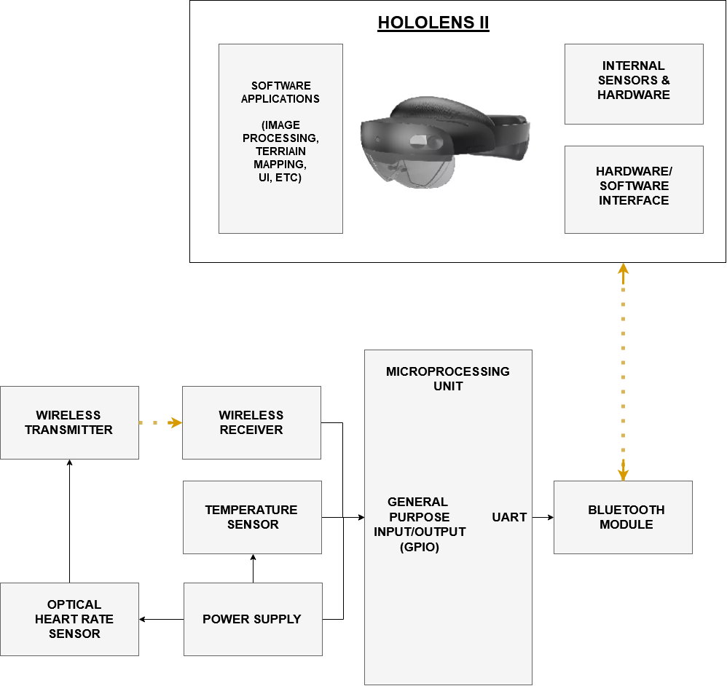
Hardware Design
External sensors to monitor suit (and astronaut) vitals
Temperature
Heart Rate
Microprocessor receives sensor data
Wirelessly transmitted via bluetooth
Teo
Notes:
The following flowchart depicts our hardware design. The optical heart rate monitor and pulse oximeter will be located on the wrist and wirelessly transmit data to our microprocessing unit. The temperature sensor will be directly wired into the microprocessor, which will be sent to the Hololens II using Bluetooth. The headset will receive the sensor data and display the information to the astronaut. We will also be utilizing the cameras in the Hololens II to record video, perform image processing on the internal GPU of the headset, and display the processed video to the astronaut.

Slide 8
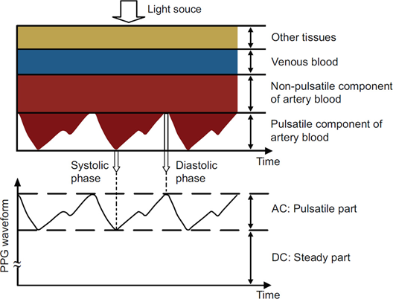
Heart Rate Monitor and Pulse Oximeter
Theory
Teo
Notes:
I want to quickly go over the theory behind the optical heart rate monitor and pulse oximeter. As light propagates through the skin, it will be reflected at every interface back towards the source. As the volume of blood in the blood vessels change, so does the amount of light reflected. If a photodiode is placed near the light source, the result has an AC signal, corresponding to the blood transmission and DC signal, corresponding to any non-pulsatile components. The heart rate can be simply calculated from the frequency of the AC signal. The oxygen saturation, or the percentage of the hemoglobin saturated with oxygen denoted by SpO2, requires a modified version of the Beer-Lambert Law to calculate and is dependent on both the AC and DC signal of two different wavelength sources. The resulting min and max of both signals can be simplified as a ratio R and calibrated to a corresponding SpO2 value from an off-the-shelf pulse oximeter.

Slide 9
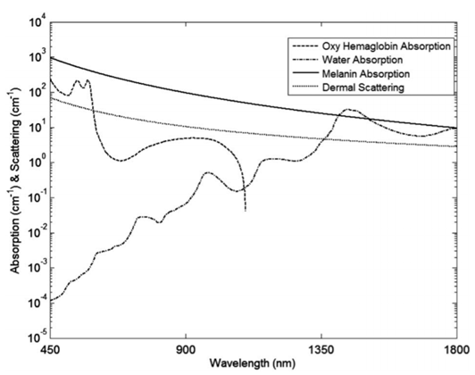
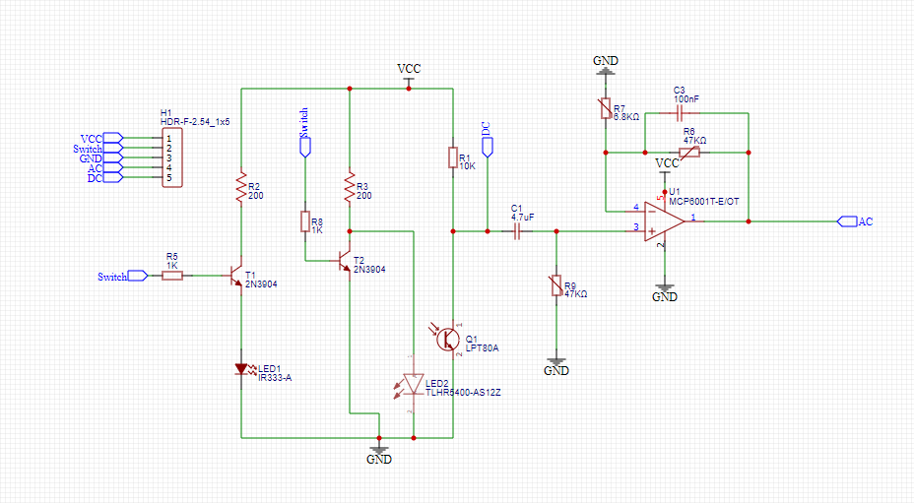
Heart Rate Monitor and Pulse Oximeter
Part Selection & Design
IR LED: Vishay Semiconductors VSMY2943G, Emitter Wavelength: 940 nm, LxW: 5.8 mm by 2.3 mm
Red LED: Cree XLamp XP-E2 LED, Emitter Wavelength: 650-670 nm, LxW: 3.5 mm by 3.5 mm,
Photodiodes: Osram LPT 80A Phototransistor, Spectral Range of Sensitivity: 450 - 1100 nm, LxW: 5 mm by 6 mm
Teo
Notes:
When choosing parts for this device, we had to consider the wavelengths of LEDs we were using as well as the size. We chose 940 nm for the Infrared LED and 660 nm for the red LED, which are very common wavelengths for off the shelf pulse oximeters. In our design, the LEDs both can’t be on at the same time as doing so would lead to interference in the signals, so we alternate which one is on with a switching input. Each LED is on for 2 seconds and the resulting photodiode voltage is analyzed.

Slide 10
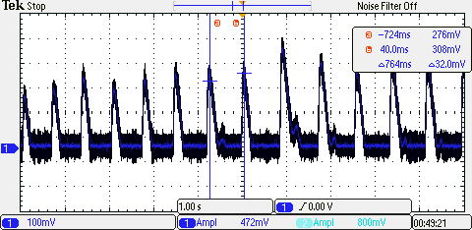
Heart Rate Monitor and Pulse Oximeter
Testing
Teo
Notes:
Here are some preliminary tests. A simple test circuit was built on a breadboard with the components listed on the previous slide and I was successfully able to measure my heart rate. The AC signal can be easily seen in the following image and the heart rate was calculated to be 78.53 BPM. From my experimentation, the signal is very dependent on orientation of the LEDs with respect to the photodiode. Through experimental testing, the distance between the center of the LEDs and the center of the photodiode was about 8 mm at the most optimum signal amplitude. Additionally, movement has a negative effect on the signal.

Slide 11
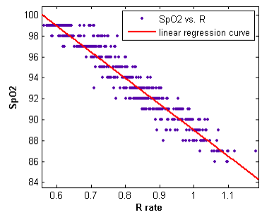
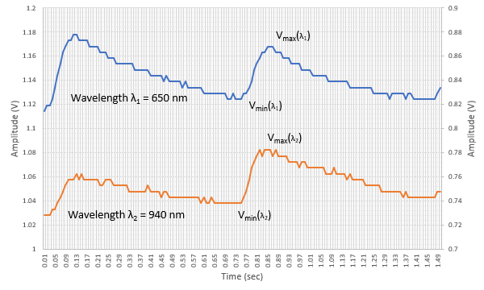
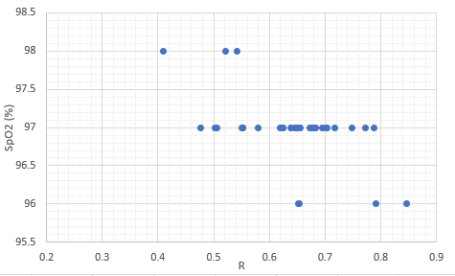
SP0₂ Calibration
Teo
Notes:
Here we see two separate measurements from both the Red and IR LED. After determining the mix and max of both signals, we can determine a value R. In the top right, we can see an example calibration curve where the R value was mapped to the corresponding SpO2 values. Unfortunately, our testing was fairly limited to just two test subjects, both of which had a resting SpO2 value of 97%. While our calibration is incomplete, we can extrapolate a relationship between R and oxygen saturation.

Slide 12
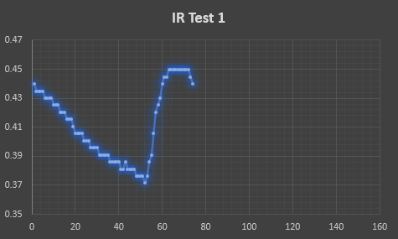
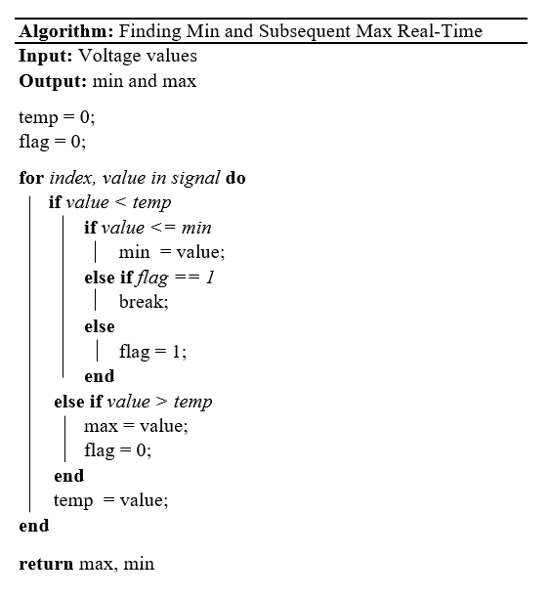
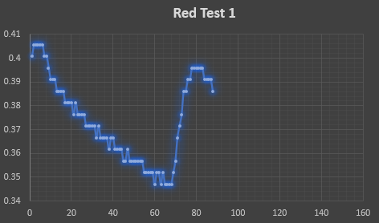
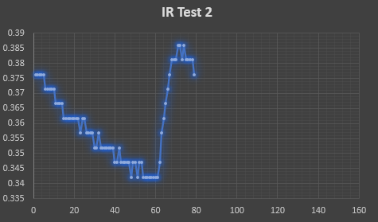
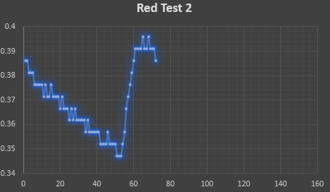
Peak Detection
Teo
Notes:
I just want to quickly go over the peak detection algorithm that I created for this project. The pseudocode can be seen on left. Once we find an absolute min, the algorithm looks for the next max and exits once it finds it. The results can be seen on the right.

Slide 13
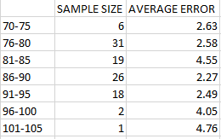
Heart Rate Accuracy
Teo
Notes:
To test our accuracy, we measured the heart rate using our designed oximeter and an off-the-shelf version. We tried to encompass a wide range of heart rates. We believe that there is no correlation between the average error and increasing heart rate. Also, the resolution was denoted to be roughly 1 BPM, matching the resolution of our off-the-shelf oximeter.

Slide 14
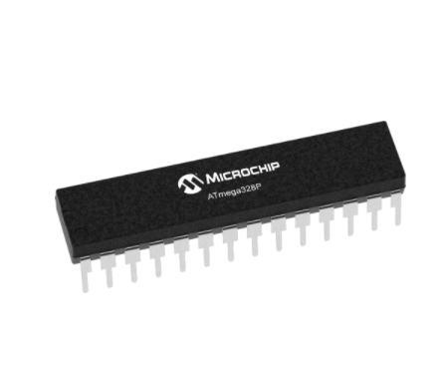
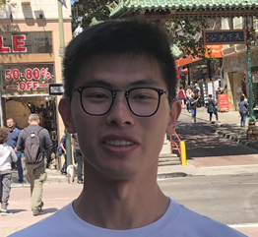
Microcontroller
-Atmega328p-pu
Same with MCU on Arduino
Program by Arduino IDE(Burn the bootloader)
Programe with C/C++
Easy to find documentation we need
Yong

Slide 15
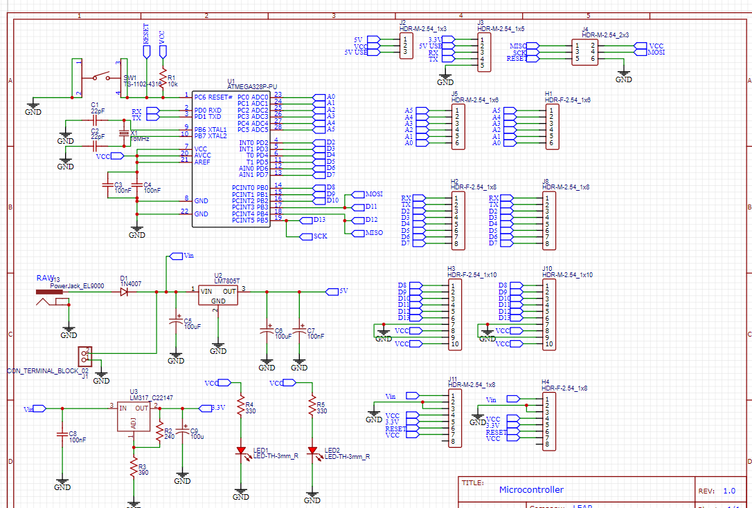
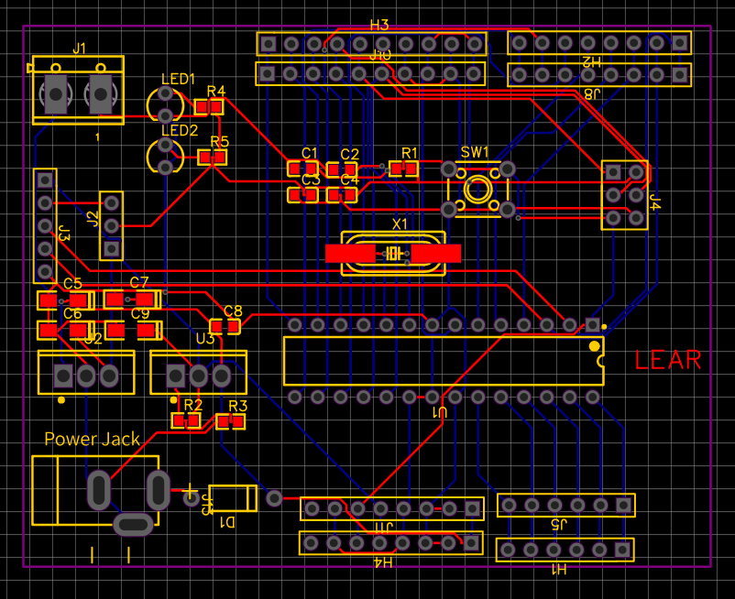
PCB for Microcontroller Module

Slide 16
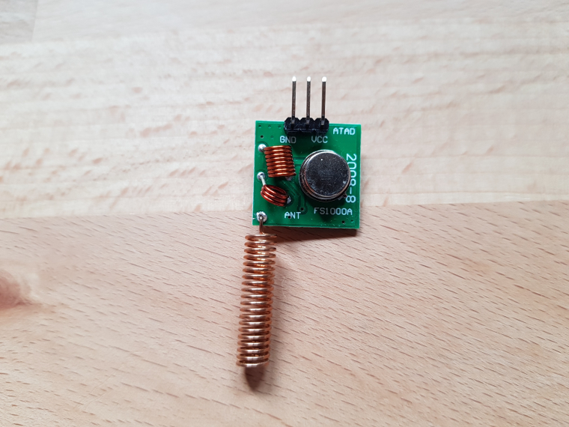
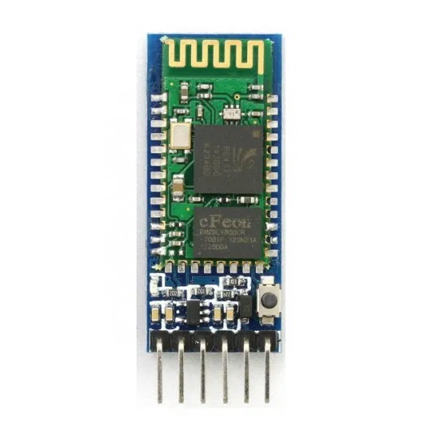
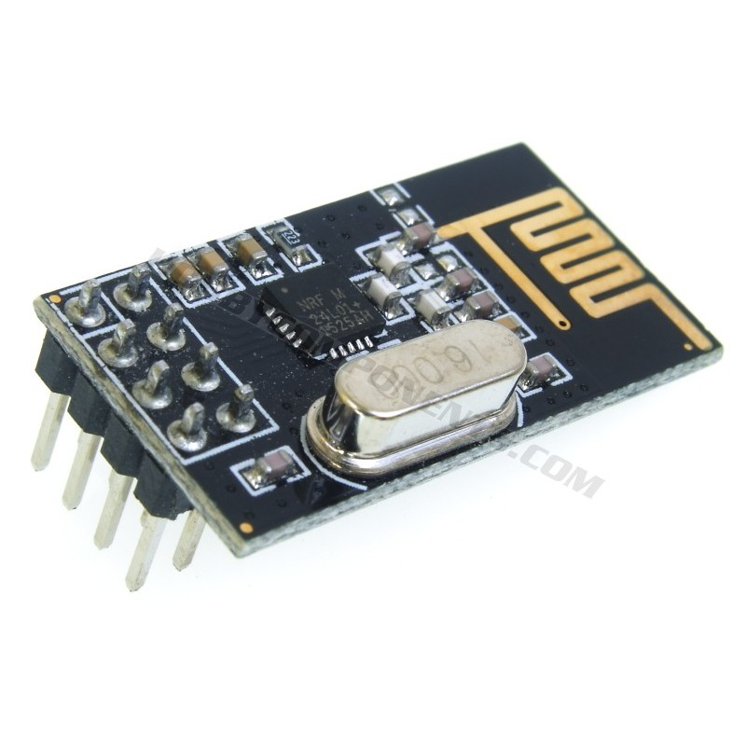
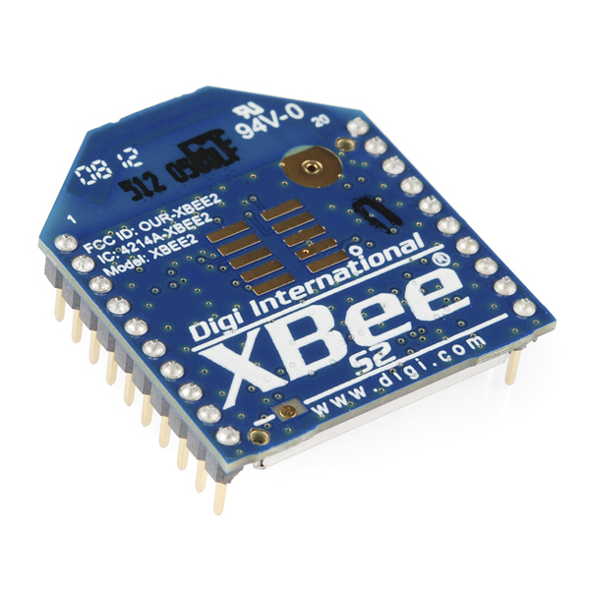
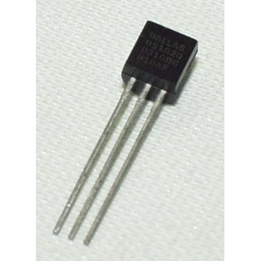
Wireless Communication Module
Goal: Serial communication streams between all sensors, microprocessing units, and the HoloLens
Parts we used: FS1000A Wireless RF Module, HC-05 Bluetooth Module,
nRF24L01 Transceiver, Zigbee Wireless Communication Module, DS18S20 Digital Temperature Sensor
Yong

Slide 17
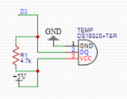
Temperature Sensor
DS18S20 Temperature Sensor
3-pin connection
One-wire structure (use Dallas Temperature Library)
4.7K ohm pull-up resistor
5V operating voltage
Yong

Slide 18
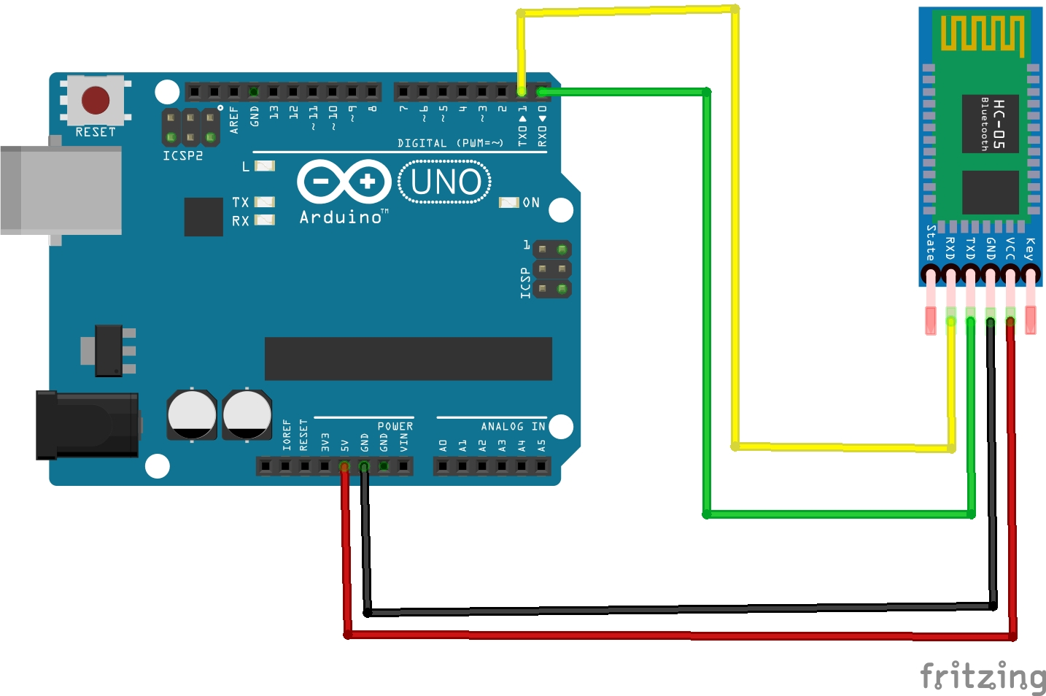
HC-05 Bluetooth Module
4-pin connection
Works on 5V or 3.3V with resistor
Easily interface with other bluetooth device
Theory use in project:
HC-05 will send data (temperature, heart rate,
oxygen saturation to the computer that
connected to the HoloLens server, then server send data to HoloLens)

Slide 19
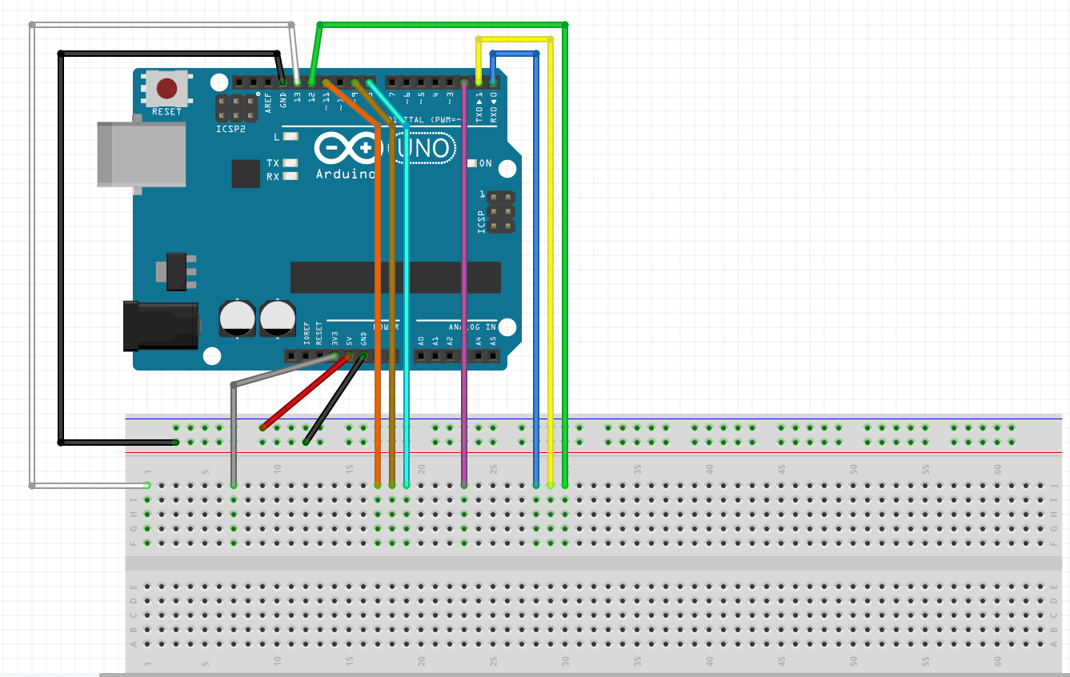
PCB Testing
Before making PCB, we need to decide
what ports we need and how can we
connect it, so we make a schematic diagram
to show all ports needed be connected to a
breadboard.
Yong

Slide 20
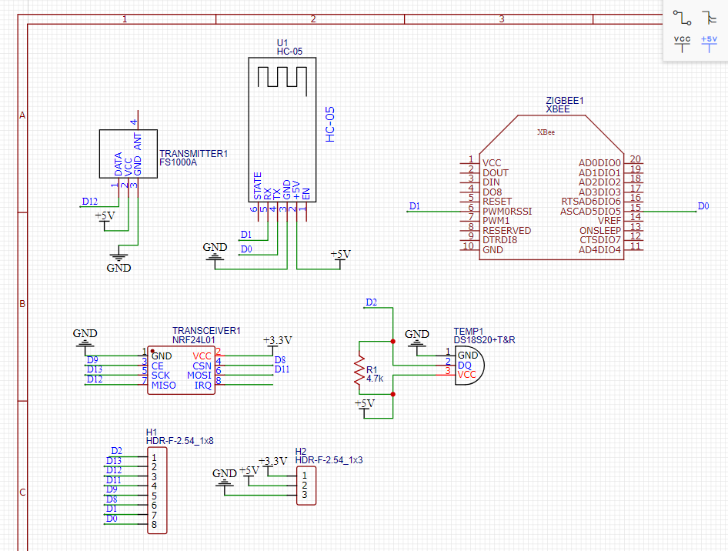
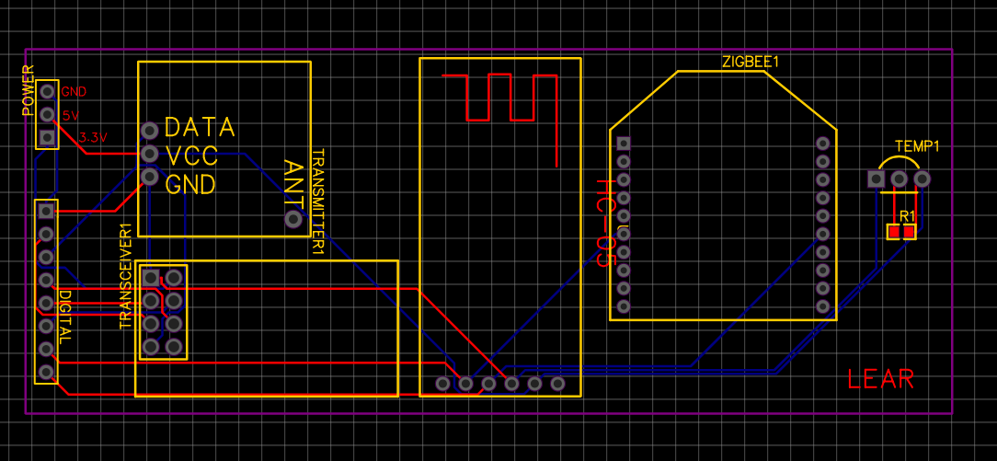
PCB for Wireless Communication Module
Yong

Slide 21
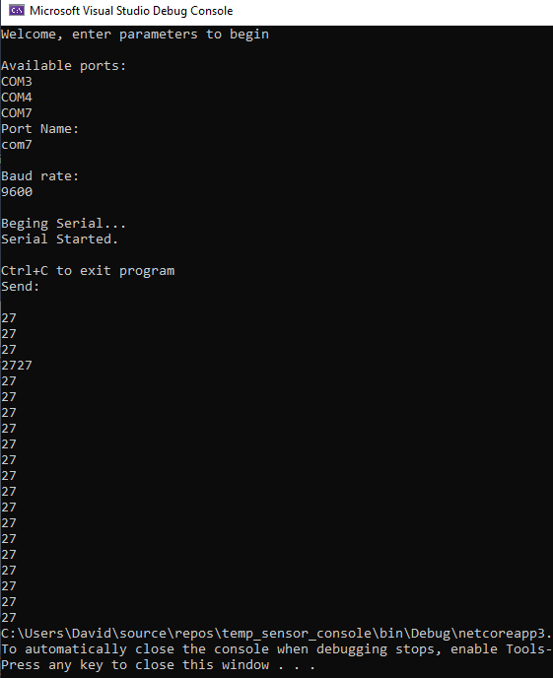
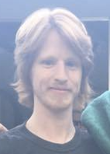
Sensor data using C# console application
Desktop computer receives data via C# console application
C# console application prints temperature to terminal
David
Notes:
53s

Slide 22
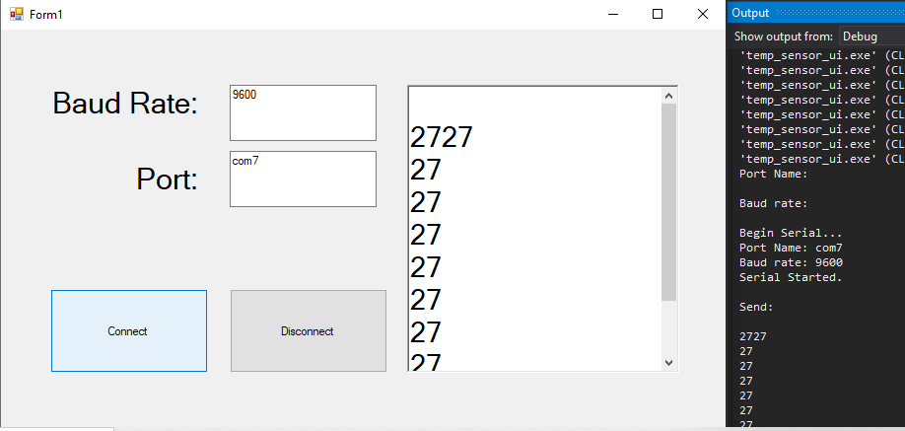
Sensor data with C# User Interface Application
David
Notes:
30s

Slide 23
Software Design
Notes:
5s

Slide 24
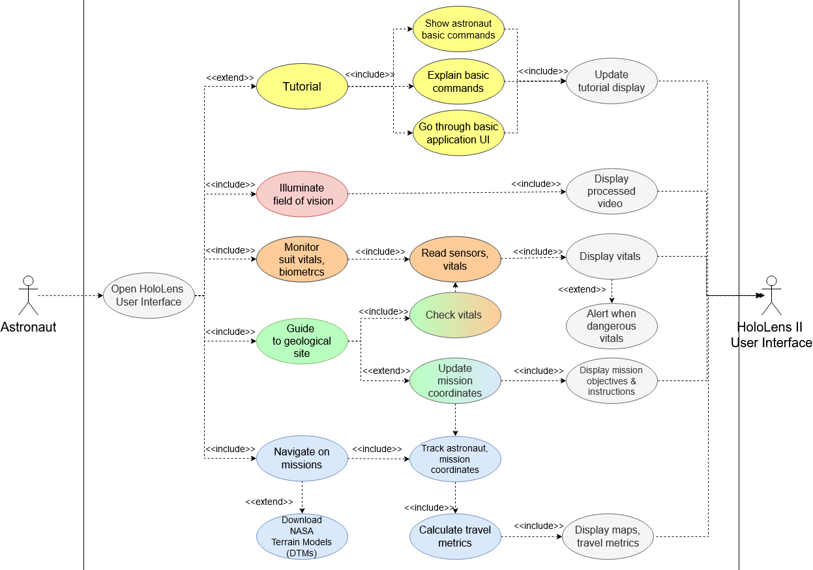
Software Design (Use Cases)
Use Cases
David
Notes:
1min, 54s

Slide 25
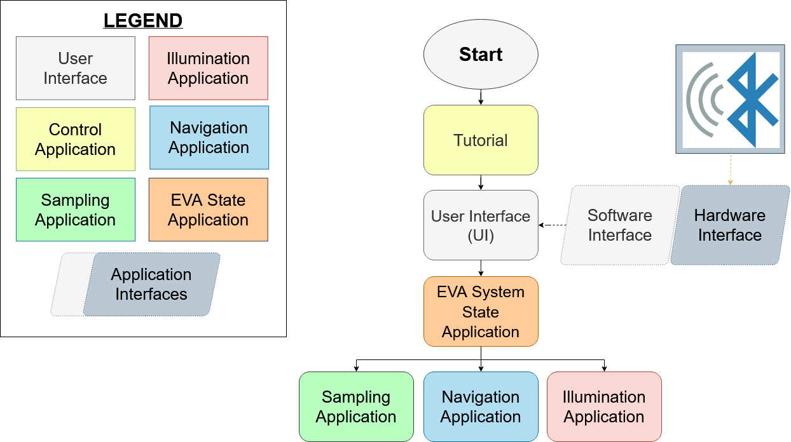
Software Design High-level Overview
NASA objectives:
Control/tutorial
EVA System State
Illumination
Navigation
Geological Sampling
David
Notes:
31s

Slide 26
EVA System State
User starts UI
Background processes record suit vitals (if mission starts)
Interfaces with Sampling application to warn astronaut if necessary
David
Notes:
41s

Slide 27
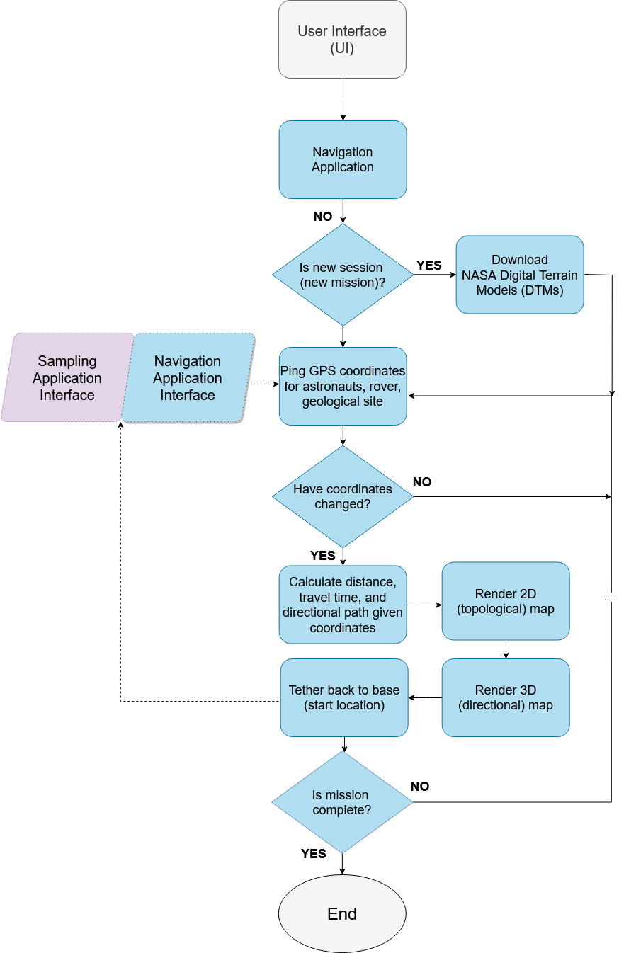
Navigation
Navigation application tethers astronaut to “home” location while they engage on mission
Updates 2D navigation map in real-time relative to geological site
Tracks current coordinates
3D directional arrow directs astronaut to geological site, home
David
Notes:
37s

Slide 28
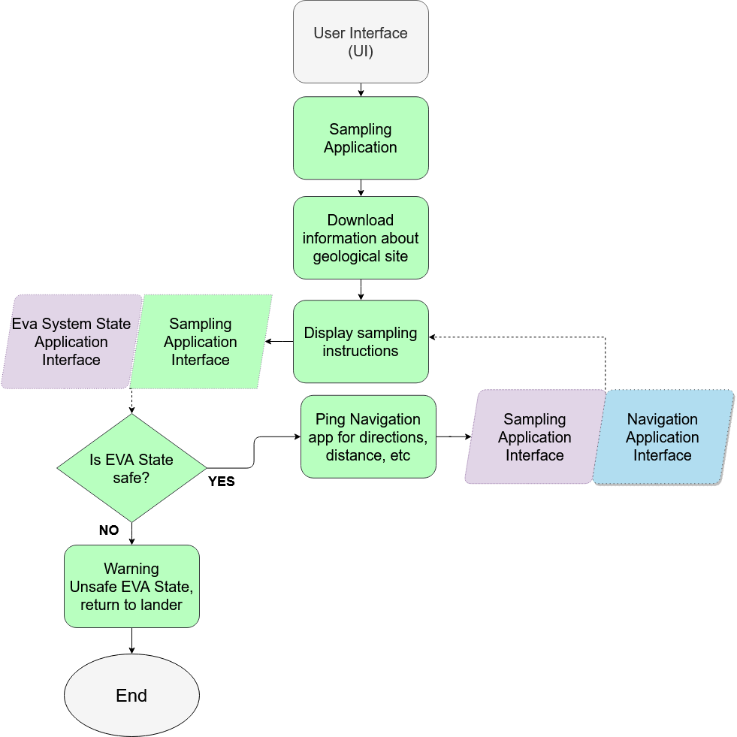
Sampling
Sampling (or “Mission”) application downloads all details about mission
Displays notebook for mission containing instructions, tasks, tools, and other important information
Interfaces with both Navigation and EVA State components
David
Notes:
17s

Slide 29
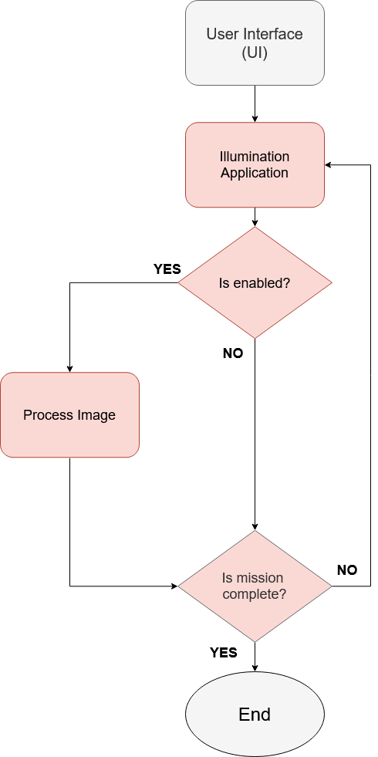
Illumination
Illumination component is toggled on/off
If on, the Hololens 2 video stream is processed to deal with high contrast environment
David
Notes:
12s

Slide 30
HoloLens Development Environment
Windows 10 OS, Visual Studio IDE, and Unity 3D engine
Microsoft-mixed reality toolkit
David
Notes:
55s

Slide 31
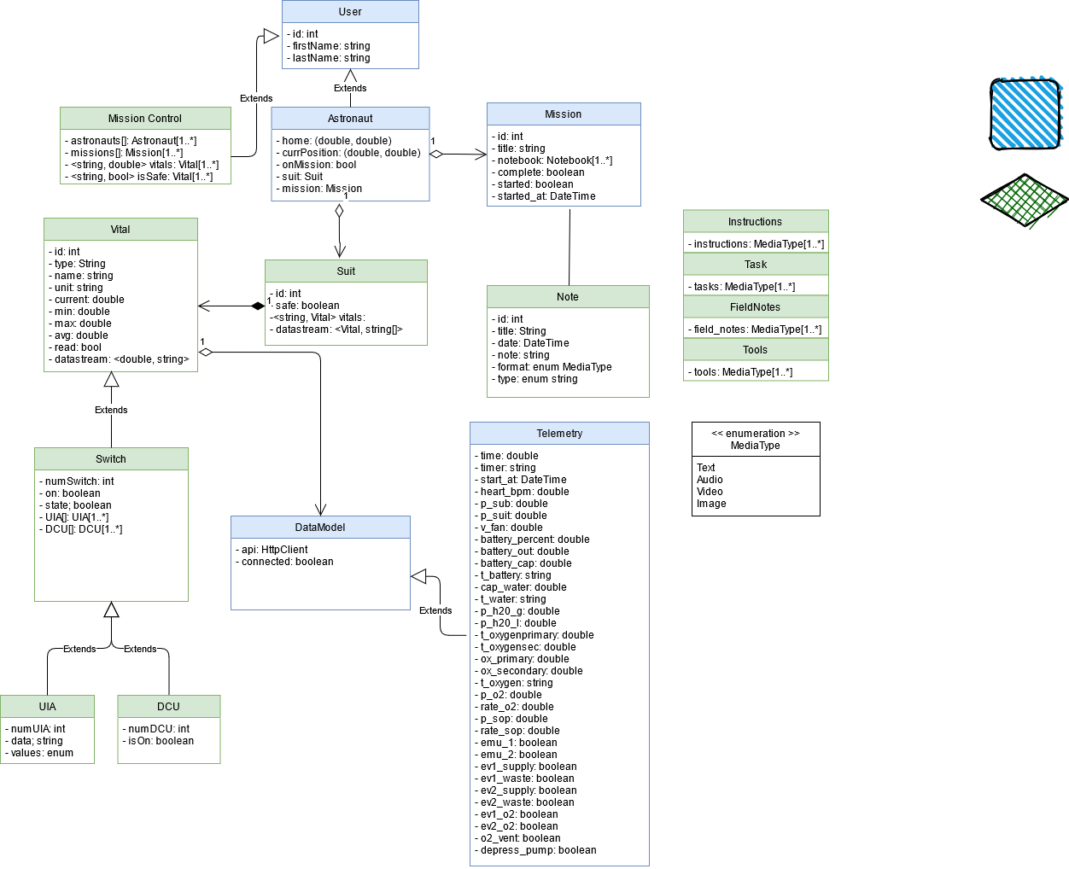
Software Organization
Backend -- processes data
SuitsUIConsole namespace
Frontend -- sends and receives data from backend, updates UI
Unity 3D engine
David

Slide 32
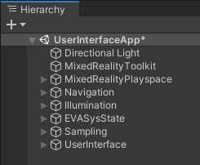
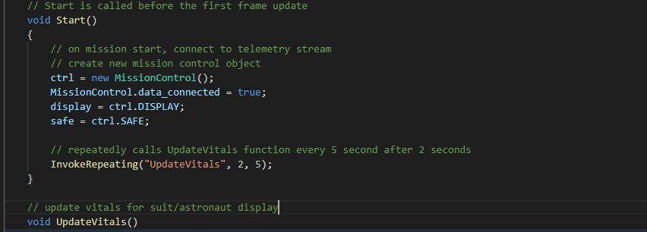
Dataflow between UI and codebase
Backend code for processing
Unity (Frontend)
Each application is an individual “Game Object” in Unity
Encapsulate outlined classes
Unity frontend instantiates a backend Mission Control object at run-time
Game Objects use Mission Control object to process data and update UI
SuitsUIConsole
(Backend)
David

Slide 33
Illumination feature
Backend code for processing
David

Slide 34
Illumination Outline
Requirements
Thresholding
Contrast Limited Adaptive Histogram Equalization
Implementation
Tested Systems and Devices
Issues

Slide 35
Illumination Requirements
Image Processing through a camera in real time.
Frames per second (fps) should be a common digital standard being 24-30 fps for movies or 60 fps.
Gray Scale Processing was chosen for speed and simplicity.
Main objective is increasing contrast in areas of interest

Slide 36
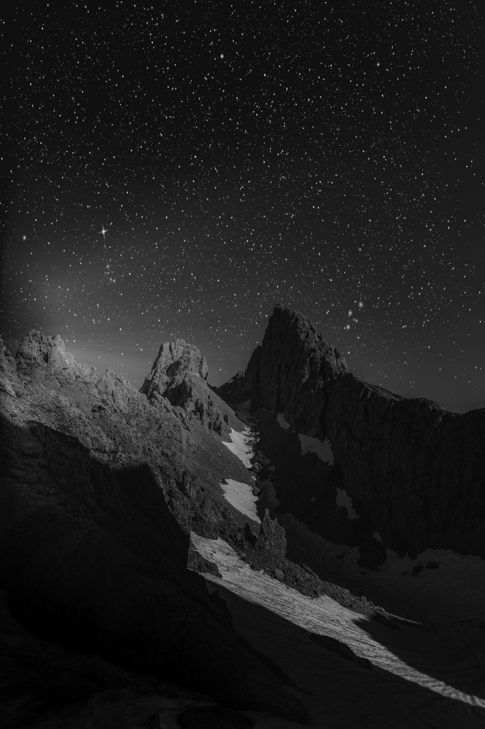
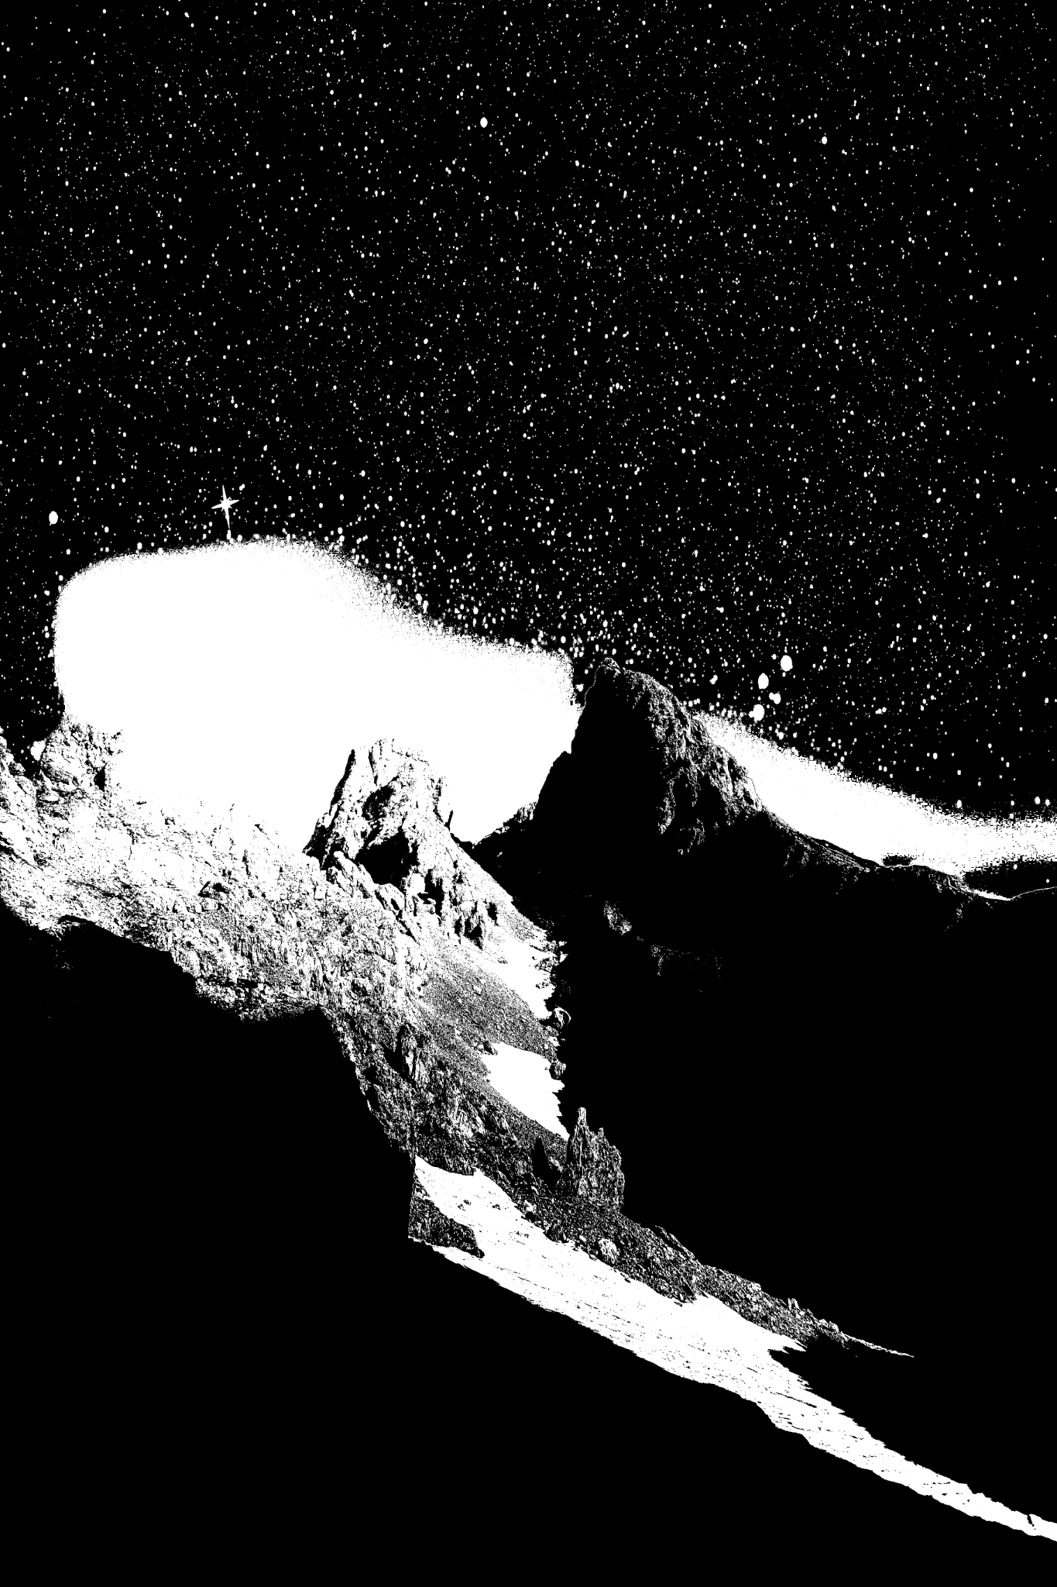
Thresholding
Original Solution based on processing times
Theory
Choosing a value and adjusting the image based on their relation to the chosen value.
Binary
Gray Level
Not incredibly useful for our problem

Slide 37
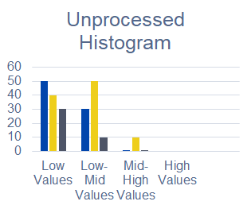
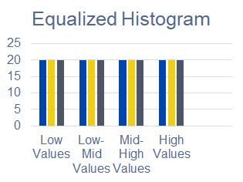
Contrast Limited Adaptive Histogram Equalization (CLAHE)
Utilizes the Histogram Equalization Technique
Histogram Equalization
Takes the values of the images and tries to equalize the frequency in which they appear.
Useful when there might be glare or washed-out images.
Global Transform

Slide 38
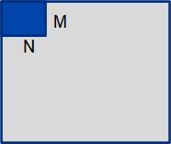
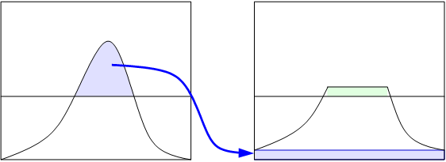
CLAHE cont.
Adaptive Histogram Equalization
Tile Size (Neighborhood)
NxM grid
At Borders Bilateral Interpolation
Contrast Limited
Clip Limit
Noise Limiting

Slide 39
Implementation
Python (Prototyping)
OpenCV
Google Colaboratory (Jupyter Notebook)
Anaconda Spyder
Didn’t display updated matrixes well
C#
Emgu.CV (.Net wrapper of OpenCV)
Visual Studio
Better Graphical User Interface (GUI)
Testing.

Slide 40
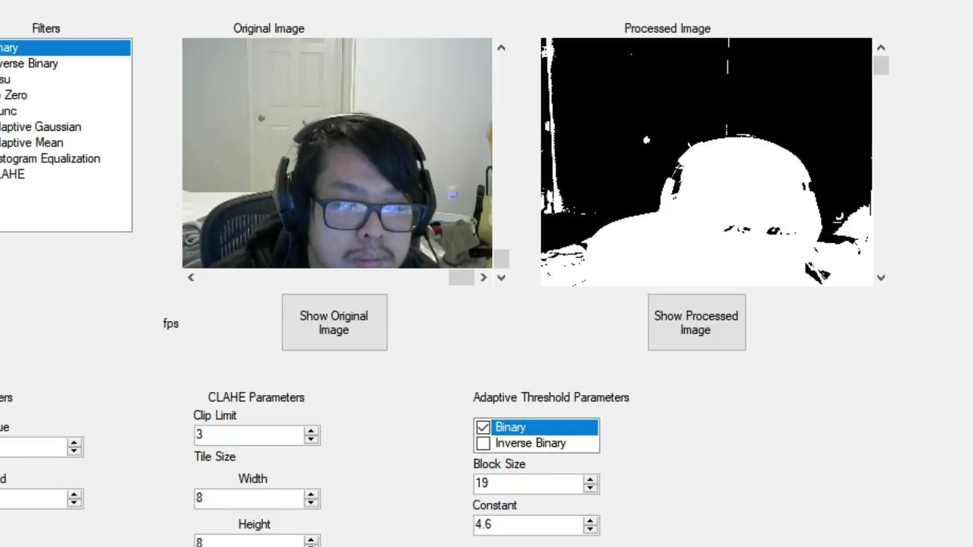
Issues
The original python programming did not display updated frames very well
Multiple Filters at once created stuttering of the frame
Preprocessing Technique
Permissions from Microsoft for HoloLens Access

Slide 41
Additional Applications
Post Processing Technique
Can be used in conjunction with a post processing technique to clear isolate certain parts of the image
Reconstruction
3D mapping for future exploration

Slide 42
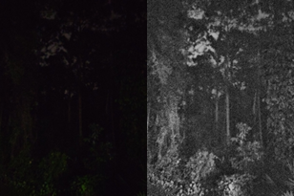
Systems and Devices
Webcam with Windows (Video)
Webcam with OSX (Video)
Pi Camera with Linux (Video)
Dash Cam Data (Video)
Camera Images (.jpeg, .tiff, …)

Slide 43
Budget and Finances
Teo
Notes:
The following table addresses our financial budget for the project as well as the funding we received. Again, we want to thank our sponsors, the Florida Space Grant Consortium and the George Jackson Foundation.

Slide 44
Questions?
Notes:
On the behalf of all of us in group 6, we would like to thank you all for taking the time to attend and listen to our presentation. We hope you enjoyed it and we look forward to answering any questions you may have. Thank you again.

Slide 45
Thank you!
Notes:
On the behalf of all of us in group 6, we would like to thank you all for taking the time to view our demo video. We hope you enjoyed it and we look forward to our discussion. We would like to express our gratitude to our sponsors, Florida Space Grant Consortium and the George Jackson Foundation. Thank you again.

