Slide 1
Lunar Exploration using Augmented Reality (LEAR)
Group 6:
Teo Malendevych Photonic Engineering
Sammy Lee Photonic Engineering
David Brown Computer Engineering
Yongsheng Xu Electrical Engineering
Sponsored By:
George Jackson Foundation
NASA Florida Space Grant Consortium
Notes:
Good Morning, today we will talking about the LEAR senior design project, Lunar Exploration using Augmented Reality. My name is Teo Malendevych, a Photonic Engineer onboard the team. I am joined by Sammy Lee, another Photonic Engineer, David Brown, a Computer Engineer, and Yongsheng Xu out of electrical Engineering. I would also like to recognize and thank our sponsors, the George Jackson Foundation and the NASA Florida Space Grant Consortium.

Slide 2
Project Overview

Slide 3
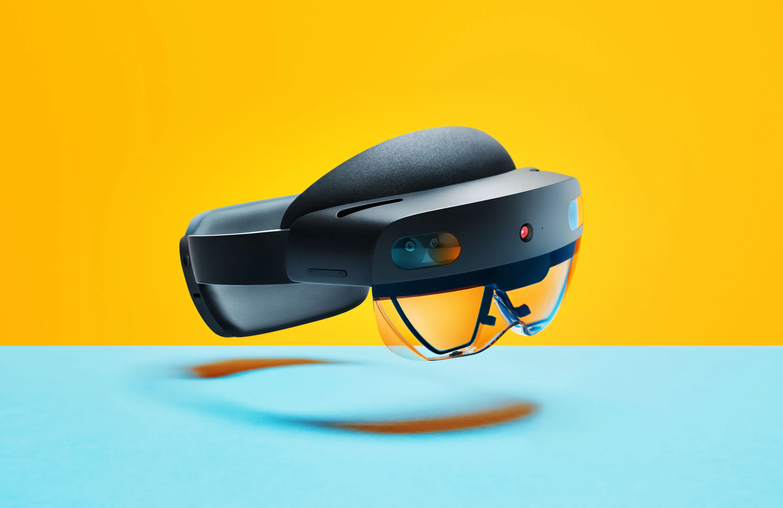
Inspiration
Teo
Notes:
The inspiration for this project starts with the NASA SUITS Challenge. As NASA pursues future Artemis missions that will land American astronauts on the moon by 2024, the agency is interested in enabling these astronauts with more assistance from modern technologies. Displays like augmented reality headsets (AR) will be implemented in future Extravehicular Activity Mobility Unit (xEMU) spacesuits to enable interfacing with lunar payloads, support science work, visualize consumables, streamline crew-to-crew communication, bolster Mission Control Center (MCC) interaction methods and navigate terrain. We are taking on the challenge. We will be utilizing a Microsoft Hololens II and all of its capabilities to aid the astronauts in navigation, tasks, and monitoring their vitals.

Slide 4
Goals and Objectives
General:
Display of Extravehicular activity (EVA) tasks
Communication with Mission Control
System Tutorial
Navigation and Task Assistance:
Guidance from point A to point B
Location of points of interest, lander, partners
Available notes and directions for tasks
Ability to capture video and images
Assistance with high-contrast areas on the moon
Peripheral Devices:
Wrist-mounted optical heart rate monitor and pulse oximeter
Outside temperature sensor
Wireless communication with headset
Teo
Notes:
In terms of our goals and objectives, our project is designed with the astronaut in mind. We are creating a User Interface for displaying extravehicular activity or EVA tasks, and communication with mission control. A system tutorial will be implemented for training new users. The Headset will guide the astronauts to and from designated locations such as the lander, geological sites, points of interest, as well as their partners on the moon. For task management, we will provide the astronaut with non-obstructive directions on tasks as well as the ability to capture video and images. Due to the Artemis Mission’s landing point on the Lunar south pole of the moon, NASA anticipates issues with lighting. Long shadows as well as over-illumination will cause problems for recognizing obstacles and terrain. Therefore, we will apply image processing techniques in the headset to aid the astronaut in these high-contrast conditions. We are also implementing a vitals subsystem outside the Hololens to measure outside temperature, the heart rate and oxygen saturation of the astronaut. This data will be wirelessly transmitted to the headset and Mission control for vitals monitoring.

Slide 5
Requirements and Specifications
Guide user in real-time to any marked coordinates of interest within a range of 2 kilometers from starting position.
Monitor suit vitals (O2, H2O, etc) and alert user if values are abnormal or approach dangerous levels.
Provide a method for taking images and videos
Monitor user pulse and alert if value approaches abnormal levels (>100 bpm or <60 bpm
Image Processing should not be less than 30 frames per second.
Heart rate monitor PCB: 5 cm x 5 cm
Measurement of heart rate and SO₂ accurate to 10%
Wireless transmission of 10 ft
Temperature measurements accurate to 2%
Operable with gloved hands
Teo
Notes:
The following slides list the requirements and specifications of our project. While there are more requirements for the NASA SUITS Challenge, we deem these as the most important. We will be focusing on navigation, task management, image processing, and our external sensors.

Slide 6
External System Design

Slide 7
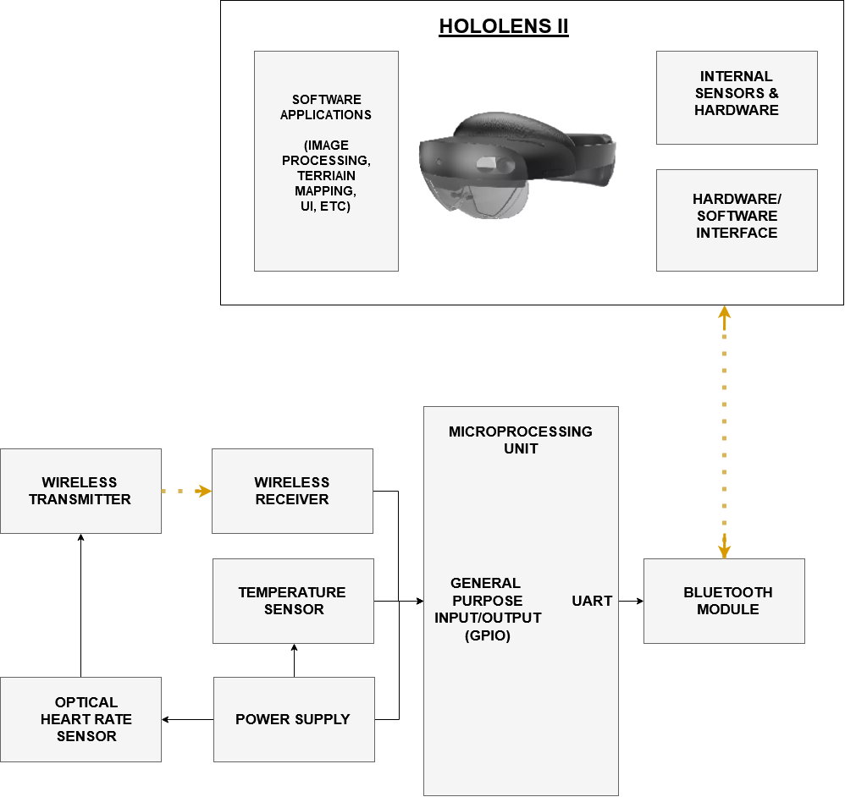
Hardware Design
External sensors to monitor suit (and astronaut) vitals
Temperature
Heart Rate
Microprocessor receives sensor data
Wirelessly transmitted via bluetooth
Teo
Notes:
The following flowchart depicts our hardware design. The optical heart rate monitor and pulse oximeter will be located on the wrist and wirelessly transmit data to our microprocessing unit. The temperature sensor will be directly wired into the microprocessor, which will be sent to the Hololens II using Bluetooth. The headset will receive the sensor data and display the information to the astronaut. We will also be utilizing the cameras in the Hololens II to record video, perform image processing on the internal GPU of the headset, and display the processed video to the astronaut.

Slide 8
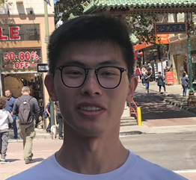
Microcontroller Consideration
 | MSP430FR6989 | Raspberry Pi 4 | Arduino Uno
Clock Frequency | 16 MHz | 1.5 GHz | 16 MHz
Memory Size | 128KB | 2GB | 32KB
Operating Voltage | 1.8V - 3.6V | 5.1V | 5V
Digital I/O pins | 12 | 40 | 14
Cost | $ 24 | $ 25 | $ 23
Yong

Slide 9
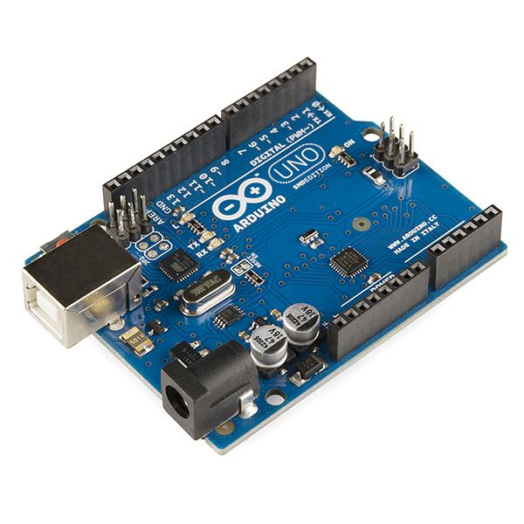
Microcontroller
-Arduino Uno R3
Open source in hardware and software
IDE software supports any OS
Programing ease
Easy to find documentations
Example projects with same electric parts we use
Yong

Slide 10
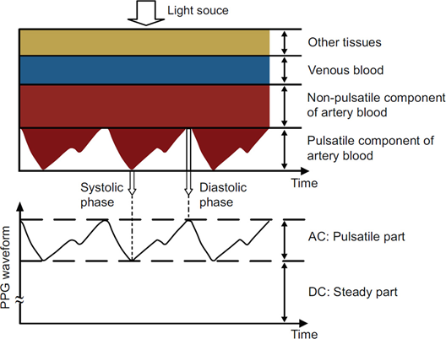
Heart Rate Monitor and Pulse Oximeter
Theory
Teo
Notes:
I want to quickly go over the theory behind the optical heart rate monitor and pulse oximeter. As light propagates through the skin, it will be reflected at every interface back towards the source. As the volume of blood in the blood vessels change, so does the amount of light reflected. If a photodiode is placed near the light source, the result has an AC signal, corresponding to the blood transmission and DC signal, corresponding to any non-pulsatile components. The heart rate can be simply calculated from the frequency of the AC signal. The oxygen saturation, or the percentage of the hemoglobin saturated with oxygen denoted by SpO2, requires a modified version of the Beer-Lambert Law to calculate and is dependent on both the AC and DC signal of two different wavelength sources. However, we don’t have all the information in the formula, specifically variable L, measuring the optical path length of the light. Therefore, we will have to calibrate the instrument using an off-the-shelf pulse oximeter.

Slide 11
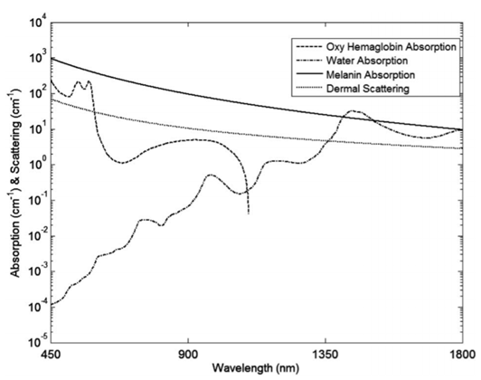
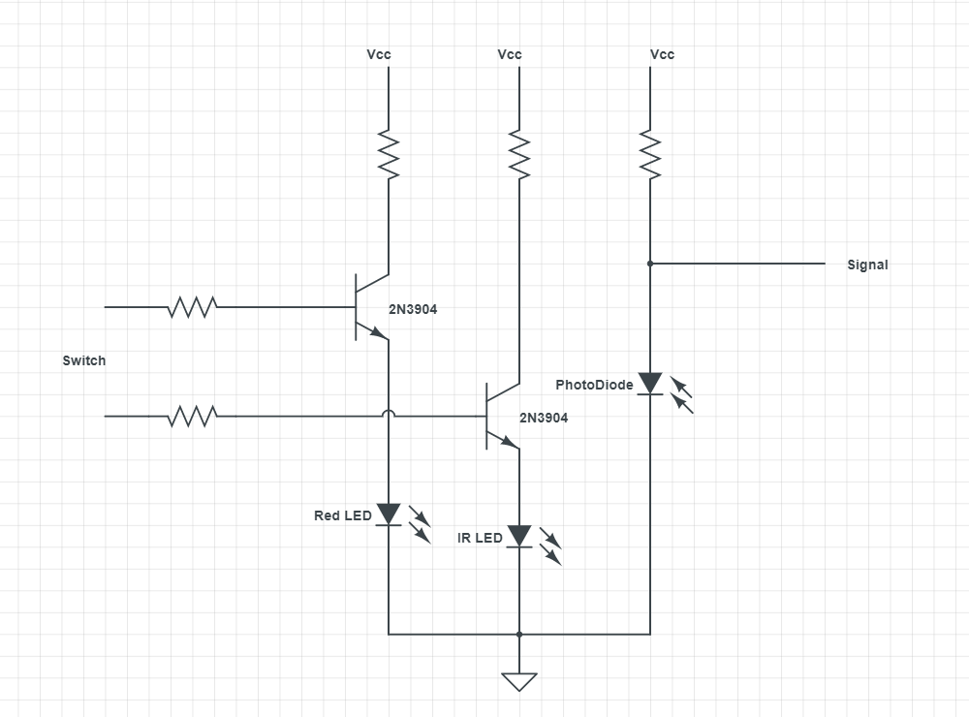
Heart Rate Monitor and Pulse Oximeter
Part Selection & Design
IR LED: Vishay Semiconductors VSMY2943G, Emitter Wavelength: 940 nm, LxW: 5.8 mm by 2.3 mm
Red LED: Cree XLamp XP-E2 LED, Emitter Wavelength: 650-670 nm, LxW: 3.5 mm by 3.5 mm,
Photodiodes: Osram LPT 80A Phototransistor, Spectral Range of Sensitivity: 450 - 1100 nm, LxW: 5 mm by 6 mm
Filters: Edmund Optics Optical Cast Longpass IR Filter, Edmund Optics IR Cut-Off Filter
Teo
Notes:
When choosing parts for this device, we had to consider the wavelengths of LEDs we were using as well as the size. We chose 940 nm for the Infrared LED and 660 nm for the red LED, which are very common wavelengths for off the shelf pulse oximeters. In our design, the LEDs both can’t be on at the same time as doing so would lead to interference in the signals, so we will alternate which one is on every five seconds. That way, we will have a continuous reading of heart rate and a measurement of oxygen saturation every five seconds.

Slide 12
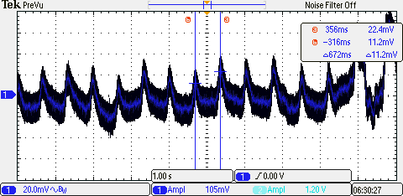
Heart Rate Monitor and Pulse Oximeter
Testing
Teo
Notes:
While we are still waiting for the pulse oximeter PCB to arrive, we did some preliminary tests. A simple test circuit was built on a breadboard with the components listed on the previous slide and I was successfully able to measure my heart rate. The AC signal can be easily seen in the following image and the heart rate was calculated to be 89.3 BPM. From my experimentation, the signal is somewhat finnicky probably due loose nature of the components, but the PCB and its housing should present us with stability.

Slide 13
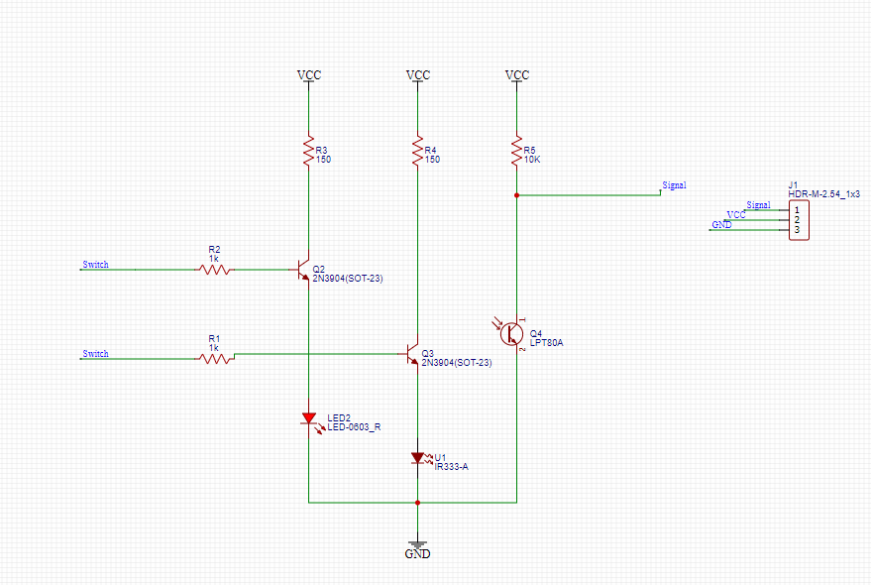
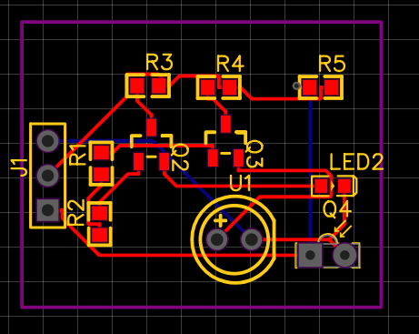
PCB Design for Heart Rate Monitor
Yong

Slide 14
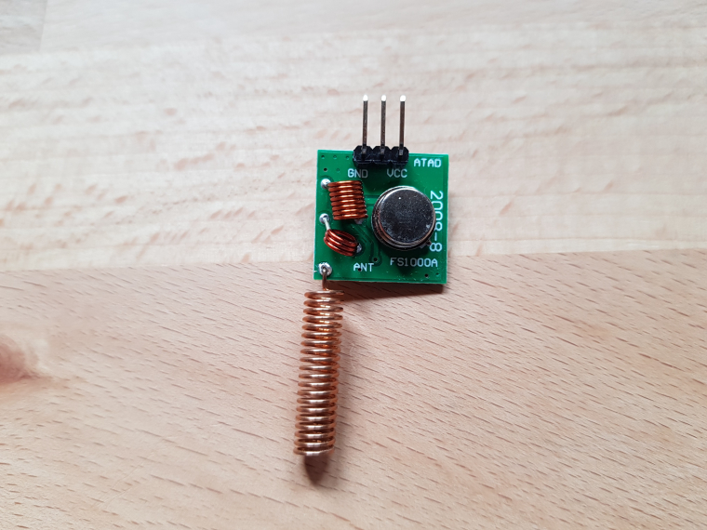
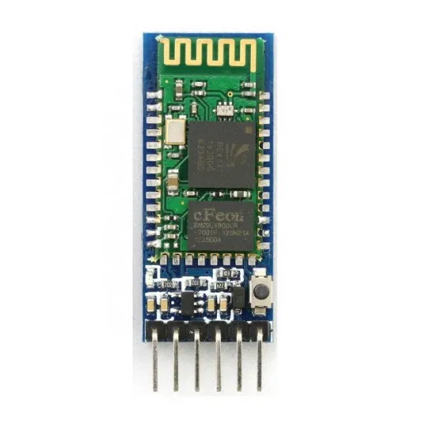
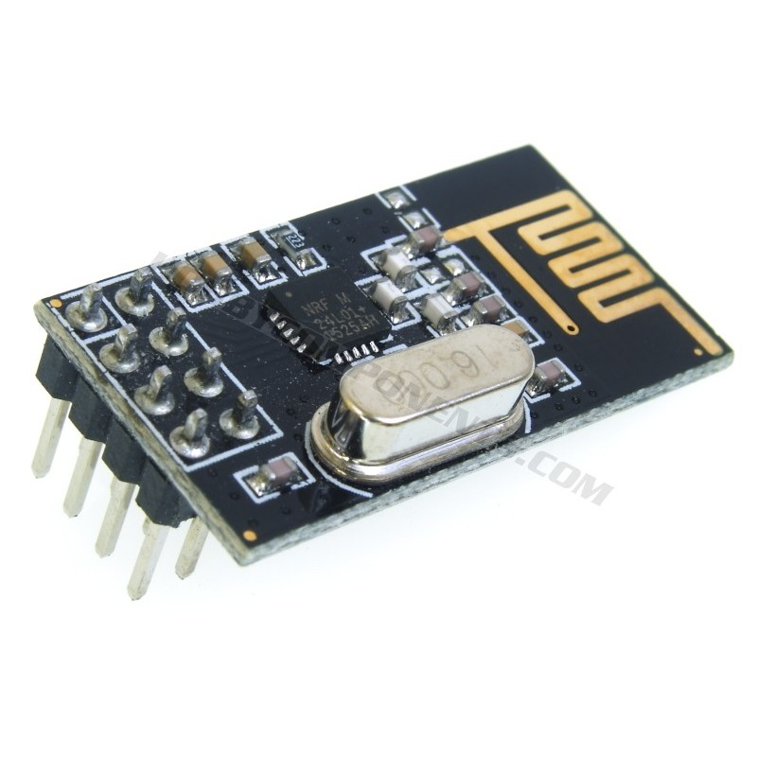
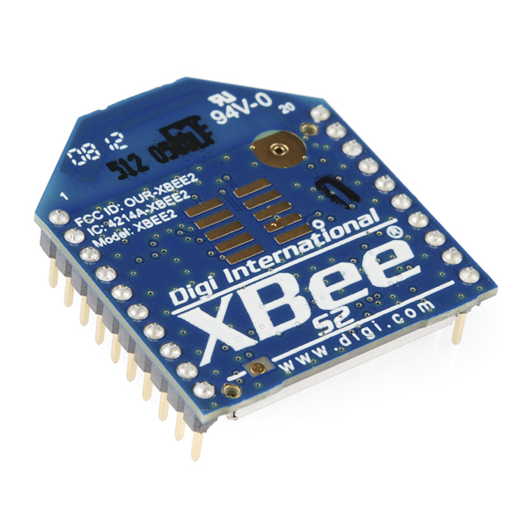
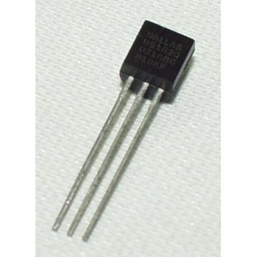
Wireless Communication Module
Goal: Serial communication streams between all sensors, microprocessing units, and the HoloLens
Parts we used: FS1000A Wireless RF Module, HC-05 Bluetooth Module,
nRF24L01 Transceiver, Zigbee Wireless Communication Module, DS18S20 Digital Temperature Sensor
Yong

Slide 15
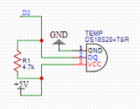
Temperature Sensor
DS18S20 Temperature Sensor
3-pin connection
One-wire structure (use Dallas Temperature Library)
4.7K ohm pull-up resistor
5V operating voltage
Yong

Slide 16
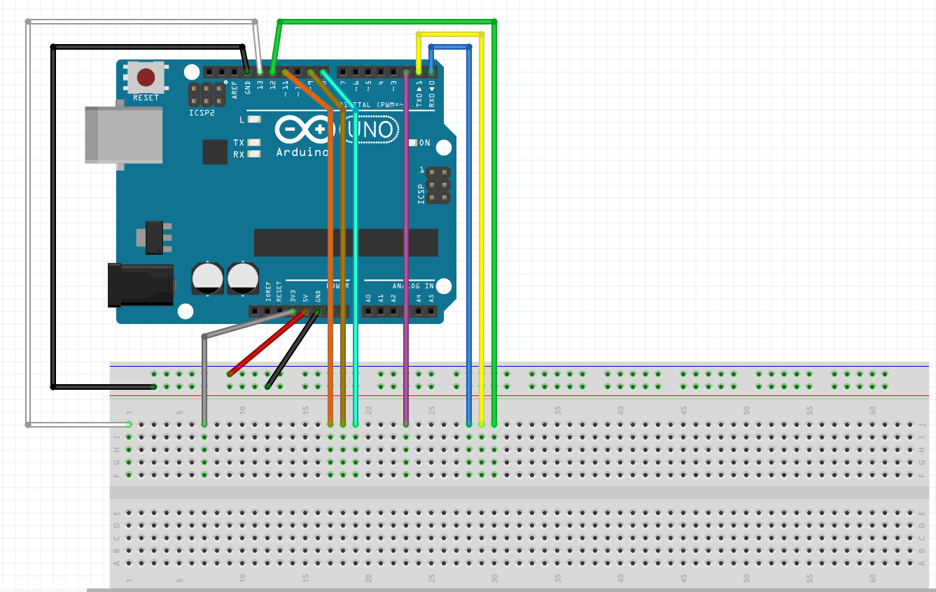
PCB Testing
Before making PCB, we need to decide
what ports we need and how can we
connect it, so we make a schematic diagram
to show all ports needed be connected to a
breadboard.
Yong

Slide 17
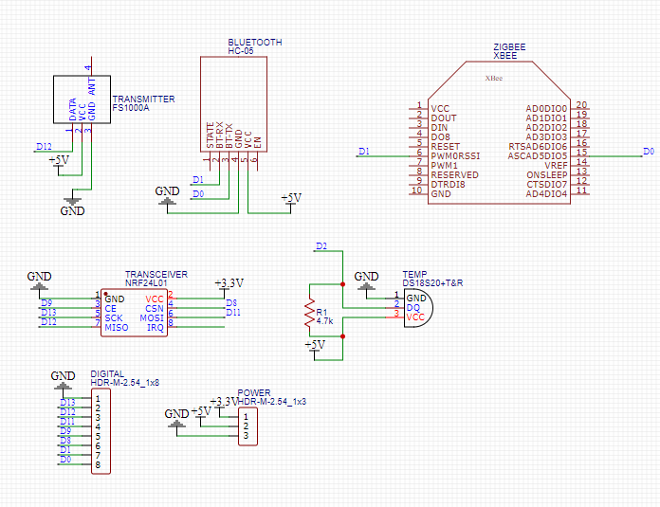
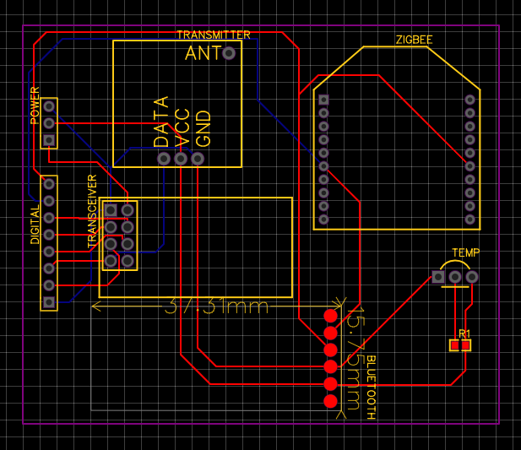
PCB for Wireless Communication Module
Yong

Slide 18
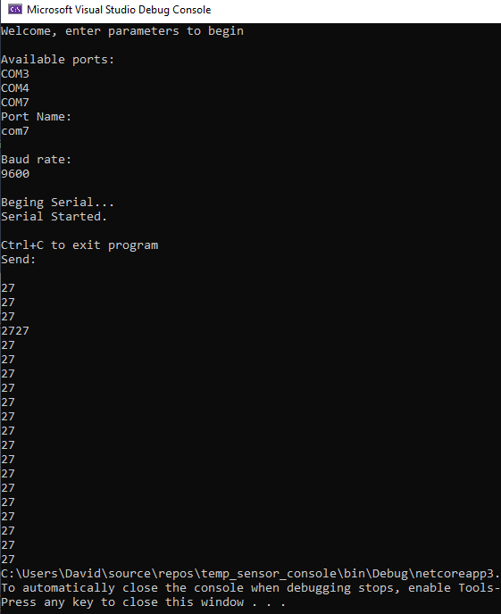
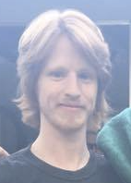
Sensor data using C# console application
Desktop computer receives data via C# console application
C# console application prints temperature to terminal
David
Notes:
53s

Slide 19
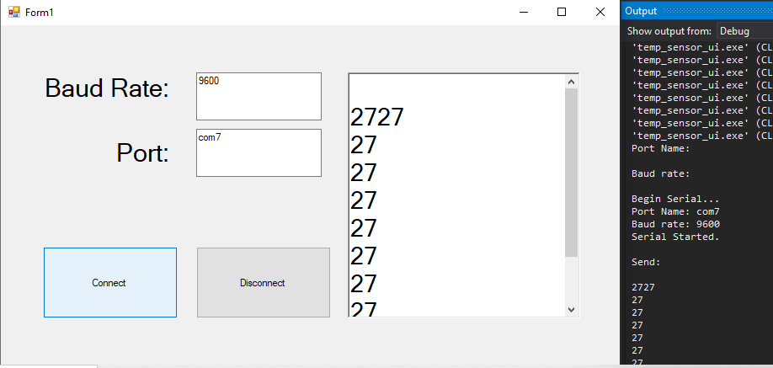
Sensor data with C# User Interface Application
David
Notes:
30s

Slide 20
Software Design
Notes:
5s

Slide 21
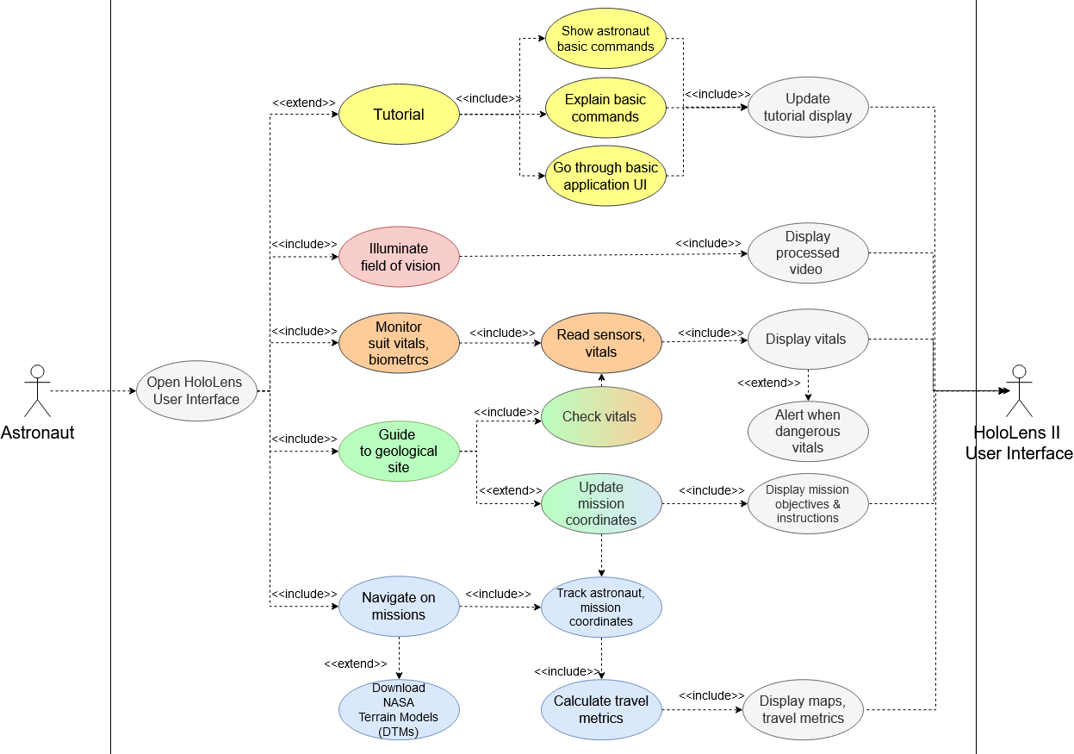
Software Design (Use Cases)
Use Cases
David
Notes:
1min, 54s

Slide 22
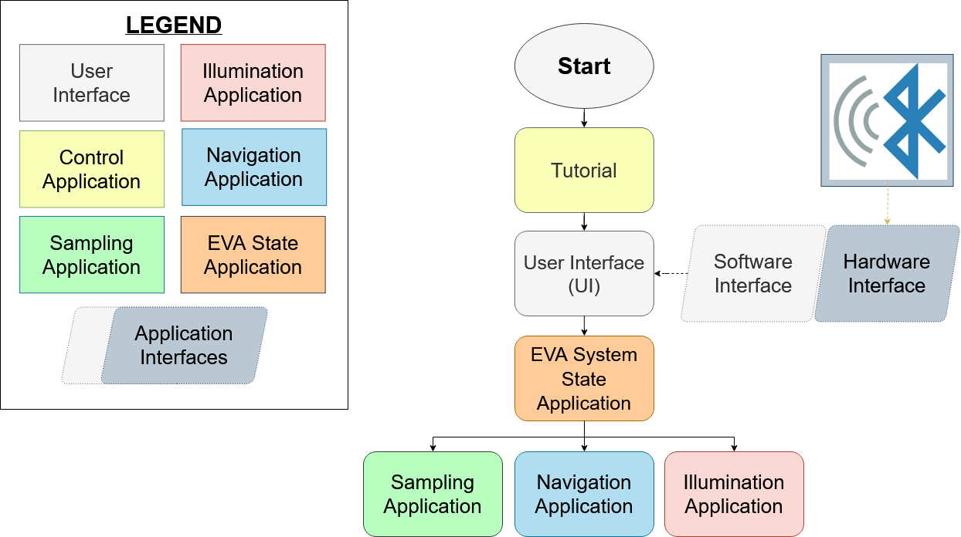
Software Design Overview
NASA objectives:
Control/tutorial
EVA System State
Illumination
Navigation
Geological Sampling
David
Notes:
31s

Slide 23
HoloLens Development Environment
Windows 10 OS, Visual Studio IDE, and 3D engine
3D engines
Unity
Unreal
Native XR
Microsoft-mixed reality toolkit
David
Notes:
55s

Slide 24
EVA System State
David
Notes:
41s

Slide 25
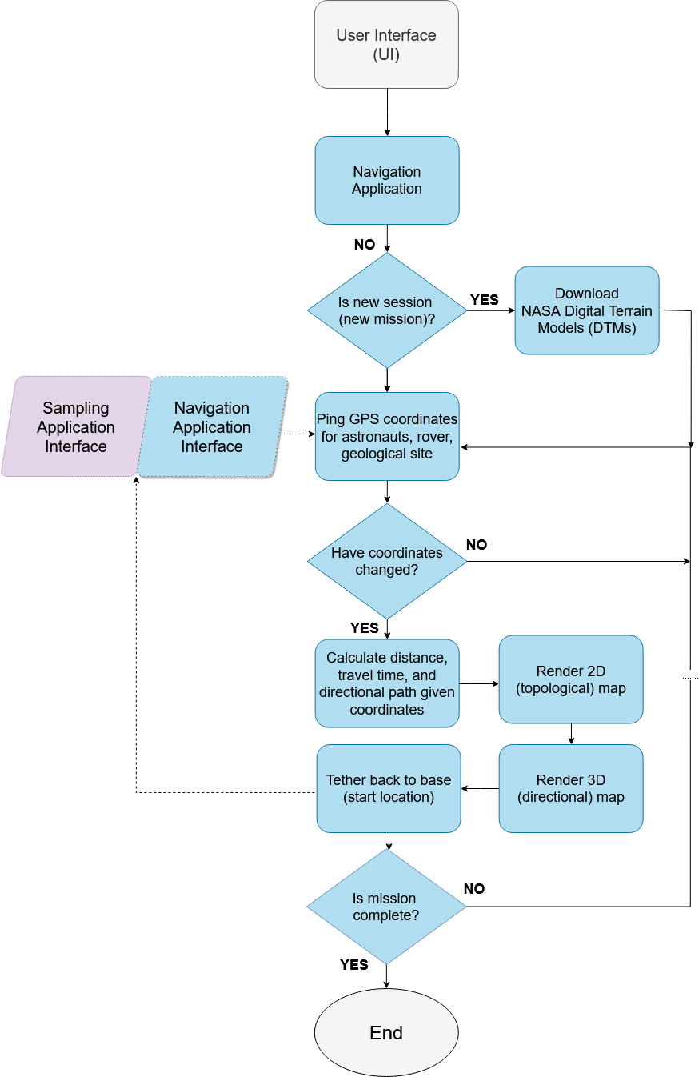
Navigation
David
Notes:
37s

Slide 26
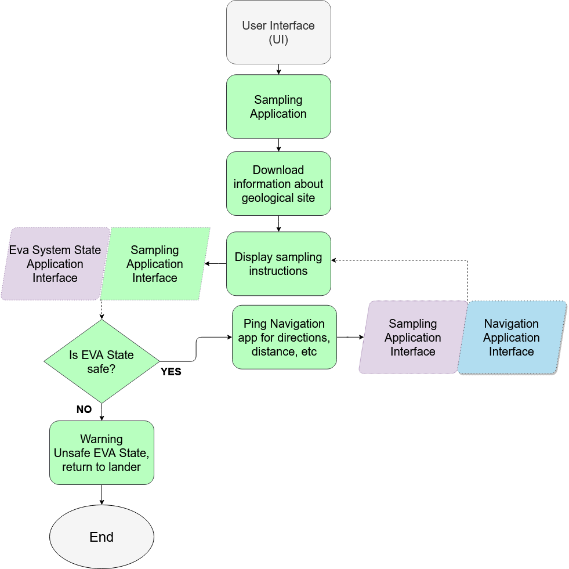
Sampling
David
Notes:
17s

Slide 27
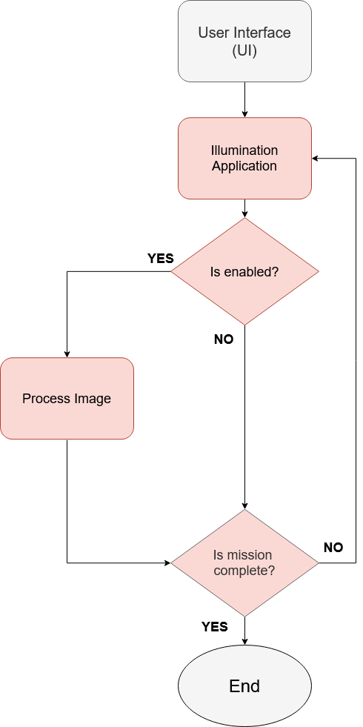
Illumination
David
Notes:
12s

Slide 28
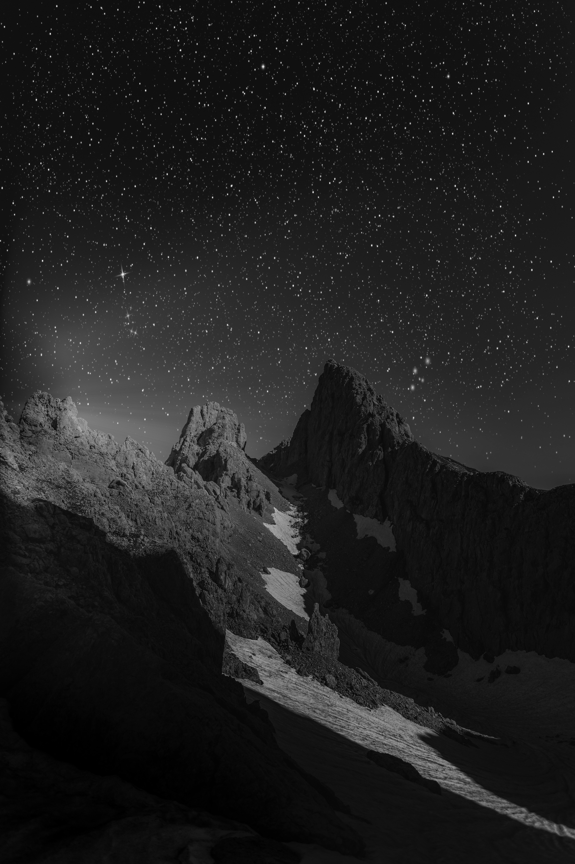
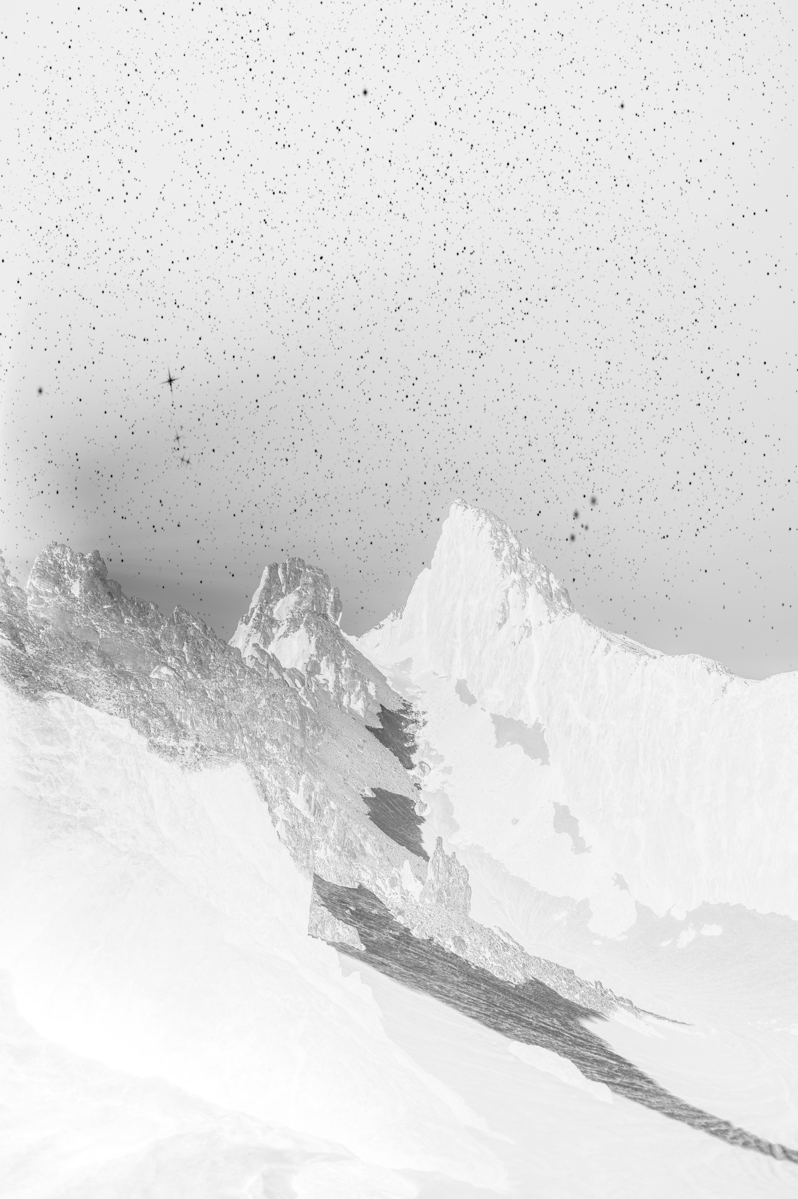
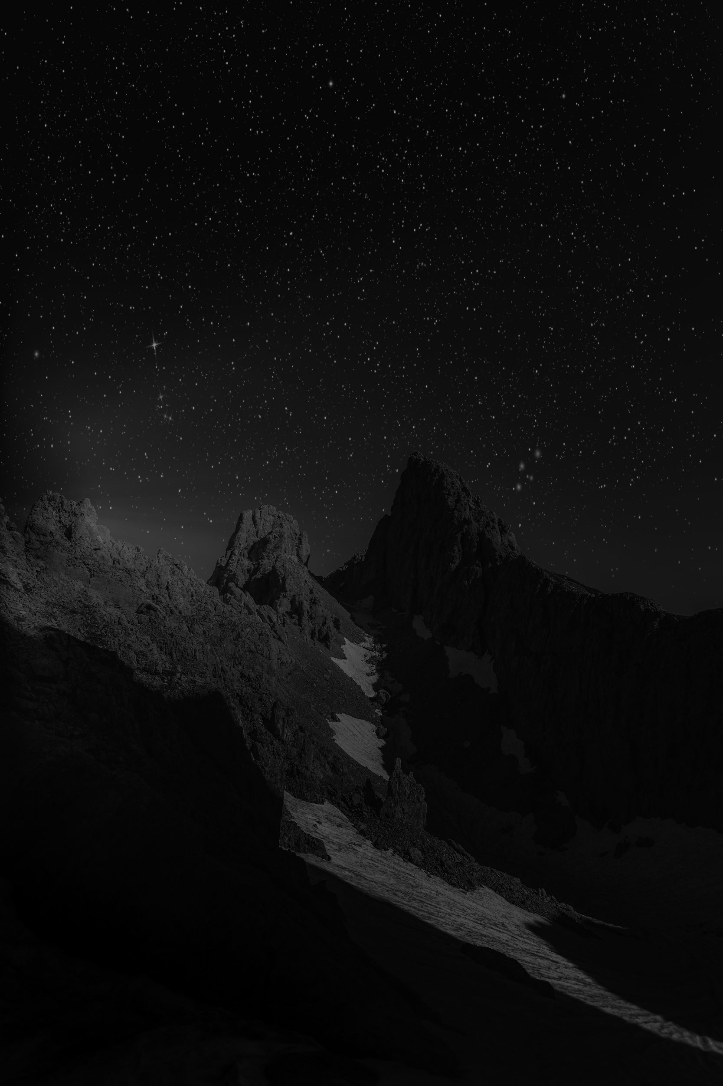
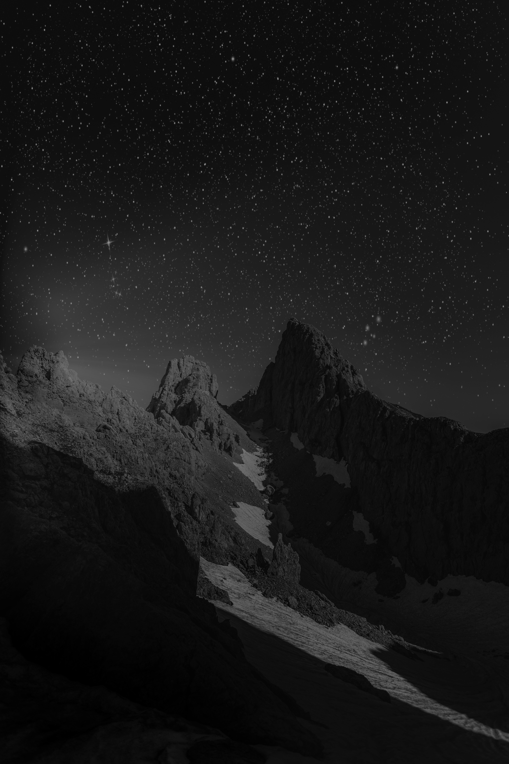
Simple Image Processing Techniques
Global Transformations: Negative Transform, Power Law Transform, Logarithm Transform, Inverse Logarithm Transforms, Simple Arithmetic Transforms
Sam
Base Image
Negative
Inverse Log
Log

Slide 29
Point Processing
Theory: We take each point run it through loops and process each individual pixel.
Some techniques include Thresholding, bit plane slicing, gray level slicing and histogram techniques.
Sam
Notes:
Point Processing is a technique that is used when we want to change or manipulate each pixel individually. This allows a greater range of control over contrast or how the image looks.

Slide 30
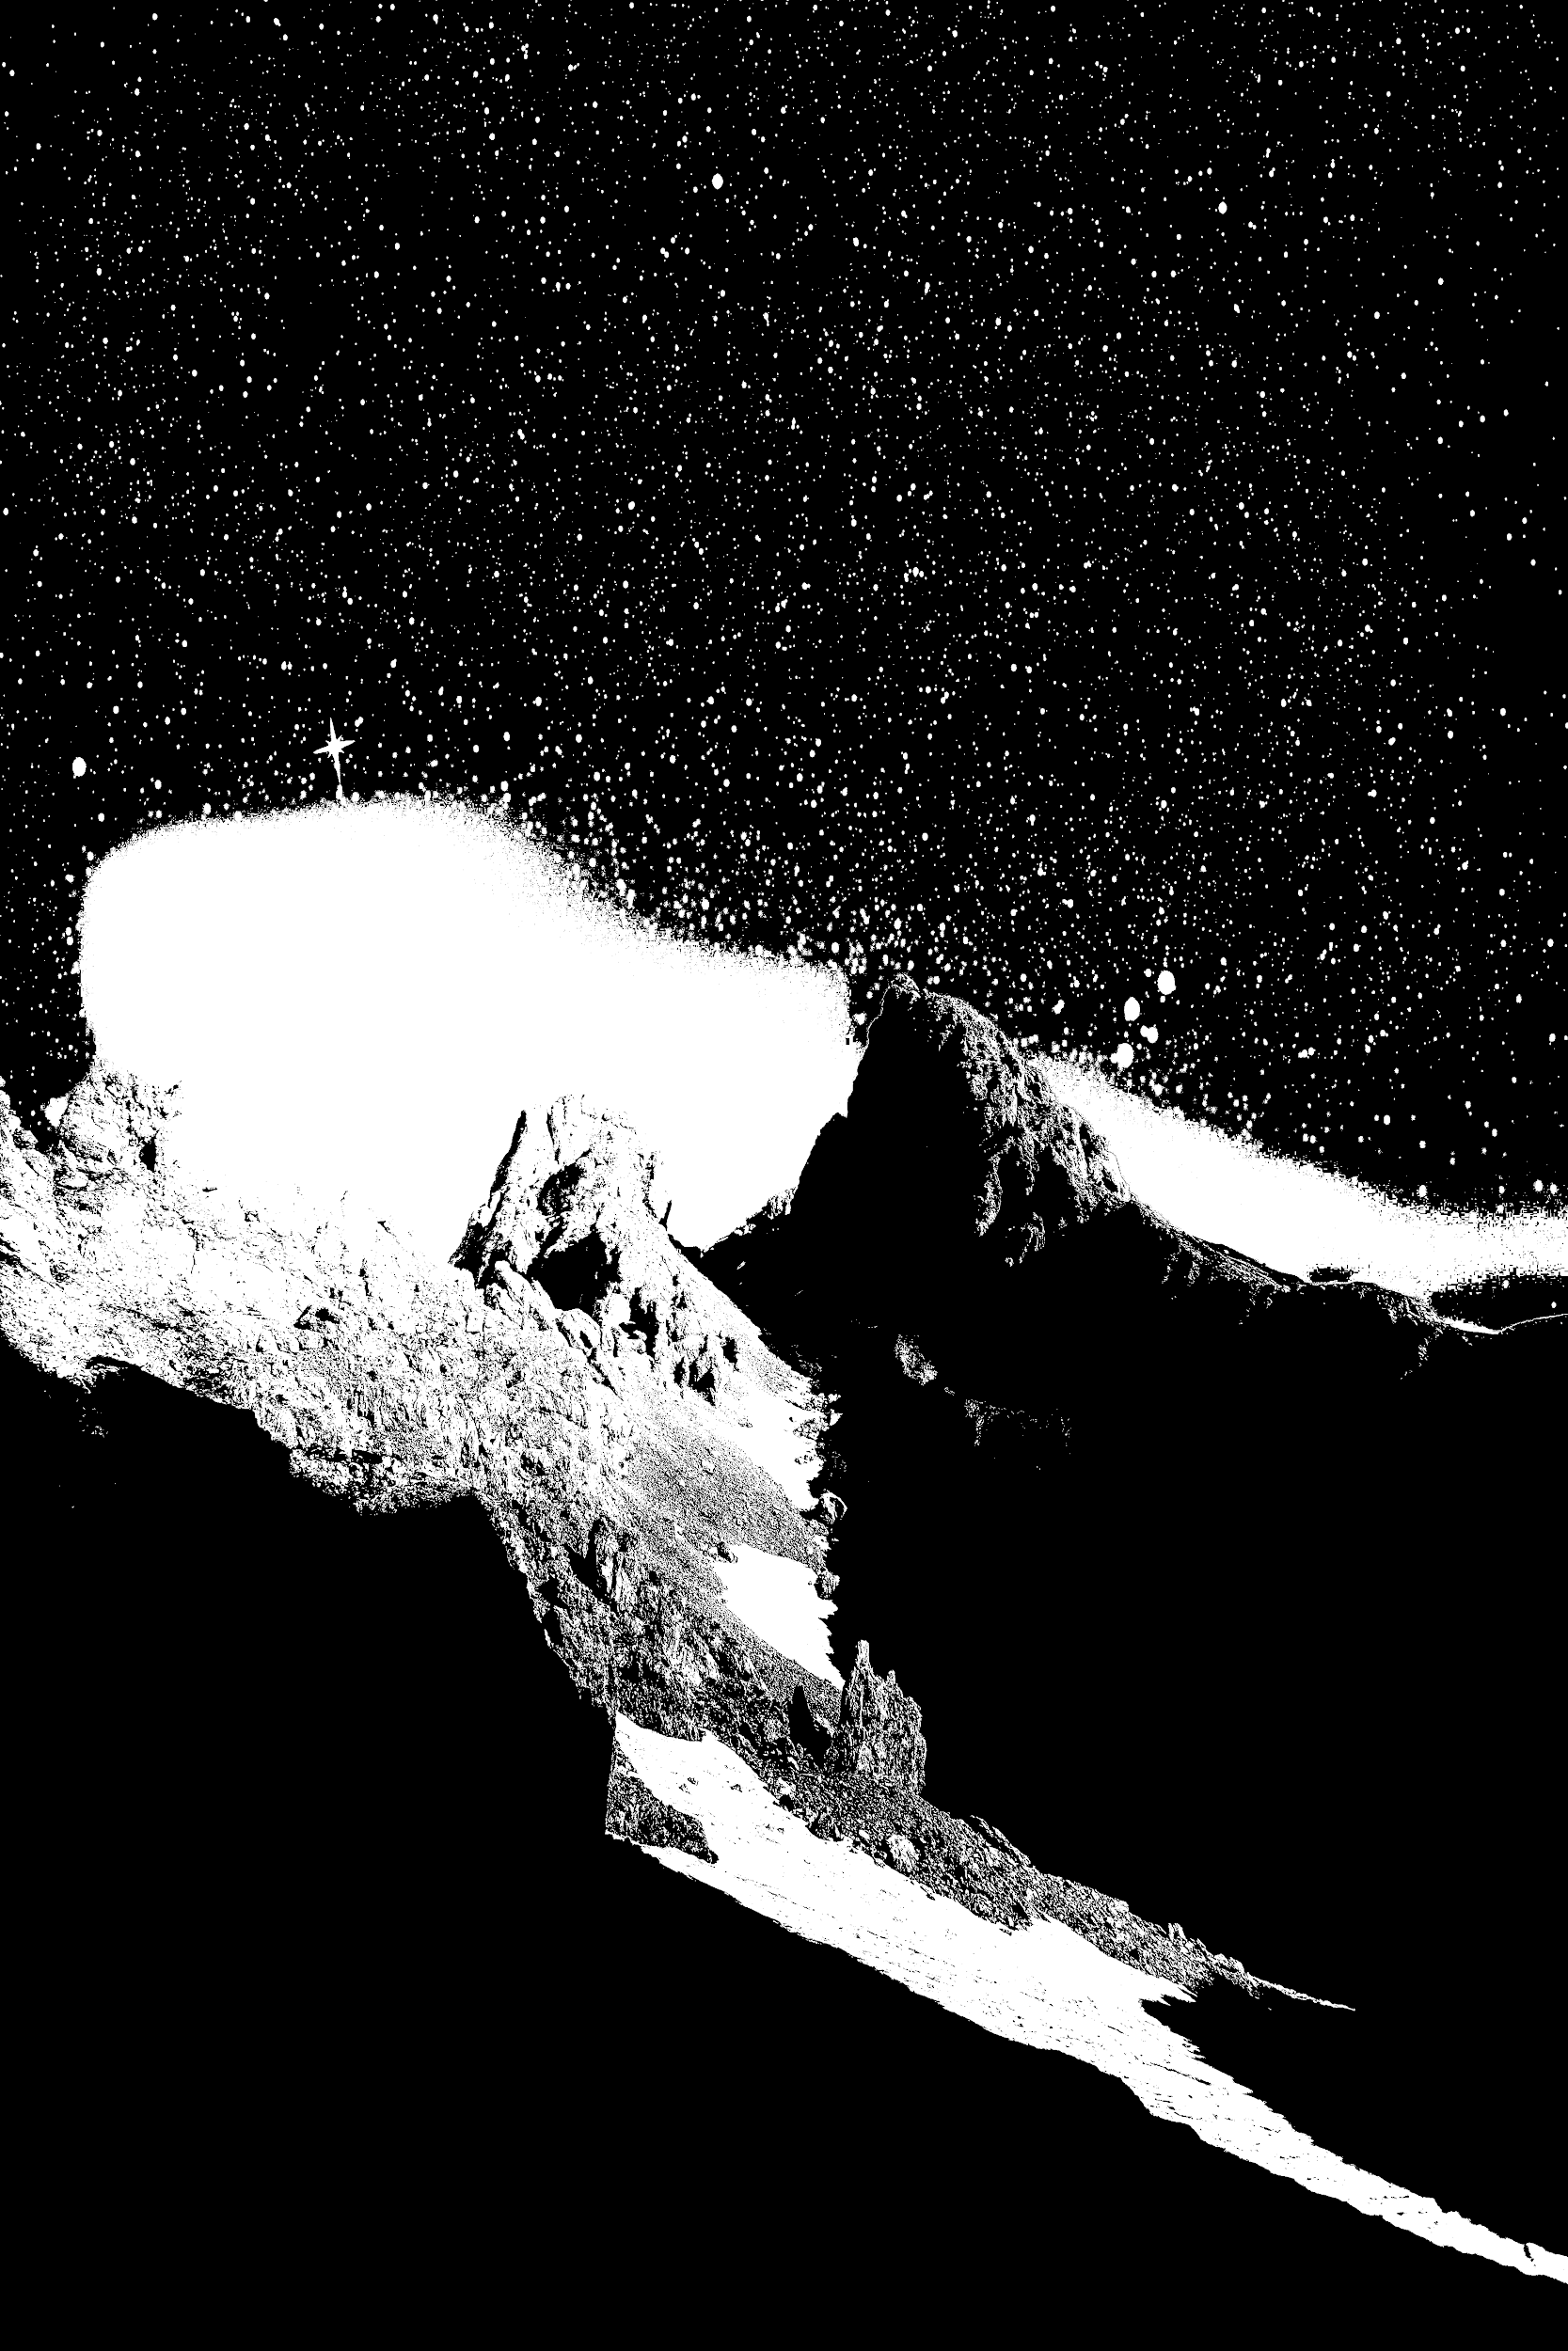
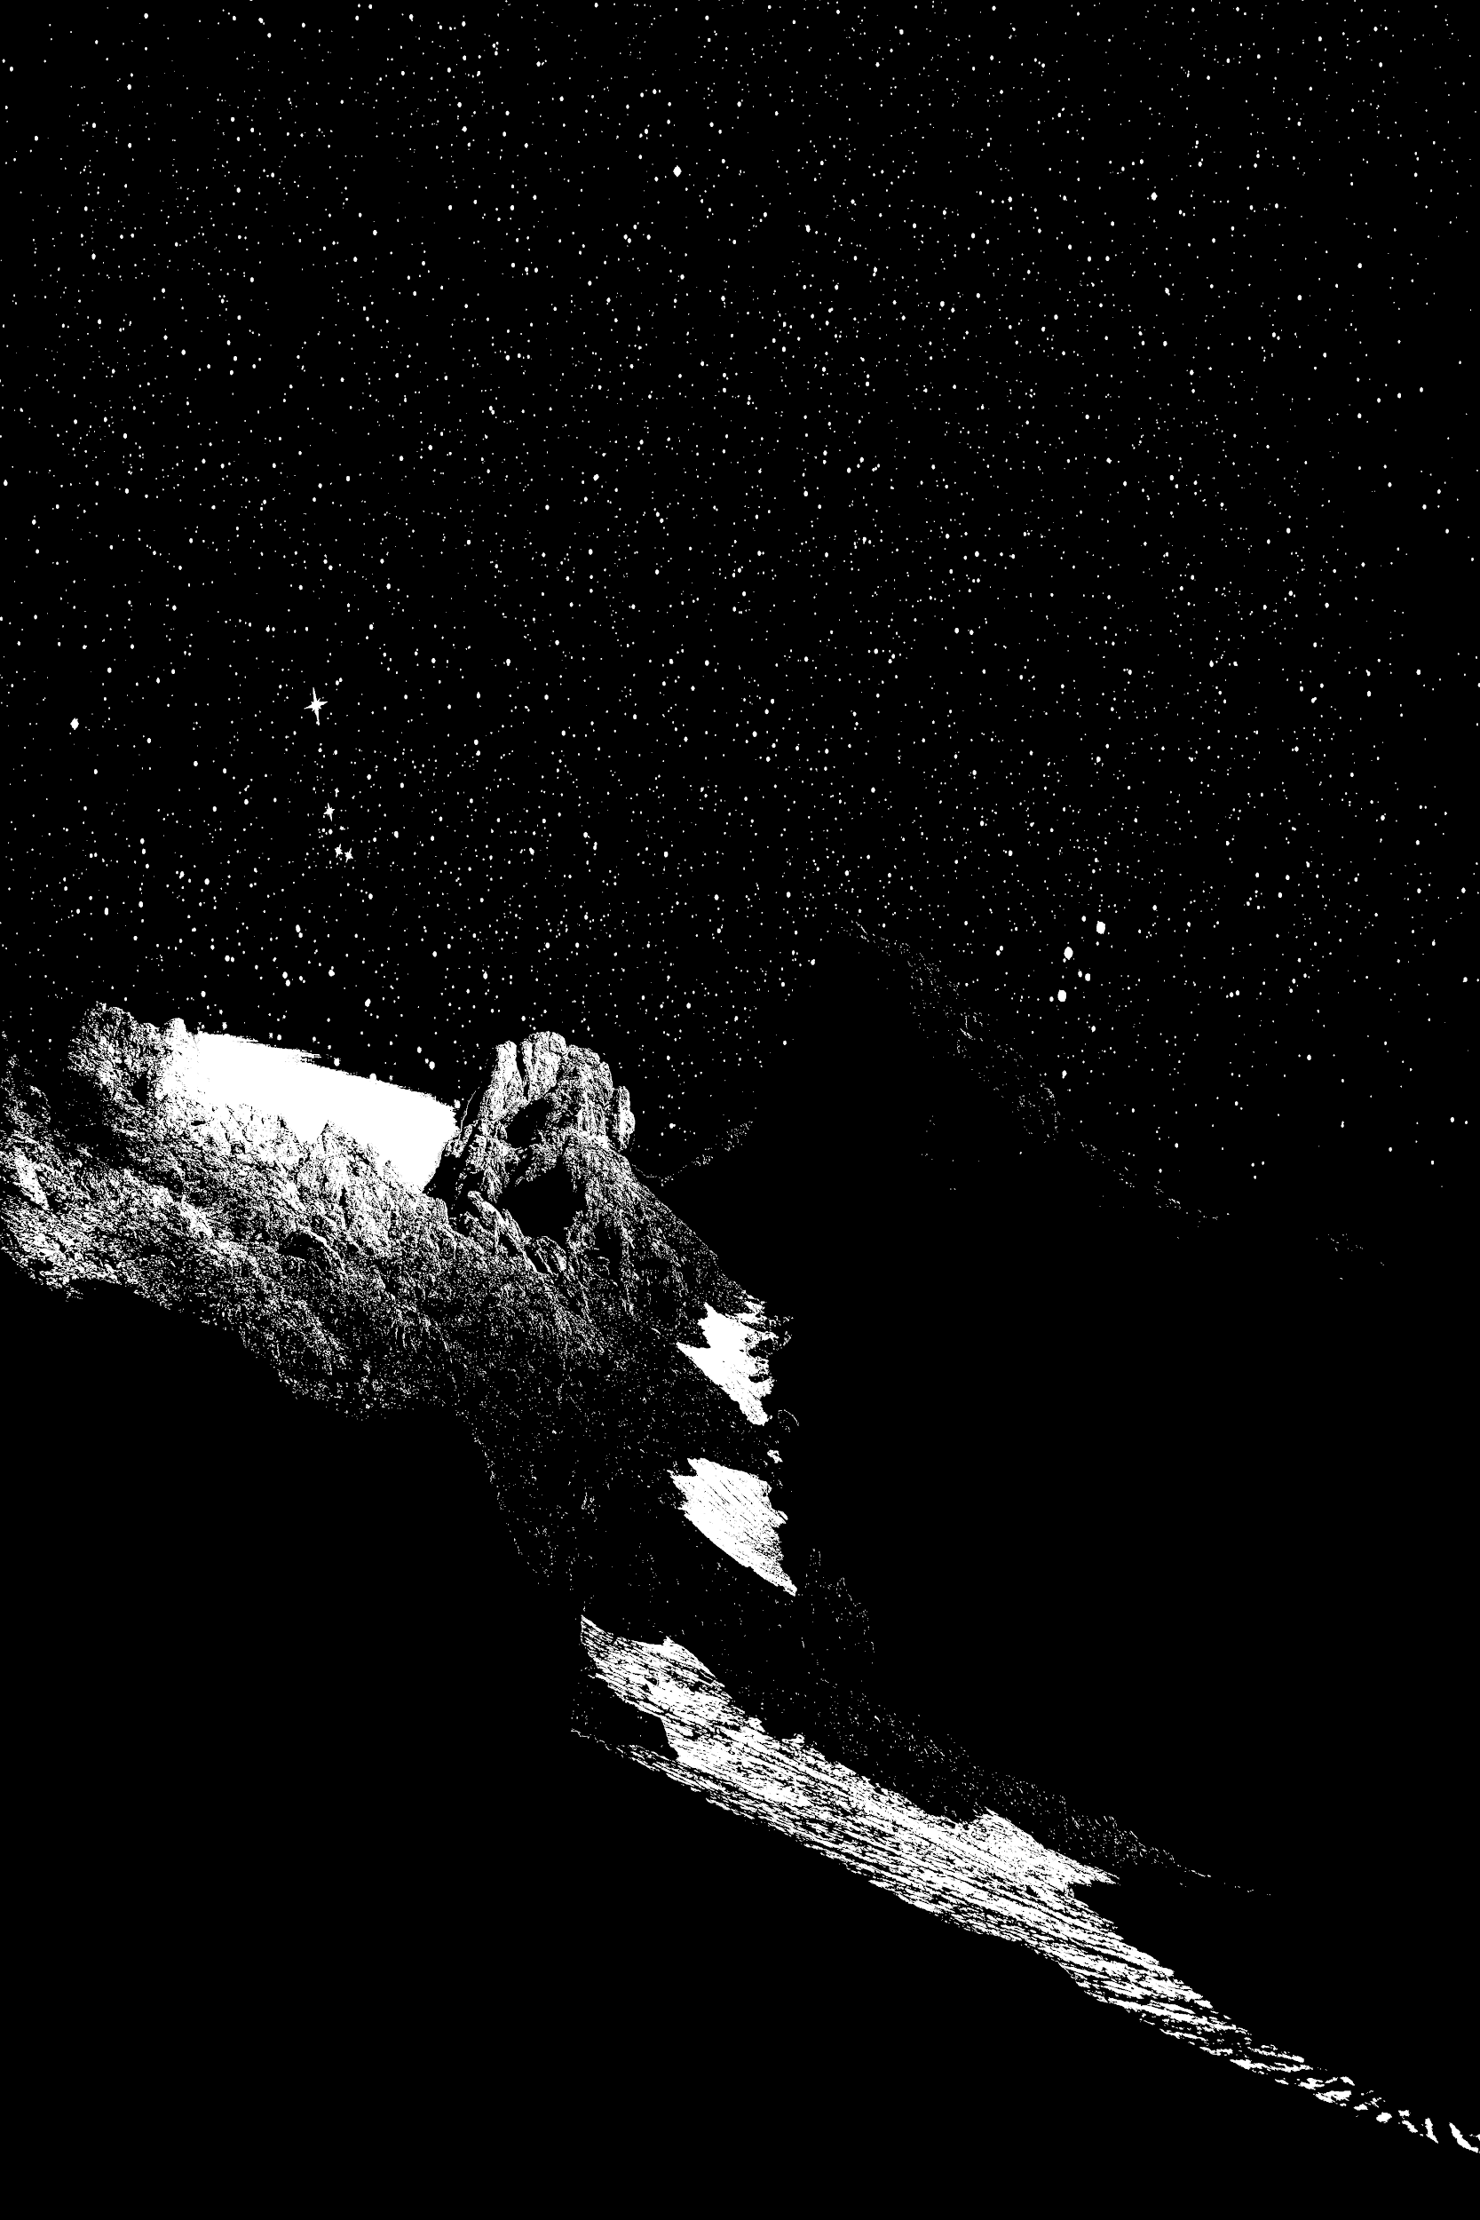
Thresholding
We take a certain pixel value and call it our threshold. We can use this threshold to either create a binary image or different levels.
Sam
Threshold at 50
Threshold at 100
Threshold at 150
Notes:
In thresholding, we create a value in which anything above it or below it is changed to isolate differents part of the image. For a binary threshold, we force any pixel with a value above our selected threshold black and below it white.

Slide 31
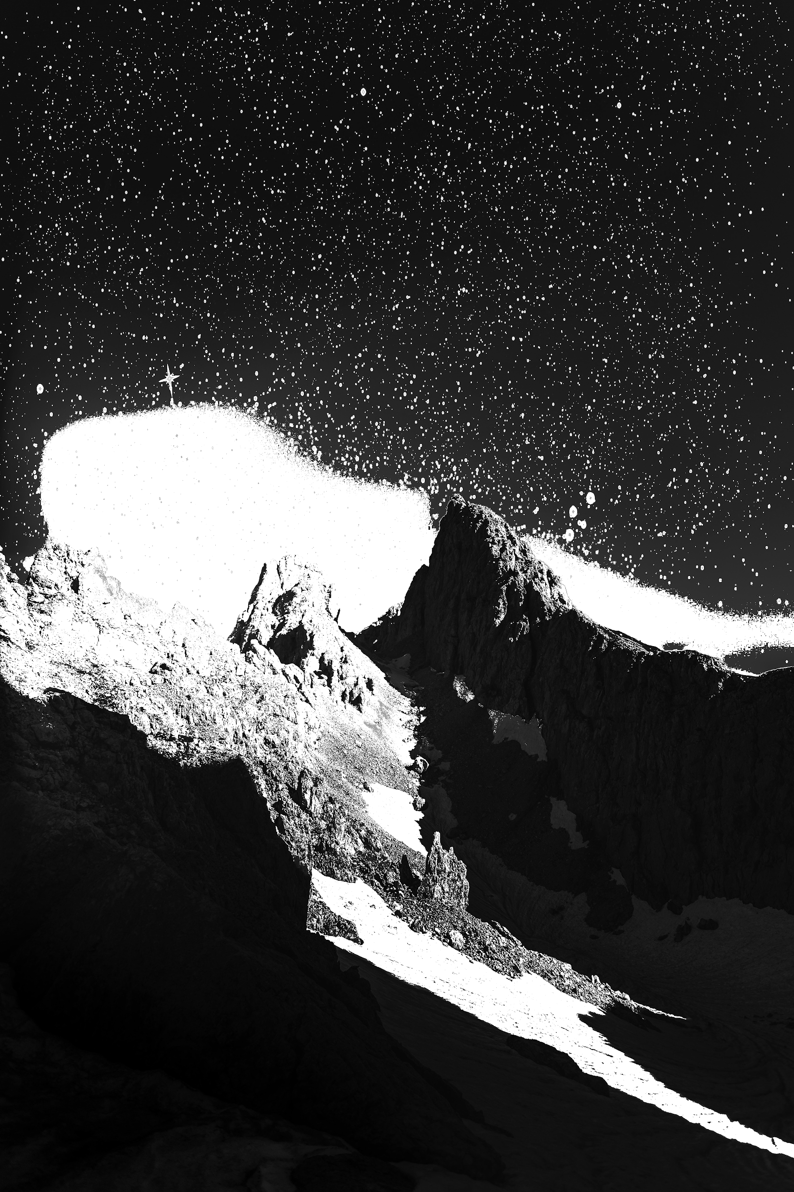
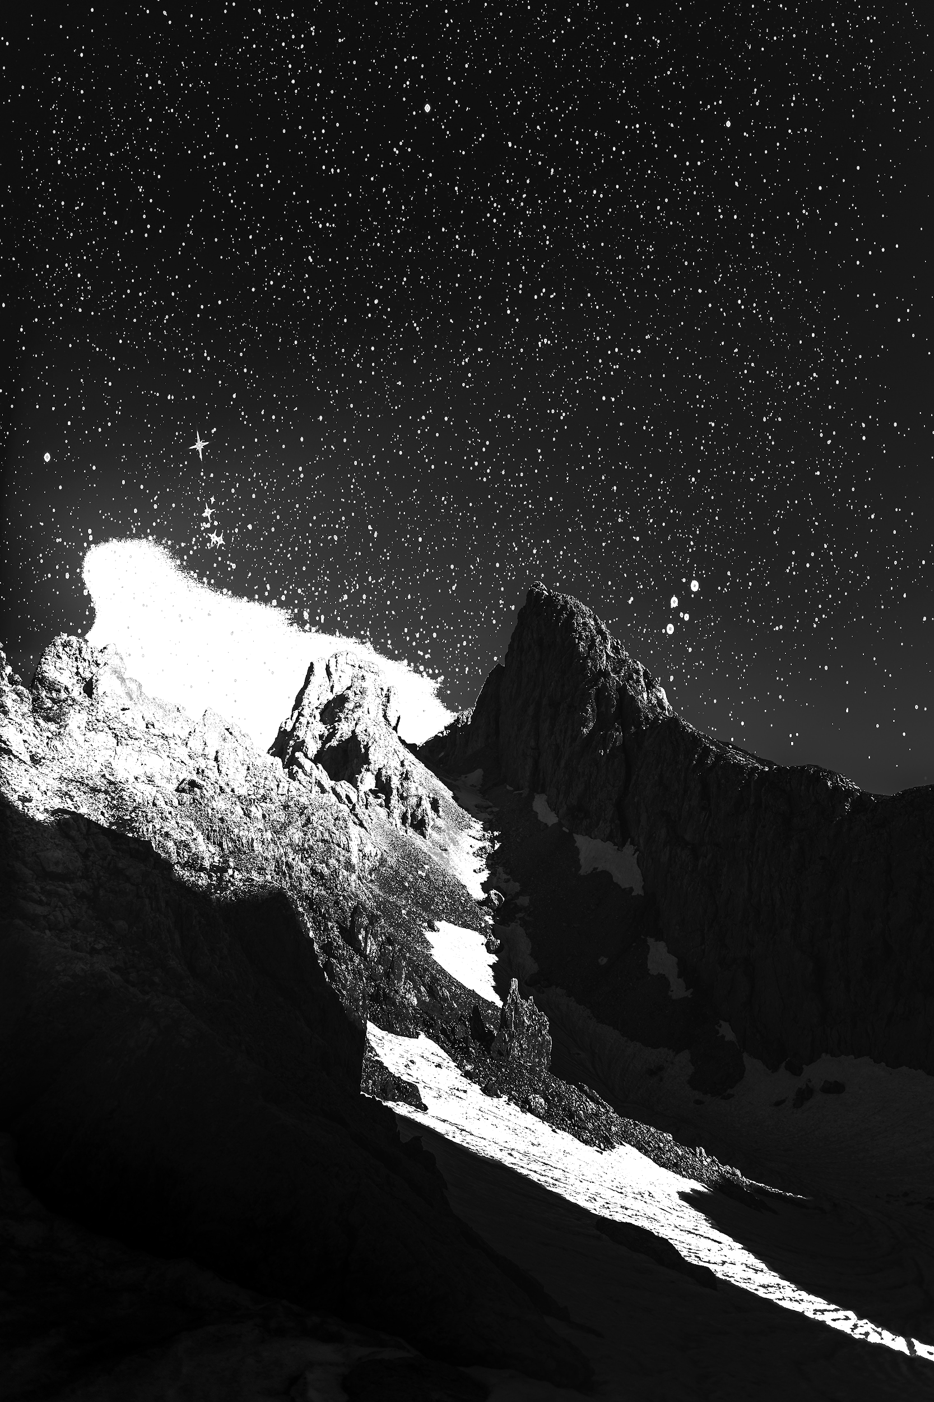
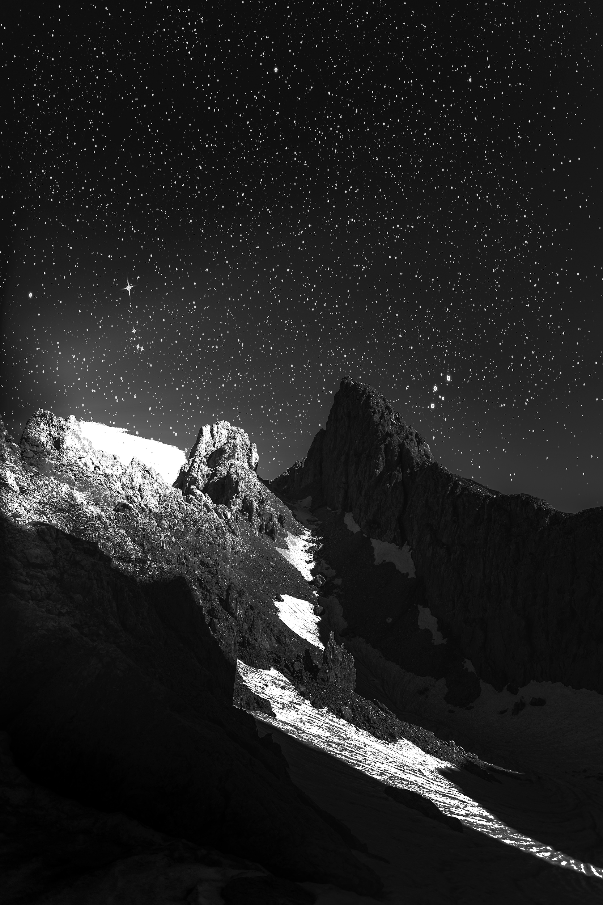
Gray Level Slicing
This takes two thresholds and keeps the grays in between them.
Sam
T1=50, T2=150
T1=70, T2=150
T1=100, T2=150
T1=150, T2=170
Notes:
Gray level slicing is similar to thresholding, we create two thresholds where anything above it or below these two thresholds are forced to black or white and everything inbetween is kept its original value without change.

Slide 32
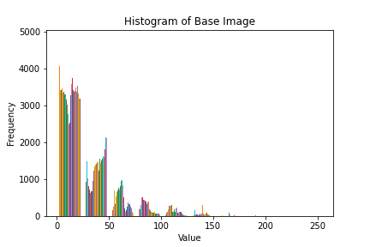
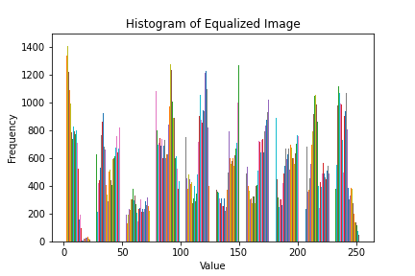
Histogram Techniques
This uses the distribution of pixels and manipulates that distribution
Sam
Notes:
With Histogram techniques, we look at the distribution of pixels in an image. We take the distribution and can change them according to our liking.

Slide 33
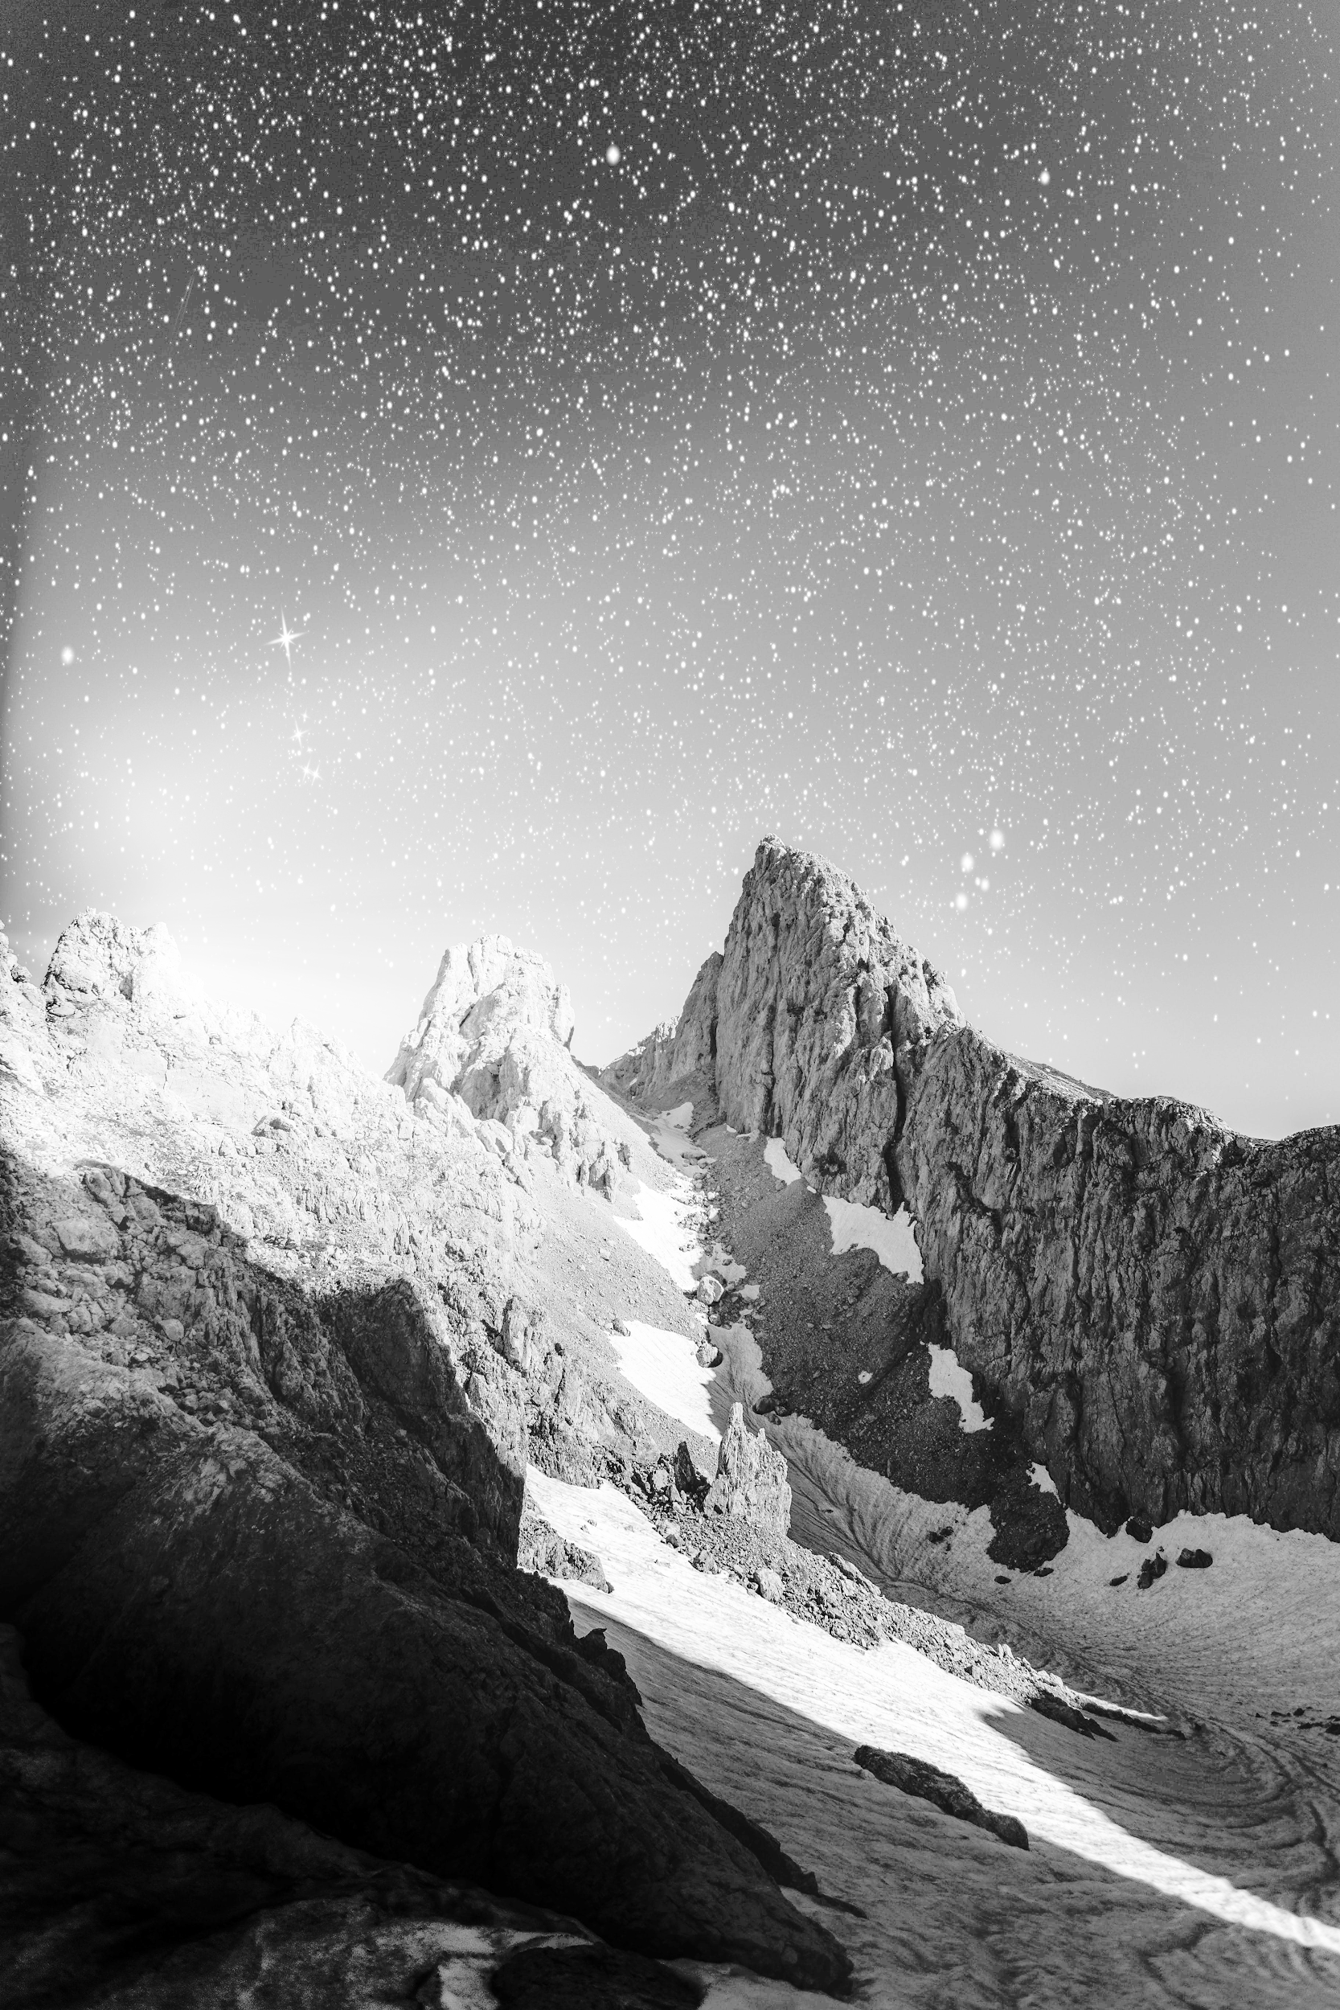
Histogram Equalization
This technique uses the histogram of the images and equalizes it using the equalized histogram. The version used below is a global transform.
The base image from the last slide show an abundant quantity of values around 0
We can see that a lot of the details that were hard to discern are revealed after processing
Sam
Notes:
Histogram equalization is a global transform. It utilizes the distribution of the image and tries to create an equal number of pixels for each value.

Slide 34
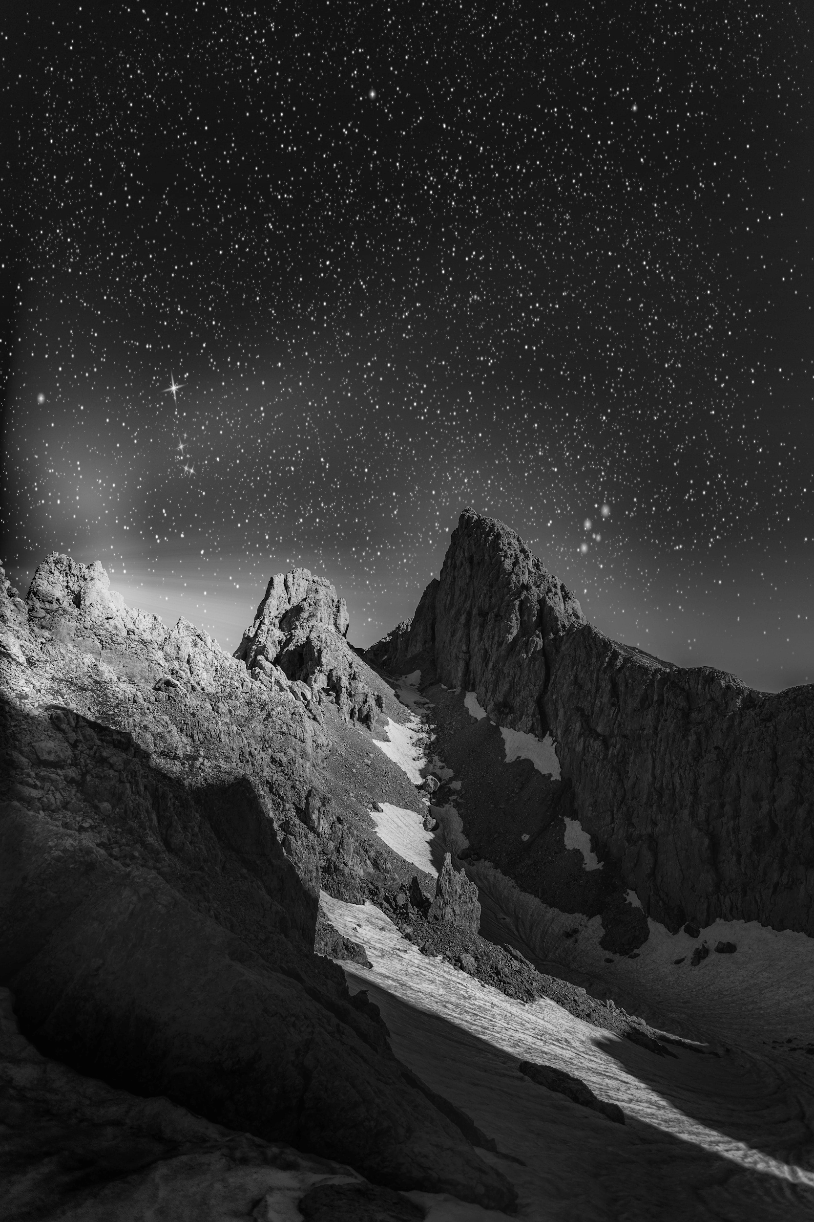
Adaptive Histogram Equalization (AHE)
The image is divided into sections through a grid like system. Each area has its own histogram equalization. It creates a local transform on the image compared to the global used previously
Base
Global
Local
Sam
Notes:
Adaptive Histogram Equalization works similarly to the point processing in its localization. It creates local area transformation through the image. It has some variant and we will be focusing on the Contrast Limited Variant

Slide 35
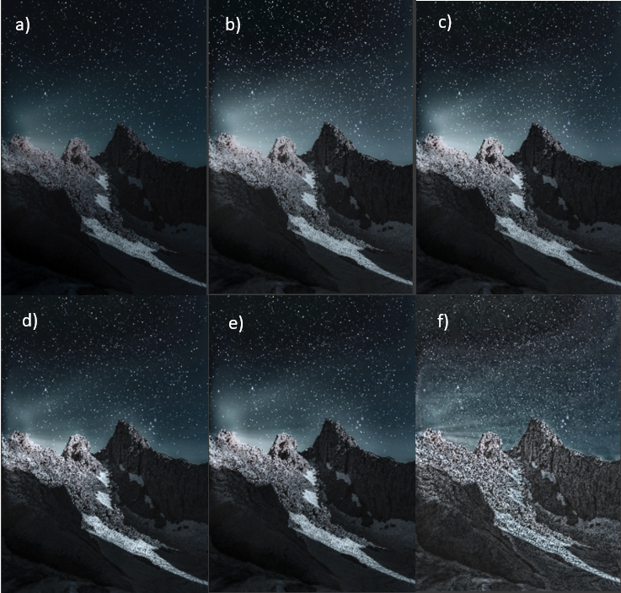
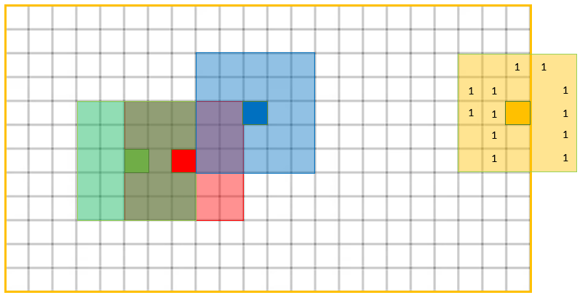
Contrast Limited Adaptive Histogram Equalization (AHE)
- Runtime - O(n²)
- Computation might be intense on the headset and cause battery life to deplete
Sam
Notes:
The image below shows how Adaptive Histogram Equalization works. It takes a pixel and its surrounding neighborhood and uses this information to equalizes its local histogram. The problems faced by regular Adaptive Histogram Equalization is that it over amplifies contrast in near constant regions. This can cause amplified noise. The Contrast Limited variant will clip the histogram at a certain value before processing so that noise in the system will not be amplified.

Slide 36
Video Processing
Currently some of the global transforms can be directly implemented. These include: Log Transform, Inverse Log Transform, Gamma Transform and Negative Transform. The simple global transforms were all able to be implemented into the video stream without much difficulty.
Thresholding techniques were also available in a different sense using the Computer Vision Library. There is an adaptable local thresholding similar to how AHE works.
Sam
Notes:
With Video processing we can look at a video in two different senses. A stream of constant data or a stream of images. With the simples transforms, the stream of data works beautifully. There is some thresholding functions in the computer vision library that also can be applied to the stream of data.

Slide 37
Current Video Processing Problems
Point processing doesn’t translate well into video processing. With a video each pixel is changing values based off time. The way that our point processing was implemented was in applying the transform and saving it to another matrix. Attempting the same approach caused errors due to size of the data coming in.
The proposed solution is in trying to take and process and redisplay the image in such a way that the astronaut doesn’t feel sick from it. This technique may not be viable for our current goal.
Sam
Notes:
Some current Video Processing Problems are that The point processing or histogram equalization techniques don’t really work when we try to use a stream of data. So this is where the second view of the video comes in. We can process each image and then show it or recombine them to create a video. The concern with this solution is in its processing time. Since we have to process each image individually, if the timing between the images isn’t smooth or fast enough, we can create a distortion between perception and the astronauts movements. This can make the astronaut very sick and be completely opposite to the purpose of the video processing to begin with.

Slide 38
Edge Detection Solution
Using edge detection we can create an outline of what is happening in the astronauts environment without that much information. It can be used in real time and can possibly help astronauts have an idea of the area they are around if there is not much illumination.
The processing is minimal compared to some of the other techniques listed.
This technique has not been implemented for testing yet.
Sam
Notes:
Edge detection was a proposed solution for when there isn’t much contrast. We could implement edge detection and create an outline of the objects around the astronaut. We believe this would only be used if non of the other processing techniques were helpful and the astronaut needed a bit more information.

Slide 39
Processing Times of Techniques (Python)
Negative | .1883 s | Threshold Inv Binary | .1768 s | Adaptive ThresholdG | .3647 s
Log | .2434 s | Threshold Trunc | .1687 s | Otsu Threshold | .1688 s
Inv Log | .2683 s | Threshold To Zero | .2009 s | Bilateral Filtering | .9840 s
Gamma | .1978s | Threshold To Zero Inv | .1609 s | Erosion | .1540 s
Threshold Binary | .2071 s | Adaptive ThresholdM | .1638 s | Dilation | .1572 s
Sam
Notes:
Here we look at the processings times of the techniques that use the stream of data. Most of which are found within the computer vision library. After the initial processing, the stream stays on there doesn’t seem to be any real delay in the video capture. Theses techniques can be used in combination with each other. There hasn’t really been any problems during testing. All the test were done using an old laptop and may not be indicative of what the HoloLens can really do. We did not do the test on the HoloLens because we only recently received it.

Slide 40
Processing Times Continued
Single Value Thresholding through Point Processing : 83.8702 seconds.
Histogram Equalization : 2.2255 seconds
CLAHE:2.4905 seconds
Each of these test were used to capture 30 frames and process them.
Video Recombination: .700645 seconds.
Sam
Notes:
The techniques used for these processing times involved the image variation of the video. Each technique had to capture and process 30 images. The number 30 was used such that we could create a 30 frames per second video. The 30 frames per seconds is a standard for video. We can see that the times are above 1 second which may rule out the technique with recombination. The current method used was to capture an image and save it, and then process it and save it. A proposed solution was in simply capturing 1 frame over and over again possibly in an infinite loop and processing and showing just the processed image. This technique was tested and the times were more similar to the 30 frames per second requirement.

Slide 41
Current Progress in Video Processing
Simple Processing Techniques Implementation (Complete)
Thresholding Techniques Implementation (Complete)
Video Point Processing (Complete)
Recording processing time for each technique (Complete)
Python translation to C (Not Complete): waiting on completion of test and HoloLens2 delivery.
Sam
Notes:
This is progression of what was done and what is still necessary. We’ve completed most of our testing and implementation in Python. There may be a necessity to translate the techniques into C# which is native to the HoloLens Environment. The proposed solution in the previous slide still needs to be worked on.

Slide 42
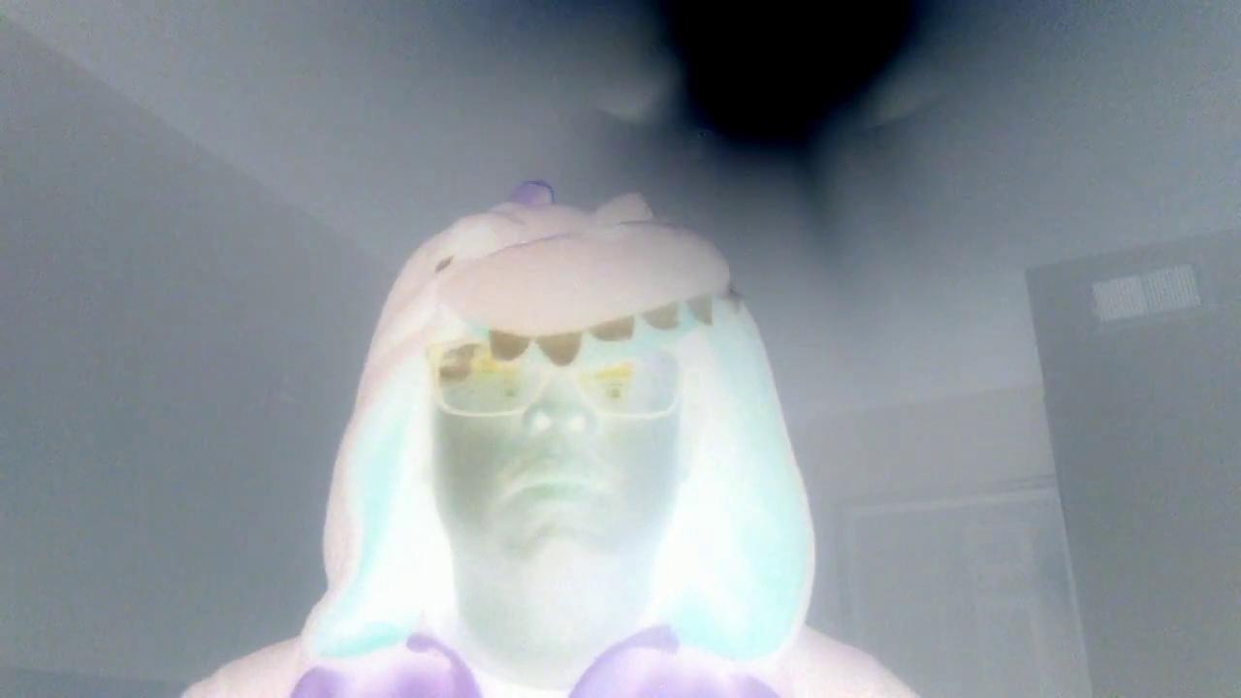
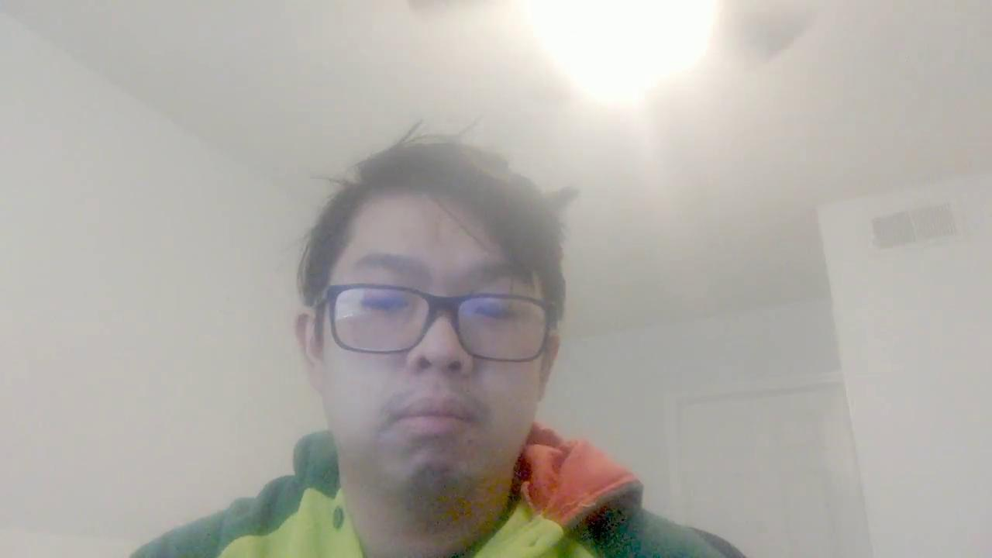
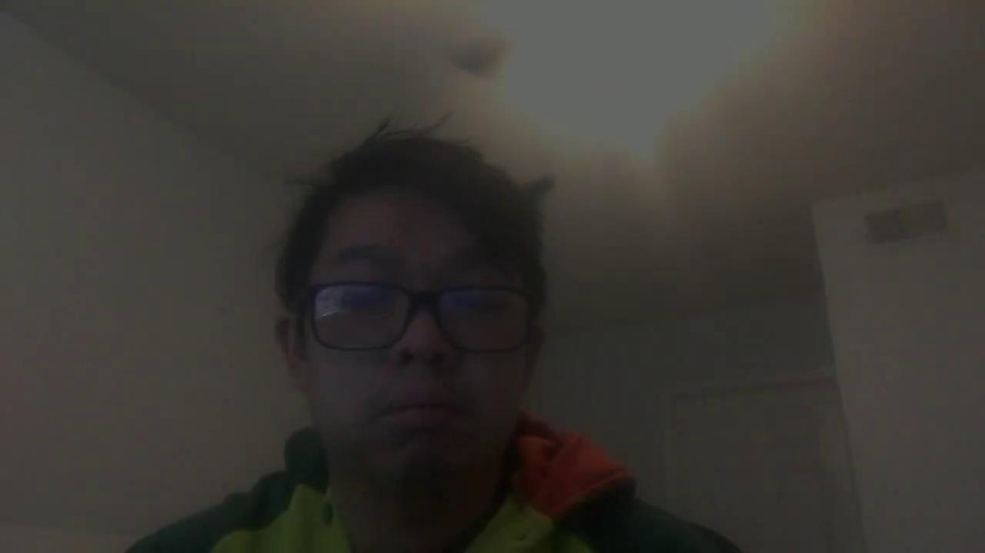
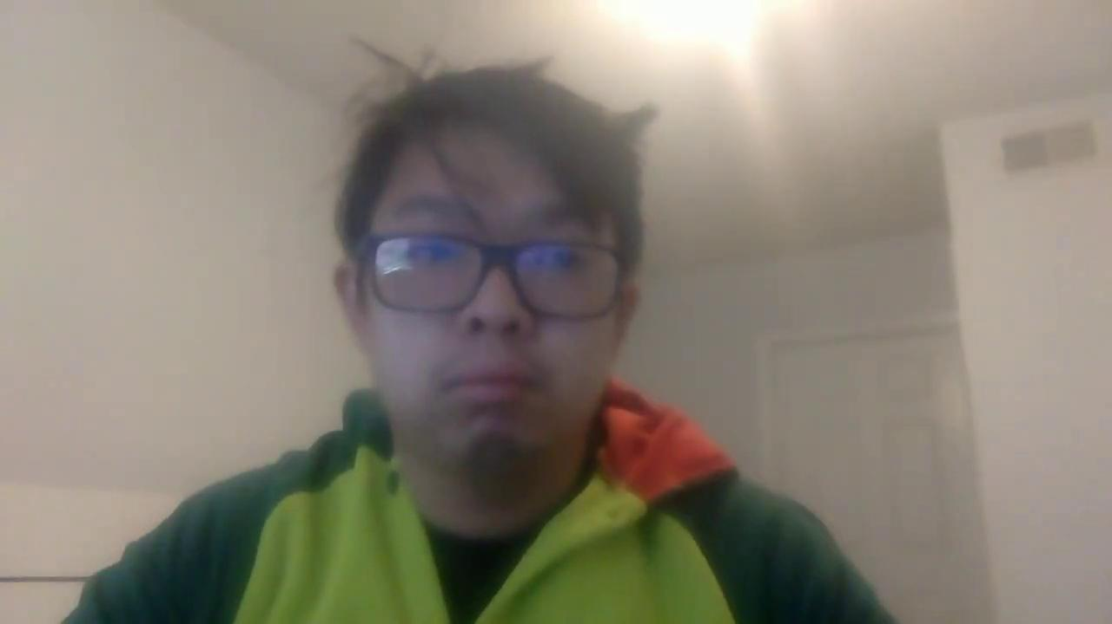
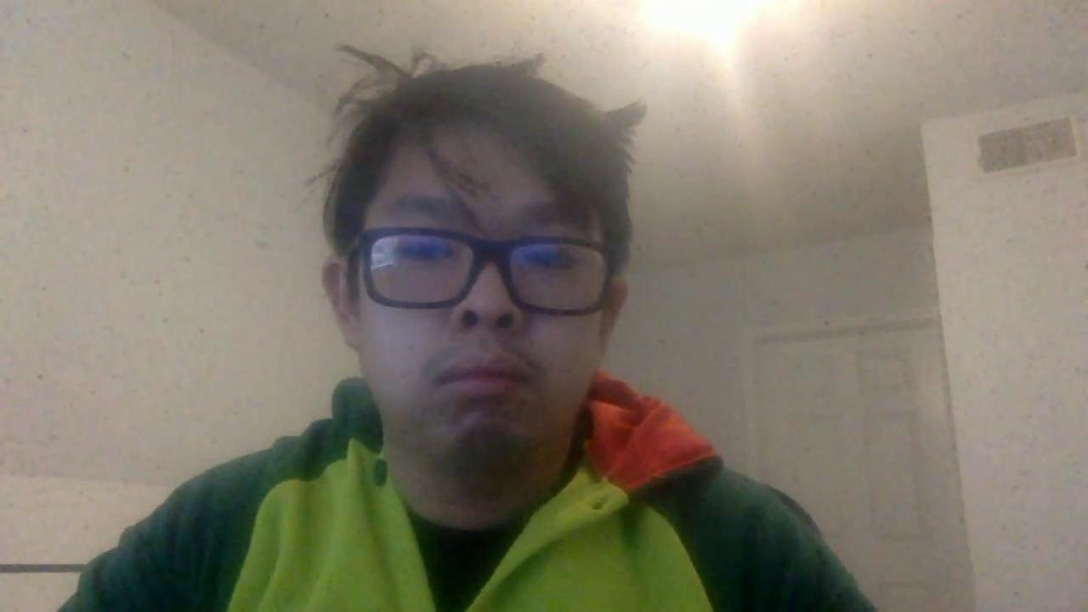
Video Demonstration
Negative
Log
Gamma
Inverse Log
Sam
Bilateral
Erosion
Dilation
Notes:
These are some of the test of the simple transforms using the data stream. The Log, Gamma, and Inverse Log work similarly to a saturation transform. Bilateral Filtering is a smoothing filter. Erosion tries to remove small white spots or noise but shrink the image. And Dilation will try to make the image bigger. We can see a combination of Erosion and Dilation working together to take away noise without a noticible difference in our object.

Slide 43
Remaining Tasks
UI development in Hololens 2
Utilizing the image processing code in the headset
Interfacing with the wireless communication module
Calibrating Pulse oximeter
Data processing programing
Lots of testing
Teo
Notes:
Far and away our largest constraint during this project has been administrative.The purchase of the Hololens as well as the processing of grant funding took a longer time than anticipated. We did receive the Hololens II at the beginning of the week, so we are ready to transfer the UI development as well as the image processing into the headset. We will also be testing the wireless interface with the Hololens II as well. Calibration with the pulse oximeter and subsequent data processing will also be done once the PCB is received. Of course, there will be lots and lots of testing along the way to our final product.

Slide 44
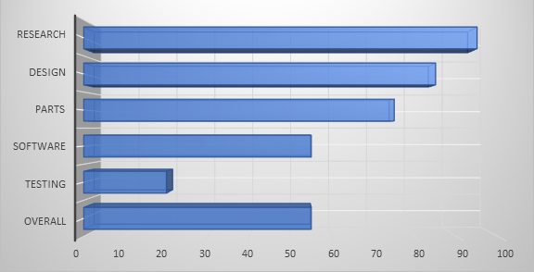
Progress
Teo
Notes:
Our progress can be visualized in the following chart. Due to the delayed acquisition of the Hololens, our testing has been limited, but will increase in the coming weeks.

Slide 45
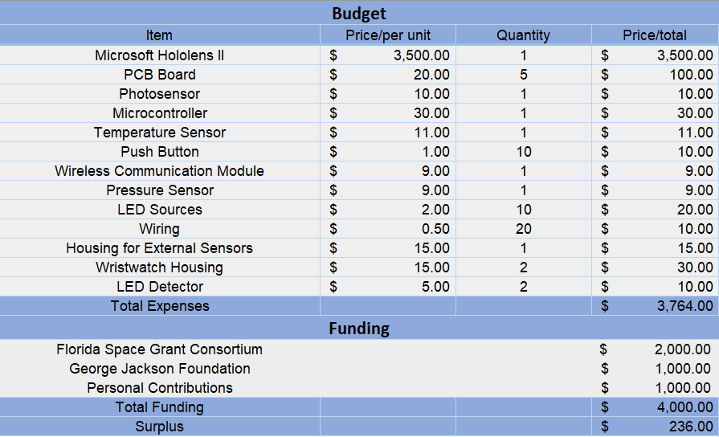
Budget and Finances
Teo
Notes:
The following table addresses our financial budget for the project as well as the funding we received. Again, we want to thank our sponsors, the Florida Space Grant Consortium and the George Jackson Foundation.

Slide 46
Questions?
Notes:
On the behalf of all of us in group 6, we would like to thank you all for taking the time to attend and listen to our presentation. We hope you enjoyed it and we look forward to answering any questions you may have. Thank you again.

