Slide 1
Group 1 Automotive Night Vision Imaging System (ANVIS)
Emmalynne Clarkston
Julian Ortiz
Carole Pearson
Rudy Valentin

Slide 2
Motivation
According to the National Highway Traffic Safety Administration, drivers are three times more likely to be involved in a fatal accident at night.
As drivers ourselves, we have all had trouble driving in low visibility scenarios.
The National Center for Biotechnology Information notes the impact on pedestrians, stating that they can be up to seven times more at risk of being hit in the dark.
Something must be done!
Notes:
Our motivation for this project stems from our own experiences as drivers as well as research that we did as a team while brainstorming. Studies from both the National Highways Traffic Safety Administration and the National Center for Biotechnology show a significant difference in danger when driving at night. We came to the conclusion that something must be done.

Slide 3
Solution
We propose an installable system that uses a Heads Up Display (HUD) outlining the road to overlay the driver's original visual perception.
The outline will be captured with a combination of cameras and infrared sensors.
The images captured by the sensors will be processed and merged into one enhanced image to be projected on the windshield.
To further increase safety, this primary HUD will be accompanied by two secondary HUDs that will show the car's diagnostics, side views and rearview.
Furthermore, the live feed captured by all of the sensors will be recorded and sent to an external device for use by law enforcement or insurance purposes.

Slide 4
Goals and Objectives
Have a functioning HUD that includes a projector and two different displays: one in the middle that is permanently fixed to the windshield, and two optional pop-up displays on the left and right sides.
The main display will show images from the infrared sensor at the front of the car and will vary in brightness by user voice commands.
The secondary displays will show images from the side cameras, back camera, and OBD information. Switching between side displays will be done through voice commands.
The images will be saved to a USB drive for 24 hours.

Slide 5
Specifications
Power Consumption | 25 Watts
Operating Hours | 7:00pm - 7:00am
Operating Conditions | Rain, Low Light
Display Refresh Rate | 30 Hz
Projection size | 6.75 x 12 inches
IR wavelength | 850 nm
IR image sensor field of view | 70 deg
Rear color camera field of view | 135:180 deg
Side color camera field of view (x2) | 45 deg

Slide 6
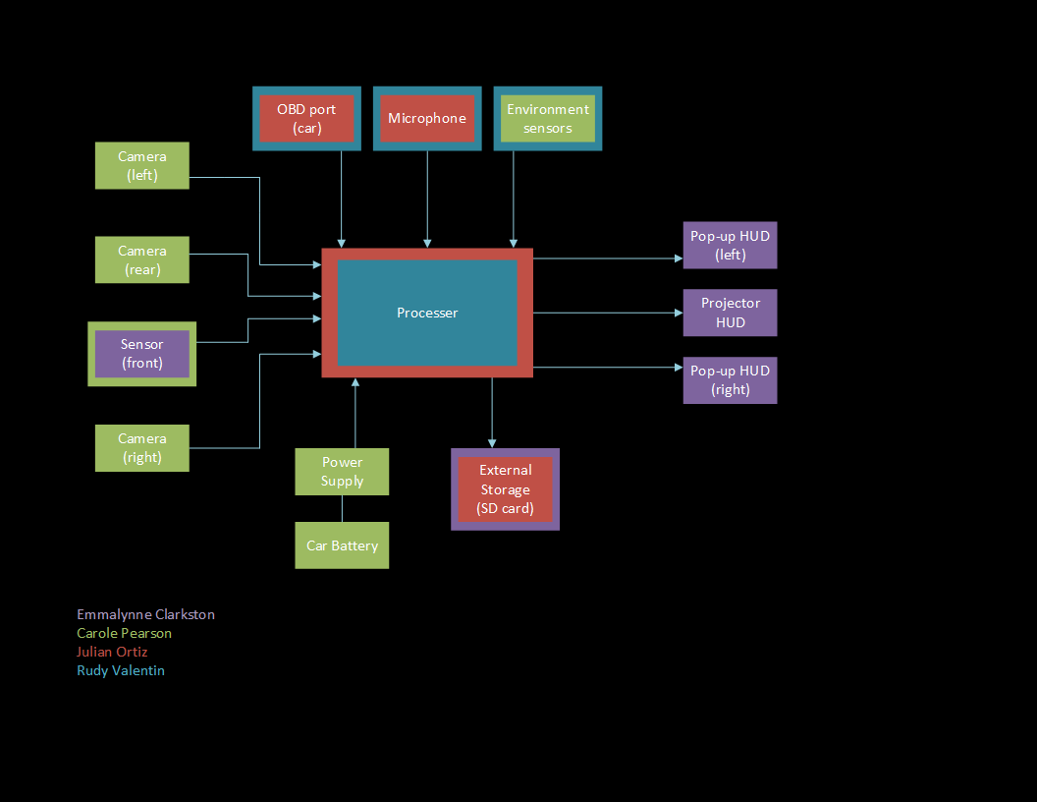
Block Diagram

Slide 7
Hardware: Power Supply and Camera Selection
Carole Pearson
Electrical Engineering

Slide 8
Power Supply Requirements
Notes:
The power supply requirements include a 5V rail for the Jetson Nano, the Luma Projector, the IR Sensor, and the R and L cameras, as well as a 12V rail for the backup camera.
Our total power stays below our requirement of 25W.
The Car Battery outputs roughly 12V and can be accessed through the fusebox of the car.

Slide 9
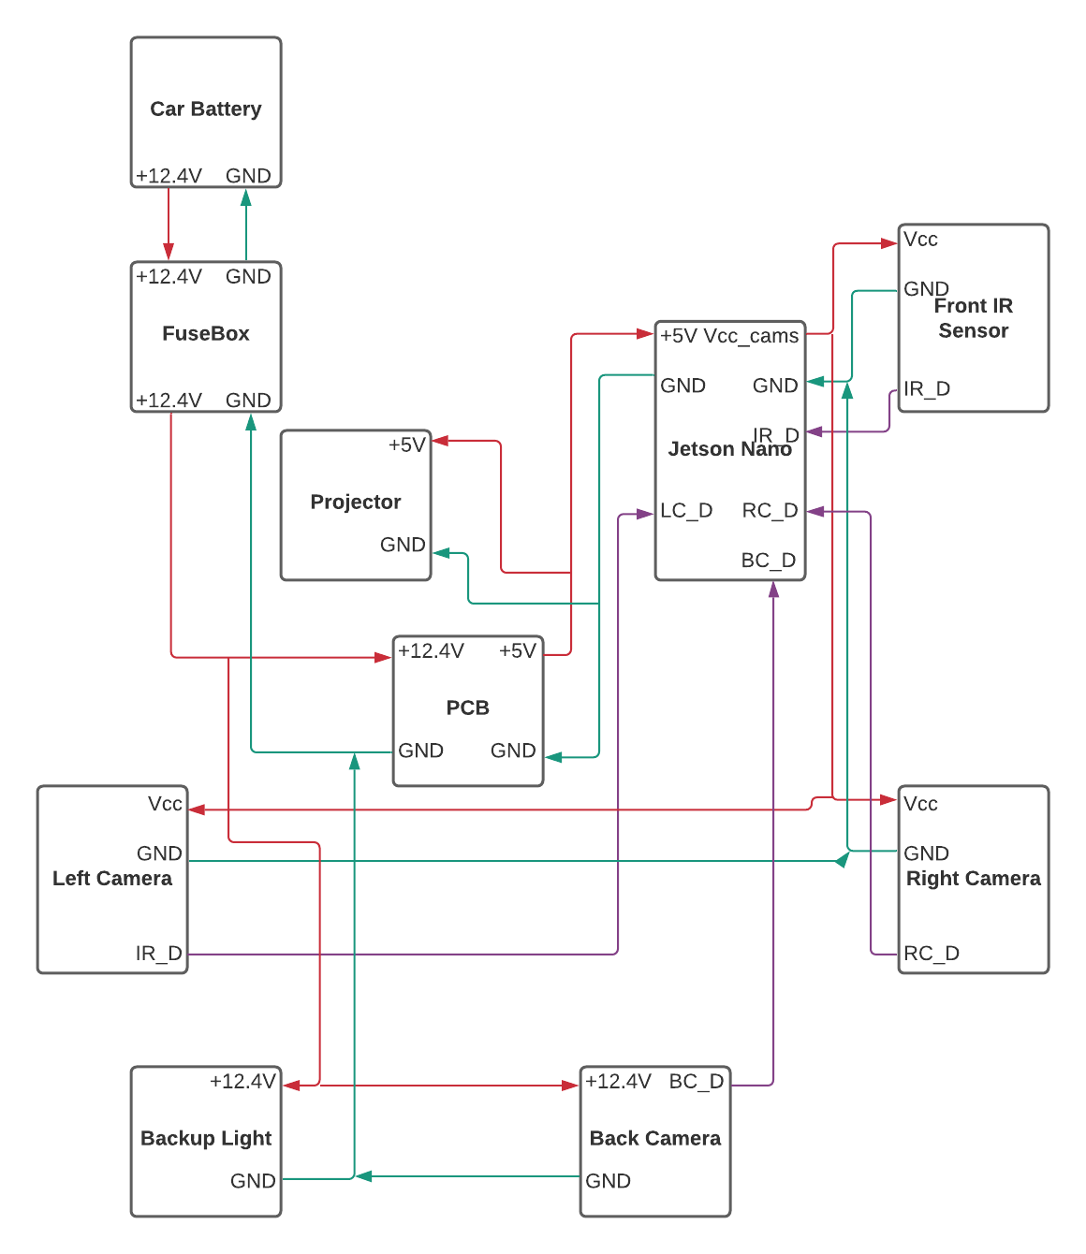
Physical Wiring Design
The PCB will be used to take 12V from the car battery, via the fuse box, and convert it to 5V to power the Jetson Nano and the Projector.
The Jetson Nano will then power the IR Sensor and the two Side Cameras
The Backup Camera connects directly to the car via the right backup light.

Slide 10
PCB Schematic
This PCB will convert +12V from the car battery to the 5V and 4A required by the Jetson Nano and the Luma Projector
Notes:
This is the pcb schematic. A TI part, the TPS 56528, was used as well as the Webench Power Designer to design the schematic.
Input and Output holes were created to allow us to solder on connections to input power and the two loads.

Slide 11
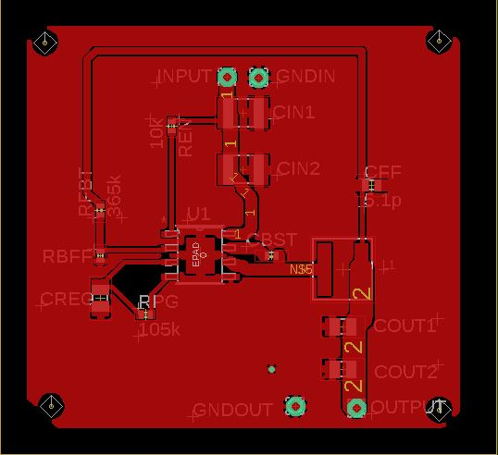
PCB Layout
Notes:
The layout was designed in Eagle. Four mounting holes are used on the outside of the device to pin it to its mount device.

Slide 12
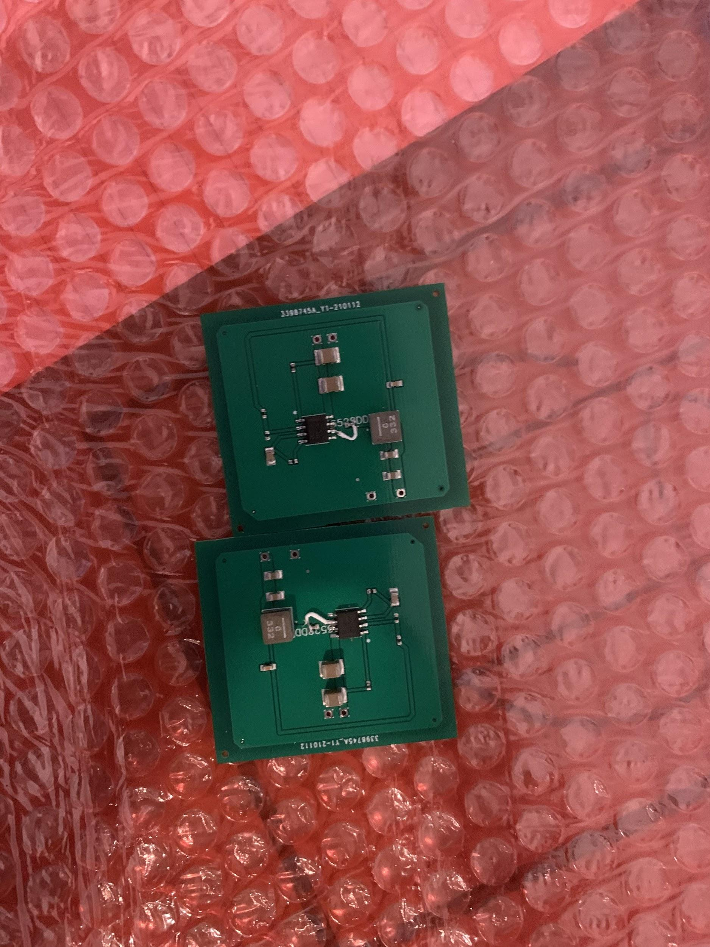
PCB Progress
The PCB was designed and ordered through JLCPCB
We are currently in the testing and debugging phase.

Slide 13
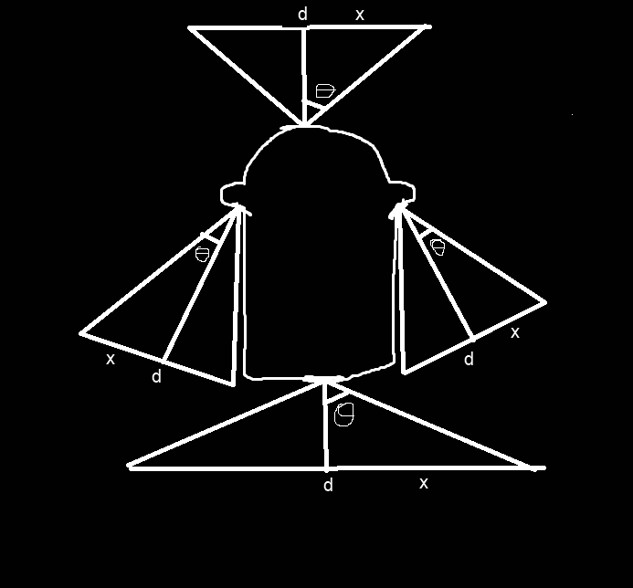
Camera Selection
Field of View (FOV) is necessary to determine whether our cameras will be effective in likely scenarios.
FOV Requirements:
Front IR Sensor: 60 degrees
Side Cameras: 75 degrees
Back Camera: 135 Degrees
*Note: Image is not drawn to scale

Slide 14
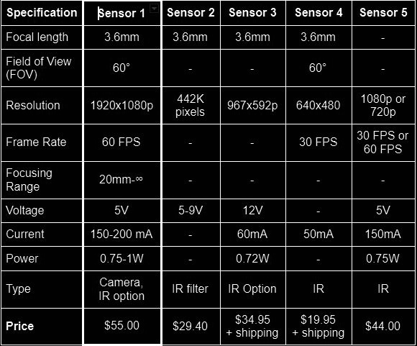
IR Sensor Selection

Slide 15
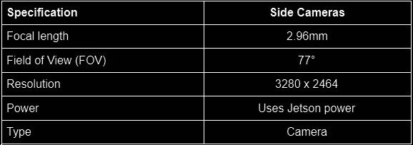
Side Camera Specifications
The side cameras came with a Jetson Nano kit that included LCD screens that will be used as the two side displays, so the ease of compatibility won these two cameras over any others that were found
They both have the correct FOV and a high resolution

Slide 16
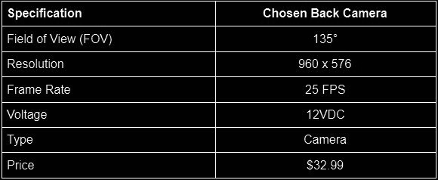
Backup Camera Specifications
The backup camera was chosen for its quicker frame rate, compatibility with the car power, and low price

Slide 17
HUD Implementation & Housing Design
Emmalynne Clarkston
Optical Engineering and Computer Science

Slide 18
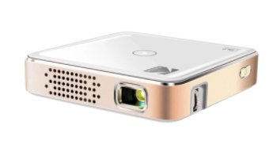
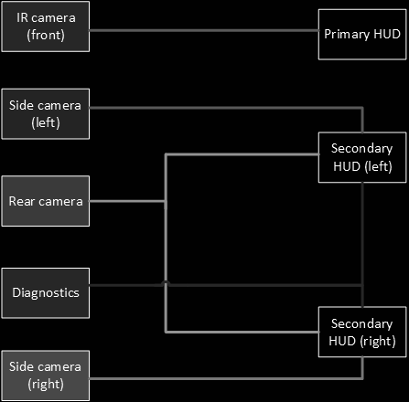
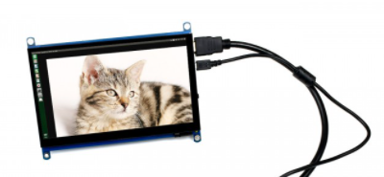
HUD Implementation

Slide 19
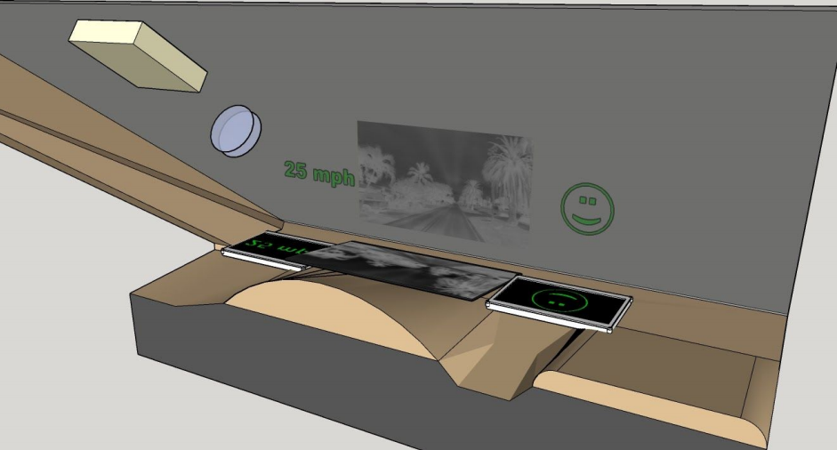
HUD Implementation
*Scale model of CR-V dash with the HUD implementations

Slide 20
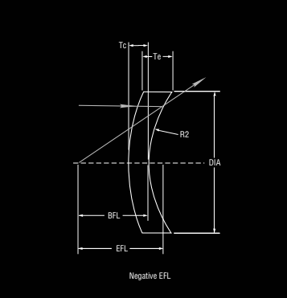
Meniscus Lens
Magnifies image
Prevents spherical aberrations
Aperture | 2 in
Material | Fused Silica
Refractive Index at 486.10 nm | 1.46313
Refractive Index at 587.60 nm | 1.45847
Refractive Index at 656.30 nm | 1.45637
Effective Focal Length | -500 mm

Slide 21
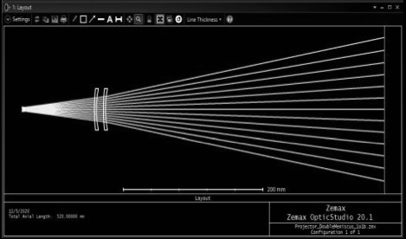
Optical Projection Design - Main HUD
Parameter | Value
Projection distance | 50 cm
Initial divergence angle | 7.42°
Initial aperture size | 5 mm
Lens aperture size | 50.8 mm
Lenses | MSCN020HAR.11
Projector | Luma 75
Final image size | 13 in

Slide 22
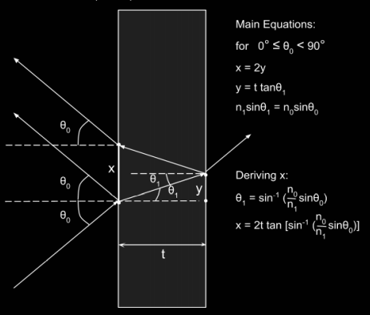
HUD Reflection - Ghost Image Reduction
Optical
Blurring
Thin prism
Image Processing
Pixel shift

Slide 23
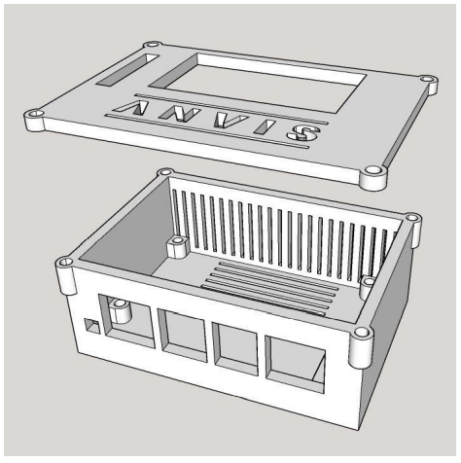
Equipment Housing and Mount Designs
Component | Case | Mount
Processor | ✓ | -
Projector | ✓ | ✓
IR Camera | ✓ | ✓
Color Camera | ✓ | ✓
LCD | ✓ | -
PCB | ✓ | -
PCB + Processor Rack | - | -

Slide 24
Image Processing & Microcontroller Integration
Julian Ortiz
Electrical Engineering & Computer Engineering

Slide 25
Goals and Requirements
Develop an Algorithm that will take information provided by an IR sensor and processes it to aid the user in low visibility scenarios
Develop an Algorithm that will save information taken by side mounted cameras to be used for law enforcement and insurance purposes
Everything should be controlled using a single Microcontroller

Slide 26
Technological Choices
Algorithms
To deal with image processing Python was the best choice to be used to develop the algorithms needed
Microcontroller
The main powerhouse for ANVIS was chosen as a NVIDIA Jetson Nano

Slide 27
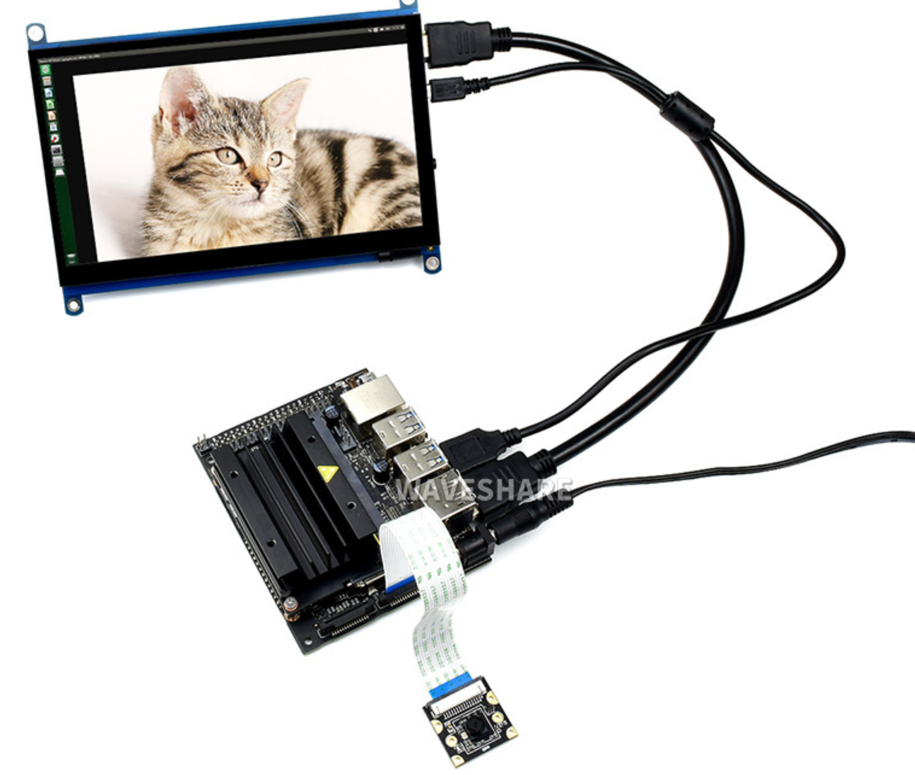
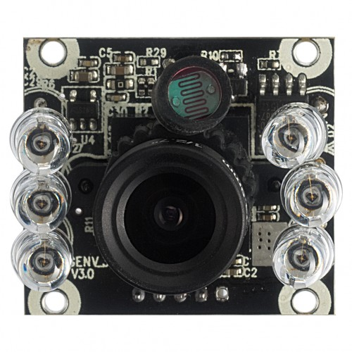
Jetson Nano System
Running Linux
2 x CSI 8MP Cameras (IMX219-77)
2 x 7 in HDMI LCD Touch Displays
1 x IR sensor (UC20MPD-ND) connected through USB

Slide 28
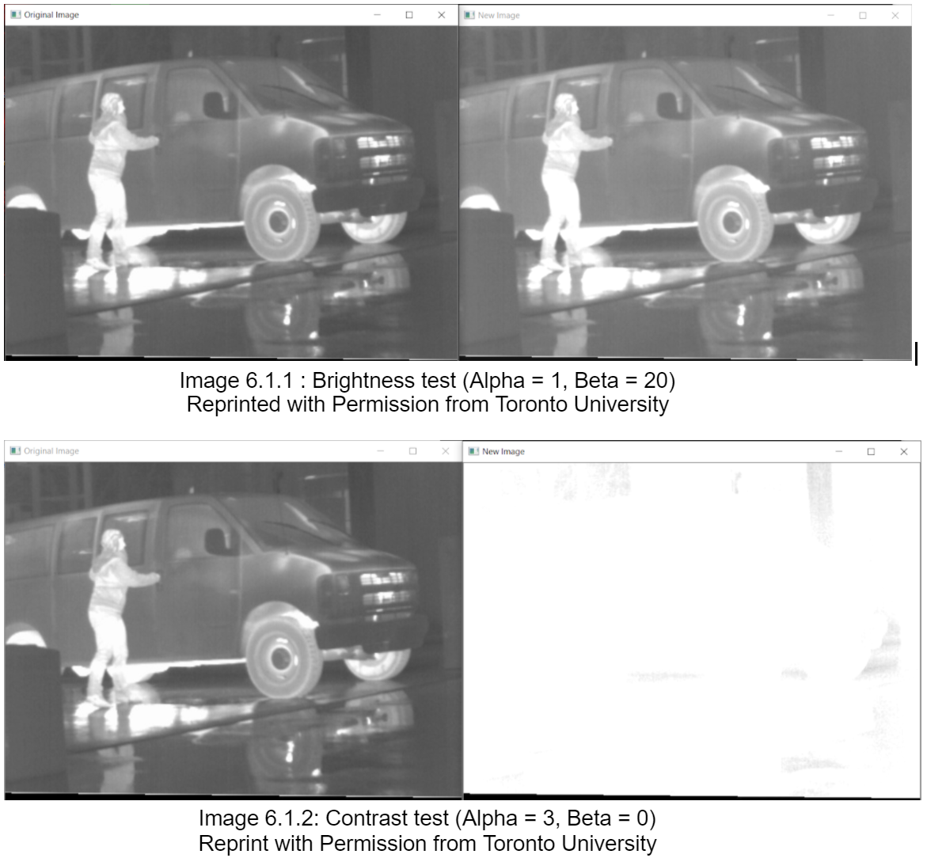
Algorithm Design
Contrast and Brightness
We developed an algorithm that used two variables, alpha and beta. When these variables are changed the output of is changed by either changing the brightness or the contrast on the incoming image.
Alpha = Contrast
Beta = Brightness

Slide 29
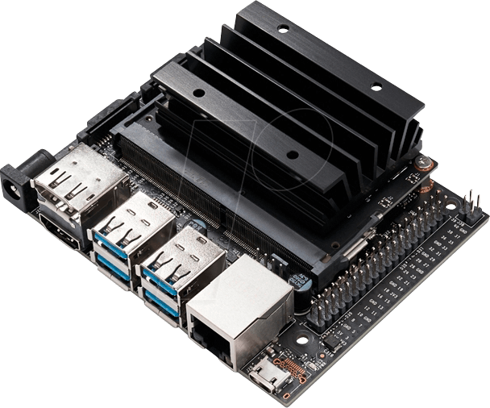
Current Progress
Contrast and Brightness algorithm is fully functioning and complete
Jetson Nano is running on its own OS (linux) and has all programs needed installed
All sensors and cameras needed have been purchased
Test the Jetson Nano connected to all of its parts
Develop algorithm for side cameras and LCD displays

Slide 30
Voice Recognition & OBD
By: Rudy Valentin (Electrical Engineering)

Slide 31
Selecting a Voice Recognition API
Work Offline
CMU Sphinx, Google, IBM
Developer Documentation

Slide 32
Speech to Text Recognition
Structure of Speech
Phones
Senones
Recognition Process
Utterances
Feature Vectors
Recognition Models
Language Model
Phonetic Dictionary
Acoustic Model

Slide 33
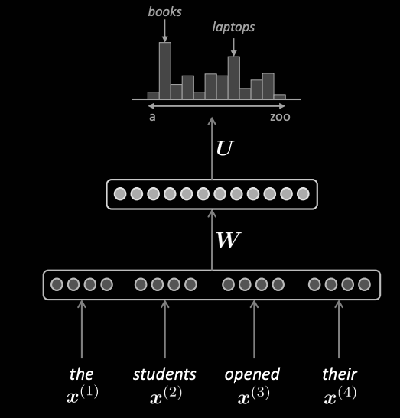
Language Model
Restrict word search
Increase prediction accuracy

Slide 34
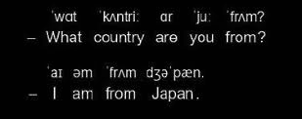
Phonetic Dictionary
Maps words to phones
Contains information about pronunciations

Slide 35
Acoustic Model
Acoustic properties of words
Information about what words sound like

Slide 36
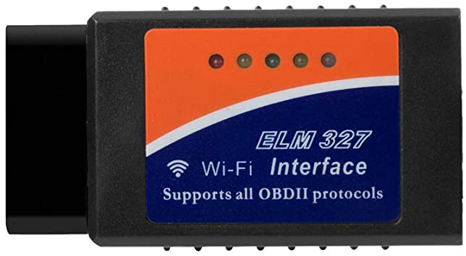
OBD
OBD Information Display
ELM 327 Adapter with ISO 9141-2 Protocol

Slide 37
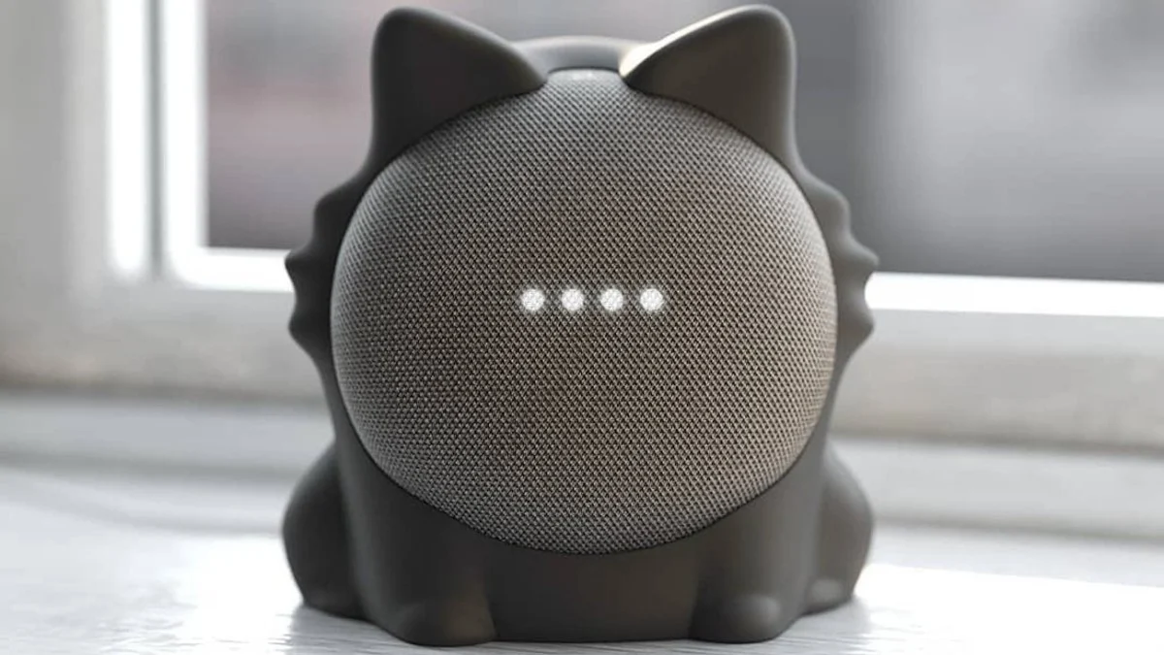
Final Implementations
Voice commands
System control
Control system settings

Slide 38
Administrative Content

Slide 39
Work Distribution
 | Projector Design | Power System Design | Casing Design | Voice Recognition | Image Processing | Camera Selection | OBD Design
Emmalynne | ✓ |  | ✓ |  | ✓
Carole |  | ✓ |  |  |  | ✓
Julian |  |  |  | ✓ | ✓
Rudy |  |  |  | ✓ |  |  | ✓

Slide 40
Budget
purchased (Y/N) | Part | Quantity | Member | Cost | Shipping + tax | Total
Y | Jetson Nano Starter pack | 1 | Julian | $99.00 | $0.00 | $99.00
Y | LCD Display Kit + Camera | 2 | Rudy | $124.78 | $23.00 | $147.78
Y | Kodak Luma 75 Projector | 1 | Emmalynne | $179.99 | $12.60 | $192.59
Y | IR Sensor | 1 | Carole | $51.00 | $9.60 | $60.60
Y | back camera | 1 | Carole | $32.99 |  | $32.99
Y | av/rca to usb converter | 1 | Carole | $10.00 |  | $10.00
Y | OBD | 1 | Julian | $21.99 | $0.00 | $21.99
N | Microphone | 1 | Rudy | $22.99 |  | $22.99
Y | SD card | 1 | Carole | $24.49 |  | $24.49
Y | USB HUB | 1 | Julian | $11.99 | $0.00 | $11.99
Y | Other | 1 |  |  |  | $20.00
Y | PCB | 1 |  | $43.00 | $0.00 | $43.00
Y | parts | 1 |  | $54.00 | $0.00 | $54.00
Y | soldering | 1 |  | $80.00 | $0.00 | $80.00
Y | awm 20861 | 2 |  |  |  | $0.00
 |  |  |  |  | Total = | $821.42

Slide 41
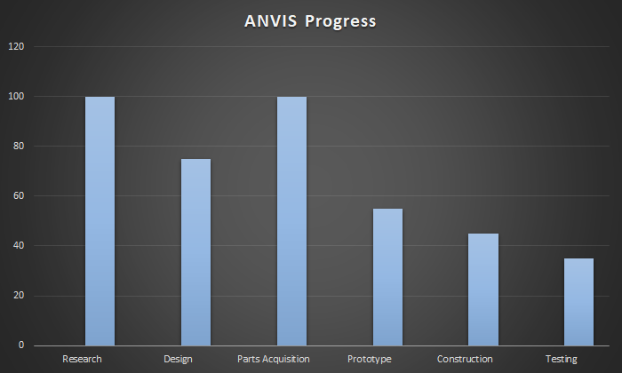
ANVIS Progress

Slide 42
Questions?

