Slide 1
Solar powered Water Filtration System
Group 24

Slide 2
Project Motivation
https://www.thenational.ae/world/rains-or-not-india-faces-drinking-water-crisis-1.194811
-Help underdeveloped countries
-Make a difference in someone’s life
-Decrease the number of deaths
https://news.un.org/en/story/2019/08/1045051
https://www.prweb.com/releases/the_point_of_grace_academy_children_in_kenya_africa_do_not_have_access_to_clean_safe_drinking_water_cannedwater4kids_cw4k_is_trying_to_change_that/prweb15813295.htm
https://www.livemint.com/Politics/WoHowGWquof0lr7KPDV7GO/India-has-worlds-highest-inhabitants-without-safe-water-re.html

Slide 3
Goals and Objectives
Create a simple, efficient water filtration system with low power consumption
-Solar panels
Make it portable
-Small in size and lightweight
Build an Android app
-Shows sensors data (pH, turbidity, and
temperature)

Slide 4
Quality Standards from EPA (Environmental Protection Agency)
Factors | Acceptable Level
pH of Water | 6.5-8.5
Turbidity | For systems that use conventional or direct filtration, at no time can turbidity (cloudiness of water) go higher than 1 nephelometric turbidity unit (NTU), and samples for turbidity must be less than or equal to 0.3 NTU in at least 95 percent of the samples in any month. Systems that use filtration other than the conventional or direct filtration must follow state limits, which must include turbidity at no time exceeding 5 NTU.
Dust Lead Hazard | 40 micrograms of lead per square foot (µg/ft²) to 10 µg/ft² on floors and from 250 µg/ft² to 100 µg/ft² on window sills.
Make it portable
-Small in size and lightweight
https://www.epa.gov/sites/production/files/2016-06/documents/npwdr_complete_table.pdf

Slide 5
Quality Standards of the Air Quality Index (AQI) from EPA (Environmental Protection Agency) Cont’d.
Air Quality Index (AQI) Values | Level of Health Concern
When the AQI is in this range: | … air quality conditions are:
0-50 | Good
51-100 | Moderate
101-150 | Unhealthy for Sensitive Groups
151-200 | Unhealthy
201-300 | Very Unhealthy
301-500 | Hazardous
Make it portable
-Small in size and lightweight
https://www3.epa.gov/airnow/aqi_brochure_02_14.pdf

Slide 6
Quality Standards of H2O from EPA (Environmental Protection Agency) Cont’d.
Chemicals | SDWR (Secondary Drinking Water Regulations)
Aluminum | 0.05 to 0.2 mg/L
Chloride | 250 mg/L
Color | 15 color units
Copper | 1.0 mg/L
Corrosivity | non-corrosive
Fluoride | 2.0 mg/L
Foaming agents | 0.5 mg/L
Iron | 0.3 mg/L
Manganese | 0.05 mg/L
Odor | 3 threshold odor numbers
Silver | 0.1 mg/L
Sulfate | 250 mg/L
Total dissolved solids (TDS) | 500 mg/L
Zinc | 5 mg/L
Make it portable
-Small in size and lightweight
https://www.epa.gov/sites/production/files/2018-03/documents/dwtable2018.pdf

Slide 7
Component | Design Specification
Case | < 5 lbs
Solar Panels (4) | Open: 34.4 x 9.6 x 0.1 in Folded: 7.6 x 9.6 x 0.8 in Weight: 1.7 lbs
Solar Panels Output | 19.8 W
Microcontroller | 2.7 in X 2.1 in
Water precision | ± 5 degrees Fahrenheit
Water tank | At least ½ a gallon of H20
Water pump | 4 L/min
Water pump | < 12V to power save on battery power
UV lamp | < 12 W
Bluetooth | < 6V
Specifications

Slide 8
Block Diagram
Sediment Filter
Pre-Carbon Filter
Solar Panels
UF Filtration Membrane
Battery
Water Pump
Water Flow Sensor
Water Flow Sensor
Purified Water Outlet
UV - Chamber
pH Sensor
MCU
MCU
Power
Turbidity Sensor
Filtration System
Peripherals
LCD Display
Bluetooth Transmitter

Slide 9
Filtration System
Sediment Filter
Pre-Carbon Filter
Solar Panels
UF Filtration Membrane
Battery
Water Pump
Water Flow Sensor
Water Flow Sensor
Purified Water Outlet
UV - Chamber
pH Sensor
MCU
MCU
Power
Turbidity Sensor
Filtration System
Peripherals
LCD Display
Bluetooth Transmitter

Slide 10
Water Filtration System
Consist in four different types of filters:
Sediment filter
Pre-carbon filter
Ultrafiltration membrane
Ultraviolet water purifier
Combination of these filters ensures purified water meets all required standards
For convenience of the user the filters selected have minimum lifetime of 12 months

Slide 11
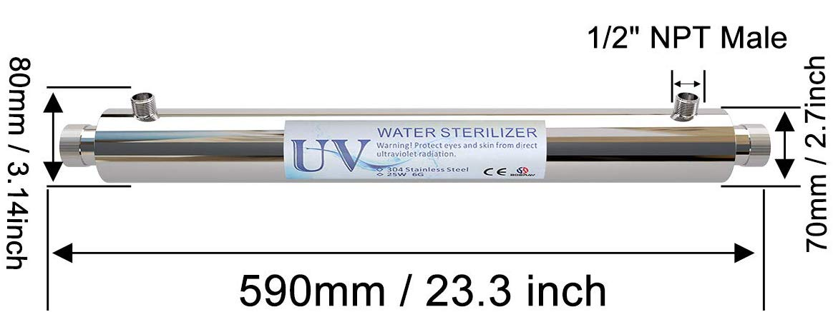
Ultraviolet filter
Selection criteria:
Large lifetime
Low power consumption
Cheap to reduce overall cost
Overall effectiveness
Ultraviolet water purifier | Size | Cost | Lifetime | Power consumption
Express Water – Ultraviolet Water Filter | 16 x 4.5 x 3.6 inches | $69.99 | 6 months | 12 W
Boeray Ultraviolet Light Water Purifier | 17.8 x 4.9 x 3.9 inches | $53.99 | 12 months | 6W

Slide 12
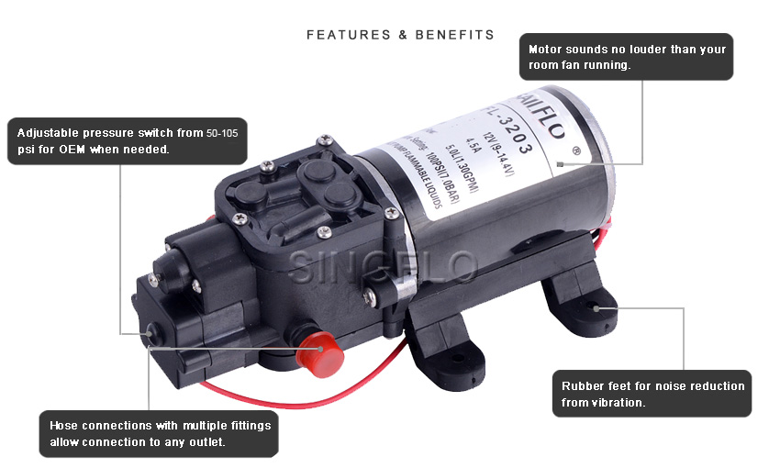
Water Pump
Comparison of 2 types of water Pump:
Transfer water pump easy to maintain, more efficient, large use of energy
Submersible water pump not portable, less efficient, conserve energy
Specifications:
Voltage: 6-12 volts
Current Drawn: 1.7 Amp
Liters per minute: 4.3 L/min
Cost: $16.48
17cm x 10cm x 67cm

Slide 13
MCU
Sediment Filter
Pre-Carbon Filter
Solar Panels
UF Filtration Membrane
Battery
Water Pump
Water Flow Sensor
Water Flow Sensor
Purified Water Outlet
UV - Chamber
pH/Temperature Sensor
MCU
MCU
Power
Turbidity Sensor
Filtration System
Peripherals
LCD Display
Bluetooth Transmitter

Slide 14
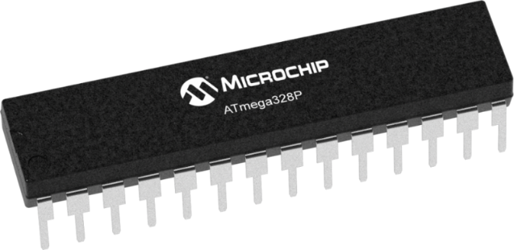
Microcontroller
 | ATSAMG51 | MSP430FR6989 | Atmega328P
Memory | 256 KB | 128 KB | 32 KB
RAM | 64 KB | 2 KB | 2 KB
Pin Size | 38 | 83 | 23
Communication Protocols | UART, I2C, SPI | UART, I2C, SPI | UART, I2C, SPI
Low-Power Mode | 103 uA/MHz | 101.25 uA/MHz | 0.75 uA/MHz
Selection Criteria:
Cheap to reduce overall cost
Enough number of pins for multiple peripherals
Low power consumption to optimize battery lifetime
Easy to mount on PCB
Compatibility with different types of sensors

Slide 15
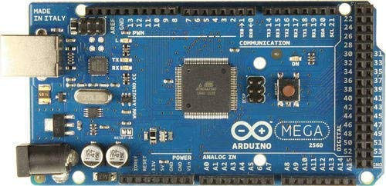
ATmega328p
• Arduino bootloader
• Compatible with multiple types of sensors
• Programmable in C
•Extensive list of hardware libraries
• Simple layout and easy to use
• Large support community
• Open source

Slide 16
Peripherals
Sediment Filter
Pre-Carbon Filter
Solar Panels
UF Filtration Membrane
Battery
Water Pump
Water Flow Sensor
Water Flow Sensor
Purified Water Outlet
UV - Chamber
pH Sensor
MCU
MCU
Power
Turbidity Sensor
Filtration System
Peripherals
LCD Display
Bluetooth Transmitter

Slide 17
Wireless Technology Selection
In order for the microcontroller to send the information received from the sensors to a mobile device a wireless communication is needed
Selection criteria:
Easy to connect to devices
Low power consumption
No need of internet connection
Easier to implement in microcontroller environment
Connection | Power Consumption | Range | Interference | Bandwidth
Bluetooth | 100 mW | 10 meters | Minimum of 2.4 GHz | 1 Mb/s
Wi-Fi | 750 mW | 100 meters | 2.4 GHz -5 GHz | 54 Mb/s

Slide 18
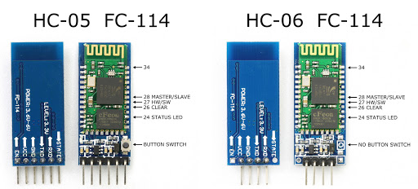
Bluetooth module comparison
 | HC-05 | HC-06
Dimension | 26.9mm x 13mm x 2.2 mm | 26.9mm x 13mm x 2.2 mm
Operating Voltage | +3.3V to +6V | +3.3V to +6V
Security | Authentication and encryption | Authentication and encryption
Operating temperature range | -20 ~ +75Centigrade | -20ºC to +55ºC
Bluetooth protocol | Bluetooth Specification v2.0 | Bluetooth V2.0 protocol standard
Pins | 6 | 4
Modes | Master or slave | Slave

Slide 19
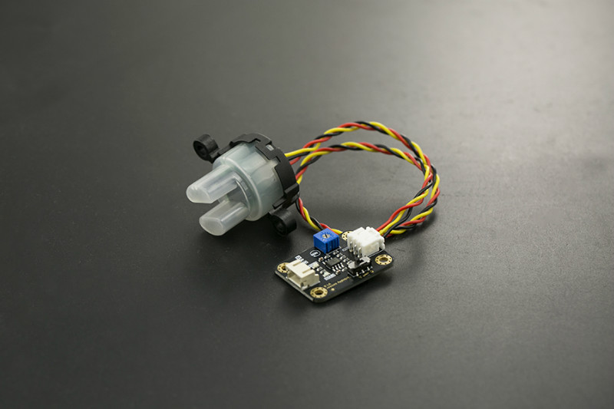
Turbidity Sensor
Selection Criteria:
Low power consumption
Low price
Turbidity Sensor Model | DFRobot Gravity SEN0189 | Thermometrics TSD - 10 | Thermometrics TSW – 10
Operating Voltage | 5V | 5V | 5V
Operating Current | 40mA (max) | 30mA (max) | 30mA (max)
Insulation Resistance | 100MΩ (min) | 100MΩ (min) | 100MΩ (min)
Operating Temperature | 5°C – 90°C | -10°C – 90°C | -30°C – 80°C
Storage Temperature | -10°C – 90°C | -20°C – 90°C | -10°C – 80°C
DFRobot Gravity SEN0189: Available from DFRobot.com
https://www.dfrobot.com/product-1394.html

Slide 20
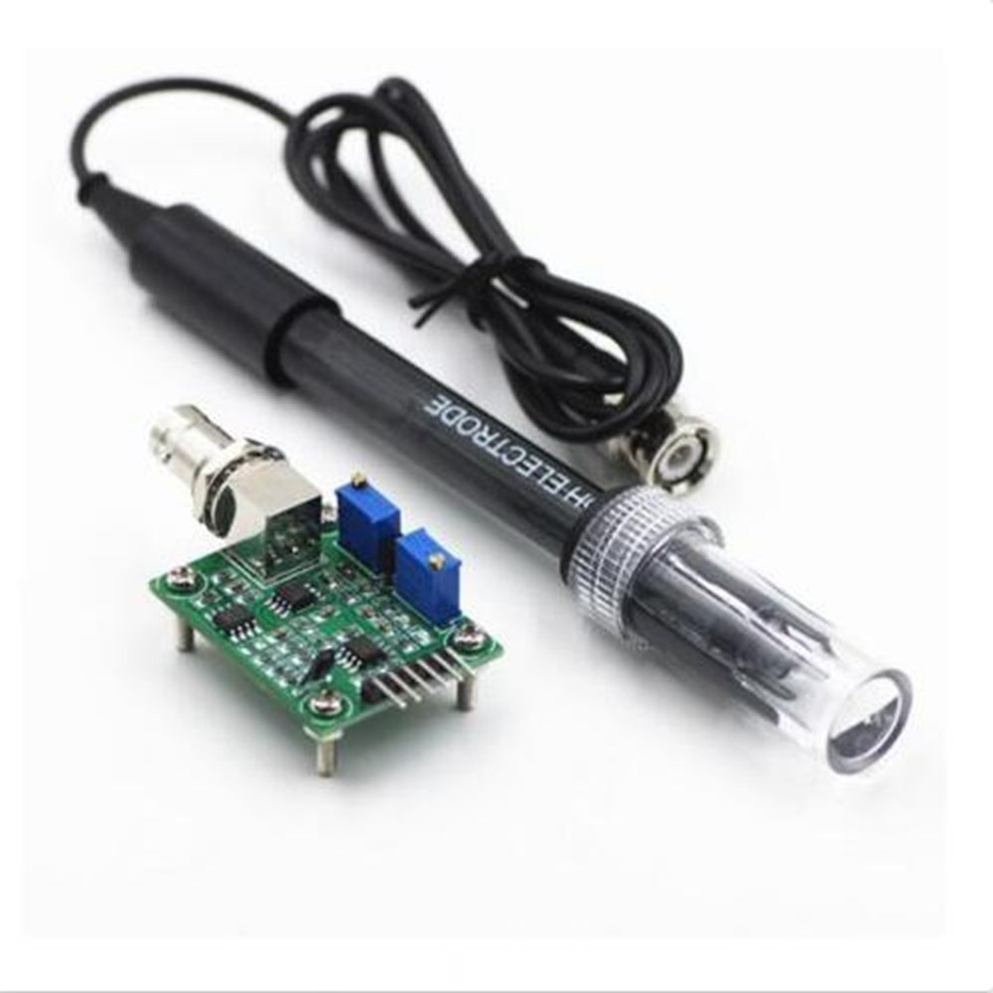
pH Sensor
Selection Criteria:
Low power consumption
Low price
Waterproof
pH sensor model | pH Measuring Range | Response Time | Waterproof | Operating Voltage
DFRobot Gravity SEN0161 | 0 – 14 pH | < 1 min | Only the tip | 5 V
DFRobot Gravity SEN0169 | 0 – 14 pH | < 1 min | Yes | 5 V
GAOHOU Probe BNC | 0 – 14 pH | < 6 sec | Yes | 5 V
GAOHOU Probe BNC: Available from Amazon.com
https://www.amazon.com/GAOHOU-PH0-14-Detect-Electrode-Arduino/dp/B0799BXMVJ

Slide 21
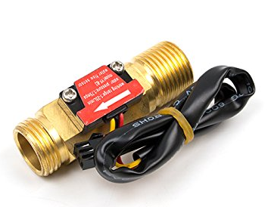
Water Flow Sensor
Selection Criteria:
Low power consumption
Low price
Durability
Water flow rate measuring capacity
Water flow sensor model | Water Flow Rate Measuring Range | Material | Working Temperature | Operating Voltage
Seeed Flow Sensor YF-B3 | 1 – 25 L/min | Cooper | < 120 ◦ C | 5 V
Seed M11 water flow sensor | 0.3 – 6 L/min | Plastic | < 80 ◦ C | 5 V
Seed G3/4 water flow sensor | 1 – 60 L/min | Plastic | < 80 ◦ C | 5 V
Water Flow Sensor YF-B3: Available from Seeedstudio.com
https://www.seeedstudio.com/Water-Flow-Sensor-YF-B3-p-2880.html

Slide 22
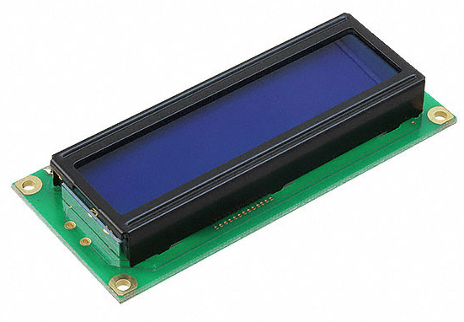
LCD Screen
LCD 16x02 screen module
System is designed so it can be operated without the application.
The LCD screen will display the readings from the sensors and alert the user in case there is a problem with the system.
https://www.digikey.com/product-detail/en/mikroelektronika/MIKROE-55/1471-1236-ND/4495600?utm_adgroup=Accessories&gclid=CjwKCAjwvtX0BRAFEiwAGWJyZOwM39n_hSP3fWXW6l0F4G0A0QhQG5_s9Y7RydgSesNh8aurzWGtcRoCvqsQAvD_BwE

Slide 23
Power
Sediment Filter
Pre-Carbon Filter
Solar Panels
UF Filtration Membrane
Battery
Water Pump
Water Flow Sensor
Water Flow Sensor
Purified Water Outlet
UV - Chamber
pH Sensor
MCU
MCU
Power
Turbidity Sensor
Filtration System
Peripherals
LCD Display
Bluetooth Transmitter

Slide 24
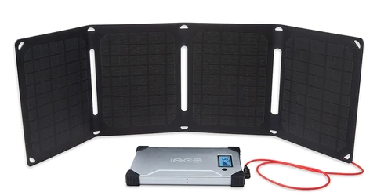
Solar Panels
Comparison of 3 types of solar panels:
Monocrystalline Cells- Small, highest efficiency, very portable
Polycrystalline Cells-Large in size (heavy), less efficient, not portable
Thin Film Cells-Large in size, less efficient, not portable
Specifications:
19 % efficiency rates, 16V output, peak current of 1.1 A, and peak power of 19.8 W
Has a built-in USB port

Slide 25
Battery
Battery Features | Lead-acid | Li-ion | Li - polymer
Weight | heavy (13 Lb.) | 1.6Lb | Light (1.5Lb.)
Energy capacity | 26,000 mAh | 24,000mAh | 24,000 mAh
Discharge stability | Less stable | stable | Very stable
Efficiency % | Less (50-70) | medium | High(>90)
safety | Less safe | Medium more volatile | More safe
Charging duration | longer | medium | Short
Cost ($) | 70 | 90 | 110

Slide 26
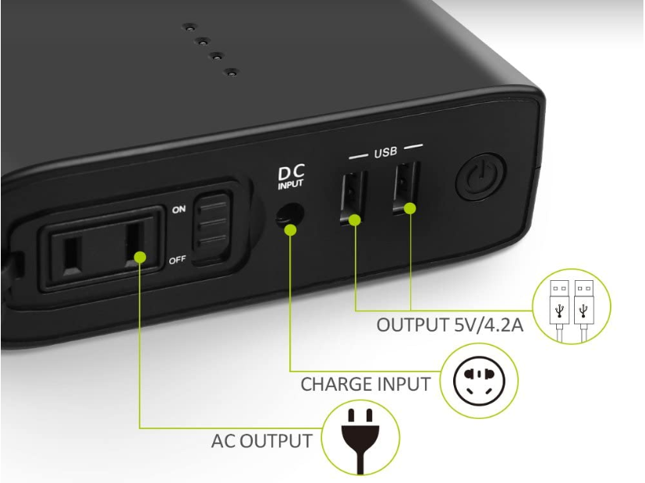
Battery Omars 2400 mAH 80W Portable power bank
Specification
Capacity : 24,000 mAh / 80 Watt Hours
Output: 2-A USB 5V 2.1A
AC output
Battery Type: Li-Polymer
DC Input:16.8V/2.0A
Dimensions
Size : 4.91*7.4*1.73 inches (124.8x188x44mm)
Weight : 2 pounds (907g)
https://www.omars.com/

Slide 27
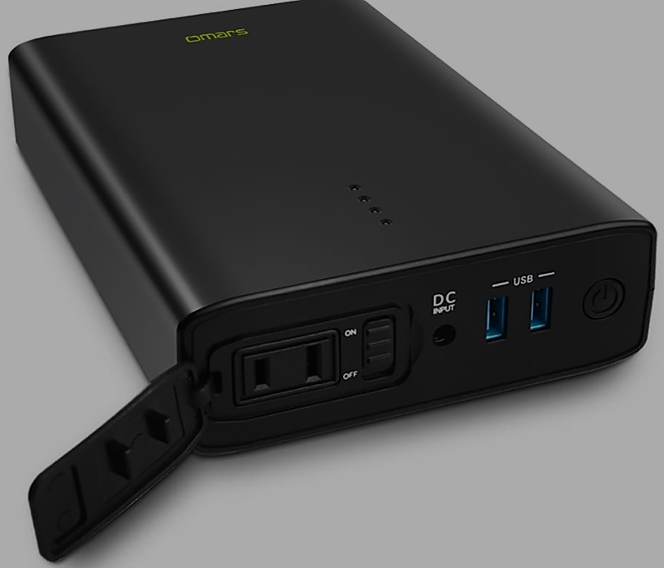
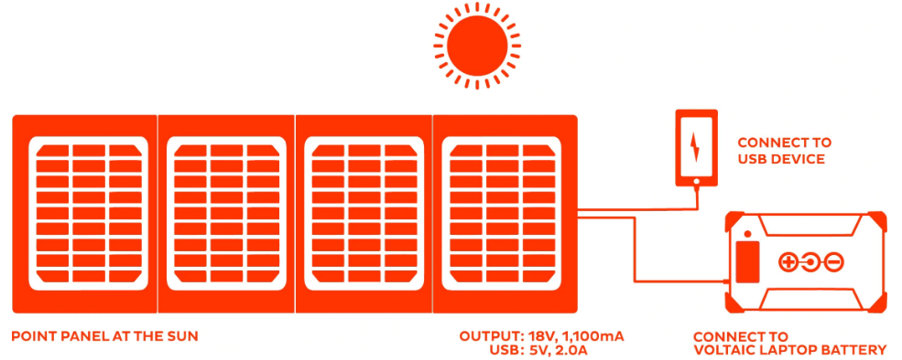
Advantages
Protection: Short Circuit, Over Charge, Over Discharge, Over Current, Over Temperature
Very light weight 2 pounds
2.5-3 hours from included additional AC charger
Safe for air travel
No need for charge controller (MPPT).
Battery features always ON mode
https://www.omars.com/

Slide 28
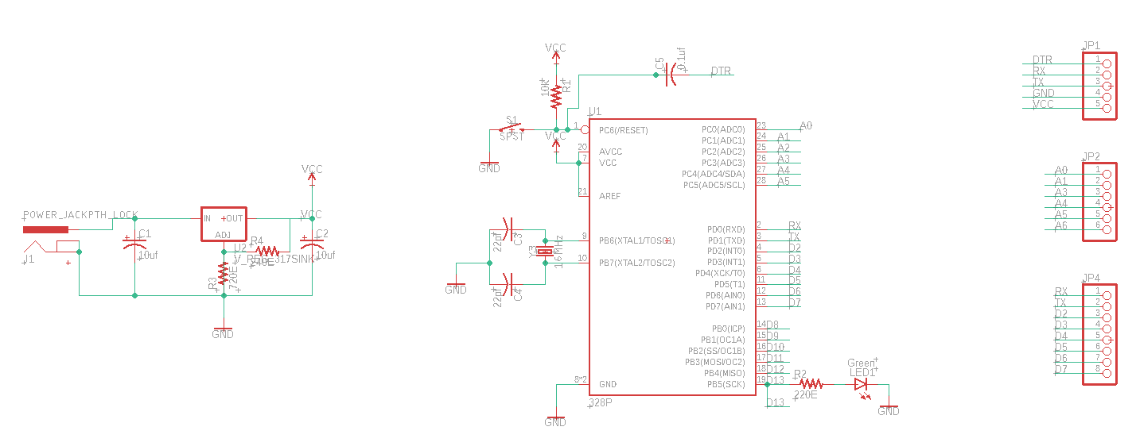
PCB schematic

Slide 29
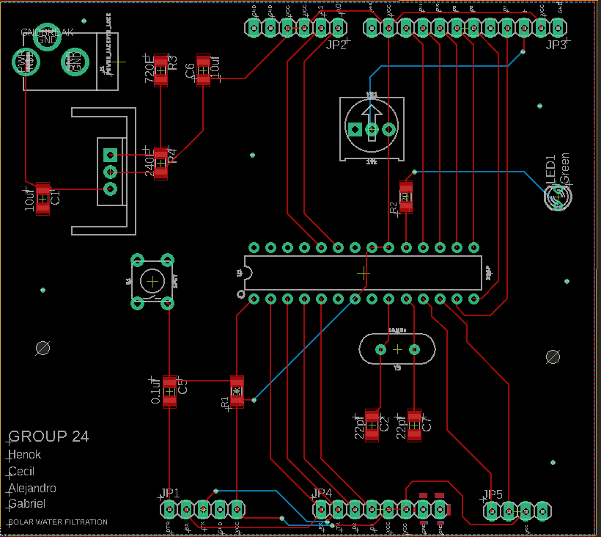
PCB Layout

Slide 30
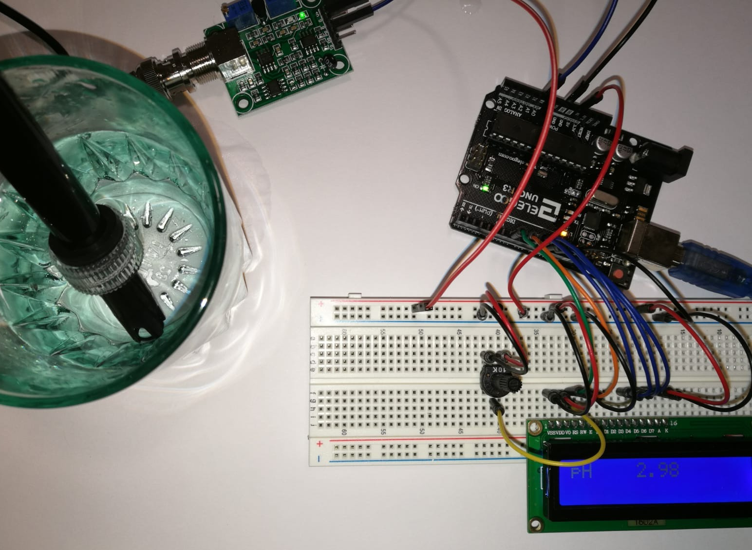
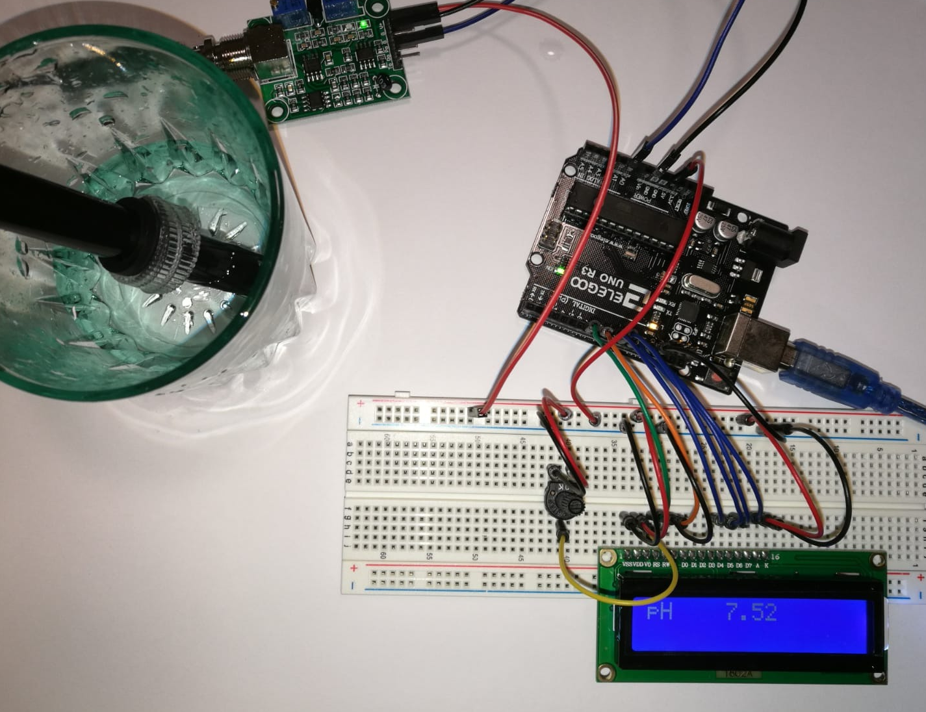
Sensor Testing
The pH sensor is tested by measuring the pH in liquids with know pH concentrations.
We used vinegar, distilled water and salted water for our tests.
Measured Substance | pH Reading | Expected pH
Vinegar | 2.98 | 2.4-3.4
Distilled Water | 7.13 | 7
Salted Water | 8.53 | ~8

Slide 31
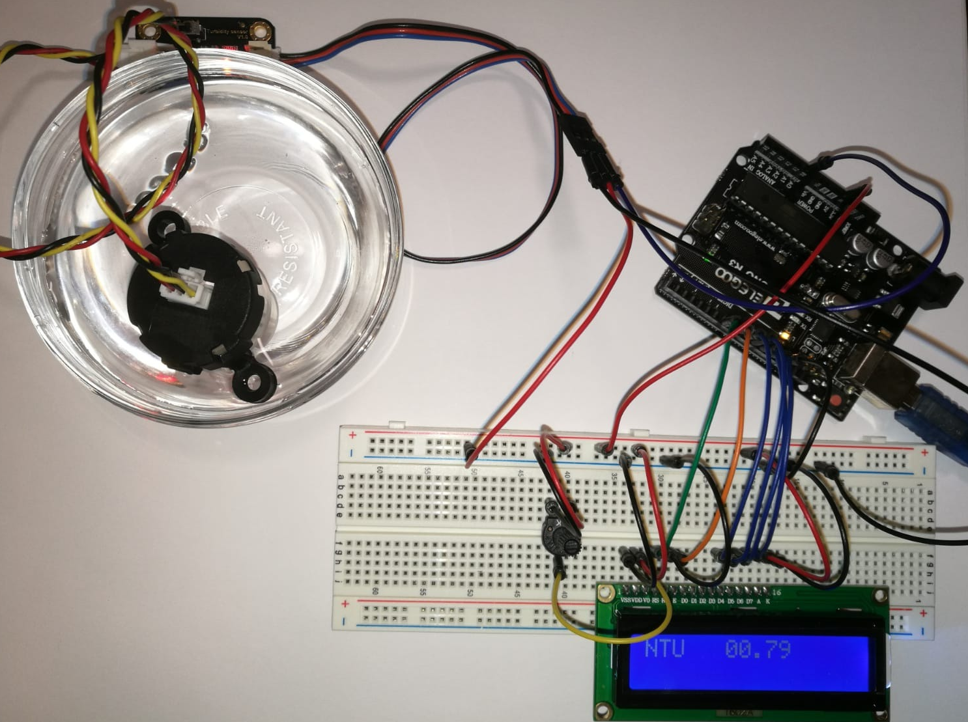
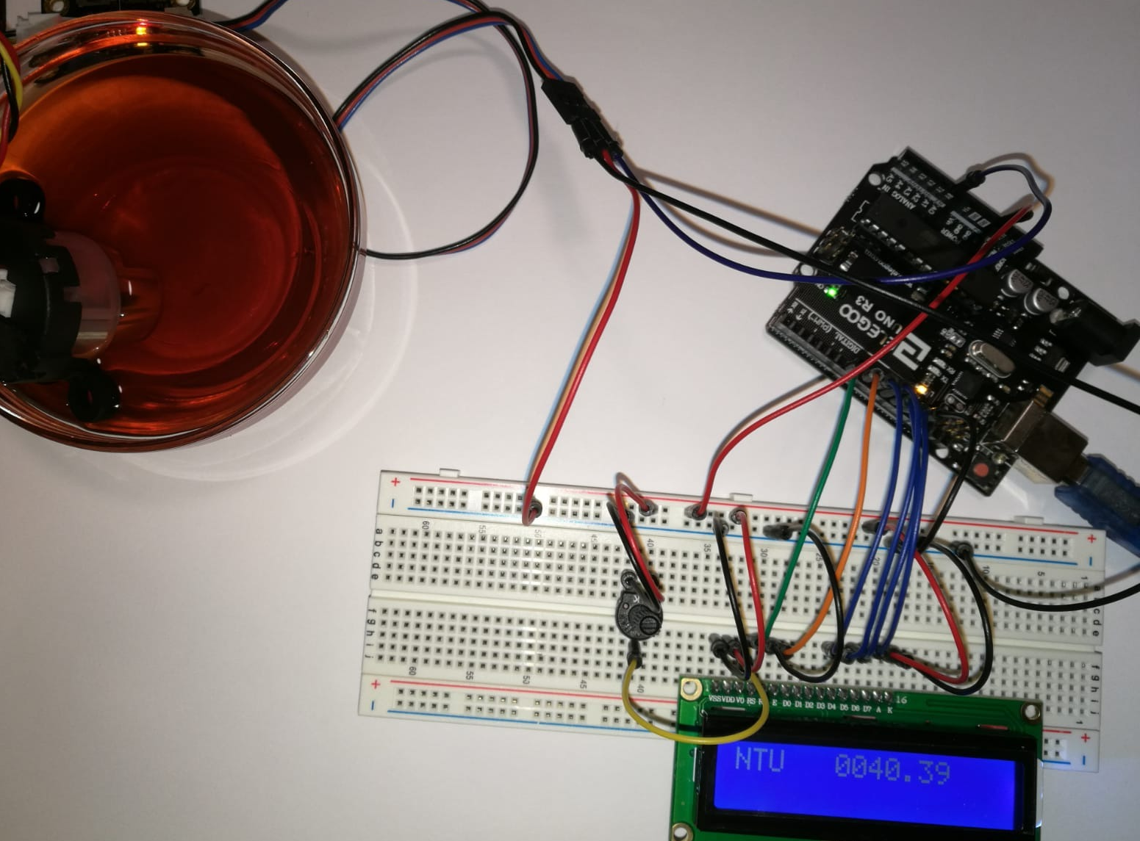
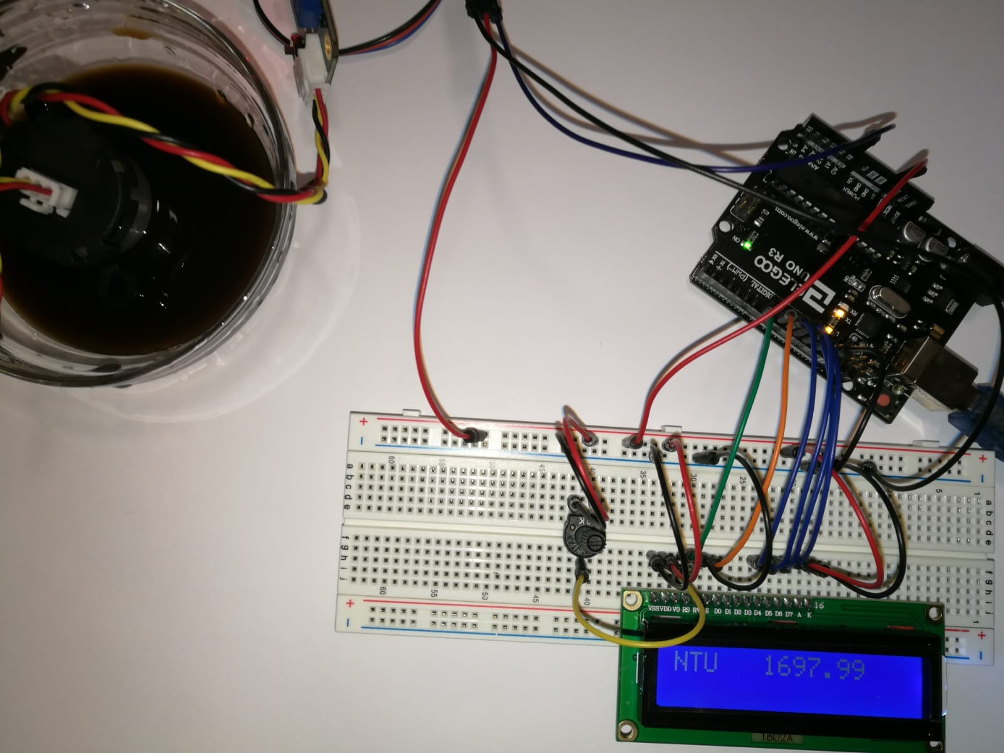
Sensor Testing
The turbidity sensor measures the amount of particles suspended in the water.
The unit for turbidity measurement is called NTU.
The higher amount of particles in the water, the higher the NTU value.
Subtance | Turbidity (NTU) Reading
Liquid #1 | 0.79
Liquid #2 | 40.39
Liquid #3 | 1057.19

Slide 32
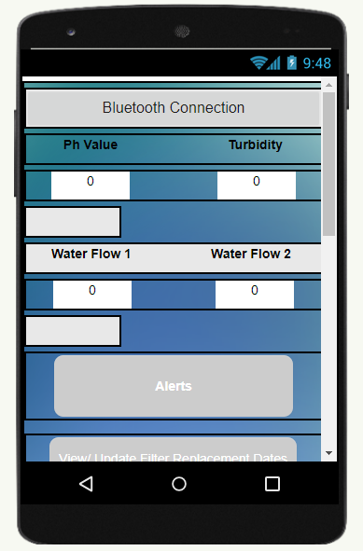
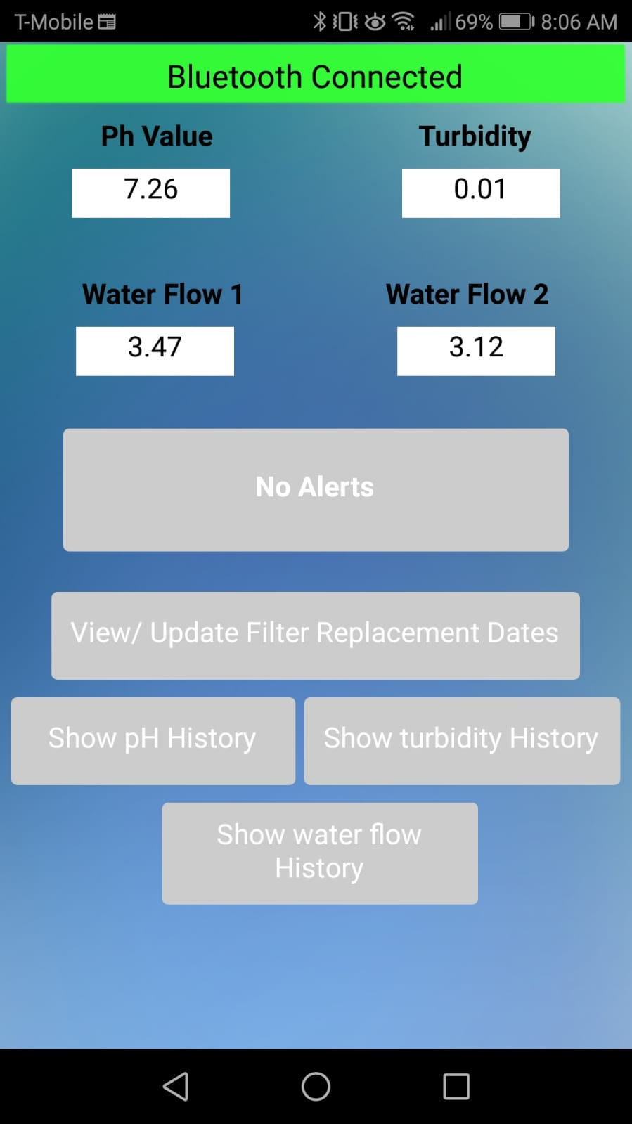
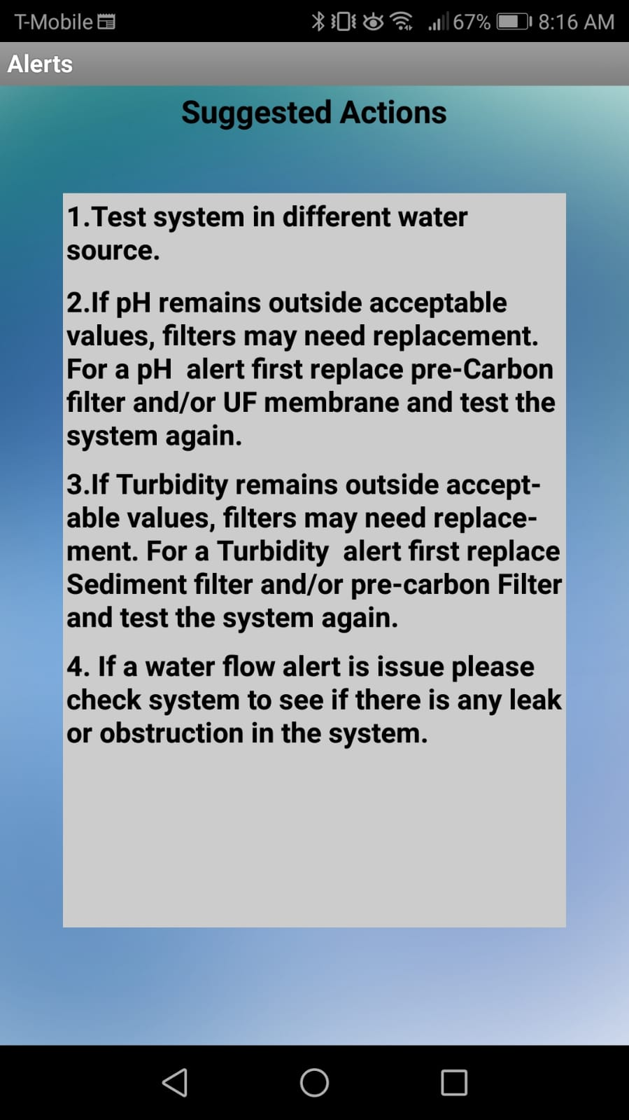
Software Testing

Slide 33
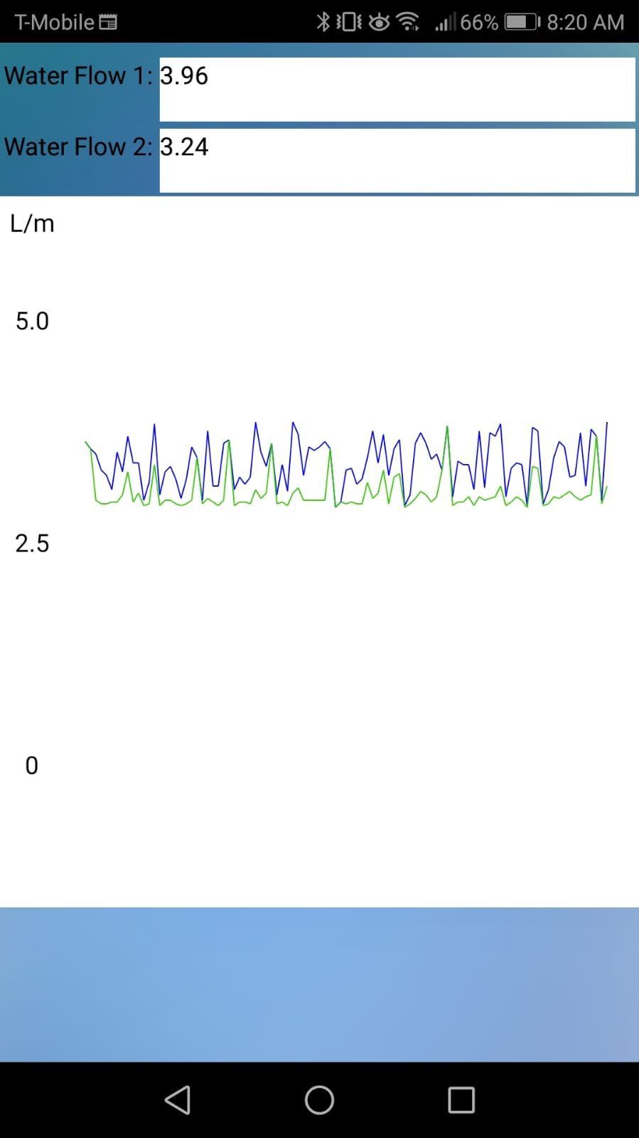
Software Testing

Slide 34
Work Distribution
Task | Alejandro | Cecile | Henok | Gabriel
Wireless Communication | ✓ |  |  | ✓
Mobile Application | ✓ |  |  | ✓
Microcontroller |  |  | ✓ | ✓
Power Supply | ✓ |  | ✓
Rechargeable Battery |  | ✓ | ✓
Sensor Integration | ✓ | ✓
Water filtration Module |  |  | ✓ | ✓
User Interface | ✓ |  |  | ✓
PCB Design | ✓ |  | ✓
Solar Panel Integration | ✓ | ✓
Primary task ✓
Secondary task ✓

Slide 35
Project constraints
Access to laboratory due to covid-19 pandemic
Shipment delays
Water leaks
UV- Filter
Powers from Ac – 120V
Need for additional circuitry

Slide 36
Project Expenses
Number | Component name and | Vendor’s Name | Cost/unit
1 | Arc 20W Solar charger kit | Voltaic Systems | 97.10
2 | Waterproof Case | GSI outdoors | 24.22
3 | Miscellaneous (magnets, components, pin headers) | Home Depot / Sparkfun and Mouser | 75.02
4 | Omars 2400mAH Battery | Well-made brands | 65.0
5 | Housing (case) | Fright harbor | 42.0
6 | Microcontroller (X2) | ELEGOO | 14
7 | PCB | Mouser | 35
8 | Water pump | Amazon | 15.48
9 | Sediment filter | DFRBOT | 7.99
10 | Turbidity sensor | DFRBOT | 15
11 | Ph/temperature sensor | GAOHOU | 38
12 | Water flow sensor (X2) | Amazon | 22
13 | Ultrafiltration membrane | Amazon | 19.0
14 | Pre-carbon filter | Amazon | 15
15 | Bluetooth module | Mouser | 8
16 | LCD | ELEGOO | 8
17 | Document printing | Office depot | 17
 | Grand Total |  | 517.81

Slide 37
Progress …

Slide 38
Any Questions… ?

