Slide 1
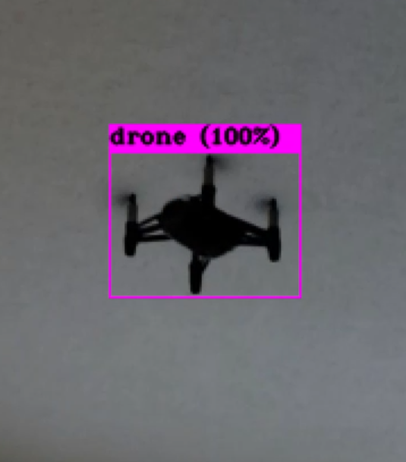
Reactionary Targeting Defense System (RTDS)
Group 19
Joey Musante
Chance Reimer
Calvin Sands
Notes:
All

Slide 2
Motivation
 | Total Recreation/Model Fleet (Million sUAS Units)
Year | ● Low | ● Base | ● High
2018 | 1.25 | 1.25 | 1.25
2019 | 1.29 | 1.31 | 1.35
2020 | 1.31 | 1.35 | 1.44
2021 | 1.31 | 1.37 | 1.52
2022 | 1.32 | 1.38 | 1.59
2023 | 1.32 | 1.39 | 1.66
Since their inception, UAVs/UASs (or drones) have quickly leapt from the defense and aeronautics industries to the commercial market.
In the US, the regulations surrounding flying personal drones is yet largely unstandardized, and therefore preventative measures are also unstandardized.
Any existing methods to prevent a drone entering a private or restricted airspace require manual intervention.
Additionally, weaponized drones demand a response to not only protect privacy, but lives as well.
Notes:
Calvin
Start with "Keep drones out of airspace"

Slide 3
Objectives
Small “turret” featuring a mounted camera on servos providing a dual axis of rotation.
Fast object-detection using YOLO, trained exclusively to identify quadcopters.
Tracking software that will center the camera’s focus on an observed drone.
Red-dot laser that will “paint” the targeted drone once the camera has centered its vision.
Notes:
Joey
High level narrative

Slide 4
Specifications
Description | Value | Unit
Must draw bounding box around drone within set amount of time | 5 | seconds
Hardware must be able to track targets in all directions | - | -
Hardware must be able to track targets within a set field of view | 180 | degrees
Hardware must be able to follow target movement for accurate firing within a specific range | 6 | inches
Tracking algorithm must exceed a minimum Intersection Over Union | 50 | percent
Firing laser must track within a minimum radius of the center of the drone body | 10 | inches
Displayed feed must show processed sensor data in real time | <10 | milliseconds
Firing apparatus must be able to track targets within a set field of view | 180 | degrees
PCB Hardware must connect to AC power | <15 | watts
Notes:
Notate the demonstrable specs – cut AC power

Slide 5
System Overview

Slide 6
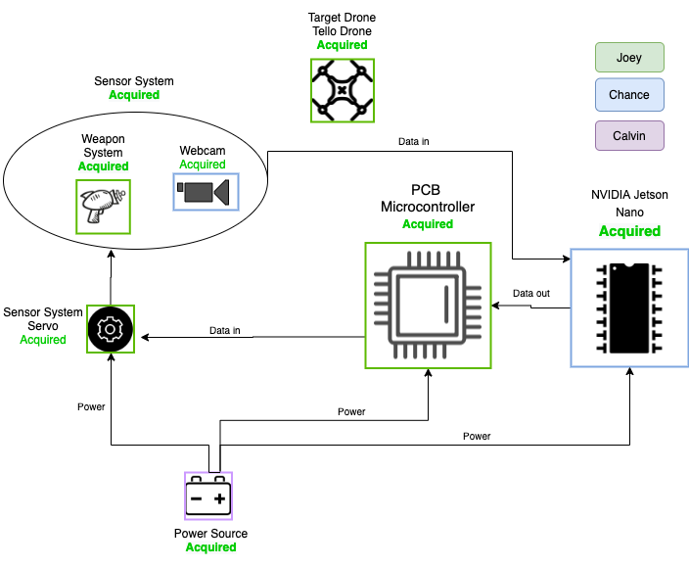
System Design Diagram
Notes:
Joey

Slide 7
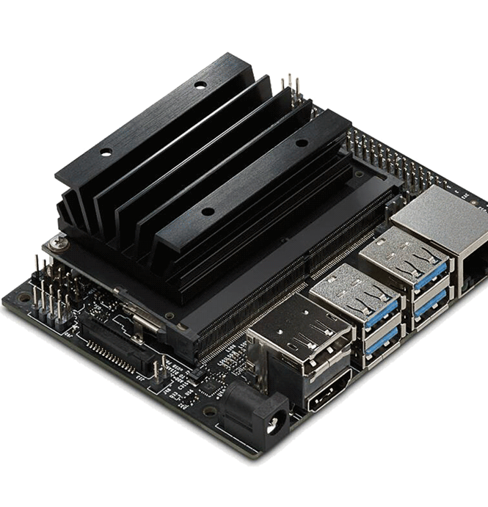
Development Platform
Board | Jetson Nano | ZCU104 | Raspberry Pi 4
Video Decoding | 4K @ 60 fps | 4k @ 60 fps | 4K @ 60 fps
GPU | 128-core Maxwell GPU | Mali-400 MP2 | Broadcom VideoCore VI
System Memory | 4GB 64-bit LPDDR4 | 64-bit LPDDR4 | 4GB 64-bit LPDDR4
GFLOPS | 500 | 461e-6 (461K) | 13.5
Power Consumption | 10W | Variable (based on Design) | 3.4W
Manufacturer | NVIDIA | Xilinx | Raspberry Pi Foundation
Cost | $99 | $895 | $55
Dimensions | 69 x 45 mm | 150 x 179 mm | 88 x 58 x 19.5 mm
Notes:
Chance

Slide 8
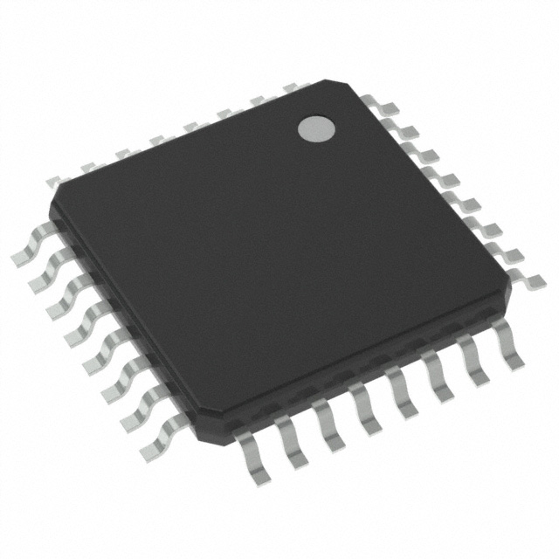
Servo Control PCB
Microcontroller | Arduino Uno | MSP430 | ATtiny85
Power consumption | 0.740 mW | 0.851 mW | 0.370 mW
Max Clock | 20 MHz | 16 MHz | 20 MHz
GPIO pin count | 23 | 16 | 8
Current output per pin | 100 mA | 48 mA | 40 mA
Flash memory | 32 KB | 16 KB | 8 KB
RAM size | 2 KB | 512 B | 512 B
Manufacturer | Arduino | TI | Microchip
Cost | $24.95 | $2.32 | $1.20
Dimensions | 68.6 x 53.4 mm | 12 x 10 mm | 9.50 x 9.75 mm
Notes:
Joey

Slide 9
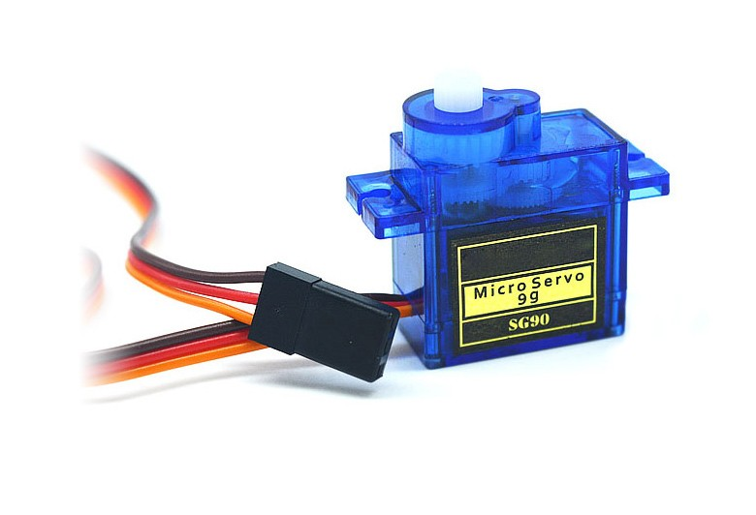
Servos
Servo | SG90 9g | HS-422 | HS-645MG | HS-755HB Giant
Max Torque (oz/in) | 25 | 45.8256 | 111.0946 | 152
Speed (sec/60o) | 0.12 | 0.21 | 0.24 | 0.23
Weight (g) | 9 | 45 | 55 | 110
Manufacturer | Tower Pro | Hitec | Hitec | Hitec
Cost | $5 | $13 | $29 | $25
Dimensions | 23.0 x 12.2 x 29.0 mm | 40.6 x 19.8 x 36.6 mm | 40.6 x 19.8 x 37.8 mm | 59.0 x 29.0 x 50.0 mm
Notes:
Joey

Slide 10
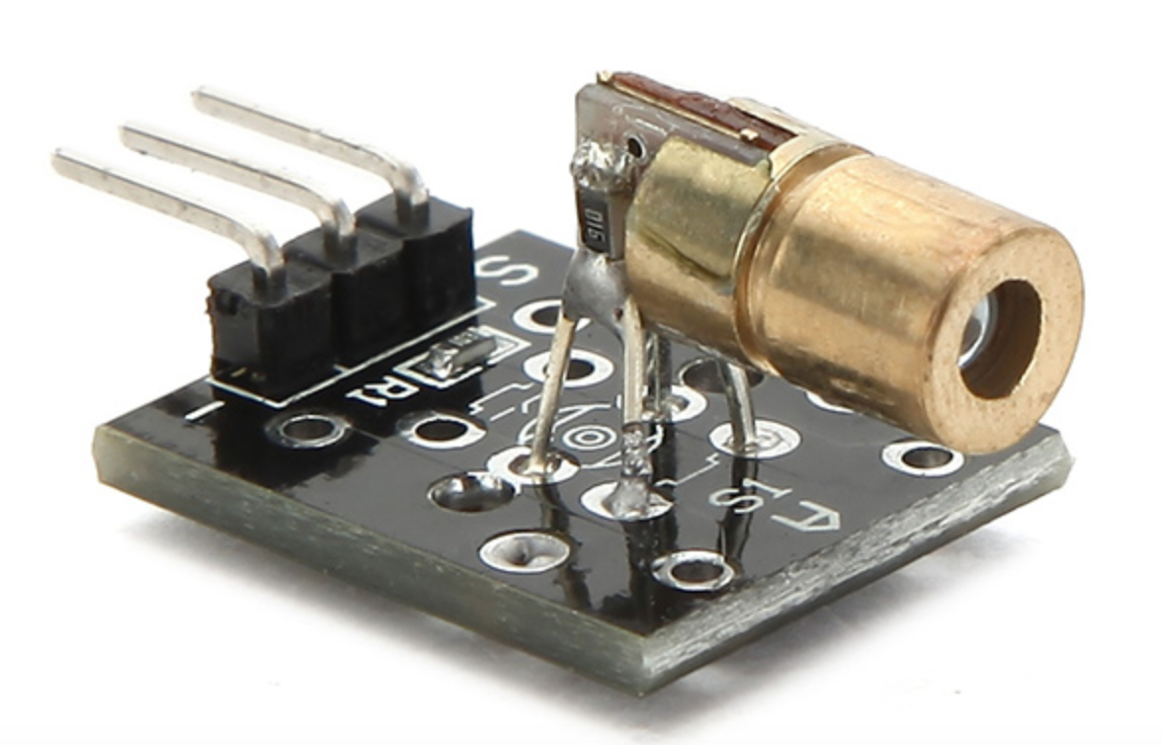
Laser
Laser | KY-008 | CL650AD5-YC6 | LTLD505T
Supply Voltage | 5 Vdc | 5 Vdc | 2.6 Vdc
Current | 30 mA | 35 mA | 45 mA
Wavelength | 650 nm | 650 nm | 650 nm
Color | Red | Red | Red
Manufacturer | Tower Pro | CivilLaser | Lite On
Cost | $0.70 | $2.00 | $2.49
Dimensions | 18.5 x 15 mm | 6 x 12 mm | 5.6 x 3.5 mm
Notes:
Joey

Slide 11
Camera
Camera | See3Cam CU30 | 397 | 56-581
Resolution | 1080p | 640 x 480 | 510 x 492
Framerate | 60fps | 30 fps | 30 fps
Data Type | UYVY
Connection | USB3.0 | Serial | Serial
Manufacturer | e-con Systems | Adafruit Industries LLC | Edmund Optics
Cost | $179 | $40 | $99.97
Dimensions | 40.7 x 40.7 x 33.4 mm | 32 x 32 mm | 20 x 32 x 32 mm
Notes:
Calvin (UYVY uses luminescence, and chrominance, not red, green or blue)

Slide 12
Data Transfer
We needed a method of transferring data between the PCB and Jetson Nano
We mainly focused on reliability and cost when considering our options
Camera | UART | SPI | I2C
Speed | Up to 115.2Kbps | 10Mbps+ | Up to 3.4Mbps
Complexity | Simple | Difficult | Moderate
Scalability | Only 1 device per UART port | Theoretically unlimited | Limited by address size
Required Wires | 2 | 4 | 2

Slide 13
Hardware Design

Slide 14
Sensor Systems Mount
We decided to 3D print a mount for our camera and laser
By using two 9g Micro servos we can pan and tilt the camera and laser
Notes:
Joey

Slide 15
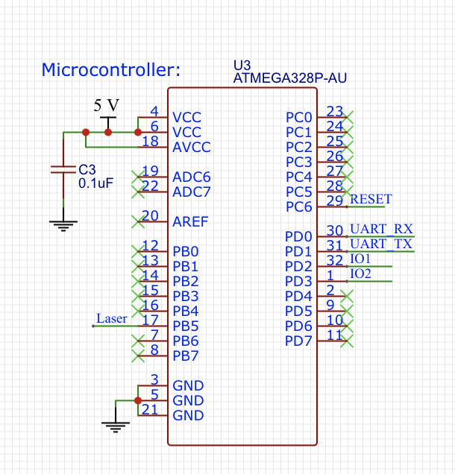
Servo Control PCB
Chose the atmega328p for simplicities sake
Main issue we encountered in PCB design was UART connection between between PCB and Jetson Nano
Solving this problem required some Engineering!
Notes:
Joey

Slide 16
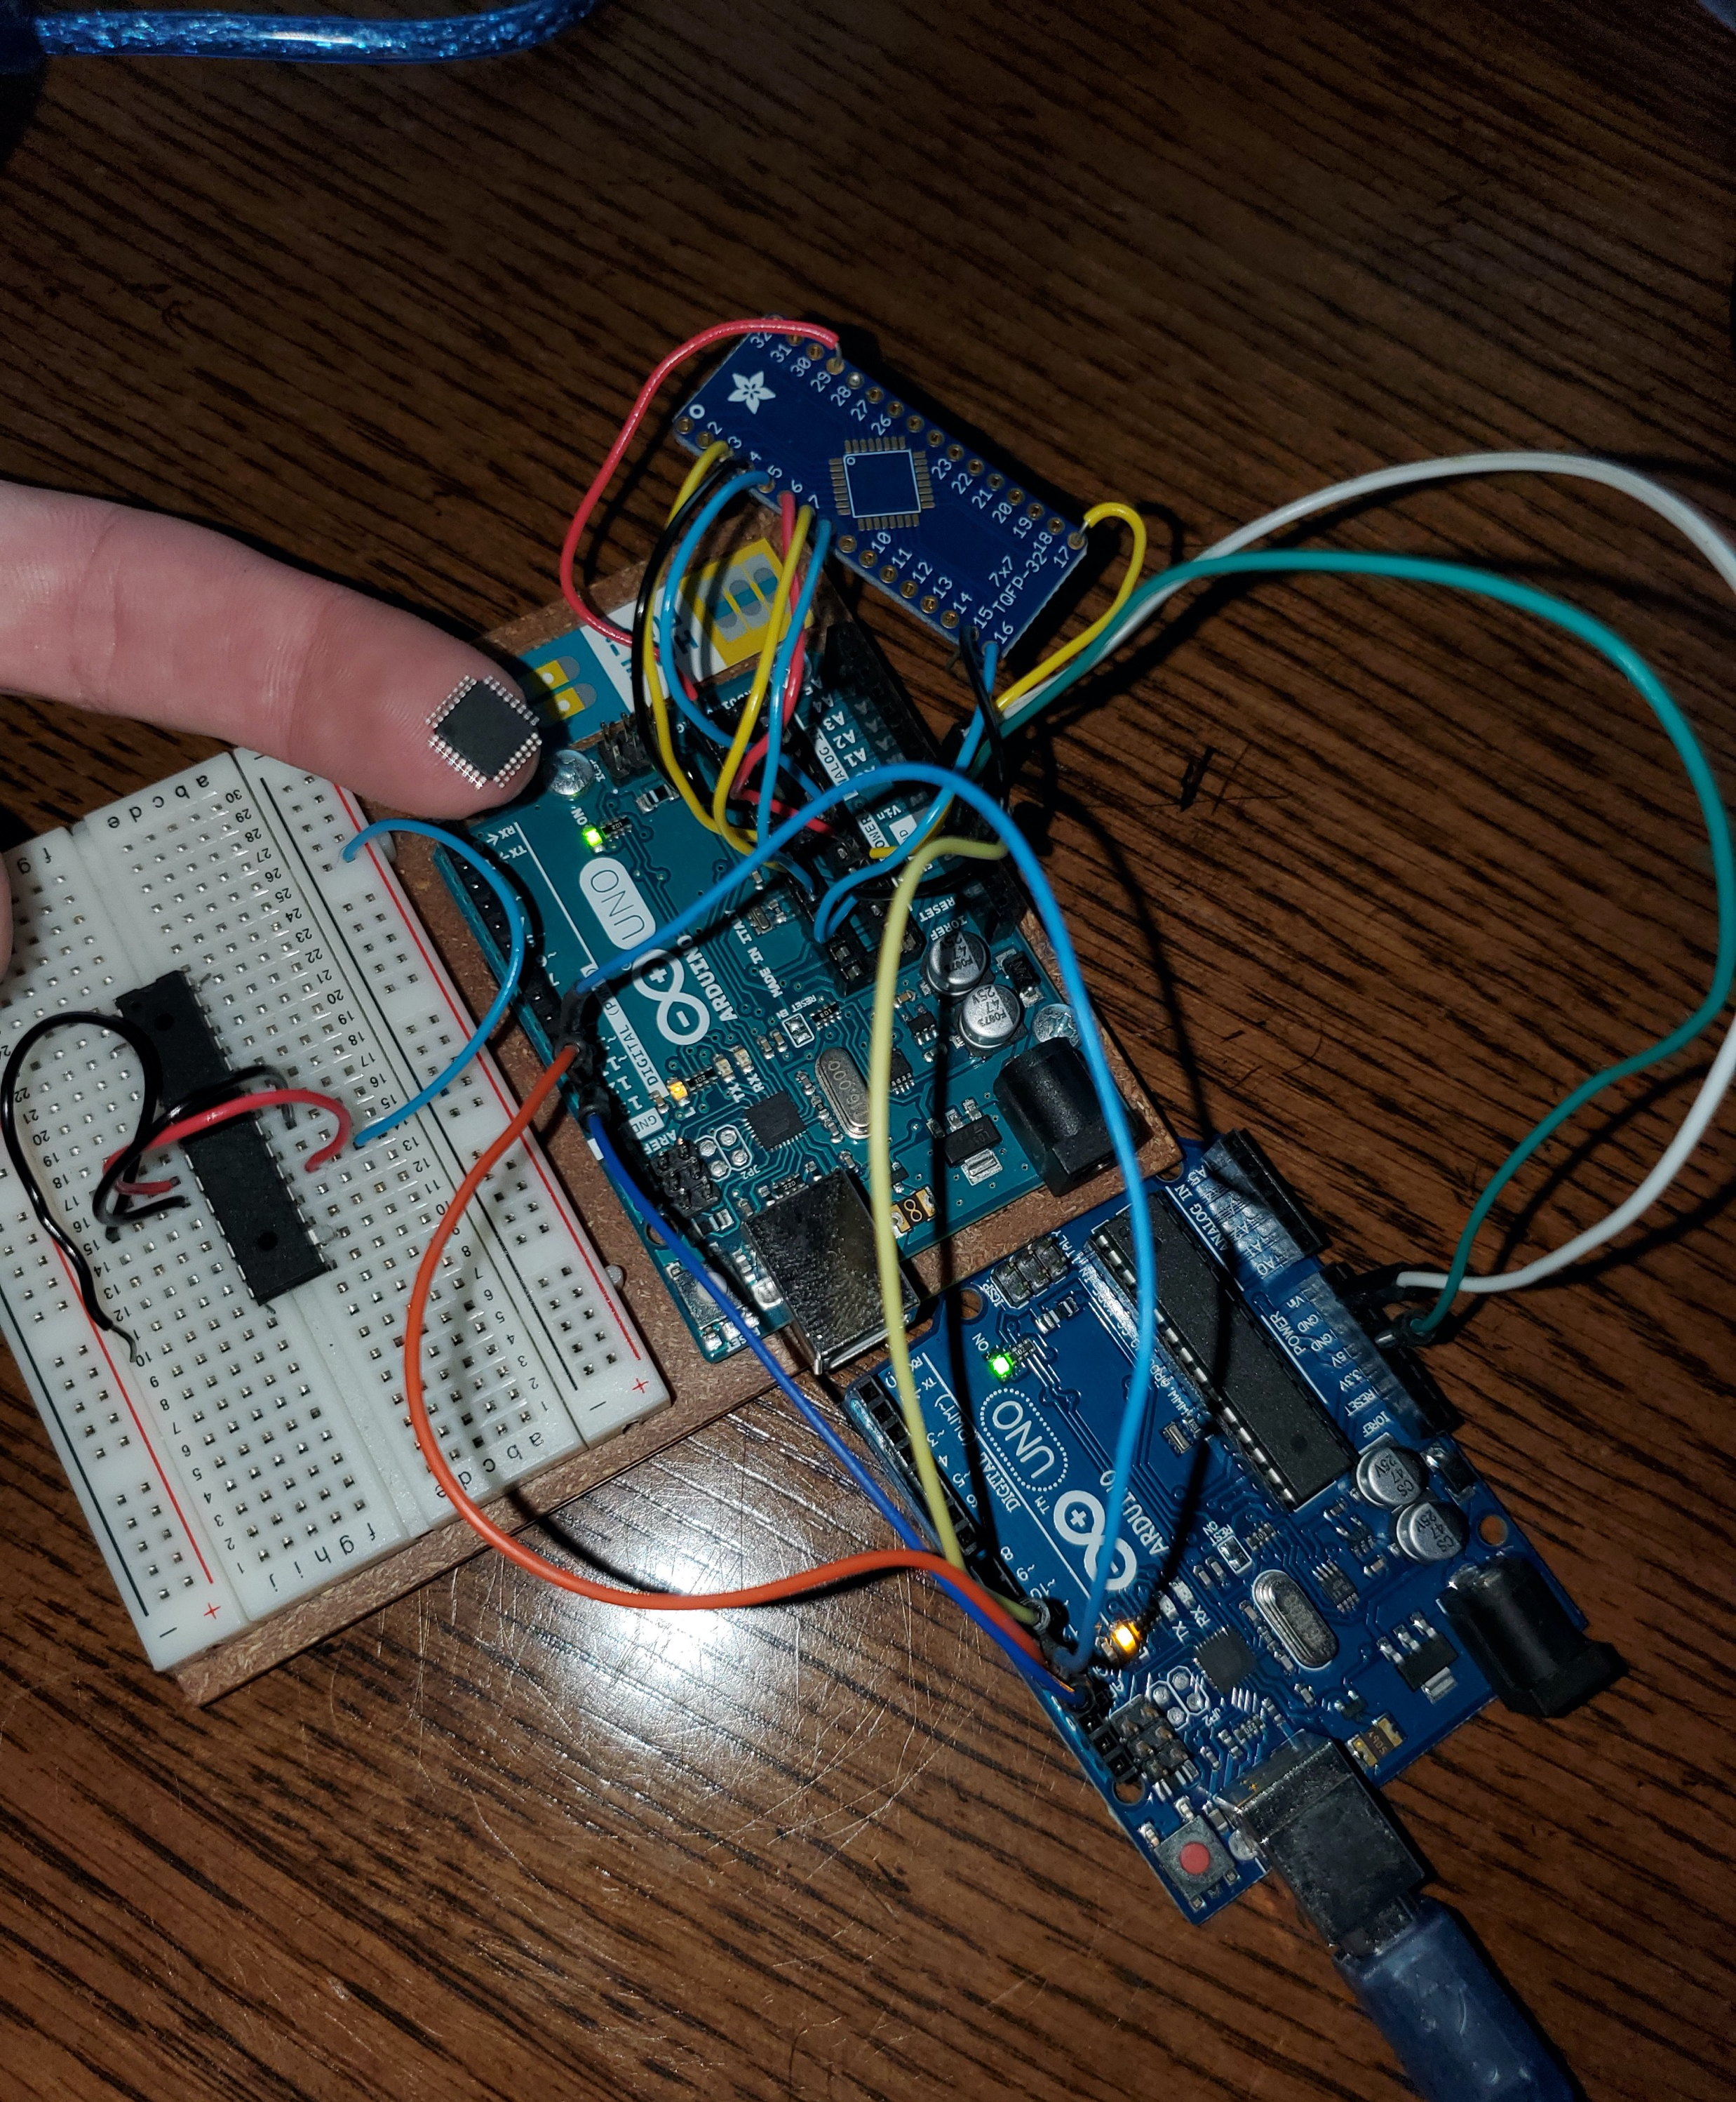
Burning the Bootloader
In order to burn the bootloader to the MCU we needed to do some ”Engineering”
The set up in the picture to the right was used in order to accomplish this cumbersome task
Notes:
Joey

Slide 17
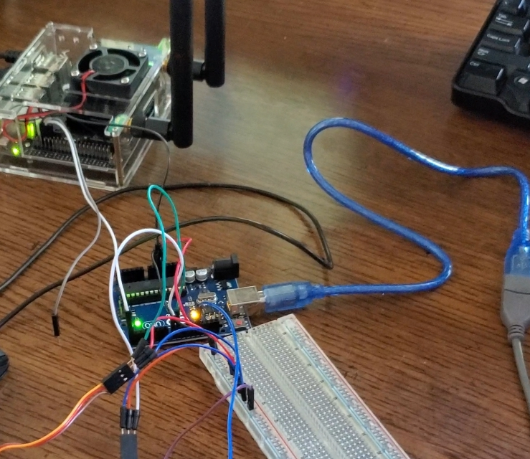
UART Connection
When testing our connection we noticed we were getting about 20% accuracy between the two boards
After much hair pulling, we realized it had to do with the Jetson Nano running its TX/RX pins at 3.3v and Arduino running at 5v
To test our theory we used a simple voltage divider from the Arduino to the Jetson board
Demo of connection
Notes:
Joey

Slide 18
Logic Level Shifters
With the use of two logic level shifters we were able to effectively communicate between the two boards
One is used to step the voltage up to 5V from the TX pin on the Jetson
Other is used to step down the voltage from TX pin on the Arduino to 3.3V
Notes:
Joey

Slide 19
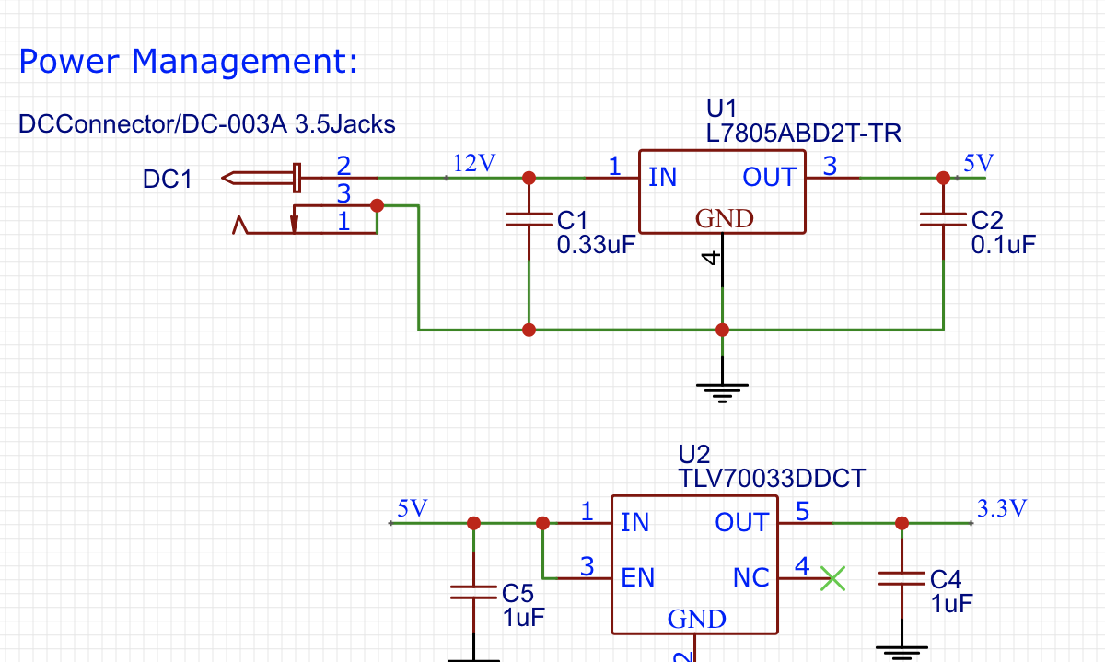
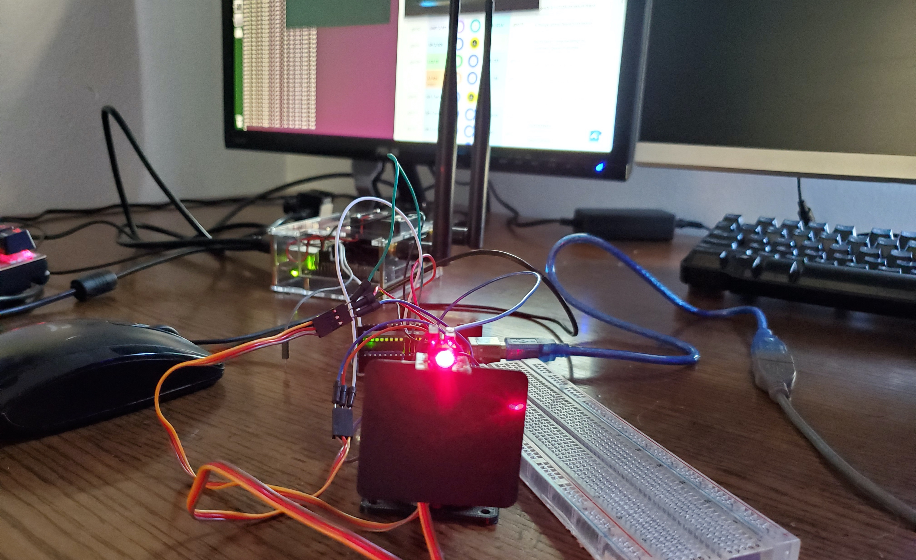
Power Supply
Due to the nature of our project implementing a battery pack wasn’t nessassry
We decided to use a 12V barrel plug to power the PCB
This plug shall provide enough power to run both servos and the LASER
Notes:
Joey

Slide 20
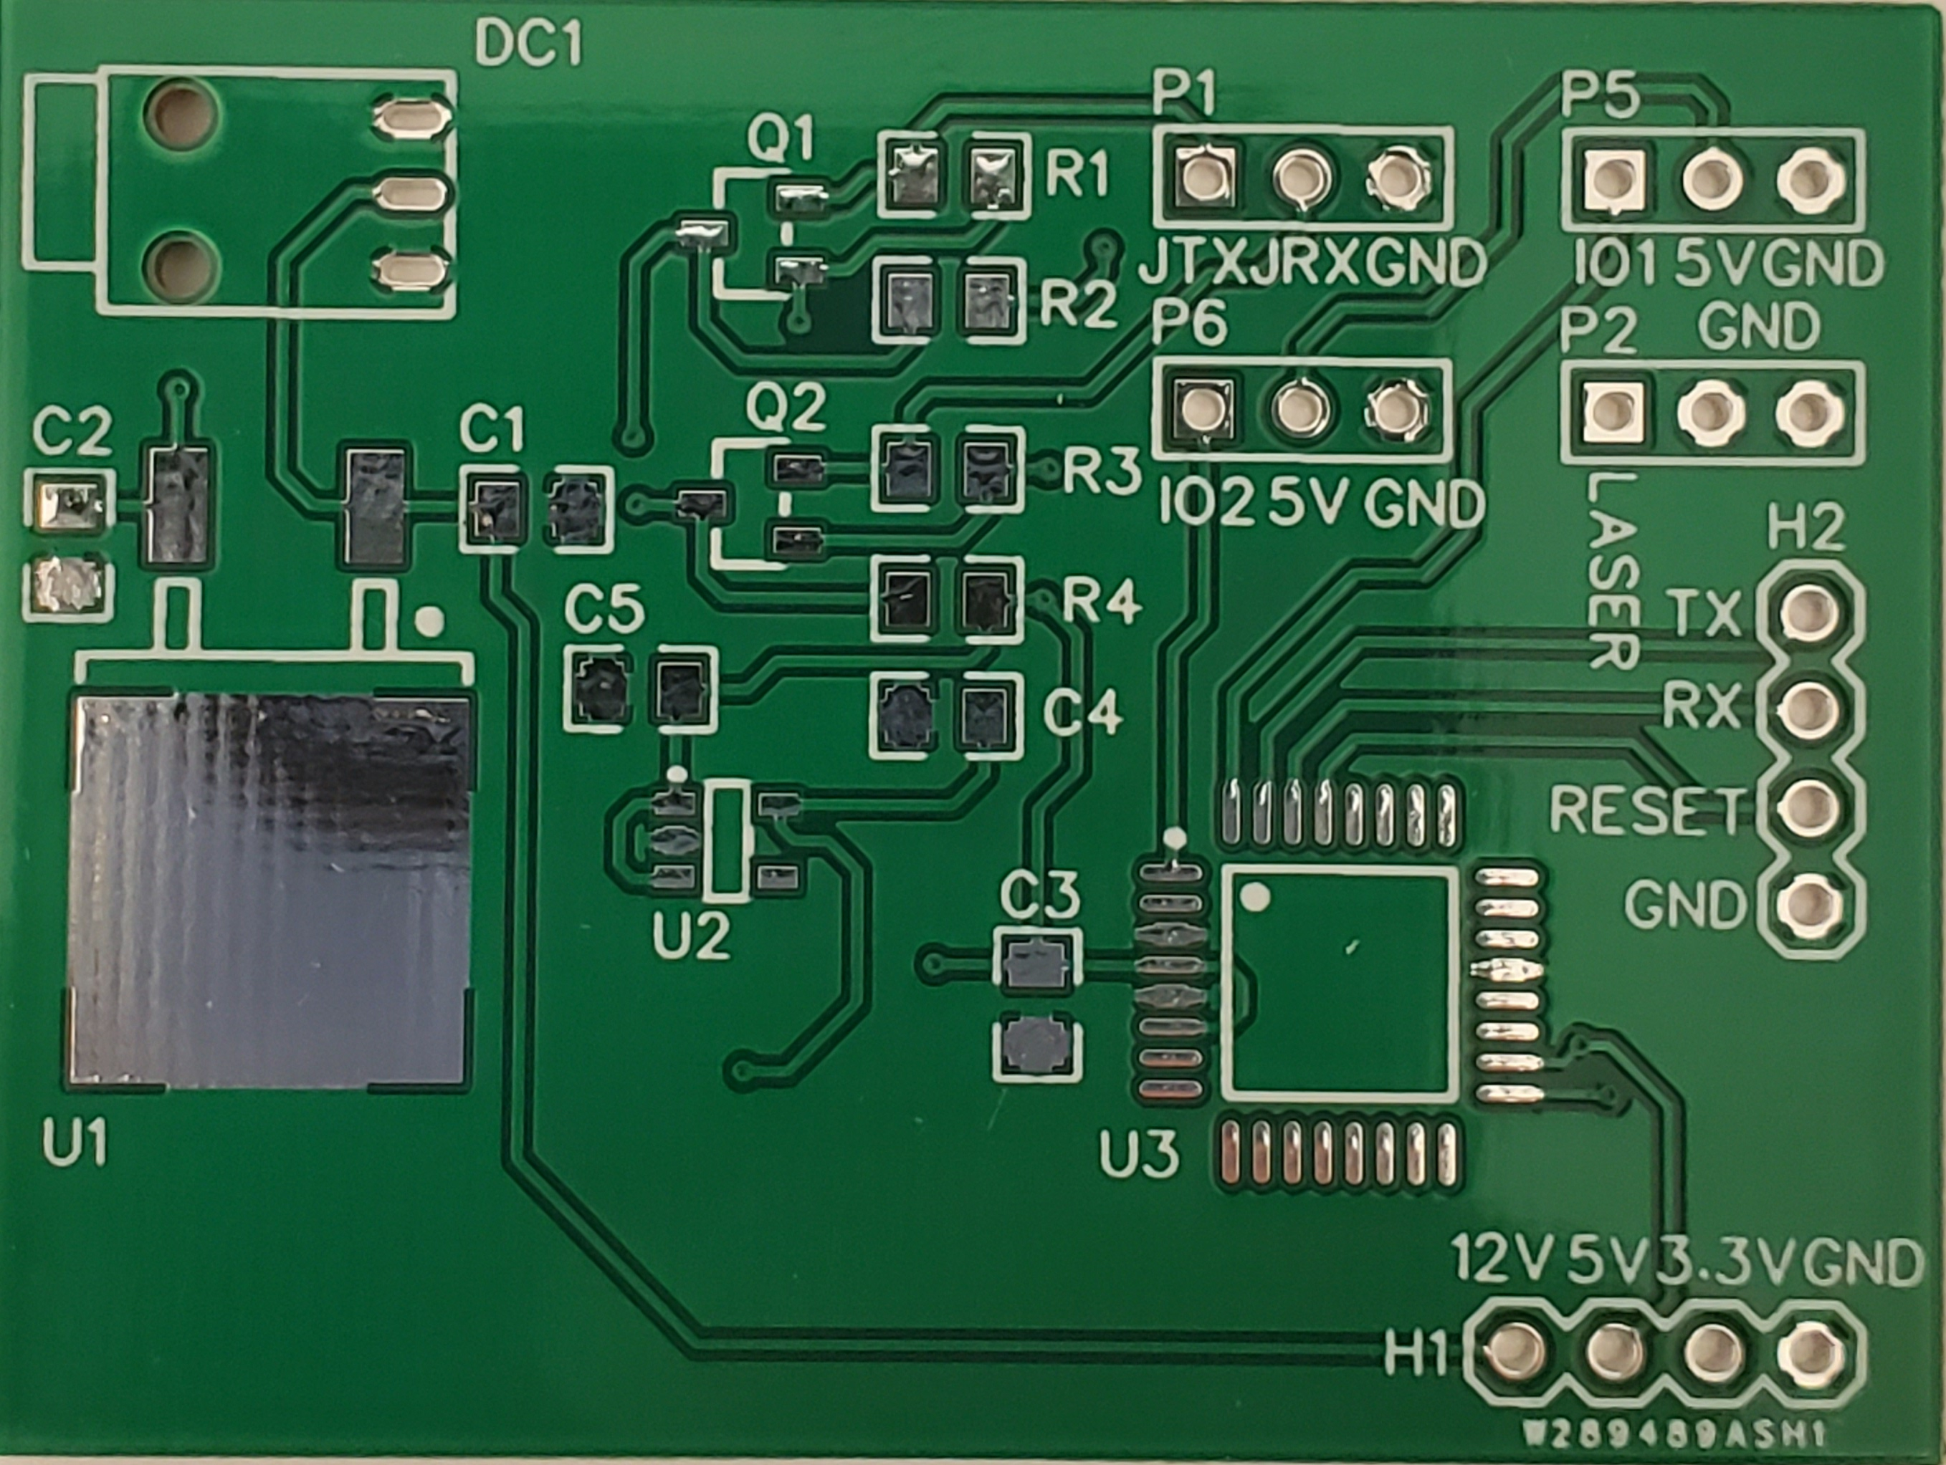
Revision 1 of our Servo Control PCB
PCB main components:
Atmega328p
2 Linear voltage regulators
2 Logic Level Enhancement Mode Field Effect Transistors
Notes:
Joey

Slide 21
Software Design

Slide 22
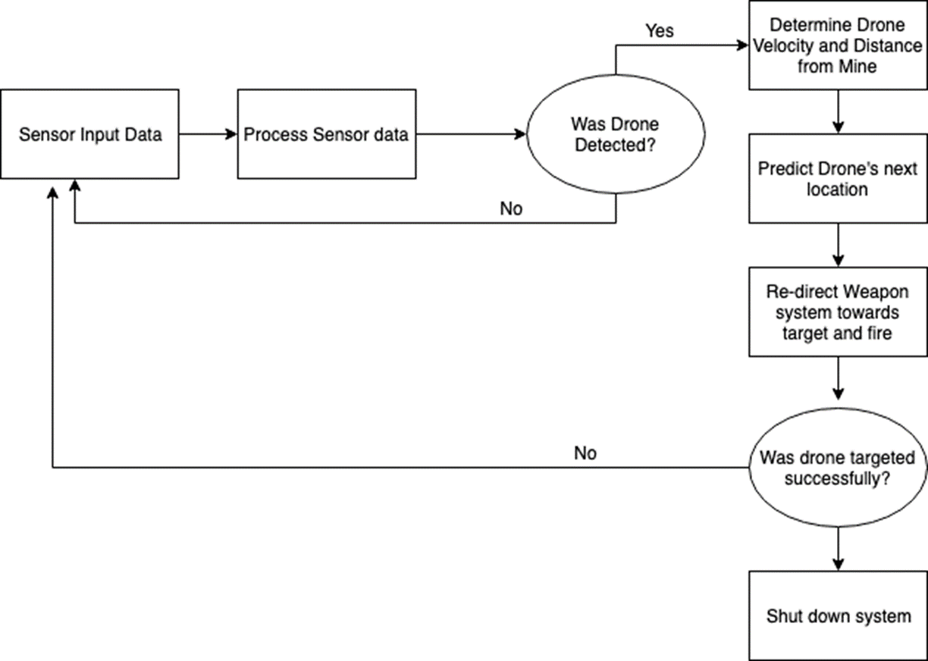
Software Flowchart
Notes:
Chance

Slide 23
The Data Pipeline
UYVY camera input stream
DeepStream SDK YOLO inferencing
Inter-process socket for sending DeepStream metadata
Python Application using metadata for targeting
Serial Communication Between Slave and Python App
Slave board drives servos to move camera
Notes:
Chance

Slide 24
DeepStream SDK
Video Source
(UYVY Stream)
The DeepStream SDK is built using the Gstreamer platform, meaning that processing occurs through a pipeline of plugins that perform actions on data
DeepStream SDK comes ready with prebuilt plugins for tracking, and applying ML algorithms, simplifying development
Allows for developers to create plugins to suit their needs
Notes:
Chance

Slide 25
Inter-process Communication
ZeroMQ is a “universal messaging library”, utilized to send messages over local addresses, or to other computers/servers
To simplify the purpose of each process, it was decided to have the Deepstream Pipeline send useful metadata over a local port to a listening python application responsible for commanding the slave board
Notes:
Chance

Slide 26
Google Protocol Buffers – Compressing Packets
To further increase speed, Protocol buffers were utilized to serialize the metadata, decreasing packet size
Simple to implement and utilize across multitude of programming languages
Notes:
Chance

Slide 27
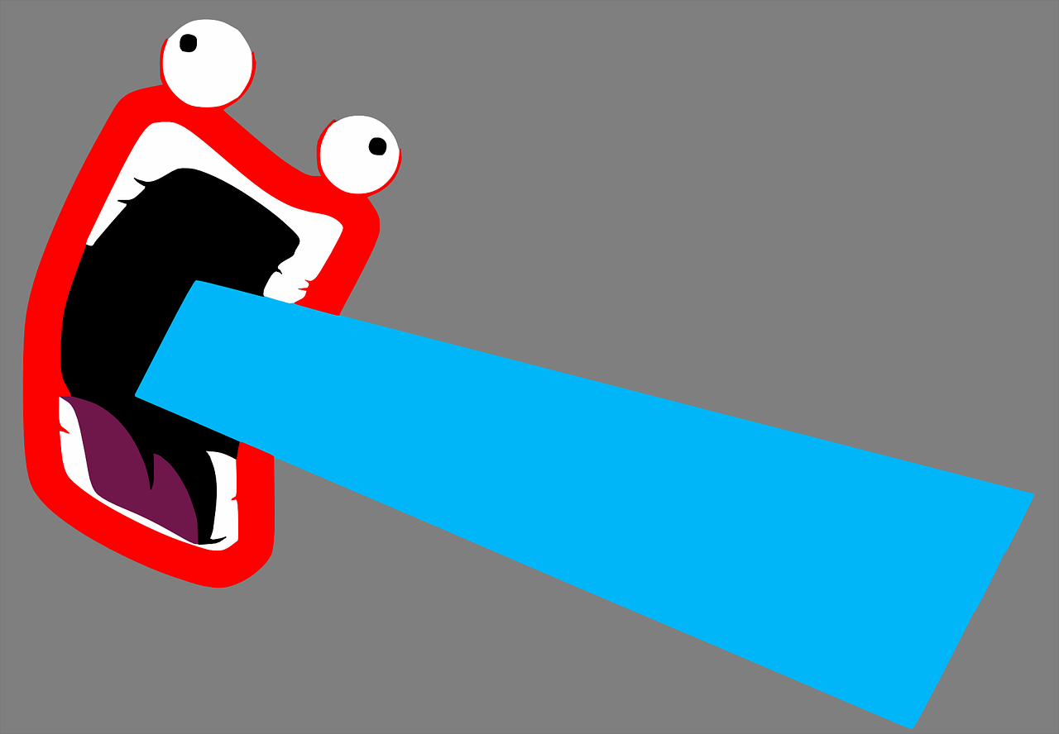
Python Communication Application
Uses metadata sent by the DeepStream Pipeline to generate relevant data necessary to command the slave microcontroller board to accurately track the detected object, and when to fire on the tracked object
Notifies user of tracking in progress, and the estimated speed and distance of the drone
Responsible for determining when a object has left field of view
Metadata
Depiction of DeepStream C application communicating to Python, 2020, colorized
Notes:
Chance

Slide 28
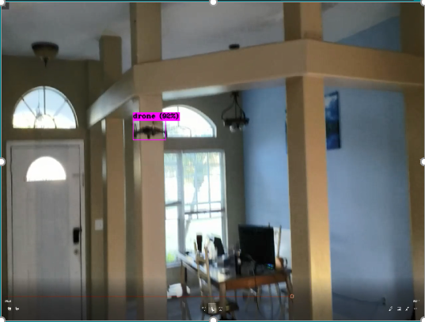
Serial Python Application Cont.
X+
Utilized metadata includes the bounding box (size of detection), location of detection (x, y coordinates, ect), and type of detection (label of object detected)
The application utilizes the most recent two detections to determine speed, and direction of the tracked target (size of target is assumed known)
The application utilizes its known hit box and most recent detection for commanding the Slave IO
Y+
Fire Region
Notes:
Chance

Slide 29
Slave IO Communication Protocol
Start
X
Y
CRC-8
End
Word length of 5 bytes, consisting of a start and end byte, two 8bit signed integers, and a CRC verifying the validity of the signed integers.
The Slave IO board is responsible for verifying the CRC and moving the servos to the desired position. The communication loop is open ended, no acknowledges will be waited upon by the Jetson Nano.
Reserved word for firing on object, a timer is attached to this word on both the Arduino and the Jetson, ensuring that it will not be constantly emitted.
Notes:
Chance

Slide 30
Slave IO Microcontroller - Programming
Receive full message
Verify CRC
Check for Fire Indication
Move Servo if not reserved fire indication
The microcontroller board is responsible for moving the servos and notifying the python driver if its commands are nearing the viewing window
The ATMEGA328p libraries for serial do not allow for access to underlying interrupt, but the buffer of 64bytes is sufficient to prevent overflow as long as amount of data sent is mitigated
Timer based Interrupt is used to fire laser
Notes:
Chance

Slide 31
Machine Learning Training & Optimization
Notes:
Let’s grab a broad overview again of the system before we dive into the weeds of the machine learning elements of RTDS.
As Joey explained, the hardware camera starts by capturing imagery in a video feed around the RTDS
As Chance explained, his pipeline provides that video stream to the YOLO algorithm being run on the Jetson Nano
What is the YOLO algorithm exactly, and how do we get it to do what we want? How do we train it?

Slide 32
You Only Look Once (YOLO) & DarkNet
YOLO is a novel object detection algorithm developed by individuals from University of Washington, Allen Institute for AI, & Facebook AI Research
Uses one CNN across the whole image, instead of “sliding window”- or “region-of-interest”-based techniques.
Darknet (maintained by YOLO dev Joseph Redmon) is the official Linux-based implementation of the YOLO algorithm
Darknet logo, 2019
Notes:
YOLO stands for You Only Look Once, and was developed in 2015 by a team of researchers led by Joseph Redmon.
It was designed to be a unique form of object detection by improving both on its efficiency and accuracy.
Darknet is the Linux-based implementation of the YOLO algorithm that was also developed and maintained by Joseph Redmon.
It is written in C and maintained open-source on Github.
Up to this point, the most popular forms of object detection used techniques that required multiple scans of the target image, in which the classifier was compared to each region on the image and the resemblance of that region to the classifier was what was used to determine if the object was found in that spot.
The obvious inefficiency with this method however is the multiple convolutions required for one image at each of those regions of interest.
YOLO uses a single convolutional neural network on the image as a whole, both in training and in validation, which does a number of things:
It speeds up the classification process
Helps the training model learn the object in the context of the rest of the image
Helps the training model learn what is NOT the object

Slide 33
YOLOv3 vs Tiny YOLO
YOLOv3
Uses a 106-layer full CNN
Too heavy to use on some constrained systems
Tiny YOLOv3
Uses a mere 24-layer CNN
Much quicker, but less accurate
Model​ | Train​ | Test​ | mAP​ | FLOPS​ | FPS​
YOLOv3-320​ | COCOtrainval​ | test-dev​ | 51.5​ | 38.97 Bn​ | 45​
YOLOv3-416​ | COCOtrainval​ | test-dev​ | 55.3​ | 65.86 Bn​ | 35​
YOLOv3-608​ | COCOtrainval​ | test-dev​ | 57.9​ | 140.69 Bn​ | 20​
YOLOv3-tiny​ | COCOtrainval​ | test-dev​ | 33.1​ | 5.56 Bn​ | 220​
Notes:
Darknet (Joseph Redmon’s open-source code of YOLO) actually implements multiple optimizations of the algorithm under different hyperparameters.
Most notably, YOLOv3 (the third and most current version of YOLO) uses a 106-layer full convolutional neural network.
Contrast that with Tiny YOLOv3, which uses a convolutional neural network about a quarter that size at 24-layers.
YOLO as it stands, despite its efficiencies over other algorithms, is still very computationally expensive and can run poorly on constrained systems, such as our Jetson Nano on the RTDS.
Tiny YOLO solves this problem by being much quicker, at the cost of accuracy.
Shown here are three variations on the network resolution – 320x320 pixels, 416x416 pixels, and 608x608 pixels, and their results, respectively – vs Tiny YOLO (which, for the record uses a network resolution of 416x416)
You can see the trade-off in accuracy, with the mAP, or mean average precision, of Tiny YOLO being about 60% that of YOLOv3-416, but return in speed, with Tiny YOLO being over 6x faster.
Initial tests on the Jetson Nano proved that Tiny YOLO would be the optimal choice for the RTDS in order to maximize the speed of image processing.

Slide 34
YOLO – Training and Use
Hyperparameters
Iterations: Number of times a batch is loaded for training
4000
Batch: Volume of images loaded per iteration
64
Subdivisions: Number of times the Batch is split and sent to the processor
8
Network Resolution: Size to which input images are scaled
height & width, 416x416
Metrics
Mean Average Precision:
“False positive rate”
Intersection over Union:
Percent of area intersection between prediction and actual regions
Frames per Second:
Approximate rate at which Tiny YOLO could process each frame from a live feed
Notes:
As mentioned previously, YOLO’s hyperparameters, shown in the left column, allow it to be optimized for certain solutions.
Shown here are the hyperparameters provided by Tiny YOLO.
Initial tests performed while trying to train the very first models for the RTDS saw us try a number of different variations on these hyperparameters, most notably on the network resolution and subdivisions.
None of these variations on the provided hyperparameters provided any results that were better – if not objectively worse – than those for which Tiny YOLO had already been optimized.
The right column enumerates the metrics used to determine the success of a trained model.
The aforementioned mean average precision provides us a sort of accuracy metric
Intersection over Union gives a further metric beyond accuracy to describe how tight around the object the bounding box is fit.
The frames per second describes the approximate speed of the model, with higher frames per second equaling a faster image processing rate.
These three metrics, along with the practical application of the model to the RTDS camera to actually try and identify our drone, are the basis on which we judge the success of any given trained model.

Slide 35
YOLO – Dataset Selection
Drone-Net: A custom-made dataset of images of quad-copter drones
Maintained by Chuan-en Lin
https://github.com/chuanenlin
~2400 unique images, all drones
mAP: 93.39%
IOU: 69.78%
FPS: ~60
Notes:
Now that we have the configuration of our model established, we need a dataset to train from.
It would turn out that a proper dataset for one’s object detection model is the most important variable when it comes to training.
Our first attempt at training a model to track our drone used an open-source repository called Drone-Net.
It contains about 2400 unique photographs of a variety of quadcopter drones.
The metrics from this initial model were promising, with a relatively high mean-average-precision and Intersection-over-Union, with a frames-per-second that would allow it to run functionally on the Jetson Nano.

Slide 36
YOLO – Dataset Selection
Overfitting occurred, as all images in the dataset feature drones as large, centered, and in focus.
Notes:
However, it became evident very quickly that the model was overfitted to this dataset, which turned out to not be an accurate representation of how we anticipate the RTDS will be identifying its nearby drones.
The drone-net dataset, upon a more critical review, contained an overwhelming majority of low-resolution, simple images that featured large, centered drones with very little distraction, obscurity, or alternative focus.
In other words, it was a lot of big pretty pictures of drones, and none that were obscured, blurry, or in motion as we expect the RTDS to have to identify.
In this clip you can see how the model fails to identify the drone until it is very close to it, nearly filling the whole frame.
And anytime the drone becomes partially obscured by falling outside the frame at all, the model loses sight of it.
If we expected the RTDS to identify a drone in even minimally realistic conditions, this issue with the dataset needed to be resolved.

Slide 37
YOLO – Training and Use
New dataset created from scratch, using video of our test drones
These videos are subdivided into images and used for training
Currently contains about 2300 images
Overfitting was avoided by taking multiple videos in various environments and angles/perspectives
Notes:
The solution the team decided on was to start from scratch and build our own dataset.
While considerations were briefly made to simply add to the existing drone-net dataset, it was feared that we would need to match, and preferably exceed, the volume of images in drone-net in order to begin to see positive results.
In order to get testing sooner, we started from zero.
We captured images using video of our target test drones in flight, using a variety of cameras, environments, resolutions, and lighting qualities.
The videos were then parsed into intervalled frames, which were subsequently annotated for the model, and then trained on.
Our earliest versions of the model, such as this one, used only 700 images – well below the recommended 2000 images – while our most recent model is exceeding 2300 unique images, and counting.

Slide 38
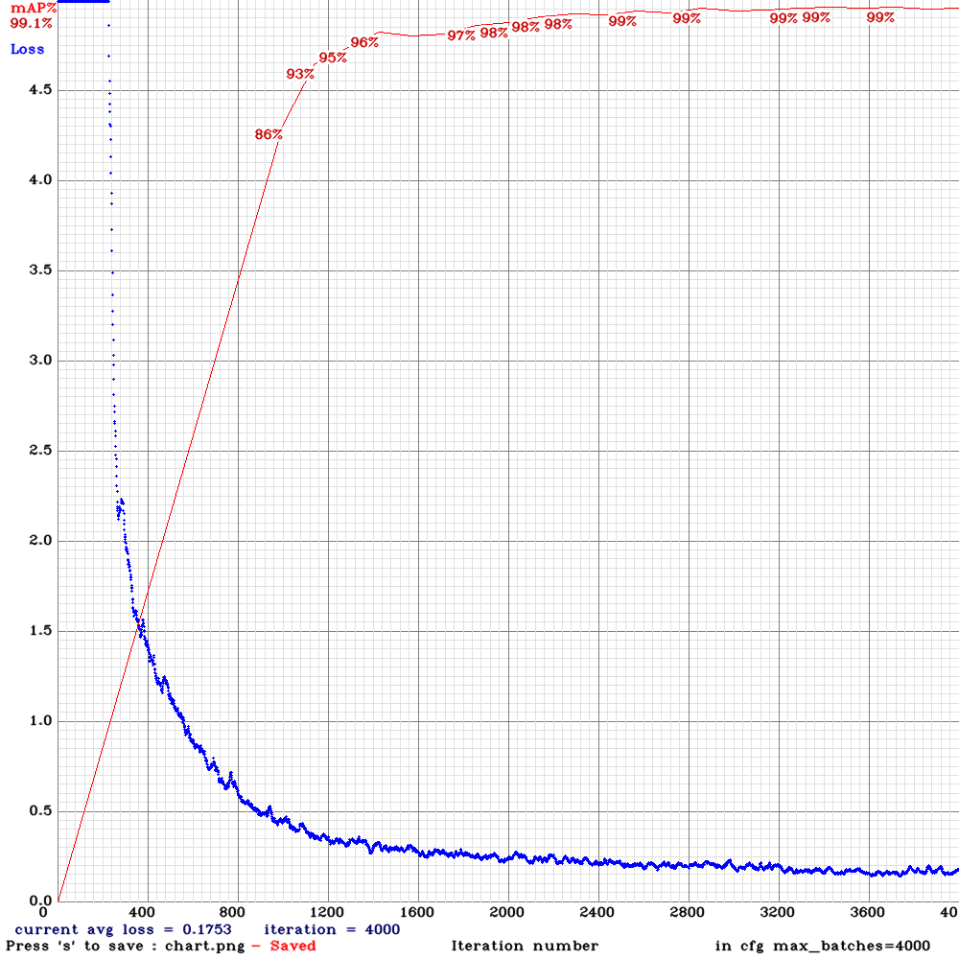
YOLO – Training and Use
mAP: 99.24%
IOU: 80.09%
FPS: ~114
Model​ | Train​ | Test​ | mAP​ | FLOPS​ | FPS​
YOLOv3-320​ | COCOtrainval​ | test-dev​ | 51.5​ | 38.97 Bn​ | 45​
YOLOv3-416​ | COCOtrainval​ | test-dev​ | 55.3​ | 65.86 Bn​ | 35​
YOLOv3-608​ | COCOtrainval​ | test-dev​ | 57.9​ | 140.69 Bn​ | 20​
YOLOv3-tiny​ | COCOtrainval​ | test-dev​ | 33.1​ | 5.56 Bn​ | 220​
Notes:
The results from our most recent model are shown here, having a mean-average-precision of 99%, an intersection-over-union of 80%, and a frames-per-second of about 114.
One final comment that could be made about understanding these results:
When compared to those of the displayed results earlier when talking about the different YOLO optimizations, it appears as though our model is massively superior to those trained by the developers themselves.
The critical difference however is simply the dataset.
These models here were trained on what could be described as a benchmarking dataset, called COCO: “Common Objects in Context”.
The COCO dataset also has over 200,000 labeled images, compared to our 2300.
But, more importantly, the COCO dataset, has 80 different object categories, compared to our 1: drones.
Therefore the anomaly of such high precision from our model can be attributed to a much smaller margin of error possible compared to training on the COCO dataset.

Slide 39
Administrative Details

Slide 40
Work Distribution
Team Member | Power & PCB Design | Servo Controller Communication | Embedded Systems Integration | Object Detection Training
Joseph Musante | Primary | Primary
Chance Reimer | Secondary | Secondary | Primary | Secondary
Calvin Sands |  |  | Secondary | Primary

Slide 41
Rejected Ideas
FPGA Computer Vision System
SDSOC immature product with buggy tutorials and long compile times made development unattractive.
Weapons System
Air cannon
Water gun
BB gun
Notes:
Chance

Slide 42
Budget
Component | Price | Status
Jetson Nano Development Board | $120 | Acquired
Tello Quadcopter Drone | $79 | Acquired
Servo Motors | $20 | Acquired & Tested
PCB | $6 | Acquired & Tested
PCB Components | $40 | Acquired & Tested
Laser Pointer | $5 | Acquired
Camera | - | Provided
Logic Converters | $8 | Acquired & Tested
Total | $278
Notes:
Joey

Slide 43
Successes
Early issues with voltage differences caused significant problems with UART communication.
Stepped up/down voltage between boards.
Original YOLO training model & dataset did not suit our detection goals.
Generated our own dataset.
Notes:
Chance

Slide 44
Current Progress Overview
Notes:
Joey

Slide 45
Moving Forward
Increase diversity of YOLO dataset and continue retraining model
Continue testing PCB and components as we continue integrating
Improve network communication
Finish servo tracking algorithm development
Notes:
Calvin

