Slide 1
DOMINANCE: LAND MINE
Department of Electrical and Computer Engineering
University of Central Florida
Dr. Lei Wei
Corey Hogue – EE
Joe Rivera – EE
Kristopher Sipe – CpE
Justin Wu – CpE
Notes:
Joe

Slide 2
Objective Statement
Customer requires a stationary mine capable of
Target Identification
Target Tracking
Wireless Video Datalink
Autonomous Disruption
Our solution is to use the latest computer vision and deep learning algorithms to target Unmanned Aerial Vehicles and disable them with a custom net launcher.
Notes:
Joe
Our customer, Lockheed Martin, wants us to develop a stationary mine capable of Identifying, Tracking, and Disrupting opponent UAVs on a competition track.
In order to meet their requirements, we will use the latest computer vision and deep learning algorithms to locate opponent UAVs and disable them with a custom net launcher.

Slide 3
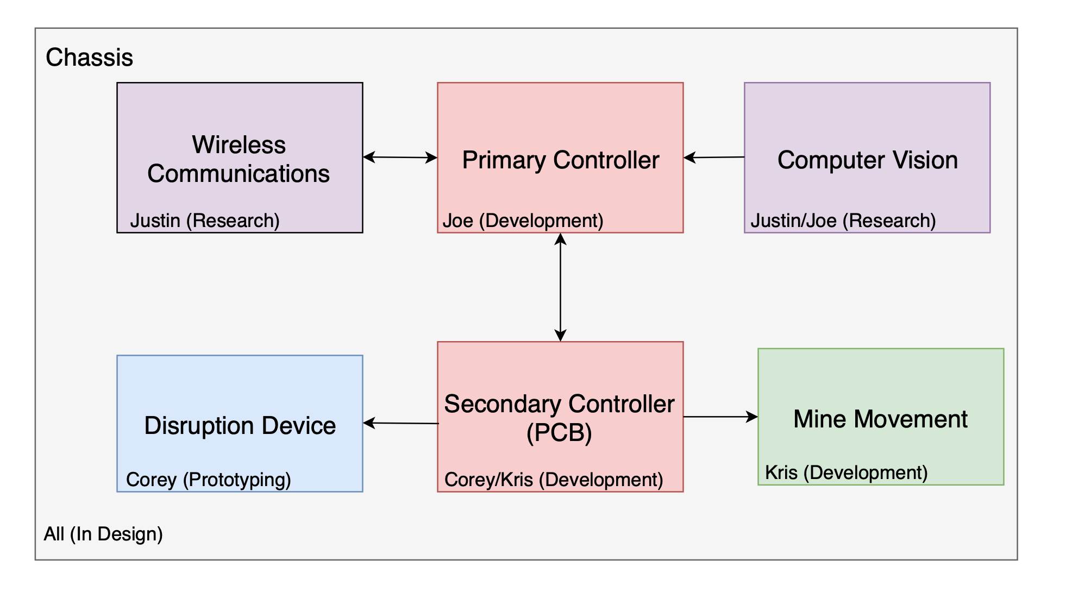
Responsibility Flowchart
Notes:
Justin

Slide 4
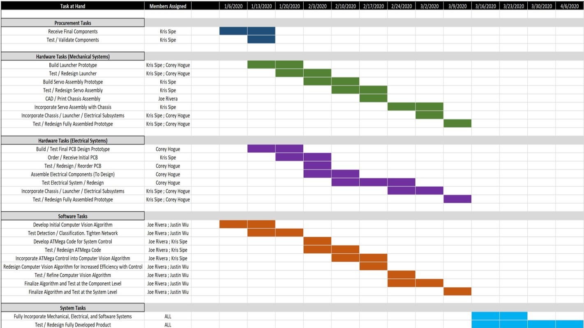
Gantt Chart
Notes:
Justin
Parts being order (solenoid, PCB,…)
Corey: Launcher design
PCB Design #2
Kris: UART with the big easy driver
Justin: Prediction algorithm
Uart communication, aurduino and jetson
Joe: Object detection and training the model

Slide 5
Requirements - Design
Requirements | Description
Dimension Size | 1.5 ft x 1.5 ft x 1.5 ft (L x W x H)
Stationary | Mine must remain stationary
Blast Radius | Horizontal: 3 feet Vertical: 10 feet
Budget | $700 w/ $350 additional for prototyping
E-Stop | Emergency stopping mechanism
No Jamming | RF, laser, acoustic confuser, etc.
No High Velocity Projectiles | Bullets, arrows, etc.
Wireless Video Datalink | Realtime camera feed
Notes:
Justin
Maximum size of 1.5 ft. x 1.5 ft. x 1.5 ft. (L x W x H)
Mine must remain stationary
Blast Radius
Horizontal: 3 feet
Vertical: 10 feet
Maximum budget: $700 w/ $350 additional for prototyping
E-Stop
Teams are not allowed to use any kind of RF jamming, laser jamming, high-velocity projectile, liquids, acoustic confusers
Utilize a wireless video datalink to a ground station laptop

Slide 6
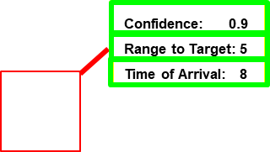
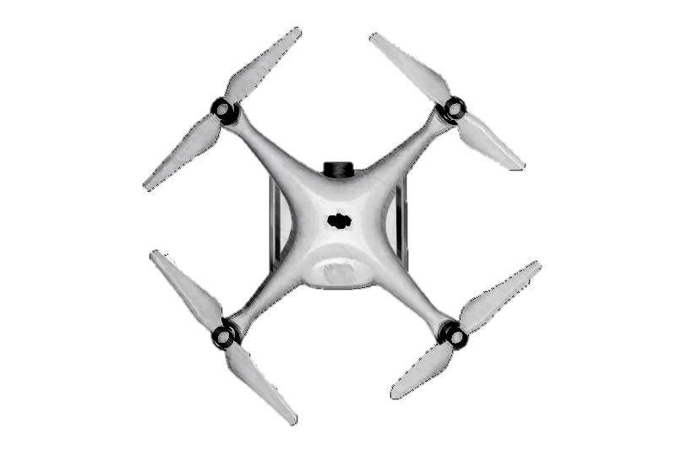
Requirements – Target Acquisition
Requirements | Description
Bounding Box | Red centered overlay
Metadata Box | Confidence, Range to Target, Time of Arrival
No YOLO | Not allowed to use any YOLO Deep Learning architecture
Symbology Example
Metadata Box
Notes:
Justin
Generate a large red bounding box overlay centered on the UAV
Metadata box
Confidence (Normalized, 0 ≤ x ≤ 1)
Range to Target (feet)
Time of Arrival (seconds)
Teams are not allowed to use any YOLO Deep Learning architecture variant

Slide 7
Standards
Standards | Description
IEEE 802.11 | Wi-Fi Communication
ISO/IEC 12207 | Software Life Cycle
IPC Printed Circuit Board Standards | Design, Production, and Manufacturing of PCBs
IEC 61140:2016 | Electronic Standards
PEP 8 | Style Guide for Python Code
Power Supply Standards | Safety standards against fire, shock, and injury
Notes:
Justin
Wi-Fi
Software Life Cycle
---
Electronics standard
Style Guide for Python Code
---

Slide 8
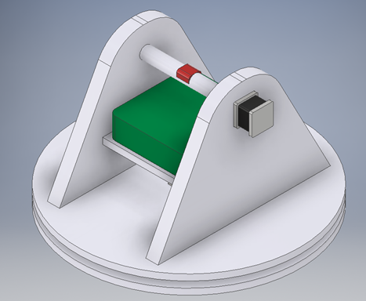
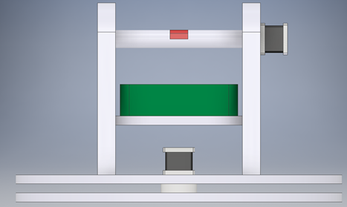
Prototype Chassis Model
Legend
Green | Jetson Nano and PCB Housing
Black | Stepper Motors
Red | Net Launcher Mounting Point
Notes:
Corey
Green:
Red:
Black:

Slide 9
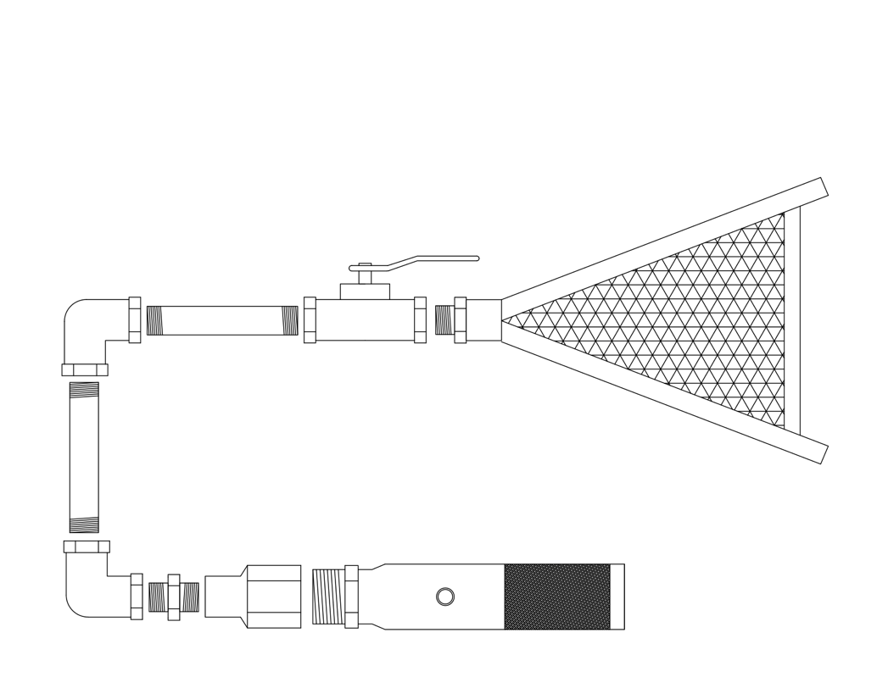
Net Launcher Design
12g CO2 Adapter
Brass Piping for Pressure Regulation
Pressure (psi) = 5910 / Volume(in³)
Valve for Releasing Pressure
Prototype: Mechanical Ball Valve
Final: Electronic Solenoid
Net Deployment System
C.
D.
B.
A.
Notes:
Corey
Did we have measurements? Like a formula for how far it might shoot or PSI
A. Easily replaceable cartridges for changing out in-between rounds
B.
C.
D.

Slide 10
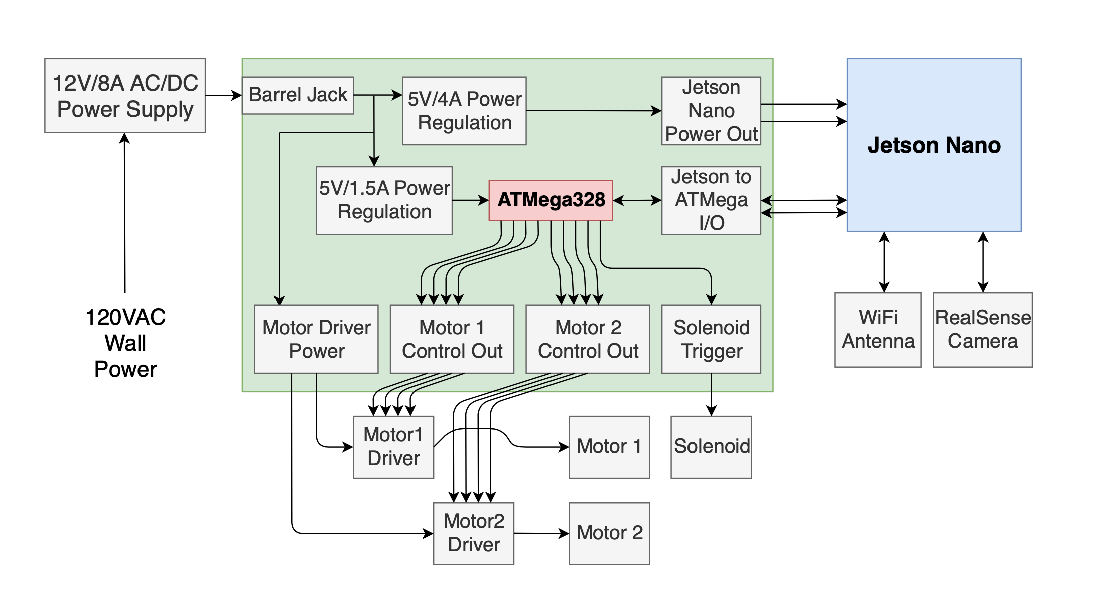
Hardware Integration Block Diagram
Notes:
Kris

Slide 11
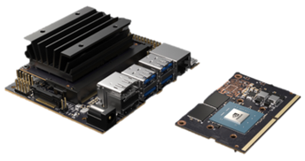
Primary Controller
Purpose:
Process live video feed
Compute detection and tracking algorithm
Selection Criteria:
Supports easy interfacing with external components.
Features 4 USB Type A ports.
Features GPIO rail (17 pins) with UART communication support.
Developed with computer vision in mind.
Cost effective relative to alternative processors.
 | NVIDIA Jetson Nano Developer Kit
Operating Voltage | 5VDC
Max CPU Clock Frequency | 1.43 GHZ
GPU / VPU | 128-core NVIDIA Maxwell GPU / H.265@4K & H.264@1080P
Temperature Range | 25$℃$ - 97$℃$
GPIO Pin Count | 17
Max Power Consumption | 10W
Unit Price | ~ $99
Notes:
Kris

Slide 12
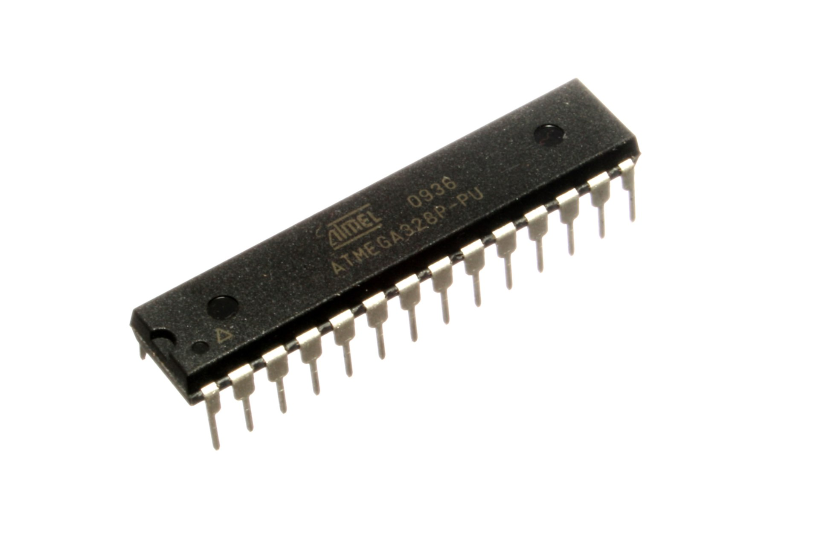
Secondary Controller
Purpose:
Manages secondary devices (Power, servo, etc.)
Selection Criteria:
Supports easy interfacing with external components.
Features GPIO pins capable of PWM and UART communications.
Bountiful amount of documentation online.
Ease of developing and flashing software.
 | ATMEL ATMega328
Operating Voltage | 2.7 - 5VDC
Max CPU Clock Frequency | 16 MHz
Bit Count | 8-bit
Analog I/O | Input Only / PWM Output
Temperature Range | -40$℃$ - 125$℃$
GPIO Pin Count | 23
Unit Price | ~ $2
Notes:
Kris

Slide 13
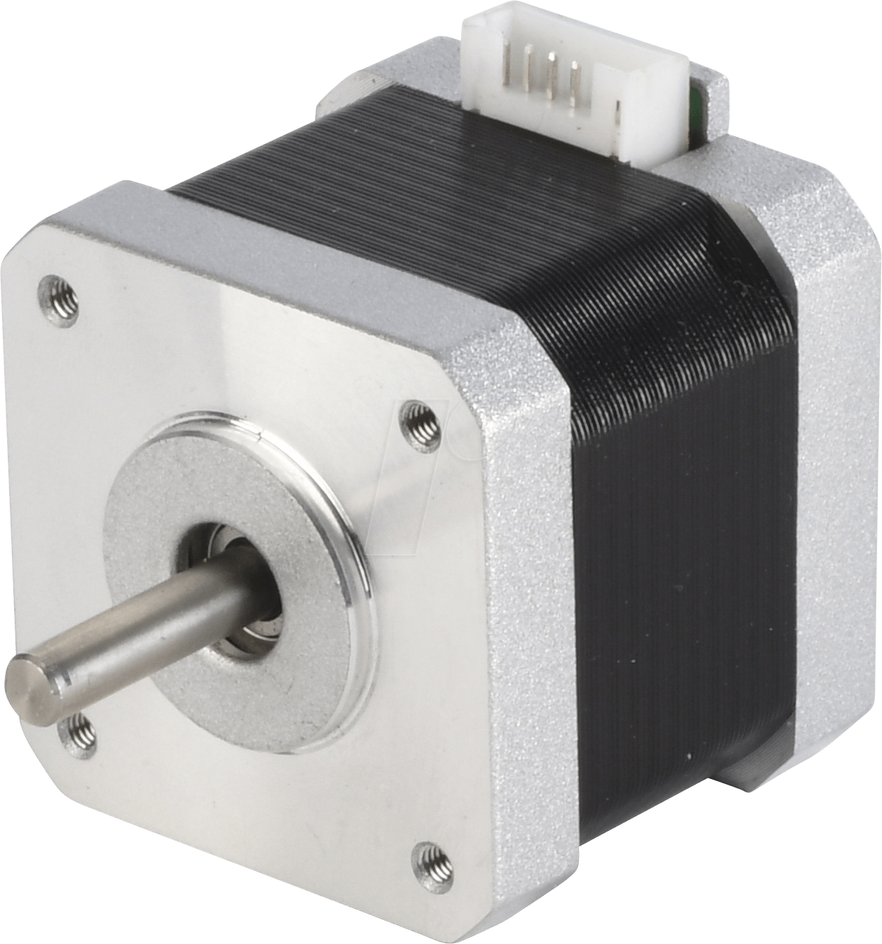
Stepper Motor
Purpose:
Necessary for motor movement
Selection Criteria:
Stepper motors provide a higher stationary and low-velocity torque than servo motors.
Low amount of Amps/Phase relative to torque output
Ease of control with precise movement.
Controlled by ATmega328 via motor driver
 | Nema 17 Bipolar Stepper Motor
Amps Per Phase | 0.4 Amps
Holding Torque | .26 Nm
Number of Steps | 200
Step Angle | 1.8$°$
Motor Weight | 280 g
Unit Price | $7.63
Notes:
Kris

Slide 14
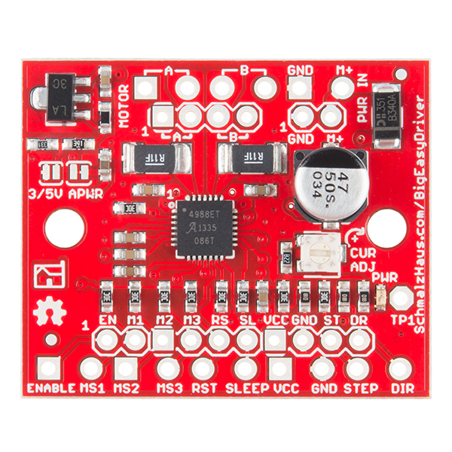
Motor Driver
Purpose:
Generate precise motor movement
Selection Criteria:
Capable of driving a single bipolar stepper motor at 2 Amps/Phase.
Controllable via an ATmega328.
Compatible with Arduino's "Stepper" library.
 | Big Easy Driver
Logic Control Voltage | 5V
Motor Supply Voltage | 6-30V
Amperage per Phase Rating | 1.4-1.7A+
Number of Motors Able to Control | 1
Unit Price | $19.95
Notes:
Kris

Slide 15
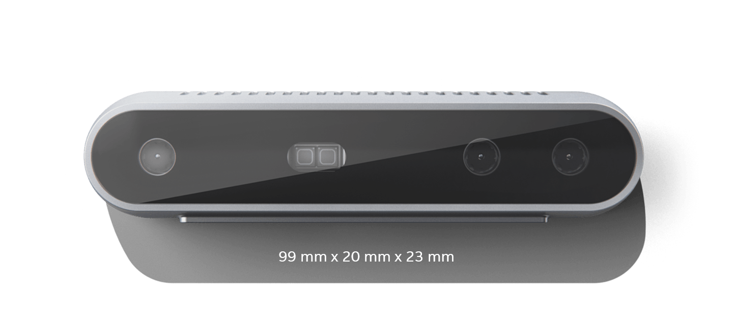
Stereo Camera
Purpose:
Necessary to collect metadata
Used to program prediction algorithm
Selection Criteria:
Stereoscopic camera configuration allows for electronic depth sensing.
Accommodates requirement for tracking within engagement zone.
Includes built-in SDK and library support.
 | Intel RealSense Depth Camera D415
Horizontal FOV | 69.4$°$
Vertical FOV | 42.5$°$
Color Camera Focal Length | 1.93 mm
Depth Technology | Active IR / Stereo
Minimum Depth Sensing Range | 0.16 m
Maximum Depth Sensing Range | 10 m
Solution Price | $150
Notes:
Kris

Slide 16
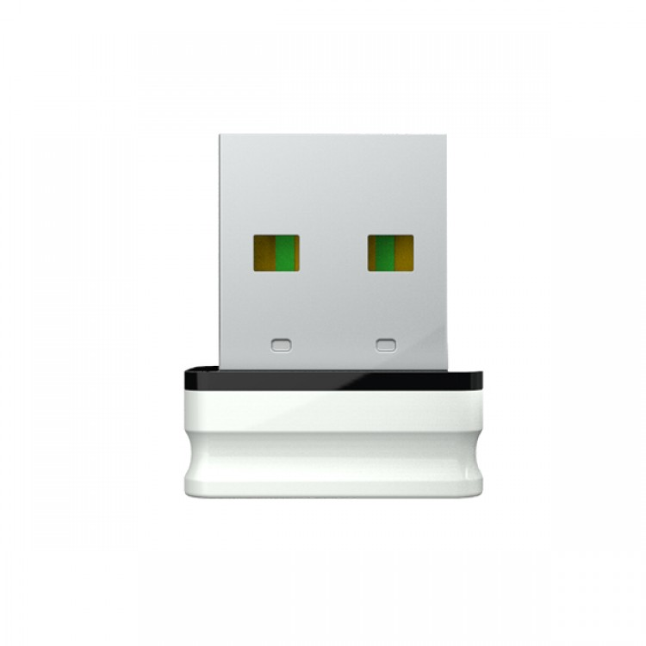
Wi-Fi Module
Purpose:
Connect Mine and ground station to Local Area Network
Establish live video feed
Selection Criteria:
Bandwidth to support live stream
Ease of use
Price
USB interface
 | CF-WU810N
Price | $6
IEEE support | IEEE 802.11 b/g/n
Power Consumption | 20 dBm
Frequency Range | 2.4 GHz
Chip Set | RTL 8188EUS
Security | WPA/WPA2
Encryption | 64/128/152 WEP
Max Data Rate | 150 Mbps
Interface | USB 2.0
Notes:
Justin
Need to find wifi module that supports bandwidth
Easy plug and play
Cheapest option

Slide 17
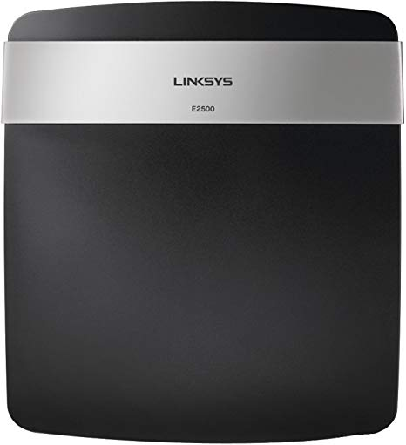
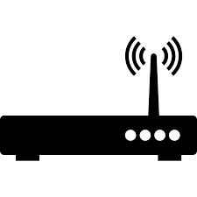
Router
Purpose:
Establish a Local Area Network for Wi-Fi capable devices
Selection Criteria:
Price
Bandwidth support
 | Linksys E2500
Antennas | 4 internal antennas (3.5 dbi)
Wireless Standards | IEEE 802.11n IEEE 802.11g IEEE 802.11b IEEE 802.11a
Frequency | 2.4/ 5 GHz
Wireless Security | WEP WPA/WPA2
Price | $17.89
Notes:
Justin
Local area network
Cheapest Price

Slide 18
Budget
Part Name | Quantity | Price Per Unit
Jetson Nano Dev Kit | 1 | $98.00
ATMEL ATMega328 | 1 | $6.99
Intel RealSense D415 | 1 | $149.00
64GB MicroSD Card | 1 | $13.99
PCB Manufacturing | 5 | $3.00*
12V 8A Power Supply | 1 | $10.99
NEMA 17 Stepper Motor | 2 | $7.63
Big Easy Driver | 2 | $19.95
Net Launcher | 1 | $100.00*
Solenoid | 1 | $70.00*
CO2 Cartridges (15 Count) | 1 | $6.97
6’ x 6’ Mesh Net | 1 | $36.00
Chassis Construction | 1 | $40.00*
Electronic Components (Wires, Headers, Connectors, Etc) | 1 | $30.00*
Total Costs |  | $592.52
* This budget is fully expected to change over the course of development
Notes:
Justin
350 for prototype and 700 for final

Slide 19
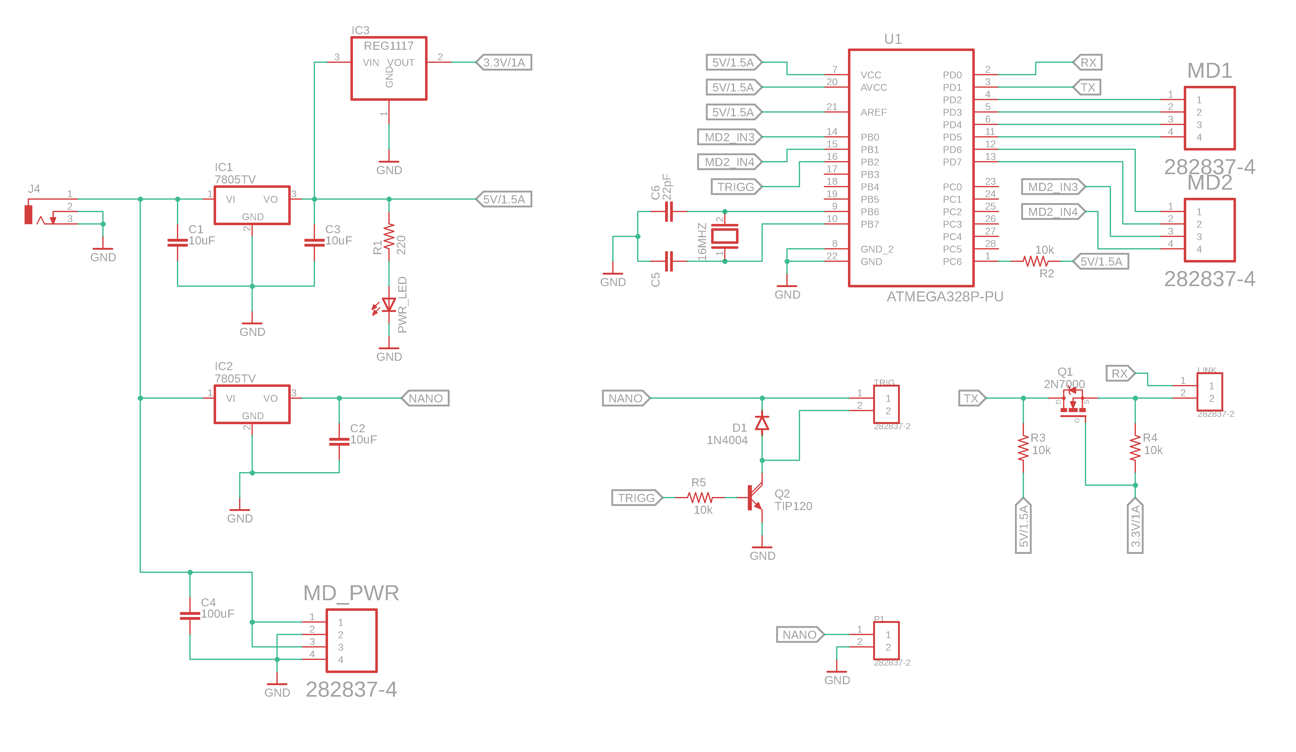
PCB Schematic
Notes:
Corey

Slide 20
PCB Schematic
Power Regulation
Notes:
Corey

Slide 21
PCB Schematic
MCU
Notes:
Corey

Slide 22
PCB Schematic
Inputs/Outputs
Notes:
Corey

Slide 23
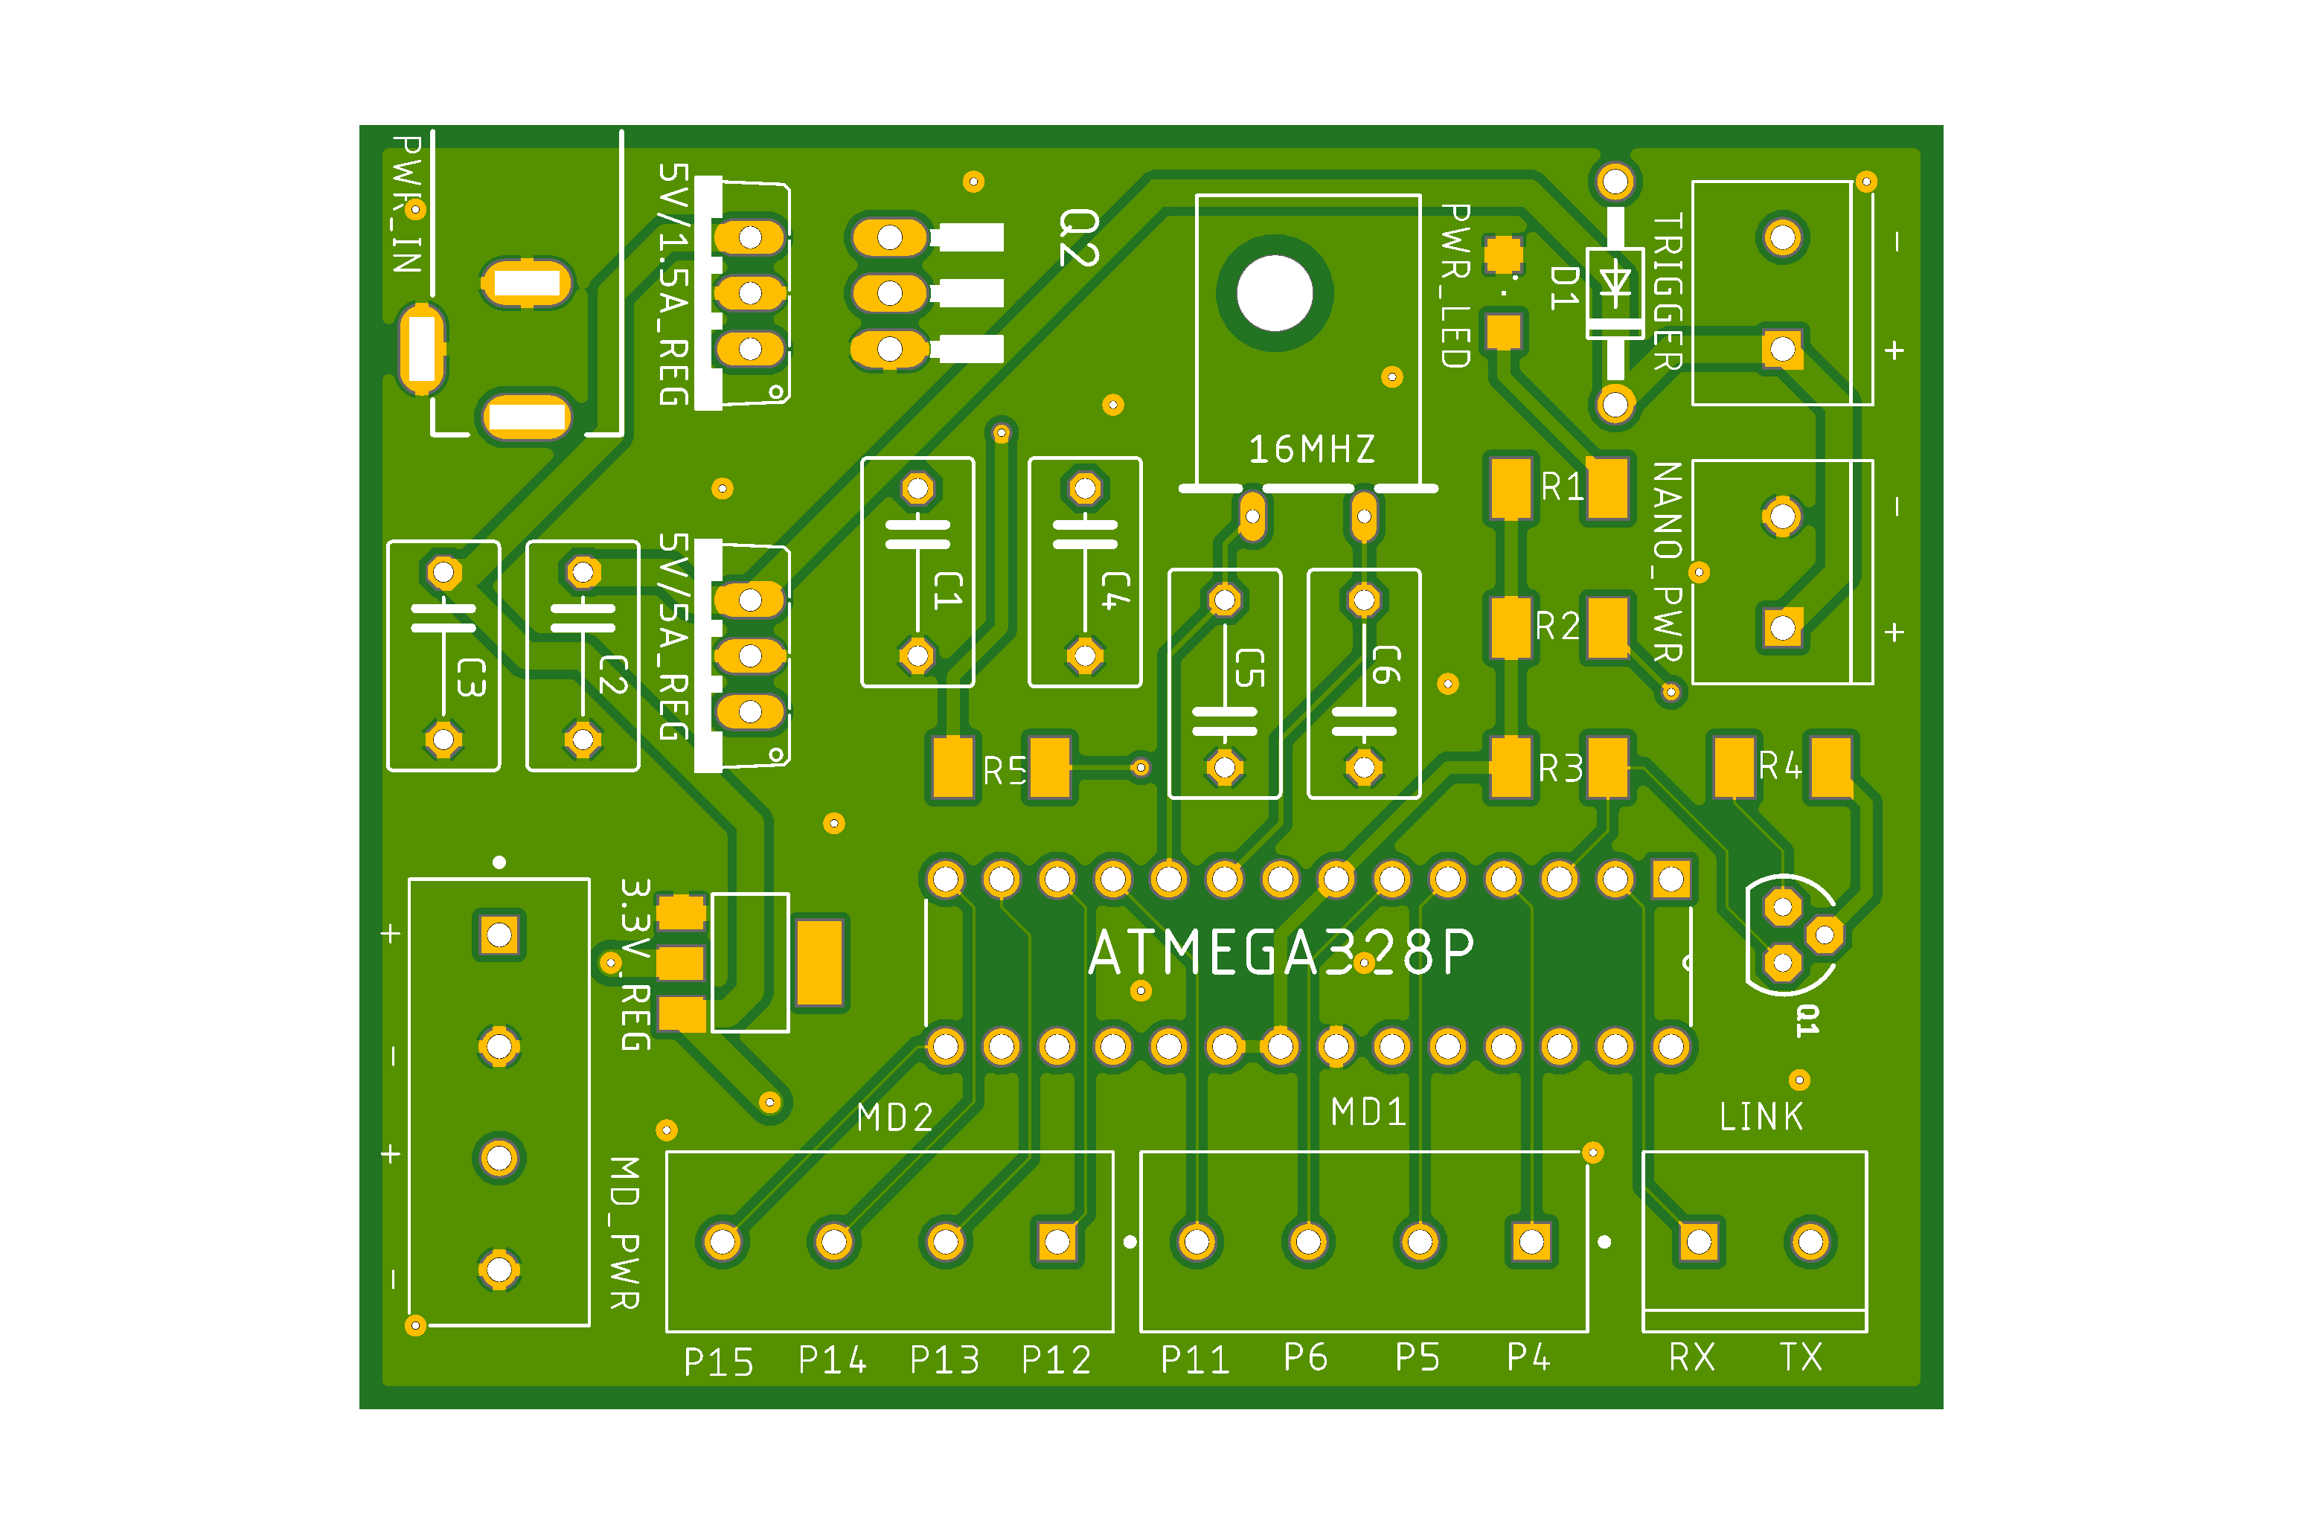
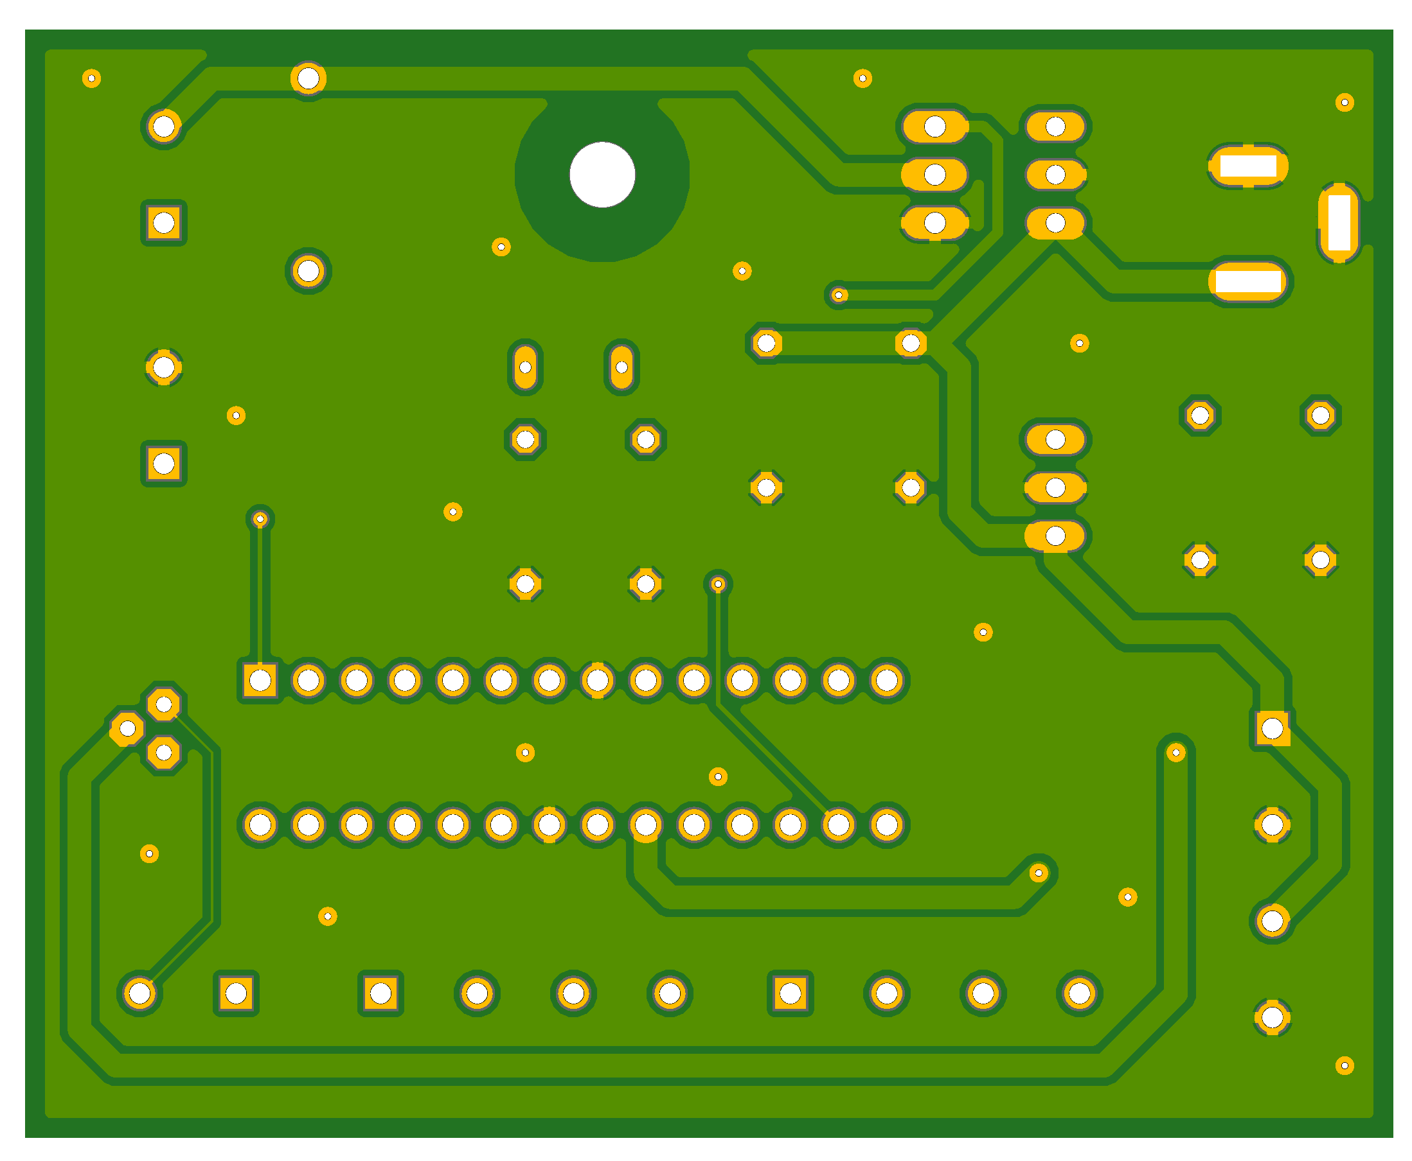
PCB Design
Notes:
Corey

Slide 24
Software Used – Libraries
Python:
OpenCV
TensorFlow 2.0
Faster RCNN w/ MobileNetV2 Backend
TensorRT integration
TensorRT: optimization library, major speed up on Nvidia GPUs
Matlab:
Deep Learning Toolbox
GPU Coder Toolbox
Arduino IDE:
C++ for ATmega
Notes:
Joe
OpenCV – used to capture camera input and handle video display for GUI
TensorFlow – training object detector
TensorRT – convert model to CUDA C/C++ highly optimized and deployable object detection functions.
Matlab – CNN prototyping and GPU Coder as alternate deployment method

Slide 25
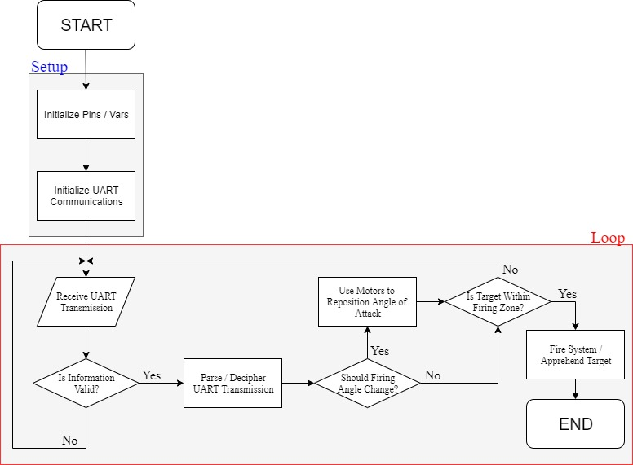
ATmega328 Software Flowchart
Notes:
Kris
Process tracked drone location
Determine motor steps from current location
Send signal to motor drive
If fire signal is true, activate launcher

Slide 26
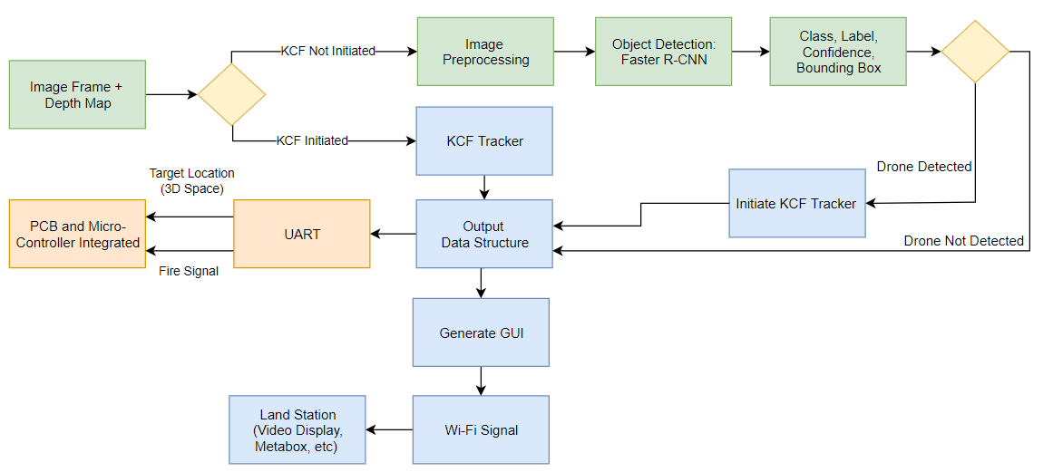
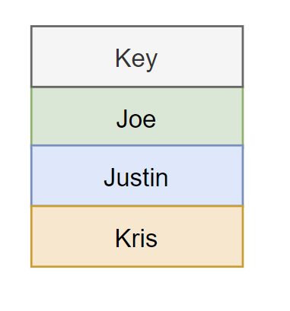
Software Integration Block Diagram
Notes:
Joe
Start with a frame and depth map from our camera.
If the tracker isn’t already running, we’ll run the object detector to get a new detection location to feed into the tracker.
We’ll run the tracker off of this location for subsequent frames until it breaks or degrades, so we’ll set a 5 second time-out. Before we run the object detector again.
If nothing is detected, we keep running the detector on subsequent frames until a detection is returned.
The information: the class, confidence, bounding box, and depth map are stored in an output data structure, where information is sent to generate the GUI and move the motors

Slide 27
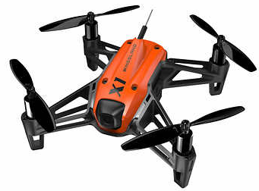
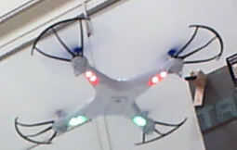
Custom Dataset
Two Class Dataset: ~6,500 Drone Instances and ~12,000 Clutter Instances
Dataset Consists of:
LM Data Collections (Innovation Center)
Online Images (Kaggle Dataset)
Training and Test sets were sequestered with a random with a random 80 – 20 split.
Sample Images from Dataset
Notes:
Joe
In order to train our CNN, we built a dataset of drone and background images from online sources and data we collected in person in the Innovation Center.
Currently, we have ~6,500 images of drones, and ~12,000
We sequestered our training and testing sets with a random 80, 20 split

Slide 28
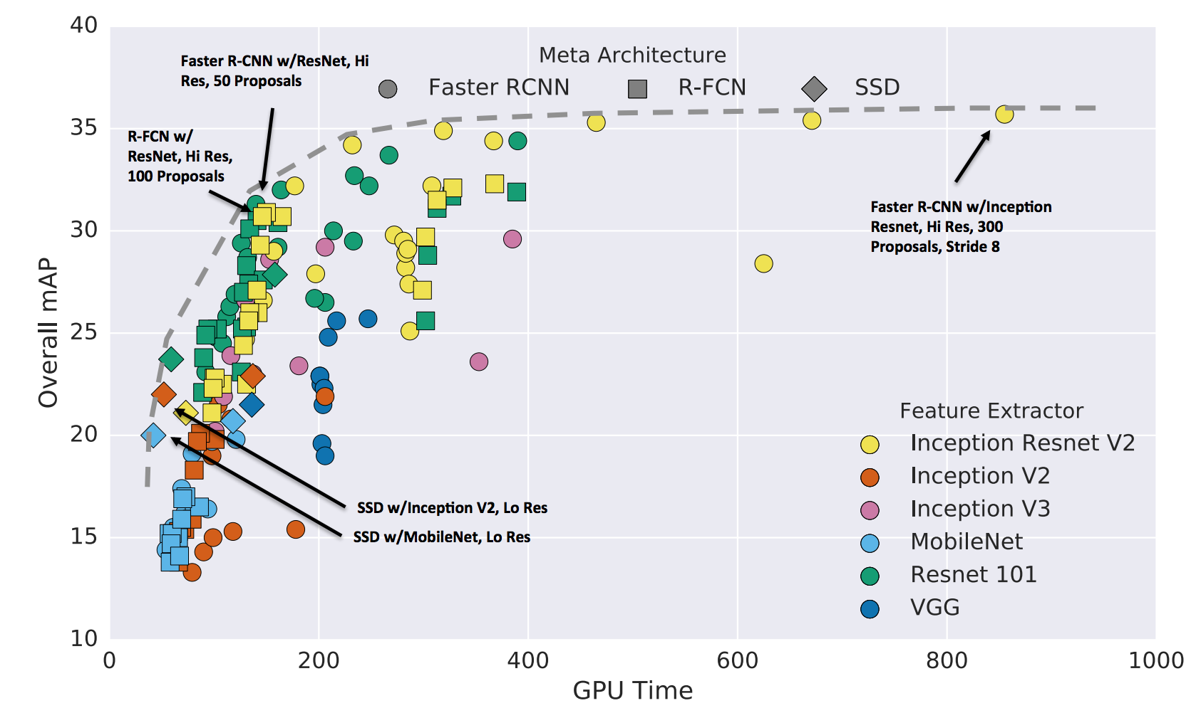
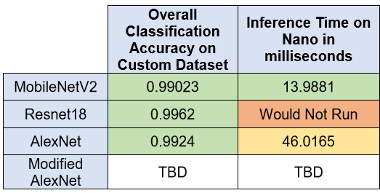
Neural Network Algorithm Selection
Object Detection:
Faster R-CNN
Single Shot Detector
Fast R-CNN
R-CNN
CNN Backend:
MobileNetV2
AlexNet
ResNet18
Notes:
Joe
We chose to use a Convolutional Neural Network based Object Detector because it suites the customer’s requirements of a bounding box, classification, and confidence score perfectly.
The graph on the right shows the results of an academic study comparing speed vs accuracy trade-off for commonly used object detector models. As you can see along the pareto frontier, Faster RCNN typically has the best speed/accuracy trade-offs.
Next we tested different CNN backends to use for the Object detection method, and we chose, based on speed/accuracy trade-off.

Slide 29
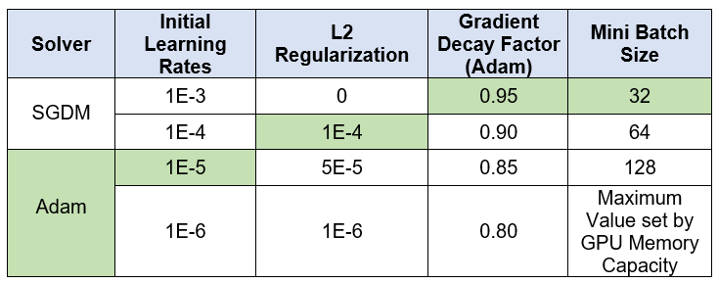
Algorithm Hyperparameters
Optimal Hyperparameters tested via grid search
Notes:
Joe

Slide 30
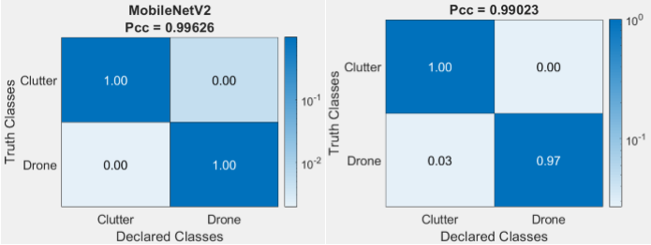
Confusion Matrix
Notes:
Joe

Slide 31
Target Tracking Selection
KCF Tracker:
Pro: Good accuracy and speed. Generalizes well
Con: Does not recover from full occlusion
MIL Tracker:
Pro: Good performance. Handles partial occlusion
Con: Does not recover from full occlusion. Tracking failure is not reported reliably
TLD Tracker:
Pro: Works the best under occlusion over multiple frames
Con: Many false positives
Medianflow tracker:
Pro: Good at reporting tracker failures
Con: Fails under large motion
Ref: https://www.learnopencv.com/object-tracking-using-opencv-cpp-python/
Notes:
Joe
KCF, unless MIL for partial occlusion.

Slide 32
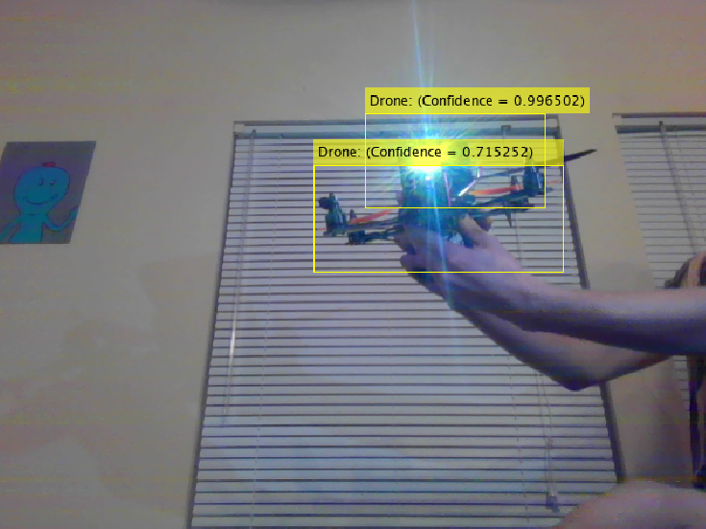
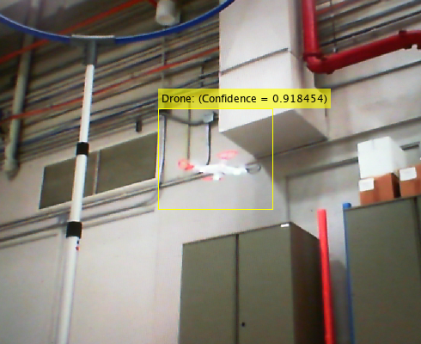
Object Detection Demo
Testing Image (left) & Training Image (right)
Notes:
Joe-
Drone Images

Slide 33
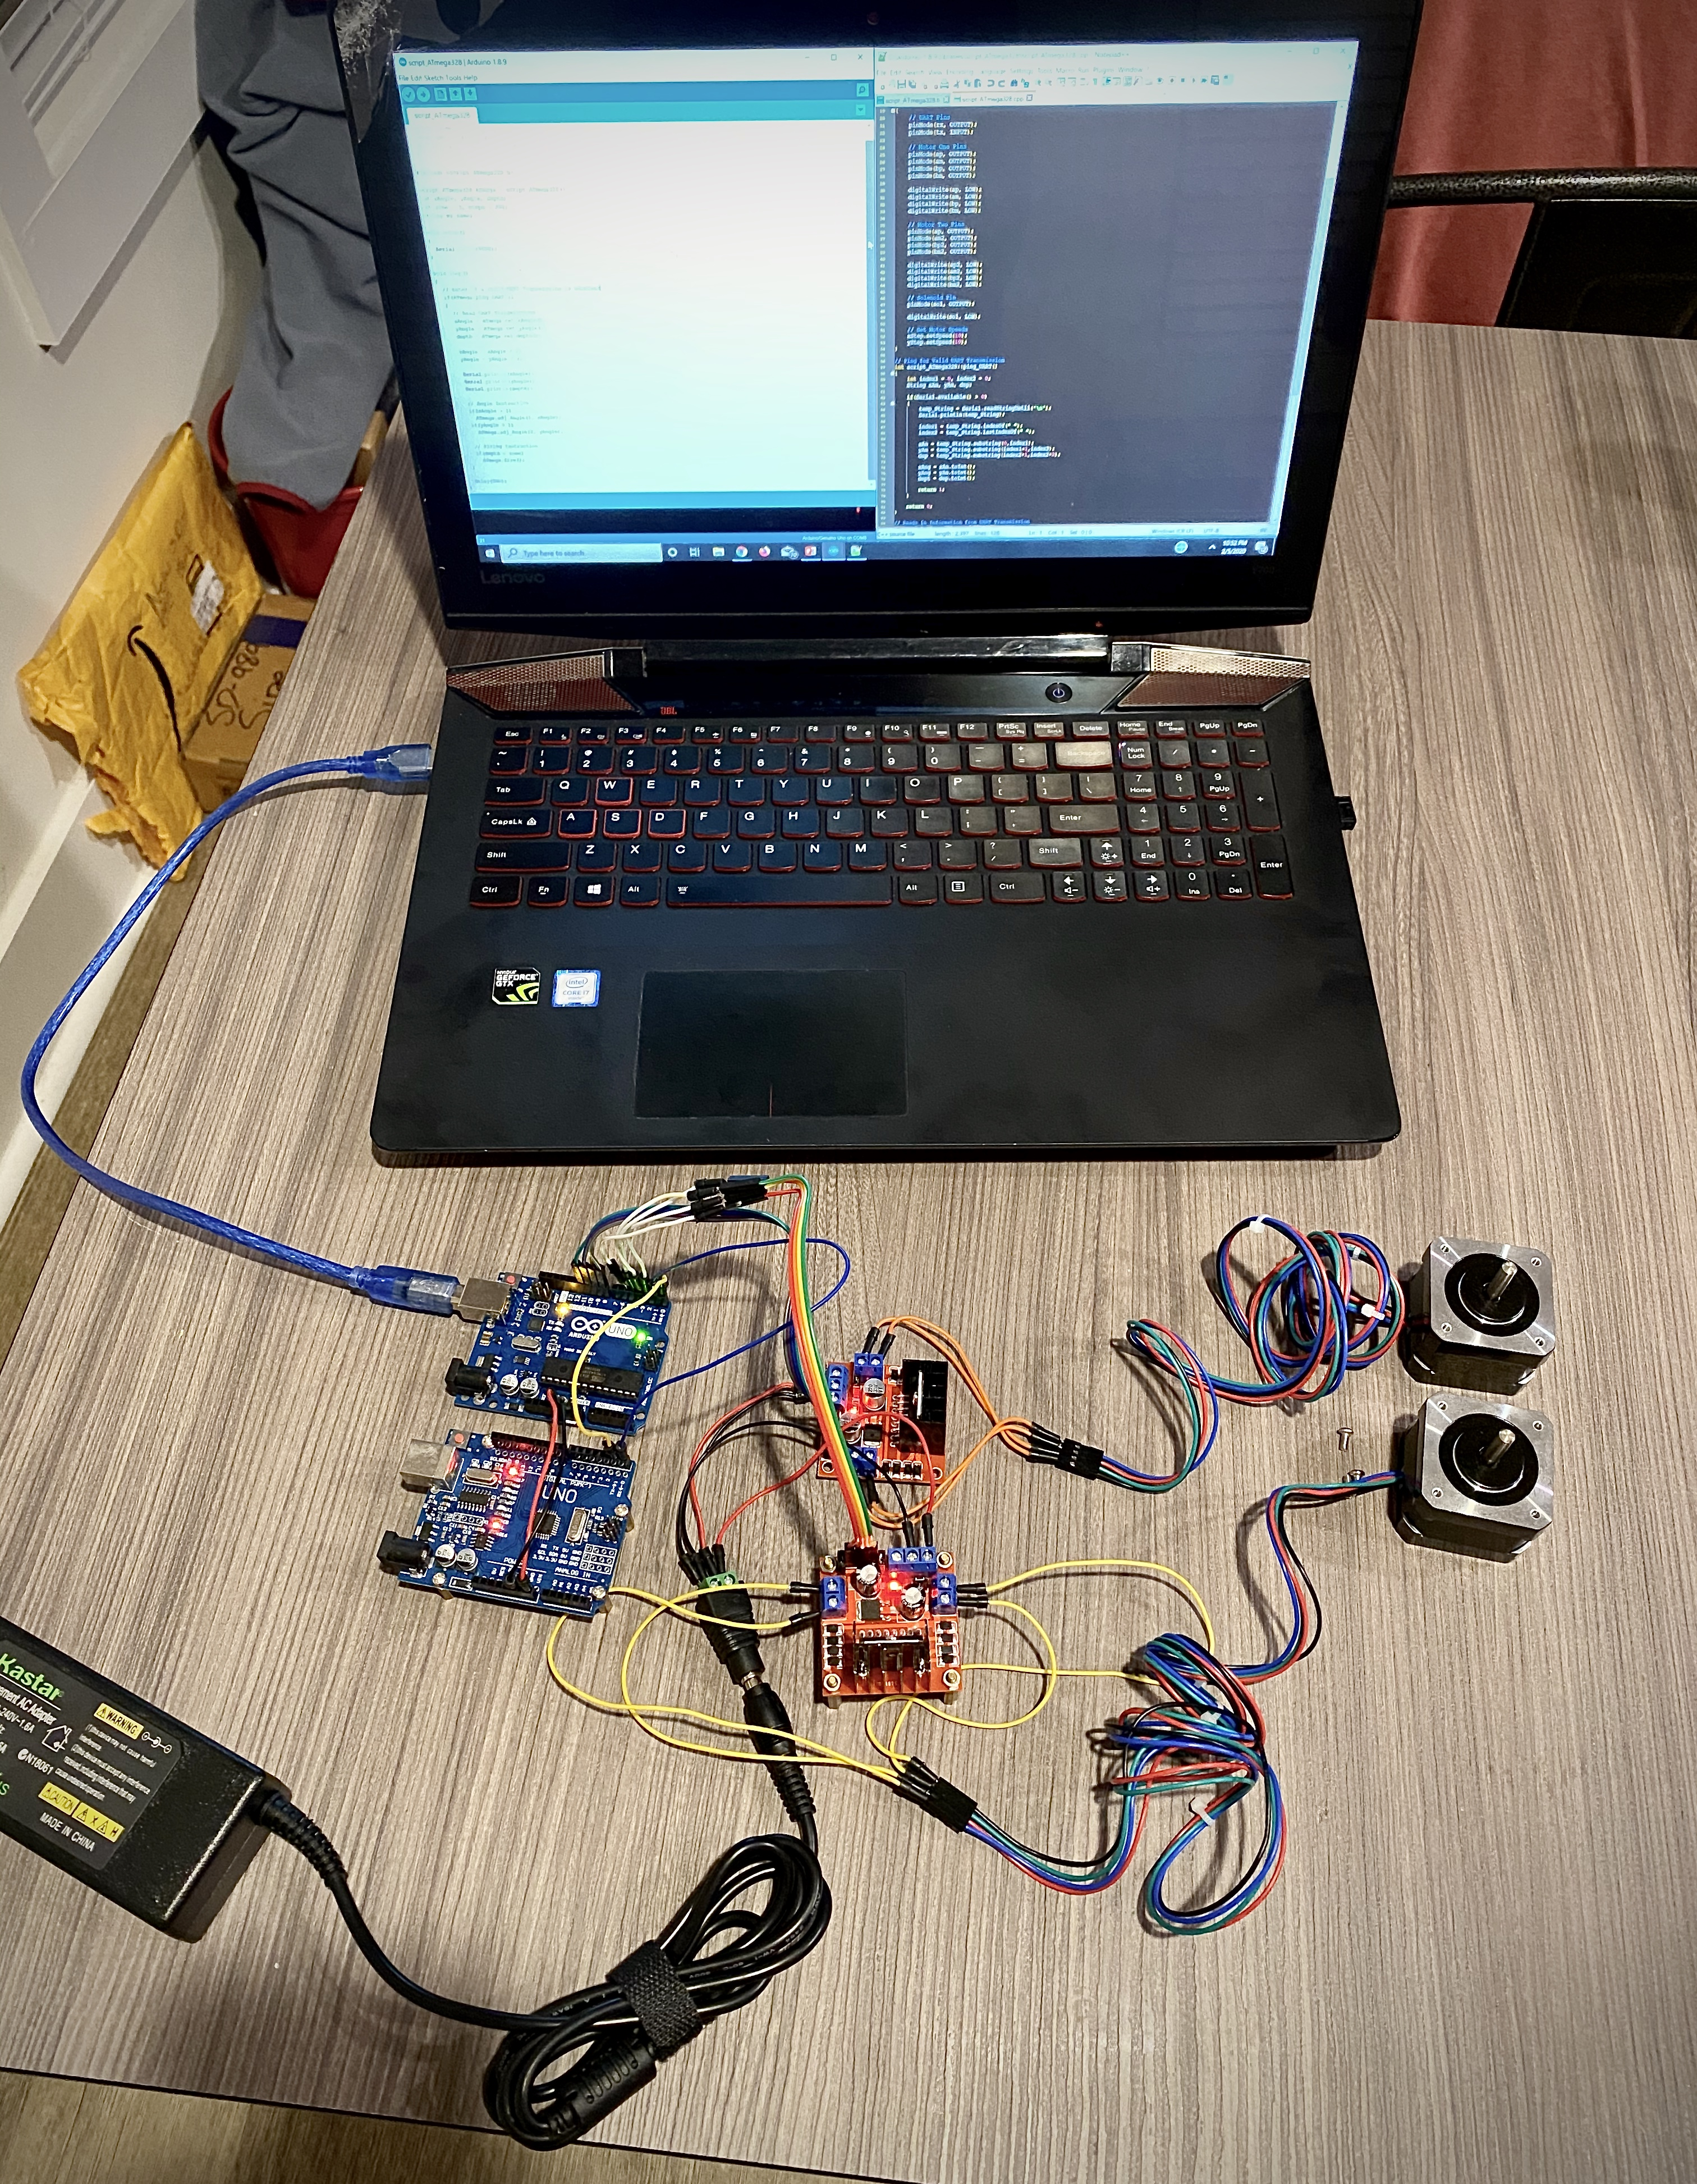
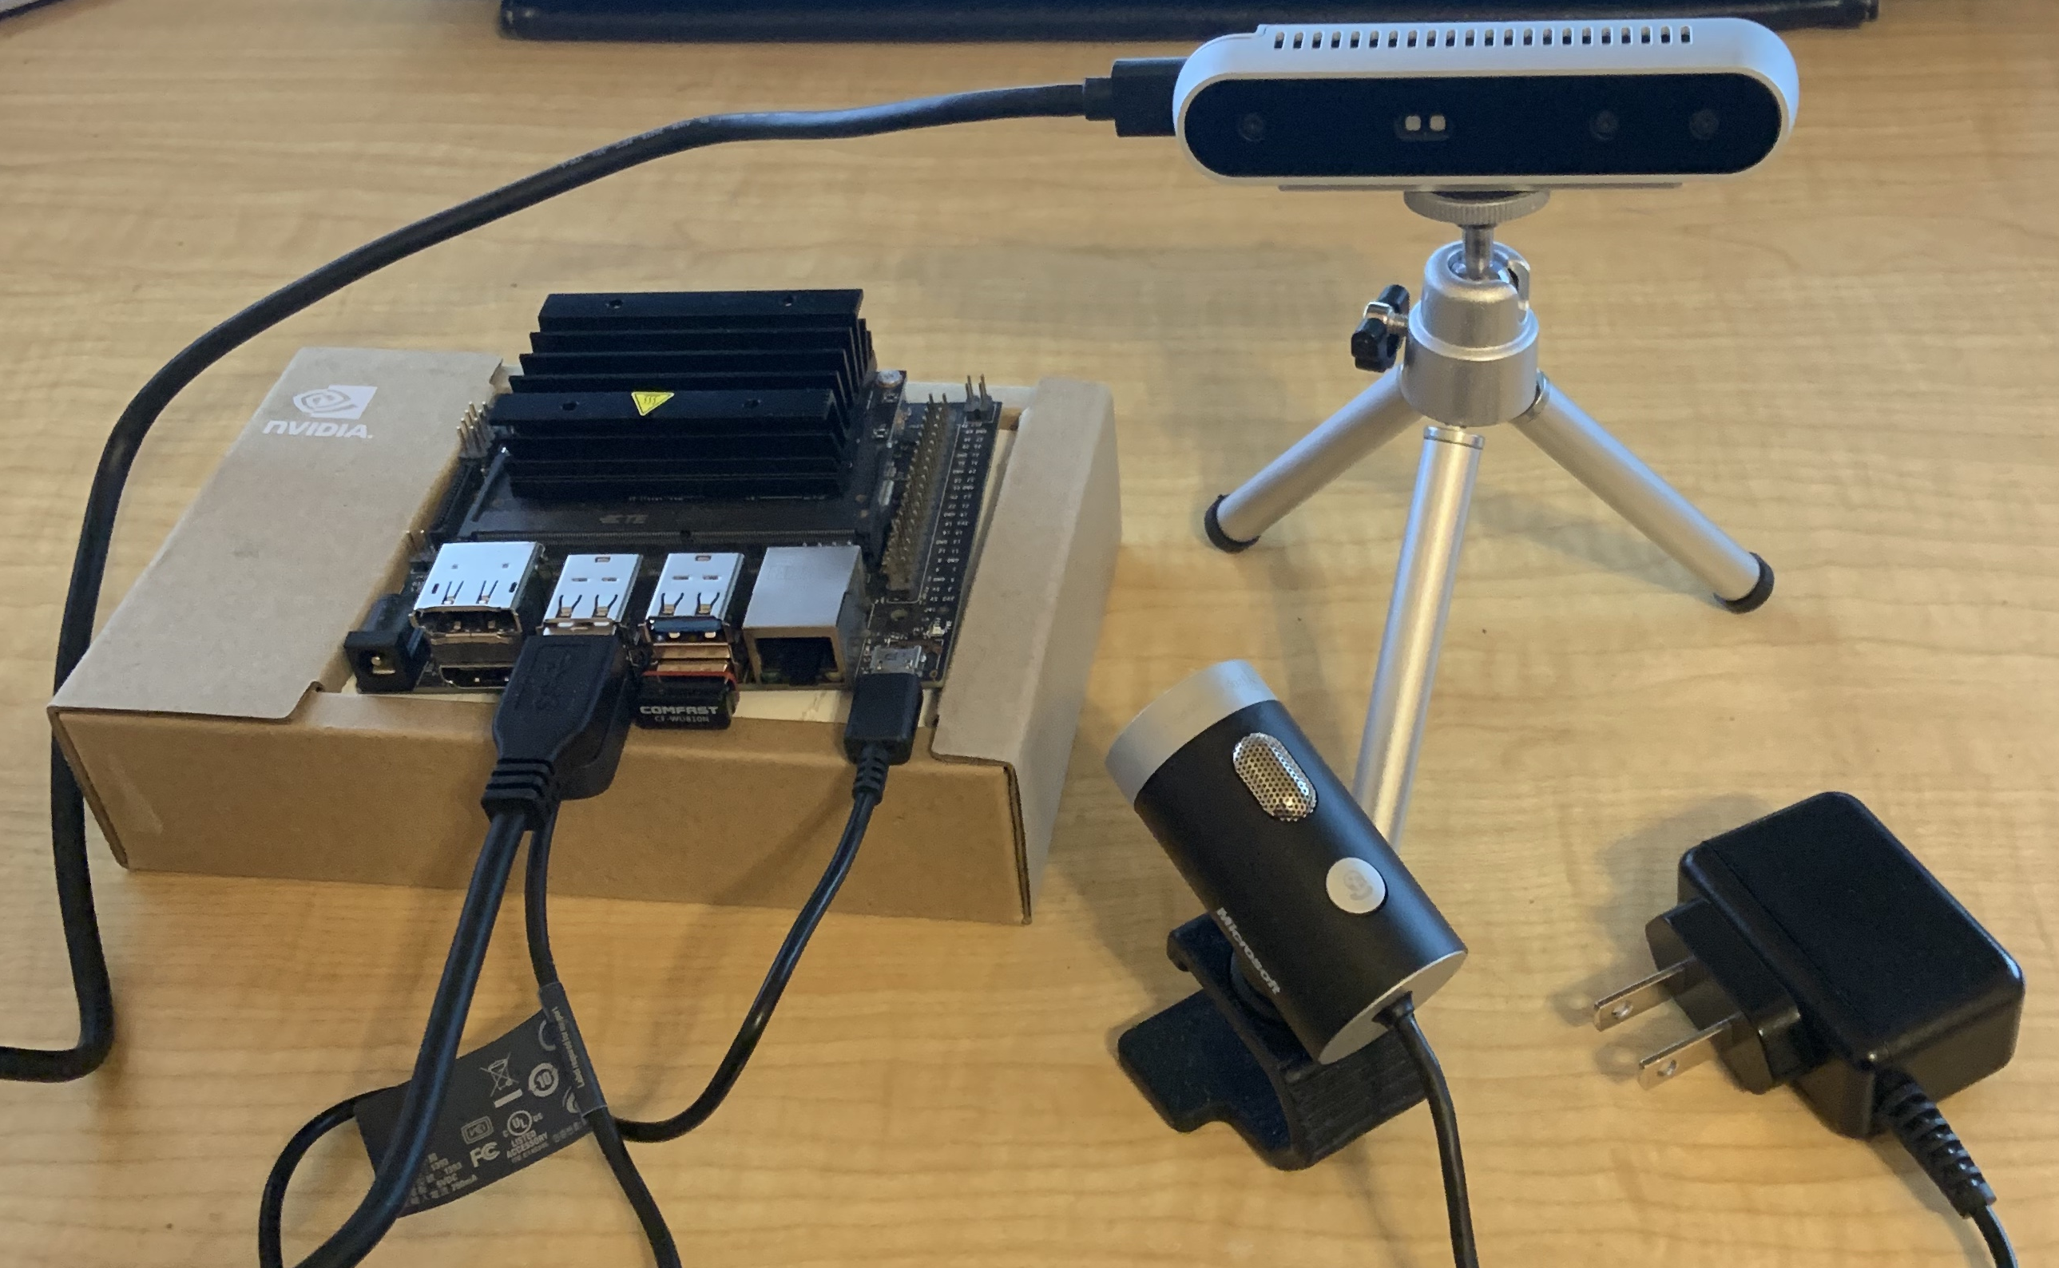
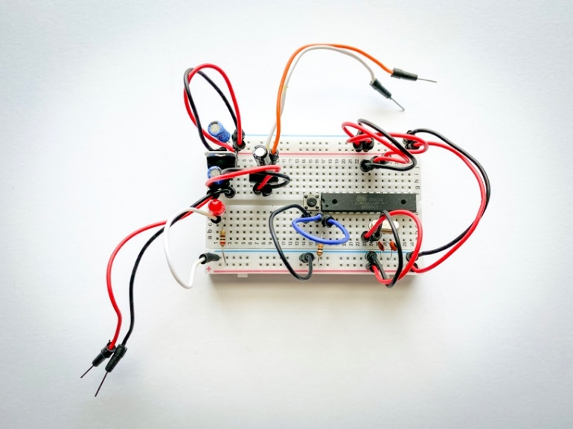
Prototyping
Notes:
Justin

Slide 34
Risk Analysis & Reduction
Risk | Level | Mitigation
UART Communication |  | Redundant Signals Simplify Design
Object Detection |  | Simplify Object Detection with frame differences Starting Position, Game Theory
PCB Design |  | Trial and Error
Launcher Design |  | Prototyping
Chassis Design |  | Prototyping
Notes:
Justin
Object Detection:
Simplify Object Detection with frame differences
Take advantage of starting position, game theory
UART:
Redundant signals
Simplify design
PCB:
Trial and error/ Prototyping

Slide 35
Stretch Goals
Bounding Box Deconfliction on object detection / tracker outputs
Camouflage
NN Hardware Optimization Trade Studies: TensorRT, cuDNN, etc.
More Projectiles
More Mines
Secondary Launching Mechanisms
Notes:
Justin

Slide 36
Questions?
Notes:
Joe

