Slide 1
UCF Senior Design Project
Drone Mine Obstacle Avoidance (DOMINANCE)
Jonathan Tucker – Signal/Image Processing Engineer Staff
Andrew Kirk – Signal/Image Processing Engineer
Scott Nelson – Director,
Applied Research Sensor Systems & Technology
8/12/2019
Notes:
Kenny

Slide 2
About Us
Jonathan Tucker, Signal/Image Processing Engineer Staff
BSEE, University of Central Florida
MSEE, University of Central Florida
10+ years at LM
Expertise: Signal & Image Processing
jonathan.d.tucker@lmco.com
Andrew Kirk, Signal/Image Processing Engineer
BSPSE, University of Central Florida
MSEE (In Progress), University of Central Florida
5+ years at LM
Expertise: Signal & Image Processing
andrew.kirk@lmco.com
Notes:
Kenny & Jonathan

Slide 3
Project Overview/Goals
DOMINANCE involves the design, build, and demonstration of an aerial vehicle with autonomous capabilities in object detection, object tracking, and GPS-denied obstacle avoidance/navigation while in the presence of ground-based adversarial mines
Additionally, one adversarial mine team will engineer a custom offensive system with the capability of detecting, tracking and disrupting the flight of the aerial vehicles
Notes:
Jonathan

Slide 4
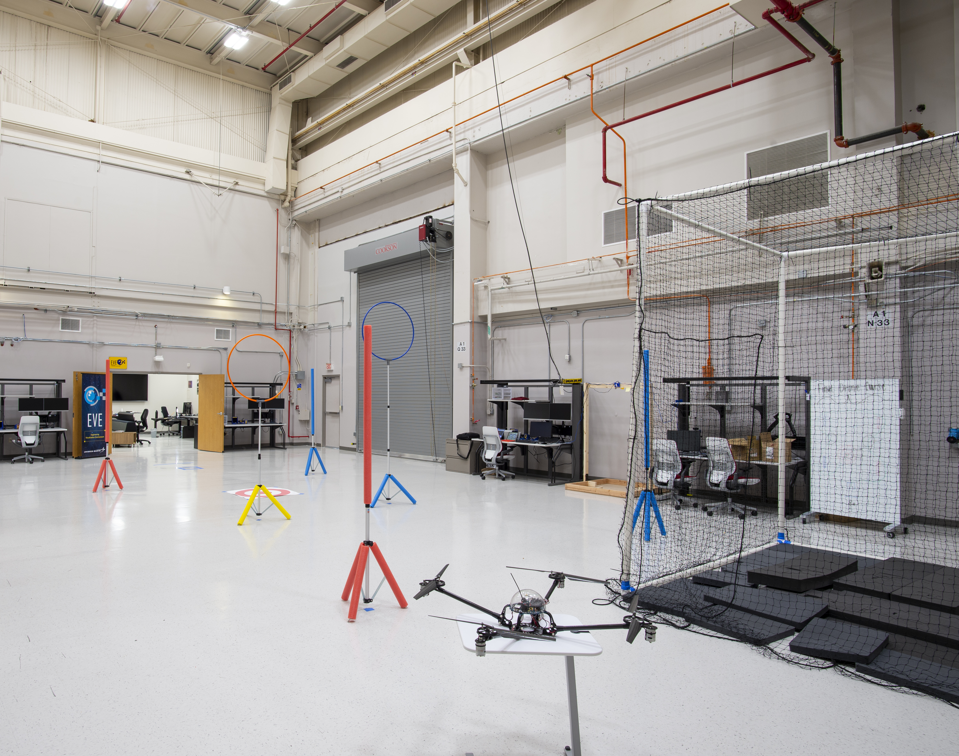
Course Description
Indoor location at LMMFC – IRIS Drone Lab
Course is fully enclosed indoors
Only 2 team members, judges, and MFC customers will be allowed inside the lab’s operating cage during roundplay
All other participants & spectators will remain inside the viewing area outside IRIS lab
Obstacle Maneuvers
Ring – fly through once
Pylon (single) – loop around once
Double Pylon – loop around both
pylons once and pass through middle
Acoustic Waypoint – land within predefined proximity and take off again
Note: Acoustic waypoints and double pylons not shown. Actual course layout is not shown above.
IRIS Drone Lab
(No Indoor GPS Available)
Operating Cage
Ring
Single Pylon
Notes:
Jonathan

Slide 5
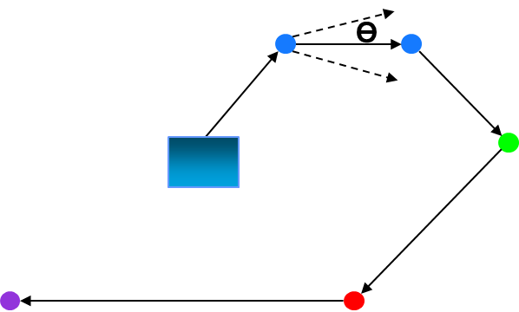
Course Description
30’ x 60’ (45’ Ceiling)
Notional Course Design
Legend
Ring
Pylon
Double Pylon
Acoustic Waypoint
Mine
Half-Angle next obstacle FOV search area
Mine Blast Radius
Ө
Starting Area
Notes:
Jonathan

Slide 6
UAV Teams

Slide 7
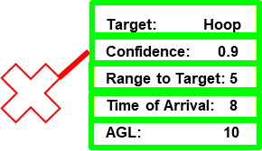
Requirements
Physical Platform
Maximum UAV size of 1.5 ft. x 1.5 ft. x 1.5 ft. (L x W x H)
Constrained by 3.0 ft diameter ring obstacles
Budget
Maximum budget:
UAV teams (3) ⬄ $1,650
Maximum as-demonstrated cost:
UAV teams ⬄ $1,100 w/ $550 additional for prototyping
Symbology & Video Datalink
Obstacle Identification
Generate a large red “X” overlay on the center of the identified obstacle
Metadata box
Target: (“Ring”, “1x Pylon”, “2x Pylon”, “Acoustic”)
Confidence (Normalized, 0 ≤ x ≤ 1)
Range to Target (feet)
Time of Arrival (seconds)
AGL (Height Above Ground Level (AGL), feet)
Utilize a wireless video datalink to a ground station laptop
This portion of the project does not count against “as-demonstrated” cost (e.g. laptop, router, etc.)
Sensor (suggested)
Imaging, Sonar, Microphone array
Symbology Example
Metadata Box
Notes:
Kenny

Slide 8
Requirements
Detection
Teams must detect obstacles in general to prevent collisions and to pass information along for obstacle identification
Teams are not allowed to use any YOLO Deep Learning architecture variant
Identification
Teams must identify obstacle types including the following: rings, single pylons, double pylons, and acoustic waypoints
Imaging sensor(s) (e.g. visible cameras, Lidar, etc.) must be used to identify rings and pylons
Acoustic sensor(s) (e.g. microphone, microphone array, etc.) must be used to identify acoustic waypoints
Teams are not allowed to use any YOLO Deep Learning architecture variant
GPS-Denied Navigation
UAV flight navigation must use a GPS-denied solution
Examples may include: Simultaneous Localization and Mapping (SLAM), EKF-SLAM, FastSLAM, etc.
Maximum FOV required is TBD angle for finding the next obstacle
Team Data Collects
Teams will be required to collect their own training & testing data for system development
Suggested team data collects should include both indoors and outdoors sites (improves model generalization)
Outdoor data collects
Must comply with any local Orlando and UCF law enforcement guidelines
UAV flights must utilize GPS geofence waypoints
Utilize LM-supplied obstacle course (Can be checked out via UCF POC: Paula TBD)
Notes:
Kenny

Slide 9
Requirements
UAV Roundplay (2 rounds: With Ground Mine, Without Ground Mine)
Height Restrictions AGL (Violations will cause round gameplay forfeit)
Maximum: 45 feet
Round goal: successfully navigate course obstacles while performing obstacle maneuvers and avoiding ground mine(s) that may be present while scoring the most points
Points
Obstacle maneuvers
Ring: 1 point
Single Pylon: 2 points
Double Pylon: 3 points
Acoustic Waypoint: 4 points
Points multipliers
points = (totalConsecutiveObstacles*accumulatedPointsPerObstacle)
The total accumulated score from 2 rounds will be recorded as the final score
Penalties
Poorly controllable UAV platforms will cause round forfeit, at discretion of judges
Inoperable video datalink will cause round forfeit
Notes:
Kenny

Slide 10
Requirements
Aerial Vehicle (AV) Operational Modes
Auto-Navigation (“Auto-Nav”)
Autonomously detect, identify and navigate to obstacle
Auto-Maneuver
Autonomously perform appropriate obstacle-specific maneuver
Manual
Release all vehicle control to the human pilot
Example: Team realizes AV is slowly not responding as expected in Auto-Nav mode
E-Stop
Stop all lateral movement and reduce thrust for a controlled crash landing
Example: Team realizes AV is not responding at all and/or flying uncontrollably
Take off/Land
Perform a controlled take off and/or landing at the beginning or end of a round (Note: this will occur after round time has begun)
Teams must provide video evidence of their designs demonstrating each of the AV operational modes to LM customers by TBD
Notes:
Kenny

Slide 11
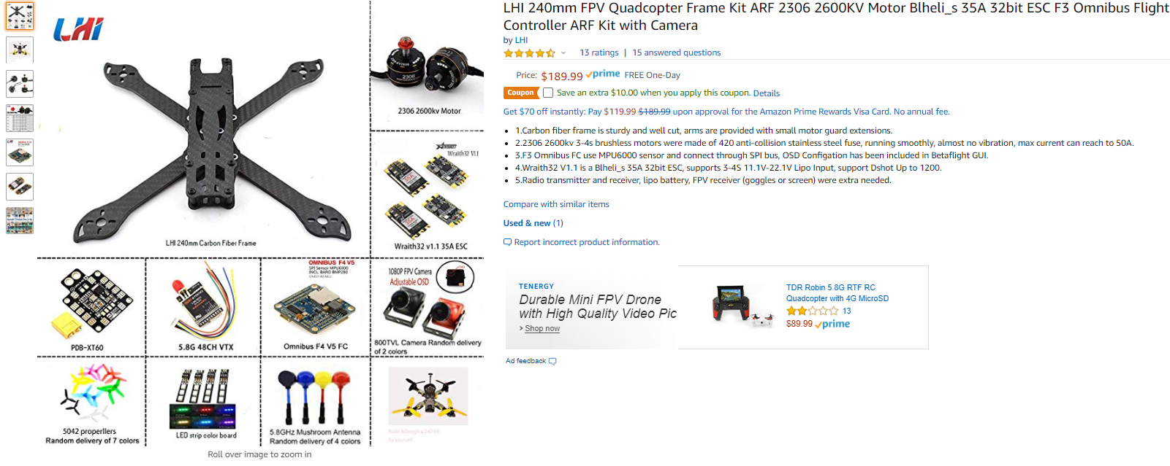
Quadcopter Starter Kits
UAV teams should leverage starter kits to rapidly begin data collection & algorithm development
This encourages parallel development with custom UAV platform design
It is up to the individual teams to determine their trade studies for down-selecting particular kit components
An example kit is shown below
Notes:
Kenny

Slide 12
Customer Demonstration
Rounds
Teams are able to repair their vehicle during roundplay with no penalty
Each team will have 2 opportunities to compete in 10-minute rounds
1 UAV team will compete with mine team present
1 UAV team will compete without mine team present
No special takeoff material on ground (expect tile flooring)
Landing time is not part of round time but must be < round break = 10 min.
No human-in-the-loop cued tracks
Notes:
Kenny

Slide 13
References
Airspace Map
Only explicit airspace restriction at UCF is a high altitude Class B airspace
FAA ceiling AGL of 400 feet still applies

Slide 14
Mine Team

Slide 15
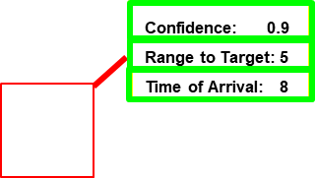
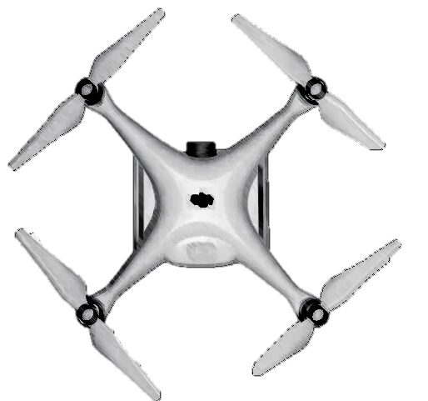
Requirements
Physical Platform
Maximum size of 1.5 ft. x 1.5 ft. x 1.5 ft. (L x W x H)
Mine must remain stationary
Blast Radius
Horizontal: 3 feet
Vertical: 10 feet
Budget
Maximum budget:
Mine Team (1) ⬄ $1,050
Maximum as-demonstrated cost:
Mine team ⬄ $700 w/ $350 additional for prototyping
Total mines built is unconstrained but within budgetary limits
Symbology & Video Datalink
Target Identification
Generate a large red bounding box overlay centered on the UAV
Metadata box
Confidence (Normalized, 0 ≤ x ≤ 1)
Range to Target (feet)
Time of Arrival (seconds)
Utilize a wireless video datalink to a ground station laptop
This portion of the project does not count against “as-demonstrated” cost (e.g. laptop, router, etc.)
Symbology Example
Metadata Box
Notes:
Kenny

Slide 16
Requirements
Physical Platform
Maximum size of 1.5 ft. x 1.5 ft. x 1.5 ft. (L x W x H)
Budget
Maximum budget:
Mine Team (1) ⬄ $1,050
Maximum as-demonstrated cost:
Mine team ⬄ $700 w/ $350 additional for prototyping
Symbology & Video Datalink
Target Identification
Generate a large red “X” overlay on the center of the identified obstacle
Metadata box
Target: (“Ring”, “1x Pylon”, “2x Pylon”, “Acoustic”)
Confidence (Normalized, 0 ≤ x ≤ 1)
Range to Target (feet)
Time of Arrival (seconds)
AGL (Height Above Ground Level (AGL), feet)
Utilize a wireless video datalink to a ground station laptop
This portion of the project does not count against “as-demonstrated” cost (e.g. laptop, router, etc.)
Symbology Example
Metadata Box
Confidence: 0.9
Range to Target: 5
Time of Arrival: 8
Symbology Example
Metadata Box
Notes:
Kenny

Slide 17
Requirements
Targeting Sensors (suggested)
Imaging, Microphone array, LIDAR
Detection
Teams must detect/identify UAVs
Teams are not allowed to use any YOLO Deep Learning architecture variant
Tracking
Teams must spatio-temporally track UAVs
Teams are not allowed to use any YOLO Deep Learning architecture variant
UAV Disruption Mechanism(s)
Disallowed: any kind of RF jamming, laser jamming, high-velocity projectile, liquids, acoustic confusers
Team Data Collects
Teams will be required to collect their own training & testing data for system development
Suggested team data collects should include both indoors and outdoors sites (improves model generalization)
Outdoor data collects
Must comply with any local Orlando and UCF law enforcement guidelines
UAV flights must utilize GPS geofence waypoints
Utilize LM-supplied obstacle course (Can be checked out via UCF POC: Paula TBD)
Notes:
Kenny

Slide 18
Requirements
Mine Roundplay (2 rounds: With Ground Mine, Without Ground Mine)
Round goal: detect, track and disrupt the flight of the aerial vehicles
Pass Criteria
Successfully disrupt 1 UAV such that it falls to the ground
Fail Criteria
Inoperable video datalink
Inability to detect, track, and disrupt 1 UAV such that it falls to the ground
Notes:
Kenny

Slide 19
Requirements
Mine Team Operational Modes
Auto-Detection
Autonomously detect UAV
Auto-Tracking
Autonomously track UAV
Auto-Disruption
Autonomously utilize blast mechanism(s) to disrupt UAV flight
E-Stop
Stop all disruption blast mechanisms
Example: Team realizes mine is not responding at all or properly
Teams must provide video evidence of their designs demonstrating each of the Mine operational modes to LM customers by TBD
Notes:
Kenny

Slide 20
Customer Demonstration
Rounds
Mine team is not able to repair their mine during roundplay, if the UAV is flying
Mine team will have 3 opportunities to compete in 10-minute rounds
No human-in-the-loop cued tracks
Notes:
Kenny

Slide 21
All Teams

Slide 22
Customer Demonstration
Judges
2 judges will be placed around the ground station laptop located in either the operating cage
Responsible for tracking points and/or successful mine team pass/fail events
Multiple judge scores will be averaged to calculate a particular team’s round score
Customers
Clarify any rule discrepancies
Keep competition flow on schedule
Safety check list
Confirm all mode functionality by TBD
Deliverables
Interim Preliminary Design Review (PDR), 2nd week of December 2019
Customer final design presentation, April TBD 2020, at LM
As-demonstrated itemized budget spreadsheet
Key lessons learned including what teams would have done differently if they repeated the challenge
Customer demonstration, April TBD 2020, at LM
HW and SW
Completed DOMINANCE UAV and/or ground mine(s), all additionally purchased parts, and SW
Teams will need to arrange to drop off their systems at LM after the UCF engineering showcase
Arrange drop off day/time with Jonathan Tucker or Andrew Kirk
Notes:
Kenny

Slide 23
Customer Demonstration
Agenda:
TBD
Day of competition materials list
UCF UAV teams
1x DOMINANCE UAV and support equipment (including ground station laptop)
UCF Mine team
DOMINANCE mine(s) and support equipment (including ground station laptop)
LM
TBD
Notes:
Kenny

Slide 24
Questions?
Suggestions
Encourage different groups on your team to be responsible for various sub-systems
Create a schedule for all phases of design and testing, and adhere to it
Generate trade studies to balance complexity, cost/affordability, performance of various sensors/techniques
Helps you meet your requirements, budget, and schedule
Perform integration and testing of sub-systems as soon as possible!
Notes:
Kenny

Slide 25
Status
Team <insert team name>:
…
Team <insert team name>:
…
Team <insert team name>:
…
Team <insert team name>:
…

Slide 26
Actions
LM
Upcoming meeting with UCF coordinators occurring on July 18th
Need to purchase obstacle course items and setup the course as soon as possible
Get BOE and materials list from Matt Bartoe/Jason Cooley by 07/24 (awaiting standard size definitions)
Pitch BOE and materials list to Nelson for purchase approval on OH by 07/25.
Purchase 2 sets of obstacle course materials by 07/25.
Build both sets of obstacle course materials and take notional advertisement pictures by 09/02.
Setup pylons obstacles
Working hoop obstacle build-up (expected completion by 09/18)
Provide 1 set to UCF (Paula ?)
Need to pitch project in CECS senior design 1 class during design selection
Scheduled for September 11th & 13th
Update project description and provide before Fall classes start in August 26th
Focus on optimizing clear role definitions of each engineering discipline in project description
Define multiple dry-run pre-demonstration dates at LM
Establish available LM dates where teams can visit the demo lab site and/or collect data with our LM obstacle course objects
(Req) Define Half-Angle next obstacle FOV
Completed Action
Incomplete Action
Notes

Slide 27
Actions
LM
(Req) Define requirements/constraints for adversarial mine design and interplay with notionally smaller/lighter weight custom UAV platform (compared to previous years’ competition designs)
Must be a static mine (near & far range parameters will be provided to mine team to abstract actual course layout and allow mine design)
It is up to the mine team to meet designing in confusers in both EO and acoustic domains. This can be accomplished via 1 mine with combined confusers or multiple mines with either combined or separate. This is limited only by team budget. Disallowed design options: any kind of RF jamming, laser jamming, high-velocity projectile, liquids. Note: the first third of the obstacle course is mine-safe, the remaining two-thirds are mine-vulnerable.
Allow relocation of static mine during round play OR create multiple same-design mines?
Sign sponsorship payment form (Under review by Scott Nelson, expecting approval)
(Req) Clarify logistics associated with enabling/disabling acoustic waypoints and/or unique waveforms or common songs being played or combination thereof.
Teams
…
UCF Faculty
…
Completed Action
Incomplete Action
Notes

Slide 28
Notes:
Jonathan

