Slide 1
A.I.R.E. Autonomous Intelligent Roof Enclosure
UCF Senior Design 2 - Group 8
Sarah Riseden – Electrical Engineering
Lauren Miller – Computer Engineering
Ron Acevedo – Electrical Engineering
Christopher Smith – Electrical Engineering
Sponsor: Open Aire - Retractable Roofs and Skylights

Slide 2
Motivation
Unpredictable weather can affect many outdoor businesses
Retractable roof enclosures allow for the outdoors to be enjoyed indoors
Smart system allows for enclosure to predict weather before it happens not as it happens
Energy efficient system has been shown to save customers up to 30% a year in energy costs. *
* Statistic taken from our sponsor, Open Aire’s, website.
Notes:
Build upon what is already there
Open Aire brings the outdoors to be enjoyed indoors
Open Aire has limited sensors and capabilities

Slide 3
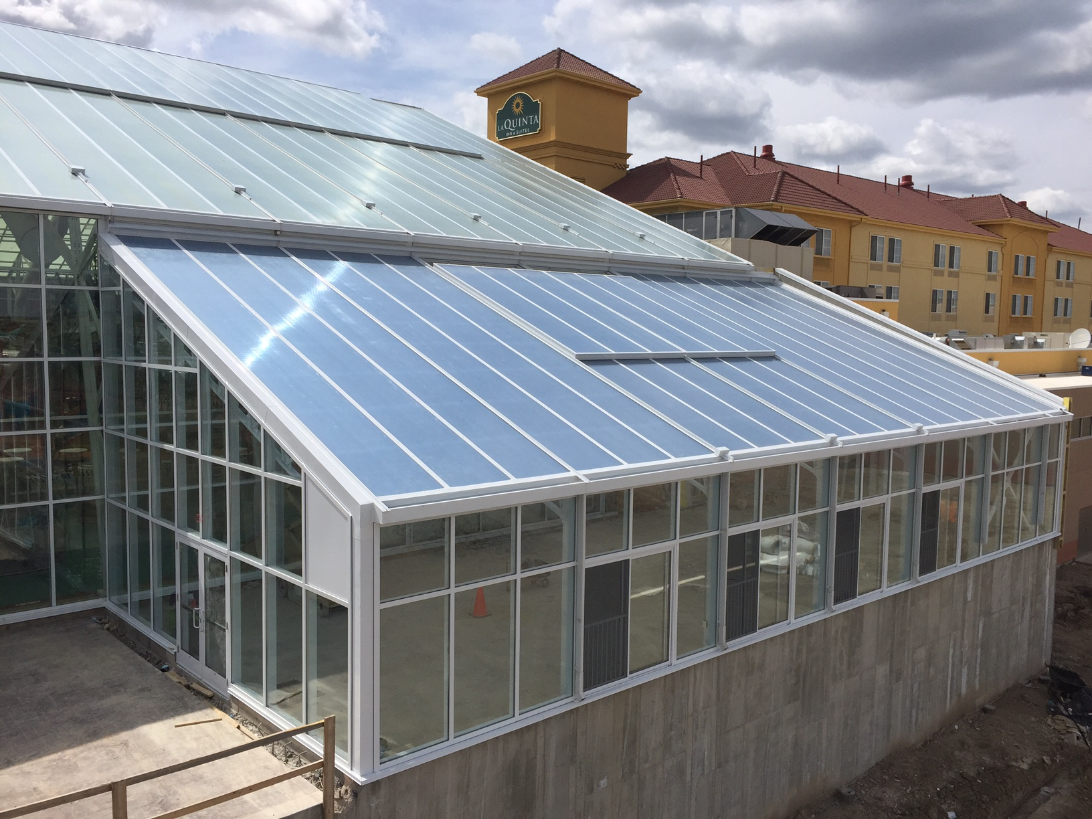
Design and Inspiration Current examples of our sponsor's recent projects.
Notes:
Sarah
Making the control system for this roof, making it more smart
Here are some designs that our sponsor has done recently. As you can see, the roof is made up of glass panels which slide along a track. In order to update this, we are leaving the physical design a lone but adding more sensors to make it a "smart" system

Slide 4
Goals
Wanted to update our sponsor’s current semiautomated design, which includes only a few sensors to detect weather.
Addition of sensors for the 6 main characteristics of weather
Addition of app for weather updates and user control of the roof system
Notes:
Ron - Increase predictability and reliability
Add a few more sensors and a phone application

Slide 5
System Requirements Specifications
Specification Number | Specification
1 | The system shall have a retractable roof
2 | The system shall have a microcontroller capable of handling weather sensing data and signal processing
3 | The system shall have a solar panel system not exceeding 8 cubic feet
4 | The system shall have a lithium battery pack for back-up power, to be charged by the solar panel system
5 | The system shall have a battery management system for handling charging cycles of the lithium ion battery pack
6 | The system shall have an array of regulators providing +12V, +5V, and +3.3V power lines
7 | The system shall have weather sensing technology capable of interacting with the microcontroller
8 | The system shall have waterproof protection for all electronic components that require it
Notes:
Here are the system requirement specifications. The underlined specifications are the ones that drove a lot of the choices for the different hardware we selected for this project. Those specifically are 6 & 7
Needed proper voltage for the vast array of sensors, and needed a microcontroller that would be able to handle the high number of input and output signlas

Slide 6
Enclosure Specifications
Specification Number | Specification | Value | Unit
9 | Dimensions | 2x2x1 | feet
10 | Weight | < 30 | lbs
Notes:
Lauren
The enclosure is very simple, a 2 foot by 2 foot by 1 foot high structure, that with the roof and sensor kit included will not exceed 30 lbs

Slide 7
Power Module Specifications
Specification Number | Submodule | Specification | Value | Units
11 | Solar Panels | Power Delivery | 1 – 5 | Watts / Panel
12 | Lithium Ion Battery | Package | 18650
13 | Reverse Polarity | MOSFET Rds(on) | < 0.05 | Ohms
14 | 12 V Regulator | Input Voltage Range | 3.2 – 12.6 | Volts
15 | 5 V Regulator | Input Voltage Range | 11 – 13 | Volts
16 | 3.3V Regulator | Input Voltage Range | 5 – 3 | Volts
17 | Battery Management System | Supply/Output Voltage Range | 3.2 – 12.6 | Volts
18 | Battery Management System | Fault Protection | Overcurrent Protection
19 | Battery Management System | Fault Protection | Overvoltage Protection
Notes:
Chris

Slide 8
Sensor Module Specifications
Specification Number | Module | Specification | Value | Unit
20 | Anemometer | Resolution | < 10 | meters/second
21 | Barometric Pressure Sensor | Accuracy | +/- 5 | millibar
22 | Temperature Sensor | Accuracy | +/-1% | ºCelsius
23 | Humidity Sensor | Accuracy | +/3% | Relative Humidity
24 | Rain Sensor | Response Time | < 240 | seconds
25 | Light Sensor | Spectral Range | 1500 | nanometer
26 | Bluetooth | Range | 50 | meters
Notes:
Sarah – wanted to highlight accuracy for the price we could get

Slide 9
Microcontroller Unit Specifications
Specification Number | Specification | Value | Unit
27 | Microcontroller will be hard coded with an identification number | 8 | Bits
28 | For specific sensors, their status will be polled | 60 | seconds
29 | The Weather API will be polled for predictions | 60 | seconds
30 | Microcontroller will signal a roof reaction when deemed necessary in an appropriate time frame from receiving measurements | 30 | seconds
31 | Code will only require half of the microcontroller’s available storage | 128 | kiloBytes
32 | Weather API prediction data will be stored on the microcontroller | 32 | kiloBytes
Notes:
Lauren –
Each unit will have a unique ID encoded,
the MCU needs to be able to handle the communication with all 6 sensors.
And leave half or more than half of the available storage for holding weather statistics and prediction data

Slide 10
Mobile Application Specifications
Specification Number | Specification
33 | Application shall provide exact parameters for Microcontroller to signal roof enclosure
34 | Application shall support iOS 9.0 and above
35 | Application shall support iPhone 6s Models and above
36 | Application shall support Bluetooth 4.0 and above
37 | Application shall decode sensor data in a human readable manner
38 | Application shall show sensor data from last minute of reading
39 | Application shall follow security protocol for storing Username Password information in the database.
Notes:
Ron –
Read the highlighted specifications, as well as summary specification numbers 34-36

Slide 11
Standards
Standard Name | Description
Bluetooth 5.1 | To ensure best security and speed with Bluetooth connectivity
RoHS 3 Directive 2015/863 | To ensure environmental safety and promote greener product manufacturing
AES/SS IEEE 307-1969 | To ensure accurate and viable sensor performance parameter definitions
USB 3.0 | To ensure reliable connection with any industry-standard USB connector
ANSI C | To ensure code is readable for reproductivity
Notes:
Chris – BT, RoHS, Sensor standards to make sure we're up to date

Slide 12
Engineering Constraints
Constraint Type | Constraint Description
Financial | Total project must be under $2000 USD
Sensor Hardware | Sensors must be capable of either digital output via UART, I2C, or SPI, or analog input via voltage or current in order to interface reliably with ATmega1280 microcontroller
Manufacturability | Passive components must be in packages 1206 or larger for hand-solderability
Mobile Software | Must be compatible with latest generation of iOS
Bluetooth | Bluetooth module CYBT-423028-02 will need to be programmed within Wiced IDE
Environmental | To comply with RoHS standards, components must be free of lead and PCB material must be environmentally sustainable
Notes:
Chris
*** Should be at 3 minutes max ***

Slide 13
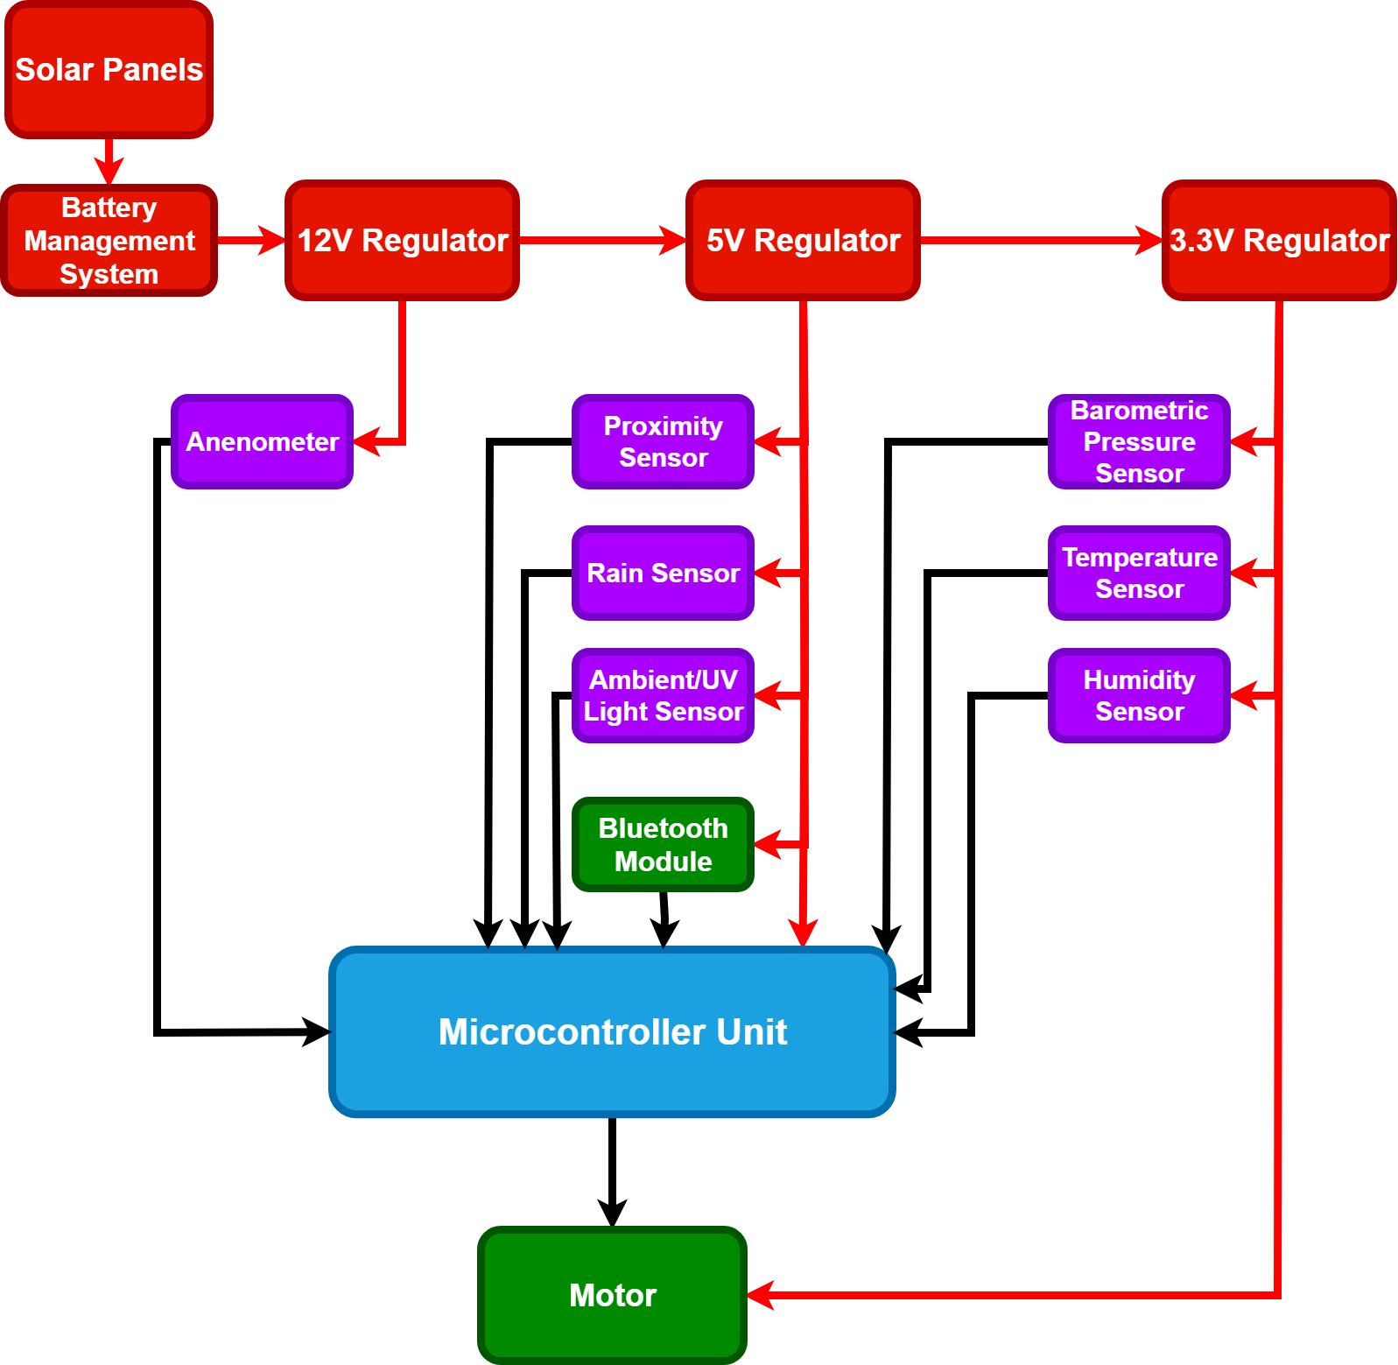
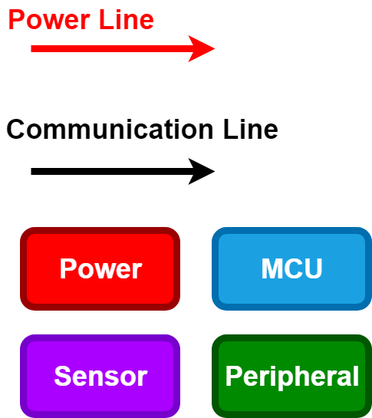
Overall block diagram (CHRIS)
System
Overview
Notes:
Chris (Start)
Start with hardware, go into MCU, sensors, and power

Slide 14
HARDWARE

Slide 15
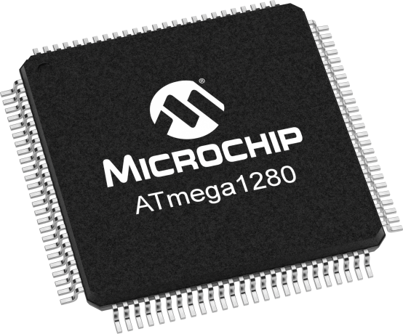
Microcontroller Unit
ATmega1280
128 KB flash memory size
16-channel, 10-bit ADC converter
Lots of documentation on Arduino for easy programming
Notes:
Chris

Slide 16
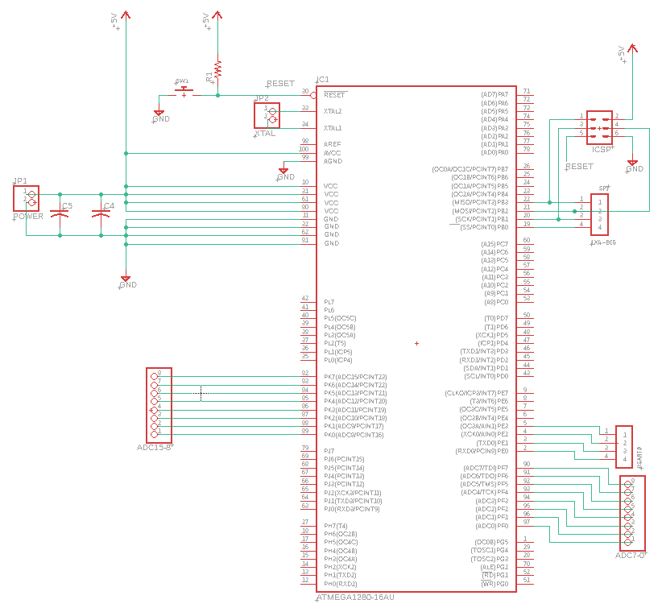
Microcontroller PCB Schematic

Slide 17
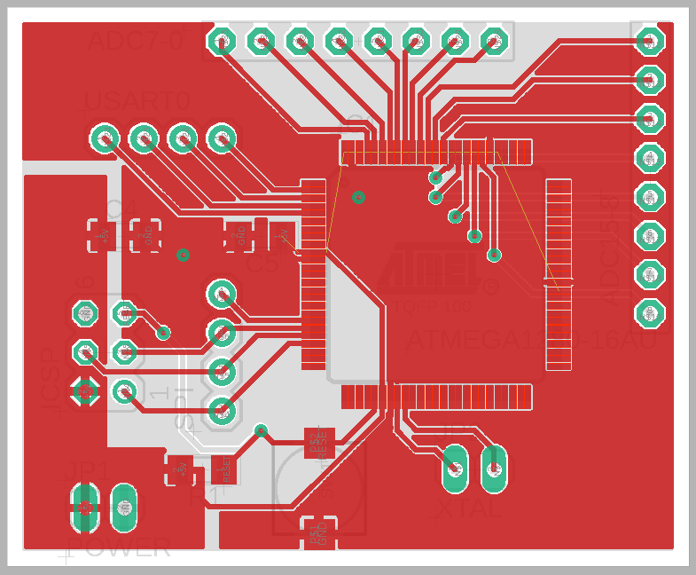
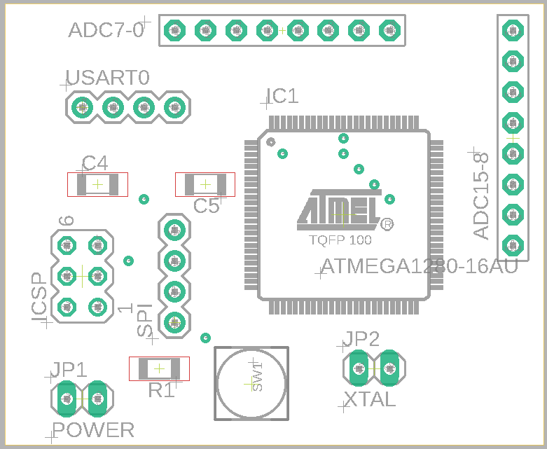
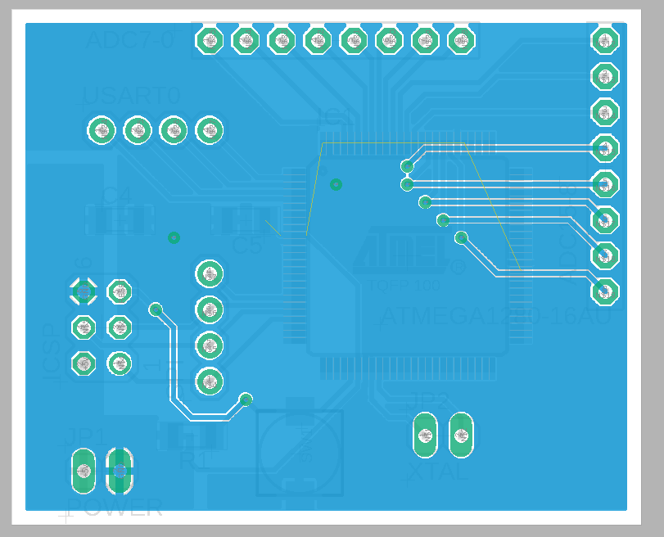
Microcontroller PCB Layout
Notes:
Chris

Slide 18
Sensor Module
The following sensors will be used for weather prediction. All sensors are RoHS compliant, and were chosen to be inexpensive, and small enough to fit on our model building.
Proximity*
Wind/Anemometry*
Rain*
Barometric Pressure
Humidity
Temperature
Light and UV
*Sensors already implemented by sponsor
Notes:
Ron
Aside from the sensors that are currently included by OpenAire, the team is adding a barometric pressure, humidity……

Slide 19
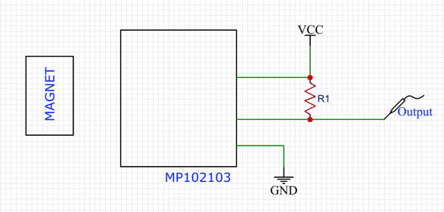
Proximity Sensor - MP102103
Used to sense the location of the roof as it moves along the track
Hall Effect sensor uses magnetism to detect a target within the specified range of 4mm
Senses a target made of a magnetic material
Operating Voltage: 4.5-24V
Output voltage signal sent to motor
Cost: $5.41
Notes:
Sarah (Start)
The proximity sensor is used to track the location of the roof as it moves along the track, so we know if the roof is opening or closing and how the motor should be behaving. It is small enough to fit on the track without obstructing movement, and takes a low voltage input

Slide 20
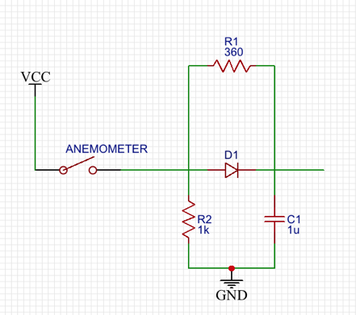
Anemometer – Jacksking Cup Anemometer
Cup design is highly accurate and currently used by our sponsor
Operating Voltage: 12-24V
Outputs PWM signal which can be converted to windspeed using the average number of rotations over a time period
Cost : $29.99
Notes:
The anemometer is a cup design (currently used by openaire) and it sends PWM Signal that the MCU reads and translates into a wind speed. This is one of our more expensive sensors and needs a higher voltage that then rest of them

Slide 21
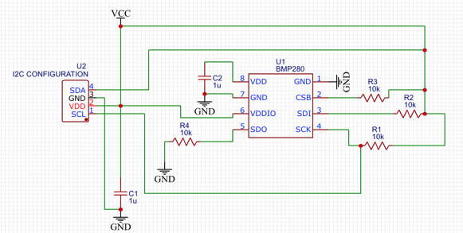
Barometric Pressure Sensor – BMP280
Piezo-resistive pressure sensing technology
Highly accurate with long term stability within the pressure range of 300-1100 hPa
Operating Voltage: 3.3V
Operating Temperature: –45 - +85 degrees Celsius
I2C communication
Cost: $9.95
Notes:
The pressure sensor will be used for our weather predictions. Changes in pressure usually indicates a change in weather causing rainfall and high winds. The sensor has i2c capabilities

Slide 22
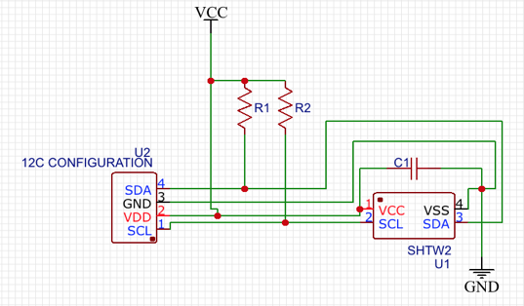
Humidity Sensor - SHTW2
Capacitive humidity sensor measures changes in capacitance of a material as moisture comes into contact with it
Operating Parameters: 0-100% humidity with +/-3% RH accuracy
Capacitance Range: 150-200pF
I2C communication with A/D converter built-in
Cost: $3.04
Notes:
Humidity sensor uses the changing capacitance of a material to sense the presence of moisture, it also has a temperature sensor built in for back up. I2c with ac to dc conversion built in

Slide 23
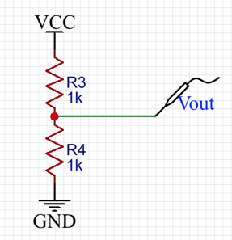
Temperature Sensor – B57863S
Bead thermistor design makes it small and easy to implement in our system
Tolerance: +/-1%
Operating Temperature: –55 – 105 degrees Celsius
Output voltage can be converted to a temperature value
Cost: $2.93
Notes:
Temperature sensor is a small thermistor, which is super easy to implement, and easy to calculate a temperature reading from the change in resistance of the sensor.

Slide 24
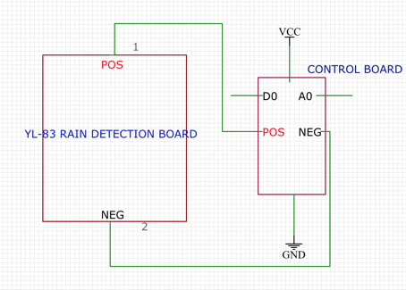
Rain Sensor – YL-83
Conductive rain sensor
Operating Voltage: 5V
Includes regulating circuitry with A/D converter
Output: high/low voltage signals to indicate rain versus no rain
Response time: 1sec
Cost: $7.81
Notes:
Conductive rain sensor works similarly to capacitive humidity sensor. This sensor includes regulating circuitry and an ac/dc converter so it is easy to place on our pcb.

Slide 25
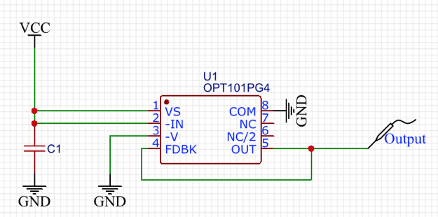
Visible Light Sensor - OPT101
Integrated photodiode and transimpedance amplifier
8-pin integrated circuit with leakage current error, noise, and gain peak protection
Operating Voltage: 2.7-36V
Spectral Range: 400-1000nm
Cost: $8.80
Notes:
Chris – for ambient light

Slide 26
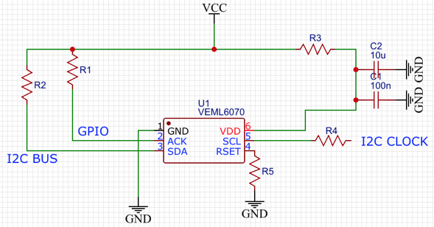
UV Light Sensor - VEML6070
Digital output photodiode with I2C supported circuitry
Integrated circuit containing photodiode, low pass filter, and I2C interface
Maximum Operating Voltage: 5.5V
Spectral Range: 280-400nm
Cost: $2.77
Notes:
Chris – UV light

Slide 27
Sensor Module PCB Design
For this, we needed all sensors outside while the important circuitry must be kept inside away from harsh weather
We went with a design that includes two PCBs, one containing all sensors (outside) connecting to the circuitry PCB (inside)
All sensors needed to be outside to ensure accurate readings, away from any noise that could be introduced by being close to the main circuitry and the MCU.
Notes:
Sarah
Our pcb design for the sensors is a dual pcb design. On pcb will be outside with all of our sensors on it as they need to be out in the elements for the most accurate readings, and the sensitive circuitry will be kept inside out of the weather.

Slide 28
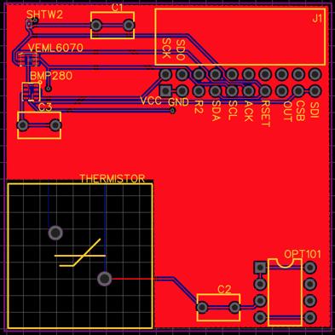
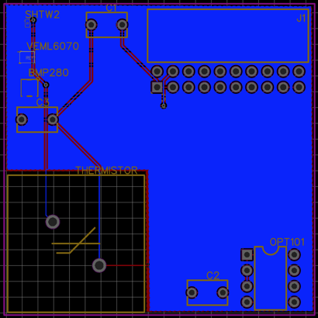
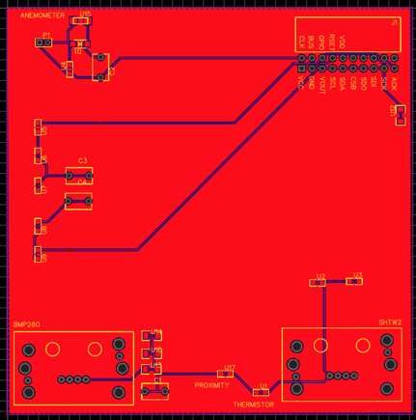
Sensor Module PCB Design cont.
Outside PCB: top (left) and bottom (right)
Inside PCB: top (left) and bottom (right)
Notes:
Sarah (Stop) - outside pcb connects via jumpers to inside pcb

Slide 29
Sensor Test Plan
Sensor | Test
Temperature | Sensor will be exposed to four different temperatures, two of which will be at the extremes of the range, in order to check for the validity of the measurement and the relay of the data to the microcontroller.
Humidity | Sensor will be exposed to four different humidities in order to check for the validity of the measurement and the relay of the data to the microcontroller.
Wind | Sensor will be exposed to different wind speeds from different directions to check that the wind is detected and the speed measured accurately.
Rain | Sensor will be exposed to different rates and volumes of water to check that the signal to the microcontroller is accurate and timely.
Barometric Pressure | Sensor will be monitored for 24 hours and compared to the National Weather Service’s data for those 24 hours. Verify that the Weather API is polled whenever there was a change.
Light | Sensor will be exposed to different light levels and UV indexes to check accuracy. Verify that the signal to change interior lights is sent when light lumination changes.
Notes:
Lauren
Each sensor will be tested for communication readings and accuracy. Each sensor will be exposed to 4 different measurements, two at the extremes, and two in the middle. The exceptions to this is the rain sensor since it only returns a boolean for if it is raining or not, and the barometric pressure sensor will just be evaluated for a 24 hour period and will be checked against the National weather service for accuracy

Slide 30
Power Module
The power module will be charged with safely and efficiently providing power to all subsystems and components of the AIRE system
Geared towards high efficiency and low cost, the power module contains five (5) sections that will work together to harness energy from the environment, protect itself from user error, and provide power to the AIRE system
Notes:
Chris

Slide 31
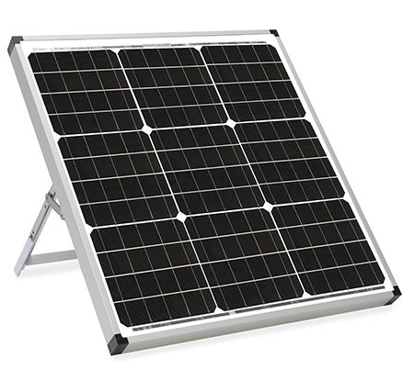
Solar Panels
Allows autonomy and limited self-sufficiency while also being environmentally friendly
ECO-Worthy brand provides 5 Watts of power generation purchasable from Amazon and includes a 5-year warranty
Reference:
[Untitled illustration of a solar panel system]. Retrieved January 22, 2020 from https://www.specialized.net/zamp-solar-usp1005-portable-45-watt-single-solar-panel-kit.html

Slide 32
Battery Management System
This subsystem includes a lithium ion battery pack, battery charger controller, and reverse polarity protection
Lithium ion battery back includes a 3-series configuration of 18650 cells. These cells have an impressively high energy density that allows efficient storage of power.
The charge/discharge cycle of this battery pack is controlled by multiple battery charge controllers, which balance each individual cell to ensure they maintain their health throughout the lifetime of the AIRE system
To ensure the power system is not vulnerable to user error when replacing the battery, reverse polarity protection circuitry is implemented as well

Slide 33
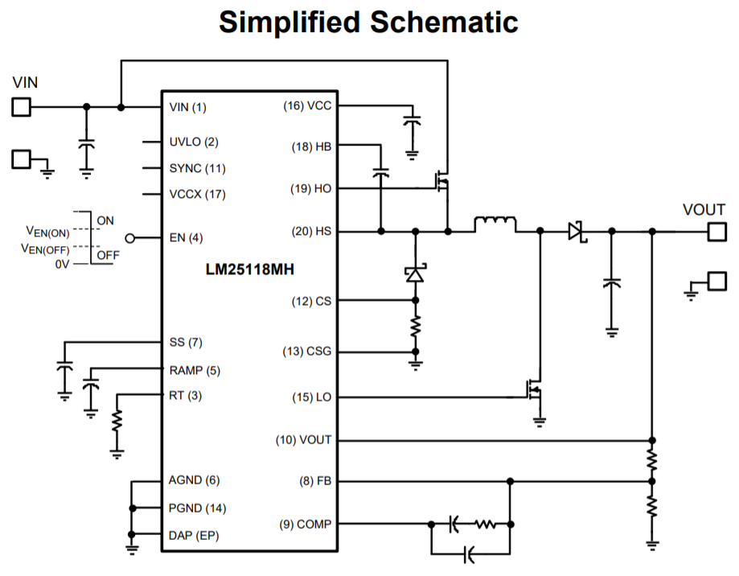
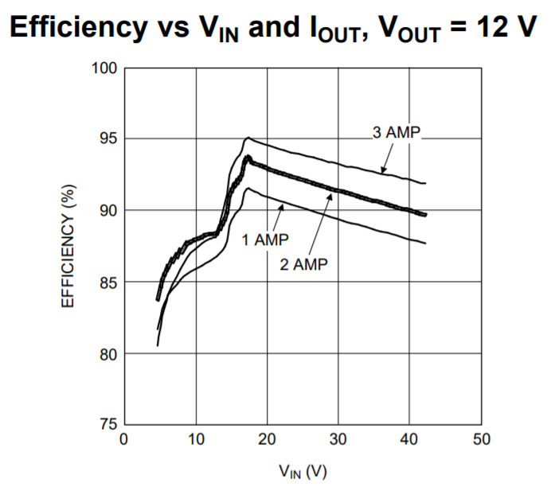
12V Buck-Boost Controller
The 3-S battery back will have a voltage range of 9V when discharged, up to 12.6V when fully charged, and a nominal voltage of 10.8V.
To accommodate, the 12V regulator will need to have both buck and boost capability
Reference:
Texas Instruments, "LM25118 Wide Voltage Range Buck-Boost Controller ," LM25118 datasheet, July 2011 [Revised Mar. 2018].

Slide 34
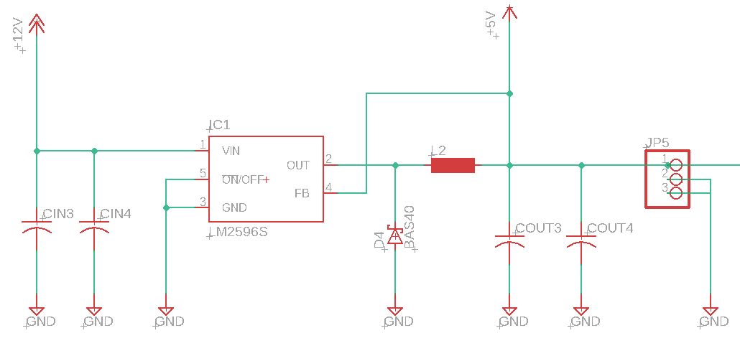
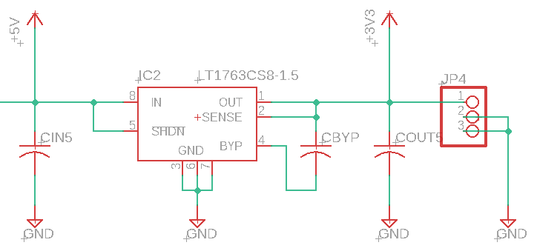
5V Buck Converter
LM2596
Team is familiar with IC, low external component count
Only need buck functionality since input is +12V
3.3V Voltage Regulator
LT1763 Low Dropout Regulator
82.5% efficiency for only $5 per unit

Slide 35
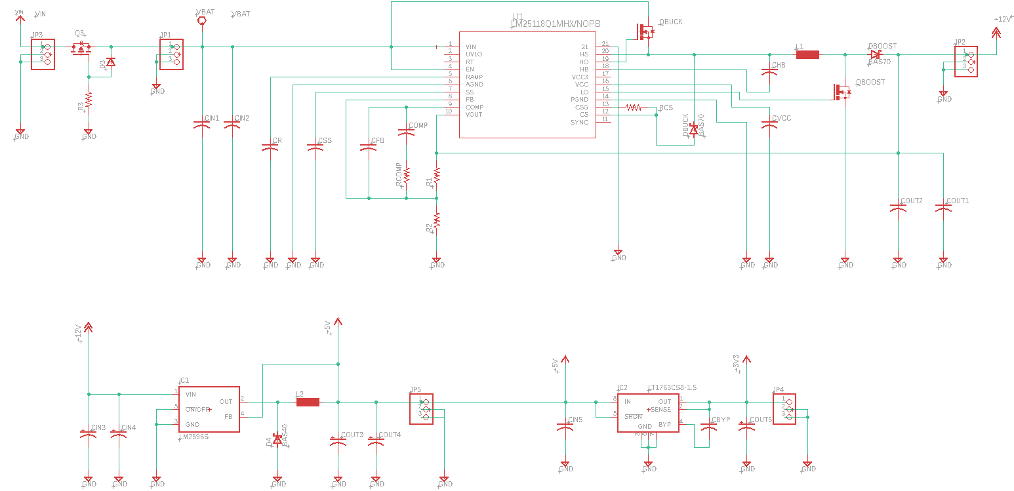
Voltage Regulator PCB Schematic

Slide 36
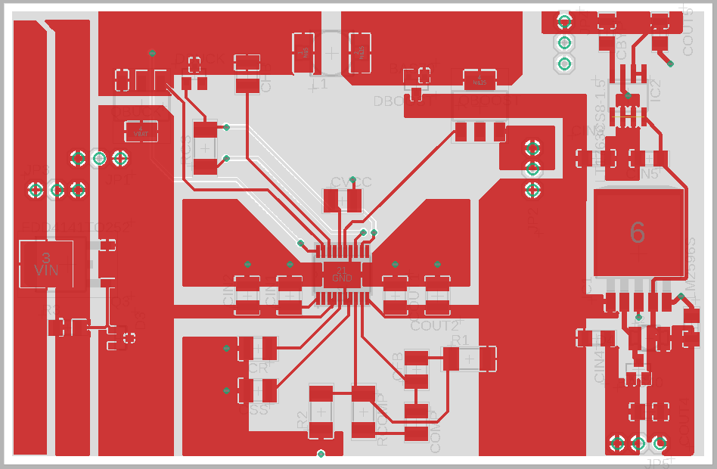
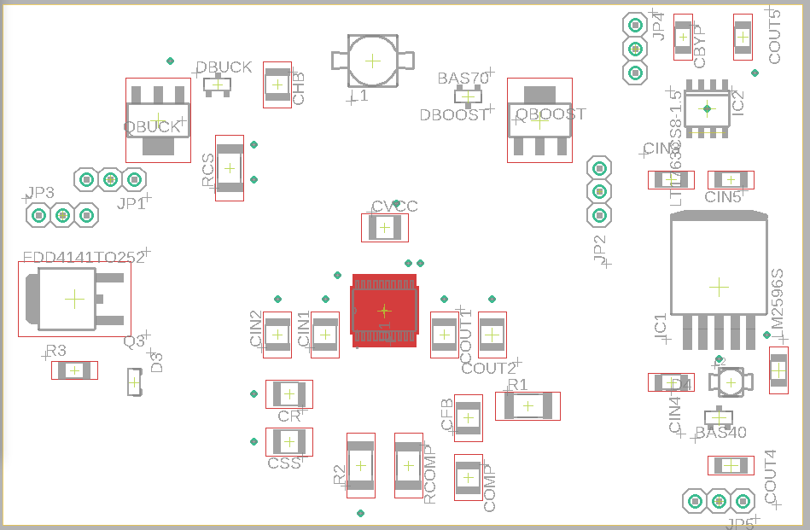
Voltage Regulator PCB Layout

Slide 37
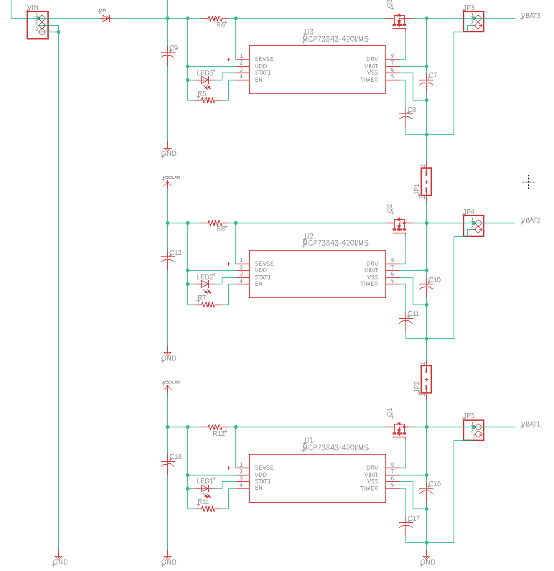
Battery Management PCB Schematic

Slide 38
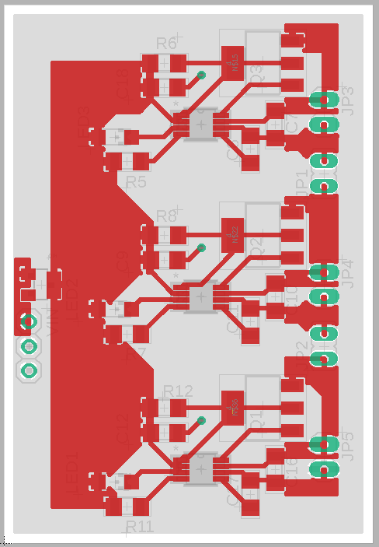
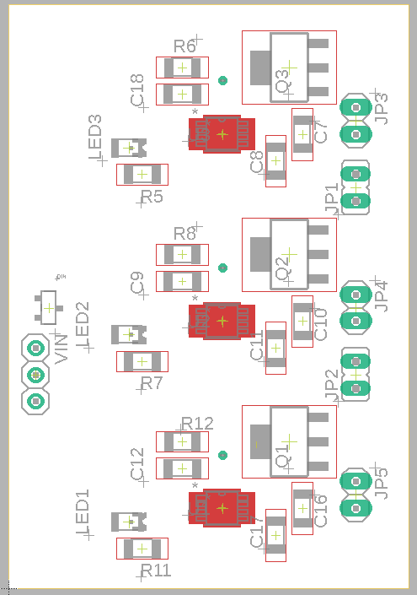
Battery Management PCB Layout

Slide 39
SOFTWARE
Notes:
Ron get ready

Slide 40
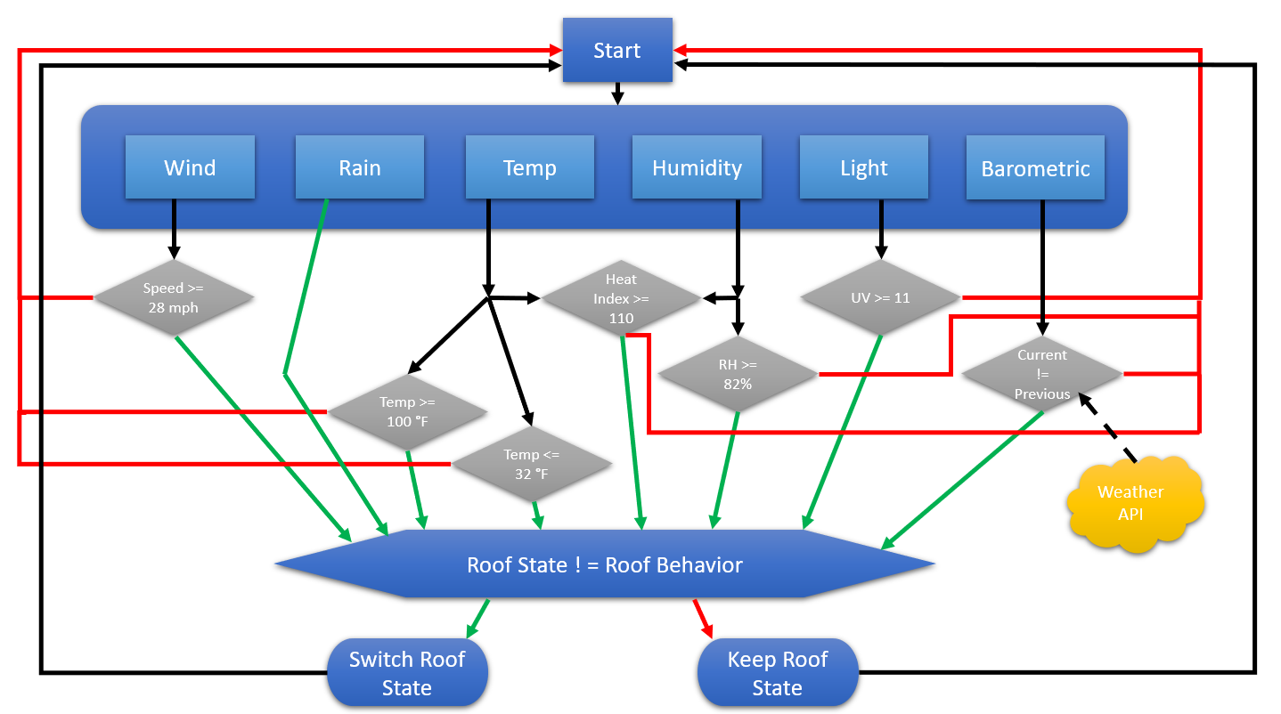
Software block diagram
Notes:
Ron (start)
Includes a lot of conditionals to find out if certain weather is active
Some measurements are used for multiple conditions and states, such as temperature
If inclement weather is sensed, the current roof state (open or closed) is checked, and if the desired behavior is different then the roof will open or close based

Slide 41
Sensor Algorithms
Default values for the extremes for each sensor, these can be changed during each kits set up
Values for each kit are stored within a table in the database, with the unique kit id
Measurement/Condition | Value | Unit
Windy | 28 | Miles per Hour
Raining | NA | NA
Temperature (Maximum) | 100 | Degrees Fahrenheit
Temperature (Minimum) | 32 | Degrees Fahrenheit
Relative Humidity | 82 | %
Heat Index | 110 | Degrees Fahrenheit
Barometric Pressure | 101.325 | KiloPascals
UV | 11 | UV Index
Notes:
Lauren (Start)
Default values for all of the sensor's measurements, these can be changed during the initial set up of the sensor kit by the user. Most of these measurements come from the National Weather Service research and measurements for averages in here in Florida

Slide 42
Sensor Algorithms Continued
Most values come directly from sensor measurements, however heat index and pressure extremes comes from unique equations based on other measurements/characteristics
Heat index is calculated from both relative humidity and temperature:
Atmospherics pressure differs based on elevation from sea level:
Notes:
Most of the weather conditions' measurements come straight from the sensors, but some weather conditions require a sensor's measurement to be used in a calculation. As you can see Heat Index, which is important for the amount of time and exertion a human can spend outside, is calculated using both temperature and relative humidity. The normal atmospheric pressure value is based off of elevation from sea level, so the default value will be changed based on location

Slide 43
Roof Algorithm/Behaviors
Default actions will be in response to the measurements/conditions the sensors report, along with the data that will be pulled in from the Weather API
Default behaviors can be changed during kit set up
Depends on structure type
Measurement/Condition Changes | Roof Behavior for Pool Structure | Roof Behavior for Greenhouse Structure
Windy | Close | Close
Raining | Close | Open
Temperature (Maximum) | Open | Open
Temperature (Minimum) | Close | Close
Relative Humidity | Close | Open
Heat Index | Close | Close
Barometric Pressure | Close | Open
UV | Close | Open
Notes:
Lauren
Whenever inclement weather is sensed, whatever action that the roof needs to take will be based off of the defined roof behaviors. Just like the sensor defined values, these behaviors can be changed during the initial setup. Obviously different structures care about different weather conditions, so the default values will be based off of structure type initially.

Slide 44
IOS Application
Swift Based Application
Capabilities:
Open/close roof
Control light ambience/color
Change default attributes
Modify accesses and such based on account permissions
Access weather metrics collected by system
Notes:
Ron :
Summarize powerpoint above

Slide 45
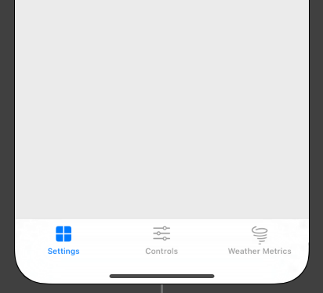
IOS Application GUI
The application will begin with a login screen
Authentication leads to tab-based interface
Views
Login
Settings
User Authorizations
Roof Settings
Controls
Weather Metrics

Slide 46
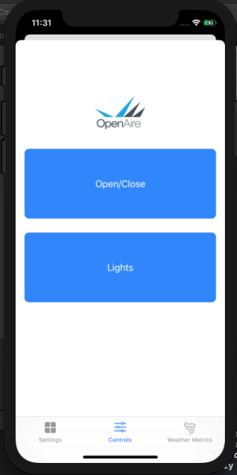
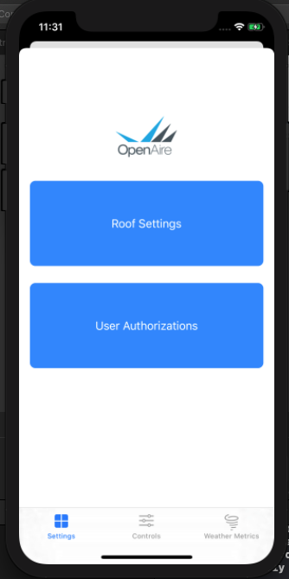
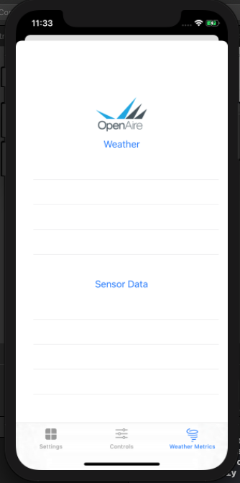
IOS Application GUI
Notes:
Ron:
Mention 3D touch

Slide 47
IOS Application security
Email and Password based authentication
Credentials provided by OpenAire
‘Firebase SDK Authentication’ based
Notes:
Ron (Stop)

Slide 48
Bluetooth
Bluetooth module will connect the kit to an iOS application
CYBT 423028
Not implementing Wifi due to power constraints
The phone application will need to communicate with the microcontroller to update user settings and weather data
Bluetooth will be to utilized to send data to and from the kit for the kit's weather statistics and predictions
Implement security for connecting:
PKA cryptography and RSA encryption
Notes:
Lauren (Start)
A bluetooth chip, specifically the CYBT 423028will be used for communication between the board and the phone application
We did not want to implement a wifi chip due to power constraints of the PCB, as it is only going to be powered by a battery pack
The phone application will be the main connection to the database we will be implementing and will be polling the API for weather predictions, and all this data will be pushed to the board via bluetooth

Slide 49
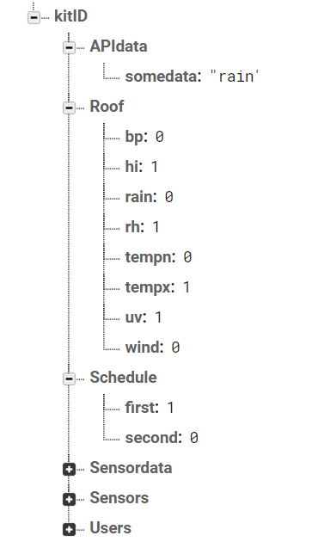
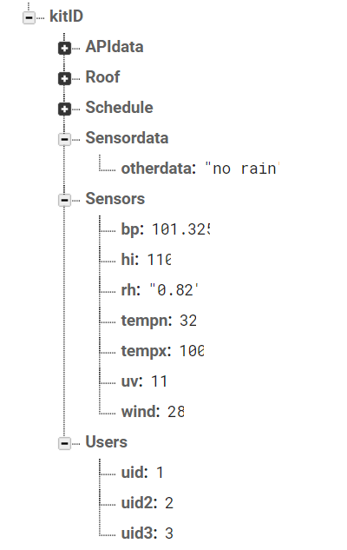
Database
Google's Firebase
Google's test lab and real time hosting and debugging
Firebase uses JSON pairs rather than the normal tables found in regular database
Main branch is off of the Kit identification number
Notes:
Lauren
To hold all the user settings and weather predicition and collected measurement data for each kit, we are implementing a database. Specifically we are suing google's firebase. We chose firebase because of its easy connecting to swift applications. You also get a ton of buillt in storage and security features from google
6 main json token pairs that will be used to hold all the data for each sensor system.
Users – hold hard coded kit ID number and the unique customer user id
Permissions - different user ids and and permissions for each for a given kit
Preferences – holds all the defined sensor values we talked about earlier
Behaviors – all the roof behaviors that are defined for each kit
Sensors Collection – average data collected by the sensors for each kit
API Predictions – collected API polled data for predicitons for a given kit

Slide 50
Weather API
Utilizing a weather API to be able to use predictions in order to schedule roof behaviors
Required data from API: precipitation probability, air quality, lightning strikes, and weather warnings
Increases system's reliability and functionality
Dark Sky API and the MeteoGroup lightning API
Both allow limited free calls
Polling of the API will take place in the iOS application and prediction data will be sent to the system via Bluetooth
Notes:
Lauren (Stop)
To enhance our sensor systems functionality and reliability we wanted to implement weather predicitons to alert users of possible inclement weather and schedule the roof to trigger a behavior before the weather arrives to the structure
Dark Sky API in combination with MeteoGroup's lighting strike API
Data we will be polling from the APIs are precipitation probability, air quality, lighting strikes, and weather warnings

Slide 51
Administration
Notes:
Sarah (Start)

Slide 52
Group Roles
Group Member | Software/Firmware | Sensor Module | Motor Module | Power Module
Christopher S. |  | X | X | X
Lauren M. | X | X
Ron A. | X |  | X
Sarah R. |  | X | X | X
Notes:
Group roles: sarah and chris mostly hardware. Ron and lauren mostly software

Slide 53
Milestones
IOS Application Front-End interface almost finalized
Database tables are almost finalized
All active components and modules ordered and placed in on-campus storage (except anemometer)
PCBs ordered and shipped, expected arrival in 2 weeks (Feb 11, 2020)
Hardware Progress: 25%
Software Progress: 70%
Overall Completion: 45%
Notes:
Chris

Slide 54
Finances and Budget
The members of this group would like to thank our sponsor, Open Aire, for inspiring and funding this project. Special thanks to Deborah Baker and Donie Riseden for coordinating with us throughout the duration of this project.
Notes:
Sarah (Stop)

Slide 55
Module | Item | Qty | Item Price | Cost Estimate
Microcontroller | Microcontroller | 2 | 50 | 100
Power | Power Module | 1 | 20 | 20
 | Battery Management System | 1 | 20 | 20
 | PV panels | 2 | 15 | 30
Sensors | Temperature Sensor | 1 | 10 | 10
 | Barometric Pressure Sensor | 1 | 50 | 50
 | Pressure Plate Sensor | 1 | 15 | 15
 | Humidity Sensor | 1 | 25 | 25
 | Anemometer (Wind speedometer) | 1 | 50 | 50
 | Adaptive light sensor | 1 | 10 | 10
Wireless | Wi-Fi Module | 1 | 20 | 20
 | Bluetooth Module | 1 | 20 | 20
Peripherals and Drivers | Motor Driver | 1 | 10 | 10
 | Fan Driver | 1 | 10 | 10
 | Stepper Motor | 1 | 20 | 20
 | Fan | 1 | 10 | 10
Miscellaneous | Miscellaneous Passives | 1 | 50 | 50
 | PCB Design and Fabrication | 5 | 5 | 25
 | Glass Tinting | 1 | 100 | 100
 | Waterproof Enclosure | 1 | 200 | 200
Total Cost |  |  |  | $735
Notes:
Budget was an estimated $1000, spent a little over $700, received $2000. Parts selection was based soley on being able to stay within budget

Slide 56
Issues and Concerns
Anemometer has been delayed on delivery (earliest delivery is end of February)
Initial delay on funds

Slide 57
References
[a] ZF Electronics, “Magnetic Proximity Sensors (Hall Effect),” MP1021 datahseet, June 2017.
[b] Jacksking, “Jacksking Anemometer, 360 12V-24V DC Pulse Signal Output Aluminum Alloyed Wind Speed Direction Sensor Measurement Tool,” B07SN1V427, Oct. 2019.
[c] Bosch Sensortec, “Digital Pressure Sensor,” BMP280 datasheet, May 2015
[Revised Jan. 14].
[d] Sensirion “Datasheet SHTW2”, SHTW2 datasheet, 2017 [Revised July 2017]
[e] Little Fuse, “Leaded Thermistors”, PR103J2 datasheet, 2018 [Revised Feb. 26 2018]
[f] Texas Instruments, “OPT101 Monolithic Photodiode and Single-Supply Transimpedance Amplifier”, Opt101 datasheet, Jan. 1994 [Revised Jan. 2015]
[g] Vishay, “UVA Light Sensor With I2C Interface”, VEML6070 datasheet, 2019 [Revised Sept 12, 2019]
[h] ECO-Worthy, “Polycrystalline Solar Panels”, ECO-Worthy datasheet 2019
[i] Great Power, “Lithium Ion Battery”, PRT-13189 datasheet, July 7, 1028
[j] Microchip, “Advanced Single or Dual Cell Lithium-Ion/ Lithium-Polymer Charge Management Controllers”, MCP73842 datahseet, 2013
[k] Texas Instruments, “LM25118 Wide Voltage Range Buck-Boost Controller”, LM25118 datasheet, July 2011 [Revised Mar. 2018]
[l] Texas Instruments, “LM2596 SIMPLE SWITCHER® Power Converter 150-kHz 3-A Step-Down Voltage Regulator”, LM2596 datasheet, Nov. 1999 [Revised May 2016]
[m] Linear Technology, “500mA, Low Noise, LDO Micropower Regulators”, LT1763 datasheet, 2019
[n] Atmel, “8-bit Atmel Microcontroller with 16/32/64KB In-System Programmable Flash”, ATMEGA 1280 datasheet, 2014
[o] Cypress “EZ-BTTMXRWICED® Module”, CYBT-423028-02/CYBT-423054-02/CYBT-423060-02 datasheet, 2019 [Revised Sept. 26, 2019][p] Progressive Automations, “PA-07 Datasheet”, PA-07 datasheet, 2019

Slide 58
Questions?

