Slide 1
Environment Adaptive Automotive Headlight
Group 5
Justin Kleier – PSE
Michael Zeiher – PSE
Justin Owle – CE
Ivan Bernal Garcia – EE
SPRING 2020

Slide 2
Motivation
Driving at night can be up to three times more dangerous than daytime driving. This is due to decreased reaction time caused visual impairments such as lack of illumination and flash blindness.
Lack of illumination limits the sight distance as well as depth perception and peripheral vision.
Oncoming headlights can cause flash blindness. Which can leave an afterimage seen as a dark spot in our vision causing us to not see clearly and can even disorient drivers.

Slide 3
Goals and Objectives
Goals | Objectives
Increase safety for the driver | Increase light output for better sight clarity Increase sight distance (farther light throw) Proper beam selection (I.e. High, Low and Fog light)
Increase safety for oncoming drivers | Adaptive beam to decrease glare and effects of flash blindness/afterimage
Abide by Florida Laws on lighting requirements during specific weather conditions | Turn on Headlights with rain, fog or smoke Only use Low beams and Fog lights during rain, fog and smoke conditions (Eliminates tunnel effect) Lights on from dusk to dawn hours

Slide 4
Specification
1. | FDOT (Florida Department of Transportation) standards
2. | Rain, fog and ambient light sensor to signal headlights to turn on
3. | Image processing/ software to control the LED brightness and on off state
5. | 12V at 20 Amps supply limit from car battery (Measure both turn on and constant state)
6. | Low beam LEDs Controlled by a microcontroller
7. | Sensor sampling 2 - 5 Hz
8. | Must determine if there is an oncoming car
9. | Determine the position of the car or light source
10. | Consider back scatter from the headlight to help determine weather
11. | Measure effective sensing distance
12. | Measure effective response time

Slide 5
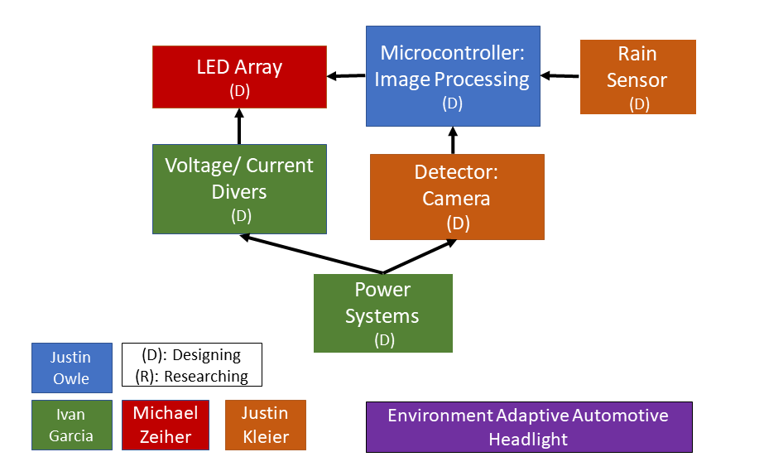
System Block Diagram

Slide 6
Optical Systems
Low Beam
High Beam
Fog Light
Rain sensor

Slide 7
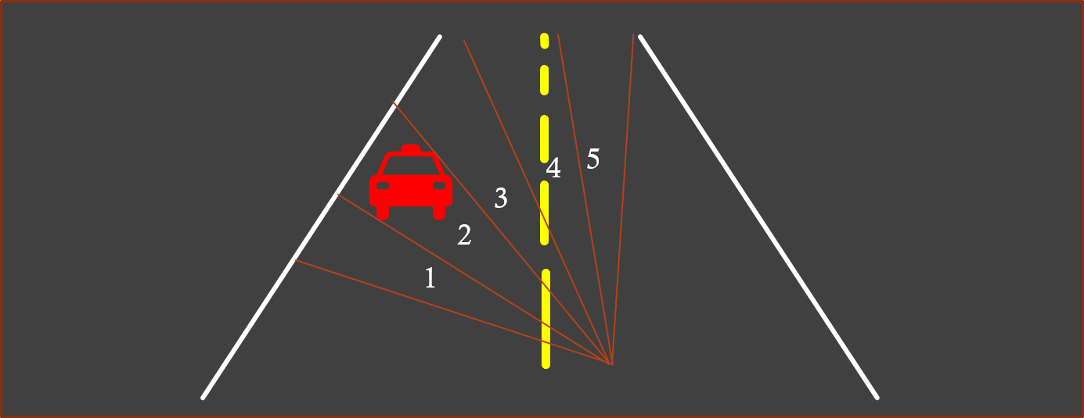
Low Beam
Our low beam is the adaptive part of the system consisting of 5 LEDs each projecting an equal portion of the systems full field of view (FOV)

Slide 8
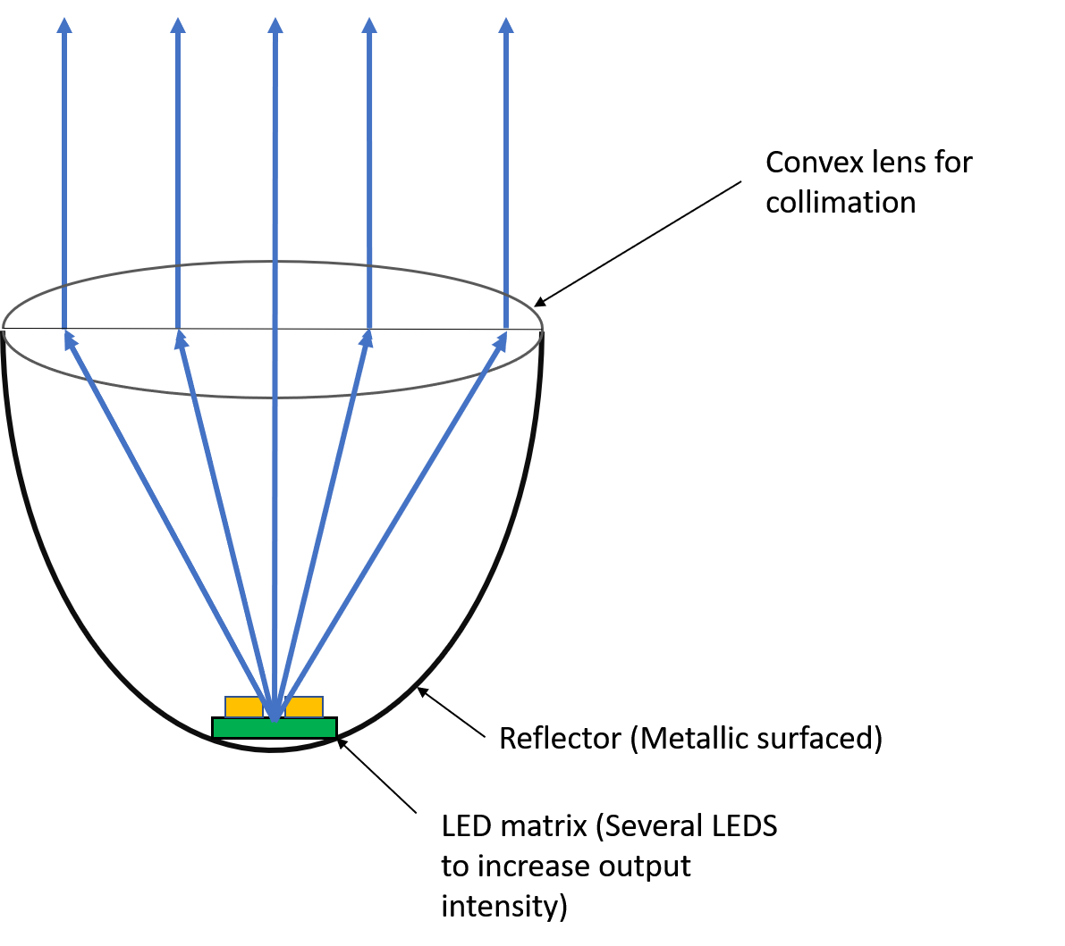
Low Beam design
Projector style assembly
Used to magnify the LED array and easily control the beam divergence.
LED color selection
A white source similar in color to halogen bulbs provides the best balance of comfort and visibility characteristics.
Part Number​ | Vendor​ | Lumens​ | Viewing Angle | Size (mm)​ | Price​ | Color Temp.
MKRAWT-00-0000-0B0HG440F | Mouser | 840 | 120 | 7 x 7 | $ 5.90 | 4000 K

Slide 9
Lenses
We are testing two lens diameters
Diameter | 10 mm | 20 mm
Focal Length | 7 mm (Seller reference only) | 16.5 mm
Cost | $0.85 | $1.00

Slide 10
Projected Beam Shape
In focus | In focus white balanced adjusted | Slightly out of focus
*Different LED (same physical dimensions)

Slide 11
High Beam
Reflector Bucket assembly
We decided upon an elliptical reflector based high beam to allow for control of large area illumination and present other forms of lighting design.
LED color selection
Broad band source of high intensity to aid in clarity of reflections.
Part Number​ | Vendor​ | Lumens​ | Viewing Angle | Size (mm)​ | Price​ | Color Temp.
MKRAWT-00-0000-0B00H40E2 | Mouser | 970 | 120 | 7 x 7 | $ 5.90 | 5700 K

Slide 12
Fog Light
The beam shape is to be rectangular in which the light expands rapidly to cover the width of the road but a small divergence in the y-axis such that the light stays low and path does not extend up into the fog impairing vision.
Part Number​ | Vendor​ | Lumens​ | Viewing Angle | Size (mm)​ | Price​ | Color Temp.
MKRAWT-00-0000-0B0HG440F | Mouser | 840 | 120 | 7 x 7 | $ 5.90 | 4000 K

Slide 13
Rain Sensor
$$φ_{c}$$
Index of Refraction | Critical Angle = $φ_{c}$ | Angle from interface = $θ_{c}$ | Angle of incidence = $θ_{i}$
$n_{1}=1.492$ ${ n}_{2}=1.000$ | 42.086º | 47.914º | >90º
Solution: Cut the acrylic face to position normal along desired beam path θ = 137.914º/42.086º

Slide 14
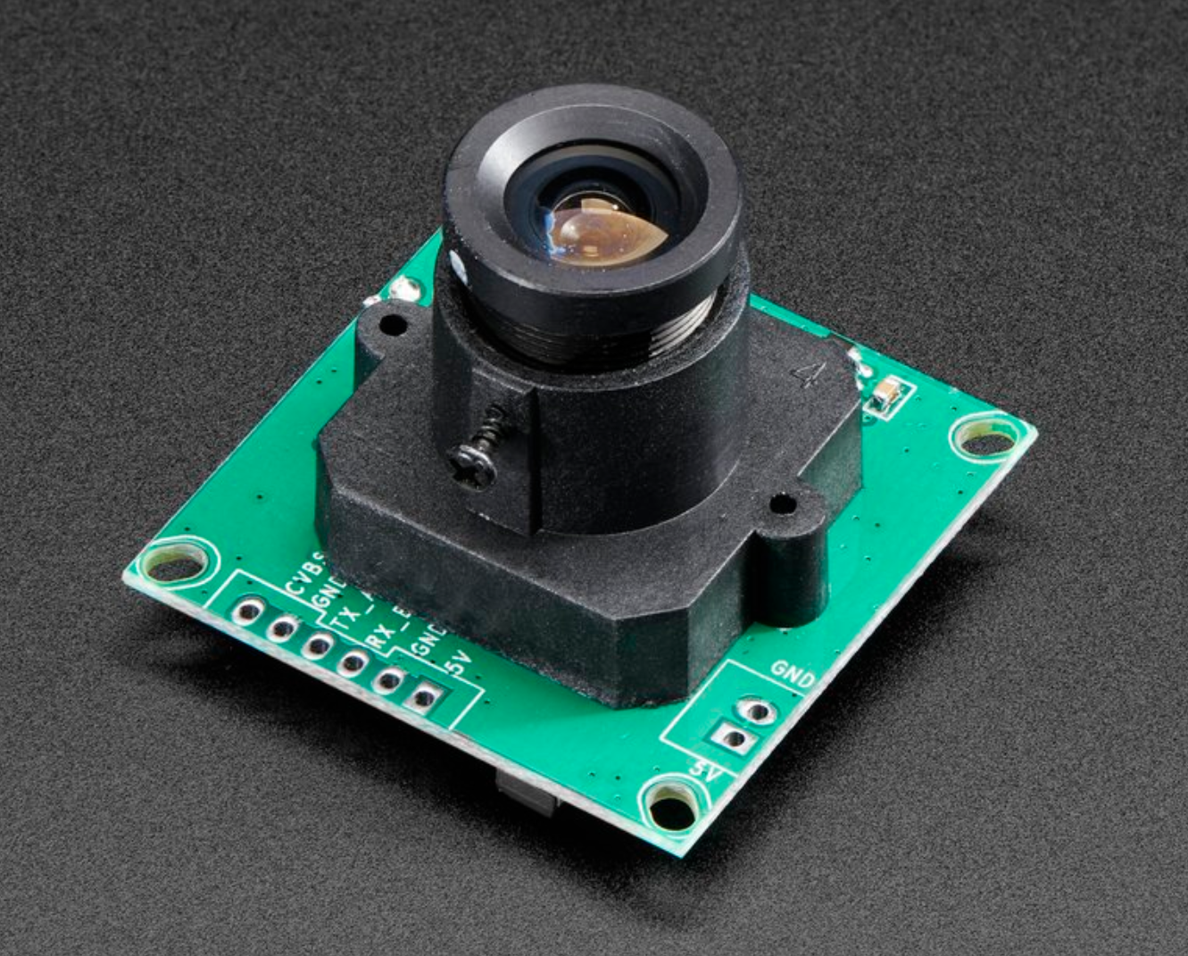
Camera system
Picture is needed to determine which LEDs will be on
The microprocessor will analyze the picture taken
Set the LEDs to their states
Camera | Part Number | Price | Vendor | Resolution
TTL Serial JPEG Camera with NTSC Video | 397 | $39.95 | Adafruit | 160X120

Slide 15
What the controller sees

Slide 16
How the LED data is stored
0 for "off" or light detected
1 for "on" or light not detected

Slide 17
How the data is interpreted
Output | Camera Input | Light Sensor Input | Water Sensor Input | State
High Beam LEDs | 111111 | 1 | 0 | 01111111
LED 0 | XXXXX1 | X | X | XXXXXXX1
LED 1 | XXXX1X | X | X | XXXXXX1X
LED 2 | XXX1XX | X | X | XXXXX1XX
LED 3 | XX1XXX | X | X | XXXX1XXX
LED 4 | X1XXXX | X | X | XXX1XXXX
FOG LED | 000000 XXXXXX | 0 X | X 1 | X0000000 1XXXXXXX
Notes:
Fog LED being on means the LEDs 0-4 auto turn on and high beams off.

Slide 18
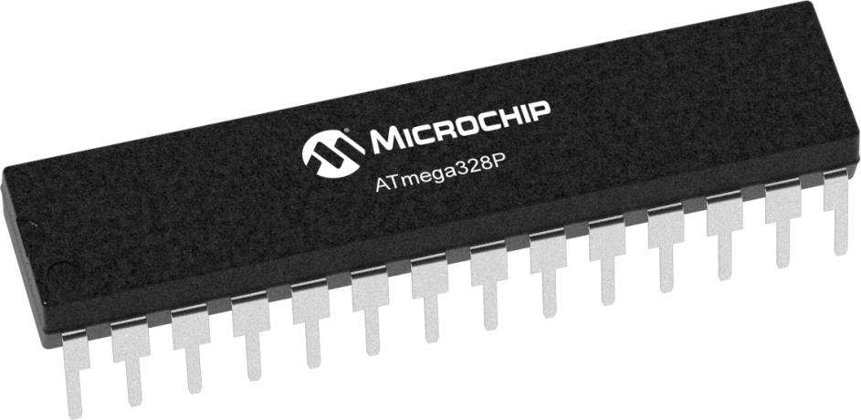
Microcontroller
We have been using an Arduino for testing
Chip used on the board is an ATmega328P
Part Number | Price | Pins | Bits
ATMEGA328P-AU | $2.01 | 32 | 8

Slide 19
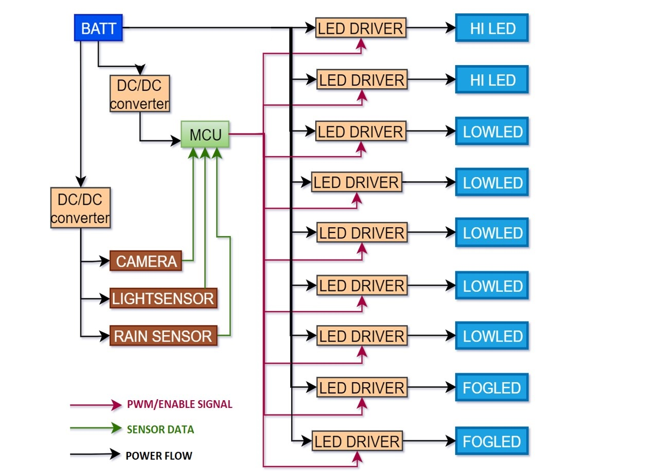
Electrical Systems Overview
Notes:
*A typical car battery can supply approximately 240 W, 12 V at 20 A, changes 12 – 14.5

Slide 20
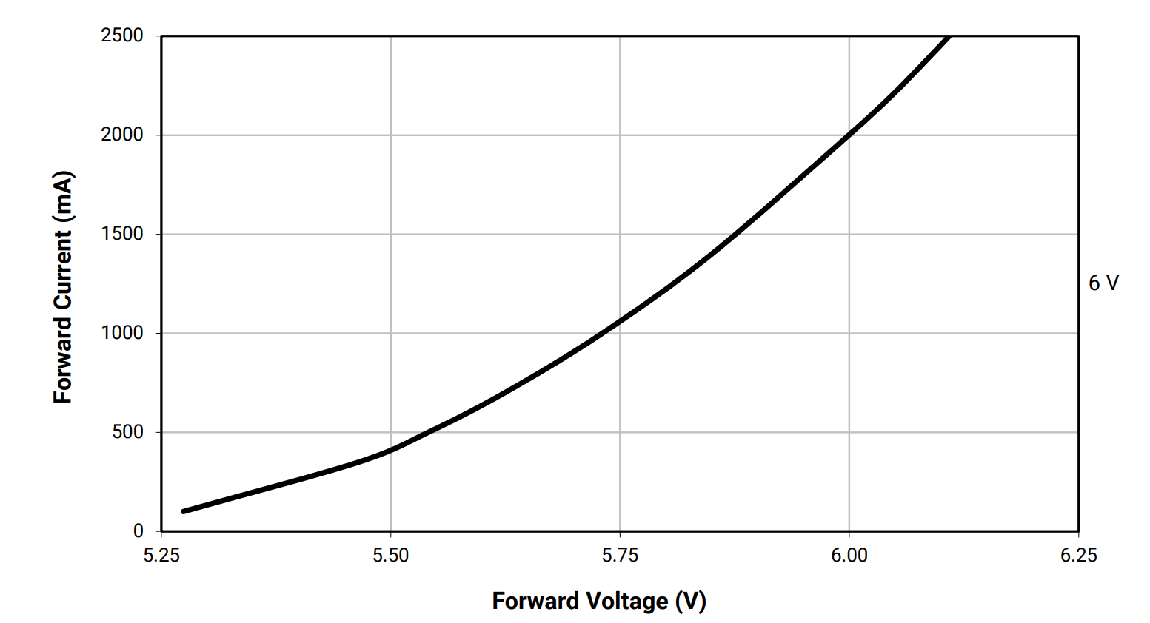
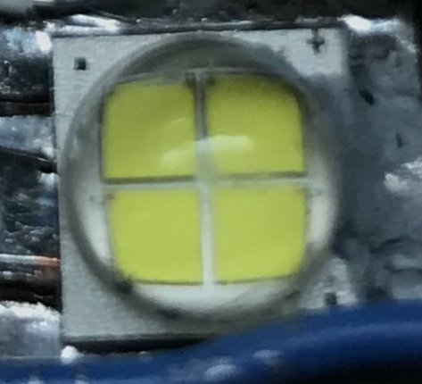
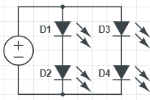
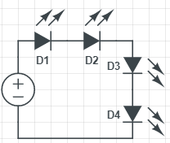
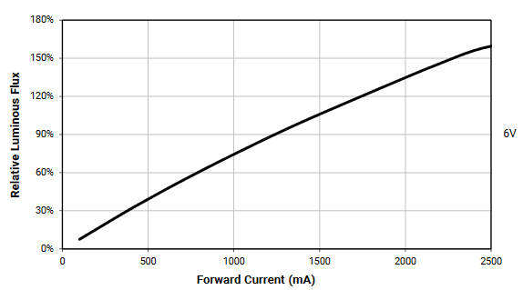
LED power requirements
Two configurations (6 Volts or 12 Volts)
Aiming for 1.4 amps
Constant Voltage(CV) vs. Constant Current(CC)
Notes:
__ there’s 2 configurations to the arrange the LEDS, 6 and 12 explain the picture
__Why not the 12 volt configuration?
If the voltage falls below 12 volts , leds wont be as bright
-need a buck-boost driver.
Harder to implement and harder to find SIMPLE driver
__ the LEDS are able to handle 3 amps
Not recommended, too hot that they can damage themselves or other components
additionally Pushing more current decreases the lifetime of the LED
__For small LEDS you can simply use a resister /not the case for these large more powerful LEDS
__Explain Constant voltage verses constant current
__A small change in current wont affect brightness of the LED, but small change in voltage will
https://www.mouser.com/datasheet/2/90/XLampMKR-471822.pdf

Slide 21
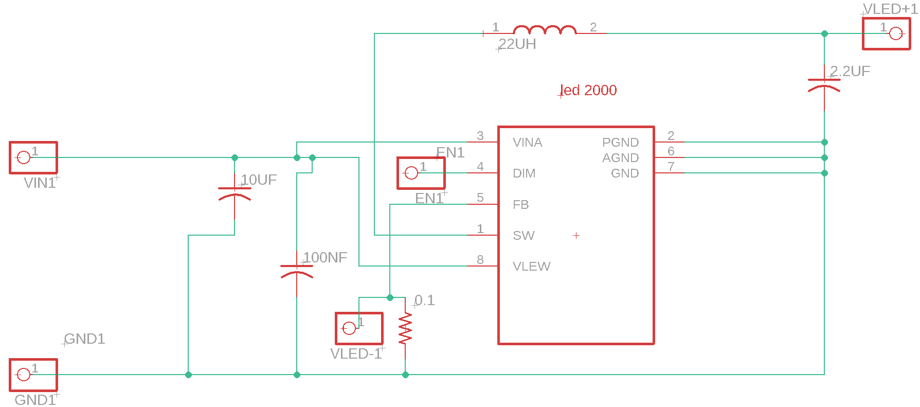
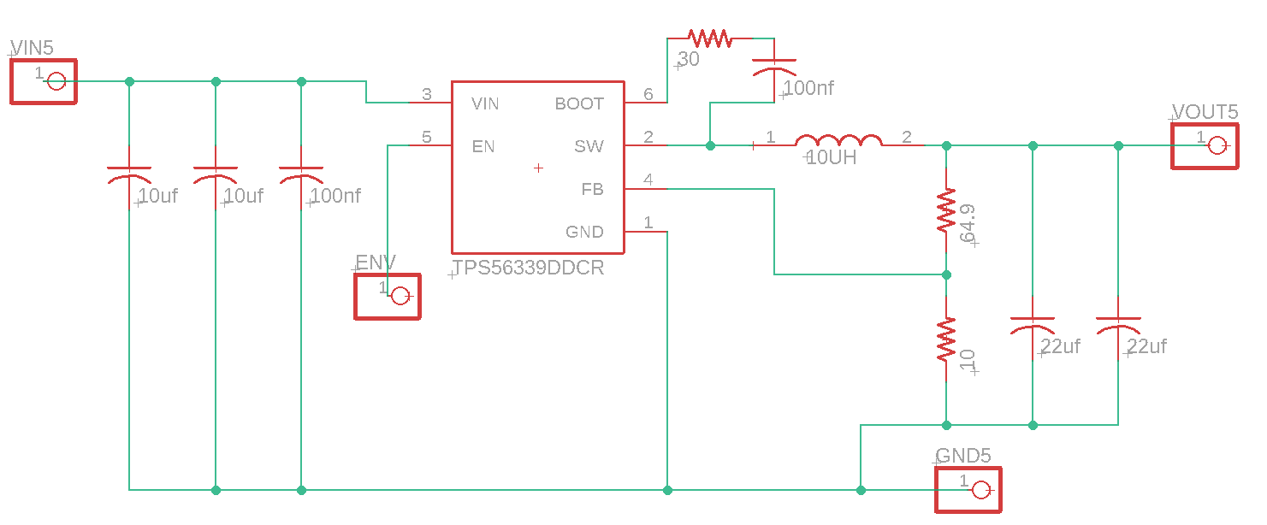
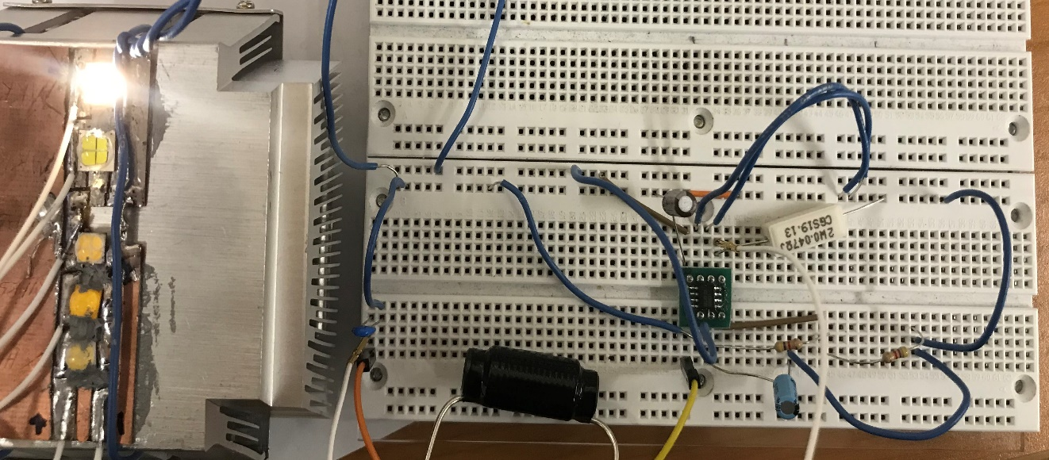
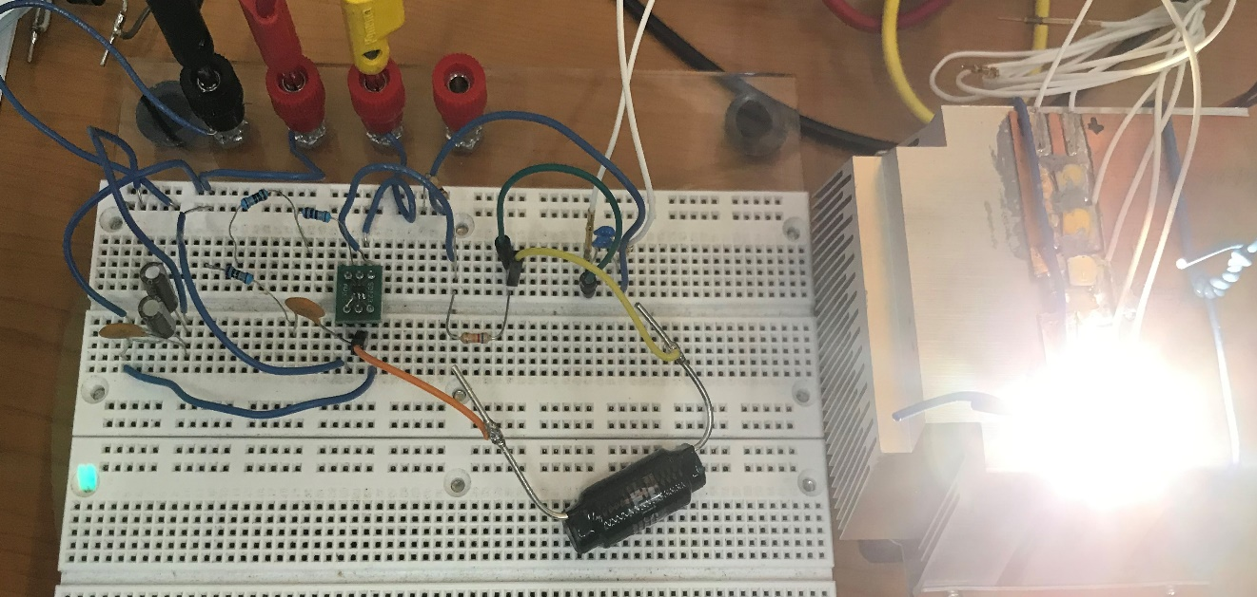
LED Drivers Rev. 1
LED driver IC on a breakout board
Through hole components
Issues
LED2000 CC
TPS56339 6 V CV
Notes:
Bought the ICs and soldered them onto the breakout board
- getting an evaluation board would be far expensive
None of the drivers could handle 12 votls
would flicker or then blow up

Slide 22
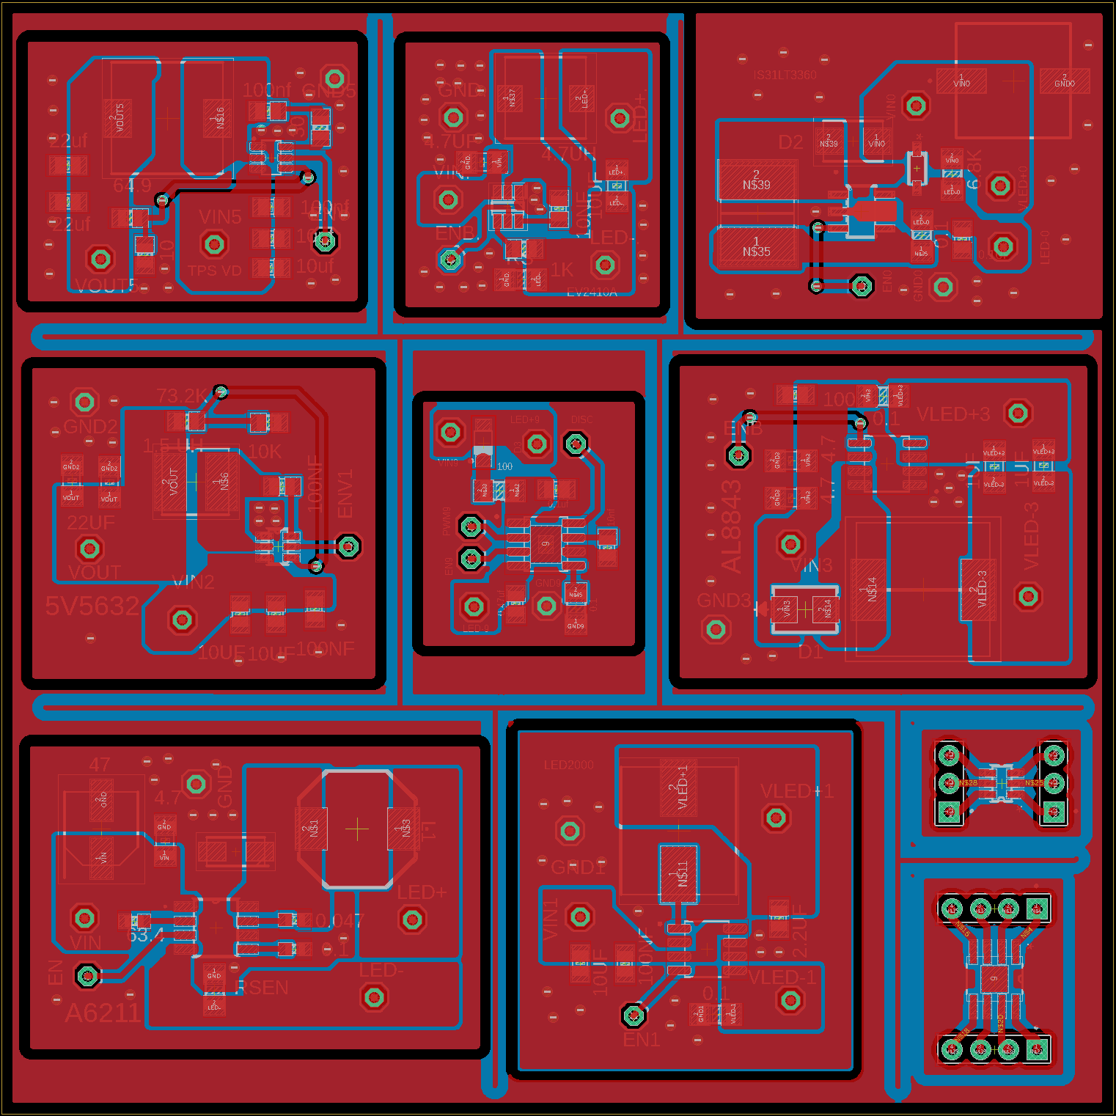
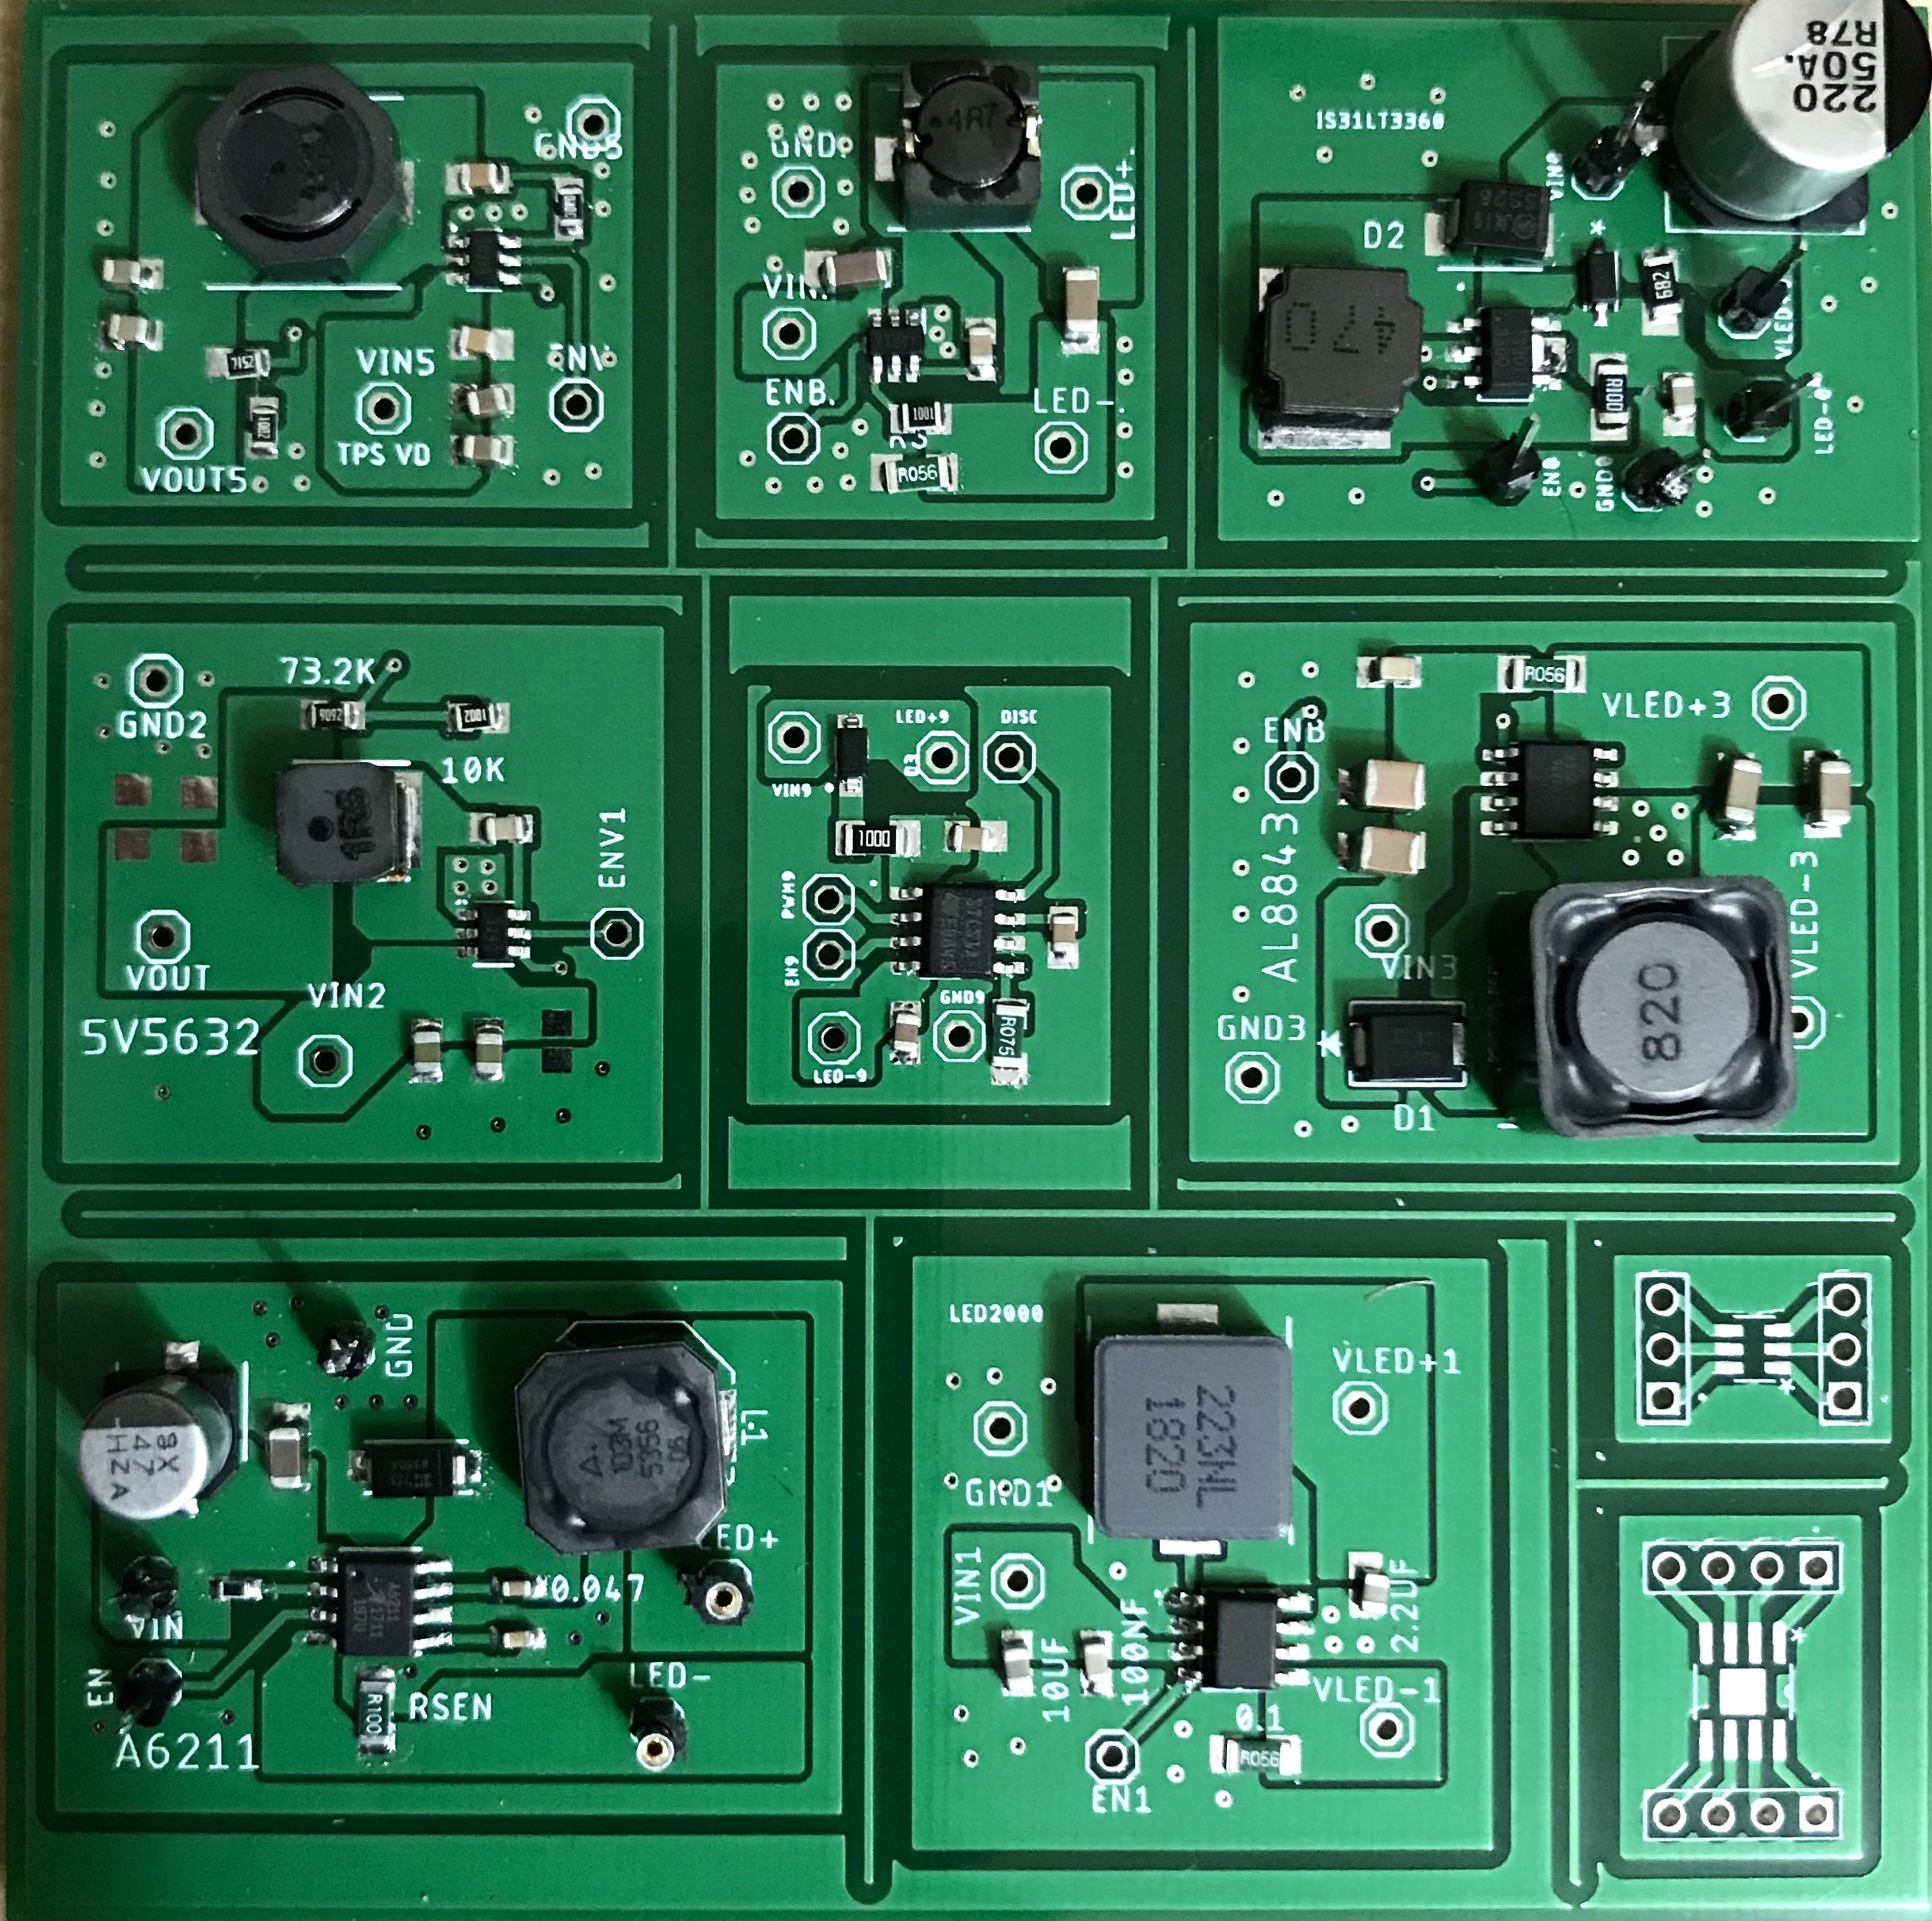
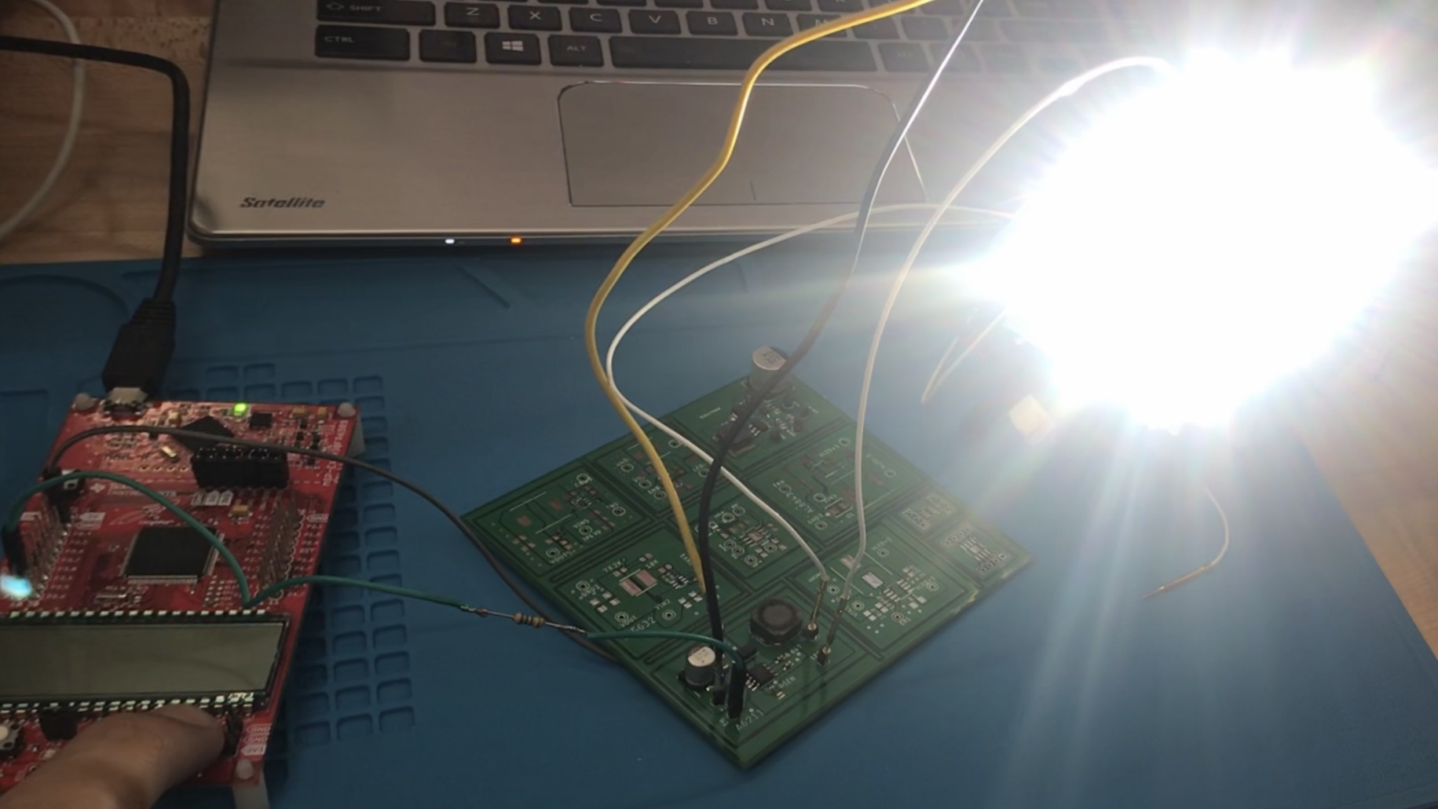
LED Drivers Rev. 2
LED driver design revisions
Added more drivers
All SMD components
6 VOLT CV
MP2410AG CC
IS31LT3360 CC
5 V DC-DC
STCS1A CC
AL8843 CC
PCB Detail
Cost: 2$ + 12.70$ shipping
1 oz copper
2 layers
Dimensions: 100mm*100mm
Manufacturer: JLCPCB
A6211 CC
LED2000 CC
Notes:
Used the evaluation board schematic and their recommenced inductors
Thermal testing left

Slide 23
LED driver comparison
 | A6211 CC | LED2000 CC | AL8843 CC | STCS1A CC | TPS56339 CV | MP2410AG CC | IS31LT3360 CC
MANUFATURE | Allegro MicroSystems | STMicroelectronics | Diodes Incorporated | STMicroelectronics | Texas Instruments | Monolithic Power Systems Inc | Issi
COST OF ONE DRIVER | $6.68 | $4.82 | $5.53 | $5.37 | $4.15 | $4.38 | $3.70
Vin (V) | 6 - 48 | 3-18 | 4.5 – 40 | 4.5 – 40 | 4.5 - 24 | 4.2 - 24 | 6 - 40
MAX IOUT (A) | 3 | 3 | 3 | 1.5 | 3 | 2 | 1.2
Efficiency (%) | 87 | 92.5 | 91.2 | 90 | 93 | 94.2 | 85
Notes:
Why these?
Simple to implement
Many led drivers can get complicate and expensive (large number of external compents)
A6211_____ is PWM expensive do to the inductor almost 2.54
LED2000 ____works great and it is cheaper as well
AL8843____ works great
STCS1A____ no good== strobe light
TPS56339___no control (PWM)
MP2410AG___
IS31LT3360___ limited current output

Slide 24
Sensor and MCU power supply
DC to DC Buck converter
 | Operational Voltage
Laser Diode | 5
Light sensors (photoresistor) | 5
Camera (TTL) | 5
MCU (ATMEGA328P) | 1.8 – 5.5
 | TPS563240DDCT
MANUFATURE | Texas Instruments
COST OF ONE DRIVER | 3.55
MAX IOUT (A) | 3.5
Efficiency | 91.3
Vout(V) | 0.6 - 7 (Adjustable)
Notes:
Having a buck converter is better than a linear converter
Linear converter can heat up/ quite efficient.
Laser diode current draw 25 ma
Camera current draw 75ma

Slide 25
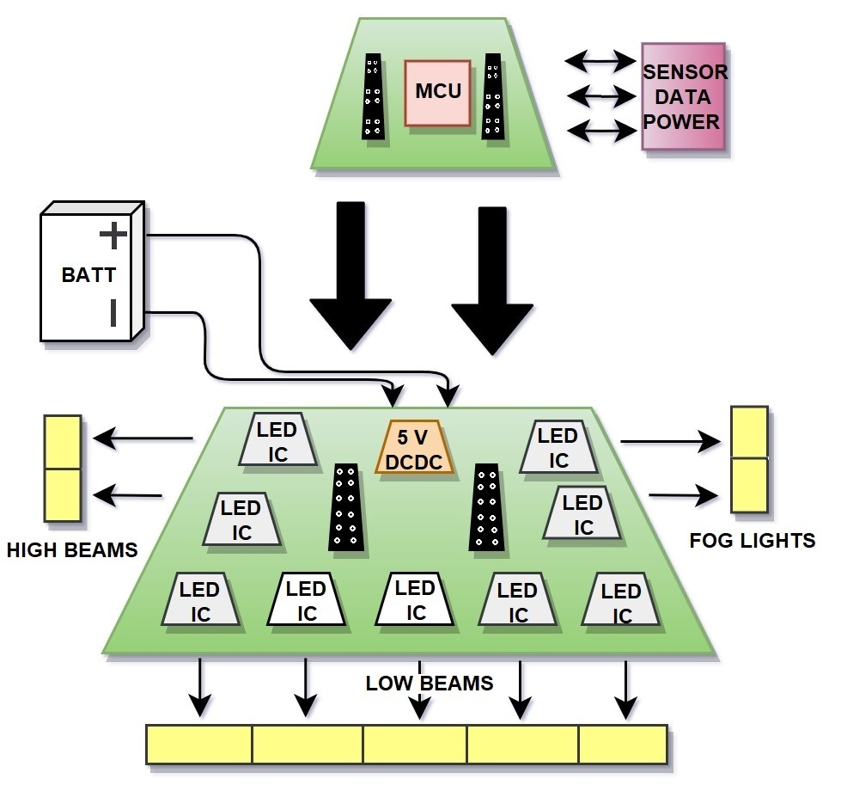
Final PCB Design
Modular design
PCB Details
1oz copper
2 layer
100x100 mm
Each LED driver outputs around 10 watts
90 watts in total
Notes:
If heat does become can go for 2 oz cooper
Future complete design
-modulate
-attached similar to the booster pack in the embedded systems class

Slide 26
Administrative Content

Slide 27
Work Distribution
 | Justin Kleier | Michael Zeiher | Justin Owle | Ivan Bernal Garcia
LEDs | X
Low Beams | X | X
High beams |  | X
Rain Sensor | X
Fog lights |  | X
LED Drivers |  |  |  | X
PCB |  |  |  | X
MCU |  |  | X
Camera |  |  | X
Image Processing |  |  | X

Slide 28
Financing
This project is funded entirely by the group. Our goal is to keep the cost of the project below $500.
Total spent this far $432.86
All components ordered and in final testing. Projected additional cost to be $70.
Overall cost is projected to be slightly over budget but as some components were personally loaned to the project from members, the amount truly spent is currently $392.91.

Slide 29
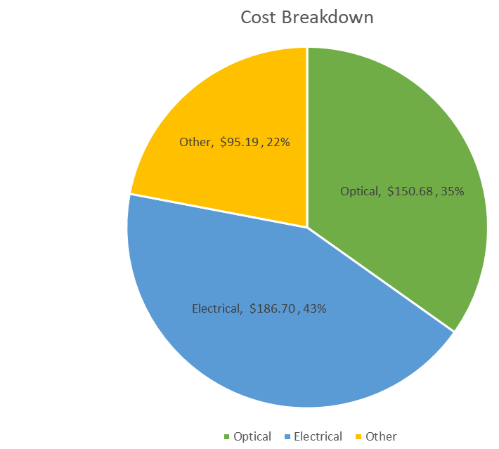
Budget

Slide 30
Questions

Slide 31
Progress

