Slide 1
CFS Chlorophyll Fluorescence Spectrometer
Group 1
David Maria, Computer Engineering
Luke Preston, Electrical Engineering
Robert Bernson, Photonic Science & Engineering
Samuel Knight, Photonic Science & Engineering

Slide 2
Motivation
Plants are vital to human culture, so they must be kept healthy
Hard to tell if a plant is sick, especially if it has green leaves
Check chlorophyll for photosynthetic performance
Traditional lab tests take too long, chemical-based
CFS is non-chemical, faster than lab test
Easy for non-technical user to understand results

Slide 3
Goals & Objectives
Deliver a low-cost alternative to commercial market products
Make a device which is easy to transport, use, and store (portable)
Simple, modest design that a casual user with a smartphone can use
Robust quality to sustain normal wear-and-tear
Solid-state components to prevent expensive repairs
Mobile application for casual user to observe results from an app
Analysis includes optical spectrum and classification, i.e., “Good health”, “Fair health”, “Poor health”, etc.

Slide 4
Specifications
Parameter | Metric | Reason
Manufacturing cost | ≤ 500 USD | Meets cost goal
Size/Volume | ≤ 4000 cm³ | Meets size goal
Power delivery | ≤ 5 W | Meets heat production
Wireless communication | Bluetooth 4.0 Bluetooth Low Energy mechanism | Facilitates communication to smartphone app
Radio power consumption | ≤ 50 mW | Low power consumption for power circuit
Sample analysis time | ≤ 60 seconds | Fast results
Spectrum analyzed | 600 – 700 nm | Chlorophyll's peak emission spectrum
Notes:
David: Analysis time, wireless comms Luke: Power consumption, battery life, power delivery Bobby: Cost, volume, spectrum

Slide 5
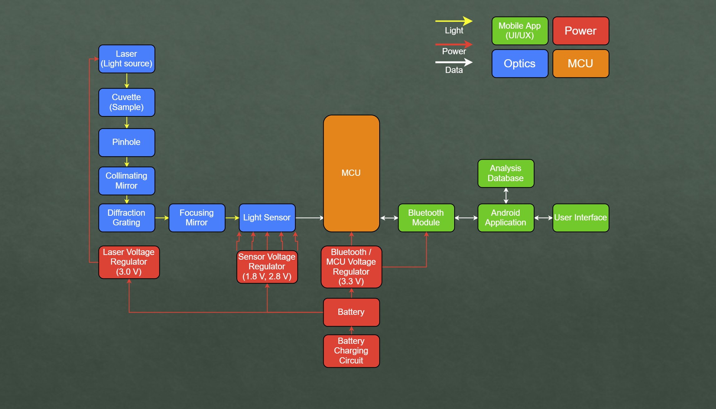
Block Diagram

Slide 6
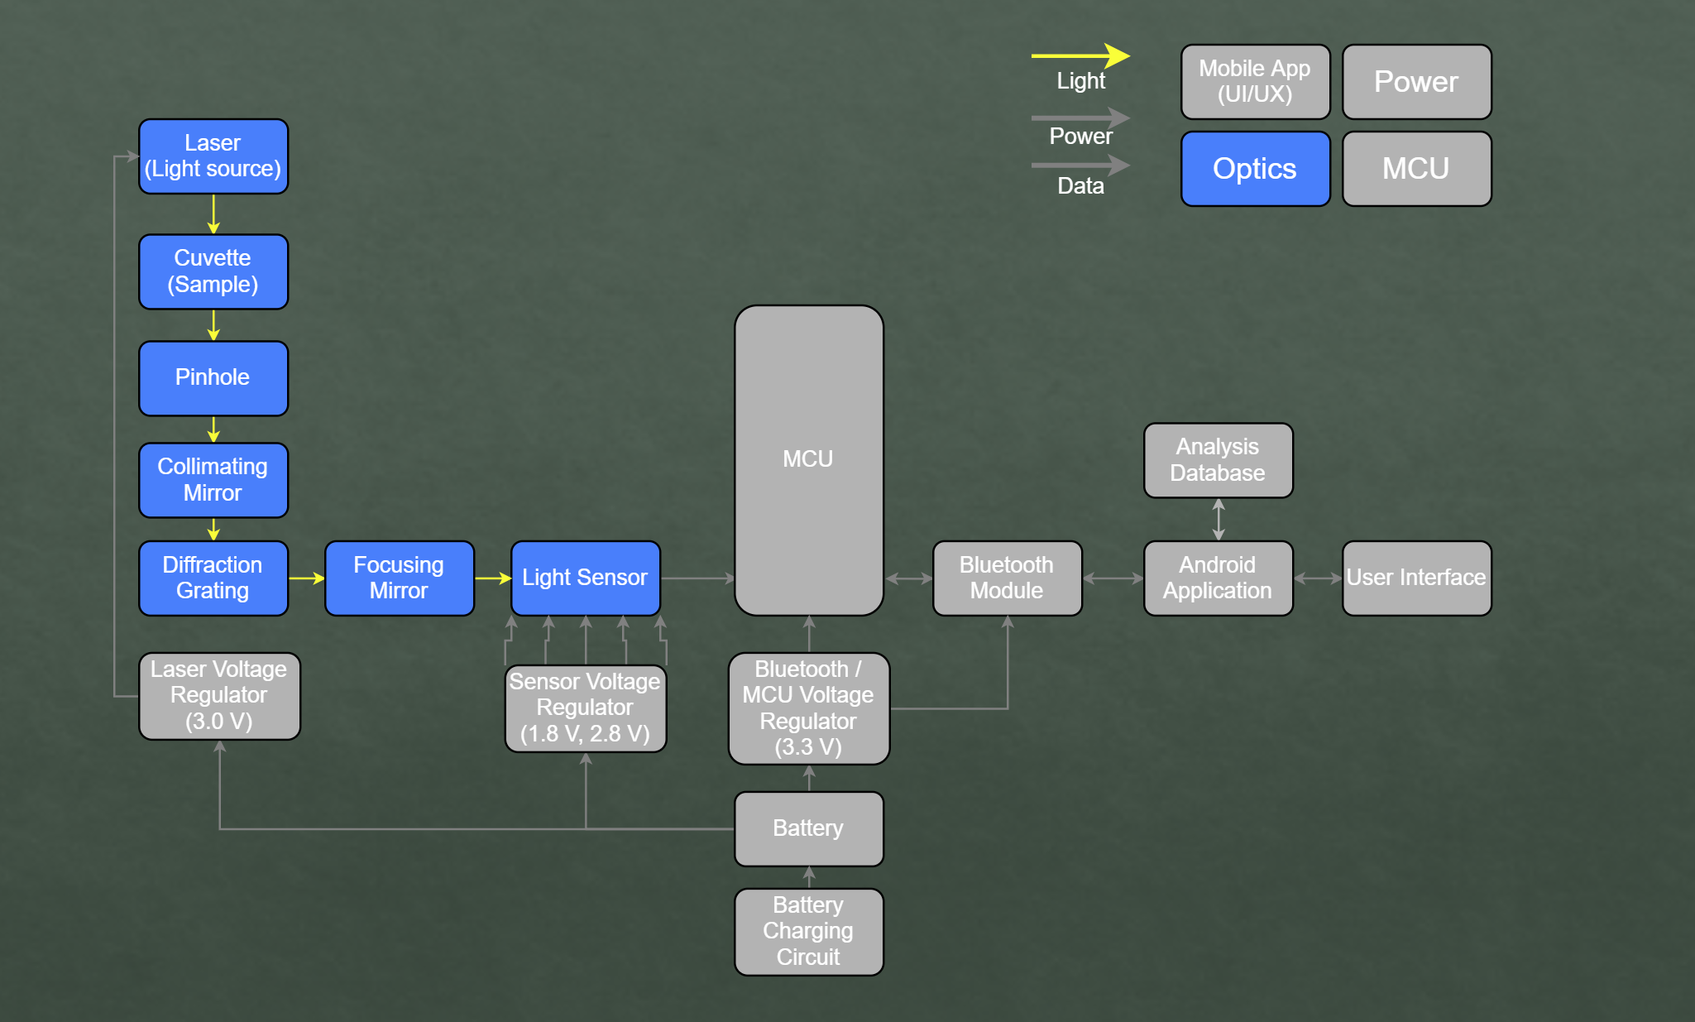
Optics

Slide 7
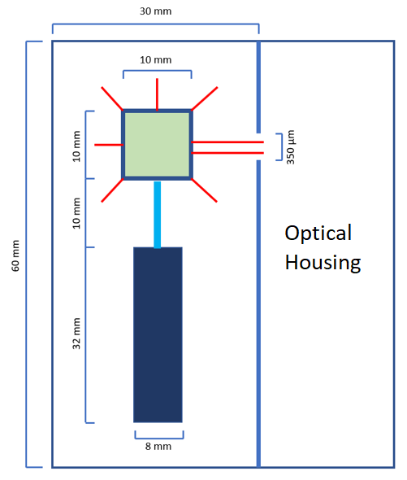
Laser Housing Section
Houses laser module and cuvette containing sample
Laser center λ = 405nm
Separated from spectroscopy section by optical slit
Two mounts
One for laser module
One for 10 mm quartz cuvette

Slide 8
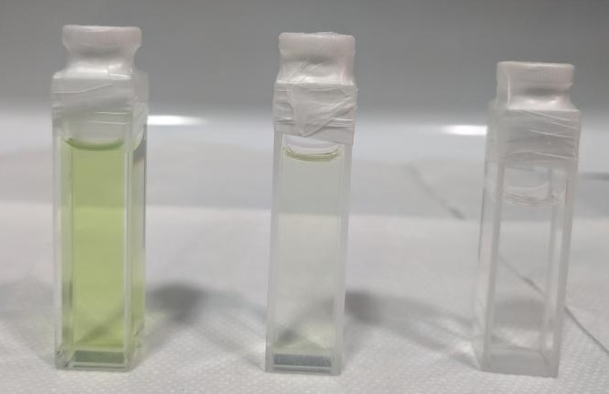
Chlorophyll Sample Preparation
Process:
Pick a leaf from a known species of plant
Break up the leaf into smaller pieces and weigh out a 1-gram sample
Add the sample to a mixture containing 150mL of acetone
Muddle the mixture together for 1 minute and pour through a coffee filter
The remaining solution is added to a cuvette to be tested by the CFS

Slide 9
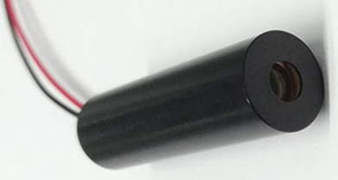
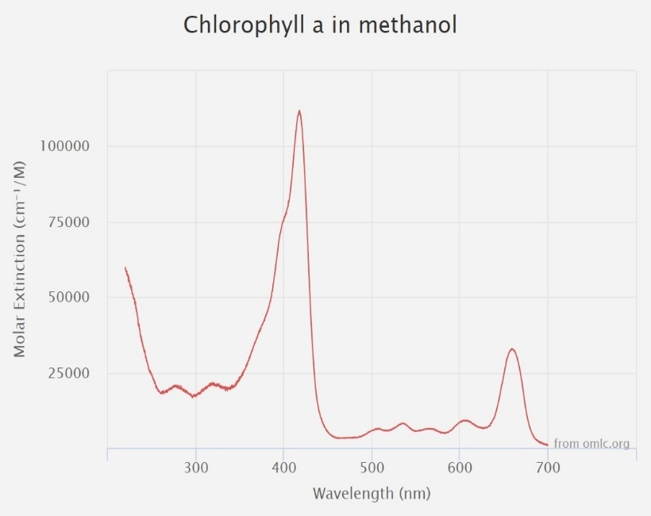
Laser Module
Purpose: Provide light source for fluorescence
Manufacturer | Zhuhai MZLASER Tech Co LTD
Part No. | MZH8340550D-AL01A
Cost | $9.00
Wavelength | 405 nm
Beam Size | 8 mm @ 10 m
Power | 50mW @ 3 V
Vendor | Alibaba
Manufacturer | Wavelength | Cost
Frankfurt Laser Co. | 415 nm | $5000.00
Power Technology Inc. | 420 nm | $6310.00
RPMC | 430 nm | $500.00
Zhuhai MZLASER | 405 nm | $9.00

Slide 10
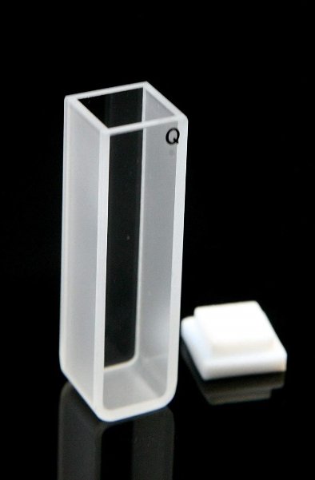
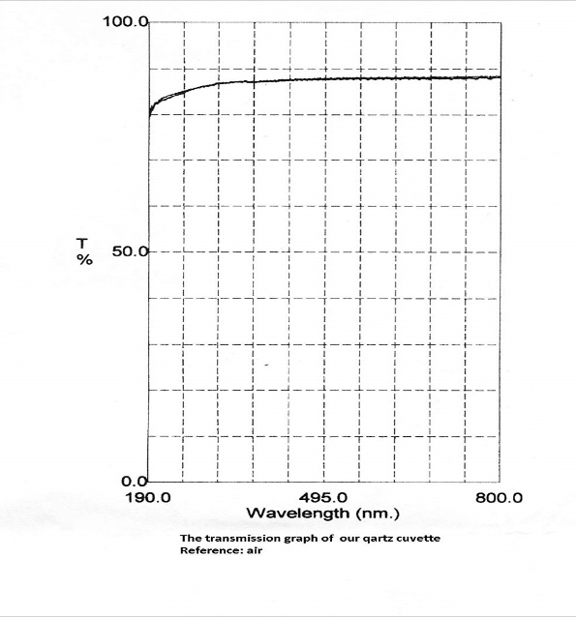
Quartz Cuvette
Purpose:
Contain Chlorophyll a Sample
Quartz has a high transmission across the necessary range of wavelengths
Allows 405 nm laser light to pass through and illuminate sample
Allows 600-700 nm fluorescent light to emit through container
Manufacturer | Science Outlet
Part No. | 100-40-10
Cost | $9.99
Volume | 3.5 mL
Dimensions | 12.5 x 12.5 x 45 mm
Thickness | 1.25 mm
Vendor | Amazon
Manufacturer | Volume | Dimensions | Cost
Lichen Cottage | 3.5 mL | 12.5 x 12.5 x 45 mm | $19.94
Alpha Nanotech | 3.5 mL | 12.5 x 12.5 x 45 mm | $21.00
Bitomic | 3.5 mL | 12.5 x 12.5 x 45 mm | $17.50
Science Outlet | 3.5 mL | 12.5 x 12.5 x 45 mm | $9.99
Notes:
Quartz has a relatively high transmission at 405nm

Slide 11
Optical Slit
Purpose:
Allow fluorescent light to pass onto collimating mirror while preventing directional 405 nm laser light from passing through
Ideal thickness: 350 µm
System uses 200 µm since 350 µm would have to be
machined by hand
Image of slit propagates through optical cavity

Slide 12
Original Spectroscopy Section
Intense angles between optics lead to unexpected astigmatism, clipping at grating interface
Image of slit at the sensor was spread out into a wide rectangle; no spectrum imageable

Slide 13
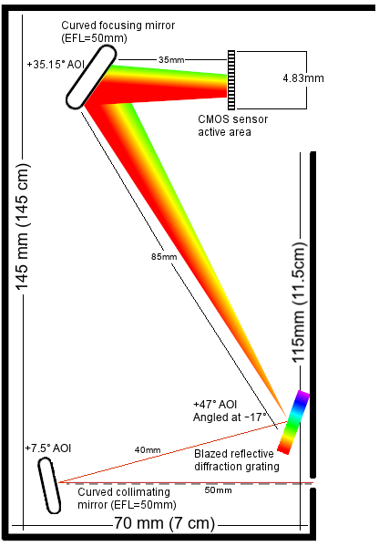
New Spectroscopy Section
Grating moved position; angle of incidence changed
Collimating mirror angle decreased
Focusing mirror unchanged
Sensor moved to astigmatized focal point
Light now focuses properly
No clipping
No visible astigmatism

Slide 14
Collimating & Focusing Mirrors
Purpose:
Collimate light from the pinhole and direct it to the diffraction grating
Focus light from the diffraction grating onto the sensor
Silver-coated, offering >97.5% reflectance from 450 to 2000 nm
For applications near 780 nm, silver exceeds aluminum in quality
F# = 1.98, which captures a lot of light but doesn’t provide much depth of field; difficult to focus
Manufacturer | ThorLabs
Part No. | CM254-050-P01
Cost | $60.34
Scratch-Dig | 40-20
Diameter | 25.4 mm
Focal Length | 50 mm
Vendor | ThorLabs
Manufacturer | EFL | Diameter | Cost
Edmund Optics | 50 mm | 25.4 mm | $165.00
Newport | 50 mm | 25.4 mm | $141.00
ThorLabs | 50 mm | 25.4 mm | $60.34

Slide 15
Diffraction Grating
Purpose:
Split the light coming from the collimating mirror into its component wavelengths
Grating has an efficiency of 62 – 73% in the CFS’s waveband (600 to 700 nm)
Cheaper than 25 x 25mm grating
Manufacturer | MKS | Newport
Part No. | 33066FL01-270R
Cost | $89.00
Grooves/mm | 300
Spectral range | 300 – 1000 nm
Wavelength of maximum efficiency | 500 nm
Size | 12.5 x 25 mm
Vendor | MKS | Newport
Manufacturer | Grv/mm | Size | Cost
ThorLabs | 300 | 25 x 25 mm | $117
Newport | 300 | 25 x 25 mm | $109
Newport | 300 | 12.5 x 25 mm | $89

Slide 16
CMOS Sensor Array
Purpose:
Observe the light coming from the focusing mirror and transmit pixel intensity profile data to the CPU for processing
History of successes at UCF using CMOS over linear
Operates in analog, digital, or I/O mode
Built-in ADC
68 – 78% QE in the CFS’s waveband (600 – 700 nm)
Monochromatic pixels; only one QE/sensitivity curve
3.66mm
Manufacturer | ON Semiconductor
Part No. | AR0130CSSC00SPBA0-DR
Cost | $8.38 / unit
Active area | 4.86 x 3.66 mm
Supply Voltage | 1.8 V & 2.8 V
Operating Wavelength | 300 – 950 nm
ADC Depth | 12 bits
Vendor | DigiKey
Manufacturer | Sensor Type | Supply Voltage | ADC Depth | Cost
Melexis | Linear | 3 – 3.3 V | 8 bits | $13.65
Renesas | CMOS | 2.25 – 3.63 V | 8 or 12 bits | $20.00
AMS | Linear | 3 – 5 V | 8 bits | $9.80
ON Semi | CMOS | 1.8 V & 2.8 V | 12 bits | $8.38

Slide 17
MCU

Slide 18
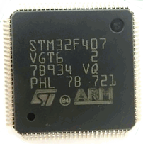
STM32 ARM CPU
Control laser module operation
Control sensor operation
Control data flow
Low Cost: $8.82
Affordable development board: $8.79
Low Power Consumption: 58.5 mW at 1.95 V
Modern and capable CPU
Supports UART, I2C, SPI
Sufficient GPIO connectivity
CPU | Chip Cost | Dev Board Cost | GPIO
MSP 430FR2672 | $3.85 | $15 | Not Enough
STM32F407VET | $4.41 | $9 | Enough
FS32K144 | $5.00 | $65 | Enough

Slide 19
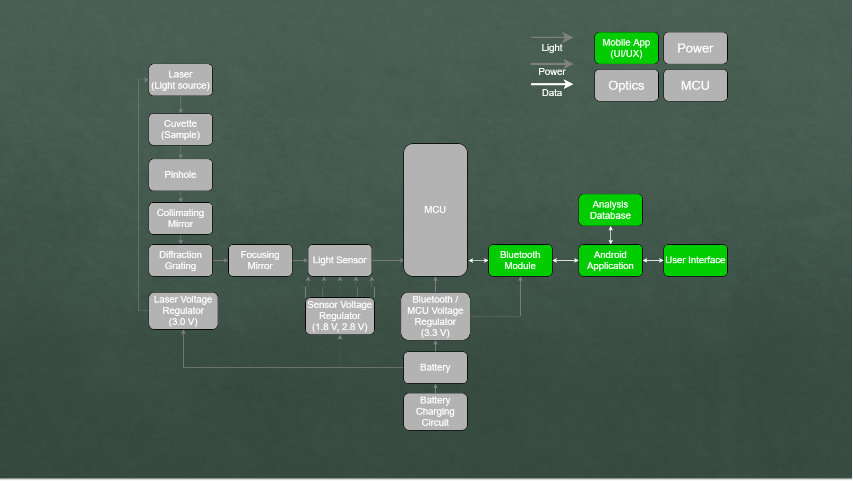
Mobile Application

Slide 20
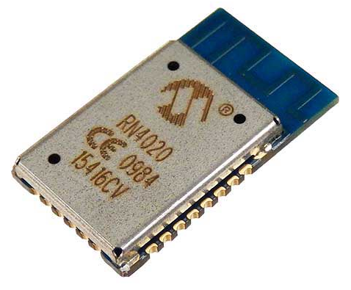
Bluetooth Module
Provide communication between CFS and smartphone
Bluetooth preferable to an on-board display
Low Power Consumption: Peak power draw of 31.2 mW
Low Voltage: 1.95 Volt supply needed
Low cost: $15.40
Supports Bluetooth Low Energy
Module | Manufacturer | Size | Cost | Power Consumption | Bluetooth Version | Vendor Used
HC-05 | ITead Studio | 12.7 x 27 mm | <$10 | Medium | V2.0 | N/A
RN4020 | Microchip | 11.5 x 19.5 x 2.5 mm | $15 | Very Low | V4.1, BLE | Amazon
ESP32 | Espressif Systems​ | 25.5 × 18 × 3.1 mm | <$20 | Low | V4.2, BLE+EDR | N/A

Slide 21
Software
Design Choice | Final Selection
Supported Mobile Operating System(s) | Android
Earliest Supported Android API | API level 21
Mobile Application Local Database Technology | SQlite3
Mobile Application Programming Language | Java
Embedded Software Language | C
Embedded Software IDE | System Workbench for STM32

Slide 22
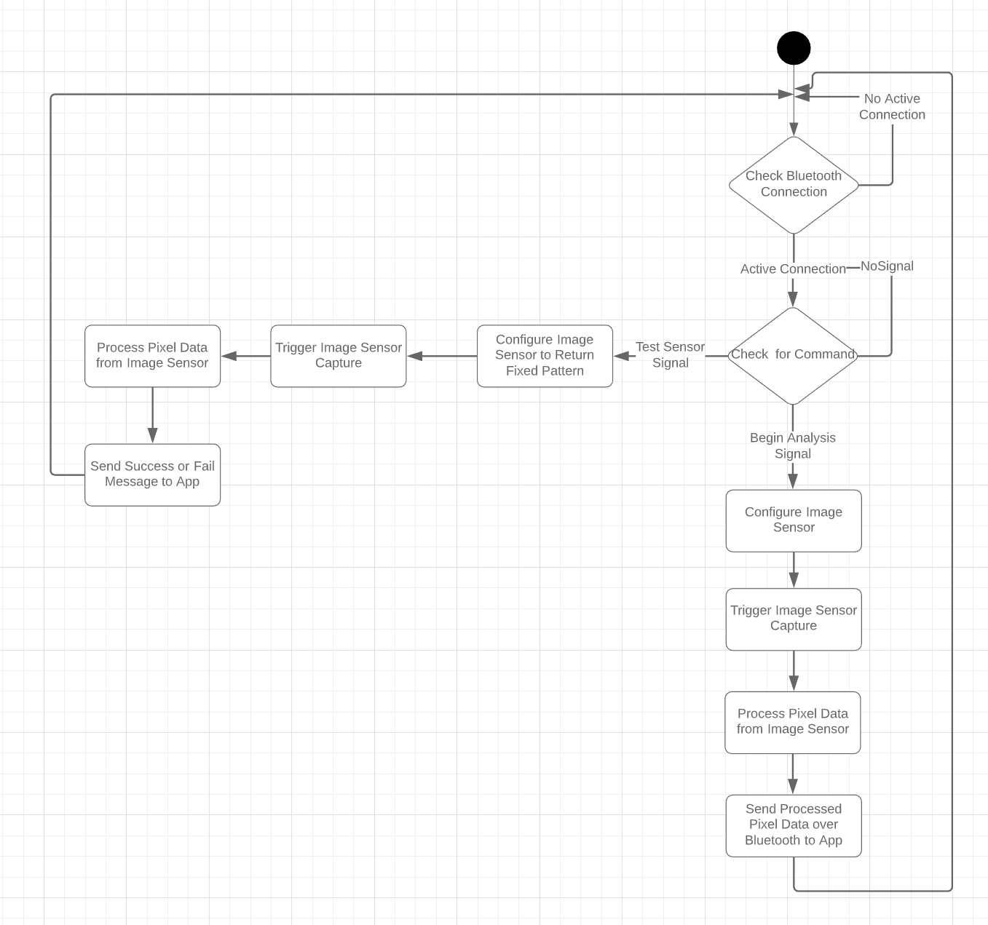
Embedded Software Logic

Slide 23
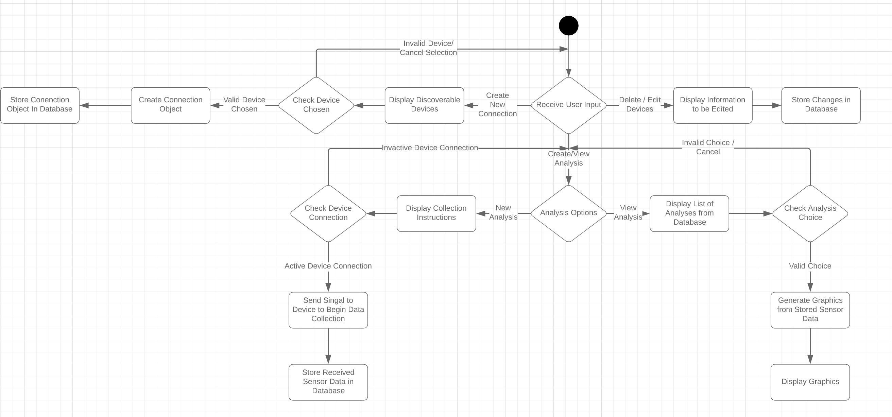
Application Logic

Slide 24
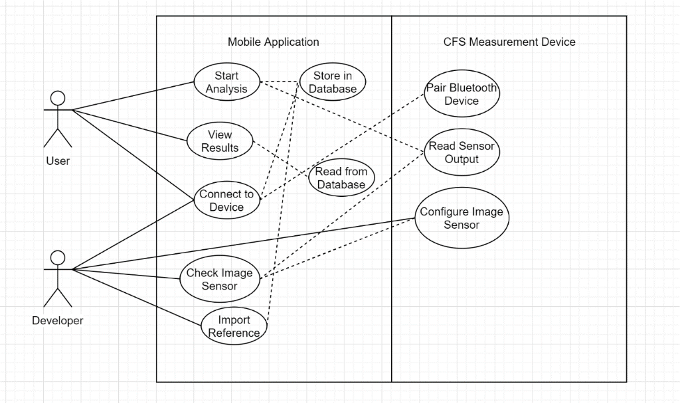
Application Use Case Diagram

Slide 25
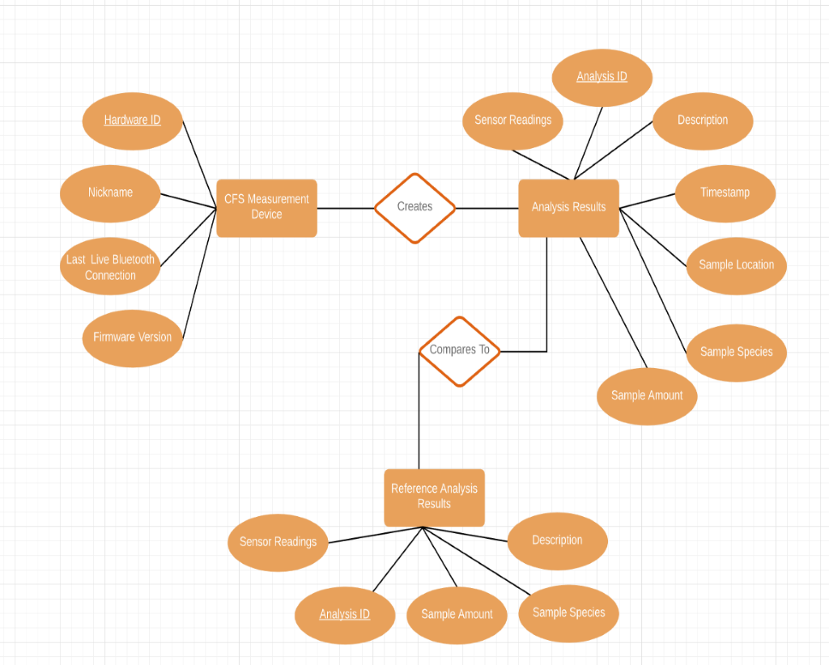
Entity Relationship Diagram

Slide 26
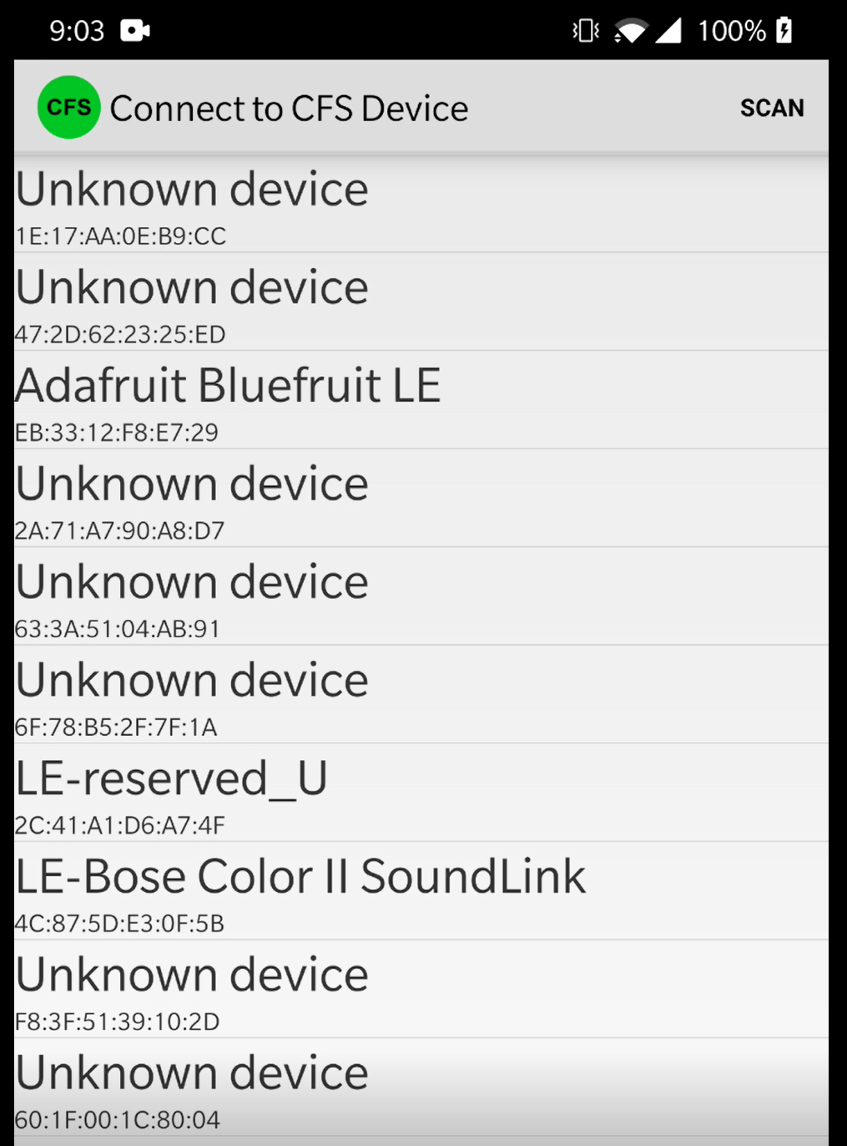
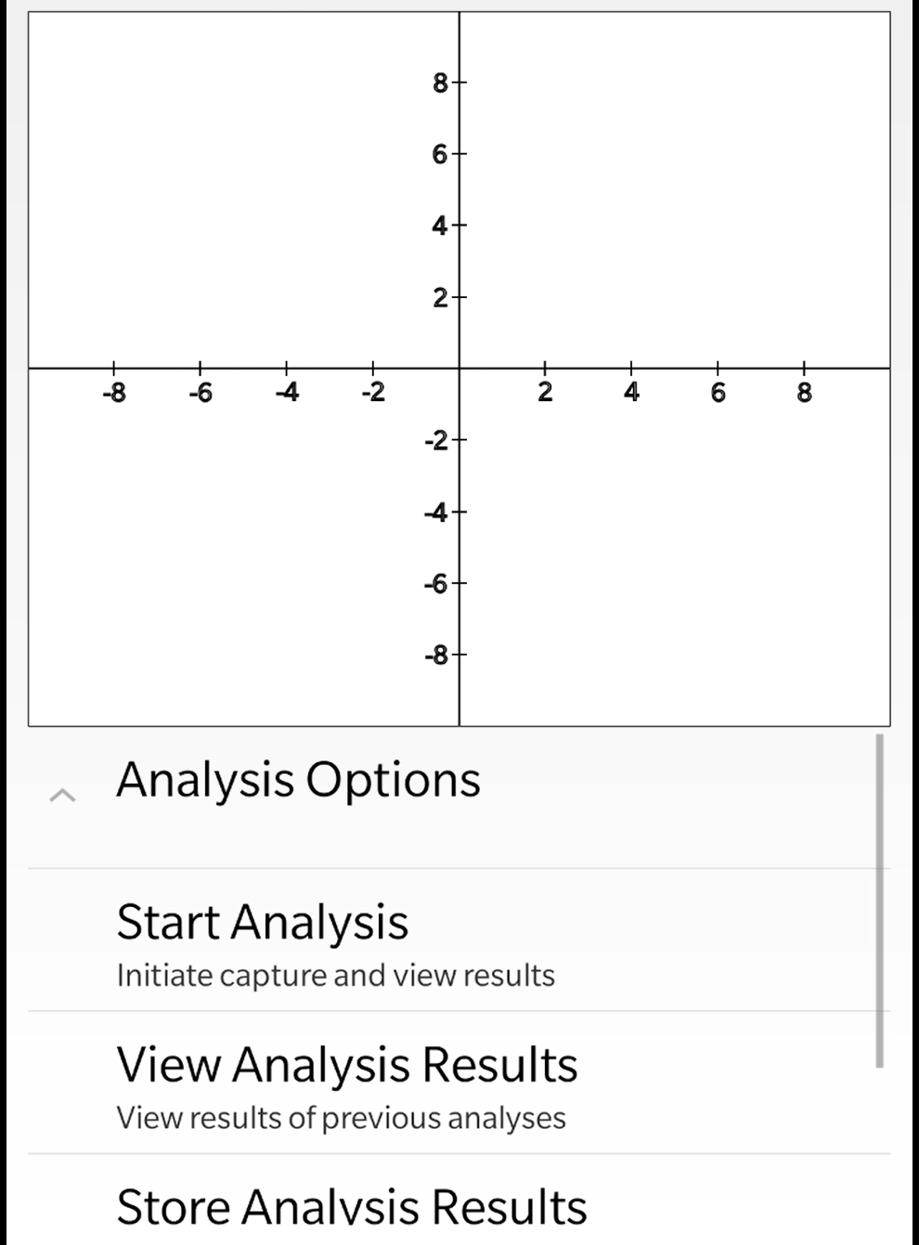
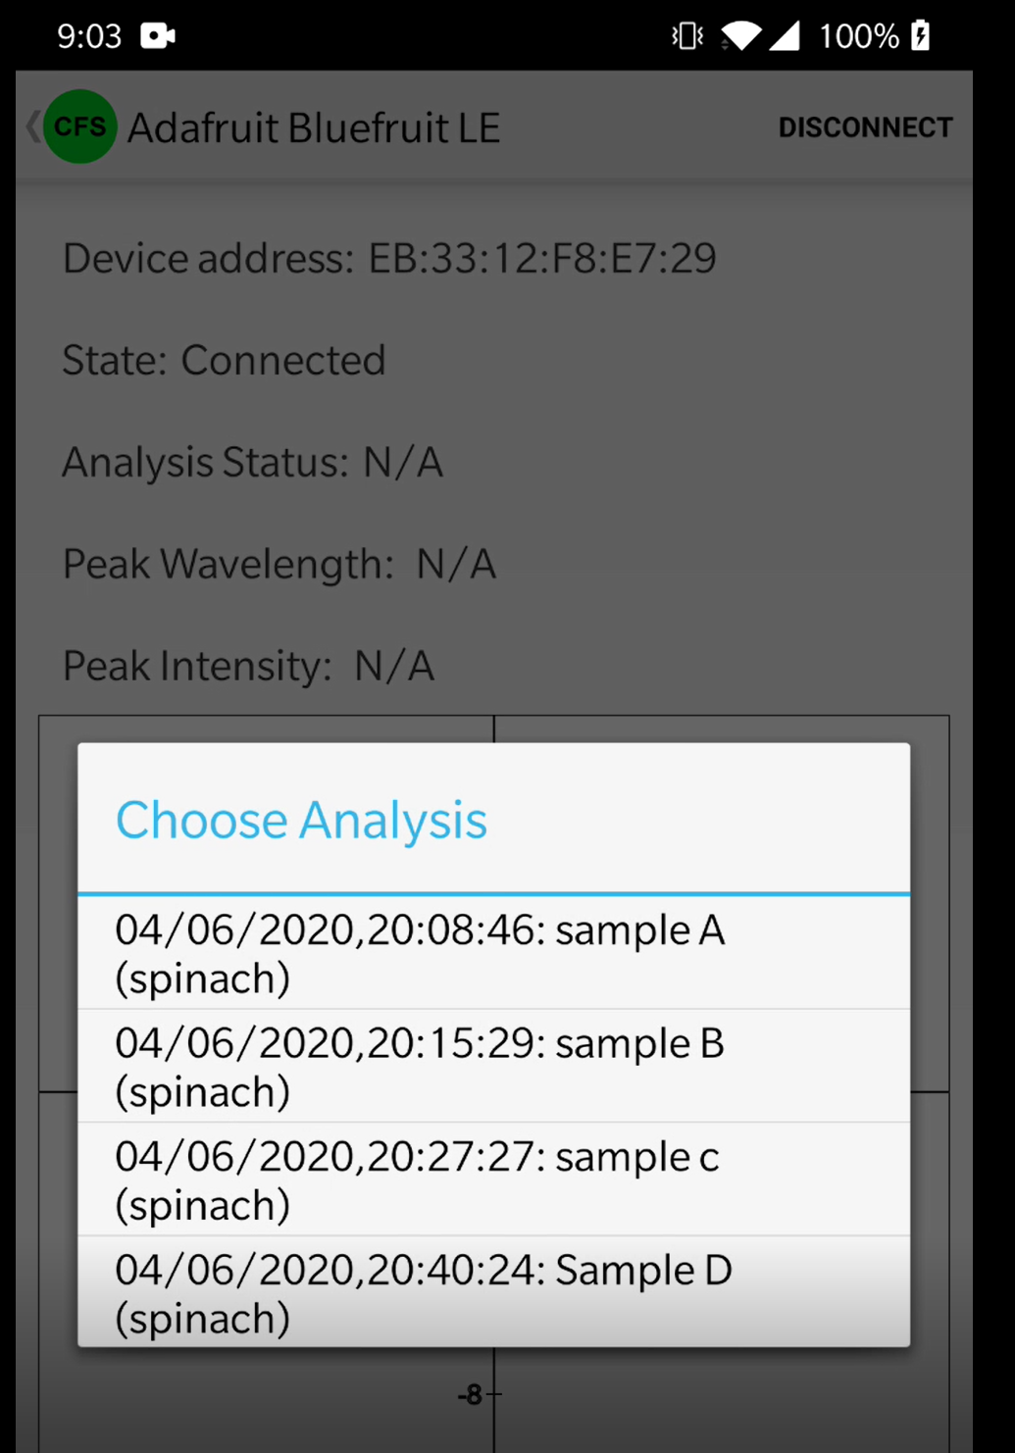
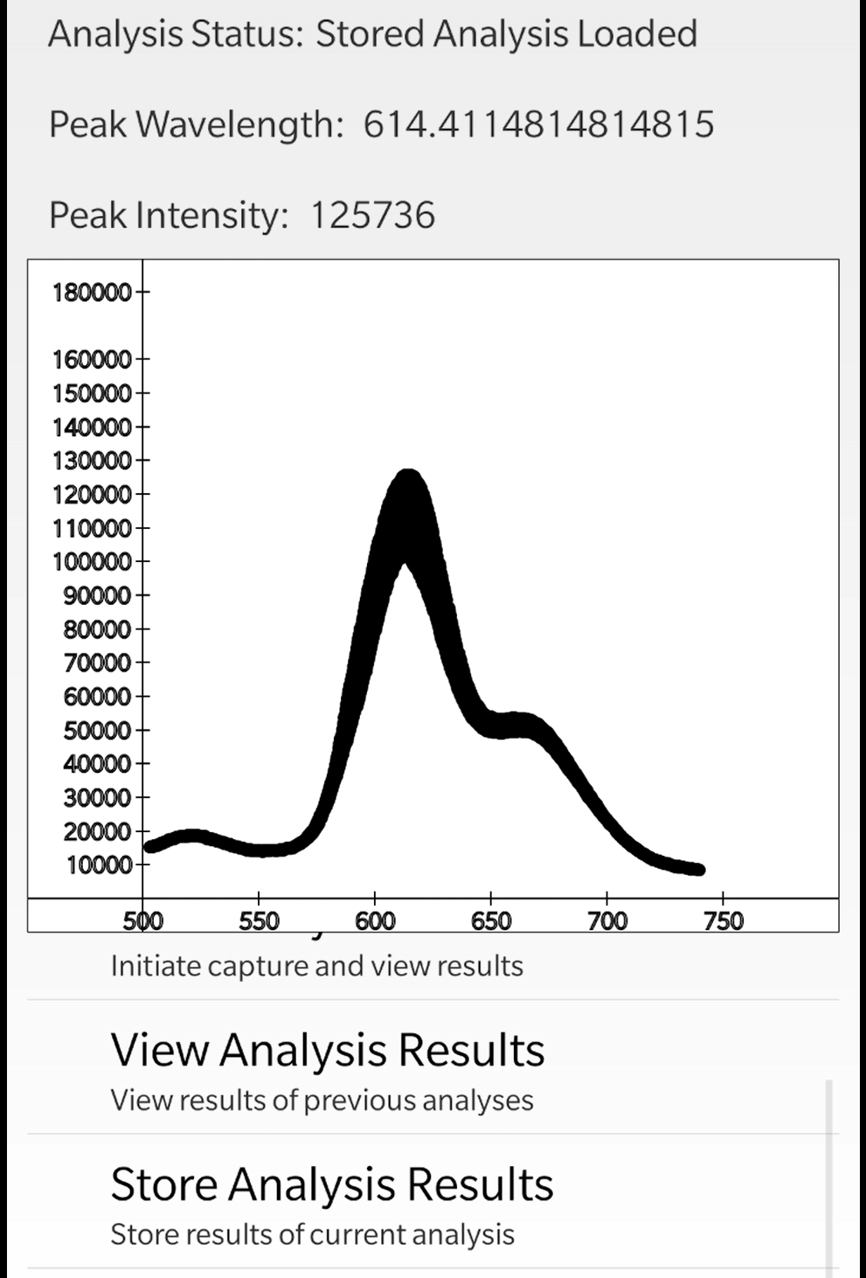
Mobile phone GUI
Searching for devices
Analysis Options
Choosing Stored Analyses
Viewing Analysis Results

Slide 27
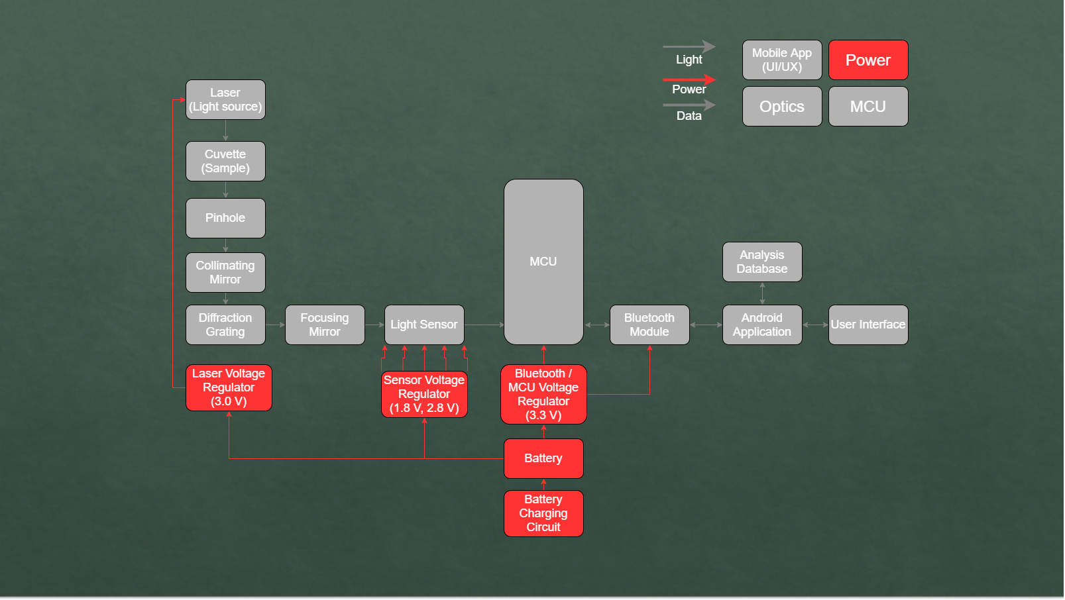
Power System

Slide 28
Power Supply Circuit
Battery & charging circuit
3.3 V for CPU & BT
3.0 V for laser module
1.8 V for CMOS sensor digital power
2.8 V for CMOS sensor analog power

Slide 29
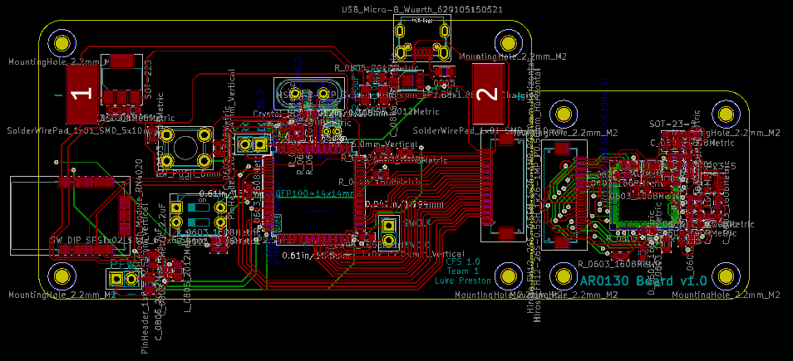
Printed Circuit Board Design
Schematic separated into 2 PCBs
Sensor mounted in place
Connected by ribbon cable
USB charging
Debugging pinouts added

Slide 30
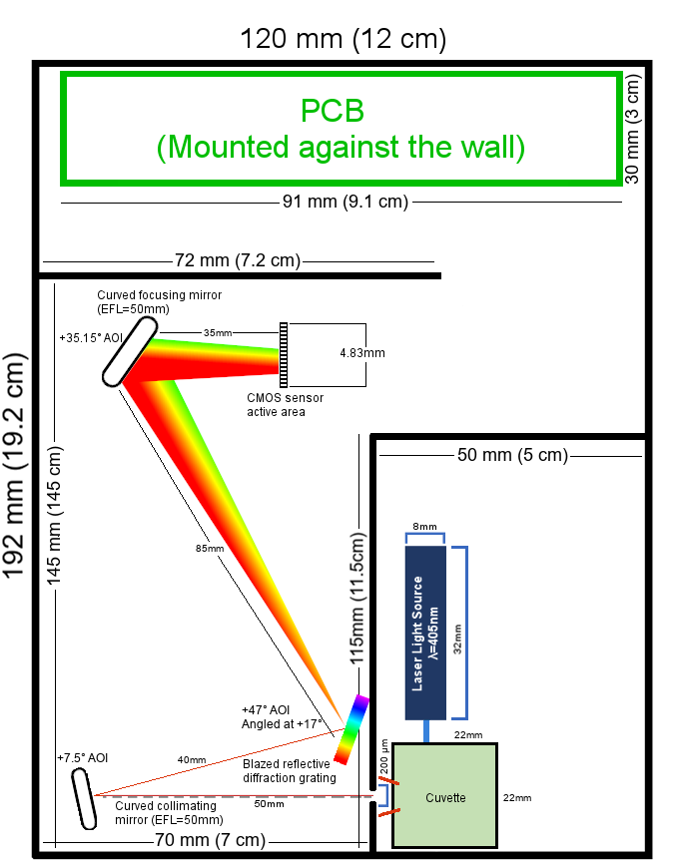
Housing Design
Cost to build: $0.00
Critical that the spectroscopy section and pump section be isolated from stray light
Housing never completed and fully enclosed due to COVID-19 shutdown
Device can only be operated in a completely dark room

Slide 31
Component & Integration Testing

Slide 32
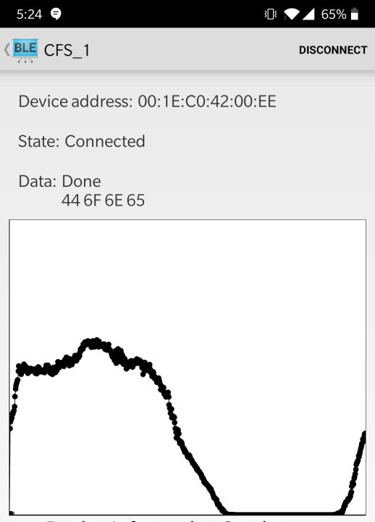
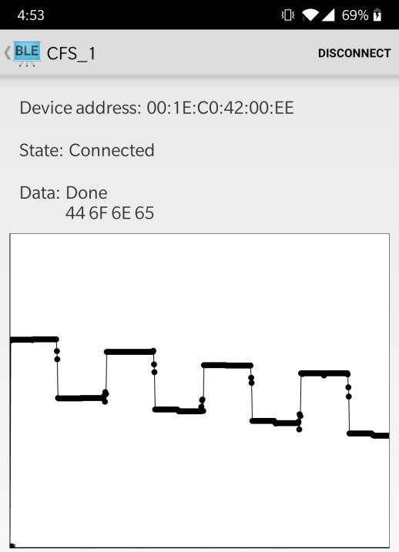
Software Development Prototype
Bluetooth Sensor
MCU
Image Sensor
STM32F407 Blackboard Development Board
RN4020 Bluetooth Low Energy Module
UART
OV7670 Image Sensor
Digital Camera Memory Interface
Android Application
Developed and Debugged using Android Studio

Slide 33
Prototype Used for Testing
(From left to right, top to bottom)
Laser test source
Power supply
Laser pump source
Chlorophyll sample
Collimating mirror
Reflective diffraction grating
USB enabled sensor
Focusing mirror

Slide 34
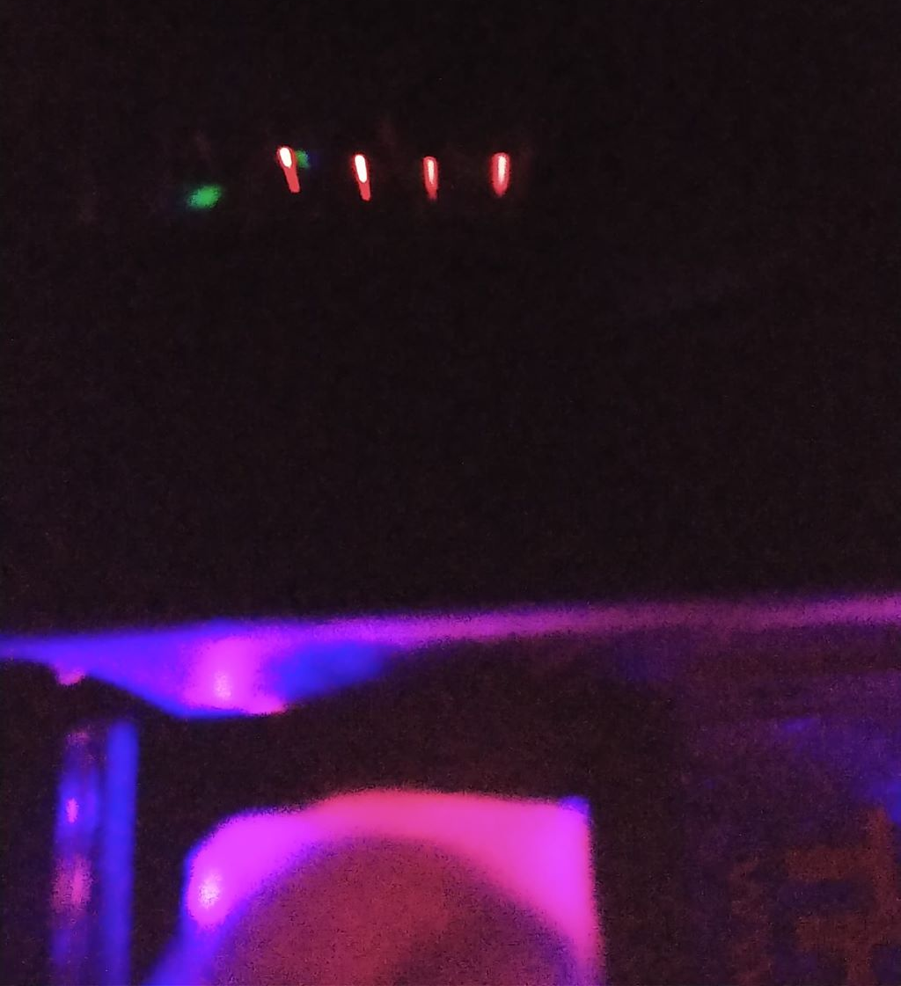
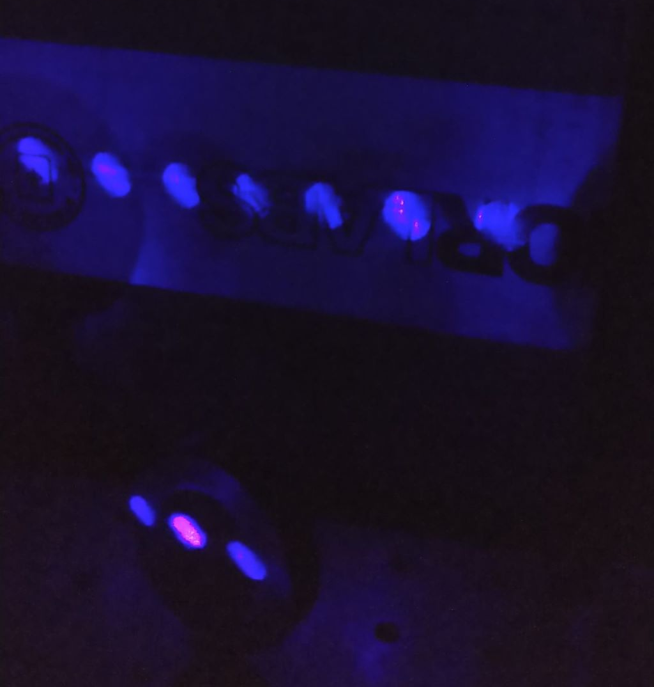
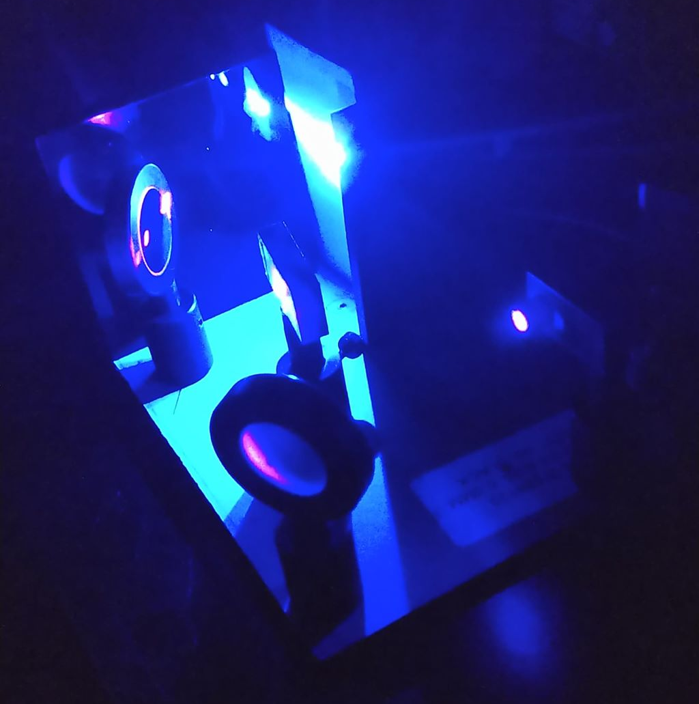
Optics Testing
Grating held in front of entrance slit to show modal diffraction
Grating diffracting laser light in multiple modes with mirror pictured (bottom)
Laser (right side) propagating through optical system to screen (top center)

Slide 35
Initial Integration Testing
Connected AR0130CS sensor to laptop via USB cable
Used built-in Camera program in Windows to view spectrum
Could see fluorescence spectrum from chlorophyll, green light scattering from laser due to sensor not completely isolated

Slide 36
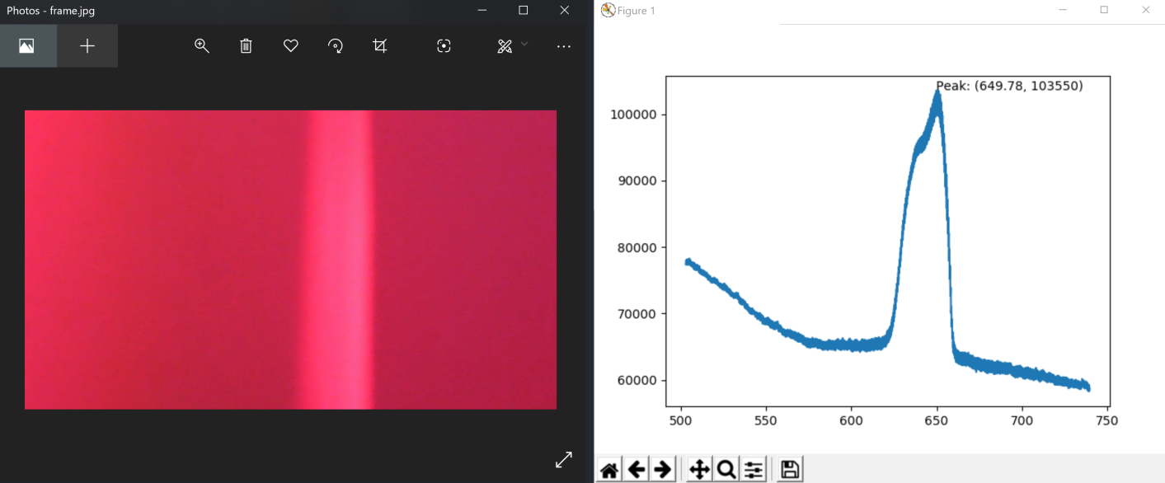
Fluorescence Calibration
Calibrated using labeled green and red laser sources from a laser light show module
Once peaks were located by pixel, x-axis was shifted and relabeled so peaks were at correct wavelengths, not pixels
Resolution is 5.4 px/nm or 0.185 nm/px

Slide 37
Fluorescence Testing
Newest sample on top shows peak wavelength 667 nm
Scattering from laser
Old sample on bottom shows peak wavelength at 665 nm
Chlorophyll fluorescence spectrum peaks range from 662 to 669 nm depending on sample age
Samples are within this range as expected

Slide 38
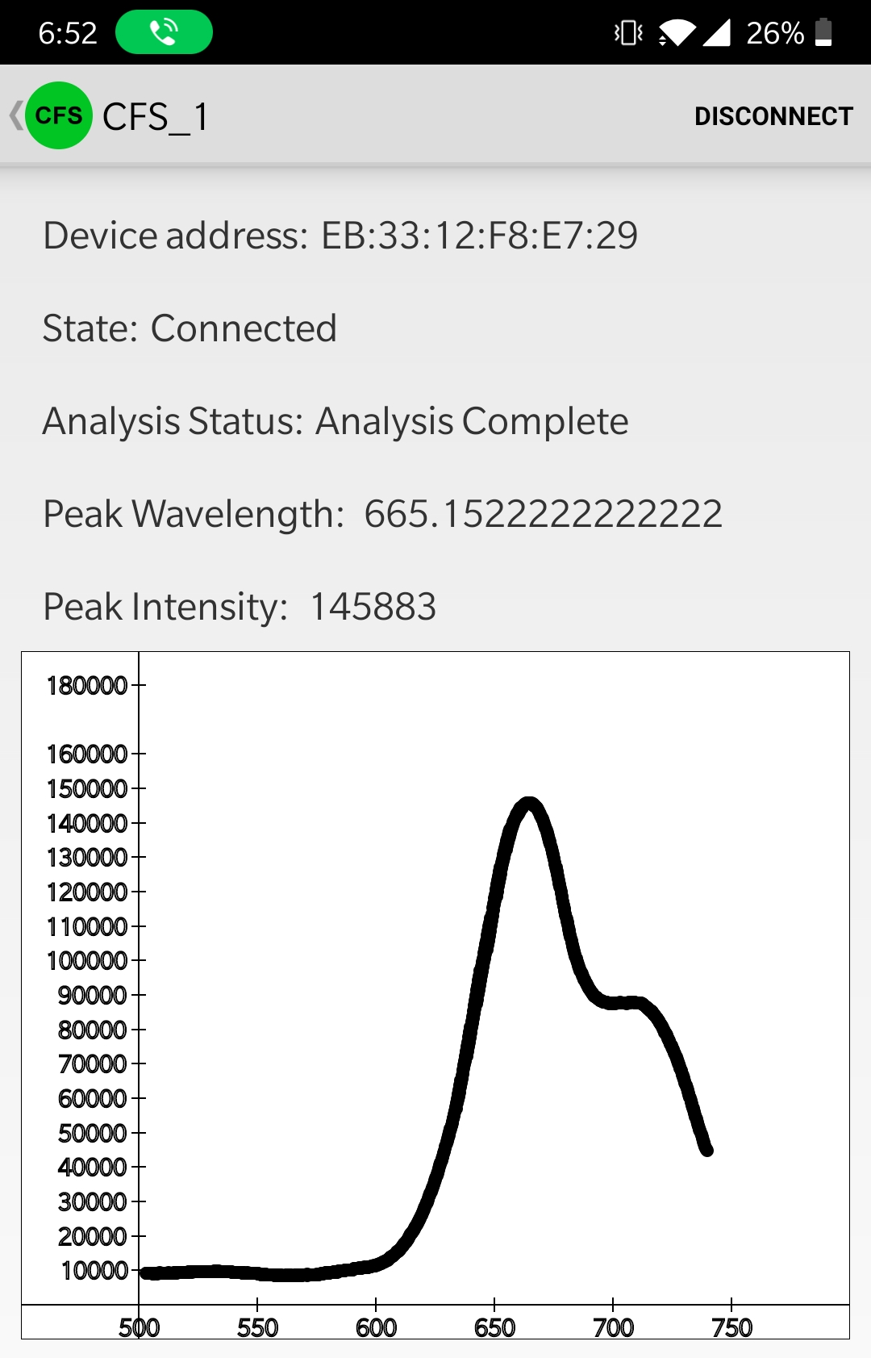
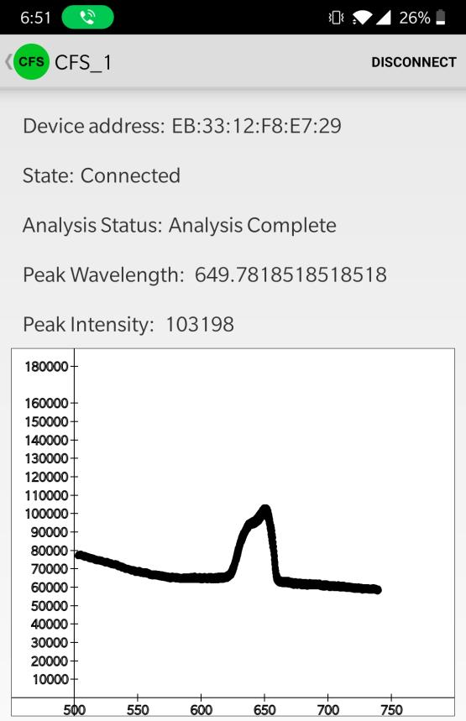
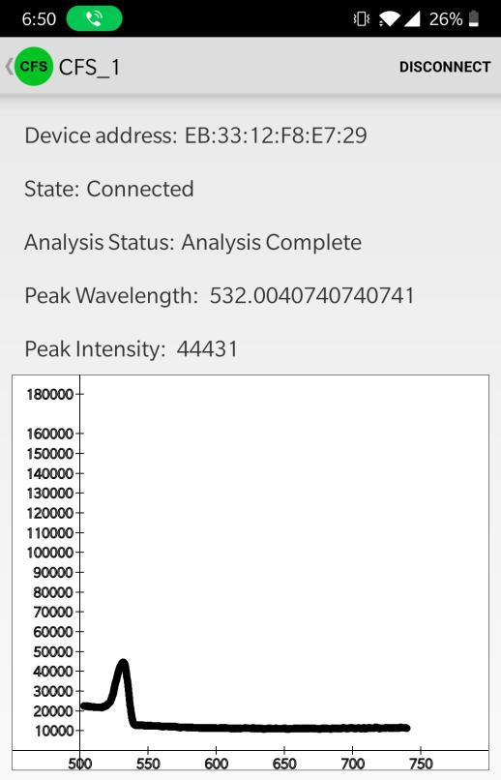
Final Integration Testing
Connected calibrated Optics system to Mobile Application
Bluetooth Low Energy Connection
Chlorophyll Sample
Red Laser
Green Laser

Slide 39
Current Health Metric
The CFS measures and displays the fluorescence spectrum of Chlorophyll a
Allows us to determine the peak emission wavelength
Our device then compares the measured spectrum to an already known healthy spectrum of the same plant species (reference sample)
If the sample has a peak intensity less than 60% of our reference sample our device has determined it to be unhealthy
Spectrum of an unhealthy sample (black) in comparison to a reference sample (green) both recorded with our device
Notes:
Our device determines relative plant health
A measured sample must be compared to a reference sample of the same species which has already been determined to be healthy
Our device determines a measured sample to be unhealthy if its peak intensity is less than 60 % of the peak intensity of the reference sample

Slide 40
Possible Future Health Metrics
Since we can determine our peak emission wavelength and our peak fluorescence intensity F_{M}, if we were to add more sources to our device it would be possible to determine other chlorophyll fluorescence parameters
By using a saturating white light it is possible to determine the fluorescence decrease ratio R_{Fd}=(F_{M}/F_{S}) – 1
F_{S} is the steady state fluorescence
If the R_{Fd} > 2.5, sample is getting enough sunlight
By using a pulsed red LED in conjunction with a saturating white light, it is possible to determine the maximum quantum yield F_{V}/F_{M}
F_{V} is the variable fluorescence
0.74 < F_{V}/F_{M} < 0.85, sample is normal (i.e. healthy)
Notes:
By knowing our peak emission wavelength, it is possible to find other common chlorophyll fluorescence parameters
However, these parameters would require other light sources not included in our device
Unfortunately, timing and COVID-19 concerns prevented us from adding these sources to our device
Using a white light source we could determine the steady state fluorescence which would allow us to determine the fluorescence decrease ratio
An Rfd value greater than 2.5 tells us the measured sample is getting enough sunlight
Using a pulsed red LED we could determine the variable fluorescence which would allow us to determine the maximum quantum yield
If the measured sample has a Fv/Fm between the values of 0.74 and 0.85 then it is determined to be healthy

Slide 41
Final Product Specifications
Parameter | Goal Metric | Final Metric | Meet Spec?
Manufacturing cost | ≤ 500 USD | 400 USD | Yes
Size/Volume | ≤ 4000 cm³ | 1958.4 cm³ (19.2 x 12 x 8.5 cm) | Yes
Power delivery | ≤ 5 W | 3.61 W | Yes
Wireless communication | Bluetooth 4.0 Bluetooth Low Energy mechanism | Bluetooth 4.0 Bluetooth Low Energy mechanism | Yes
Radio power consumption | ≤ 50 mW | 39.6 mW | Yes
Sample analysis time | ≤ 60 seconds | 40 seconds | Yes
Spectrum analyzed | 600 – 700 nm | 500 – 740 nm | Yes

Slide 42
Administrative Content

Slide 43
Work Distribution
Task | Primary | Secondary | Workload | Major
Pump source section design | Robert | Samuel | Medium | PSE
Chlorophyll sample holder design | Robert | Samuel | Medium | PSE
Spectroscopy section design | Samuel | Robert, Luke | High | PSE
Sensor testing | David, Luke | Robert, Samuel | High | CE, EE, PSE
Integration testing | Samuel, David | Robert | High | PSE, CE
CFS housing design | Samuel | Robert | Medium | PSE
PCB testing and design | Luke | David | High | EE, CE
Power circuit design | Luke | David | Low | EE
Embedded software design | David | Luke | High | CE
Mobile application design | David | Luke | Medium | CE

Slide 44
Budget & Financials
Component | Supplier | Device Section | Quantity | Total Cost
Laser source | Zhuhai MZLAZER Tech Co LTD. | Laser housing | 2 | $40.38
Cuvette | Scientific Lab Solution | Laser housing | 2 | $20.00
Mirrors | ThorLabs | Optical housing | 2 | $120.68
Diffraction grating | Newport Corporation | Optical housing | 1 | $89.00
CMOS Sensor | ON Semiconductor | Optical housing | 4 | $34.68
PCB | Oshpark LLC | PCB | 3 | $46.00
CPU | STMicroelectronics | PCB | 2 | $8.82
Development board | STMicroelectronics | Dev board | 1 | $8.79
Bluetooth module | Microchip | PCB | 1 | $29.85
Final Cost |  |  |  | $398.20

Slide 45
Progress
Laser and cuvette not mounted
Diffraction grating not mounted properly
Sensor not mounted properly
Final machining not completed
Device not isolated from light, can only operate in a completely dark room
PCB hardware redesign not received

Slide 46
Q&A

