Slide 1
CFS Chlorophyll Fluorescence Spectrometer
Group 1
David Maria, Computer Engineering
Luke Preston, Electrical Engineering
Robert Bernson, Photonic Science & Engineering
Samuel Knight, Photonic Science & Engineering

Slide 2
Motivation
Plants are vital to human culture, so they must be kept healthy
Hard to tell if a plant is sick, especially if it has green leaves
Check chlorophyll for photosynthetic performance
Traditional lab tests take too long, chemical-based
CFS is non-chemical, faster than lab test
Easy for non-technical user to understand results

Slide 3
Goals & Objectives
Deliver a low-cost alternative to commercial market products
Make a device which is easy to transport, use, and store (portable)
Simple, modest design that a casual user with a smartphone can use
Robust quality to sustain normal wear-and-tear
Solid-state components to prevent expensive repairs
Mobile application for casual user to observe results from an app
Analysis includes optical spectrum and classification, i.e., “Good health”, “Fair health”, “Poor health”, etc.

Slide 4
Specifications
Parameter | Metric | Reason
Manufacturing cost | ≤ 500 USD | Meets Cost goal
Size/Volume | ≤ 0.15 m³ | Meets Size goal
Power delivery | ≤ 115 W | Meets heat production
Battery life | 6 hours | Convenience
Wireless communication | Bluetooth 4.0 Bluetooth Low Energy mechanism | Facilitates communication to smartphone app
Radio power consumption | 100 – 500 μW | Low power consumption for power circuit
Sample analysis time | ≤ 2 seconds | Fast results
Spectrum analyzed | 600 – 700 nm | Chlorophyll's peak emission spectrum
Power delivery is an old spec from previous tungsten bulb design
SWaP initially overestimated
Needs to be reevaluated to match current design
Notes:
David: Analysis time, wireless comms Luke: Power consumption, battery life, power delivery Bobby: Cost, volume, spectrum

Slide 5
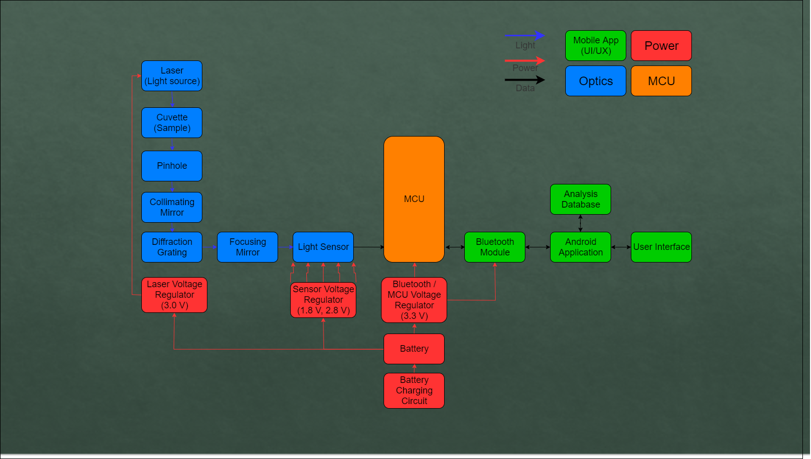
Block Diagram

Slide 6
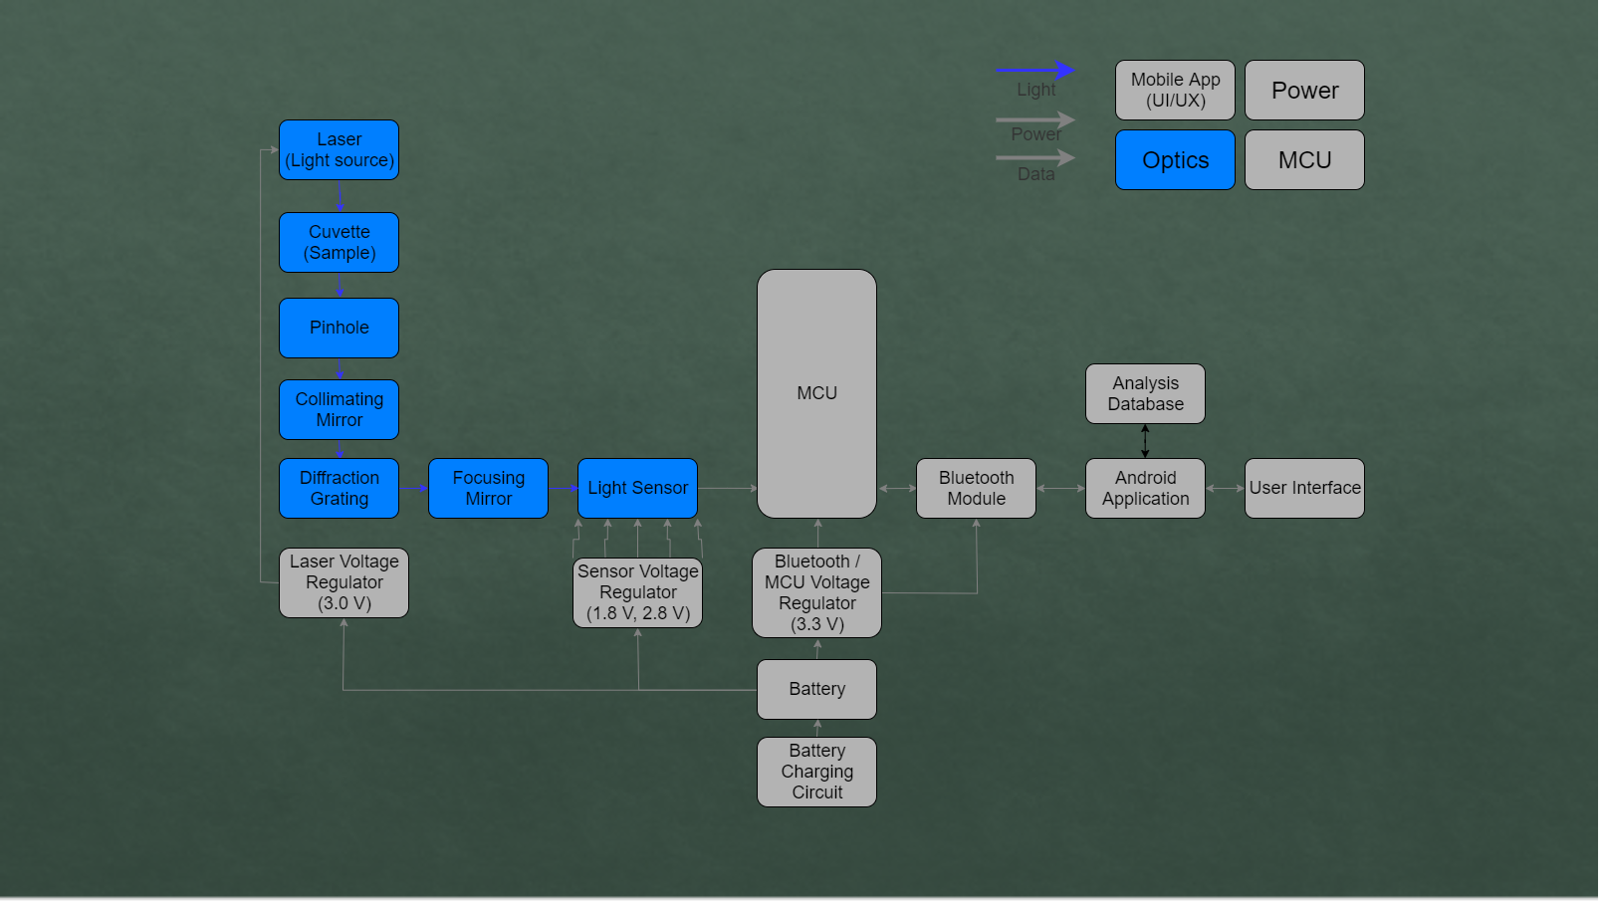
Optics

Slide 7
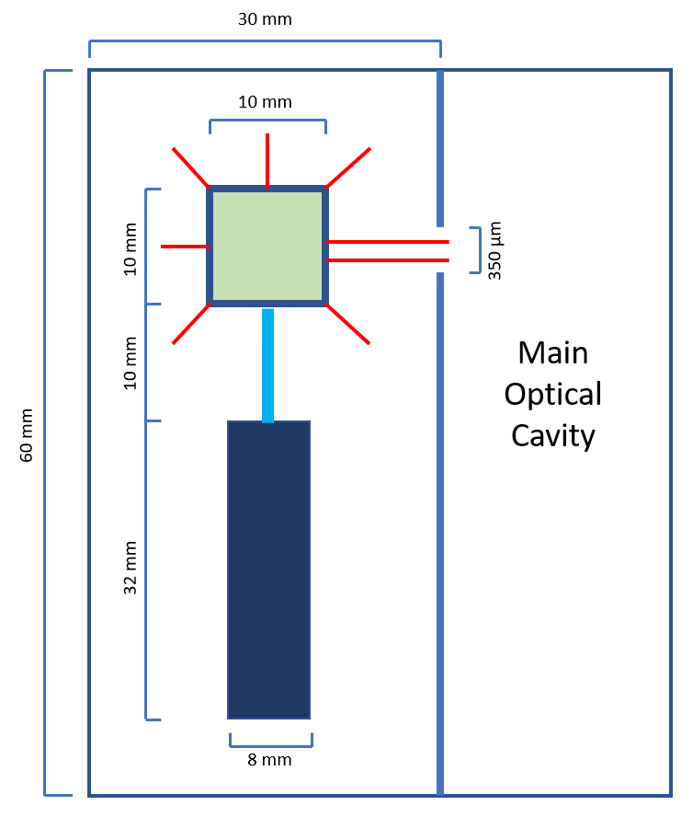
Laser Cavity
Houses laser module and cuvette containing sample
Where process of fluorescence takes places
Separated from main optical cavity by optical slit
Two mounts
One for laser module
One for 10 mm quartz cuvette

Slide 8
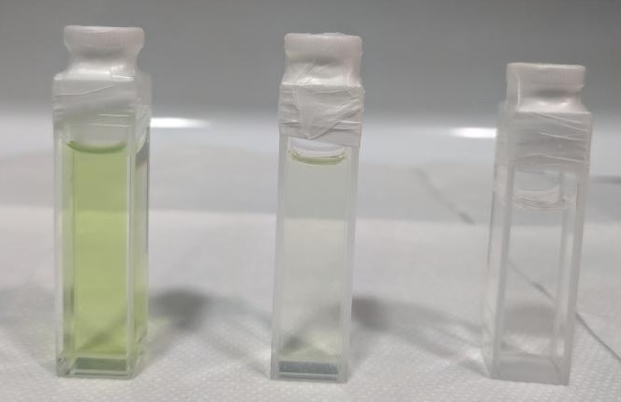
Chlorophyll Sample Preparation
Process:
Pick a leaf from a known species of plant
Break up the leaf into smaller pieces and weigh out a 1-gram sample
Add the sample to a mixture containing 150mL of acetone
Muddle the mixture together for 1 minute and pour through a coffee filter
The remaining solution is added to a cuvette to be tested by the CFS

Slide 9
Chlorophyll Sample Reference
The CFS determines relative plant health
Must obtain a reference sample for each species of plant
Can obtain reference sample from database or by using CFS on a plant sample already determined to be healthy
Compare tested samples to reference sample
Similar fluorescent spectrum = Healthy Sample
Similar/greater intensity, full range of wavelengths
Dissimilar fluorescent spectrum = Unhealthy Sample
Lower intensity, missing wavelengths

Slide 10
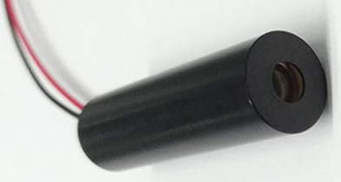
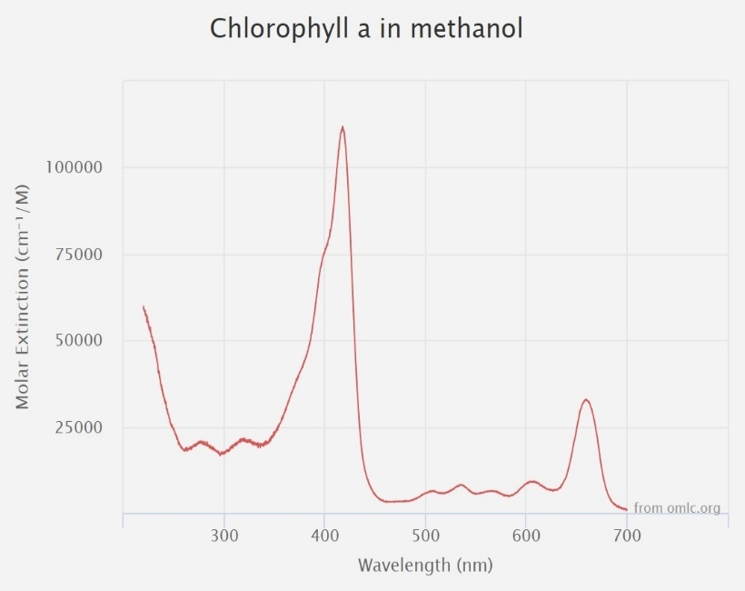
Laser Module
Purpose: Provide light source for fluorescence
Manufacturer | Zhuhai MZLASER Tech Co LTD
Part No. | MZH8340550D-AL01A
Cost | $9.00
Wavelength | 405 nm
Beam Size | 8 mm @ 10 m
Power | 50mW @ 3 V
Manufacturer | Wavelength | Cost
Frankfurt Laser Co. | 415 nm | $5000.00
Power Technology Inc. | 420 nm | $6310.00
RPMC | 430 nm | $500.00
Zhuhai MZLASER | 405 nm | $9.00

Slide 11
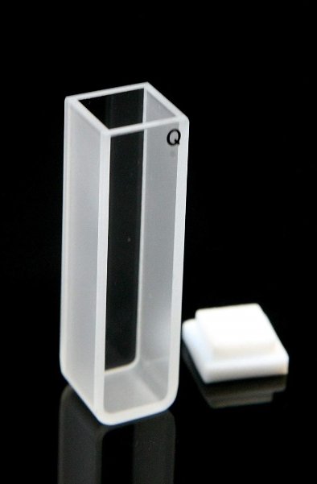
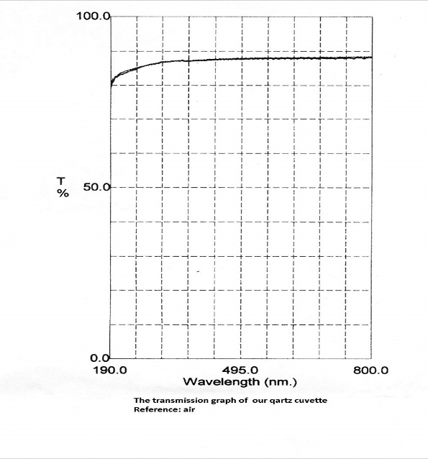
Quartz Cuvette
Purpose:
Contain Chlorophyll a Sample
Allows 405 nm laser light to pass through and illuminate sample
Allows 600-700 nm fluorescent light to emit through container
Manufacturer | Science Outlet
Part No. | 100-40-10
Cost | $9.99
Volume | 3.5 mL
Dimensions | 12.5 x 12.5 x 45 mm
Thickness | 1.25 mm
Manufacturer | Volume | Dimensions | Cost
Lichen Cottage | 3.5 mL | 12.5 x 12.5 x 45 mm | $19.94
Alpha Nanotech | 3.5 mL | 12.5 x 12.5 x 45 mm | $21.00
Bitomic | 3.5 mL | 12.5 x 12.5 x 45 mm | $17.50
Science Outlet | 3.5 mL | 12.5 x 12.5 x 45 mm | $9.99

Slide 12
Optical Slit
Purpose:
Allow fluorescent light to pass through onto collimating mirror while preventing directional 405 nm laser light from passing through
Thickness: 350 µm
To be machined
Image of slit propagates through optical cavity

Slide 13
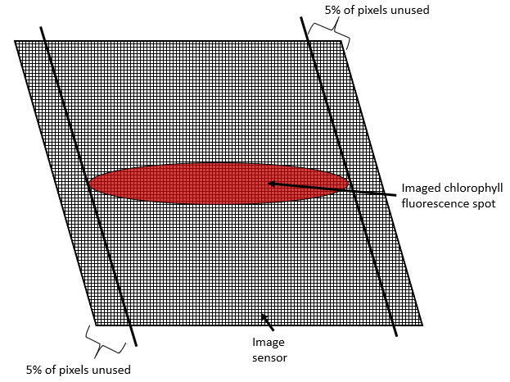
Optical Cavity
Propagates light from slit to sensor
Splits chlorophyll light into component wavelengths
Small sensor active area, aim for 90% beam match

Slide 14
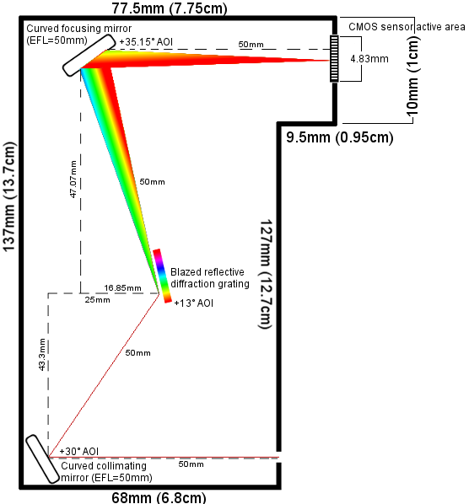
Expected signal loss from propagation is -2.71dB to -3.92dB, depending on wavelength observed
Loss will be normalized at the output
Longer wavelength means greater total expected loss
Expecting most loss at grating and sensor

Slide 15
Collimating mirror
Purpose:
Collimate light from the pinhole and direct it to the diffraction grating
Silver-coated, offering >97.5% reflectance from 450 to 2000 nm
For applications near 780 nm, silver exceeds aluminum in quality
F# = 1.98, which captures a lot of light but doesn’t provide much depth of field; location is important
Manufacturer | ThorLabs
Part No. | CM254-050-P01
Cost | $60.34
Scratch-Dig | 40-20
Diameter | 25.4 mm
Focal Length | 50 mm
Manufacturer | EFL | Diameter | Cost
Edmund Optics | 50 mm | 25.4 mm | $165.00
Newport | 50 mm | 25.4 mm | $141.00
ThorLabs | 50 mm | 25.4 mm | $60.34

Slide 16
Diffraction grating
Purpose:
Split the light coming from the collimating mirror into its component wavelengths
Grating has an efficiency of 62 – 73% in the CFS’s waveband (600 to 700 nm)
Cheaper than 25 x 25mm grating
Manufacturer | MKS | Newport
Part No. | 33066FL01-270R
Cost | $89.00
Grooves/mm | 300
Spectral range | 300 – 1000 nm
Wavelength of maximum efficiency | 500 nm
Size | 12.5 x 25 mm
Manufacturer | Grv/mm | Size | Cost
ThorLabs | 300 | 25 x 25 mm | $117
Newport | 300 | 25 x 25 mm | $109
Newport | 300 | 12.5 x 25 mm | $89

Slide 17
Focusing mirror
Purpose:
Capture light reflected from the diffraction grating and focus it on to the CMOS sensor
Silver-coated, offering >97.5% reflectance from 450 to 2000 nm
For applications near 780 nm, silver exceeds aluminum in quality
F# = 1.98, which captures a lot of light but doesn’t provide much depth of field
Manufacturer | ThorLabs
Part No. | CM254-050-P01
Cost | $60.34
Scratch-Dig | 40-20
Diameter | 25.4 mm
Focal Length | 50 mm
Manufacturer | EFL | Diameter | Cost
Edmund Optics | 50 mm | 25.4 mm | $165.00
Newport | 50 mm | 25.4 mm | $141.00
ThorLabs | 50 mm | 25.4 mm | $60.34

Slide 18
CMOS Sensor Array
Purpose:
Observe the light coming from the collimating mirror and transmit pixel intensity profile data to the CPU for processing
History of successes at UCF using CMOS over linear
Operates in analog, digital, or I/O mode
Built-in ADC
68 – 78% QE in the CFS’s waveband (600 – 700 nm)
Monochromatic pixels; only one QE/sensitivity curve
3.66mm
Manufacturer | ON Semiconductor
Part No. | AR0130CSSC00SPBA0-DR (short, ARDR)
Cost | $8.38 / unit
Active area | 4.86 x 3.66 mm
Supply Voltage | 1.8 V & 2.8 V
Operating Wavelength | 300 – 950 nm
ADC Depth | 12 bits
Manufacturer | Sensor Type | Supply Voltage | ADC Depth | Cost
Melexis | Linear | 3 – 3.3 V | 8 bits | $13.65
Renesas | CMOS | 2.25 – 3.63 V | 8 or 12 bits | $20.00
AMS | Linear | 3 – 5 V | 8 bits | $9.80
ON Semi | CMOS | 1.8 V & 2.8 V | 12 bits | $8.38

Slide 19
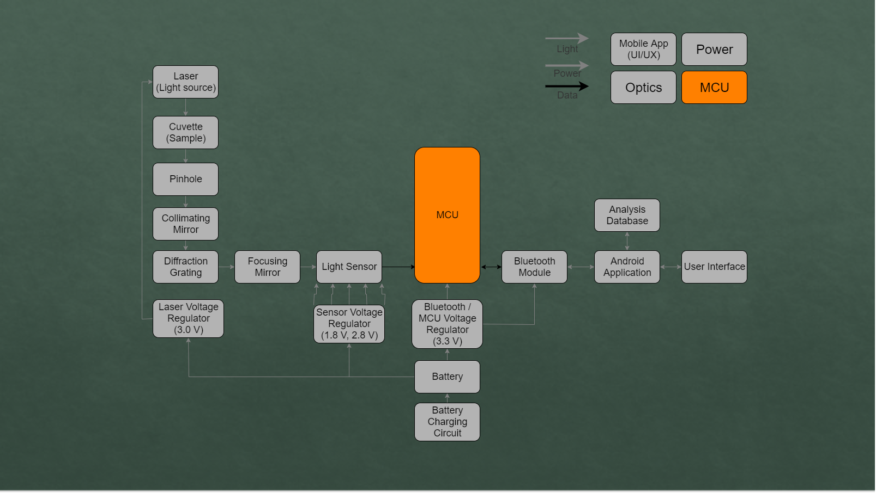
MCU

Slide 20
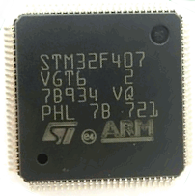
STM32 ARM CPU
Control laser module operation
Control sensor operation
Control data flow
Low Cost: $8.82
Affordable development board: $8.79
Low Power Consumption: 58.5 mW at 1.95 V
Modern and capable CPU
Supports UART, I2C, SPI
Sufficient GPIO connectivity
CPU | Chip Cost | Dev Board Cost | GPIO
MSP 430 | $3.85 | $15 | Not Enough
STM32 | $4.41 | $9 | Enough
FS32K144 | $5.00 | $65 | Enough

Slide 21
Mobile Application
Mobile Application

Slide 22
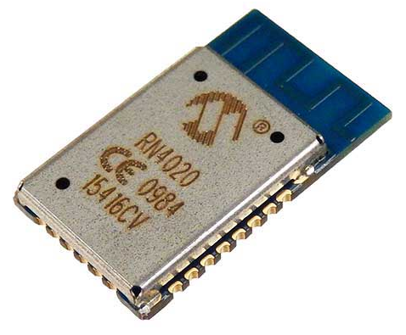
Bluetooth Module
Provide communication between CFS and smartphone
Bluetooth preferable to an on-board display
Low Power Consumption: Peak power draw of 31.2 mW
Low Voltage: 1.95 Volt supply needed
Low cost: $15.40
Supports Bluetooth Low Energy
Module | Manufacturer | Size | Cost | Power Consumption | Bluetooth Version
HC-05 | ITead Studio | 12.7 x 27 mm | <$10 | Medium | V2.0
RN4020 | Microchip | 11.5 x 19.5 x 2.5 mm | <$20 | Very Low | V4.1, BLE
ESP32 | Espressif Systems​ | 25.5 × 18 × 3.1 mm | <$20 | Low | V4.2, BLE+EDR

Slide 23
Software
Design Choice | Final Selection
Supported Mobile Operating System(s) | Android
Earliest Supported Android API | API level 21
Mobile Application Local Database Technology | SQlite3
Mobile Application Programming Language | Kotlin
Embedded Software Language | C
Embedded Software IDE | Keil IDE

Slide 24
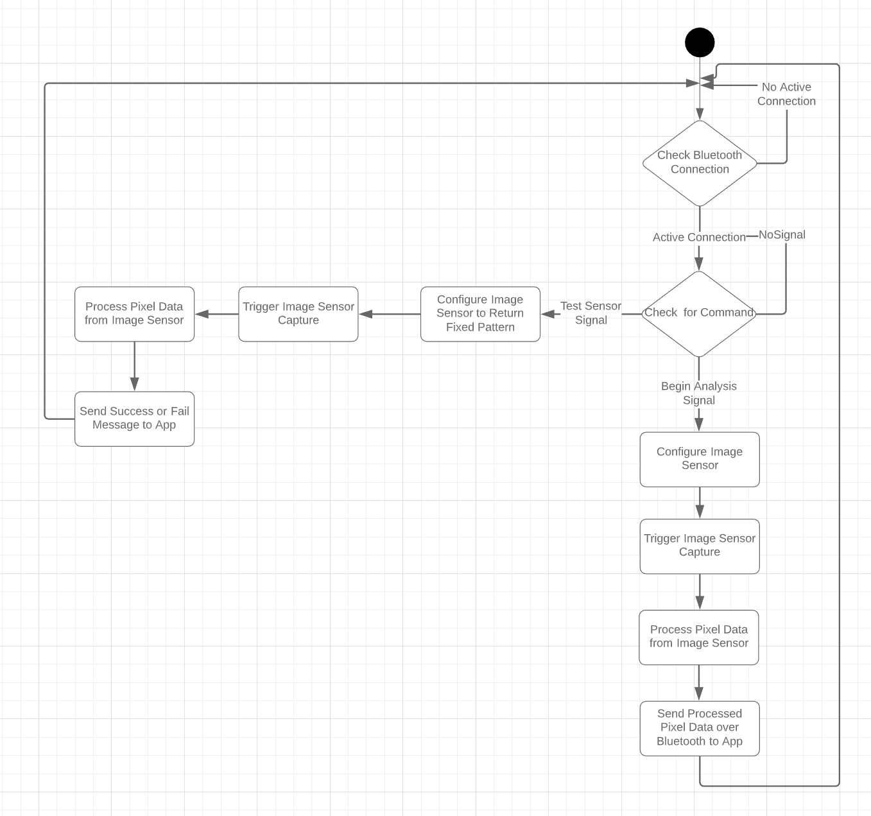
Embedded Software Logic

Slide 25
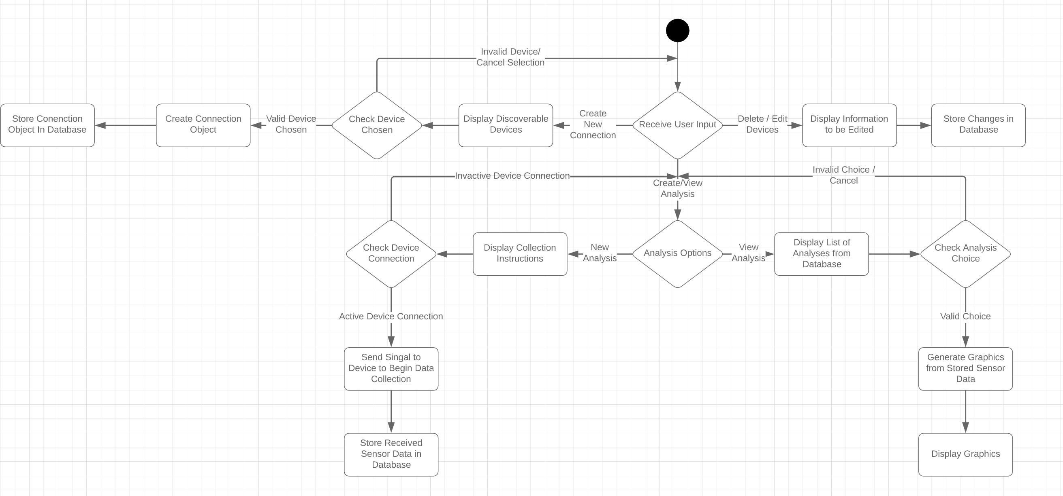
Application Logic

Slide 26
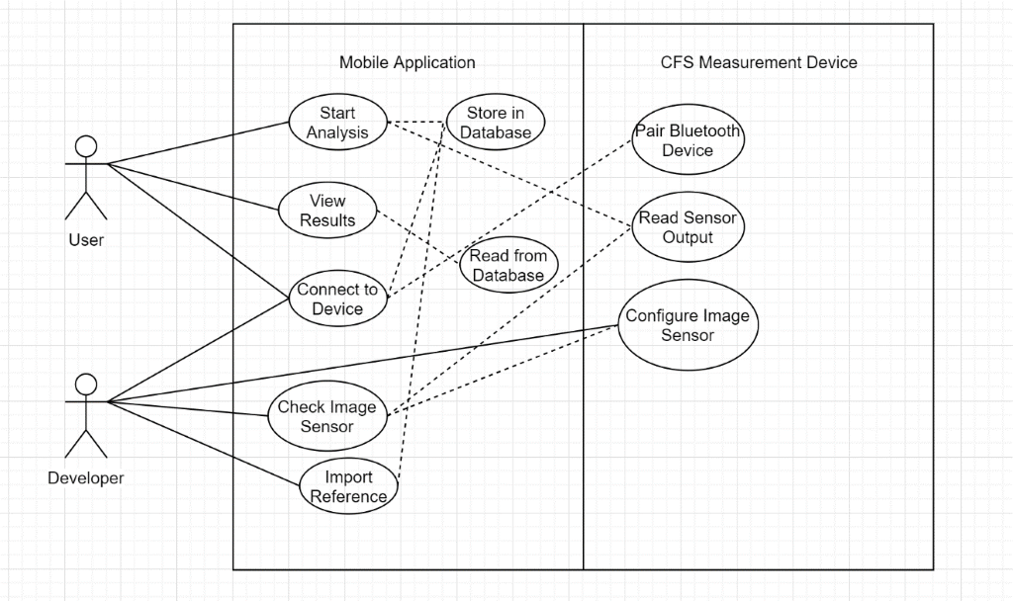
Application Use Case Diagram

Slide 27
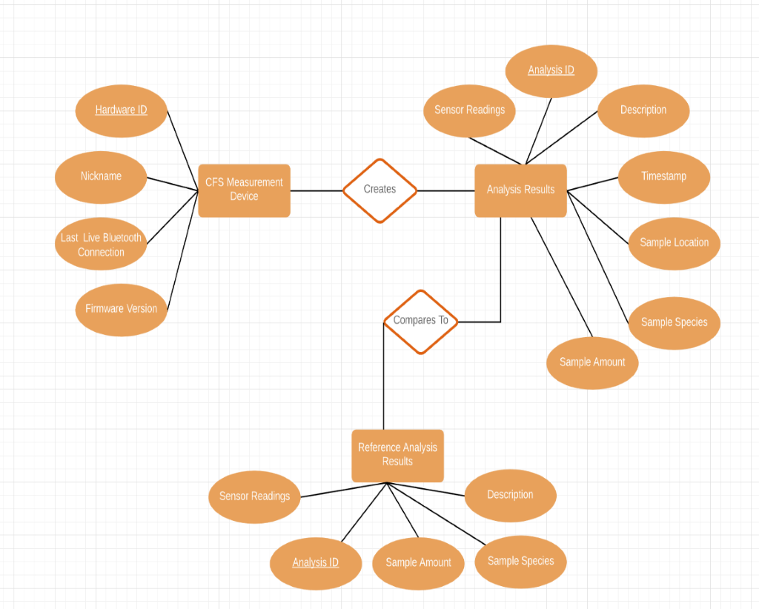
Entity Relationship Diagram

Slide 28
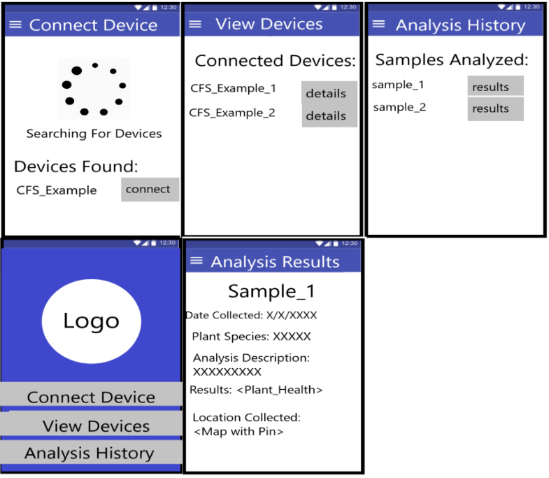
Mobile phone GUI

Slide 29
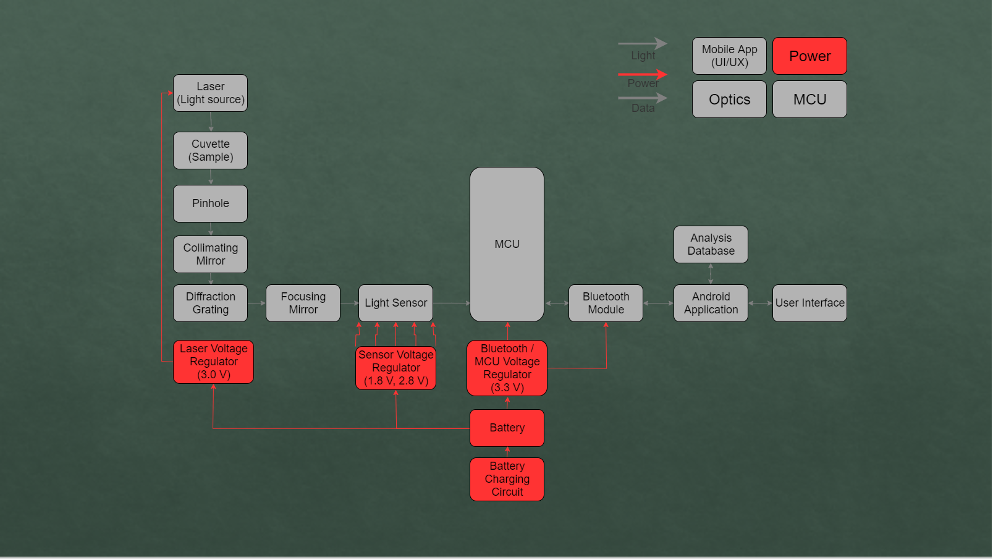
Power System

Slide 30
Power Supply Circuit
Battery & charging circuit
1.95 V for CPU & BT
3.0 V for laser module
1.8 V for CMOS sensor digital power
2.8 V for CMOS sensor analog power

Slide 31
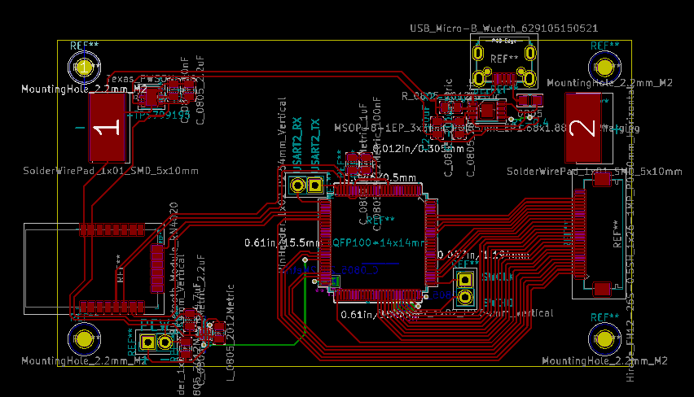
Printed Circuit Board Design
Schematic separated into 2 PCBs
Sensor mounted in place
Connected by ribbon cable
USB charging
Debugging pinouts added

Slide 32
Module Testing / Prototyping
Part Name | Description | Date Ordered | Date Received | Testing Date
MZH8340550D- AL01A | Light Source | 11/05/2019 | 11/15/2019 | 11/25/2019
33066FL01-270R | Reflective Diffraction Grating | 11/07/2019 | 11/15/2019 | 11/24/2019
STM32F407VET6 | Development Board | 11/05/2019 | 11/10/2019 | 11/21/2019
ARDR CMOS Monochromatic Sensor | Imaging Sensor | 11/05/2019 | 11/11/2019 | 11/25/2019
RN4020 | Bluetooth Module | 11/07/2019 | 11/11/2019 | 11/21/2019

Slide 33
Laser Testing
Specification | Company-Listed | Manually-Tested
Peak Wavelength | 405 nm | 405 nm @ 23°C
Optical Power | 40 – 45 mW | 44.4 mW @ 33.5 cm
Beam Spot Diameter | 6 mm @ 10 m | 4.4 mm @ 33.5 cm
Powered by Keithley 2231A-30-3 triple channel DC power supply
Operating voltage: 2.8 V
Gentec-ϵ Maestro 234907 Power Meter for peak wavelength and optical power

Slide 34
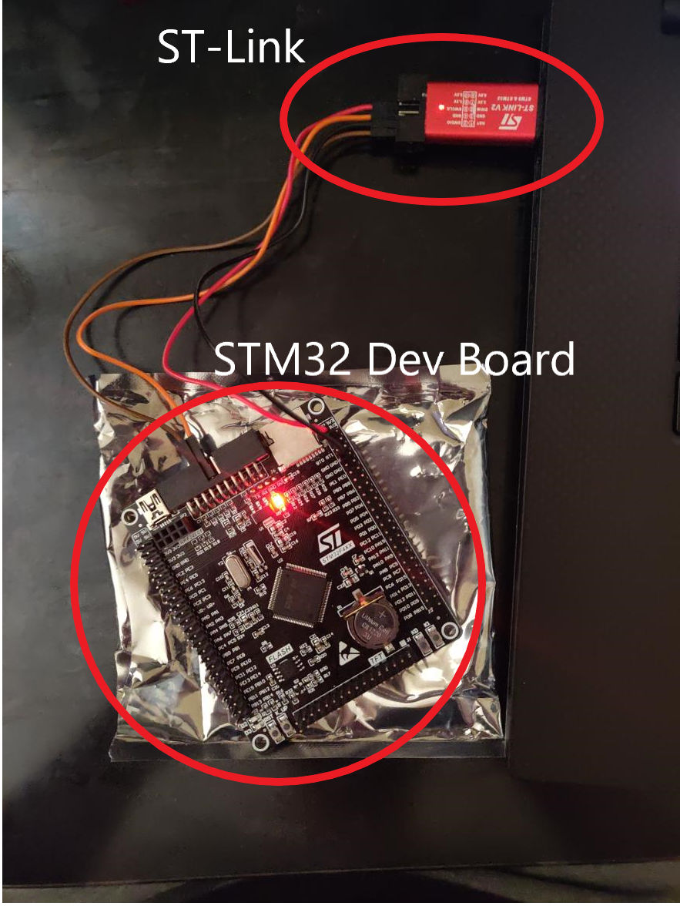
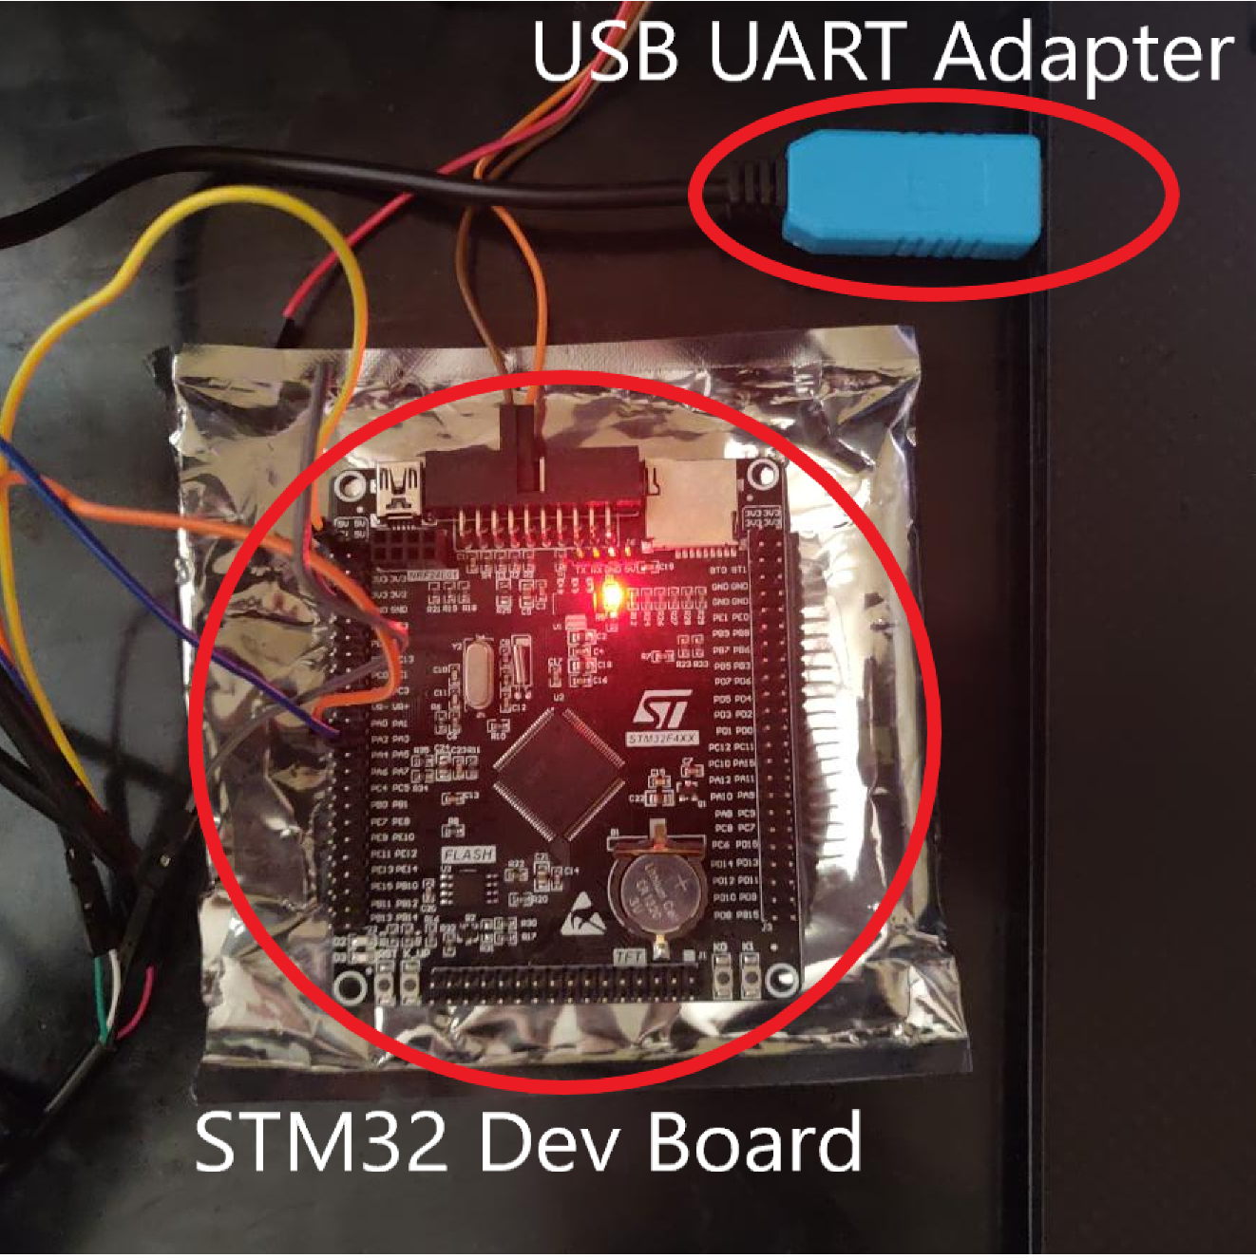
MCU Testing
Tested:
Deploying code to MCU
Serial Communication

Slide 35
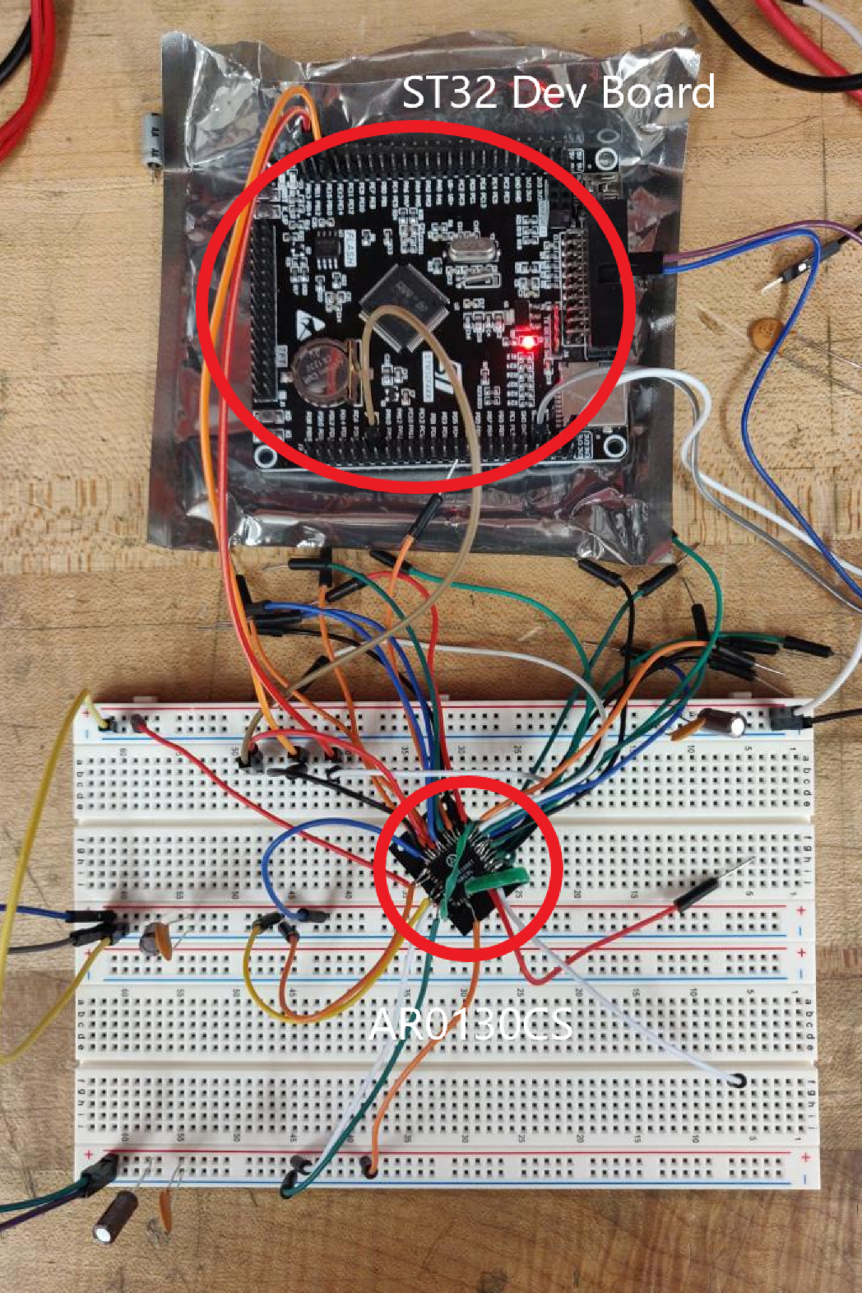
Image Sensor Testing
Tested:
I2C Connectivity
Testing in Progress:
Receiving pixel data over Digital Camera Interface (DCMI)

Slide 36
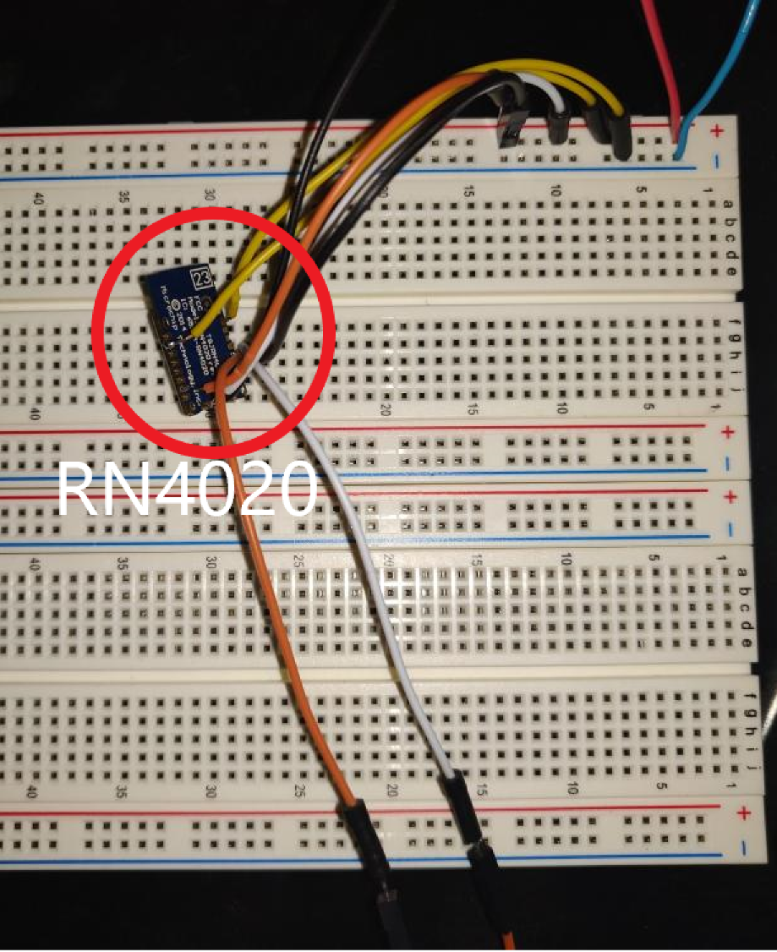
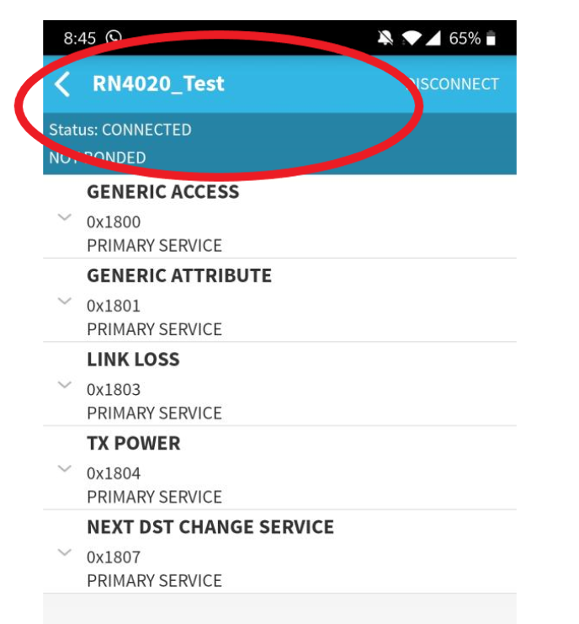
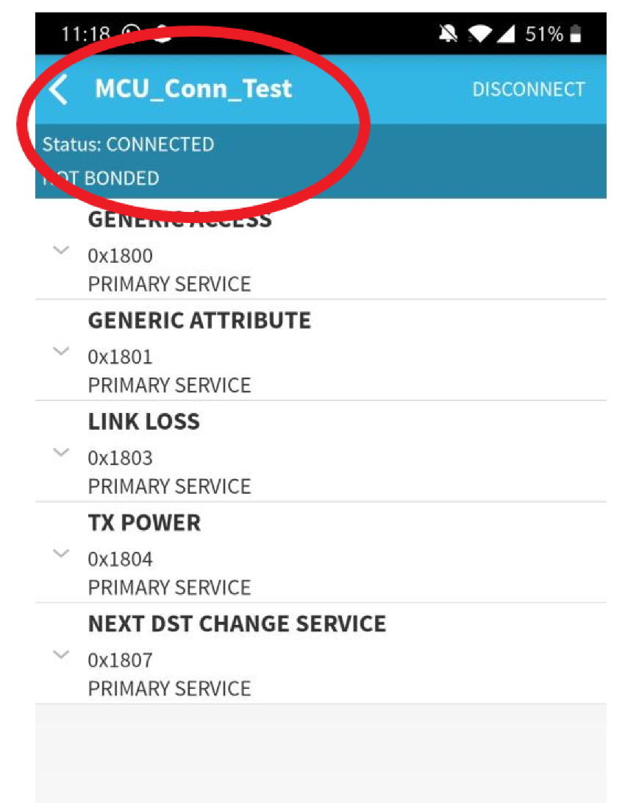
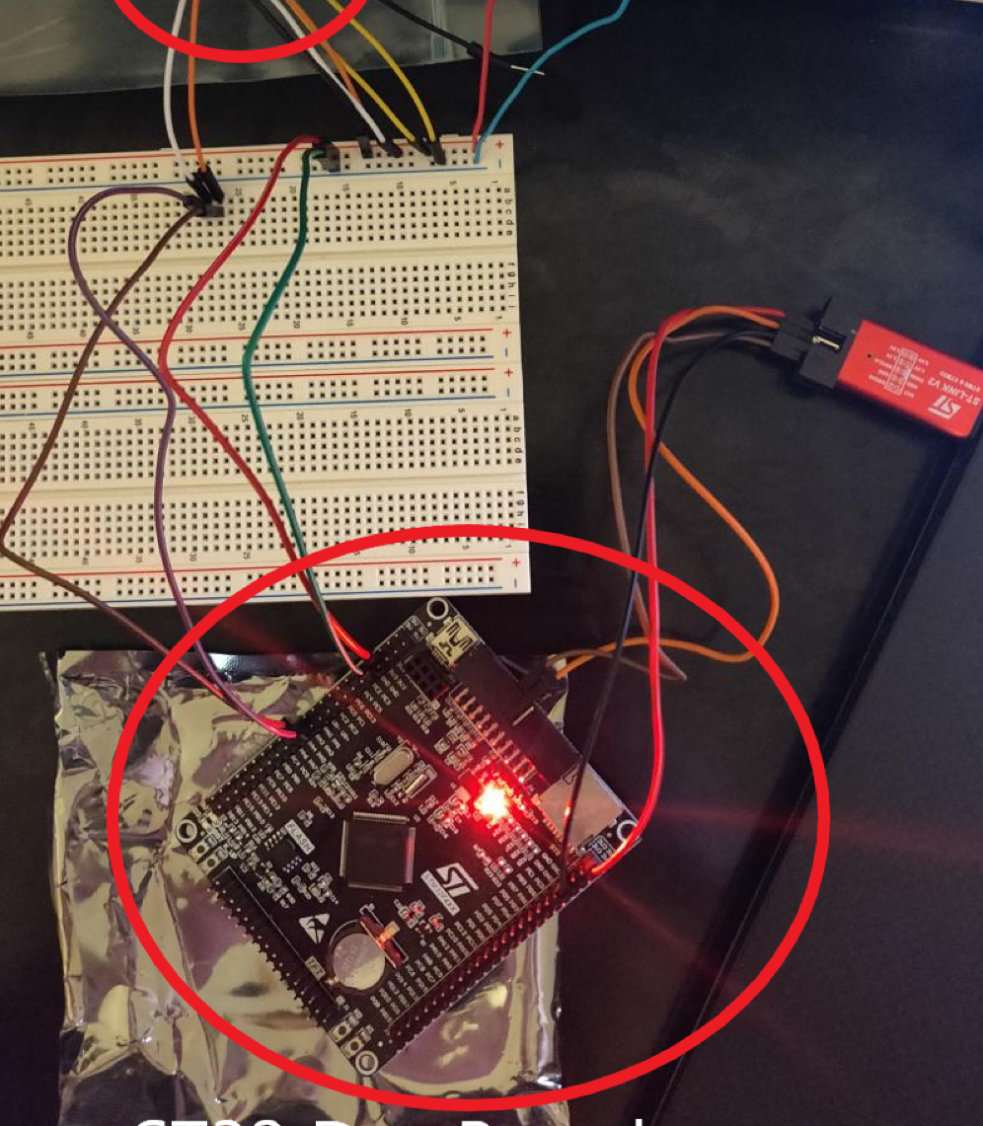
Bluetooth Module Testing
Tested:
Module Broadcast Capability
MCU Connectivity
Data Output

Slide 37
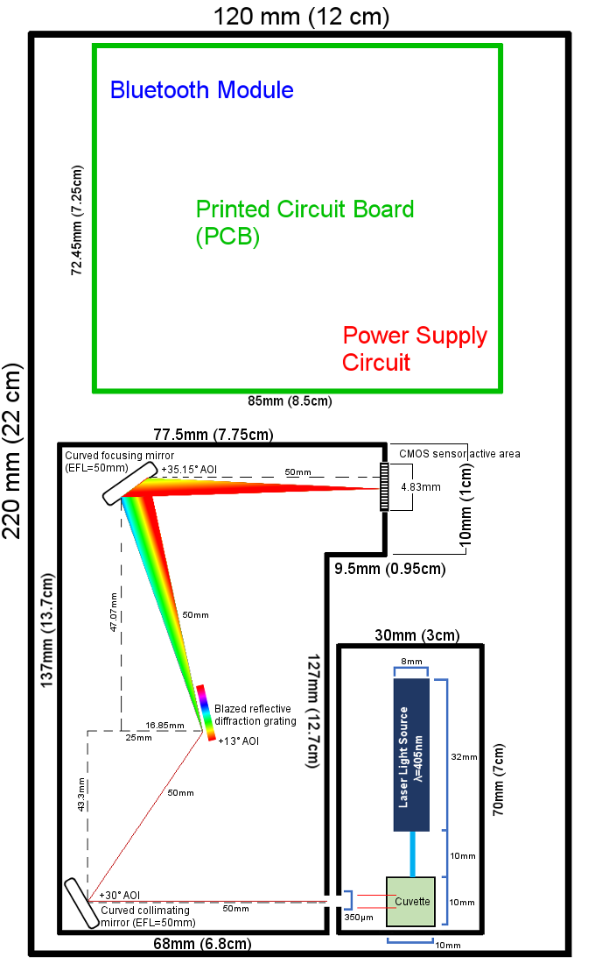
Housing Design
Smaller than a sheet of paper, shorter than a thick book
Cost to build: $0.00
Critical that the optical cavity and pump cavity be isolated from stray light

Slide 38
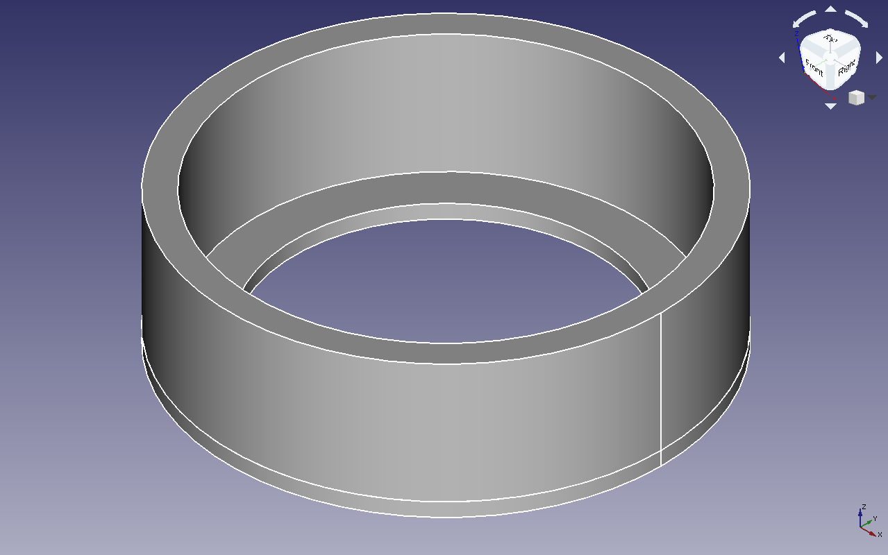
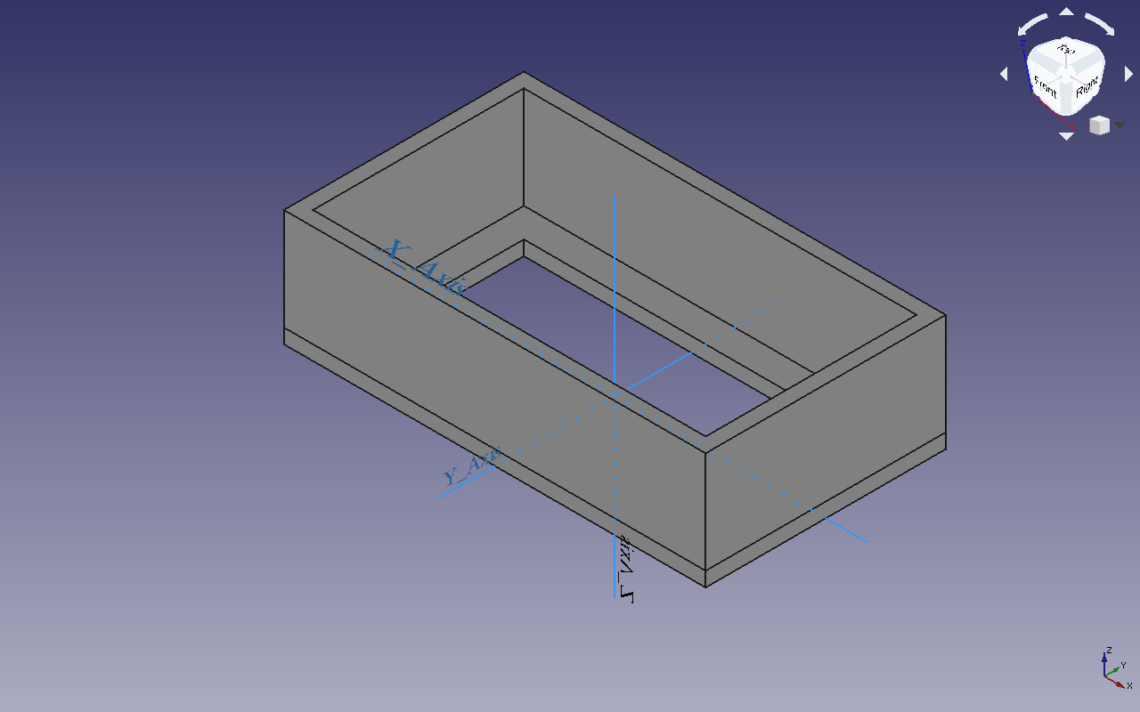
Optics holder designs
One design for mirrors, one for grating
Optics held in place with a thumb screw at the top
Small enough to be machined for free
Mount and post awaiting design

Slide 39
Administrative Content

Slide 40
Work Distribution
Task | Main | Assistant | Workload | Major
Light source cavity design | Robert | Samuel | Medium | PSE
Chlorophyll sample holder design | Robert | Samuel | Medium | PSE
Optical cavity design | Samuel | Robert, Luke | High | PSE
Sensor testing | David, Luke | Robert, Samuel | High | CE, EE, PSE
CFS housing design | Samuel | Robert | Medium | PSE
PCB design | Luke | David | High | EE, CE
Power circuit design | Luke | David | Low | EE
Embedded software design | David | Luke | High | CE
Mobile application design | David | Luke | Medium | CE

Slide 41
Budget
Component | Supplier | Device Section | Quantity | Total Cost
Laser source | Zhuhai MZLAZER Tech Co LTD. | Laser cavity | 2 | $40.38
Cuvette | Scientific Lab Solution | Laser cavity | 2 | $20.00
Mirrors | ThorLabs | Optical cavity | 2 | $120.68
Diffraction grating | Newport Corporation | Optical cavity | 1 | $89.00
CMOS Sensor | ON Semiconductor | Optical cavity | 4 | $34.68
PCB | Oshpark LLC | PCB | 3 | $25.00
CPU | STMicroelectronics | PCB | 2 | $8.82
Development board | STMicroelectronics | PCB | 1 | $8.79
Bluetooth module | Microchip | PCB | 1 | $29.85
Device housing | CREOL Machine Shop | CFS | 1 | $0.00
Final Cost |  |  |  | $377.20

Slide 42
Financials
Self-financed by the group
Not currently seeking outside funding
Housing cavity expected to cost $0.00 based on quote by vendor, keeps project considerably under budget

Slide 43
Progress
Optical mount design in progress
Machining needs to be done
Full integration testing needs to be done
Final assembly

Slide 44
Unsolved Issues/Problems
Machining parts to exact dimensions and strict tolerances
Fine-tuning mirror angles by hand leads to unexpected losses
Spectrum testing unfinished (pixel programming and matching)
CMOS sensor testing unfinished

Slide 45
Q&A

