Slide 1
AUVSI Competition Drone - Laki2 -
Group 11
Brandon Cuevas (EE, CpE)
Garett Goodale (EE)
Nicholas Omusi (EE, CpE)
Nicholas Peters (EE)

Slide 2
Goals & Objectives
Develop electronics for a "small" unmanned aerial system (sUAS/drone)
Enable control and communications between drone, unmanned ground vehicle (UGV), and ground control station (GCS)
Meet the requirements outlined by the Autonomous Unmanned Systems International (AUVSI) Student Unmanned Aerial Systems (SUAS) competition
Collaborate with Robotics Club members and other teams including mechanical engineering and computer science

Slide 3
AUVSI SUAS Competition Outline
The SUAS competition consists of three main stages: waypoints, payload drop, and search
Waypoint Stage: the sUAS must fly through a series of waypoints with the payload, for approximately 4 miles
Payload Drop Stage: the sUAS must drop a UGV onto a GPS waypoint; the UGV must carry a water bottle to another GPS waypoint after landing
Search Stage: the sUAS must fly over a 0.125 square mile area, where it must locate a series of ground targets that consist of a colored letter on top of a colored shape
During all 3 phases, the sUAS must contend with a random set of no-fly zones that are uploaded to it from the ground station. The no-fly zones are virtual volumes that the sUAS must navigate around to avoid point losses.

Slide 4
Sample Mission Map
White Triangle: Pit Area Tent
Red Star: Flight Line Tents
Red Outline: No-Fly Zone Boundary
Yellow Pins: Boundary Judge Stations
Blue Outline: Waypoint Sequence
Green Outline: Search Area
Blue Circle: Off-Axis Object
White Pin: Last Known Position (LKP) of Emergent Target
DROP Pin: Air Drop Location
Notes:
Image Reference:
AUVSI Seafarer Chapter, "Competition Rules | SUAS 2019," 2019. [Online]. Available: http://www.auvsi-suas.org/static/competitions/2019/auvsi_suas- 2019-rules.pdf.

Slide 5
Electrical Design Scope
The electrical and computer engineering design team is responsible for 3 major areas of scope: autonomous flight, payload delivery, and area search
Autonomous Flight | Payload Delivery | Area Search
Battery System capable of powering flight motors and auxiliary systems | UGV controller capable of following waypoints | Camera system with gimbal
Battery Monitor reporting battery state information | Control of payload drop system | Integration of computer hardware capable of processing the images
Flight controller capable of following waypoints | Communication system on UGV | Communication system capable of relaying images from sUAS to GCS
Communication system capable of relaying telemetry from sUAS and UGV

Slide 6
Requirements & Specifications
Subsystem | Requirements
Flight Controller | Maintain the drone stability Respond to waypoint commands Accept manual override Report position telemetry Land safely at a designated point after mission completion
Power System | Supply 6000 peak watts to flight motors at 22 volts Supply 48 watts continuous at 12 volts to computers Store enough energy to allow the UAS to complete all mission tasks Monitor battery, current, voltage, charge, and temperature Report status information to the flight controller or main computer
Notes:
Moose

Slide 7
Environmental Considerations
Batteries should be disposed of by proper recycling
Drone should be within FAA regulations for sUAS
<50 pounds all up weight Stay 5 miles from airports
Only fly with 2 miles or more visibility Stay within line of sight
Comply with FCC regulations
Radio frequency use is not regulated by competition
Any debris should be cleaned up in the event of a crash
Notes:
Moose

Slide 8
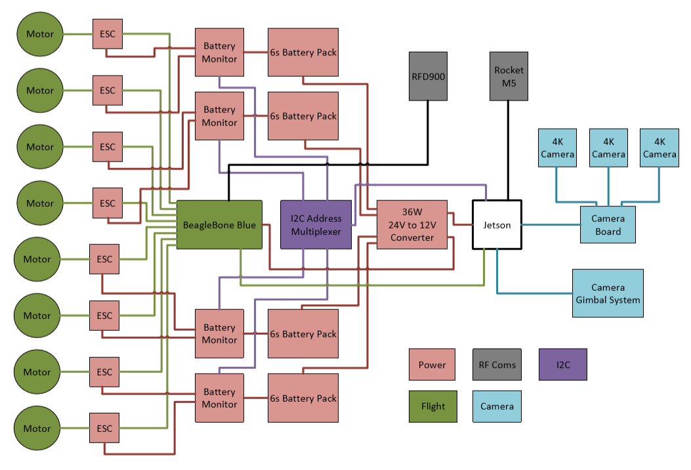
System Overview
Notes:
Moose

Slide 9
Flight Controller: BeagleBone Blue
Why?
8 Servo Outs
1GHZ Processor
Power for telemetry radio
Free...
Usage
Drone Navigation – ArduCopter
Radio Communication – RFD900x
Servo Control
Takes commands from Jetson
Notes:
Moose

Slide 10
Cameras & Gimbal System
<2 centimeters
UAV
13 MP (4096x3120) 19 frames per second
>100 feet
Ground Control
Station
Notes:
https://commons.wikimedia.org/wiki/File:Aerial_Photography_UAV_Icon.svg

Slide 11
Cameras & Gimbal System
Camera Requirements
Wide area image
Mid-flight streaming
Maintain pixel ground size of 2cm per pixel at a height of at least 100 feet
Gimbal Requirements
Lightweight
Simple operation
Camera: e-CAM130_TRICUTX2
Triple-camera unit with high bandwidth live streaming
Interfaces directly with Jetson Processor
Streams 13 Megapixels (4096 x 3120) at 19 frames-per-second
Gimbal: GoolRC 2D
Brushless motors; making it lightweight
2-axis gimbal
Notes:
Moose

Slide 12
Main Processor
Choices were NVIDIA TX2 or an Intel i7
Both have same form factor
TX2 was chosen for lighter weight, greatly increased processing power, more flexible I/O (I2C/SPI/UART), and reduced electrical power requirements
Cameras can take advantage of dedicated CSI-2 camera lanes
Worked very well for RoboSub
Confirmed working with cameras
Notes:
Nick
https://developer.nvidia.com/buy-jetson

Slide 13
Camera Testing
Cameras tested against small scale target
Middle A scales to same as real target from 60 meters AGL
Contrast decreases with size due to lens limits
60 meters AGL gives ~150 meters total frame width

Slide 14
Drop System
UAV Approaches Drop Point
Rover Controller Actuates 3 Holding Servos to Initiate Release
Rover Lowers Using Motor-Dampened Cable & Winch System
Rover Controller
Actuate
↓ Gravity Acceleration
3-Servo Array
EM Motor Braking ↑
Release
DROP
Rover
Cable & Winch System

Slide 15
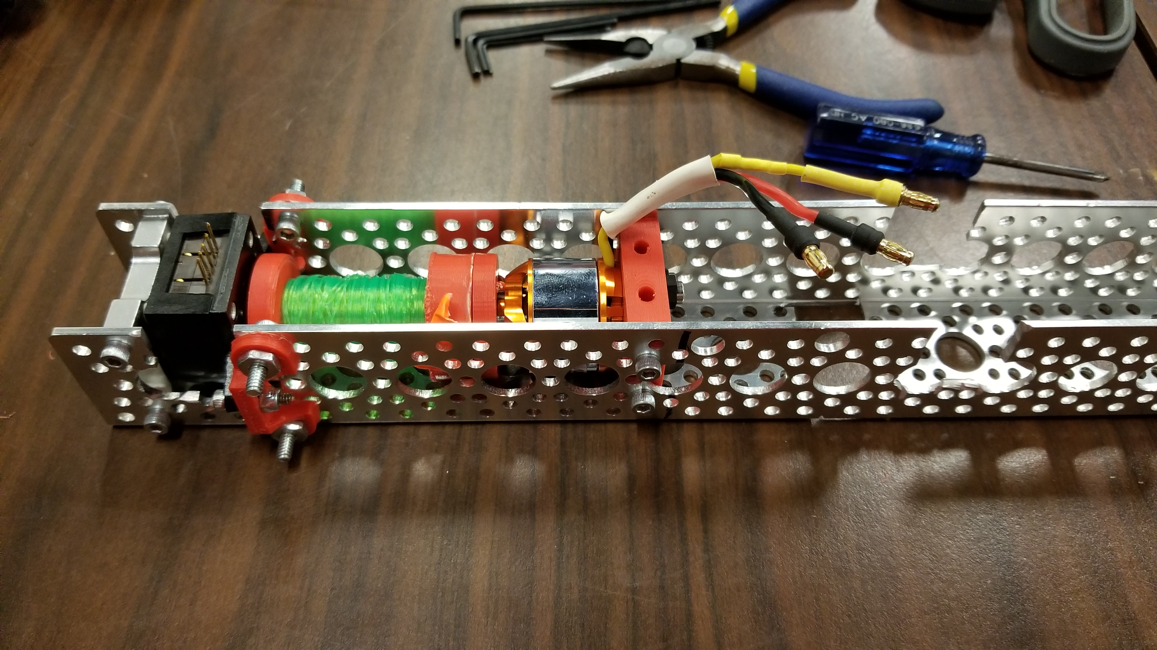
Drop System
Mechanical design results in 3 servos holding rover to UAS on rover side
Rover controller must actuate all 3 servos for a drop
Rover is landed using cable and winch system
Winch uses brushless motor as electromagnetic brake
Notes:
Nick

Slide 16
Communication
UAV → GCS - State information
- GPS coordinates
- Image data
- IP packets
Unmanned Aerial Vehicle
900 MHz/5.8 GHz
Antenna Tracker - Receive GPS coordinates of UAV from GCS
- Adjust antenna orientation to track UAV
Ground Control Station
Unmanned Ground Vehicle
2.4 GHz
UGV → GCS - State information
- GPS coordinates

Slide 17
Video Streaming
 | Rocket M5 | Rocket 5AC Lite | Bullet IP67
Weight (g) | 272 | 250 | 213
Max Power Consumption (W) | 8 | 8.5 | 7
Max Receive Sensitivity (dBm) | -96 | -96 | -93
Max Output Power (dBm) | 27 | 27 | 21
Max Band-width | 40MHz | 60MHz | 40MHz
MIMO | Yes | Yes | No
External Antenna Connectors | Yes | Yes | Yes
Cost ($) | Donated | 135 | 129
Requirements
700m of Range
5.8Ghz Frequency Band
27 Mbits/s
Device Considerations
Rocket M5
Bullet M5
Rocket 5AC Lite
Notes:
Garett

Slide 18
Rocket M5 Testing
Both Tests Were Done with Ubiquiti AMO-5G13 Omni Directional Antennas
First Test
Signal Quality = (Receiver Sensitivity)/ (Max Receiver Sensitivity)
Decreased Signal from trees/cars
Poor Orientation Control
Fresnel Zone Infractions

Slide 19
Fresnel Zone Interference
Obstructions Cause Significant Signal Attenuation

Slide 20
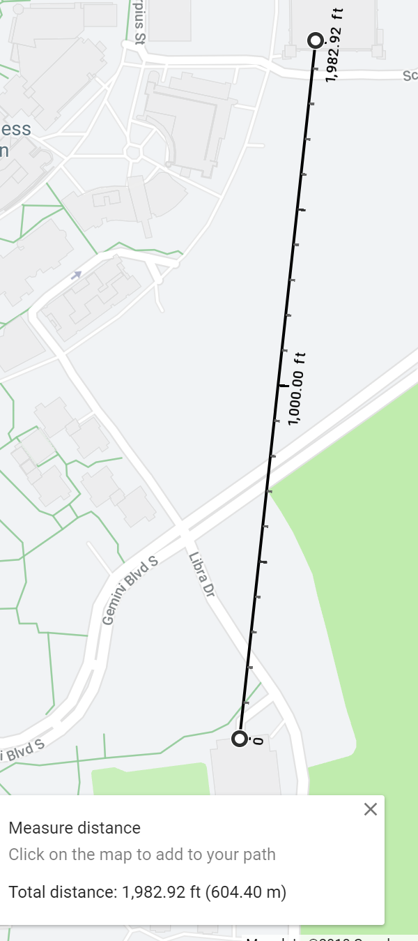
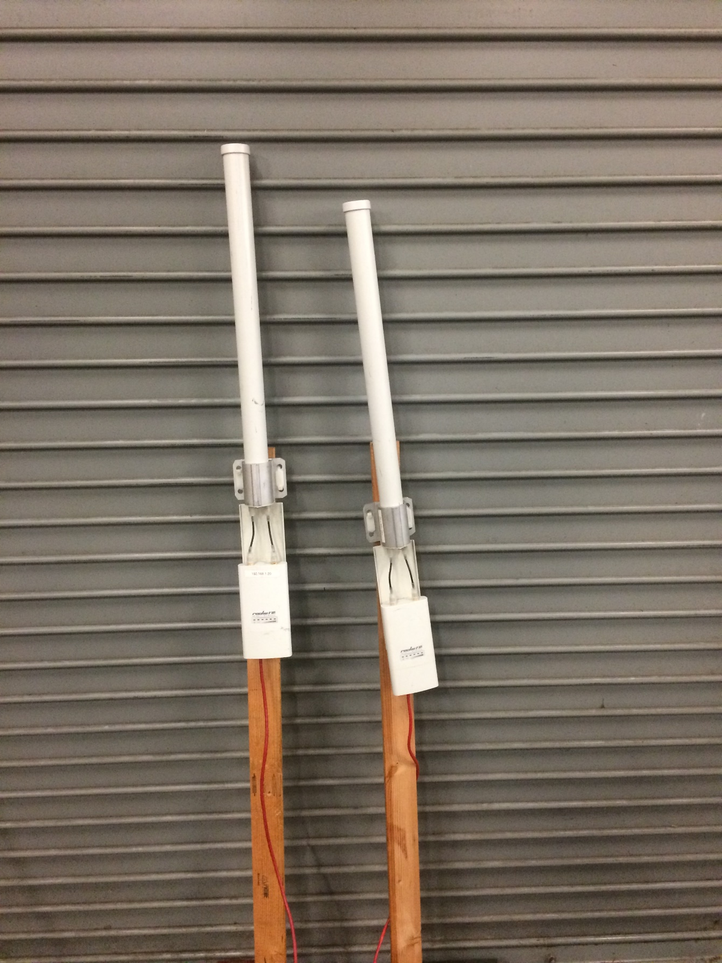
Second Test
Second Test
Between Garages Libra and C
-60 to -68dBm RSSI
40 Mbits/s
-70 to -78dBm RSSI When Held Sideways
15Mbits/s when held sideways
Takeaways
Susceptible to Orientation
Heavy
Dr. Gong’s Recommendations
Dual Yagi’s on the Ground
Rubber Duck Monopoles on Drone
600 Meter Range Test

Slide 21
Antenna Tracking
Justification
Subpar results with omnidirectional antennas
Uploading image data at range is vital
Required when using directional antennas for longer range
Considerations
No objects taller than 15 ft are permitted
Must use available power sources
Design must account for wire entanglement
Notes:
Brandon

Slide 22
Antenna Tracking
UAV
Antenna Tracker Software (ArduPilot) - Initialize: set origin using base GPS coordinates
- Receive GPS coordinates of UAV from GCS
- Perform triangulation calculations for target pan and tilt coordinates
- Perform PID calculations for smooth motion
- Adjust antenna orientation to track UAV using pan and tilt servos
70° Antenna Beam Width Overlapping at Extremes for 360° Coverage
GPS Coordinates
Antenna Tracker Hardware
Tilt Servo (90°)
Ground Control Station
Pan Servo (300°)
300° Servo Range
+
-
Servo Controller
DC-DC Buck Converter
Field Power Supply
Notes:
https://commons.wikimedia.org/wiki/File:Aerial_Photography_UAV_Icon.svg

Slide 23
Telemetry
Requirements
Report state information from flight controller of sUAS to GCS
Report GPS coordinates at a rate of at least 1 Hz
Maintain highly reliable link at long range (~ 3 km)
Considerations
Any losses in communication will result in significant point losses
Airfield environment for relatively reduced interference
RF spectrum will not be managed
Frequency Band: 900 MHz (Sub-1 GHz)
Notes:
Brandon

Slide 24
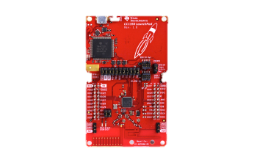
Telemetry: CC1350
Specification | Value | Notes
Frequency Bands | 915 MHz | Programmable
Max Transmit Power | 15 dBm | Sub-1 GHz
Receiver Sensitivity | -110 dBm | SimpleLink Sub-1 GHz
LoS Range | 200 meters | Field tested
Interface | MCU (UART, I2C, GPIO) | High flexibility due to availability of MCU
Compact, low power, low cost, easy interfacing

Slide 25
CC1350 Field Test Results

Slide 26
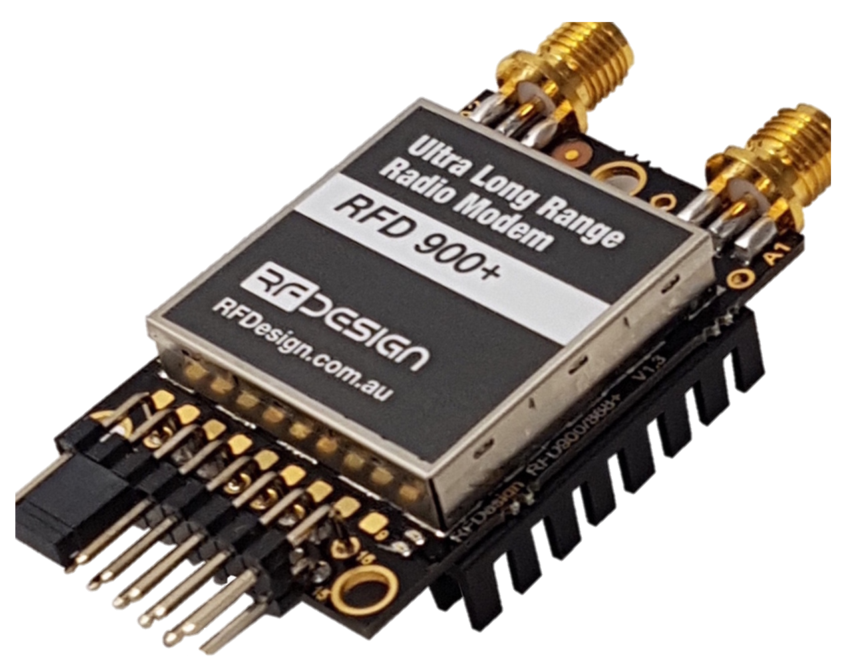
Telemetry: RFD900x Modem
Specification | Value | Notes
Frequency Bands | 902-928 MHz | Ideal frequency range
Max Transmit Power | 30 dBm | Relatively high output power (1 watt)
Max Receiver Sensitivity | -121 dBm | Excellent sensitivity
Advertised LoS Range | 25 miles (40 km) | Much higher than other options; more depending on antenna and GCS setup
Interface | TTL UART, GPIO | Simple and flexible interfacing
High power offers greater theoretical range than required
Still relatively compact and versatile, 250 kbps sufficient
Notes:
http://store.rfdesign.com.au/rfd-900p-modem/

Slide 27
Power: Requirements
Power requirements driven mostly by propulsion (6000W)
Battery capacity for 7 miles of range
Notes:
Nick

Slide 28
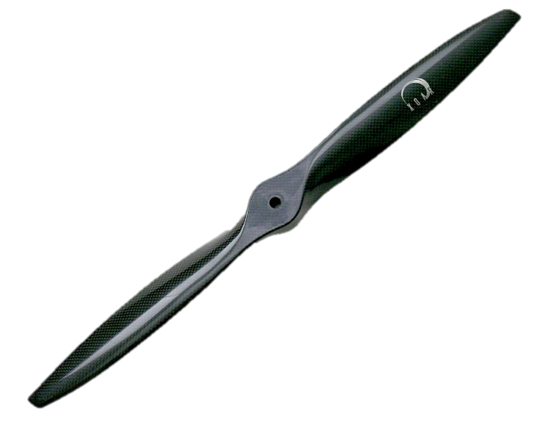
Motors
Requirements
Produce enough thrust to carry drone weight times 1.8
Selected XOAR T5010
Widely used in drones of comparable size and role
Good data from manufacturer about power and thrust
Static testing shows agreement with manufacturer data
4500RPM @ 36A with 19.5x7 prop
19.5 inches
Notes:
Nick
https://www.xoarintl.com/rc-propellers/gas-props/PJT-Sport-Prop-Type-A-Carbon-Fiber-Propeller/

Slide 29
Batteries
Design process had to be coupled with motor selection
Used xCopterCalc software to estimate range based on component selections
Settled on NCR20700 cells in 6S20P configuration
Split into 4 batteries of 30 cells each to keep current manageable
Each battery powers 2 opposing rotors to keep demand balanced
All 4 batteries feed to computer power through regulator board
Notes:
Nick

Slide 30
Battery Monitoring
Requirements
Measure 25.2V full charge voltage
Measure 75A maximum discharge rate
Report results over digital bus
Parts
LTC2944 – Very simple to use, limited options for meeting the required measurement ranges
BQ34110 – More complex, has unneeded features for charging control
BQ34Z100 – Complex software, but best support for our requirements
Notes:
Nick

Slide 31
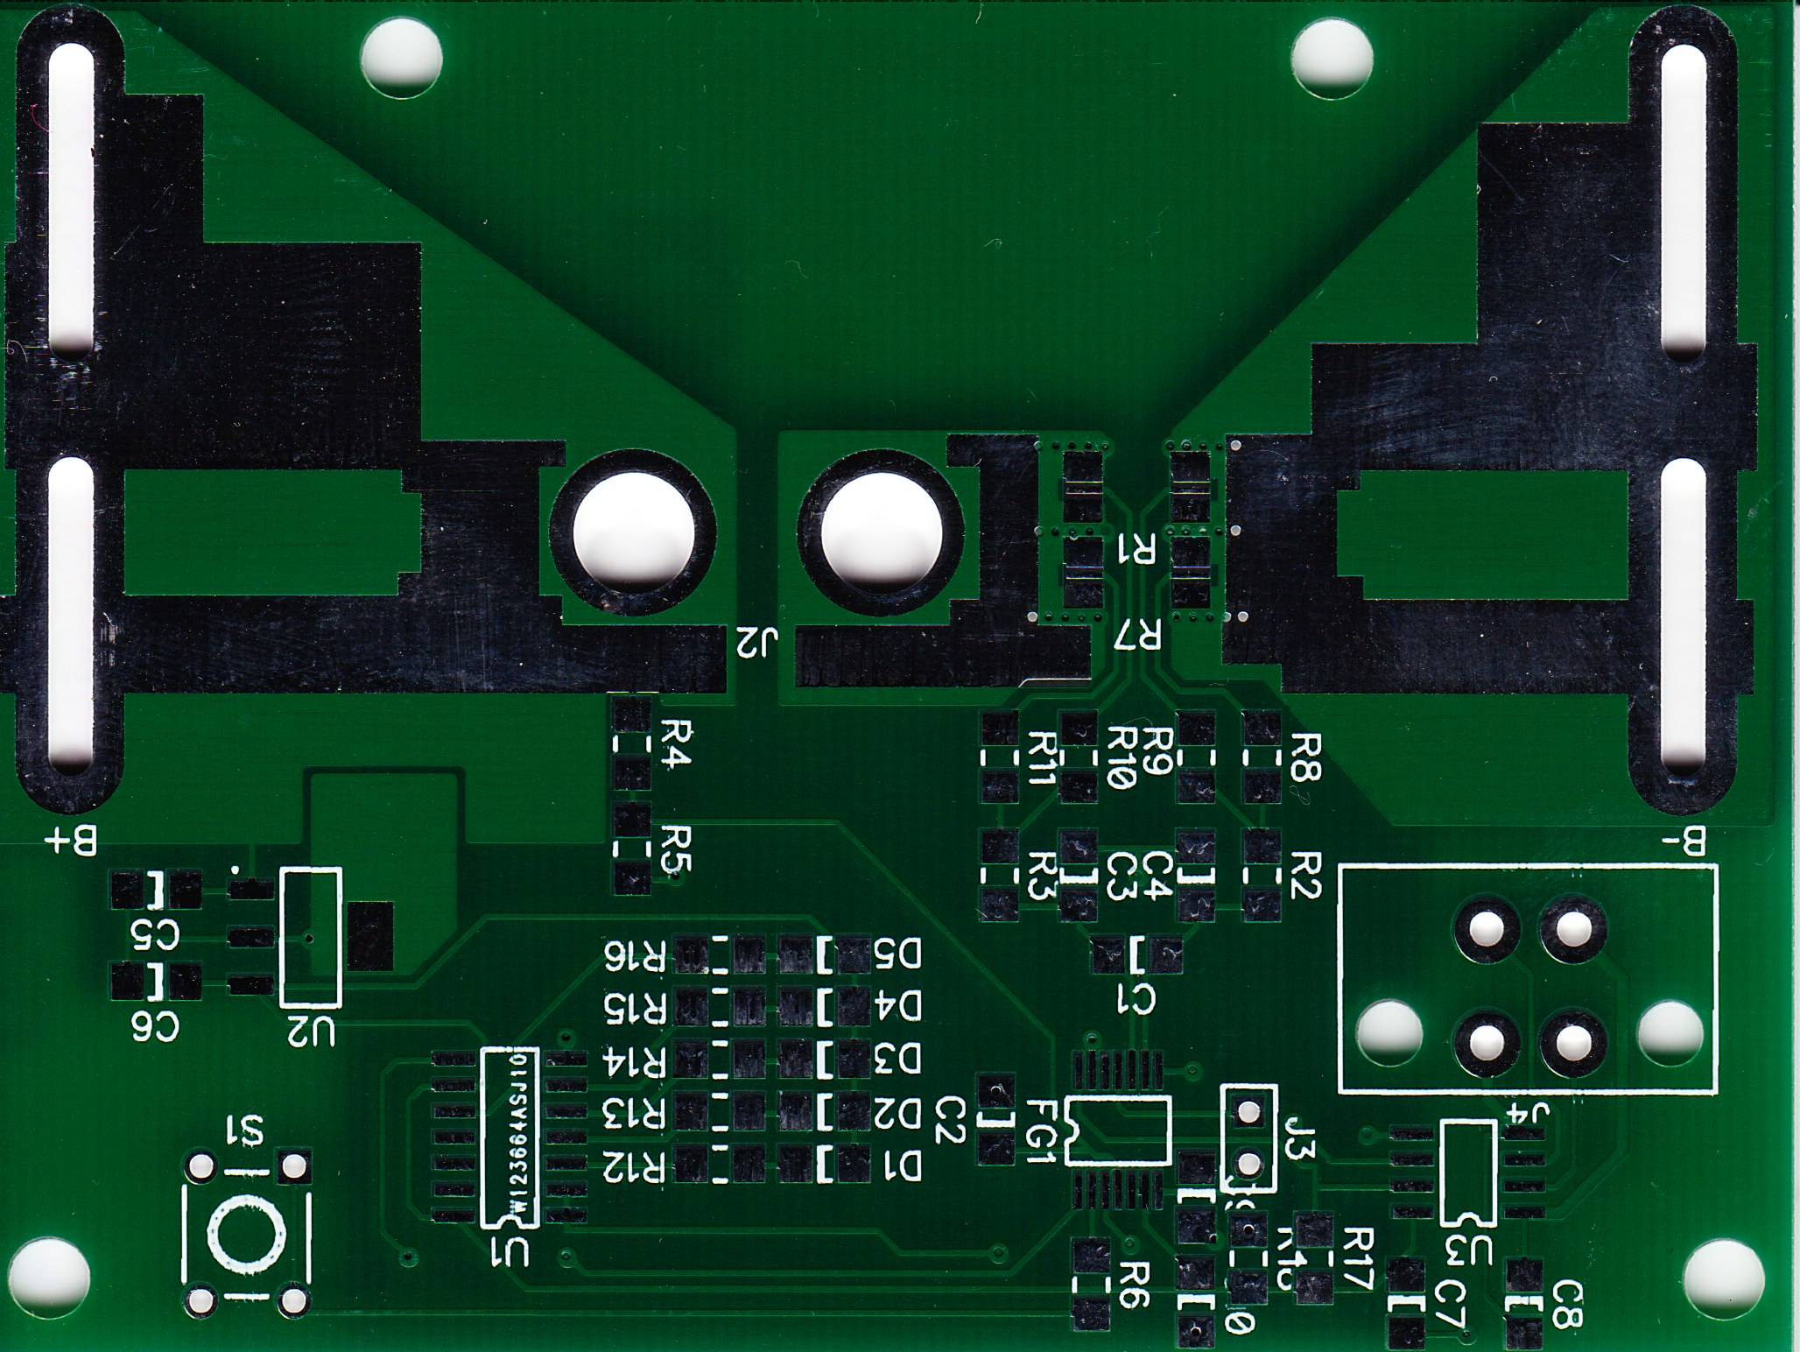
Battery Monitoring
BQ34Z100 was chosen
Using a Jetson allows battery monitor software to be in Python
LED indicator useful to preflight checks
Easy footprint to solder
Free!
Current shunt selected to be 1mOhm and 2mOhm in parallel
2/3mOhm gives 50mV full scale (3 Watts)
Uses low Iq linear regulator instead of discrete circuit

Slide 32
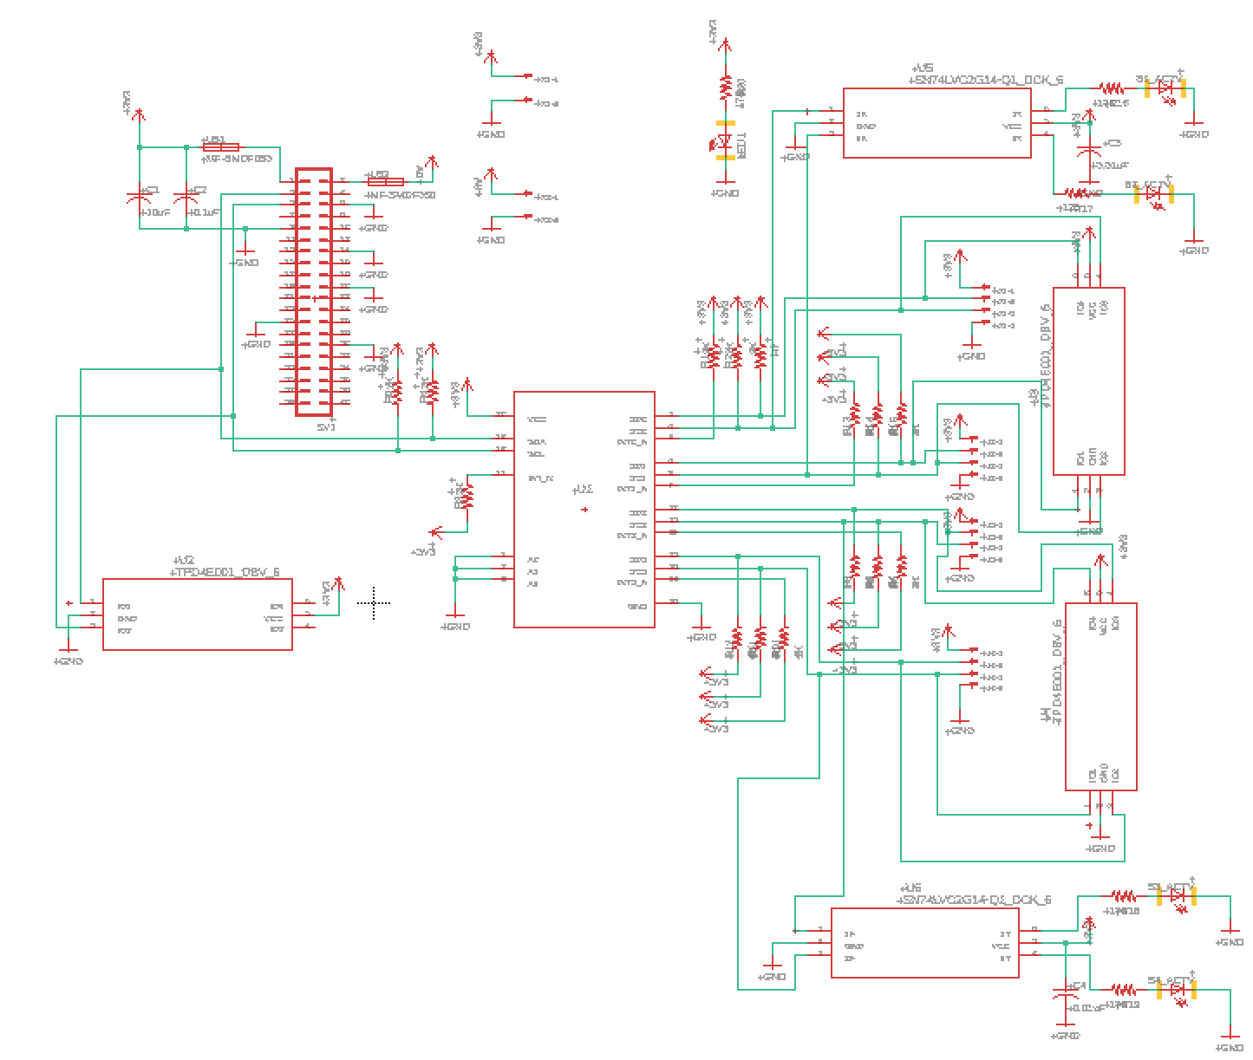
I2C Multiplexing
All Battery Monitoring chips Have the Same I2C Address
Address Resolution Required
Multiplexing Requires Fewer Components
I2C Multiplexers Available from TI for Free
Notes:
Garett

Slide 33
Power PCB
Design Parameters
In: 24 Volt
Out: 4 amps@ 12 Volts
Powered Components
Beaglebone Blue
Ubiquiti M5 Rocket (Power Over Ethernet)
Jetson TX2
Camera Gimbal
Notes:
Moose

Slide 34
Notes:
http://sankeymatic.com/build/
Power Input [10] Beaglebone Blue
Power Input [8] Ubiquiti M5 Rocket
Power Input [20] Jetson TX2
Power Input [2] GoolRC Gimbal
Power Input [2.1] Losses
Power Input [5.9] Reserve
Beaglebone Blue [5] RFD900x
Beaglebone Blue [5] BB Processor
Jetson TX2 [3.5] Cameras
Jetson TX2 [15] TX2 Processor
Jetson TX2 [1.5] TX2 Reserve

Slide 35
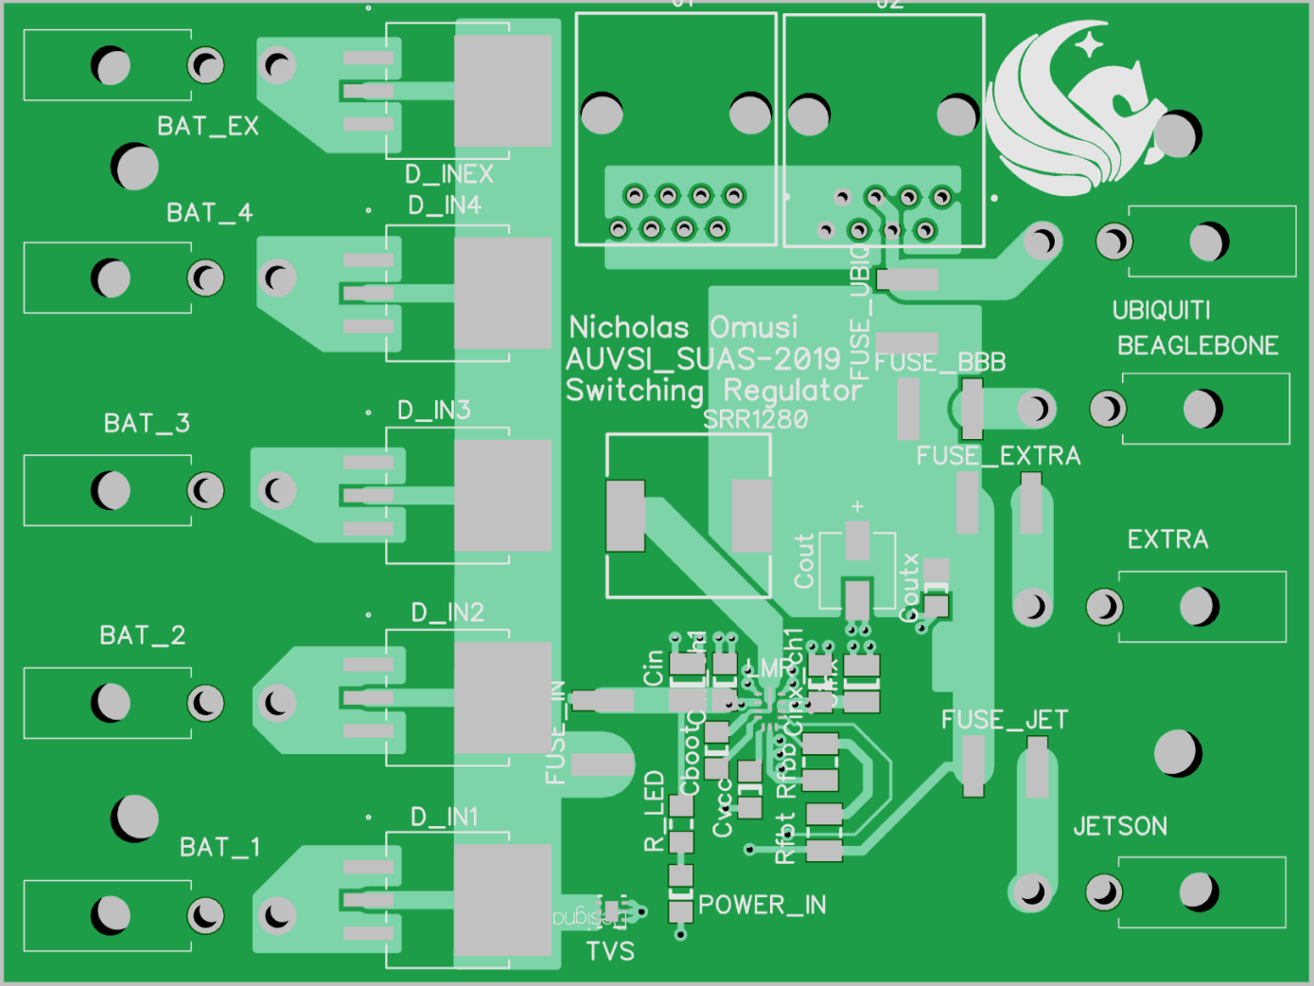
Power PCB Components
SM74611 – Ideal Bypass Diodes
- Minimal power dissipation
LMR33630 – Step-Down Switching Regulator
- High efficiency, small footprint
TVS2700 – TVS Diode
- Surge protection
Modular Jack Connectors (Ethernet Ports)
- Allows Power over Ethernet injection for the Rocket M5
Fuses
Notes:
Moose

Slide 36
Budget
Item | Cost Per Unit | QTY | Actual Cost | Item | Cost Per Unit | QTY | Actual Cost
Propulsion |  |  |  | Camera Lenses | $ 59.50 | 4 | $ 238.00
Electronic Speed Controller | $ 17.99 | 16 | $ 287.86 | Camera Gimbal | $ 53.56 | 1 | $ 53.56
20700 Batteries | $ 6.50 | 138 | $ 897.00 | Shipping
20700 Batteries | $ 6.50 | 22 | $ 143.00 | XOAR Shipping | $ 100.00 | 1 | $ 100.00
XOAR 19.5" x 7 Propeller Pair | $ 73.29 | 12 | $ 879.48 | IMR Batteries Shipping | $ 15.87 | 1 | $ 15.87
XOAR 5010 Motor | $ 60.82 | 10 | $ 608.16 | IMR Batteries Shipping | $ 8.90 | 1 | $ 8.90
PCB Components |  |  |  | DigiKey Shipping | $ 3.75 | 1 | $ 3.75
Big Resistor | $ 0.66 | 5 | $ 2.97 | Other
Small Resistor | $ 0.66 | 5 | $ 2.97 | RFD900x Telemetry Bundle | $ 198.55 | 1 | $ 198.55
1-mOhm Sense Resistor | $ 1.75 | 5 | $ 7.88 | GPS Module | $ 39.99 | 1 | $ 39.99
2-mOhm Sense Resistor | $ 1.75 | 5 | $ 7.88 | 400GB microSD | $ 83.92 | 1 | $ 83.92
I 2C Isolator | $ 7.40 | 5 | $ 33.30 | 5.8 GHz Yagi Antenna | $ 19.94 | 2 | $ 39.88
550mA Poly Fuse | $ 0.73 | 2 | $ 1.31 | 2.4 GHz Yagi Antenna | $ 11.07 | 1 | $ 11.07
1A Poly Fuse | $ 0.48 | 4 | $ 1.73 | Free TI Components
1.5A Poly Fuse | $ 0.71 | 4 | $ 2.56 | Gas Gauge IC | $ - | 10 | $ -
Ethernet Jack | $ 0.60 | 4 | $ 2.16 | Shift Register | $ - | 5 | $ -
Capacitor | $ 1.02 | 2 | $ 1.84 | I2C Multiplexer | $ - | 5 | $ -
Inductor | $ 1.25 | 2 | $ 2.25 | TVS Protection Diodes | $ - | 10 | $ -
Red LED | $ 0.17 | 50 | $ 7.43 | Schmidt Trigger Inverter | $ - | 5 | $ -
Position Header | $ 2.38 | 2 | $ 4.28 | 3A Switching Regulator | $ - | 5 | $ -
25' 12 Gauge Wire | $ 44.98 | 1 | $ 44.98 | Large Diodes | $ - | 10 | $ -
Copper Strip | $ 9.95 | 1 | $ 9.95 | Regulator | $ - | 5 | $ -
4mm Bullet Connectors | $ 3.27 | 8 | $ 26.16 | BeagleBone Blue | $ - | 4 | $ -
XT90 Connectors | $ 5.80 | 4 | $ 23.20 | CC-ANTENNA-DK2 | $ - | 4 | $ -
500g 0.8mm Solder | $ 22.99 | 1 | $ 22.99 | LAUNCHXL-CC1350 | $ - | 4 | $ -
DigiKey Promo code | $ (50.00) | 1 | $ (50.00) | TOTAL |  | $ 4,513.81
Camera System
Camera System | $ 749.00 | 1 | $ 749.00 | Projected Total |  | $ 4,320.00
TOTAL: $4,513.81
PROJECTED: $4,320.00
Notes:
Garett

Slide 37
Statement of Progress (% Complete)
Notes:
Garett

Slide 38
Immediate Actions To Move Toward Completion
Receive and Test Yagi Antennas
Implement antenna tracking & telemetry system
Construct and wire physical components
Configure Ardupilot for Antenna Tracking
Test and Refine PCB’s
Receive and Test New Camera Lenses
Develop Software for Battery Management
Complete ArduPilot Setup
Notes:
Garett

