Slide 1
Medical GPS Unit 4-ctive Response Duty
By Group 9:
Andrew Lucena – Electrical Engineering
Angello Garcia – Electrical Engineering
Giovanni Martinez – Electrical Engineering
Italo Travi – Computer Engineering

Slide 2

Recognizing the Problem
First responders main cause of deaths are related to cardiac problems
Heightened vitals from adrenaline in the field can result in heart-attacks
In the last 5 years 76 fire-fighters died in the line of duty. 88.1% while on-duty, and 75 of them were due to Stress/Overexertion.
100% were related to heart and respiratory problems
Notes:
Problem:
Solution: Our goal is to design a device capable of reducing on-duty deaths and monitor those dealing with cardiac or physiological stress

Slide 3
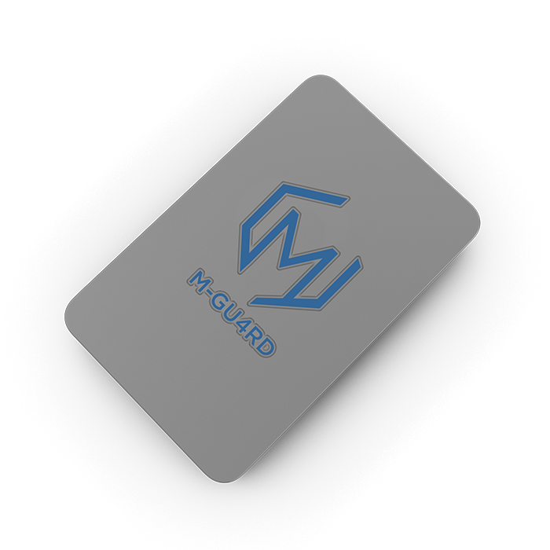

INTRODUCING THE M-GU4RD
Notes:
NARRATIVE ~2, ~3 MIN
-COMPONENTS ON MODULE
-ATTACHMENTS (ECG)
-GUI

Slide 4
Introducing the m-gu4rd
Ideally, the device would be customizable with various sensors and utilities given the circumstance
Various applications such as for First Responders, Firefighters, Military/Police Officers, and Medical Practices
Our design consists of two parts:
  A body attachable device that detects a person’s vitals and location
  A GUI capable of decoding the vitals, location, and status of all unit members in real-time and indicate dangerous level fluctuations in a person’s vital signs

Slide 5
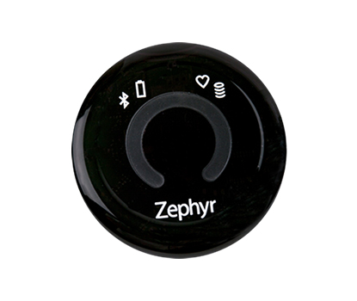
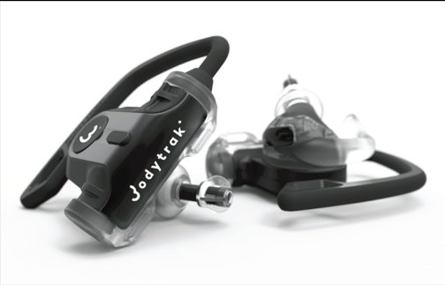
Similar products
Notes:
Products are still being tested
Prices widely vary and can be expensive

Slide 6
Goals and objectives
Create something that directly helps people
Maintain a flexible design
Develop a more condensed and portable device
Must be lightweight, accessible, and easy to use
Must be affordable and accessible to all consumers

Slide 7
Requirements and specifications
The M-GU4RD shall take the following vitals: Respiratory rate, Heart Rate and Temperature
The M-GU4RD shall provide an accurate geographical location of the user
The M-GU4RD shall implement a rechargeable power source
The Graphical Unit Interface (GUI) shall display the sensor data
The M-GU4RD shall have a transmission range of at least 50 meters

Slide 8
Requirements and specifications
Specifications | Value | Metric
Dimensions | 20x15x5 | cm
Weight | <5 | lbs
Power lifetime | >4 | hours
Cost | <400 | U.S Dollars
Installation time | <60 | seconds

Slide 9

Overall project block diagram
Power Supply
GPS
MCU
Battery Charger
Temperature Sensor
RF Module (Tx)
Battery
ECG and Respiration sensor
RF Module (Rx)
7.2v
Buck Converter
GUI
5v
Power
Sensors
RF Communications
Graphical Unit Interface
Microcontroller

Slide 10
Physical design
Notes:
NARRATIVE ~2, ~3 MIN
-COMPONENTS ON MODULE
-ATTACHMENTS (ECG)
-GUI

Slide 11
Hardware design
Biometric Sensors:
  Heart-rate (ADS1292R ECG/Respiration Shield)
  Respiration-rate (ADS1292R ECG/Respiration Shield)
  Body temperature (DS18B20 Digital Temperature Sensor)
Other Components:
  MCU (AtMega2560 processor)
  GPS with altimeter (NEO-6M GPS Module)
  RF module (APC-220 Wireless Transceiver)
  Battery (3.6V Lithium Ion Battery x2)
Notes:
Narrative of component selection as well as relating hardware parts with design specifications and requirements

Slide 12
Software design
MCU, GPS, ECG, temperature and RF modular integration
  Arduino IDE (C, C++)
  Module Libraries
Receiver Mobile Host (Mobile GUI)
  Android Platform (Java)
  Future Development for iOS and Microsoft

Slide 13
sensors

Slide 14
Electrocardiogram sensors
 | Dimensions | Price | Power Consumption | Features
ADS1292R ECG/Respiration Shield | 64mmX63mm | $46.73 | 2.7 to 5.25V | Three electrodes, UI, and respiration sensor
BMD101 | 10mmX10mm | $50-$60 | 3.3V | Single metal electrode compatible w/ Android and Windows
AD8232 ECG Sensor Module | 4mmX4mm | $15.99 | 2.0-3.5V | Only detects heart-rate and sacrifices accuracy
Raspberry Pi Sensor | N/A | $4.00 | 3.3V | Finger contact device, affordable but not as accurate

Slide 15
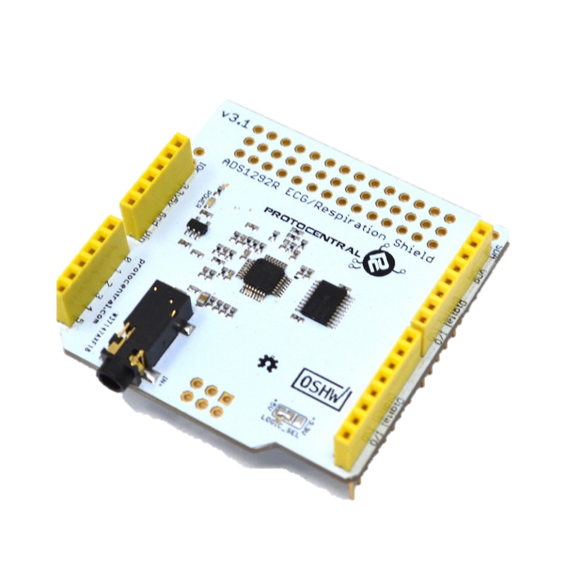
Heart rate module - ADS1292r
Uses an electrocardiogram (ECG) to monitor heart-rate
Uses a Pneumograph to monitor respiration-rate
Comes with three attachable electrodes and its own UI
Relatively inexpensive considering it reads two vitals
Dimensions | Price | Power Consumption
64mmX63mm | $46.73 | 2.7 to 5.25V

Slide 16
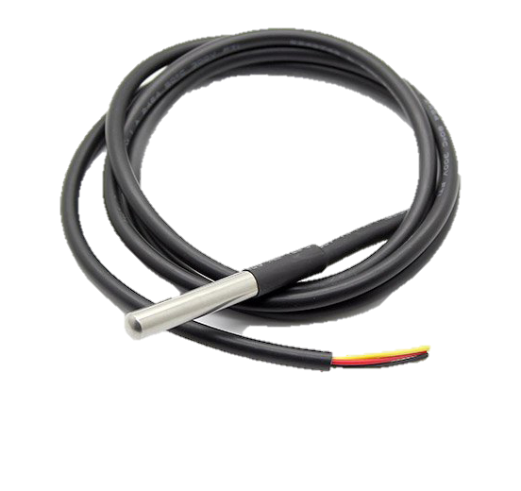
Temperature module – ds18b20
Will be used to monitor body temperature
Sensor is waterproof and affordable
Has a simple one wire data sensor
Dimensions | Price | Power Consumption | Temperature Range | Accuracy
1mX50mmX50mm | $2.32 | 3.0-5.5V | -67°F to 257°F | ±0.9°F
Notes:
Wearable

Slide 17
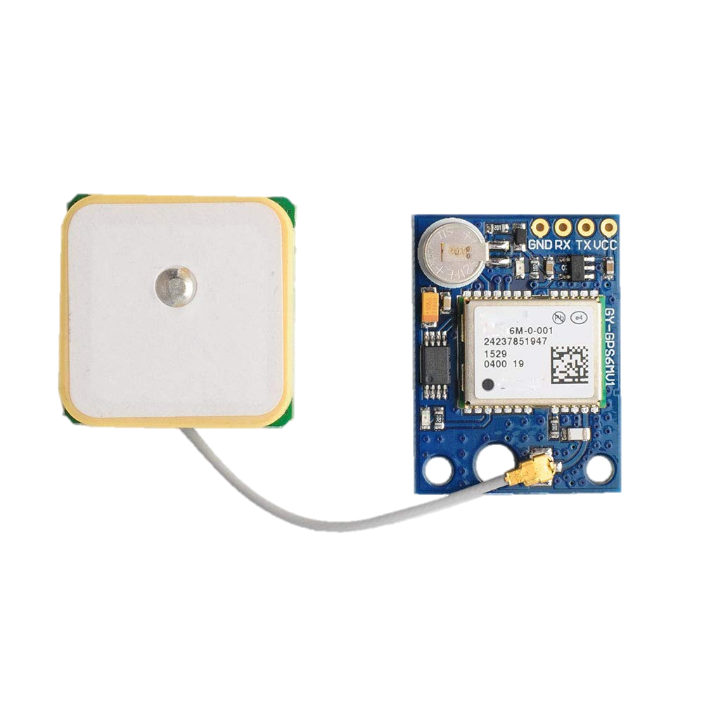
GPS Module - neo-6m
Inexpensive module.
Low power consumption.
Very accurate.
Comes with an antenna.
 | NEO-6M | EM-506 | SparkFun Venus
Dimensions | 36mmx26mmx4mm | 30mmx30mmx11mm | 30mmx18mmx14mm
Power | 3.6-5V 39mA | 4.5-6.5V 45-55mA | 3.3V 29mA
Accuracy | 2.0m | 2.5m | 2.5m
Refresh Rate | 5Hz | 1Hz | 20Hz
Cost | $15.95 | $39.95 | $49.95
Antenna Included | Yes | Yes | No

Slide 18
Wireless communication

Slide 19
Type of technology
 | Bluetooth | WiFi | RF
Power Consumption | 2 | 1 | 2
Range | 1 | 2 | 3
Cost | 3 | 2 | 1
Reliability | 1 | 2 | 3
Frequency | 2 | 2 | 3
 | 9 | 9 | 12
 |  |  | Best | 3
 |  |  | Moderate | 2
 |  |  | Worst | 1

Slide 20
Different types of rf modules
Specs\RF Module | SMAKN® 433 MHz | APC 220 | nRF24L01+ 2.4GHz Wireless Transceiver
Power Consume | 3V-12V | 3.5-5.5V | 1.9-3.6V
Air Data Transfer | <9.6 Kbps | 2400 - 19200bps (9600bps default) | 250kbps
Cost | $16 (Antenna included) | $35 | $12
Range | 500m | 1000m | 100m
Reliability | 1 | 3 | 2
Easy Implementation | 3 | 2 | 1
Best | 3
Moderate | 2
Worst | 1

Slide 21
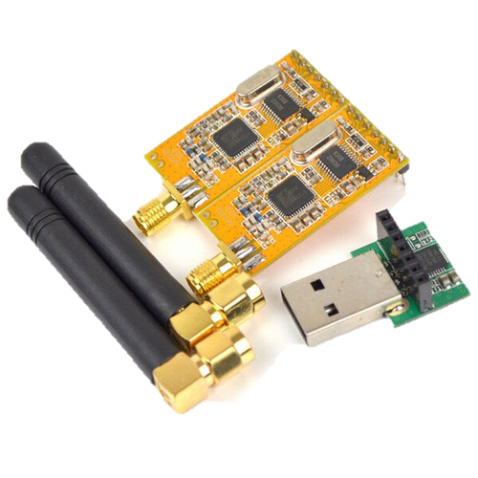
Rf module - apc220
Frequency of operation of 433 MHz
Tested over 100 meters in neighborhood area
Air Data Transfer of 192000bps
Highly reliable and easy to implement
Low Power Consumption
More than 100 Channels
Dimensions | Price | Power | Line of Sight Range | Output Power
37 X 17 X 6.5 mm | $30 | 3.5-5.0V | 1000 meters | 20 mW

Slide 22
Microcontroller unit

Slide 23
Microcontroller unit
Processor | UART | Memory | Price
Atmega2560 | 4 | 256KB | $12.20
Atmega328P | 1 | 64KB | $5.31
ARM Cortex A53 | 4 | 128KB | $65.41
MSP430 | 2 | 55KB | $19.59

Slide 24
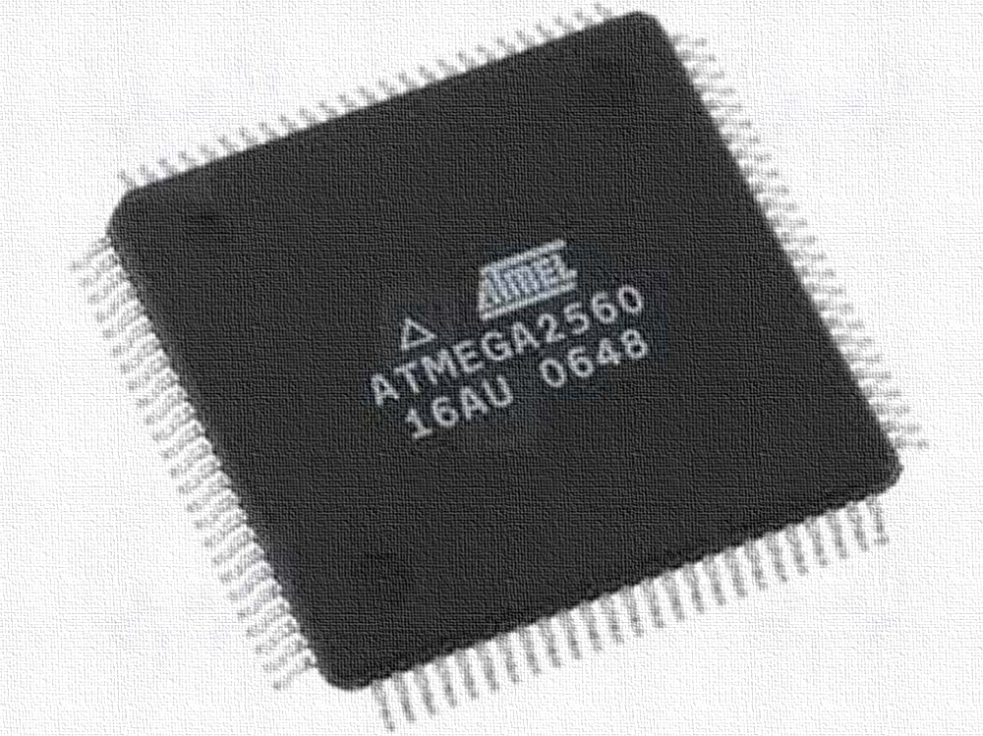
AtmEga 2560-16au
RISC Architecture
UART, SPI, I2C, JTAG
86 GPIOs
High speed data transfer through the RF modules.
Add sensors for future development
Notes:
A Reduced Instruction Set Computer architecture, is one whose instruction set architecture (ISA) allows it to have fewer cycles per instruction (CPI)

Slide 25
software

Slide 26
Software
Module integration and data sampling (C, C++)
Health Standards algorithms (Data processing logic)
Network transfer and Error checking (C, C++)
Graphical User Interface (Java)
Geographical Interface (Java)

Slide 27
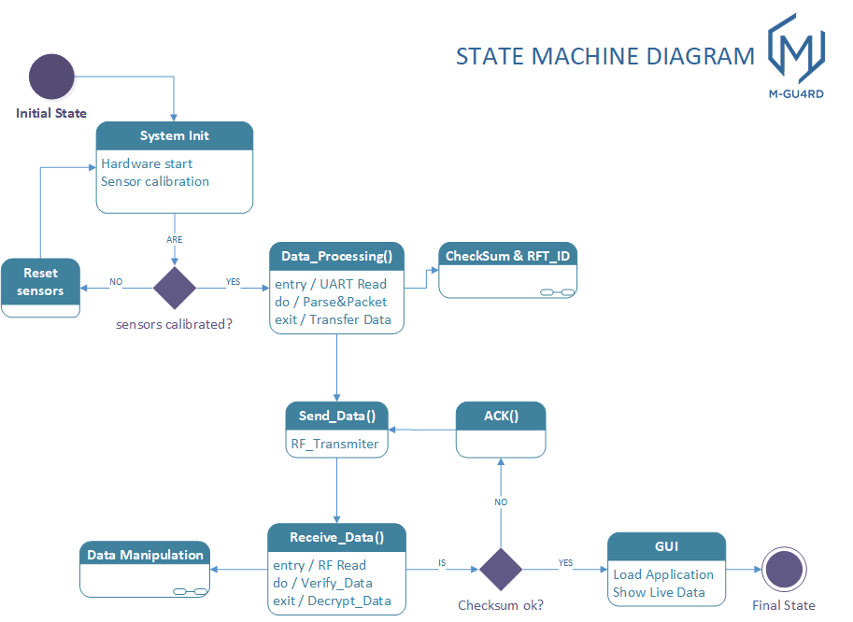

Slide 28
Graphical user interface (GUI)

Slide 29
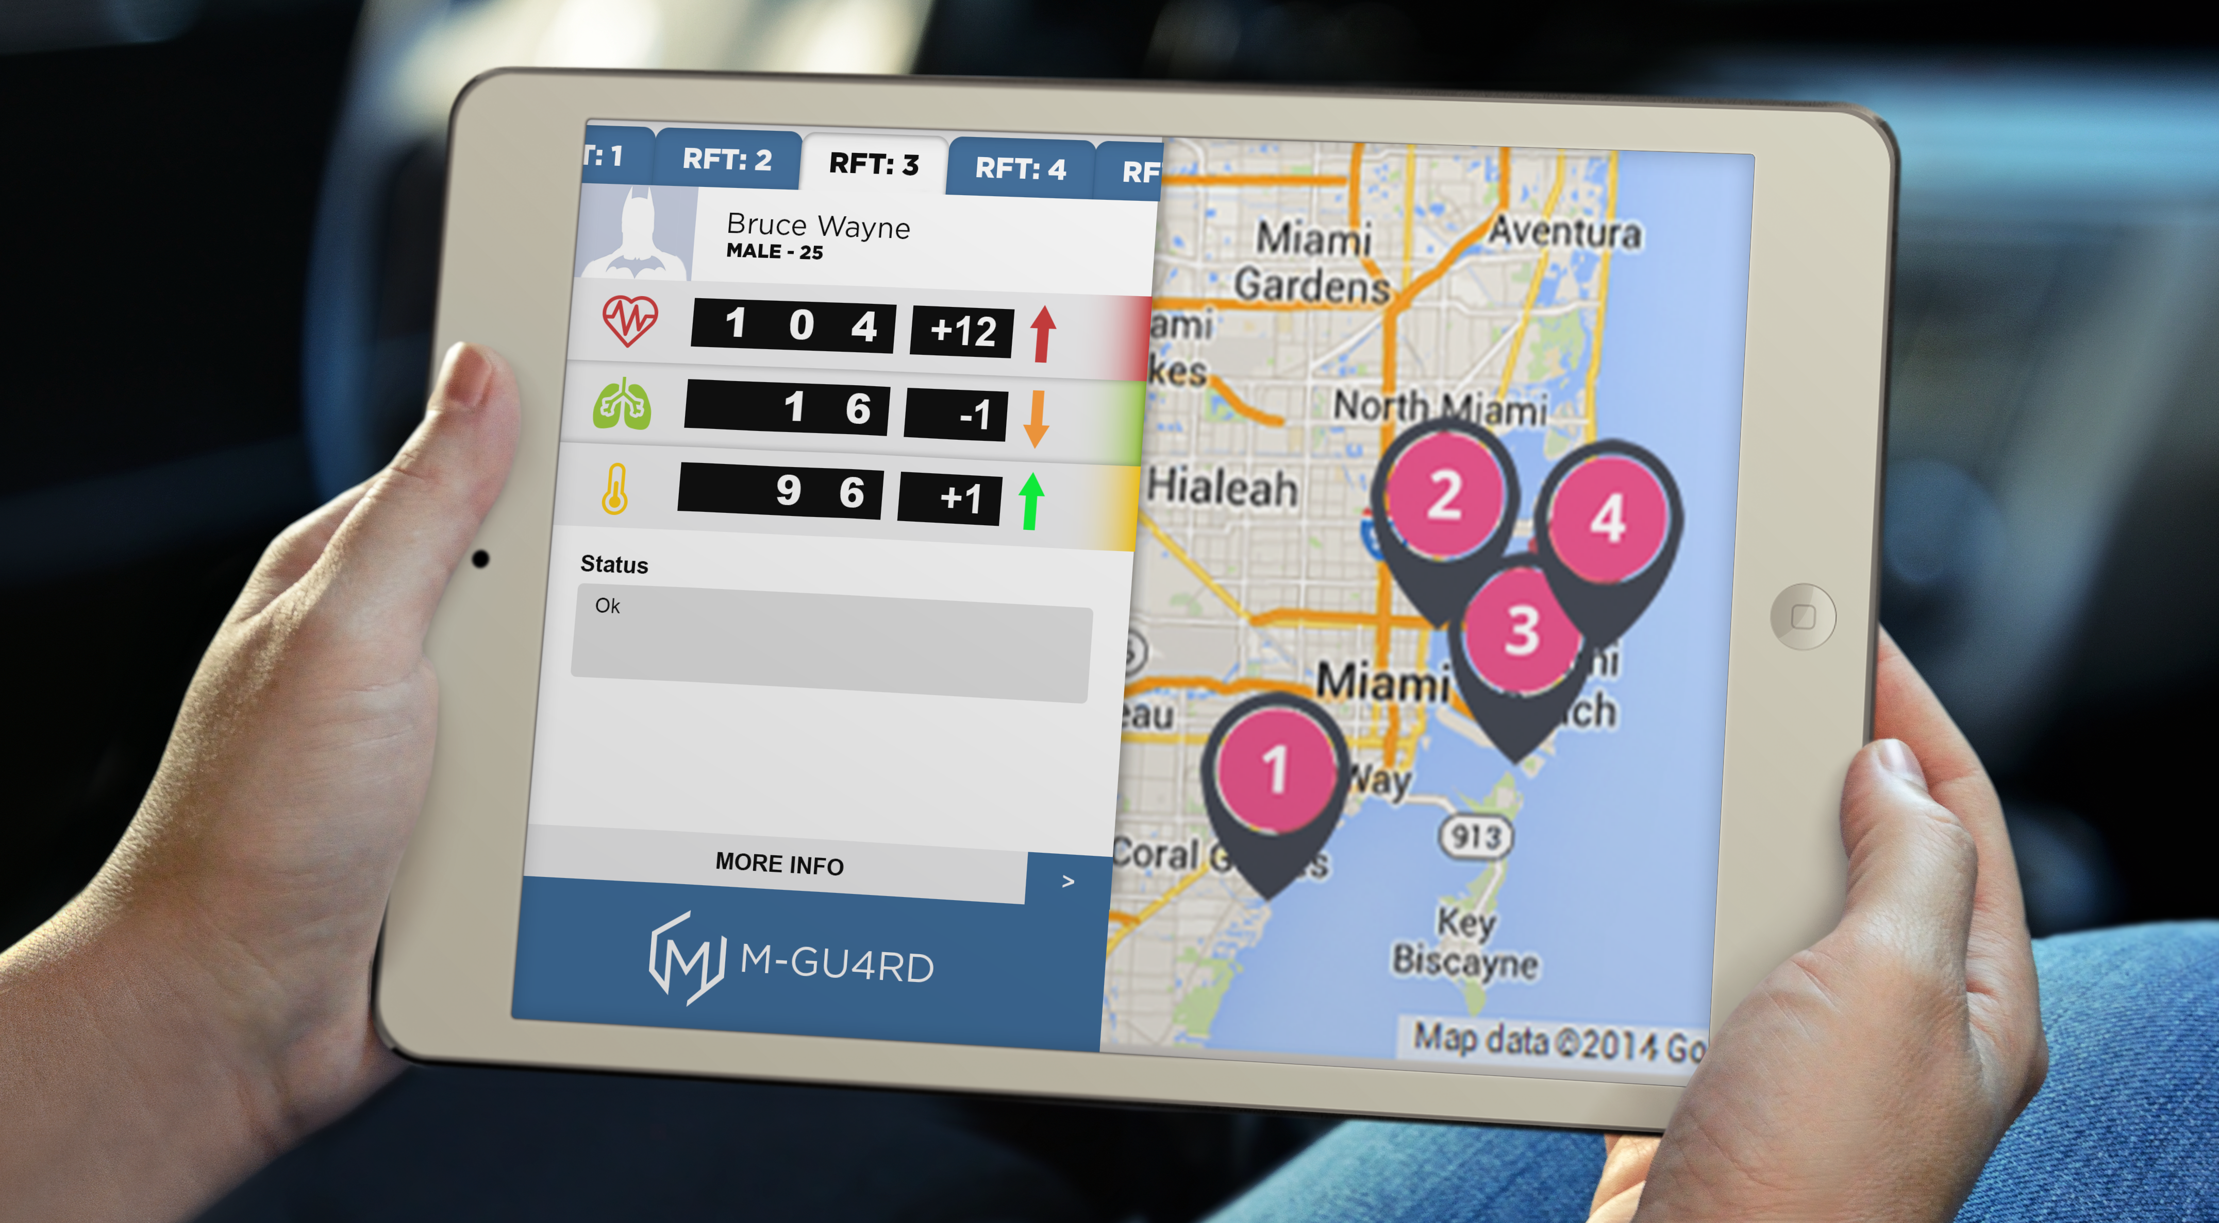
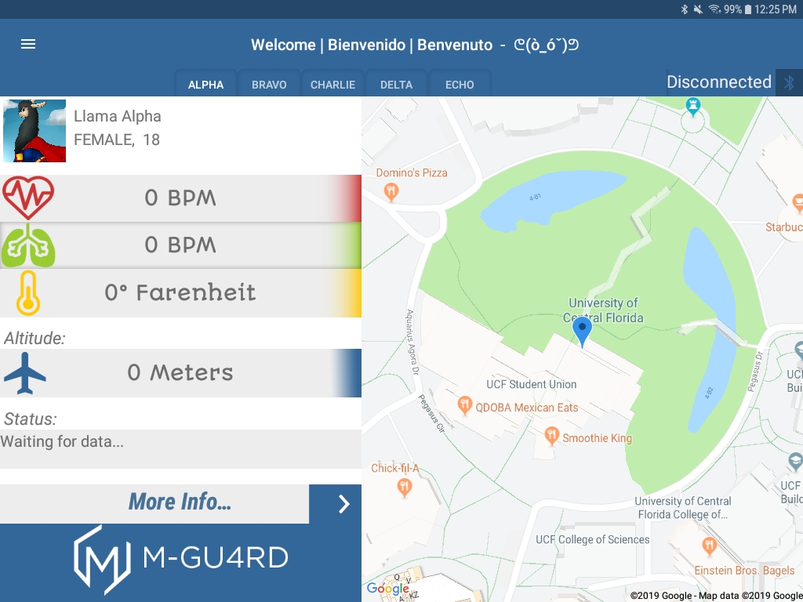
Graphical user interface
Notes:
BAT-MAAAAAAN!

Slide 30
Casing

Slide 31
Case design
Material chosen Acrylonitrile butadiene styrene (ABS) resistant to up to 105 °C (221 °F)
Open case to extract the batteries if needed
Multiple openings for Barrel Jack and Sensors

Slide 32
power

Slide 33
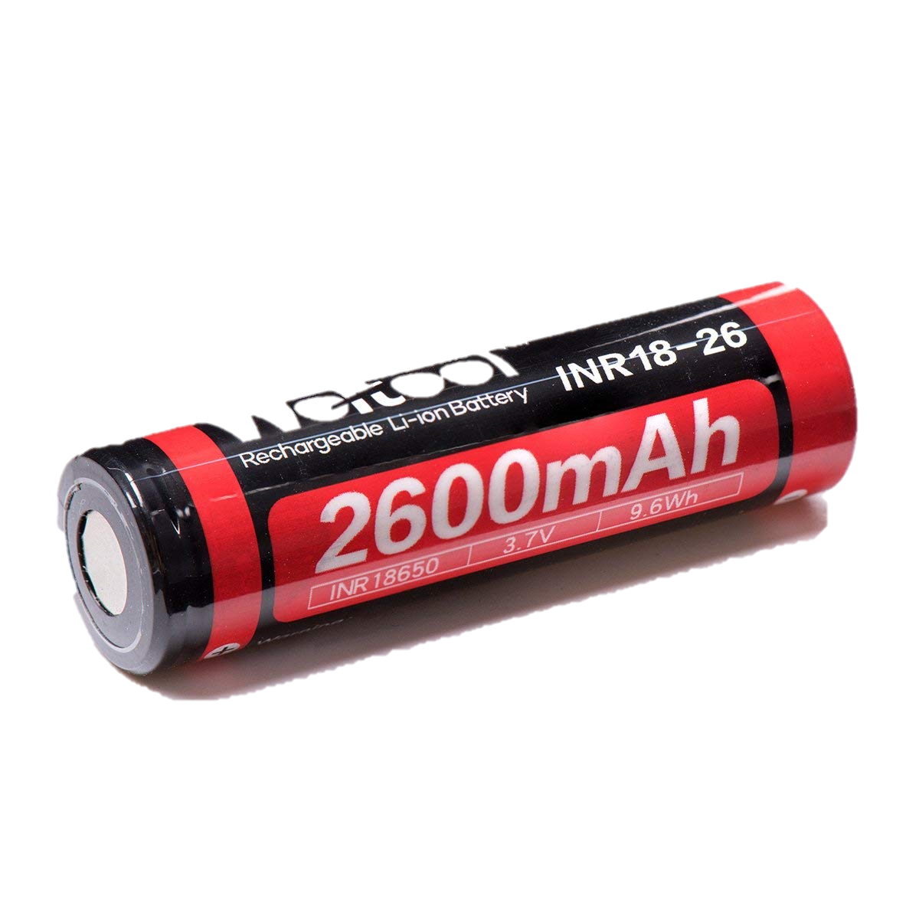
Battery
18650 3.6V Lithium Ion Battery 2600mAh x2 (connected in series)
Rechargeable, light weight, small size, large charge for application.
Cost: $7.59/unit
>4 hour battery life.

Slide 34
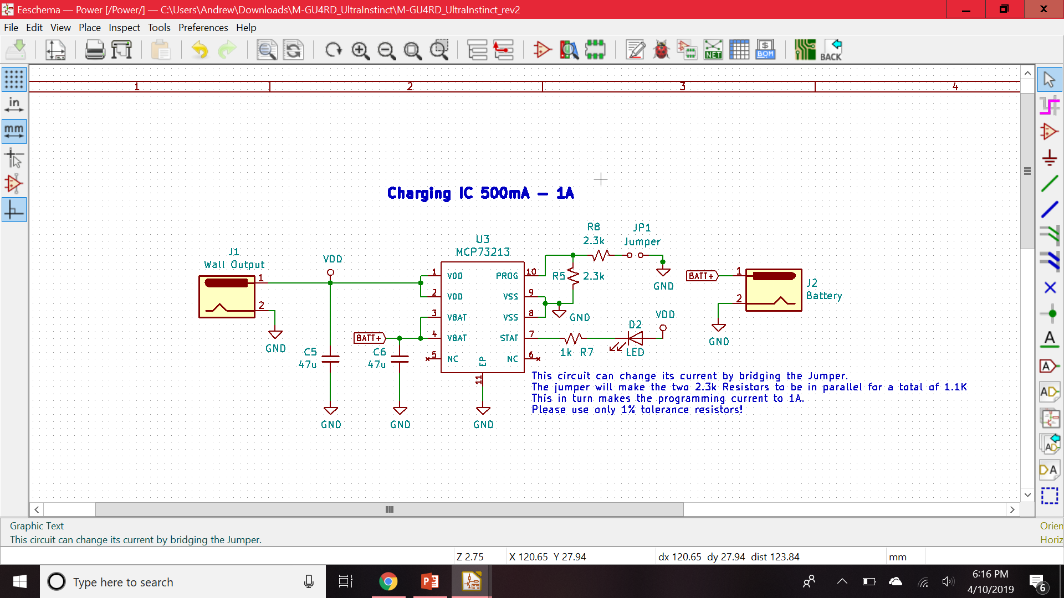
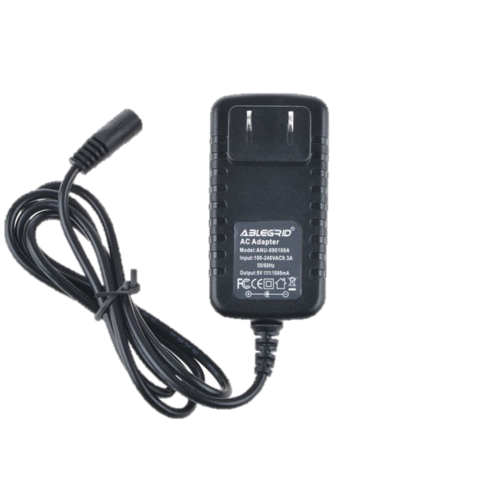
Battery Charging Circuit
MCP73832 – Lithium Ion Charge Management Controller.
AC wall adapter inputs 9V to the charging circuit.
Programmable resistor to set charge current.
Notes:
- Gio, fix writing since we are using a different charging circuit

Slide 35
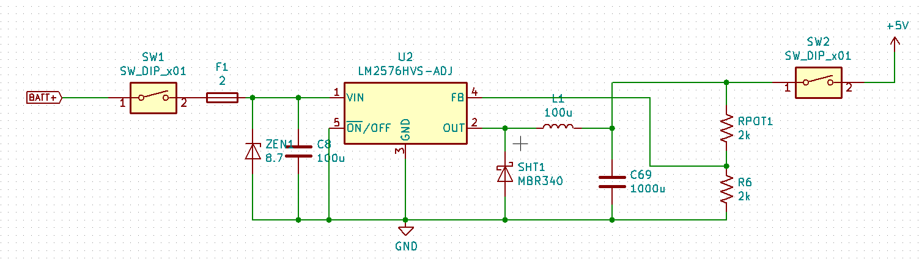
Buck Converter
LM2567-ADJ – Adjustable Switching Buck Converter.
1N5238B – 8.7V Zener Diode.
PPTC 2A Resettable Fuse.
Notes:
- Gio, fix writing since we are using a buck instead of boost

Slide 36
Schematics and pcb

Slide 37
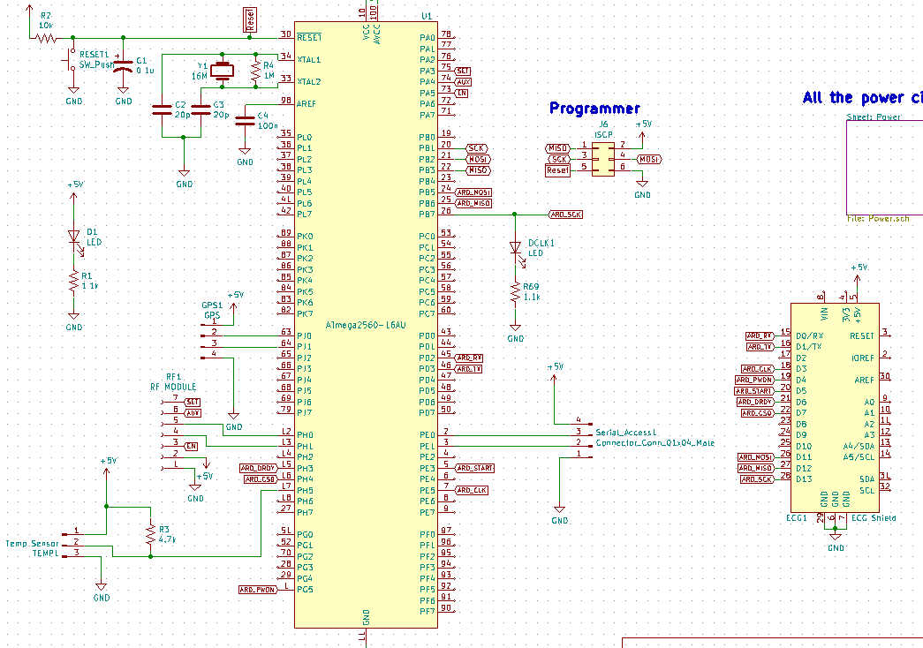
Schematics

Slide 38
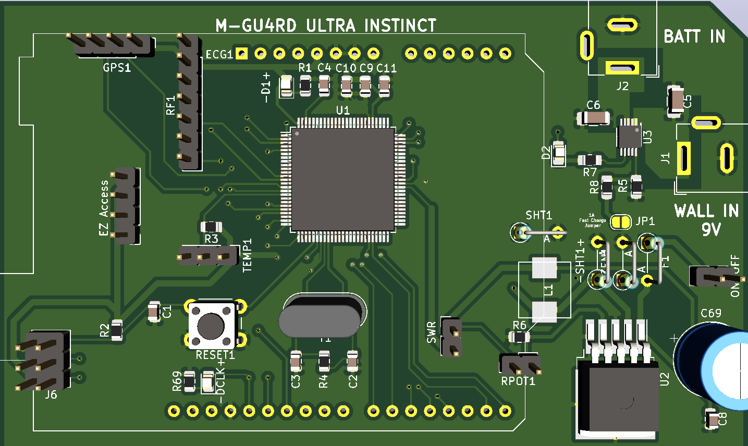
Pcb 3D Model

Slide 39
administrative

Slide 40
Engineering standards and Constraints (ABET)
Health Insurance Portability & Accountability Act (HIPAA)
FCC Constraints
Software Standards (ISO/IEC/IEEE)
  ISO/IEC 9899 the C standard
  OpenCL (Open Computing Language) framework
Economic and Time Constraints

Slide 41
WORK DISTRIBUTION
 | Power | Sensors | Software/GUI | Wireless Communication | PCB
Angello | Secondary |  |  | Primary | Secondary
Andrew |  | Primary | Secondary |  | Secondary
Giovanni | Primary | Secondary |  |  | Secondary
Italo |  |  | Primary | Secondary

Slide 42
Budget and financing
Component | Unit Cost
3.6V Lithium Ion 18650 Battery 2600mAh (x2) | $7.59
9V 3A AC Wall Adapter | $10.05
Atmega2560 Chip | $12.20
NEO-6M GPS Module | $15.66
ADS1292R ECG/Respiration Shield | $46.73
DS18B20 Digital Temperature Sensor | $2.32
APC220 RF Module | $24.58
PCB | $18.33
LM2576-ADJ Switching Buck Converter | $2.03
MCP73832 Battery Management Chip | $0.57
Resistors/capacitors etc. | $14.52
TOTAL UNIT COST | $162.17
Component | Cost
3.6V Lithium Ion 18650 Battery 2600mAh (x2) | $15.18
9V 3A AC Wall Adapter | $10.05
Atmega2560 Chip (x2) | $24.40
NEO-6M GPS Module | $15.66
ADS1292R ECG/Respiration Shield | $46.73
DS18B20 Digital Temperature Sensor | $15.00
APC220 RF Module | $24.58
PCB (x8) | $97.76
LM2576-ADJ Switching Buck Converter | $4.06
MCP73832 Battery Management Chip | $1.71
Resistors/capacitors etc. | $76.64
Battery Holder | $2.60
5V 3A AC Wall Adapter | $9.95
TPS61230A 5V Boost Converter (x2) | $4.12
TOTAL DEVELOPMENT COST | $348.44
Notes:
ADD 3rd column or another slide for R&D

Slide 43
Challenges
Issues with calibrating the ECG sensors
Issues with calibrating the respiratory sampling data
Problems integrating drivers for RF modules with multiple mobile OS
Problems implementing multiple radio frequencies selection
Problems feeding the proper power to the multiple devices

Slide 44
Future developments
Improve ECG for proper calibration
Add more features such as Gas sensor, panic button and Altimeter
Reduce size of PCB and Case
Continue development on the GUI to add more features

Slide 45

Questions?

