Slide 1
Reduced Gravity Flight: TEARDR0P
Group 32
Andrew Brahim, EE
Jourdain Francis, CpE

Slide 2
Motivation
Low cost reduced gravity experimentation
Other methods include the use of the the NASA Zero Gravity Flight (the “Vomit Comet”), Drop towers, the International Space Station
Time effective testing and availability
Further expansion of the use of drones in industry

Slide 3
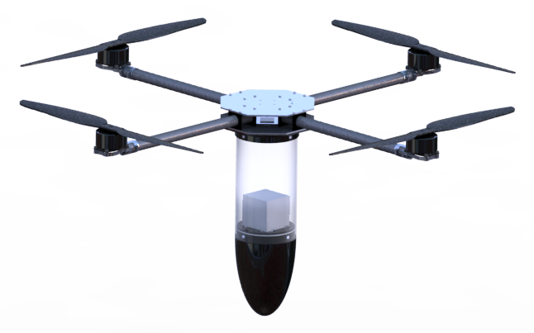
Goals and Objectives
A quadcopter capable of simulating a reduced gravity environment
A Terrestrial Experimentation and Research Drone Regulating 0-G Parabola [TEARDR0P]
Autonomous flight missions
Carry a small payload for experimentation
Datalog sensor readings and process them into an easily understandable format

Slide 4
Specifications & Requirements
Parameter | Specification
Reduced Gravity Time | 2.5-7.5 secs
Reduced Gravity Environment | 10⁻⁵-10⁻¹G
Maximum Drop Height | 400ft
Payload Weight | <10lbs
Payload Dimension | 7.5in x 5.125in x 14.375in

Slide 5
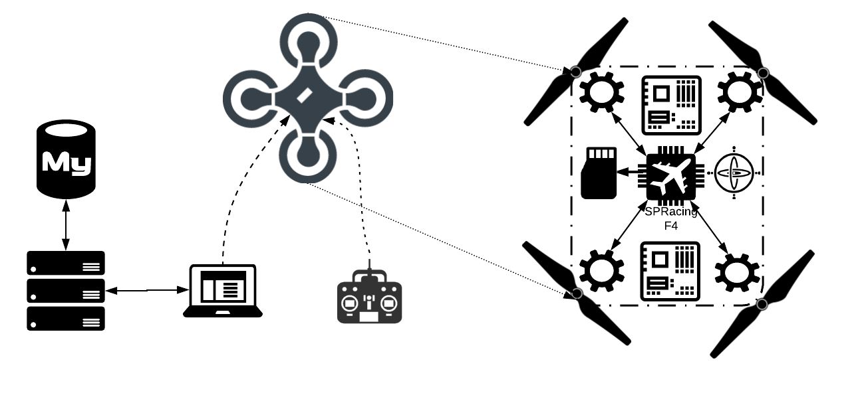
Top Level Diagram

Slide 6
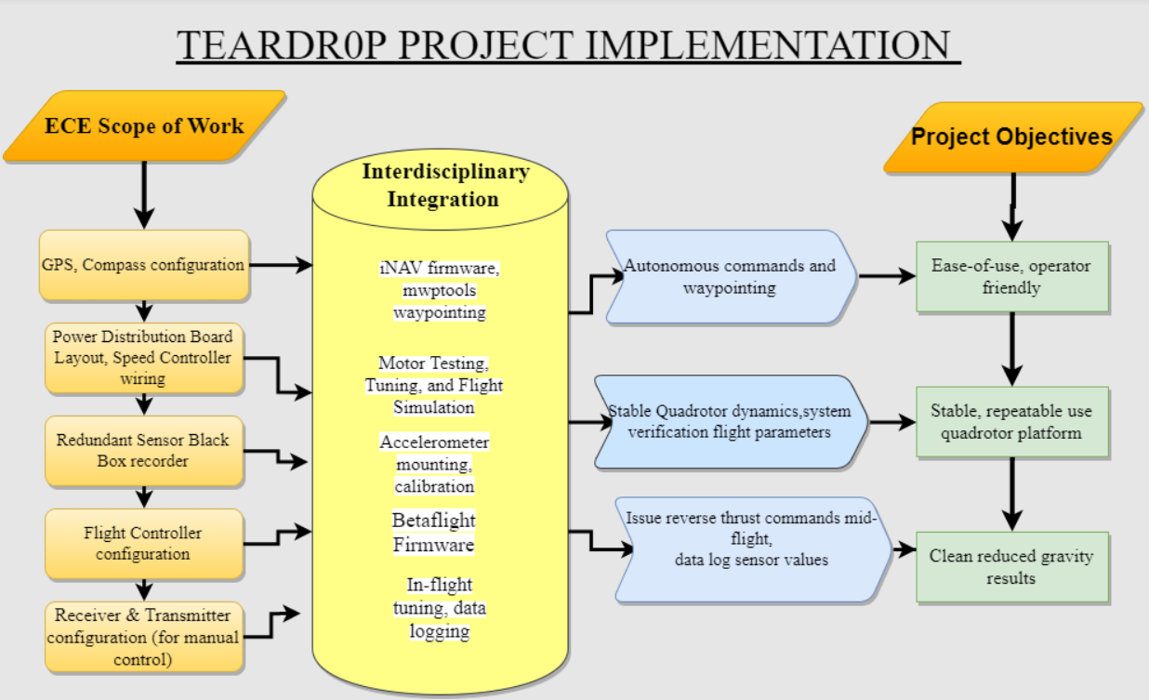
Interdisciplinary Implementation

Slide 7
Flight Systems

Slide 8
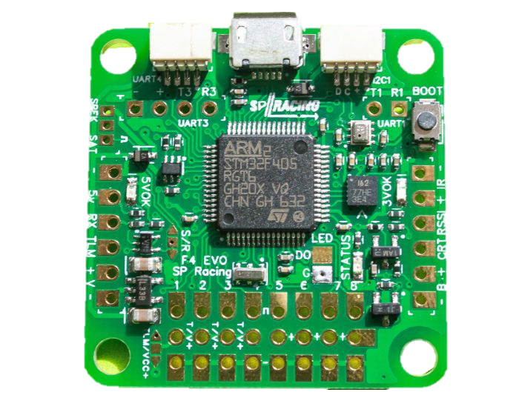
Flight Controller
SP Racing F4 EVO vs 3DR Pixhawk Mini
Parameter | SP Racing F4 Evo | 3DR Pixhawk
GPS | Not included (Hardware can be added) | Yes
Autopilot | Available through external means | Yes
Onboard IMU | ICM 20602 IMU | ICM 2060
Barometer | BMP280 | MS5611
Processor | STM32405, ARM | STM32F427, ARM
Compatible Software | Cleanflight/Betaflight BLHeli32 | Arducopter
Bidirectional Support | Yes | No
SD Storage | Yes | No
Cost | $37 | $250

Slide 9
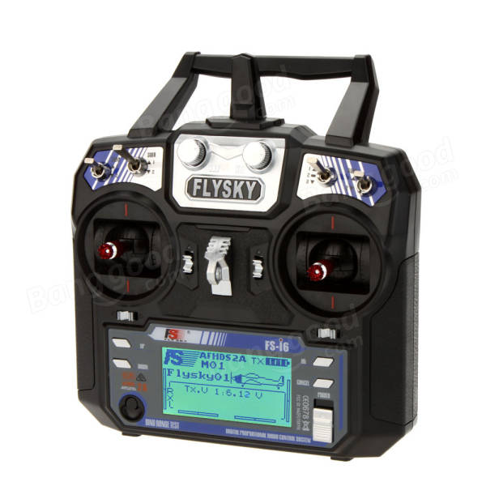
Receiver & Transmitter
FlySky FS-i6
6 Channel 2.4Ghz with telemetry
Bandwidth: 500KHz
Uses UART2/PPM
IBUS Telemetry
Receiver: 4.0-6.5V
Price: $36.99

Slide 10
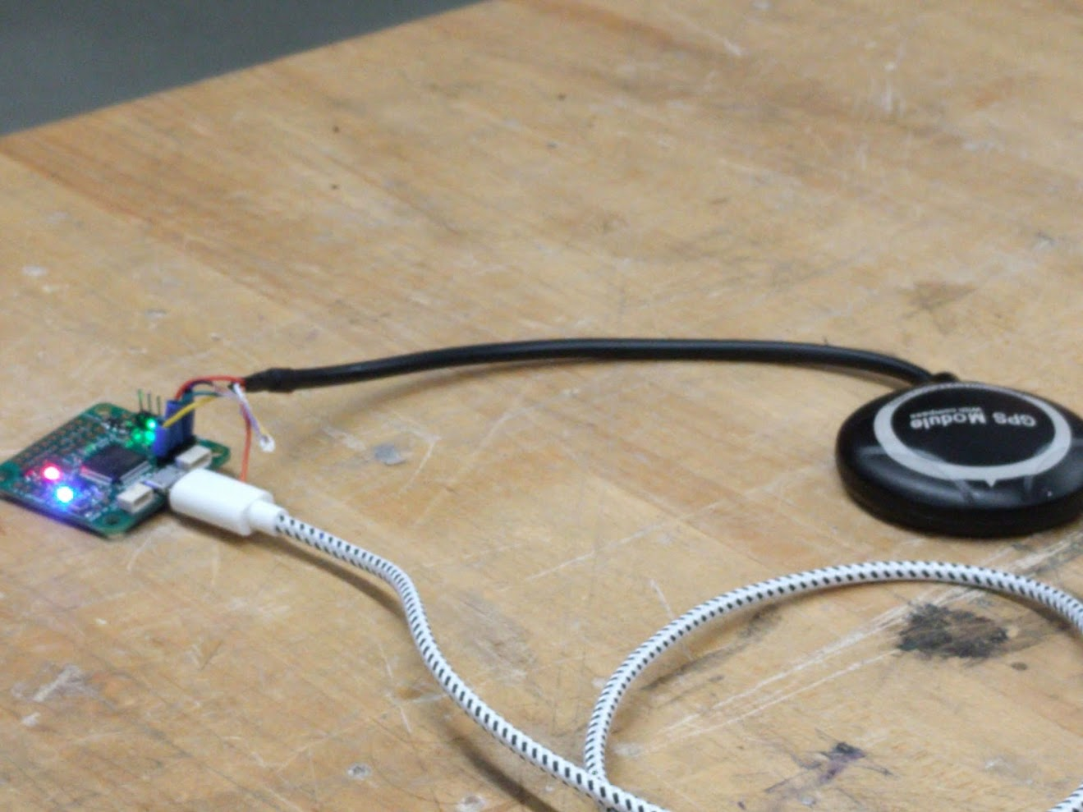
GPS
Ublox M8N
Accurate up to 2.5m
Heading accuracy of 0.5°
Velocity accuracy of 0.1 m/s
Maximum altitude ceiling of 50,000 meters.
GPS accuracy may vary based on location of the test flight
GNSS (Global navigation satellite system) support

Slide 11
Power Distribution & ESCs

Slide 12
Battery
Lumenier 16000mAh LiPo Battery
Parameter | Specification
Voltage / Cell Count | 22.2V (6 Cell)
Capacity | 16000mAh
C-Rating | 20c – Burst 40c
Discharge Plug | EC5
Weight | 2010g
Price | $269.99

Slide 13
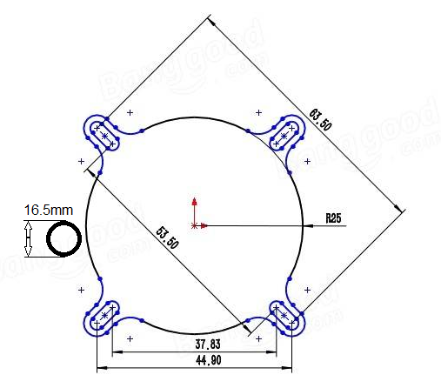
Power Distribution
Lantian 7oz 200A
Hobbywing 5V/3A Switching Regulator (UBEC)
Price: $5.55
Supplies battery voltage to ESC’s and UBEC
V
DC-DC regulator supplied with a 2-6 cells lithium battery pack
Supplies safe and consistent voltage for flight controller and receiver
Input: 5.5V-26V
Price: $2.99

Slide 14
Speed Controllers
Lumenier BLHeli_32 51A
Input: 2-6s LiPoly
Constant: 51 A
Burst: 80 A
BEC: No BEC
DSHOT 1200 protocol
Bidirectional mode
Latest Bl Heli 32 firmware
GD32 ARM Cortex-M MCU, 72mhz clock speed, PWM freq 48khz

Slide 15
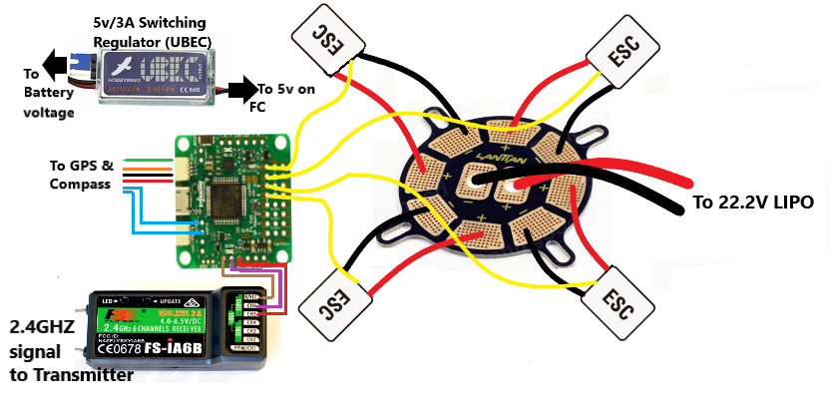
Power Distribution Board Wiring

Slide 16
Black Box Sensor

Slide 17
Black Box Sensor/ PCB
Arduino based
Added redundancy to the sensor capabilities
MPU 9250 9-axis (Gyro + Accelerometer + Compass)
Raw data stored into an SD Reader
Makes up for lack of redundancy when choosing SP Racing F4 EVO over the 3DR Pixhawk Mini
Has DC power jack for 9-volt battery box power source
Can also be powered from main PDB (contingency: to save all-up weight)

Slide 18
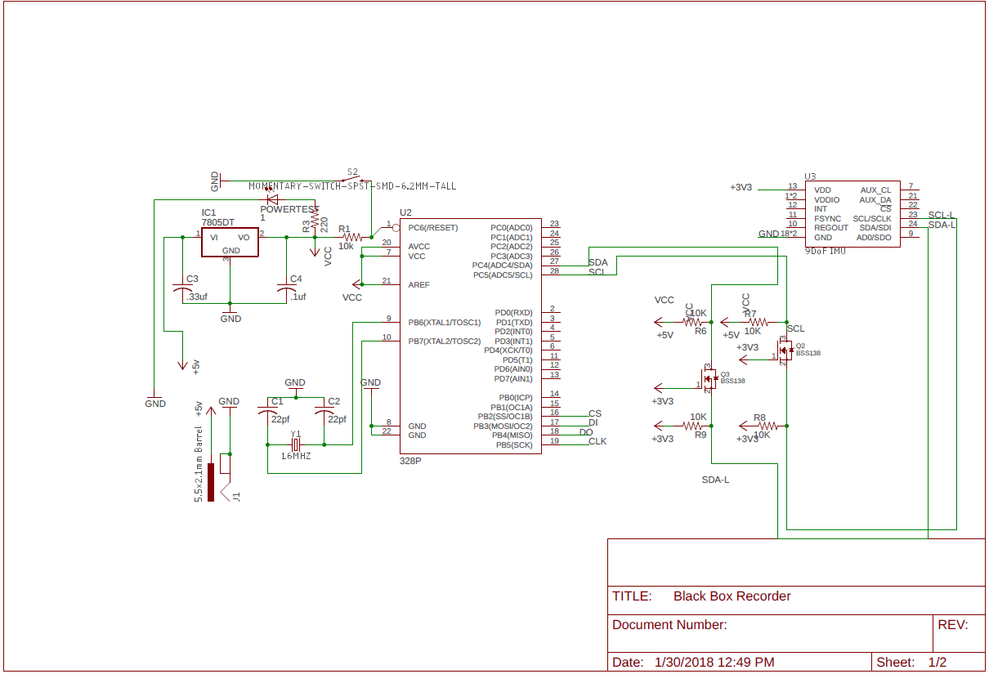
Black Box Sensor/ PCB Schematic
Notes:
We can highlight different parts to explain and expand this to multiple slides

Slide 19
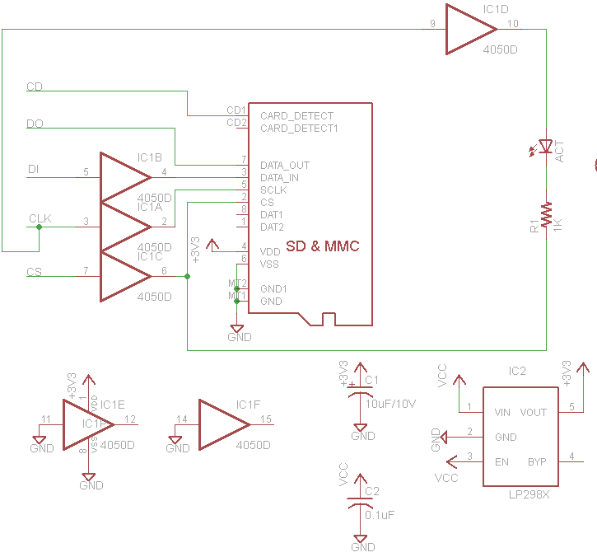
Black Box Sensor/ PCB Schematic
Notes:
We can highlight different parts to explain and expand this to multiple slides

Slide 20
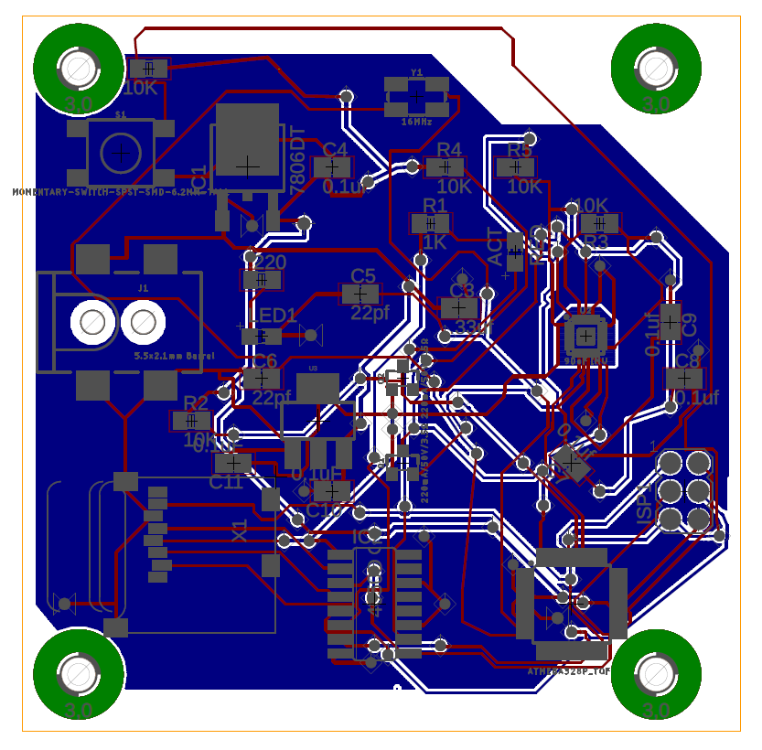
Black Box Sensor/ PCB Layout
Notes:
We can highlight different parts to explain and expand this to multiple slides

Slide 21
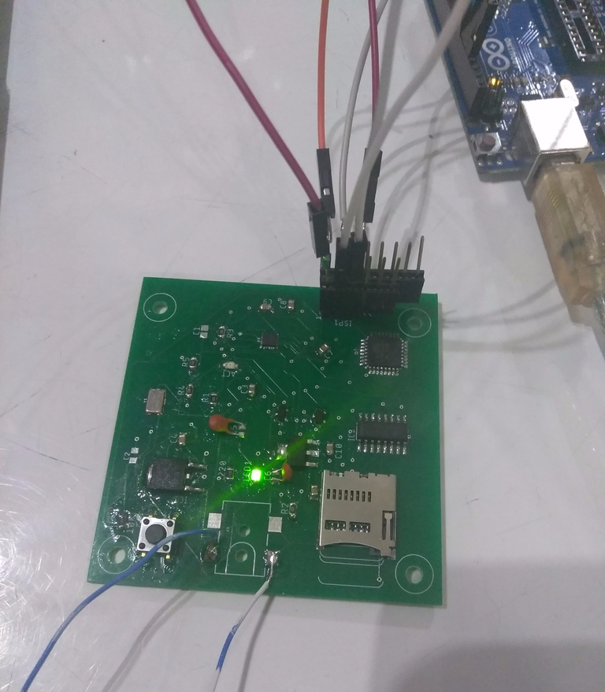
Black Box Sensor/ PCB Final Board
Notes:
We can highlight different parts to explain and expand this to multiple slides

Slide 22
Software
Flight Controller Configuration - Betaflight
DSHOT Commands
BLHeli_32 Passthrough and Telemetry Support
SP Racing F4 EVO compatible
Automatic Notch Filtering
Blackbox Logging
Failsafe configuration

Slide 23
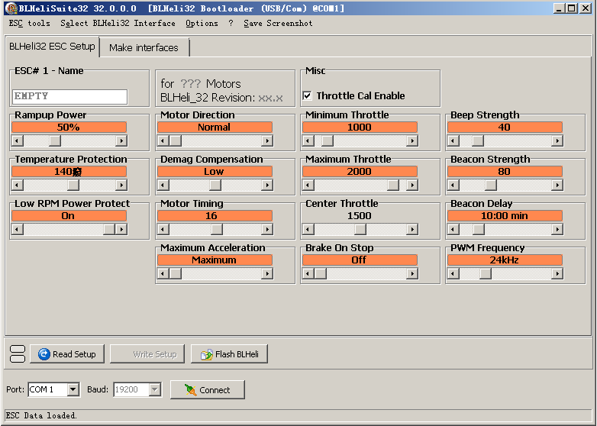
Software
ESC Controller Configuration – BLHeli_32
Configure the onboard speed controller using a Betaflight passthrough
Direct configuration of ESC from flight controller with DSHOT commands
Motor calibration

Slide 24
Software
Drone Autopilot Software– iNAV & MWP
Waypoint missions
Physically map and trace out the course of action for the quadcopter drone
Needed for GPS modes: external GPS, magnetometer, barometer
MWP allows for uploading XML Mission Scripts

Slide 25
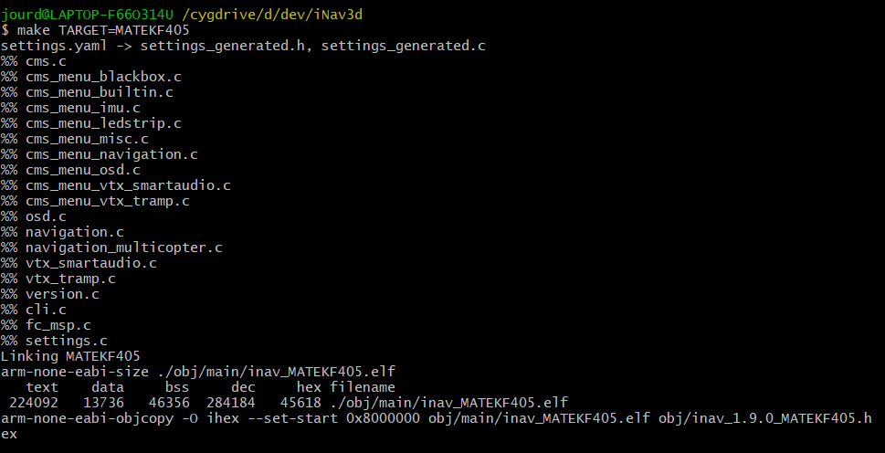
Software
Drone Autopilot Software– iNAV3D
Custom firmware developed by KenImhof, branched from iNAV
Incorporates features to enhance 3D navigation beyond base iNAV, i.e. reverse thrust control
Modification to the iNAV3D navigation code was needed to achieve desired microgravity results

Slide 26
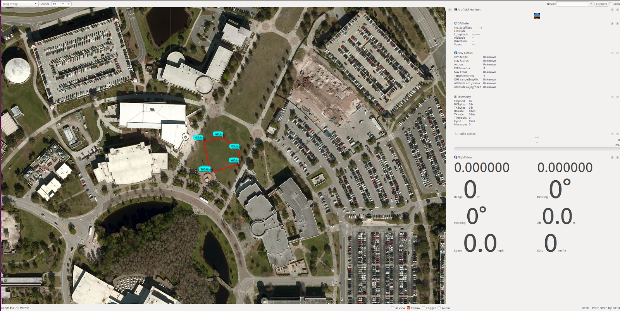
Software
Drone Autopilot Software– iNAV & MWP

Slide 27
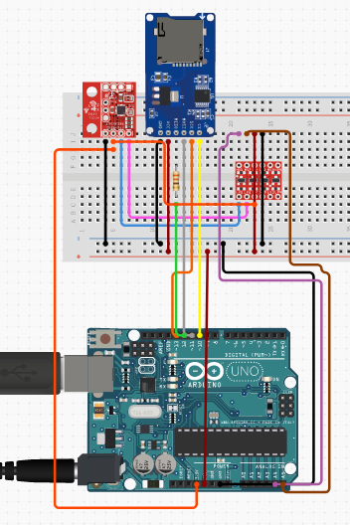
Testing & Simulation
Blackbox Protoyping

Slide 28
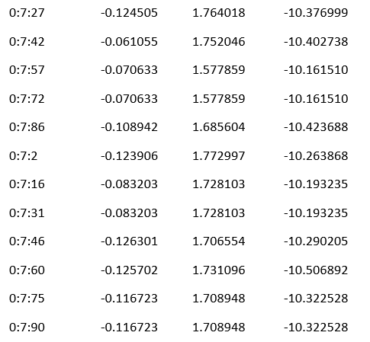
Testing & Simulation
Notes:
We can highlight different parts to explain and expand this to multiple slides

Slide 29
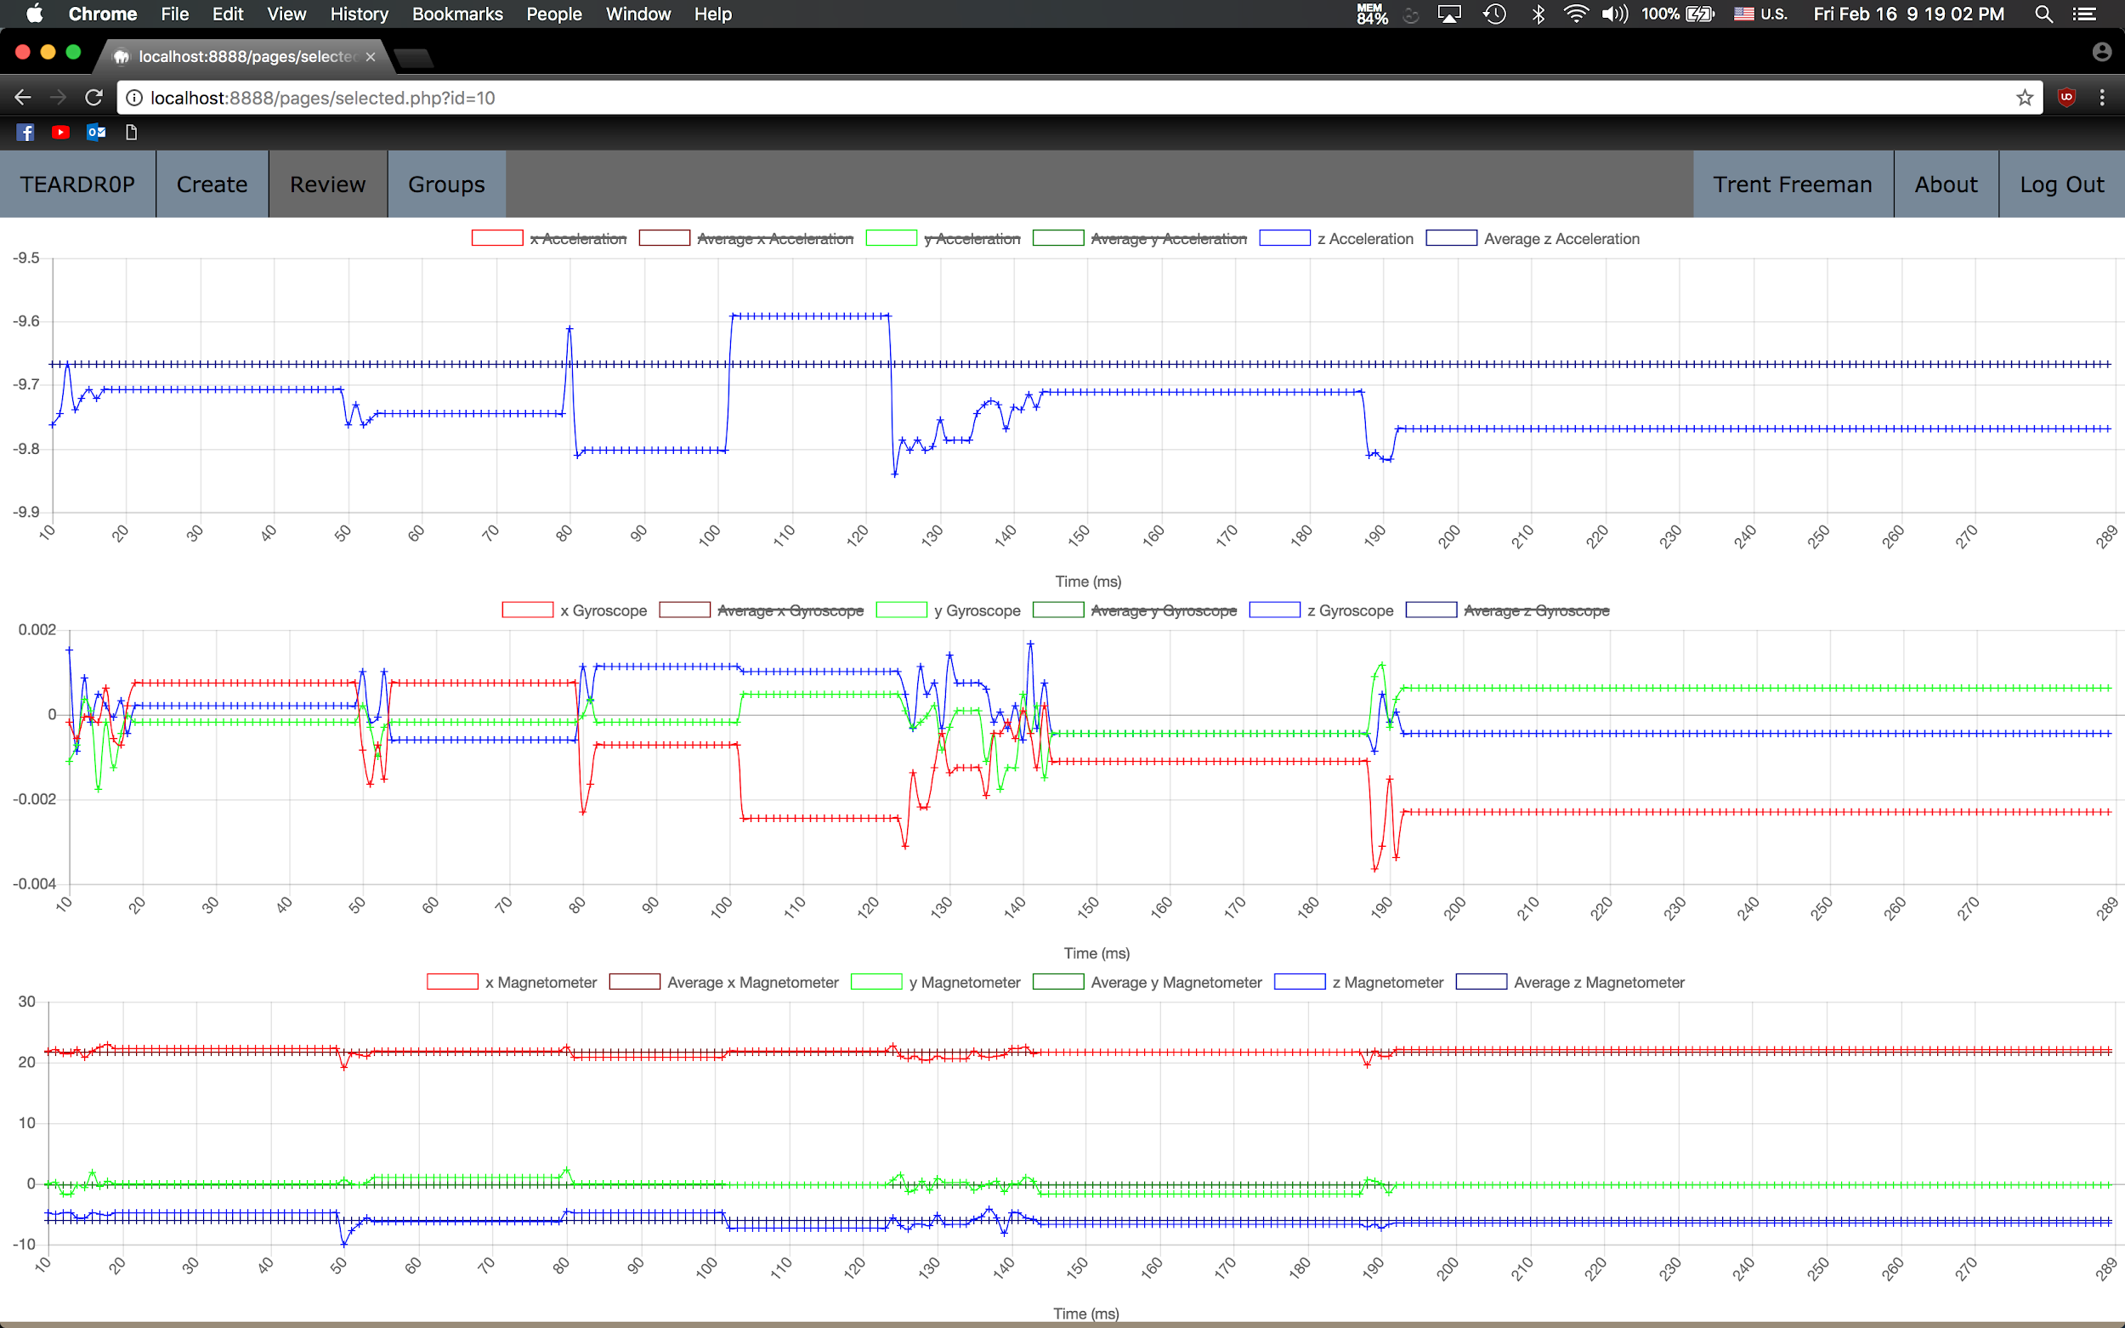
Testing & Simulation
Notes:
We can highlight different parts to explain and expand this to multiple slides

Slide 30
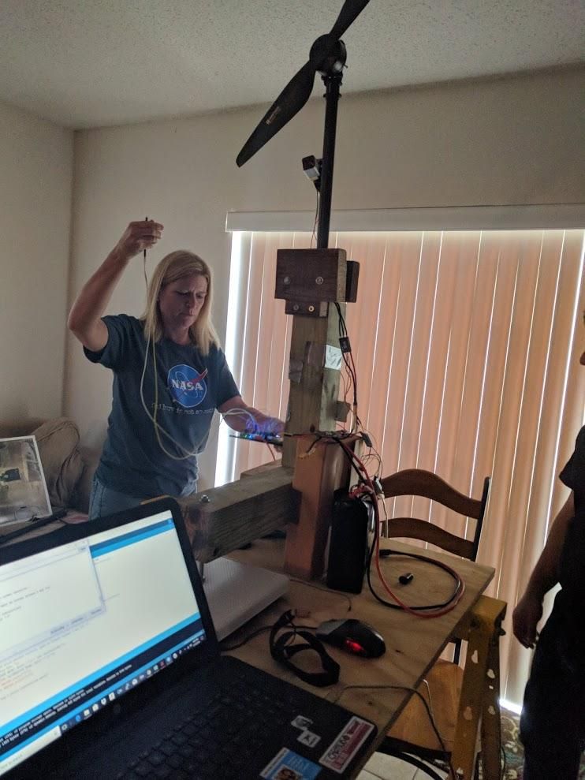
Testing & Simulation
Thrust and Torque Testing – Integration with MAE
Thrust Rig
Measures weight from thrust on analog scale
Comparator circuit with phototransistor to measure RPM
Arduino used to run motors

Slide 31
Testing & Simulation
Thrust and Torque Testing – Integration with MAE

Slide 32
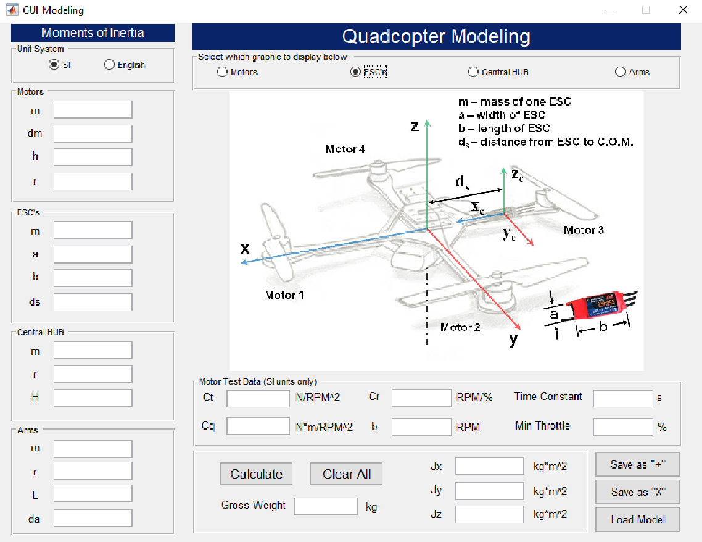
Testing & Simulation
MATLAB Simulink & FlightGear
Motivation: Ability to test various control system approaches to best obtain clean reduced gravity, and iron out kinks in our flight dynamics
FlightGear enables a fully-fledged simulation of our craft in certain simulated scenarios
Flight dynamics uses our drone dimensions
Thrust and torque calculations fed into the data analyzer in the Quad Sim GUI MATLAB application
Quad Sim attitude simulation to test hovering with yaw, roll, and pitch responses
Create aerospace blocks in Simulink and then simulate in flight gear

Slide 33
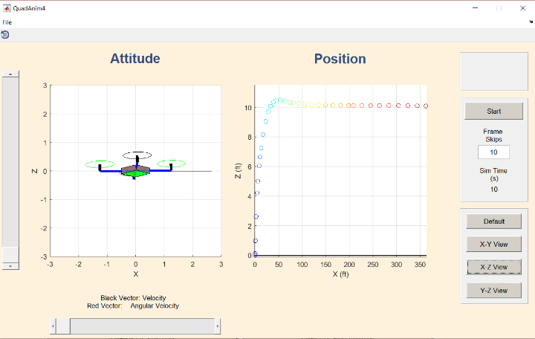
Testing & Simulation

Slide 34
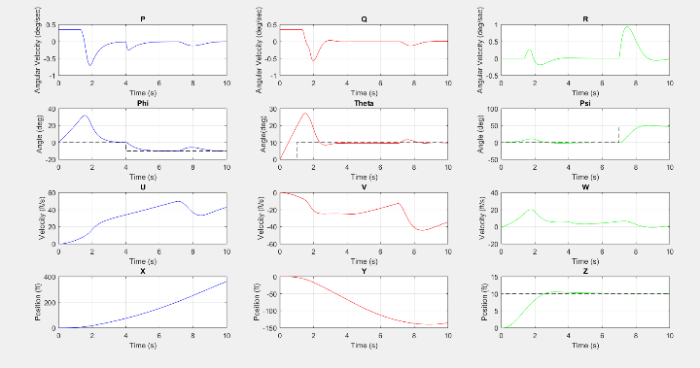
Testing & Simulation

Slide 35
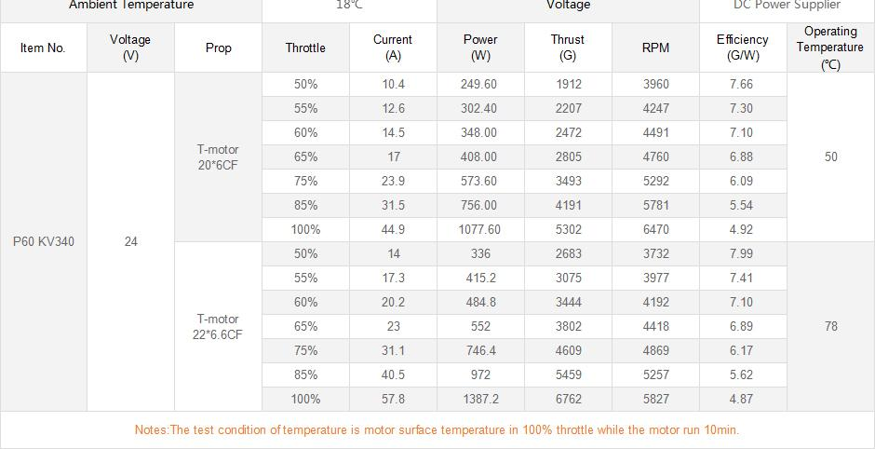
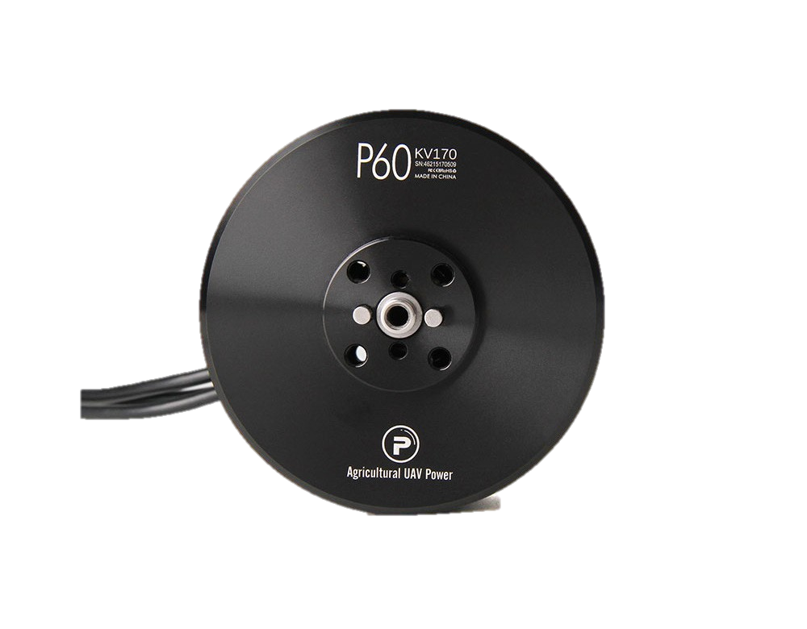
Interdisciplinary Implementation-MAE
Motor: P60 KV340
Propellers: P22x6.6 Prop
Arms: Carbon Fiber Tubing

Slide 36
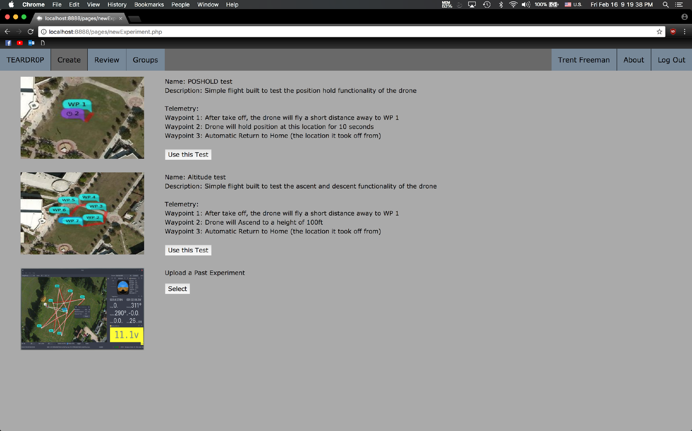
Interdisciplinary Implementation-CS
WebApp implements:
Connecting PC to drone via USB
User sign-in
Mission Selection
Remote launch using FlySky FS-i6
Auto Abort Sequences in case something goes wrong
Collect, store, and display flight information

Slide 37
Test Flights

Slide 38
Administrative Content

Slide 39
Work Distribution
Name | Power Distribution | PCB | Simulation | Prototyping/Data Collection | Firmware Integration/Configuration
Andrew | X | X | X
Jourdain |  |  | X | X | X

Slide 40
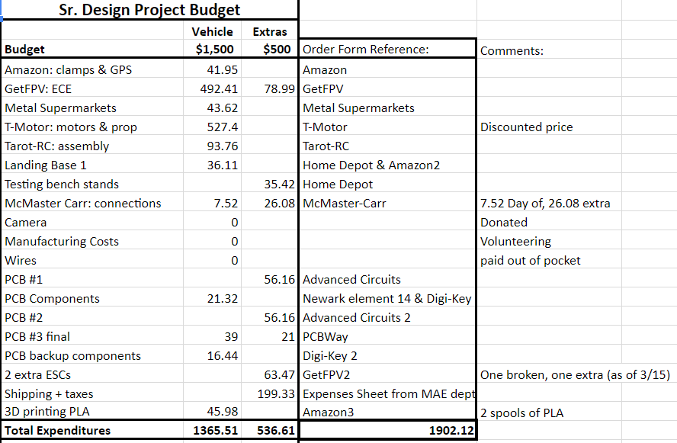
Overall Budget

Slide 41
ECE Budget
Item | Cost | Quantity
SP Racing F4 EVO | $37 | 1
FlySky FS-i6 (tx & rx) | $37 | 1
Ublox M8N GPS | $26 | 1
Lumenier 16000mAh LiPo Battery | $270 | 1
Lumenier BLHeli_32 51A | $25 | 6
Lantian 7oz 200A | $5.55 | 1
UBEC Regulator | $2.99 | 1
PCB | $54.32 | 3
Total | $691.51

Slide 42
Financing
Sponsored by Northrup Grumman
Total Budget: $2000 ($1500 for Build/ $500 for Testing)
Donation of wire and sample chips reduce cost

Slide 43
Issues
Delay in progress due to hardware issues (PDB short, blowing ESCs, PCB errors)
Bidirectional speed control support came at a cost of having to research and learn additional software/firmware suites to build an autonomous platform (piecemeal hardware, e.g. gps)
Custom firmware builds leads to instability, causes errors in typically straightforward procedures
Pilot availability limits testing days, flight location and constraints limits full scale testing of more advanced mechanisms

Slide 44
Questions?

