Slide 1
Team
RED
ROBOCOPTER
GROUP 28
Pamela Echevarria – EE
Jarryd Salas – EE
Branden Griffin – CE
Joey Velez-Ginorio - CE

Slide 2
Red Team
Robocopter
Interdisciplinary Project Consisting of
ME: Matthew Newman, Mathew Pistone, Jeremy Meehan,
Greg Potter
AE: Anton Keys, Christopher Vallee, Matthew MacAllister
EE: Pamela Echevarria, Jarryd Salas
CE: Branden Griffin, Joey Velez-Ginorio
CS: Tarek Medrano, Khandoker Ahmed, Angel Mercado
Tasked to design and build an autonomous drone who’s motivation is to have a defense vehicle that will not require human life to be at risk. This drone can detect other “prey” drones, attack them, avoid obstacles and transmit Live First Person view video to a ground station via wifi.

Slide 3
Goals & Requirements
Robocopter
Design and build an autonomous quadcopter
Size ≤ 4x4x4 ft.
Max budget of $2000 → $1500 for final as-demonstrated drone.
Quadcopter must have protective shell within required design limits
Transmit highlighted video imagery via wifi
Display algorithm used to identify/track prey
Be able to search, pursue, reset, and repair if necessary in attempt to cause a controlled collision with prey drones autonomously
Complete with as many points possible two 10 min rounds of competition

Slide 4
Hardware Parts

Slide 5
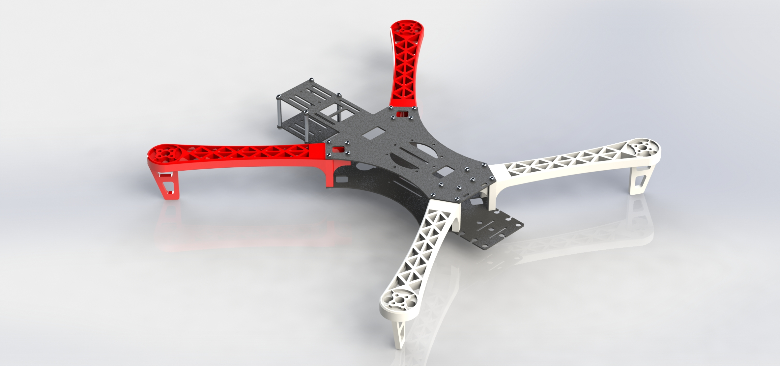
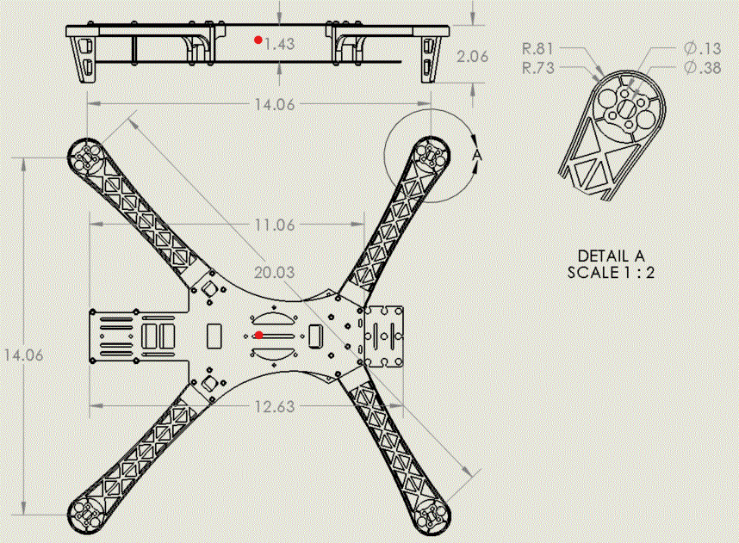
Frame
HJ MWC X-Mode Alien
Materials:
ABS Plastic (Arms)
Fiberglass (Body)
Aluminum (Hardware)
Propeller range: 10” - 12”
Total Weight: 347g
Ample Surface Area
Well balanced center of mass (red dot)

Slide 6
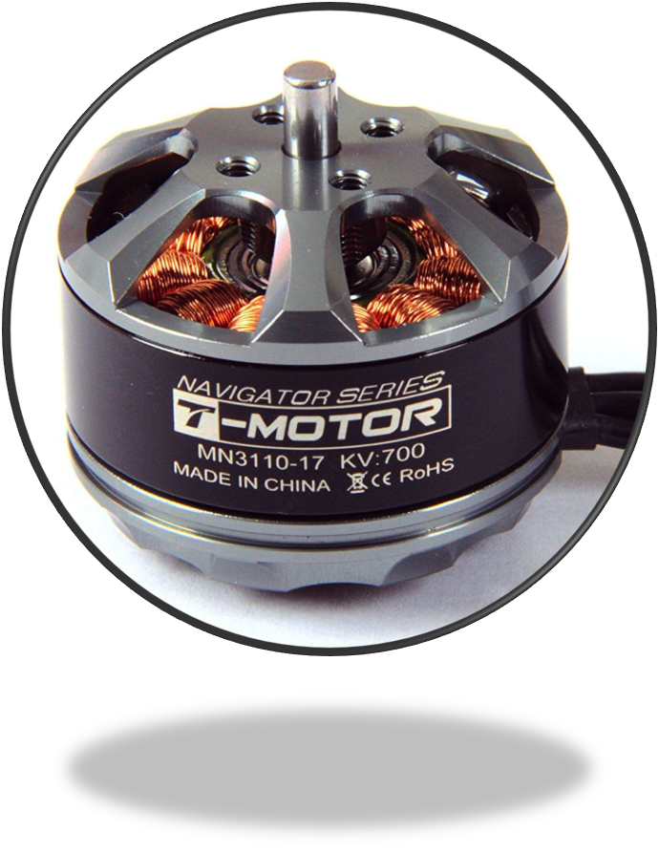
Motors
Brushless T-Motor Navigator Series MN3110-KV700
Technical Data
Rating: 700kV
Motor Dimension: Φ37.7×28.5mm
Weight: 80g
No.of Cells(Lipo): 3-4S
Max Continuous current(A)180S: 21A
Max. efficiency current: (3-10A)>80%
Thrust Range: 620-1540g

Slide 7
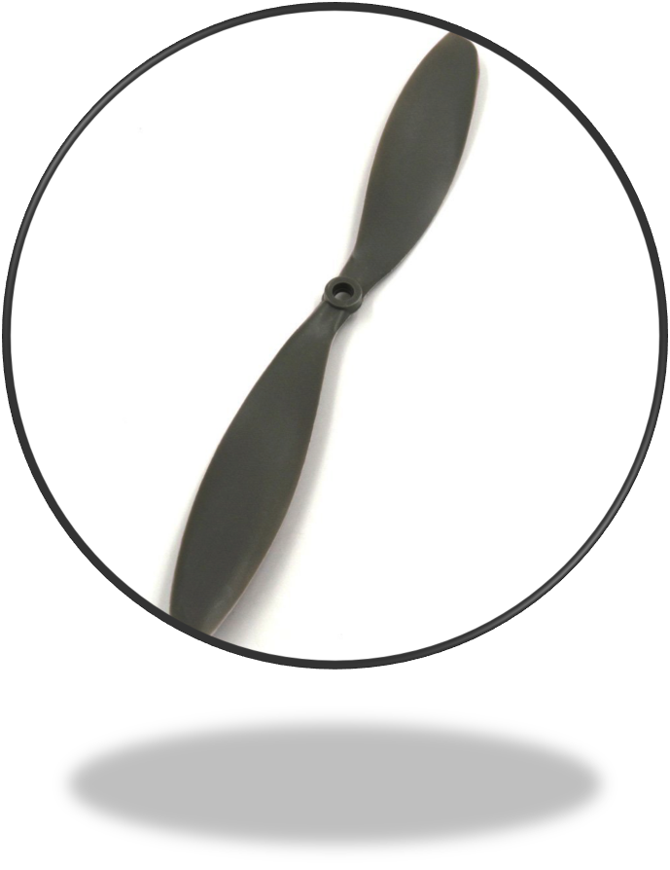
Propellers
RAYCorp 1147 11x4.7
Technical Data
Diameter: 11 inches
Pitch: 4.7
Shaft Diameter : 6 mm
Weight: 6 grams
Material : High Quality ABS Plastic

Slide 8
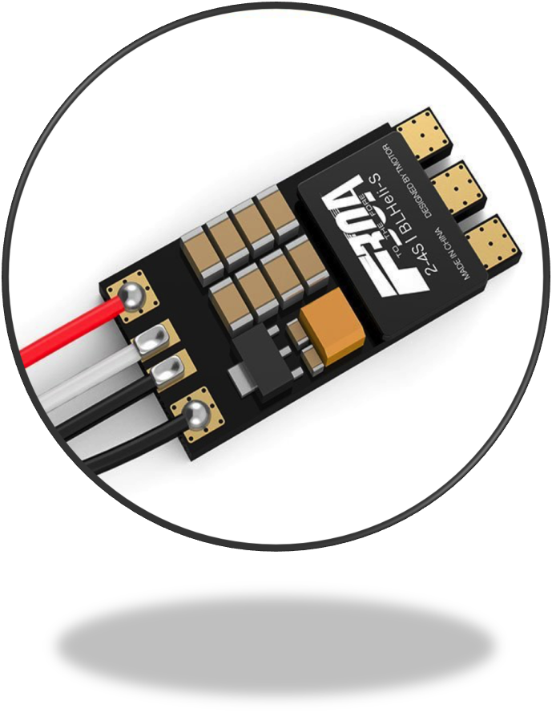
Electronic Speed Controller (ESC)
T-Motor 30A BLHeli_S 2-4S FPV version ESC
Technical Data
Continuous Current: 30A
Motor Max Continuous Current - 21A
Add 20% = 25.2A
Lightweight: 4.3 grams
Size: 25.5mm*12.7mm*5mm
Input Voltage: 7.4V-14.8V
Firmware: BLHeli_S
BEC: No

Slide 9
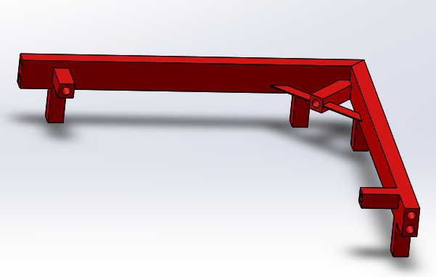
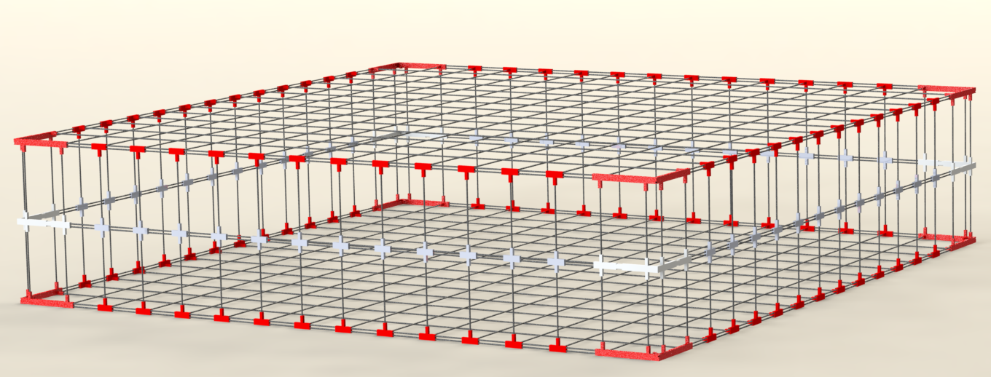
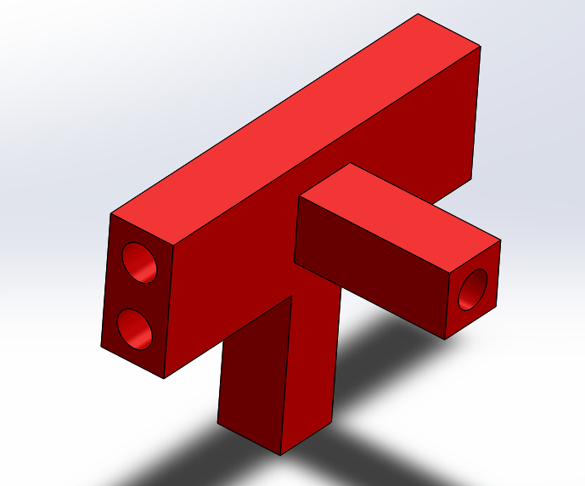
Protective Cage
Materials: .060 inch graphite rods and 3D printed Nylon fittings
Lightweight
Strong and durable
Ease of manufacturing
Rectangular Design:
Low surface area for amount of coverage
Repetition for easier manufacturing
Symmetrical design allows efficient mounting
Ease of modification if needed

Slide 10
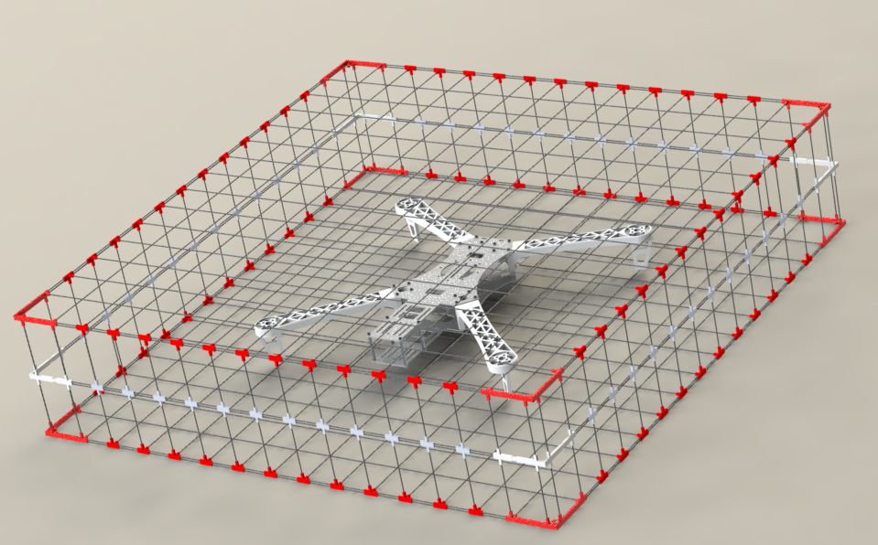
Protective Cage

Slide 11
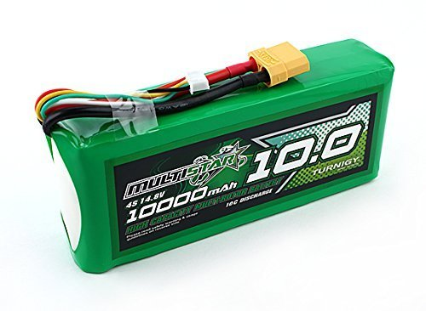
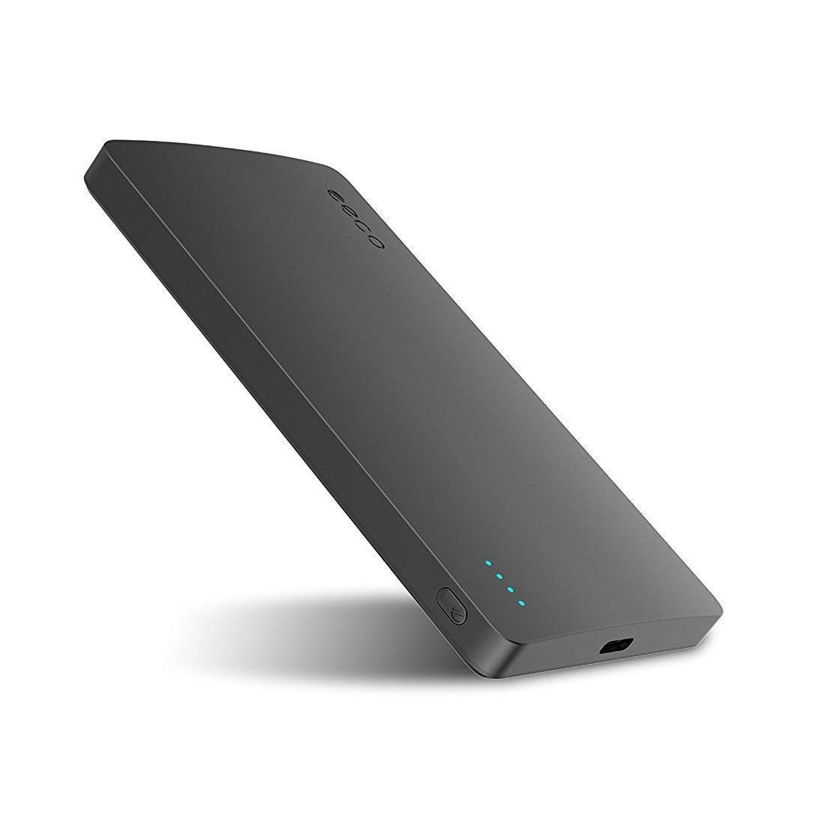
Batteries
Capacity: 10000mAh
Total Current Draw: for 2600g thrust @ 85+% throttle 56,160mA. Need 9,379mAh for 10 minutes.
Configuration: 4S1P/ 14.8V
Weight: 803g
Size: 6.3 x 1.4 x 2.6 inches
XT90 to XT60 Adapter used
Capacity: 5000mAh
Total current draw: 3750mA = 80 minutes
Output: 5V/3A
Type C Port - Micro USB adapter is used
Weight: 128g
Size: 125mm* 68mm*11mm
Motors & Flight Controller
Multistar Lipo Pack
Electronics
eeco Ultra Slim Power Bank
Notes:
ATMega328 chip: 0.3mA (active mode)
FTDI Chip: Max 100mA
Camera: 650mA @5V
Intel Compute Stick: Max 3A
Motors: 14.04A each=56.16A

Slide 12
Weight Analysis
Part | Weight (g)
Frame | 347
Cage | 454
Motors | 80
Props (4) | 24
ESCs | 5
Battery 1 | 128
Battery 2 | 803
Camera | 159
Intel Stick | 59
Flight Controller | 16
PCB | 25
IR Sensor | 6
Ultrasonic (4) | 76
XT60 Adapter | 18
Micro to C Adapter | 6
Total: | 2467
MAX: | 2600

Slide 13
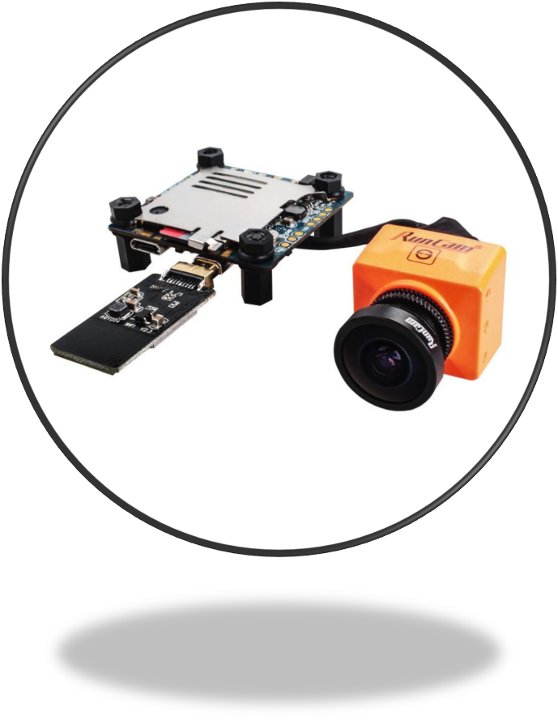
Camera
RunCam Split 2
Technical Data
Weight: 23g
Size: PCB-38*38mm/Lens Module-22*20mm
Supports 64GB micro SD card
Has wifi chip
Latency: <= 51.3ms
Input voltage: DC 5-17V/ DC 5V(USB)
Video Resolution: 720@60fps in FPV and 1080@60fps in Recording
Working Current: 650mA@5V

Slide 14
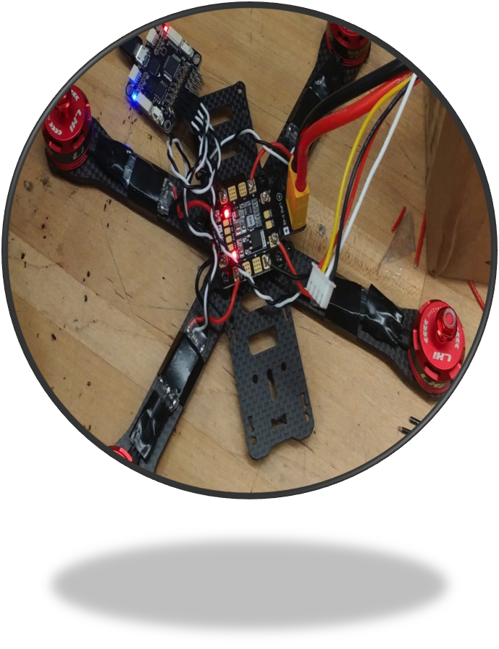
Prototype
LHI 220 Quadcopter Kit Full Carbon Frame Kit
2300KV Brushless Motors
Littlebee 20A Mini ESC
F3 Flight Controller Board Cleanflight
700TVL camera
Weight: 589.67g

Slide 15
Design

Slide 16
Hardware Layout
Motor
Motor
Battery 2
Intel Stick
ESC
ESC
PCB
Camera
Battery 1
PDB
Flight Controller
Power Module
ESC
ESC
Motor
Motor

Slide 17
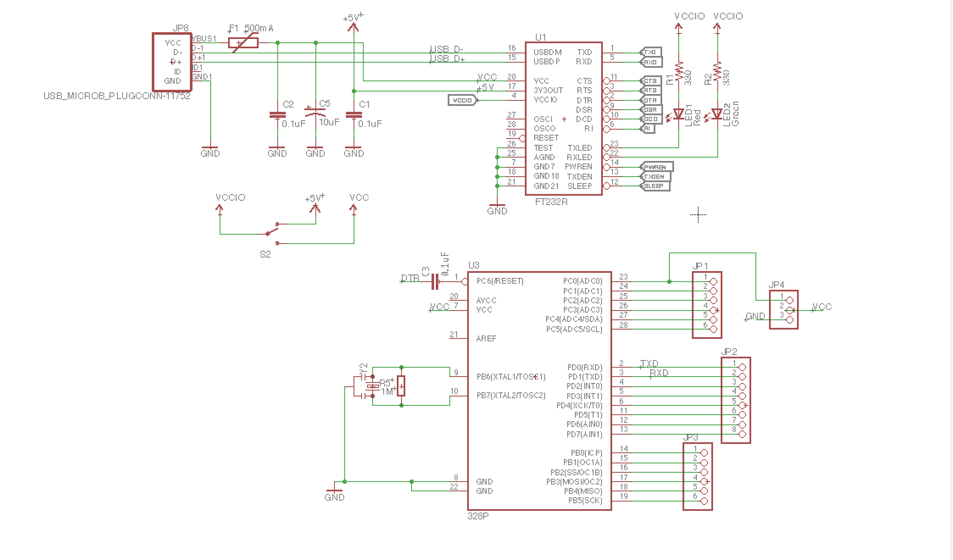
Schematic
Printed Circuit Board (PCB)

Slide 18
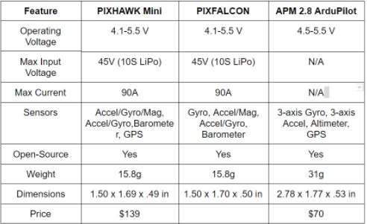
Flight Controller

Slide 19
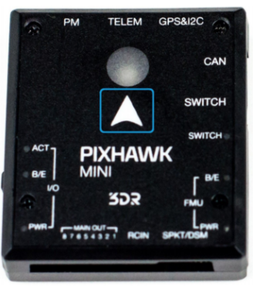
PIXHAWK Mini
3 internal sensors (Gyro/Accel/Mag)
Open-source
Multiple connections such as UART, I2C, and CAN
Flight Controller

Slide 20
915 MHz Telemetry Radio Set
allows ground station to communicate to quadcopter
allows view of in flight data
QGroundControl program
open source
FrSky ACCST Taranis Q X7 Transmitter with X8R receiver
open source firmware
multiple channels for multiple flight modes
RC Transmitter/Receiver and Telemetry

Slide 21
Obstacle Avoidance - Sensors
Feature | SRF02/SRF05 | XL-MaxSonar | Sharp GP2Y0A02YK0F | Sharp GP2Y0A21YK0F
Sensor Type | Ultrasonic | Ultrasonic | Infrared | Infrared
Detection Distance | 0-14.76 ft | 20-25.1 ft | 7.87-59.06 in | 3.94-31.50 in
Response Time | N/A | 10 Hz reading rate | 38 ms | 39 ms
Operating Voltage | 0-5 V | 3.3-5.5 V | 4.5-5.5 V | 4.5-5.5V
Current Consumption | 4mA | 3.4mA | 33mA | 40mA
Weight | .32 oz | .32 oz | .17 oz | .17 oz
Dimensions | 1.81 x 1.1 x .75 in | N/A | 1.16 x 0.5 x .85 in | 1.16 x .52 x .53 in
Price | $7 | $40 | $9 | N/A

Slide 22
Design 1 (Testing)
Ultrasonic sensor (0 - 14 ft range)
Positioned closer to base due to longer detection range
Infrared sensor ( 8in - 5ft range)
Positioned on the ends of the arms due to shorter detection range
Obstacle Avoidance - Sensors

Slide 23
Design 2 (Probable)
Ultrasonic sensors
5 total
1 on each side of base (front/back/left/right)
1 on bottom of base
Obstacle Avoidance - Sensors

Slide 24
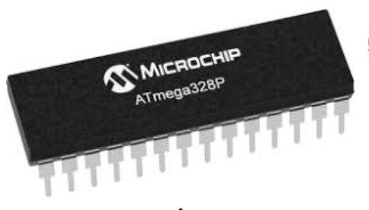
Microcontroller
Requirements:
Sufficient I/O Lines
Lightweight
Easy to integrate
Low power requirement
ATmega328p met these requirements
Arduino Uno utilizes this chip
1.8 to 5.5 V operating voltage
23 GPIO Lines
.2 mA active power draw
32 kb flash memory, 2kb ram
~20 Mhz processing speed

Slide 25
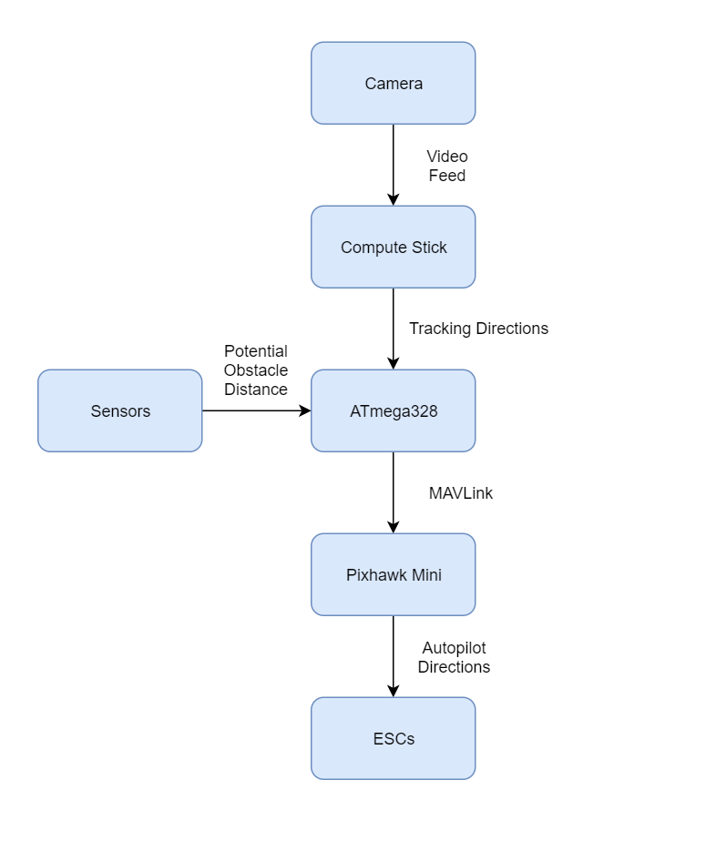
Software Implementation
Intel Compute Stick processes video feed, returns tracking directions
ATmega328 processes tracking directions and relays them to Pixhawk Mini through MAVlink
ATmega328 also processes sensor information, makes course correction through MAVlink if necessary
Autopilot on Pixhawk Mini takes directional instructions and makes meaningful changes to ESC’s to change course

Slide 26
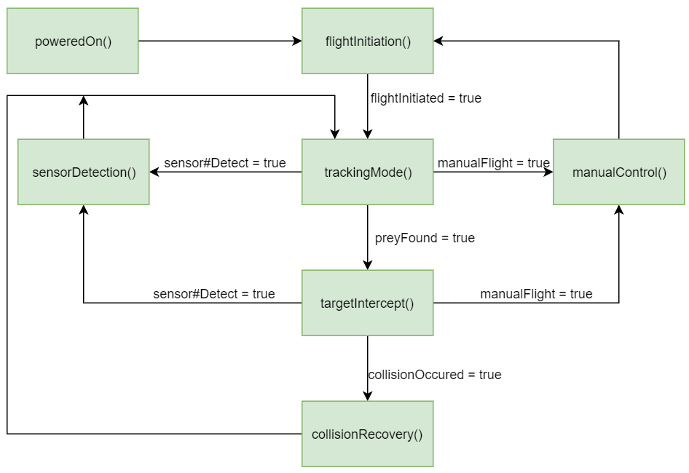
Software Functional Flow

Slide 27
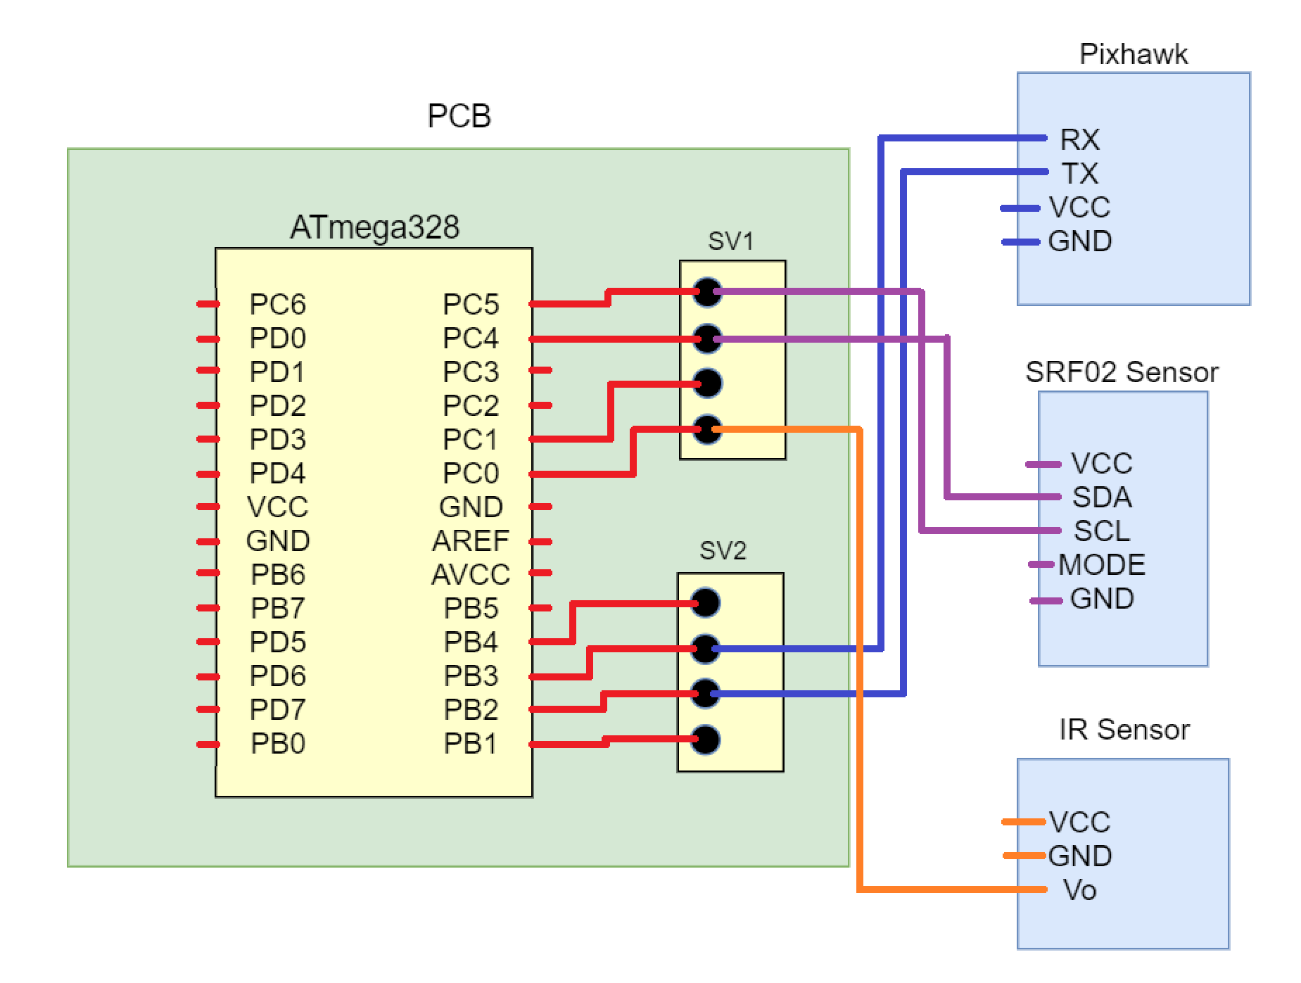
MAVLink
Protocol for communicating with autopilot on flight controller
Will allow us to send messages from ATmega328 to Pixhawk Mini
The serial pins on the telemetry port of the Pixhawk will connect to digital (PWM) pins of ATmega328
Some example commands:
MAV_CMD_NAV_TKEOFF : Takeoff from ground or hand
MAV_CMD_DO_SET_REVERSE : Set direction of aircraft to forward ( = 1) or reverse ( = 0

Slide 28
Choosing a computer
 | Intel Compute Stick | Raspberry Pi 3b | BeagleBone Blue | Nvidia Jetson TK1
Cost | $130 | $35 | $80 | $192
CPU | <1.44 Ghz | <1.2 GHZ | < 1.5 MHz | < 2.3 GHz
RAM | 2 GBs | 1 GB | 512 MBs | 2 GBs
Weight | 59 g | 42 g | 36 g | 120 g

Slide 29
Intel Compute Stick
Requirements:
Run an operating system
Easy to integrate
Powerful enough to do video processing

Slide 30
Operating Cycle - Video Processing
Detection - Convolutional Neural Network (CNN) via TensorFlow
Tracking - Median Flow Tracker via OpenCV

Slide 31
Detection
Using popular open source machine
library created by Google - Tensorflow
Includes a set of pre-trained models for tasks like object recognition and detection, e.g. CNNs
Also features tools for training your own models for object recognition and detection
There are lots of similar frameworks, but TensorFlow is nice for it’s relative ease of use, well-kept documentation, and Python support

Slide 32
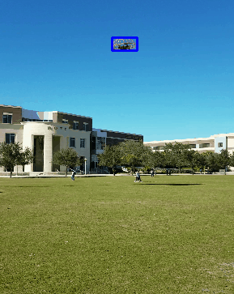
Tracking
Using another popular open source machine
library - OpenCV
Includes a set of implementations for easier training of tracking algorithms, like Median Flow Tracking
Again, lots of similar frameworks, but OpenCV is nice for it’s large community of users, lots of documentation, and support for Python

Slide 33
MCU / CPU Communication
Atmega328 will be connected via micro usb to the Intel Compute Stick
Programs on the Compute Stick can open a serial port and send data to the Atmega328
e.g. direct low-level motor commands with results of video-processing

Slide 34
Progress

Slide 35
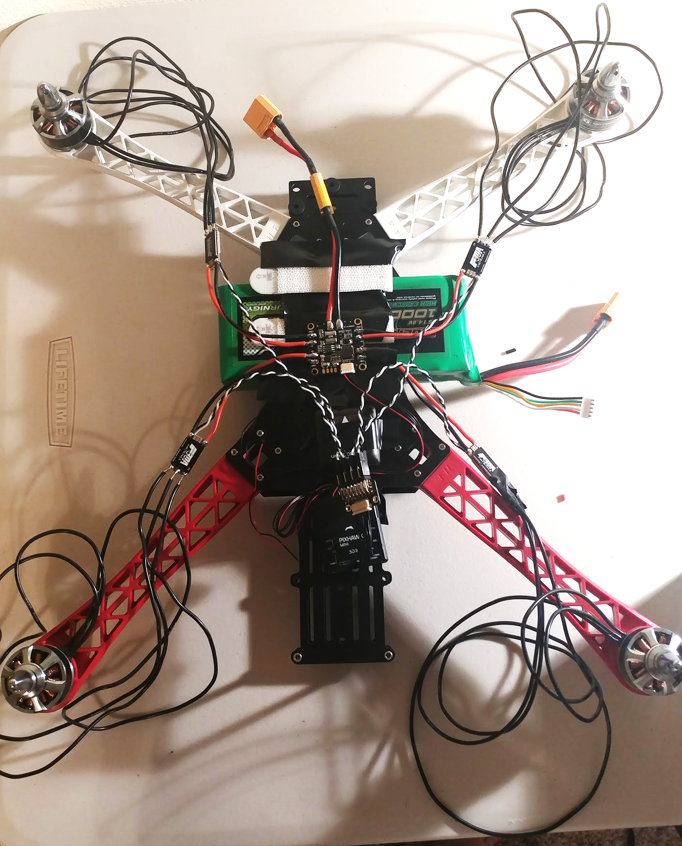
Drone Progress - Build

Slide 36
Work Distribution
Pamela Echevarria
Jarryd Salas
Branden Griffin
Joey Velez-Ginorio
Electrical Engineering (BSEE)
Electrical Engineering (BSEE)
Computer Engineering (BSCE)
Computer Engineering (BSCE)
Power Supply - Weight Analysis, ESCs/Motors
PCB Design
Build
Flight Management - Sensors, Flight Controller
RC Communication
Build
MCU - Programming
Communication of the PCB with all components
Build
MCU - Programing
MCU/CPU Integration

Slide 37
Progress
Research
Requirements
Design
Part Selection
90%
Parts Acquisition
Ordering through UCF
Remote Control is on it’s way
Need to order additional parts for backup
90%
Hardware Implementation
Built and ran test on prototype
On last phase of PCB
Need final drone working
40%
Software Implementation
Establish MAVLink
Implement flight and tracking
5%
Testing
Did prototype testing - motors, FC, sensors
Test flight of final drone
Test tracking of final drone
40%
Overall
Need finalized PCB to work
Need final drone to work
Have run multiple tests
50%

Slide 38
Budget Analysis
$2,000 Budget
60.31% Used $1,206.29 Spent
$1,500 Final Product Budget
64.24% Used
$963.65 Spent
$500 Testing Budget
48.52% Used
$242.64 Spent
ECE
MAE, CS
ECE
MAE, CS
36.41% Used
$546.20 Spent
27.83% Used
$417.45 Spent
37.53% Used
$187.66 Spent
10.99% Used
$54.98 Spent

Slide 39
Challenges
MavLink Communication
Programming Pixhawk with Mission Planner Software
Camera Connection Issues
Budget Constraints

Slide 40
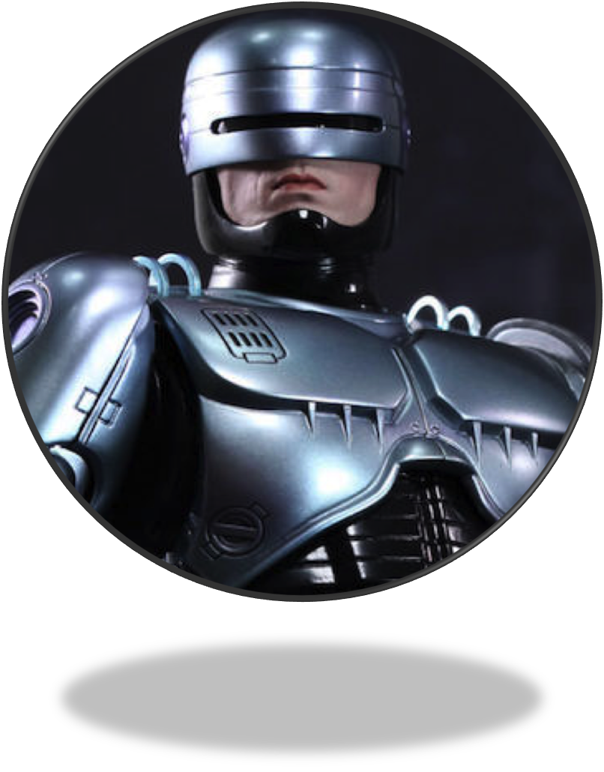
¿QUESTIONS?

