Slide 1
Arcadia Spider Robotic Hub
Group 24
Dries Kassabi – Electrical engineer
Said MourFik – electrical engineer
Angel Mandujano – electrical engineer
Steven Solis – Photonics and optics engineer

Slide 2
Agenda
Introduction/Project overview
Functional Overview
Software Design
Electrical Design
Structural/Mechanical Design
Administrative Information

Slide 3


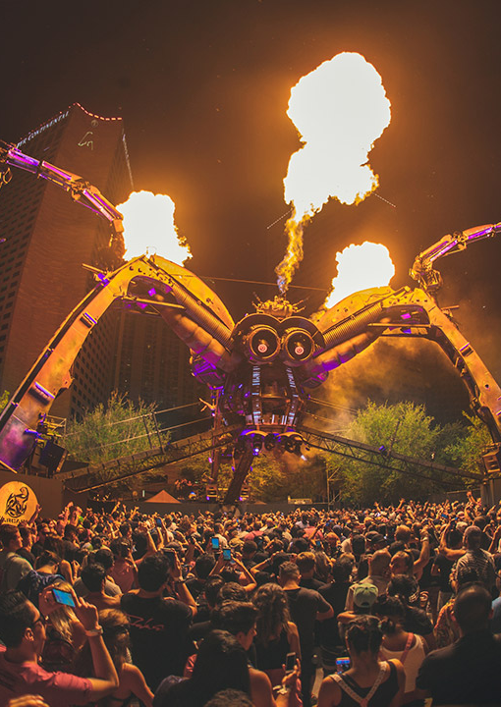
Motivation
Electronic Dance Music (EDM) has evolved into $7.1 billion industry
  Most revenue comes from live shows
Arcadia Spectacular brings their Spider to Ultra Music Festival annually
  Expressed interest in addition to stage that would interact with crowd under the DJ booth

Slide 4
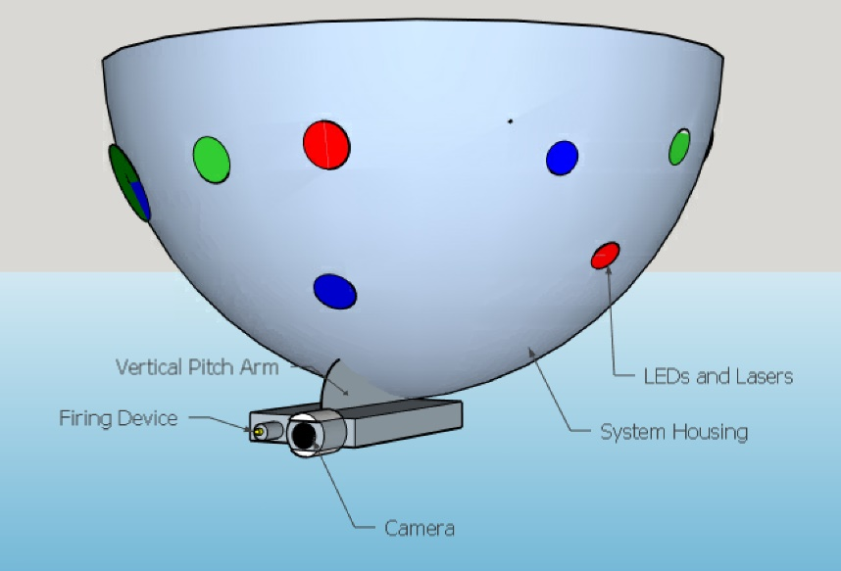
The Idea
Semi-autonomous tele-opeated robotic hub
Dubbed the Arcadia Spider Robotic Hub (ASRH)
Full-Scale Features
  Light show
  Onboard C02/Cryo Blaster
  Onboard camera
    Live video feed
    Allows the ASRH to ‘see’

Slide 5
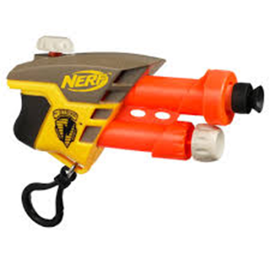
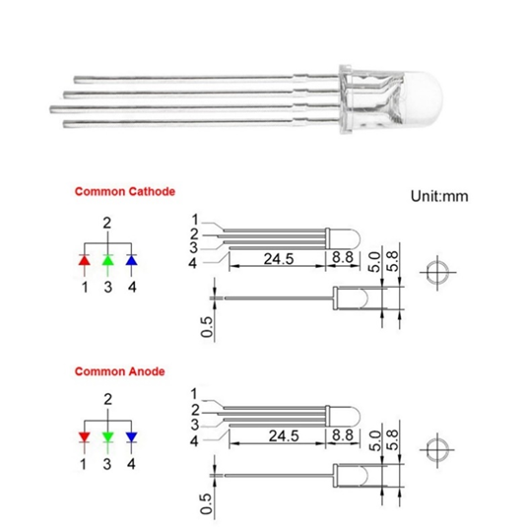
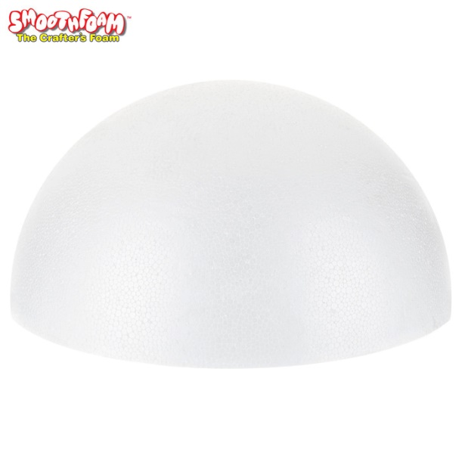
Our Project
Small-Scale prototype of full-scale vision
Demonstrate Computer/Electrical Engineering design principles with cheaper/more accessible parts
  C02 replaced by Nerf SecretStrike
  Structure composed mainly of Styrofoam
  Use of small/inexpensive LEDs

Slide 6
Design goals and requirement specifications
Design Goals
Easy to use with robust response
Captivating Light show
Semi-autonomous (automatic processes with manual control)
Detect and track objects of interest (colors, faces, etc.)
Low cost
Low power consumption
Requirement Specifications
360 degree rotation on Yaw axis
75 degree rotation on Pitch axis
Less than 1 second of input latency
At least 330mW of optical output
At least 1 automatic process
Weighs less than 15 pounds
Costs less than $1000 to build
Consumes less than 66 watts

Slide 7
Major System components
To achieve design goals and meet requirements, there are 3 major system components necessary
3 Motors (Pitch, Yaw, Gun)
LED Controller and LEDs
Microcontroller/Processor

Slide 8
Major System Components: Motors
When selecting motors, the following factors were considered
  The Yaw motor needed to be able to continuously rotate 360 degrees to meet design requirement
  The Gun motor needed to be small enough to easily mount onto Nerf SecretStrike, but powerful enough to activate its trigger

Slide 9
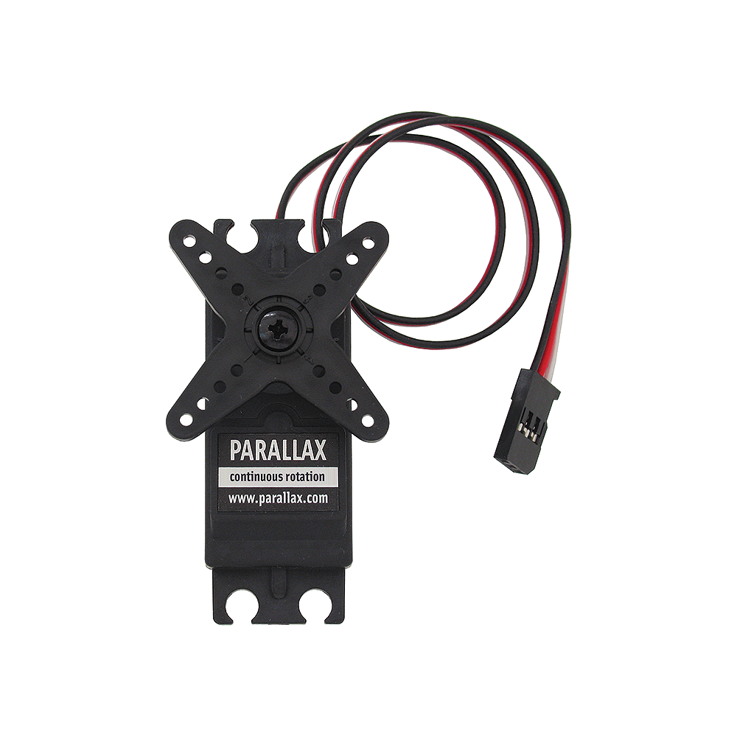
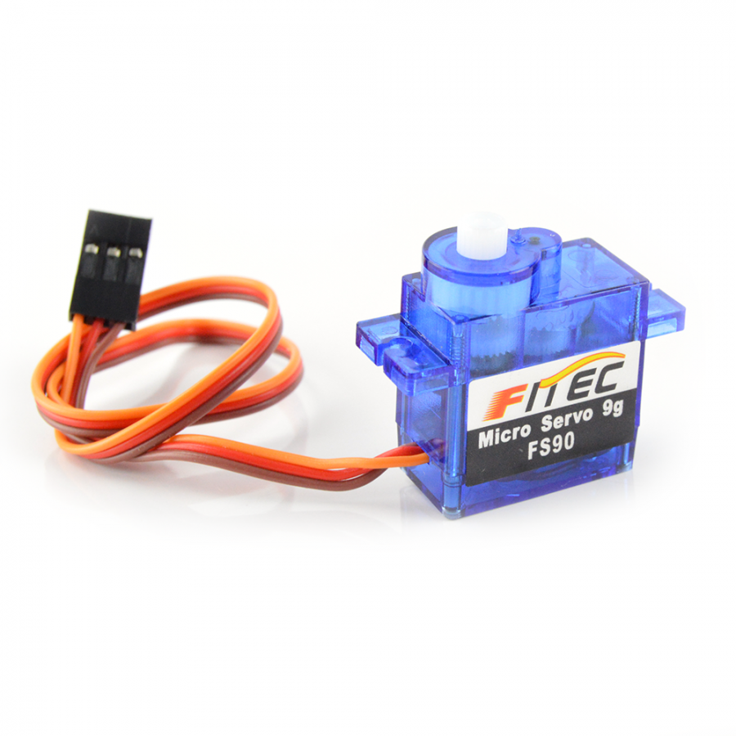
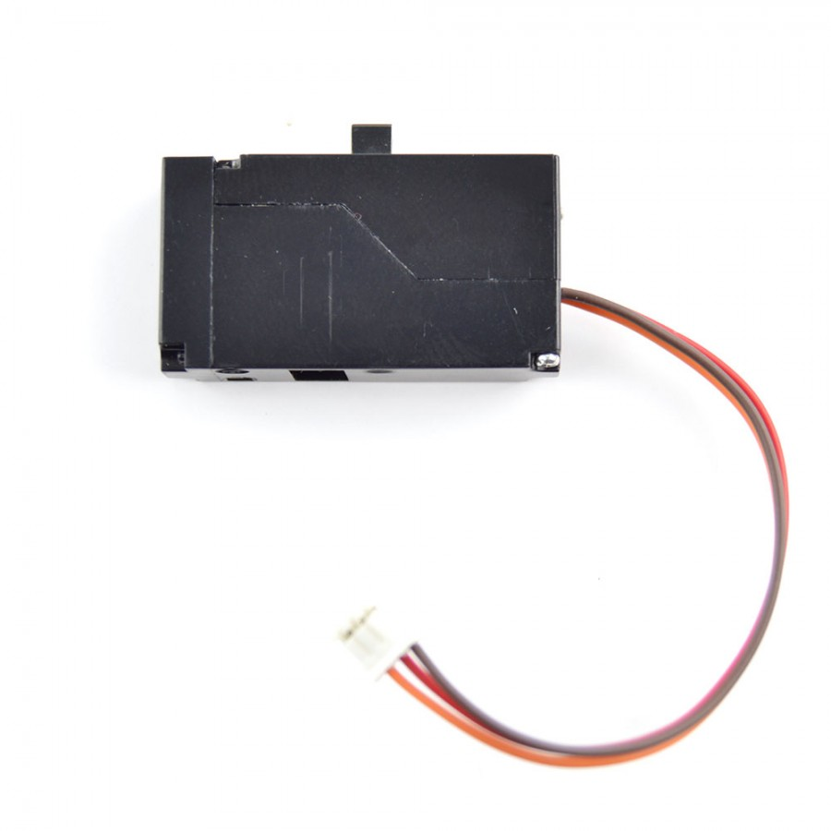
Major system components: Motors
 | Parallax Continuous Rotation Servo | 9g Micro Servo Motor | VS-19 Pico Linear Servo
Operating Voltage (V) | 4.8-6 | 4-6 | 3.7
Torque (kg-cm) | 2.73 | 1.3 | 0.06
Weight (g) | 42.5 | 9 | 3.7
Size (mm) | 55.8x19x40.6 | 23.2x12.5x22 | 29x7.3x15.7
Signal Width (ms) | 1.3-1.7 (determines rotation) | 0.544-2.4 (determines position 0-180 degrees) | 0.8-2.2 (determines position end to end
Price | Free ($13.99) | $3.56 | $9.85
For the Yaw motor, the obvious choice was the Parallax motor
  Had 360 degree rotation capability
  Several already on hand from past projects
For the Pitch motor, Parallax was also selected
  9g Micro Servo was initially considered
  Decided that having Pitch and Yaw on identical control scheme would make things easier in the future
For the Gun motor, 9g Micro Servo was selected
  Originally designed for VS-19, but had inadequate torque

Slide 10
LED Controller Goals
Allow the user to control the appearance of the LEDs
Have a library of colors and sequences for the user to choose
Easy for the user to alter programmed color sequences in between uses
Powered by the ASRH power supply
Provide visual cues to the audience so they can determine what action the hub is performing.

Slide 11
LED Controllers
Trinket
LP55281 LED DRIVER
Library with built in functions easily available
Abundance of documentation
>100 LEDs can be controlled by a single Trinket
LEDs can be powered by separate or same source as the Trinket
USB micro connection for loading programs
Smaller footprint
Components > $30 for 18 LEDs
Serial programming is necessary
Limited color options
Limited to 13 LEDs per chip
Provides power for the LEDs
PCB required, large footprint for components to fit
Components < $30 for controlling 20 LEDS

Slide 12
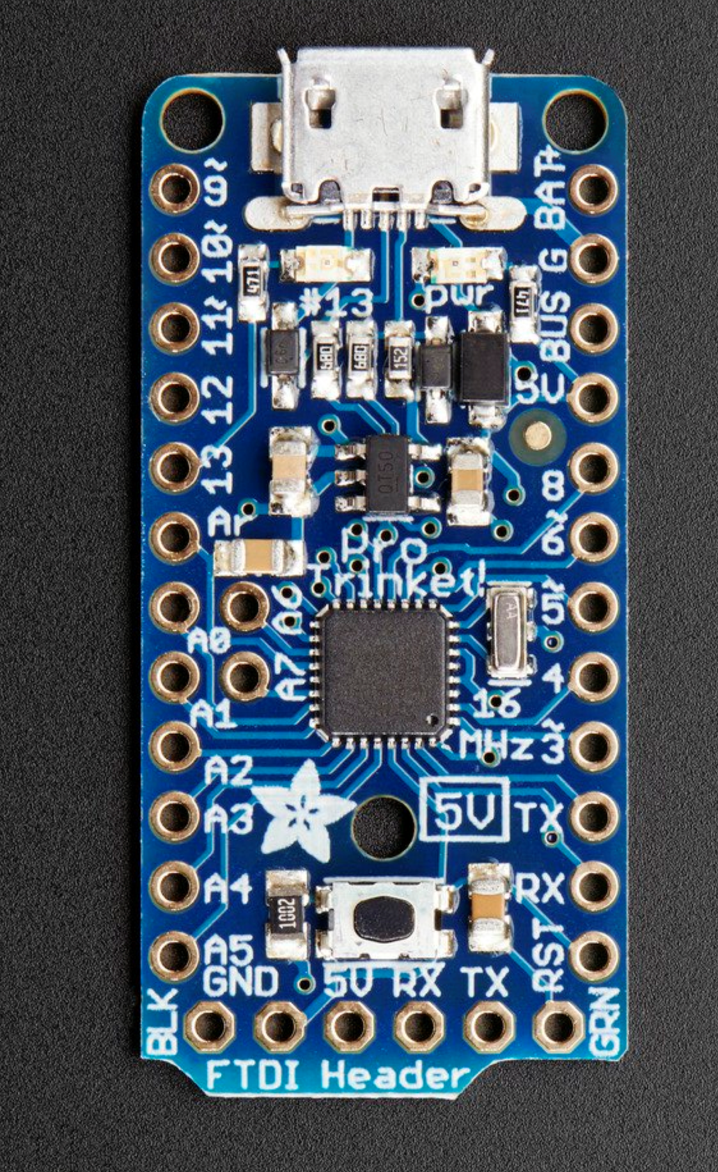
Arduino Trinket PRO
ATmega328P 16MHz chip 28/k flash available for running scripts.
10 GPIO pins available
Small footprint ≈ 1 in²
Onboard power regulator can power a string of 9 LEDs if there is no separate supply for the LEDs
Options for power include a hardwired battery back, micro USB from a powered USB port, and the ASRH power supply. Can accept up to 16V

Slide 13
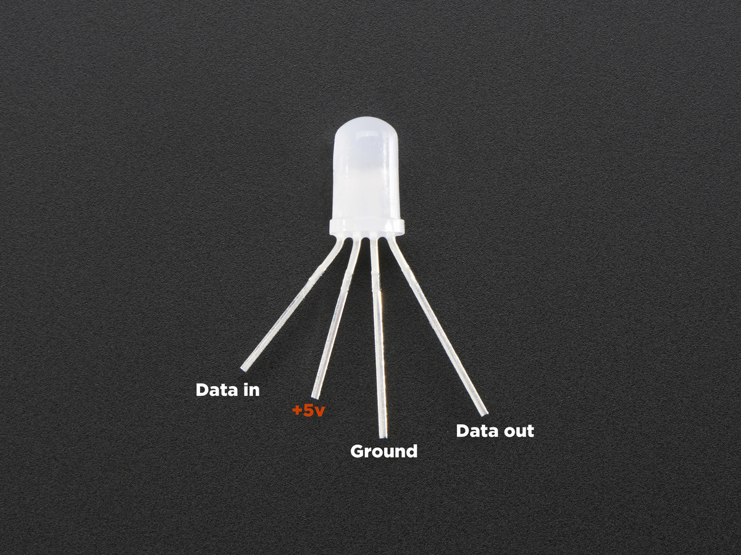
Arduino Neopixels
5v diffused RGB LEDs with 18mA current draw
Up to 18 can installed on the ASRH dome but 100 can be linked in series.
Can be individually controlled to alter brightness, color and strobe effects
Each LED has an individual driver that processes the received data from the Trinket.
Having a driver in each LED makes them susceptible to failure. Less than 20% of the purchased LEDs made it to the production stage.
Price per LED is high at $1 each

Slide 14
Major System Components: Microcontrollers/Processors
The Microcontrollers/Processors selected for the ASRH need to accomplish the following:
  Interface with a camera and display live video feed to a monitor
  Accept User input
  Perform image processing in real time
  Generate precise PWM signal to control Pitch, Yaw, and Gun motors
  Interface with Trinket and other processors if needed

Slide 15
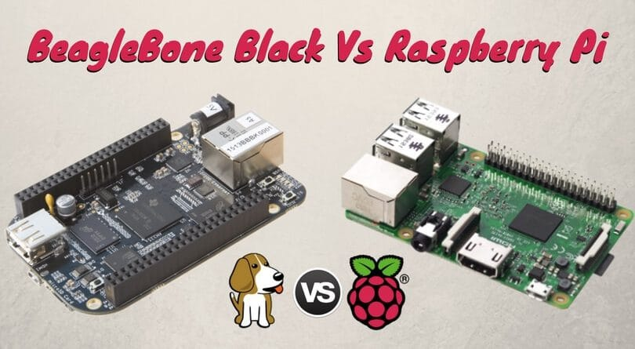


Major System Components: Microcontrollers/Processors
 | BeagleBone Black | Raspberry Pi 3 Model B | MSP430 | ATmega2560
Operating Voltage (V) | 5 | 5 | 1.8-3.7 | 4.5-5.5
CPU Speed | 800 MHz | 1.2 GHz | 16 MHz | 16 MHz
Price | $55 | $35 | $15 | $15
Raspberry Pi was selected over BeagleBone for several reasons
  More processing power for lower price
  A dedicated camera interface with HDMI output
  Multiple USB ports to support User control
How to generate PWM for motors?
  Theoretically could be done on Pi, however, image processing and precise PWM on the same processor could lead to problems
  Decided to offboard motor control to separate processor
MSP430 was chosen over Arduino
  Familiarity
  Abundant documentation
  Arduino perceived more as hobbyist platform compared to MSP430

Slide 16
Functional Block Diagram
12 V
5 V
ASRH Power Supply
Monitor
User
Raspberry Pi + Camera
5 V
1.8-3.7 V
Arduino Trinket
MSP430
5 V
4.8-6 V
LEDs
Motors

Slide 17
Functional Block Diagram
12 V
5 V
ASRH Power Supply
Monitor
User
Raspberry Pi + Camera
5 V
1.8-3.7 V
Arduino Trinket
MSP430
5 V
4.8-6 V
LEDs
Motors

Slide 18
Arduino Trinket Programming
User friendly IDE with libraries built in to control the Neopixel
Full RGB spectrum is accessible 255³ color
Brightness control of individual LEDs
Programmed sequences can be initiated via input from the GPIO pins
Ability to control more than one string of LEDs simultaneously
Programs are initiated by a combination of high/lows inputs from four of the GPIO pins allowing up to 15 programs.
The data output is sent from a 5th GPIO pin to the strand of LEDs

Slide 19
Program Function Table
Button | Pin 1 | Pin 2 | Pin 3 | Pin 4 | Outcome
A | 1 | 0 | 0 | 0 | Green
B | 0 | 1 | 0 | 0 | Red
X | 0 | 0 | 1 | 0 | Blue
Y | 1 | 0 | 1 | 0 | Yellow
Right Trigger | 1 | 1 | 0 | 0 | Firing Seq.
Guide | 0 | 1 | 0 | 1 | Face Seq.
Left Trigger | 0 | 0 | 1 | 1 | Lock-on Seq.
Down D-pad | 1 | 0 | 0 | 1 | Dim Seq.
Up D-pad | 0 | 1 | 1 | 0 | Bright Seq.

Slide 20
Functional Block Diagram
12 V
5 V
ASRH Power Supply
Monitor
User
Raspberry Pi + Camera
5 V
1.8-3.7 V
Arduino Trinket
MSP430
5 V
4.8-6 V
LEDs
Motors

Slide 21
MSP430 motor control
MSP430 acts as an intermediary between the Raspberry Pi and motors
  Receives input from Raspberry Pi
  Generates PWM signals to motors based on instructions from the Raspberry Pi using onboard timers

Slide 22

MSP430 Motor control
initClock();
initTimers();
initGPIO();
initSpeed();
speed();
pitch();
yaw();
gun();

Slide 23
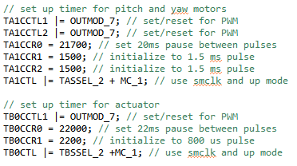
MSP430 Motor control
initClock();
initTimers();
initGPIO();
initSpeed();
speed();
yaw();
pitch();
gun();

Slide 24
MSP430 Motor control
Pin | Type | Description
P1.2 | Output | Linked with TA1.1 to generate PWM for Pitch Motor
P1.3 | Output | Linked with TA1.2 to generate PWM for Yaw Motor
P1.4 | Output | Linked with TB0.1 to generate PWM for Gun Motor
P3.0 | Input | Receives Up signal
P3.1 | Input | Receives Down signal
P3.2 | Input | Receives Left signal
P3.3 | Input | Receives Right signal
P3.4 | Input | Receives Fire signal
P3.5 | Input | Receives Lock-On signal
P3.6 | Input | Receives Scan signal
P3.7 | Input | Receives Speed Mod 1 signal
P4.1 | Input | Receives Speed Mod 2 signal
initClock();
initTimers();
initGPIO();
initSpeed();
speed();
yaw();
pitch();
gun();

Slide 25

MSP430 Motor control
initClock();
initTimers();
initGPIO();
initSpeed();
speed();
pitch();
yaw();
gun();

Slide 26
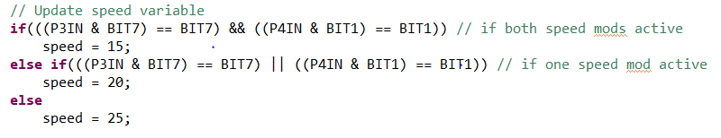
MSP430 Motor control
initClock();
initTimers();
initGPIO();
initSpeed();
speed();
yaw();
pitch();
gun();

Slide 27
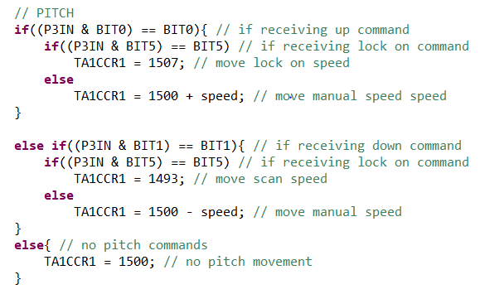
MSP430 Motor control
initClock();
initTimers();
initGPIO();
initSpeed();
speed();
pitch();
yaw();
gun();

Slide 28
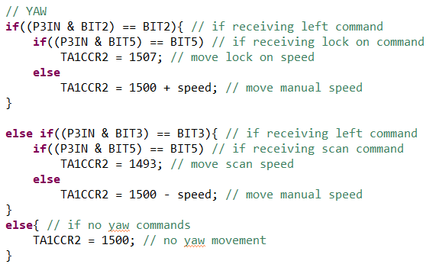
MSP430 Motor control
initClock();
initTimers();
initGPIO();
initSpeed();
speed();
pitch();
yaw();
gun();

Slide 29
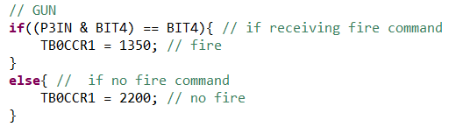
MSP430 Motor control
initClock();
initTimers();
initGPIO();
initSpeed();
speed();
yaw();
pitch();
gun();

Slide 30
Functional Block Diagram
12 V
5 V
ASRH Power Supply
Monitor
User
Raspberry Pi + Camera
5 V
1.8-3.7 V
Arduino Trinket
MSP430
5 V
4.8-6 V
LEDs
Motors

Slide 31
Raspberry Pi + Camera
Software on the Raspberry Pi accomplishes two tasks
  Real time image processing and target designation
  Allows the user to control the following via an Xbox controller
    Target detection/designation
    Motors
    LEDs
All functionalities run on a single script

Slide 32
Computer Vision methods
The two methods we are using for detection and tracking of objects of interest are:
  Color tracking
  Face tracking
Both methods can be chosen by the user through button presses on the Xbox controller

Slide 33
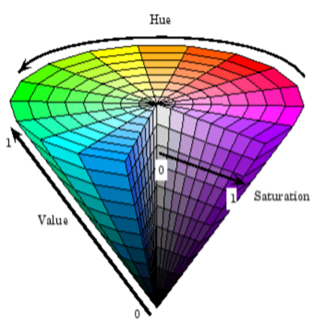
Color Detection
Convert captured frame from RGB color space to HSV space
HSV is invariant to lighting conditions, unlike RGB
Useful when working in dim lighting but can still be influenced if a colored light source is illuminating the detected object
Set lower and upper bound thresholds for each color, i.e. Green: lower = [75,80,50] , upper= [95,255,255]

Slide 34
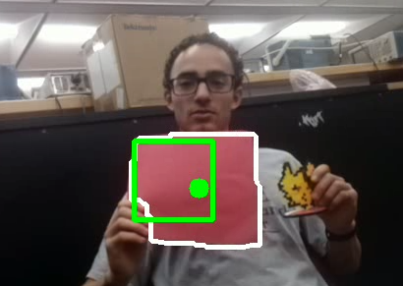
Color Detection and Tracking Implementation
Extract and filter colors with masks
Draw contours and centroids on the detected object to designate as targets
  If more than one object detected, largest is designated as target
ASRH is able to track Red, Green, Blue, and Yellow objects and switch between each at any point depending on user input

Slide 35
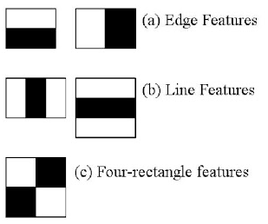
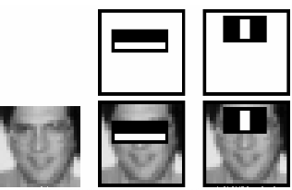
Face Detection using Haar Cascades
Haar Cascades is a machine learning based approach where cascade functions are trained from positive and negative images.
Features are extracted from these images, which are called Haar features
Each feature is a single value obtained by the sum of pixels under the white rectangle from the sum of pixels under the black rectangle
The best threshold that will classify the faces to positive and negative for each feature will be used to make a weak classifier
The final classifier is a sum of these weak classifiers

Slide 36
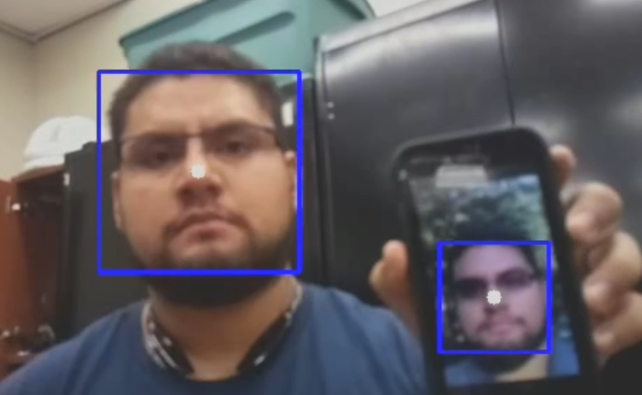
Face Detection Implementation
Face detection boxes are drawn around every face inside the captured frame
White dots are drawn in the center of each box, which is used when implementing visual servoing
Multiple faces can be detected but for our application, the first 5 detected faces will be eligible for tracking
The face detection box with the largest area is designated as the target

Slide 37
Visual servoing
The ASRH can automatically control the motors to aim at a designated target
When the user activates lock-on mode, the Pi sends the appropriate signals to MSP430 to bring target within the bounding box

Slide 38
User control
The Raspberry Pi uses a driver called ‘xboxdrv’ in concert with an open source Python class Joy() in a script called ‘xbox.py’ to make sense of controller inputs
The script that runs the ASRH imports xbox.py and creates an instance of its Joy() class, allowing use of the controller during image processing

Slide 39
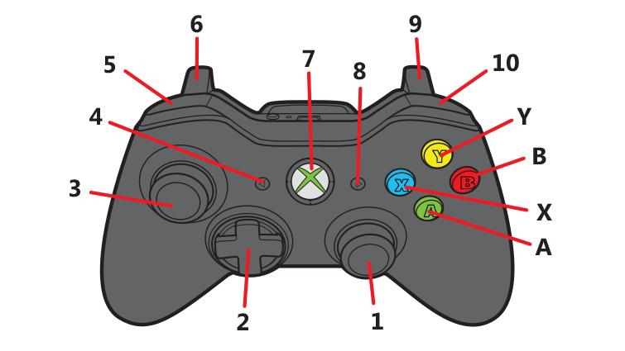
User control
Button | Turret | Lights
A, B, X, Y | Select color to track | Initiates light sequence
7 – Guide | Track faces | Initiates light sequence
2 – Dpad | Actuates Pitch/Yaw | N/A
5, 10 – LB, RB | Modifies speed | N/A
6 – LT | Initiates Lock-On | Initiates light sequence
10 – RT | Actuates Gun | Initiates light sequence

Slide 40
Functional Block Diagram
12 V
5 V
ASRH Power Supply
Monitor
User
Raspberry Pi + Camera
5 V
1.8-3.7 V
Arduino Trinket
MSP430
5 V
4.8-6 V
LEDs
Motors

Slide 41
Power Requirements
Component | Operating Voltage (V) | Maximum Current Draw (A)
7-Inch LCD Monitor | 12 | 0.5
Raspberry Pi+Camera | 5 | 2.5
Trinket+LEDs | 5 | 0.180
MSP430 | 1.8-3.7 | < 0.5
Parallax Servos | 4-6 | 2 x (0.140 ± 0.05)
9g Micro Servo | 4.8-6 | 0.700-0.800 (Stall)

Slide 42
AC-DC Converter
Instead of designing our own AC-DC converter, we elected to buy one instead
We wanted something reliable and practical to demonstrate the capabilities of the ASRH
Did not want to waste valuable time designing and testing something that could easily be purchased for a fair price

Slide 43
Power Supply Selection
Specifications | RD-50 | RD-65 | RT-125
Min Primary Output Voltage (VDC) | 5 | 5 | 5
Output Current (A) | 6 | 6 | 12
Max Output Power (W) | 54 | 66 | 132
Max Primary Output Voltage (VDC) | 12 | 12 | 12, -12
Input Frequency (Hz) | 47 to 63 | 47 to 63 | 47 to 63
Max Input Current (A) | 1.3 | 2 | 3
Output Connector Type | Screw Terminal Block | Screw Terminal Block | Screw Terminal Block
Number of Outputs | 2 | 2 | 3
Efficiency (%) | 79 | 79 | 80
Operating Temperature-Min (Cell) | -25 | -25 | -25
Type | Auto Switching | Auto Switching | Switch Selectable
Cost ($) | 14.49 | 15.95 | 26.49

Slide 44
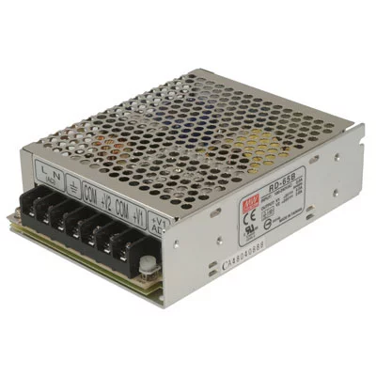
Power Supply
Main power source is the RD-65A AC/DC dual output power supply
Max power rating of 66W
Input: 88-246 VAC @ 47-63 Hz
Channel 1 output: 5 VDC, 6A
Channel 2 output: 12 VDC, 3A
Auto switching power supply with 79% efficiency

Slide 45
Power Block Diagram
RD-65
Monitor
12V
5V
Raspberry Pi+Camera/NeoPixel+LEDs
4.8-6V Regulator
3.3V Regulator
Motors
MSP430

Slide 46
Power Block Diagram
RD-65
Monitor
12V
5V
Raspberry Pi+Camera/NeoPixel+LEDs
4.8-6V Regulator
3.3V Regulator
Motors
MSP430

Slide 47



L4978 Voltage regulator
Preferred high efficiency option for regulating voltage
  Switching regulator was selected
L4978
  Protection against feedback disconnection.
  Thermal shutdown.
  Soft start function
Part Number | Package
L4978 | DIP-8
L4978D | SO16

Slide 48
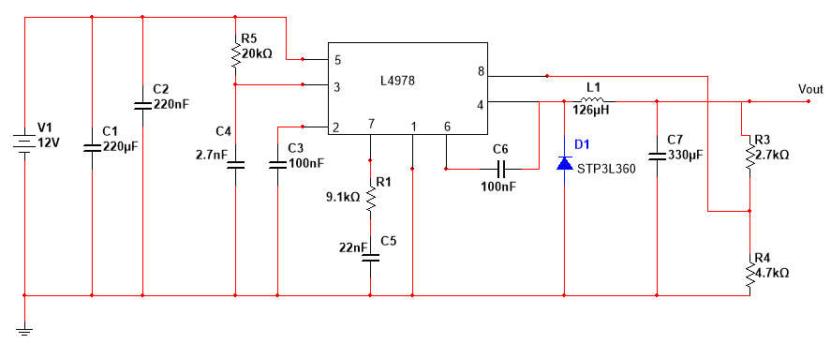
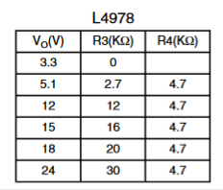
L 4978 Voltage regulator
2 Parallax Continuous Rotation Servos and 9g Micro Servo
  Take 12 VDC input.
  Output 5.1 VDC.
MSP430
  Take 12 VDC input.
  Output 3.3 VDC
Lab testing showed that each motor needed its own regulator to work properly

Slide 49
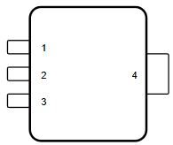
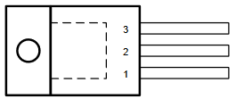
LM 317 Voltage regulator
L4978 performed unreliably in the lab even with separate regulators for each motor
Needed a reliable backup option in case more problems arose
LM317
  Short-circuit current limiting
  Thermal overload protection
Part Number | Package
LM317DCY | SOT-223 (4)
LM317KCS | TO-220 (3)

Slide 50
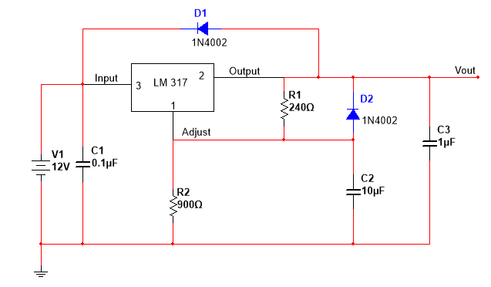
LM 317 Voltage regulator
2 Parallax Continuous Rotation Servos and 9g Micro Servo
  Take 12 VDC input.
  Output 6 VDC.
MSP430
  Take 5 VDC input.
  Output 3.3 VDC
Lab testing showed that one regulator was sufficient for all 3 motors

Slide 51
Printed Circuit board (PCB) design
Due to difficulties encountered during development, 3 different configurations were designed
  Using L4978 – 2 boards
  Using LM317 (designed before testing) – 1 board
  Using LM317 (designed after testing) – 1board

Slide 52
Configuration 1- L4978 (4 regulators)
For this configuration, 4 regulators are used to power our components
3 regulators power our servos individually
1 regulator powers the MSP430
2 separate PCBs, one power board and one signal board

Slide 53
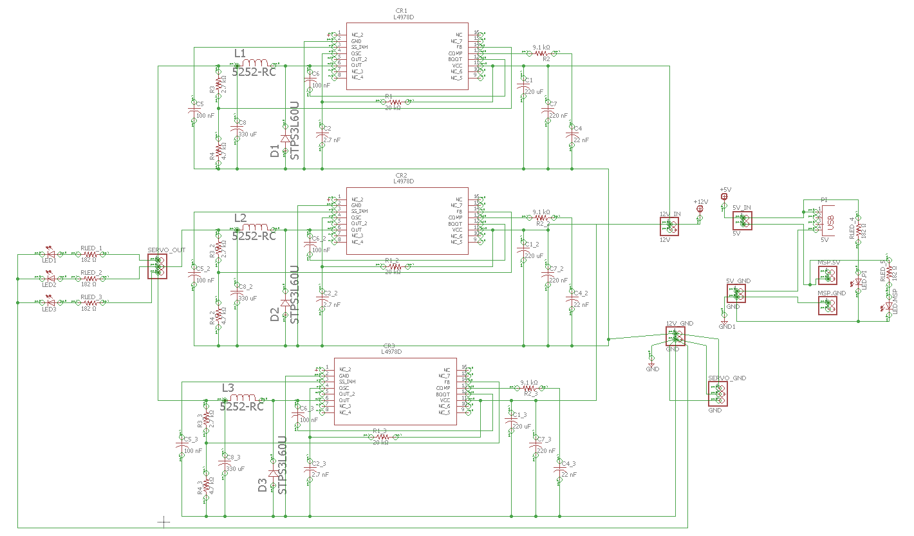
Configuration 1- L4978 (4 regulators)

Slide 54
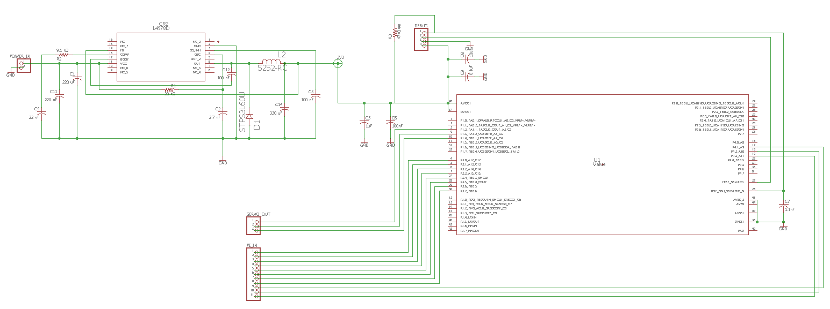
Configuration 1- L4978 (4 regulators)

Slide 55
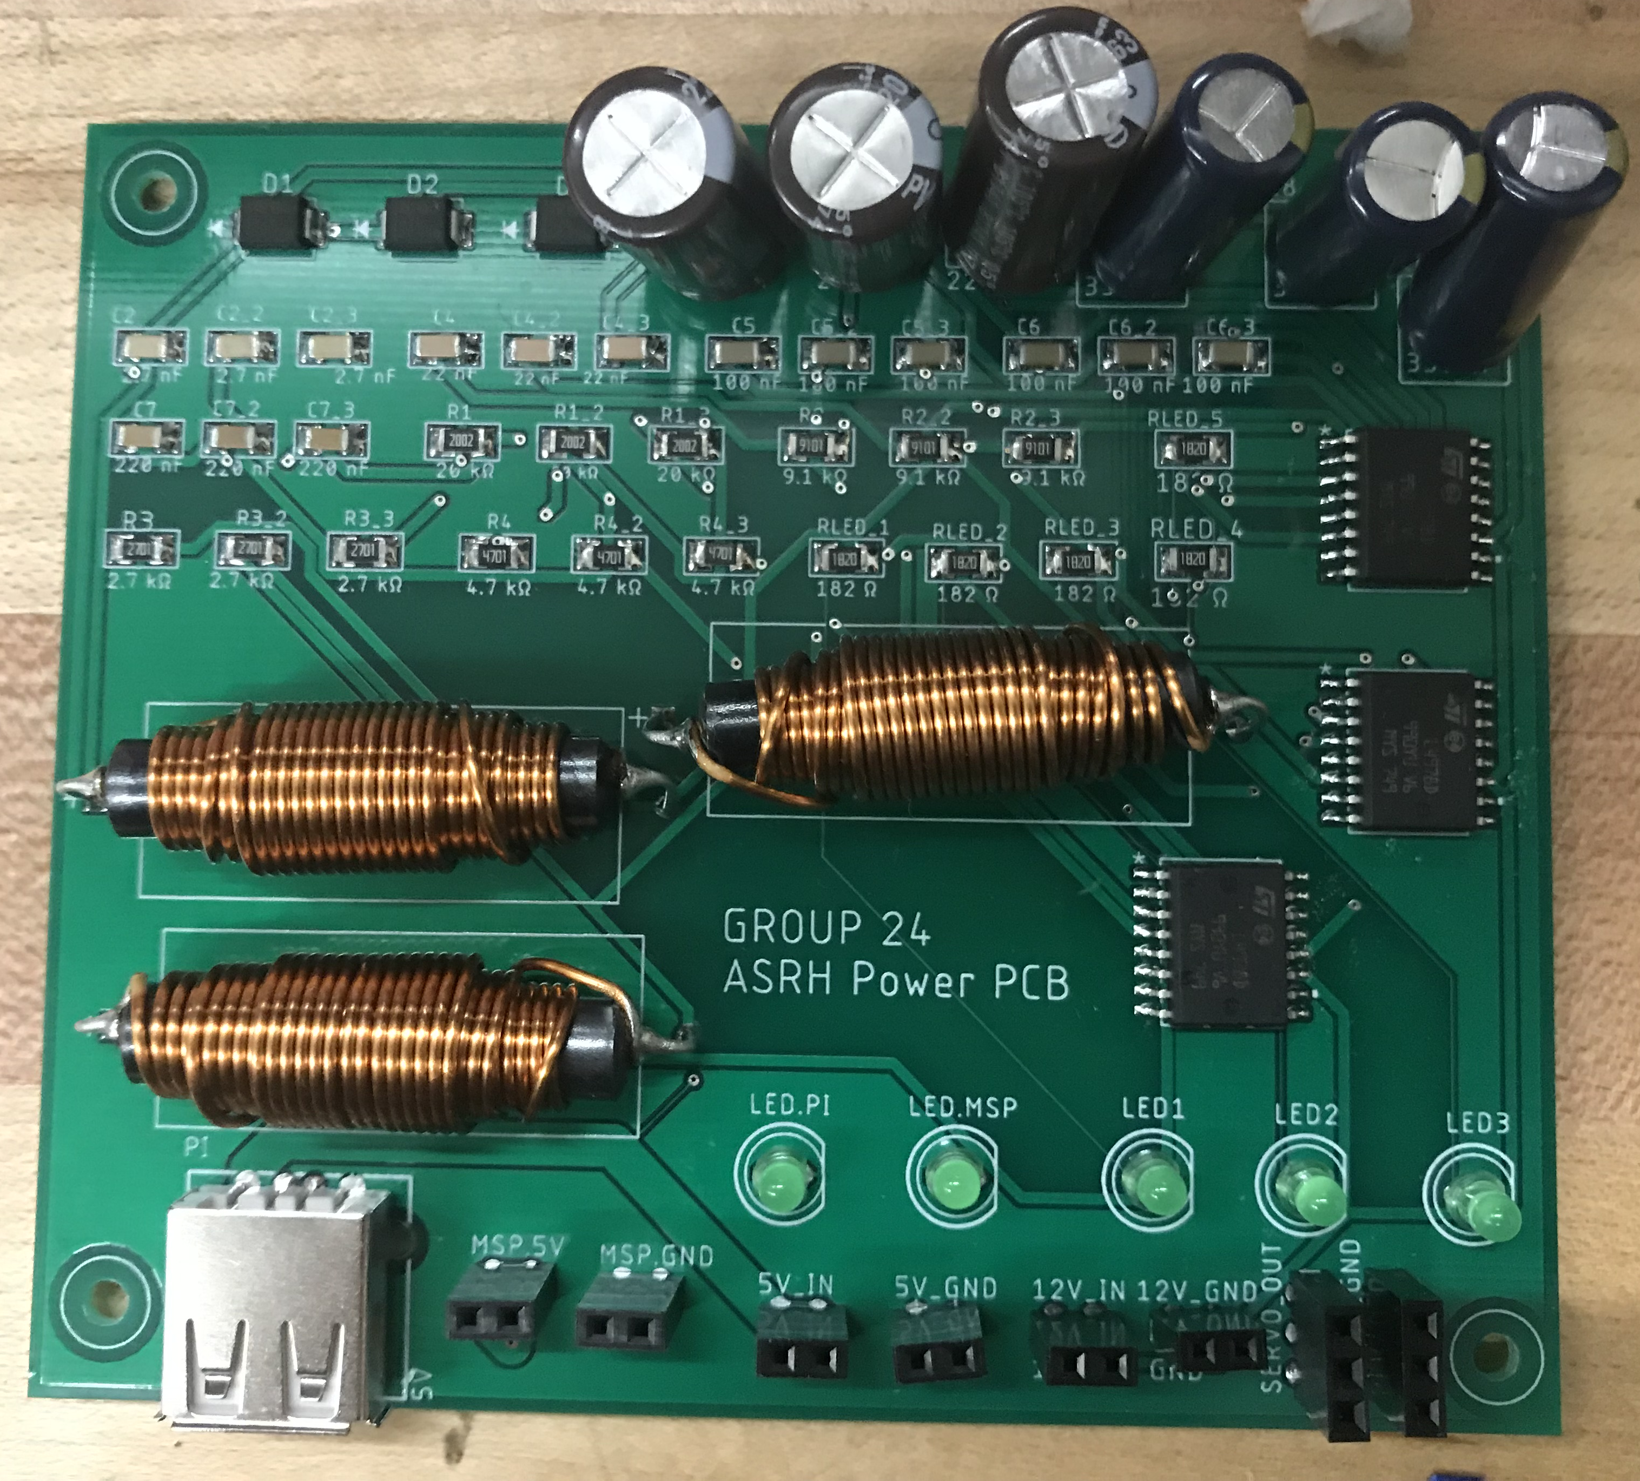
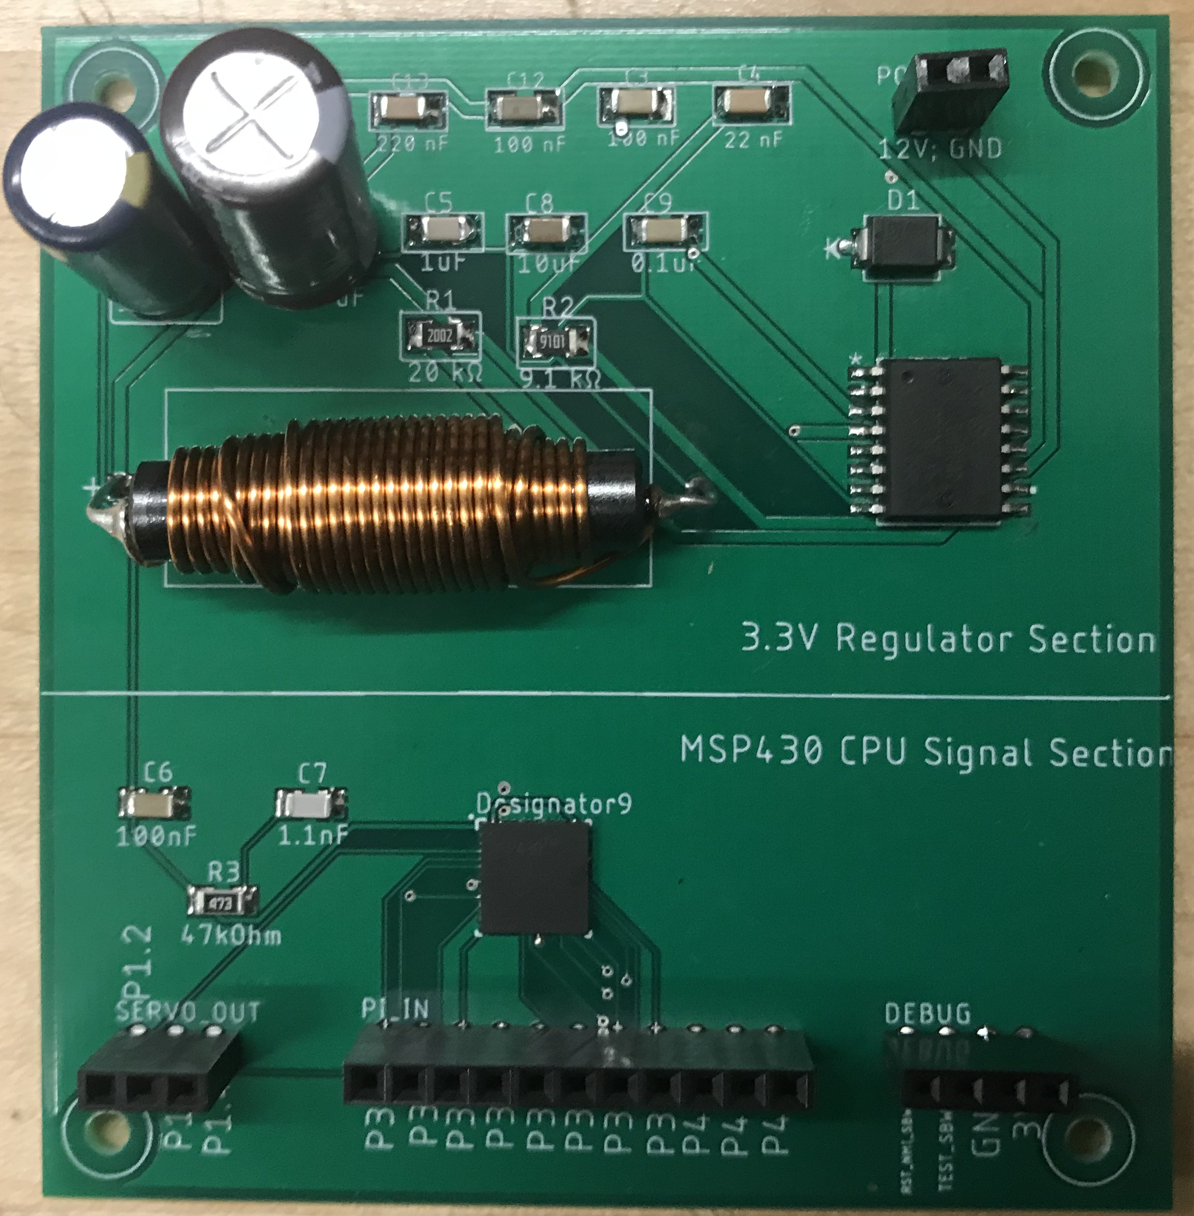
Configuration 1- L4978 (4 regulators)

Slide 56
Configuration 2- LM317 (4 regulators)
After having some issues with noise when testing the L4978 we decided to design for the LM317 PCB as a backup
While waiting for final components to arrive for testing, schematic specifications were sent out for PCB manufacturing
3 regulators were to power the servos individually, and 1 to power the MSP430
Made for a compact layout and only 1 PCB was needed

Slide 57
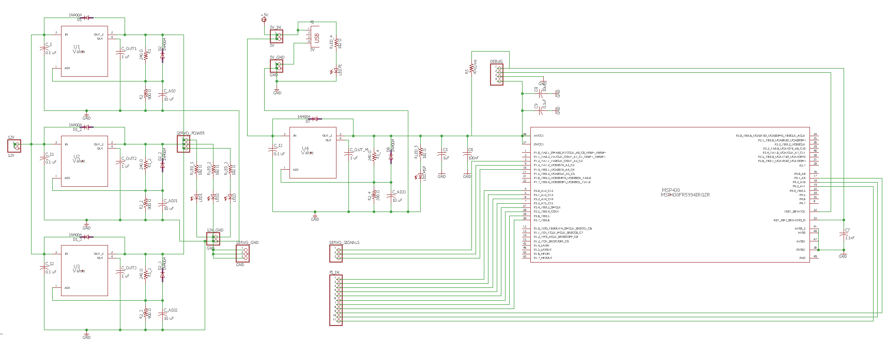
Configuration 2- LM317 (4 regulators)

Slide 58
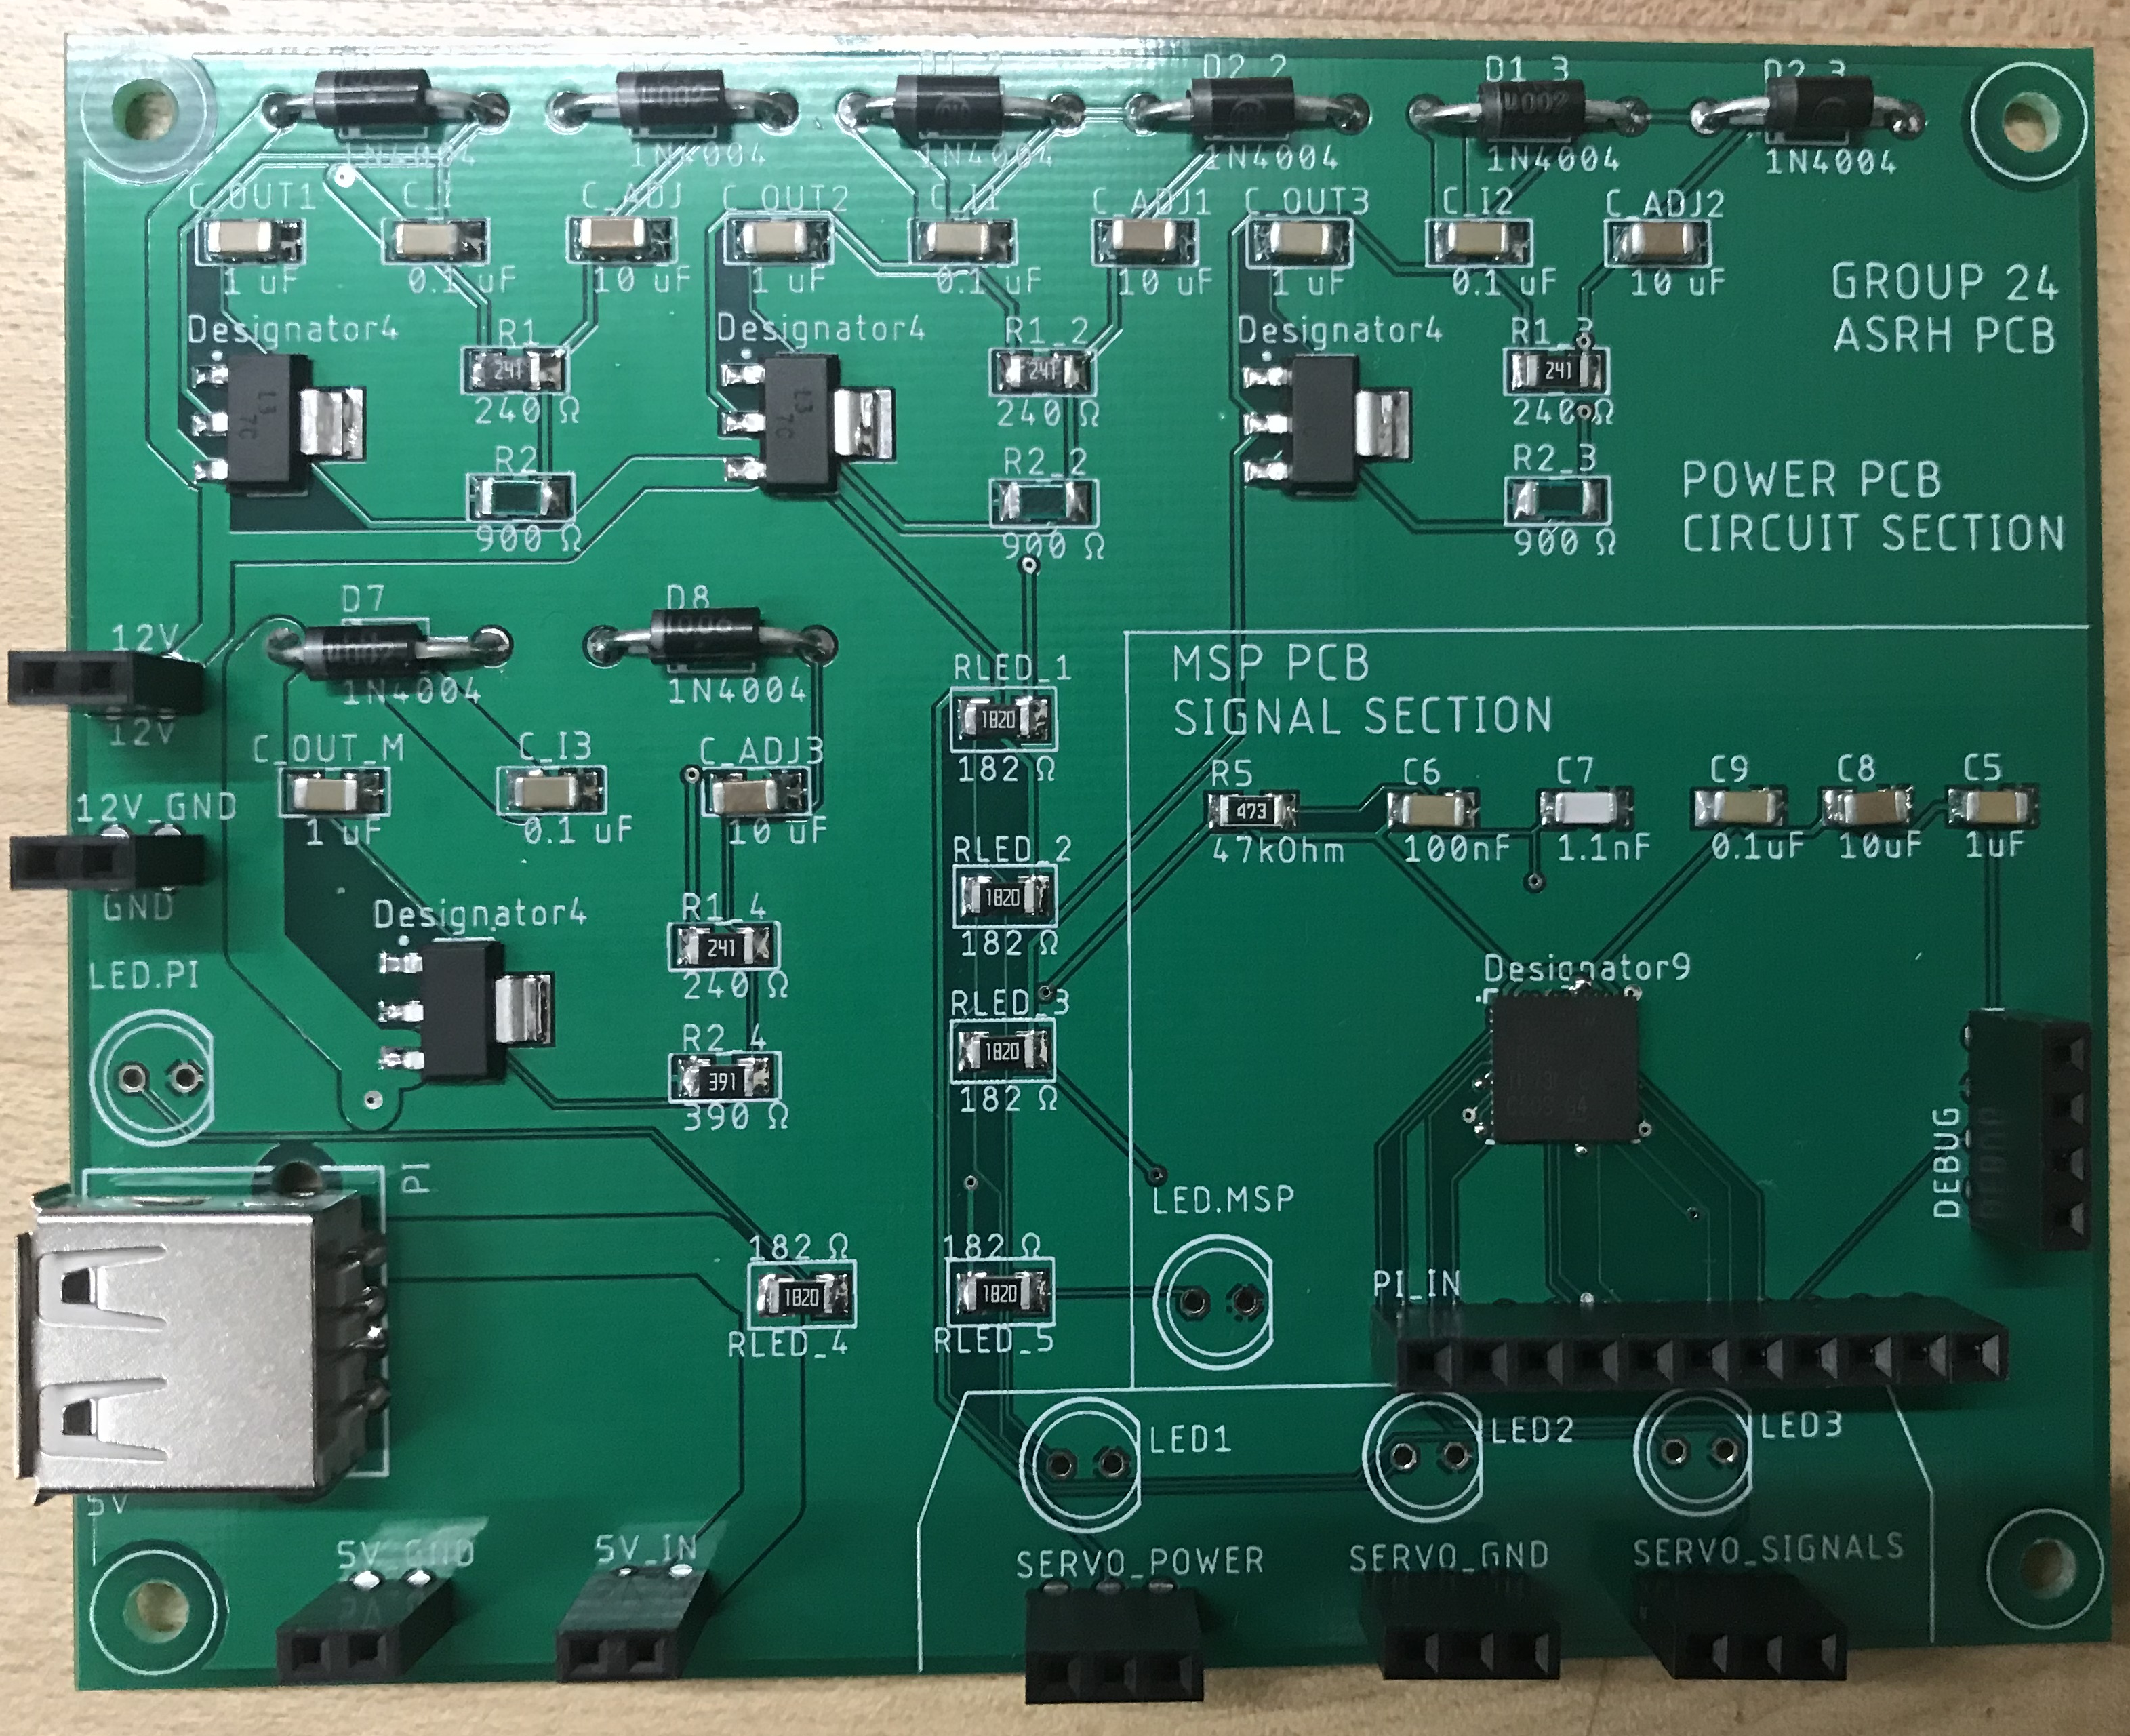
Configuration 2- LM317 (4 regulators)

Slide 59
Configuration 3 – LM317 (2 regulators)
After testing LM317, it was found that one regulator was sufficient to power all 3 motors
Since there was still time left, one last ‘optimal’ board was designed
Uses only necessary components in a consolidated layout

Slide 60
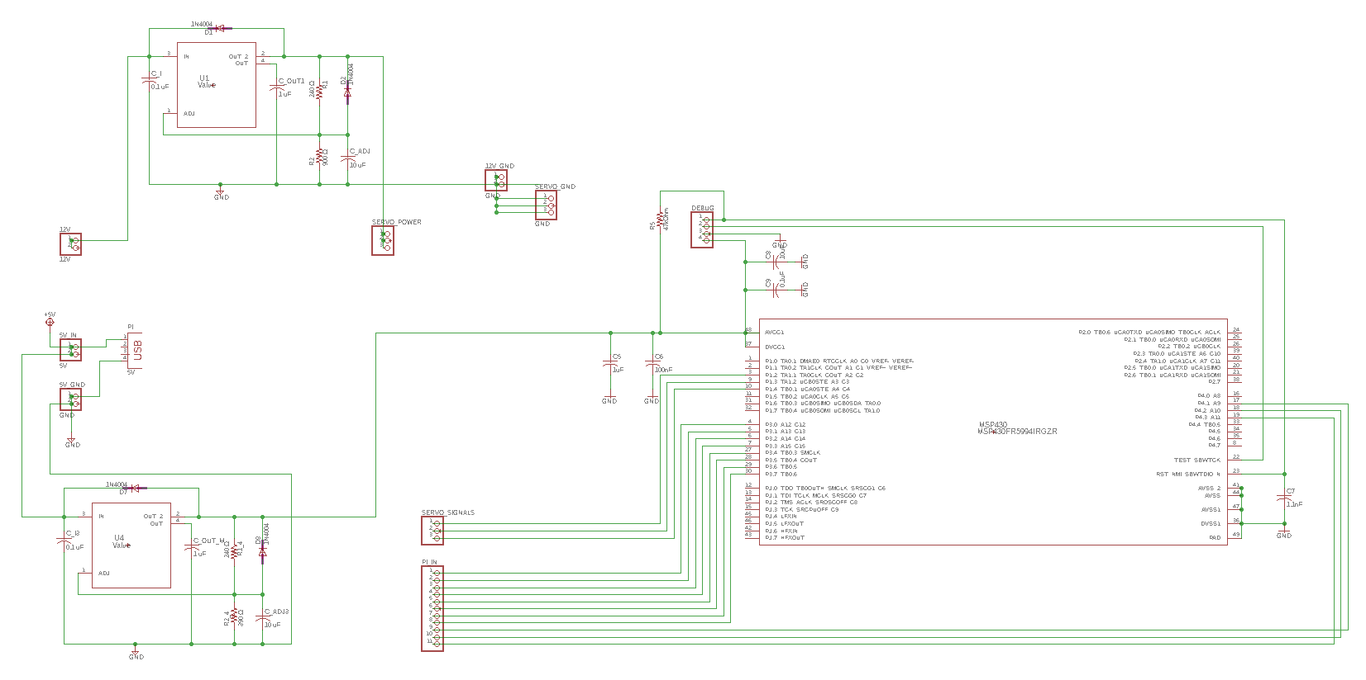
Configuration 3 – LM317 (2 regulators)

Slide 61
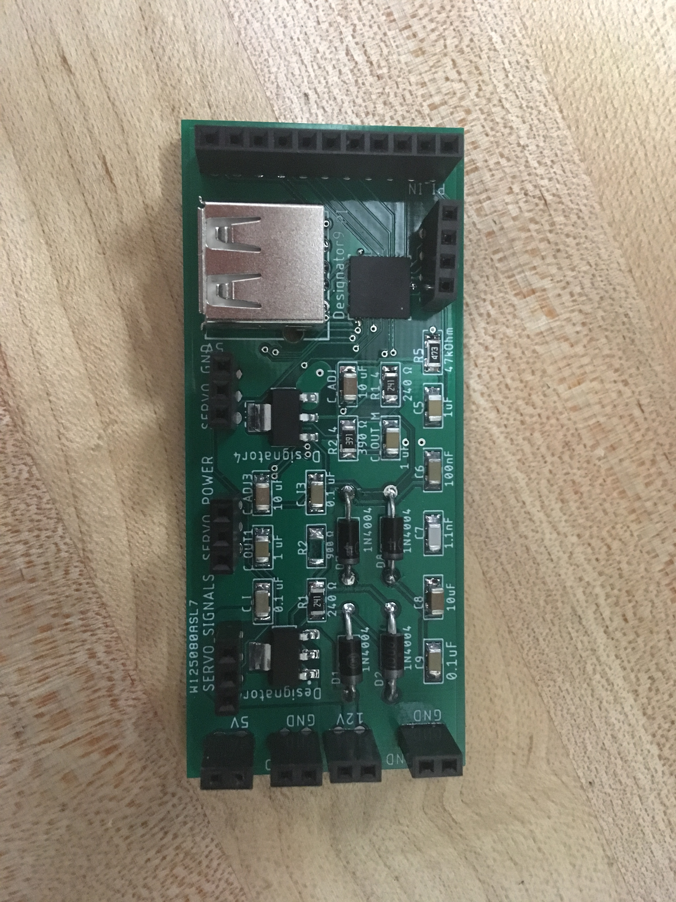
Configuration 3 – LM317 (2 regulators)

Slide 62
Structure
The ASRH is composed of 3 pieces of Styrofoam
  The base
  The platform
  The shroud
Wires are fed through the platform and wrap around

Slide 63
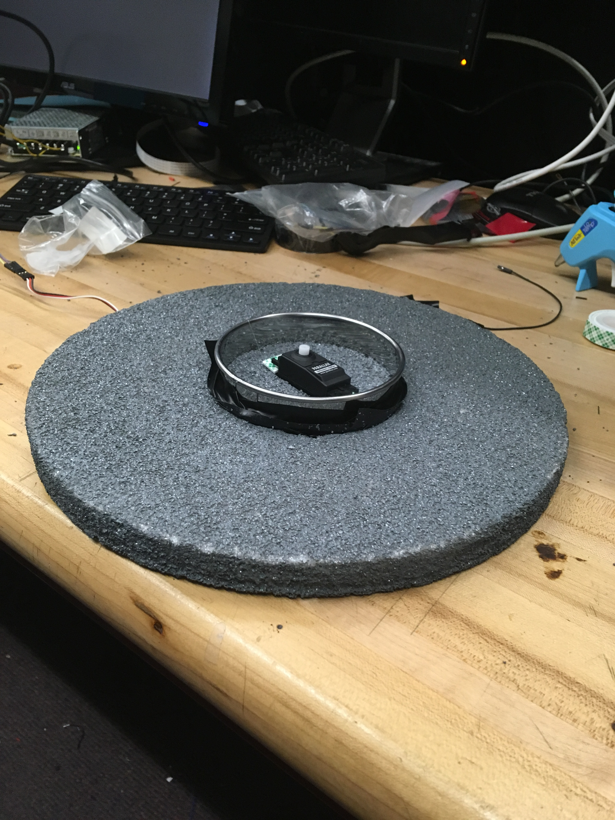
Structure

Slide 64
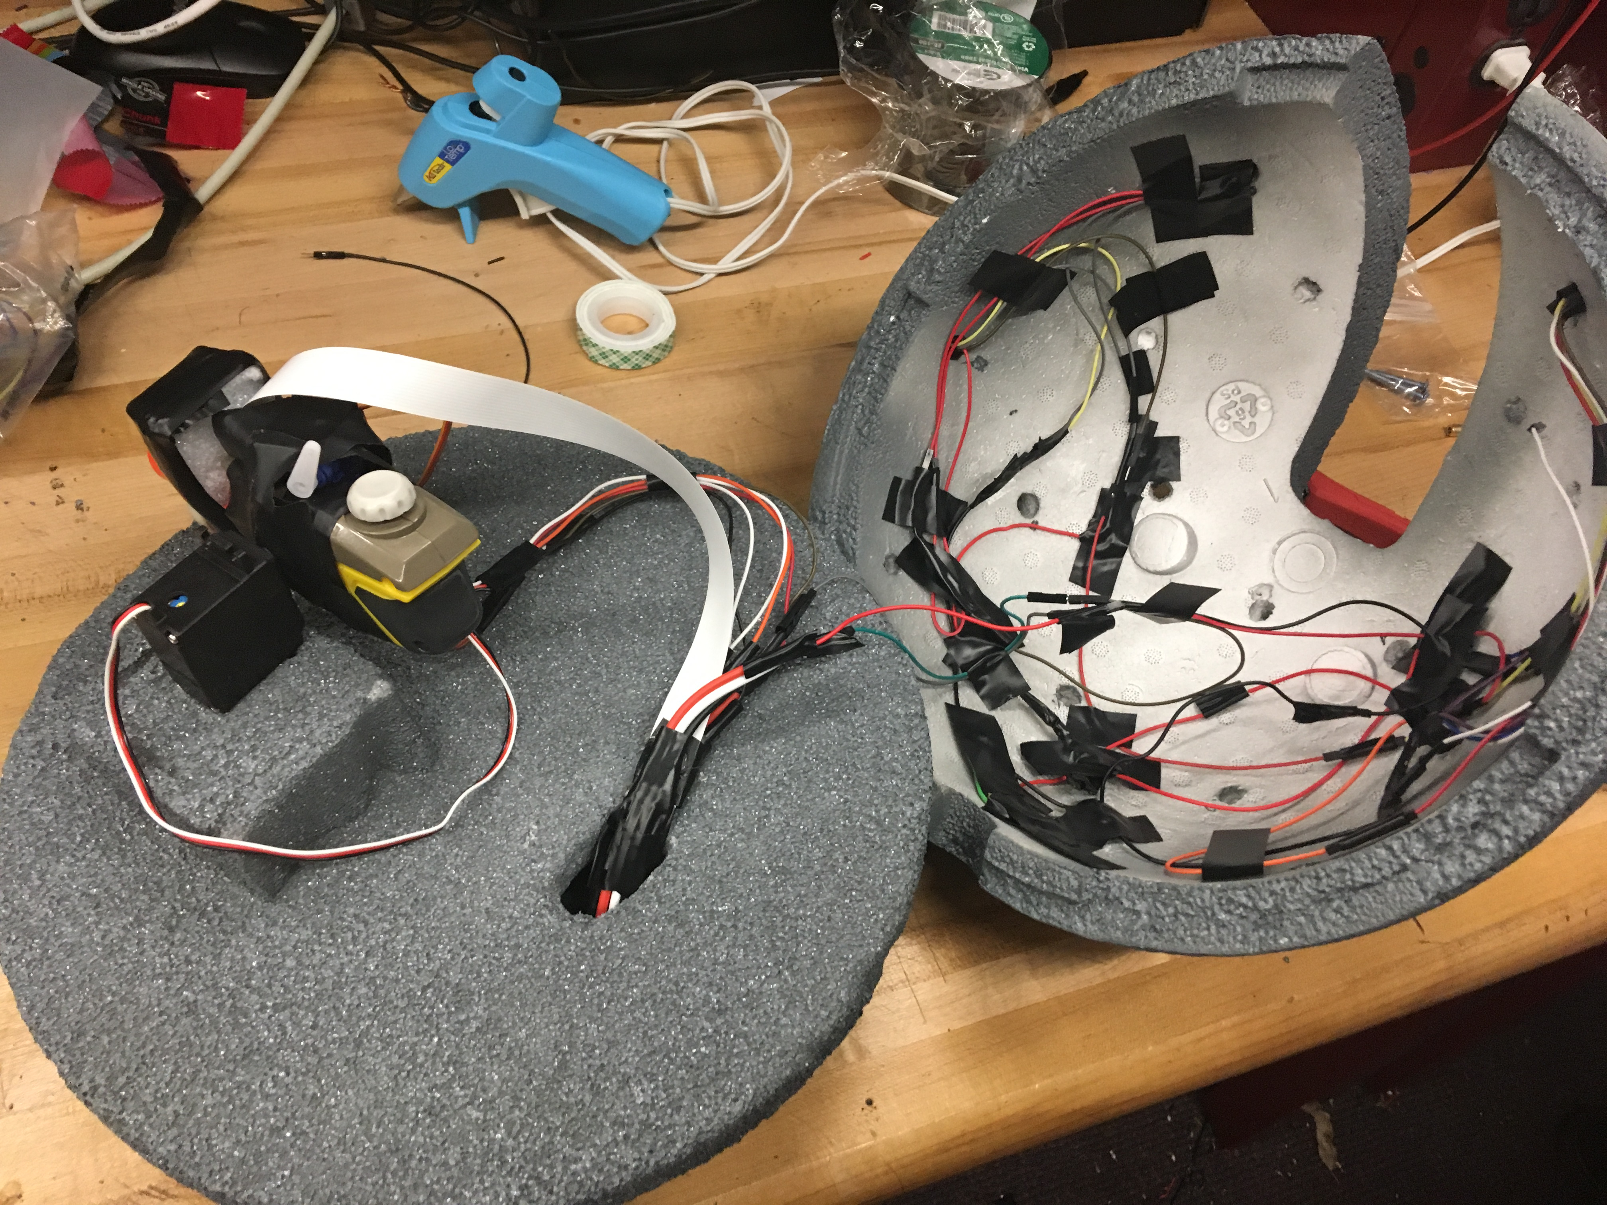
Structure

Slide 65
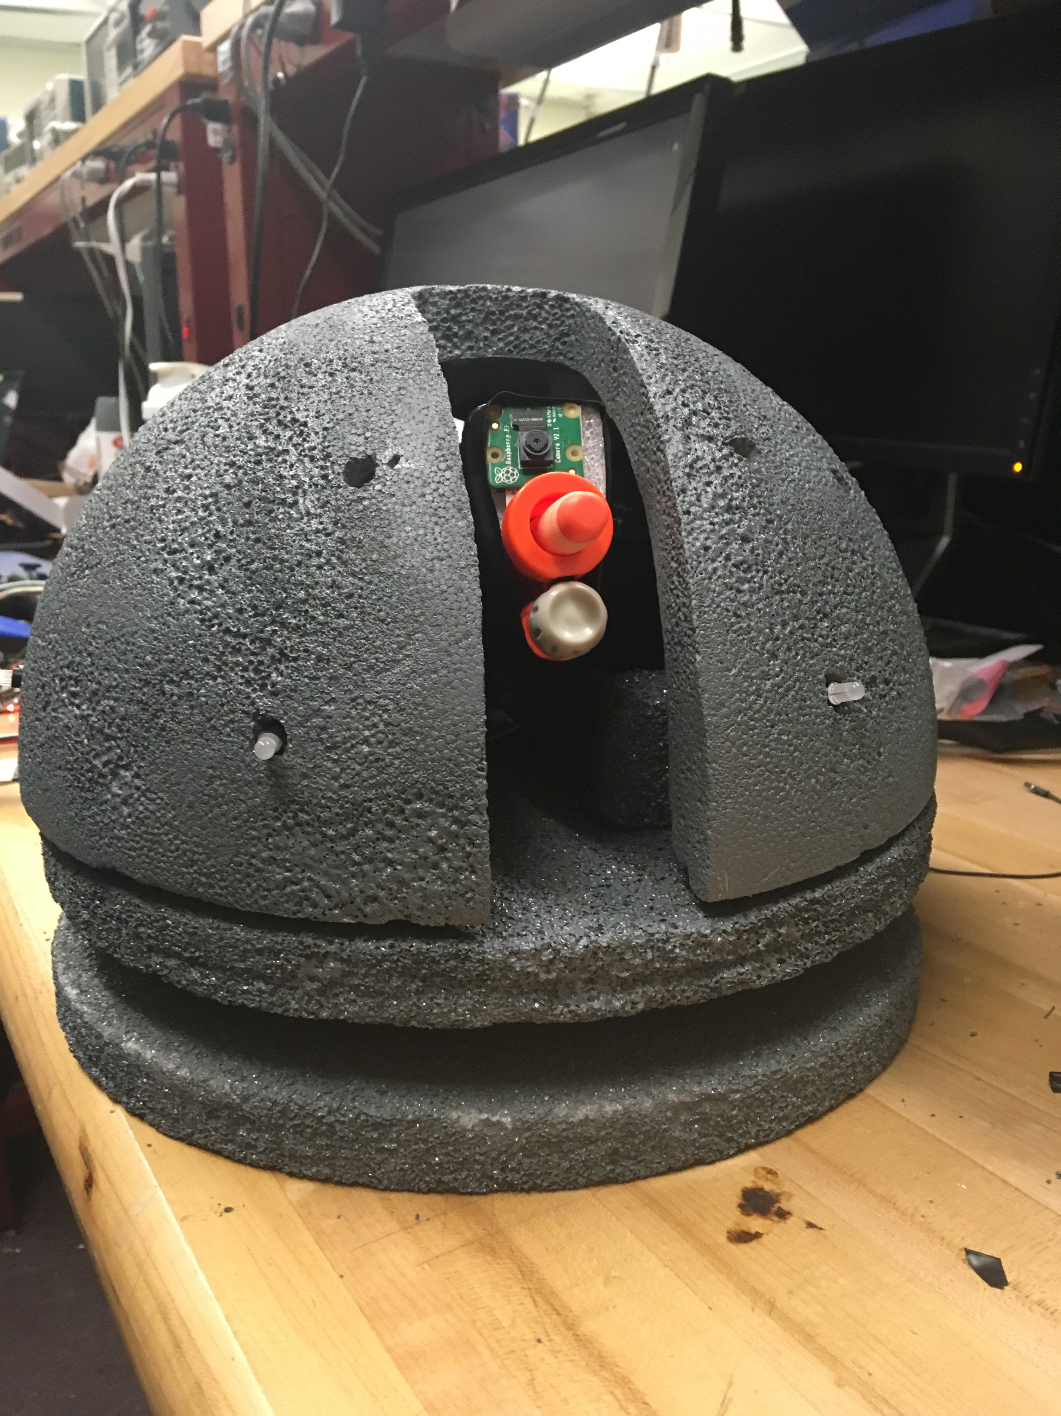
Structure

Slide 66
Work distribution
 | Power Design | PCB Design | MSP430 and Motors | Raspberry Pi | Arduino Trinket and LEDs
Dries | Secondary | Secondary | Primary | Primary | Secondary
Angel | Secondary | Primary | Secondary | Secondary | Secondary
Said | Primary | Secondary | N/A | N/A | N/A
Steven | N/A | N/A | N/A | Secondary | Primary

Slide 67
Finances
ASRH Costs
Item | Cost
Raspberry Pi 3 Model + Picamera | $ 48.99
9g Micro Servo | $ 3.60
Parallax Continuous Rotation Servos | $ 27.98
Arduino Trinket | $ 10.00
NeoPixel LEDs | $ 15.00
LASER Diodes | $ 0.60
TFT LCD Color Monitor | $ 32.99
Styrofoam Structure | $ 35.96
Nerf SecretStrike | $ 7.99
Wireless Controller | $ 25.99
Configuration 1 PCB: L4978 | $ 45.42
Configuration 3 PCB: LM317 | $ 11.93
RD-65 | $ 15.95
Total | $ 282.40
Development Costs
Item | Cost
L4978 Development | $ 30.63
LM317 Devolopment | $ 12.98
LM3478 Development | $ 57.80
TPS 561208 Development | $ 24.34
Solder Labor | $ 35.00
Jumper Wires | $ 9.99
MSP430 Development | $ 51.00
PCBs | $ 74.00
Light show development | $ 100.00
Raspberry Pi development | $ 45.00
Total | $ 440.74

